Slide 1
Finite-Time Thermodynamics
Through the Ages
2000s
1970s
1990s
Peter Salamon
San Diego State University
1980s
2010s

Slide 2
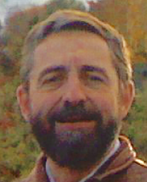
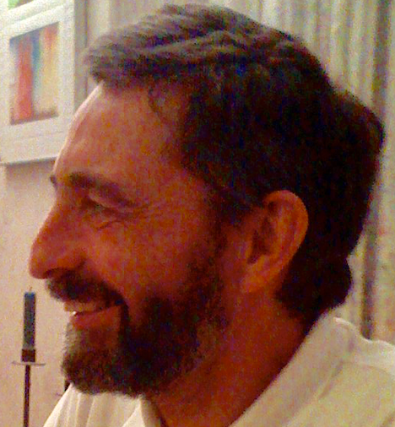
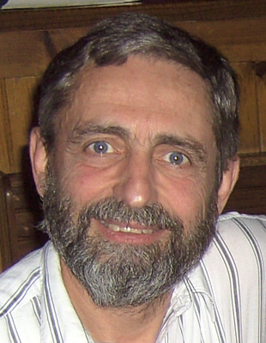

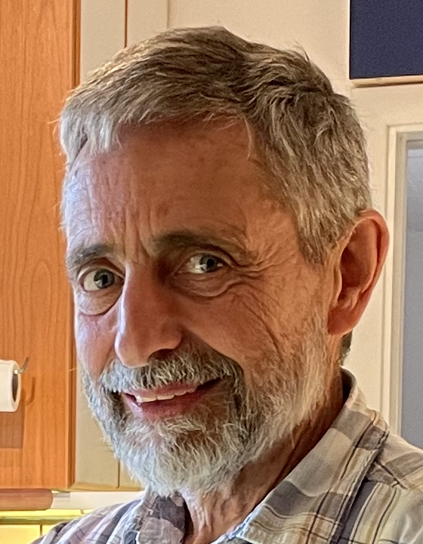

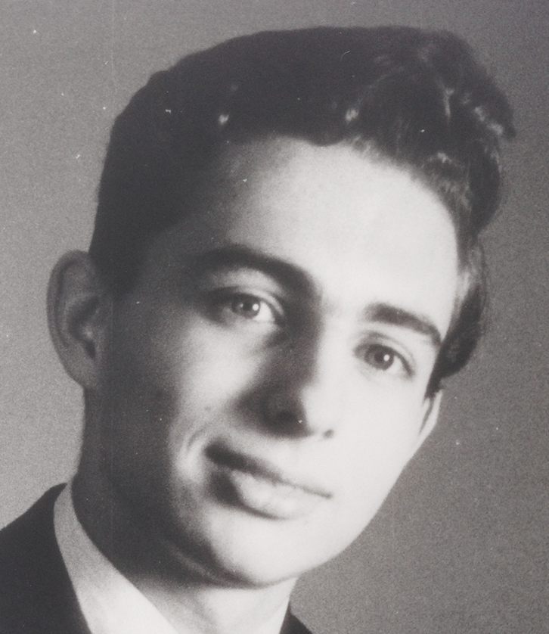
The
Ages
Notes:
story of our collaborations

Slide 3
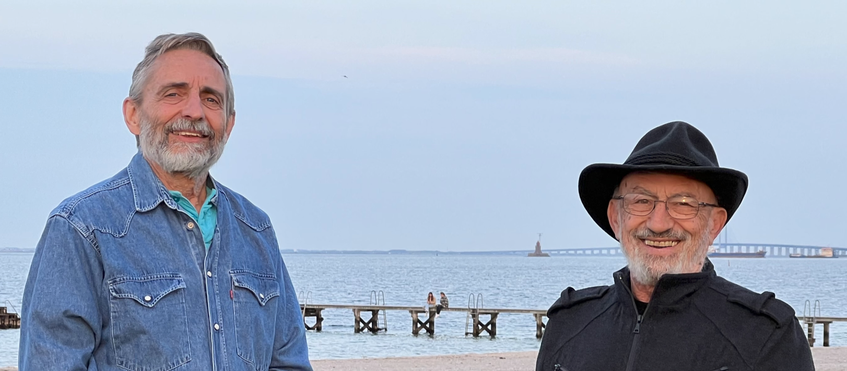
1975
The
Topics
1980
Heat
Engines
1990
Simulated
Annealing
Distillation
2000
Metagenomics
2010
Biothermodynamics
2020
Quantum Thermodynamics
Notes:
MORE LIKE PS AND BA JOINT TOPICS

Slide 4

1975 – Bjarne arrives in Chicago
Alles
in ordnung
Always up for a challenge
  from rock climbing to quartic equations
Out of this world organizational skills
Notes:
velocity dependent potentials for atomic collisions
TSRC, HJ

Slide 5
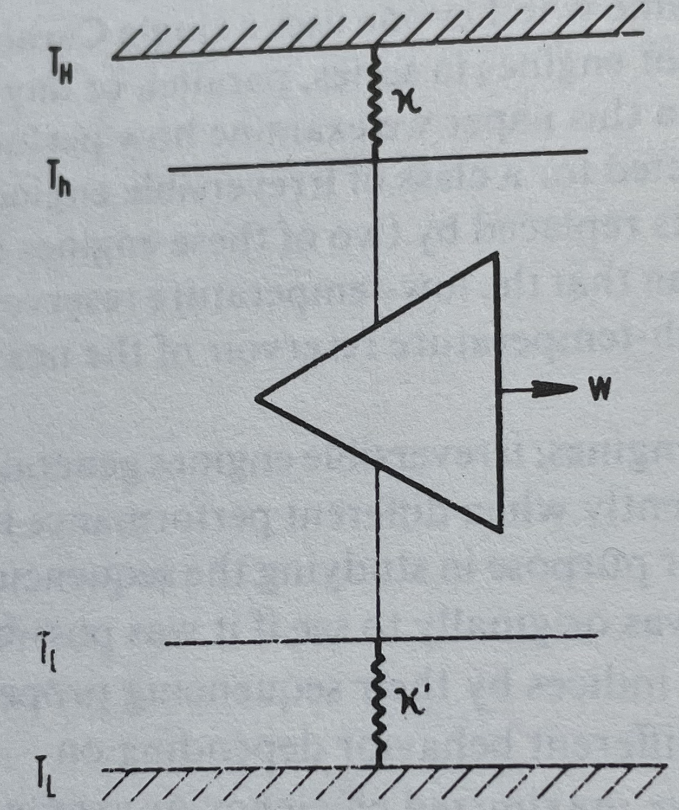
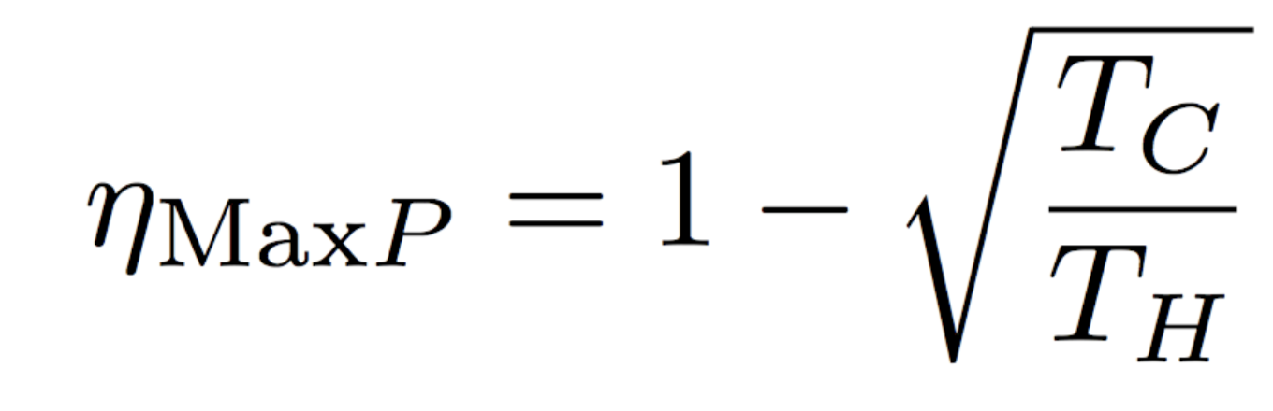
1970s
Heat engines
Min
ΔS_{u}
Max
Power
Conservationist
Industrialist
How much we care about fuel vs. time
Notes:
MYSTERY STILL PERSISTS

Slide 6
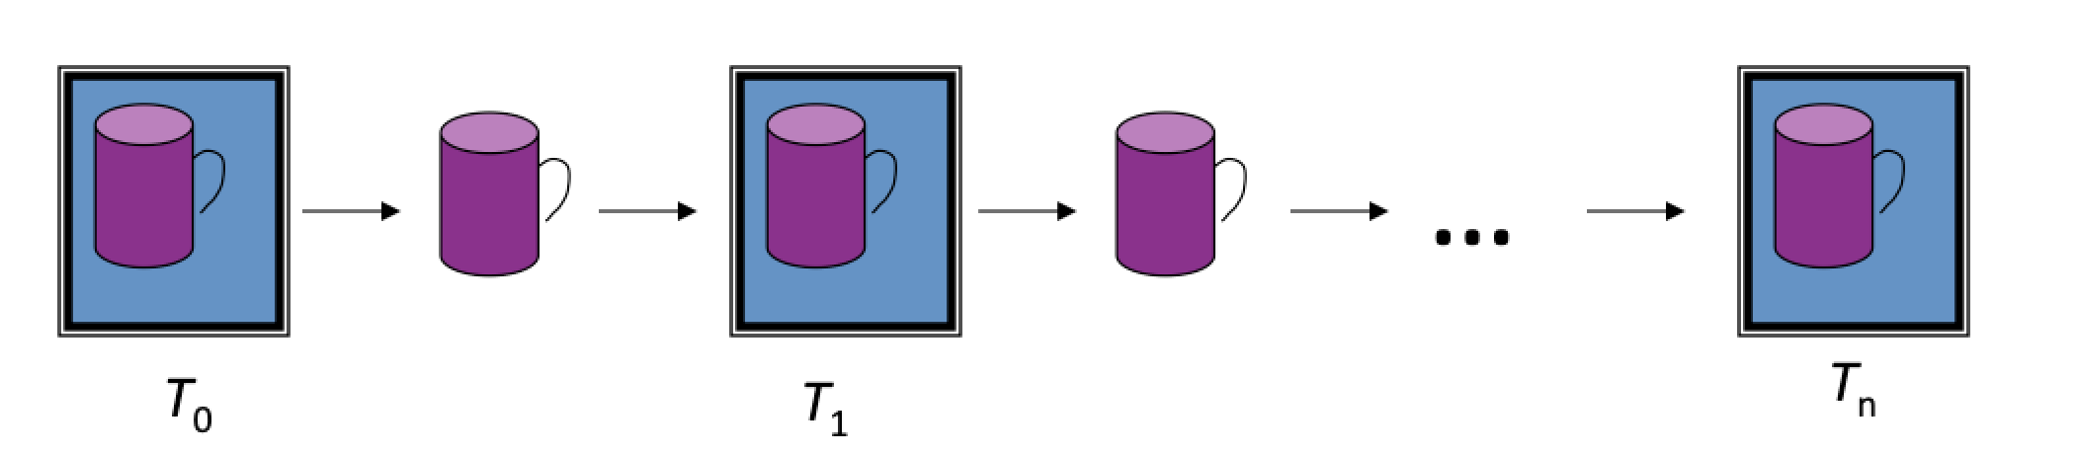
1980s – Minimum ΔS_{u}
Thermodynamic Length
=ΔL²/2
one small step
ΔS_{u} > ΔS_{u}* = L²/2n > 0
ΔL*=L/n
Constant distance per relaxation

Slide 7
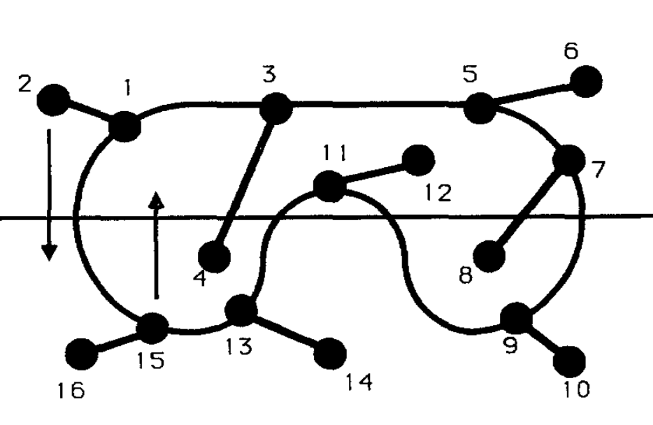
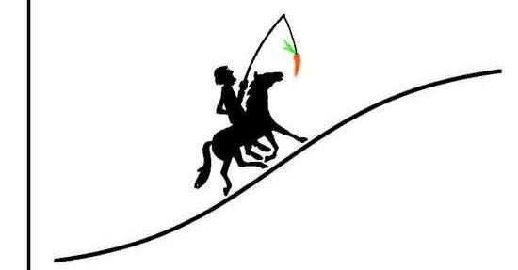
1980s – Simulated Annealing
Global optimization as thermodynamic process
Constant thermodynamic speed
Macintosh year experiment.
Worked out runtime implementations for optimal cooling.

Slide 8
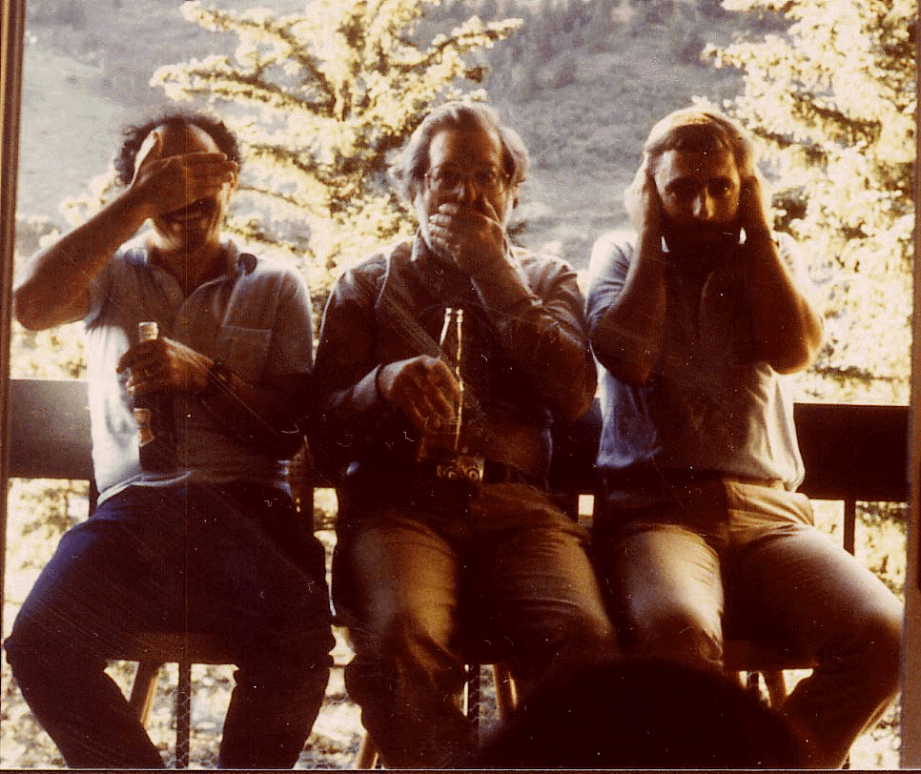
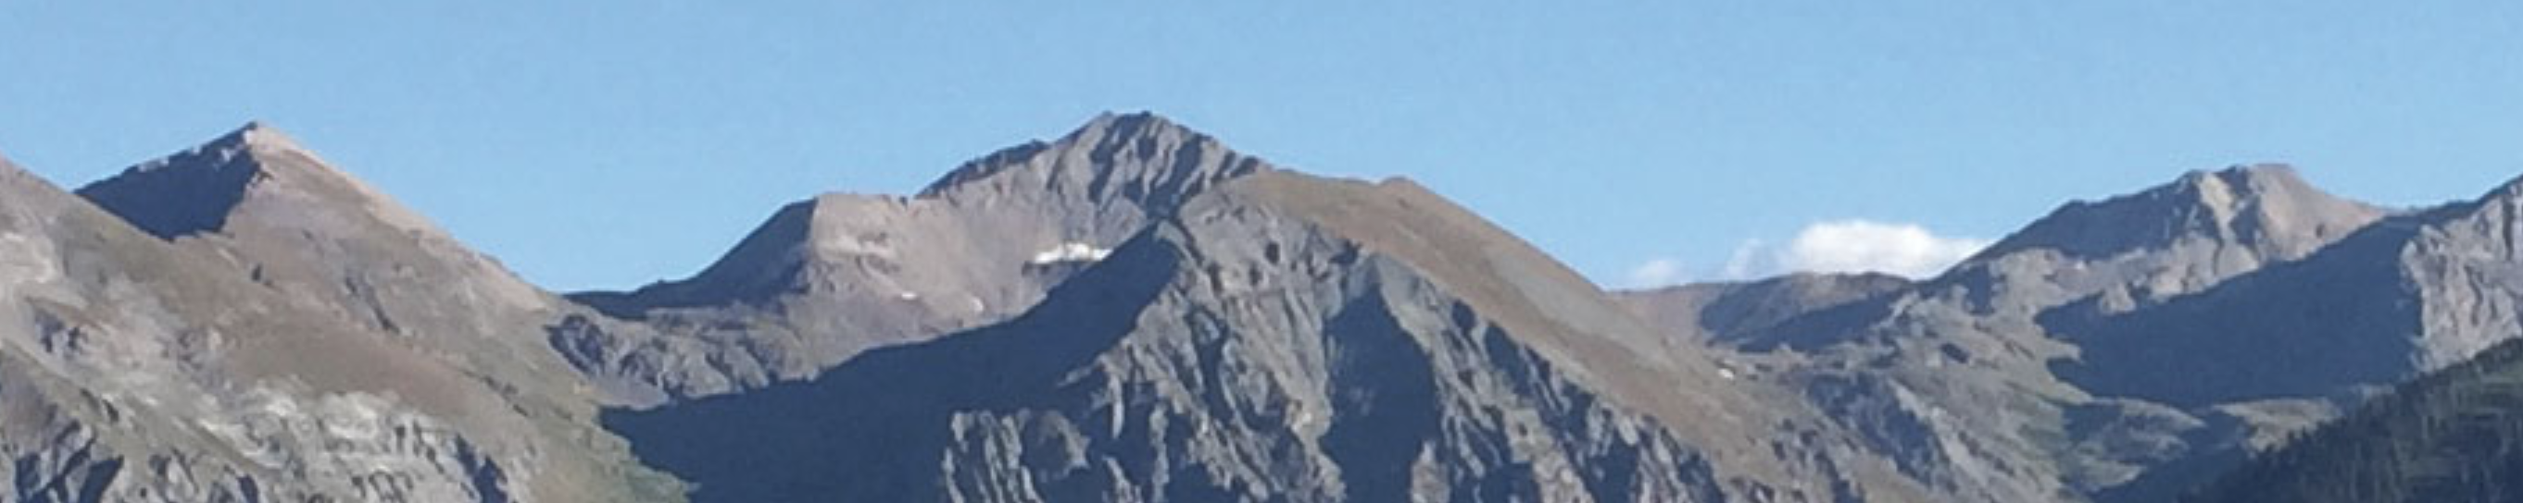
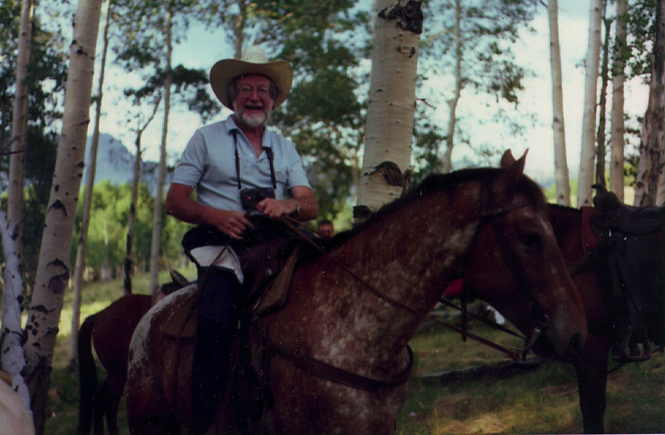
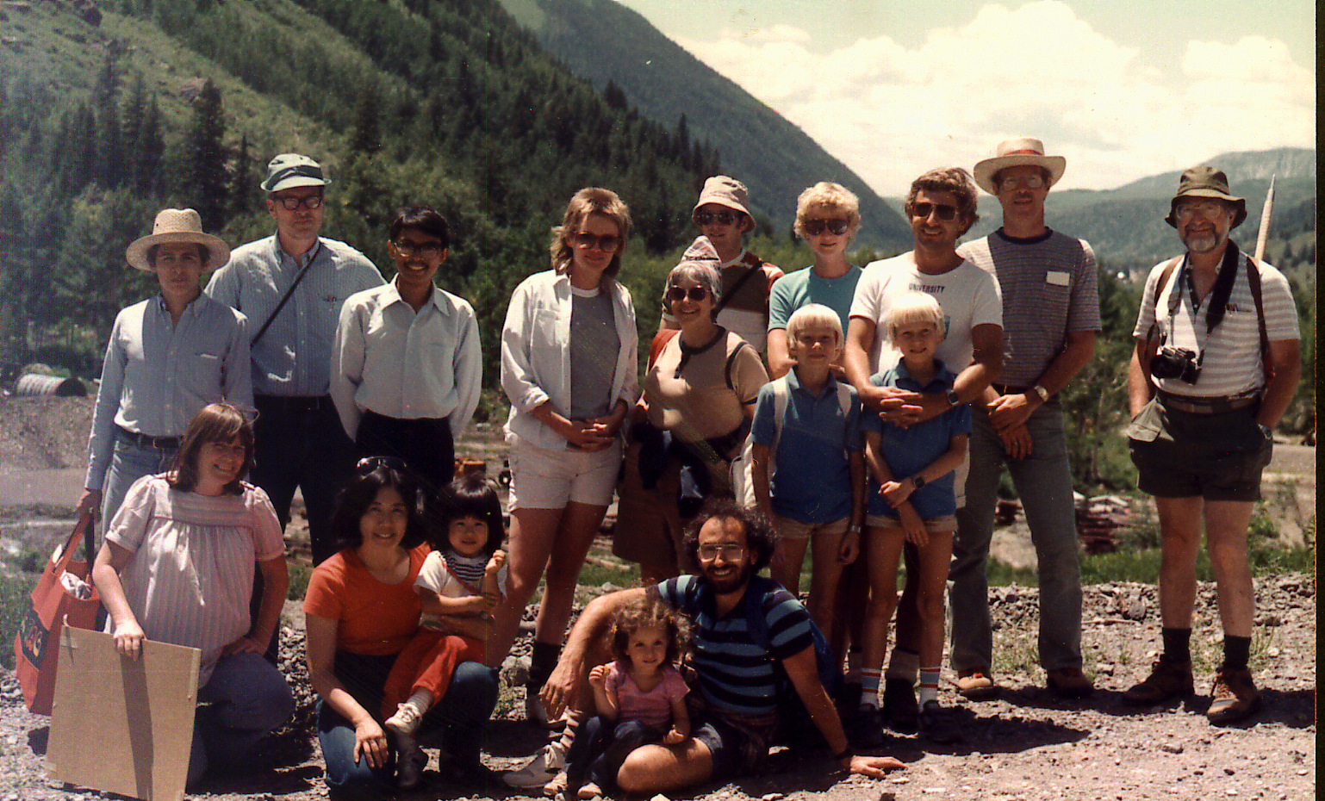
1980s – Telluride
Bjarne acquires his beard!
Notes:
DESPITE OUR ATTEMPT TO NOT SEE-SPEAK OR HEAR EVIL, WE MET RESISTANCE EVERY STEP OF THE WAY.
IT IS NOT SCIENCE
IT IS NOT ENGINEERING
…

Slide 9
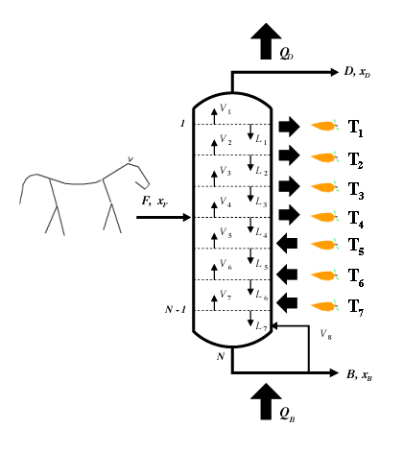
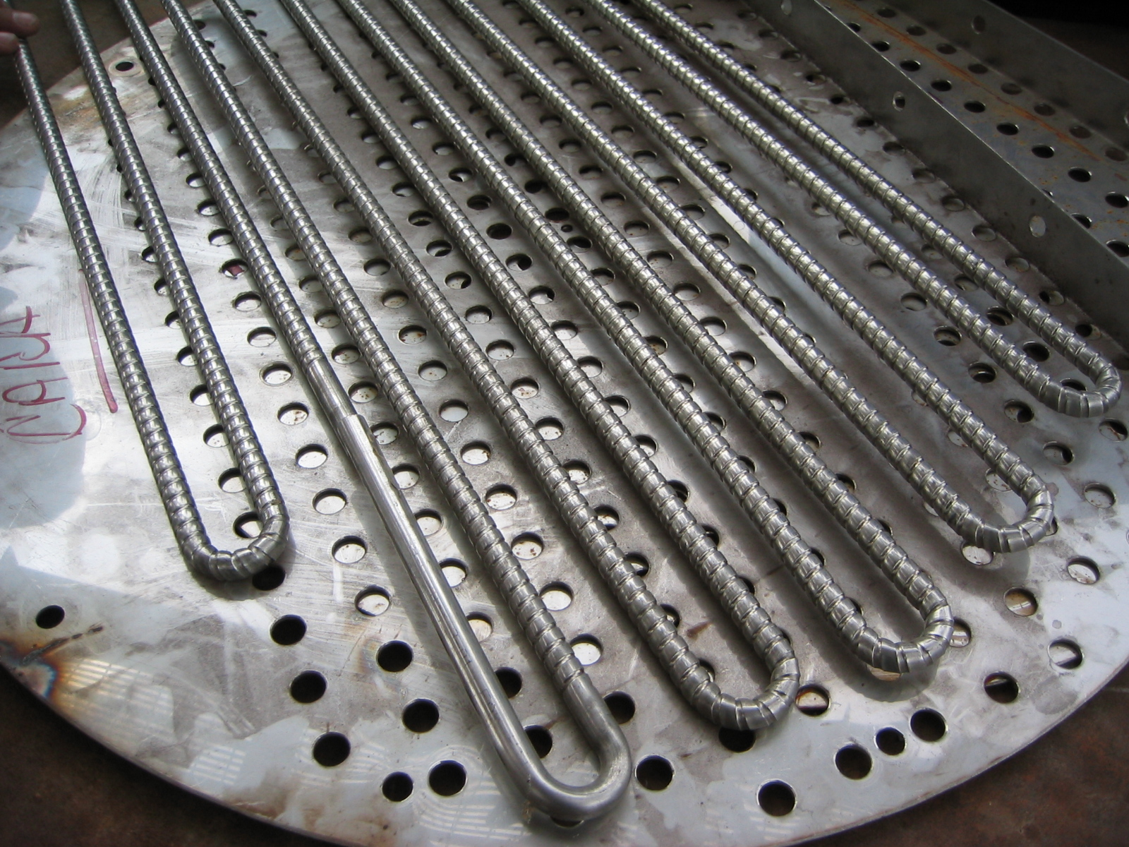
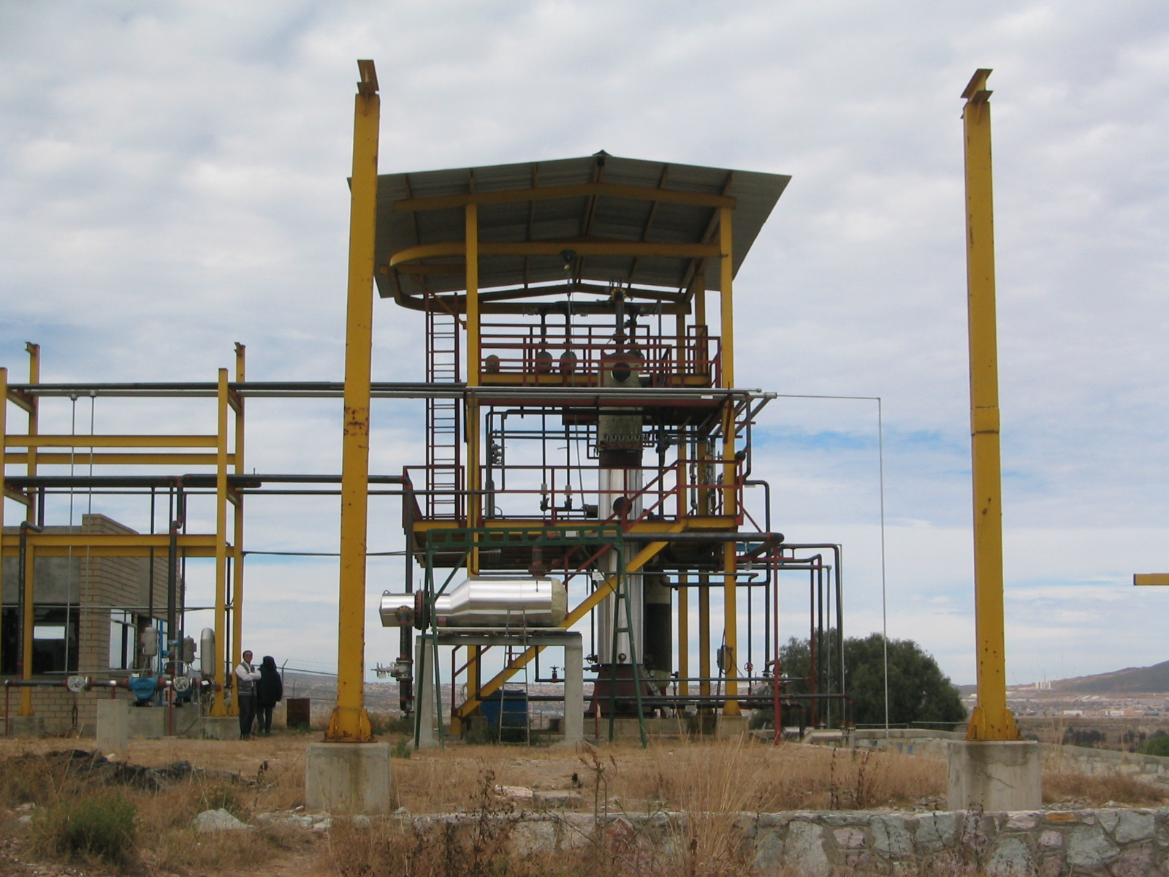
1990s – Distillation
PEMEX column in Pachuka
Notes:
Looking to apply step horse-carrot

Slide 10
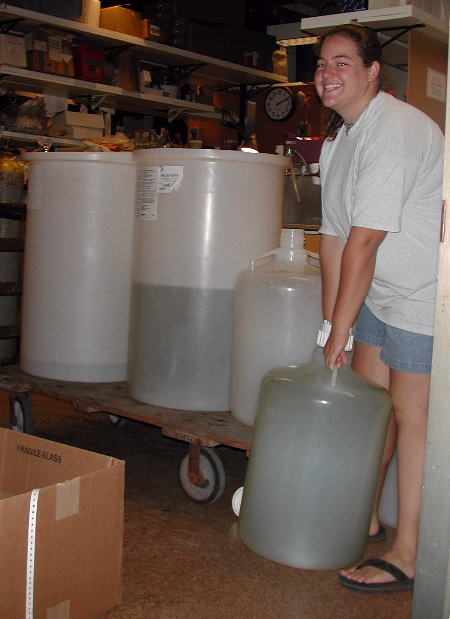
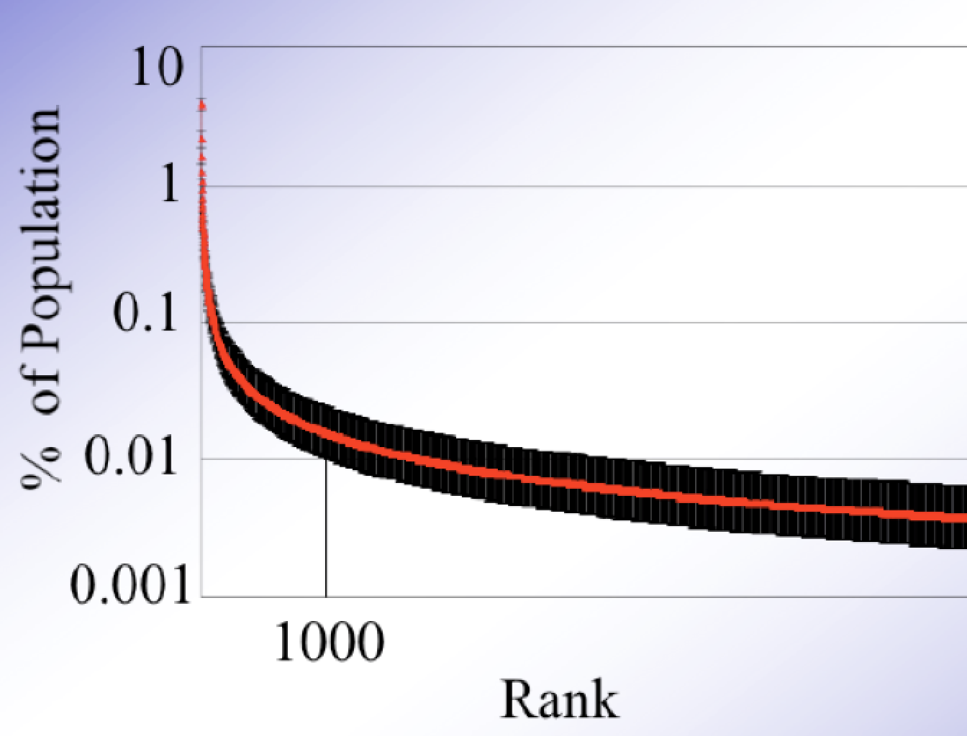
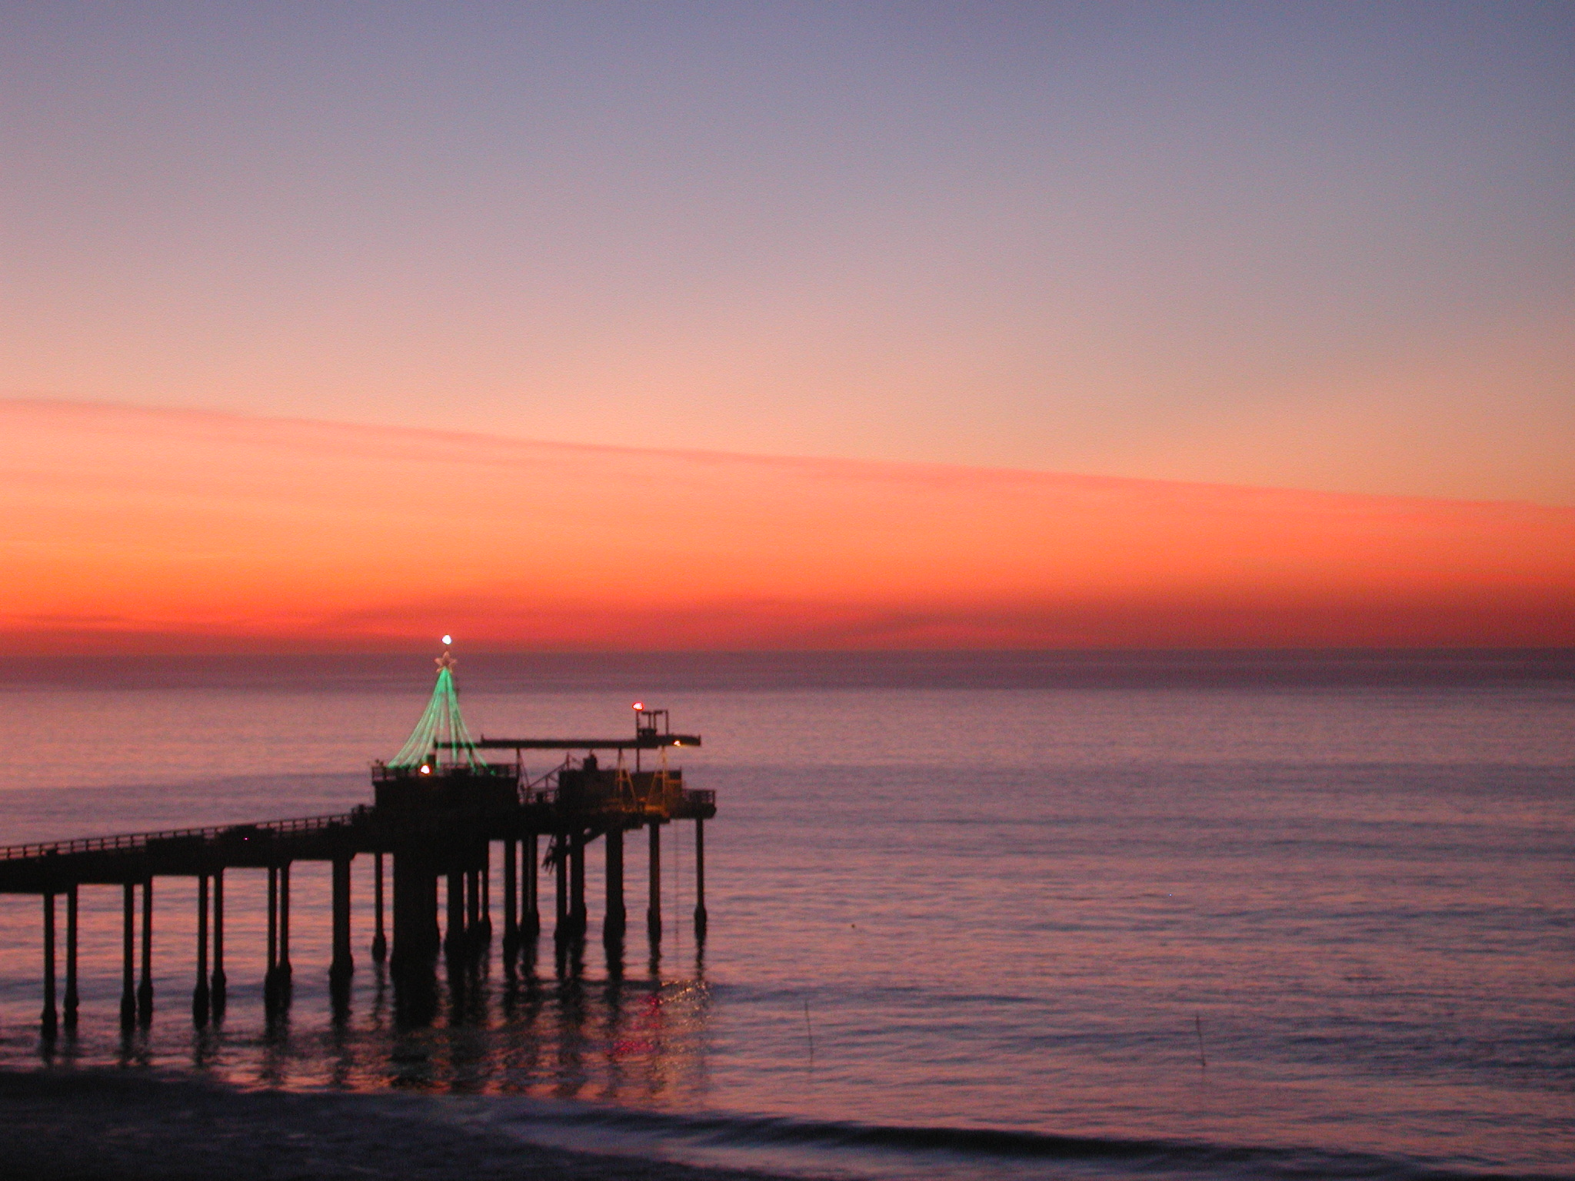
2000s – Metagenomics
The First Genomic Analysis of an Uncultured Community
Look for overlapping sequences - contigs
    An overlap indicates that 2 fragments came from the same genome
CCATGATAGGCTAACGTGCATTCGGTA
AGGCTAACGTGCATTCGGTACCTTACGA
Contig spectrum
Notes:
could not resist a sexy problem
rank-abundance

Slide 11
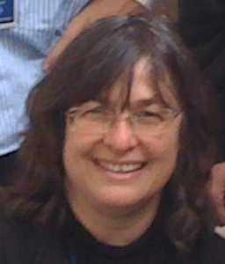
2000s – Holliday Junctions
Goes spontaneously in either direction
NOT
Biology uses many near PM3s
Free energy of staging
Notes:
staging for coherence?

Slide 12
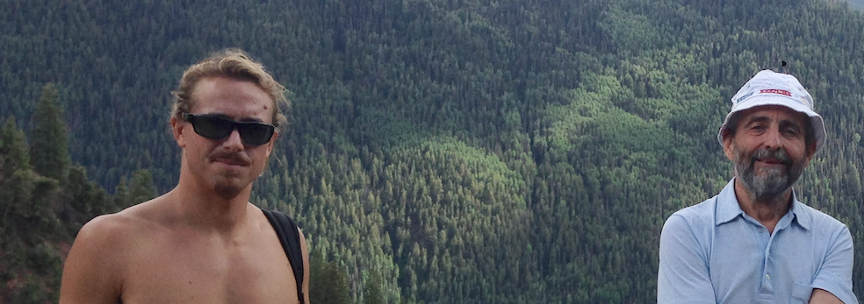
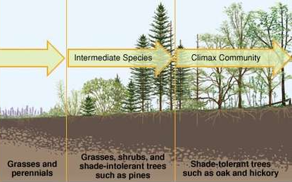
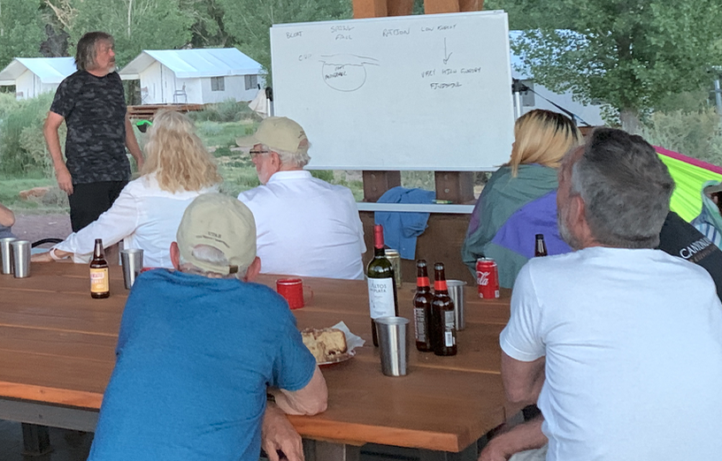
2010s – Microcalorimetry
Fast and wasteful
vs
slow and efficient?

Slide 13
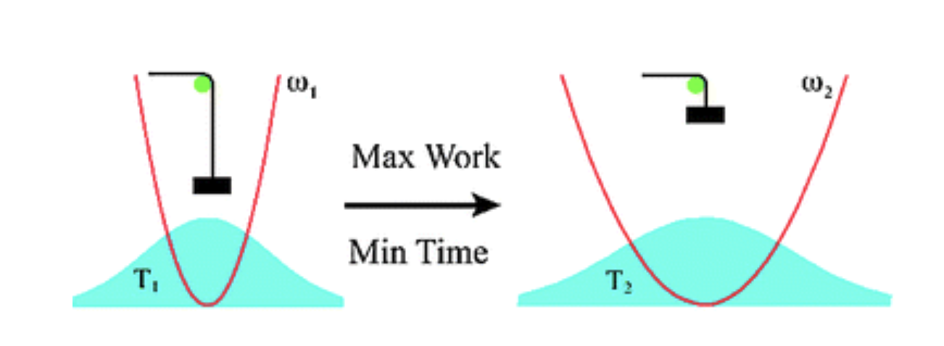
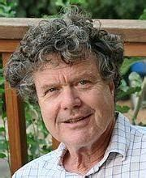

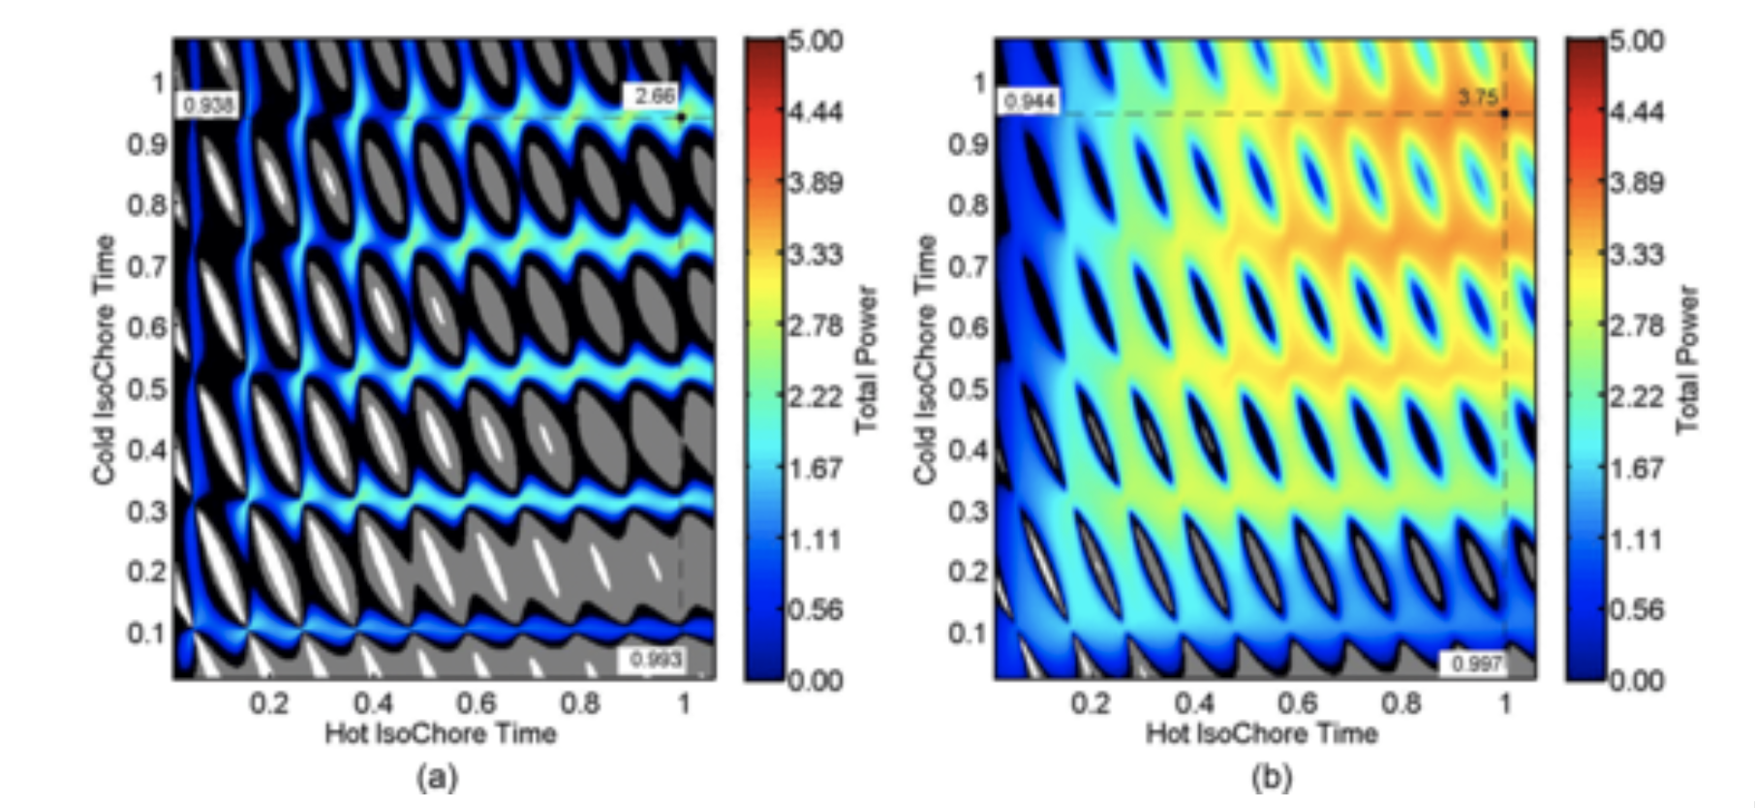
2010s – Quantum Thermodynamics
1994 Irrsee Gordon Conference
2009
2016 Map the full space of “simple” operations
Maximum power opts to use some frictional losses
Exceptional point needed for divergence
Notes:
1994 Irrsee story – gold in them thar hills

Slide 14
2020s
Thermodynamic Length comes back in an unexpected way – at the Max Power end.
Recall predicted version:
Min
ΔS_{u}
Max
Power

Slide 15
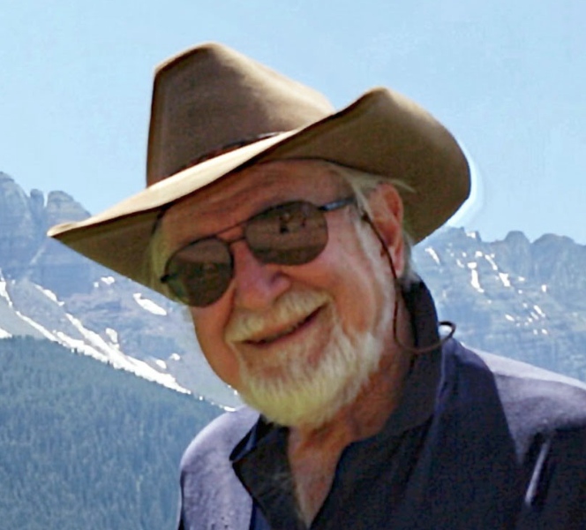
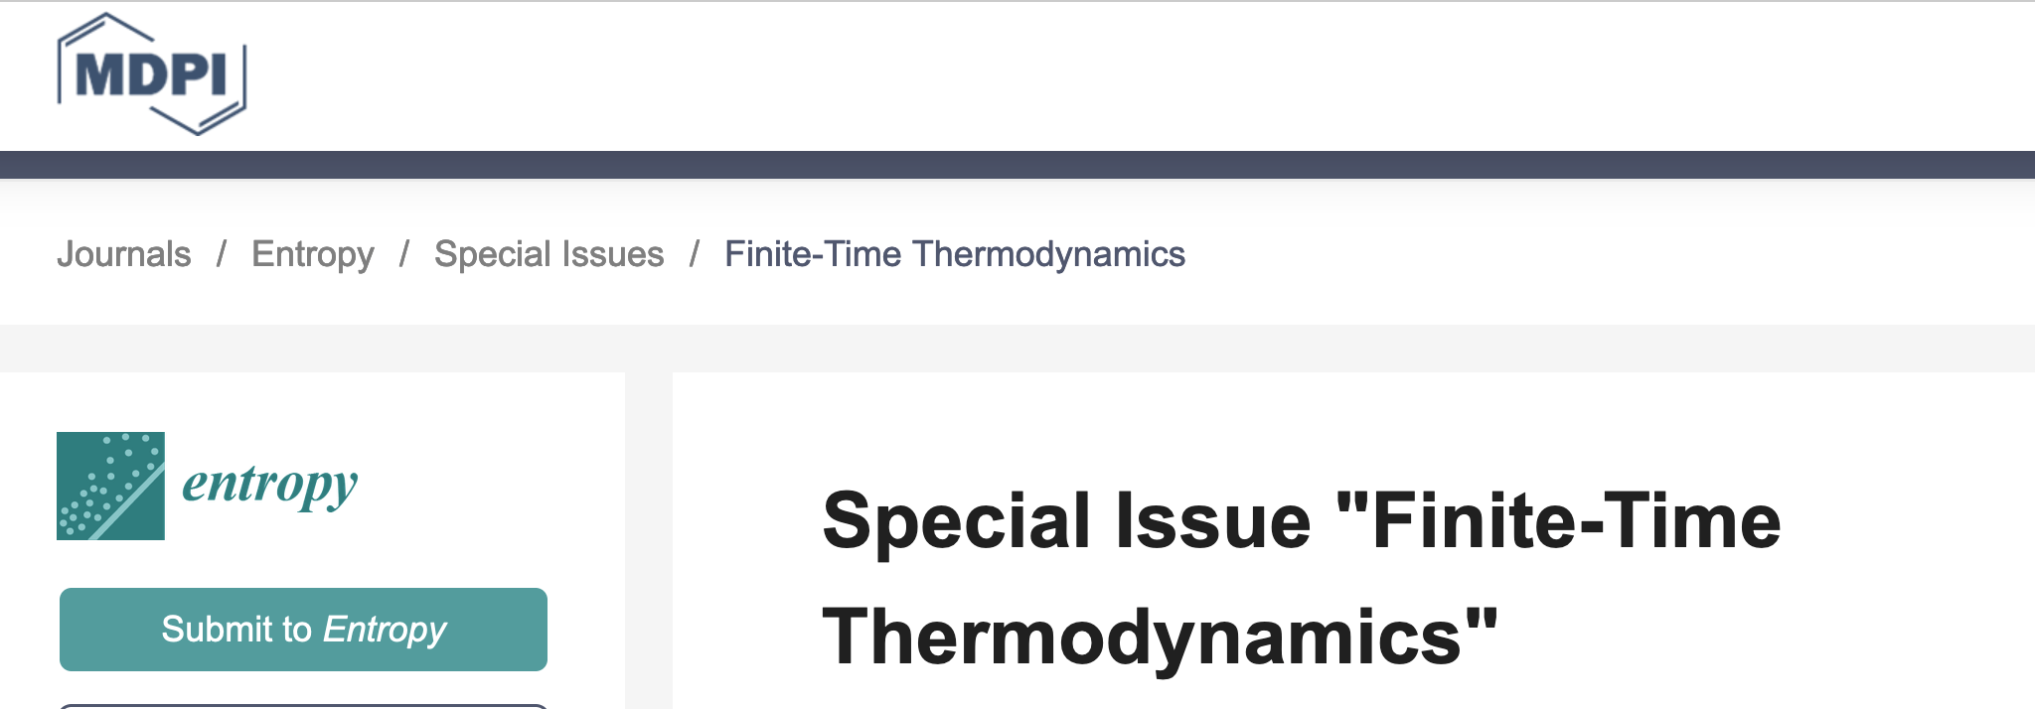
2020s

Slide 16
1975
The
Topics
1980
Heat
Engines
1990
Simulated
Annealing
Distillation
2000
Metagenomics
2010
Biothermodynamics
2020
Quantum Thermodynamics

Slide 17
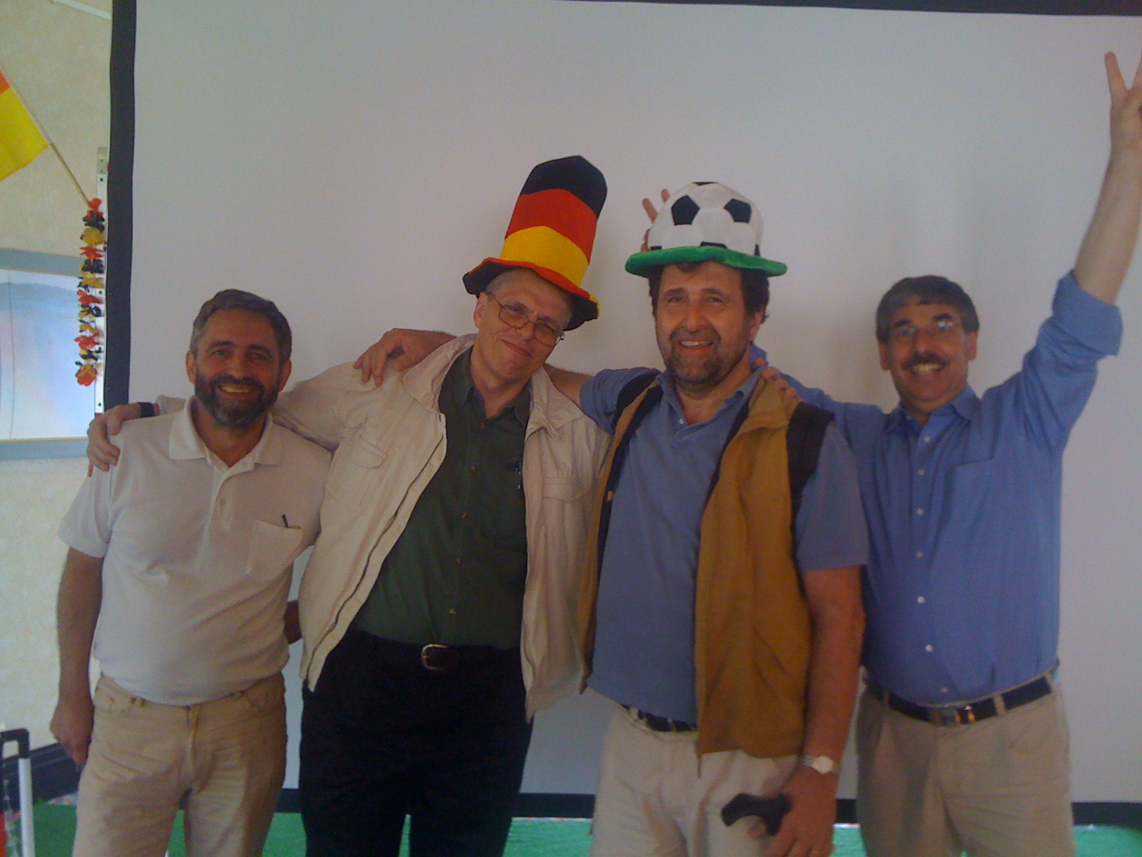

Slide 19
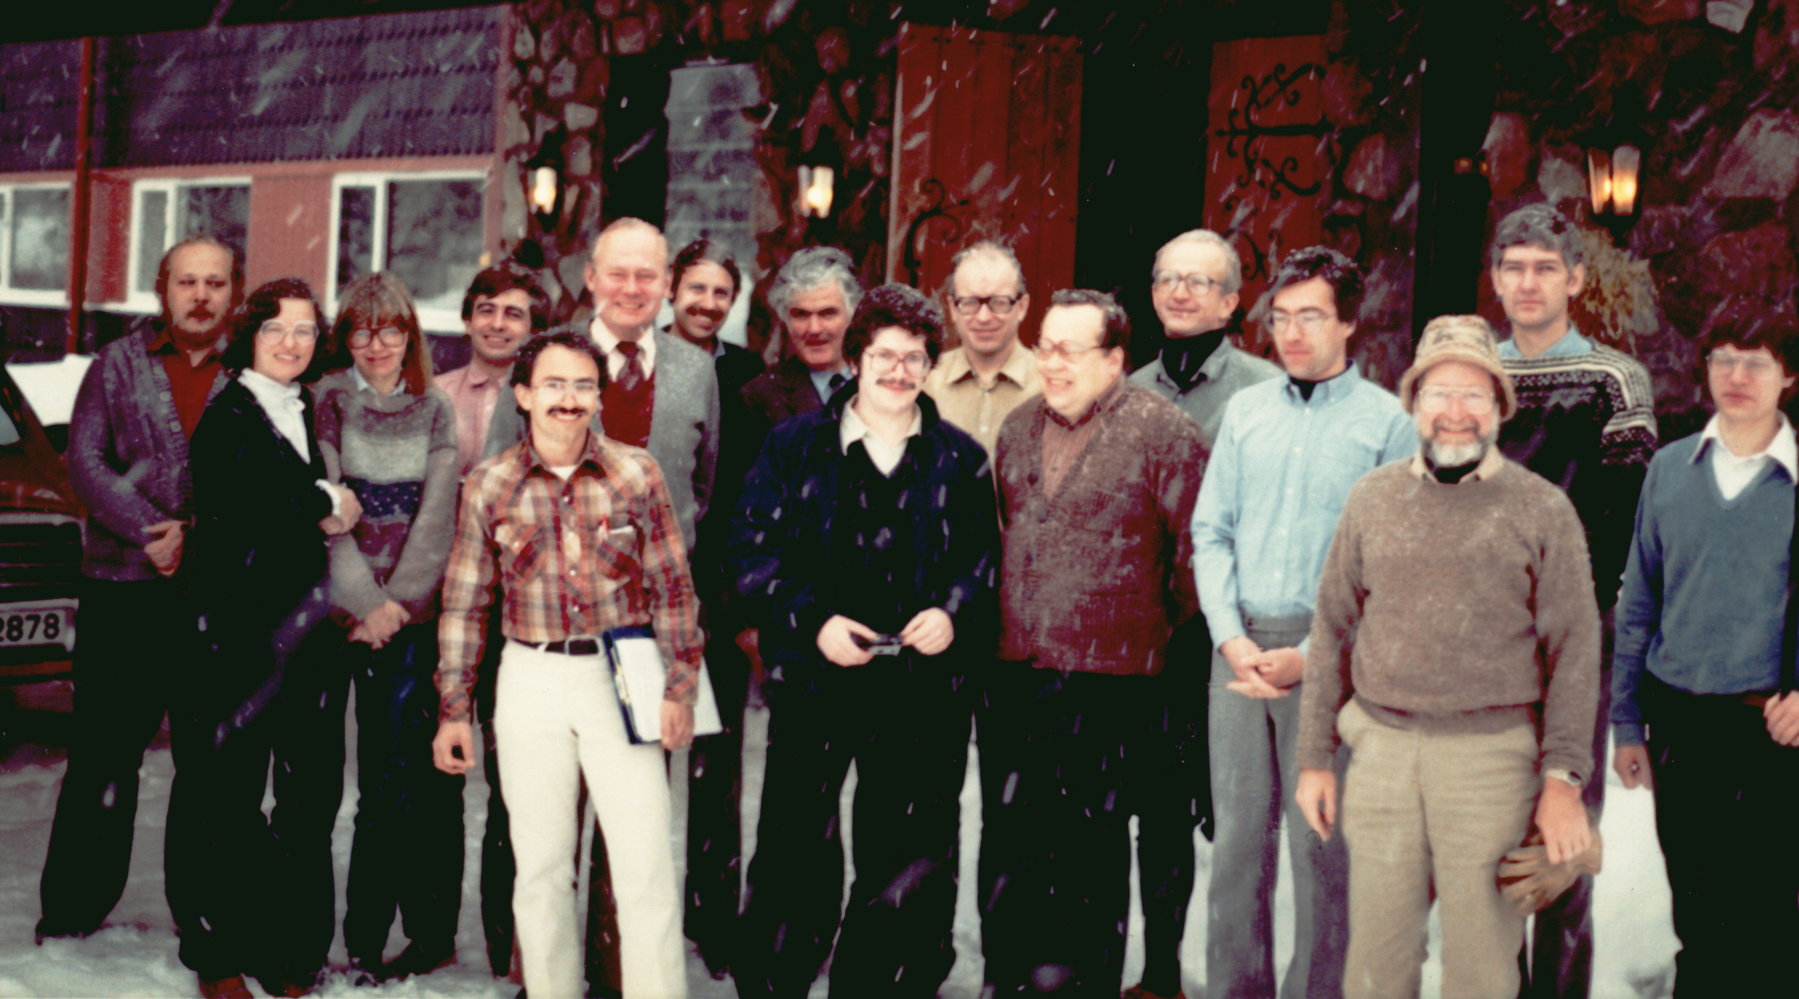

Slide 20
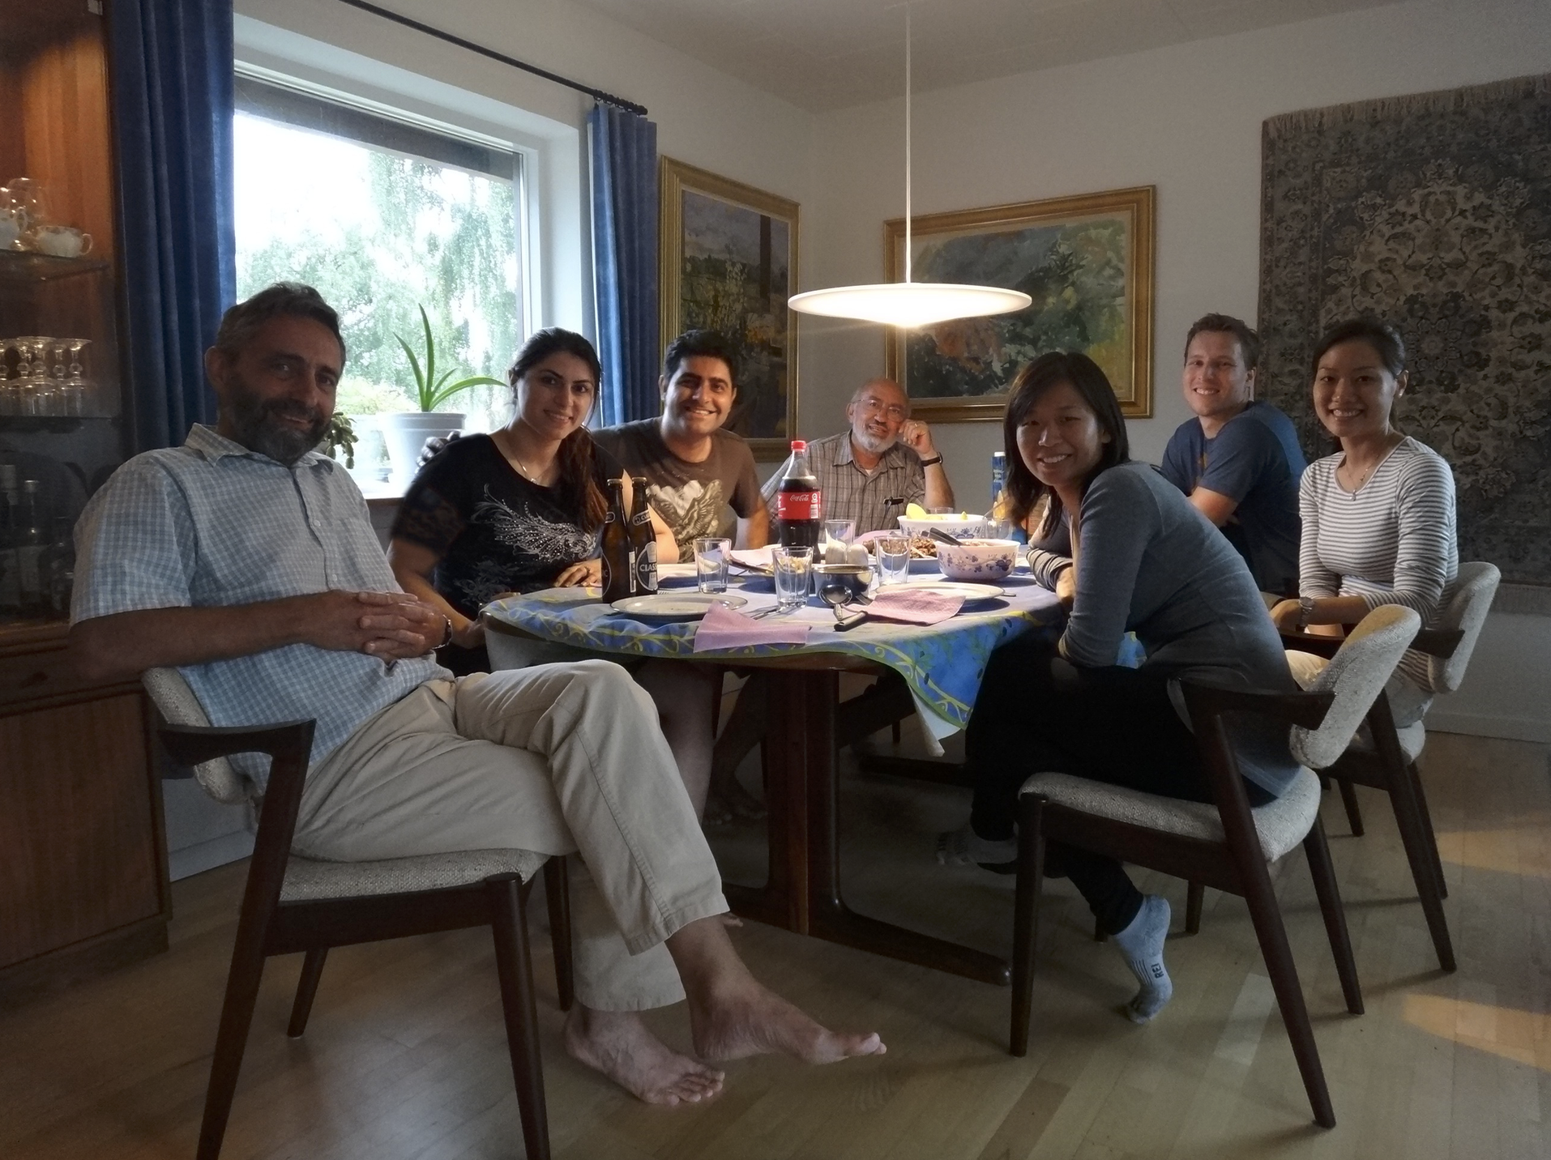

Slide 23
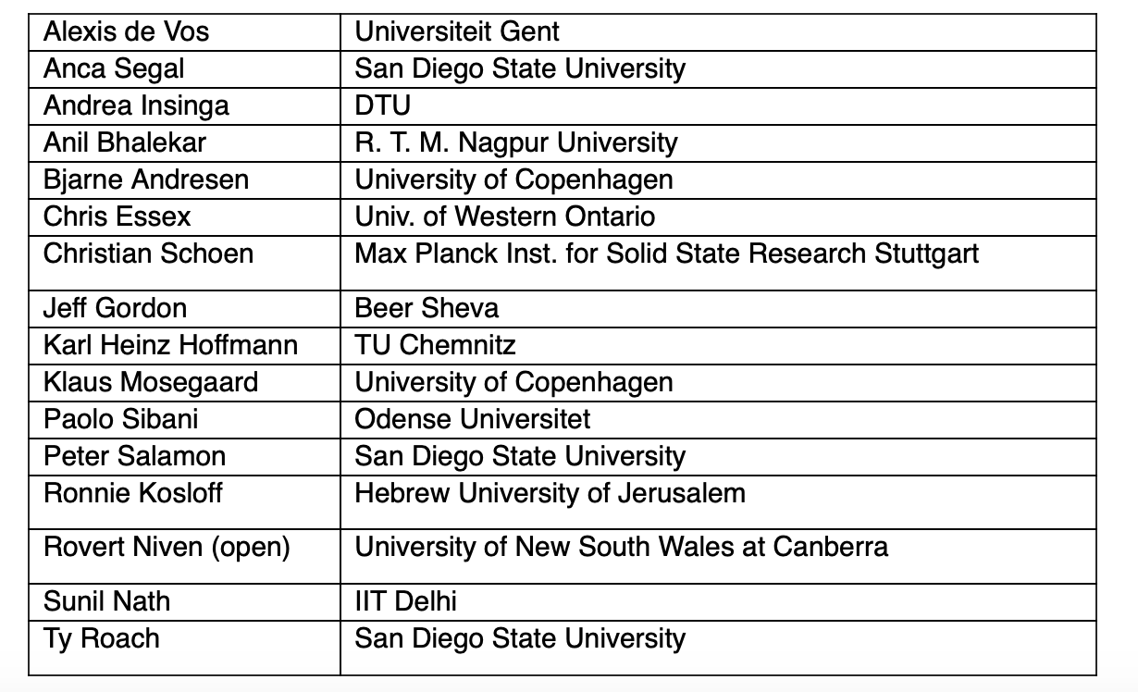
Participant List

Slide 24
Entropy Production for a Small Equilibration
System near equilibrium with the bath
Intensities of bath constant
Bath
System
Expand ΔS_{system} around final state of equilibrium
X=(U,V,…)
/2
Notes:
Bastard notation

Slide 25
