Slide 1
Photo Album
Prof. Bjarne Andresen
Visits to India during 2008 and 2017
Prepared by
Dr. Vijay M. Tangde
Department of Chemistry
Rashtrasant Tukadoji Maharaj Nagpur University, Nagpur

Slide 2
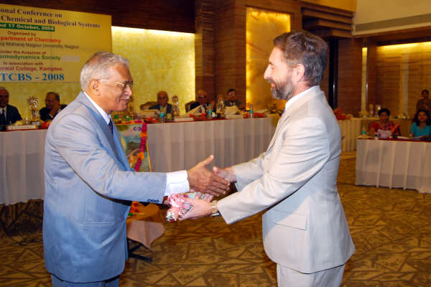
Welcome of Prof. B. Andresen by Prof. A. A. Bhalekar at the 3rd National Conference on Thermodynamics of Chemical and Biological Systems (NCTCBS-2008) at Nagpur during October 2008.

Slide 3
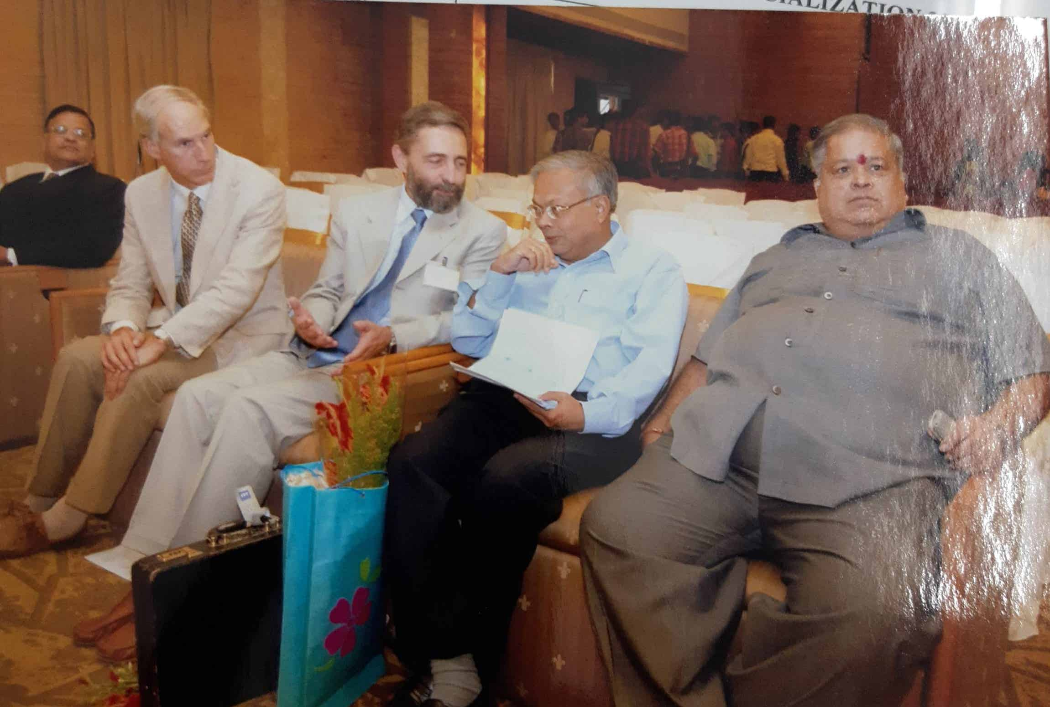
Prof. B. Andresen with Prof. Tapan Chakravarty, Dr. Parashar (Pro Vice Chancellor), David Jou and other guest speaker at the 3rd National Conference on Thermodynamics of Chemical and Biological Systems (NCTCBS-2008) at Nagpur during October 2008.

Slide 4
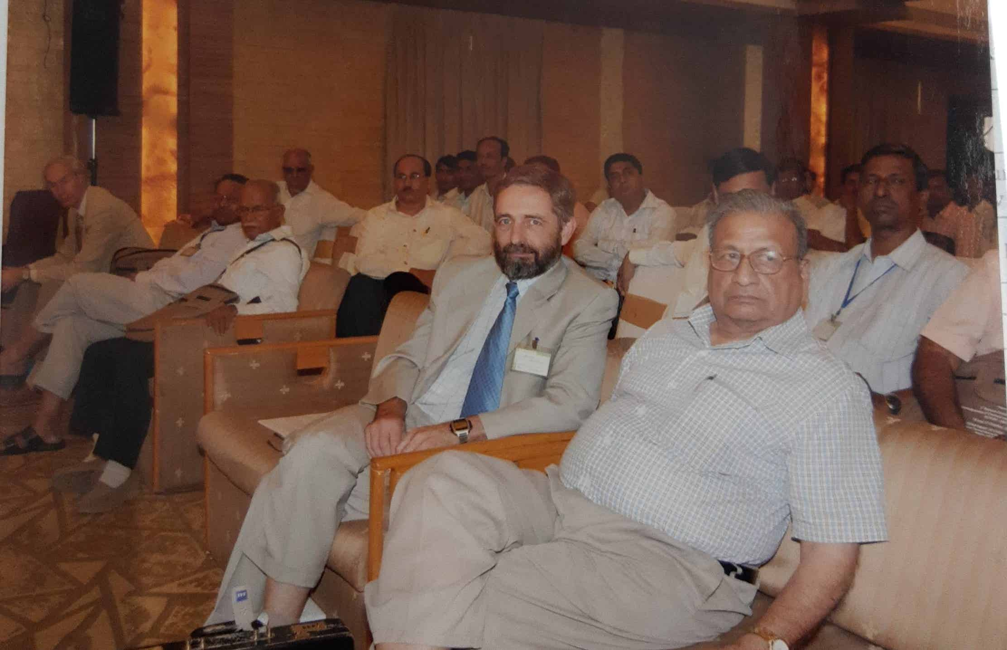
Prof. B. Andresen with Prof. D. V. S. Jain (President of the Indian Thermodynamics Society) at the 3rd National Conference on Thermodynamics of Chemical and Biological Systems (NCTCBS-2008) at Nagpur during October 2008.

Slide 5
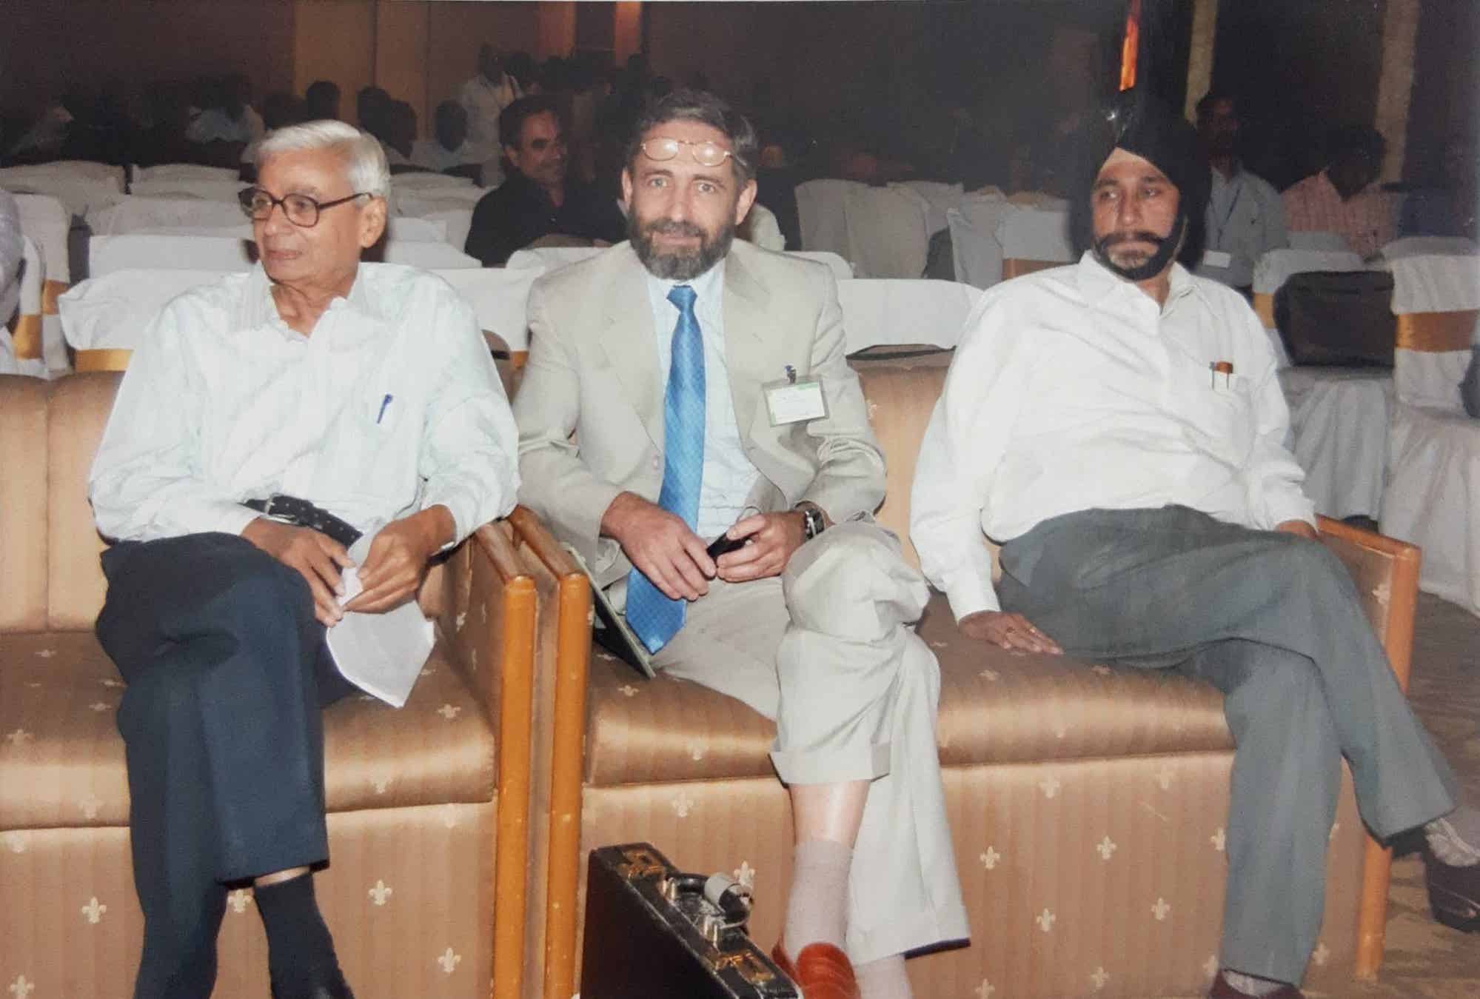
Prof. B. Andresen with Prof. H. D. Juneja (Head of the Department of Chemistry) and Professor Ahluvalia at the 3rd National Conference on Thermodynamics of Chemical and Biological Systems (NCTCBS-2008) at Nagpur during October 2008.

Slide 6
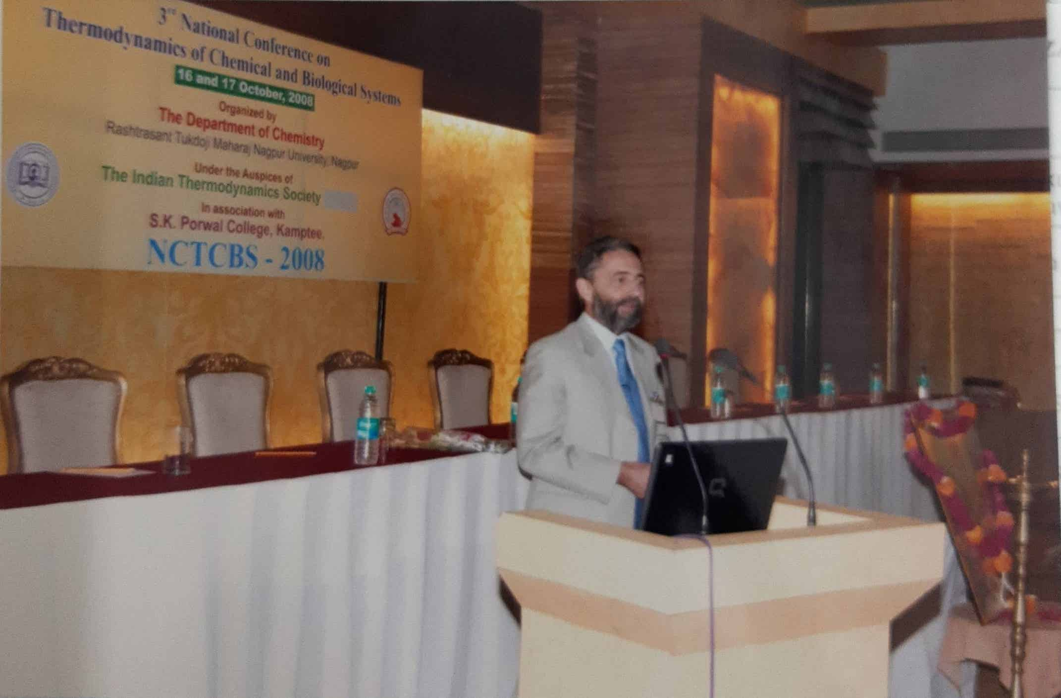
Prof. B. Andresen delivering Keynote address at the 3rd National Conference on Thermodynamics of Chemical and Biological Systems (NCTCBS-2008) at Nagpur during October 2008.

Slide 7
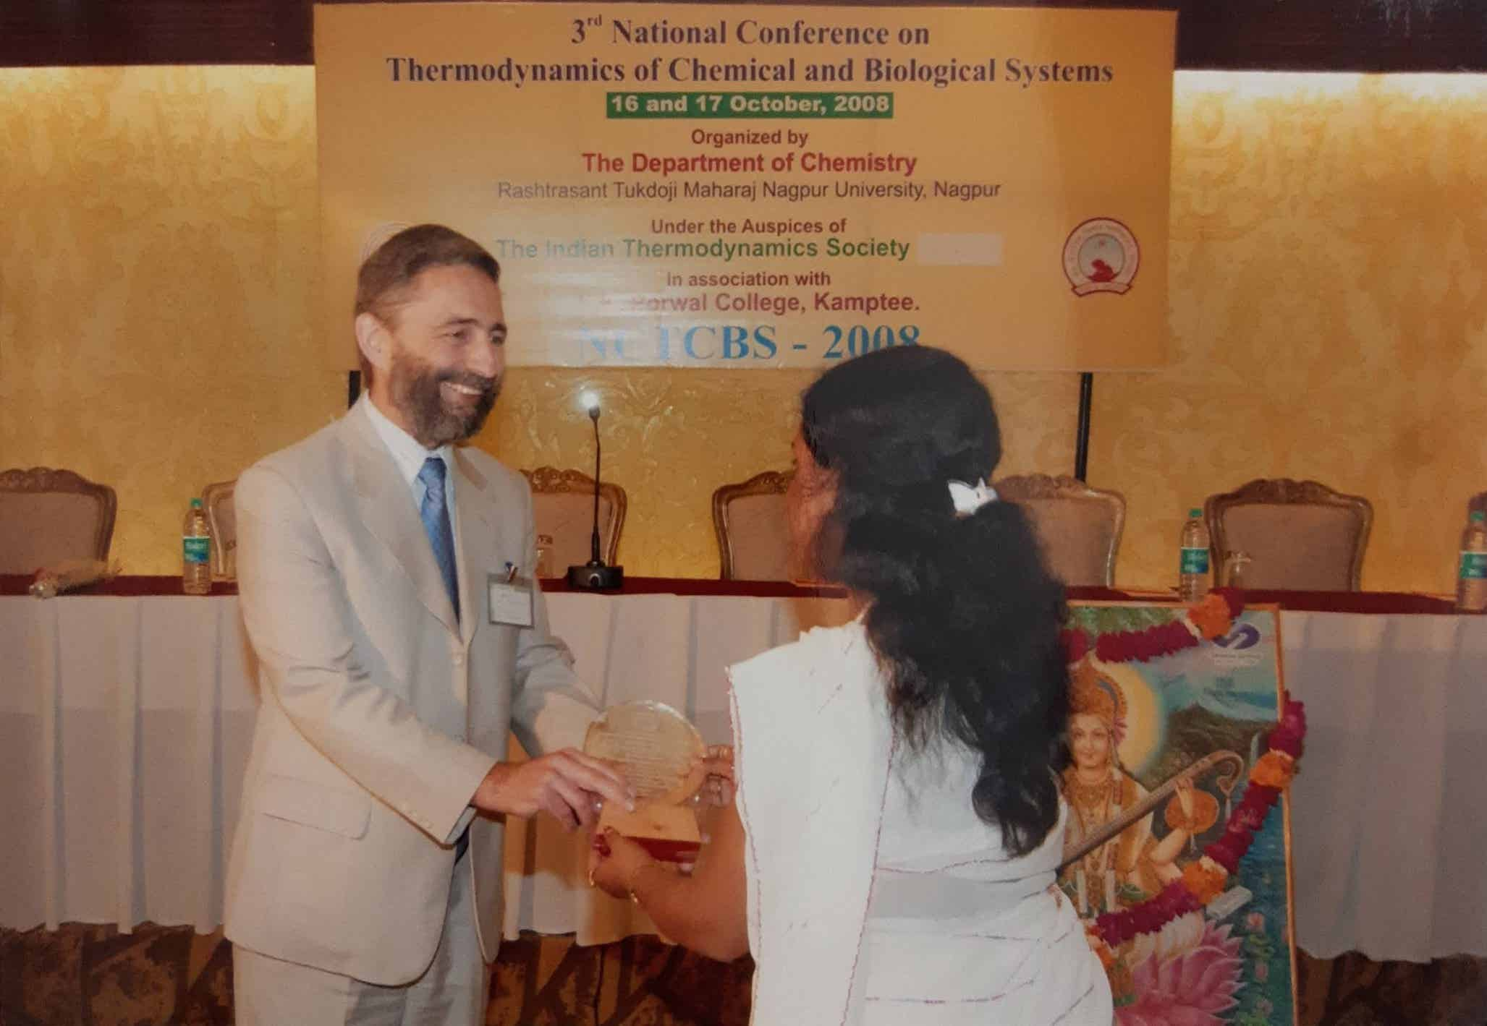
Present of memento to Prof. B. Andresen at the 3rd National Conference on Thermodynamics of Chemical and Biological Systems (NCTCBS-2008) at Nagpur during October 2008.

Slide 8
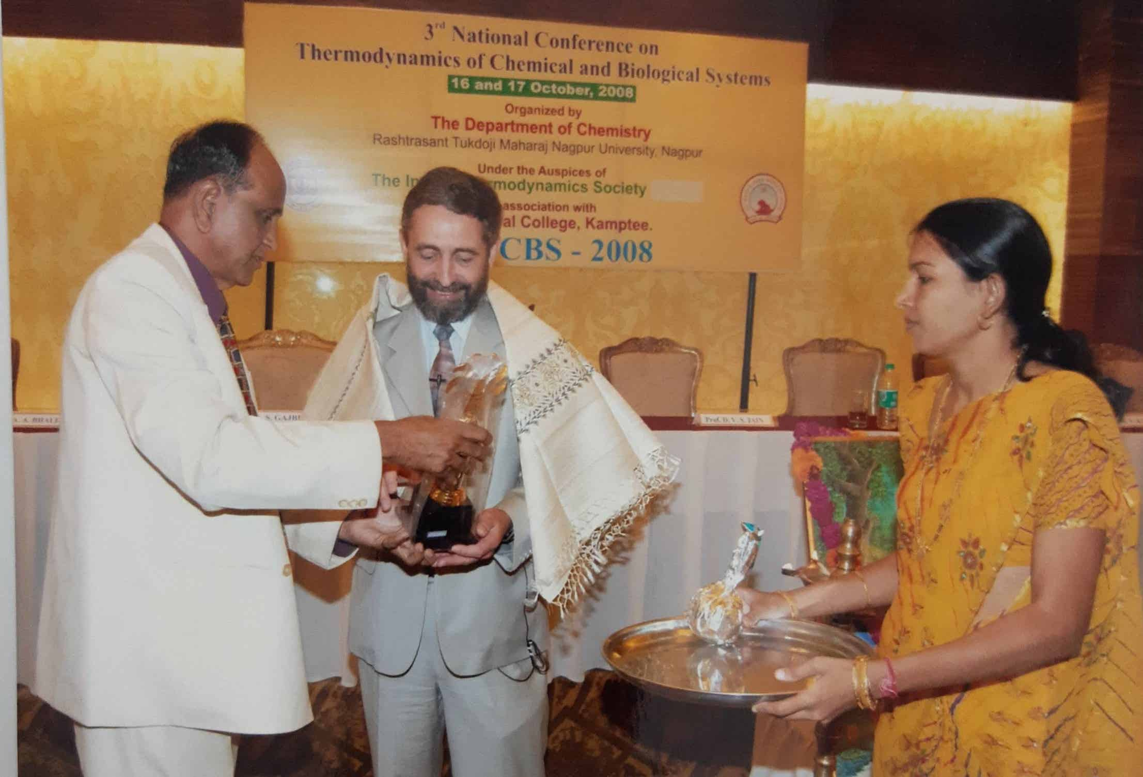
Felicitation of Prof. B. Andresen by Prof. G. S. Natarajan at the 3rd National Conference on Thermodynamics of Chemical and Biological Systems (NCTCBS-2008) at Nagpur during October 2008 also you see my student Dr Seema Rawat.

Slide 9
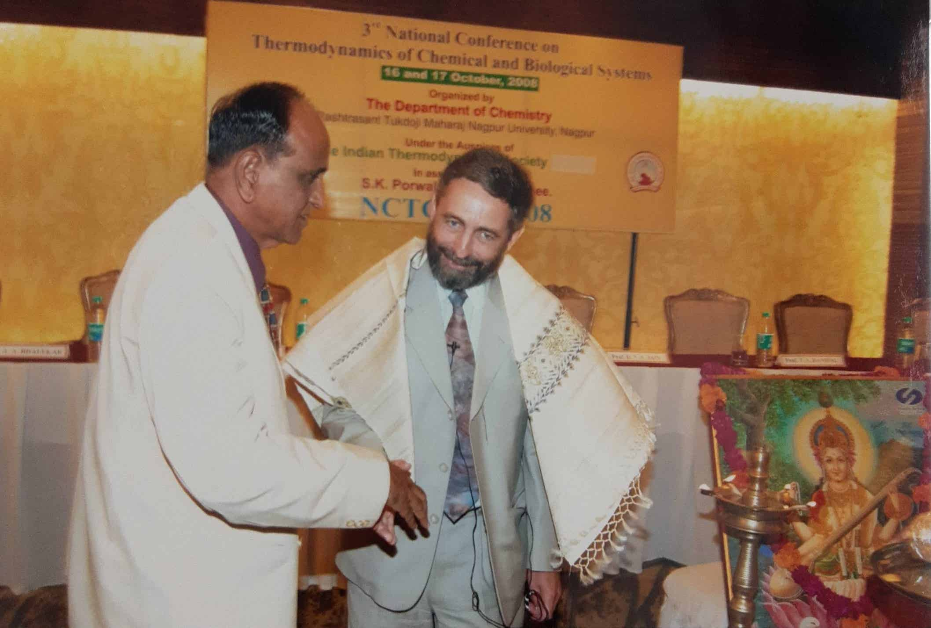
Prof. B. Andresen and Prof. G. S. Natarajan – An informal discussion.

Slide 10
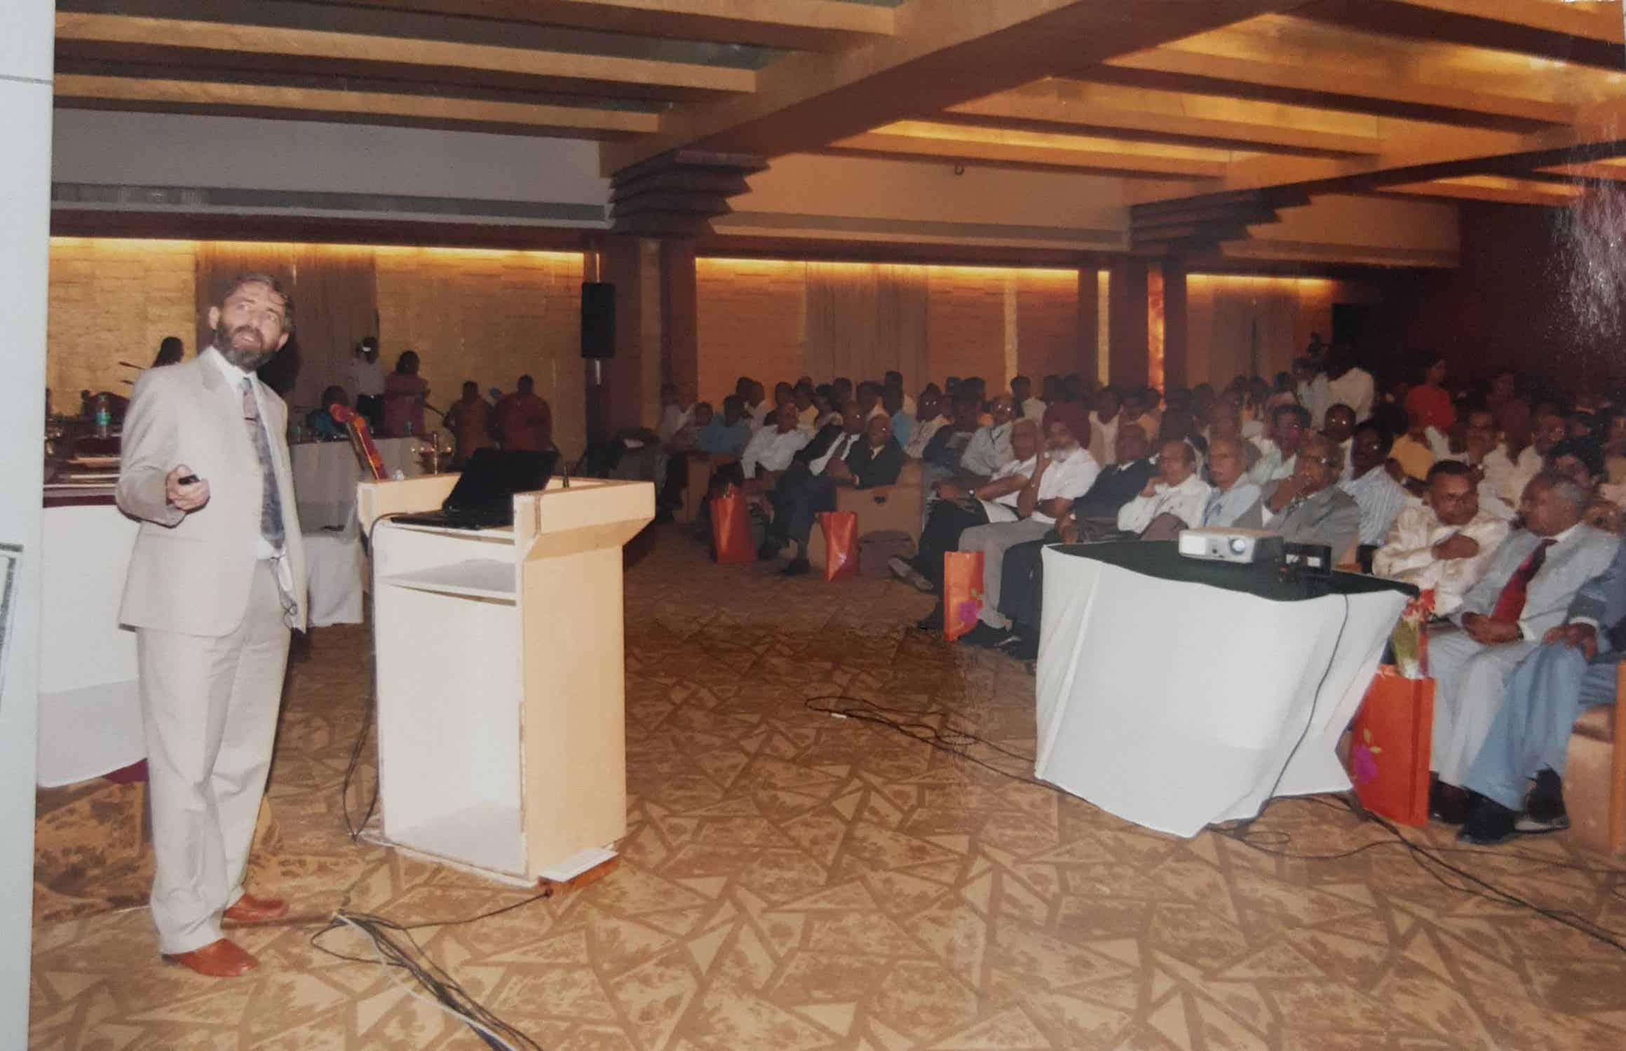
Prof. B. Andresen delivering Keynote Address at the 3rd National Conference on Thermodynamics of Chemical and Biological Systems (NCTCBS-2008) at Nagpur during October 2008.

Slide 11
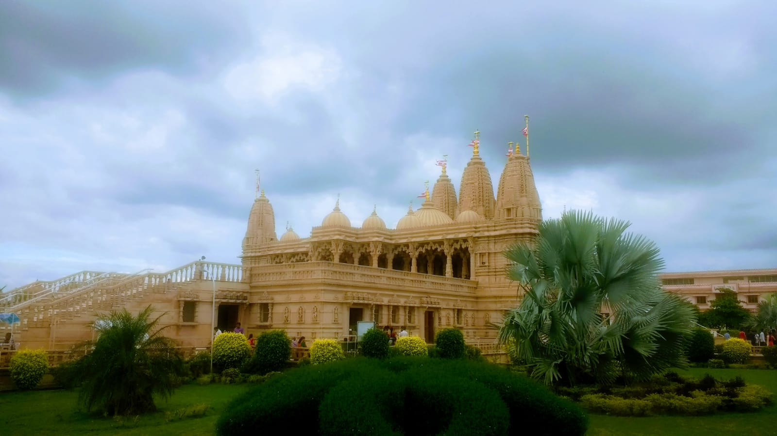
A beautiful view of Swaminarayan Temple in Nagpur

Slide 12
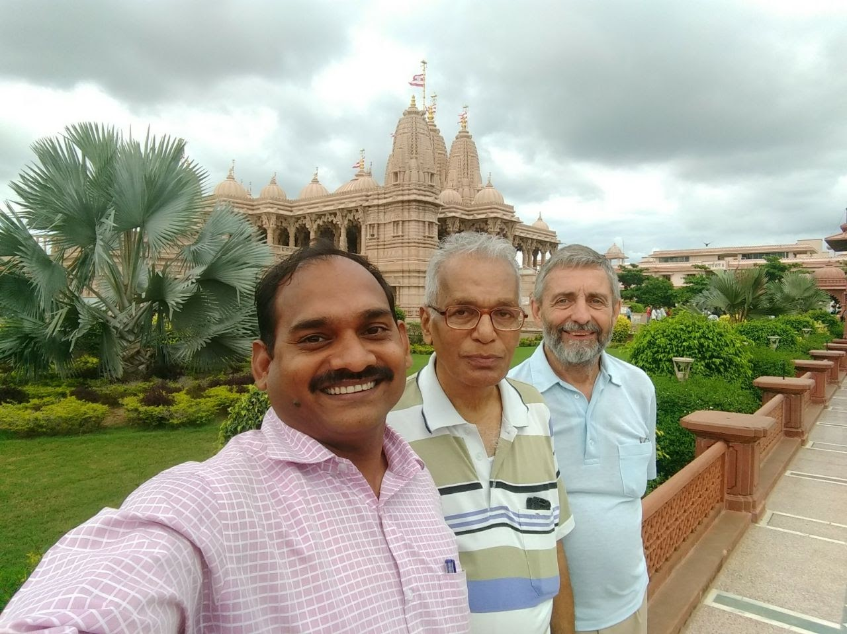
Visit to Swaminarayan Temple with Prof. A. A. Bhalekar and Dr. V. M. Tangde during his visit to Nagpur in 2017.

Slide 13
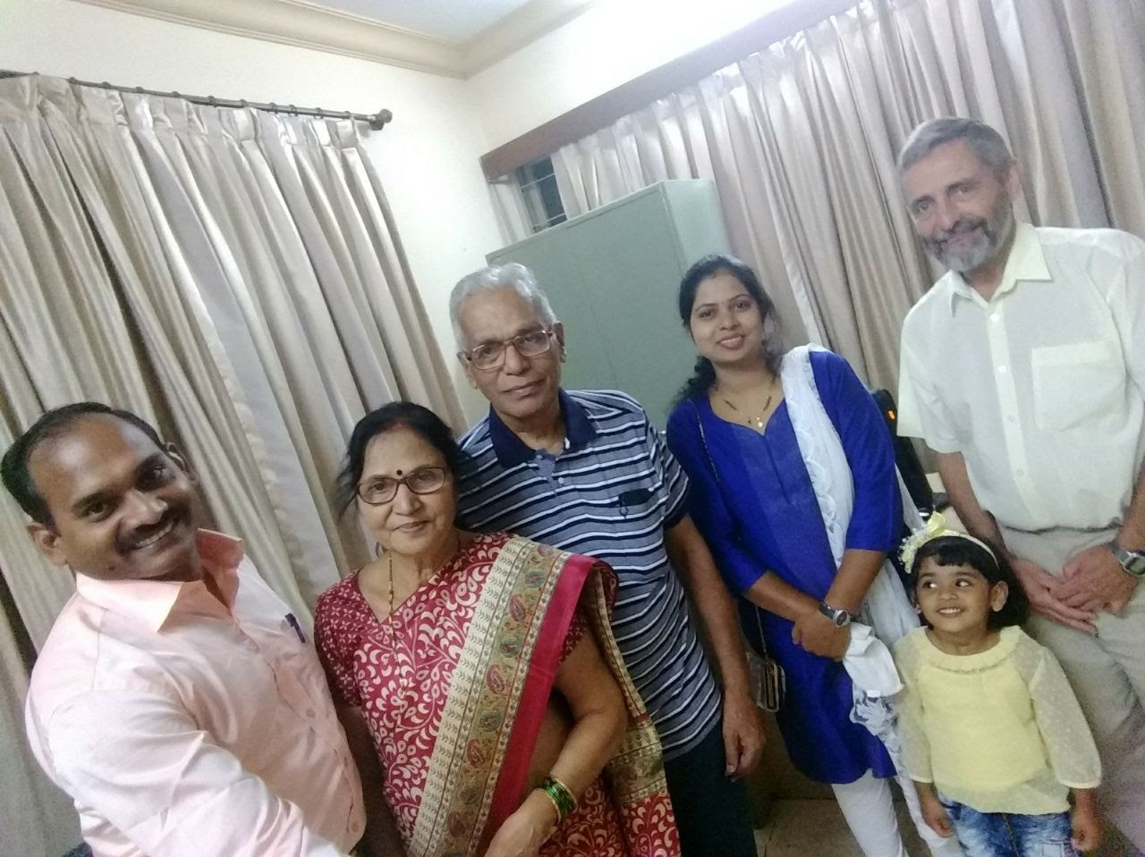
Family photo
From left, Dr. V. Tangde, Mrs. A. Bhalekar, Prof. A. Bhalekar, Mrs. D. Tangde, Ms. Nabha Tangde and Prof. B. Andresen.

Slide 14
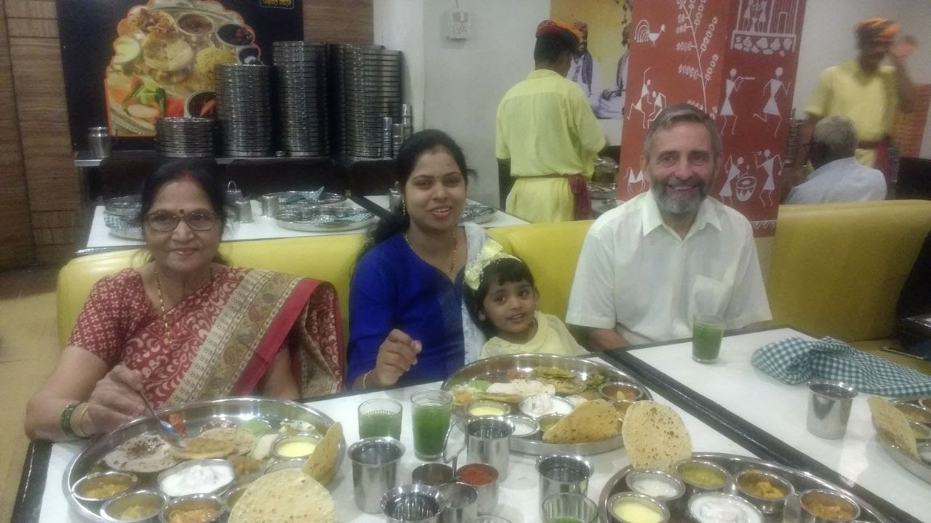
Prof. B. Andresen visited Nagpur in August 2017. Dinner with family members of Prof. A. A. Bhalekar and Dr. V. M. Tangde (Student of Prof. A. A. Bhalekar).

Slide 15
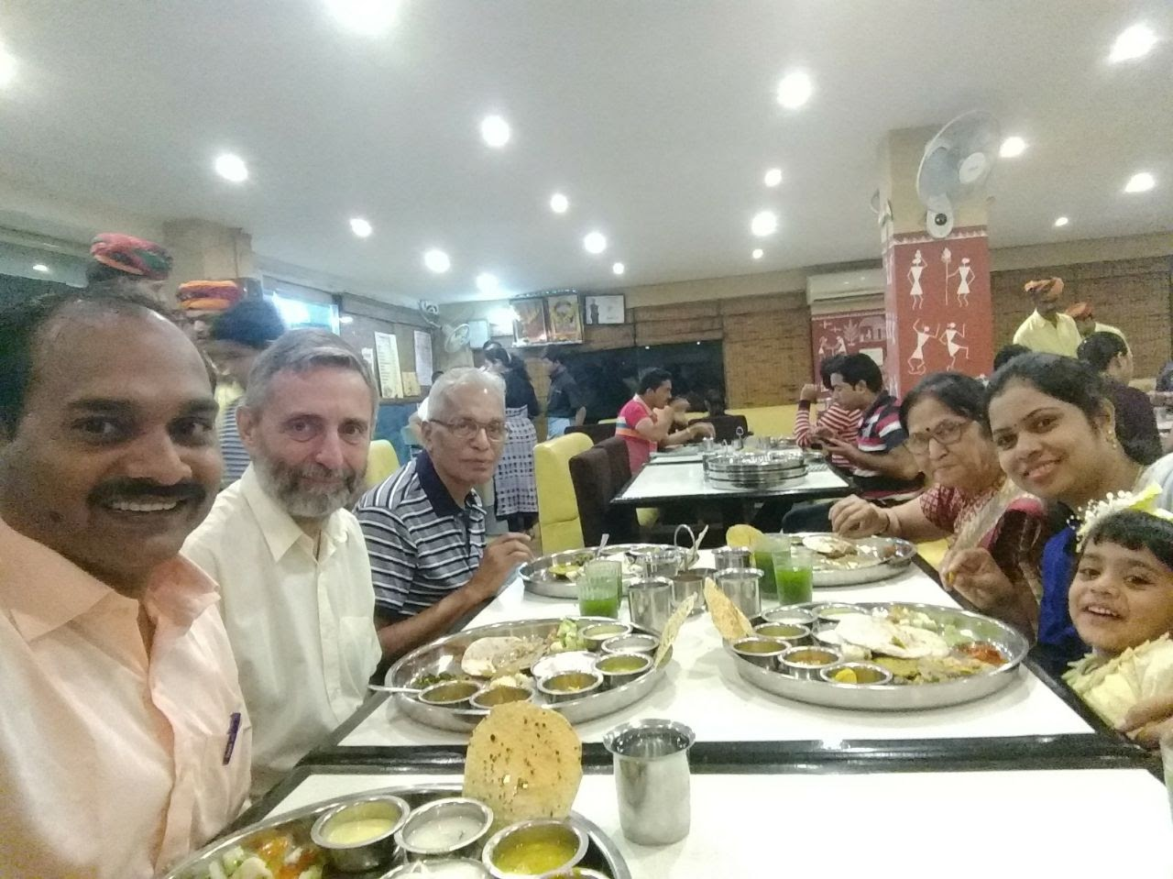
Family photo
Dinner – A typically Indian (Rajasthani Thali (plate)) at local restaurant.

Slide 16
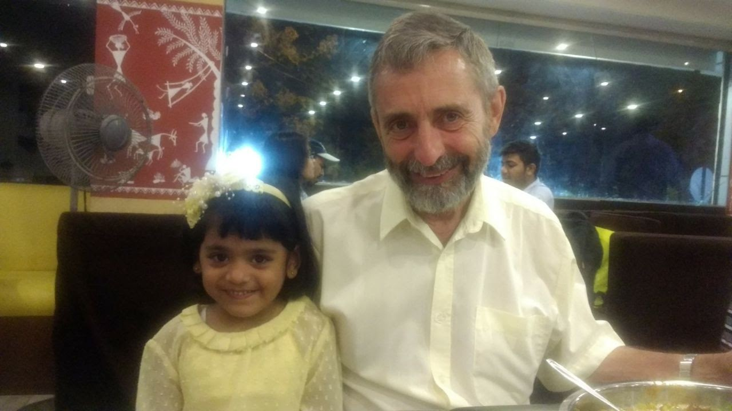
Prof. B. Andresen with my daughter (Nabha Tangde).

Slide 17
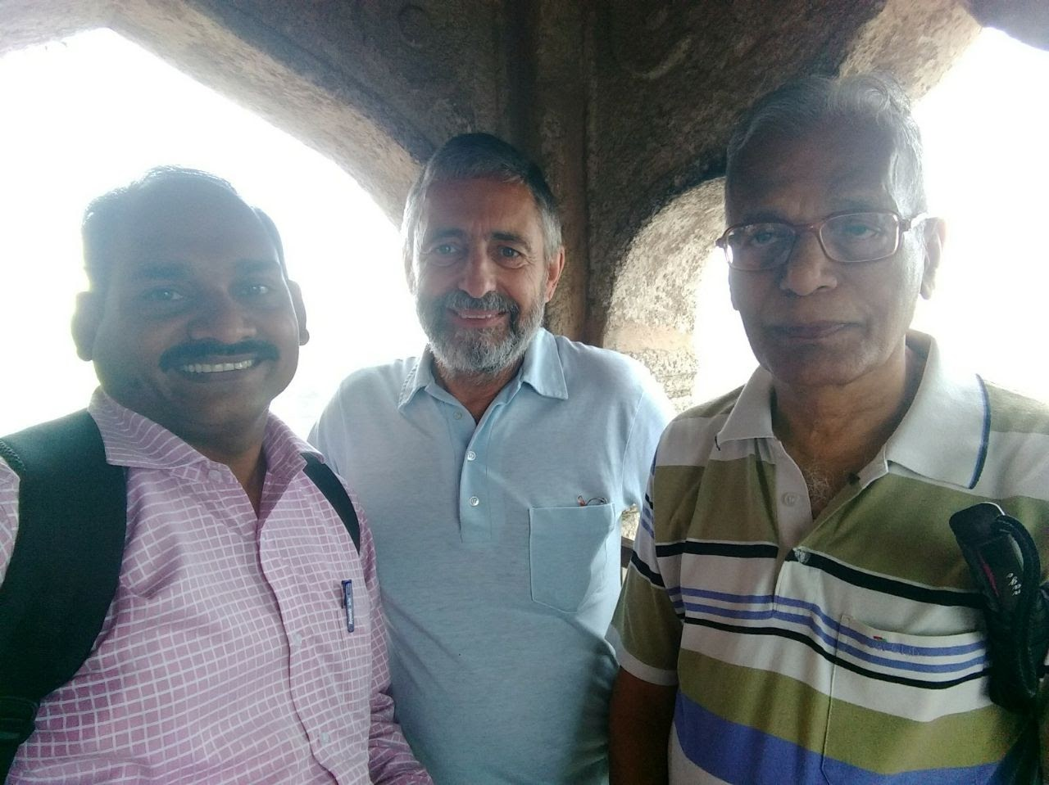
Visit to Lord Ram Temple at Ramtek. This temple is actually a fort built at a very high hill which is near by 40 km from Nagpur. Ramtek is a famous religious place. A photo taken from the top most point of the temple.

Slide 18
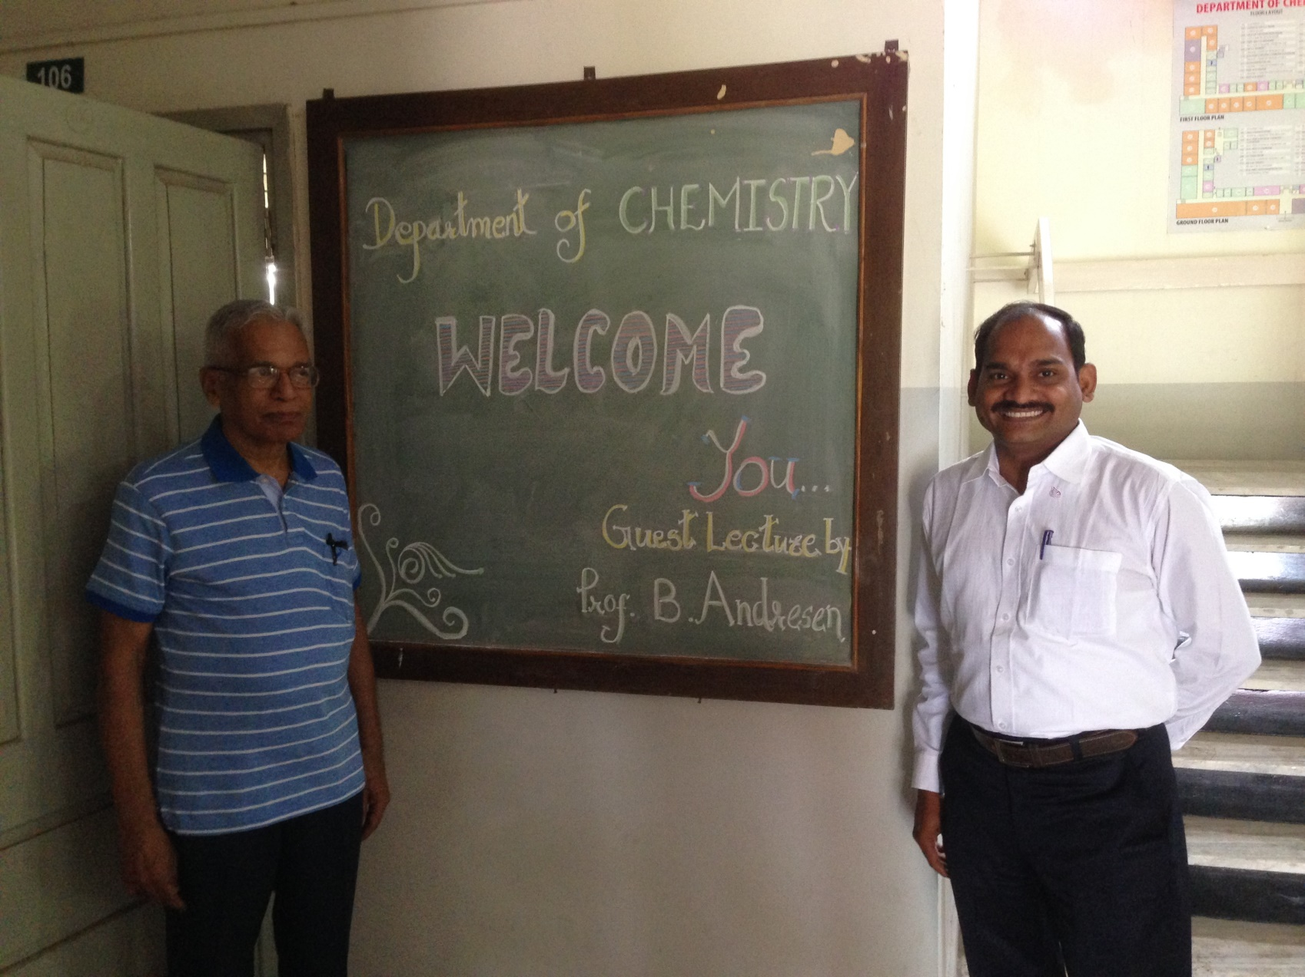
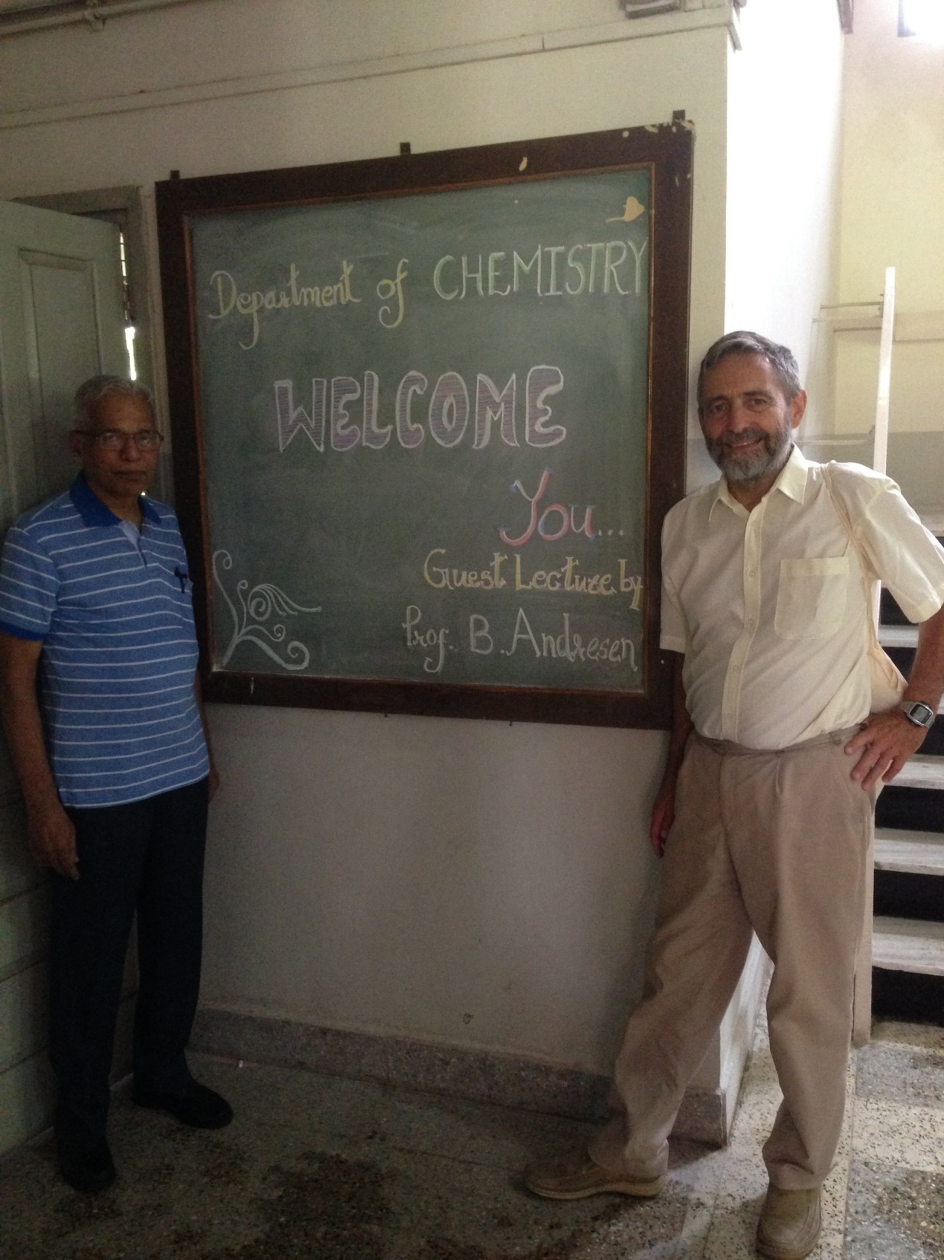
Guest lecture by Prof. B. Andresen at the Department of Chemistry, Rashtrasant Tukadoji Maharaj Nagpur University in 2017.

Slide 19
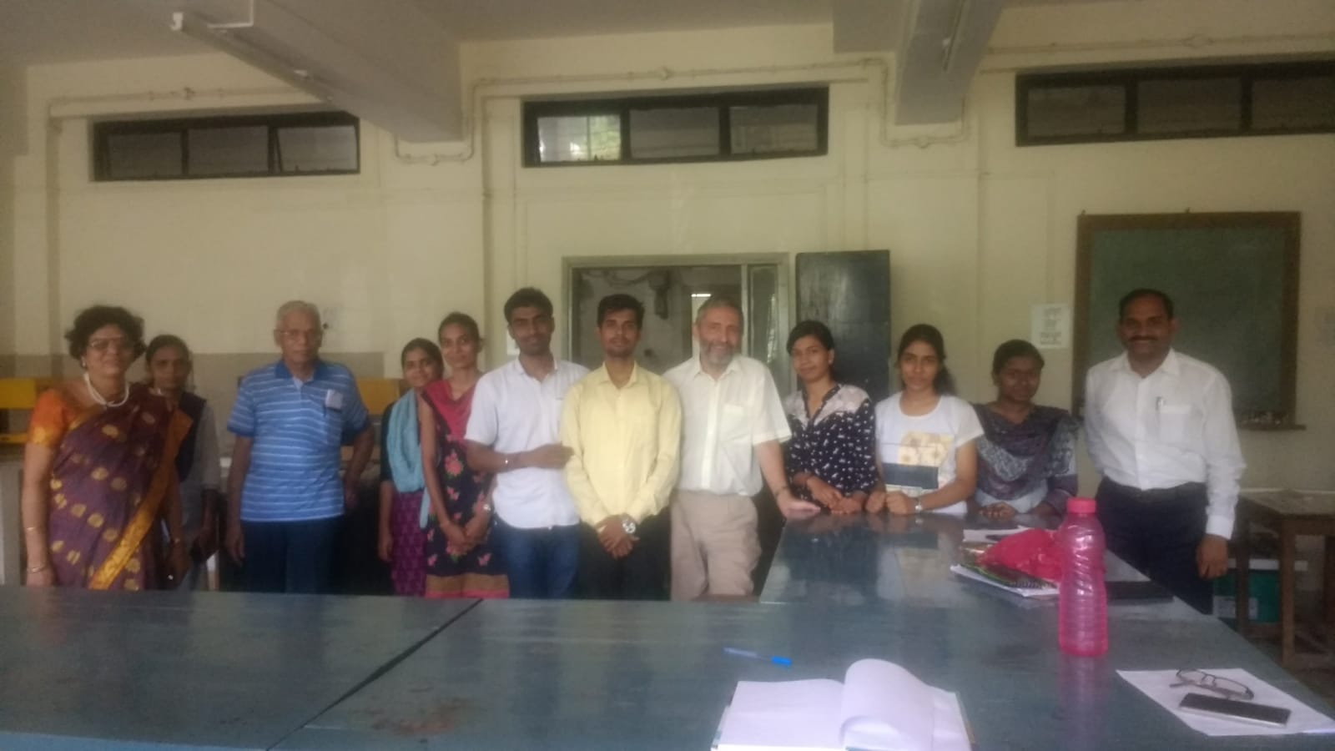
Prof. B. Andresen Visit to M.Sc. Physical Chemistry Laboratory. Students of Physical Chemistry M.Sc.

Slide 20
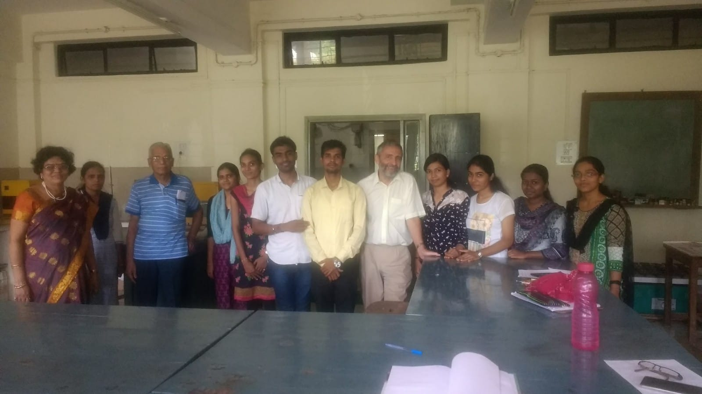

Slide 21
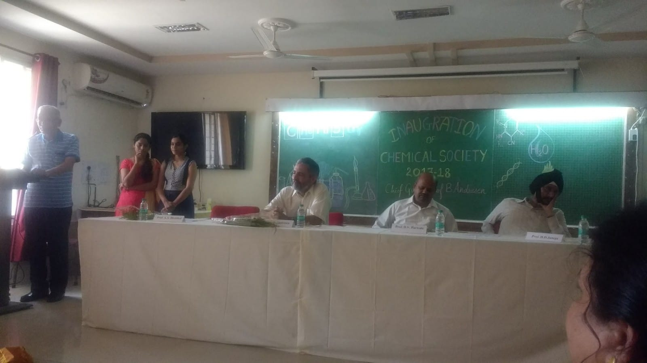
Introduction of Prof. B. Andresen by Prof. A. A. Bhalekar to the audience at the Department of Chemistry, Rashtrasant Tukadoji Maharaj Nagpur University, Nagpur during August 2017.

Slide 22
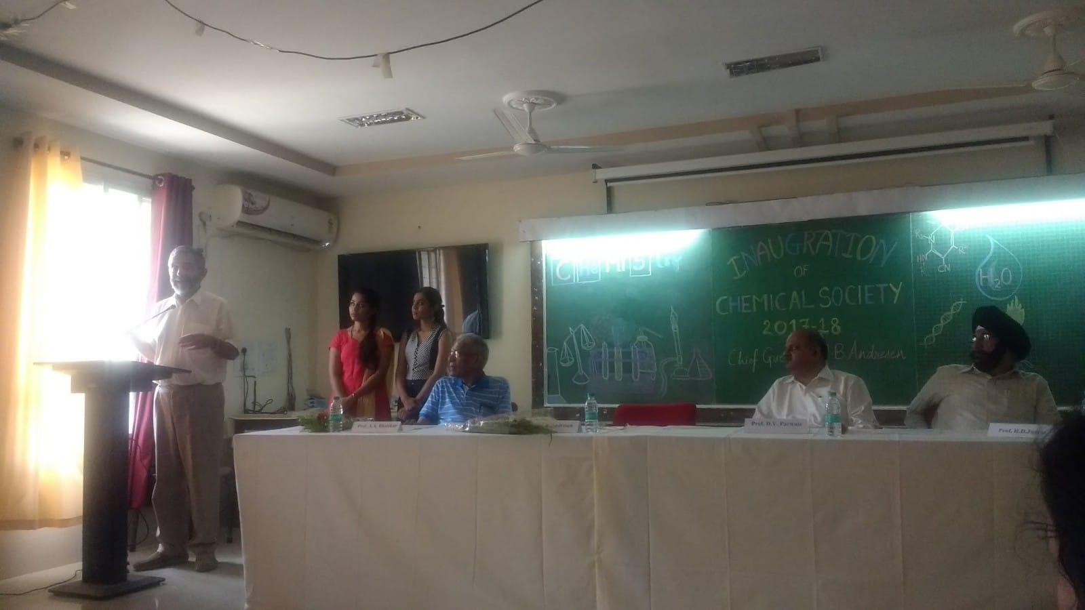
General address of Prof. B. Andresen to the audience at the Department of Chemistry, Rashtrasant Tukadoji Maharaj Nagpur University, Nagpur during August 2017.

Slide 23
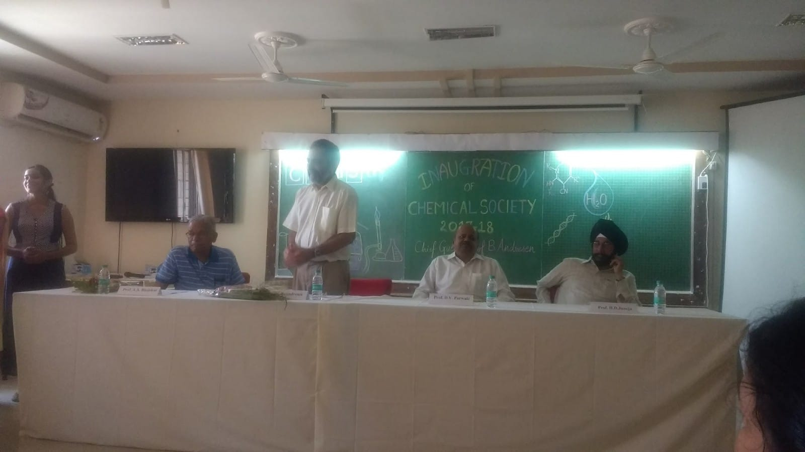
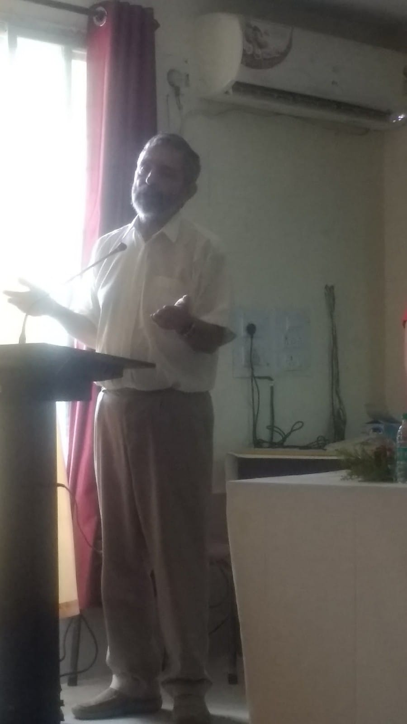

Slide 24
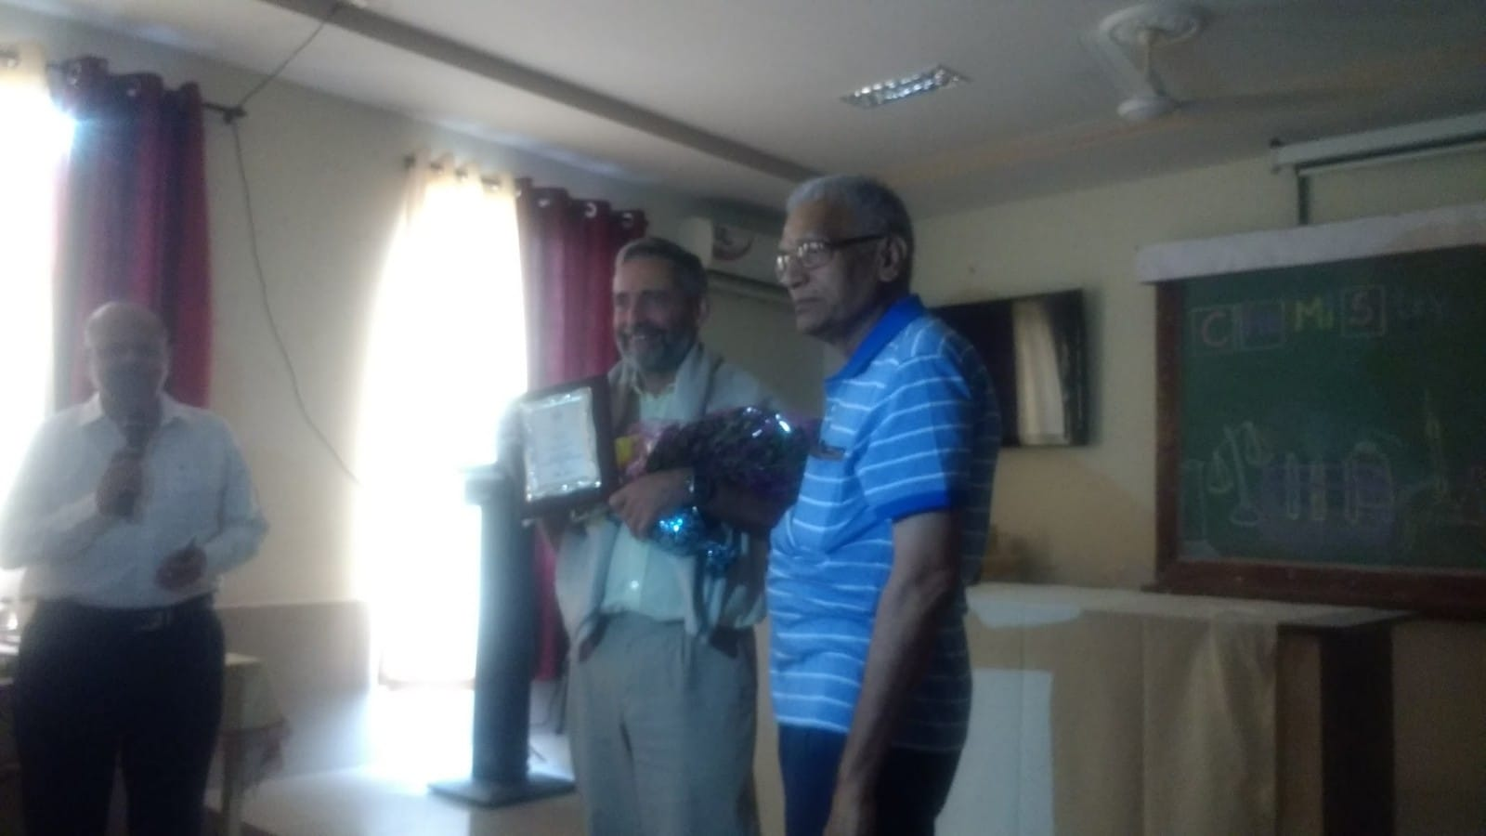
Felicitation of Prof. B. Andresen by Prof. A. A. Bhalekar at the Department of Chemistry, Rashtrasant Tukadoji Maharaj Nagpur University, Nagpur during August 2017.

Slide 25
Guest lecture by Prof. B. Andresen at the Department of Chemistry, Rashtrasant Tukadoji Maharaj Nagpur University, Nagpur during August 2017.

Slide 26
Thank You

