Slide 1



Fast eccentric and inclined inspirals into a rotating black hole
Philip Lynch
Collaborators: Niels Warburton, Maarten van de Meent and Vojtech Witzany

Slide 2
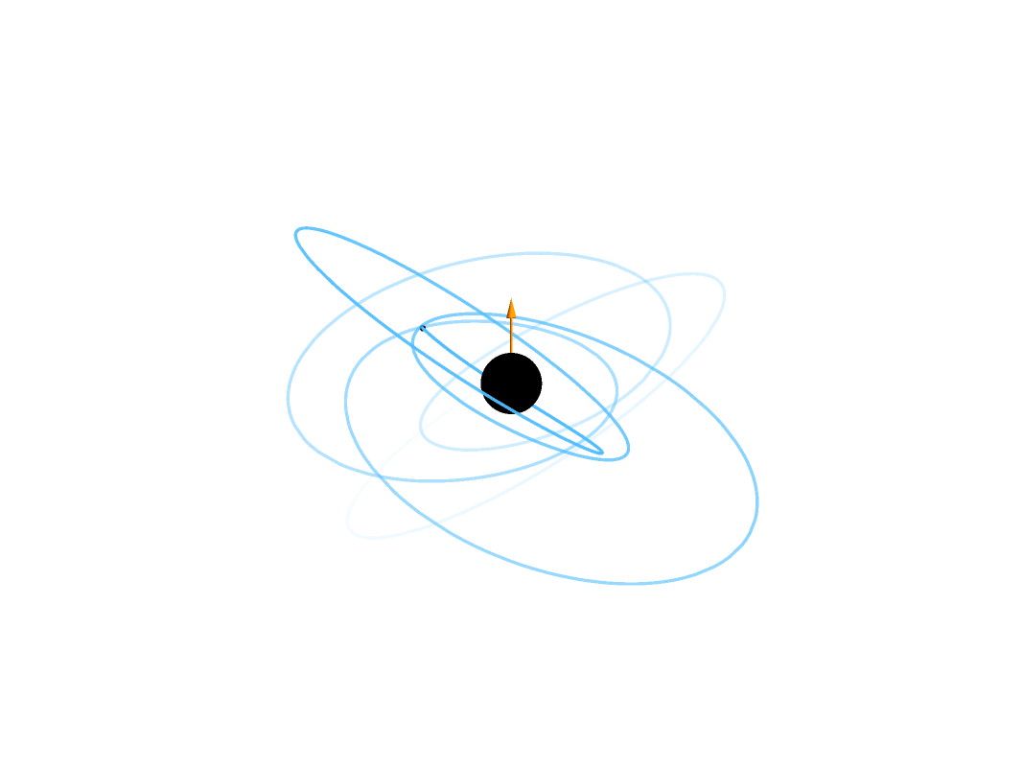
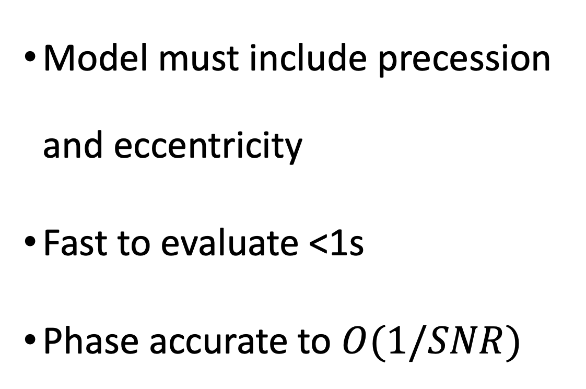
Requirements for LISA
Model must include precession and eccentricity
Fast to evaluate <1s
Phase accurate to $O(1/SNR)$

Slide 3
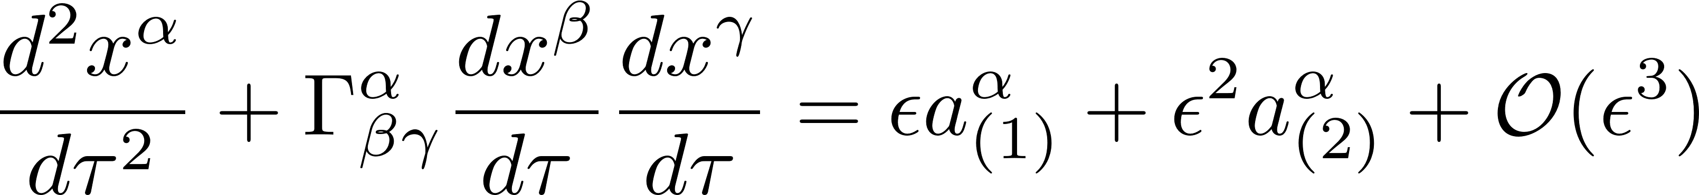
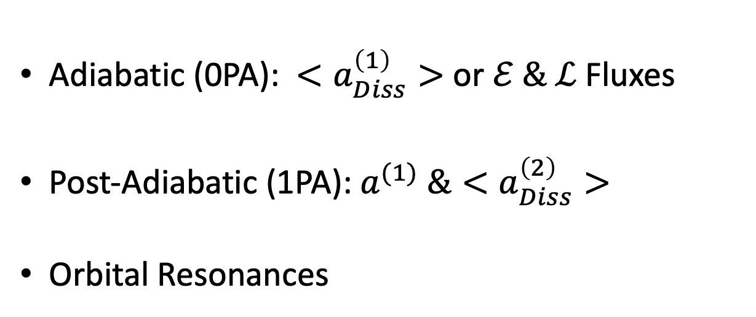
Adiabatic (0PA): $<a_{Diss}^{\left(1\right)}>$ or $ℰ \& ℒ$ Fluxes
Post-Adiabatic (1PA):$a^{(1)} \&<a_{Diss}^{\left(2\right)}>$
Orbital Resonances

Slide 4
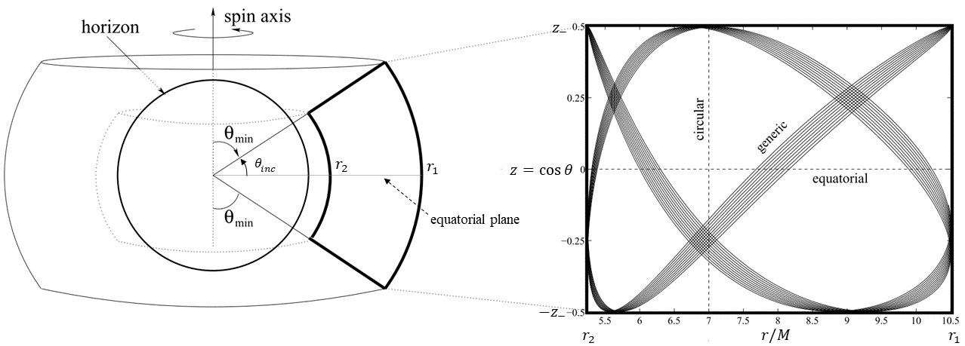
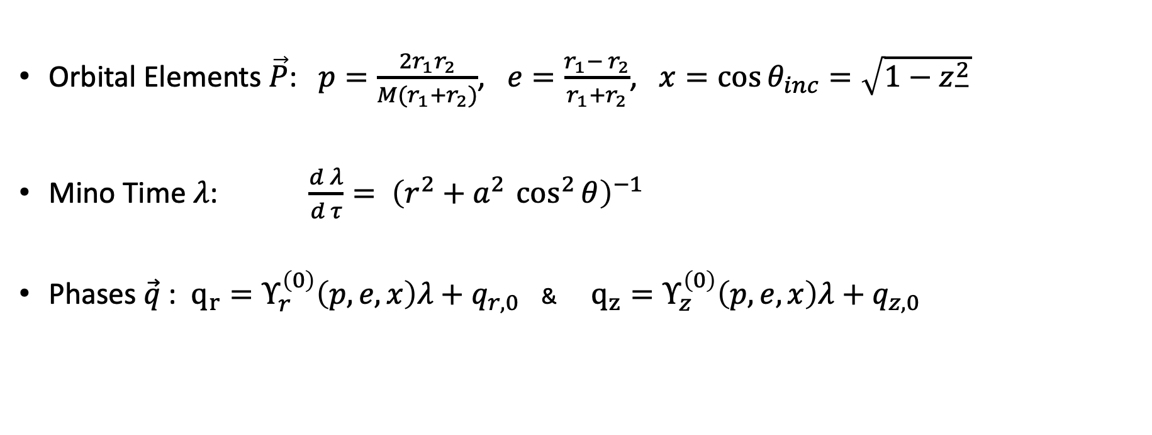
Geodesic Motion in Kerr Spacetime
Orbital Elements $\vec{P}$: $p=\frac{2r_{1}r_{2}}{M(r_{1}+r_{2})}$, $e=\frac{r_{1}− r_{2}}{r_{1}+r_{2}}$, $x=\cos{θ_{inc}}=\sqrt{1−z_{−}^{2}}$
Mino Time $λ$: $\frac{d λ}{d τ}= {\left(r^{2}+a^{2 }\cos^{2}{θ}\right)}^{−1}$
Phases$\vec{q}$: $q_{r}=Υ_{r}^{\left(0\right)}\left(p,e,x\right)λ+q_{r,0}$ & $q_{z}=Υ_{z}^{\left(0\right)}\left(p,e,x\right)λ+q_{z,0}$

Slide 5
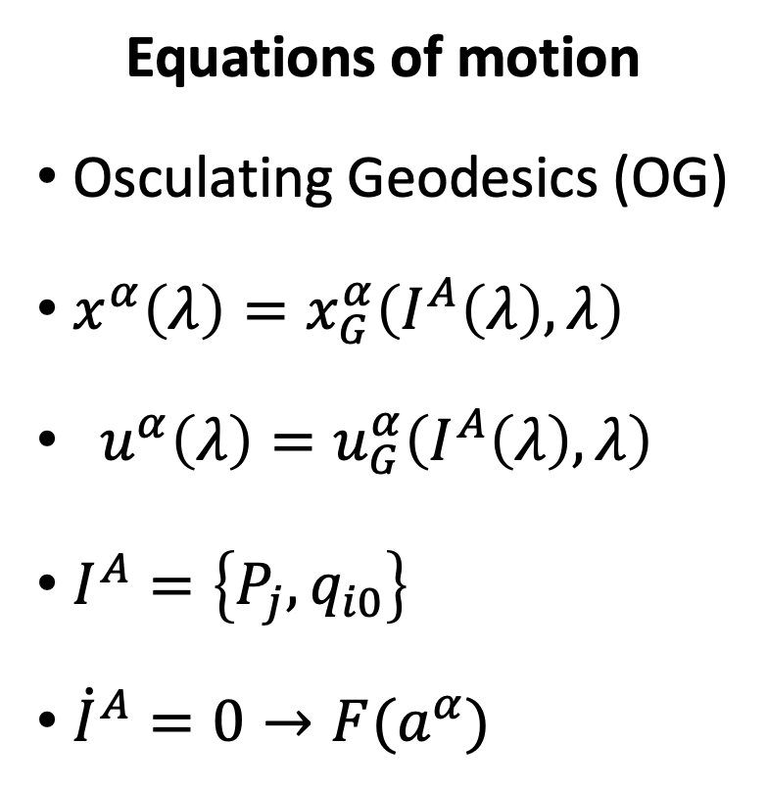
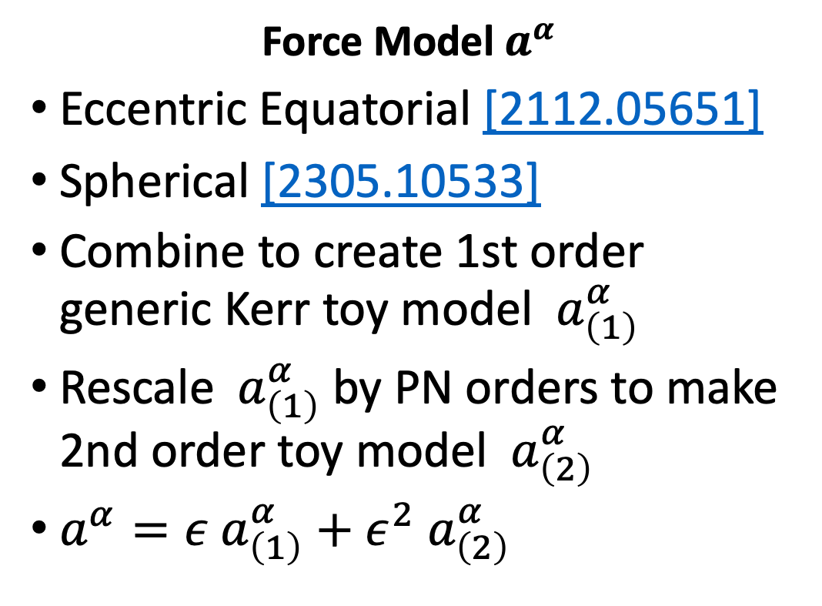
Generic Kerr Inspirals
Equations of motion
Osculating Geodesics (OG)
$x^{α}\left(λ\right)=x_{G}^{α}\left(I^{A}\left(λ\right), λ\right)$
${ u}^{α}\left(λ\right)=u_{G}^{α}\left(I^{A}\left(λ\right), λ\right)$
$I^{A}=\left\{P_{j},q_{i0}\right\}$
${\dot{I}}^{A}=0→F(a^{α})$
Force Model $a^{α}$
Eccentric Equatorial [2112.05651]
Spherical [2305.10533]
Combine to create 1st order generic Kerr toy model ${ a}_{\left(1\right)}^{α}$
Rescale ${ a}_{\left(1\right)}^{α}$by PN orders to make 2nd order toy model ${ a}_{\left(2\right)}^{α}$
$a^{α}={ε a}_{\left(1\right)}^{α}+{ε^{2} a}_{\left(2\right)}^{α}$

Slide 6
Osculating Geodesics (OG)
Near Identity Transformations (NITs)
Averaged EOM
Notes:
This needs a lot of work

Slide 7
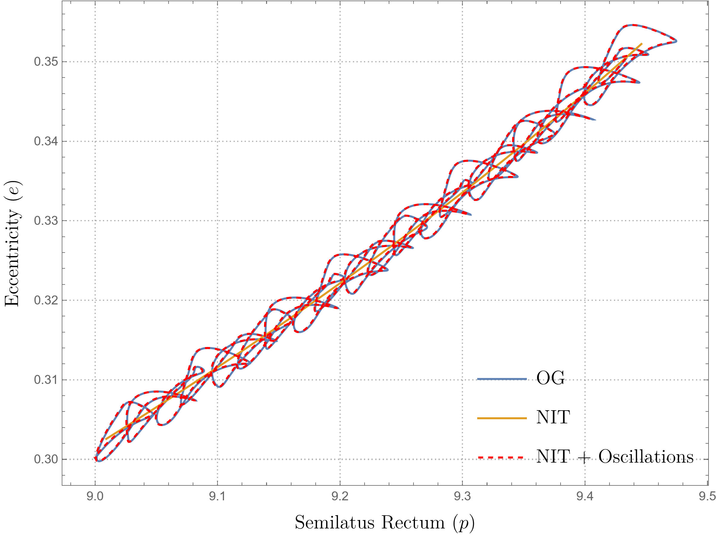

Slide 8
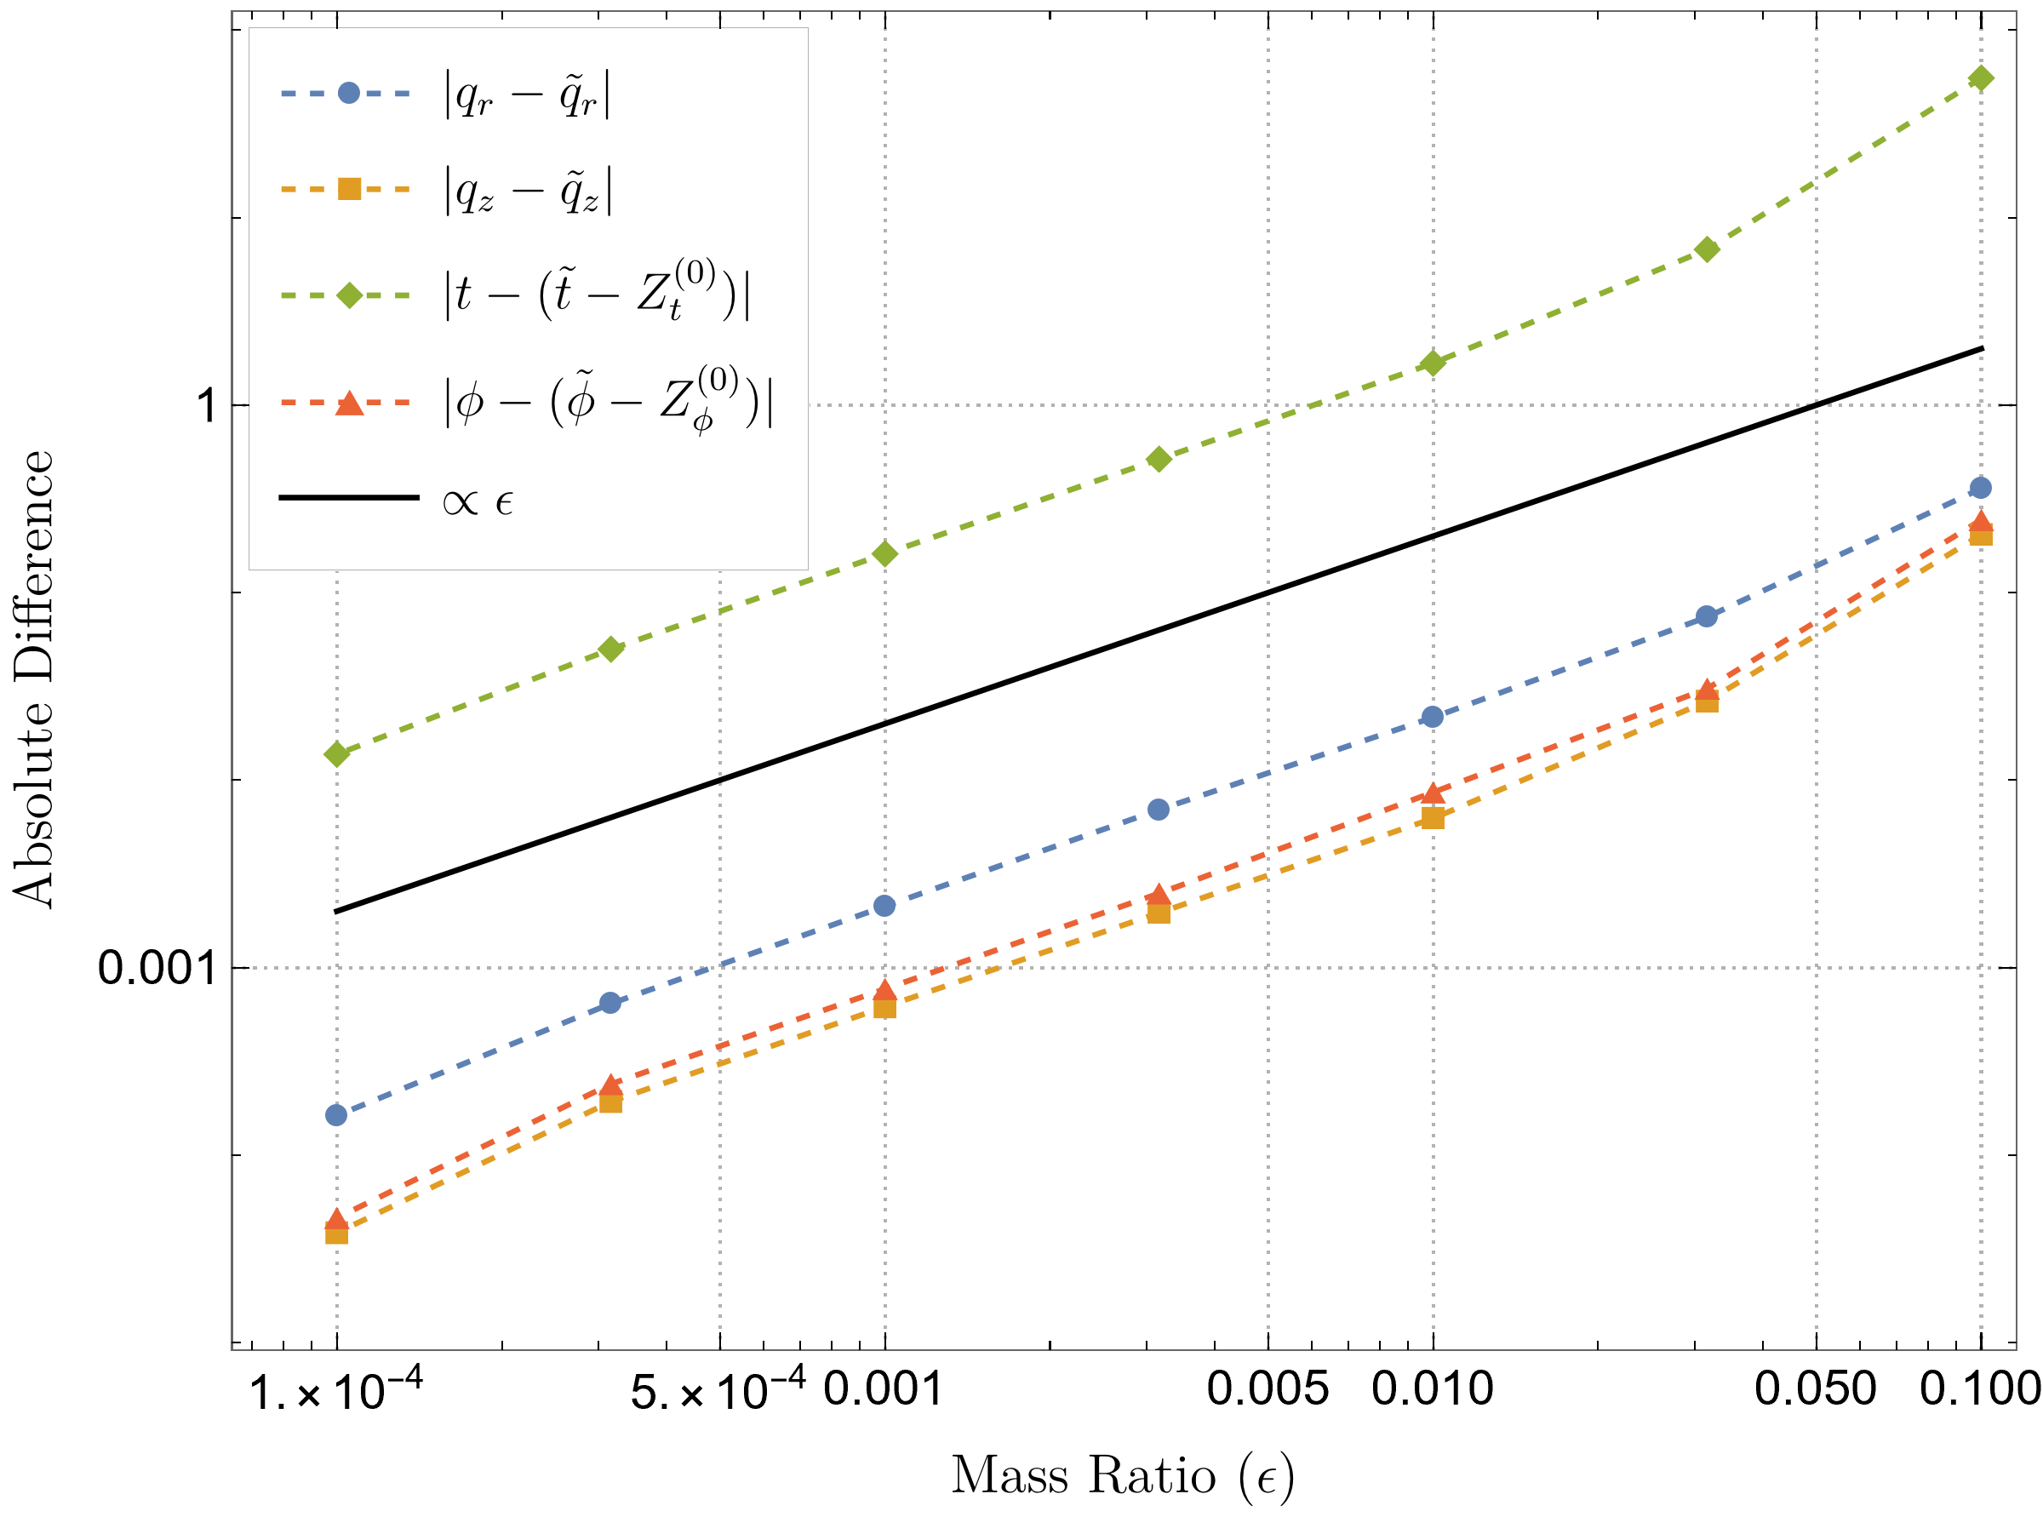
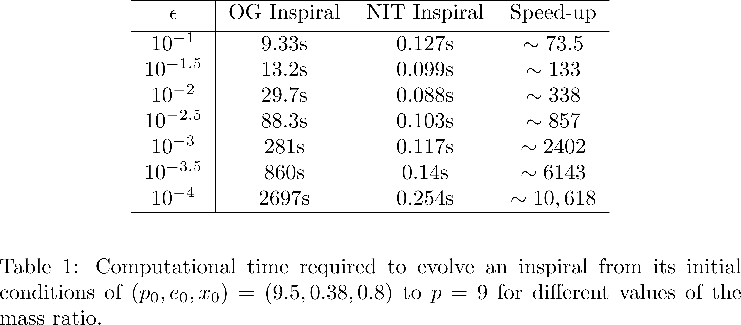
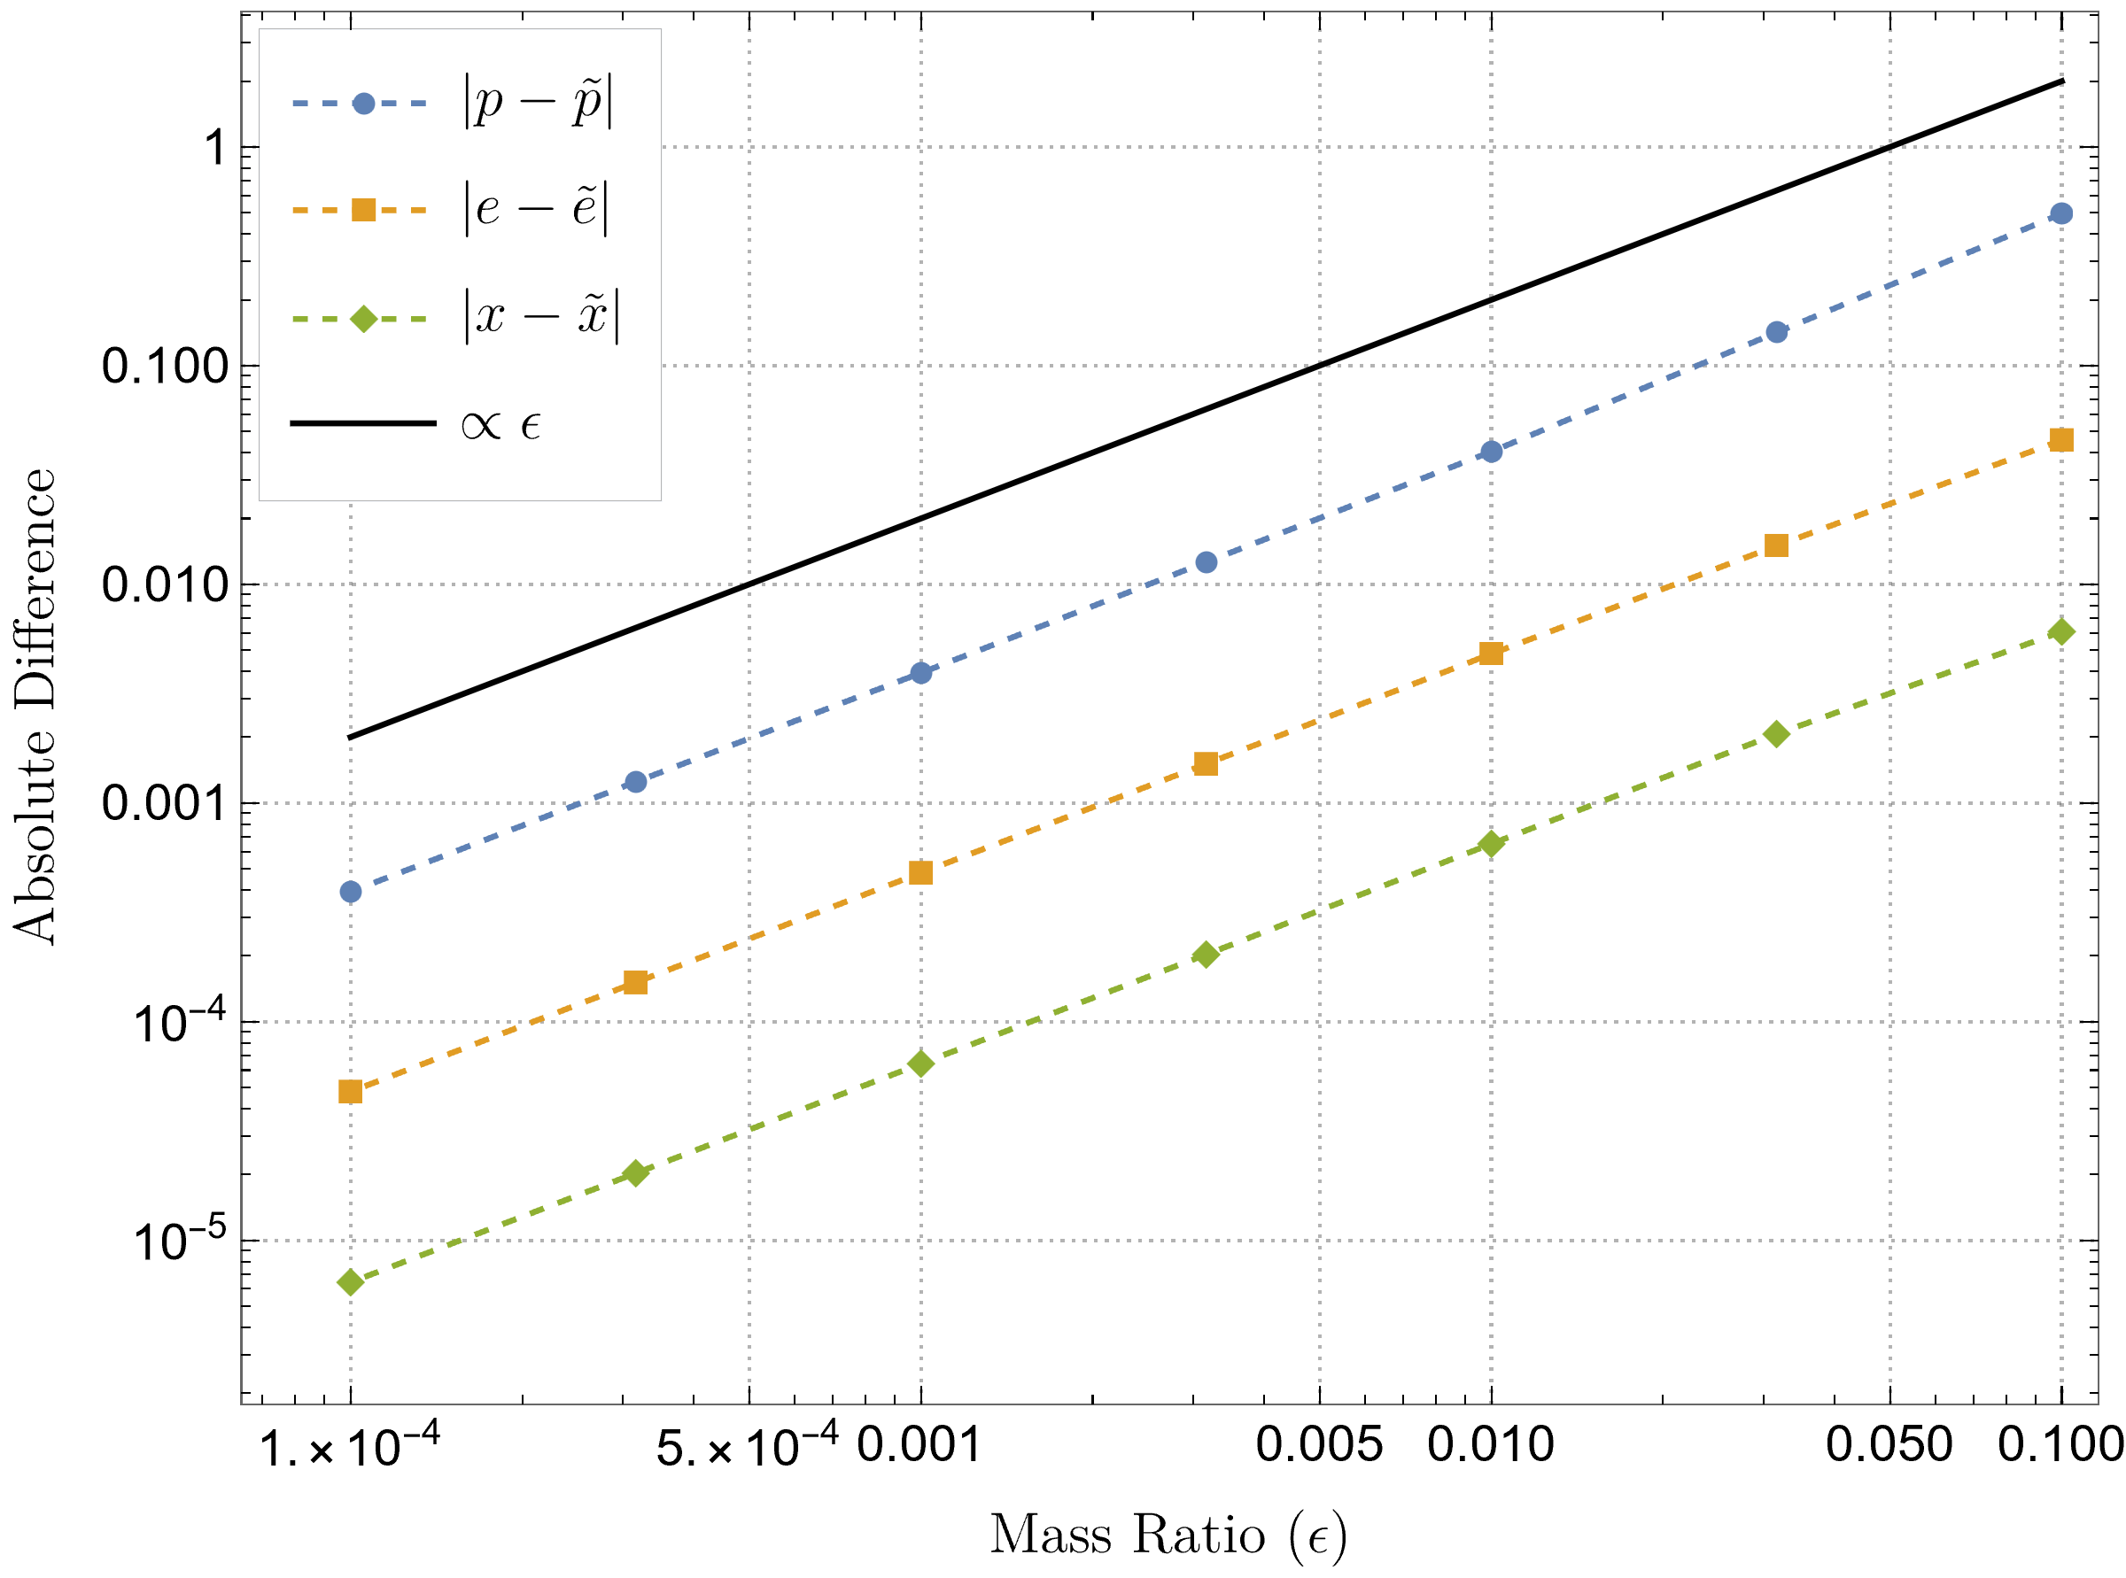
Generic Kerr NITs

Slide 9
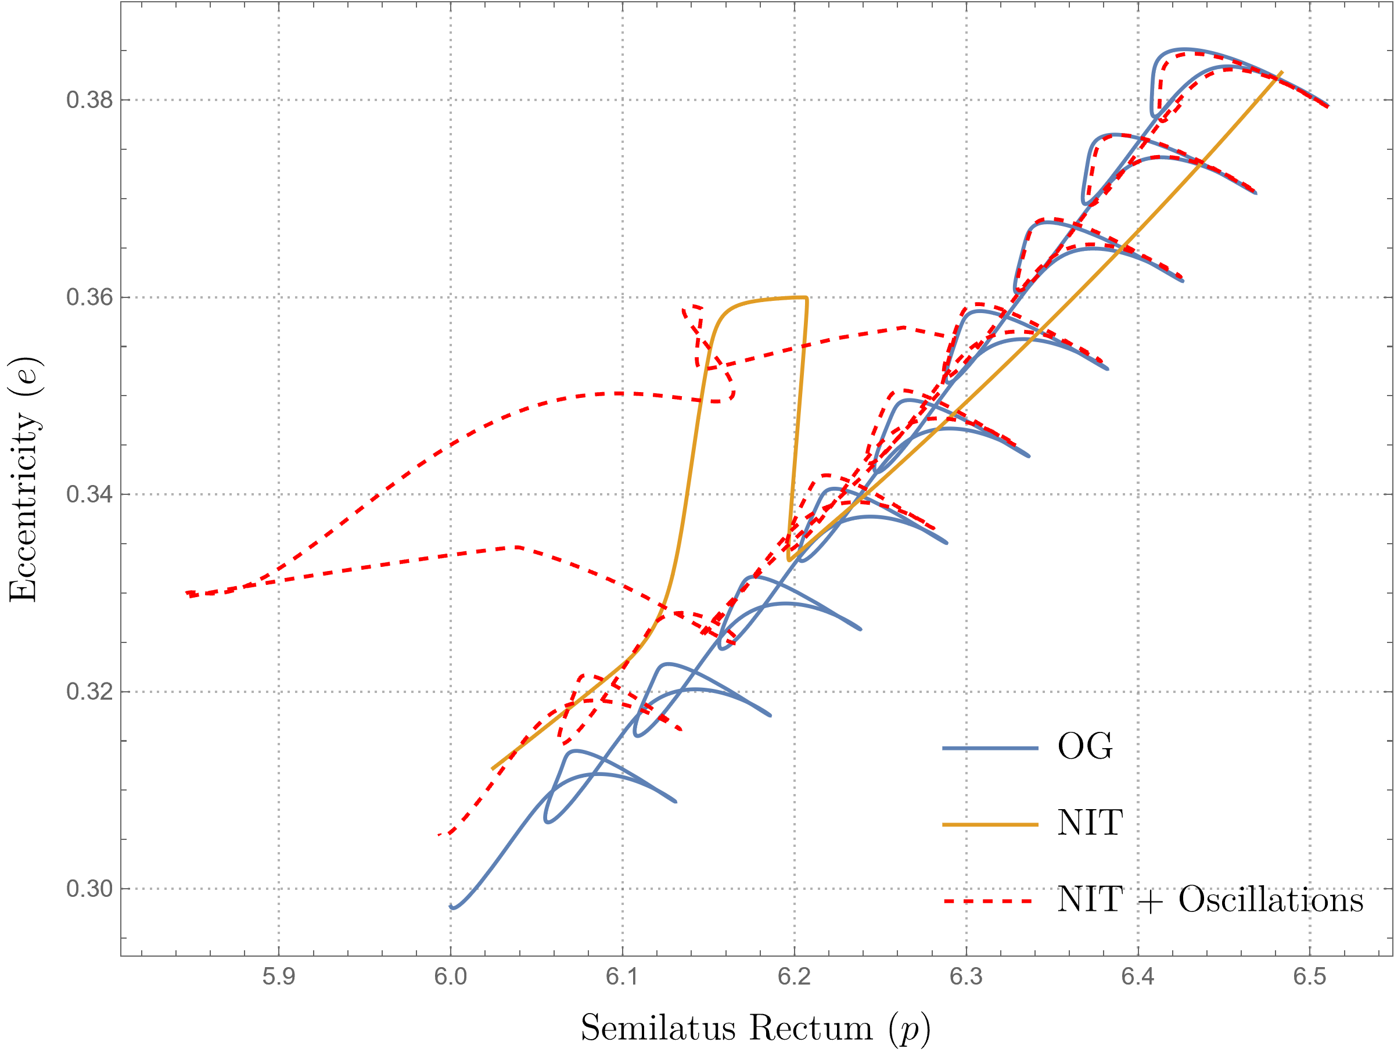
Notes:
Idea, do a version of this but with the near resonant NIT

Slide 10
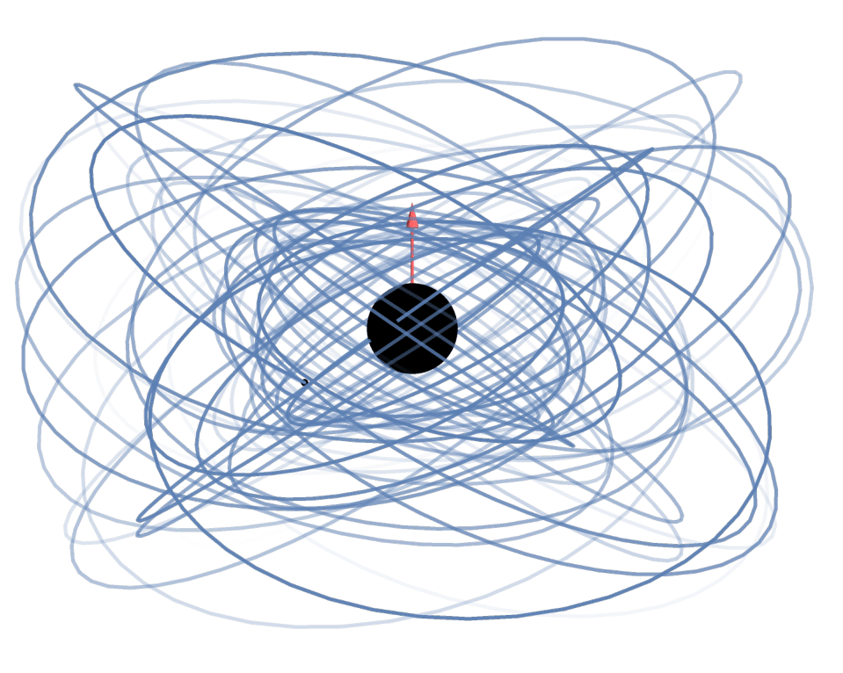
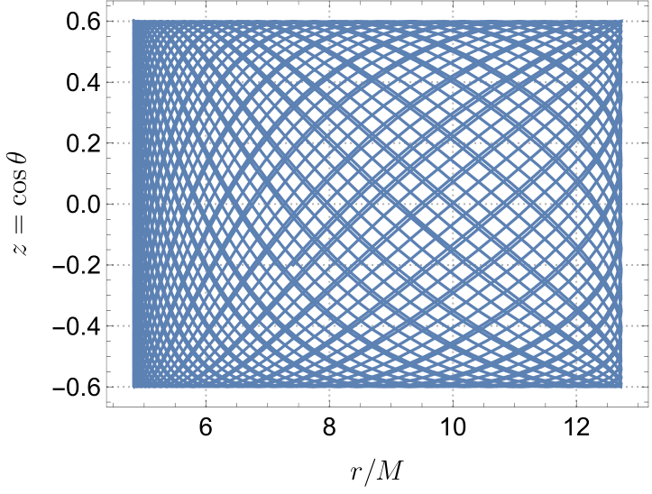
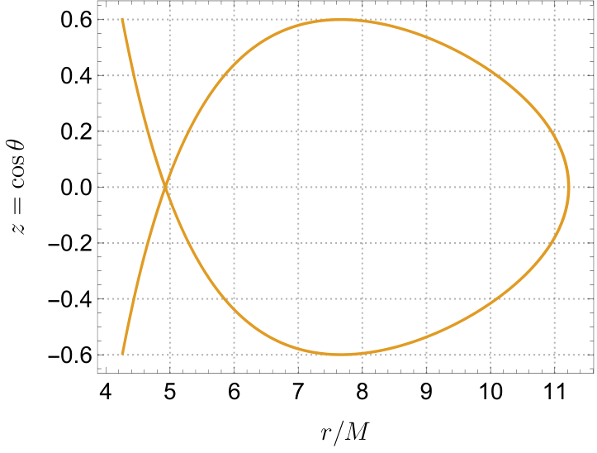
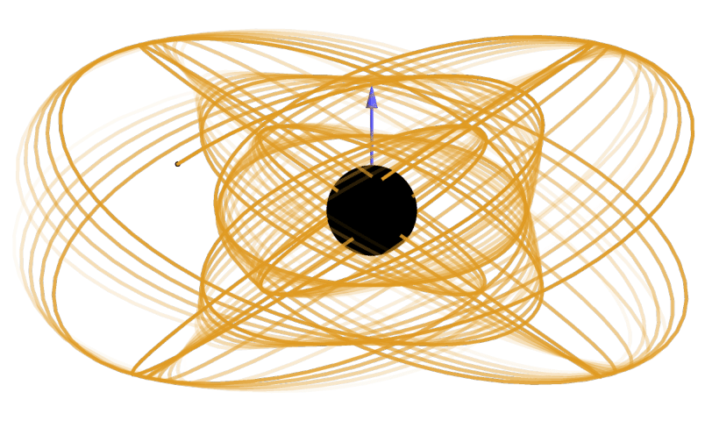
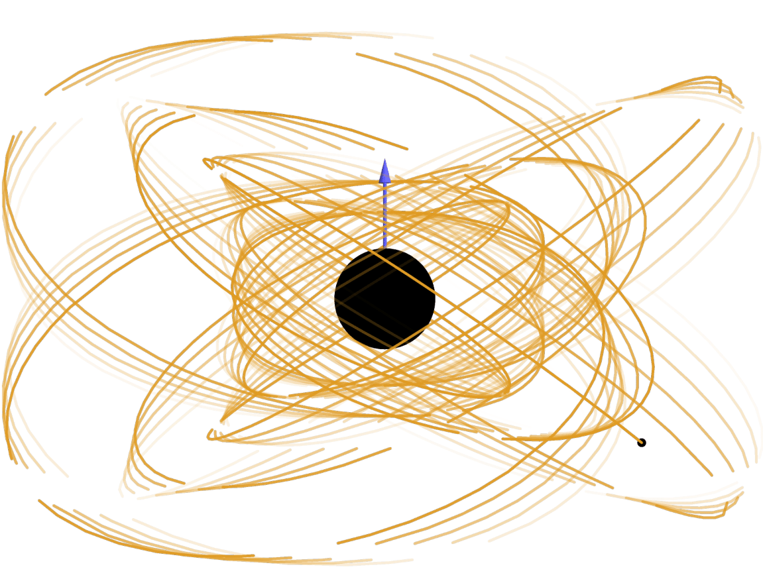
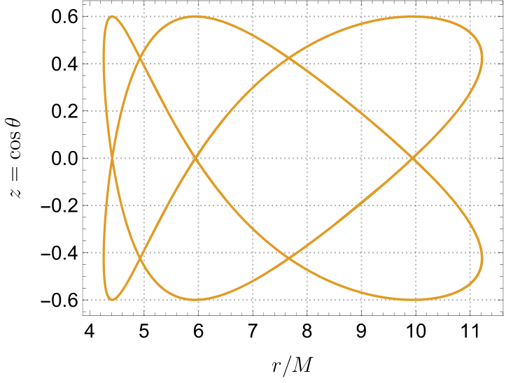
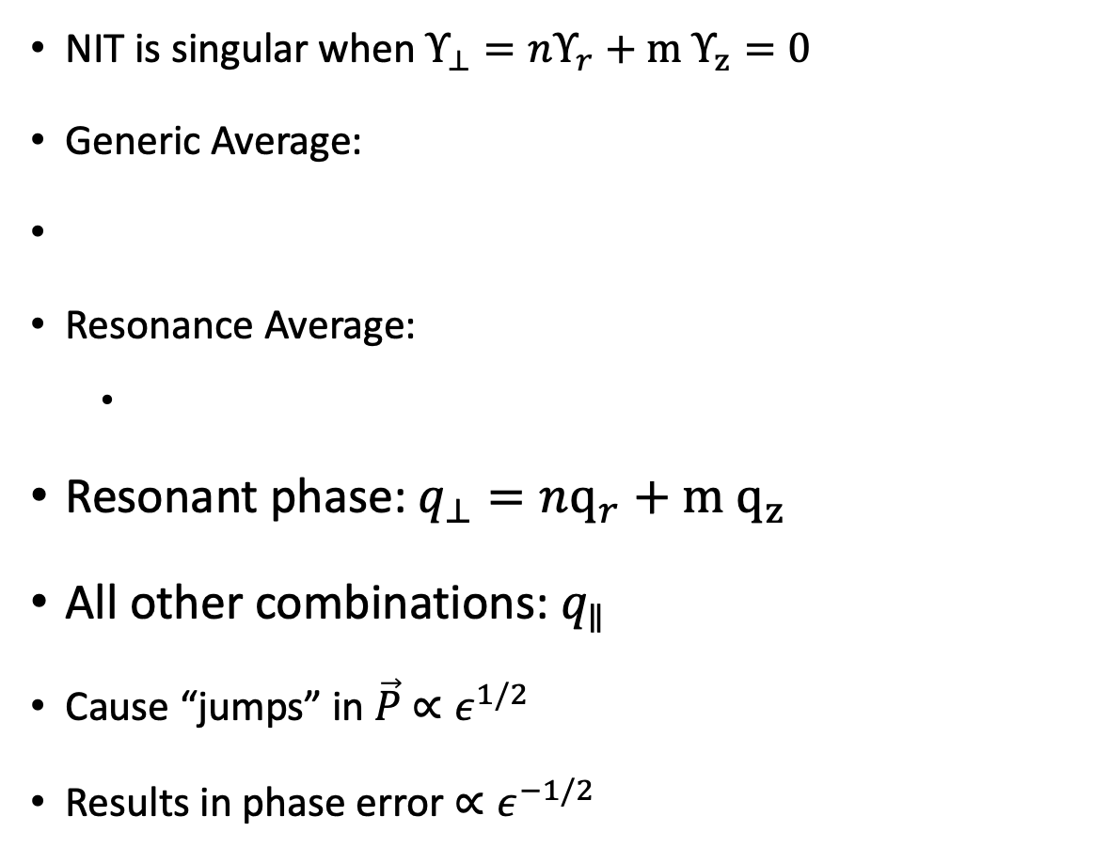
Orbital Resonances
NIT is singular when $Υ_{⊥}=nΥ_{r}+m Υ_{z}=0$
Generic Average:
Resonance Average:
Resonant phase: $q_{⊥}=nq_{r}+m q_{z}$
All other combinations: $q_{∥}$
Cause “jumps” in $\vec{P}$ $∝ε^{1/2}$
Results in phase error ${∝ε}^{−1/2}$
Notes:
This slide has too much going on

Slide 11
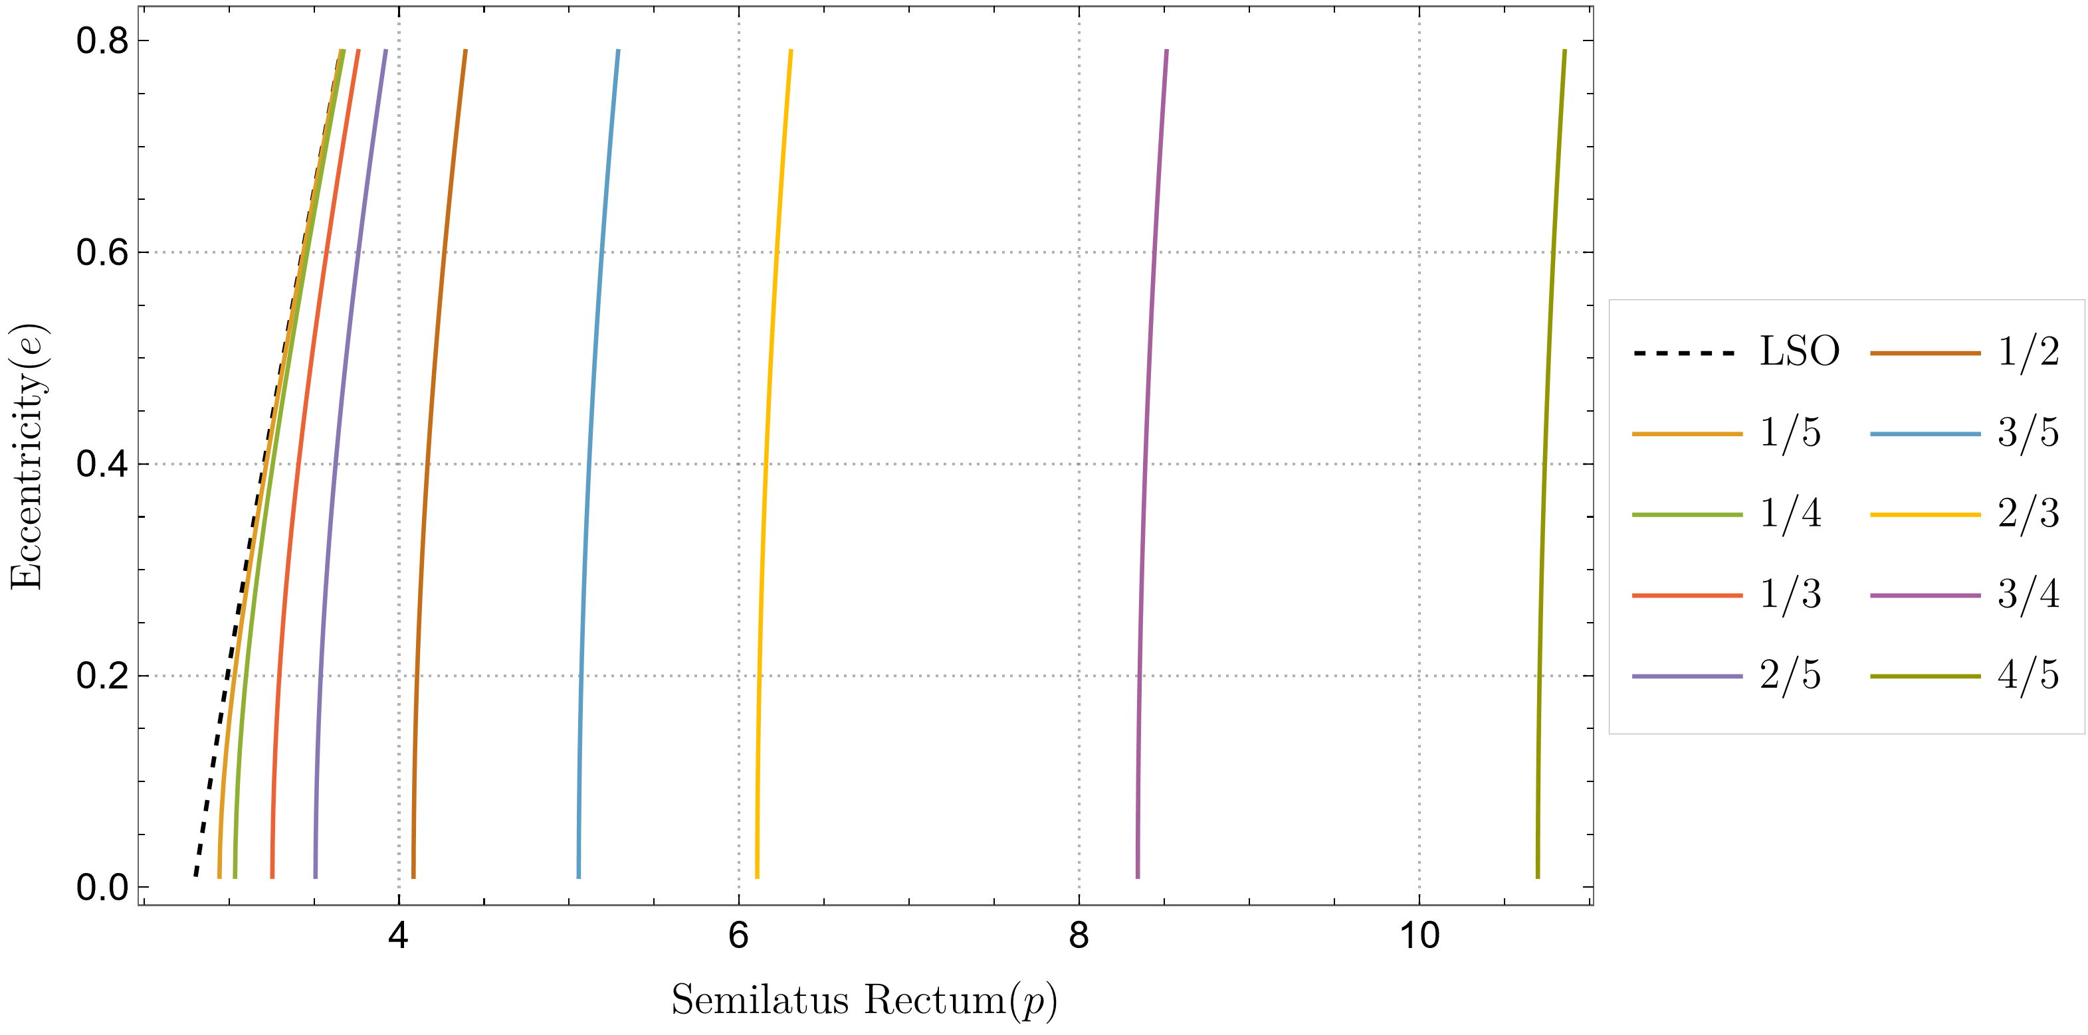
Transient Orbital Resonance Locations
Notes:
This plot but with some inspirals going through it

Slide 12
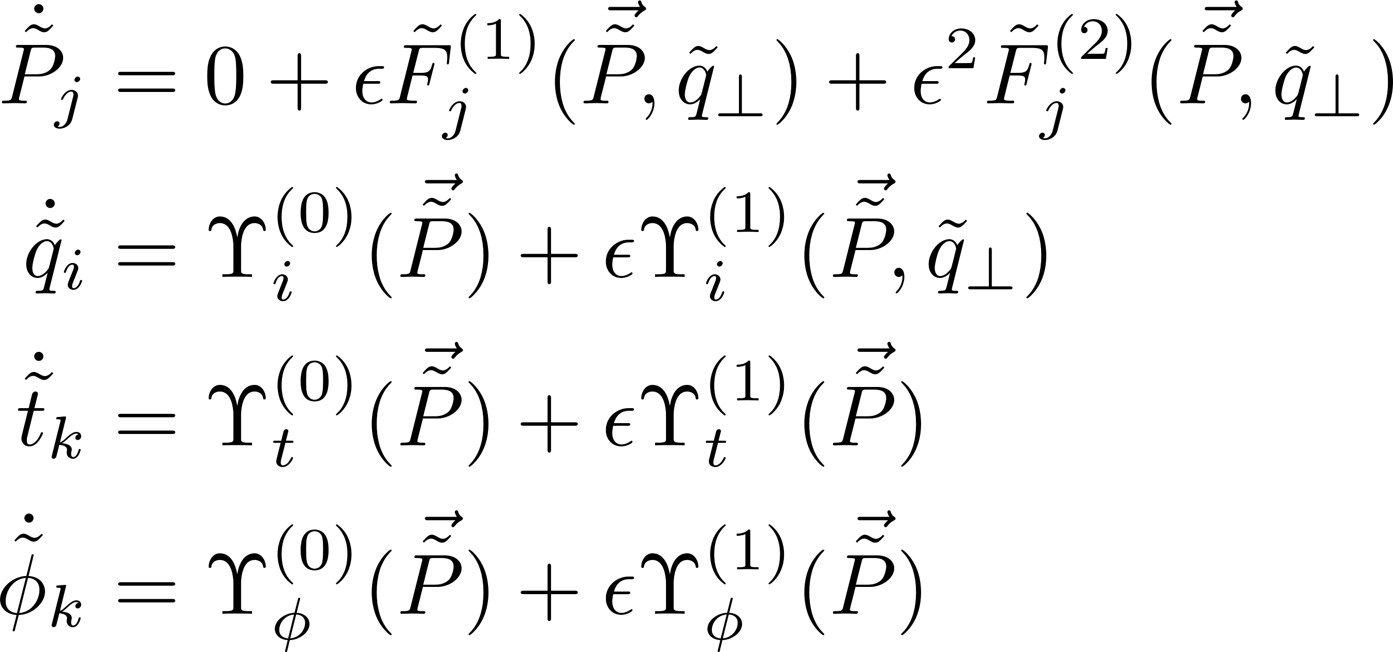
Near-Resonant NIT
Averaged EoM

Slide 13
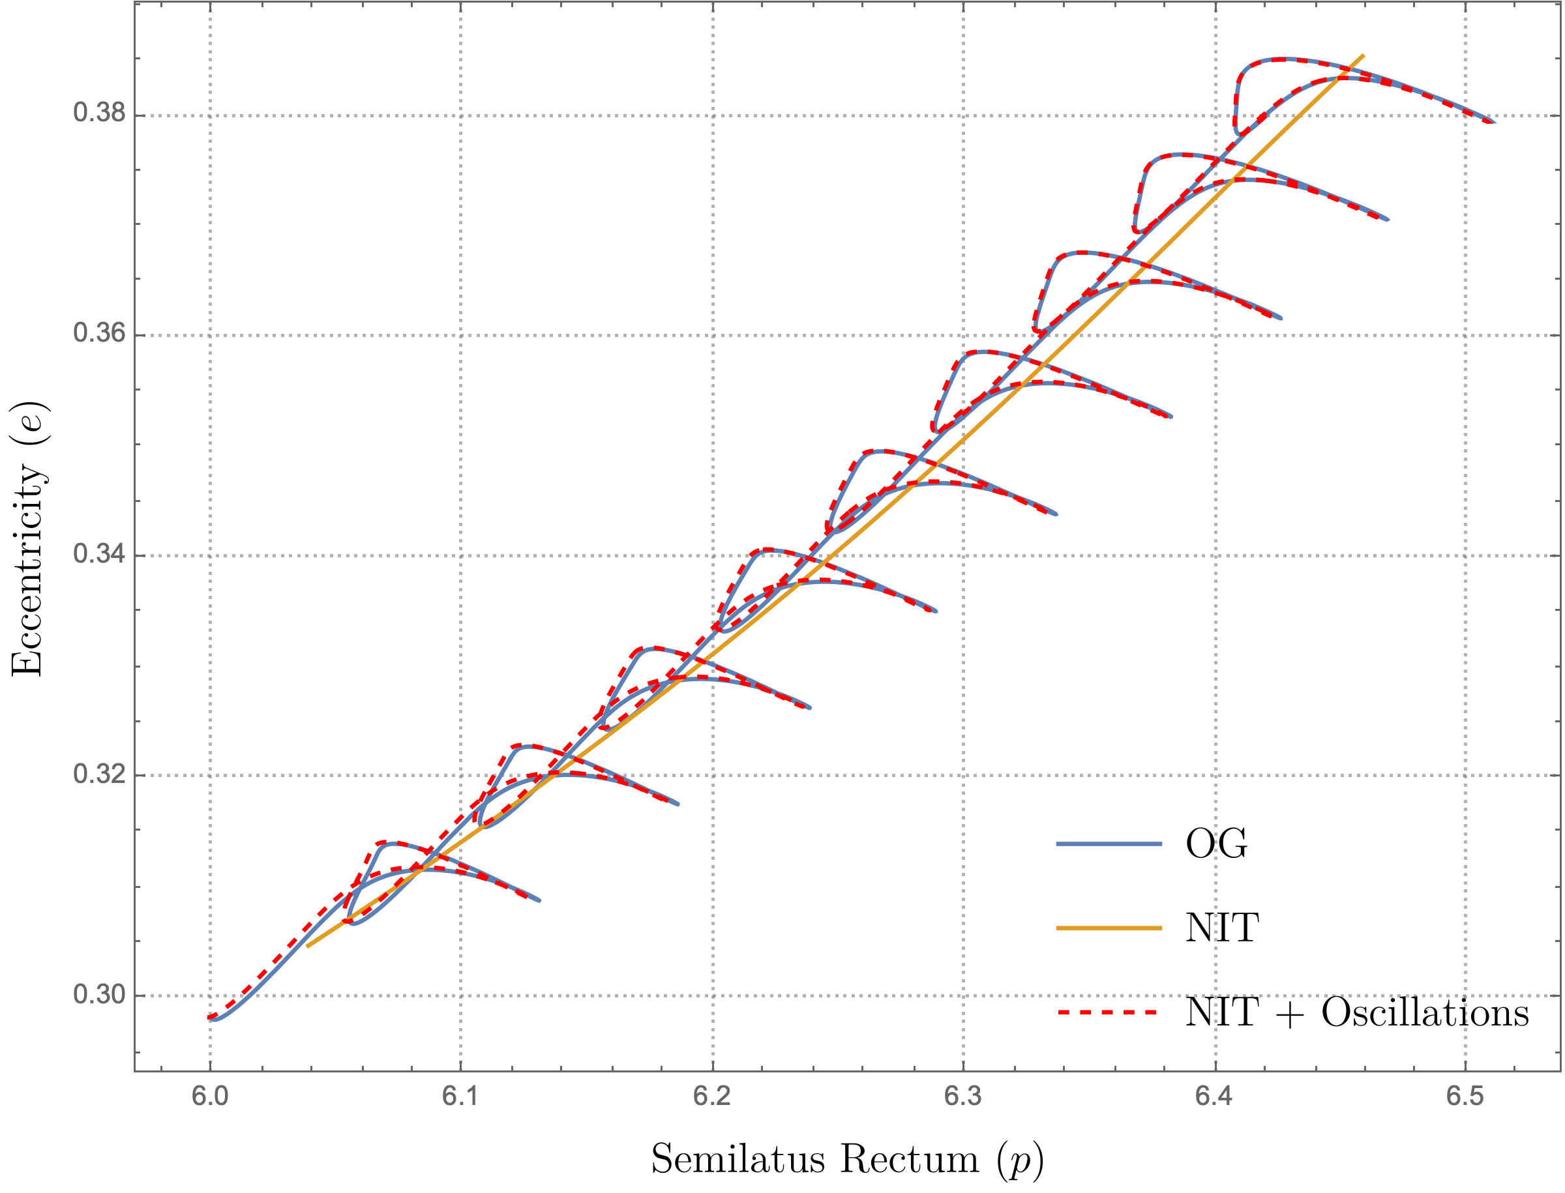

Slide 14
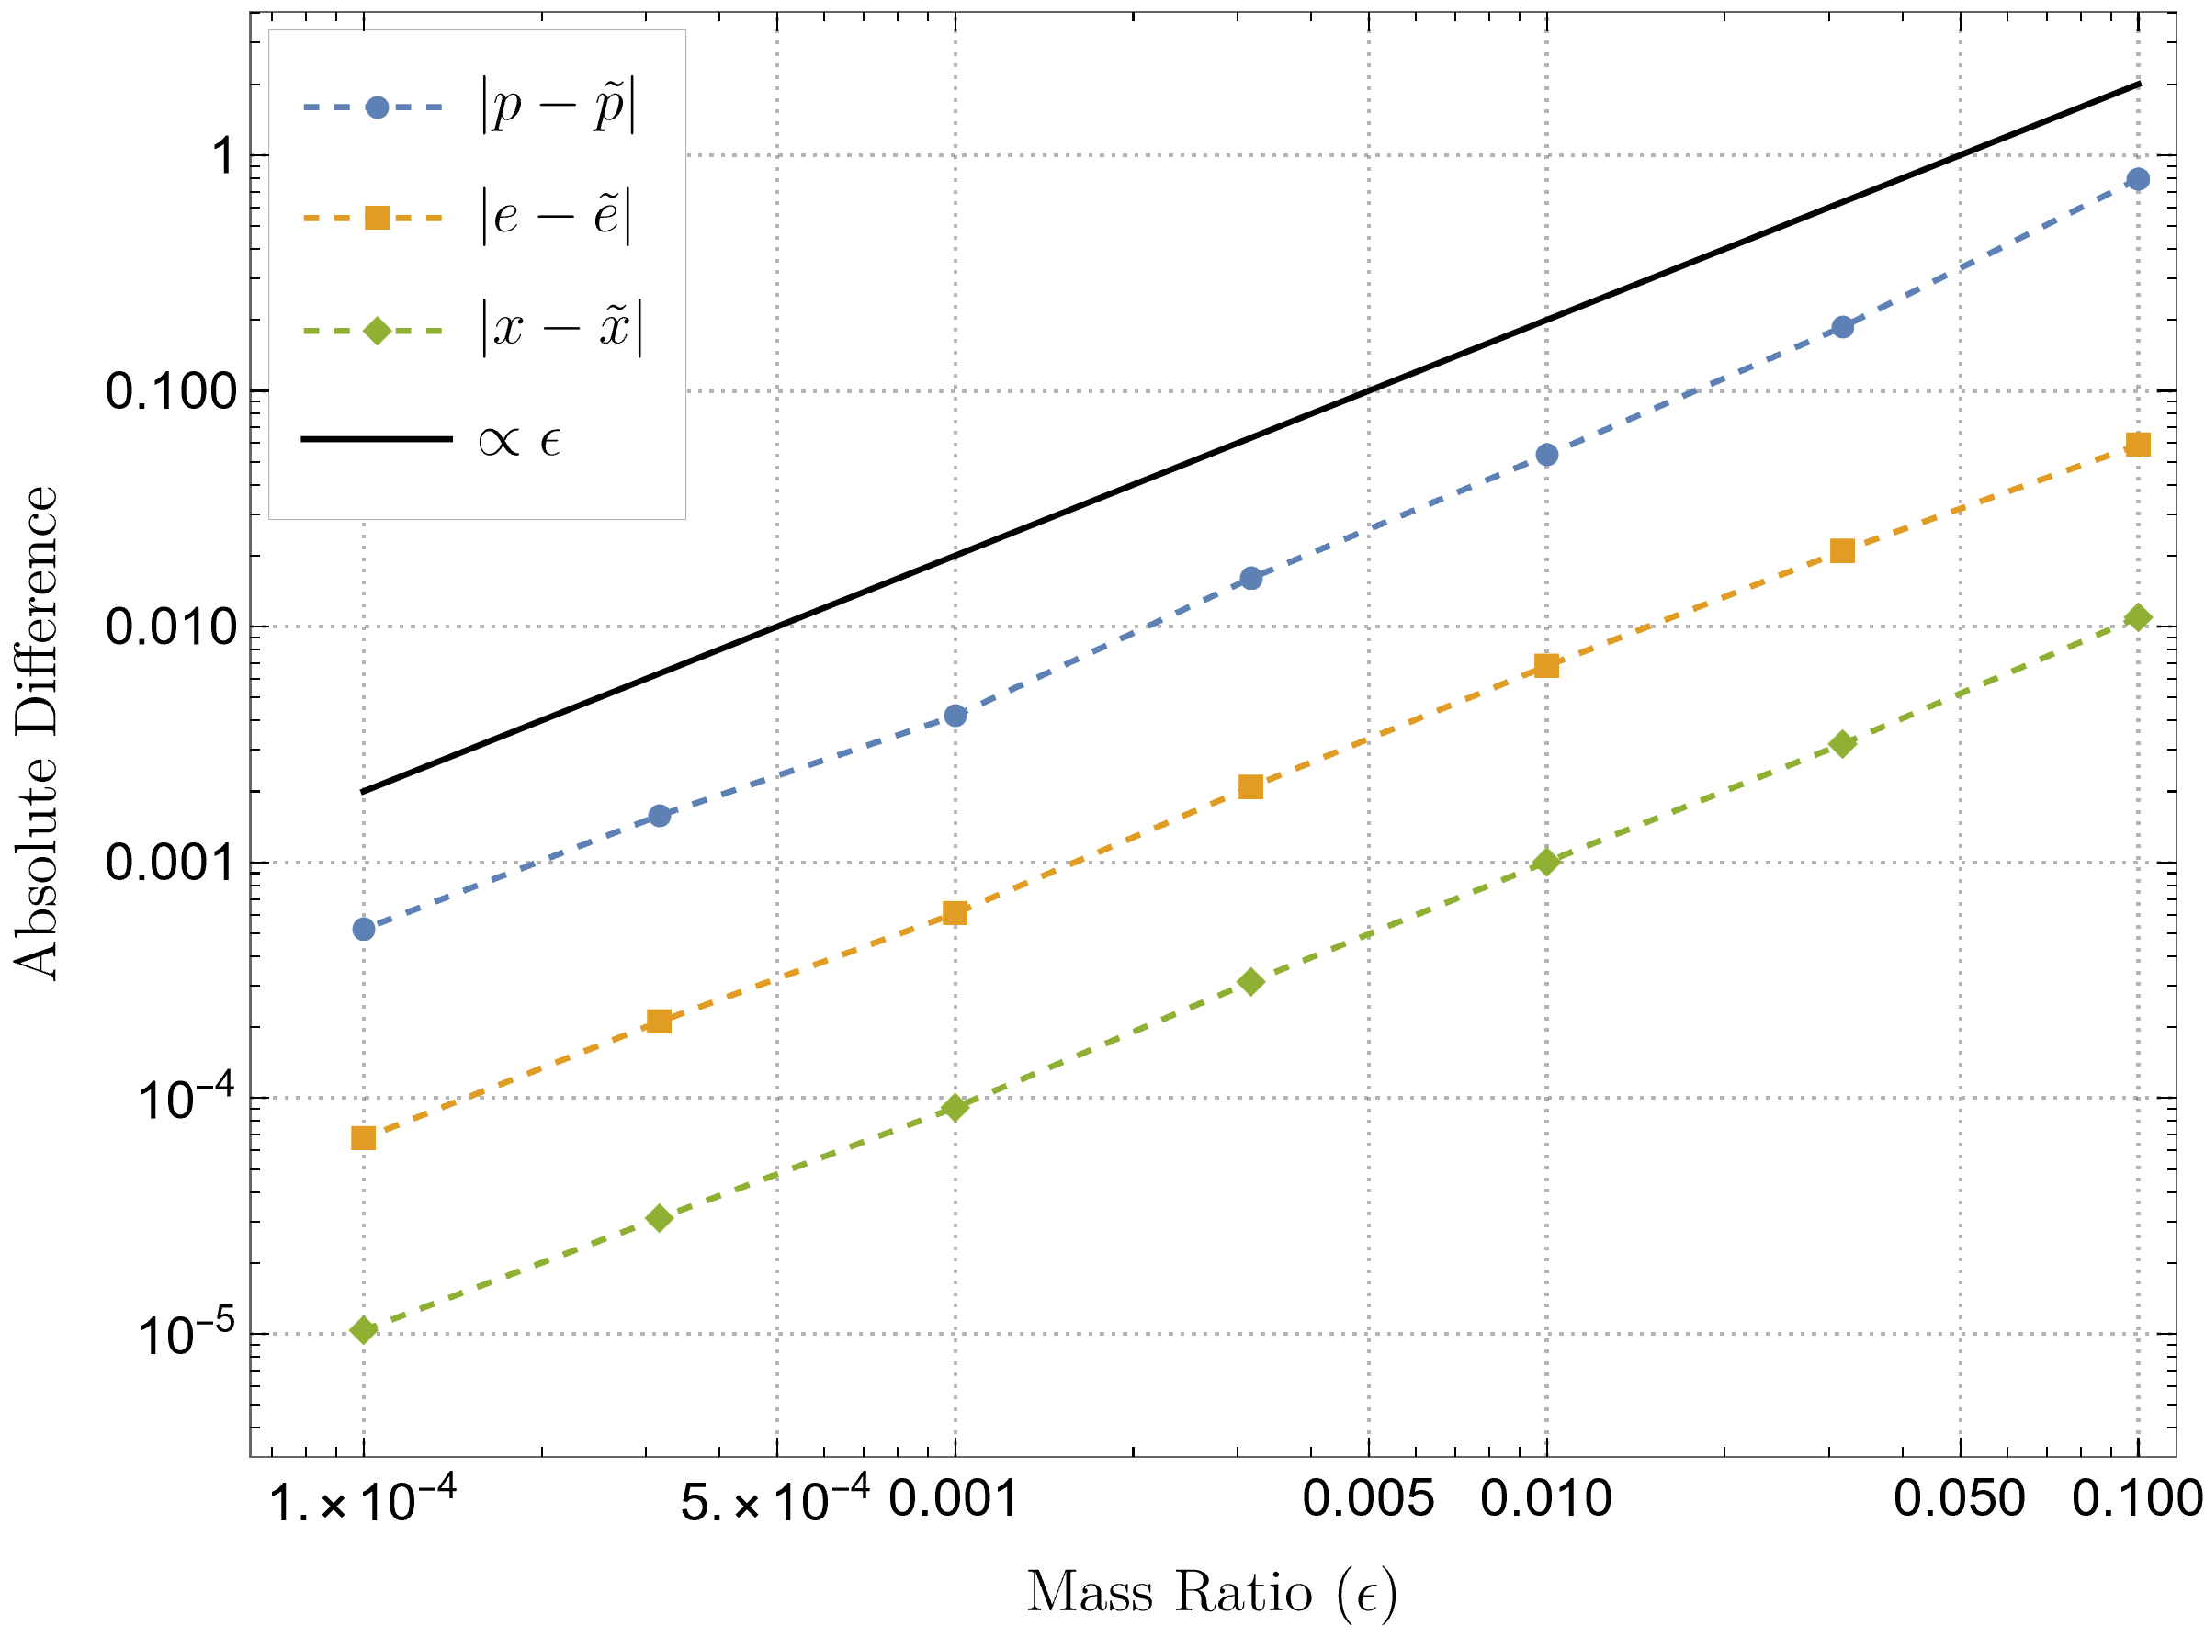
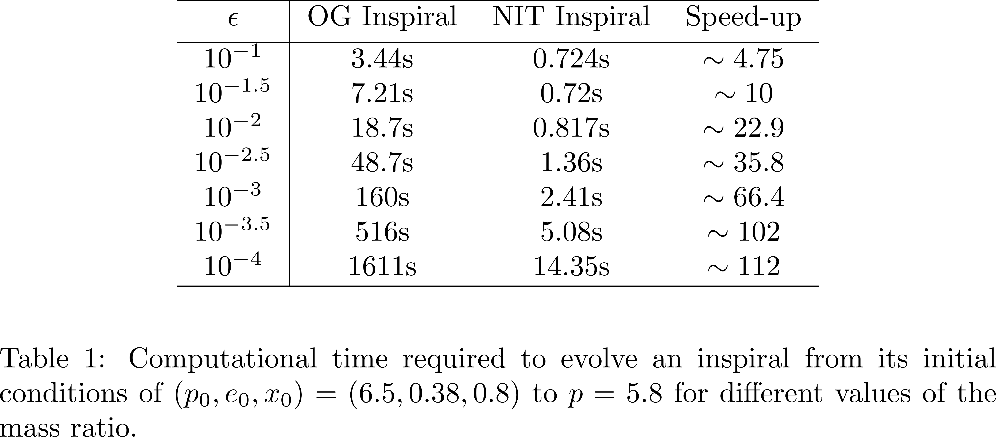
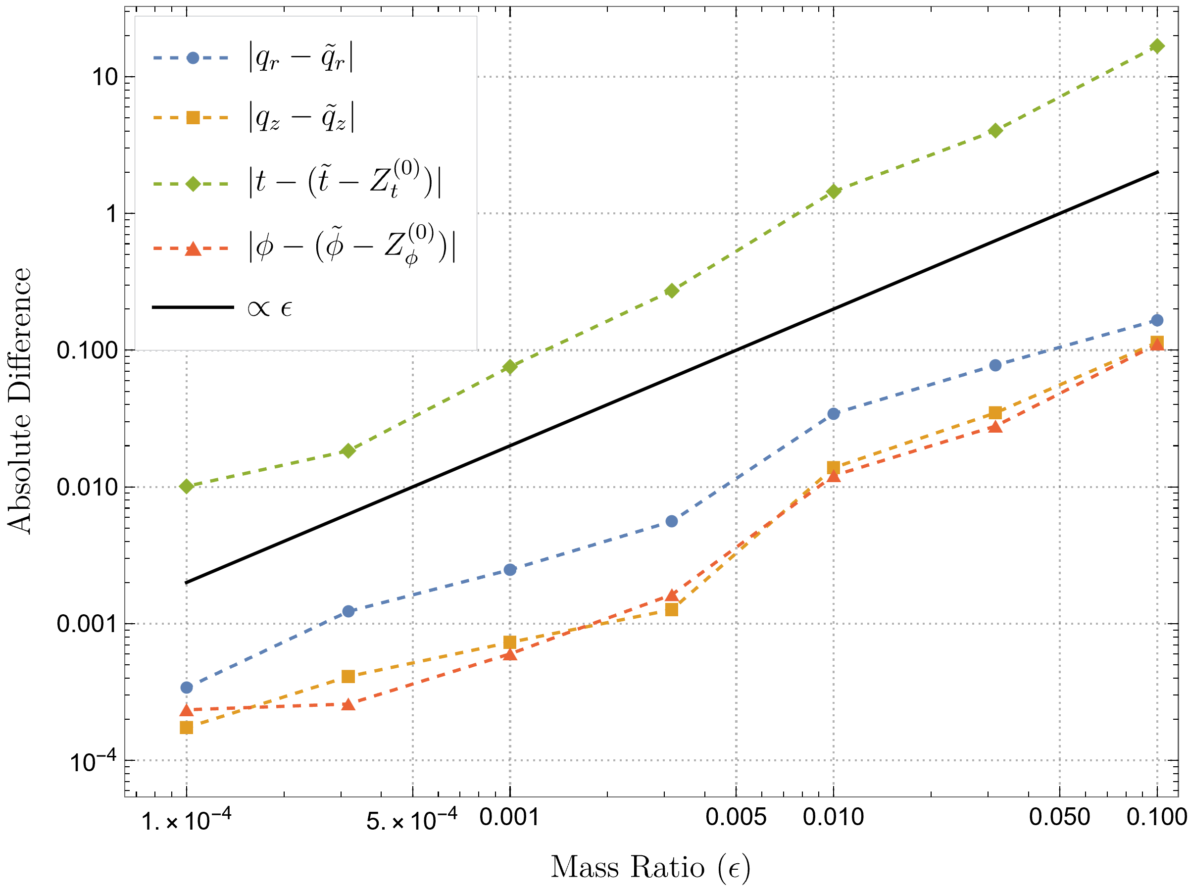
Near Resonant NIT Results

Slide 15
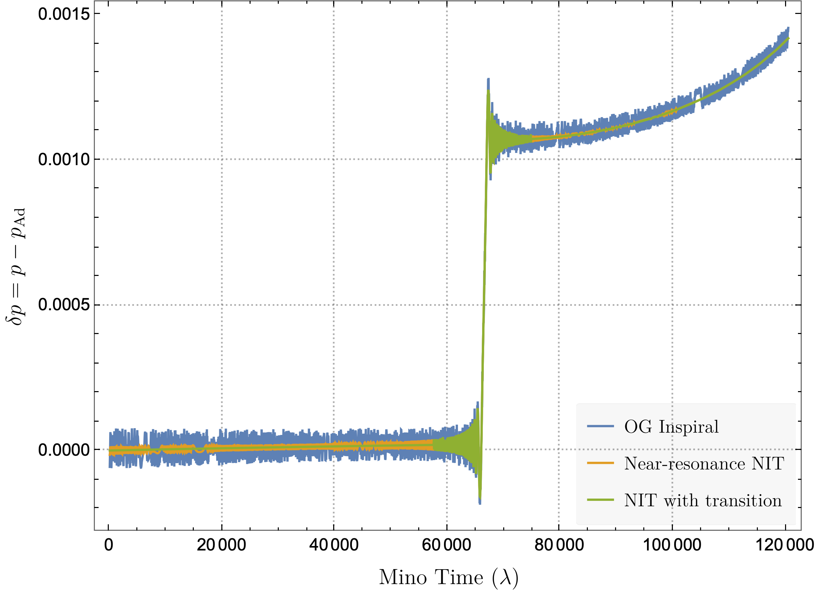
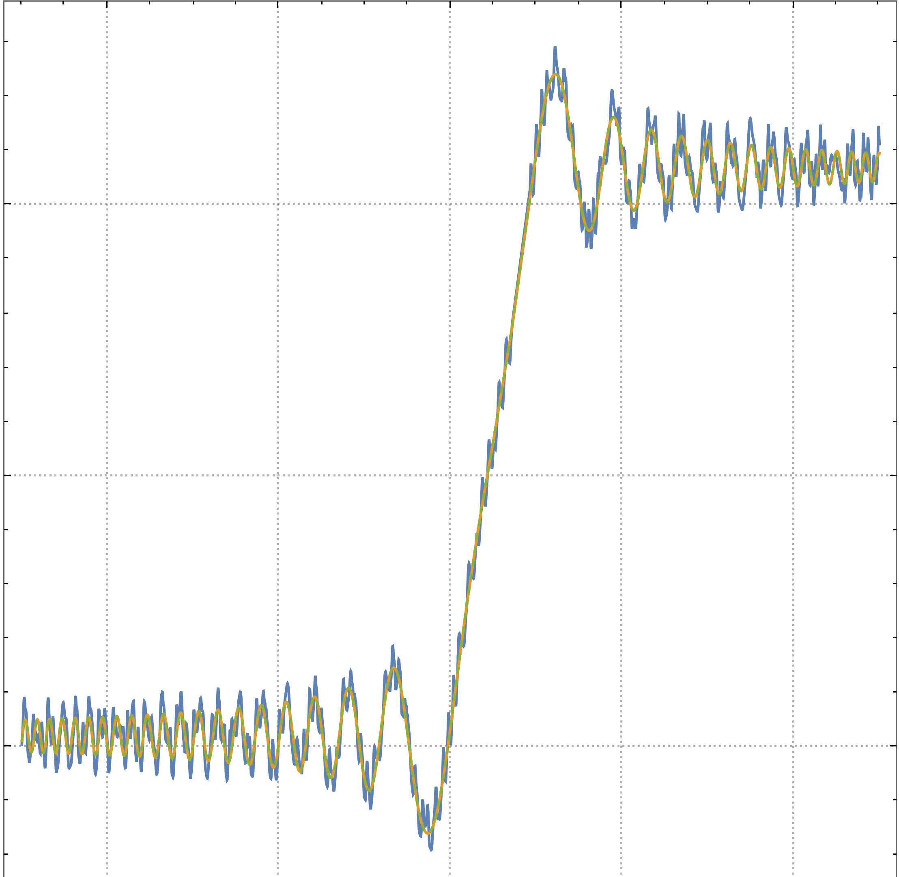
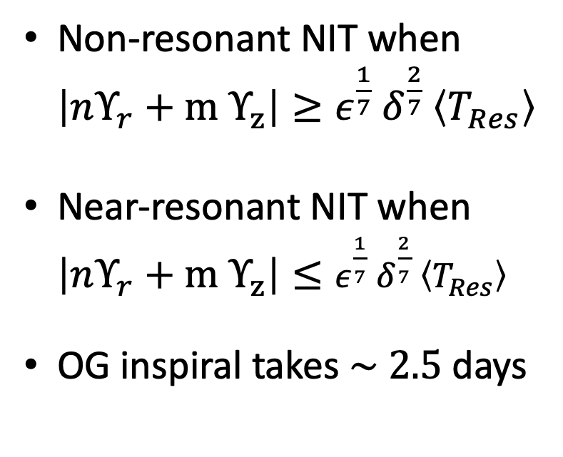
Evolving through a single resonance (2/3)
Non-resonant NIT when $\left|nΥ_{r}+m Υ_{z}\right|≥ε^{\frac{1}{7}} δ^{\frac{2}{7}} \left\langle T_{Res}\right\rangle$
Near-resonant NIT when $\left|nΥ_{r}+m Υ_{z}\right|≤ε^{\frac{1}{7}} δ^{\frac{2}{7}} \left\langle T_{Res}\right\rangle$
OG inspiral takes $\sim 2.5$days
PRELIMINARY

Slide 16
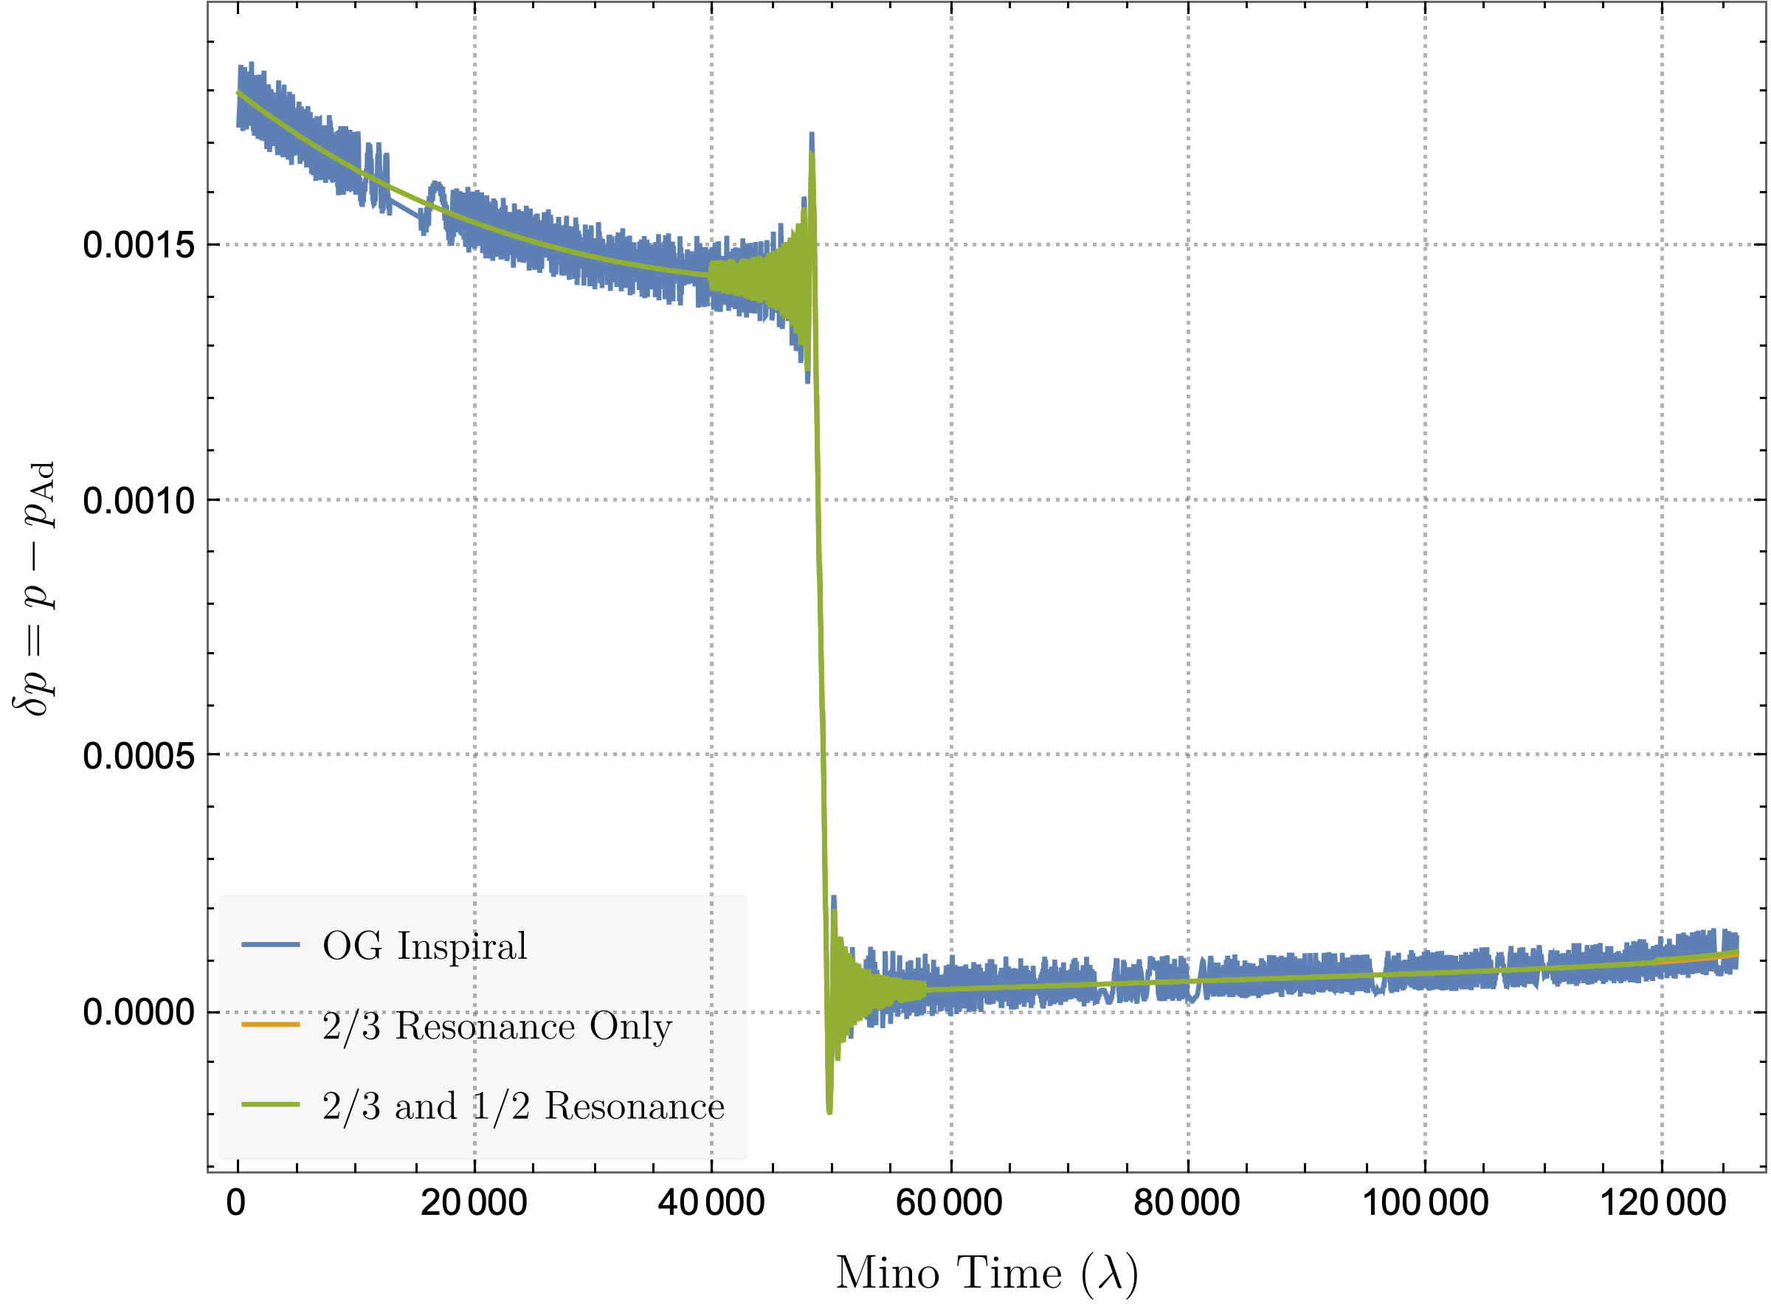
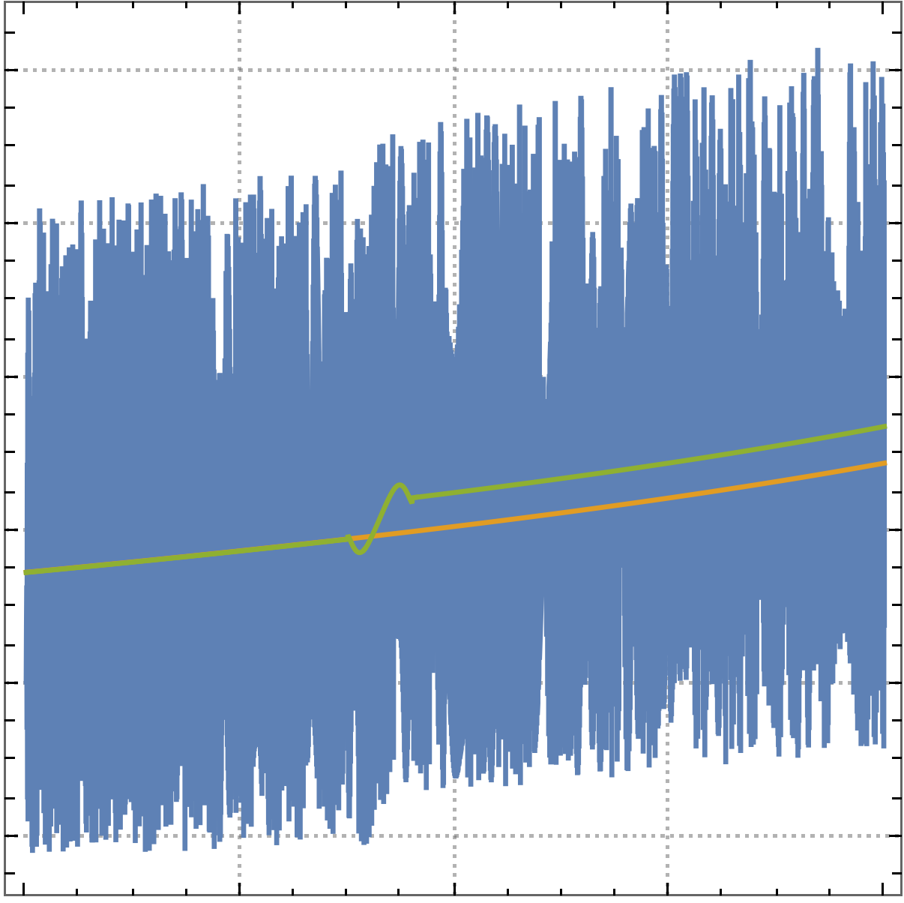
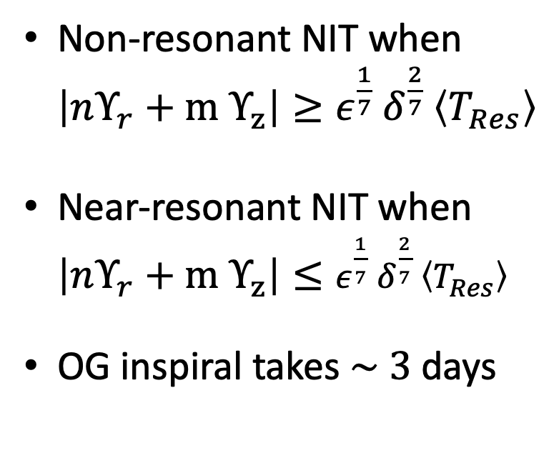
Evolving through multiple resonances (2/3 + 1/2)
Non-resonant NIT when $\left|nΥ_{r}+m Υ_{z}\right|≥ε^{\frac{1}{7}} δ^{\frac{2}{7}} \left\langle T_{Res}\right\rangle$
Near-resonant NIT when $\left|nΥ_{r}+m Υ_{z}\right|≤ε^{\frac{1}{7}} δ^{\frac{2}{7}} \left\langle T_{Res}\right\rangle$
OG inspiral takes $\sim 3$days
PRELIMINARY

Slide 17
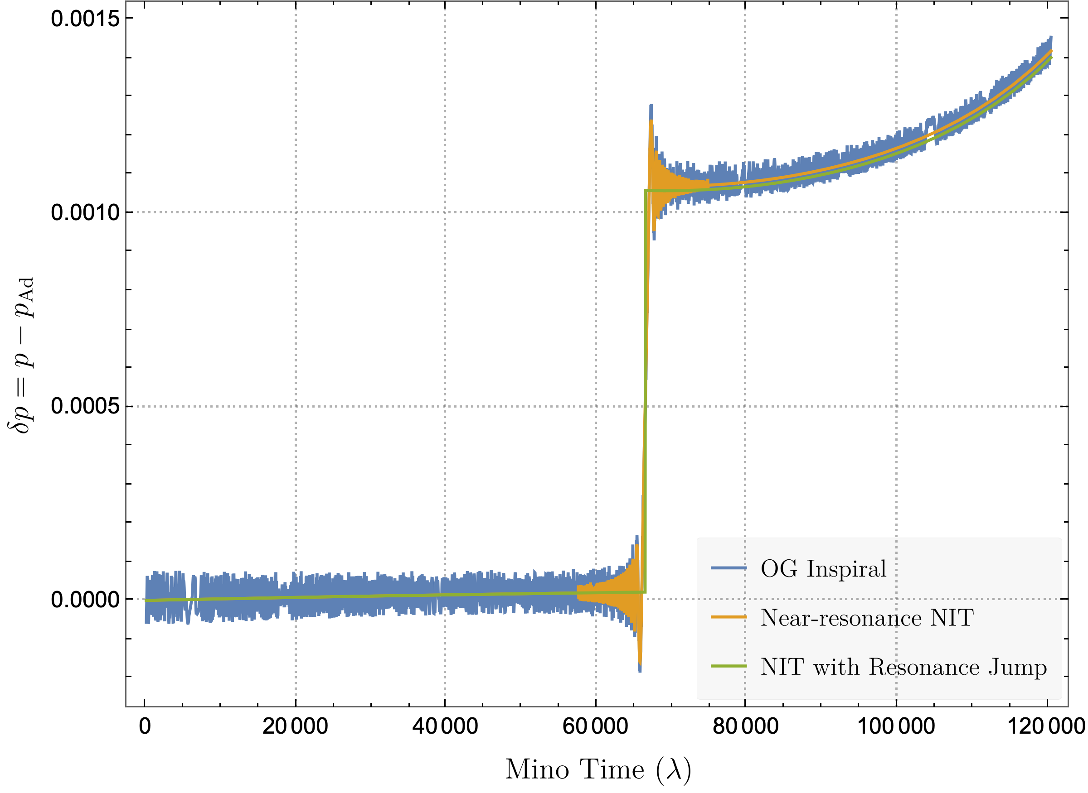
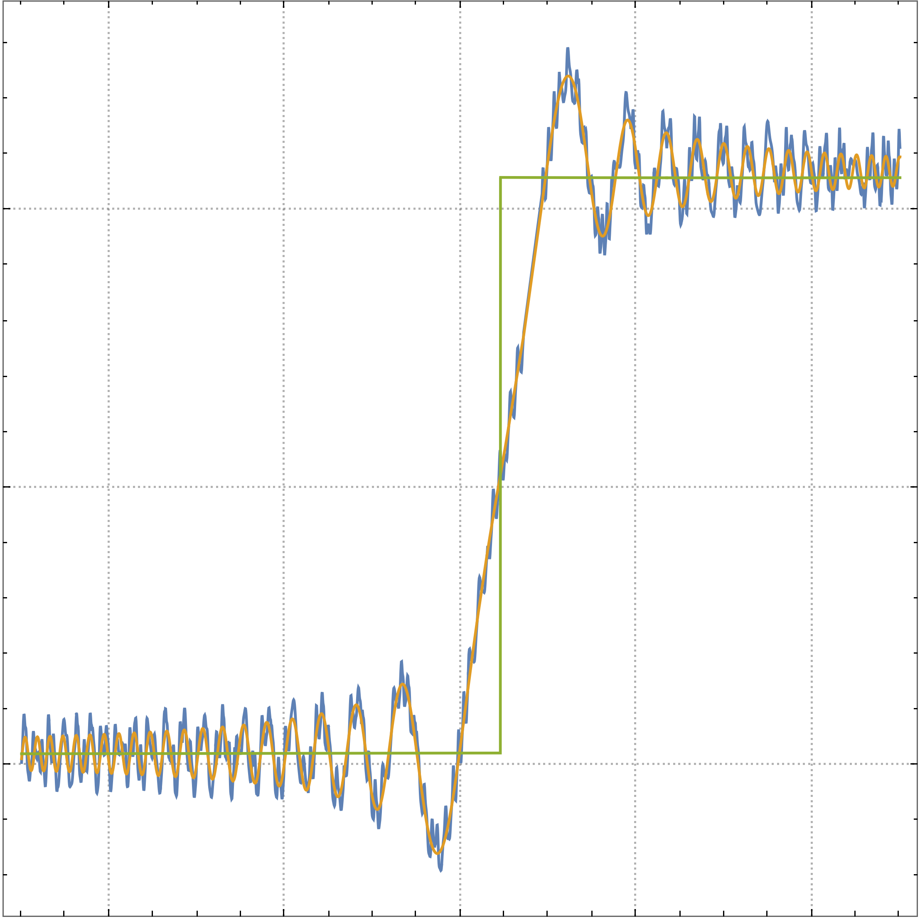
What about a Resonance Jump?
PRELIMINARY

Slide 18
Conclusions
Using NITs lets you calculate EMRI trajectories in than a second by removing oscillations from EoM
Break down near resonances, which are likely to occur
Modify NIT to remove all oscillations except the resonant ones
Fastest solution so far is to switch between full and near-resonant NIT

Slide 19
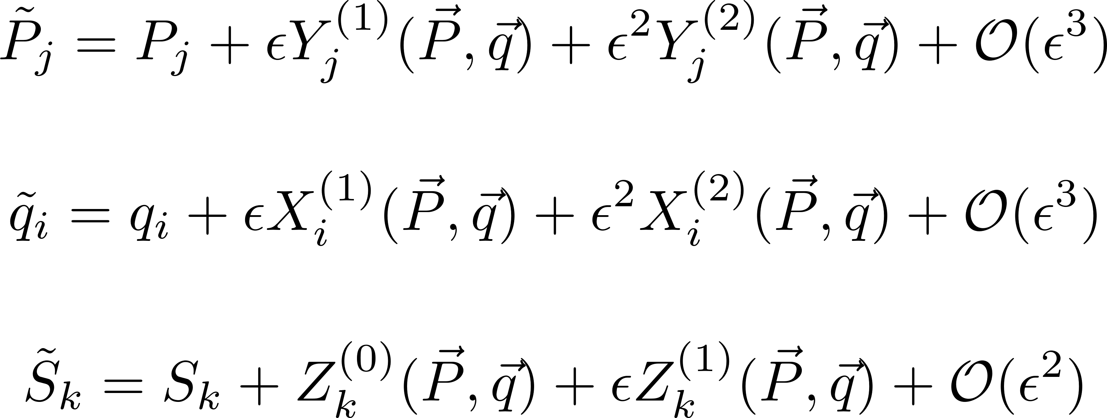
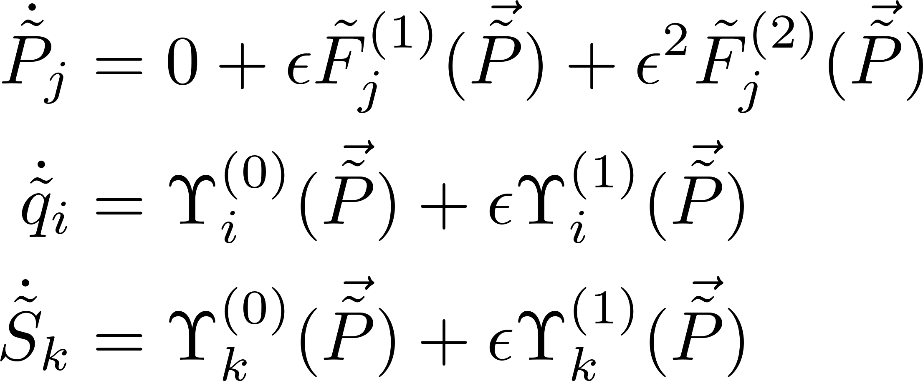

Near-Identity (Averaging) Transformations
To obtain equations of motion independent of $\vec{q}$
Transform to new variables
Geodesic Adiabatic Post-Adiabatic
Notes:
Animate Pieces

