Slide 1


Comparison of post-Minkowskian and self-force expansions: Scattering in a scalar charge toy model
arXiv:2304.09200
Oliver Long
with L. Barack, Z. Bern, E. Herrmann, J. Parra-Martinez, R. Roiban, M. S. Ruf, C.-H. Shen, M. P. Solon, F. Teng, and M. Zeng.
4th July 2023 Niels Bohr Institute, Copenhagen

Slide 2
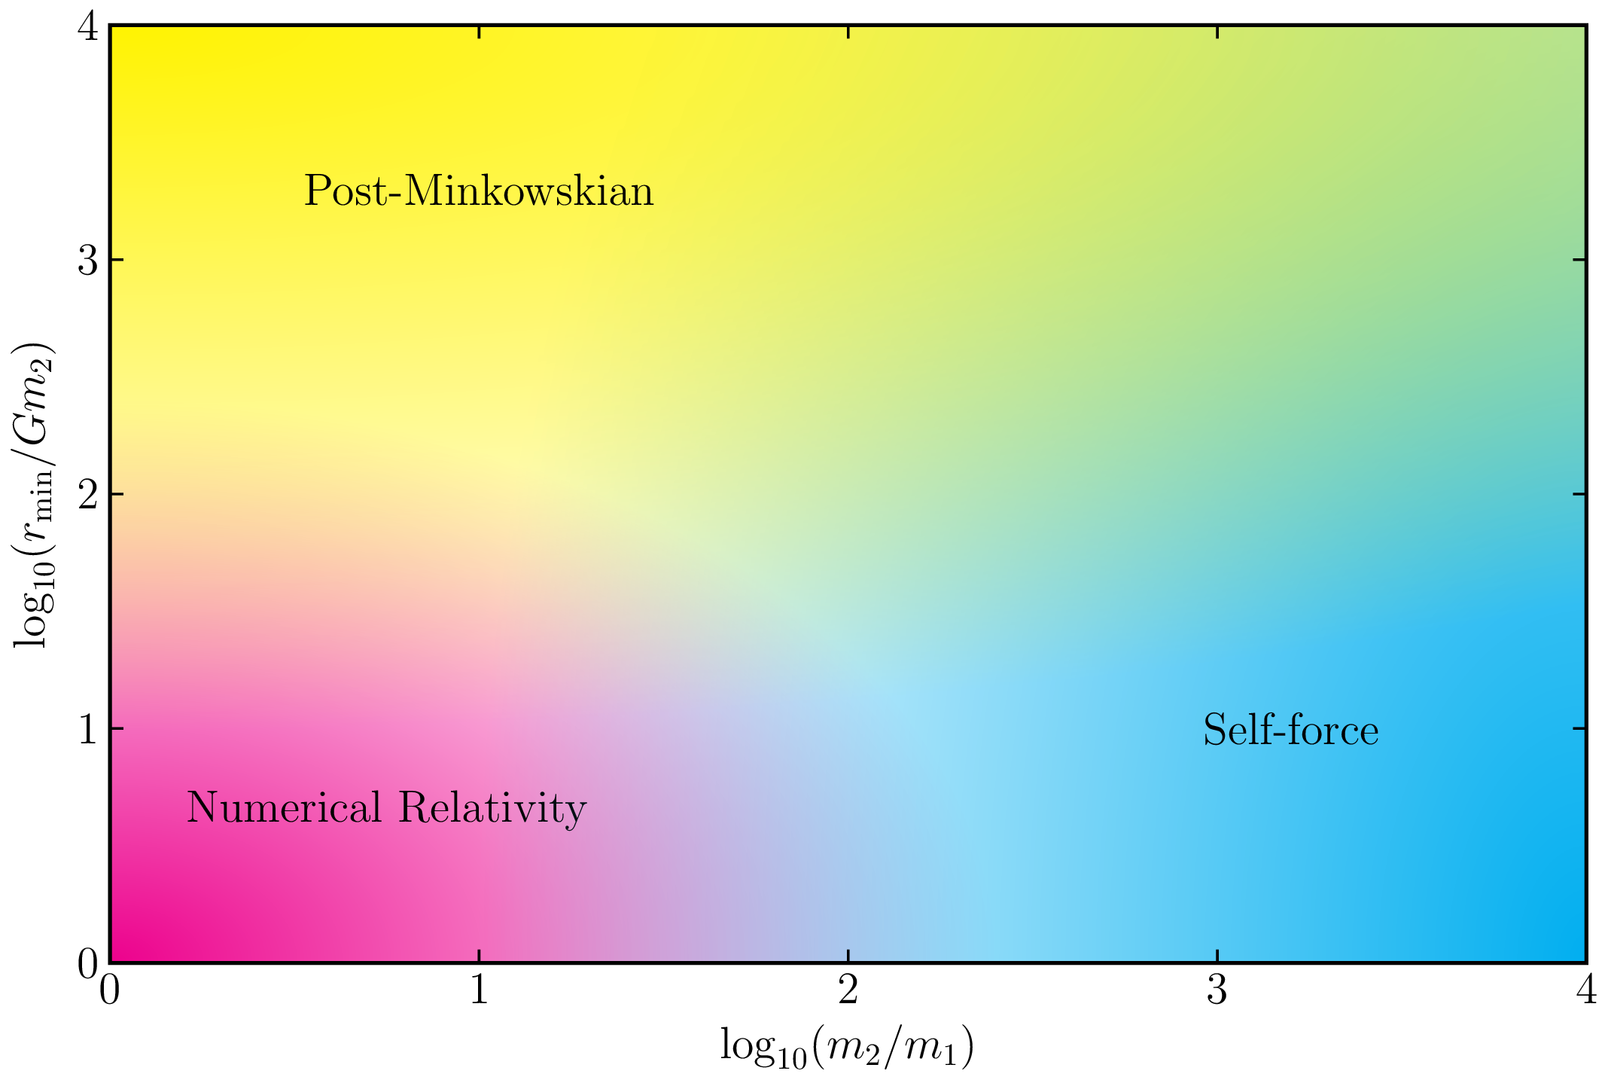
Two-body parameter space for scattering

Slide 3
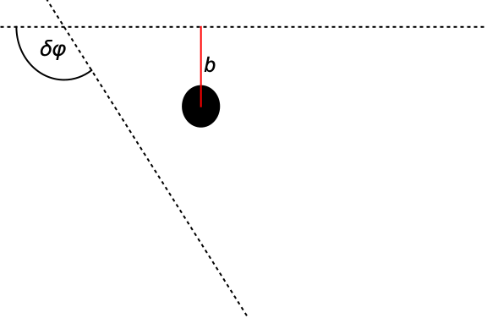
Self-force correction to the scattering angle
Scattering angle [Barack & OL ‘22]:
Can split into conservative and dissipative pieces on outgoing leg:
Functions of geodesics
Notes:
1/r factor increases difficulty as singularity at periastron

Slide 4
1+1D scalar field evolution scheme
Worldline
Scalar field obeys the Klein-Gordon equation.
Decompose in the time domain:
1+1D scalar wave equation:
Evolve finite-difference version of 1+1D equation.
Extract SF via mode-sum regularisation.
Initial conditions
Notes:
Extract SF via mode-sum regularisation

Slide 5
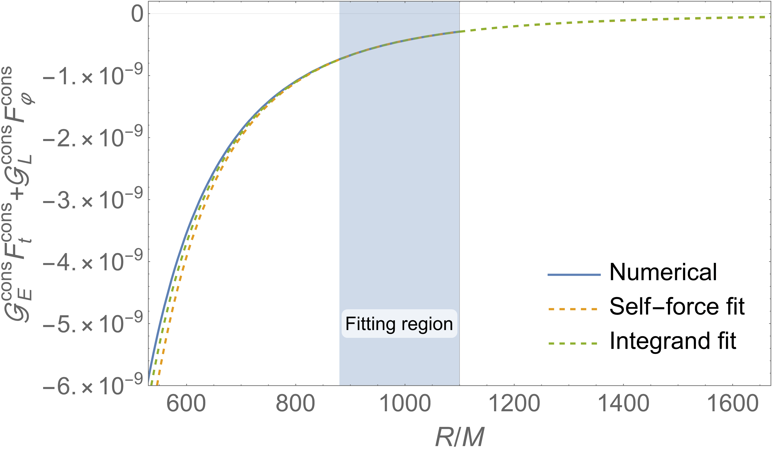
Post-processing: Truncation at finite radius
Can only numerically determine the self-force up to a finite radius
Form an analytic tail by fitting to the data:
  Fit the self-force data.
  Fit the integrand directly.
Tail contributes an error ~ 0.01%.
Numerical
Error (~1%)

Slide 6
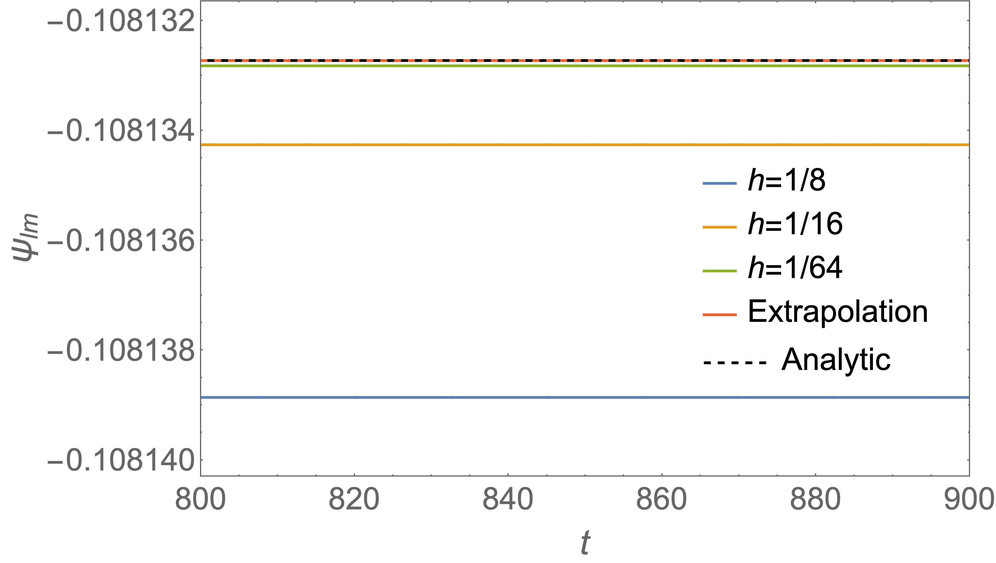
Post-processing: Richardson extrapolation
Next dominant error due to finite resolution ~ 0.1%.
Can increase the convergence from quadratic to cubic using Richardson extrapolation.
Model:
Extrapolation:
Error in extrapolation < 0.001%.

Slide 7
Scattering angle correction: PM expansion
Expansion around flat space:
2PM [Gralla & Lobo ‘22]:
3PM:
4PM dissipative:
LO
NLO

Slide 8
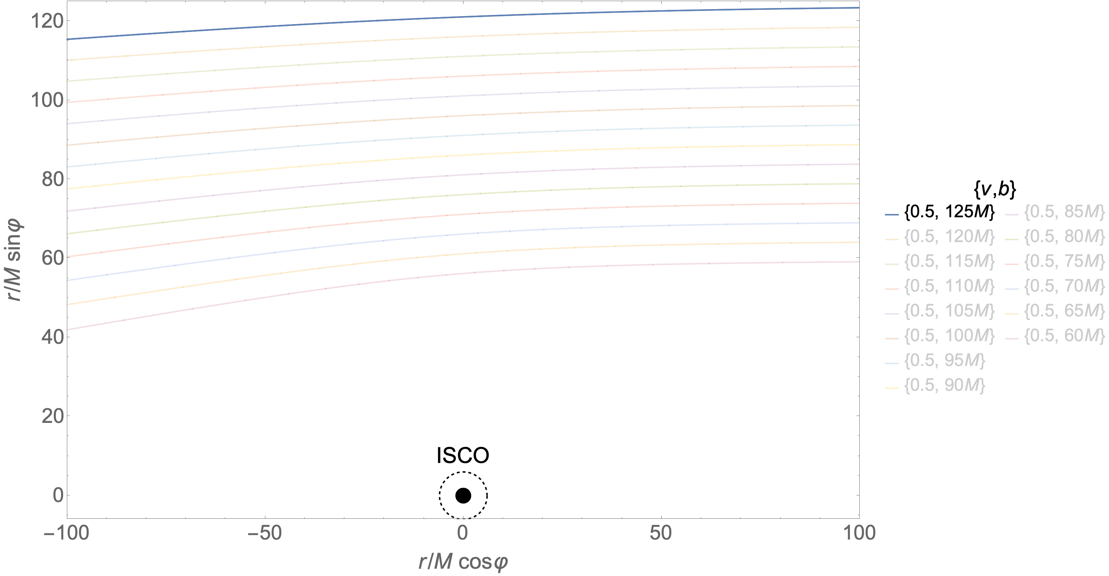
Sample orbits

Slide 9
Conservative:

Slide 10
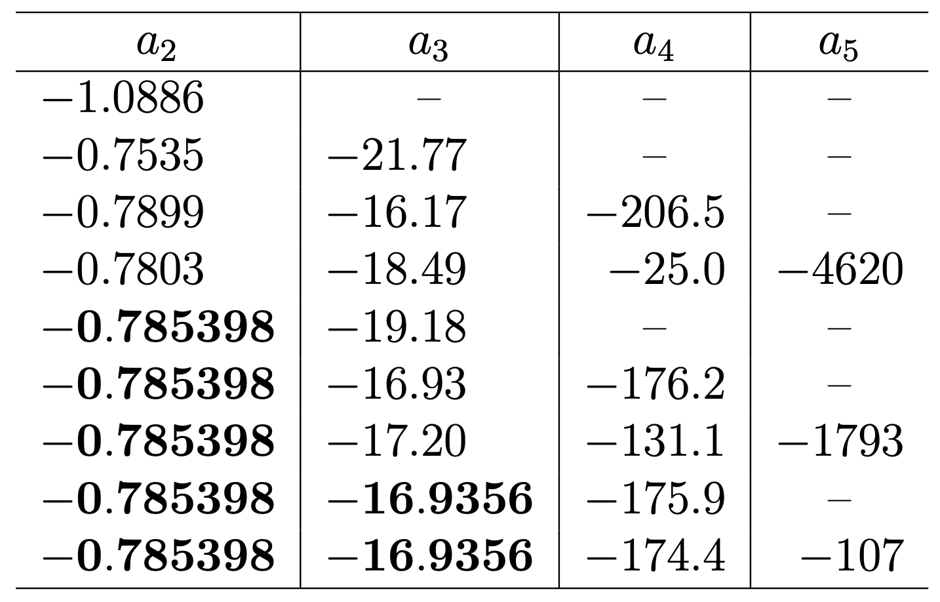
Extraction of high-order conservative PM results
PM expansion with free parameters:
Up to 3PM can fit value or use analytic value.

Slide 11
Scattering angle correction: 4PM conservative
Elliptic integrals
Free coefficients
Log term

Slide 12
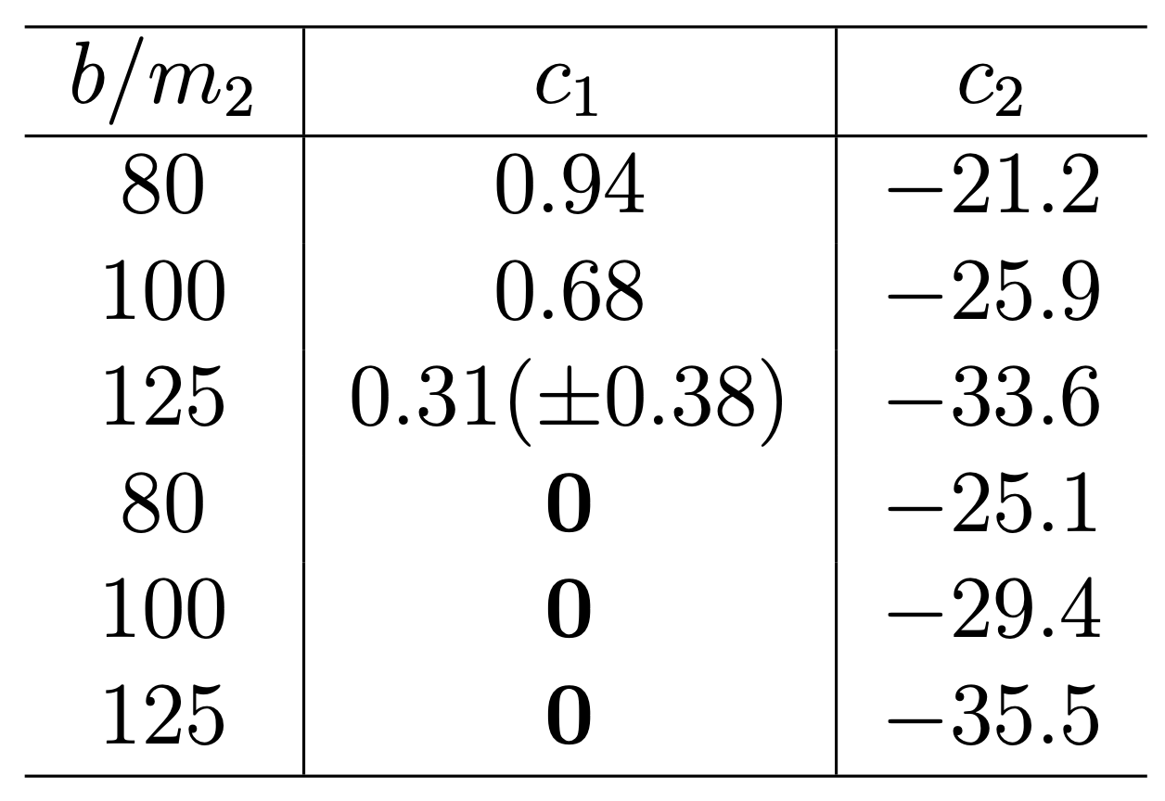
Extraction of high-order conservative PM results
Subtract known analytic parts of conservative 4PM:
are Love numbers.
Expect [Binnington & Poisson ‘09]
Fixed
(Fitting error)

Slide 13
PM comparison: Conservative

Slide 14
Dissipative:

Slide 15
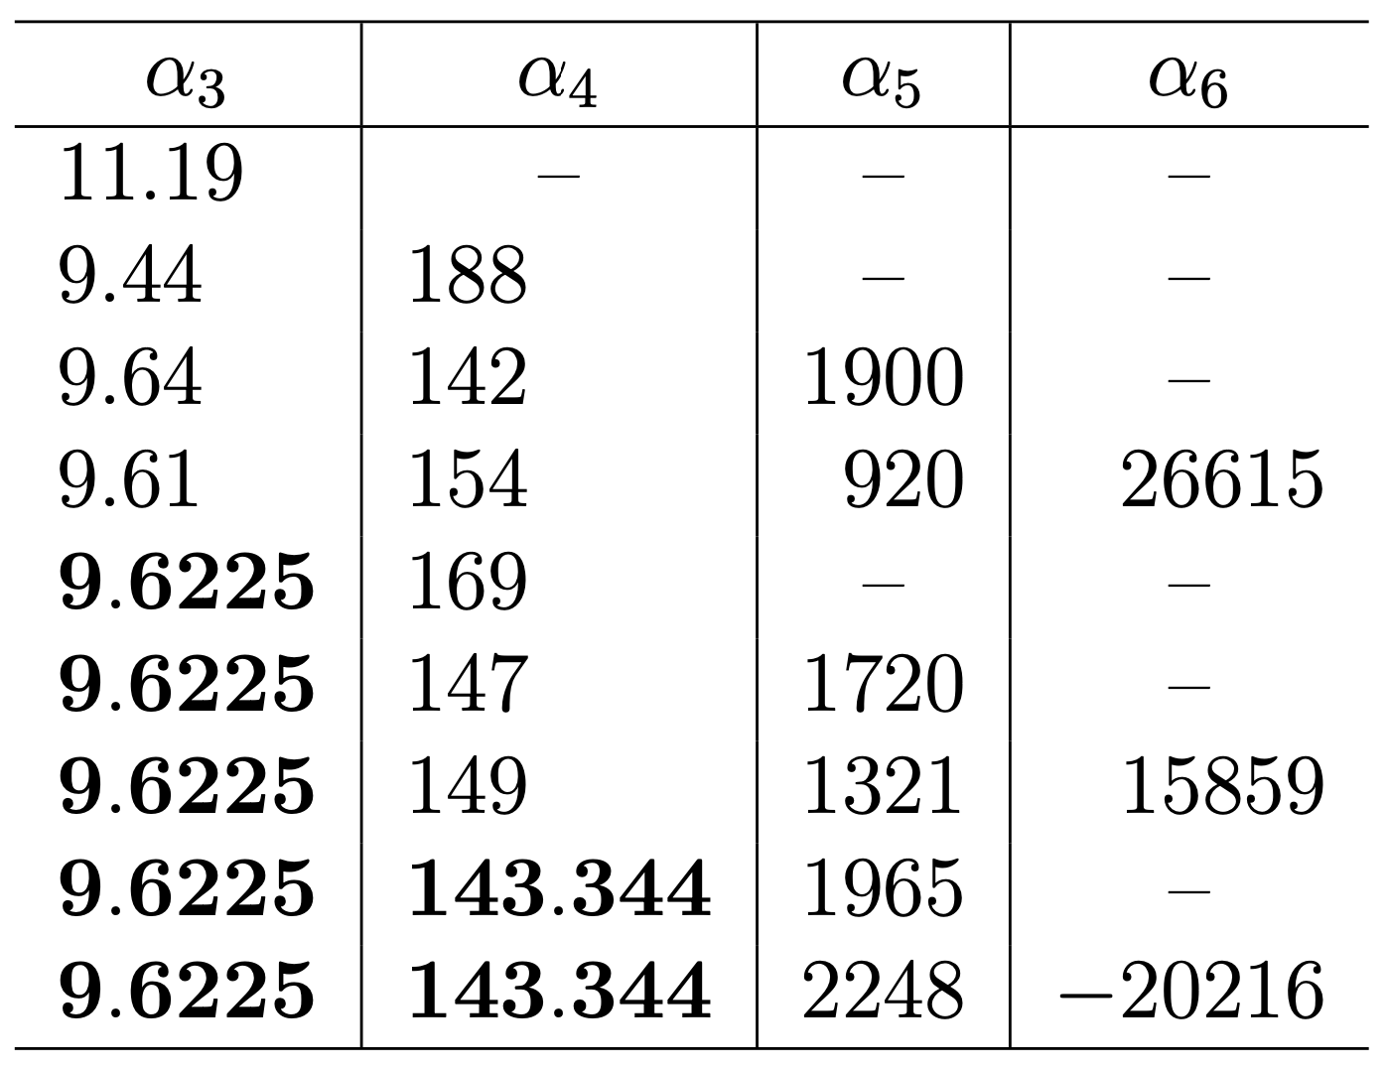
Extraction of high-order dissipative PM results
PM expansion with free parameters:
Up to 4PM can fit value or use analytic value.

Slide 16
Summary and future work
Compared numerical scalar self-force results with analytic PM results.
Good agreement for both conservative and dissipative:
  ~ 10% for LO.
  ~ 1% for NLO.
Have investigated extractions of higher-order components from numerics:
  Fixed free parameters in 4PM conservative: agreement with numerics to < 0.5%.
  Extraction of 5PM dissipative coefficient.
Future work:
  Hybrid FD/TD model for more accurate calculations (with C. Whittall).
  1+1D with hyperboloidal slicing and compactification (with R. Panosso Macedo).
  Calculate the gravitational self-force correction to the scattering angle.
  Compare to PM/NR/EOB in the gravitational case.

Slide 17
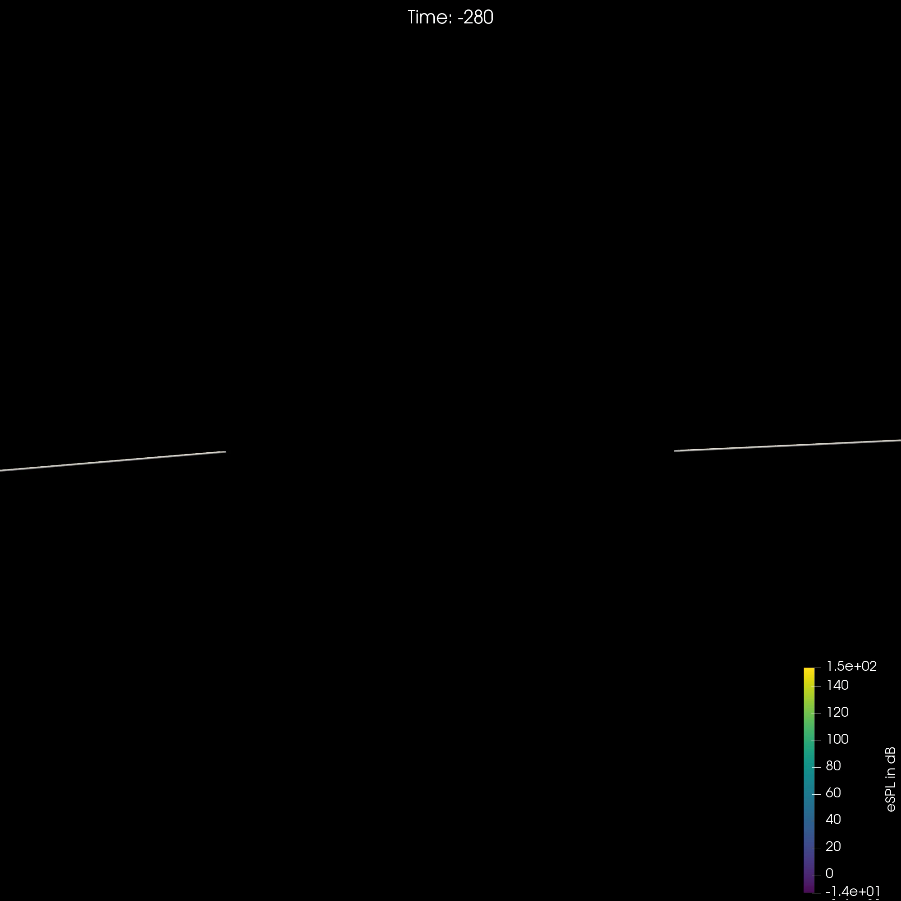

Energy density

Slide 18
Scalar field evolution scheme
Worldline
Finite-difference version of scalar wave equation:
Initial conditions
Notes:
Locally quartic, globally quadratic
Can go higher order, but we stopped here

