Slide 1
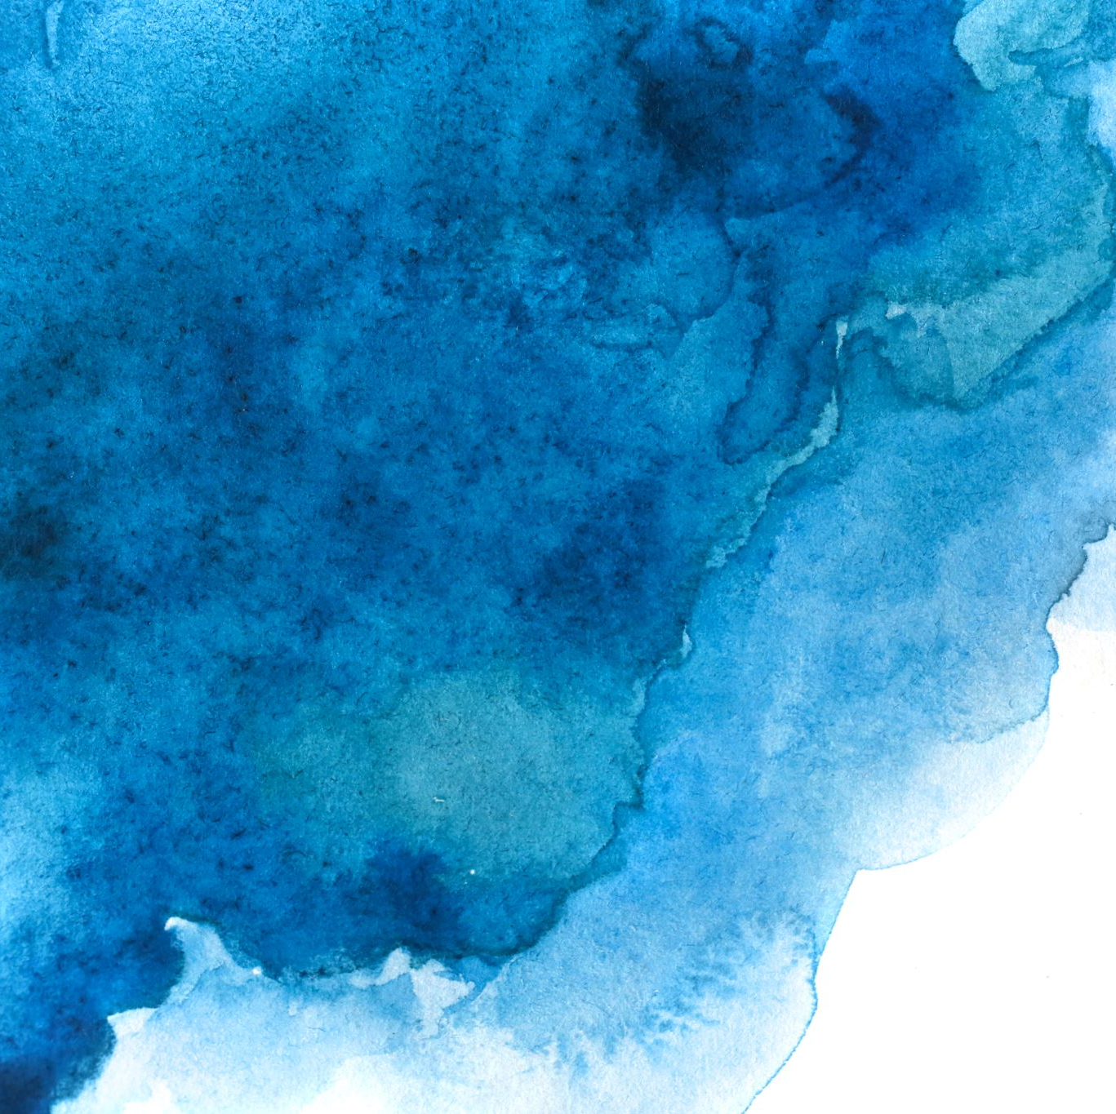
Exact solution for motion of spinning particles near static, spherically symmetric objects
Vojtěch Witzany
Charles U., Prague vojtech.witzany@matfyz.cuni.cz
In collaboration with Gabriel A. Piovano
Capra 26, 7 July 2023

Slide 2
Why care about ”spinning particle”?
In compact object binaries, spin-orbital coupling appears as a conservative effect at linear order in mass ratio (assuming Kerr bound for black holes, mass-shedding limits for neutron stars)
Also 1.5PN in a post-Newtonian expansion, 0.5PN earlier than non-trivial gravitational self-force (not obtainable from $m→μ$ rescaling and Schwarzschild geodesics)
That places it confidently into the 1PA iteration of large-mass ratio waveforms.
Need to solve for motion perturbed by spin (linear order)
Need to solve for correction to fluxes

Slide 3
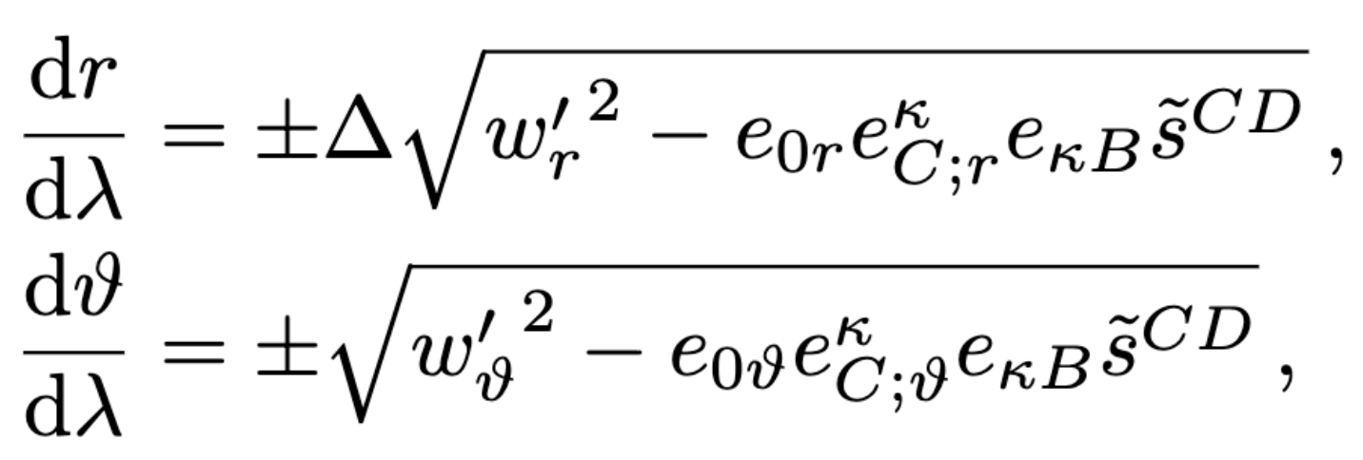
Context
2018 (VW, Steinhoff, Lukes-Gerakopoulos 1808.06582): Hamiltonians and canonical coordinates for spinning particles
2019 (VW, 1903.03651): Hamilton-Jacobi equation, separability in Kerr, constants of motion $ℰ_{so},ℒ_{so}, 𝒦_{so}, s_{∥}$, solution depends on adapted Marck tetrad and its connection
Sanity checks in equatorial plane, independent methods in special limits (Schwarzschild), contact with
Drummond & Hughes (2201.13334, 2201.13335),
Skoupý & Lukes-Gerakopoulos (2102.04819)
Saijo+ (1998),…
Annoying to deal with (ask about connection terms and watch Gabriel’s expression)

Slide 4
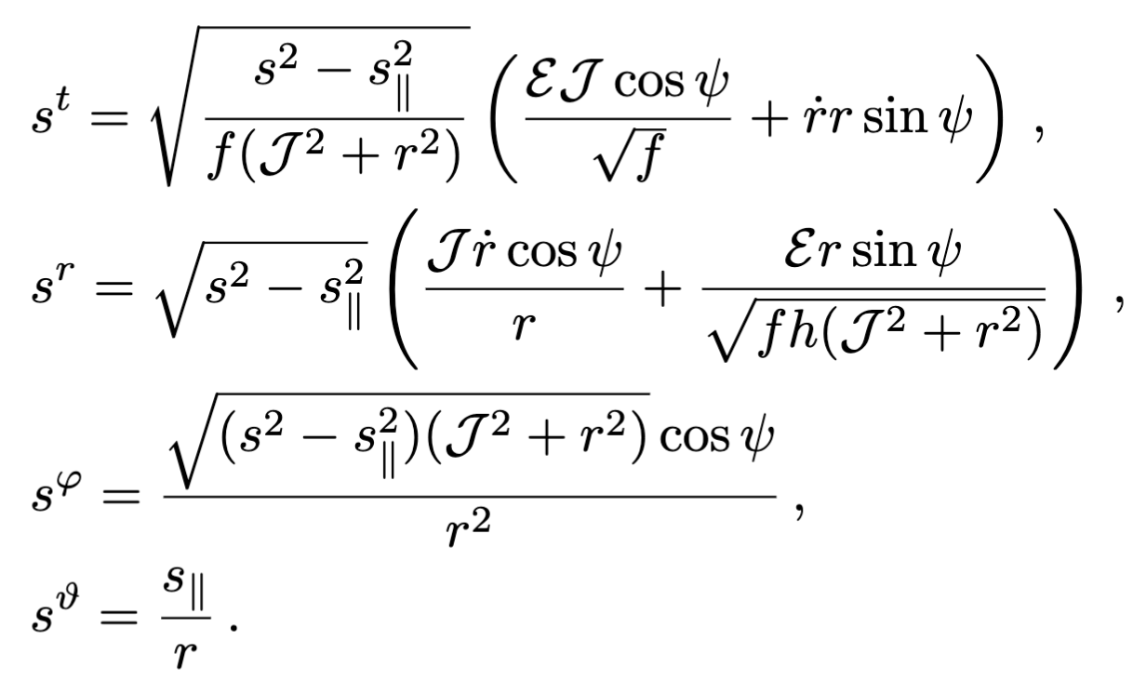
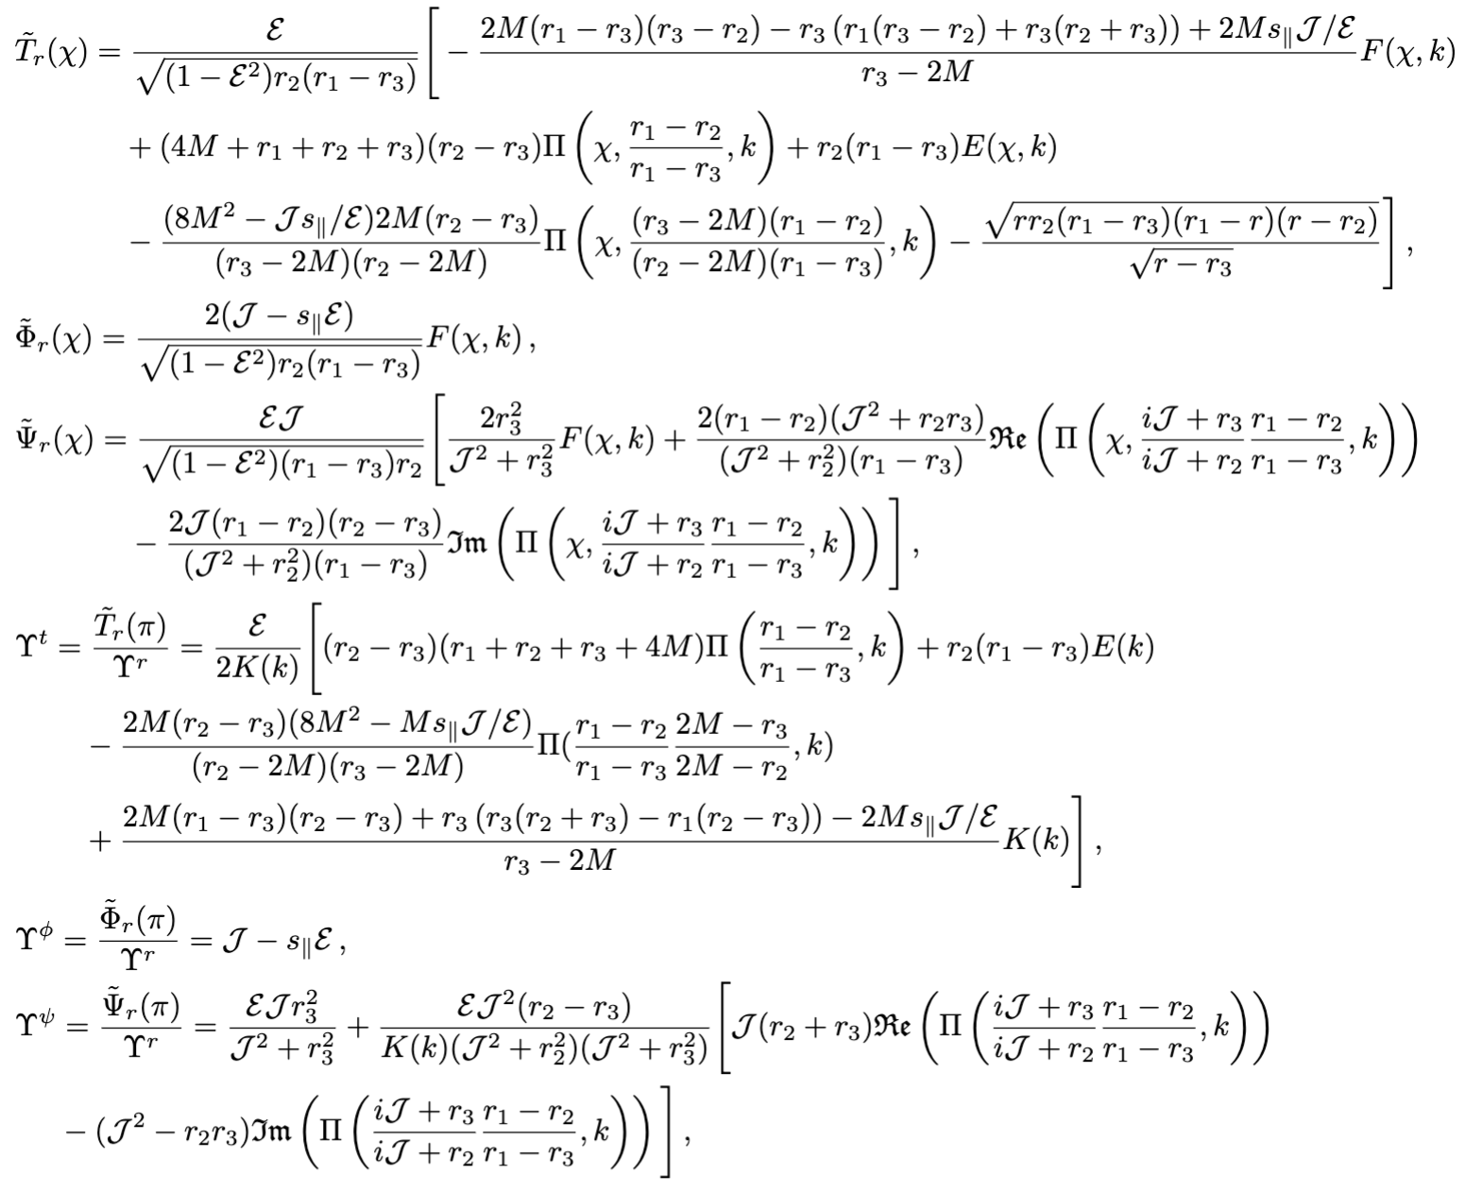
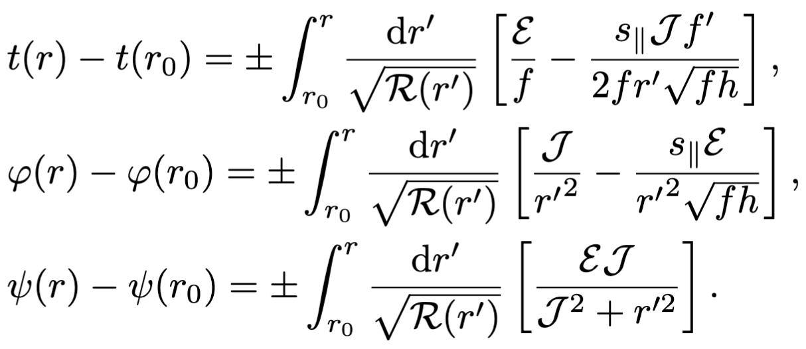
Symmetries
$$\vec{J}=”\vec{L}+\vec{S}”$$
Aligned coordinates: $δθ=O(S)$

Slide 5
Metric (why not general -> bosons stars and whatnot):
Killing constants of motion for spinning particle:
Static, spherically symmetric (x,y,z axis rotations):

Slide 6
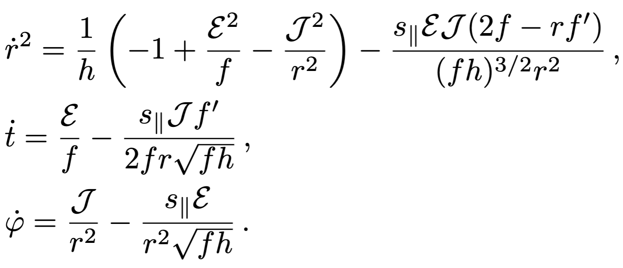
Aligned frame $\vec{z′}∥\vec{𝒥}:$ decoupling!!

Slide 7
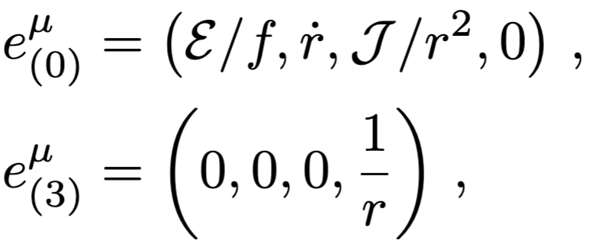
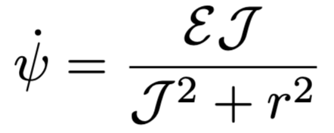
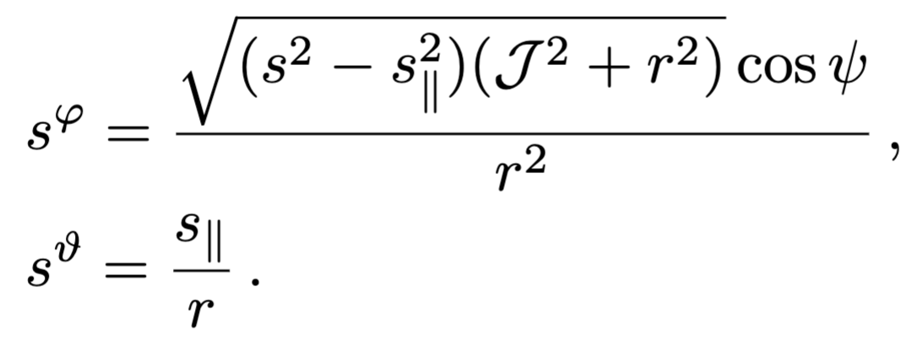
Spin sector? Parallel transport
Generalization of the tetrad of Marck (1983) for Kerr geodesics to any static, spherically symmetric space-time:

Slide 8
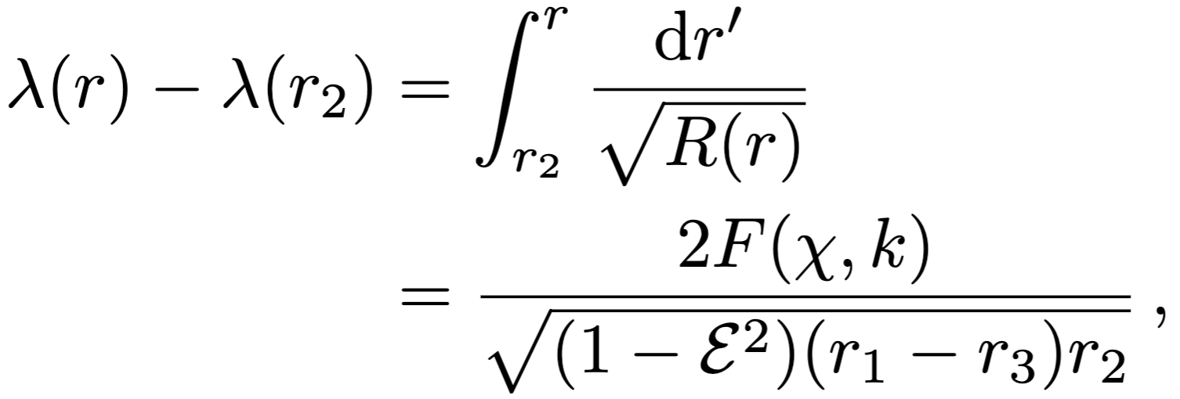
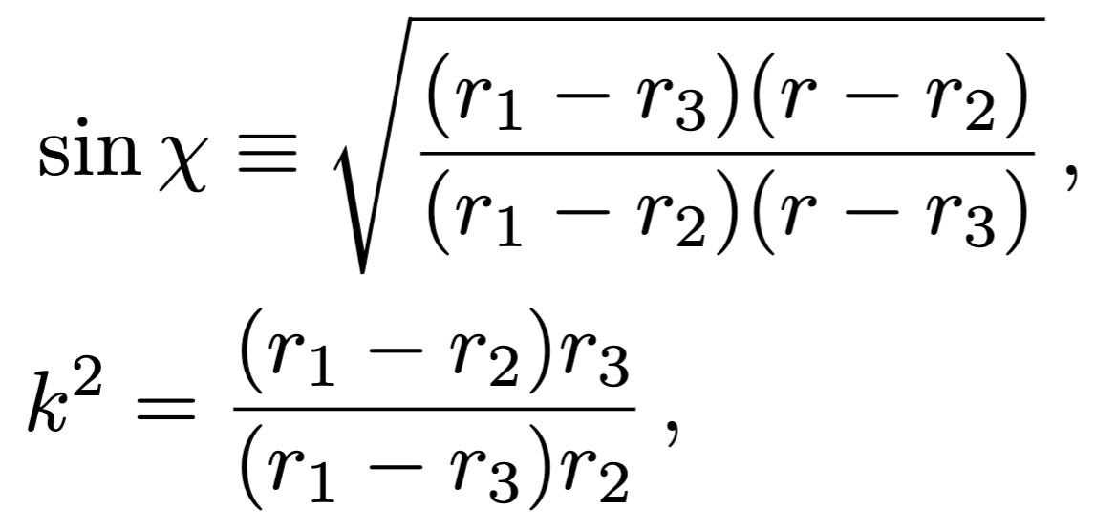
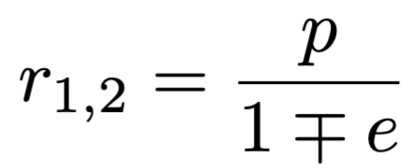
Taster: radial motion in Schwarzschild
ISCO position in closed form:

Slide 9
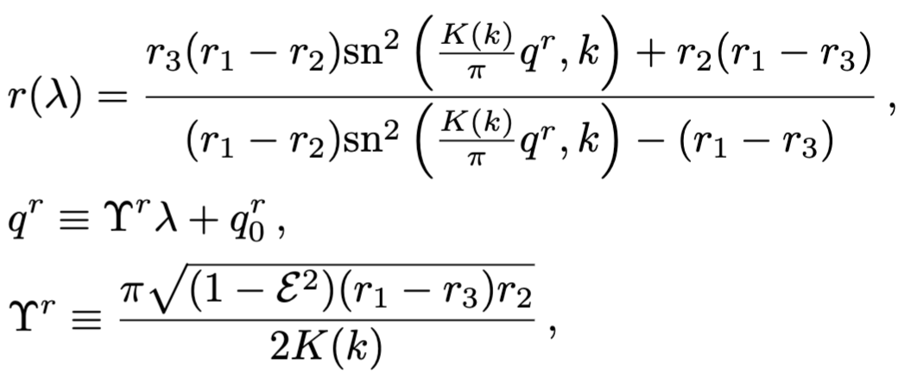
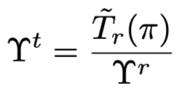
Inverting and t-motion (cf. van de Meent, 1906.05090)

Slide 10
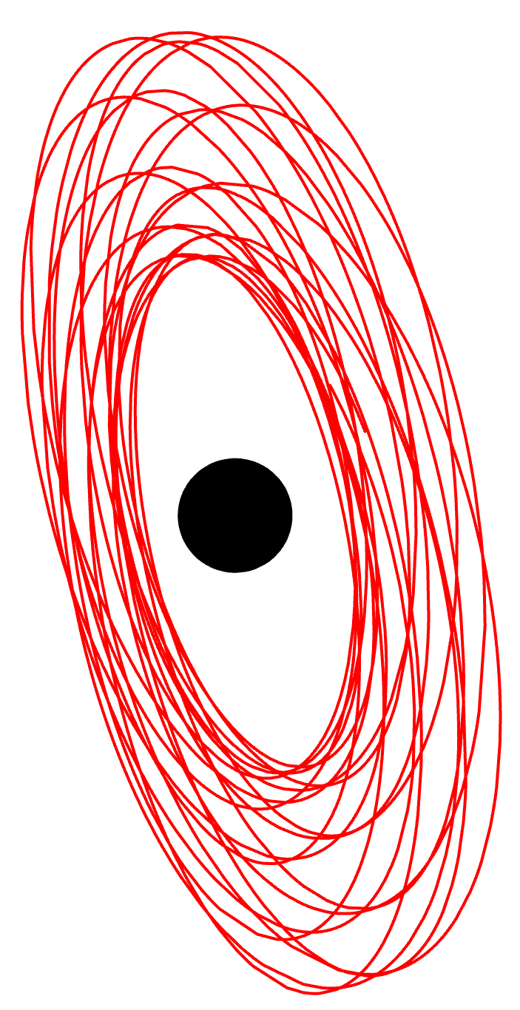
Conclusions
Spinning particle motion in spherically symmetric, static space-times fully solved by quadrature
ISCO, energy, angular momentum shifts, turning points, all depend only on $s_{∥}$
$s_{∥}$=0 means geodesic with precessing plane!
For Schwarzschild full closed-form solution in terms of angle variables $q^{r},q^{t},q^{φ},q^{ψ}$
Lookout on arxiv for Witzany & Piovano 2307.XXXXX

