Slide 1
A discontinuous Galerkin method for the distributionally-sourced s=0 Teukolsky equation
Manas Vishal (vishalmanas28@gmail.com)
Distinguished Doctoral Fellow
University of Massachusetts Dartmouth
Scott Field², Katie Rink², Sigal Gottlieb² and Gaurav Khanna¹
¹University of Rhode Island
²University of Massachusetts Dartmouth
26th Capra Meeting on Radiation Reaction in General Relativity
Niels Bohr Institute, Copenhagen, Denmark
July 05, 2023
“The aim of a talk should always be to make the audience feel smarter and not yourself.” ~ My dad

Slide 2
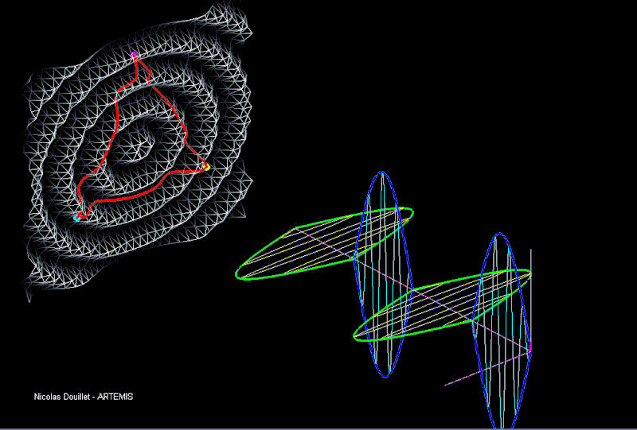
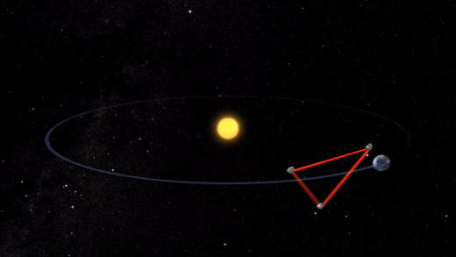
Hey LISA¹!
¹Laser Interferometer Space Antenna - Wikipedia

Slide 3
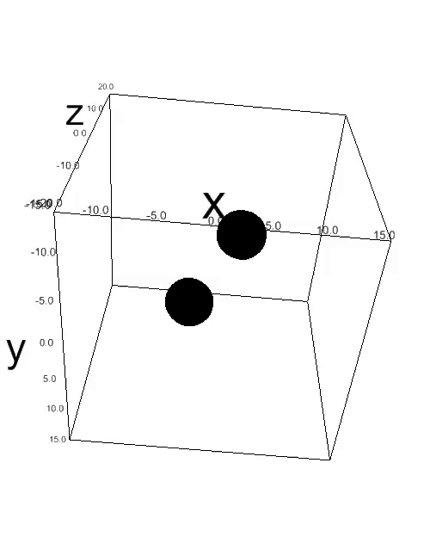
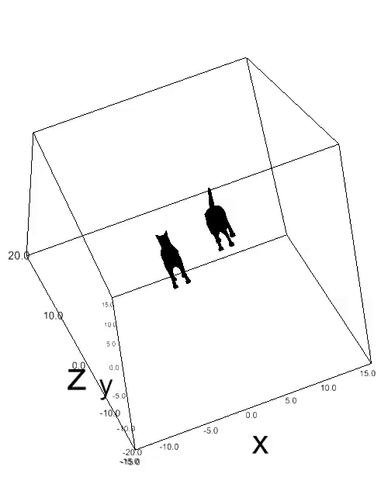
3D Animation from one of our in-house code
s-Cat-ter plot
Figure credits : MV+ friends for ICERM Numerical Relativity hackathon at Brown University
Note: The tails of the cats represent the spin on the black holes :)

Slide 4
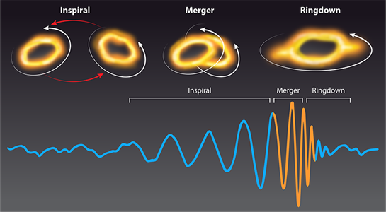
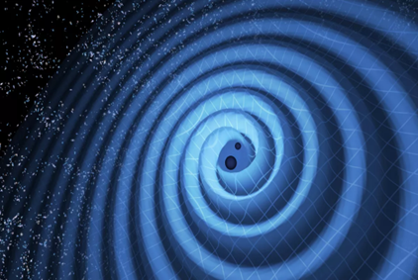
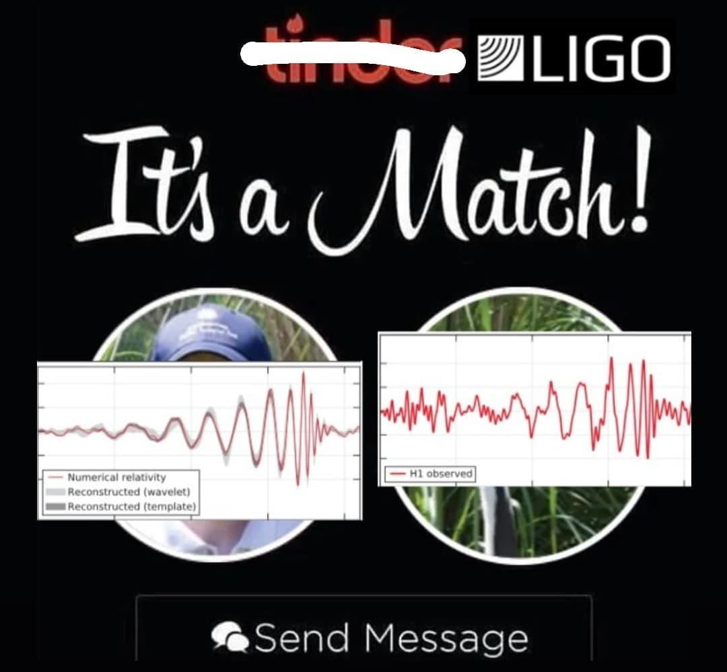
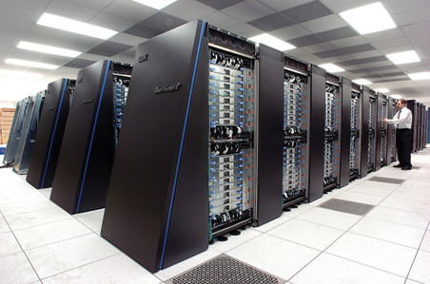
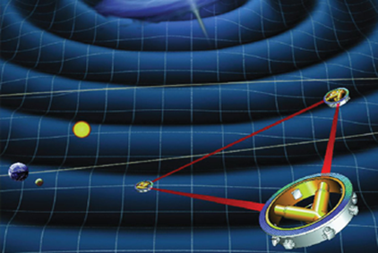
Matched Filtering 101
Figure credits : MV for fb.com/GrandUnifiedPhysicsMemes

Slide 5
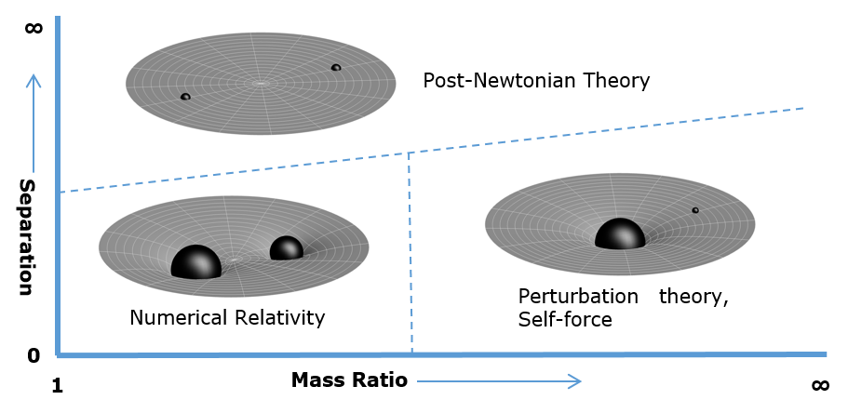
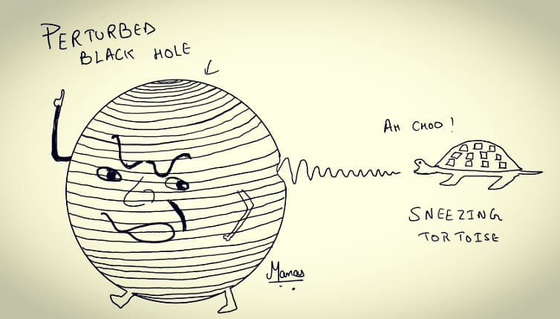
TimothyRias from Wikipedia
Inspired by C. V. Vishveshwara’s original to accommodate “tortoise coordinates”
Teukolsky equation :
where,

Slide 6
Motivation
Time domain solvers are generic and flexible, drawbacks include
Delta functions are approximated by narrow Gaussians
All time domain solvers are 2+1D
Our approach :
1+1D decomposition^{1,2}
Delta function can be modelled exactly with dG scheme
Ansatz:
Master equation in tortoise coordinates for scalar field:
[1] Nunez, Dario, Juan Carlos Degollado, and Carlos Palenzuela. "One dimensional description of the gravitational perturbation in a Kerr background." Physical Review D 81, no. 6 (2010): 064011.
[2] Stein, L. C. (2012). Probes of strong-field gravity (Doctoral dissertation, Massachusetts Institute of Technology).

Slide 7
The full coupled system by introducing auxiliary variables:
For example, with given l_{max}=6
7

Slide 8
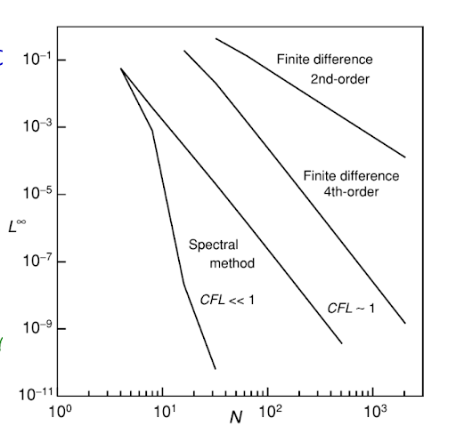
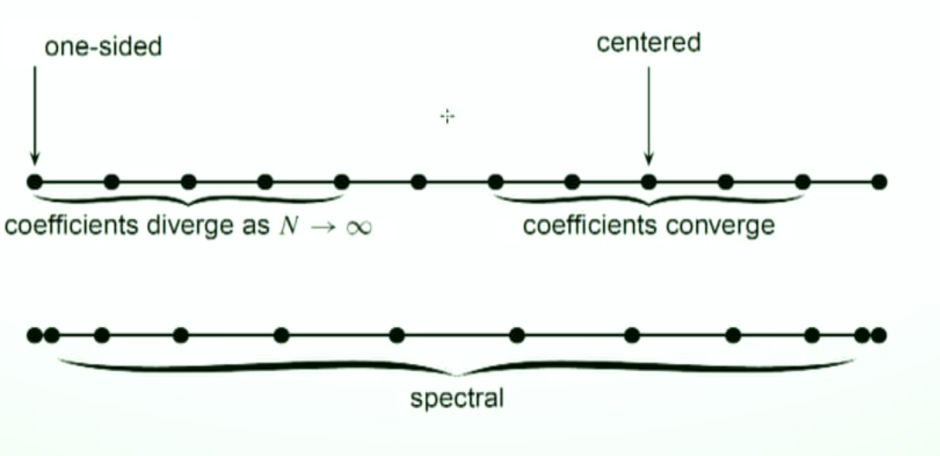
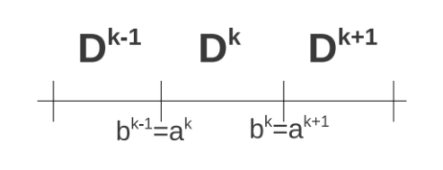
Why discontinuous Galerkin?
More efficient than finite difference methods
Easily parallelizable
Delta function can be exactly incorporated in the scheme
Exponential decay of error
Method maintains spectral accuracy for non smooth solution provided the non smoothness is located at interfaces
Fig. Credits: Saul Teukolsky

Slide 9
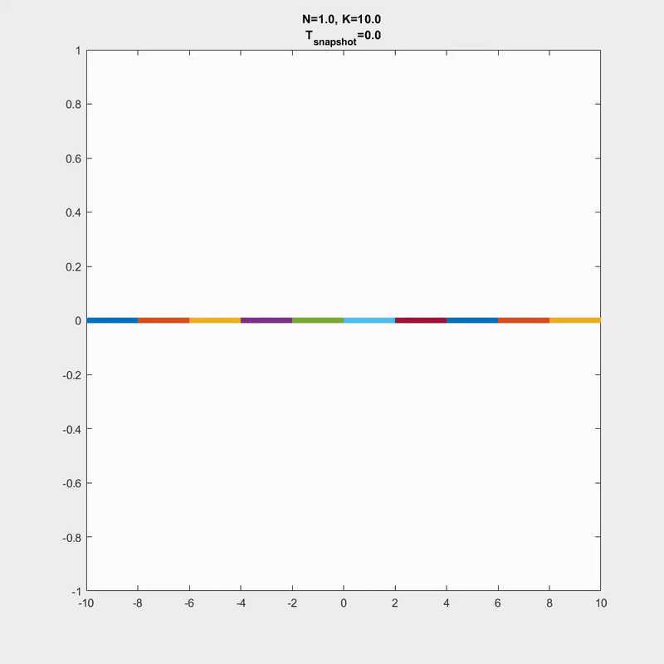
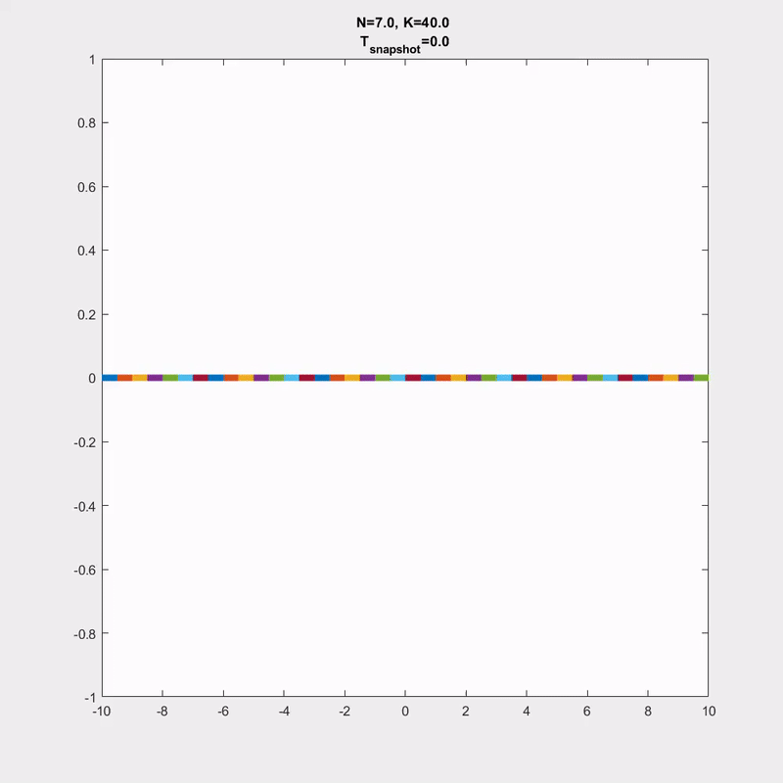
Delta source term in a wave equation

Slide 10
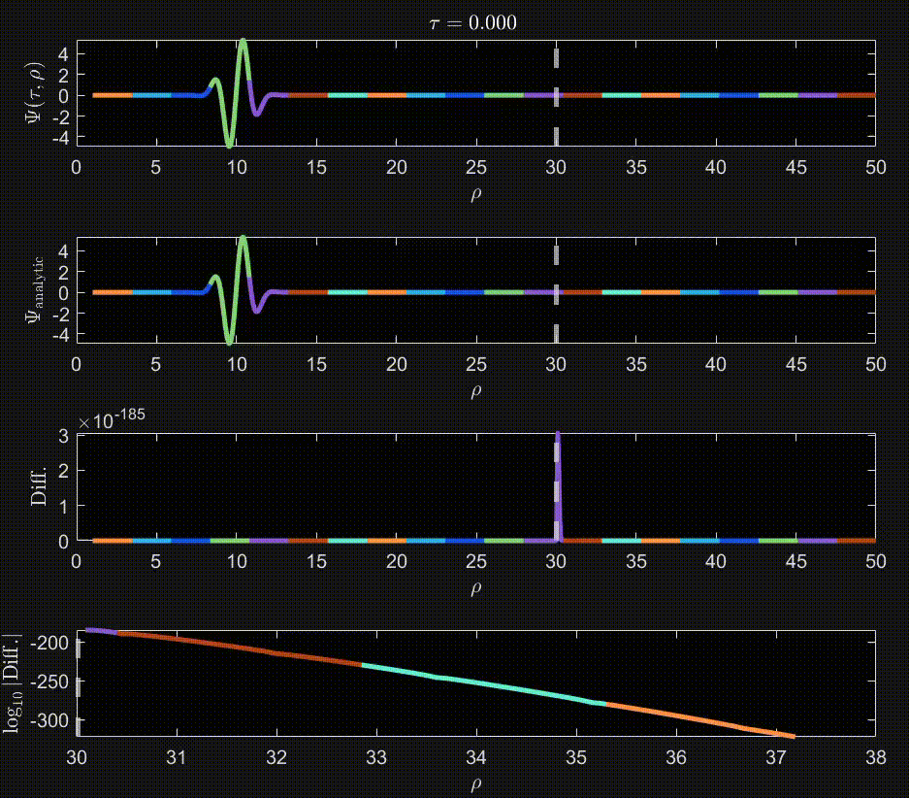
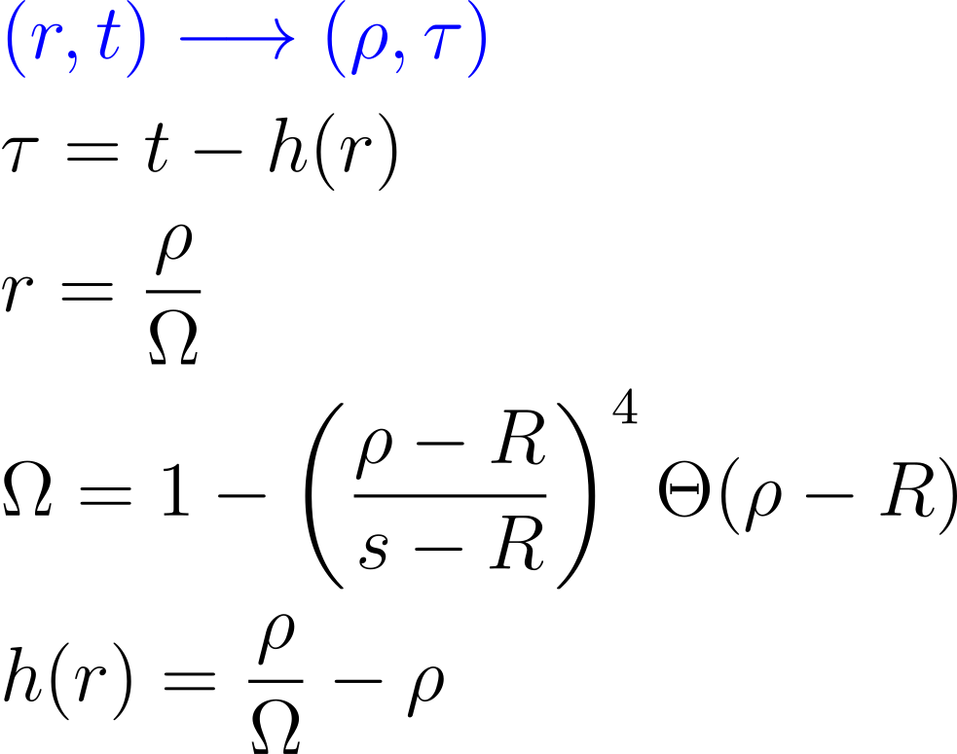
Hyperboloidal Layers¹
Null infinity
Reduces simulation time
No boundary conditions needed
[1]Zenginoğlu, A. (2011). Hyperboloidal layers for hyperbolic equations on unbounded domains. Journal of Computational Physics, 230(6), 2286-2302.

Slide 11
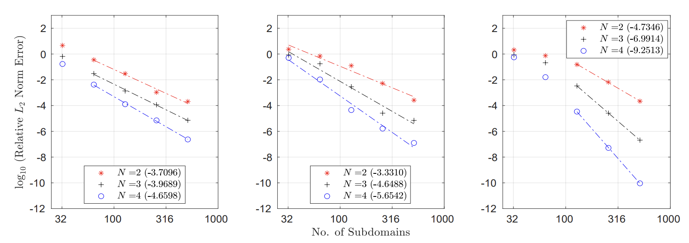
Error and Superconvergence
For sufficiently smooth solutions the error should decay like :
Left of layer
Inside layer
At future null infinity

Slide 12
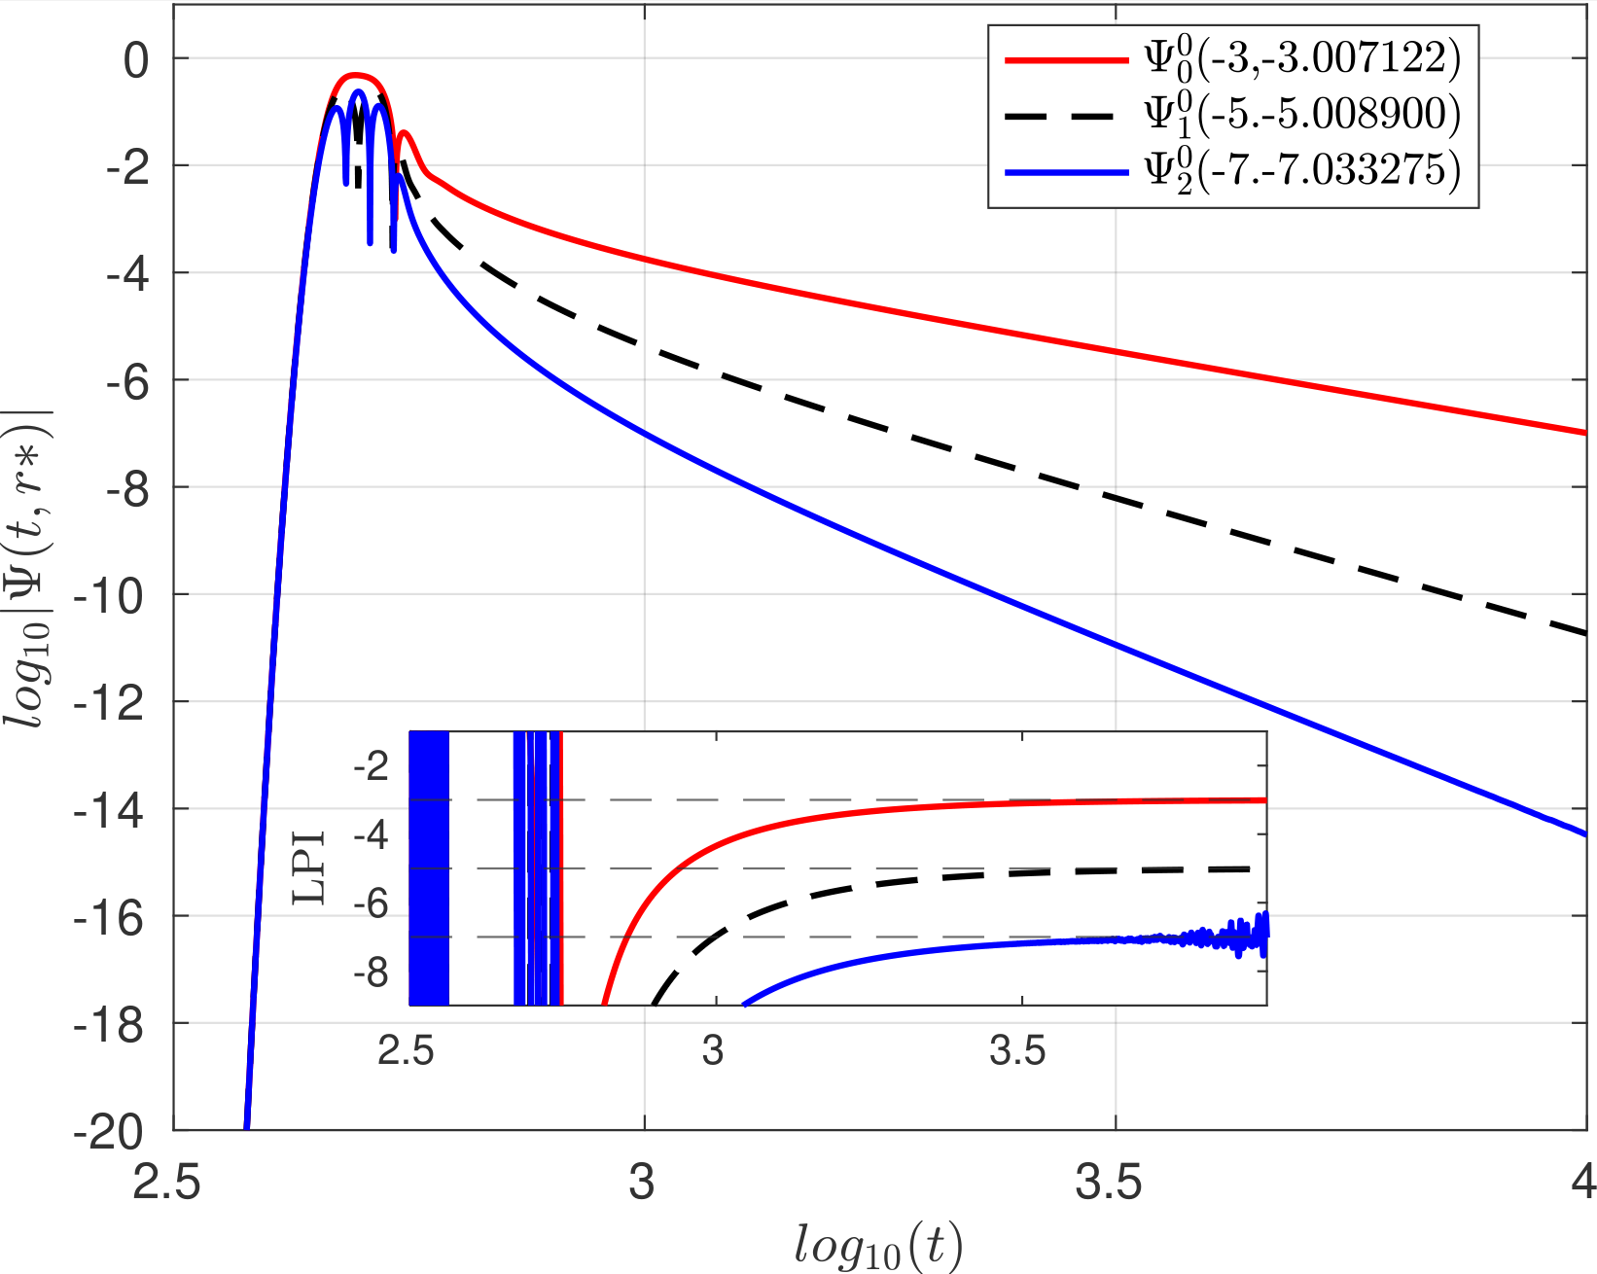
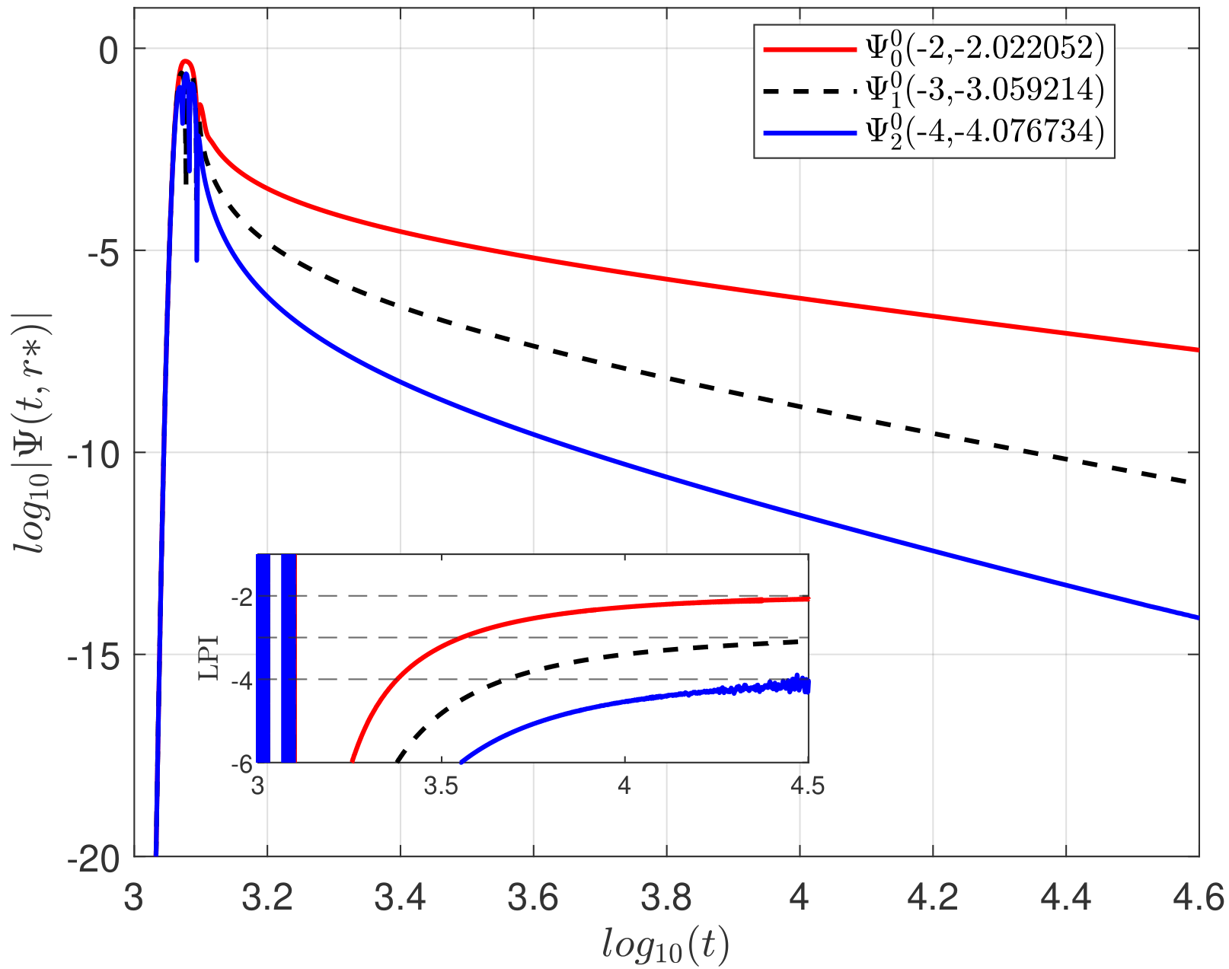
Results and code test I
The tale of tails : Schwarzschild Price Tail
N=10,
subdomains=400,
Signal extracted at a) r*=500 and b) at future null infinity
With zero initial data and a Gaussian(μ=30,σ=10) momentum Grid [-200,1200] with R=200
[1] Burko, Lior M., and Gaurav Khanna. "Late-time Kerr tails: generic and non-generic initial data sets,‘up’modes, and superposition." Classical and Quantum Gravity 28, no. 2 (2011): 025012.

Slide 13
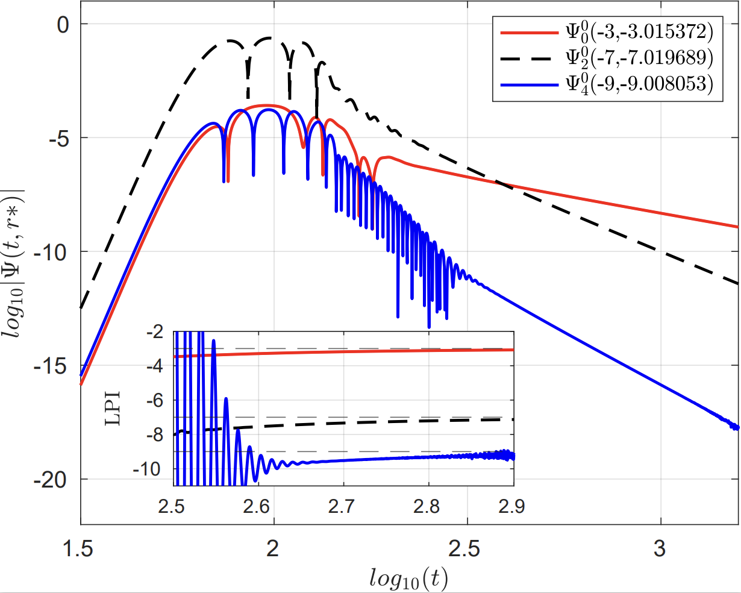
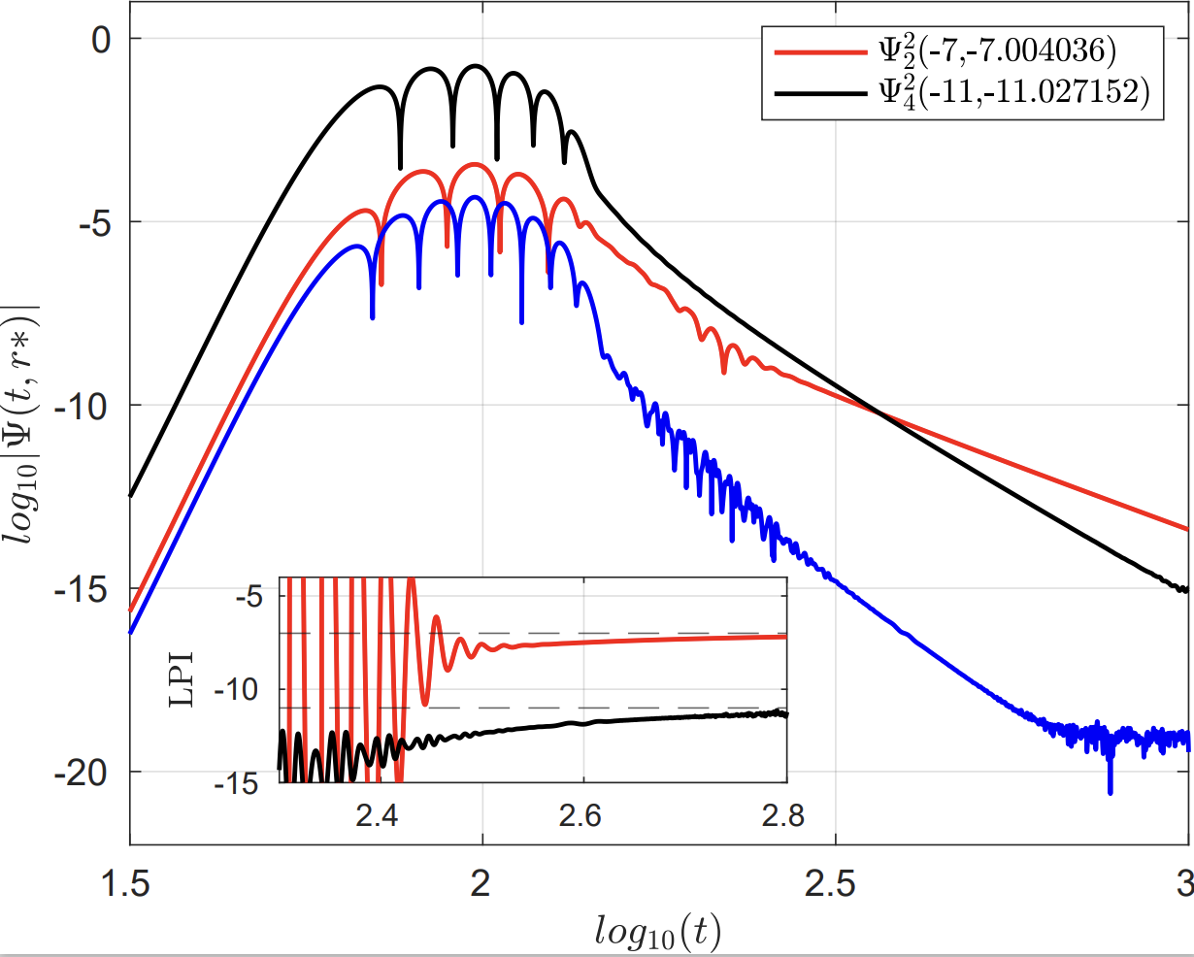
Results and code test II
The tale of tails : Kerr Price Tail
m=0
N=21, subdomains=600,
Signal extracted at r*=100 with primary spin a=0.99995M
With zero initial data and a Gaussian(μ=25,σ=6) momentum Grid [-2100,1200]
m=2
N=10, subdomains=700,
Signal extracted at r*=100 with primary spin a=0.7M
With zero initial data and a Gaussian(μ=25,σ=6) momentum Grid [-1100,400] with R=150
[1] Burko, Lior M., and Gaurav Khanna. "Late-time Kerr tails: generic and non-generic initial data sets,‘up’modes, and superposition." Classical and Quantum Gravity 28, no. 2 (2011): 025012.

Slide 14
Results and code test II
Scalar Energy Fluxes I
Where for a particle in circular orbit,

Slide 15
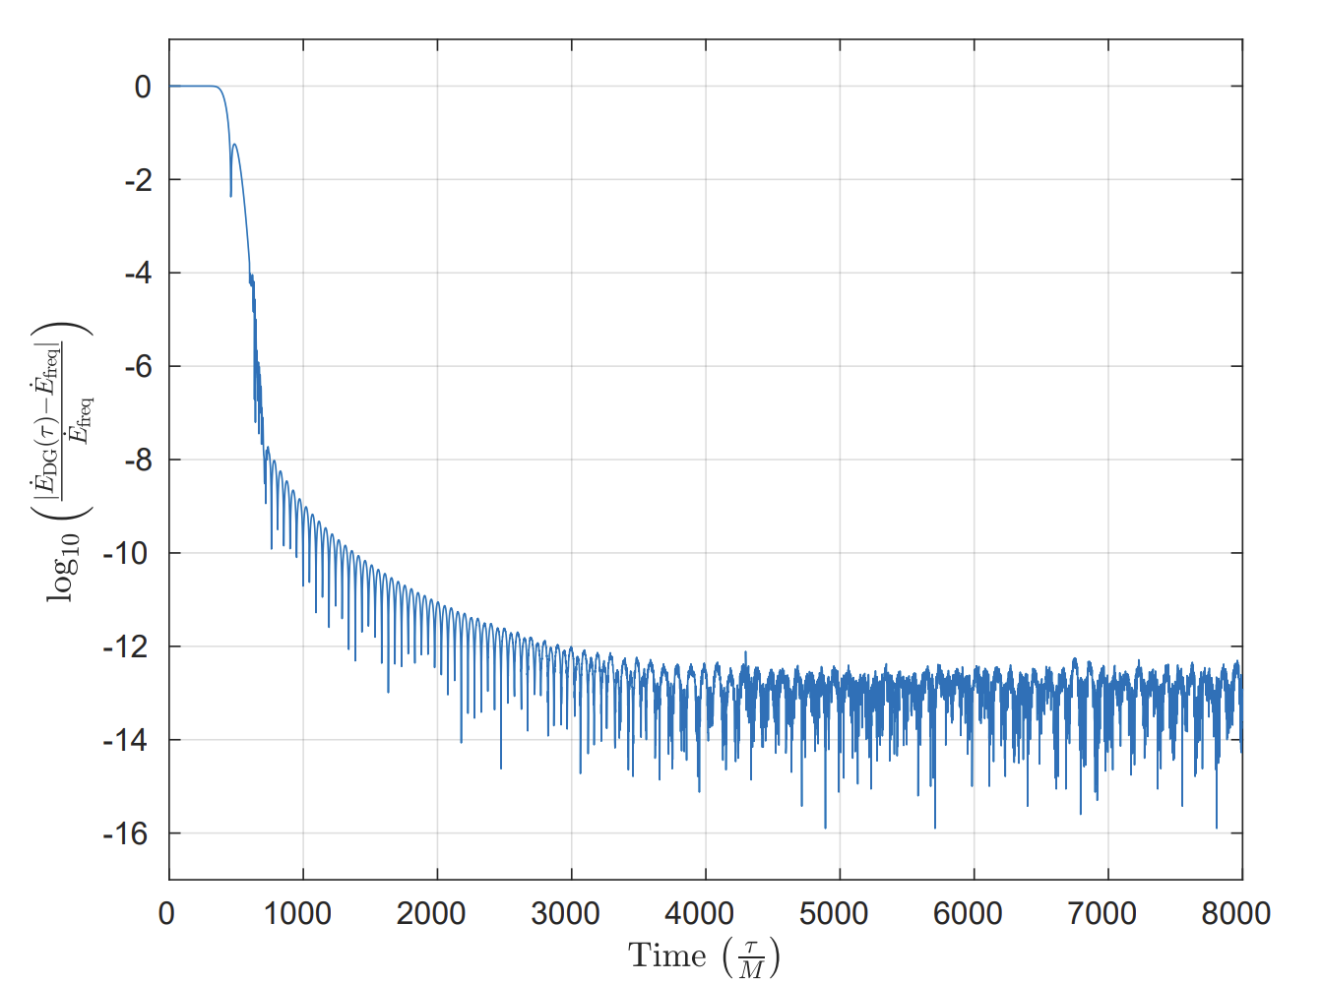
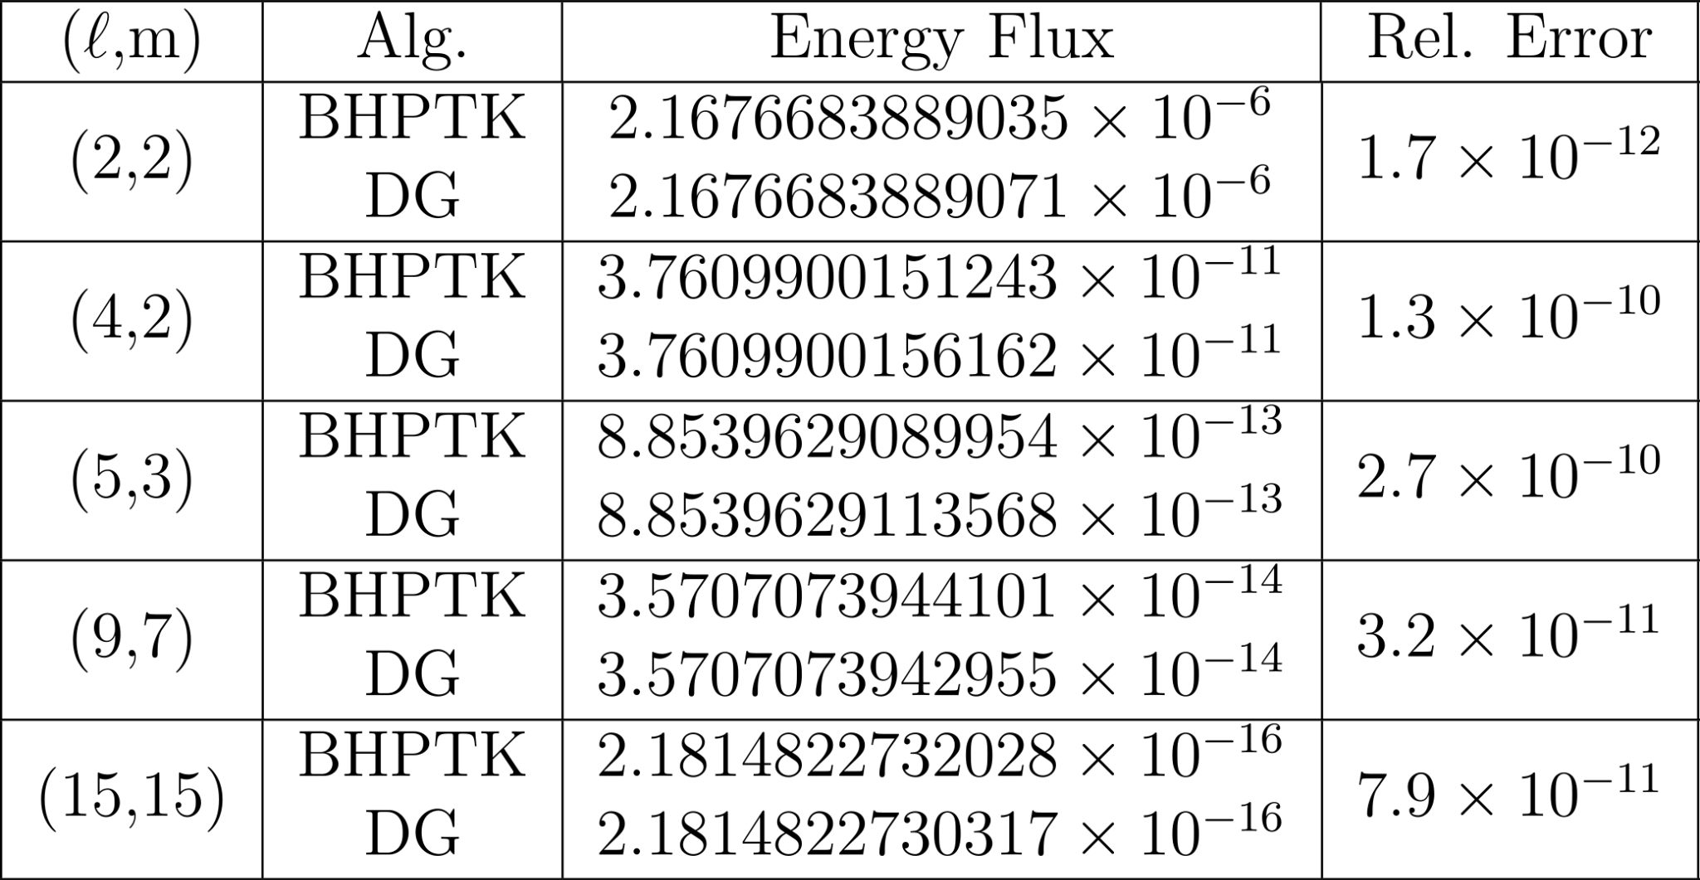
Results and code test II
Scalar Energy Fluxes II

Slide 16
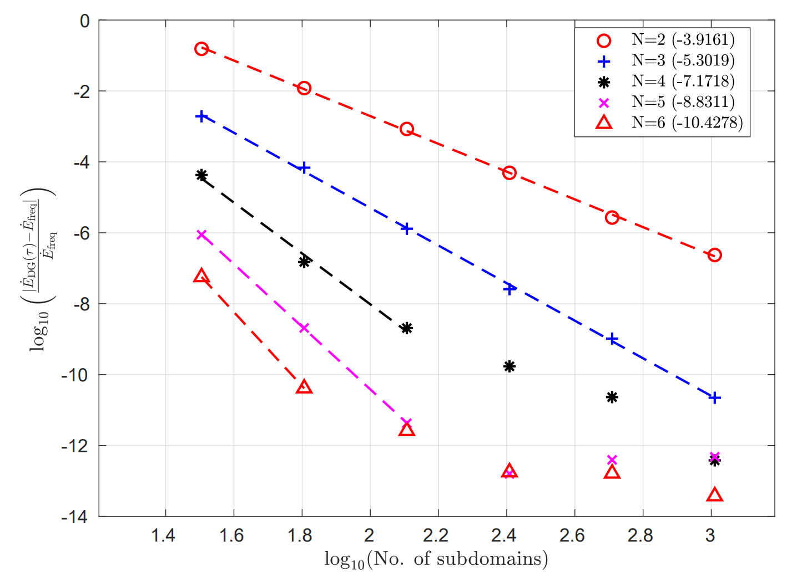
Results and code test II
Scalar Energy Fluxes II

Slide 17
Conclusion (key takeaways and tl;dr)
Work done
Solved scalar Teukolsky equation in Kerr, with and without the hyperboloidal layers in time-domain
Modeled the secondary black hole as a delta function in the dG scheme
Price law verified
Verified the spectral (super)convergence
Work in progress
Implementing in C++
Adding parallelization
Future works
Computation of gravitational waveforms
Eccentric orbits
Efficient, accurate and flexible time domain solver for EMRIs

Slide 18
That’s all folks!
Questions
/Comments?
Relevant paper coming soon to
your nearest arxiv server…

Slide 19
Extra Slides

Slide 20
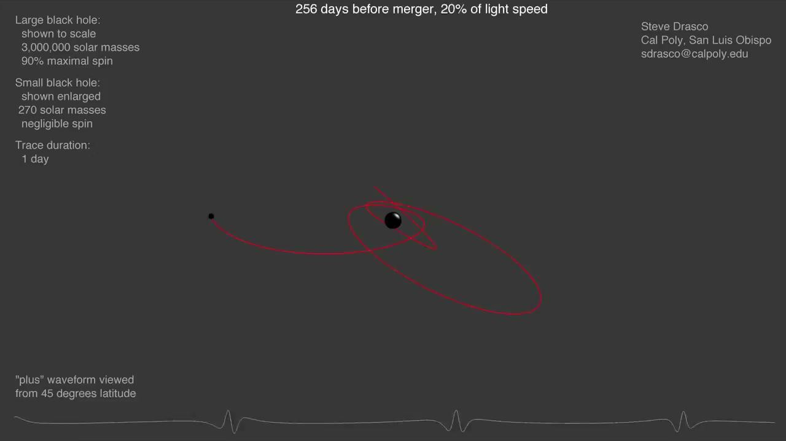
Extreme Mass Ratio Inspirals

Slide 21
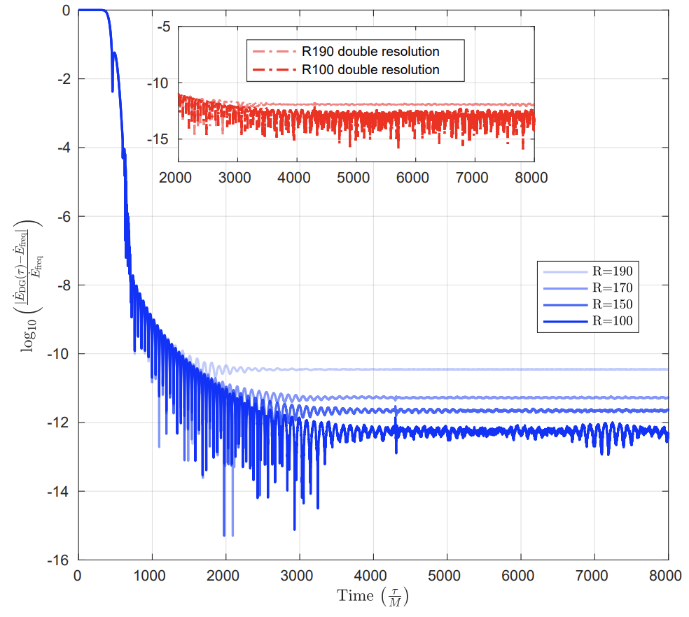
Results and code test II
Scalar Energy Fluxes III
Effects of hyperboloidal layer parameters on the solution :
Values at the null infinity depend on R, S and the resolution
Can be explained by how well the compactification function is captured

Slide 22
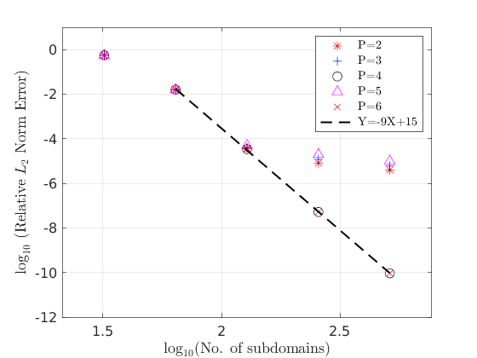

Slide 23
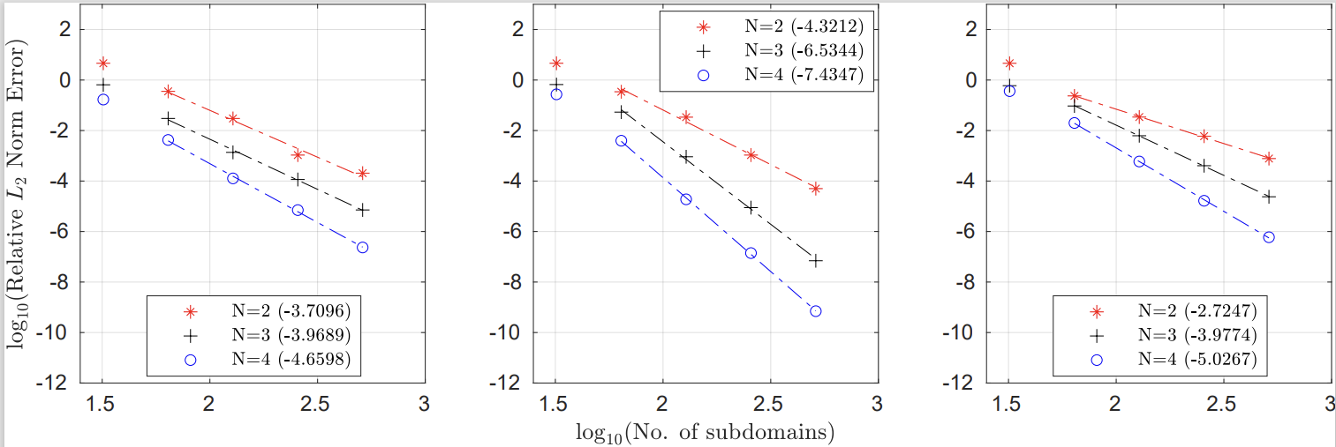
Error convergence at different points (to left of layers)
Generic dG point
Outflow point of a domain
Downflow point of a domain

Slide 24
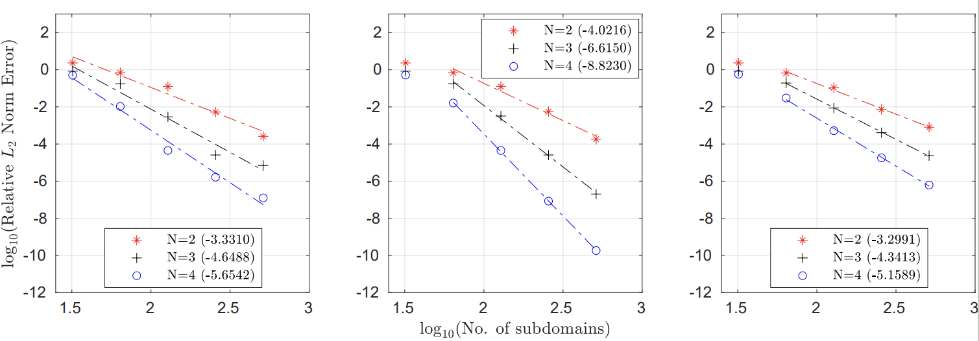
Error convergence at different points (inside the layers)
Generic dG point
Outflow point of a domain
Downflow point of a domain

Slide 25
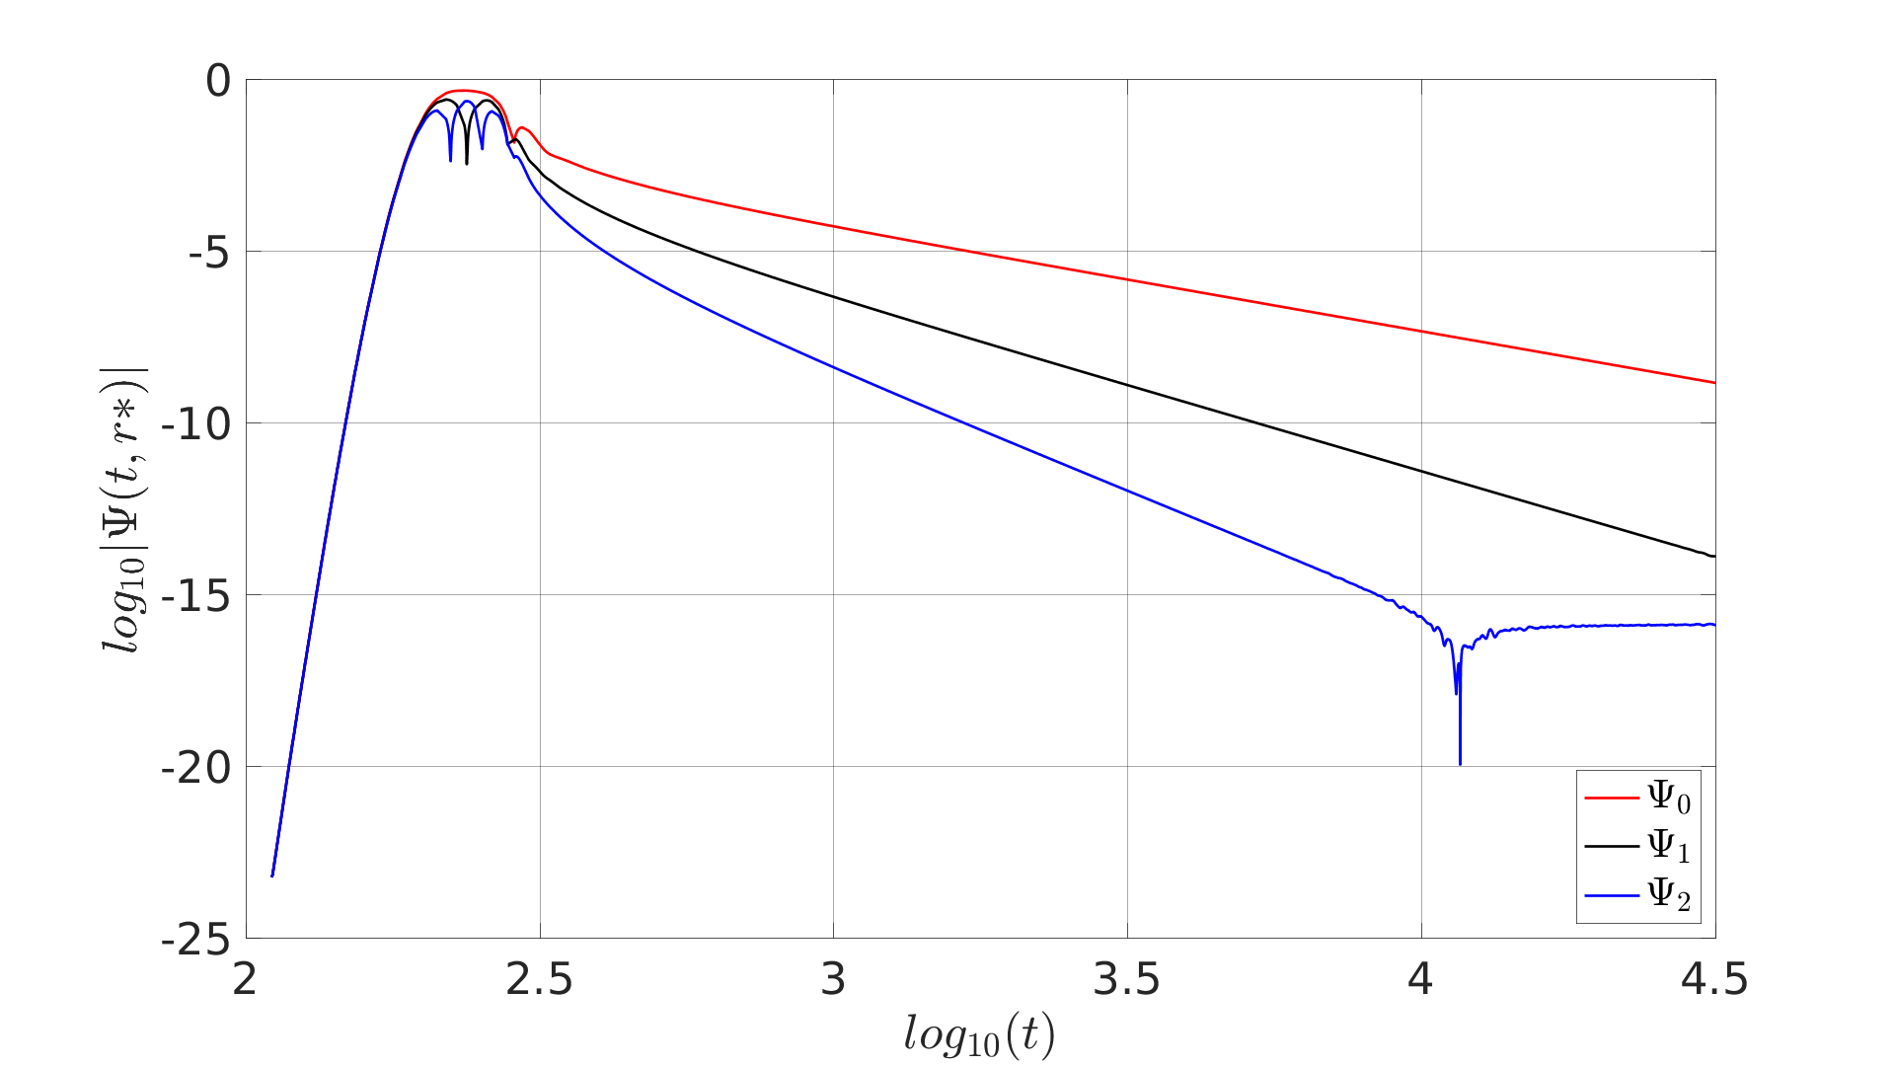
Results and code test : Schwarzschild Price Tail¹ I
Solution extracted inside the layer
N=7,
subdomains=400,
Signal extracted at r*=240M
With moving initial data as Gaussian(30,10) Grid [-200,1200] with R=200
[1] Price, Richard H. "Nonspherical perturbations of relativistic gravitational collapse. I. Scalar and gravitational perturbations." Physical Review D 5, no. 10 (1972): 2419.

Slide 26
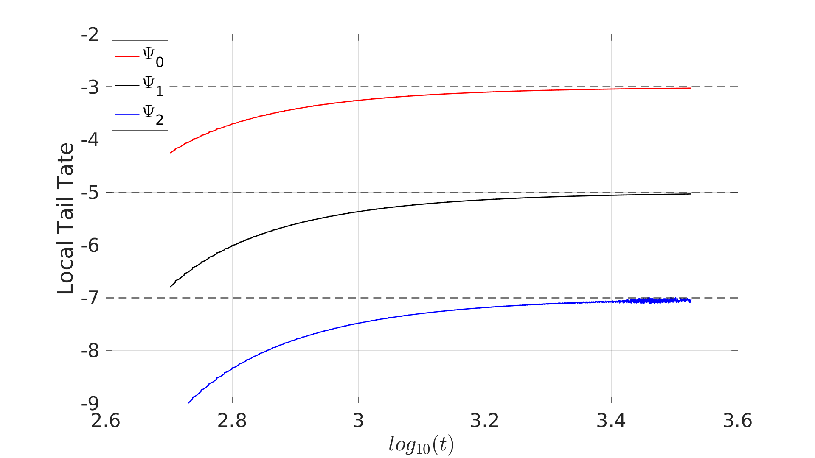
Results and code test : Schwarzschild Price Tail¹ II
Solution extracted inside the layer
N=7,
subdomains=400,
Signal extracted at r*=240M
With moving initial data as Gaussian(30,10) Grid [-200,1200] with R=200
[1] Price, Richard H. "Nonspherical perturbations of relativistic gravitational collapse. I. Scalar and gravitational perturbations." Physical Review D 5, no. 10 (1972): 2419.

Slide 27
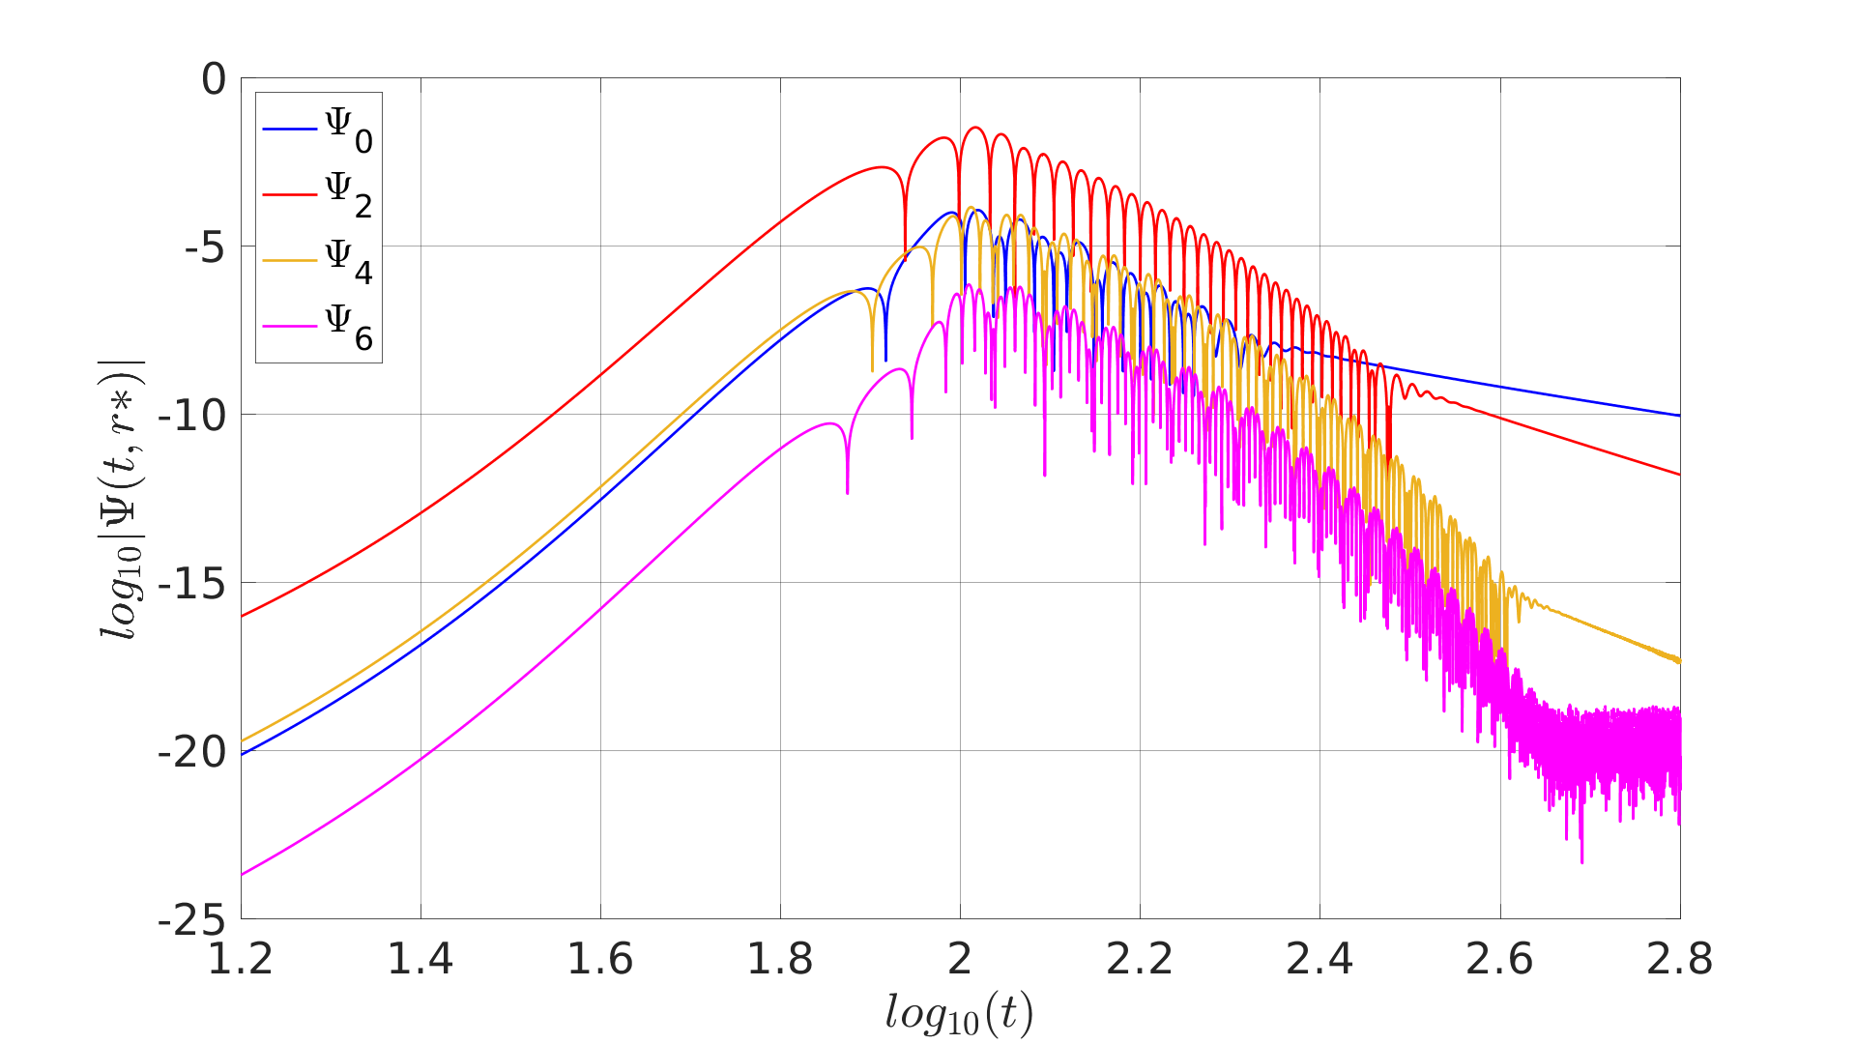
Results and code test : Kerr Price Tail I
N=16,
Subdomains=1000,
Signal extracted at r*=99M and a=0.8
With static Gaussian(2,10) initial data
in l=2 mode

Slide 28
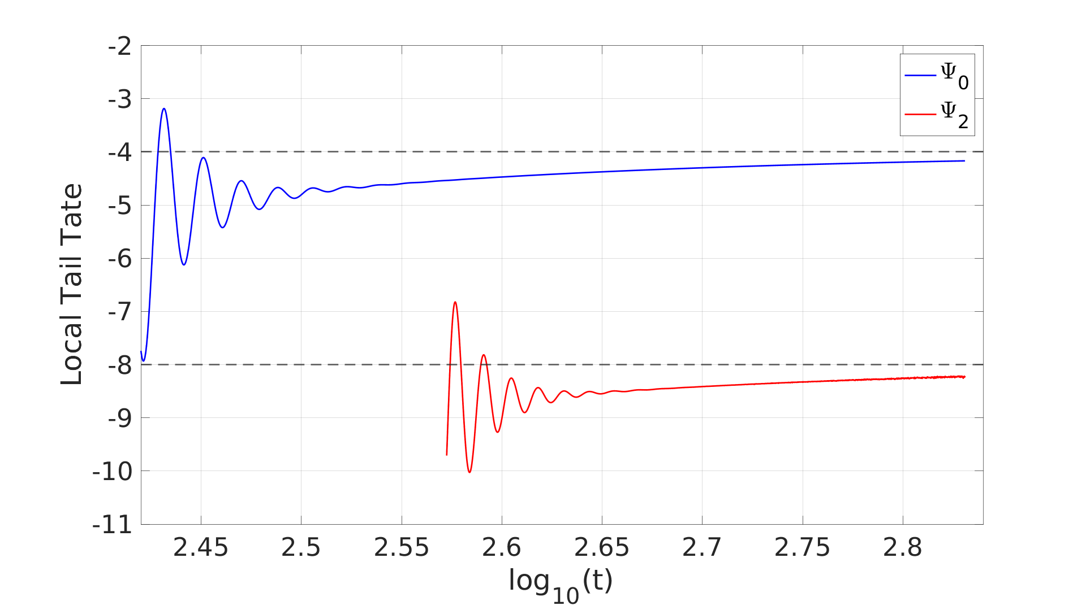
Results and code test : Kerr Price Tail I
N=16,
Subdomains=1000,
Signal extracted at r*=99M and a=0.8
With static Gaussian(2,10) initial data
in l=2 mode

