Slide 1
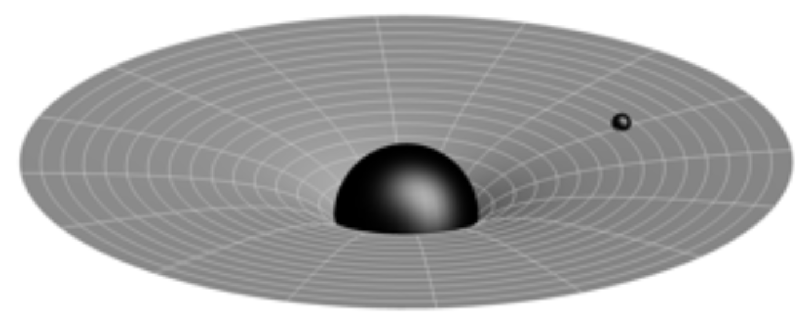
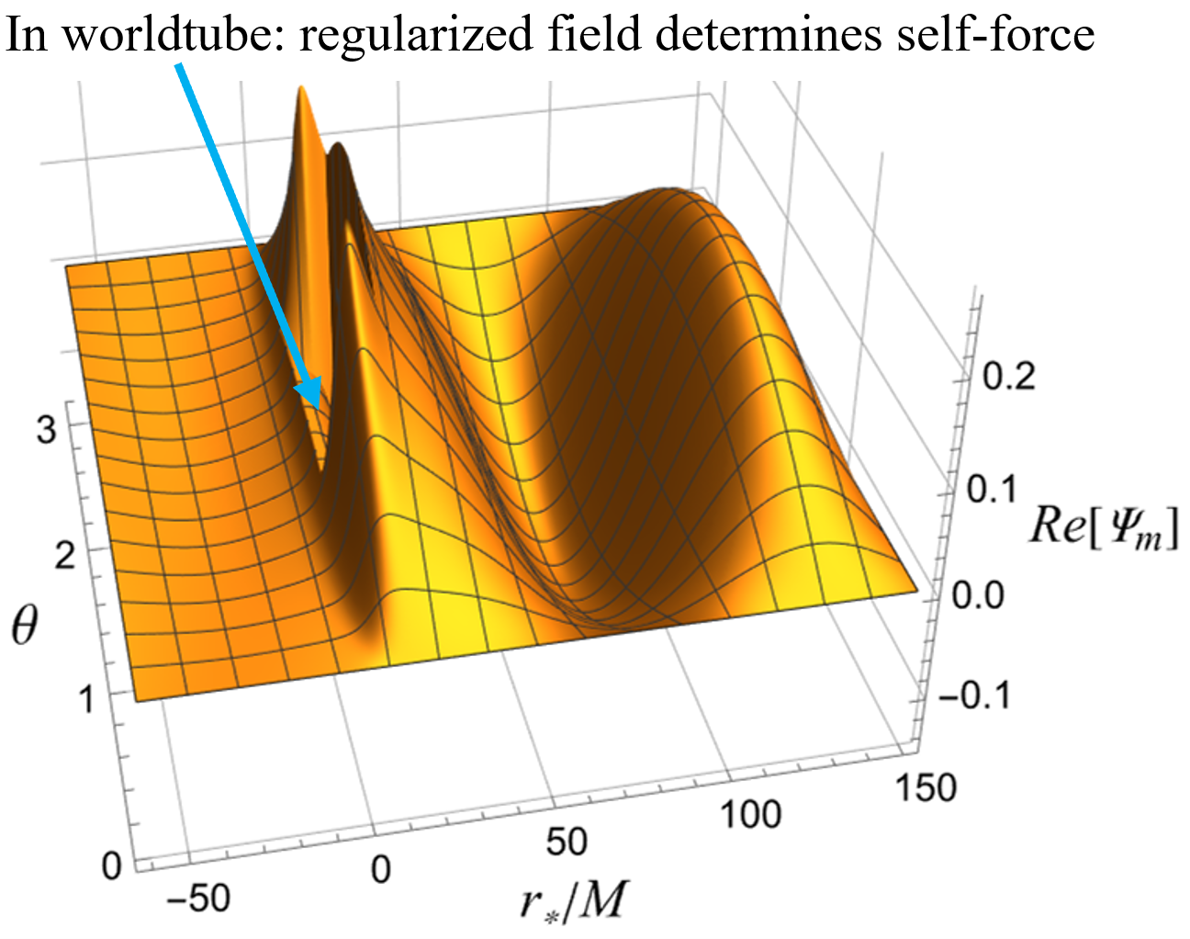
Lorenz gauge Kerr self-force via elliptic PDEs
https://arxiv.org/abs/2206.07031
Tommy Osburn, tosburn@geneseo.edu
State University of New York at Geneseo
In collaboration with Nami Nishimura
University of Maryland/AEI Potsdam

Slide 2
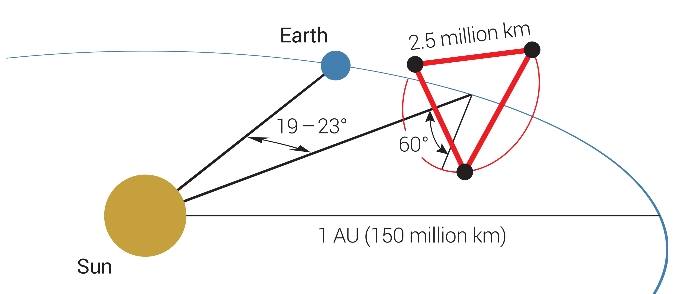
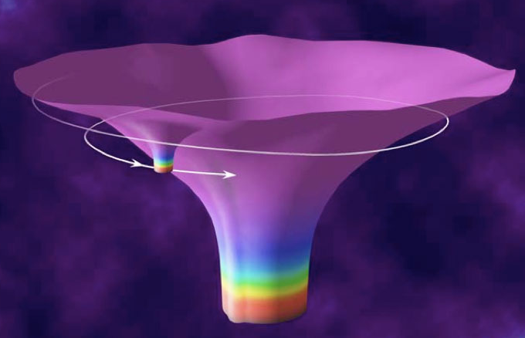
Background
Extreme Mass-Ratio Inspirals (EMRIs) are important gravitational wave sources for LISA
Precision parameter estimation/science will require templates with orbital phase error << 1 radian
Broad approach: Black Hole Perturbation Theory and Self-Force with higher order effects
Needed higher order effects include conservative self-force and 2nd order dissipative self-force
2nd order implemented for Schwarzschild (Wardell et al.2021, see Warburton’s presentation), but Kerr 2nd order self-force needs development
2nd order self-force understood in Lorenz gauge, but prior Kerr work had instabilities (Dolan et al. 2013)
Baker et al.
NASA

Slide 3
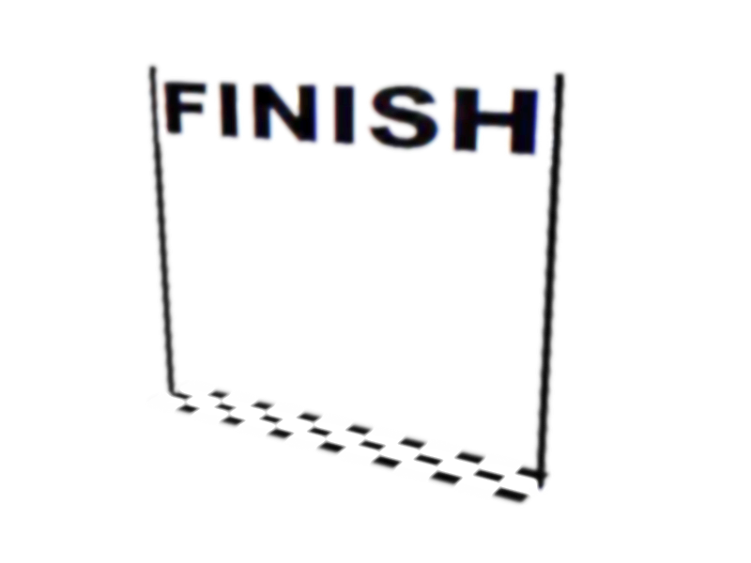
Overview
radiation gauge/GHZ
(Toomani et al. 2022)
(Green et al. 2020)
Alternate start: separable Teukolsky equation
Goal: calculate 1st order gravitational self-force for Kerr in Lorenz gauge (then try 2nd order later)
Situation: field equations not directly separable (but, Dolan et al. 2021 → Lorenz gauge via Teukolsky)
Strategy: Separate φ but do not separate θ solve PDEs ↵
Past work: Time domain ⟶ Hyperbolic PDEs, encountered time instabilities (Dolan et al. 2013)
Our approach: Frequency domain ⟶ Elliptic PDEs with r and θ derivatives, no time instabilities
This work: Develop elliptic PDE techniques by finding self-force for circular motion in Kerr spacetime with scalar fields first and then Lorenz gauge gravity
Start: non-separable Lorenz gauge field equations for Kerr
(see talks by Sam, Bourg Nasipak, & Franchini )
this work: frequency domain
time domain
?
(Thornburg, Capra 2022)
(see talk by Dolan)
1st order Kerr Lorenz gauge self-force
2nd order Kerr self-force
Future work
EMRI templates for LISA

Slide 4
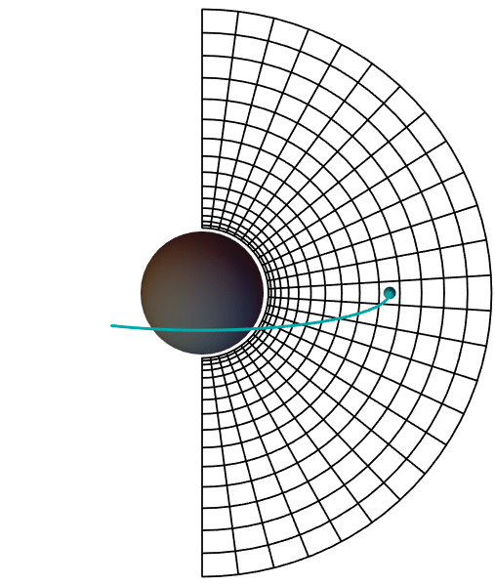
Scalar field in Kerr via elliptic PDEs:
$$∇^{α}∇_{α}Φ=−4πρ$$
Start from prior time-domain analyses (Dolan et al. 2011, Thornburg et al. 2017), but enter frequency-domain
$$Φ\left(t,r,θ,φ\right)=\frac{1}{r}\sum_{m}{Ψ_{m}\left(r,θ\right)} e^{imf(r)}e^{im(φ−Ωt)}$$
$≡−m^{2}Ω^{2}+\frac{4am^{2}ΩMr}{Σ^{2}}−\frac{{\left(r^{2}+a^{2}\right)}^{2}}{Σ^{2}}\frac{∂^{2}}{∂r_{∗}^{2}}− \frac{2iamr\left(r^{2}+a^{2}\right)−2a^{2}Δ}{rΣ^{2}}\frac{∂}{∂r_{∗}}−\frac{Δ}{Σ^{2}}\left(\frac{∂^{2}}{∂θ^{2}}+ \cot{θ}\frac{∂}{∂θ}−\frac{m^{2}}{\sin^{2}{θ}}−\frac{2M}{r}\left(1−\frac{a^{2}}{Mr}\right)−\frac{2iam}{r}\right)$
$$◻_{m}$$
$$◻_{m}Ψ_{m}=S_{m}$$

Slide 5
Numerical solution: Finite difference method
Rectangular grid with fixed $Δr_{∗}$ and $Δθ$
θ
r*
$$◻_{m}Ψ_{m}=S_{m}$$
$$\left[\begin{matrix}\begin{matrix}Ψ_{m}^{00} \\ Ψ_{m}^{01} \\ Ψ_{m}^{02} \\ ⋮\end{matrix} \\ Ψ_{m}^{10} \\ Ψ_{m}^{11} \\ Ψ_{m}^{12} \\ ⋮\end{matrix}\right]$$
Vector of unknowns
$A\frac{Ψ_{m}^{27}−2Ψ_{m}^{28}+Ψ_{m}^{29}}{Δr_{∗}^{2}}+ B\frac{Ψ_{m}^{18}−2Ψ_{m}^{28}+Ψ_{m}^{38}}{Δθ^{2}}+…=S$

Slide 6
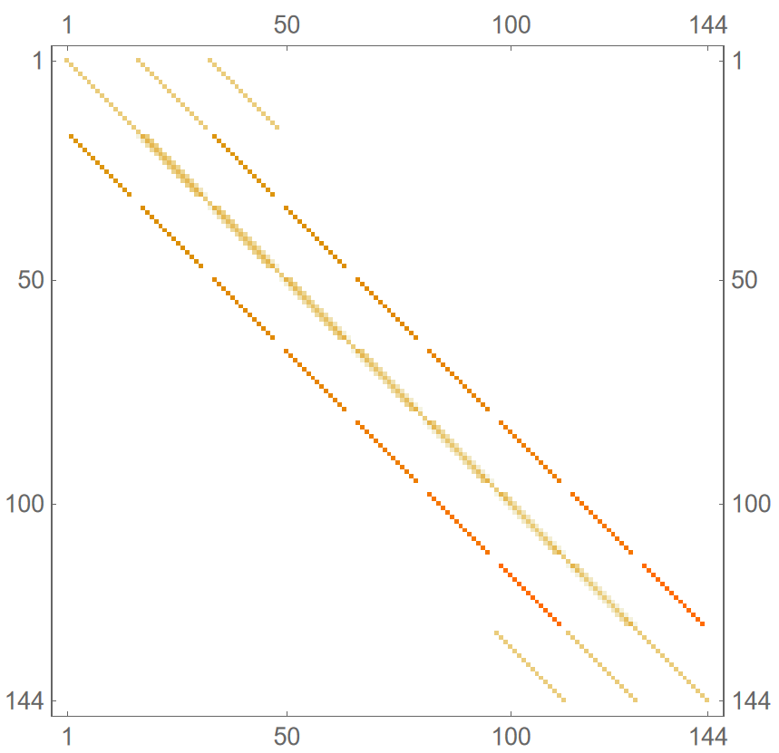
Numerical solution: Finite difference method
Rectangular grid with fixed $Δr_{∗}$ and $Δθ$
System of algebraic equations
$\left[\begin{matrix}a & b & c & d & … \\ e & f & g & h & … \\ i & j & k & l & … \\ m & n & o & p & … \\ ⋮ & ⋮ & ⋮ & ⋮ & ⋱\end{matrix}\right] \left[\begin{matrix}\begin{matrix} \\ Ψ_{m}^{00} \\ Ψ_{m}^{01} \\ ⋮\end{matrix} \\ Ψ_{m}^{10} \\ Ψ_{m}^{11} \\ ⋮\end{matrix}\right]$ =$\left[\begin{matrix}\begin{matrix} \\ S_{m}^{00} \\ S_{m}^{01} \\ ⋮\end{matrix} \\ S_{m}^{10} \\ S_{m}^{11} \\ ⋮\end{matrix}\right]$
θ
r*
Vector of unknowns
How to handle source?
$A\frac{Ψ_{m}^{27}−2Ψ_{m}^{28}+Ψ_{m}^{29}}{Δr_{∗}^{2}}+ B\frac{Ψ_{m}^{18}−2Ψ_{m}^{28}+Ψ_{m}^{38}}{Δθ^{2}}+…=S$
Linear system with sparse matrix

Slide 7
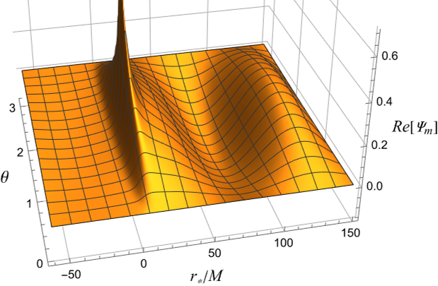
Self-force regularization: Effective source method
Field from point source blows up:
Strategy: Introduce worldtube centered on particle
Inside worldtube – Regular/Singular decomposition:
$Ψ_{m}=Ψ_{m}^{R}+Ψ_{m}^{S}$
$Ψ_{m}^{S}$ is known from an expansion and does not affect the self-force
$Ψ_{m}^{R}$ is finite and causes self-force
$◻_{m}(Ψ_{m}^{R}+Ψ_{m}^{S})=S_{m}$
$=$
m = 1
$$◻_{m}Ψ_{m}^{R}$$
$$S_{m}− ◻_{m}Ψ_{m}^{S}$$
$$=$$
$$S_{m}^{eff}$$
(see talk by Leather)
Issue: don’t have boundary condition

Slide 8
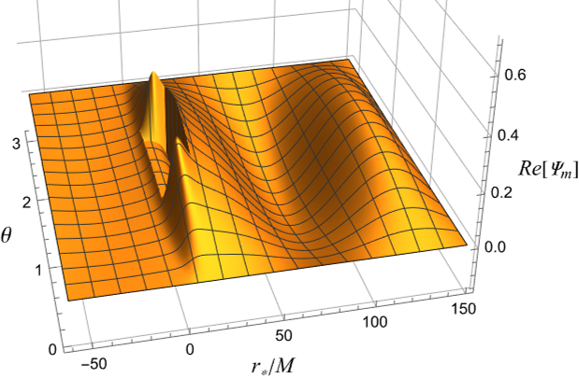
Self-force regularization: Effective source method
$$S_{m}^{eff}$$
$$≡$$
$$S_{m}− ◻_{m}Ψ_{m}^{S}$$
code by Wardell
Mathematical strategy:
$◻_{m}Ψ_{m}=0$ (outside worldtube)
$Ψ_{m}^{R}=Ψ_{m}−Ψ_{m}^{S}$ (across worldtube)
$=S_{m}^{eff}$ (inside worldtube)
(Detweiler et al. 2002, Barack et al. 2007, Vega et al. 2008, Wardell et al. 2012)
This affects the vector part of the linear system, but not the matrix part
do have boundary condition
m = 1
$$◻_{m}Ψ_{m}^{R}$$
Gradient of $Ψ_{m}^{R}$ gives self-force

Slide 9
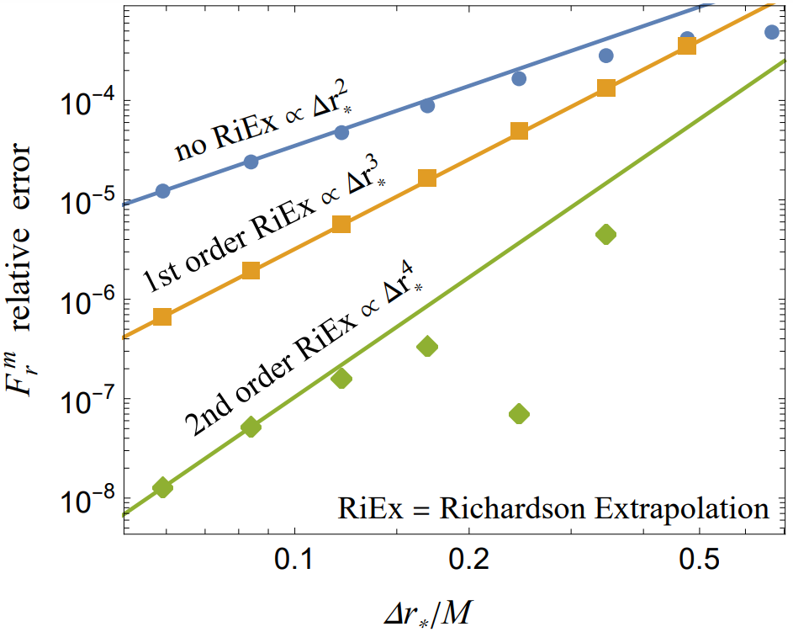
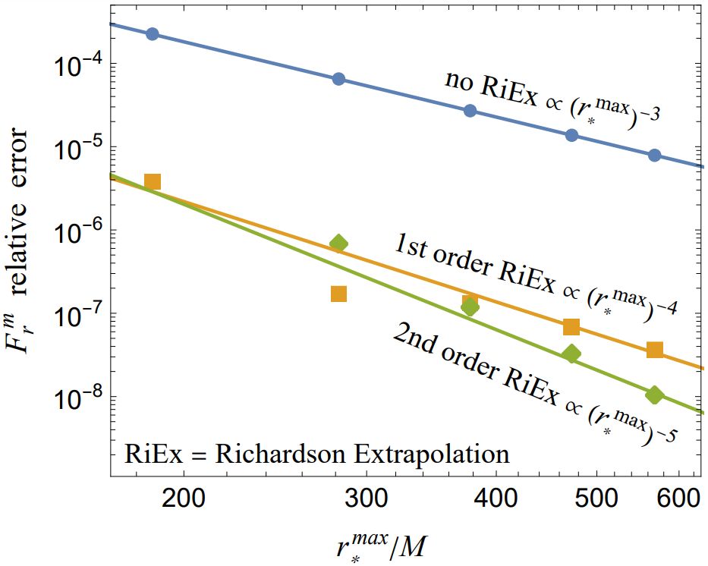
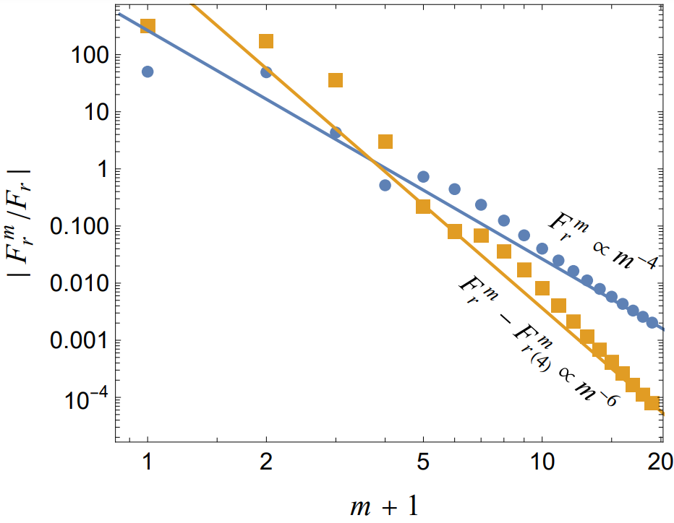
Scalar self-force calculations converge and agree
https://arxiv.org/abs/2206.07031
$$F_{α}=\sum_{m}{∇_{α}Φ_{m}^{R}}=\sum_{m}{F_{α}^{m}}$$
r₀ = 6M, a = 0.5M
Convergence with decreasing Δr* and Δθ
Convergence with increasing r*^{max}
Convergence of sum over m-modes
hyperboloidal slicing to eliminate this obstacle?
m –mode
regularization
Parameters
(Heffernan et al. 2014)
(see talk by Macedo)
m = 1
m = 1

Slide 10
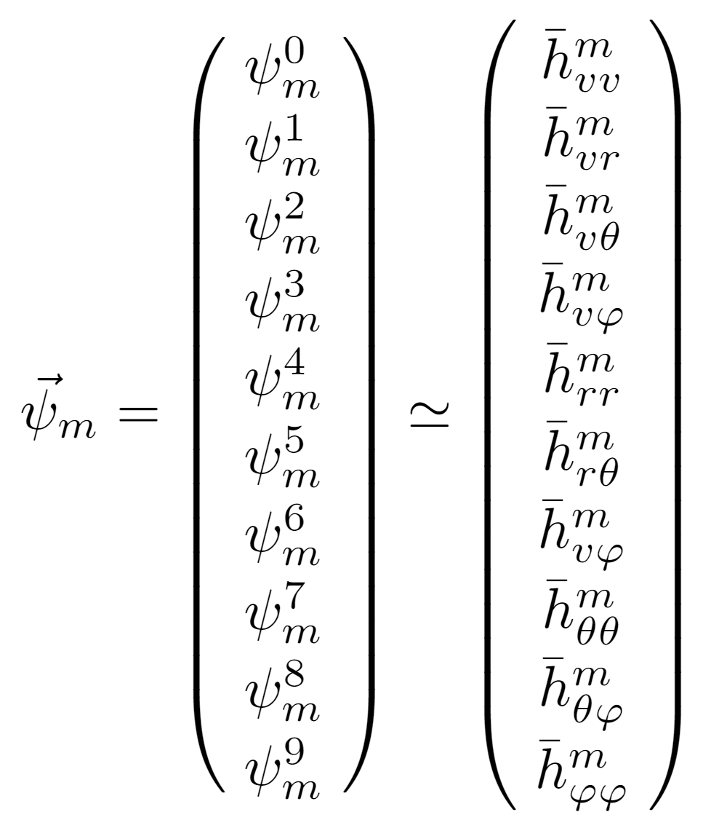
In progress: Lorenz gauge metric perturbations
Find m-modes of metric perturbation:
At each position, solve for the 10 metric components (following Dolan and Barack, use adv Eddington-Finkelstein comps w/ r factors):
Lorenz gauge field equations can be written in the following form:
For simplicity, carry over methods from scalar project (2nd-order finite difference, effective source code from Barry Wardell, etc.)

Slide 11
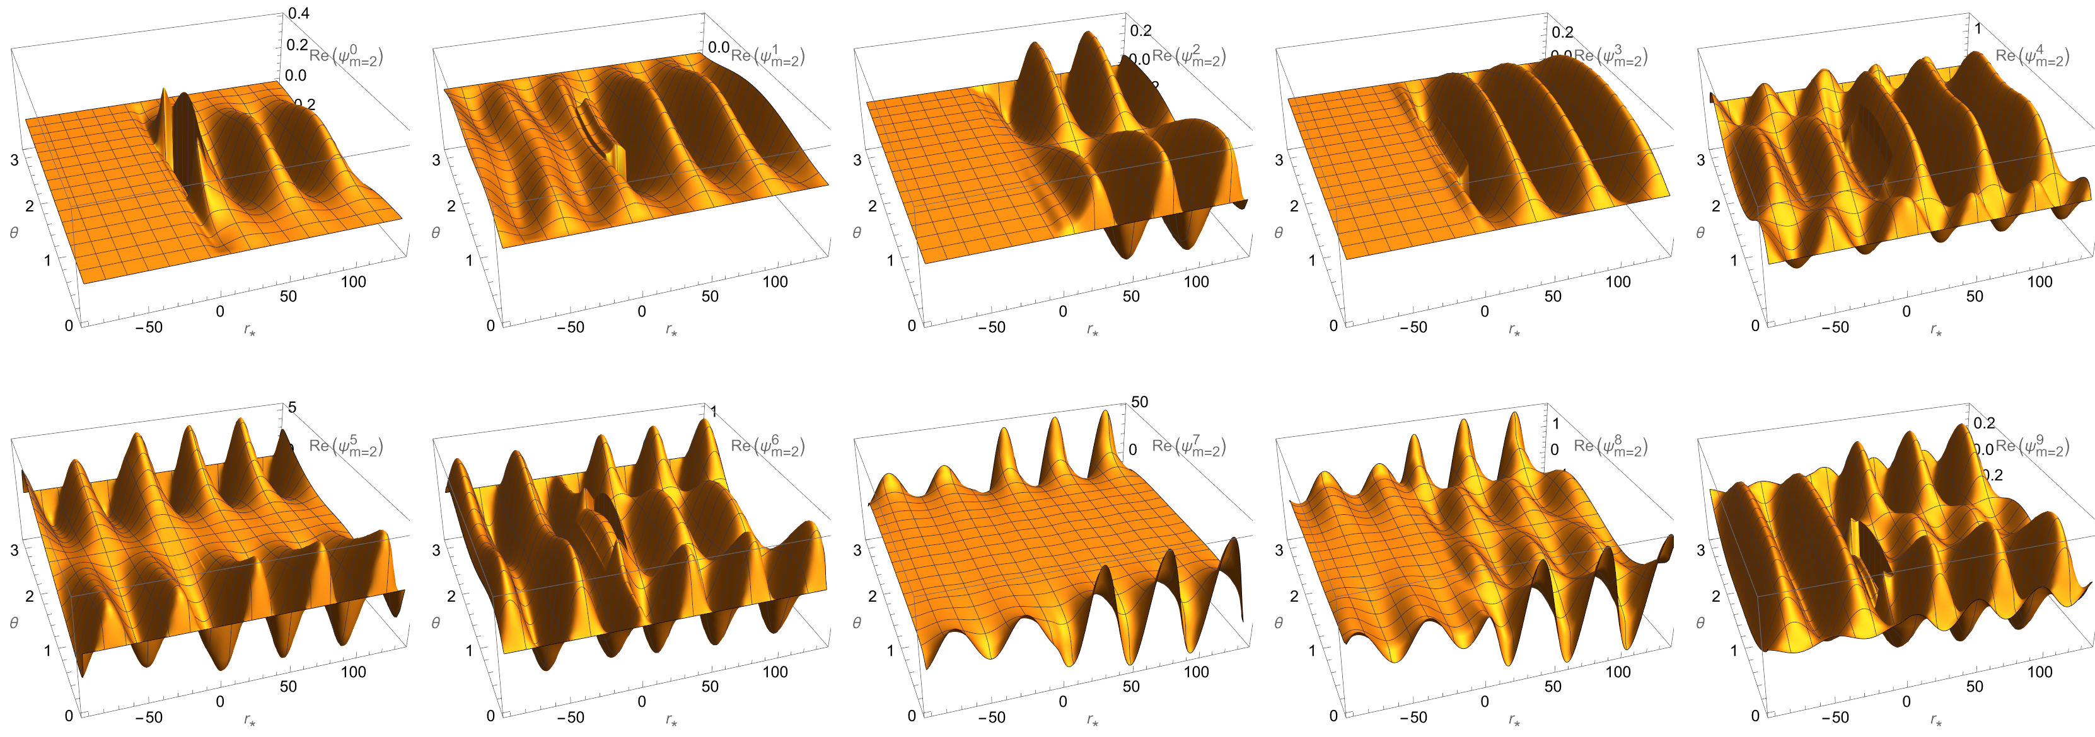
Early results: Lorenz gauge metric perturbation
m = 2 , a = 0 , r₀ = 6M
Have the m=1 issues been resolved?

Slide 12
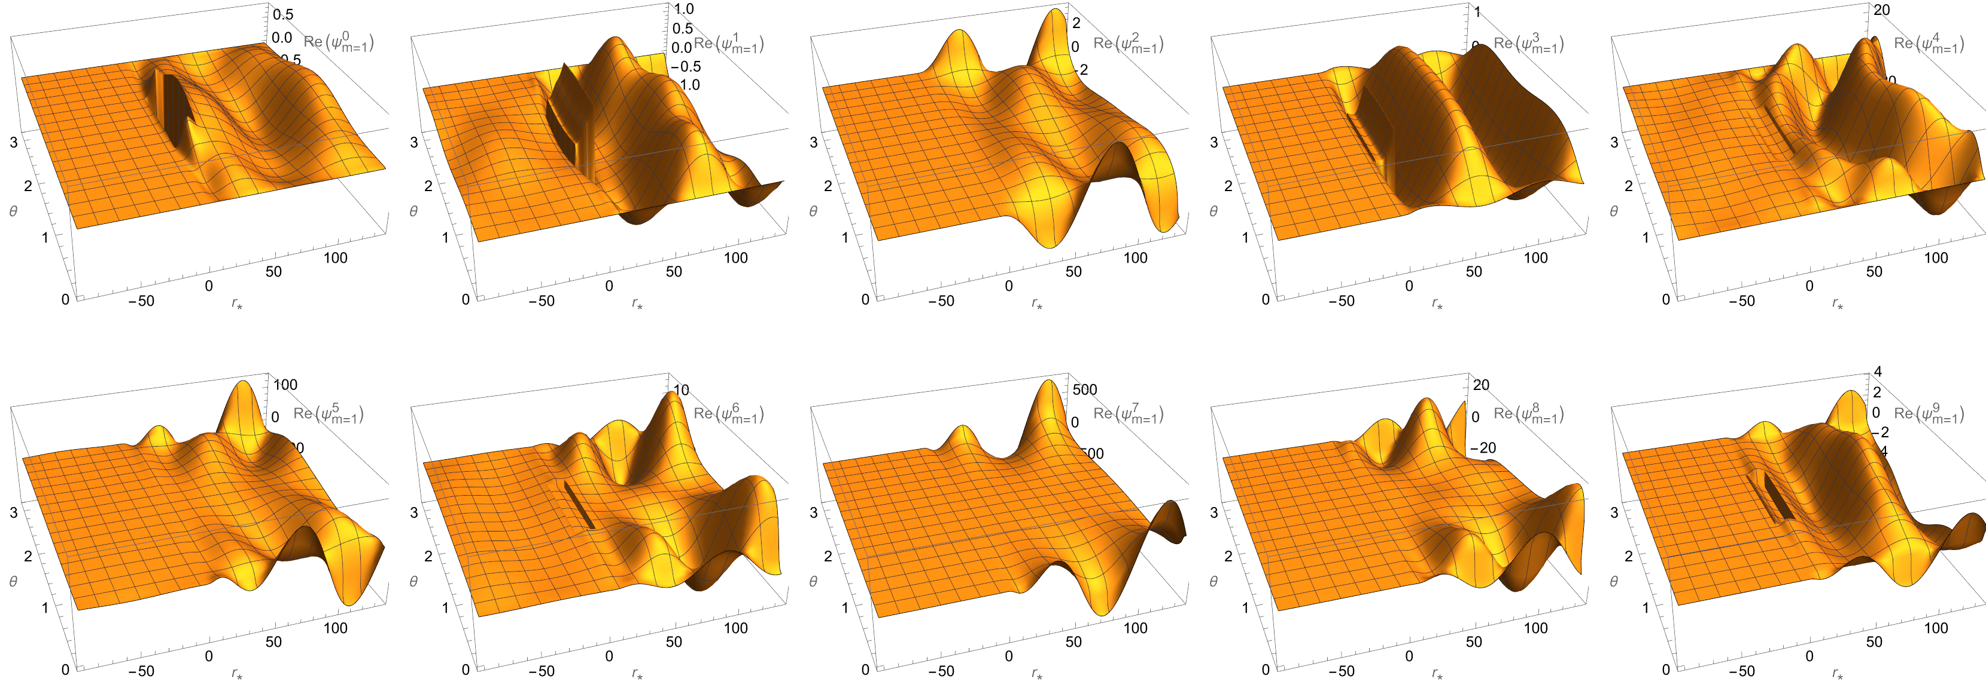
No time instability, but m=1 grows badly with r…
m = 1 , a = 0 , r₀ = 6M
Needs more investigation…

Slide 13
Concluding notes and summary
- Goal: calculate Lorenz gauge Kerr gravitational self-force
- Progress so far:
Solved r-θ PDEs in frequency domain ($\frac{∂}{∂t}=−iω$ ⟶ elliptic PDEs)
Scalar self-f0rce agrees with prior results (see: https://arxiv.org/abs/2206.07031)
Preliminary results for gravity in Lorenz gauge, resolving some issues
- Future directions:
Use faster programming language (petsc4py: Balor Brennan poster on Sat)
Finish Lorenz gauge Kerr gravitational self-force
2nd order Lorenz gauge self-force in Kerr spacetime?
Radiation gauge/Teukolsky handles eccentric/inclined, can we handle eccentric/inclined with elliptic PDEs? Source not perfectly smooth → slower Fourier convergence, but maybe there is a clever trick

Slide 14
Acknowledgements

Slide 15
Large r* analysis:
$$Ψ^{m}=e^{iωr^{∗}}\left(A\left(θ\right)+\frac{B\left(θ\right)}{r}+\frac{C\left(θ\right)}{r^{2}}+θ(\frac{1}{r^{3}})\right)$$
“naïve” condition -
BC1: $\frac{∂Ψ^{m}}{∂r^{∗}}−iωΨ^{m}=$ $θ(\frac{1}{r_{max}^{2}}$)
Less naïve - BC2: $\frac{∂^{2}Ψ^{m}}{{∂r^{∗}}^{2}} −2iω\frac{∂Ψ^{m}}{∂r^{∗}}−iωΨ^{m}=$ $θ(\frac{1}{r_{max}^{3}}$)
Sophisticated? - BC3: $\frac{∂^{3}Ψ^{m}}{{∂r^{∗}}^{3}}−3iω\frac{∂^{2}Ψ^{m}}{{∂r^{∗}}^{2}} −3ω^{2}\frac{∂Ψ^{m}}{∂r^{∗}}+iω^{3}Ψ^{m}=$ $θ(\frac{1}{r_{max}^{4}}$)
Bayliss-Turkel type boundary conditions

