Slide 1
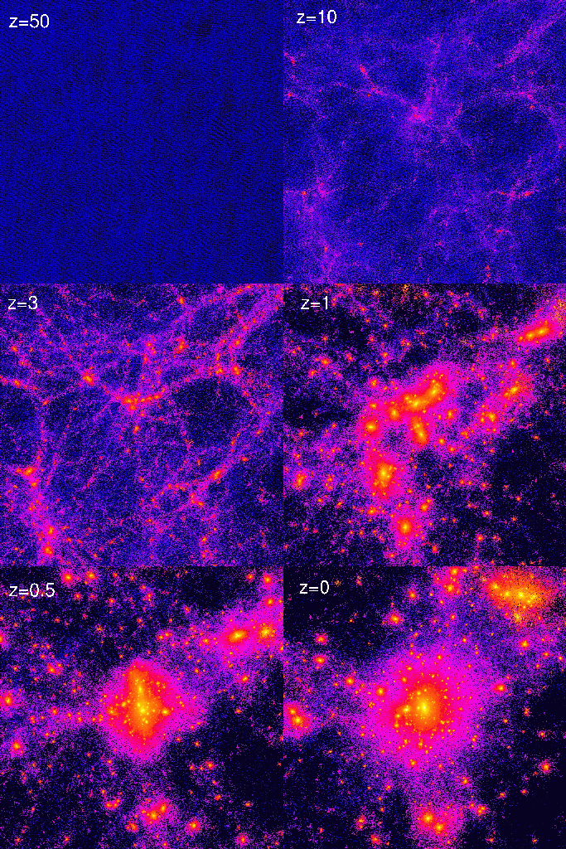
STRUCTURE FORMATION IN THE UNIVERSE

Slide 2
The growth of inhomogeneities is strongly influenced
by neutrinos
By measuring the growth of structure it is possible
to probe neutrino properties
But first we need to look at how to describe structure
Formation in the universe
Because the early universe was very close to being
homogeneous and isotropic we can to a very
good approximation use linear perturbation theory

Slide 3
GROWTH OF PERTURBATIONS, THE OLD
JEANS ANALYSIS (APPLIES ALSO TO STAR
FORMATION)
CONTINUITY:
EULER:
POISSON:
THESE EQUATIONS CAN BE LINEARIZED

Slide 4
FROM THIS ASSUMPTION THE FOLLOWING
EQUATIONS ARE DERIVED FOR THE FIRST
ORDER TERMS
FOR ρ THIS CAN BE COMBINED INTO A SINGLE
SECOND ORDER DIFFERENTIAL EQUATION

Slide 5
THIS IS RECOGNISEABLE AS A SIMPLE HARMONIC
OSCILLATOR EQUATION (WAVE EQUATION),
I.E. THE SOLUTIONS ARE
DIVIDING WAVENUMBER (INVERSE LENGTH SCALE)
IS CALLED THE JEANS’ WAVENUMBER

Slide 6
THE NATURE OF MODES ON A GIVEN SCALE IS
SIMPLY DETERMINED FROM THE RELATIVE STRENGTH
OF GRAVITATIONAL AND PRESSURE FORCES
NOW, WHAT HAPPENS IF THE UNIVERSE IS EXPANDING?
EXACTLY THE SAME ANALYSIS CAN BE PERFORMED,
WITH THE ONE EXCEPTION THAT THE UNPERTURBED
SOLUTIONS ARE THEN

Slide 7
THE CORRESPONDING EQUATIONS FOR THE
FIRST ORDER QUANTITIES ARE THEN
IT TURNS OUT THAT IN FOURIER SPACE THESE
EQUATIONS ARE MUCH SIMPLER, SO ALL QUANTITIES
SHOULD BE EXPANDED IN FOURIER MODES

Slide 8
THE EQUATION FOR THE DENSITY PERTURBATION
THEN BECOMES
THIS IS EXACTLY THE SAME EQUATION AS IN
THE NON-EXPANDING CASE, EXCEPT FOR THE
SECOND TERM
THE EXPANSION OF THE UNIVERSE ACTS LIKE
A FRICTION FORCE
EVEN IF THERE ARE GROWING MODES, THEY
CANNOT BE EXPONENTIAL

Slide 9
IN A FLAT MODEL WITH ONLY CDM THE EQUATION
BECOMES
WITH SOLUTIONS

Slide 10
FOR A MODEL DOMINATED BY Λ THE SOLUTIONS
ARE
AND FOR A CURVATURE DOMINATED MODEL
ONLY THE MATTER DOMINATED EPOCH ALLOWS
FOR POWER-LAW GROWING MODES!

Slide 11
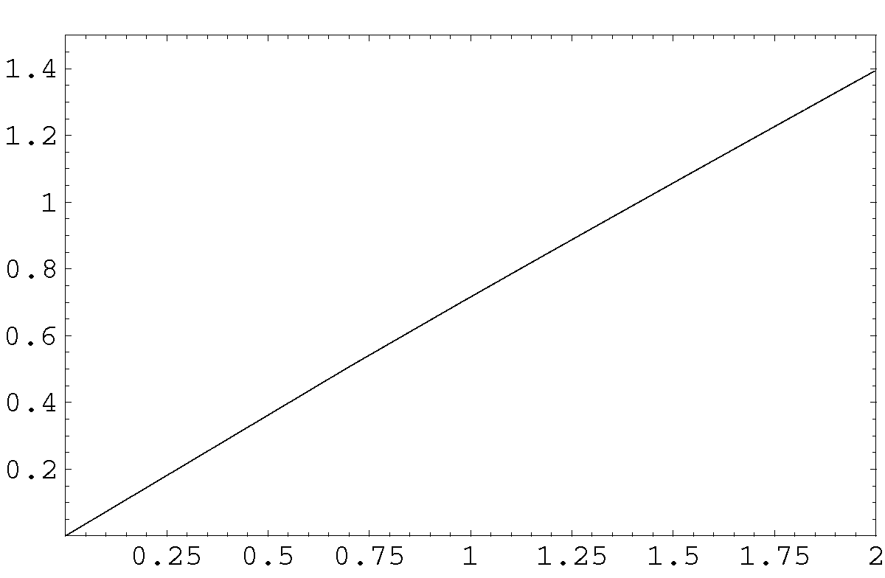
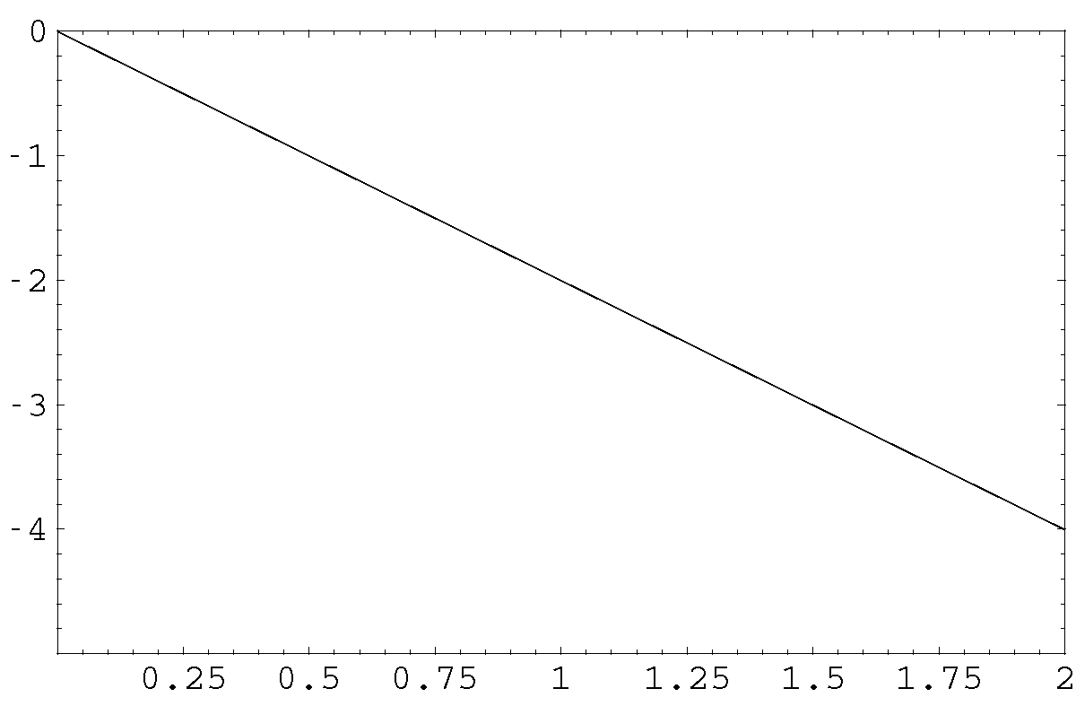
Ω=1 CDM
log(δ)
log(t)
log(ρ_{M})
log(t)
THE PRESENT

Slide 12
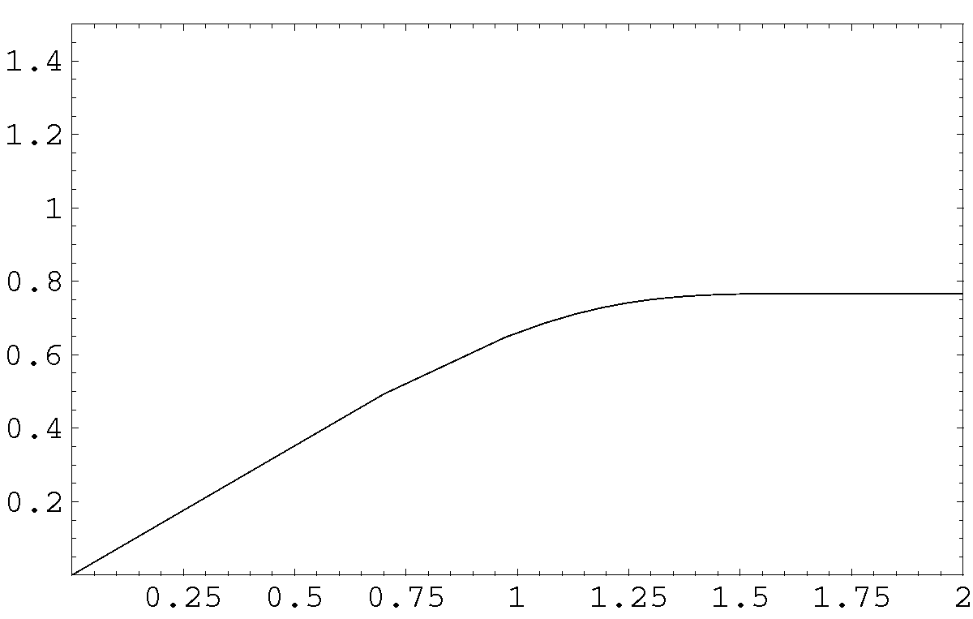
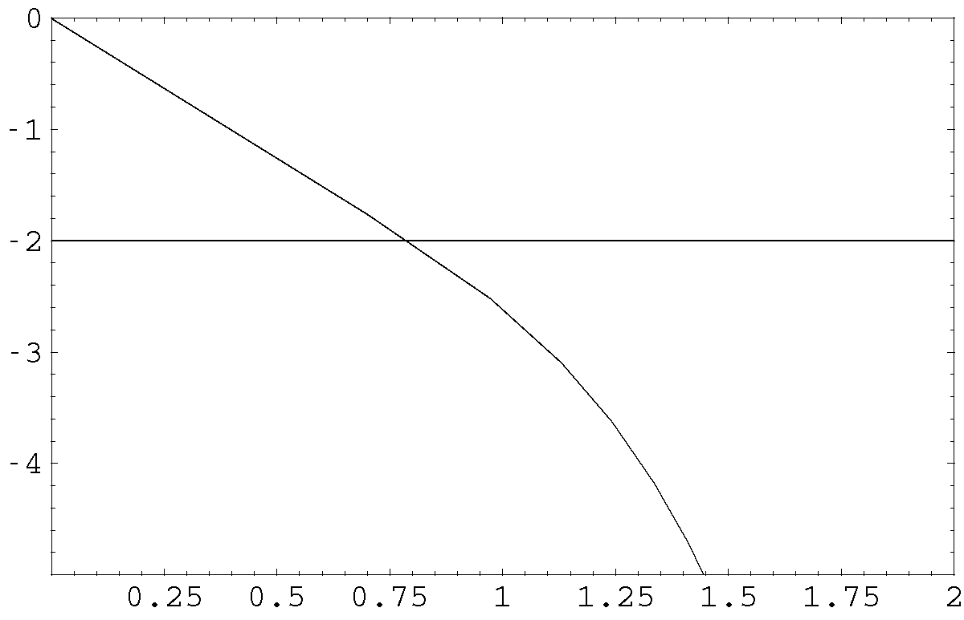
Ω_{M}=0.3 ΛCDM
log(δ)
Ω_{Λ}=0.7
log(t)
log(ρ_{M})
log(ρ_{Λ})
log(t)
THE PRESENT

Slide 13
IN GENERAL RELATIVITY THE FORM OF THE
EQUATIONS AT SMALL SCALES IS THE SAME AS
IN THE NEWTONIAN DERIVATION
HOWEVER, ON SCALES CLOSE OR, OR ABOVE THE
CAUSAL HORIZON THAT IS NO LONGER TRUE
INSTEAD, ONE WORKS FROM A PERTURBATION
AROUND THE FRW METRIC

Slide 14
Can we also descrbe neutrinos using this formalism?
The continuity and Euler equations are only closed
for a perfect fluid.
However, neutrinos are non-interacting and fast moving
which in a fluid description causes viscosity and damping…
The system of equations is now an infinite hierarchy

Slide 15
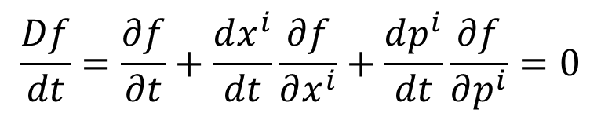


In practise it is better to start from the microscopic
Description, i.e. the Boltzmann equation
$$\frac{Df}{dt}=\frac{∂f}{∂t}+\frac{dx^{i}}{dt}\frac{∂f}{∂x^{i}}+\frac{dp^{i}}{dt}\frac{∂f}{∂p^{i}}=0$$
Just as with the fluid equations we can work with
the perturbed quantity$Ψ$
$$f=f_{0}(1+Ψ)$$
Which takes the place of the perturbed fluid quantities

Slide 16



What is the connection between the fluid description and
the Boltzmann equation?
The fluid equations are moment equations of the
Momentum integrated Boltzmann equation, i.e.
$$ρ=n m=m ∫d^{3}p f$$
$$\vec{v}ρ=m∫d^{3}p \vec{v}f$$
$$σ^{ij}ρ=m∫d^{3}p v^{i}v^{j}f$$

Slide 17
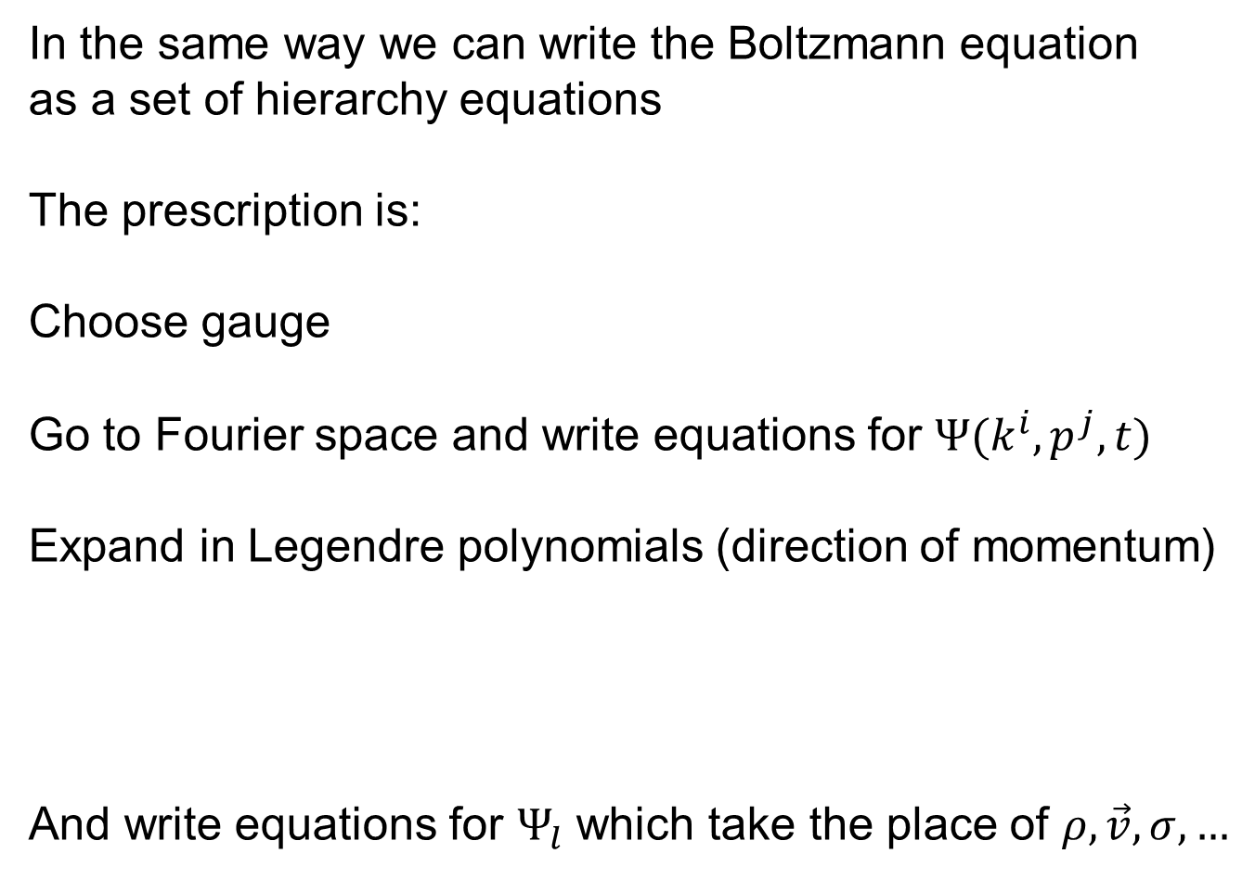
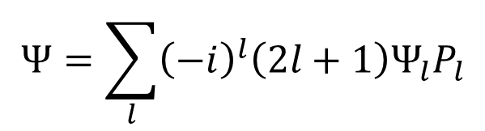
In the same way we can write the Boltzmann equation
as a set of hierarchy equations
The prescription is:
Choose gauge
Go to Fourier space and write equations for $Ψ(k^{i},p^{j},t)$
Expand in Legendre polynomials (direction of momentum)
And write equations for $Ψ_{l}$ which take the place of $ρ, \vec{v},σ,…$
$$Ψ=\sum_{l}{{\left(−i\right)}^{l}\left(2l+1\right)Ψ_{l}P_{l}}$$

Slide 18
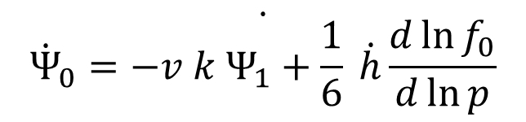
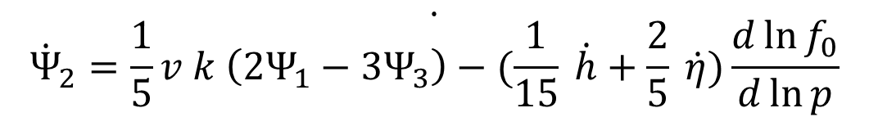
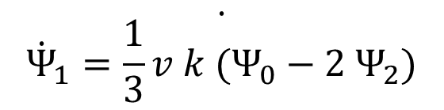
In synchronous gauge we then find
$$\dot{{\dot{Ψ}}_{0}=−v k Ψ_{1}+\frac{1}{6} \dot{h}\frac{d\ln{f_{0}}}{d\ln{p}}}$$
$$\dot{{\dot{Ψ}}_{1}=\frac{1}{3}v k (Ψ_{0}−2 Ψ_{2})}$$
$$\dot{{\dot{Ψ}}_{2}=\frac{1}{5}v k \left({2Ψ}_{1}−3Ψ_{3}\right)−(\frac{1}{15} \dot{h}+\frac{2}{5} \dot{η})\frac{d\ln{f_{0}}}{d\ln{p}}}$$

Slide 19
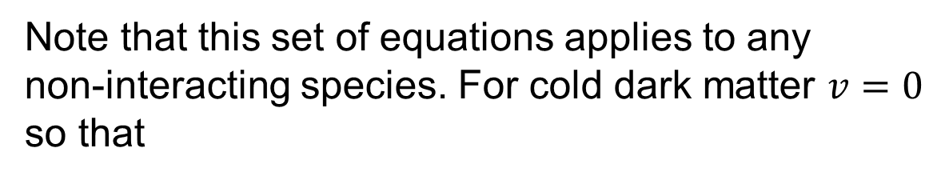

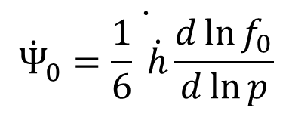
Note that this set of equations applies to any
non-interacting species. For cold dark matter $v=0$
so that
$$\dot{{\dot{Ψ}}_{0}=\frac{1}{6} \dot{h}\frac{d\ln{f_{0}}}{d\ln{p}}}$$
$$\dot{{\dot{Ψ}}_{1}=0}$$
i.e. the set of equations closes at order 1
(corresponding to the continuity and Euler eqs.,
but note that we have not used Newtonian gauge)

Slide 20
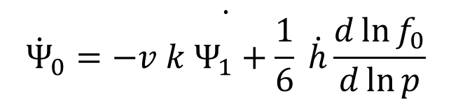
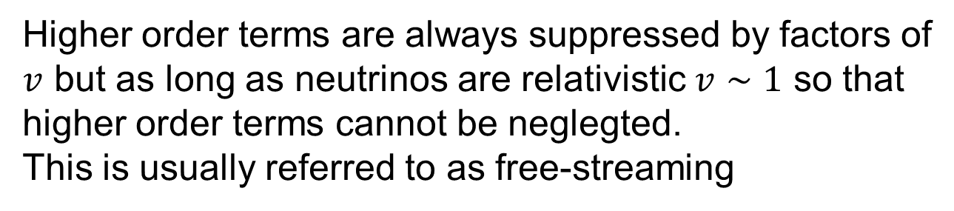
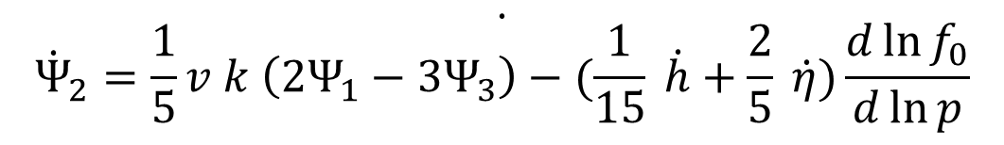
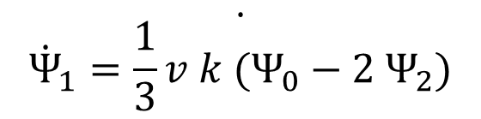
Higher order terms are always suppressed by factors of
$v$ but as long as neutrinos are relativistic $v∼1$ so that
higher order terms cannot be neglegted.
This is usually referred to as free-streaming
$$\dot{{\dot{Ψ}}_{0}=−v k Ψ_{1}+\frac{1}{6} \dot{h}\frac{d\ln{f_{0}}}{d\ln{p}}}$$
$$\dot{{\dot{Ψ}}_{1}=\frac{1}{3}v k (Ψ_{0}−2 Ψ_{2})}$$
$$\dot{{\dot{Ψ}}_{2}=\frac{1}{5}v k \left({2Ψ}_{1}−3Ψ_{3}\right)−(\frac{1}{15} \dot{h}+\frac{2}{5} \dot{η})\frac{d\ln{f_{0}}}{d\ln{p}}}$$

Slide 21

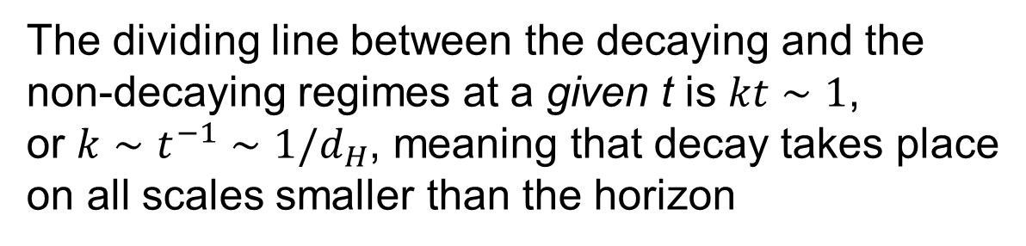
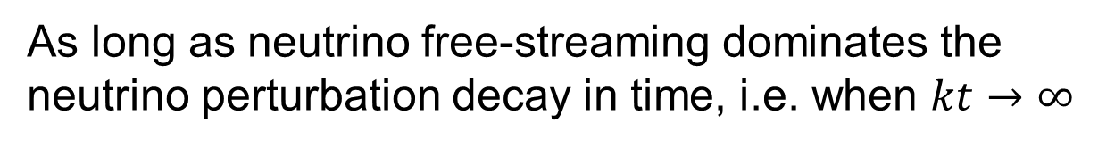
In the limit of no gravity and massless neutrinos the
solution to the hierarchy is
$$Ψ_{l}∝j_{l}(k t)$$
As long as neutrino free-streaming dominates the
neutrino perturbation decay in time, i.e. when $kt→∞$
The dividing line between the decaying and the
non-decaying regimes at a given t is $kt∼1$,
or $k∼t^{−1}∼1/d_{H}$, meaning that decay takes place
on all scales smaller than the horizon

Slide 22
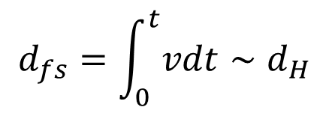
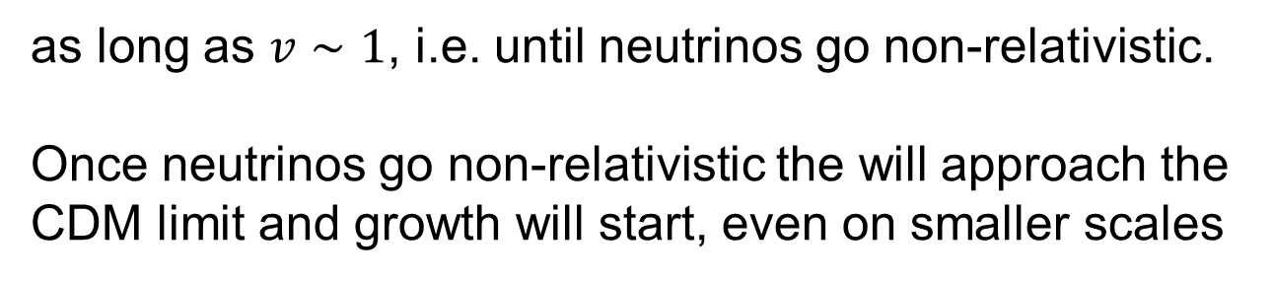
From an intuitive point of view this makes perfect sense
because we expect neutrinos not to cluster on all scales
below the comoving free-streaming scale given by
$$d_{fs}=\int_{0}^{t}{vdt}∼d_{H}$$
as long as $v∼1$, i.e. until neutrinos go non-relativistic.
Once neutrinos go non-relativistic the will approach the
CDM limit and growth will start, even on smaller scales

Slide 23
THE R.M.S. AMOUNT OF DENSITY FLUCTUATIONS
IN THE UNIVERSE CAN BE WRITTEN AS
THIS FLUCTUATION CAN BE DECOMPOSED
NATURALLY IN FOURIER MODES
WHERE IS CALLED THE POWER SPECTRUM
(NORMALLY CALLED P(k))
IT IS THE FOURIER TRANSFORM OF THE TWO-POINT
CORRELATION FUNCTION

Slide 24
THE POWER SPECTRUM CAN BE DECOMPOSED
INTO AN INITIAL, PRIMORDIAL POWER SPECTRUM,
AND A TRANSFER FUNCTION, RELATED TO THE
TIME-EVOLUTION OF PERTURBATIONS VIA THE
PREVIOUSLY DERIVED EQUATIONS

Slide 25
P_{i}(k) IS NORMALLY (WITH GOOD REASON)
PARAMETRIZED AS A SIMPLE POWER-LAW
WHERE n IS CALLED THE SPECTRAL INDEX.

Slide 26
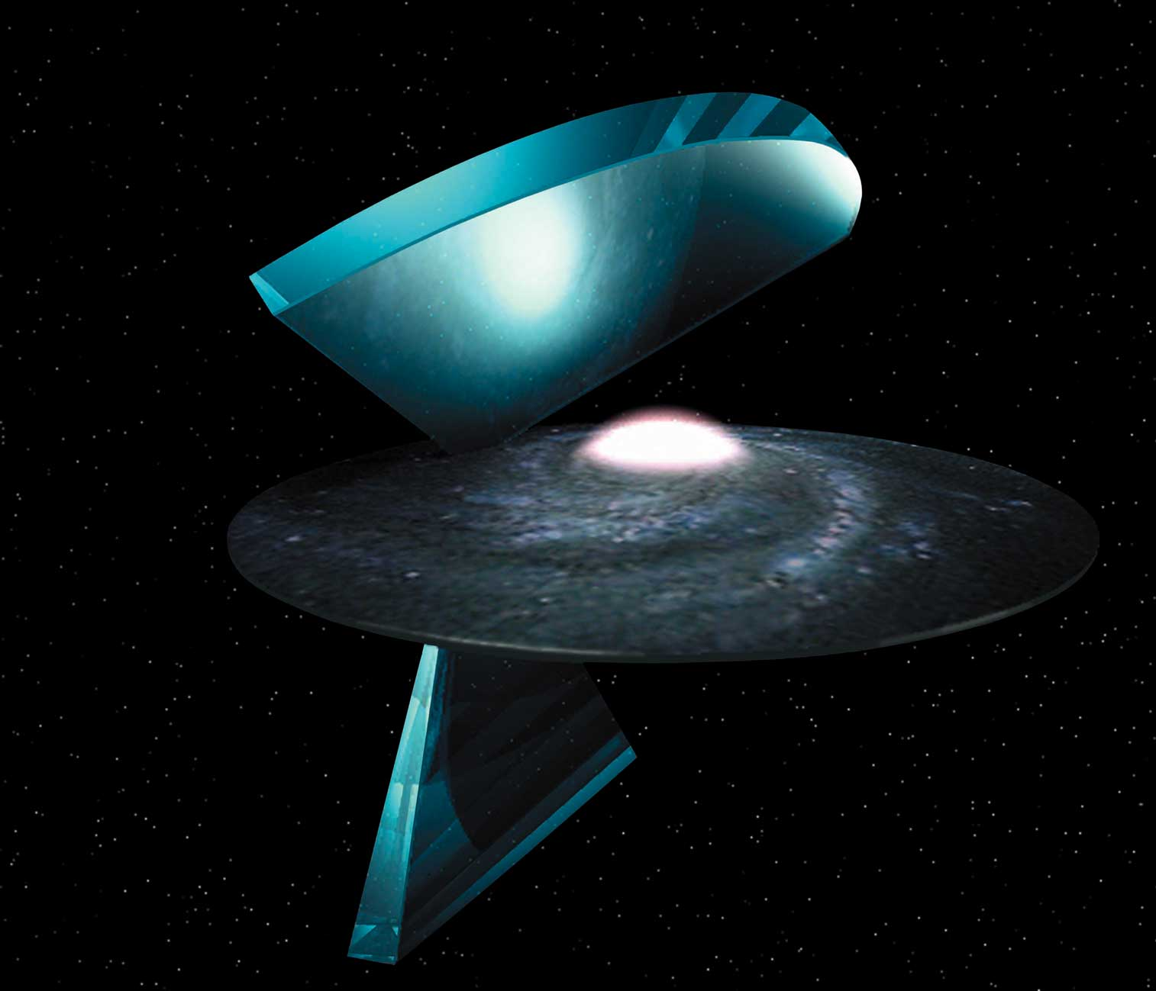
GALAXY SURVEYS

Slide 27
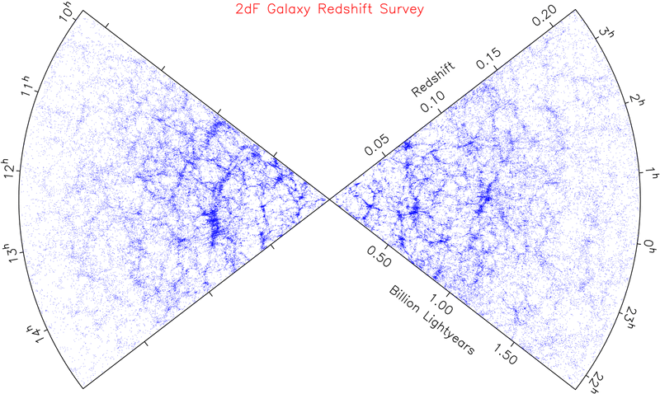
LARGE SCALE STRUCTURE SURVEYS

Slide 28
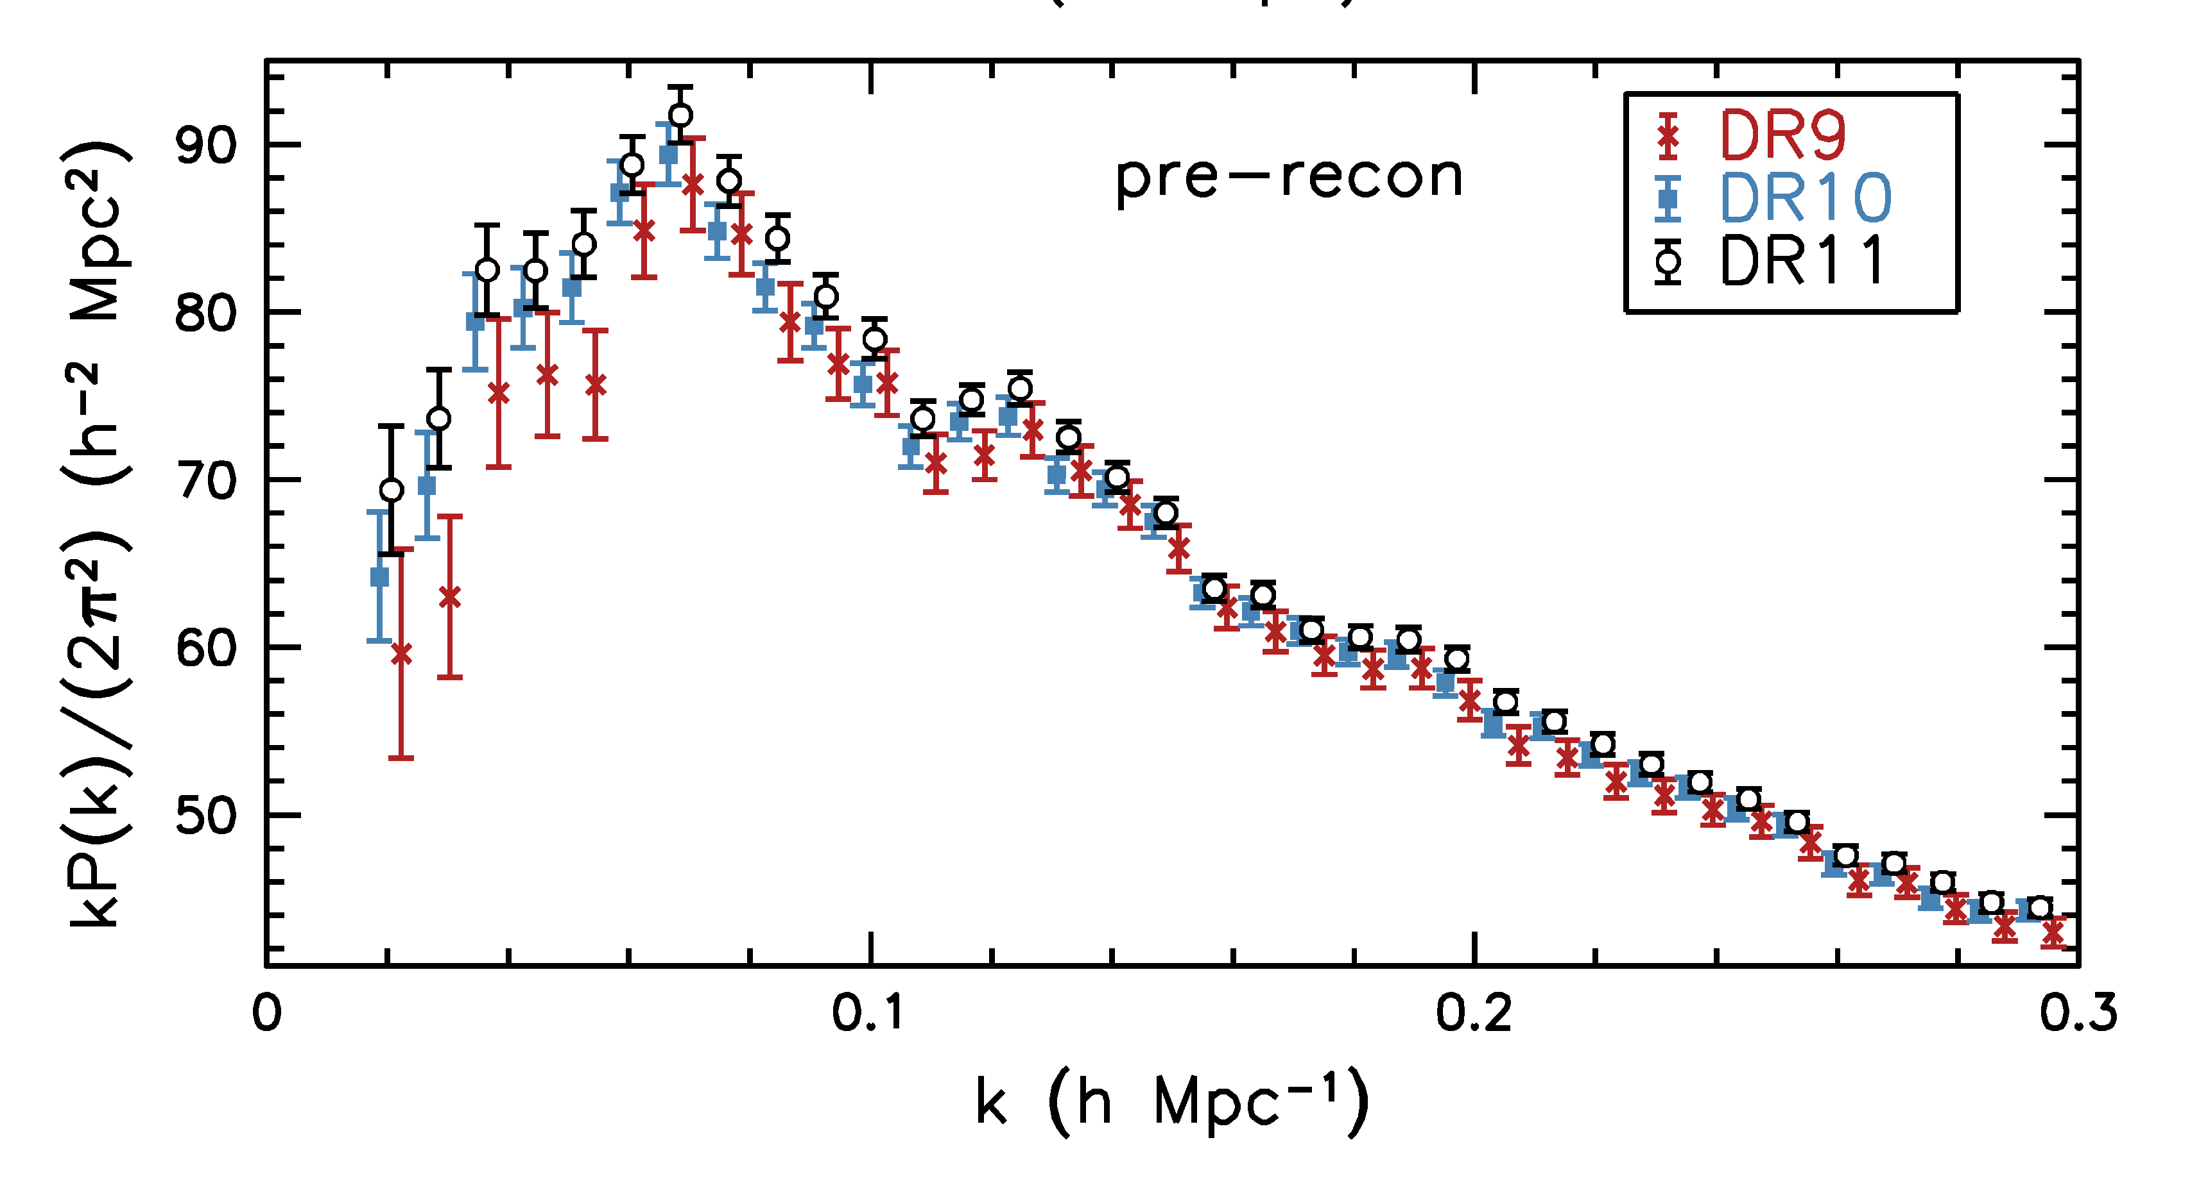
Anderson et al. 1312.4877 (SDSS)

Slide 29
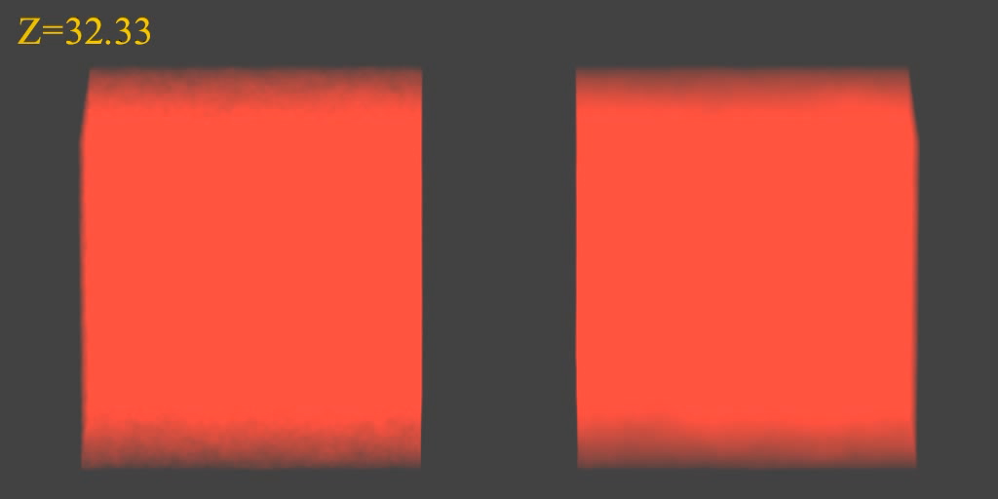
N-BODY SIMULATIONS OF ΛCDM WITH AND WITHOUT
NEUTRINO MASS (768 Mpc³) – GADGET 2
256
Mpc

Slide 30
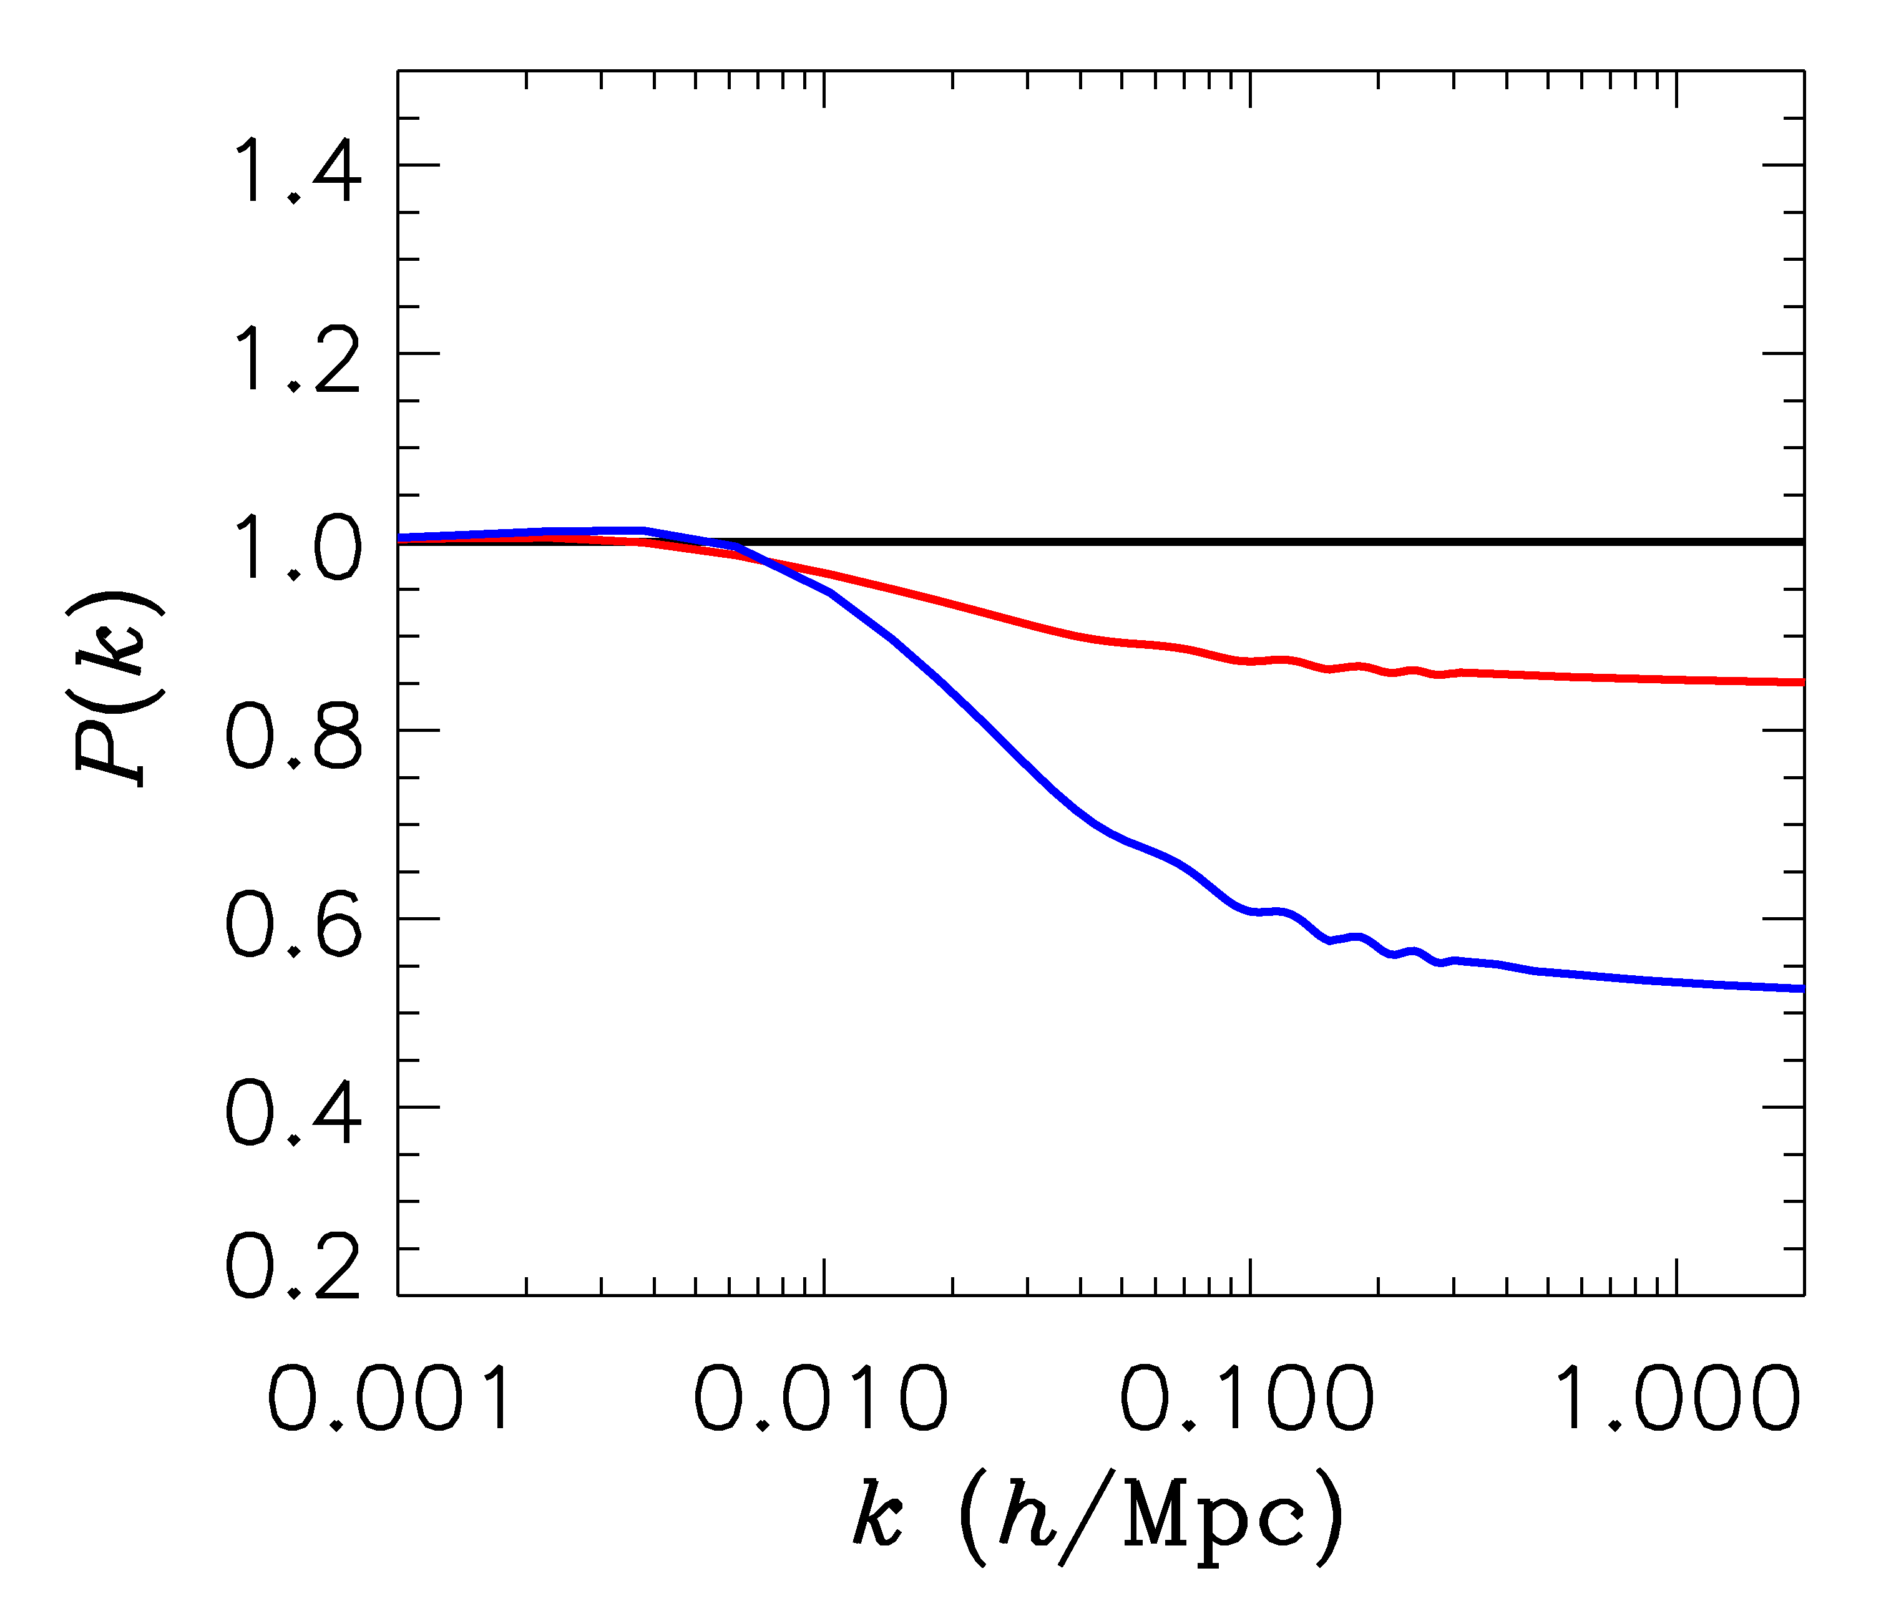
FINITE NEUTRINO MASSES SUPPRESS THE MATTER POWER
SPECTRUM ON SCALES SMALLER THAN THE FREE-STREAMING
LENGTH
Sm = 0 eV
P(k)/P(k,m_{ν}=0)
Sm = 0.3 eV
Sm = 1 eV

Slide 31
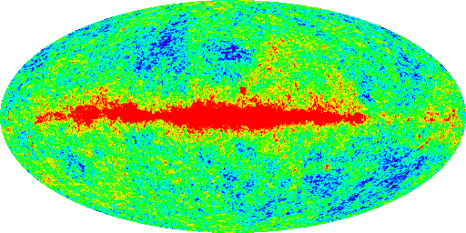
THE COSMIC MICROWAVE BACKGROUND

Slide 32
CMBR power spectrum
<…> = ENSEMBLE AVERAGE OVER DIFFERENT CMBR REALIZATIONS
This is not possible, so the average is in practise replaced by an average over m-values for each l
Introduces ”Cosmic Variance” because only 2l+1 m-values are available for each l

Slide 33
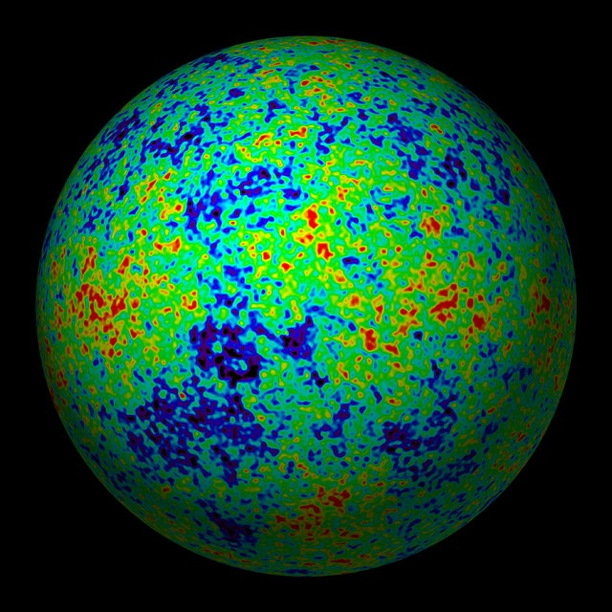

Slide 34
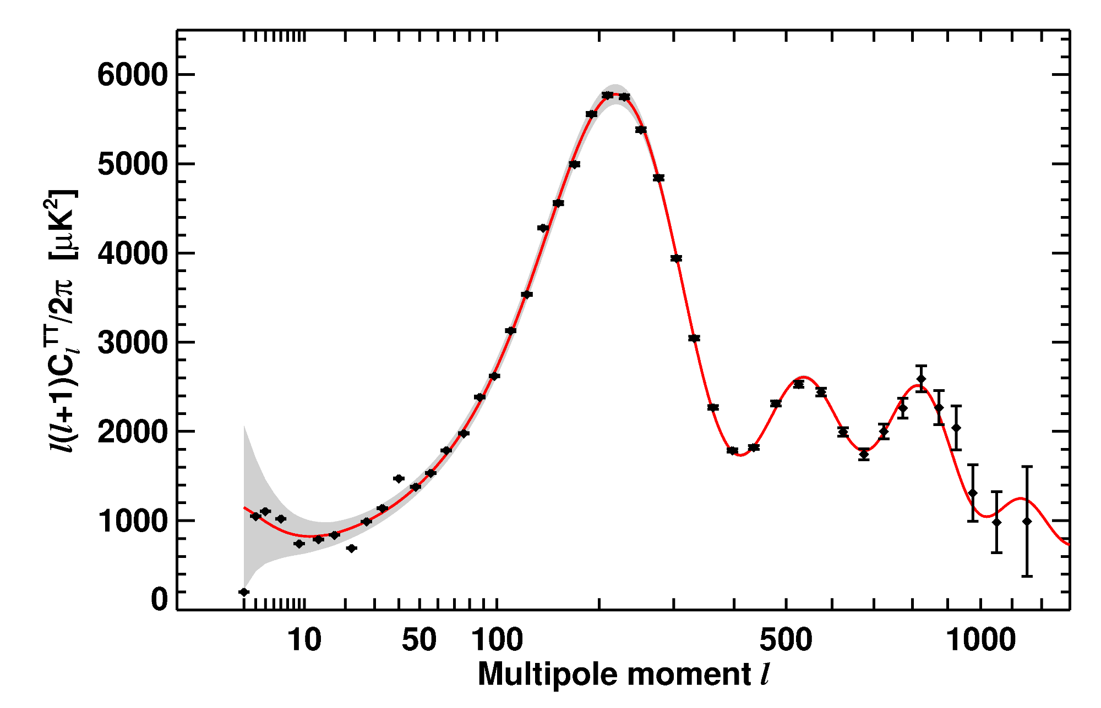
WMAP-7 TEMPERATURE POWER SPECTRUM
LARSON ET AL, ARXIV 1001.4635

Slide 35
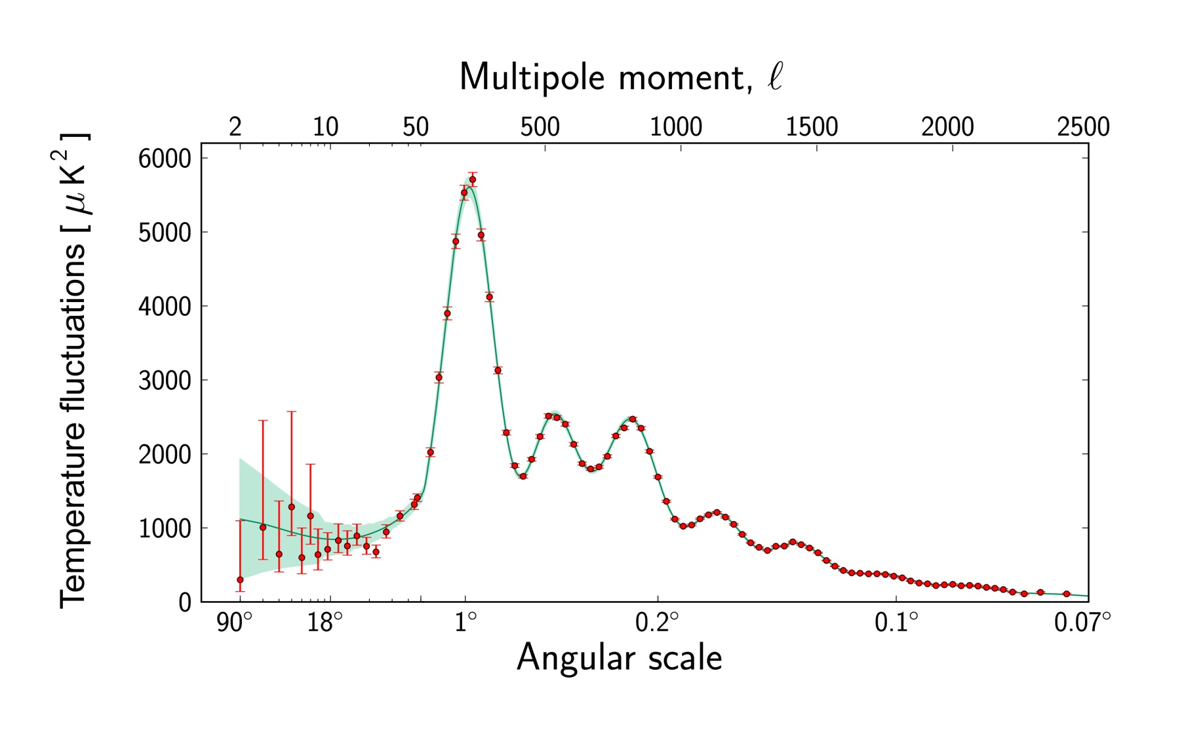
Ade et al. 2015 (Planck)

Slide 36
Interaction between photons and matter
Mainly Thomson scattering on electrons
Γ_{Thomson}: Interaction rate for photons
Η: Expansion rate of the universe
Γ_{Thomson} > H
Photons and matter in equilibrium
Γ_{Thomson} < H
Photons and matter do not interact

Slide 37
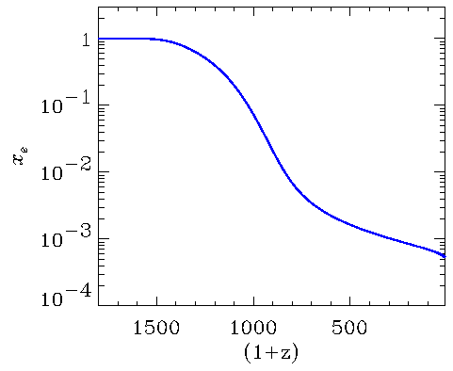
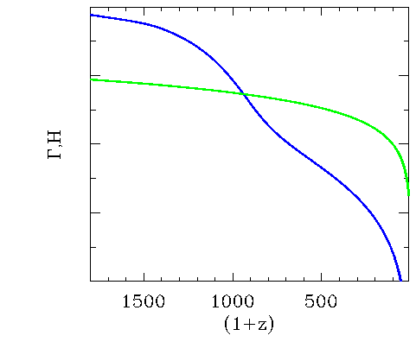
0.35
0.23
0.12
T/eV
Recombination
x_{e}
Γ
Decoupling of photons and baryons
H
Γ,H

Slide 38
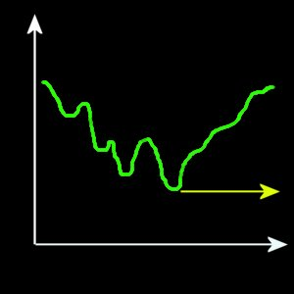
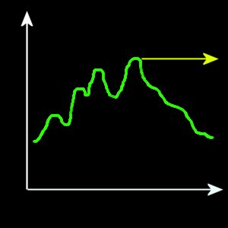
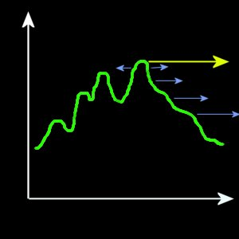
Fluctuations in the matter density will inevitably lead to fluctuations in the CMBR:
φ
Photons are redshifted as they move out of potential wells
γ
x
ρ
γ
Dense regions have higher temperature
photons have higher energy
x
ρ
γ
Photons emitted from a moving surface are red/blue-shifted
v
x

Slide 39
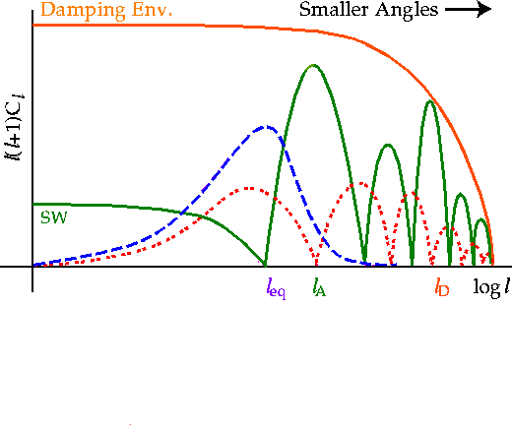
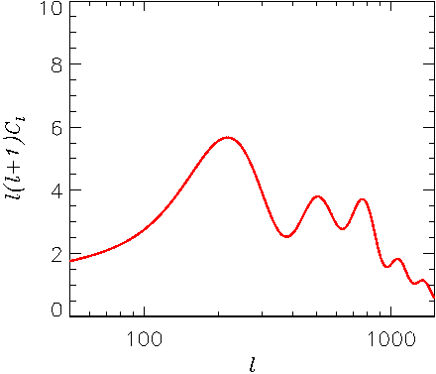
Effective T
Doppler
ISW effect

Slide 40
The CMB power spectrum C_{l} depends intricately on all the cosmological parameters
The prime example of this is the curvature of the universe
From the Friedmann equation:
Ω_{TOT}<1 k= -1 Open universe
Ω_{TOT}=1 k=0 Flat universe
Ω_{TOT} > 1 k=1 Closed universe

Slide 41
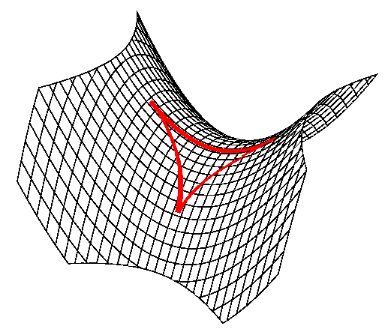
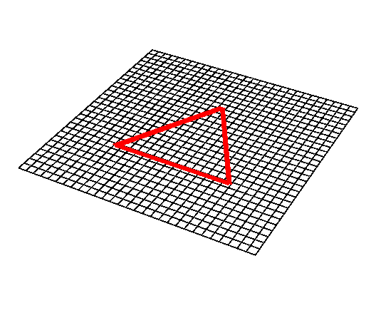
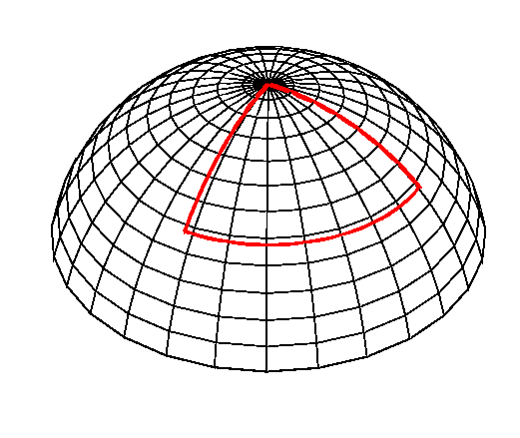
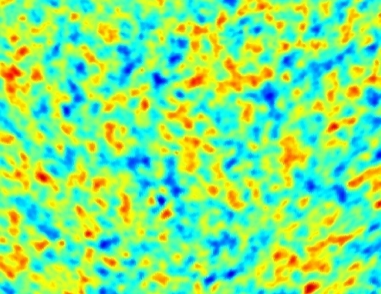
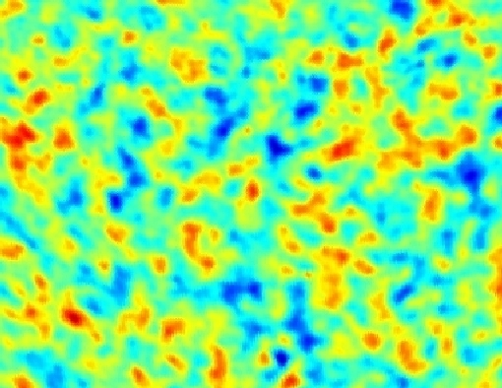
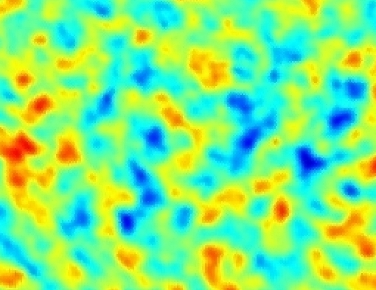
The geometry of the universe and angular scales
Open Universe Ω<1
Flat Universe Ω=1
Closed Universe Ω>1

Slide 42

What is the effect of neutrino mass on the CMB?
Very small actually…
Why?
Recombination happens at $T∼0.3$ eV when neutrinos
are still relativistic, Neutrinos look like massless particles
until after CMB formation
But: The are important secondary effects from the late
ISW effect and weak lensing which are detectable

