Slide 1
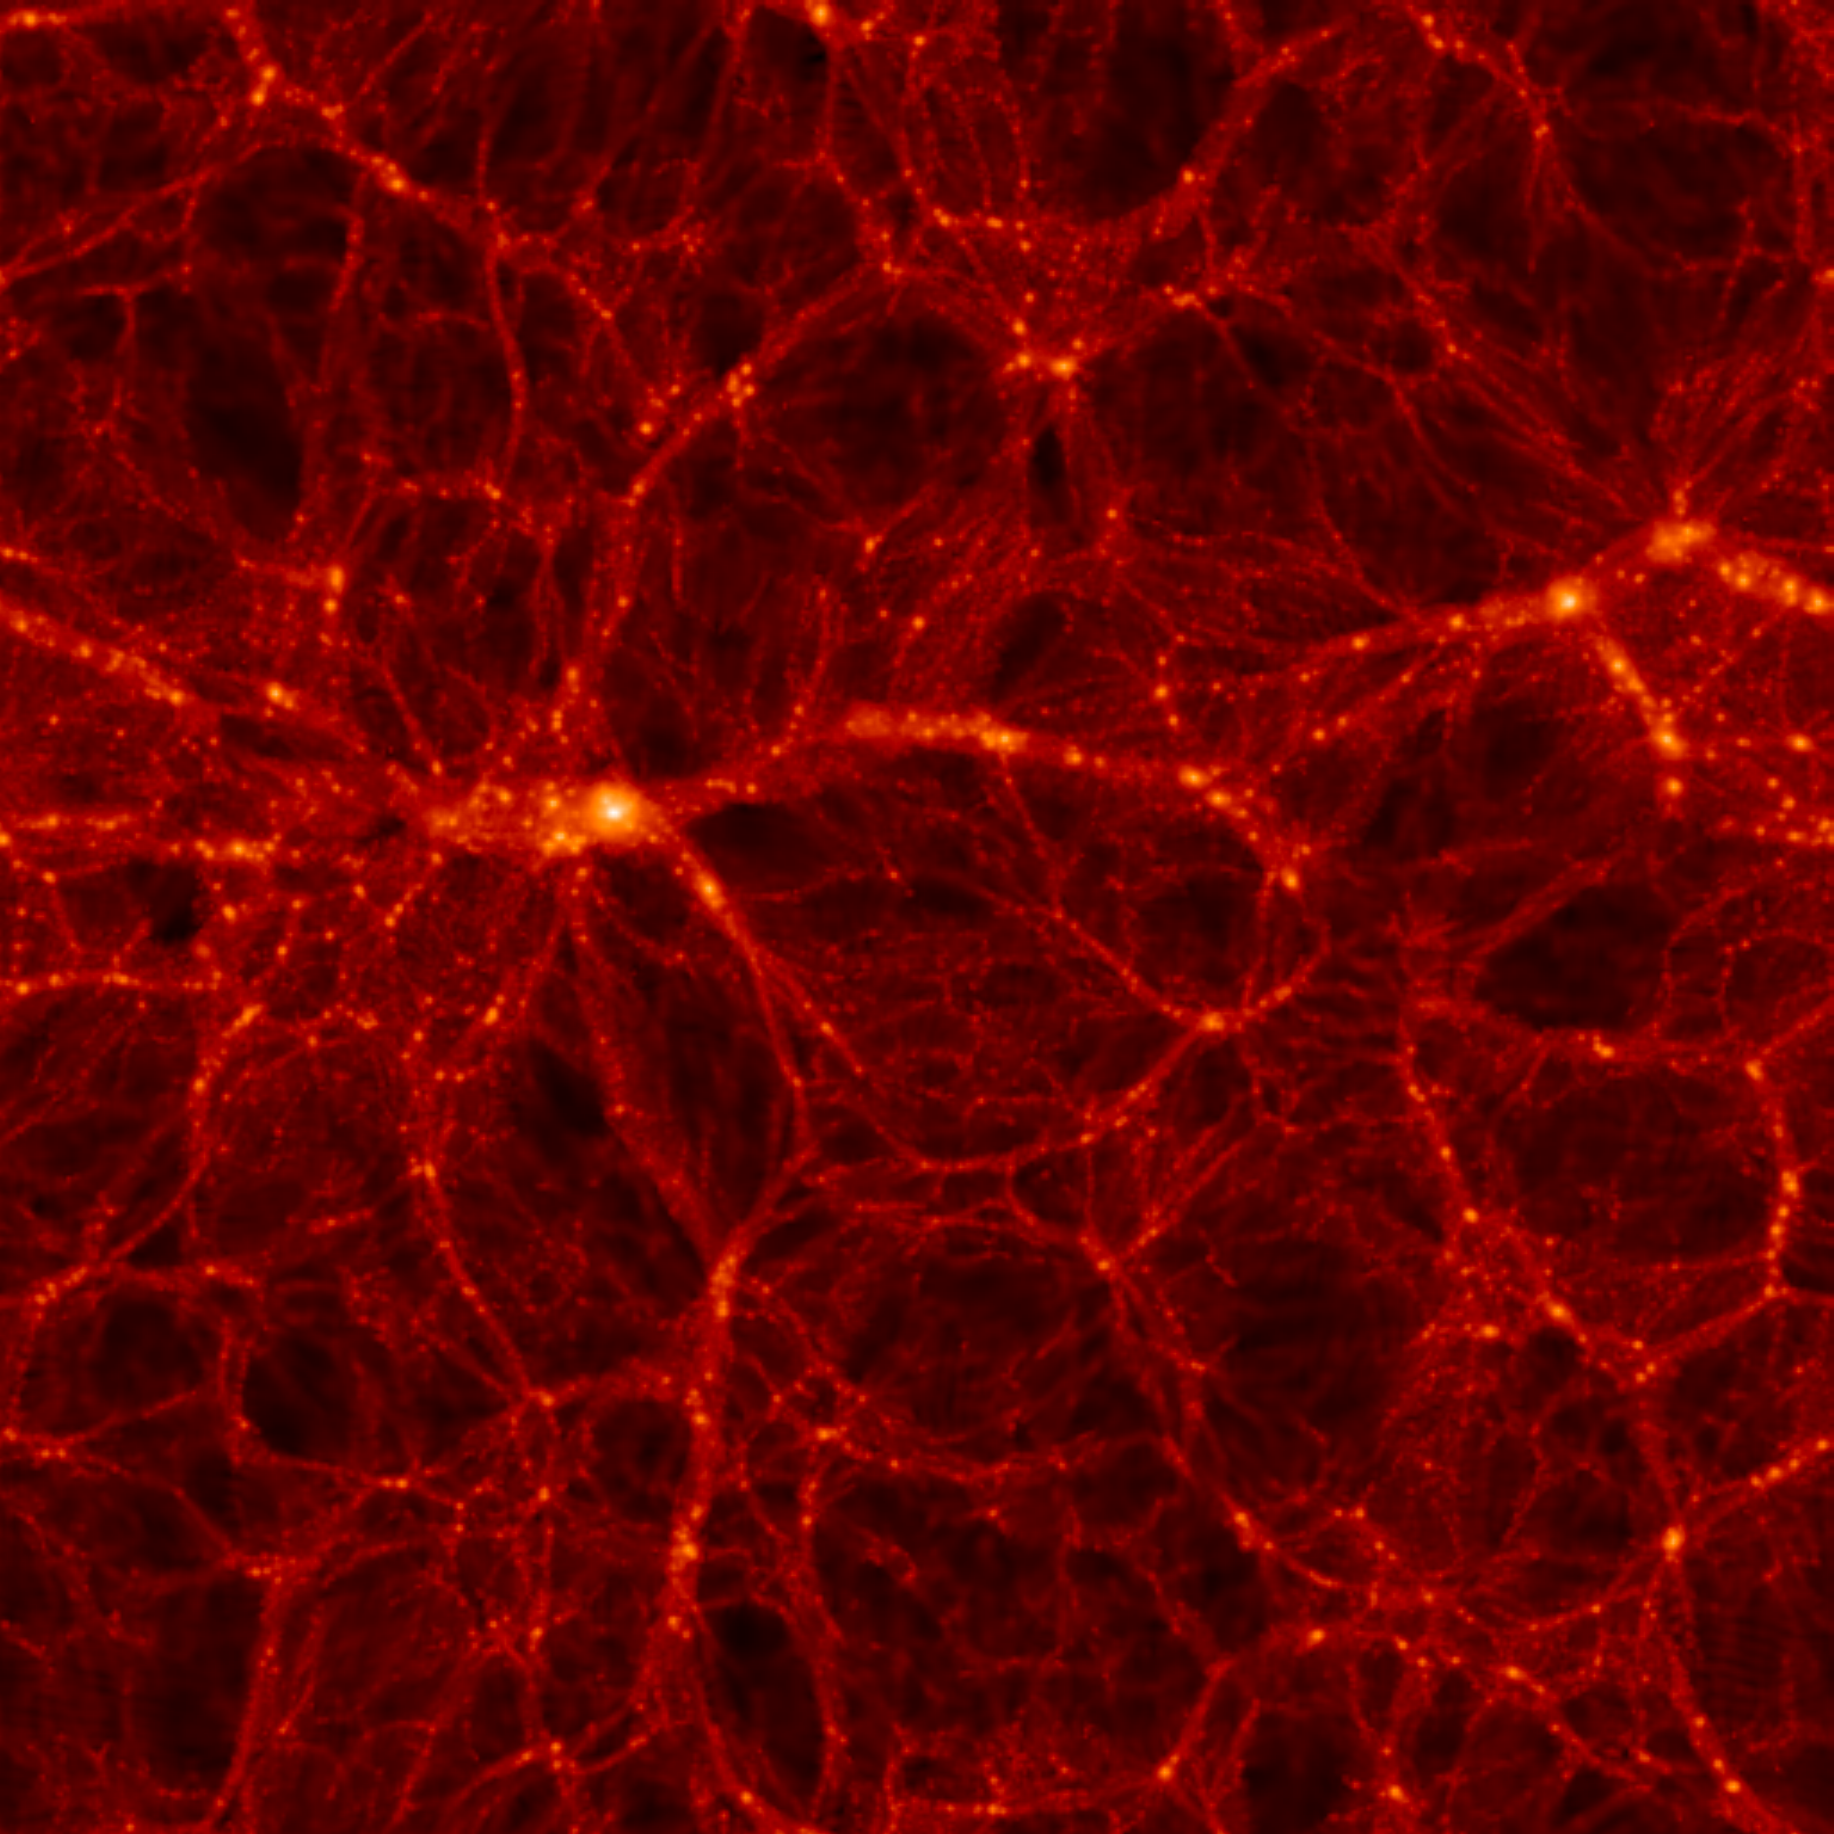
What is the Universe telling us about neutrinos?
$$ν_{e}$$
$$ν_{μ}$$
$$ν_{S}$$
$$ν_{τ}$$

Slide 2
NEUTRINO MIXING IN THE STANDARD PICTURE
FLAVOUR STATES
PROPAGATION STATES
$\left(\begin{matrix}ν_{e} \\ ν_{μ} \\ ν_{τ}\end{matrix}\right)=U$ $\left(\begin{matrix}ν_{1} \\ ν_{2} \\ ν_{3}\end{matrix}\right)$
U$=\left(\begin{matrix}1 & 0 & 0 \\ 0 & c_{23} & s_{23} \\ 0 & −s_{23} & c_{23}\end{matrix}\right)\left(\begin{matrix}c_{13} & 0 & {e^{−iδ}s}_{13} \\ 0 & 1 & 0 \\ {{−e}^{iδ}s}_{13} & 0 & c_{13}\end{matrix}\right)\left(\begin{matrix}c_{12} & s_{12} & 0 \\ −s_{12} & c_{12} & 0 \\ 0 & 0 & 1\end{matrix}\right)\left(\begin{matrix}1 & 0 & 0 \\ 0 & e^{i\frac{α_{1}}{2}} & 0 \\ 0 & 0 & e^{i\frac{α_{2}}{2}}\end{matrix}\right)$
Atmospheric
Long Baseline
Solar
Reactor
Only relevant
for 0ν2β decay
Reactor
$c_{23}=cos θ_{23}$ etc., $θ_{12},θ_{13},θ_{23}$ are the Euler angles of 3D rotation
$δ$ is the Dirac CP phase
$α_{1},α_{2}$ are Majorana phases (relevant only if neutrinos are Majorana particles)

Slide 3
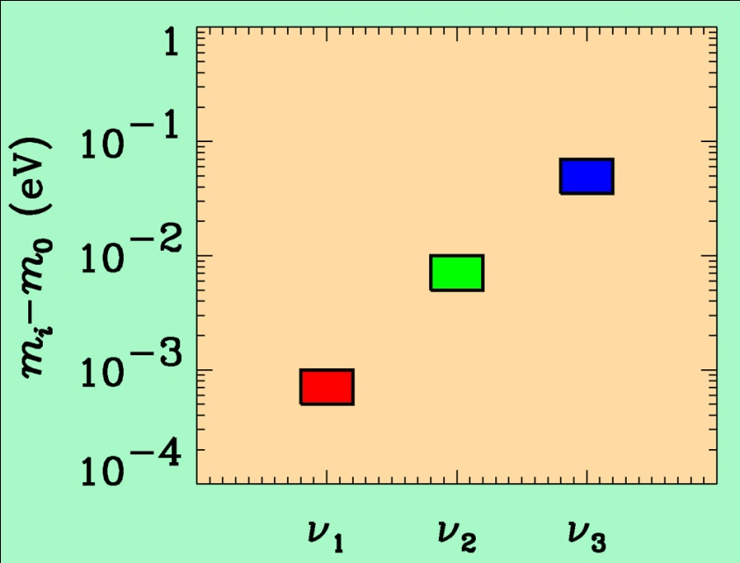
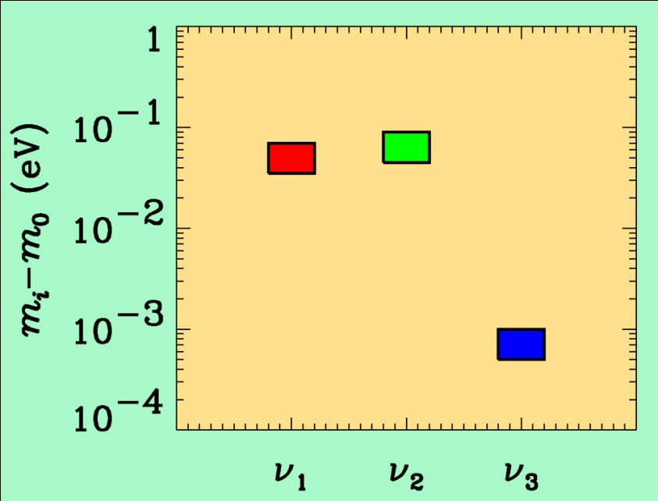
If neutrino masses are hierarchical then oscillation experiments
do not give information on the absolute value of neutrino masses
ATMO. ν
K2K
LBL
SOLAR ν
KAMLAND
Normal hierarchy
Inverted hierarchy
However, if neutrino masses are degenerate
no information can be gained from such experiments.
Experiments which rely on either the kinematics of neutrino mass
or the spin-flip in neutrinoless double beta decay are the most
efficient for measuring m₀

Slide 4
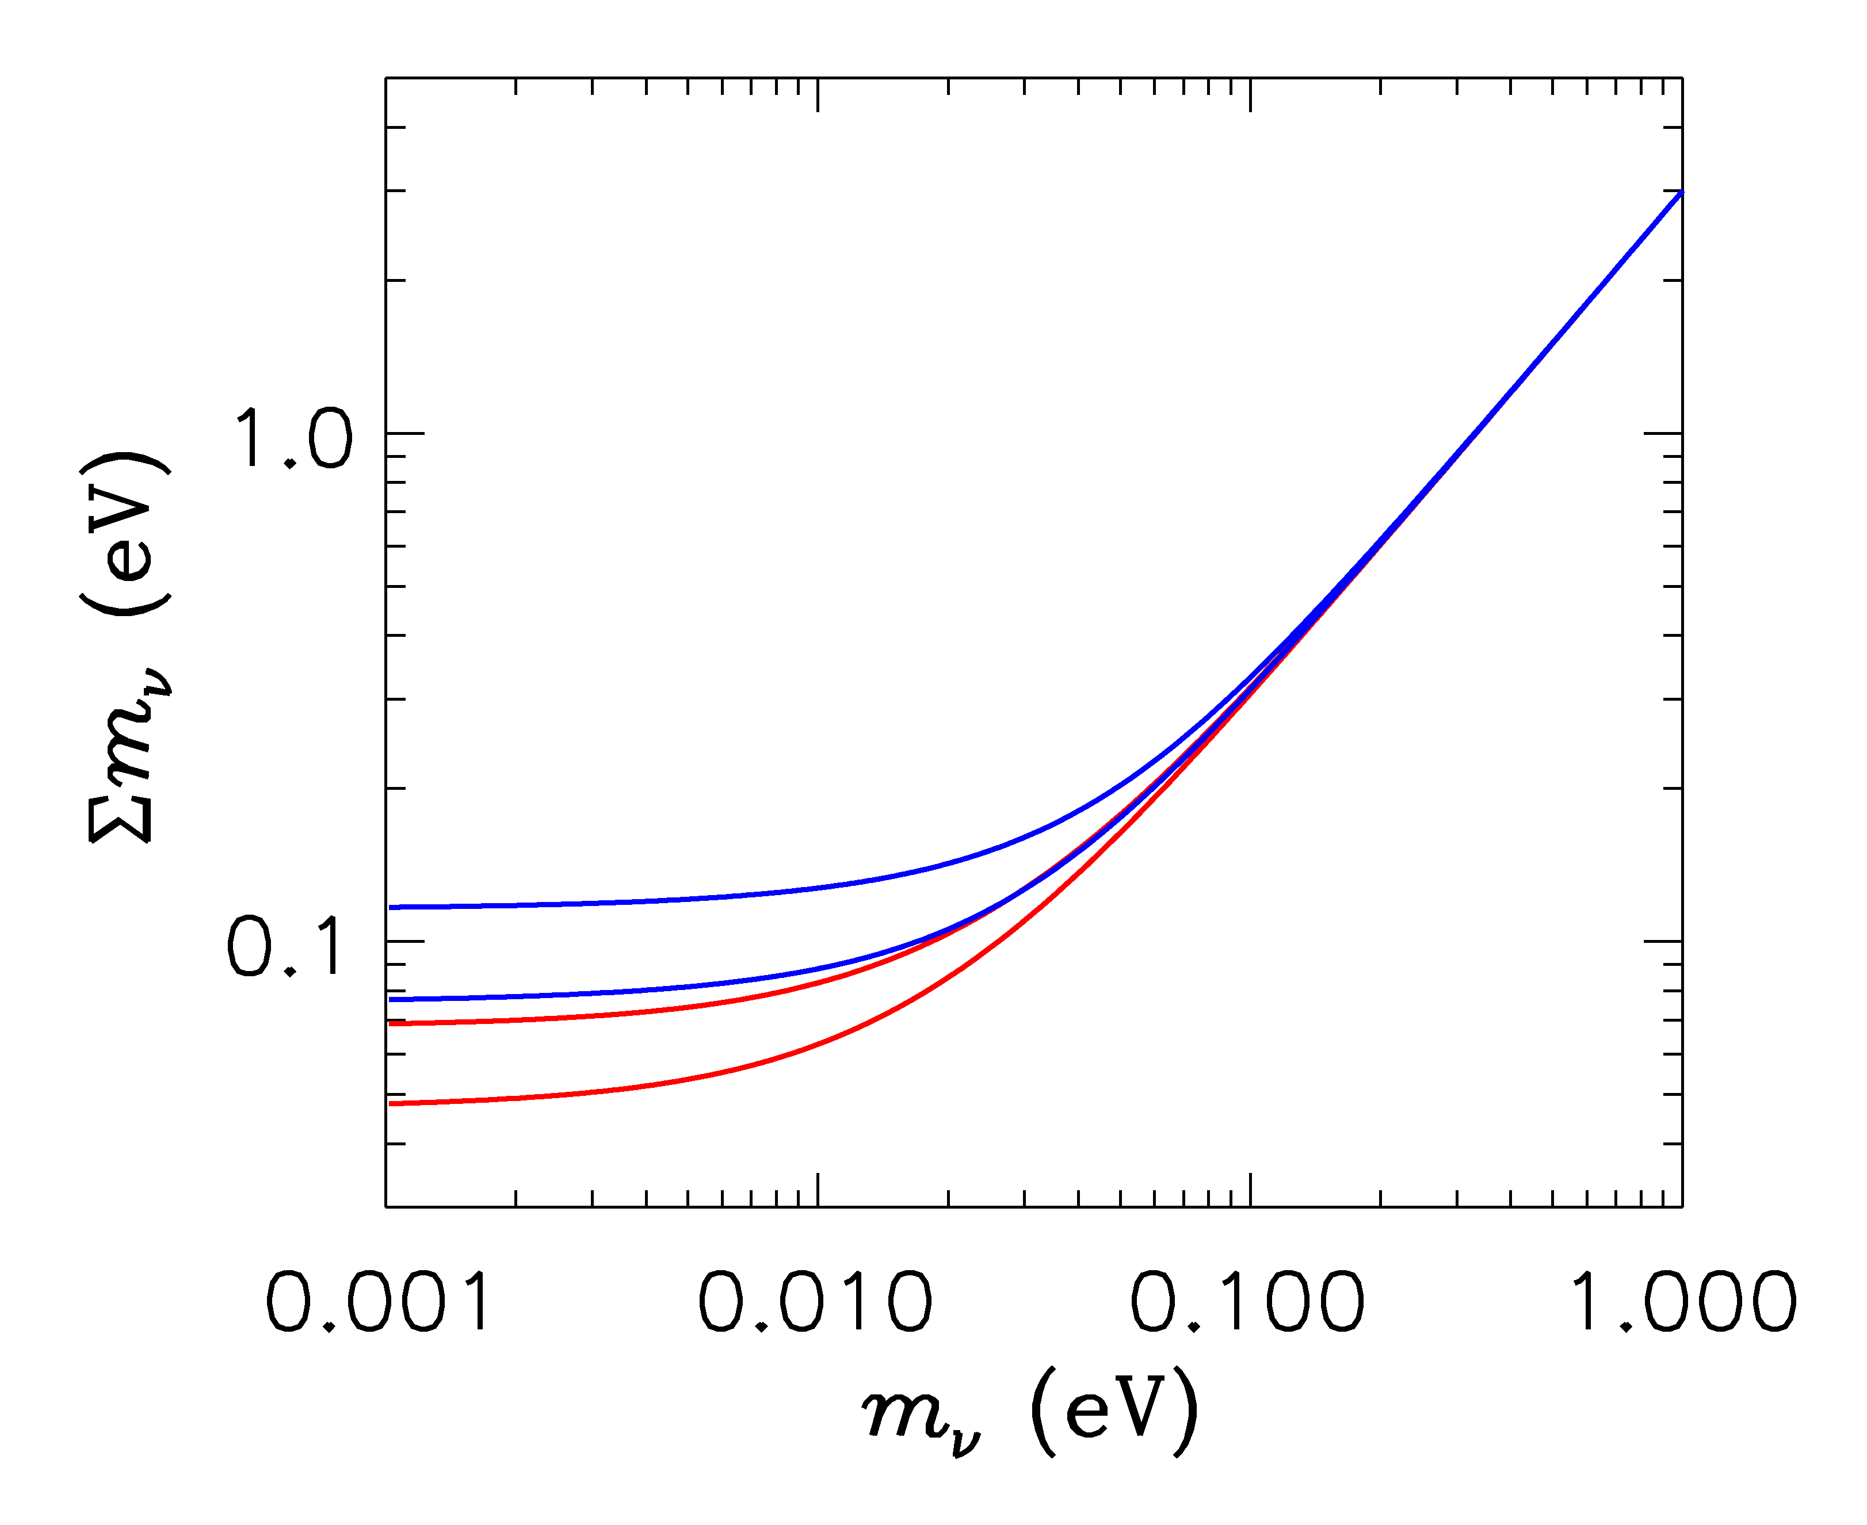
HIERARCHICAL
DEGENERATE
INVERTED
NORMAL
LIGHTEST

Slide 5
ß-decay and neutrino mass
Model independent neutrino mass from ß-decay kinematics
Only assumption: relativistic energy-momentum relation
experimental observable is m_{ν}²
T₂:
E₀ = 18.6 keV
T_{1/2} = 12.3 y

Slide 6
Tritium decay endpoint measurements have provided limits
on the electron neutrino mass
$${”m}_{ν_{e}}”<0.9 eV (95\%)$$
KATRIN experiment (Nature Physics 2022)

Slide 7
NEUTRINO MASS AND ENERGY DENSITY
FROM COSMOLOGY
NEUTRINOS (AND OTHER LIGHT, WEAKLY INTERACTING
PARTICLES) AFFECT STRUCTURE FORMATION
BECAUSE THEY ARE A SOURCE OF DARK MATTER
(n ~ 100 cm⁻³)
FROM
HOWEVER, eV NEUTRINOS ARE DIFFERENT FROM CDM
BECAUSE THEY FREE STREAM
SCALES SMALLER THAN d_{FS} DAMPED AWAY, LEADS TO
SUPPRESSION OF POWER ON SMALL SCALES

Slide 8
N-BODY SIMULATIONS OF ΛCDM WITH AND WITHOUT
NEUTRINO MASS (768 Mpc³) – GADGET 2
256
Mpc
T Haugboelle, Aarhus University

Slide 9
AVAILABLE COSMOLOGICAL DATA

Slide 10
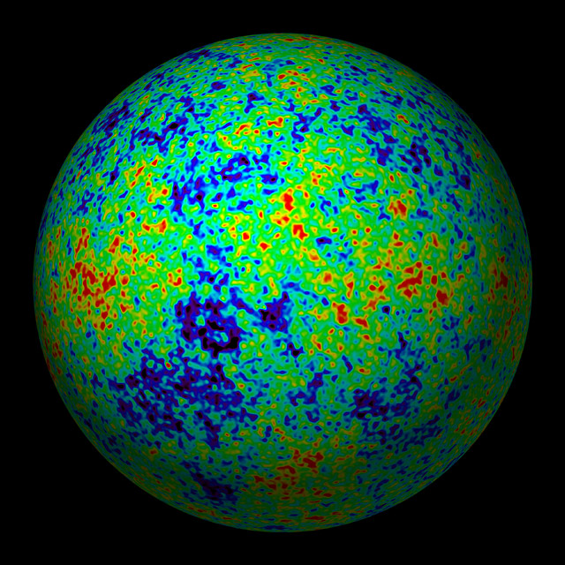
THE COSMIC MICROWAVE BACKGROUND
CMB TEMPERATURE AND POLARISATION

Slide 11
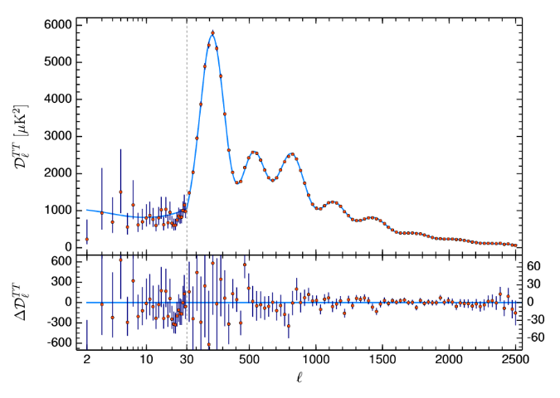
Aghanim et al. 2018 (Planck)

Slide 12
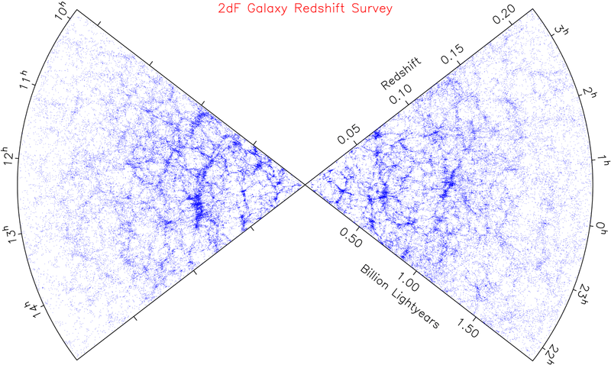
LARGE SCALE STRUCTURE SURVEYS

Slide 13
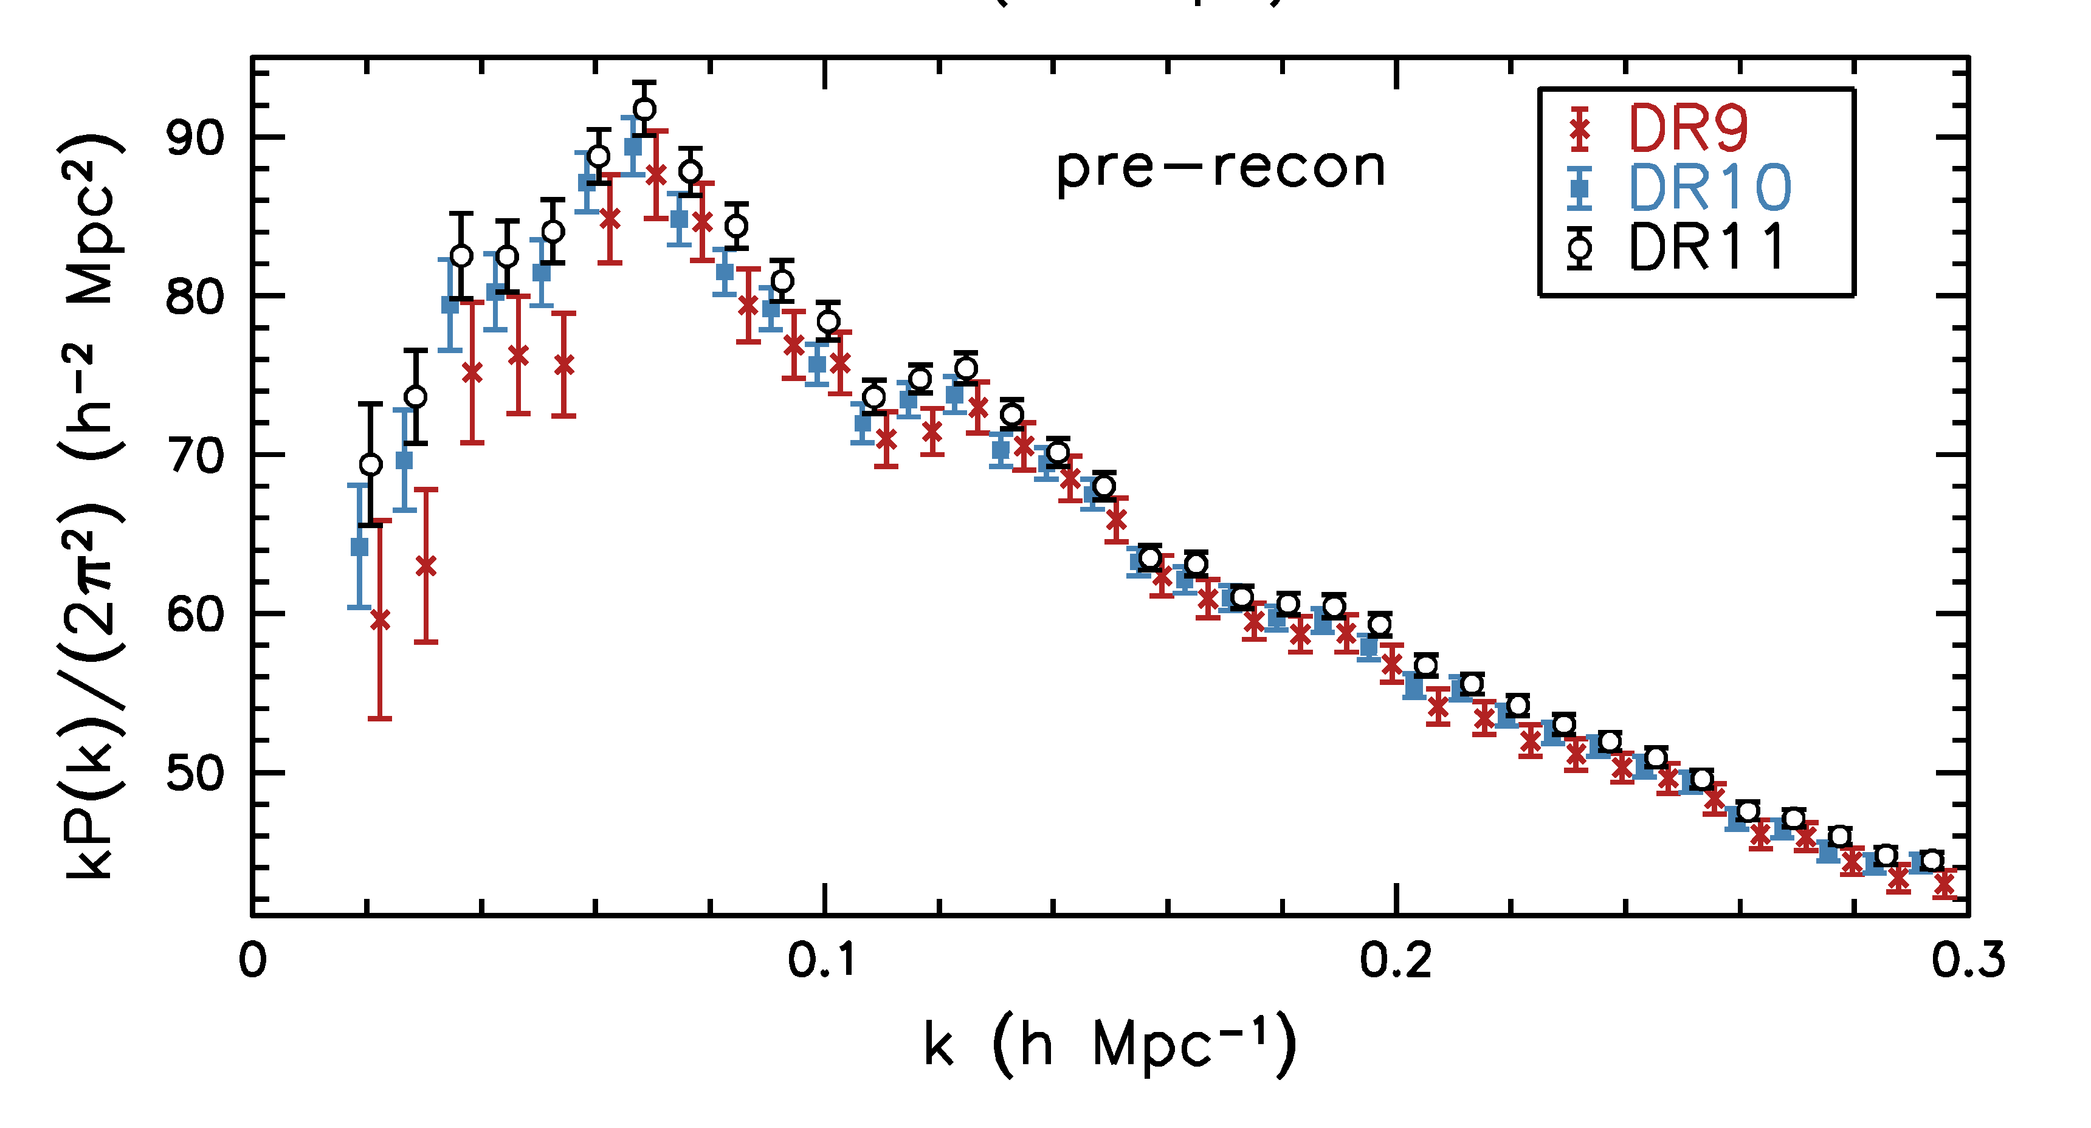
Anderson et al. 1312.4877 (SDSS)

Slide 14
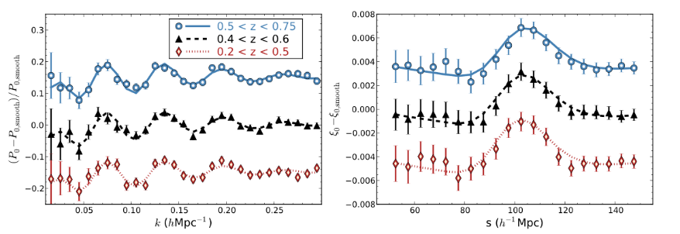
Alam et al. 1607.03155 (SDSS DR12)

Slide 15
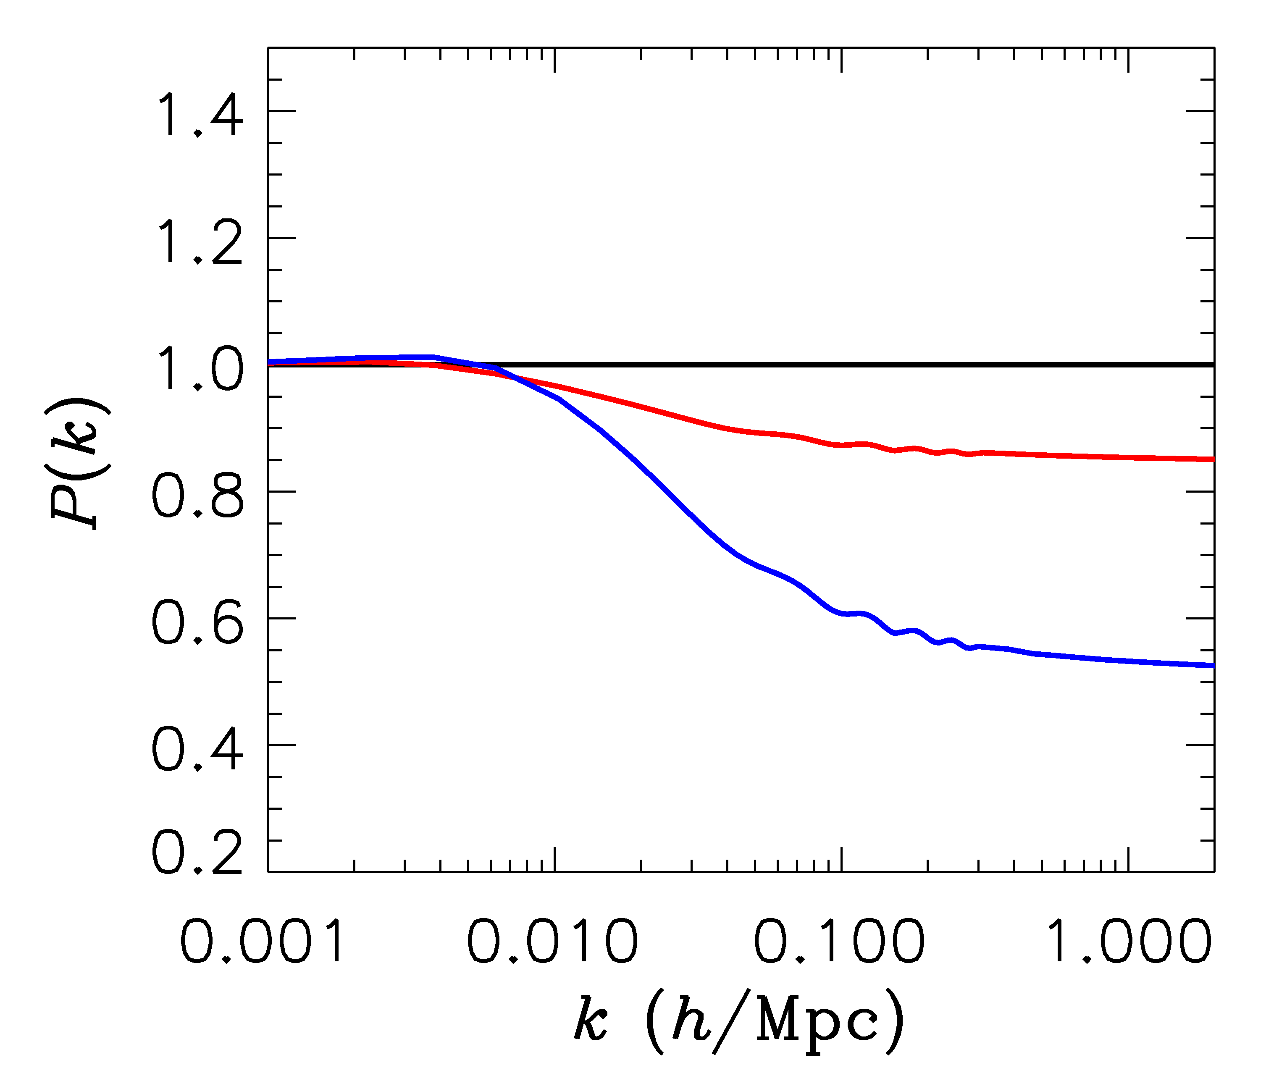
FINITE NEUTRINO MASSES SUPPRESS THE MATTER POWER
SPECTRUM ON SCALES SMALLER THAN THE FREE-STREAMING
LENGTH
$∑m_{ν}$ = 0 eV
P(k)/P(k,m_{ν}=0)
$∑m_{ν}$ = 0.3 eV
$∑m_{ν}$ = 1 eV

Slide 16
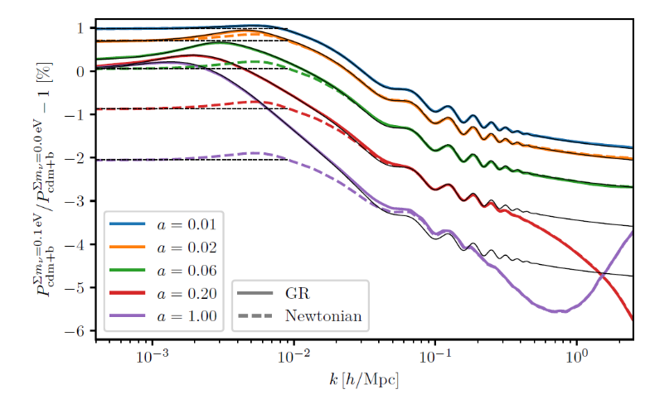
Tram et al. 1811.00904 (JCAP) (fully compatible with GR at the linear level)

Slide 17
NOW, WHAT ABOUT NEUTRINO
PHYSICS?

Slide 18
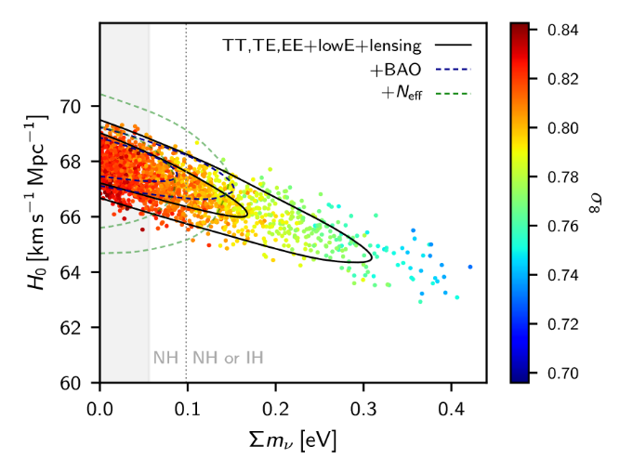
WHAT IS THE PRESENT BOUND ON THE NEUTRINO MASS?
DEPENDS ON DATA SETS USED AND ALLOWED PARAMETERS
THERE ARE MANY ANALYSES IN THE LITERATURE
AGHANIM ET AL.
(PLANCK 2018)

Slide 19
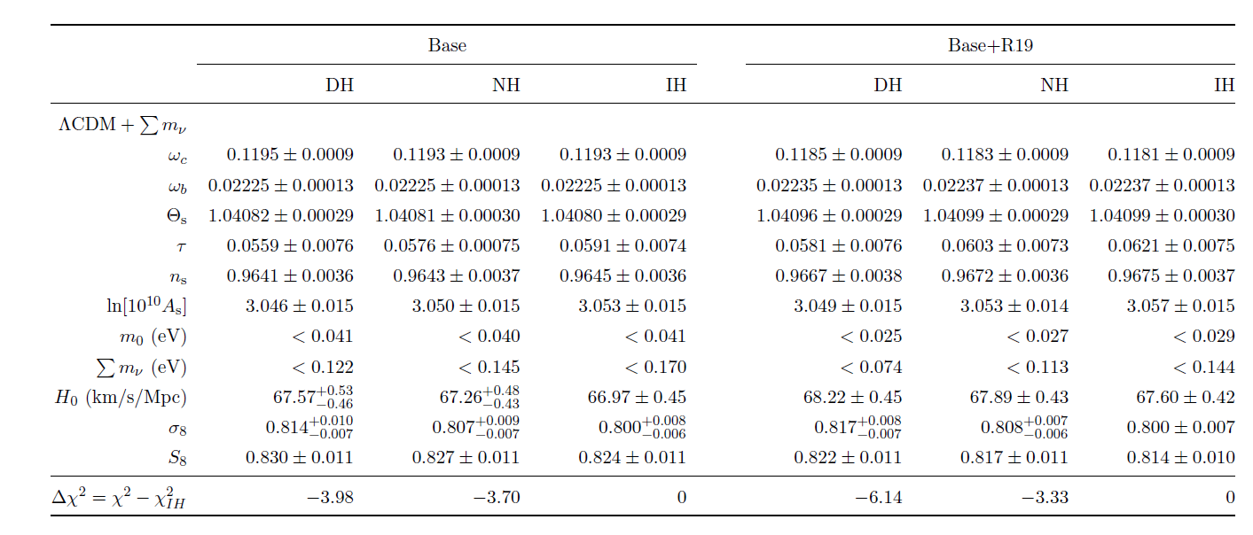
Choudhury & STH 1907.12598
See Eleonora’s talk for more detail
(and di Valentino, Gariazzo & Mena, 2207.05167 for a very recent
Analysis)

Slide 20
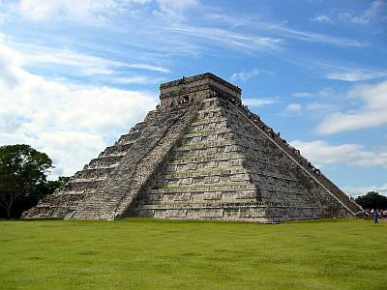
THE NEUTRINO MASS FROM COSMOLOGY PLOT
More data
+Ly-alpha
~ 0.1 eV
0.2-0.3 eV
0.2-0.3 eV
+ SNI-a
+WL
~ 0.15 eV
~0.5 eV
0.5-0.6 eV
+ SDSS
~0.15 eV
~ 0.5 eV
~0.5 eV
CMB only
0.7 eV
~ 1 eV
1.? eV
??? eV
Minimal
ΛCDM
+N_{ν}
+w+……
Larger model
space

Slide 21
How can the bound be avoided?

Slide 22
How does neutrino mass affect cosmology?
A non-zero neutrino mass leads to:
1) A modified matter-radiation transition, leading to a change in the Hubble rate and a slight increase in the early ISW effect
2) The lack of neutrino clustering below the free-streaming scale leads to a very substantial reduction in matter clustering.
This in turn leads to a substantial reduction in structure formation at all redshifts and e.g. a decrease in weak lensing

Slide 23
How can a large neutrino mass be allowed?
To be consistent with a large neutrino mass, a model can be built in two ways:
1) If the neutrino sector is left unmodified, the model has to counteract the effect of the neutrino mass, i.e. it needs more efficient clustering
2) Alternatively, neutrino physics must be modified so that a large neutrino mass does not affect structure formation substantially

Slide 24
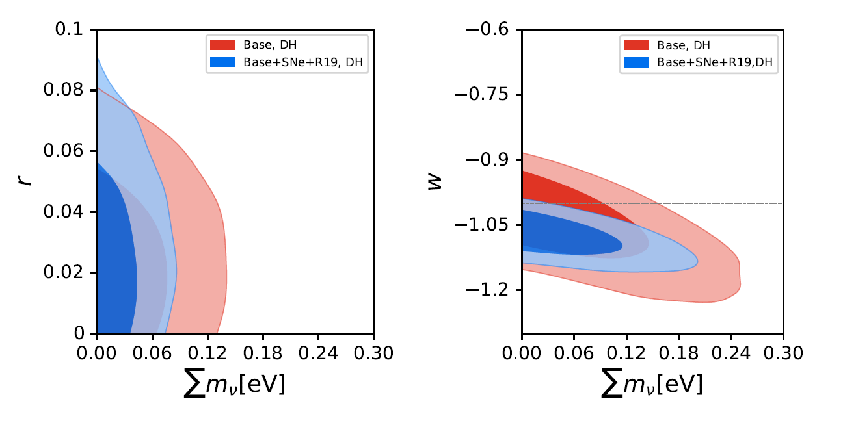
Simple examples belonging to category 1
Choudhury & STH 1907.12598

Slide 25
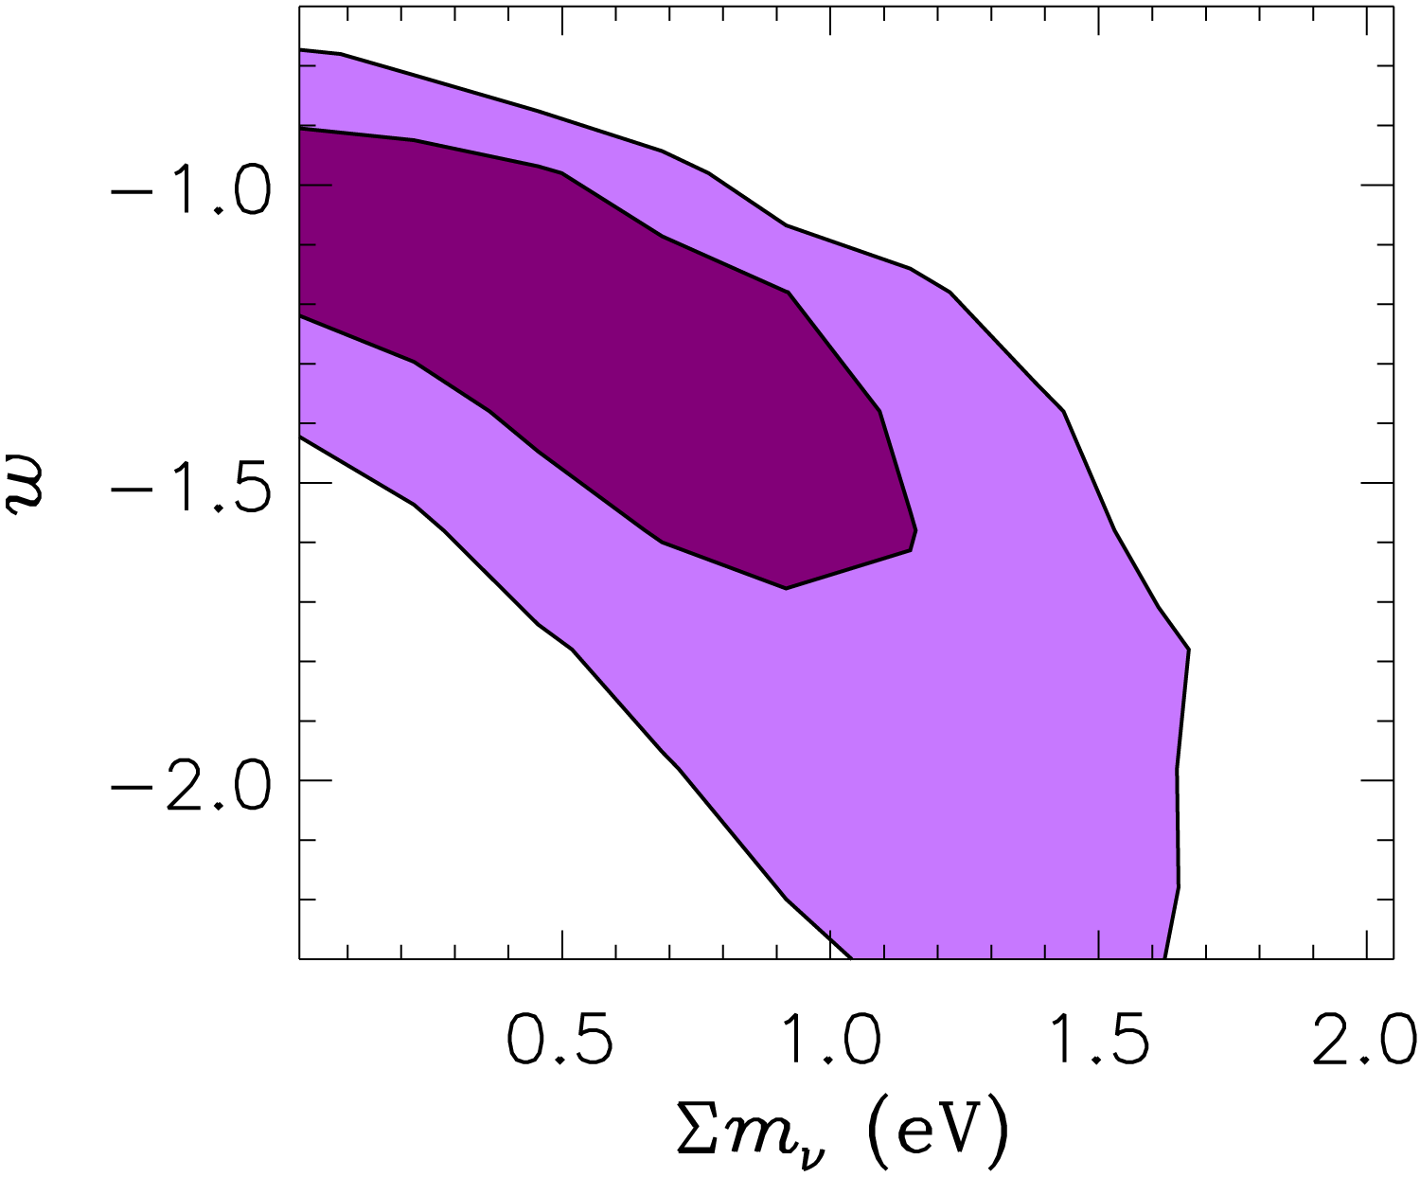
With better data it becomes increasingly hard for other cosmological
parameters to mimic the effect of a non-zero neutrino mass
For purely standard model neutrinos, the mass bound is fairly robust
2005: WMAP data
2019: Planck data

Slide 26
Examples belonging to category 2:
1) A time-varying neutrino mass
Making the neutrino mass dynamical can potentially evade cosmological bounds
Mass varying neutrinos (Fardon, Nelson, Weiner 2003)
Spontaneous neutrino mass generation (Dvali & Funcke 2016)
……

Slide 27
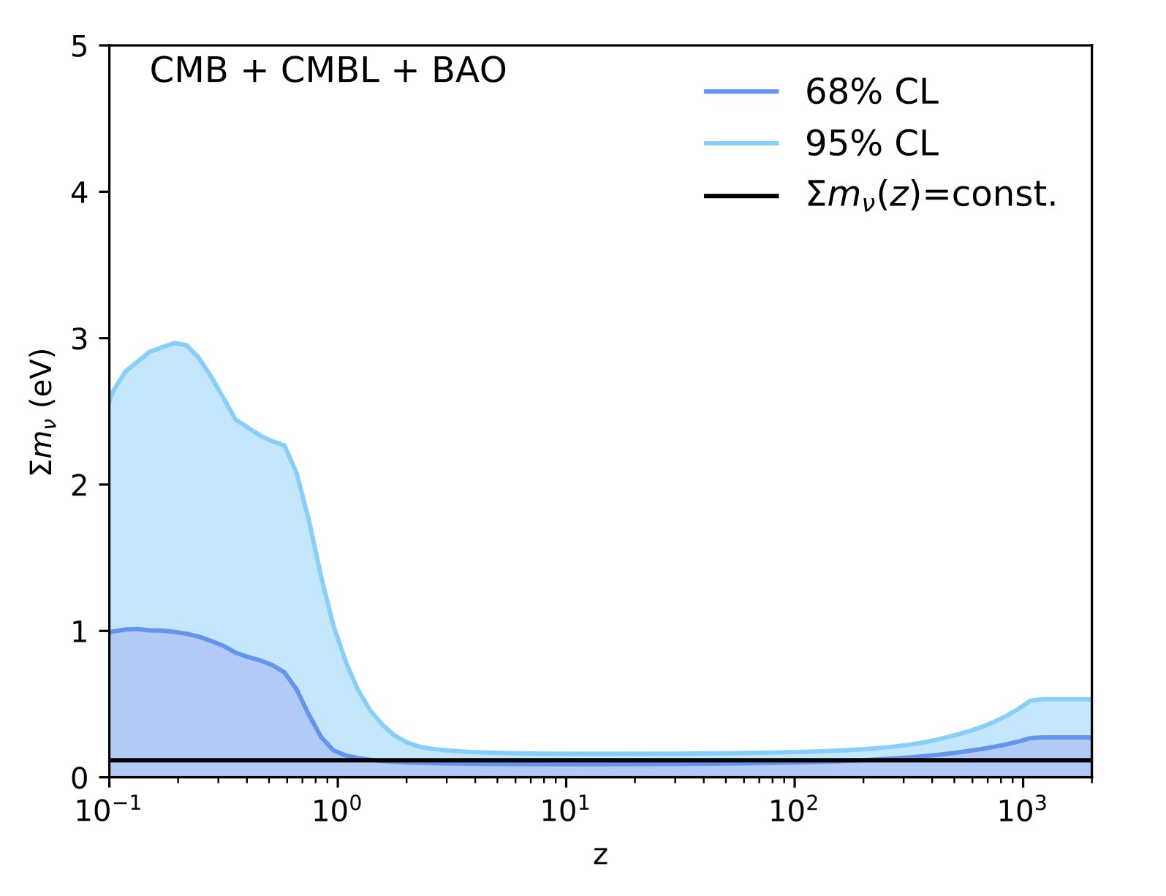
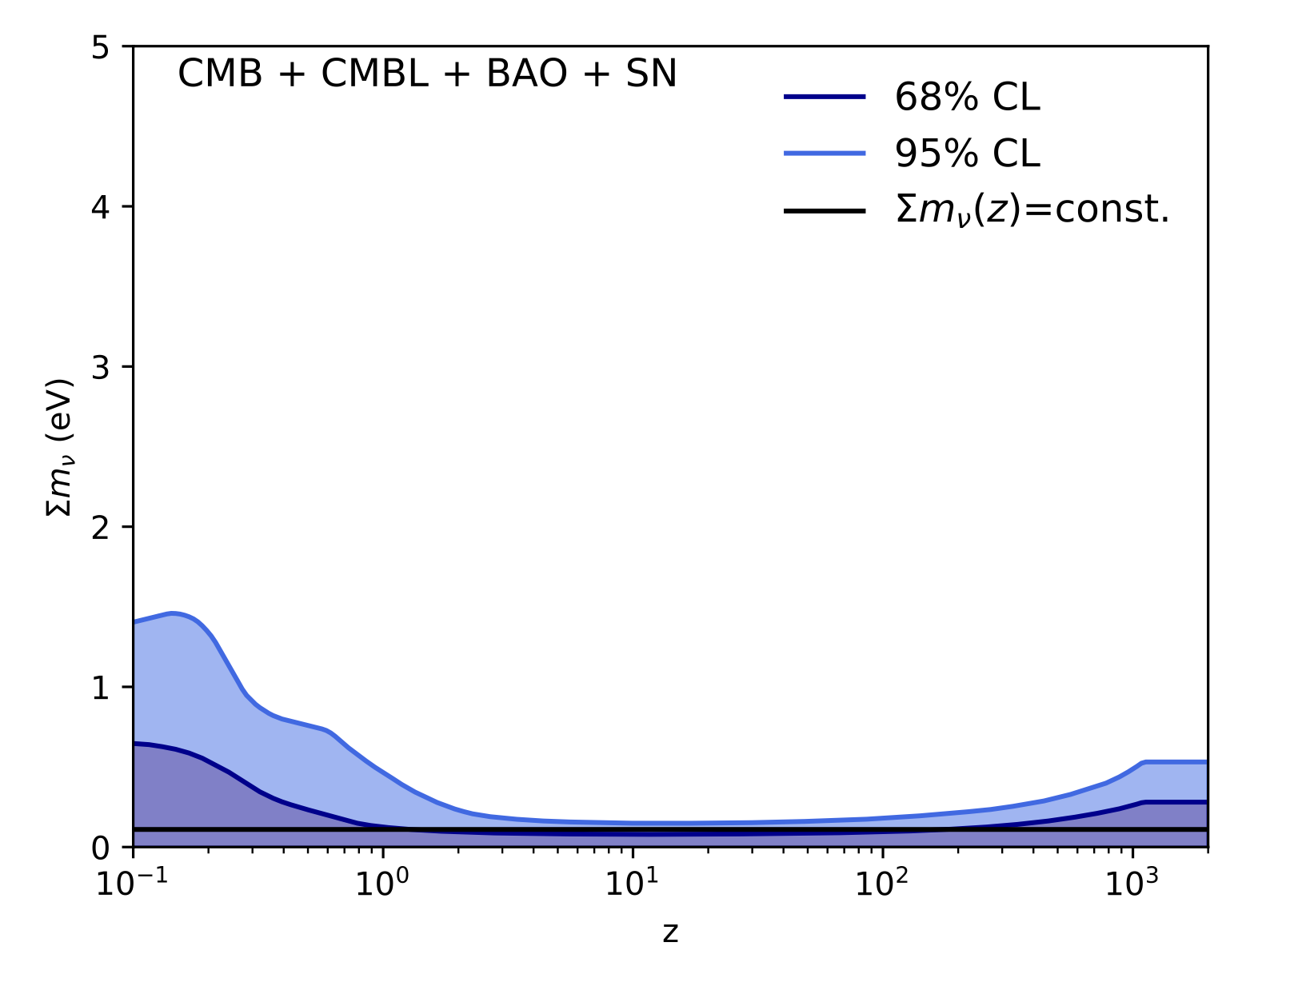
How can a large current neutrino mass be allowed?
Lorenz et al. arXiv:2102.13618

Slide 28
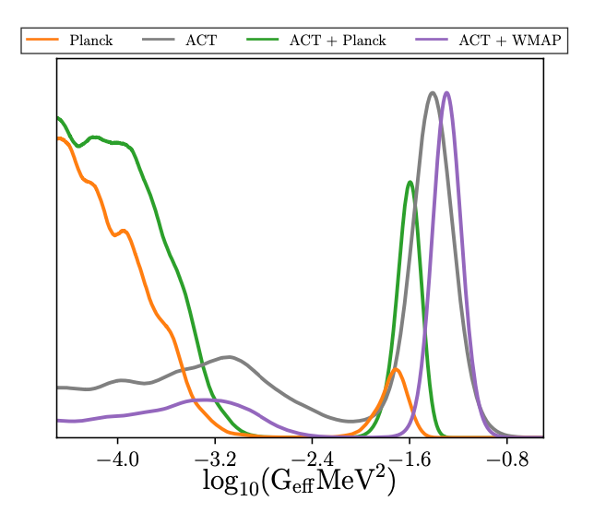
Examples belonging to category 2:
2) Non-standard neutrino interactions
The simplest example is a Fermi-like interaction (Cyr-Racine & Sigurdson 2013, Archidiacono & STH 2013, Forastieri, Lattanzi, Natoli 2015, recent works: Kreisch et al. 2207.03164, Choudhury, STH, Tram 2207.07142)
Can suppress free-streaming at early times, then decouples at late times
Surprisingly, fairly strong self-interactions
are not necessarily disfavoured
Kreis et al. 2207.03164

Slide 29
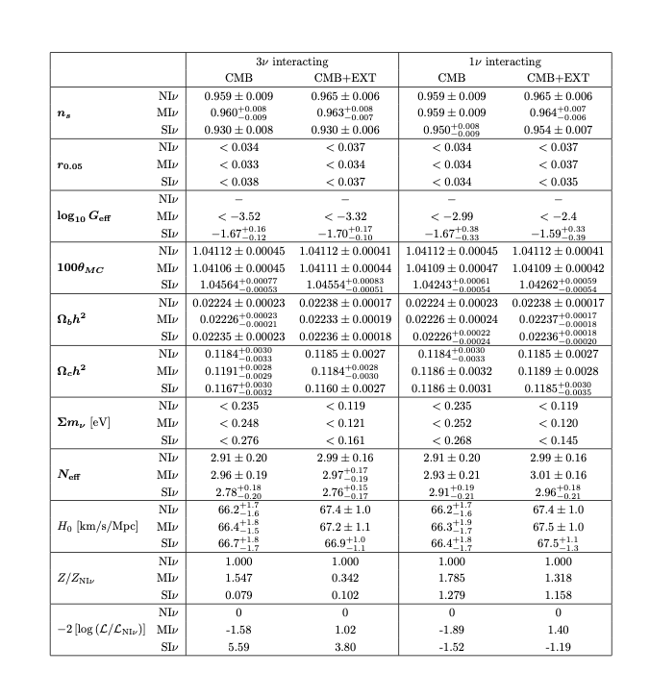
Examples belonging to category 2:
However, such interactions
have at most a moderate
effect on the mass bound
Choudhury, STH, Tram
2207.07164

Slide 30
Examples belonging to category 2:
2) Non-standard neutrino interactions
Another possibility is that neutrinos couple to a new, light (pseudo-)scalar.
This suppresses free-streaming at late time (neutrino recoupling, STH 2004)
Neutrinos can now pair-annihilate away through $\overline{ν}ν→φφ$ , effectively creating a neutrinoless universe (Beacom, Bell, Dodelson 2004)

Slide 31
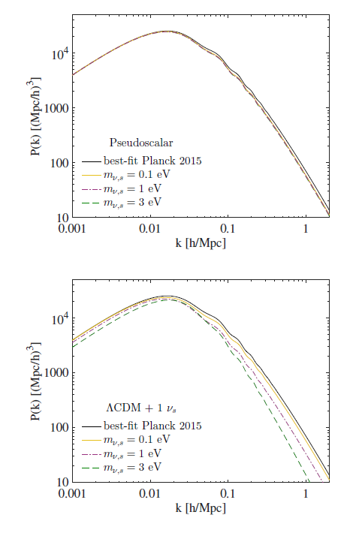
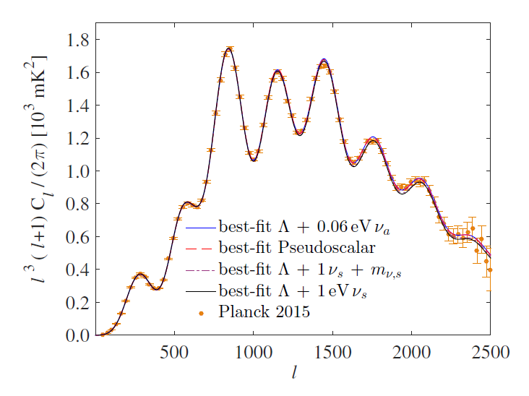
The usual suppression of matter
power does not occur because
the massive neutrinos disappear
as soon as they go non-relativistic
Archidiacono, STH, Hansen, Tram, arXiv:1508:02504 (sterile neutrinos)

Slide 32
Examples belonging to category 2:
For active neutrinos, annihilation of massive neutrinos typically requires
an interaction strong enough to completely suppress free-streaming until
after recombination – this is most likely not compatible with observations,
but some form of this scenario might work

Slide 33
And finally: Do we actually know that we have
measured a neutrino mass?
Cosmological observables (with the exception of BBN) have no flavour
Sensitivity
They measure: Current density contribution ($Ω_{ν}h^{2}$), early contribution to the radiation density ($N_{eff}$), to a very minor extent the epoch of relativistic to non-relativistic transition (but only if this lies around matter-radiation equality)
This means that:
Cosmology cannot tell if the hot dark matter is a neutrino mass or something else
Cosmology has no direct sensitivity to the mass hierarchy

Slide 34
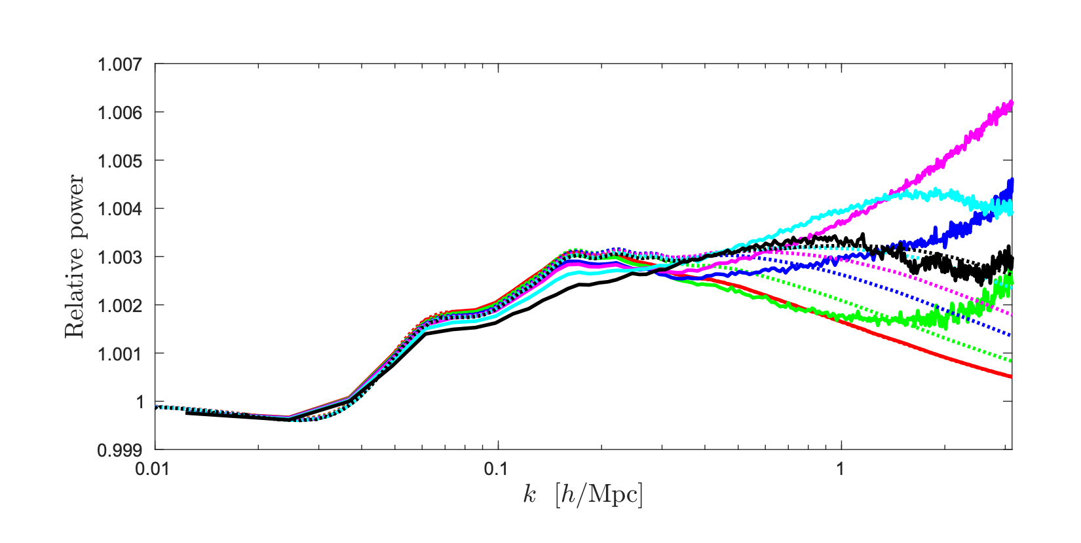
Example: What if hot dark matter was bosonic rather than fermionic
(with the same total density)?
Brandbyge & STH 1706.00025 (JCAP)

Slide 35
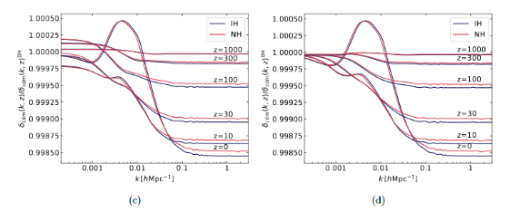
Can the specific hierarchy be measured using cosmology?
(as opposed to $∑m_{ν}$)
Archidiacono, STH, Lesgourgues, arXiv:2003.03354 (JCAP)
If $∑m_{ν}<0.07−0.08 eV$: Yes, indirectly because the inverted hierarchy can be excluded
If $∑m_{ν}>0.07−0.08 eV$: No, because even the best future data is only sensitive to $∑m_{ν}$, not to the individual masses

Slide 36
GOING BEYOND THE MASS
$$Ω=\frac{ρ}{ρ_{c}}=∑m_{ν,i}n_{ν,i}$$
$$n_{ν}=\frac{3}{4}{\left(\frac{T_{ν}}{T_{γ}}\right)}^{3}n_{γ}$$
Normally $T_{ν}={\left(\frac{4}{11}\right)}^{1/3} T_{γ}$ , but could be different. Normally the relativistic
energy density in neutrinos is quantified through the relation
$$ρ_{ν0}=\frac{7}{8}{\left(\frac{T_{ν}}{T_{γ}}\right)}^{4}ρ_{γ}$$
$$N_{eff}=\frac{ρ_{ν,rel}}{ρ_{ν0}}$$
$N_{eff}$ is a measure of any type of ”dark radiation”

Slide 37
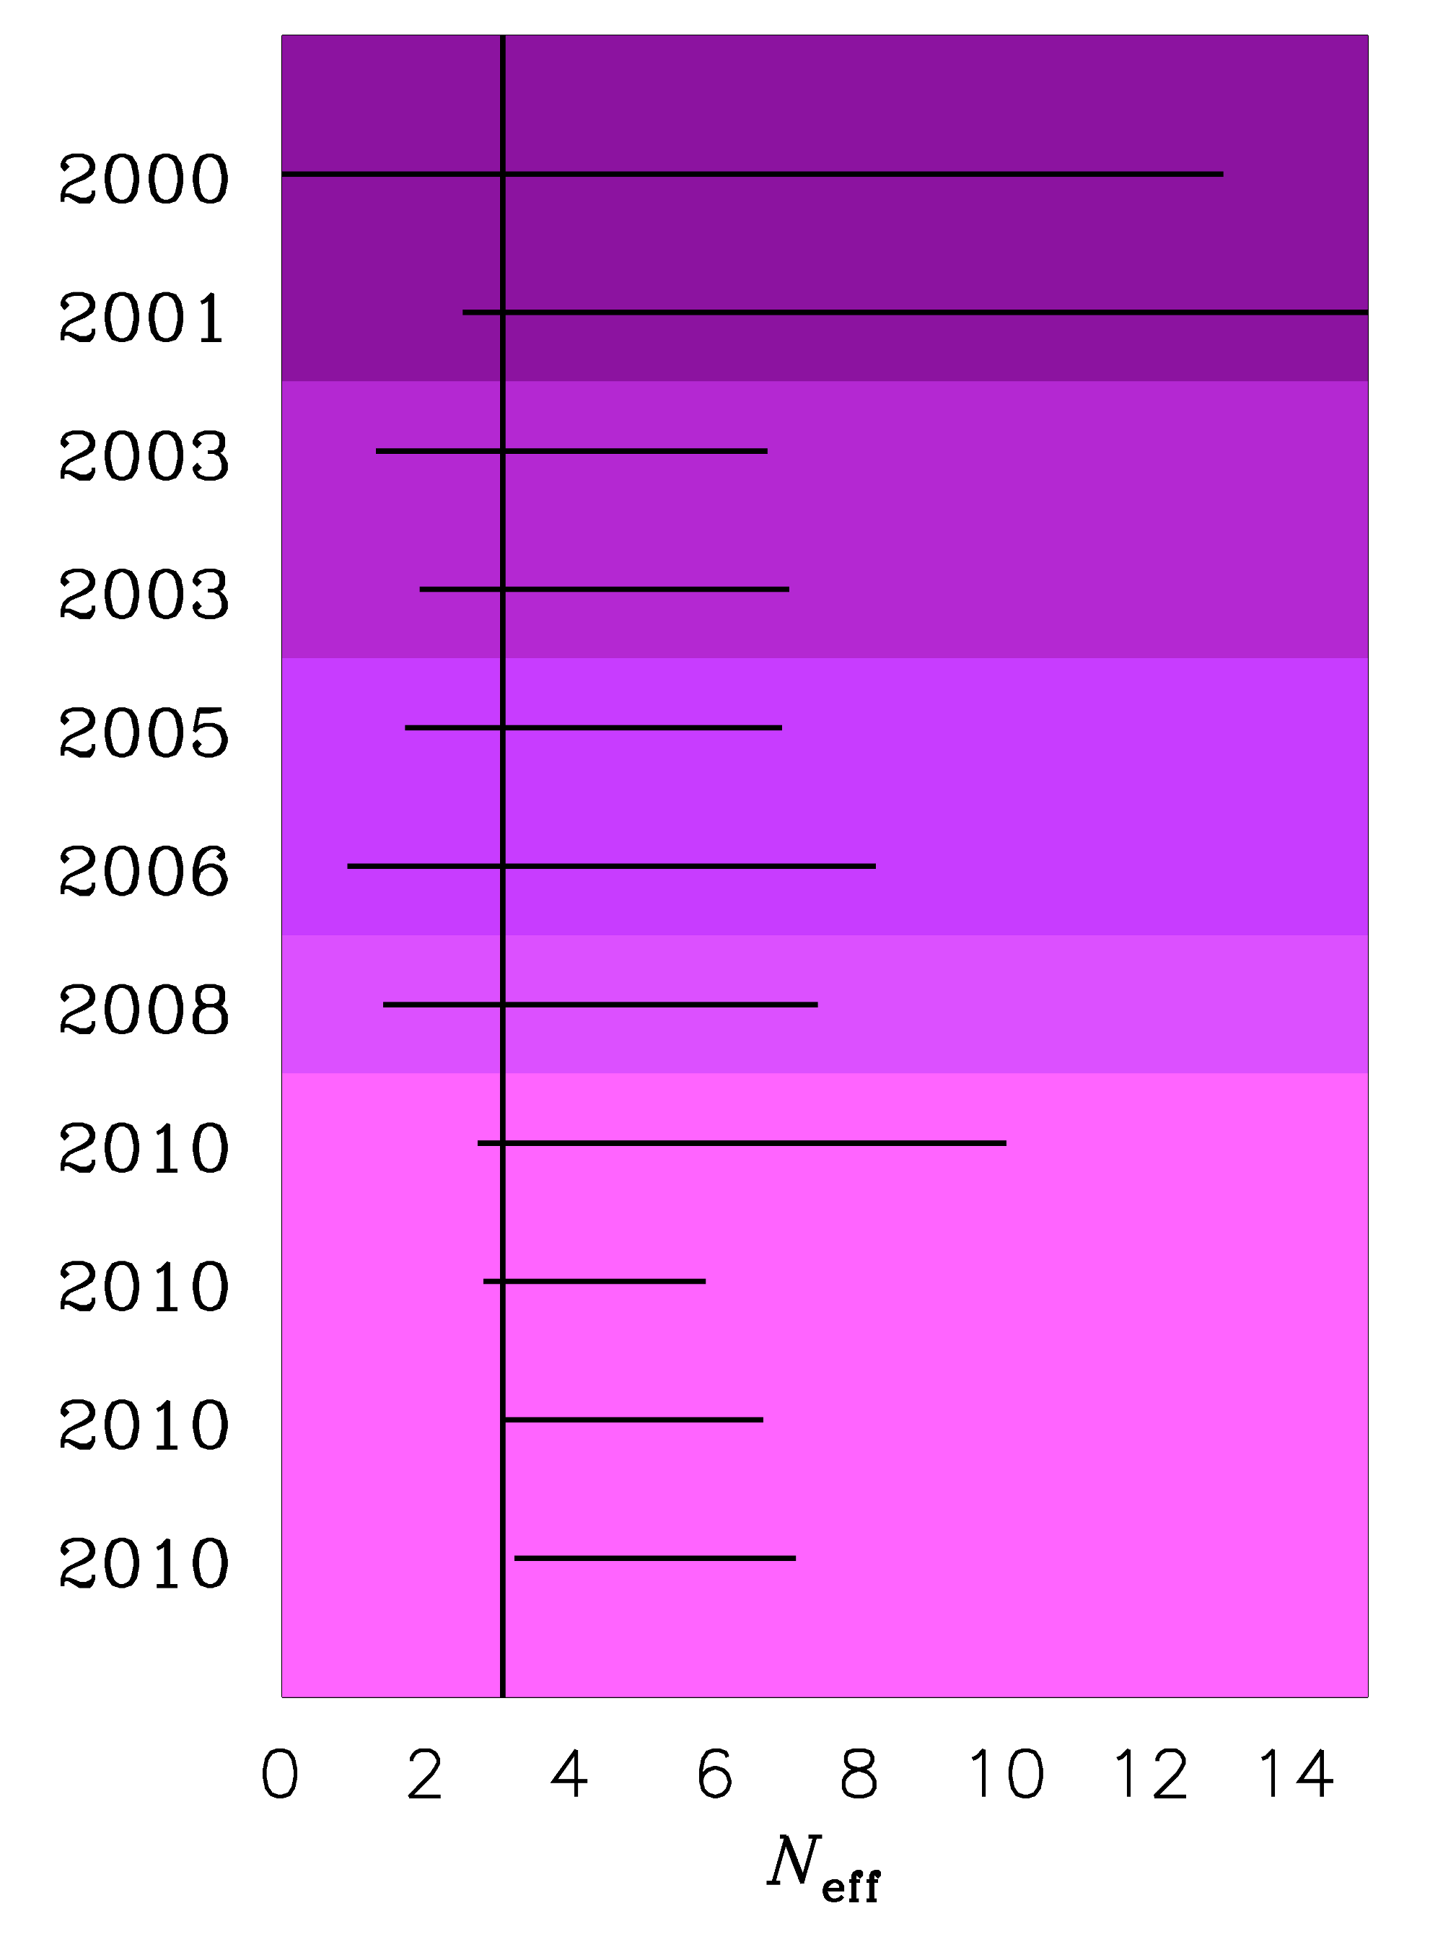
Pre-WMAP
Throwback to the
Pre-Planck era…
Slides from MPP
colloquium 2011
WMAP-1
WMAP-3
TIME EVOLUTION OF
THE 95% BOUND ON
N_{ν}
WMAP-5
WMAP-7
ESTIMATED PLANCK
SENSITIVITY

Slide 38
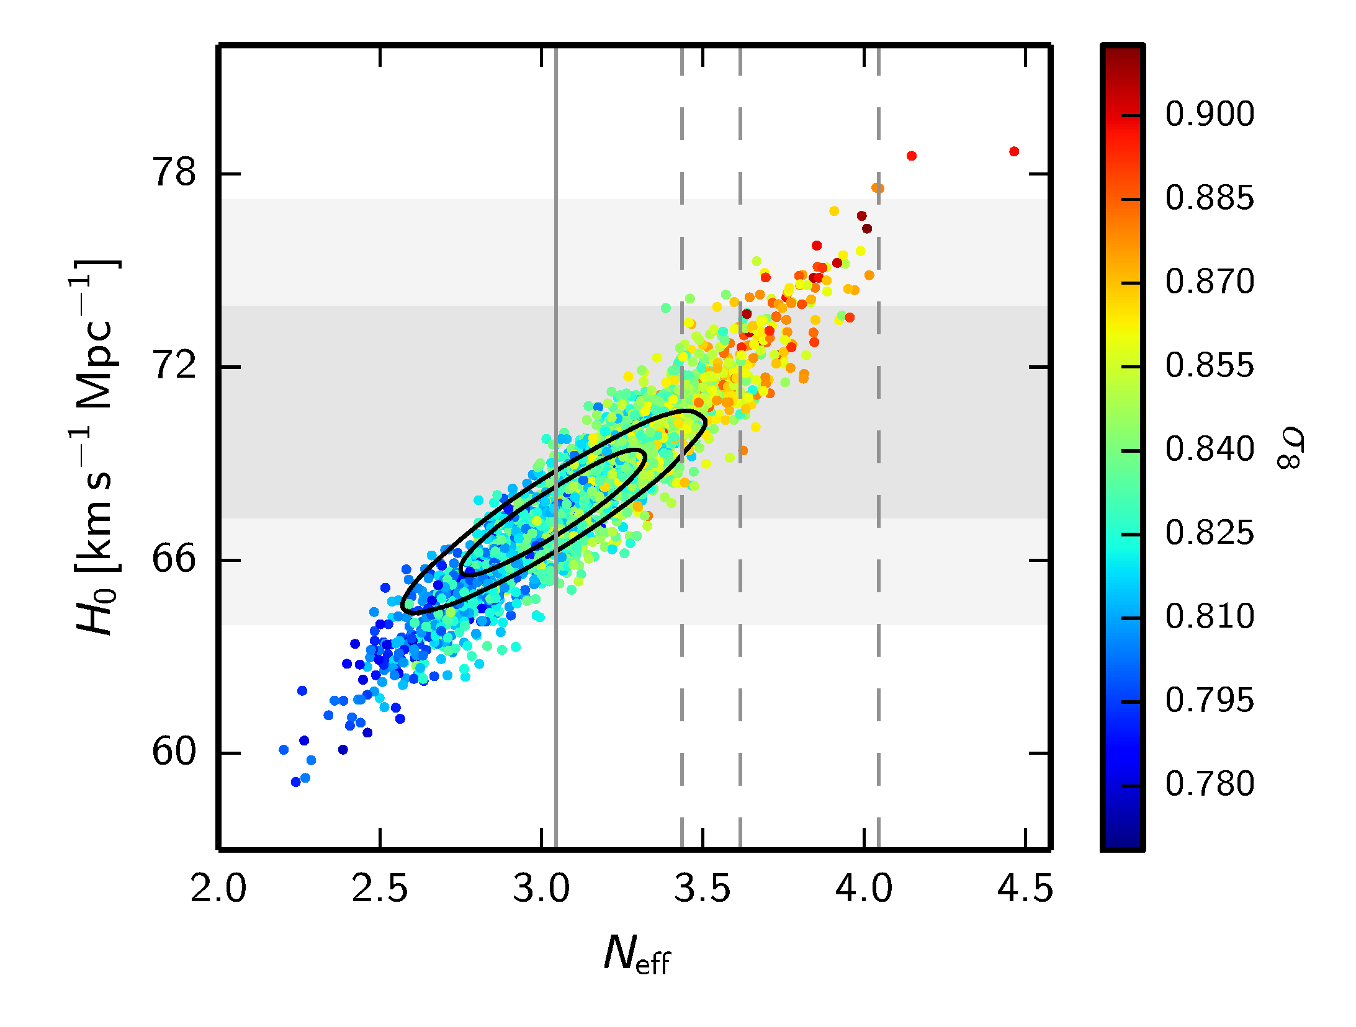
Fast forward to 2022…..
THE CONCLUSION SEEMS TO BE THAT THERE IS NO EVIDENCE
FOR ANY PHYSICS BEYOND THE STANDARD MODEL
BUT BE AWARE THAT IN EXTENDED MODELS THIS CAN BE
VERY DIFFERENT!

Slide 39
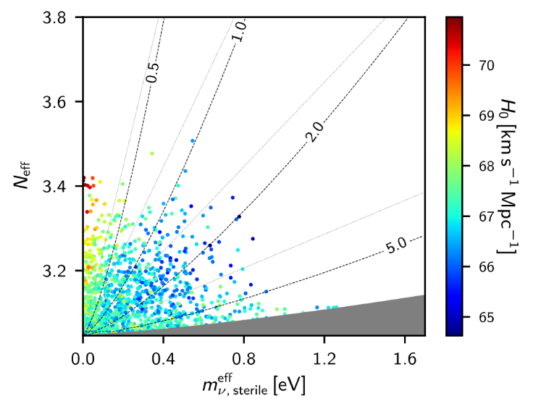
$$N_{eff}= \frac{ρ_{s}+ρ_{a}}{ρ_{ν,0}}$$
AGHANIM ET AL. (Planck 2018)

Slide 40
Bottom line: Sterile neutrinos in the
mass range preferred by SBL data
can be accomodated by cosmology,
but ONLY if they are not fully
thermalised

Slide 41
Sterile neutrinos are thermalised via a combination of oscillation and scattering
(Barbieri & Dolgov 91; Enqvist, Kainulainen & Maalampi 91, Raffelt & Sigl 93, McKellar & Thomson 94)
The neutrino matter potential is important and a very large potential could in principle prevent thermalisation
How can this be achieved?
A large neutrino lepton asymmetry
(see e.g. STH, Tamborra, Tram 1204.5861, Saviano et al. arXiv:1302.1200)
New, non-standard interactions in the sterile sector
(e.g. STH, Hansen, Tram, 1310.5926, Dasgupta & Kopp 1310.6337, Bringmann, Hasenkamp & Kersten 1312.4947, Archidiacono, STH, Hansen, Tram 1404.5915
Chu, Dasgupta & Kopp 1505.02795)

Slide 42
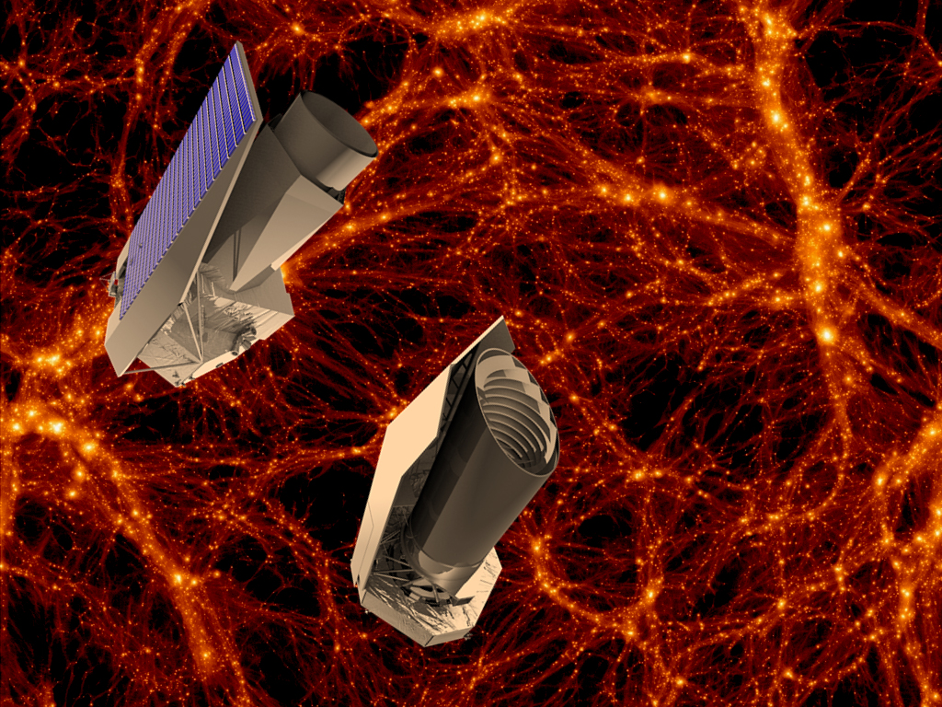
The future

Slide 43
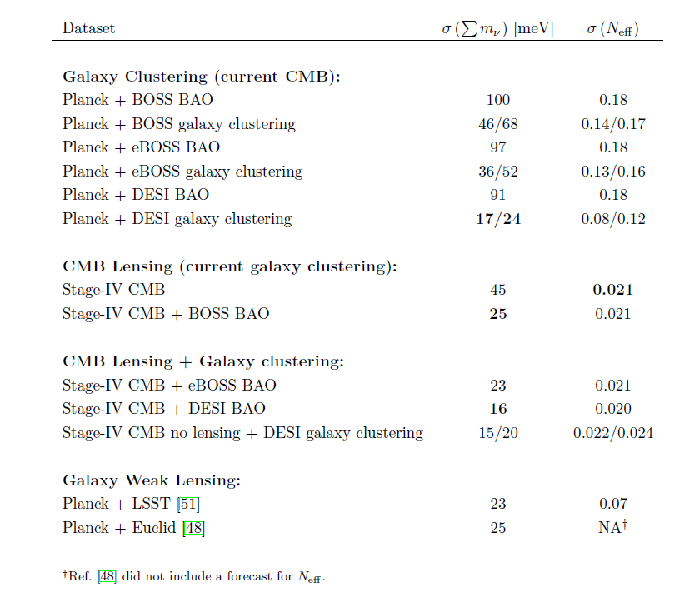
Abazajian et al., arXiv:1309.5383

Slide 44
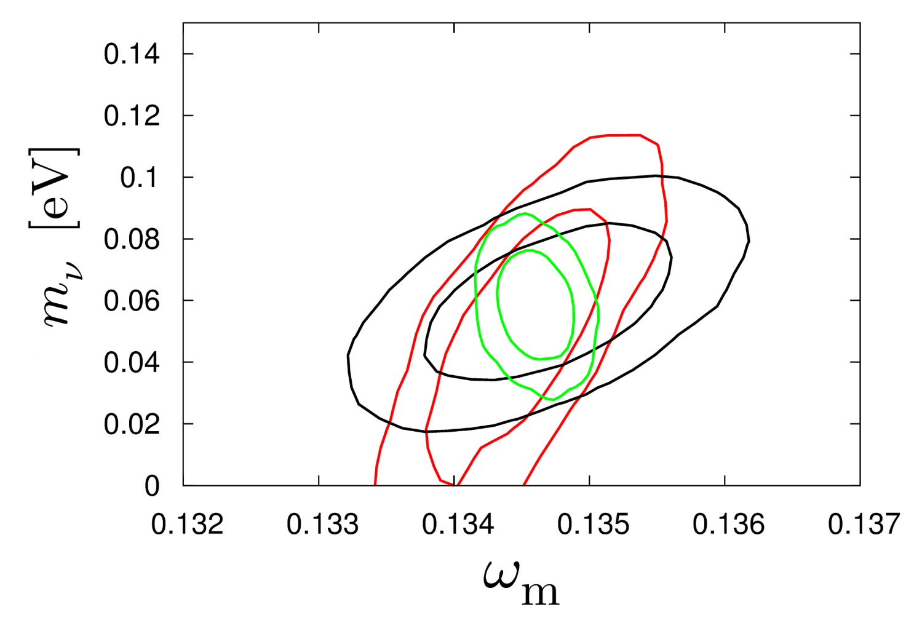
HAMANN, STH, WONG 2012: COMBINING THE EUCLID WL AND GALAXY
SURVEYS WILL ALLOW FOR AT A 2.5-5σ DETECTION OF THE NORMAL
HIERARCHY (DEPENDING ON ASSUMPTIONS ABOUT BIAS)
CMB+WL
CMB+WL+GAL
CMB+GAL
arXiv:1209.1043 (JCAP)

Slide 45
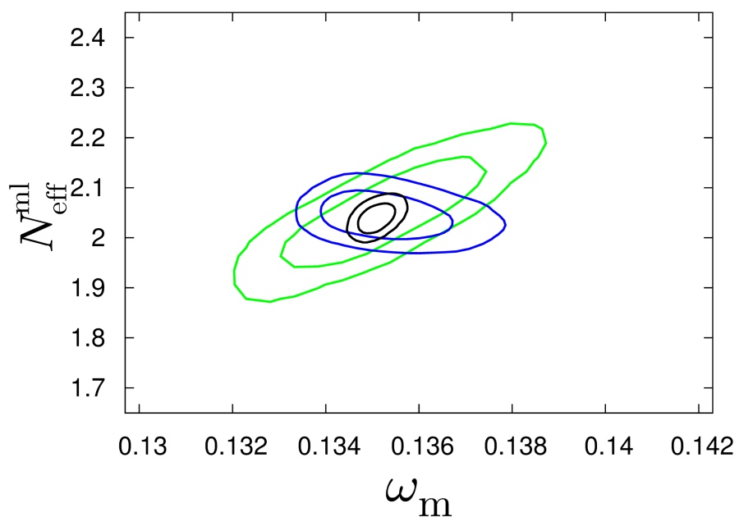
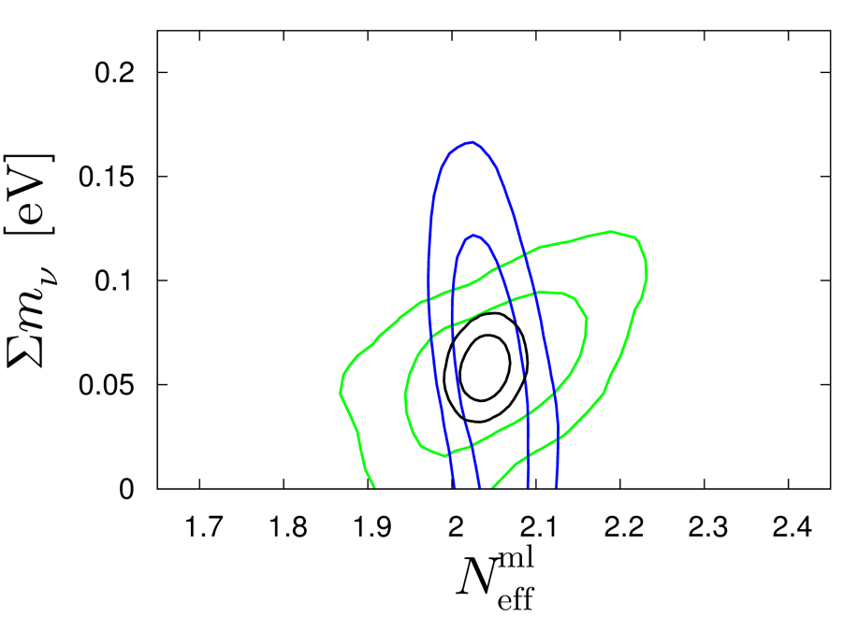
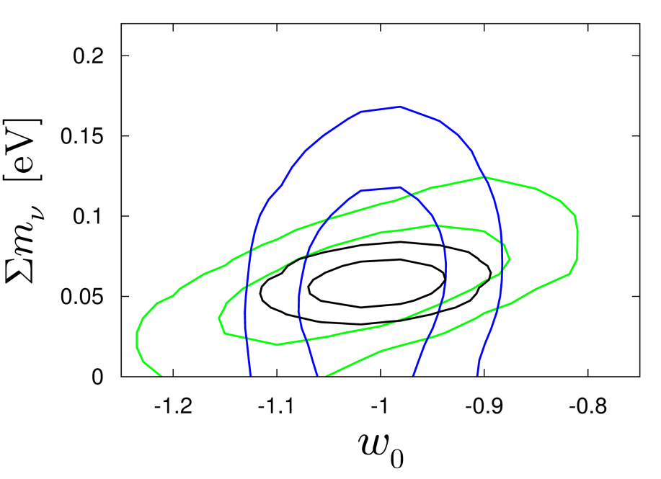
Basse, Bjælde, Hamann, STH, Wong 2013: Adding information on the
cluster mass function will allow for a 5σ detection of non-zero neutrino
mass, even in very complex cosmological models with time-varying
dark energy
arXiv:1304.2321
(JCAP)
CMB+CL
CMB+GAL+WL
ALL

Slide 46
THIS SOUNDS GREAT, BUT UNFORTUNATELY THE THEORETICIANS
CANNOT JUST LEAN BACK AND WAIT FOR FANTASTIC NEW DATA
TO ARRIVE…..

Slide 47
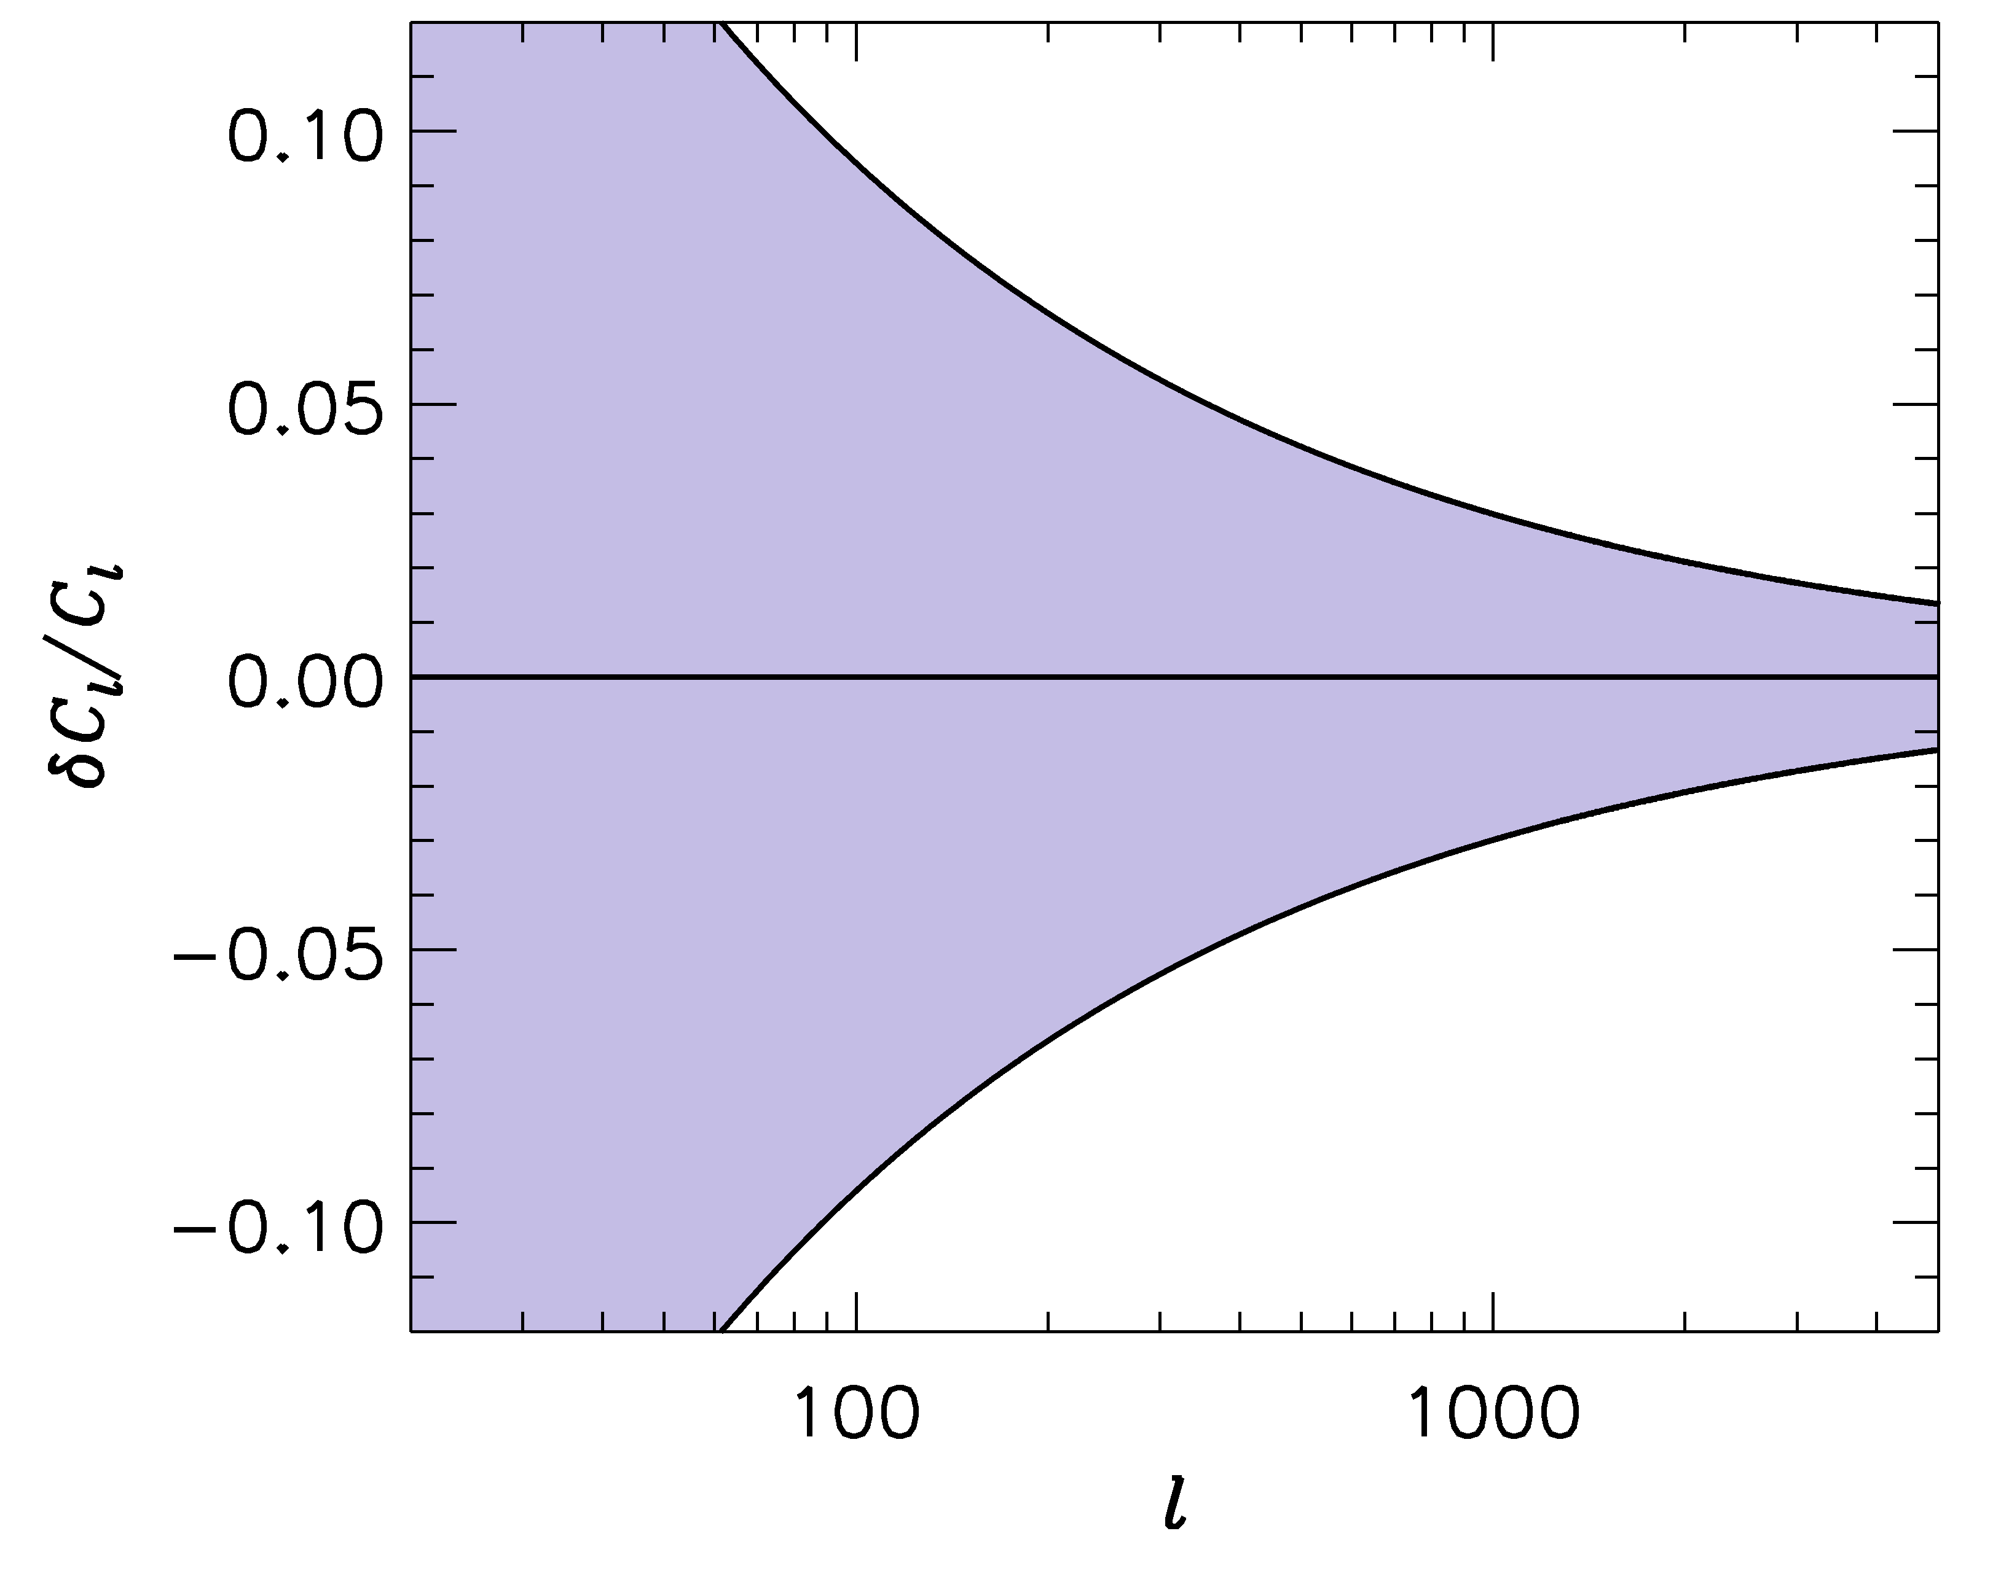
FUTURE SURVEYS LIKE LSST WILL PROBE THE POWER SPECTRUM
TO ~ 1-2 PERCENT PRECISION
-1
”LSST” ERROR BARS
WE SHOULD BE ABLE TO CALCULATE THE POWER SPECTRUM
TO AT LEAST THE SAME PRECISION!

Slide 48
IN ORDER TO CALCULATE THE POWER SPECTRUM TO 1%
ON THESE SCALES, A LARGE NUMBER OF EFFECTS MUST
BE TAKEN INTO ACCOUNT
BARYONIC PHYSICS – STAR FORMATION, SN FEEDBACK,…..
NEUTRINOS, EVEN WITH NORMAL HIERARCHY
NON-LINEAR GRAVITY
……………………..

Slide 49
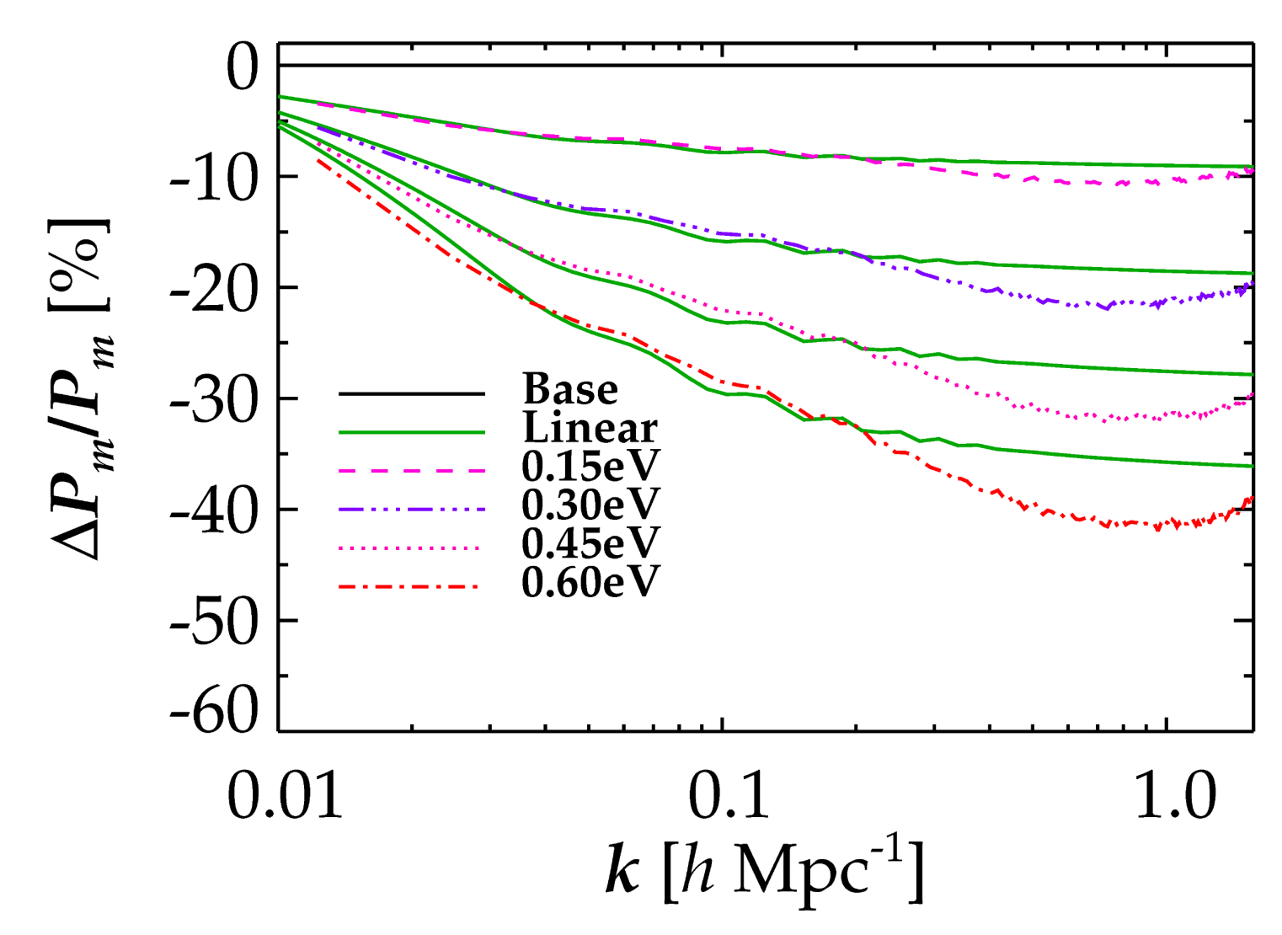
NON-LINEAR EVOLUTION PROVIDES AN ADDITIONAL SUPPRESSION OF
FLUCTUATION POWER DUE TO NEUTRINOS
LINEAR THEORY
FULL NON-LINEAR
Brandbyge, STH, Haugbølle, Thomsen, arXiv:0802.3700 (JCAP)

Slide 50
J. Brandbyge, S. Hannestad, T. Haugbølle and B. Thomsen, “The Effect of Thermal Neutrino
Motion on the Non-linear Cosmological Matter Power Spectrum,” JCAP 0808 (2008) 020
[arXiv:0802.3700 [astro-ph]].
M. Viel, M. G. Haehnelt and V. Springel, “The effect of neutrinos on the matter distribution as
probed by the Intergalactic Medium,” JCAP 1006 (2010) 015 [arXiv:1003.2422 [astro-ph.CO]].
S. Agarwal and H. A. Feldman, “The effect of massive neutrinos on the matter power
spectrum,” Mon. Not. Roy. Astron. Soc. 410 (2011) 1647 [arXiv:1006.0689 [astro-ph.CO]].
S. Bird, M. Viel and M. G. Haehnelt, “Massive Neutrinos and the Non-linear Matter Power
Spectrum,” Mon. Not. Roy. Astron. Soc. 420 (2012) 2551 [arXiv:1109.4416 [astro-ph.CO]].
F. Villaescusa-Navarro, F. Marulli, M. Viel, E. Branchini, E. Castorina, E. Sefusatti and
S. Saito, “Cosmology with massive neutrinos I: towards a realistic modeling of the relation
between matter, haloes and galaxies,” JCAP 1403 (2014) 011 [arXiv:1311.0866 [astro-ph.CO]].
E. Castorina, C. Carbone, J. Bel, E. Sefusatti and K. Dolag, “DEMNUni: The clustering of
large-scale structures in the presence of massive neutrinos,” JCAP 1507 (2015) no.07, 043
[arXiv:1505.07148 [astro-ph.CO]].
J. D. Emberson et al., “Cosmological neutrino simulations at extreme scale,” Res. Astron.
Astrophys. 17 (2017) no.8, 085 [arXiv:1611.01545 [astro-ph.CO]].
J. Adamek, R. Durrer and M. Kunz, “Relativistic N-body simulations with massive neutrinos,”
JCAP 1711 (2017) no.11, 004 [arXiv:1707.06938 [astro-ph.CO]].
J. Brandbyge and S. Hannestad, “Grid Based Linear Neutrino Perturbations in Cosmological
N-body Simulations,” JCAP 0905 (2009) 002 [arXiv:0812.3149 [astro-ph]].
Y. Ali-Haimoud and S. Bird, “An efficient implementation of massive neutrinos in non-linear
structure formation simulations,” Mon. Not. Roy. Astron. Soc. 428 (2012) 3375
[arXiv:1209.0461 [astro-ph.CO]].
J. Liu, S. Bird, J. M. Z. Matilla, J. C. Hill, Z. Haiman, M. S. Madhavacheril, A. Petri and
D. N. Spergel, “MassiveNuS: Cosmological Massive Neutrino Simulations,” arXiv:1711.10524
[astro-ph.CO].
J. Brandbyge and S. Hannestad, “Resolving Cosmic Neutrino Structure: A Hybrid Neutrino
N-body Scheme,” JCAP 1001 (2010) 021 [arXiv:0908.1969 [astro-ph.CO]].
+many others

Slide 51
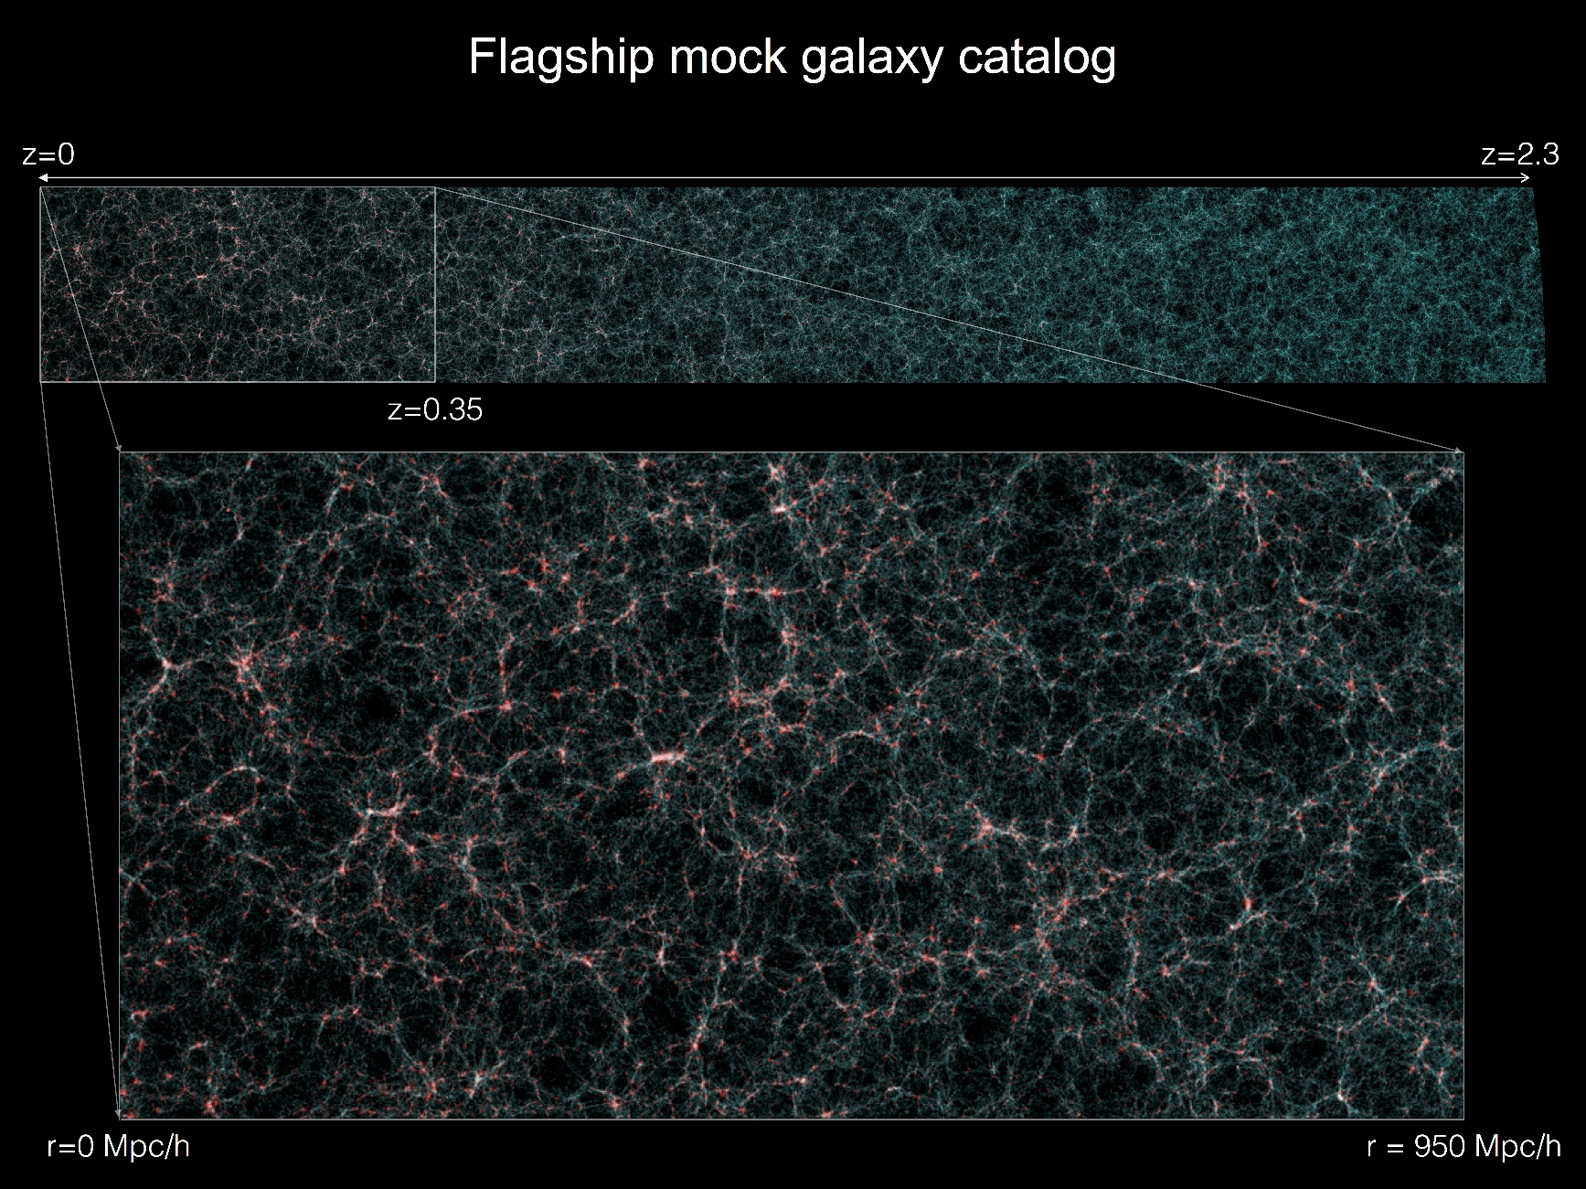
EUCLID ”flagship 2.0 run”: 4x10¹² particles in 4Gpc side-length box
(run spring 2019 on Piz Daint, Swiss HPC centre (under PRACE scheme),
using PKDGRAV3 with modifications developed using the
CONCEPT N-body code https://github.com/jmd-dk/concept)

Slide 52
Tram et al. 1811.00904 (fully compatible with GR at the linear level)

Slide 53
CONCLUSIONS
NEUTRINO PHYSICS IS PERHAPS THE PRIME EXAMPLE OF HOW
TO USE COSMOLOGY TO DO PARTICLE PHYSICS
THE BOUND ON NEUTRINO MASSES IS SIGNIFICANTLY
STRONGER THAN WHAT CAN BE OBTAINED FROM DIRECT
EXPERIMENTS, ALBEIT MUCH MORE MODEL DEPENDENT
COSMOLOGICAL DATA SHOWS NO EVIDENCE FOR NEW
PHYSICS. HOWEVER, IF eV STERILE NEUTRINOS EXIST THERE
MUST BE NEW PHYSICS IN ORDER TO RECONCILE THEM WITH
COSMOLOGY
NEW DATA FROM PLANCK AND EUCLID WILL PROVIDE A
POSITIVE DETECTION OF A NON-ZERO NEUTRINO MASS

