Slide 1
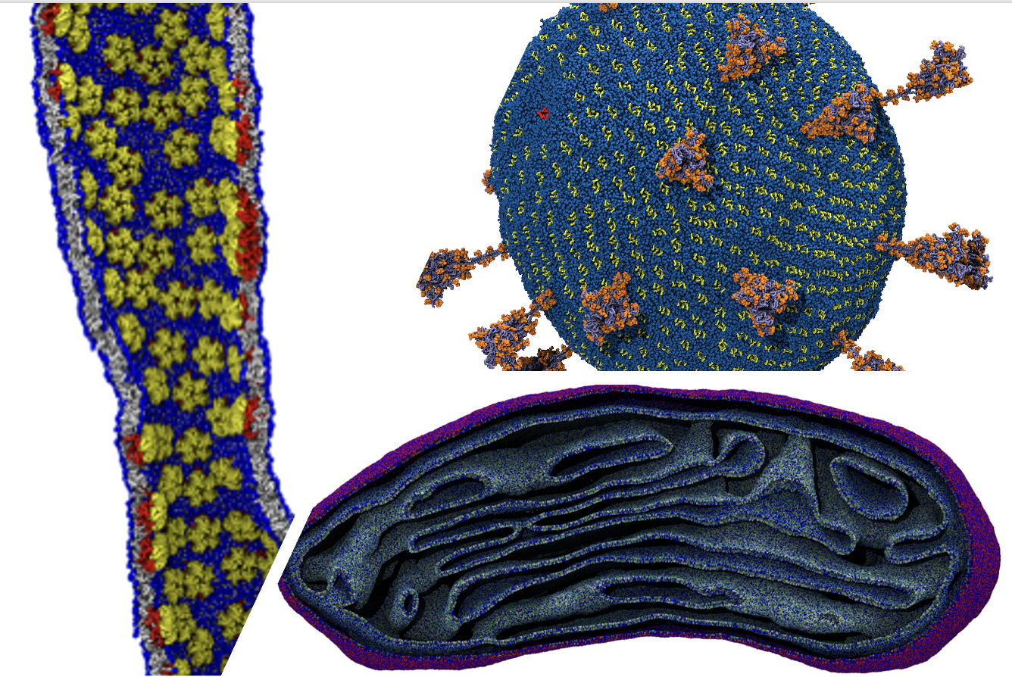
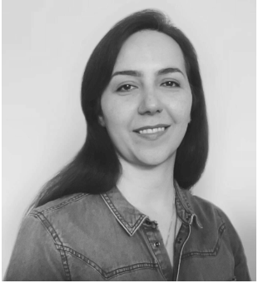
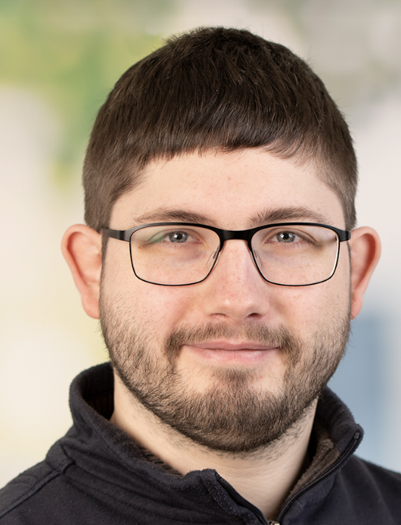
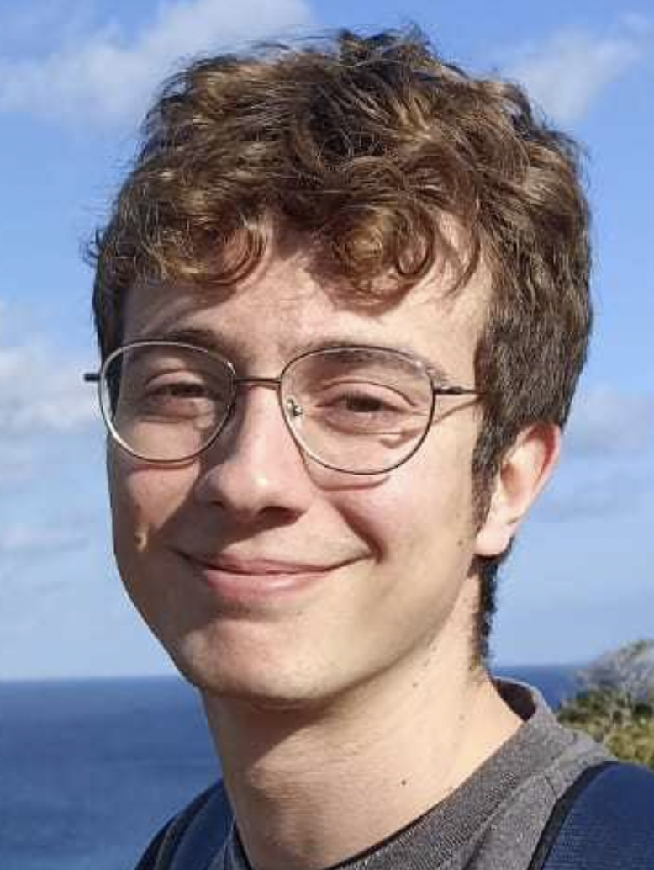
Computational Microscopy bridging the gap between simple models and complex reality
Group Leader
Weria Pezeshkian (weria.pezeshkian@nbi.ku.dk)
Computational Microscopy Group
Current members
Neda Rahmani
Fabian Schuhmann
Adrià B. Vidal

Slide 2
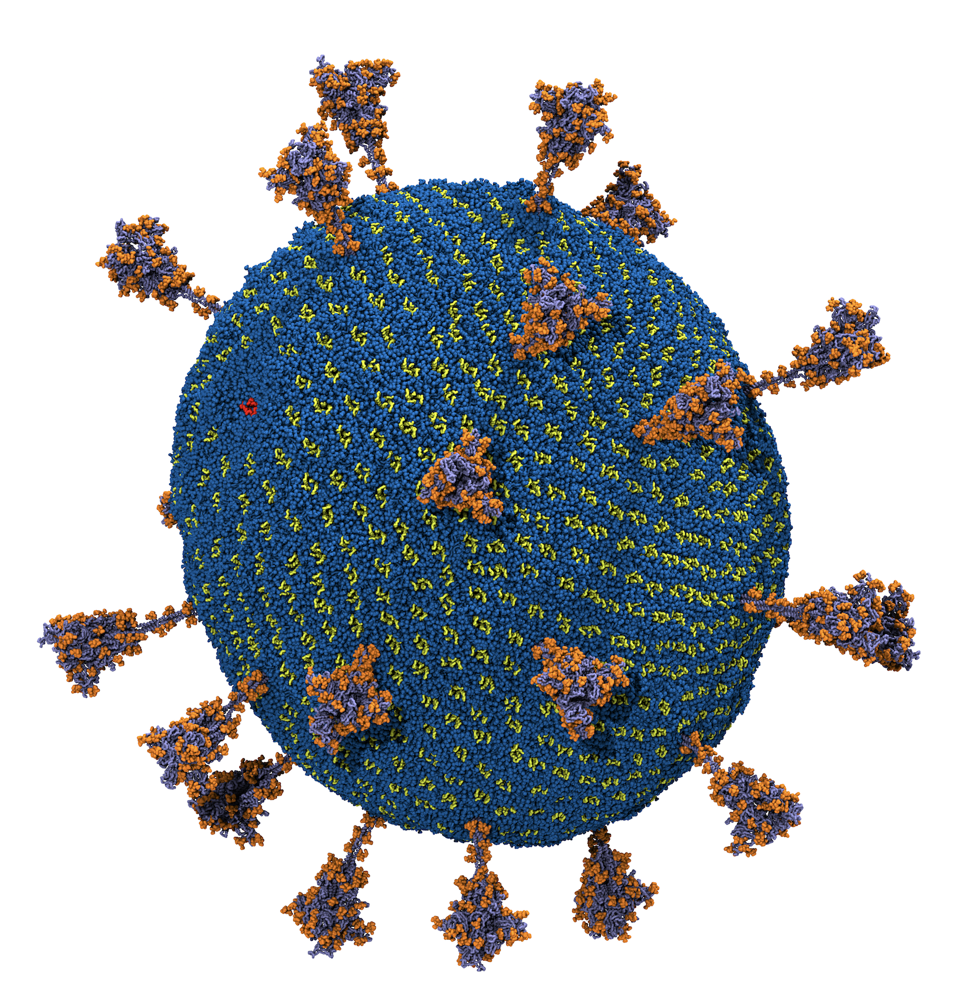
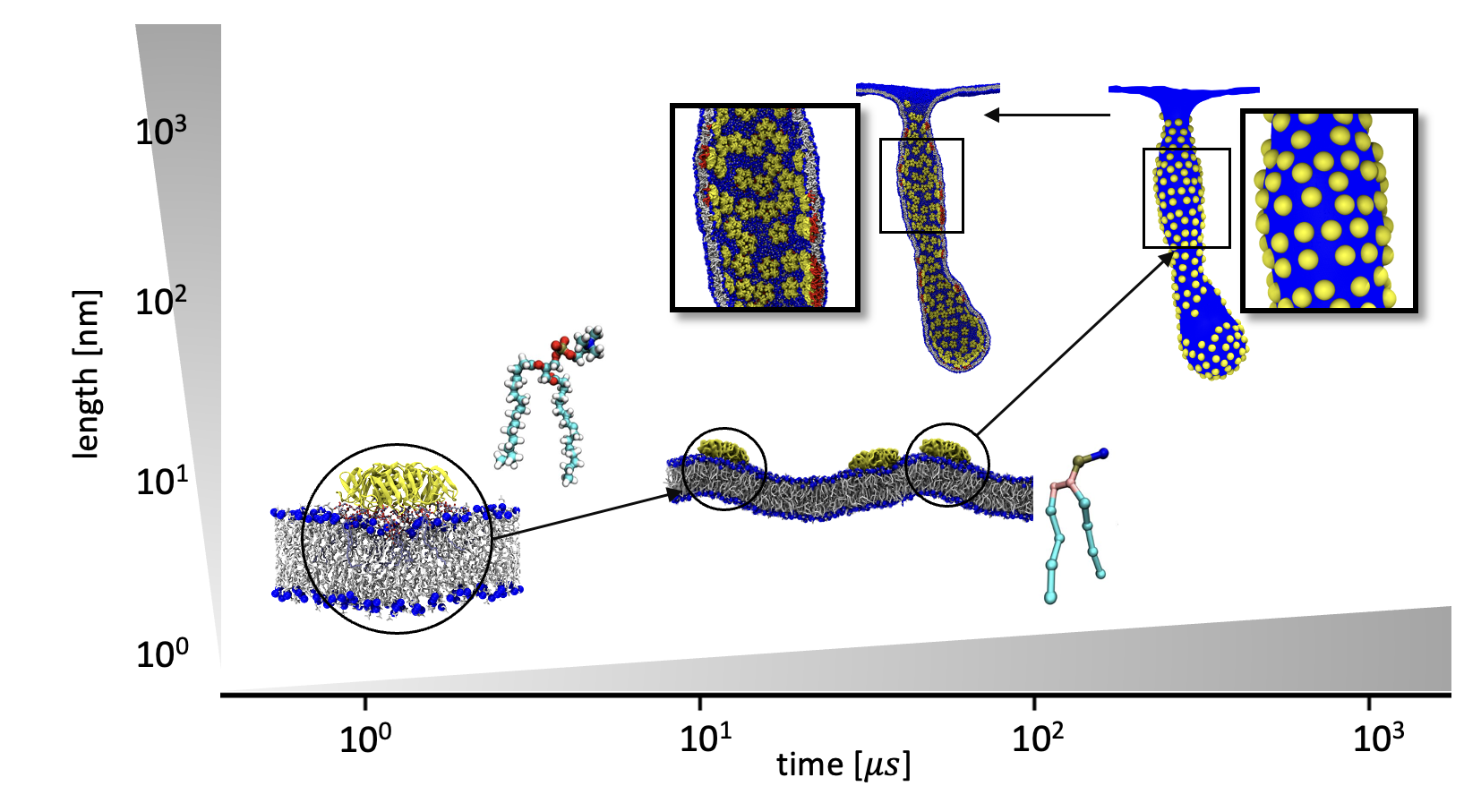
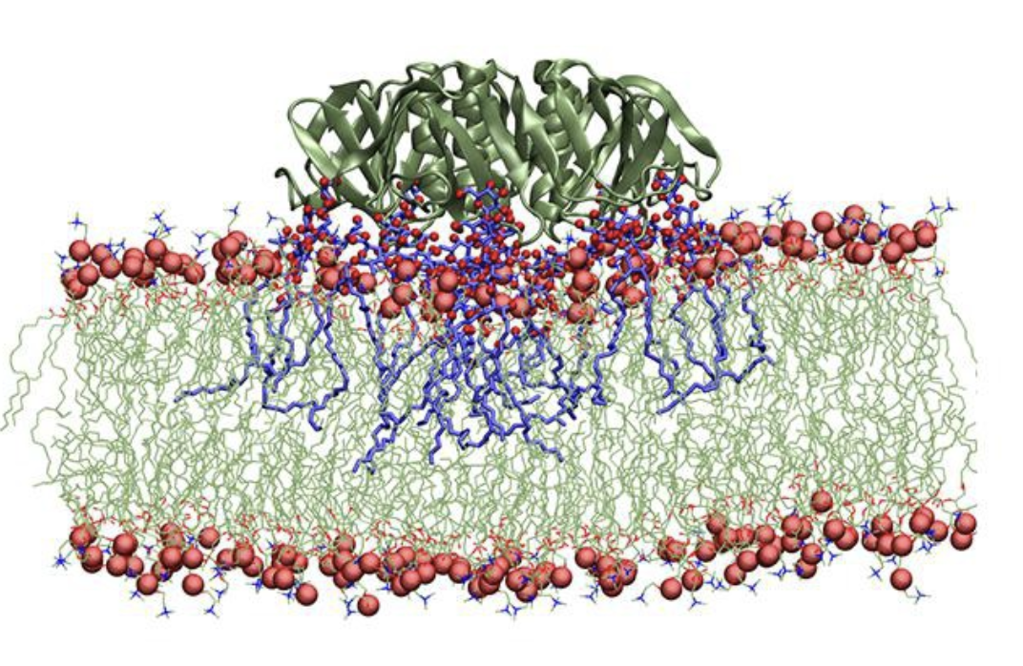
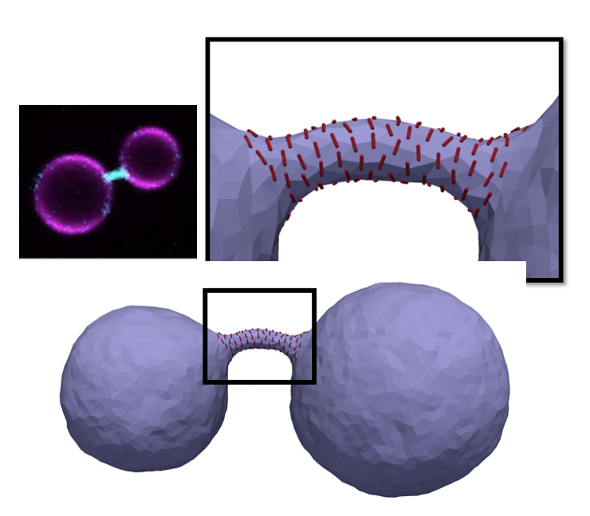
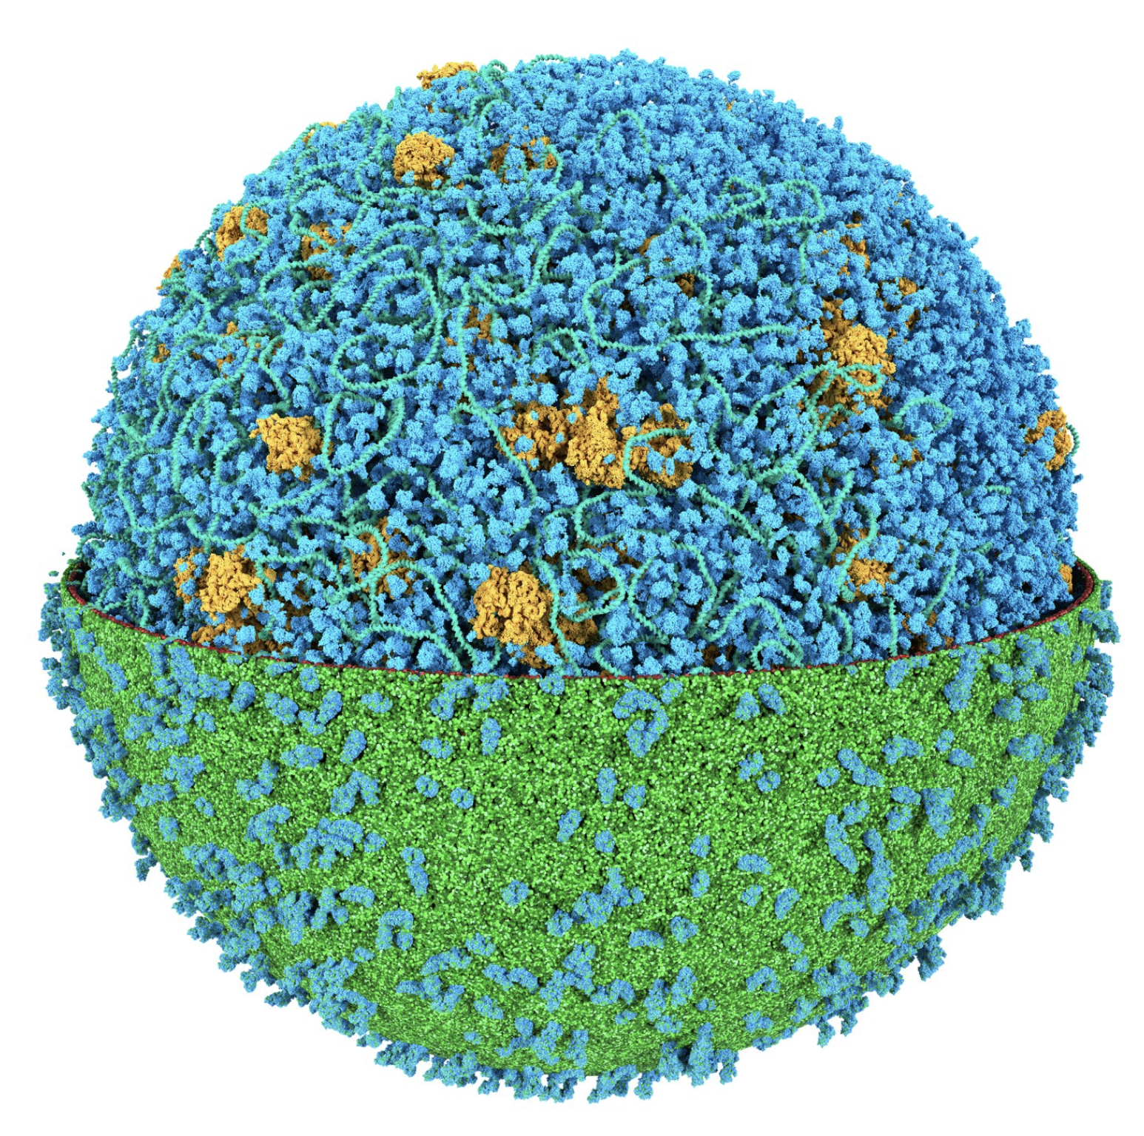
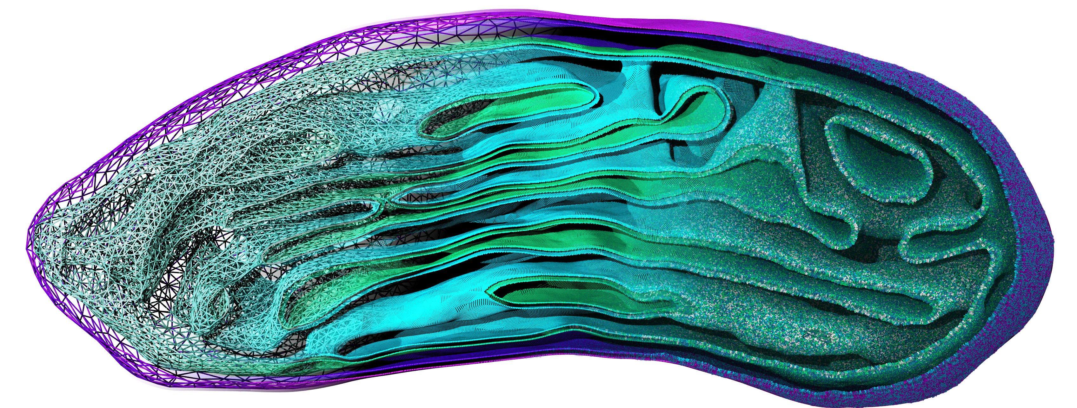
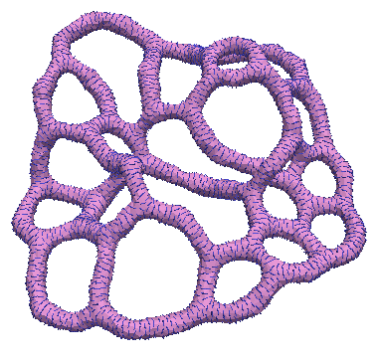
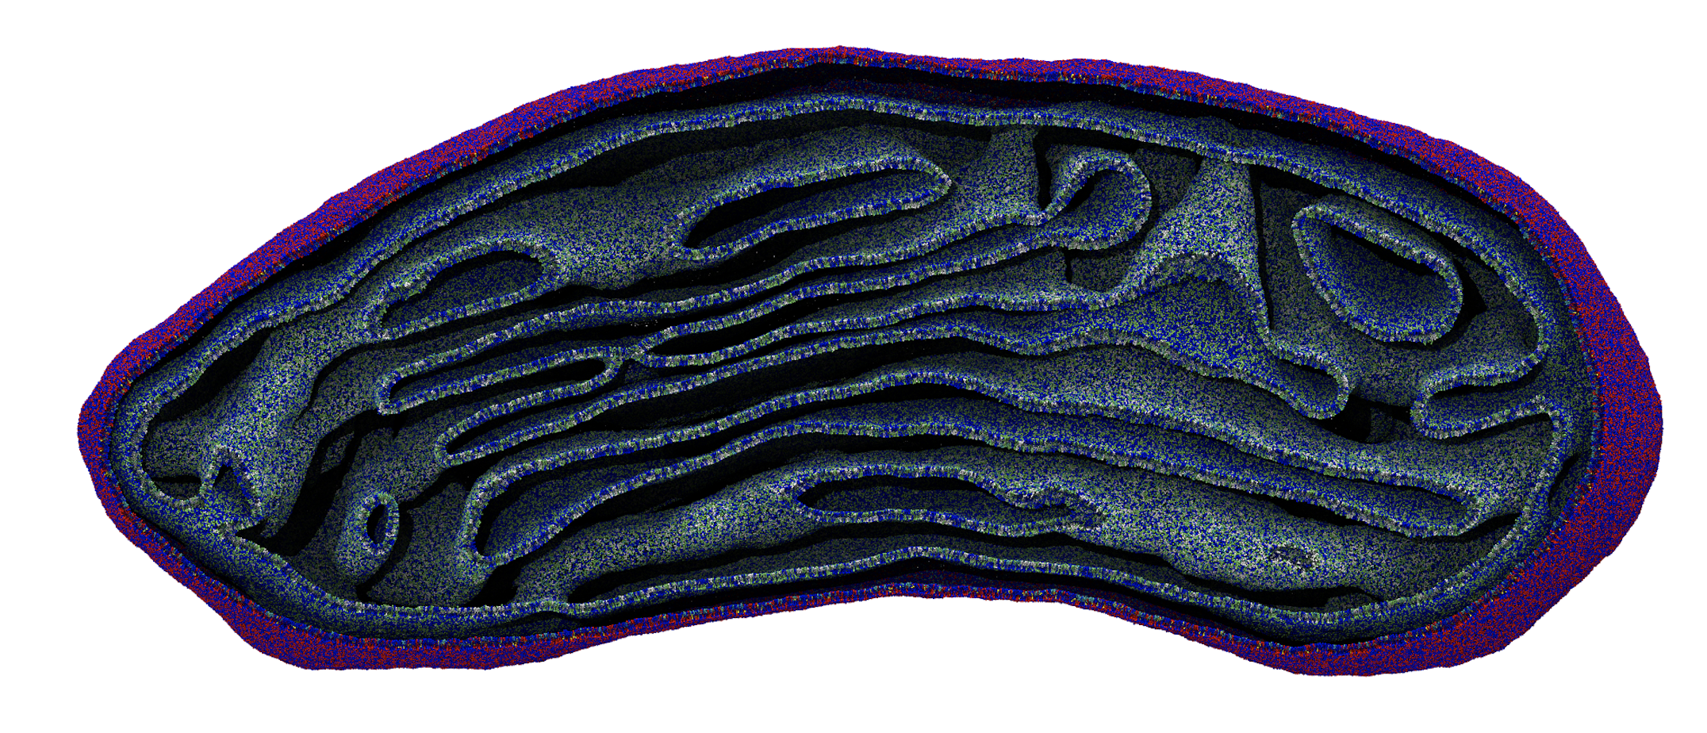
Research topics
Development
virial and toxic particles
multiscale simulations scheme
Computational Microscopy
FreeDTS: mesoscale simulation software
cell division
TS2CG: structure builder for next generation MD simulations
emergence of intracellular forms

Slide 3
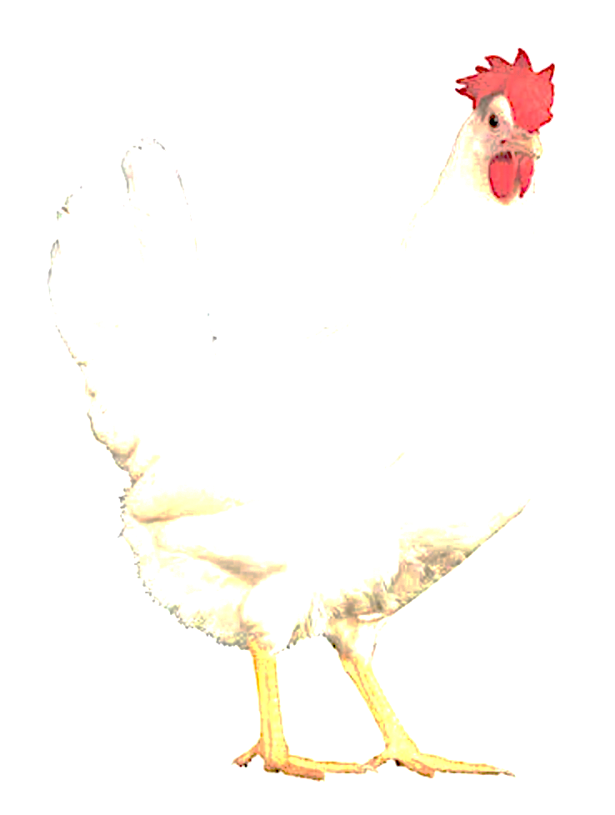
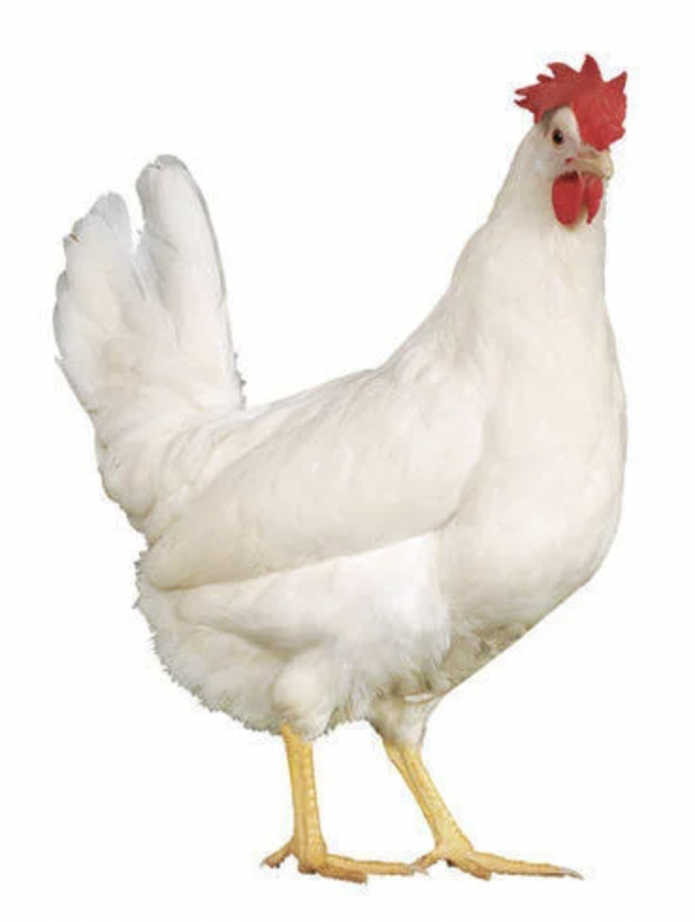
Why is important
Scientific knowledge emerges from results by different methodologies.
chicken
simulation
experiment

Slide 4
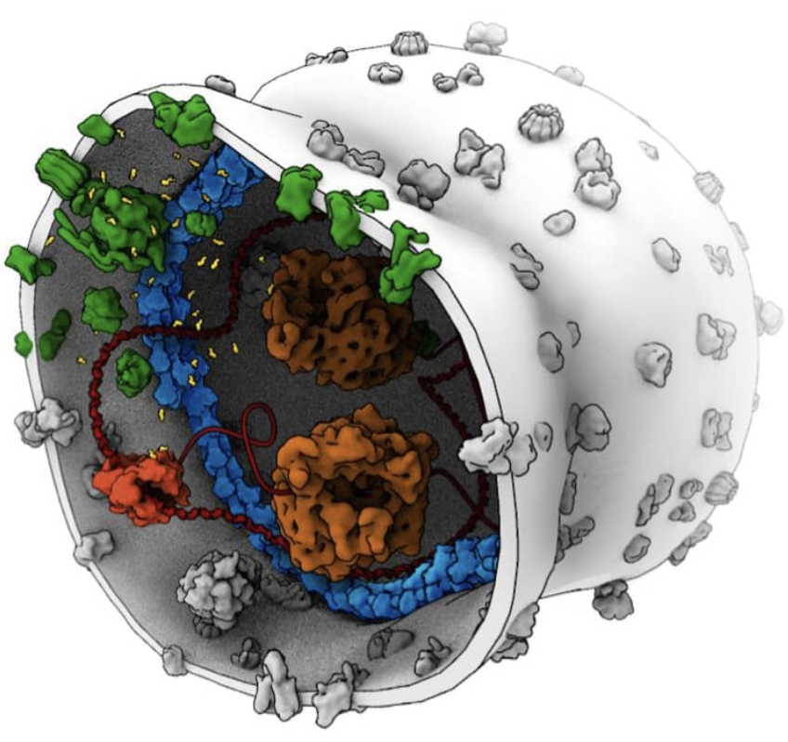
Division of artificial cells
https://www.syntheticcell.eu/

Slide 5
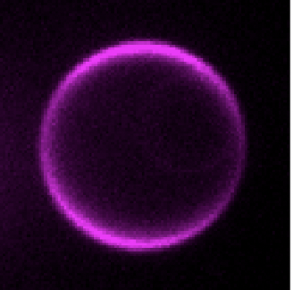
Division of an artificial cell
+
De Franceschi et al, ACS Nano (2023)

Slide 6
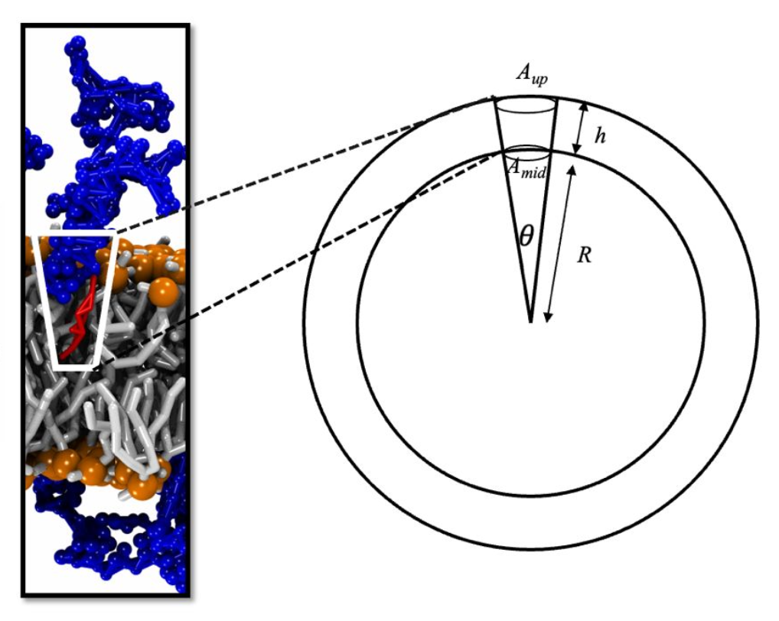
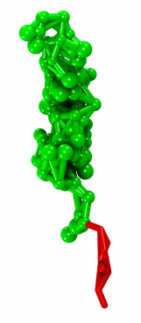
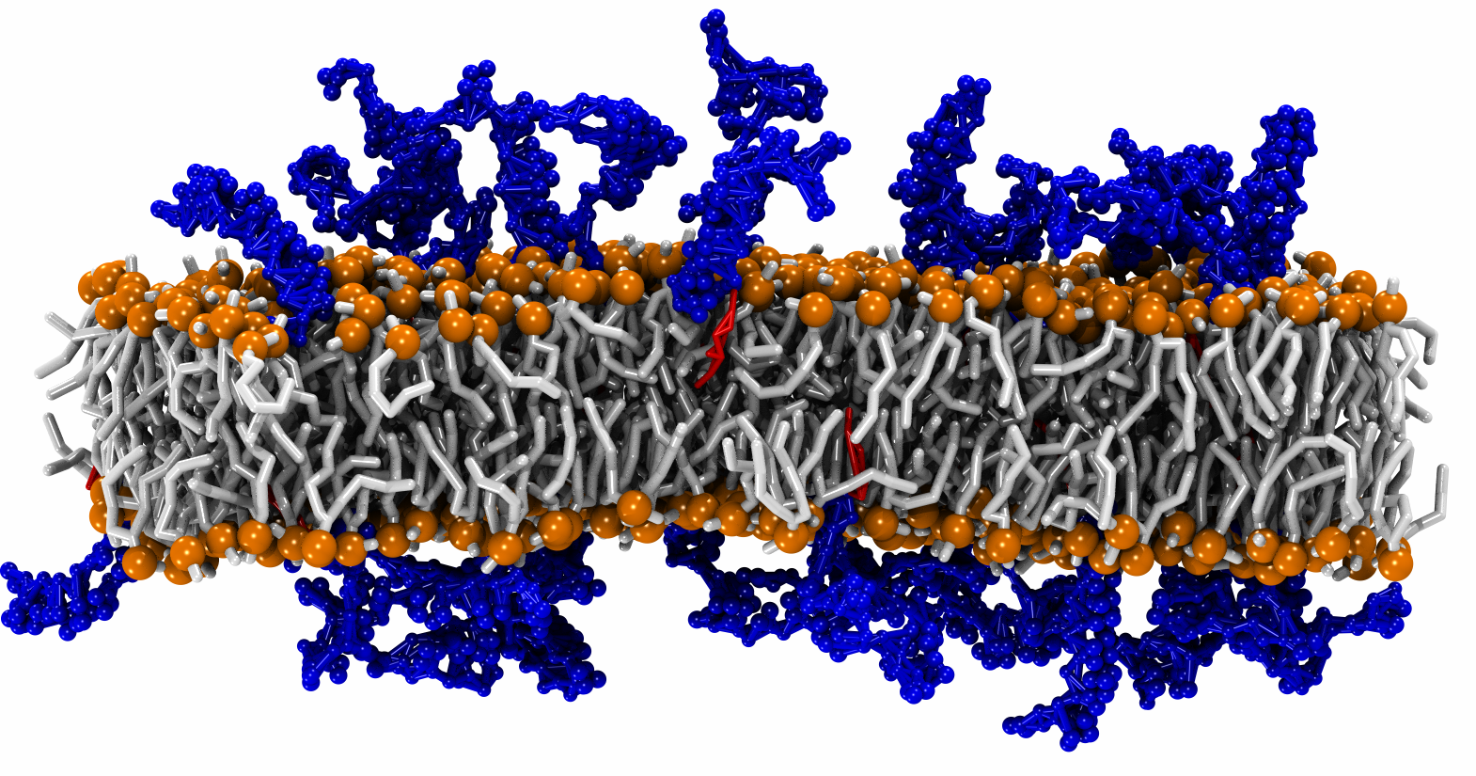
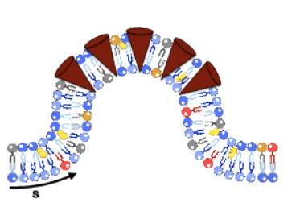
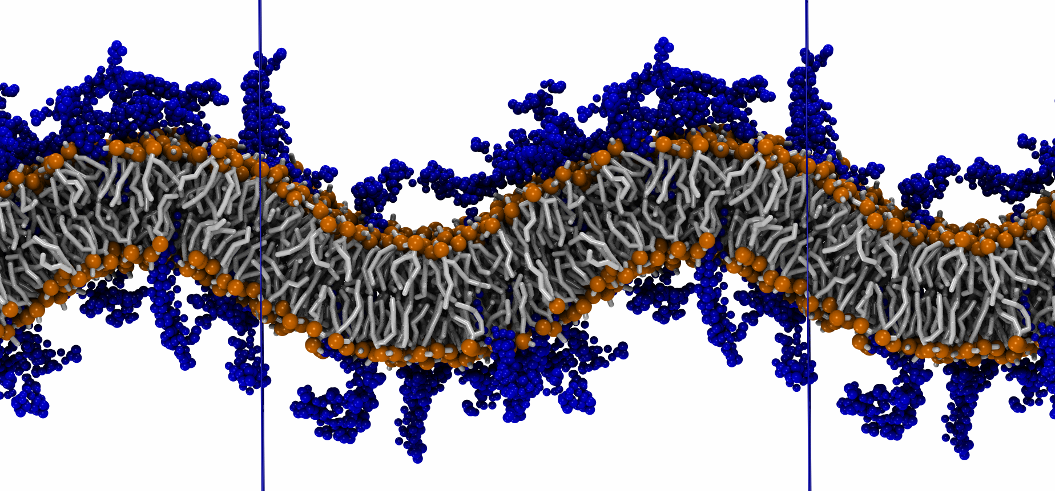
Shaping membranes
De Franceschi et al, ACS Nano (2023)

Slide 7
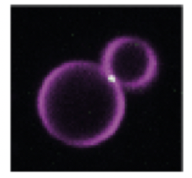
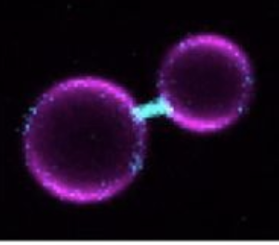
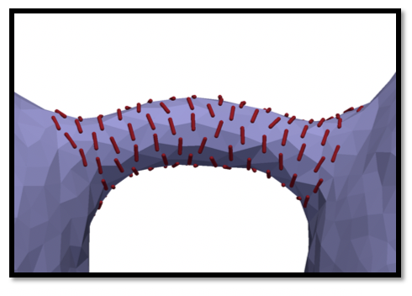
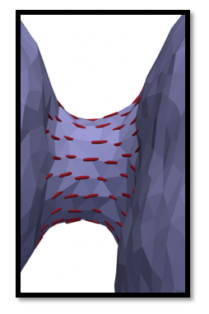
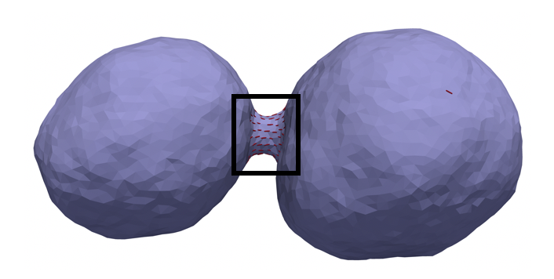
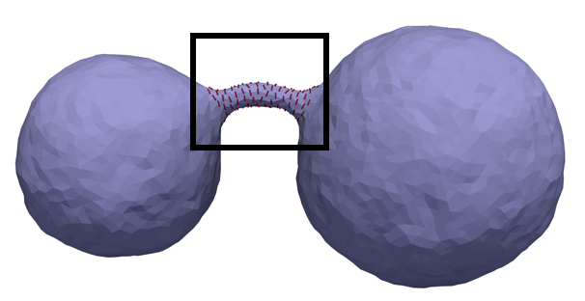
Recruitment of enzymatic proteins
negative curvature: binding from inside
positive curvature: binding from inside
N. D. Franceschi et al, ACS Nano (2023)

Slide 8
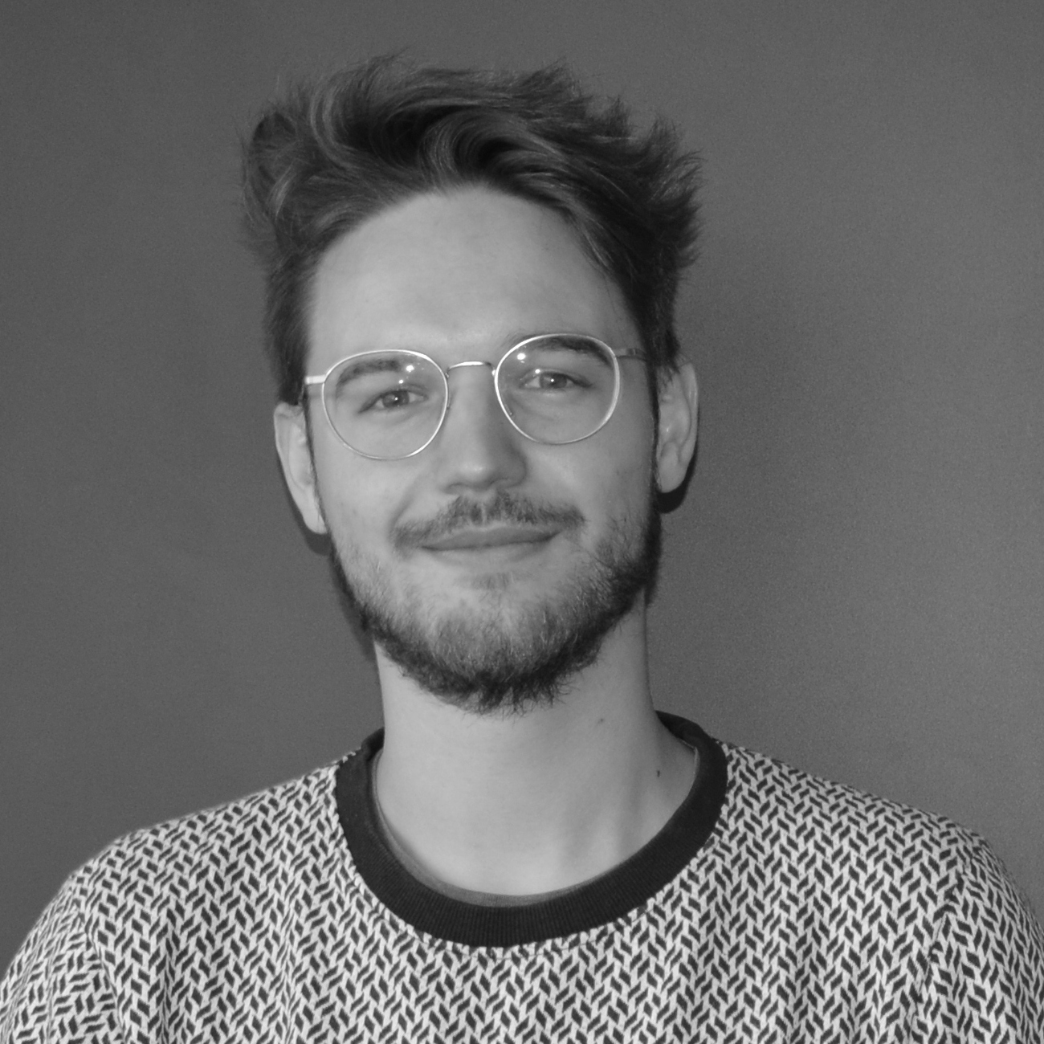
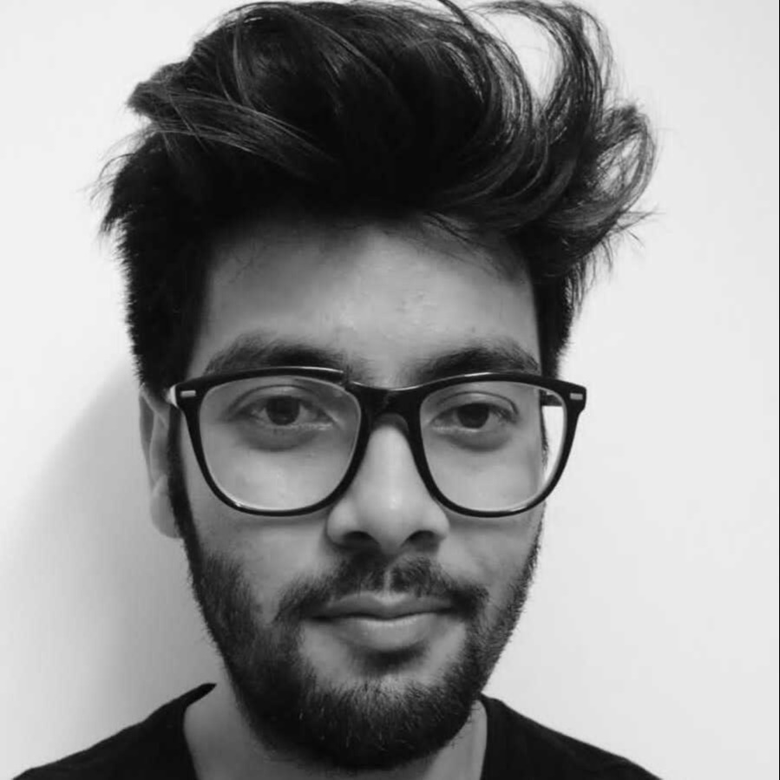
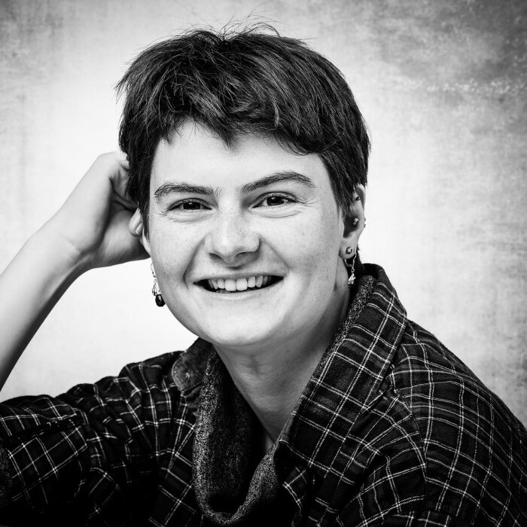
NBIA MSc Day 2023: Non-equilibrium statistical mechanics
Karel Proesmans
Group members:
Jonas Berx
Prashant Singh
Dana Kamp

Slide 9
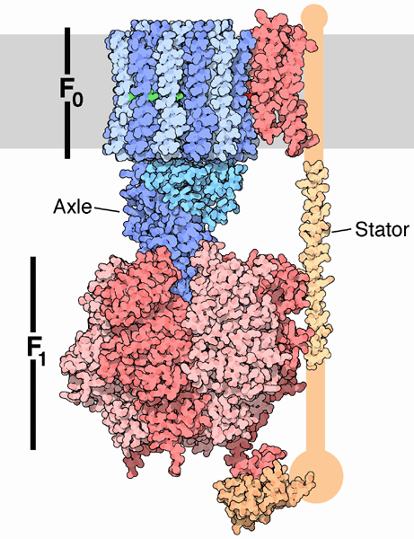
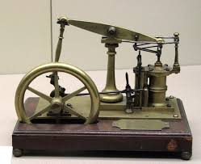
Introduction: non-equilibrium statistical mechanics and stochastic thermodynamics
Classical thermodynamics: steam engine
Stochastic thermodynamics: ATP synthase

Slide 10
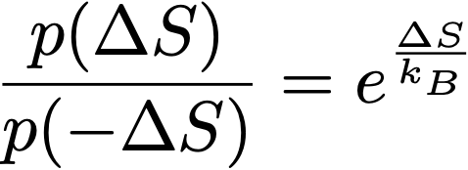
Introduction: stochastic thermodynamics
Classical thermodynamics: Second law
Stochastic thermodynamics: Fluctuation theorem

Slide 11
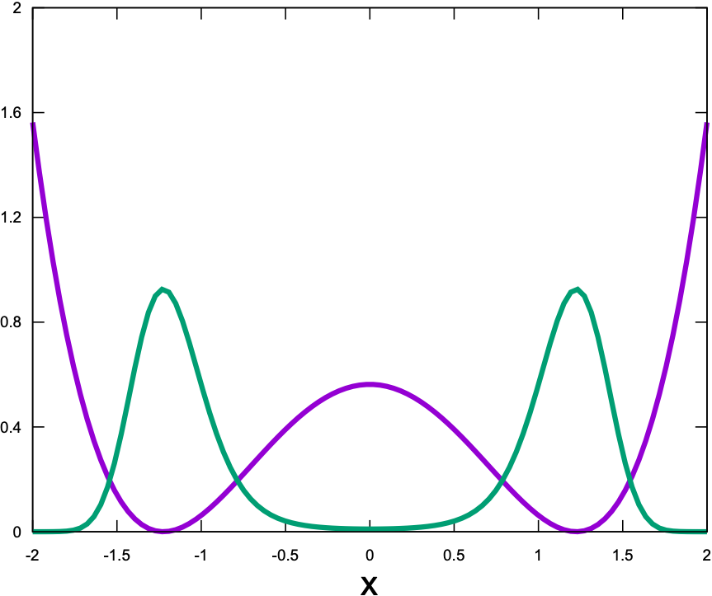
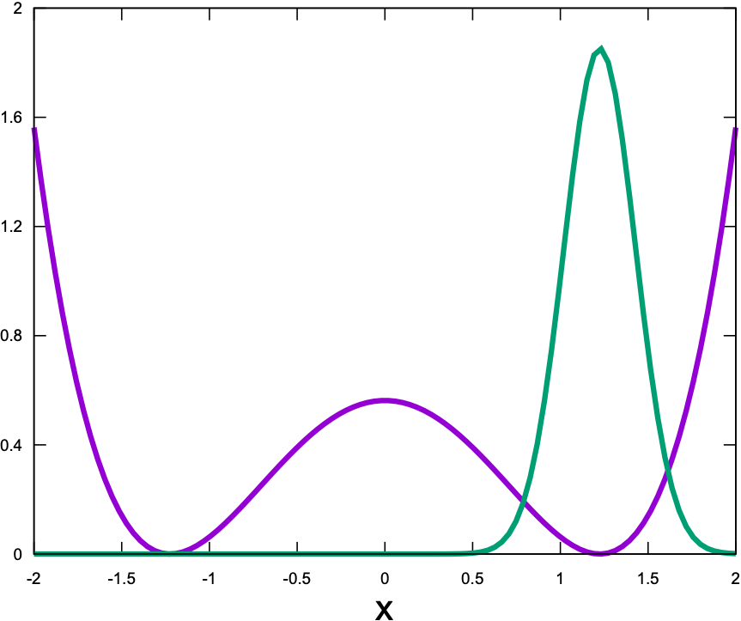
Possible projects: Machine learning optimal bit erasure
Landauer limit:
Limits under limited control (electronic+biological applications)
Machine-learning based methods

Slide 12
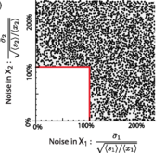
Possible projects: optimal protocols
Derive new no-go theorems for thermodynamic processes
Example:

Slide 13
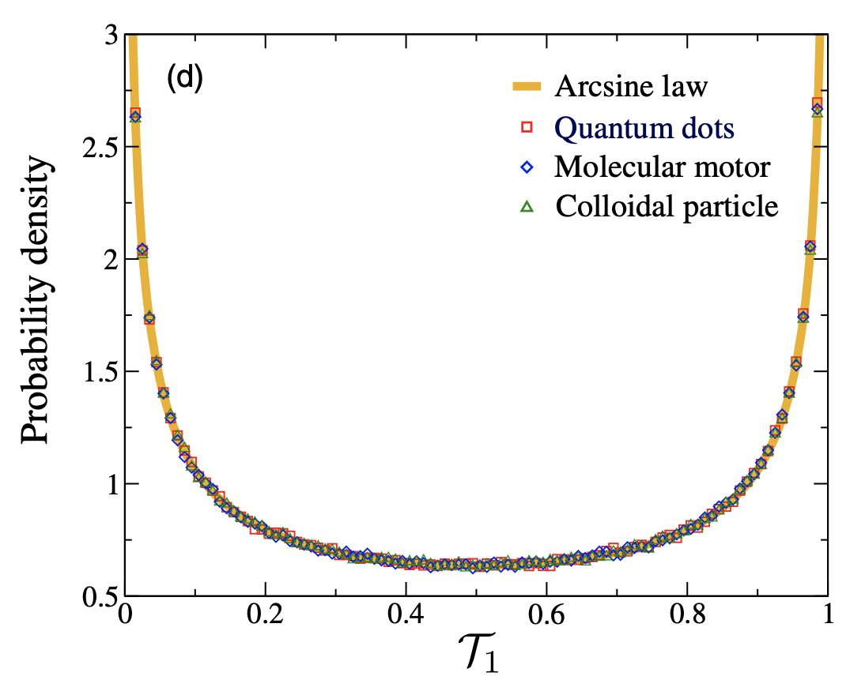
Possible projects: arcsine laws for chemical reaction networks
Arcsine laws
Applications to chemical reaction networks

Slide 14
Questions?

