Slide 1
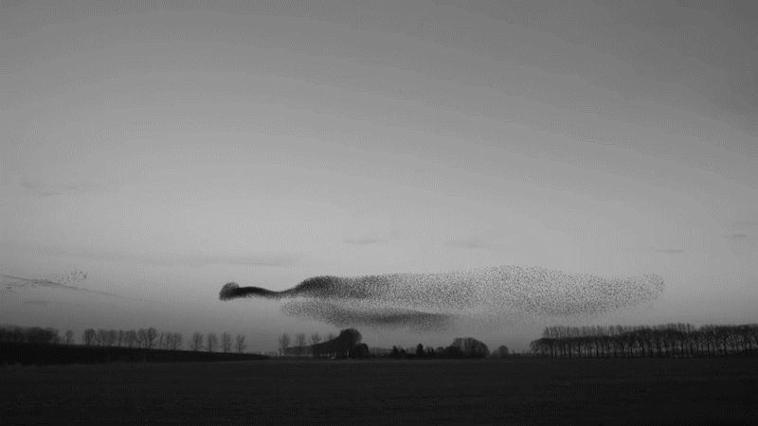

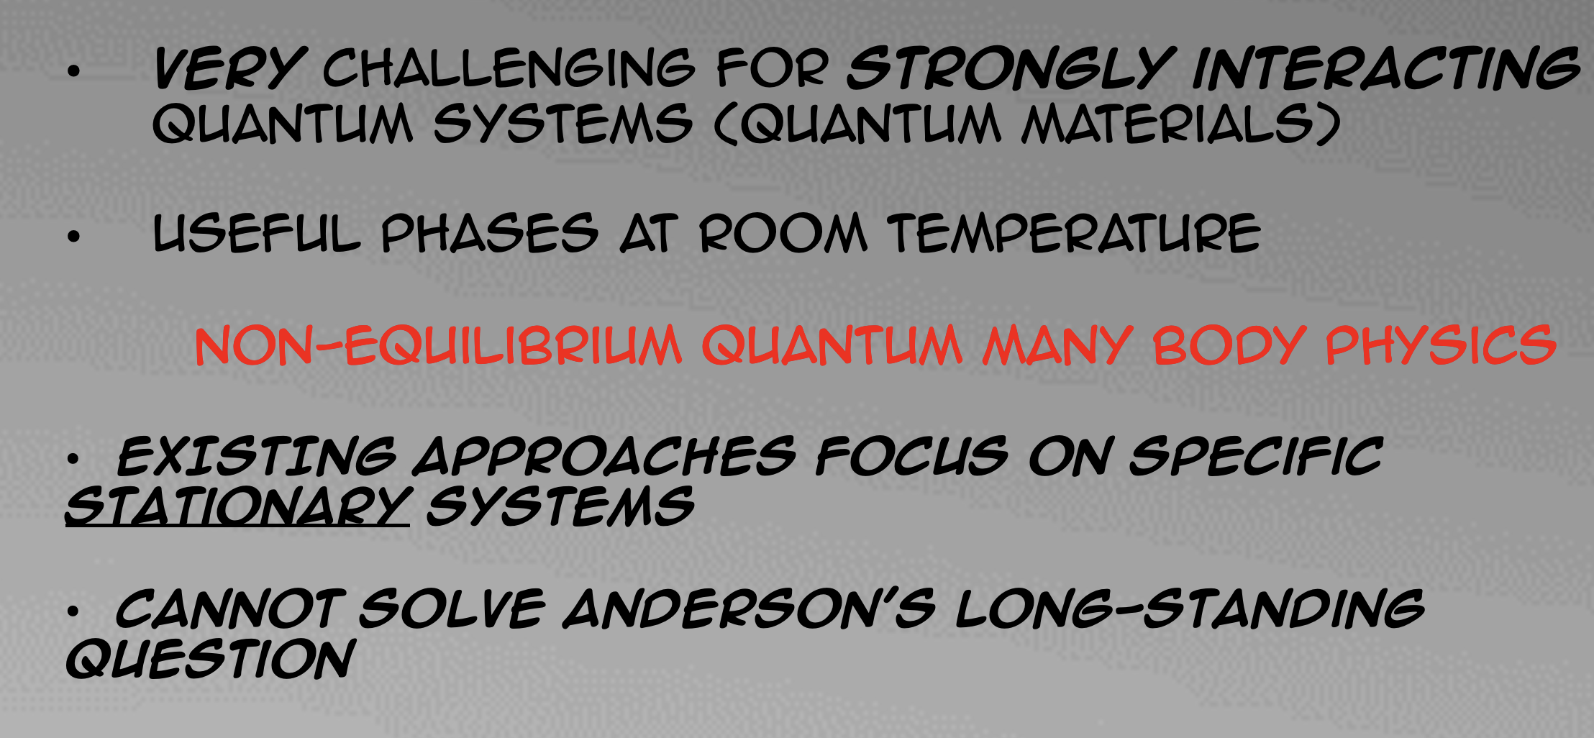
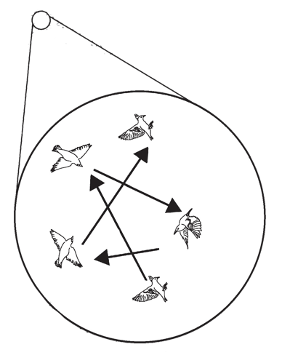
The challenge
Difficulty and importance
Very challenging for strongly interacting quantum systems (quantum materials)
Useful phases at room temperature
non-equilibrium quantum many body physics
EXISTING approaches focus on specific
stationary systems
cannot solve Anderson’s long-standing
question
Notes:
One very old challenge that has not been directly tackled except very recently is a question posed by Nobel laureate P.W. Anderson – how can we compute complex dynamics directly for the fundamental quantum laws. This flock of birds displays murmuration, a typical complex dynamical phenomenon. Computing dynamics of quantum systems exactly is impossible except for very small quantum systems, in particular it is hard for the types of systems seen in condensed matter physics such as strongly interacting materials. Limited existing approaches in non-equilibrium quantum many-body physics focus on studying system that relax to stationarity quickly, i.e., thermalize or equilibrate quickly. These non-universal approaches cannot solve Anderson’s question.

Slide 2


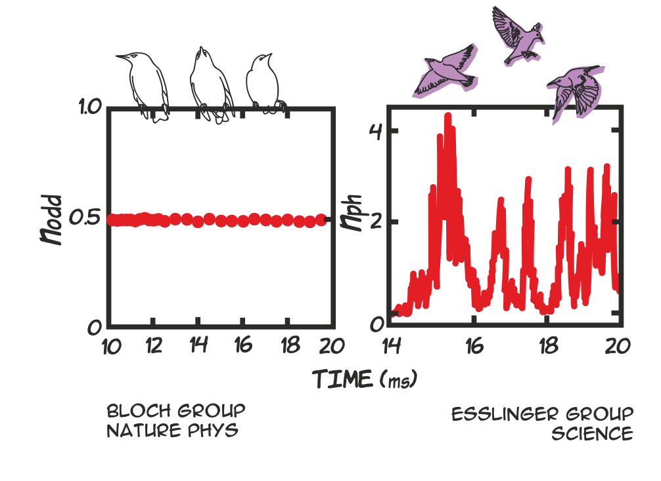

A=
+
+ …
﻿BB et al. Nat. Comm. 10 1730 (2019)
Notes:
However, a few years ago Berislav Buca developed an approach that is based on coarse graining all the irrelevant microscopic degrees of freedom in a many body quantum system using a simple algebraic relation shown above, which is like a raising operator relation, but for an extensive operator A. These relations are called dynamical symmetries.

Slide 3


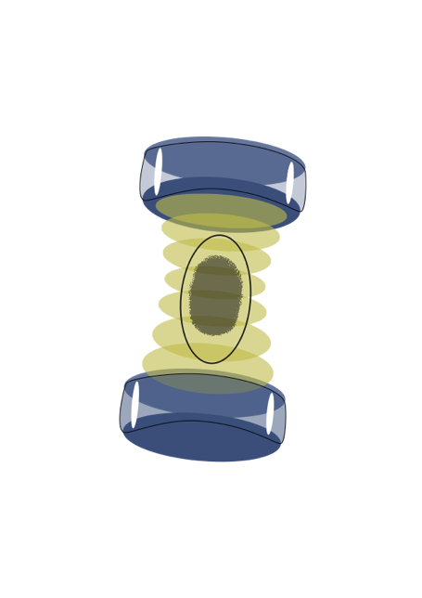

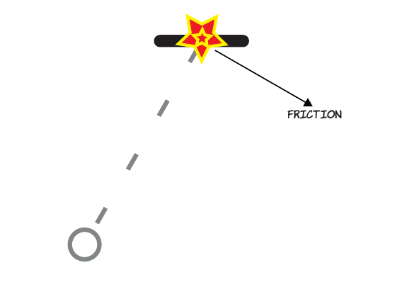
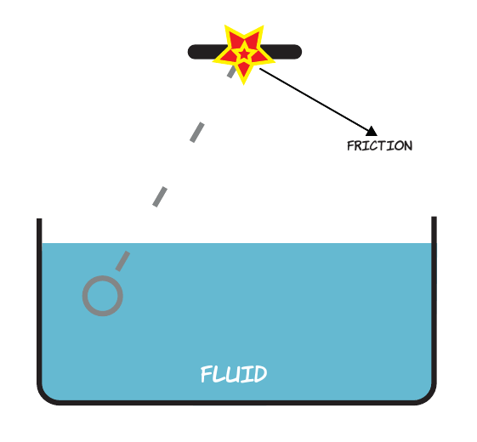
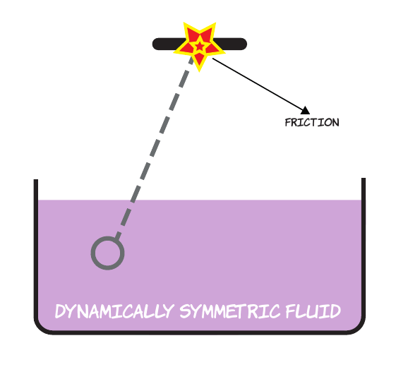

Example of a new phase of matter: Dissipative time crystal
Quantum gas In an optical cavity
Analogy
Notes:
Several experiments have been both proposed and studied using dynamical symmetry-based methods. Including a BEC gas in an optical cavity that is strongly lossy. Due to this dissipation the cavity light field displays persistent complex dynamics. Much like a counterintuitive pendulum that does not stop swinging because it is experiencing friction. Systems that display such persistent dynamics because of friction, are called “dissipative time crystals”. Likewise, recent experiments on transient light induced superconductivity above critical temperature can be understood and analysed. Finishing this line of investigation is very important because of the potential to realize light induced room temperature superconductivity and novel technologies such as levitating vehicles.

Slide 4


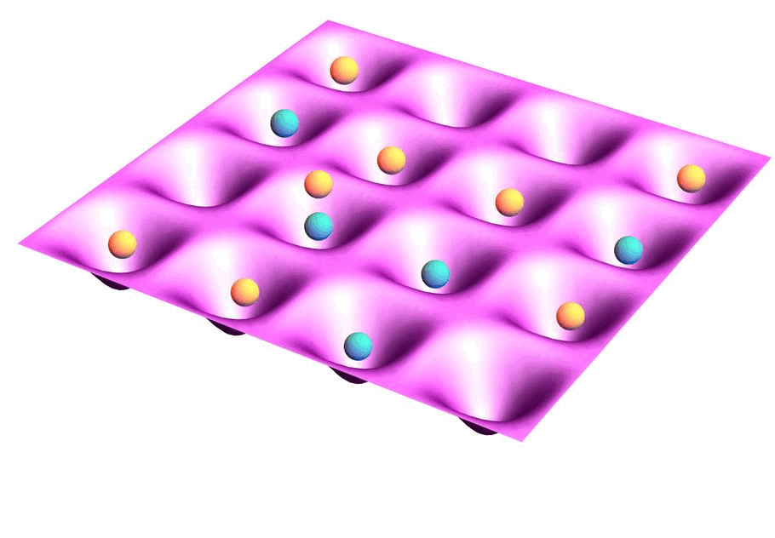
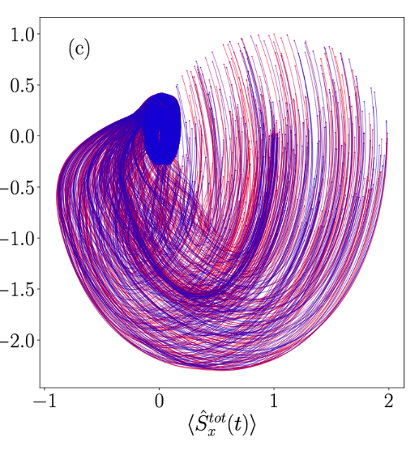




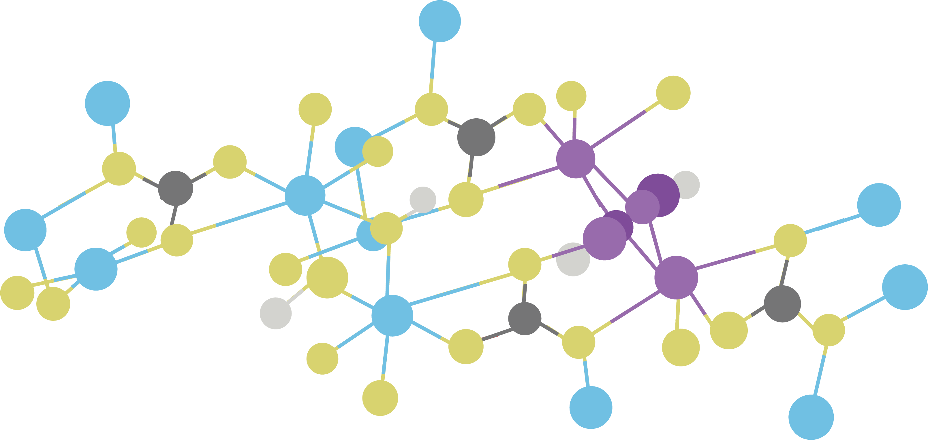
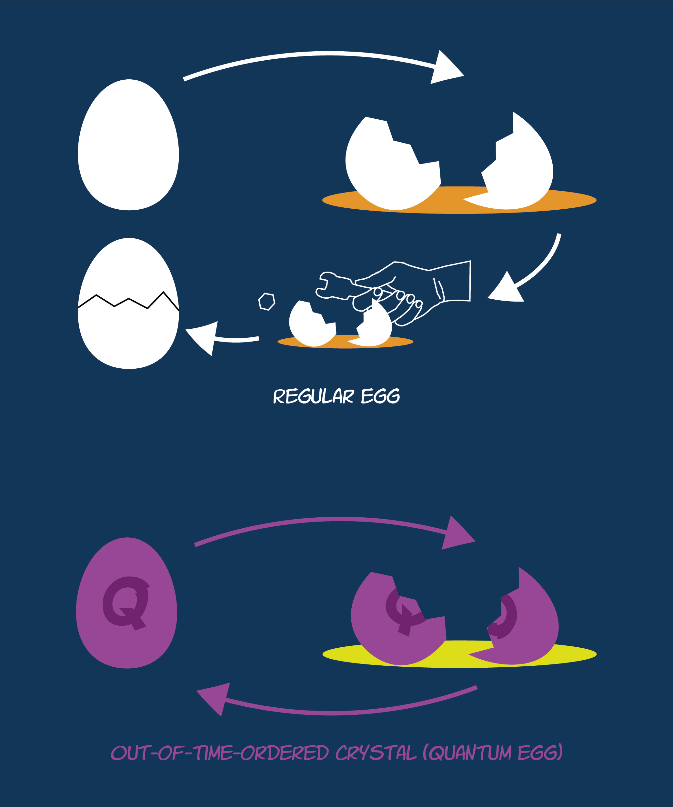
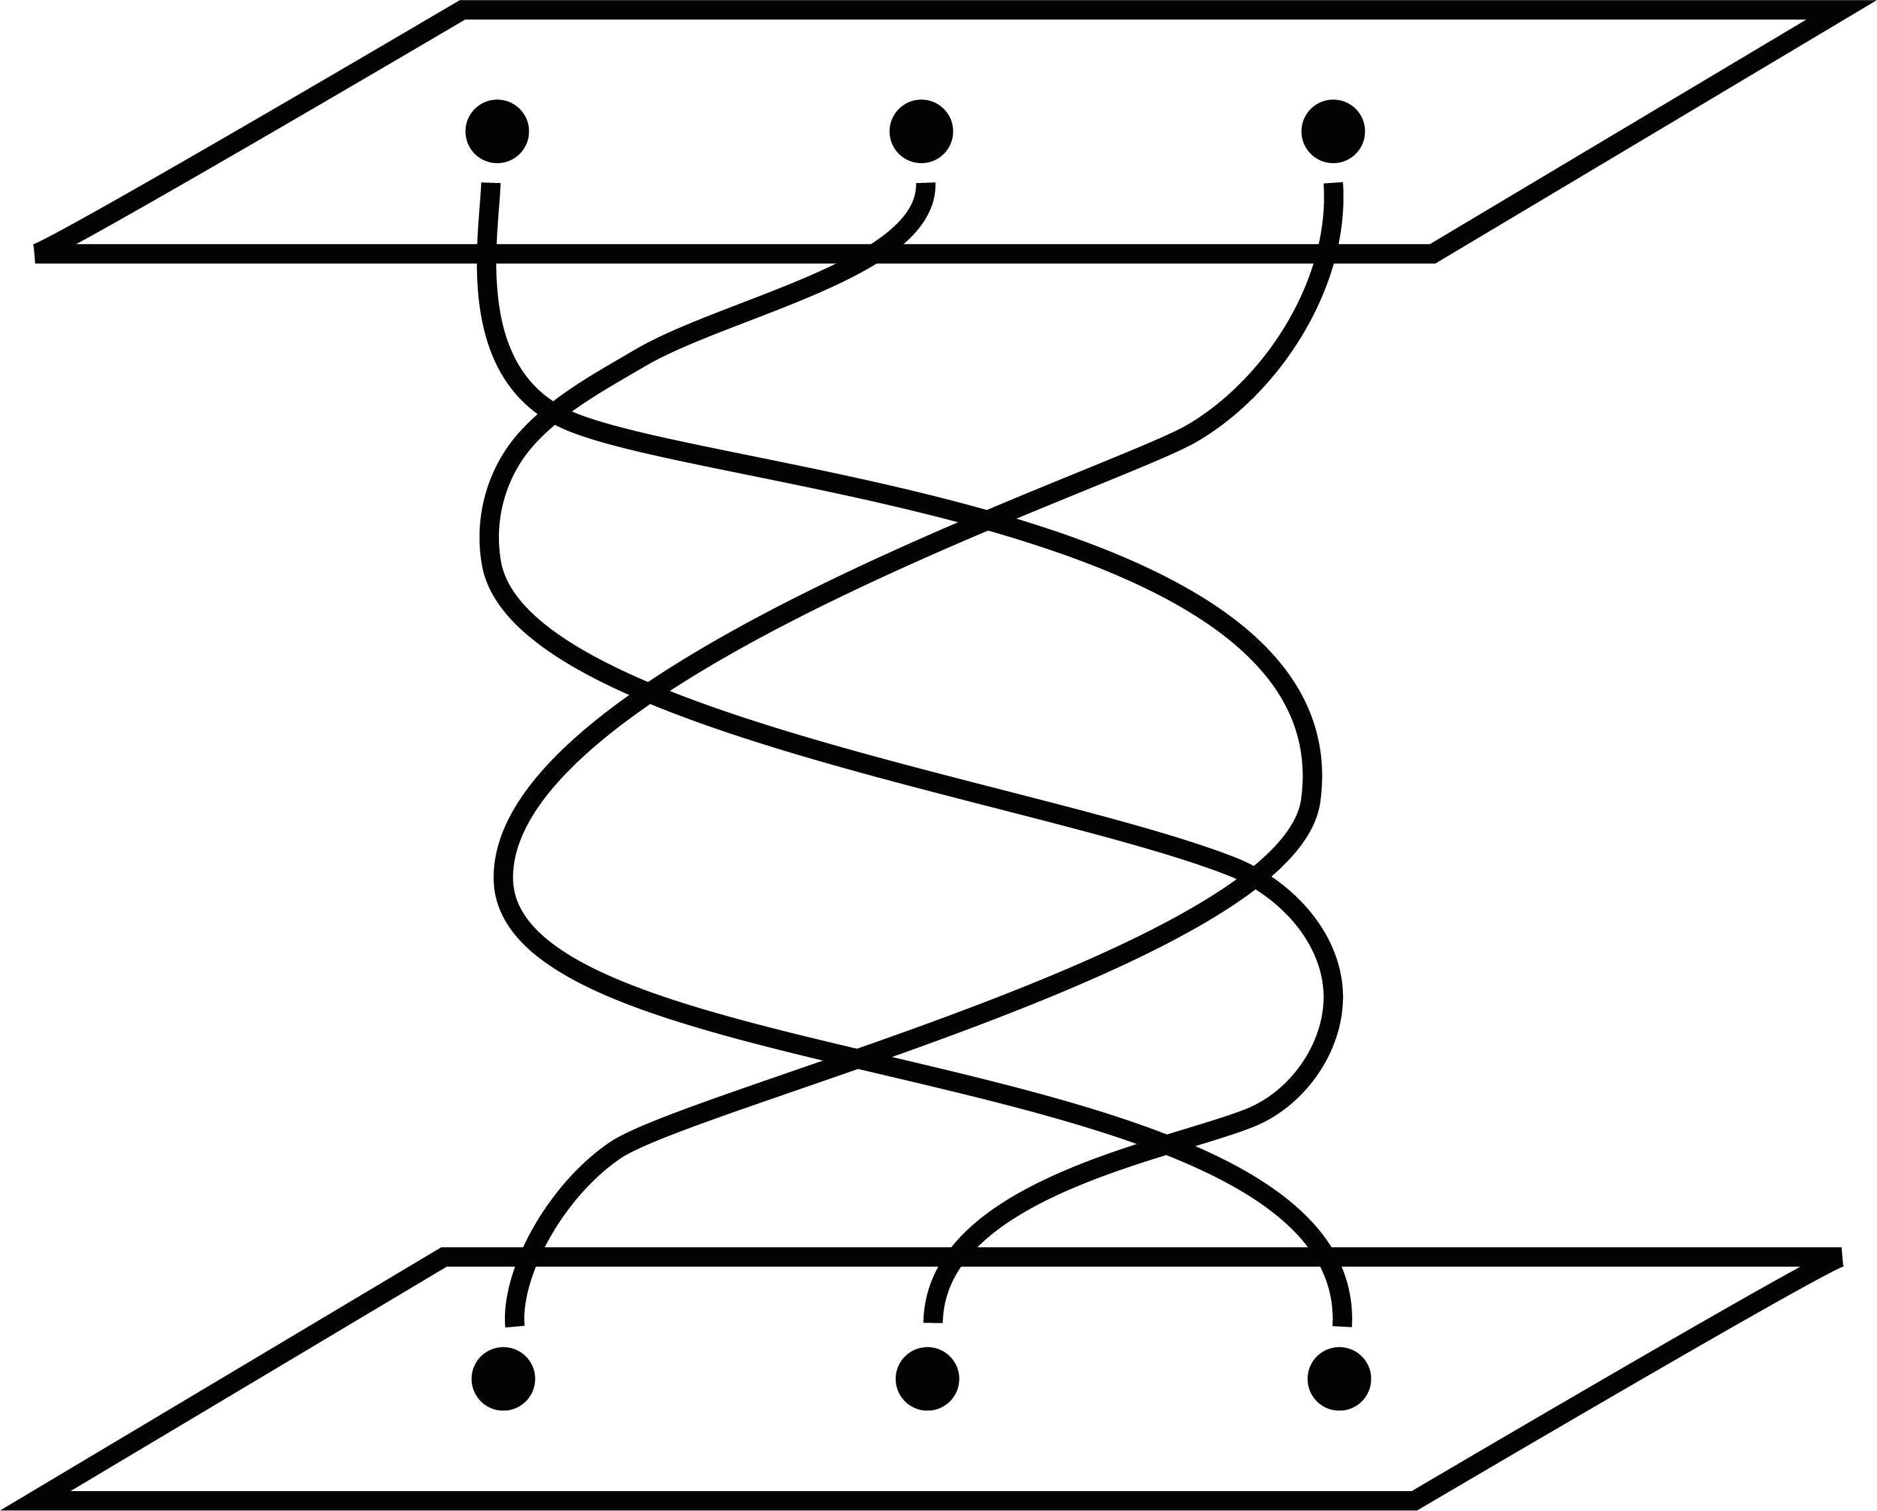

Dissipative (dissipation induced) time crystals
﻿quantum complex dynamics
BEC
Example from quantum optics
Fermions with two spin states experiencing dephasing from a spin-agnostic BEC
Stabilized quantum coherence
and stranger still
t
1
t
0
Notes:
But this approach has only been implemented and there is much more that can be studied using dynamical symmetries. Including genuinely more complex dynamics on the quantum level, new ways to protect quantum information at high temperatures, and even stranger forms of matter that can never exist at equilibrium.

