Slide 1





Relativistic Resistive Magneto-Hydrodynamics in High-Energy Heavy-Ion Collisions
Department of physics, Hiroshima University
International Institute for Sustainability with Knotted Chiral Meta Matter／SKCM².
Hiroshima University
Kobayashi Maskawa Institute, Nagoya University
Department of Physics, Nagoya University
Chiho NONAKA
In collaboration with Kouki Nakamura,
Takahiro Miyoshi and Hiroyuki Takahashi, and Nicholas J. Benoit
November 21, 2023@QM2023

Slide 2
Contents
Introduction
  Quark-gluon plasma
  QCD phase diagram and high-energy heavy-ion collisions
Success of relativistic hydrodynamic model
  Space-time evolution of after collisions
  Viscosity and observables
Relativistic resistive magnetohydrodynamics
  Strong electromagnetic field after collisions
  Construction of relativistic resistive magnetohydrodynamics
Numerical results
  Symmetric and asymmetric systems
  Charge dependent flow: Δv₁ and Δv₂
Summary

Slide 3
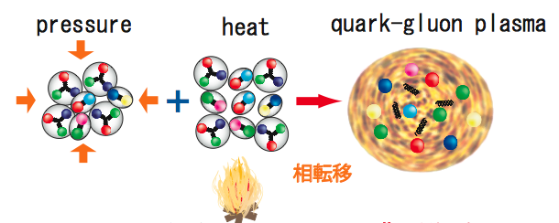
What is Quark-Gluon Plasma (QGP)?
Quarks and gluons at extreme conditions
  High temperature and/or high density
高
T
?
Quark-Gluon Plasma?
QCD Critical Point
陽子、中間子など
?
Hadron Phase
Color Super Conductor
Neutron star
μ_{B}

Slide 4
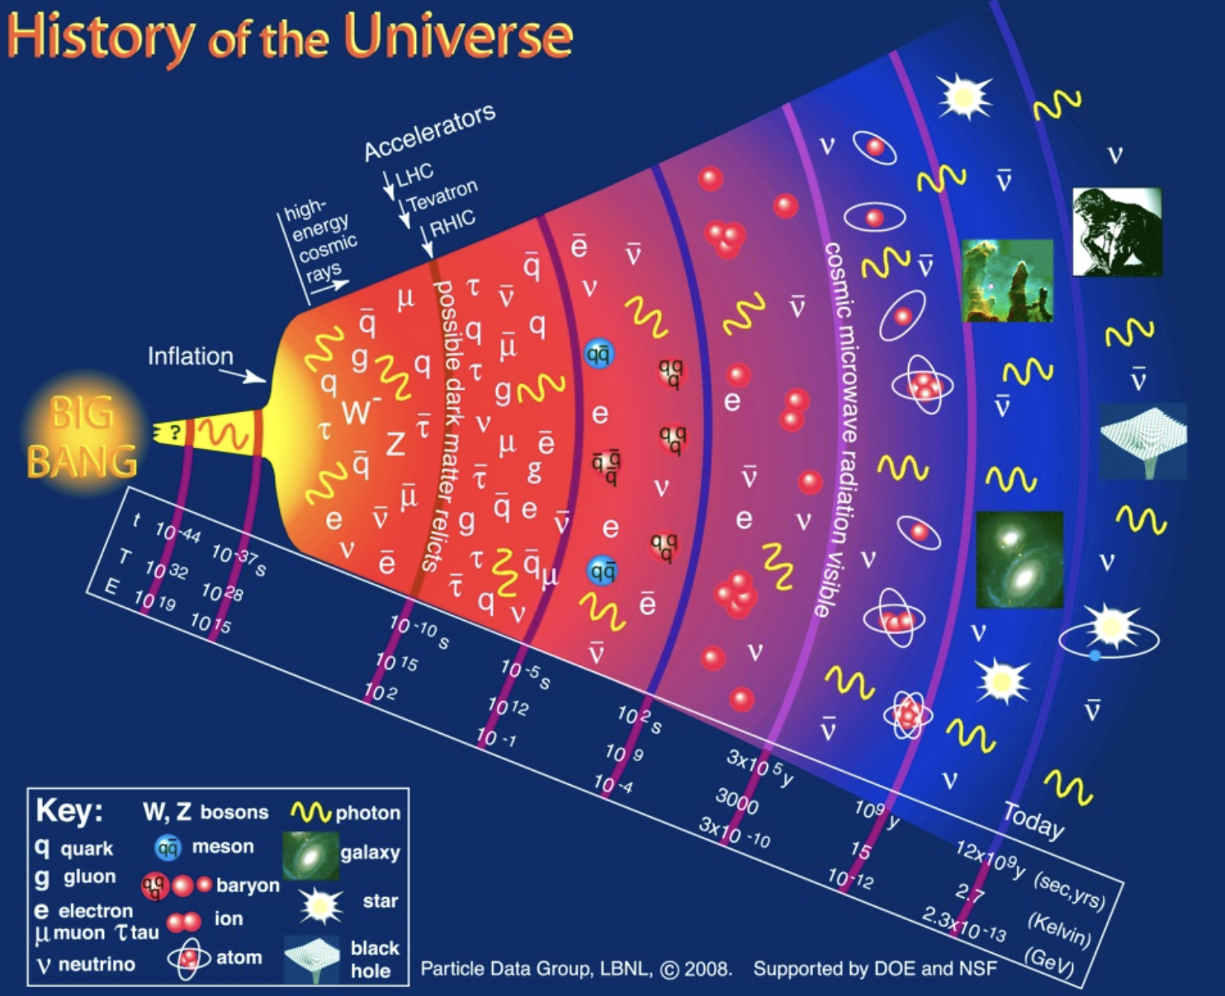
What is Quark-Gluon Plasma (QGP)?
Quarks and gluons at extreme conditions
  Early universe
高
T
?
Quark-Gluon Plasma?
QCD Critical Point
陽子、中間子など
?
Hadron Phase
Color Super Conductor
Neutron star
μ_{B}

Slide 5
What is Quark-Gluon Plasma (QGP)?
Quarks and gluons at extreme conditions
  High-energy heavy-ion collisions: Little Bang
高
T
?
Quark-Gluon Plasma?
QCD Critical Point
陽子、中間子など
?
Hadron Phase
Color Super Conductor
By Heinz
Neutron star
μ_{B}

Slide 6
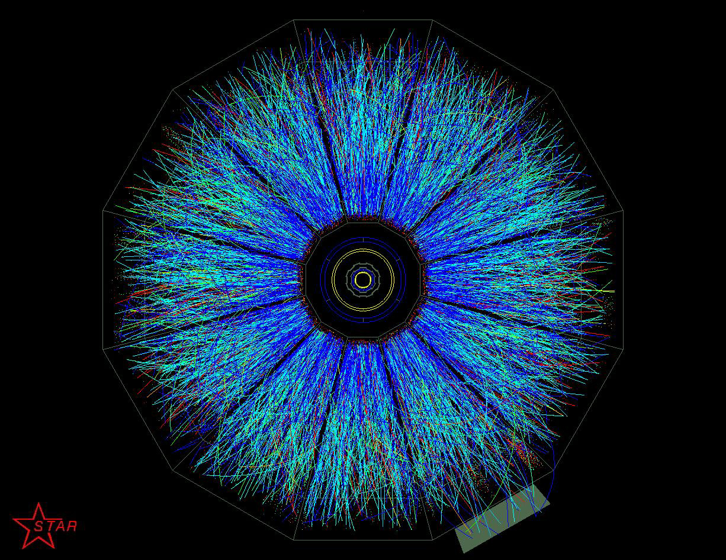
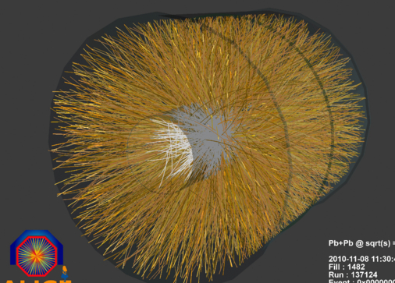
What is sQGP?
Quark-Gluon Plasma
Quarks and gluons at extreme conditions
  Relativistic Heavy Ion Collisions
高
2000: Relativistic Heavy Ion Collider
T
Success of relativistic hydrodynamic model
Strongly Interacting
Quark-Gluon Plasma
QCD Critical Point
LHC:2010
Heavy Ion collisions start!
陽子、中間子など
?
Hadron Phase
Color Super Conductor
Neutron star
μ_{B}

Slide 7
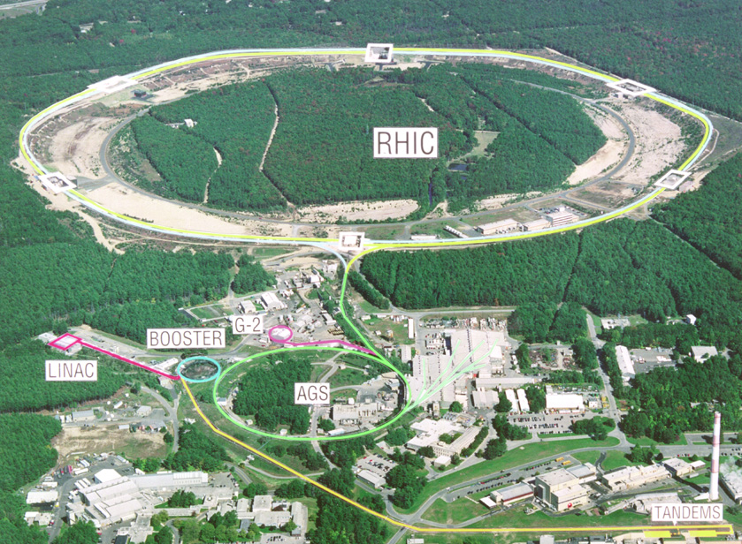
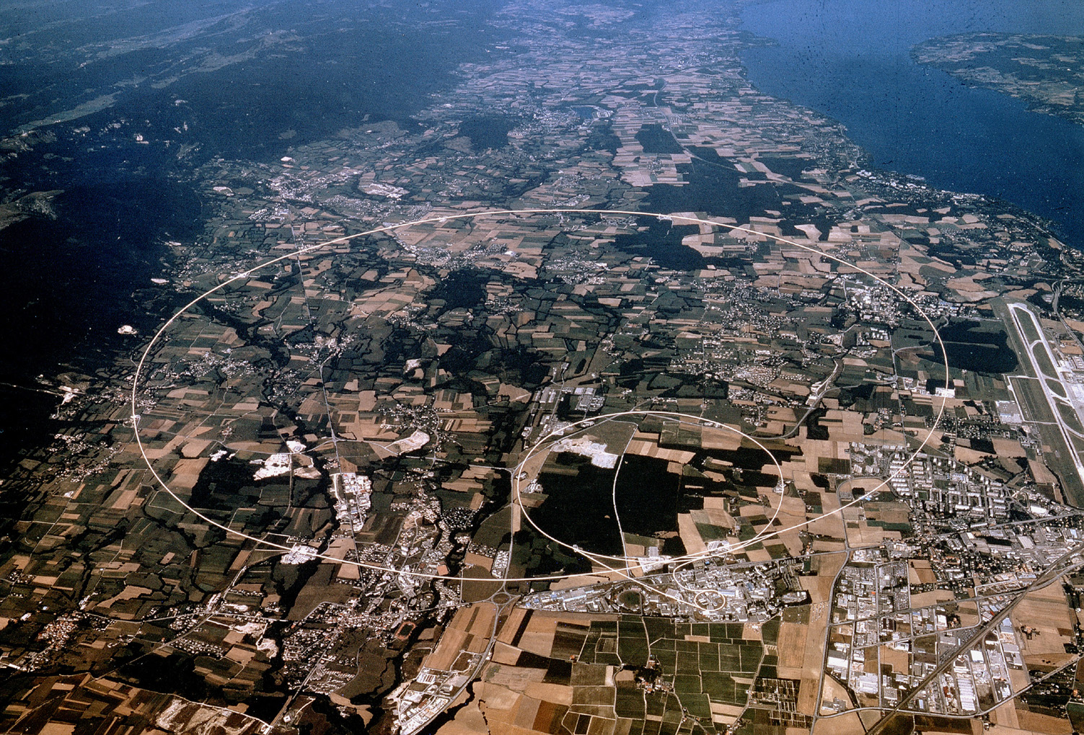
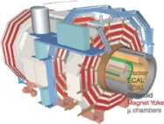
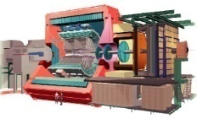
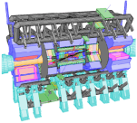


Heavy Ion Collisions
Large Hadron Collider@CERN
PHENIX
STAR
CMS
LHCb
RHIC@BNL
ALICE
ATLAS, LHCf

Slide 8
Hydrodynamic Model
Experimental data
collisions
Hadrons
Leptons
Photons

Slide 9
Hydrodynamic Model
Experimental data
collisions
Model
QGP Production?
Hadrons
Leptons
Photons
Multiple particle production
Hydrodynamic picture
Landau
Bjorken
Success of hydrodynamic model at RHIC
Relativistic viscous hydrodynamic model
One of important phenomenological models

Slide 10
Equation of State
Experimental data
collisions
hydrodynamics
Hydrodynamics
Hadrons
Leptons
Photons
QCD phase diagram
EoS: lattice QCD

Slide 11
Equation of State
Equation of State
  Lattice QCD
HotQCD,PRD90,094503(2014)
T
Quark-Gluon Plasma
QCD Critical Point
陽子、中間子など
?
Hadron Phase
μ_{B}
Color Super Conductor
(2+1) flavor, Highly improved staggered quark action
Nt=6,8,10,12,Ns=4Nt → continuum limit
Parametrization of EoS
Neutron star
MeV
finite μ: sign problem

Slide 12
Equation of State
Experimental data
collisions
hydrodynamics
Hydrodynamics
Hadrons
Leptons
Photons
QCD phase diagram
EoS: lattice QCD
Transport coefficients

Slide 13
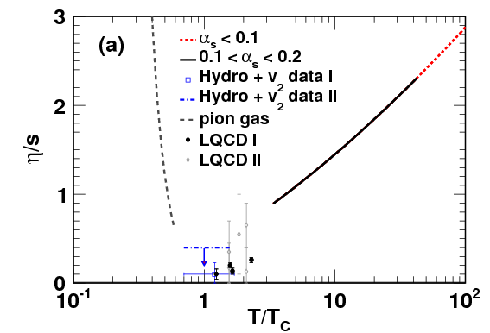
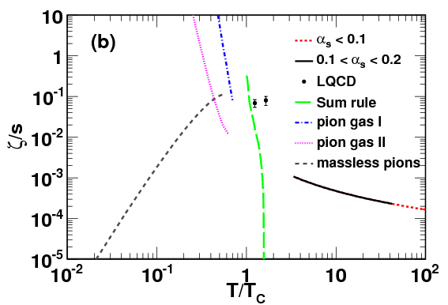
Property of QGP
Status for transport coefficients from theories
shear viscosity
bulk viscosity
Hydro
Chen,Deng,Dong,Wang,PRC87,024910(2013)
Shear viscosity takes the minimum around T_{c}.
Cf. η/s=1/4π AdS/CFT
Bulk viscosity
Temperature dependence is unclear.
Bayesian analysis: Duke, SETSCAPE, Trajectum

Slide 14

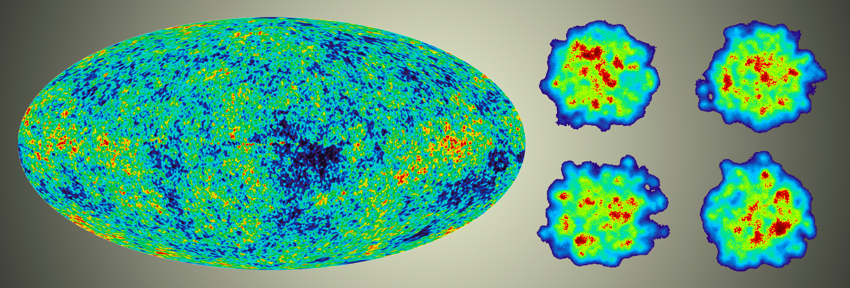
Initial Conditions
Experimental data
collisions
thermalization
hydrodynamics
Initial conditions
Hydrodynamics
Hadrons
Leptons
Photons
QCD phase diagram
EoS: lattice QCD
Transport coefficients
Energy (entropy) density distributions

Slide 15
From Fluid to Particles
Experimental data
collisions
thermalization
hydrodynamics
hadronization
freezeout
Initial conditions
Hydrodynamics
Final state interactions
Hadrons
Leptons
Photons
QCD phase diagram
EoS: lattice QCD
Hadron based event
generator
Transport coefficients
Hadronization
Energy (entropy) density distributions
Cooper Frye formula
Coalescence model

Slide 16
Quantitative Analysis
Okamoto and Nonaka, Phys.Rev. C98 (2018) 054906
Experimental data
collisions
thermalization
hydrodynamics
hadronization
freezeout
TRENTO
New hydrodynamics code
UrQMD
Phenomenological model
Parametrization
Bass et al., Prog.Part.Nucl.Phys.(1998)
Bleicher et al., J.Phys.G25,1859(1999)
Moreland et al.,PRC92,011901(2015)
Ke et al.,PRC96,044192(2017)
Application to analyses of RHIC and LHC data

Slide 17
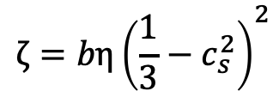
Bulk Property of QGP
Okamoto and Nonaka, Phys.Rev. C98 (2018) 054906
Experimental data
collisions
thermalization
hydrodynamics
hadronization
freezeout
Our Model
Experimental data
Shear viscosity
ALICE Pb+Pb TeV, LHC
Rapidity distributions
P_{T} distributions
Mean P_{T}
Collective flows v₂ and v₃
Bulk viscosity
$$ζ=bη{\left(\frac{1}{3}−c_{s}^{2}\right)}^{2}$$
What physical observable is interesting?

Slide 18
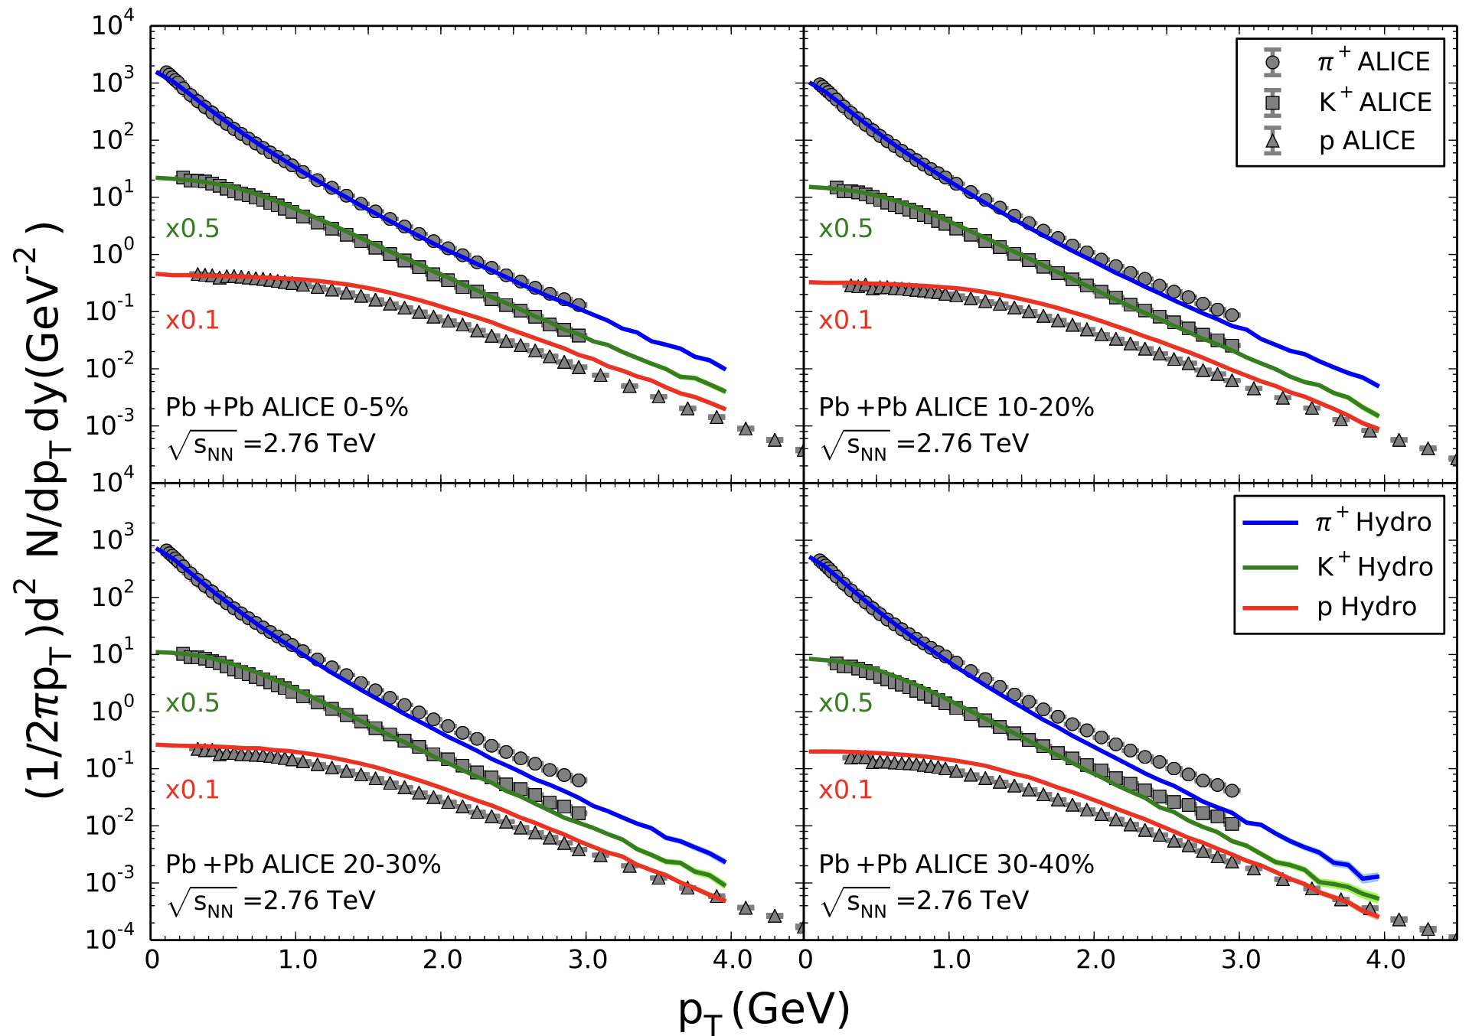
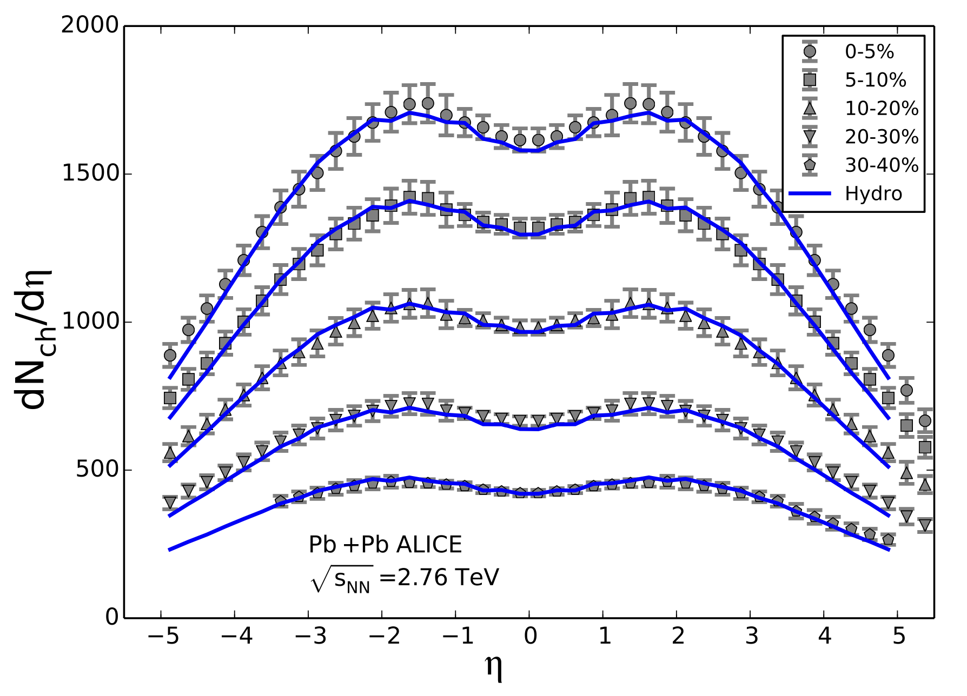
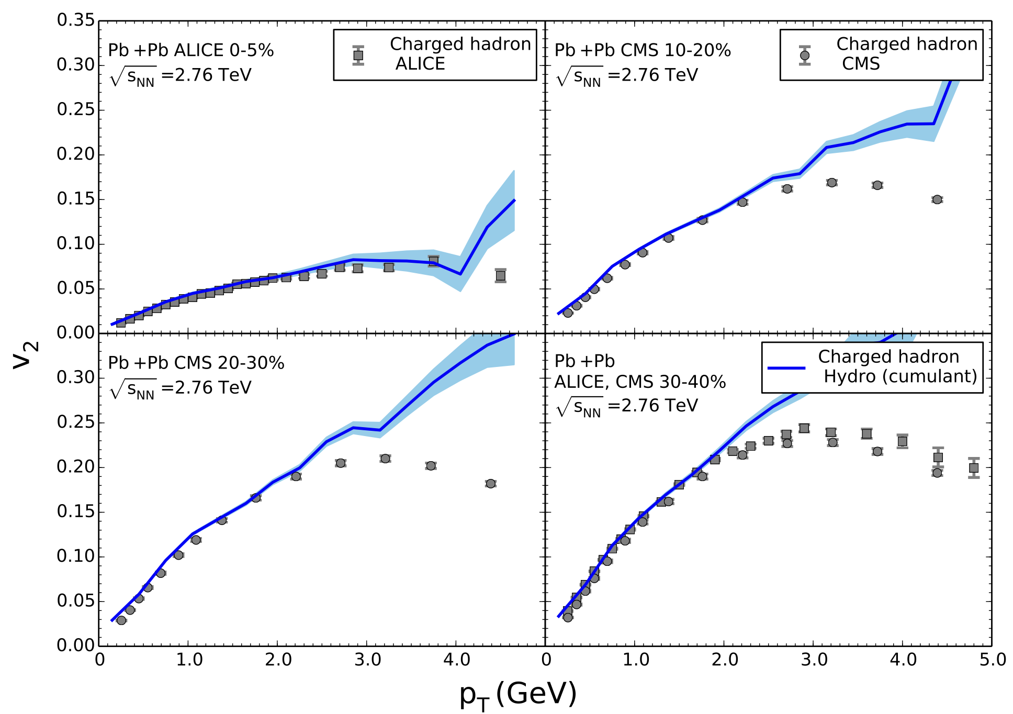
Charged Hadrons
π⁺
TeV
Pb+Pb collisions
K⁺
p
Our hydrodynamic model reproduces hadron data at the LHC.
Rapidity distribution
charged hadrons
v₂

Slide 19
Bulk Property of QGP
Okamoto and Nonaka, Phys.Rev. C98 (2018) 054906
Experimental data
collisions
thermalization
hydrodynamics
hadronization
freezeout
Our Model
Experimental data
Shear viscosity
ALICE Pb+Pb TeV, LHC
Rapidity distributions
P_{T} distributions
Mean P_{T}
Collective flows v₂ and v₃
Bulk viscosity
$$ζ=bη{\left(\frac{1}{3}−c_{s}^{2}\right)}^{2}$$
What physical observable is interesting?

Slide 20
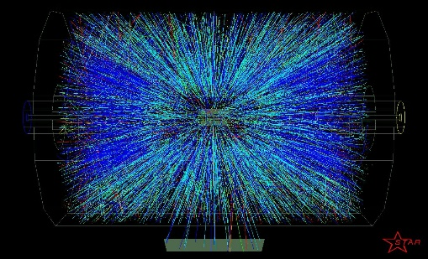

Effect on Collective Flow
pseudorapidity $η$
Collective flow as a function of η_{p}
η_{p}
η_{p}
(3+1)-d calculation
v_{n} with bulk viscosity is much closer to the ALICE data: amplitude and slope
Effect of bulk viscosity at forward rapidity is large.
Finite bulk viscosity

Slide 21
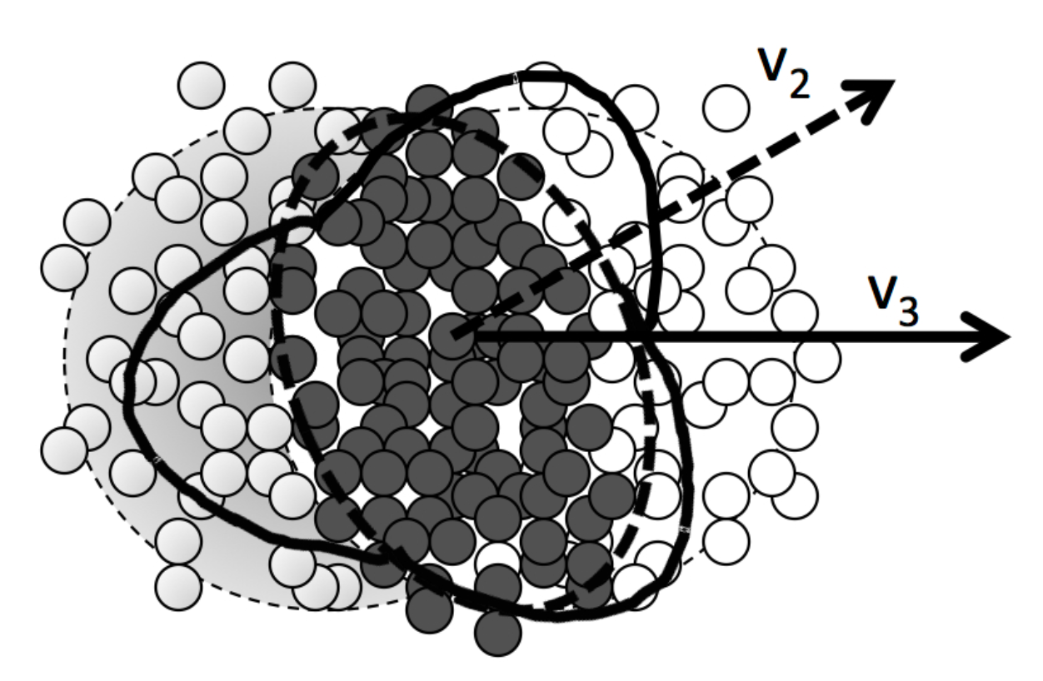
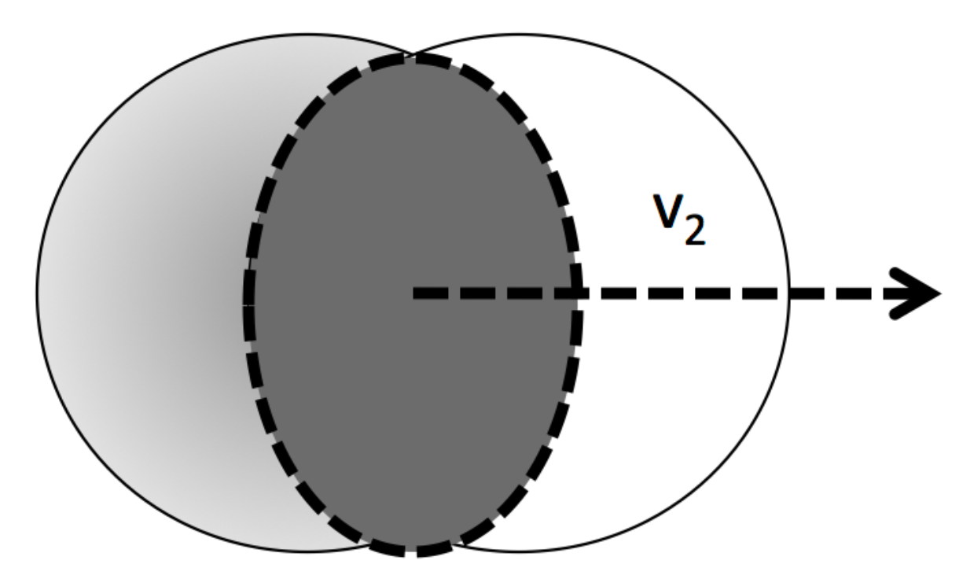
Collective Flow
almond shape
more realistic….
Reaction
plane
z
-
φ
y
x
Directed flow
Elliptic flow

Slide 22
Effect on Collective Flow
pseudorapidity $η$
Collective flow as a function of η_{p}
η_{p}
η_{p}
(3+1)-d calculation
v_{n} with bulk viscosity is much closer to the ALICE data: amplitude and slope
Effect of bulk viscosity at forward rapidity is large.
Finite bulk viscosity

Slide 23
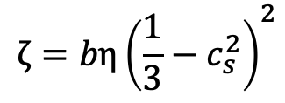

Temperature Dependent η/s
Hadron + QGP
QGP
Hadron
η_{p}
η_{p}
QGP phase: η/s(T)
Hadron phase: η/s=0.08
In both centrality classes
v₂(η_{p}) is larger.
$η/s$
$$ζ=bη{\left(\frac{1}{3}−c_{s}^{2}\right)}^{2}$$
QGP
MeV

Slide 24
Temperature Dependent η/s
Hadron + QGP
QGP
Hadron
η_{p}
η_{p}
QGP phase: η/s=0.08
Hadron phase: η/s(T)
0-5%: larger than ALICE data
30-40%: close to ALICE data
$η/s$
$$ζ=bη{\left(\frac{1}{3}−c_{s}^{2}\right)}^{2}$$
Hadron
MeV

Slide 25
Temperature Dependent η/s
Hadron + QGP
QGP
Hadron
η_{p}
η_{p}
QGP phase: η/s(T)
Hadron phase: η/s(T)
In both central classes,
close to ALICE data
$η/s$
$$ζ=bη{\left(\frac{1}{3}−c_{s}^{2}\right)}^{2}$$
Hadron + QGP
MeV

Slide 26
Temperature Dependent η/s
Hadron + QGP
QGP
Hadron
η_{p}
η_{p}
0-5 % centrality
η/s of QGP and hadron phases is important.
30-40 % centrality
η/s of hadron phase is important.
$η/s$
Hadron
Central dependence of v₂(η_{p}) reveals temperature dependence of viscosities.
Bayesian analysis

Slide 27
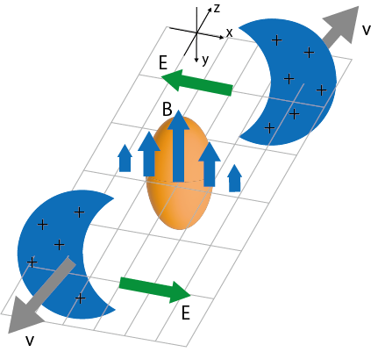
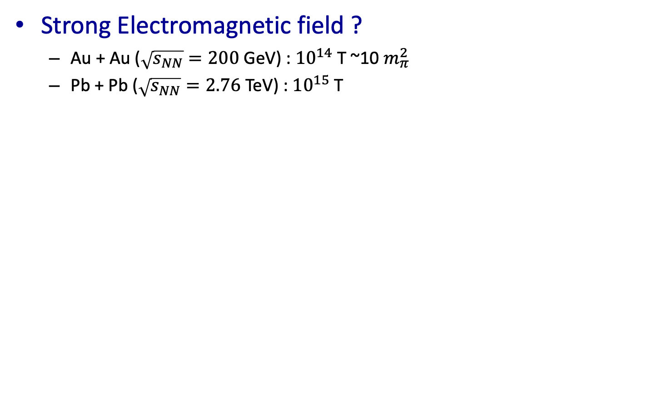
Electromagnetic Field in Heavy Ion Collisions
Strong Electromagnetic field ?
  Au + Au ($\sqrt{s_{NN}}=200$ GeV) : ${10}^{14}$ T ~10 $m_{π}^{2}$
  Pb + Pb ($\sqrt{s_{NN}}=2.76$ TeV) : ${10}^{15}$ T
Nakamura, Miyoshi, C. N. and Takahashi, Phys. Rev. C 107, (2023) 014901
Nakamura, Miyoshi, C. N. and Takahashi, Eur.Phys.J.C 83 (2023) 3, 229.
Nakamura, Miyoshi, C. N. and Takahashi, Phys. Rev. C 107 (2023) 3, 034912

Slide 28
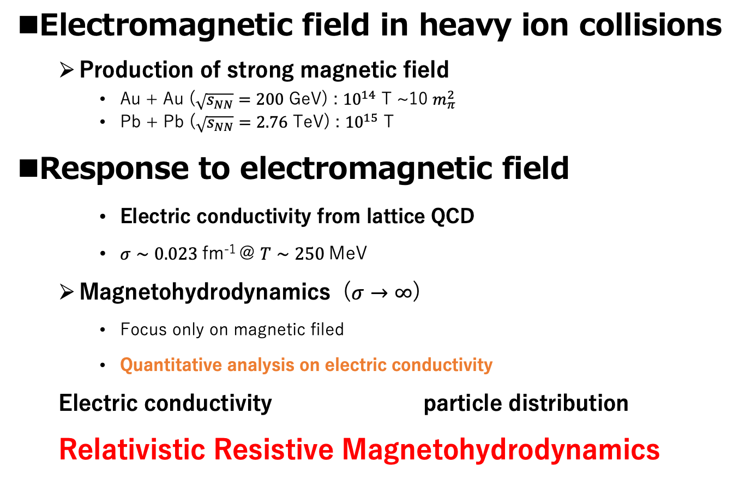
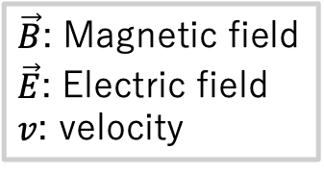
Electromagnetic Field in Heavy Ion Collisions
Electromagnetic field in heavy ion collisions
  Production of strong magnetic field
    Au + Au ($\sqrt{s_{NN}}=200$ GeV) : ${10}^{14}$ T ~10 $m_{π}^{2}$
    Pb + Pb ($\sqrt{s_{NN}}=2.76$ TeV) : ${10}^{15}$ T
Response to electromagnetic field
    Electric conductivity from lattice QCD
    $σ∼0.023$fm⁻¹ @ $T∼250$MeV
  Magnetohydrodynamics ($σ→∞$)
    Focus only on magnetic filed
    Quantitative analysis on electric conductivity
  Electric conductivity particle distribution
  Relativistic Resistive Magnetohydrodynamics
Not observed
Experimental data?
Gert Aarts, et al.
Phys. Rev. Lett., 99:022002, 2007.
Inghirami, et al, Eur. Phys. J. C (2020) 80:293
$\vec{B}$: Magnetic field
$\vec{E}$: Electric field
$v$: velocity
Reaction plane

Slide 29
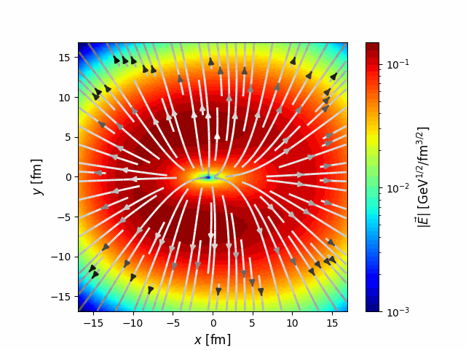
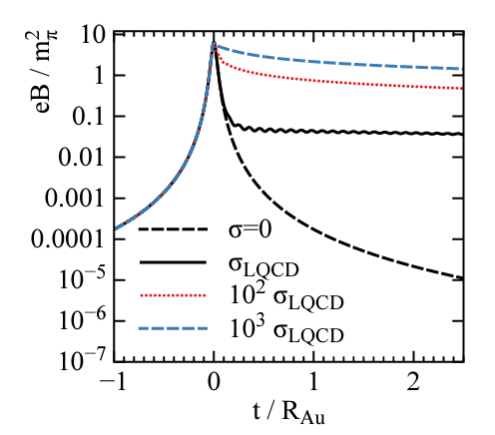



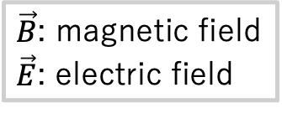
Electromagnetic Fields and Property of QGP
Electric Conductivity
  Dissipation of electric field
    Ampere’s law： $∂_{t}\vec{E}−∇×\vec{B}=−\vec{j}$
          Ohm‘s law makes electric filed dissipate
                ➡Dissipated energy to fluid
  Charge is induced.
    Charge is induced by electric field.
    Induced charge depends on charge conductivity
  Dissipation of magnetic field
    Charge conductivity of QGP
  dissipation of electromagnetic fields and charge distribution QGP
Electric field
$\vec{B}$: magnetic field
$\vec{E}$: electric field
Strength of electric field
Magnetic field
Electric field is
dissipated.
$$σ≠0$$
Suppresses of
dissipation
$$σ=0$$
L. McLerran and V. Skokov, Nucl. Phys. A 929 (2014), 184-190

Slide 30
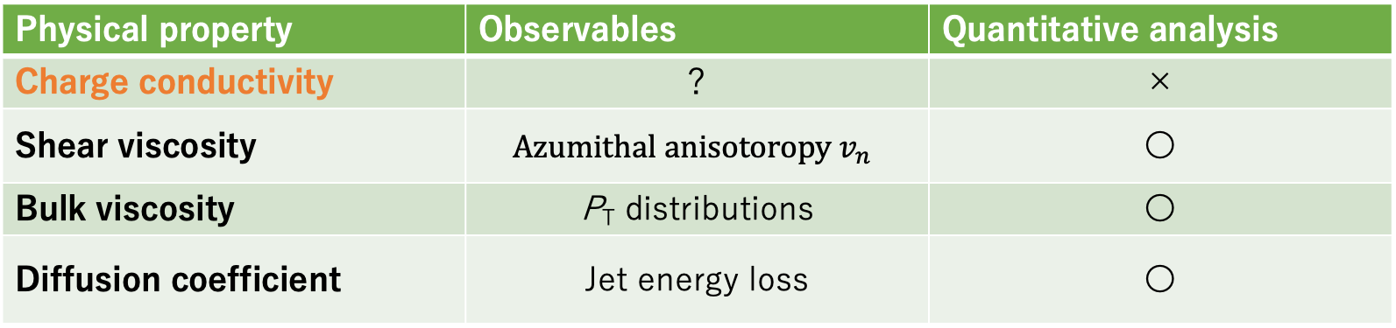
Understanding of QGP Property
Charge conductivity of QGP from analysis of high-energy heavy-ion collisions
Construction of relativistic resistive magnetohydrodynamics
Physical property | Observables | Quantitative analysis
Charge conductivity | ？ | ×
Shear viscosity | $$Azumithal anisotoropy v_{n}$$ | 〇
Bulk viscosity | P_{T} distributions | 〇
Diffusion coefficient | Jet energy loss | 〇

Slide 31
Relativistic Resistive
Magneto-Hydrodynamics (RRMHD)
Nakamura, Miyoshi, C. N. and Takahashi, PRC107, no.1, 014901 (2023)
Experimental data
collisions
thermalization
hydro
hadronization
freezeout
Initial conditions
Hydrodynamics
Glauber model
+approximate solutions of Maxwell eq.
Hydrodynamic eq. + Maxwell eq. + Ohm’s law

Slide 32





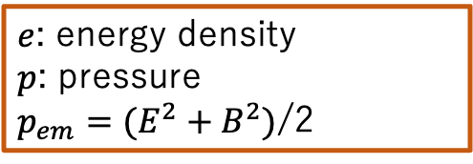

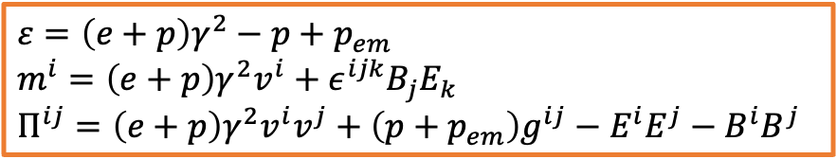


Relativistic Resistive
Magneto-Hydrodynamics (RRMHD)
Nakamura, Miyoshi, C. N. and Takahashi, PRC107, no.1, 014901 (2023)
RRMHD equation
  Conservation law＋Maxwell eq. ＋Ohm’s law
  $$∂_{μ}T^{μν}=F^{νλ}J_{λ}$$
  $$J^{μ}=J_{c}^{μ}+qu^{μ}$$
$e$: energy density
$p$: pressure
$p_{em}=(E^{2}+B^{2})$/2
$$ε=\left(e+p\right)γ^{2}−p+p_{em}$$
$$m^{i}=\left(e+p\right)γ^{2}v^{i}+ε^{ijk}B_{j}E_{k}$$
$$Π^{ij}=\left(e+p\right)γ^{2}v^{i}v^{j}+\left(p+p_{em}\right)g^{ij}−E^{i}E^{j}−B^{i}B^{j}$$
Energy Conservation
$$∂_{t}ε+∇⋅m=0$$
Momentum conservation
$$∂_{t}m^{i}+∇⋅Π^{i}=0$$
Faraday’s law
$$∂_{t}\vec{B}+∇×\vec{E}=0$$
Ohm’s law
$$\vec{J}=q\vec{v}+σγ[\vec{E}+\vec{v}×\vec{B}−\left(\vec{v}⋅\vec{E}\right)\vec{v}]$$
Ampere’s law
$∂_{t}\vec{E}−∇×\vec{B}=−\vec{j}$
  Integration with quasi-analytic solutions
$$=:{\vec{J}}_{c}$$
$$∂_{t}\vec{E}−∇×\vec{B}=q\vec{v}$$
$$∂_{t}\vec{E}={\vec{J}}_{c}$$
operator
splitting
    $${\vec{E}}_{⊥}=−\vec{v}×\vec{B}+\left(E_{⊥}^{0}+\vec{v}×\vec{B}\right)\exp\left(−σγt\right)$$
$${\vec{E}}_{∥}=E_{∥}^{0}exp⁡(−σt/γ)$$
Komissarov, Mon. Not. R. Astron. Soc. 382, 995-1004 (2007)

Slide 33

Validation of the Code
Nakamura, Miyoshi, C. N. and Takahashi, Eur.Phys.J.C 83 (2023) 3, 229.
RRMHD in the Milne coordinates
(1+1) dimensional expansion system $u^{μ}=(cosh Y, 0, 0,\sinh{Y)}$
  Comparison between quasi-analytical solution and RRMHD simulation
New Test Problem
Energy density
Electric field
Solid line : RRMHD code
Dashed line: quasi-analytical solution
Application to Heavy Ion Collisions

Slide 34
Symmetric and Asymmetric Systems
RHIC
Au-Au collisions
  Symmetric pressure gradient
  Almond-shaped medium
Cu-Au collisions
  Asymmetric pressure gradient
  Distorted Almond-shaped medium
Au
Au
Au
Cu
Hirono, Hongo, Hirano

Slide 35
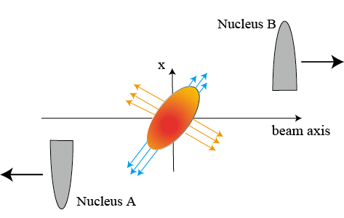
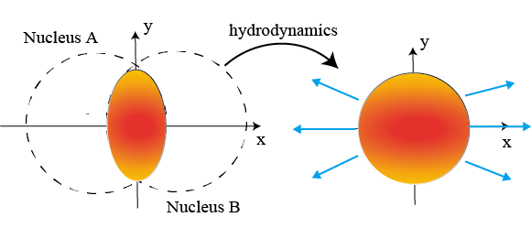
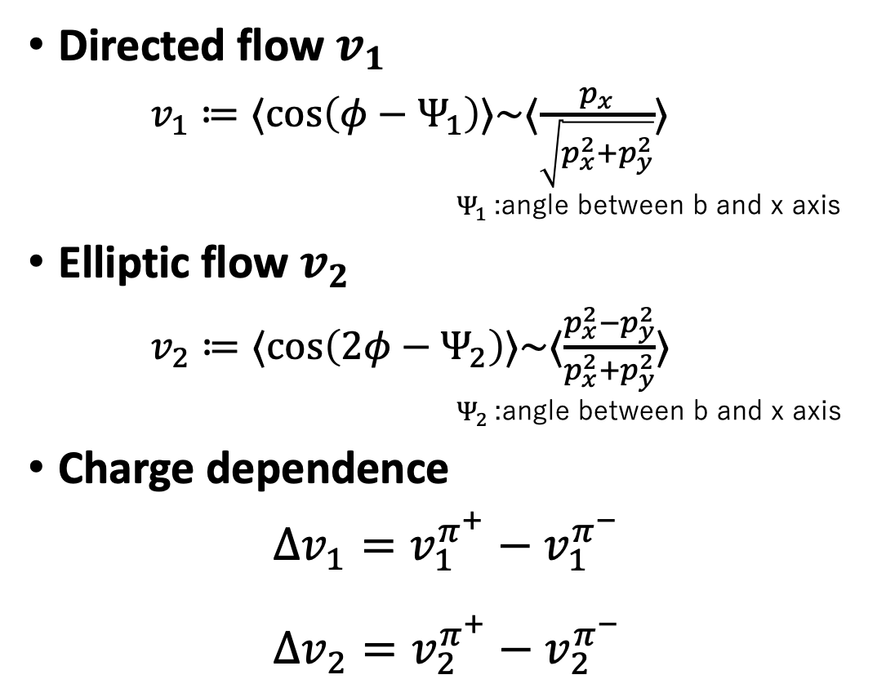


Analysis on High-Energy Heavy-Ion Collisions
$⟨ ⋅ ⟩$ : average over yield
Directed flow $v_{1}$
$v_{1}≔⟨\cos\left(φ−Ψ_{1}\right)⟩\sim ⟨\frac{p_{x}}{\sqrt{p_{x}^{2}+p_{y}^{2}}}⟩$
              $Ψ_{1}$:angle between b and x axis
Elliptic flow $v_{2}$
$v_{2}≔⟨\cos\left(2φ−Ψ_{2}\right)⟩\sim ⟨\frac{p_{x}^{2}−p_{y}^{2}}{p_{x}^{2}+p_{y}^{2}}⟩$
              $Ψ_{2}$:angle between b and x axis
Charge dependence
$Δv_{1}=v_{1}^{π^{+}}−v_{1}^{π^{−}}$
$Δv_{2}=v_{2}^{π^{+}}−v_{2}^{π^{−}}$
tilted pressure gradient
asymmetric shape
hydrodynamic expansion
$$\vec{b}$$

Slide 36

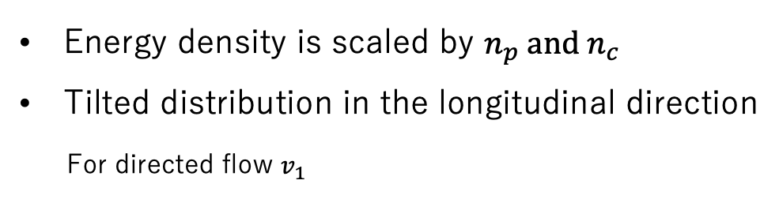
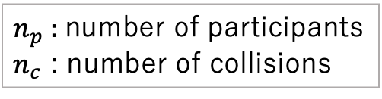

Initial Condition：QGP Medium
Bozek, et al, Phys. Rev. C 81, 054902(2010)
$n_{p}$: number of participants
$n_{c}$ : number of collisions
Tilted Glauber model
Freezeout hypersurface
Energy density
Energy density is scaled by $n_{p} and n_{c}$
Tilted distribution in the longitudinal direction
For directed flow $v_{1}$
$$x−y plane$$
$$x−η_{s}plane$$
Au+Au
Au
Au
Au
Au
Tilted pressure gradient
Au
Cu
Cu
Cu+Au
Au
asymmetric shape
distorted

Slide 37
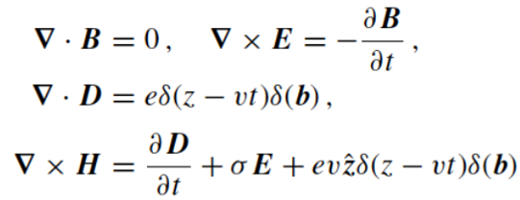
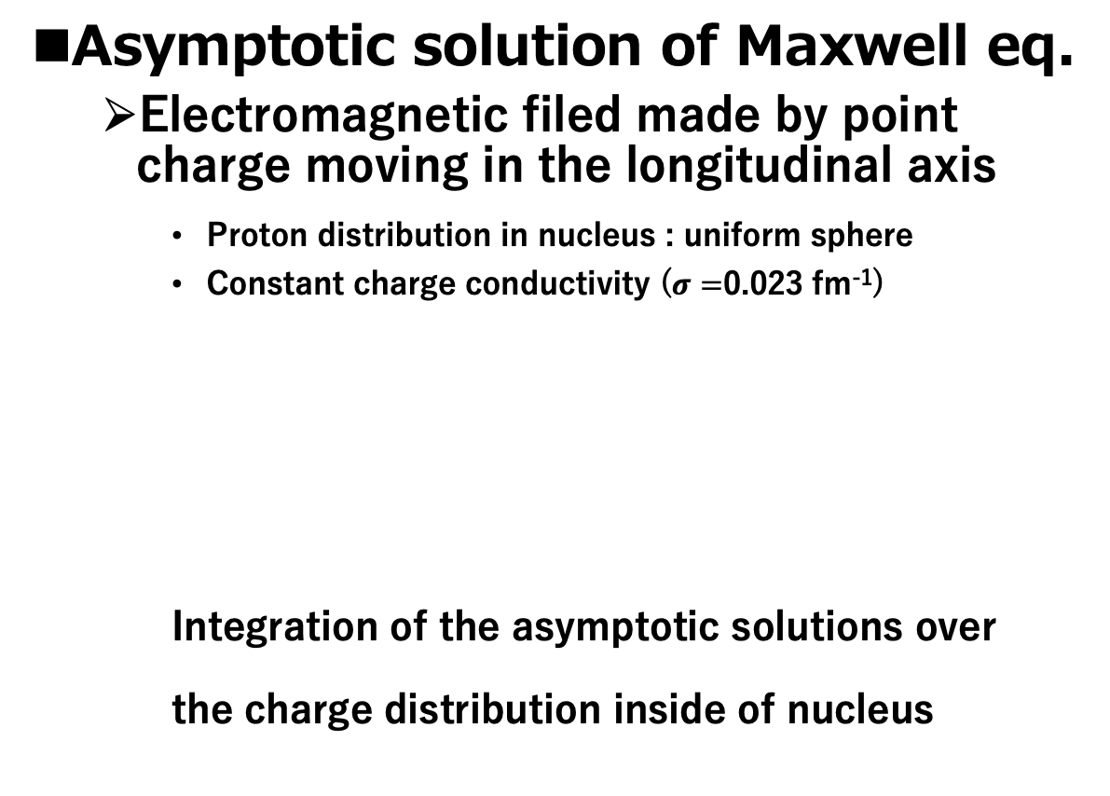
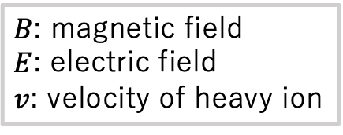
Initial Condition：Electromagnetic Fields
Tuchin, Phys.Rev.C88,024911(2013)
Asymptotic solution of Maxwell eq.
  Electromagnetic filed made by point charge moving in the longitudinal axis
    Proton distribution in nucleus : uniform sphere
    Constant charge conductivity ($σ=$0.023 fm⁻¹)
    Integration of the asymptotic solutions over
    the charge distribution inside of nucleus
$B$: magnetic field
$E$: electric field
$v$: velocity of heavy ion

Slide 38
Electromagnetic Field in Symmetric and Asymmetric Systems
Au-Au collisions
  Magnetic field
    Strong magnetic field
  Electric field
    No electric field
Cu-Au collisions
  Magnetic field
    Strong magnetic field
  Electric field
    due to the asymmetry
    of the charge distribution
Au
Au
Cu
Magnetic field
Au
Magnetic field
Electric field
E=0
Hirono, Hongo, Hirano

Slide 39






Initial Condition：Electromagnetic Fields ($η_{s}=0)$
Tuchin, Phys.Rev.C88,024911(2013)
Au＋Au（$b=10$ fm）
Cu＋Au（$b=10$ fm）
Au+Au
  Strong magnetic fields in QGP
  Electric field ～０ in QGP
Cu+Au
  Strong magnetic field in QGP
  Finite electric field in QGP
$$B_{y}$$
$$B_{y}$$
Au
Au
Au
Cu
$$E_{x}$$
$$E_{x}$$
Au
Au
Au
Cu
Freezeout hypersurface

Slide 40
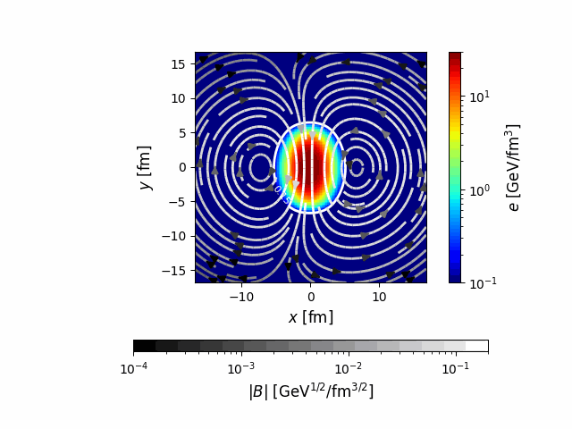
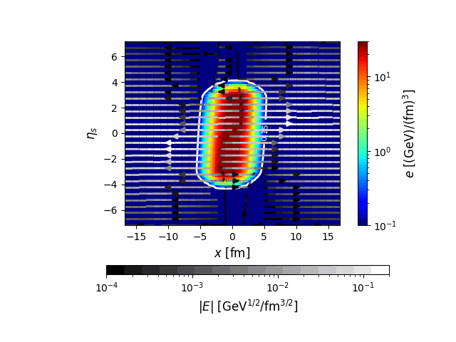

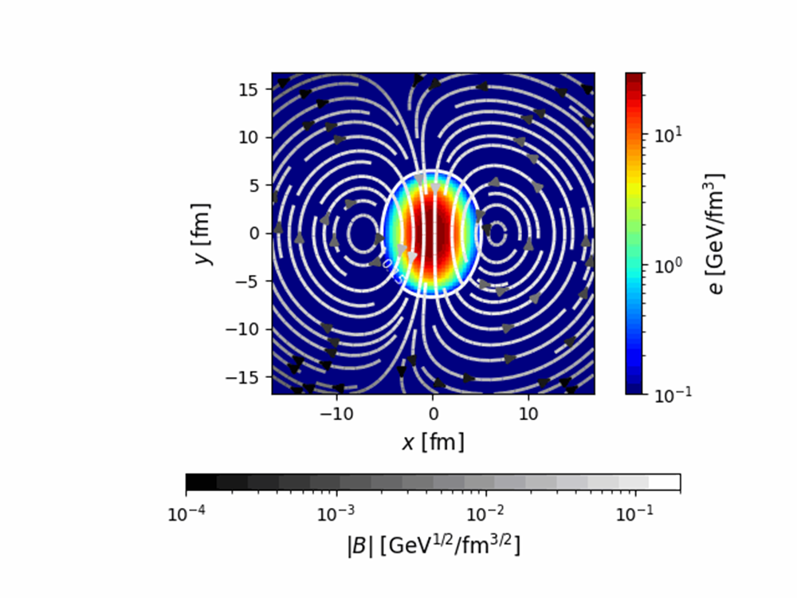






Space-time Evolution
Nakamura, Miyoshi, C. N. and Takahashi, PRC 107, no.1, 014901 (2023)
Au+Au collision system
First calculation in HIC with RRMHD code
$$x−η_{s} plane$$
$x−y$平面
Collision axis
$$η_{s}$$
Energy density
$y$ [fm]
Energy density
initial
Initial
$x$ [fm]
$x$ [fm]
Magnetic field strength
Electric field strength
Analysis of Heavy Ion Collisions

Slide 41
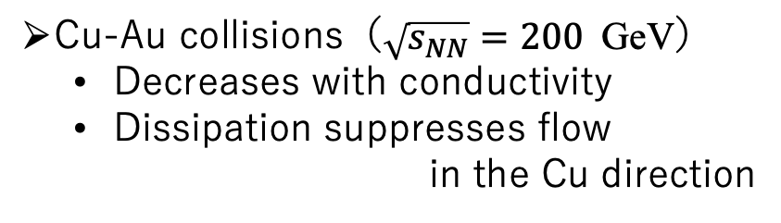



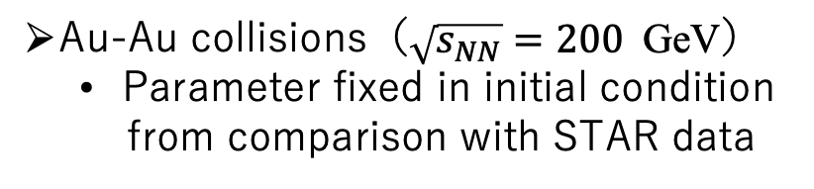





Directed Flow
$v_{1}≔⟨\cos\left(φ−Ψ_{1}\right)⟩\sim ⟨\frac{p_{x}}{p_{T}}⟩$
Nakamura, Miyoshi, C. N. and Takahashi, PRC 107, no.1, 014901 (2023)
$$η=\frac{1}{2}\ln{\frac{|p|+p_{z}}{|p|−p_{z}}}$$
Au-Au collisions（$\sqrt{s_{NN}}=200$GeV）
  Parameter fixed in initial condition
  from comparison with STAR data
Cu-Au collisions（$\sqrt{s_{NN}}=200$GeV）
  Decreases with conductivity
  Dissipation suppresses flow
  in the Cu direction
STAR Collaboration, Phys. Rev. Lett. 101 (2008), 252301
$σ=$100 fm⁻¹
$σ=1$ fm⁻¹
$σ=0$fm⁻¹
◦：STAR
$σ=$100 fm⁻¹
$σ=1$ fm⁻¹
$σ=0$fm⁻¹
$$v_{1}$$
$$v_{1}$$
Consistent with STAR data
Dissipation suppresses flow
$$η$$
$$η$$

Slide 42








Energy Transfer by Ohm Dissipation
Nakamura, Miyoshi, C. N. and Takahashi, PRC 107, no.1, 014901 (2023)
Energy Transfer
$$D\left(u\right)≔j^{μ}e_{μ}=γ[j⋅\left(E+v×B\right)−q\left(v⋅E\right)]$$
Au + Au ($η_{s}=0$)
Cu + Au ($η_{s}=0$)
Ex
Ex
Au
Au
Au
Cu
energy of
the electromagnetic field
Thermal energy
Kinetic energy
Au+Au collisions
Cu+Au collisions
$σ=100$ fm⁻¹
$σ=100$ fm⁻¹
Asymmetric dissipation
-> reduces pressures gradient
Symmetric dissipation
$x$ [fm]
$x$ [fm]
$${\text{no} \text{contribution} \text{to} v}_{1}$$
$$\text{contribution} \text{to} v_{1}$$

Slide 43
Directed Flow
$v_{1}≔⟨\cos\left(φ−Ψ_{1}\right)⟩\sim ⟨\frac{p_{x}}{p_{T}}⟩$
Nakamura, Miyoshi, C. N. and Takahashi, PRC 107, no.1, 014901 (2023)
$$η=\frac{1}{2}\ln{\frac{|p|+p_{z}}{|p|−p_{z}}}$$
Au-Au collisions（$\sqrt{s_{NN}}=200$GeV）
  Parameter fixed in initial condition
  from comparison with STAR data
Cu-Au collisions（$\sqrt{s_{NN}}=200$GeV）
  Decreases with conductivity
  Dissipation suppresses flow
  in the Cu direction
STAR Collaboration, Phys. Rev. Lett. 101 (2008), 252301
$σ=$100 fm⁻¹
$σ=1$ fm⁻¹
$σ=0$fm⁻¹
◦：STAR
$σ=$100 fm⁻¹
$σ=1$ fm⁻¹
$σ=0$fm⁻¹
$$v_{1}$$
$$v_{1}$$
Consistent with STAR data
Dissipation suppresses flow
$$η$$
$$η$$

Slide 44








Charge Dependence of Δv₂：Au＋Au
Nakamura, Miyoshi, C. N. and Takahashi, PRC 107, no.1, 014901 (2023)
$Δv_{2}=v_{2}^{π^{+}}(η)−v_{2}^{π^{−}}(η)$
  Negative Elliptic Flow
    Contribution of negative charge
    on freezeout hypersurface
    Symmetric structure:
    initial electric field to the
    collision axis
    Electric conductivity dependence is observed even in the symmetry system.
Charge distribution
on freezeout hypersurface
Ex
Au
Au
$y$ [fm]
$x$ [fm]
$x$ [fm]
$σ=0.1$ fm⁻¹
$σ=0.023$ fm⁻¹
$σ=0.0058$fm⁻¹
$$Δv_{2}$$
$$η=\frac{1}{2}\ln{\frac{|p|+p_{z}}{|p|−p_{z}}}$$
$$η$$

Slide 45








Charge Dependence of Δv₂：Cu＋Au
Nakamura, Miyoshi, C. N. and Takahashi, PRC 107, no.1, 014901 (2023)
$Δv_{2}=v_{2}^{π^{+}}(η)−v_{2}^{π^{−}}(η)$
  Negative Elliptic Flow
    Contribution of negative charge
    on freezeout hypersurface
    Asymmetric structure:
    initial electric field to the
    collision axis
    Electric conductivity dependence is observed.
Charge distribution
on freezeout hypersurface
【副論文3】 K. N., T. Miyoshi, C. Nonaka and H. R. Takahashi, arXiv:2212.02124 [nucl-th]
$$E_{x}$$
Au
Cu
$y$ [fm]
$x$ [fm]
$σ=0.1$ fm⁻¹
$σ=0.023$ fm⁻¹
$σ=0.0058$fm⁻¹
$$Δv_{2}$$
Δv₂:
initial electromagnetic field distribution
electrical conductivity
$$η=\frac{1}{2}\ln{\frac{|p|+p_{z}}{|p|−p_{z}}}$$
$$η$$

Slide 46







Charge Dependence of Δv₁：Au＋Au
$Δv_{1}=v_{1}^{π^{+}}\left(η\right)−v_{1}^{π^{−}}\left(η\right)$
  Clear dependence of charge conductivity
    Proportion to electric conductivity
    Negative charge induced in the opposite
    direction of fluid flow
    suppression of $v_{1}$of negative charge
  Δv₁ with finite σ is consistent with STAR data
    $σ=0.0058$ $\text{fm}\text{−1}$
    ex. $σ_{LQCD}=0.02\text{3 }\text{fm}\text{−1}$
    from lattice QCD
    QGP electrical conductivity from
    high-precision measurement of $Δv_{1}$
Charge distribution on freezeout hypersurface
$x$ [fm]
$x$ [fm]
$σ=0.1$ fm⁻¹
$σ=0.023$ fm⁻¹
$σ=0.0058$fm⁻¹
◦：STAR data
STAR collaboration,
Phys. Rev. Lett. 112 (2014) no.16,
162301
Gert Aarts, et al.
Phys. Rev. Lett., 99:022002, 2007.
$$Δv_{1}$$
$$η$$
$$η=\frac{1}{2}\ln{\frac{|p|+p_{z}}{|p|−p_{z}}}$$

Slide 47






Charge Dependence of Δv₁：Cu＋Au
Nakamura, Miyoshi, C. N. and Takahashi, Phys. Rev. C 107 (2023) 3, 034912
$Δv_{1}=v_{1}^{π^{+}}\left(η\right)−v_{1}^{π^{−}}\left(η\right)$
  Electric field created by initial condition
    Δ$v1 is finite at η=0$
    Asymmetry structure to $η=0$
  Proportion to electric conductivity
    Δv₁ vanishes at $η=0.5.$
  Electrical conductivity <- $Δv_{1}$ at $η=0$
  Initial electrical field from $η dependence$
  $of$ $Δv_{1}$
Charge distribution on freezeout hypersurface
$x$ [fm]
$x$ [fm]
$σ=0.1$ fm⁻¹
$σ=0.023$ fm⁻¹
$σ=0.0058$fm⁻¹
$$Δv_{1}$$
Asymmetric system has advantage in explore of
QGP electrical conductivity.
$$η$$

Slide 48
Summary
Relativistic Resistive Magnetohydrodynamic Model
RRMHD code in the Milne coordinate
  Test calculation in the 1+1 expanding system
Application to high-energy heavy-ion collisions
  Au+Au and Au+Cu systems at RHIC energy
  Directed flow
    Cu+Au: suppression of v₁ due to dissipation of electric field
  Charge dependence of Δv₁ and Δv₂
    electric conductivity from Δv₁
Future work:
Event-by-event fluctuation
Finite density
Nuclear structure Ru+Ru, Zr+Zr
Vortex
Chiral magnetohydrodynamics
….

