Slide 1
ML in the dating of ice cores
A GRU Method for Automated Annual Layer Identification
Rasmus Arentoft Nielsen Supervisors: Sune O. Rasmussen Troels C. Petersen

Slide 2
Outline
Outline
Introduction
Model & Setup
Results
Discussion
Conclusion
A broad introduction Motivation, data and a bit of glaciology
The model GRU model structure and peak detection
Results Examples and overall performance
Discussion What are the limitations of the model?
Conclusions

Slide 3
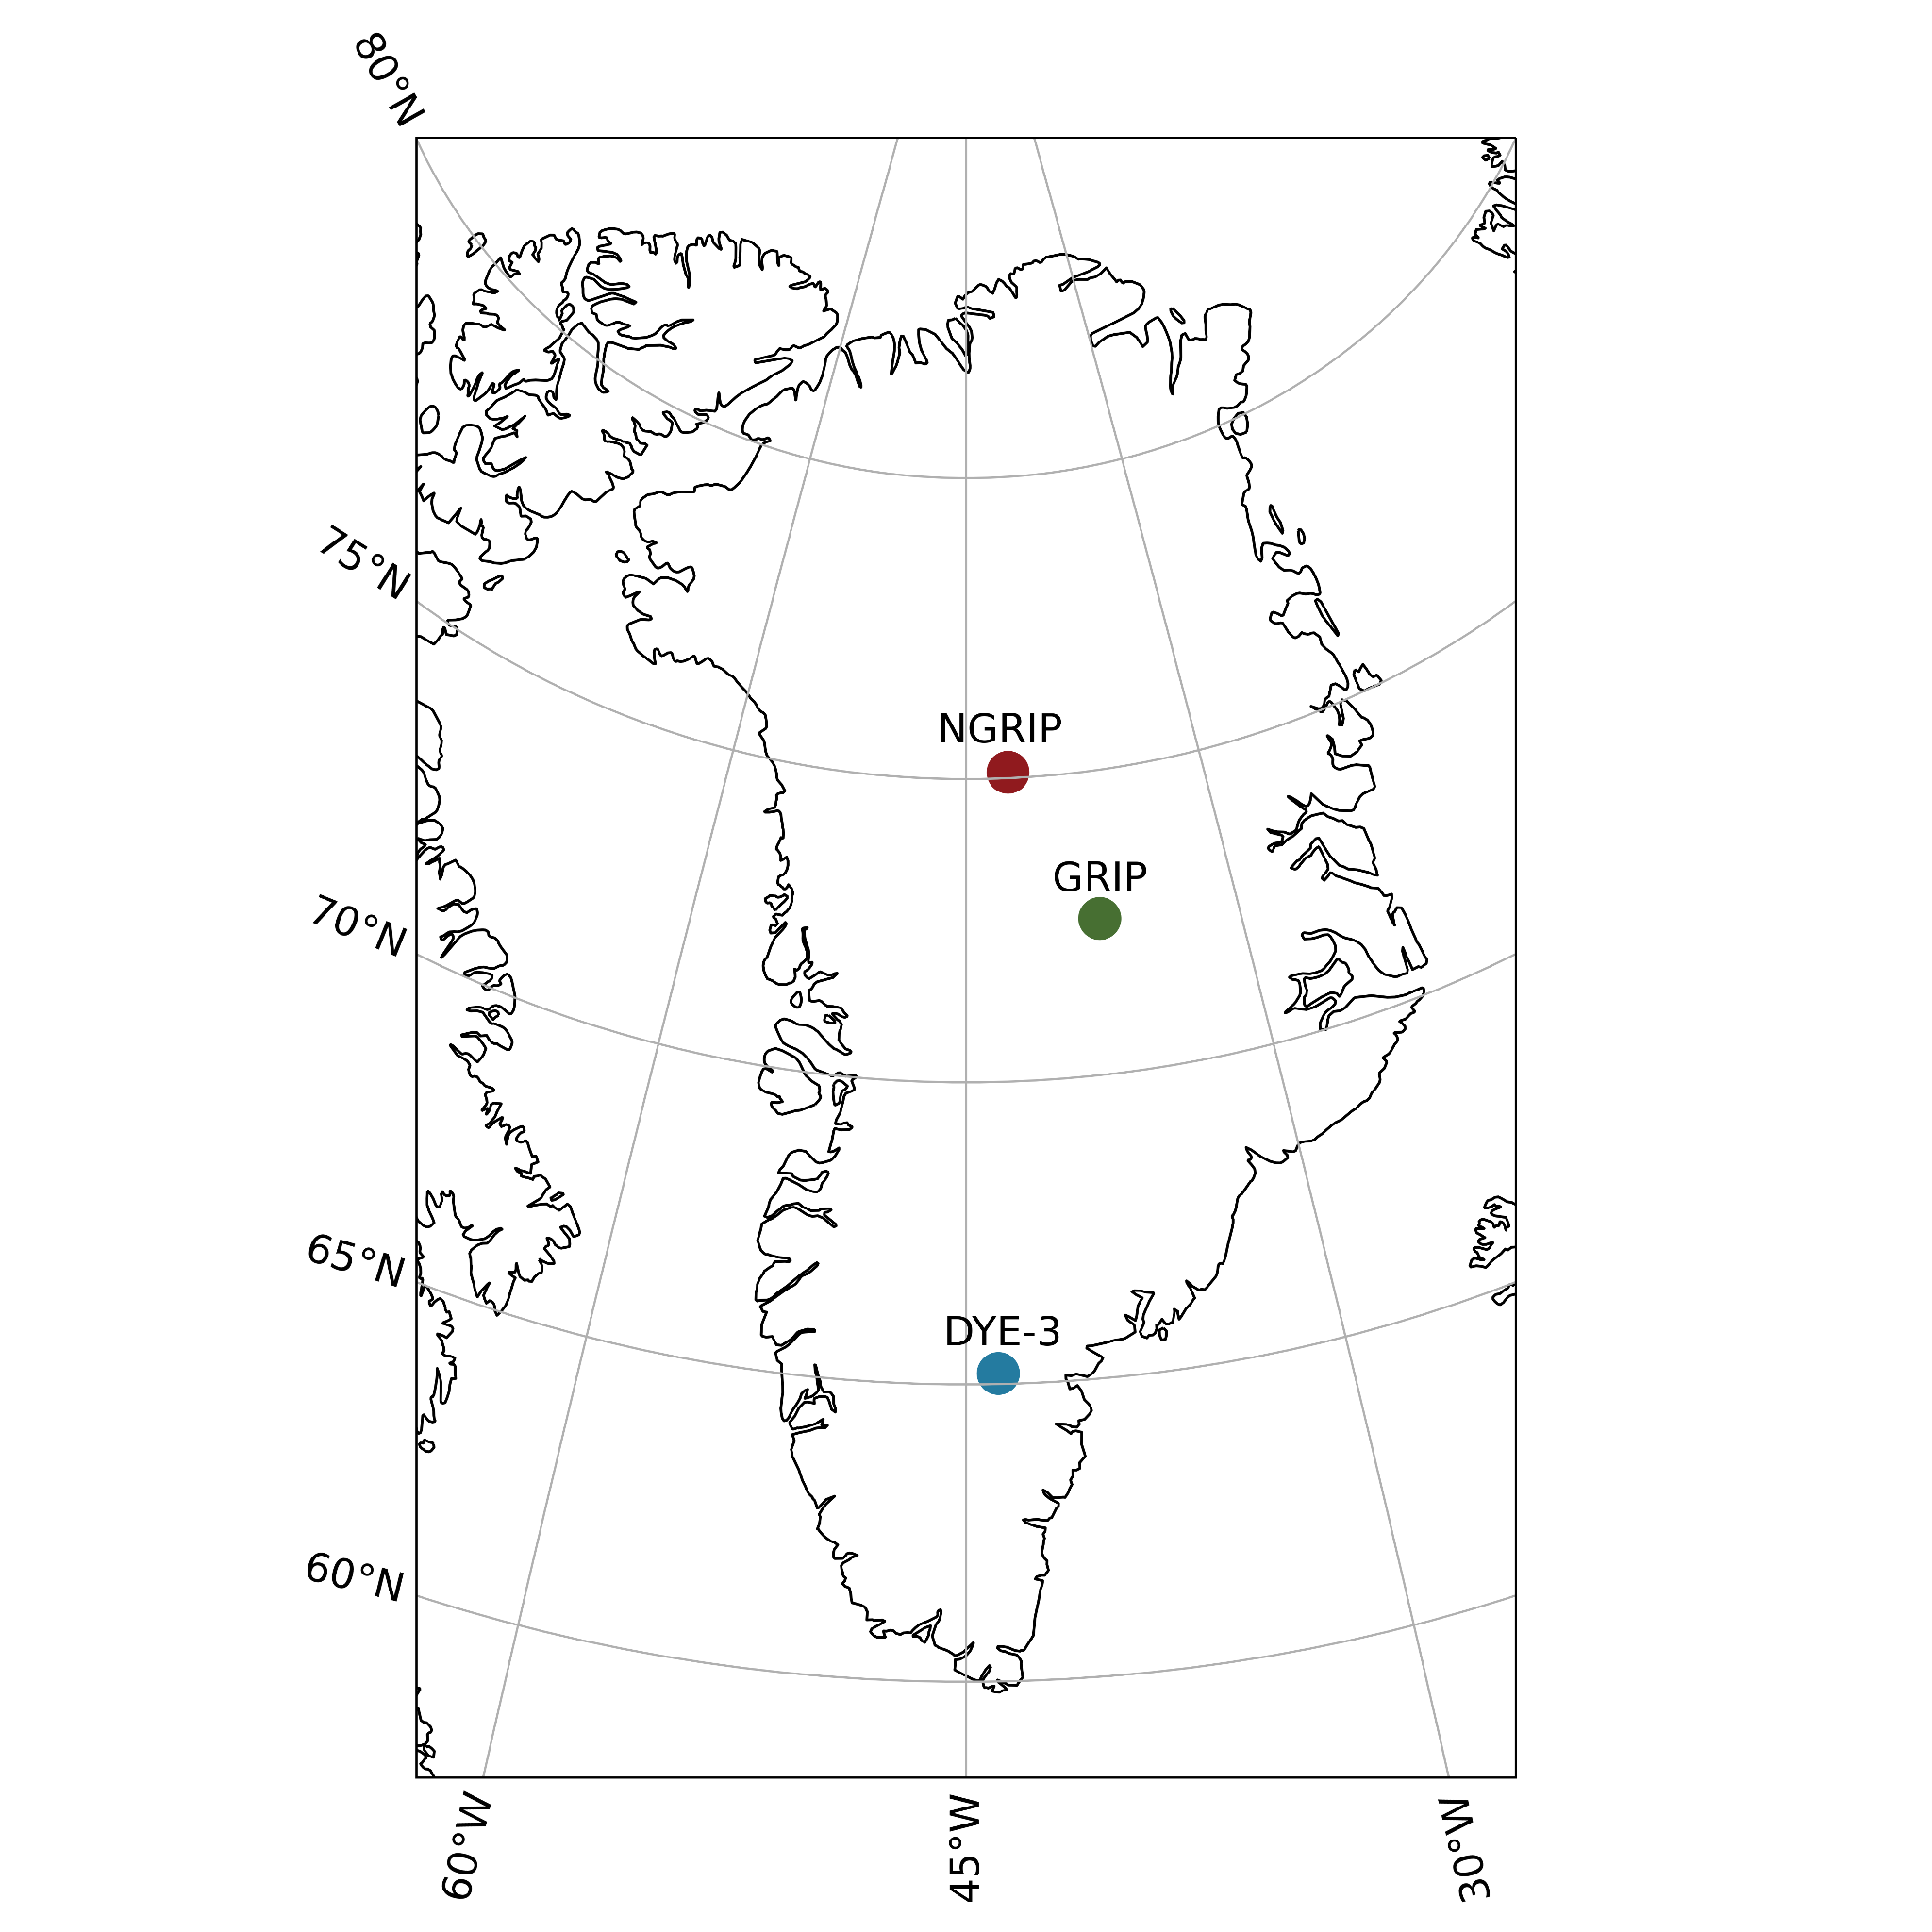
Introduction
Outline
Introduction
Model & Setup
Results
Discussion
Conclusion

Slide 4
Outline
Introduction
Model & Setup
Results
Discussion
Conclusion

Slide 5
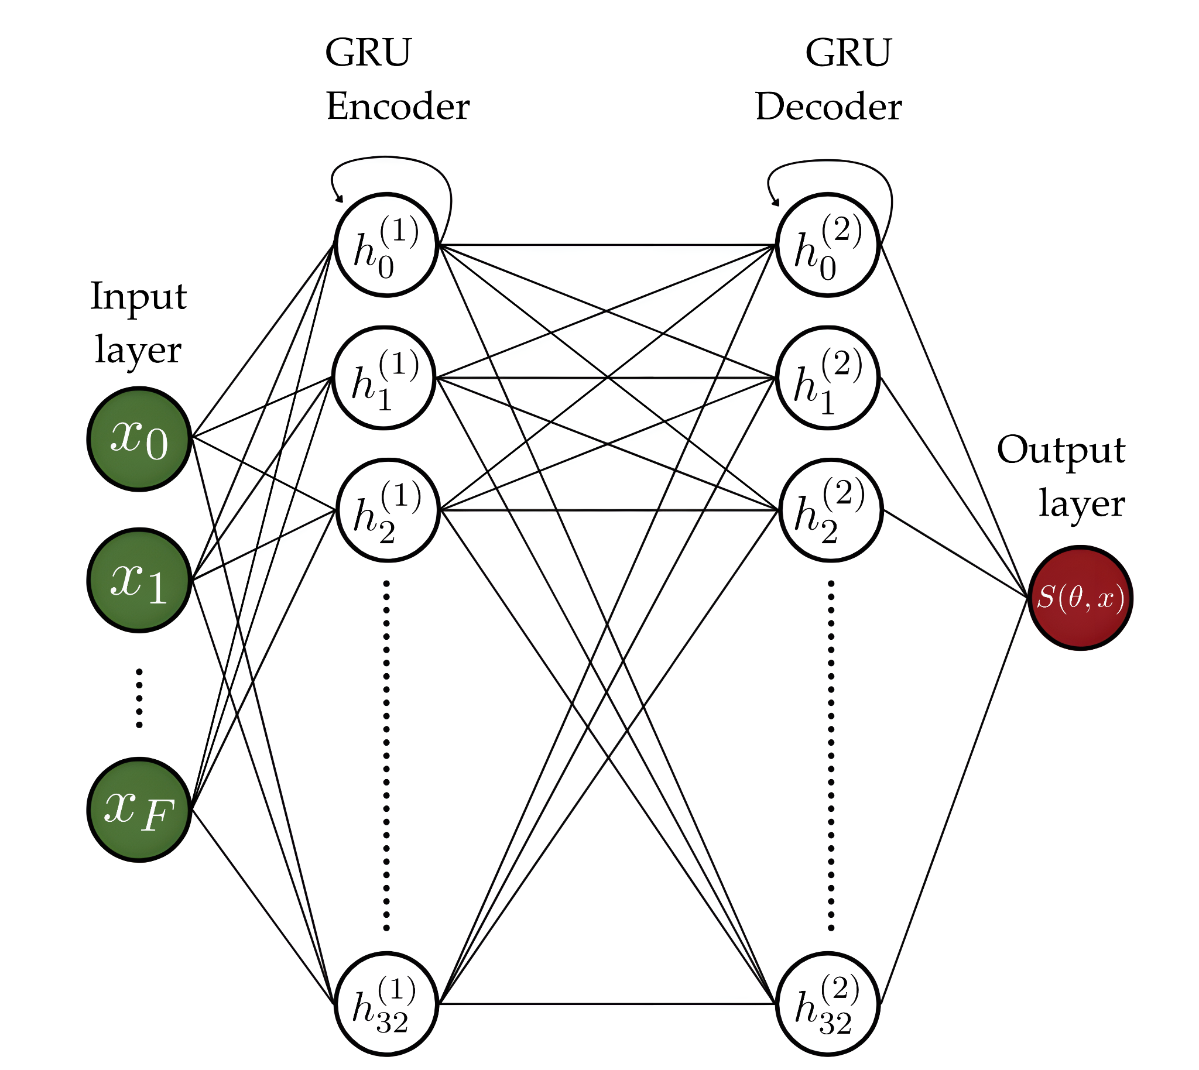
GRU Model
Outline
Introduction
Model & Setup
Results
Discussion
Conclusion

Slide 6
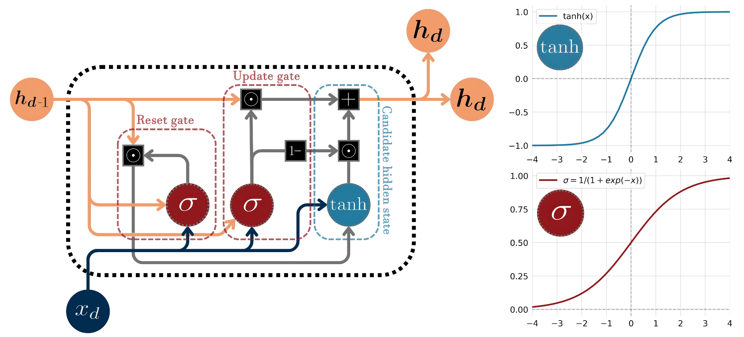
GRU - Looking Inside
Outline
Introduction
Model & Setup
Results
Discussion
Conclusion

Slide 7
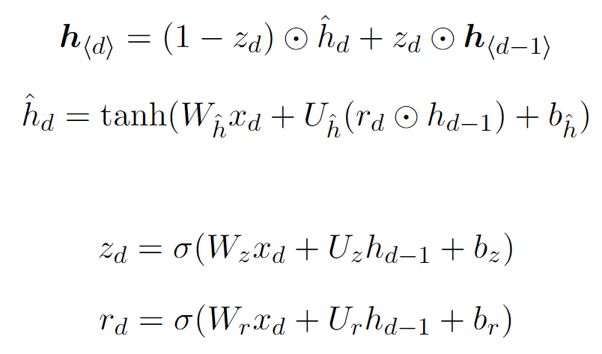
GRU - Looking Inside
Outline
Introduction
Model & Setup
Results
Discussion
Conclusion

Slide 8
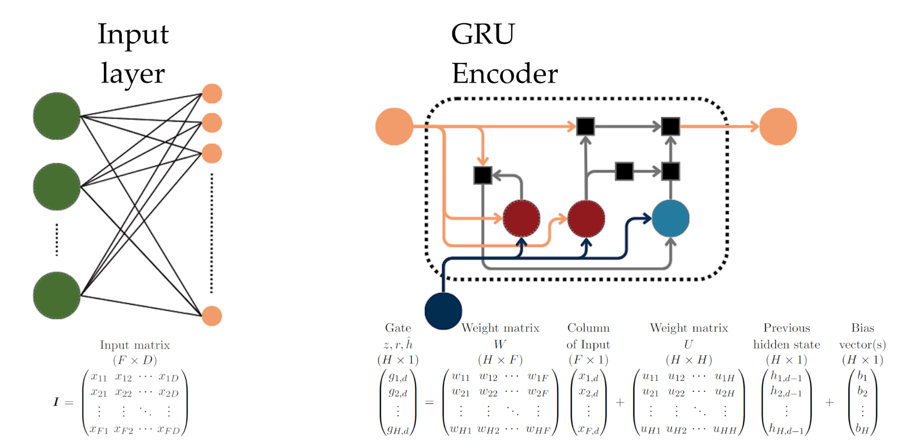
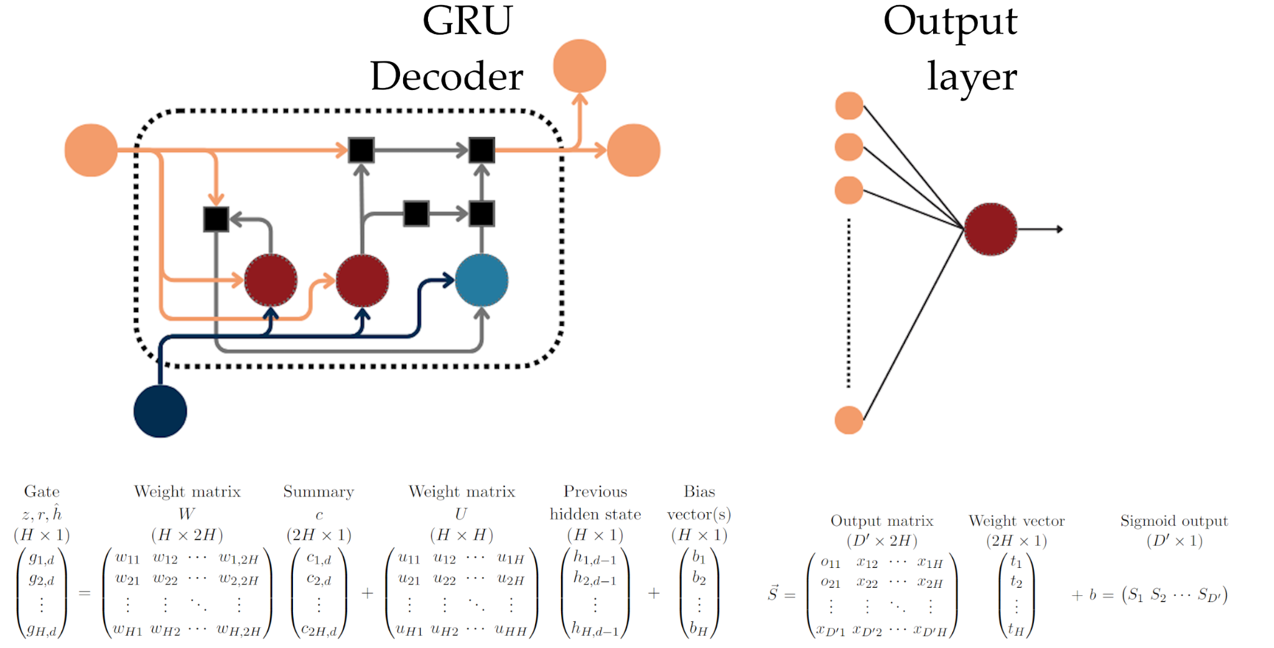
Outline
Introduction
Model & Setup
Results
Discussion
Conclusion

Slide 9
GRU Model - Setup
Outline
Introduction
Model & Setup
Results
Discussion
Conclusion
Model type | Bidirectional GRU Encoder-Decoder
Encoder | 32 neurons, return_sequences = False
Decoder | 32 neurons, return_sequences = True
Optimizer | Adam, loss = ‘binary_crossentropy’ (BCE)
Window size | 1-2 years (35-140 samples for GRIP/NGRIP) in GICC05 timescale
Learning rate | Typically [5e-4, 1e-4, 5e-5]

Slide 10
GRU Model - Making predictions
Outline
Introduction
Model & Setup
Results
Discussion
Conclusion

Slide 11
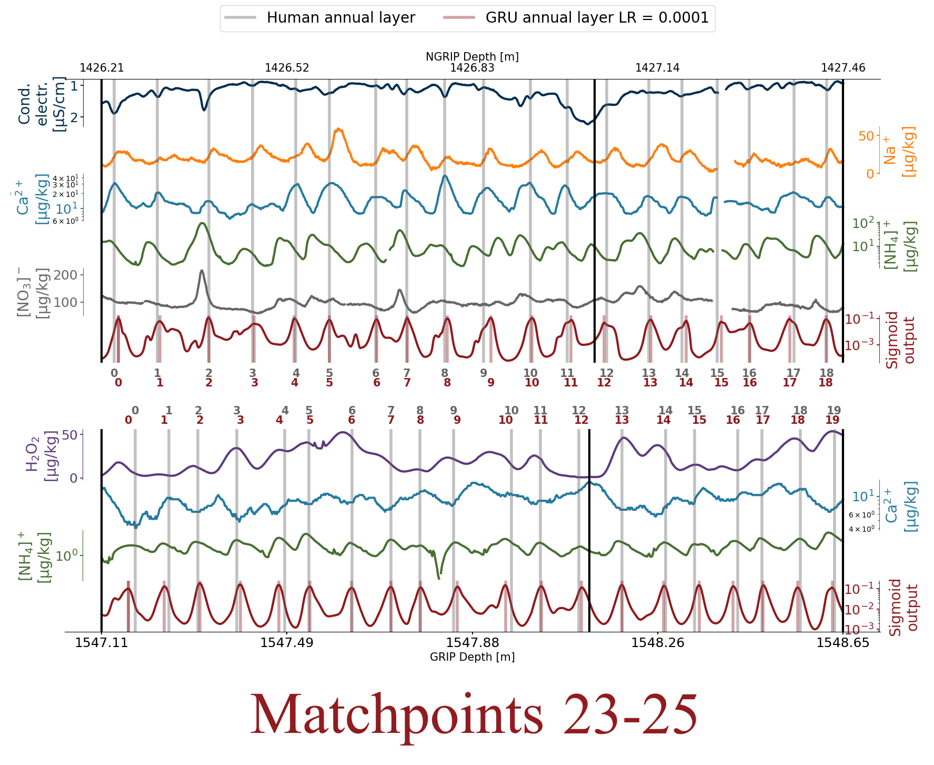
Results
Outline
Introduction
Model & Setup
Results
Discussion
Conclusion

Slide 12
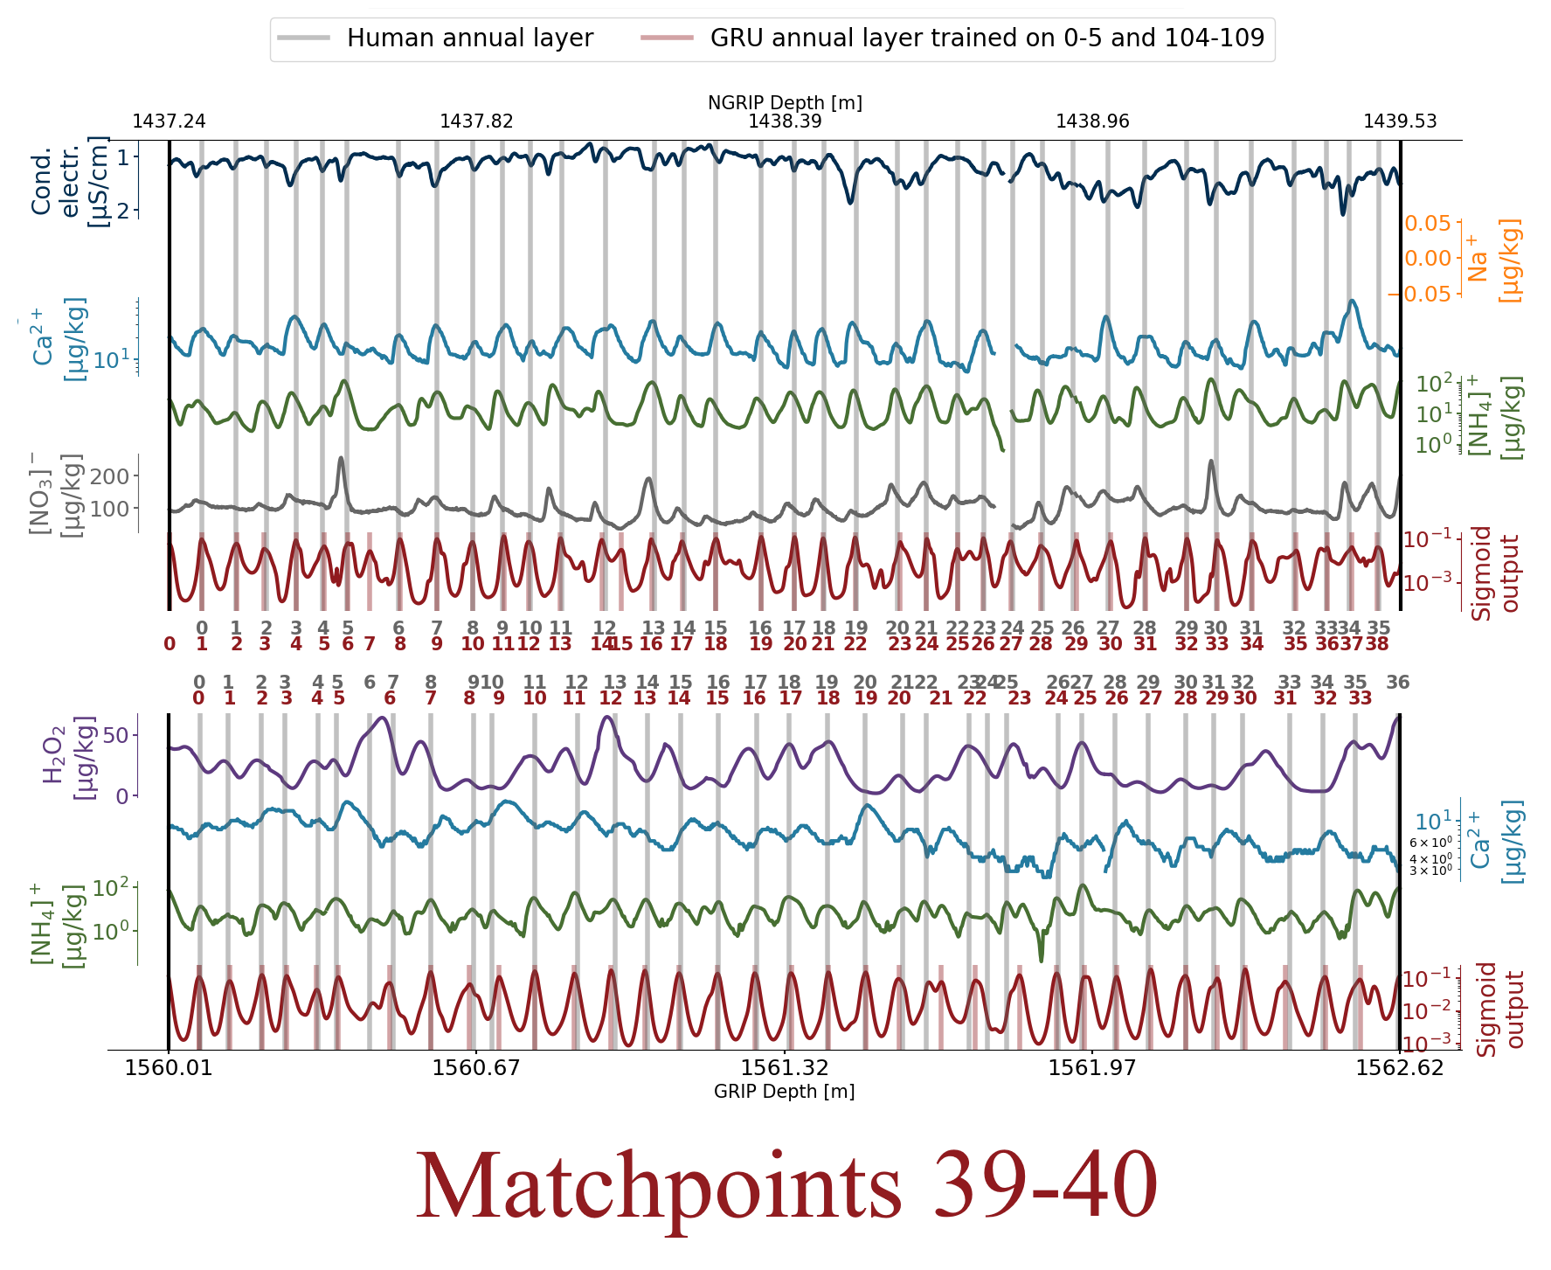
Outline
Introduction
Model & Setup
Results
Discussion
Conclusion

Slide 13
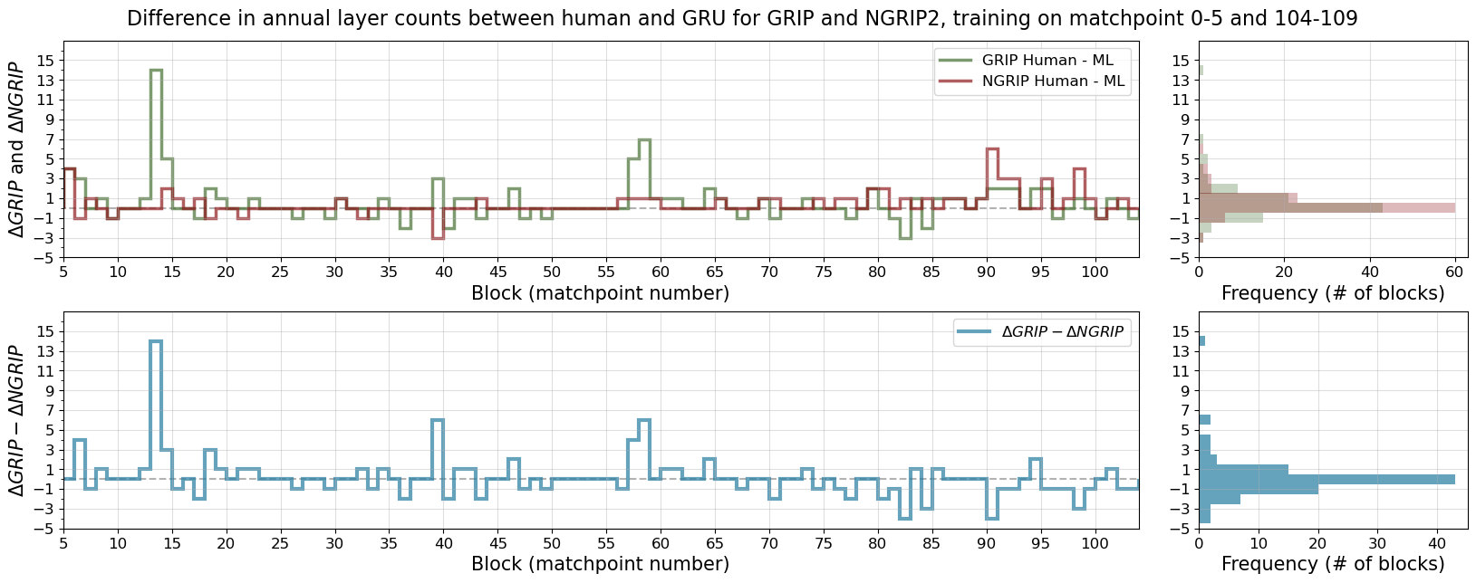
Outline
Introduction
Model & Setup
Results
Discussion
Conclusion
Within each block, 89.9% and 79.8% of GRU counts are within 1 of the GICC05 count for NGRIP and GRIP, respectively.

Slide 14
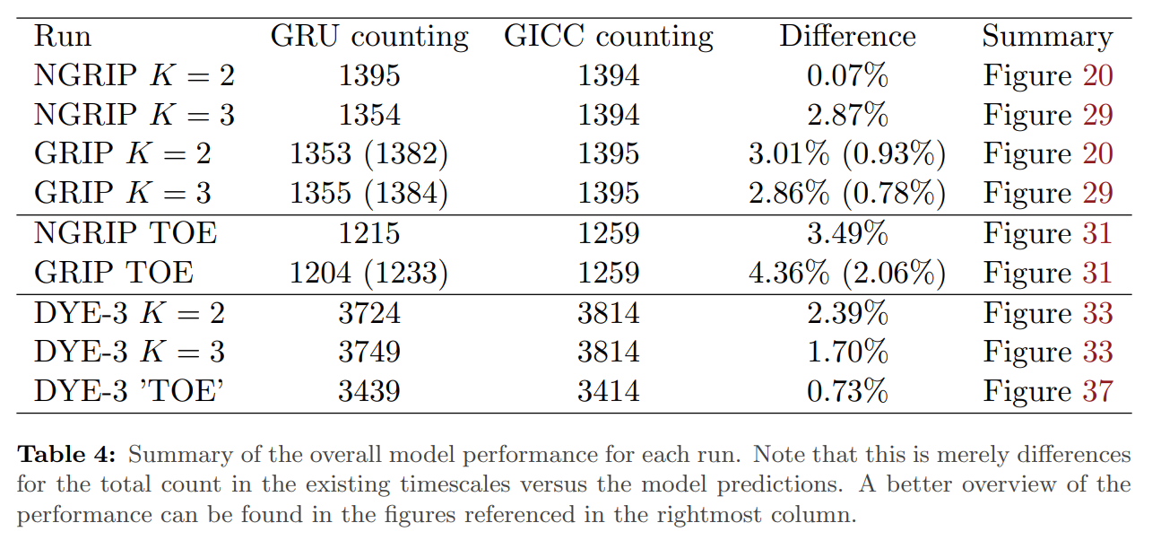
Results
Outline
Introduction
Model & Setup
Results
Discussion
Conclusion

Slide 15
Discussion
Outline
Introduction
Model & Setup
Results
Discussion
Conclusion
Training and evaluation is done using manually identified annual layers
Model assumes equidistant time-series input, but the data is a depth-series.
Peak detection is sensitive to used parameter values.
Training and testing on shorter sections of cores with similar characteristics is recommended.

Slide 16
Conclusion
Outline
Introduction
Model & Setup
Results
Discussion
Conclusion

Slide 17
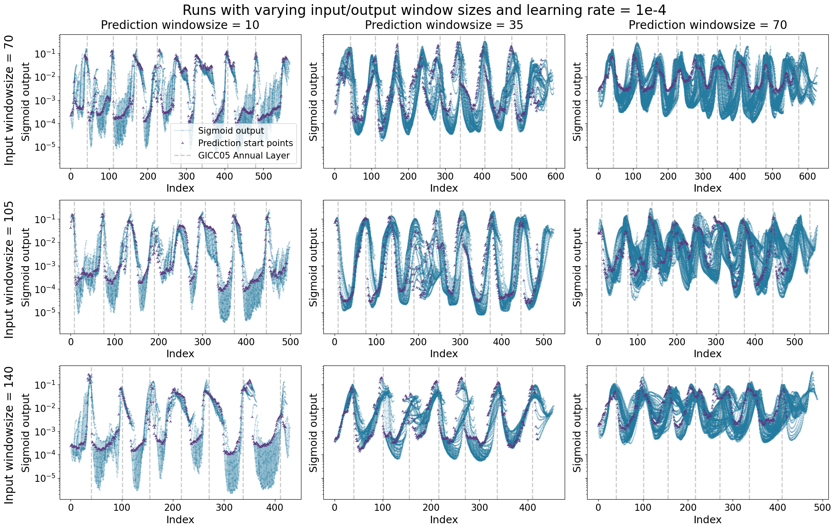
Appendix A - Hyperparameter tuning

Slide 20
Appendix B - Perturbed data for feature importance

Slide 21
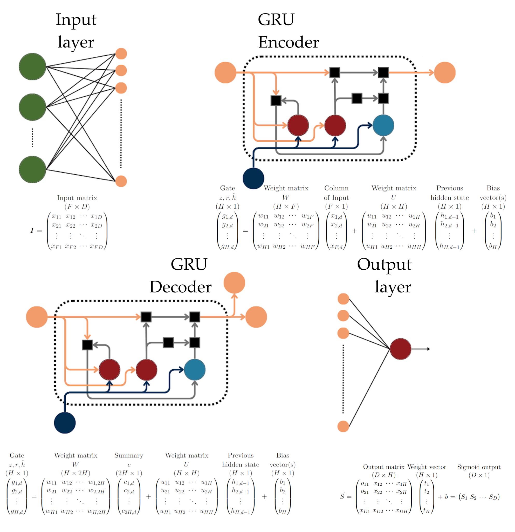
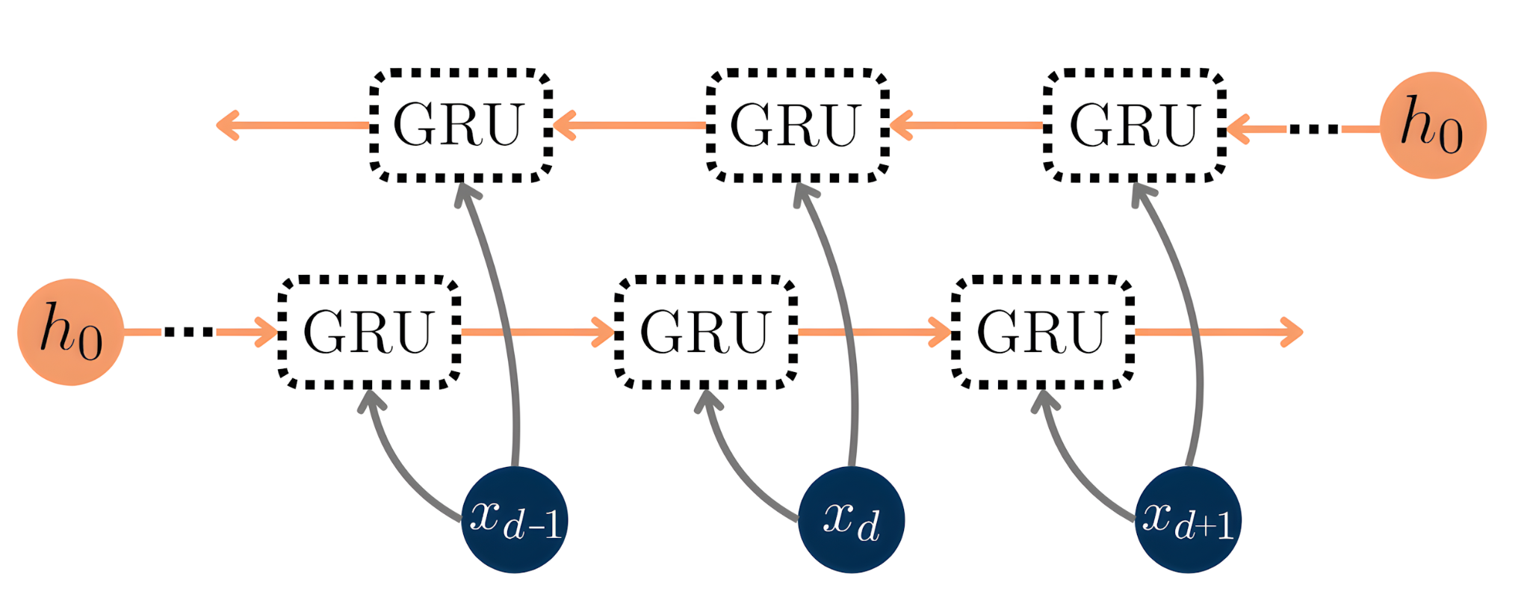
Appendix C - Model

Slide 22
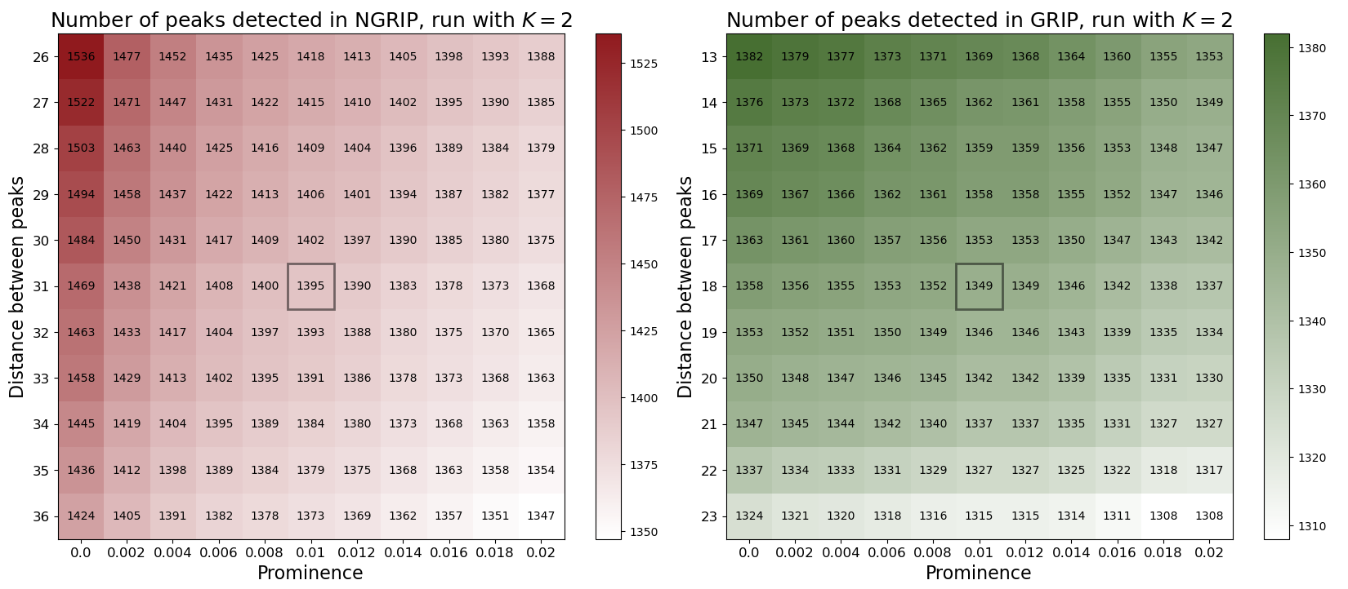
Appendix D - Sensitivity of peak detection

Slide 23
Appendix E - Pseudo-data

Slide 24
Appendix F - Data

Slide 25
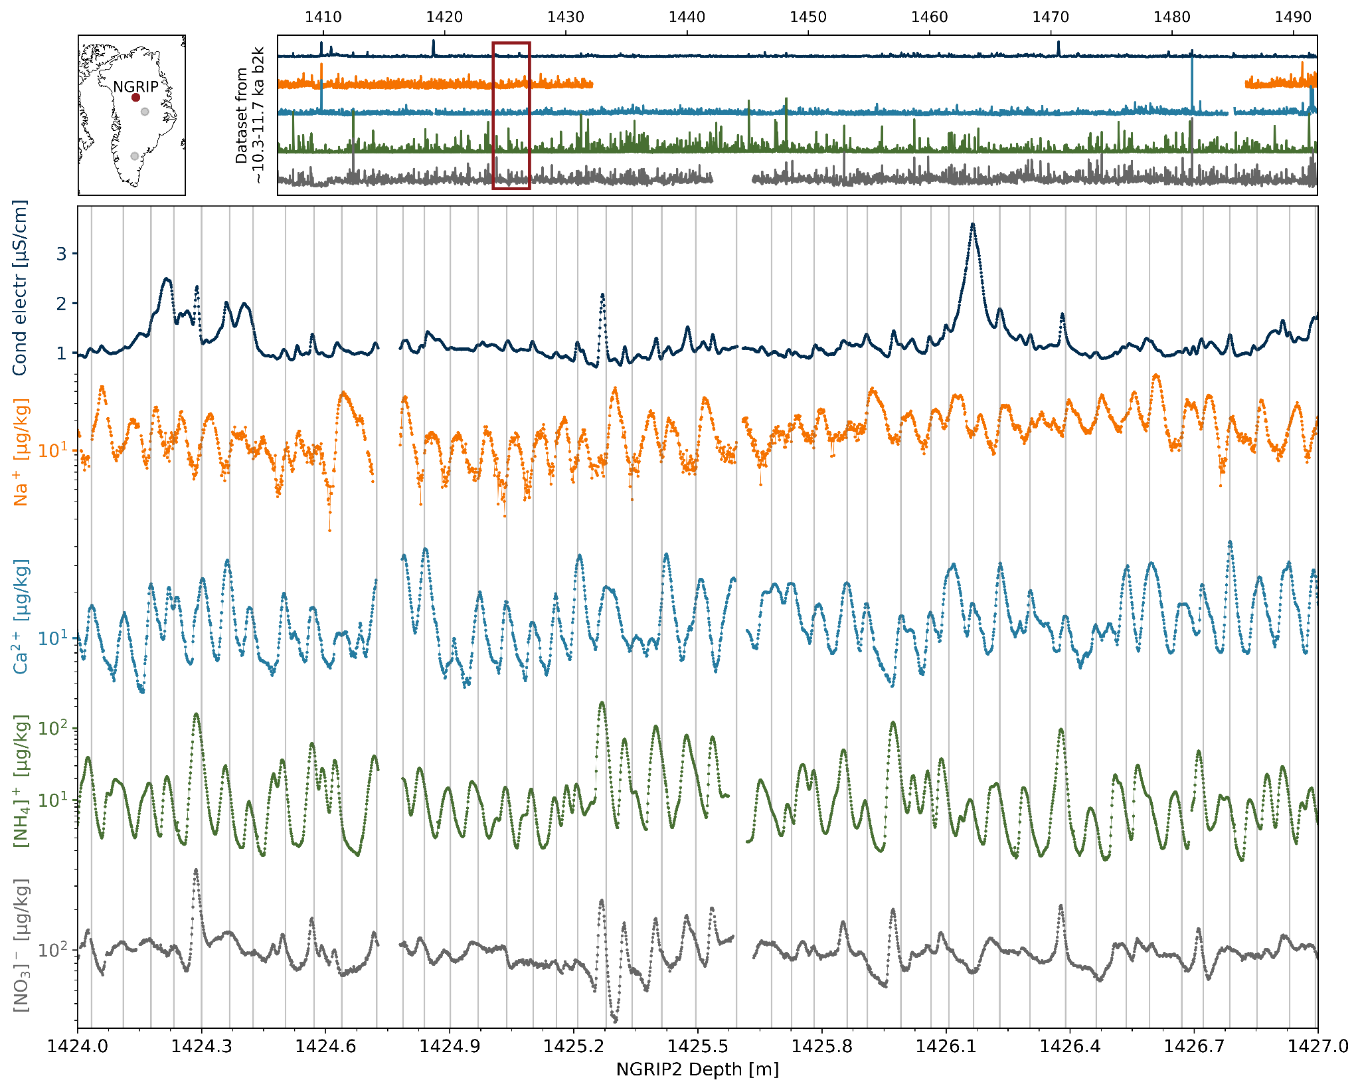

Slide 26
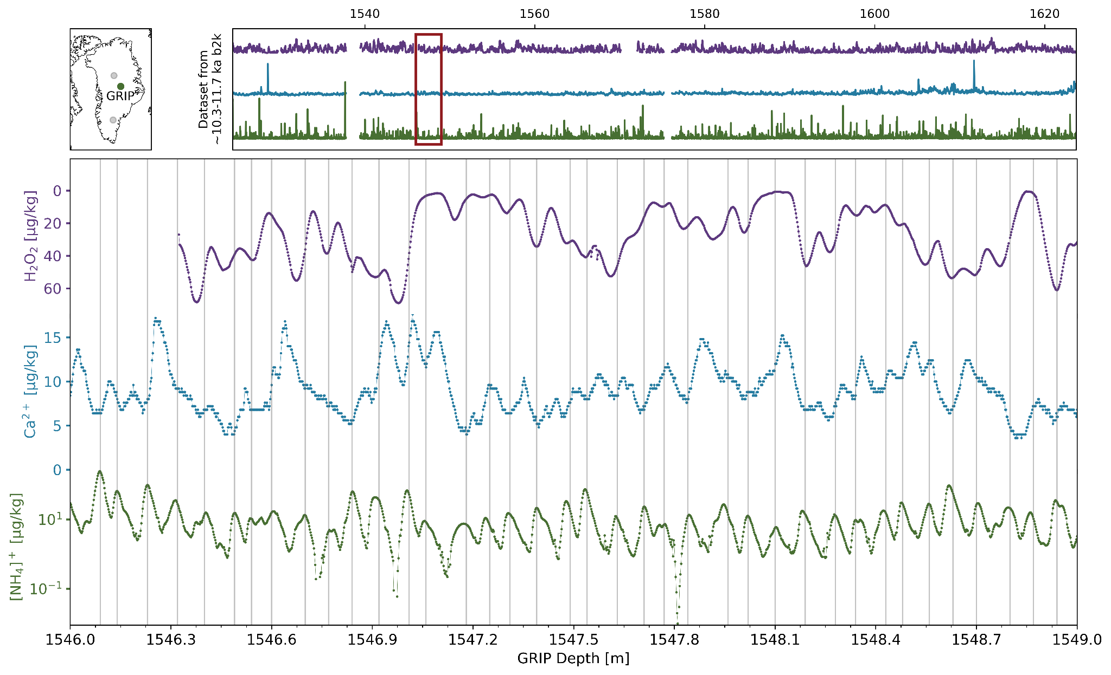

Slide 27
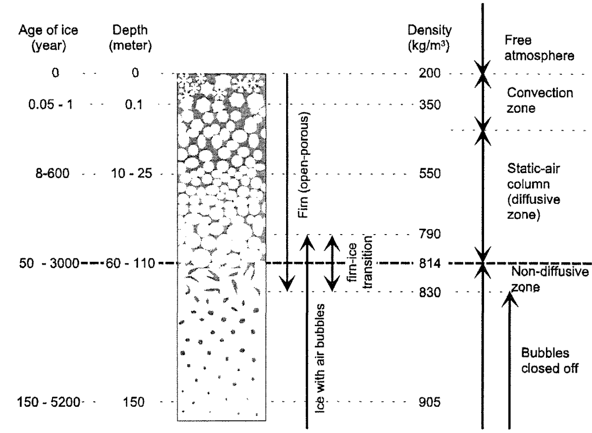
Appendix G: Glaciology

Slide 28
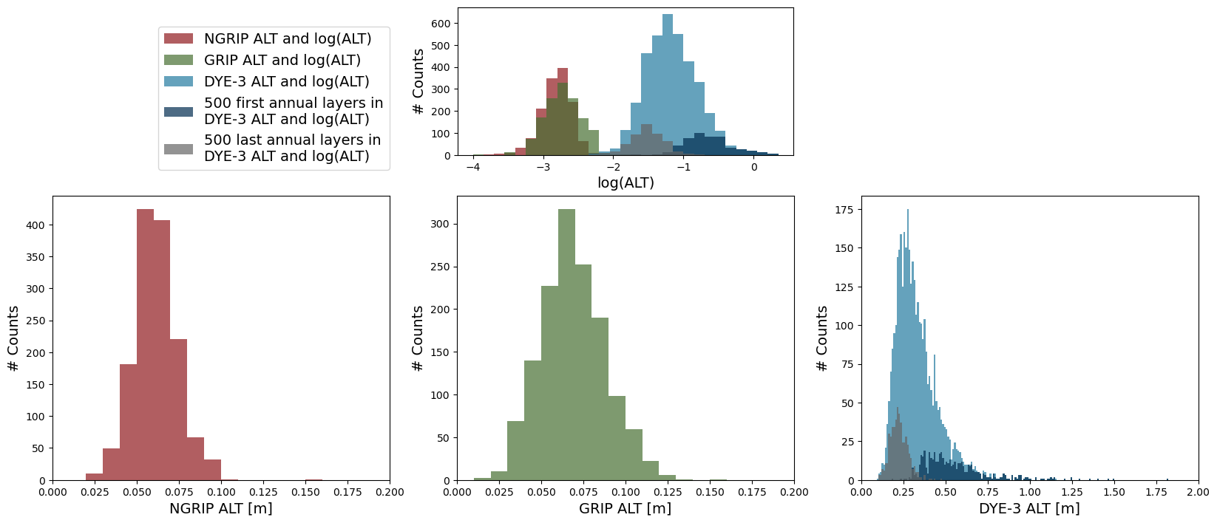
Appendix H: Annual Layer Thicknesses

