Slide 1
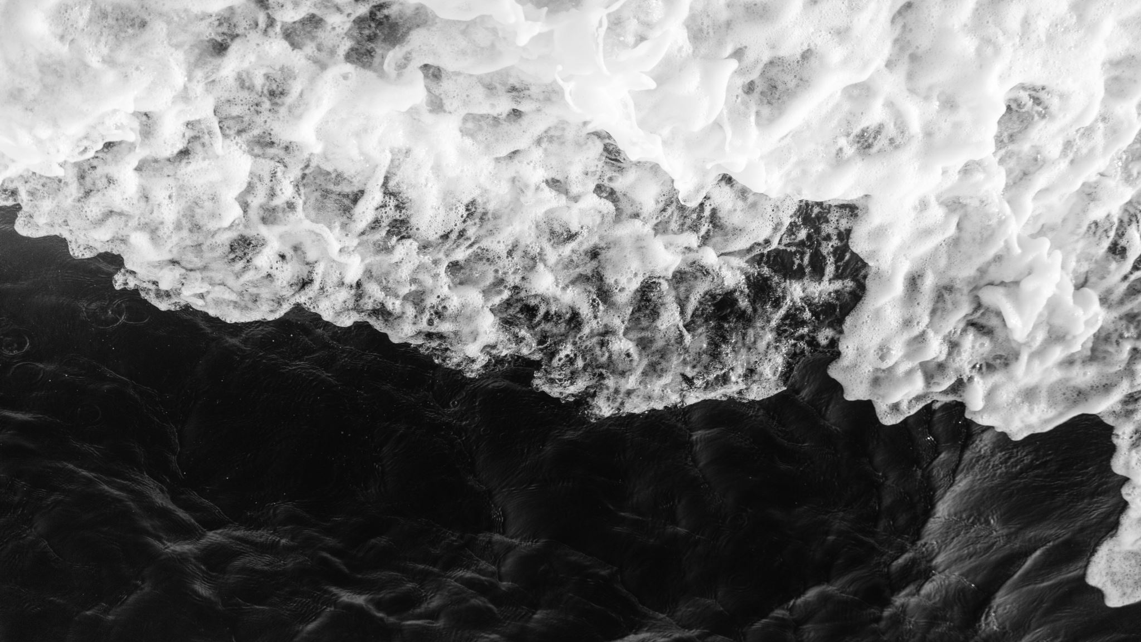
Bayesian optimization of ocean mixed layer parameterizations
Marta Mrozowska, Markus Jochum, James Avery, Ida Stoustrup, Roman Nuterman and Carl-Johannes Johnsen
20/08/2024
HAMLET-Physics, KU

Slide 2

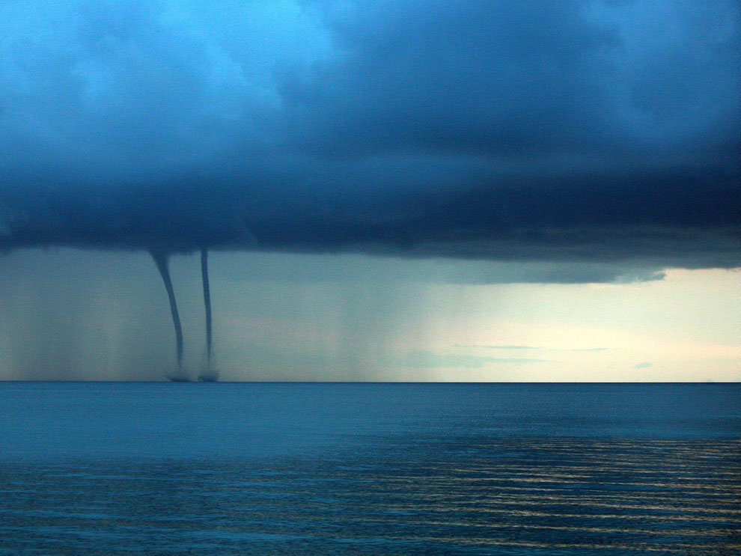

Super yacht Bayesian sinks after encounter with extremely rare water spout (20/8/24, FT)

Slide 3
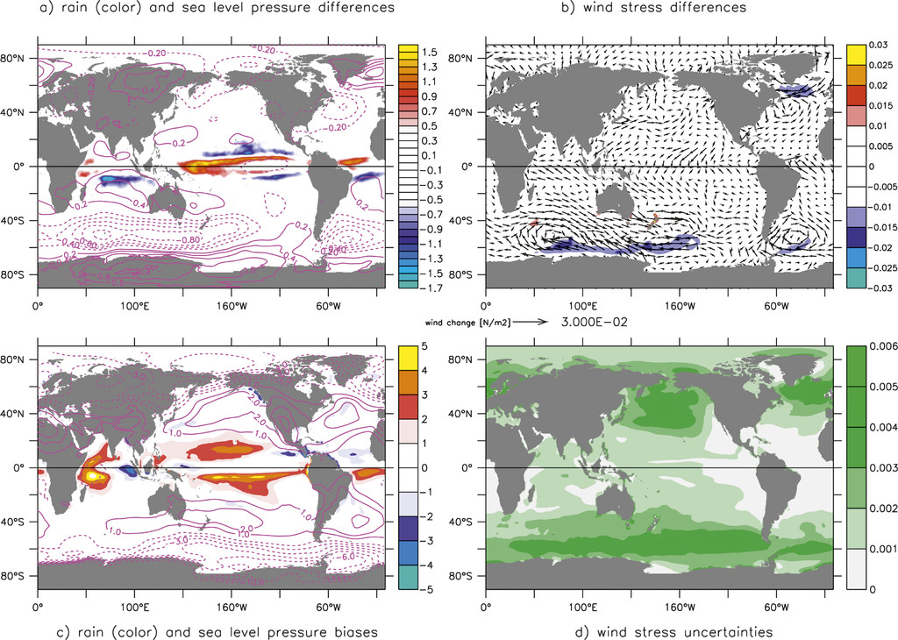
Tropical SST anomalies can lead to restructuring of the global atmosphere
Jochum et al. (2013)

Slide 4
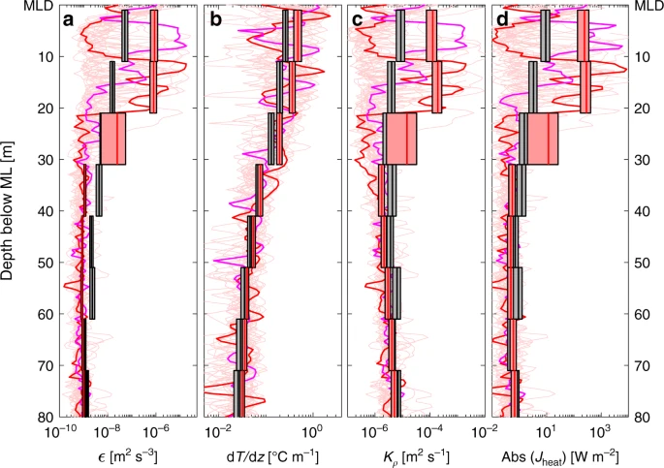
One of the largest sources of uncertainty is vertical mixing
Vertical turbulent mixing creates a homogeneous surface layer that, like a skin, exchanges heat and momentum with the atmosphere
Mixing is difficult to observe, but the mixed layer depth (MLD) is well observed and a key metric for model performance
A rare direct observation of a strong mixing
event (Hummels et al. 2020). The turbulent
diffusivity (3 orders larger than molecular) is
shown in panel c.
Foltz et al. (2003)

Slide 5
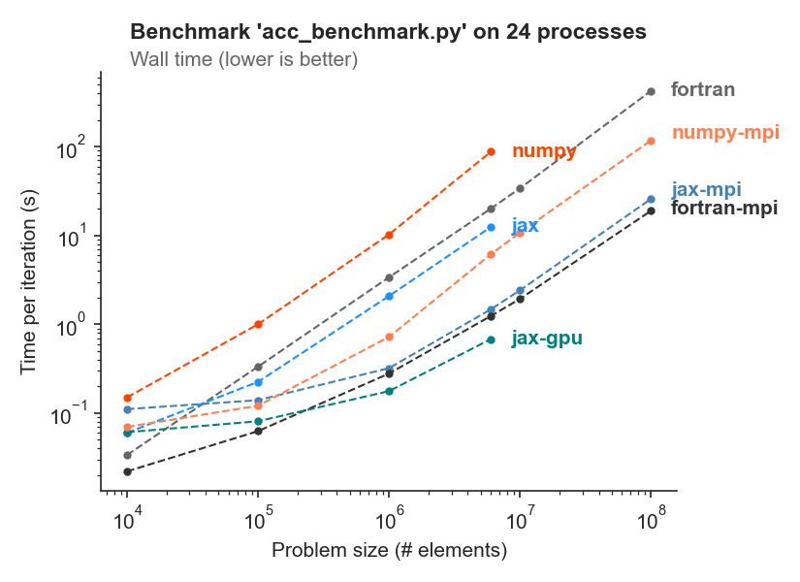
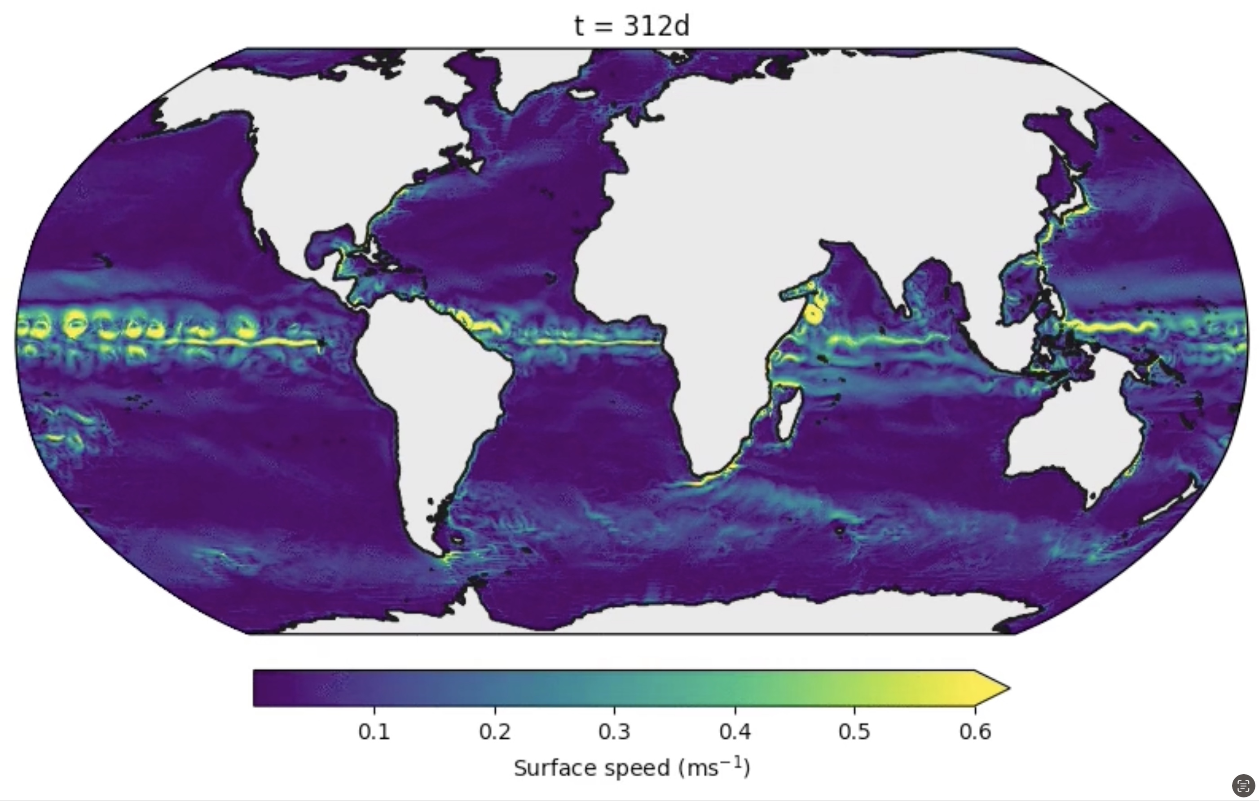
Veros: Versatile Ocean Simulator
Python/JAX
MPI for GPUs
Fortran on 2000 CPUs or Python/JAX on 16 A100 GPUs
…at a fifth of the energy!
Fortran: the Diesel of climate models!
Häfner et al. (2021)

Slide 6
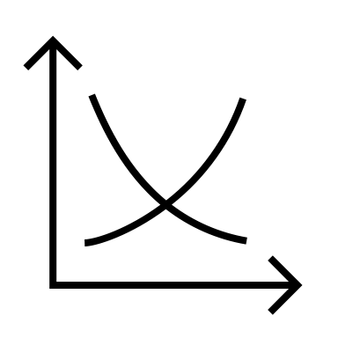


The Problem
We want to optimize the objective function
$$f: ℝ^{n}⟶ℝ$$
We don’t know anything about the function shape (so-called black box objective function)
The objective function is expensive to evaluate

Slide 7
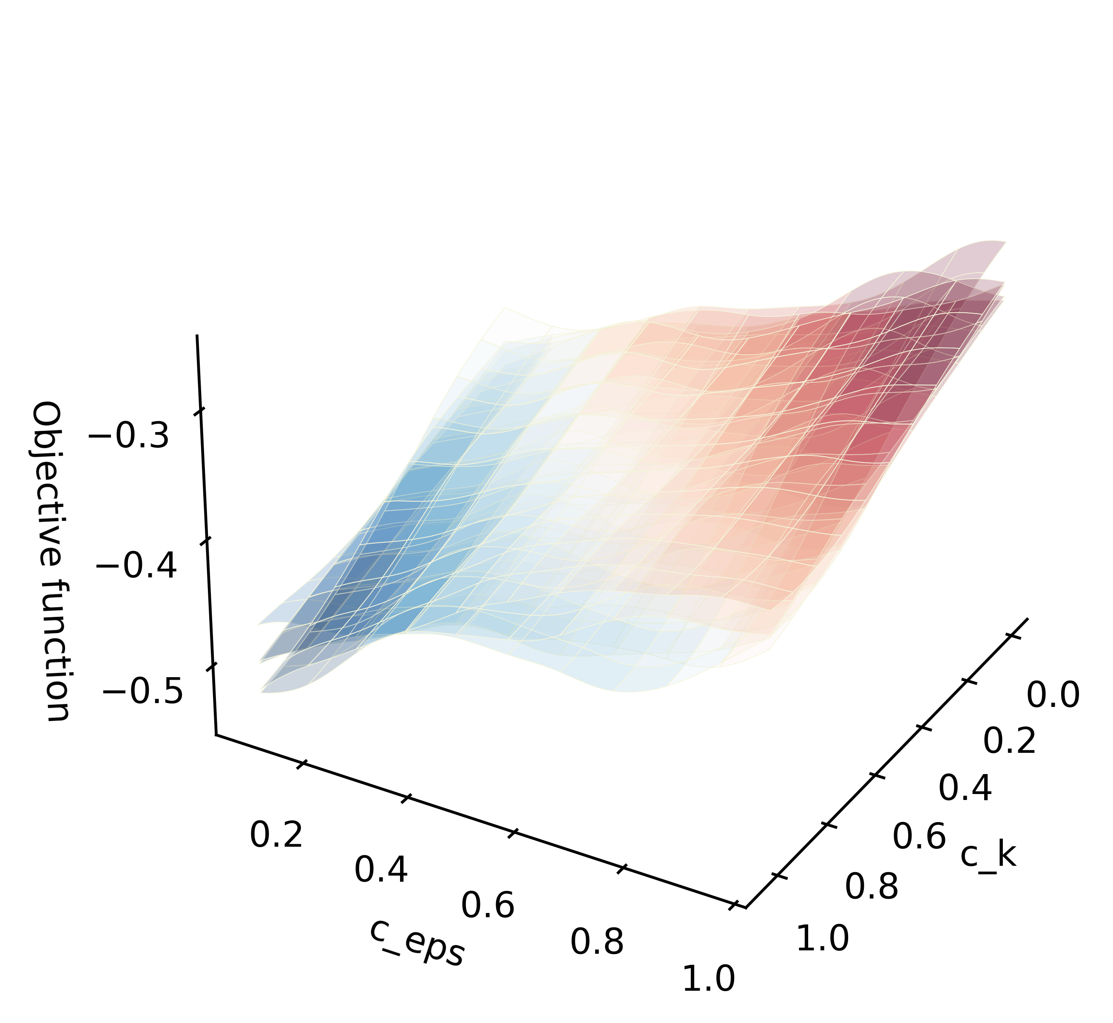
The Solution: Bayesian Optimization
Based on a few objective function evaluations, construct a surrogate model of the objective function over the full parameter space
Using the model of the objective function, decide the next optimal parameter set to evaluate

Slide 8
Agenda
Gaussian process regression models
Bayesian optimization with VerOpt
Optimizing the turbulent kinetic energy closure scheme in Veros

Slide 9
Gaussian process (GP) regression models

Slide 10
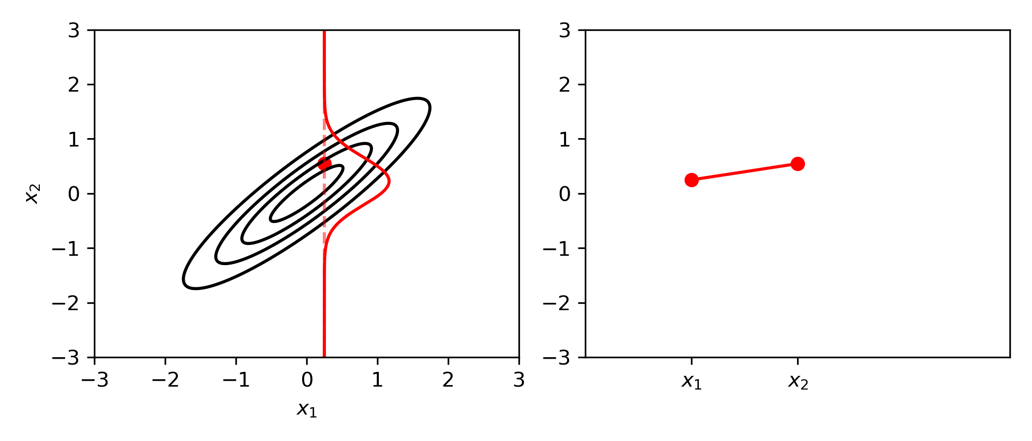


$$σ_{12}=σ_{21}=0.9$$
$$\left[\begin{matrix}x_{1} \\ x_{2}\end{matrix}\right]∽𝒩\left(\left[\begin{matrix}μ_{1} \\ μ_{2}\end{matrix}\right],\left[\begin{matrix}σ_{11} & σ_{12} \\ σ_{21} & σ_{22}\end{matrix}\right]\right)$$

Slide 11
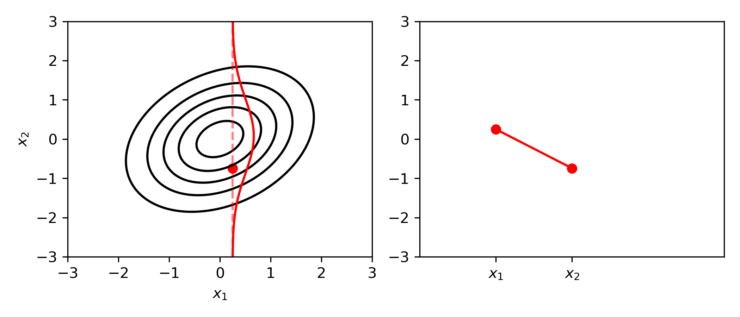

$$σ_{12}=σ_{21}=0.3$$
$$\left[\begin{matrix}x_{1} \\ x_{2}\end{matrix}\right]∽𝒩\left(\left[\begin{matrix}μ_{1} \\ μ_{2}\end{matrix}\right],\left[\begin{matrix}σ_{11} & σ_{12} \\ σ_{21} & σ_{22}\end{matrix}\right]\right)$$

Slide 12
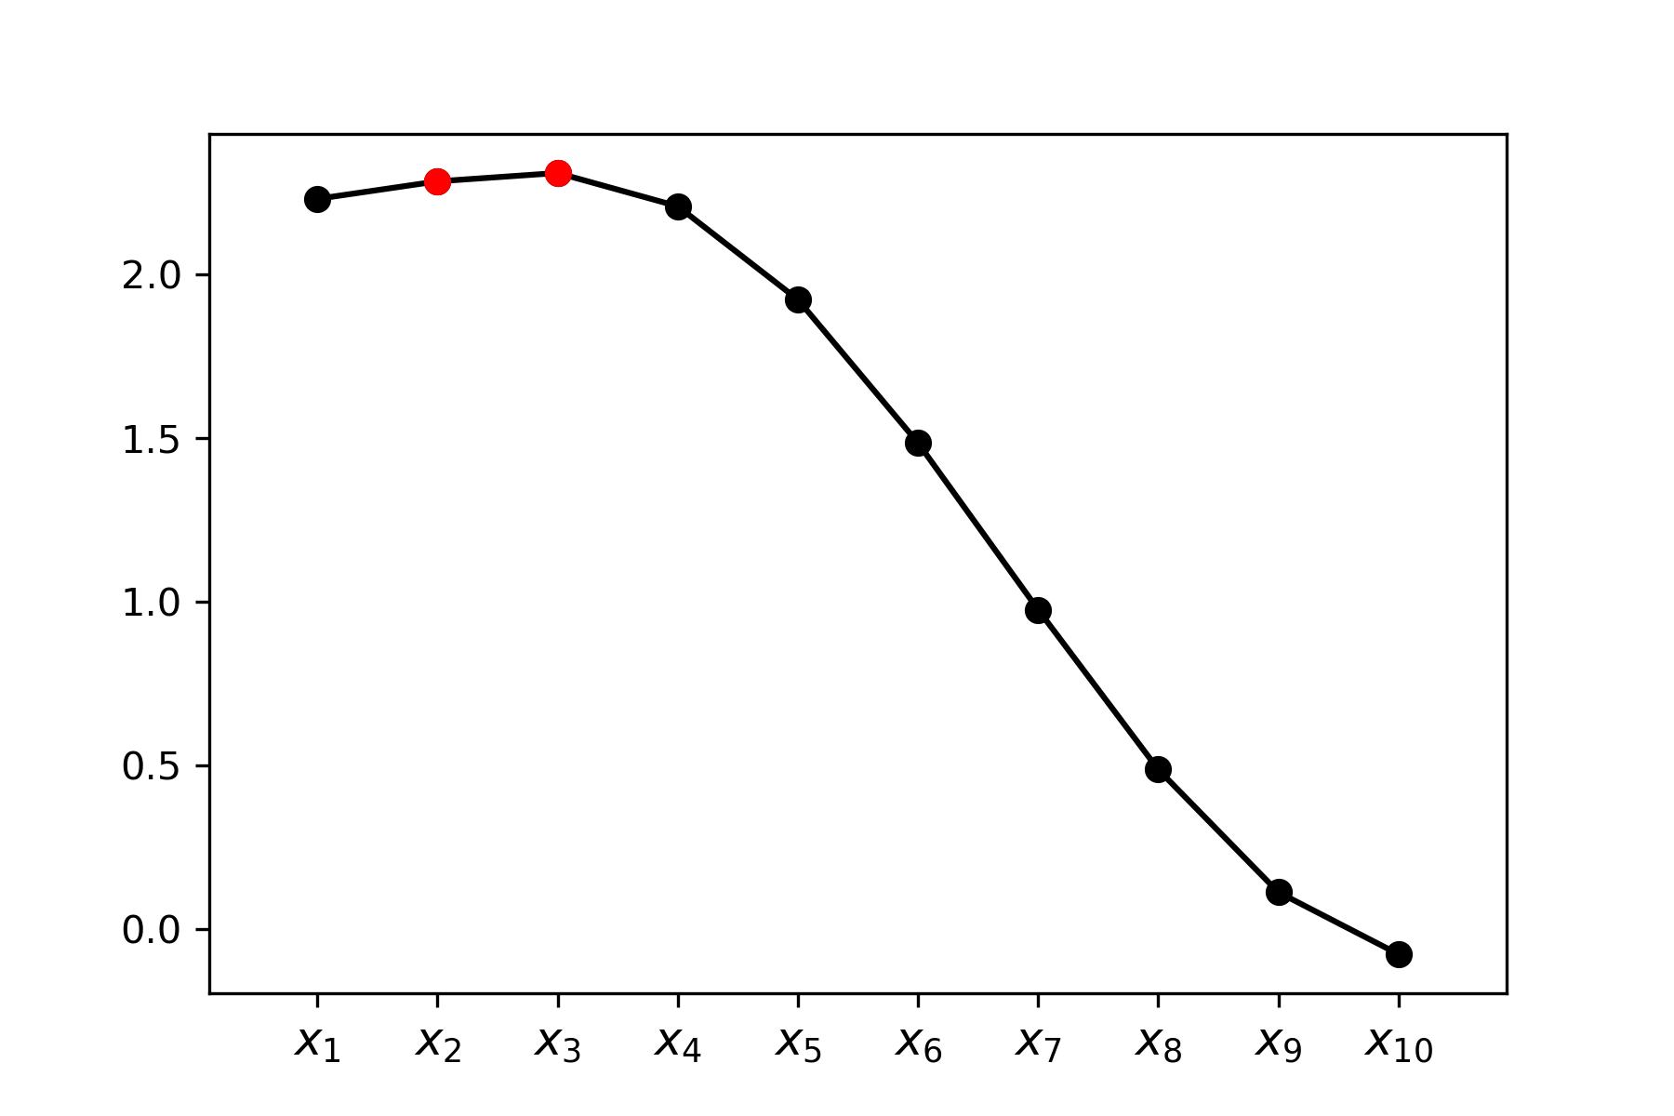
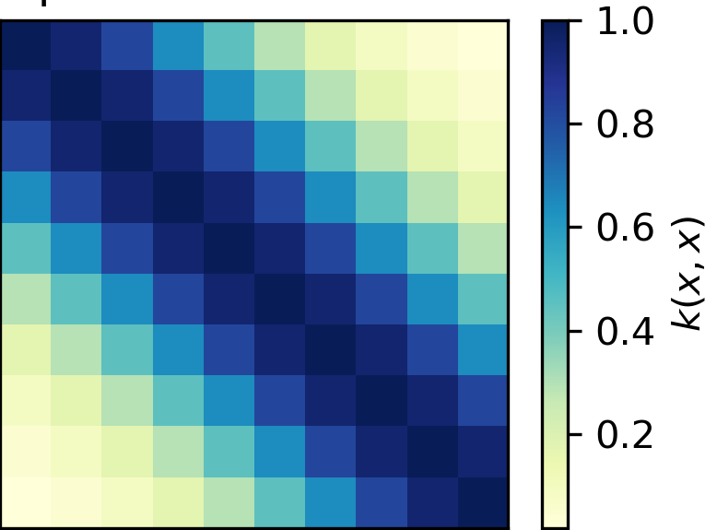
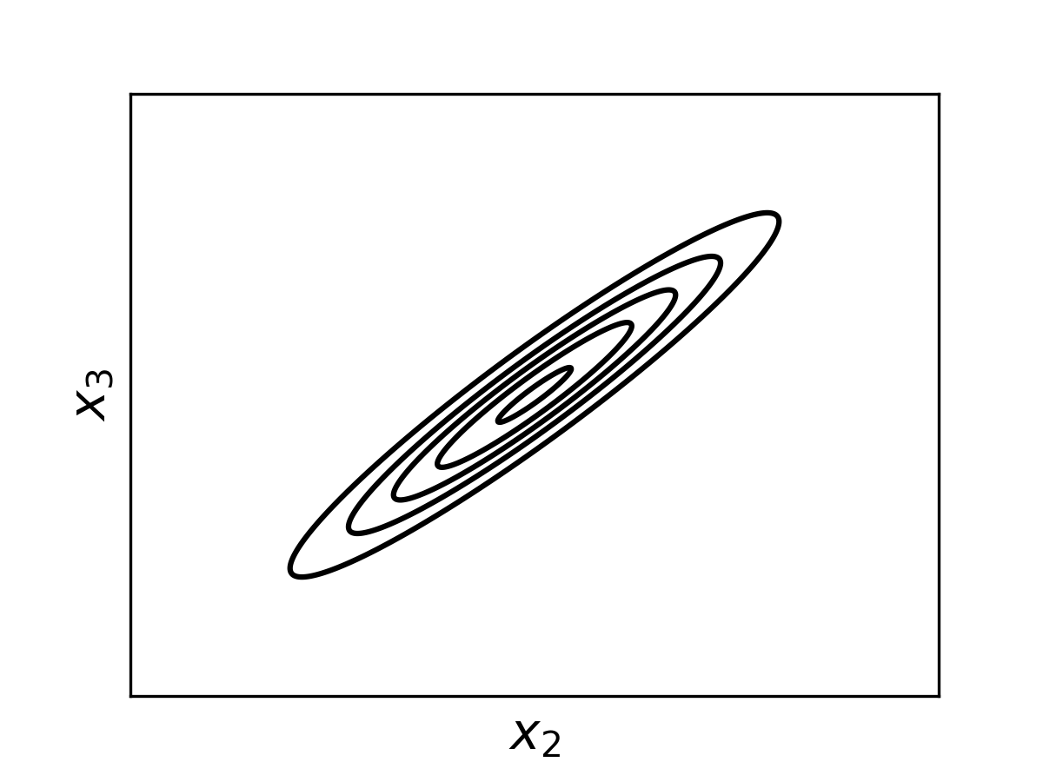




$$x∽𝒩(0,Σ)$$
$$Σ=$$
$$\left[\begin{matrix}x_{2} \\ x_{3}\end{matrix}\right]∽𝒩\left(\left[\begin{matrix}μ_{2} \\ μ_{3}\end{matrix}\right],\left[\begin{matrix}σ_{22} & σ_{23} \\ σ_{32} & σ_{33}\end{matrix}\right]\right)$$
$$σ_{23}=σ_{32}≈0.95$$

Slide 13
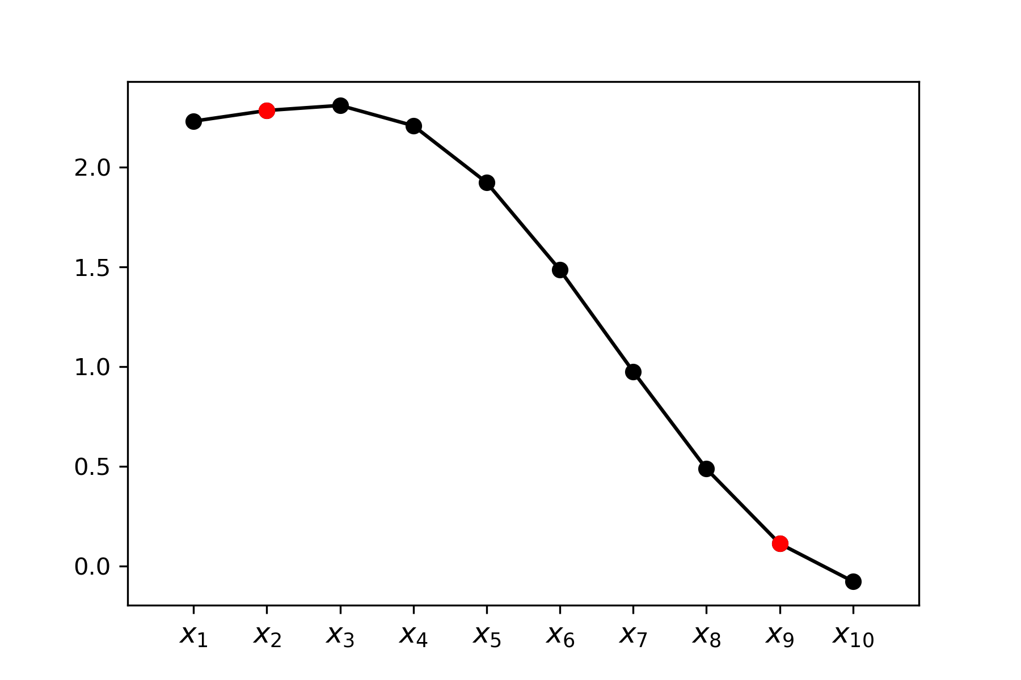
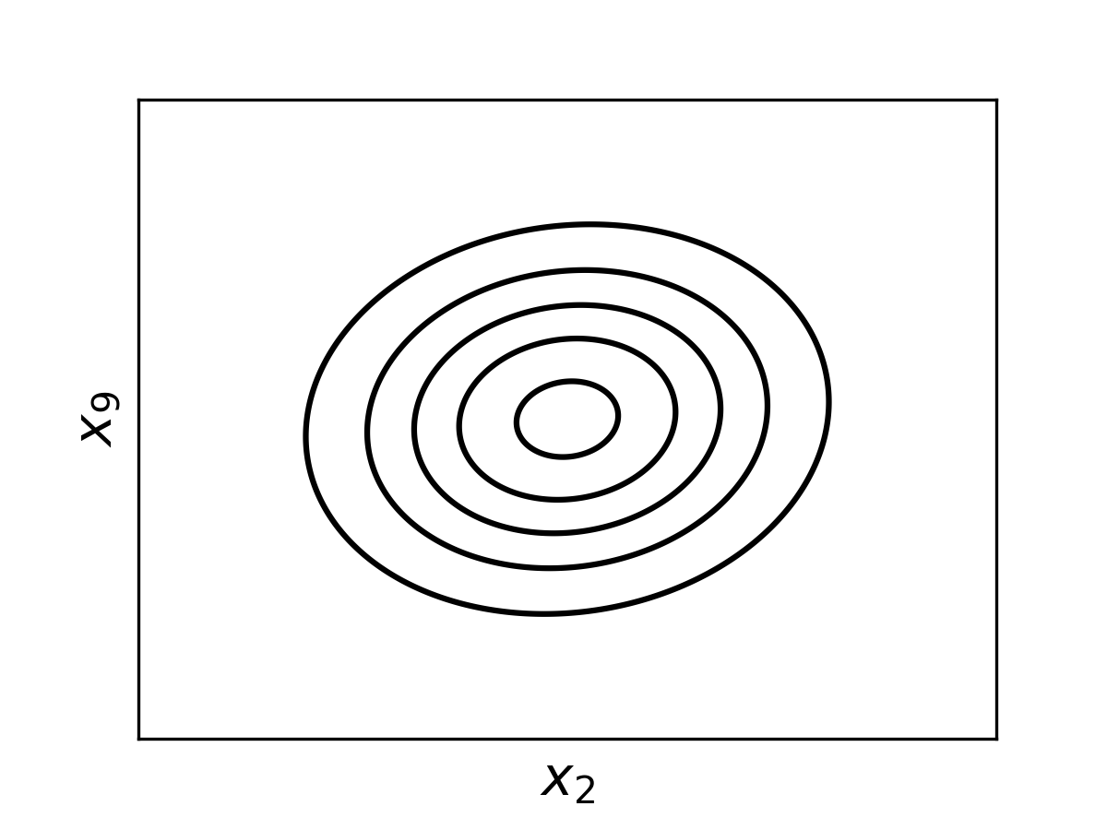


$$x∽𝒩(0,Σ)$$
$$Σ=$$
$$\left[\begin{matrix}x_{2} \\ x_{9}\end{matrix}\right]∽𝒩\left(\left[\begin{matrix}μ_{2} \\ μ_{9}\end{matrix}\right],\left[\begin{matrix}σ_{22} & σ_{29} \\ σ_{92} & σ_{99}\end{matrix}\right]\right)$$
$$σ_{23}=σ_{32}≈0.09$$

Slide 14
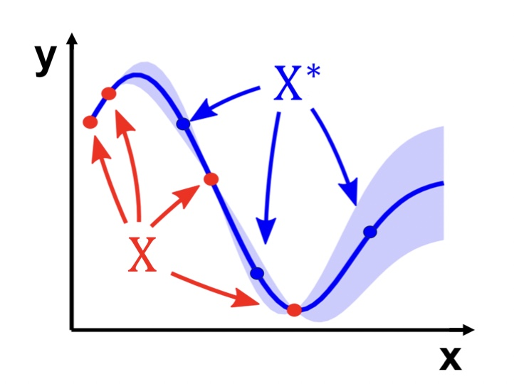
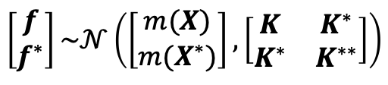


GP regression generalized
$$f^{∗}$$
X: a set of input points
X*: a set of test points
Joint distribution:
$$\left[\begin{matrix}f \\ f^{∗}\end{matrix}\right]\sim 𝒩\left(\left[\begin{matrix}m(X) \\ m(X^{∗})\end{matrix}\right],\left[\begin{matrix}K & K^{∗} \\ K^{∗} & K^{∗∗}\end{matrix}\right]\right)$$
$$x$$

Slide 15
GP regression generalized
$$f^{∗}$$
X: a set of input points
X*: a set of test points
Conditional distribution:
$$f^{∗}|f,X,X^{∗}\sim 𝒩(K^{∗T}K^{−1}f, K^{∗∗}−K^{∗T}K^{−1}K)$$
$$x$$

Slide 16
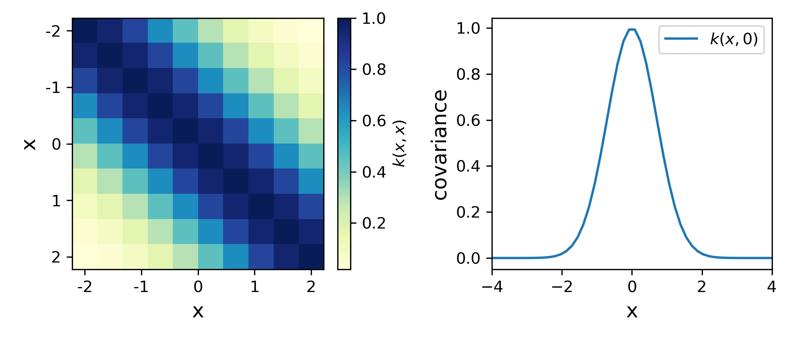
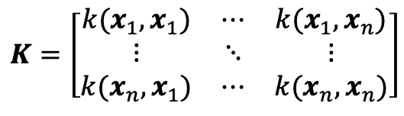
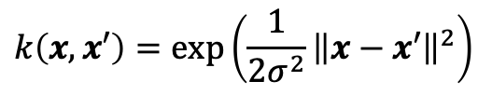
The kernel
$$k\left(x,x′\right)=exp⁡\left(\frac{1}{2σ^{2}}{\left\|x−x′\right\|}^{2}\right)$$
$$K=\left[\begin{matrix}k(x_{1},x_{1}) & ⋯ & k(x_{1},x_{n}) \\ ⋮ & ⋱ & ⋮ \\ k(x_{n},x_{1}) & ⋯ & k(x_{n},x_{n})\end{matrix}\right]$$

Slide 17
Bayesian Optimization with VerOpt

Slide 19
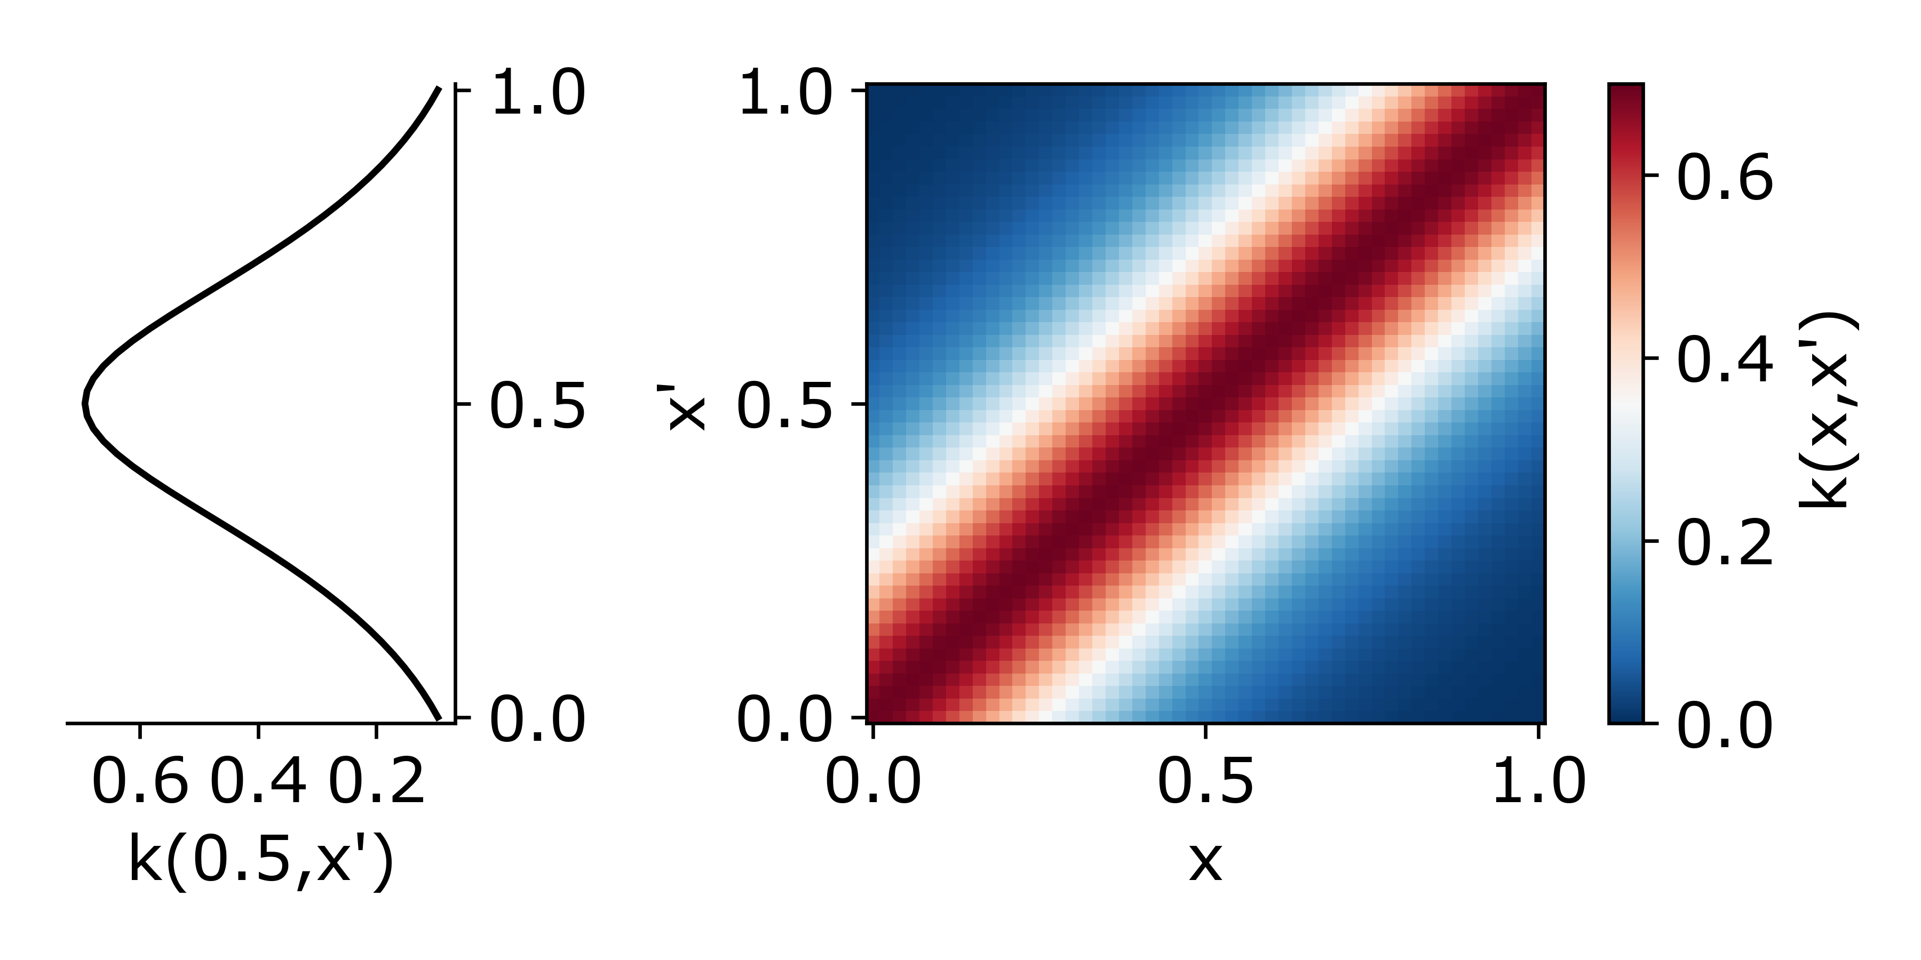
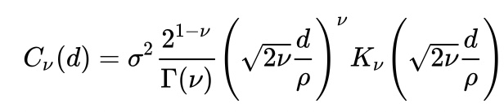
Step 0: Pick a kernel to define GP prior

Slide 20
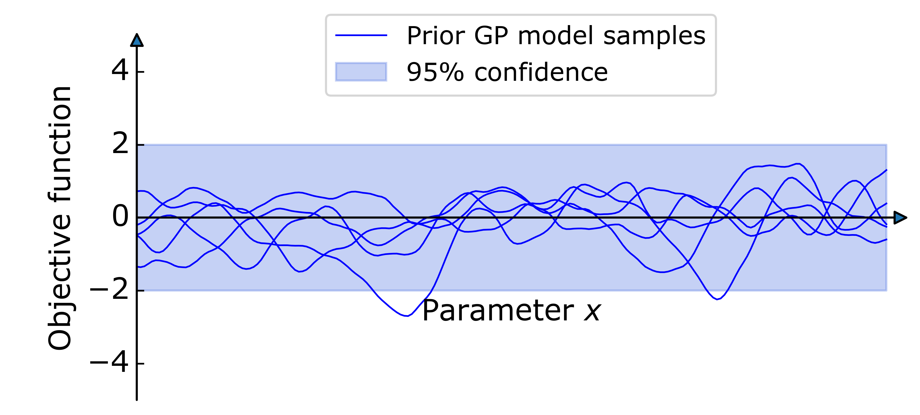
Step 0: Pick a kernel to define GP prior

Slide 21
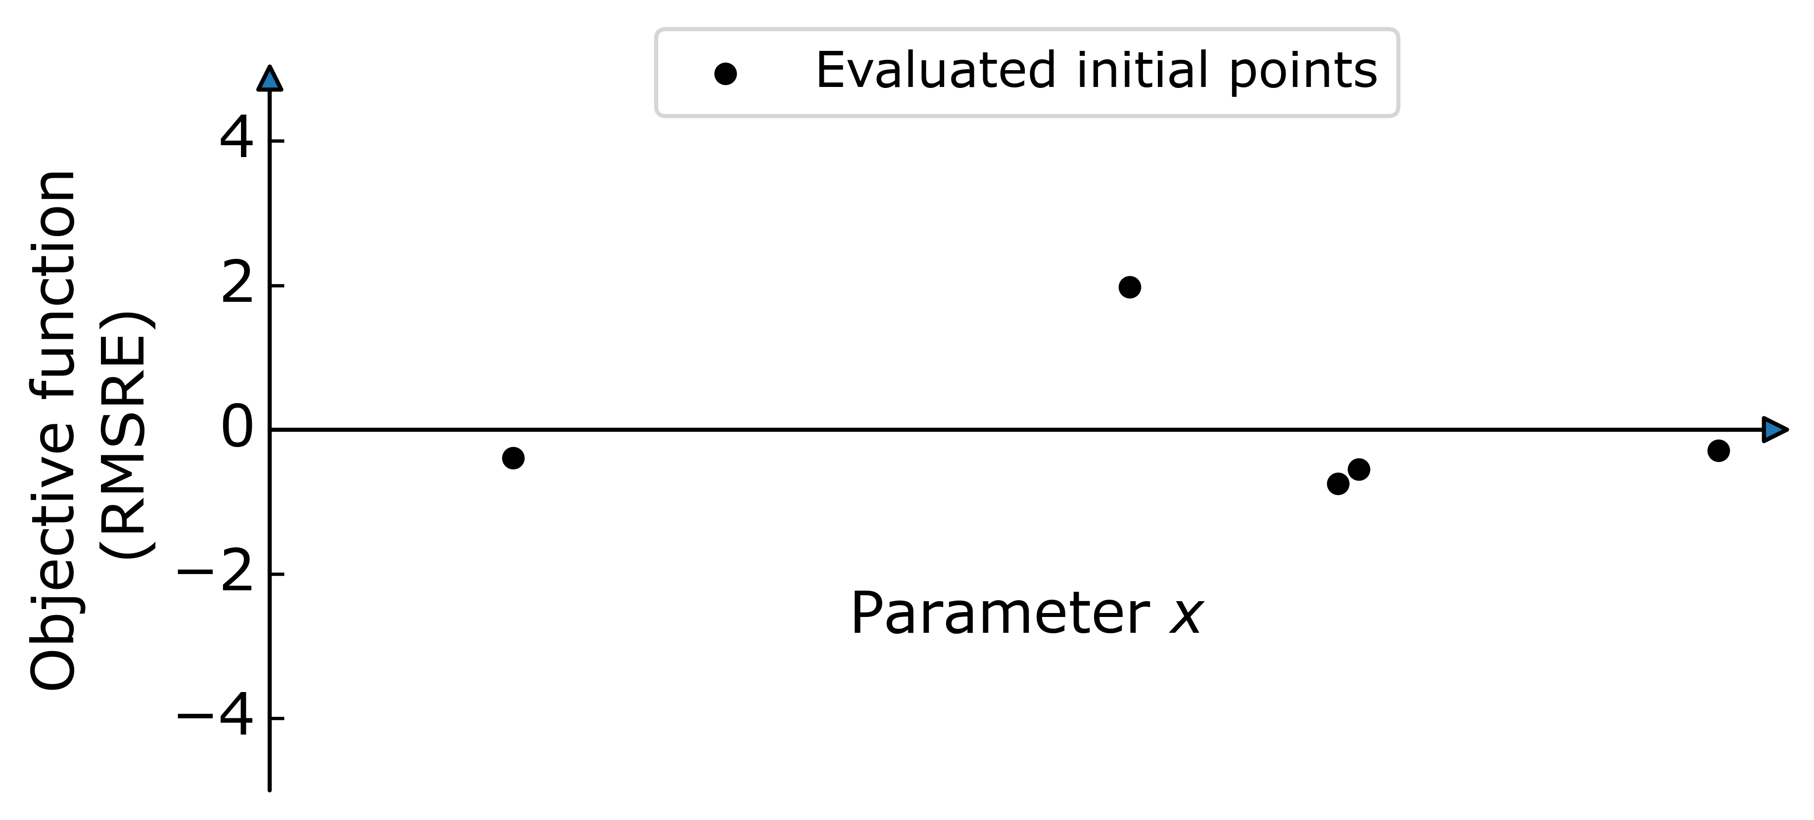
Step 1: Evaluate random initial points

Slide 22
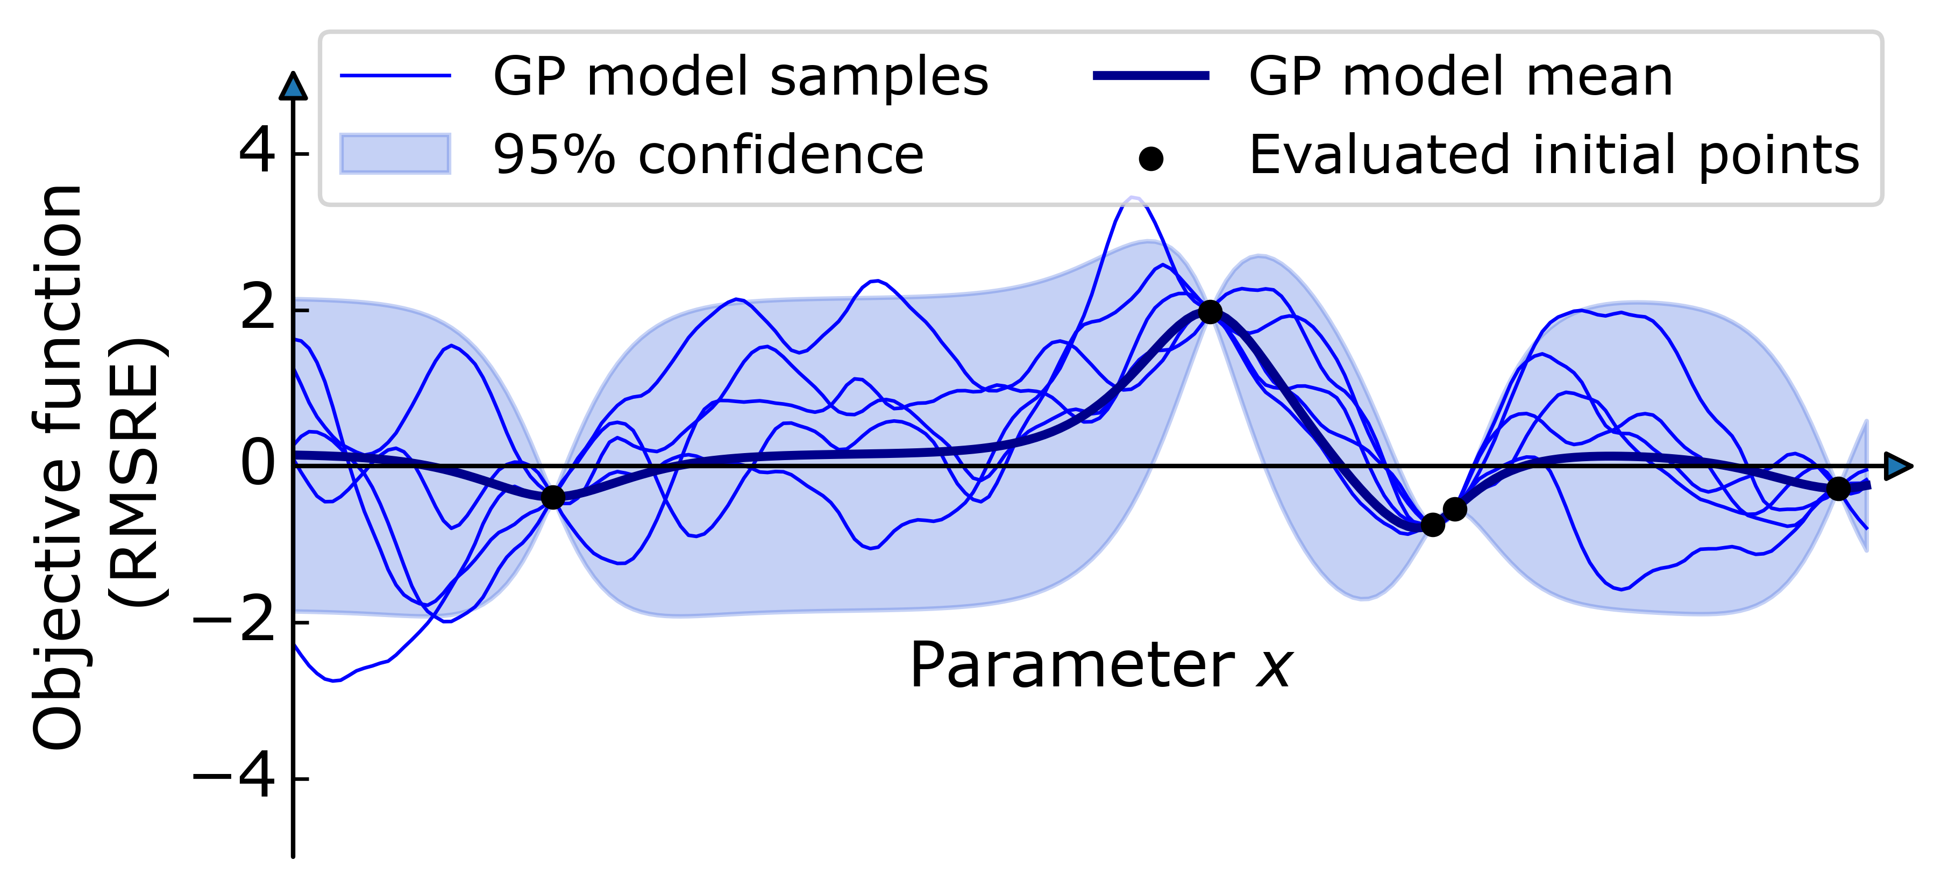
Step 2: Construct an initial GP model

Slide 23
Step 2: Construct an initial GP model
…by minimizing the log marginal likelihood with respect to the kernel hyperparameters.

Slide 24
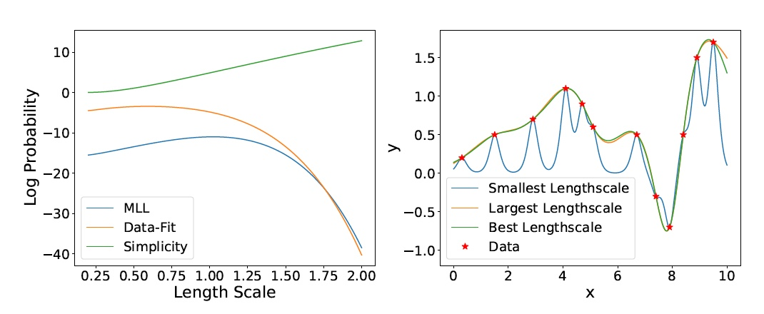
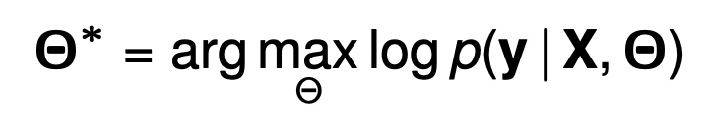
Interlude: Learning the GP model hyperparameter(s)
log(MLL) = data fit + simplicity + normalization factor
Stoustrup (2021)

Slide 25
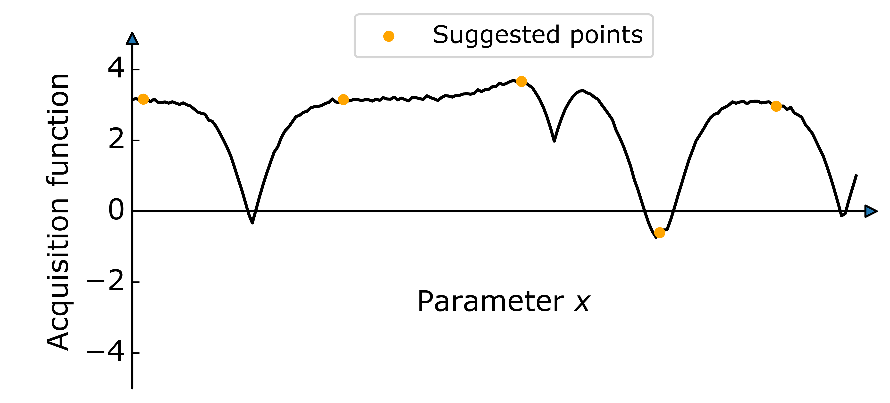
Step 3: Suggest new points to evaluate by optimizing the UCB acquisition function

Slide 26
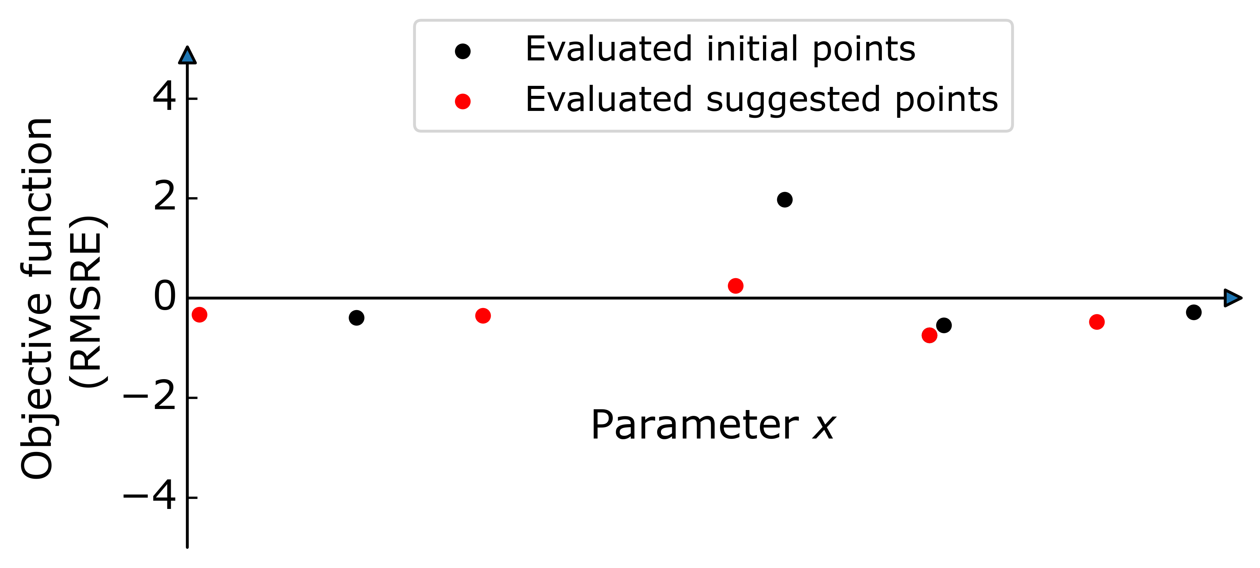
Step 4: Evaluate suggested points

Slide 27
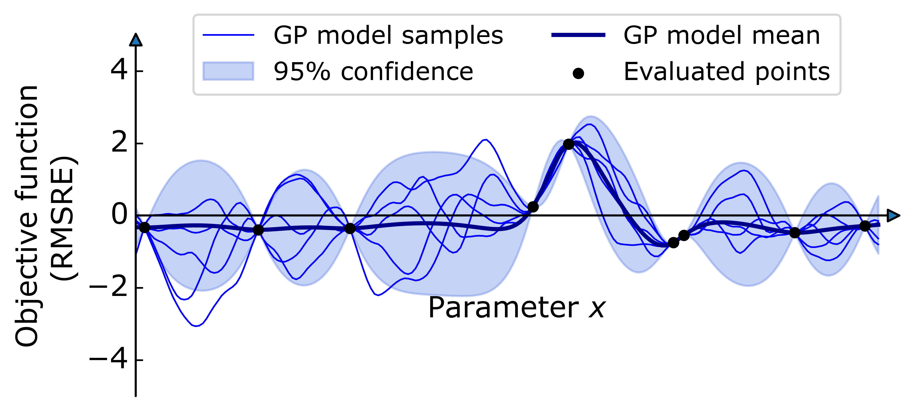
Step 4: Construct a GP model using the updated set of evaluated points

Slide 29
Optimizing the TKE closure scheme in Veros

Slide 30


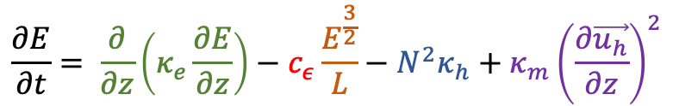




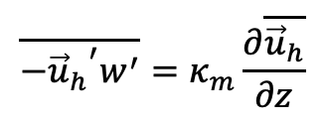

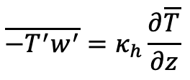


Turbulent Kinetic Energy (TKE)
$$\overline{−T^{′}w^{′}}=κ_{h}\frac{∂\overline{T}}{∂z}$$
$$\overline{−{{\vec{u}}_{h}}^{′}w^{′}}=κ_{m}\frac{∂\overline{{\vec{u}}_{h}}}{∂z}$$
Turbulent fluxes:
$$\frac{∂E}{∂t}= \frac{∂}{∂z}\left(κ_{e}\frac{∂E}{∂z}\right)−c_{ε}\frac{E^{\frac{3}{2}}}{L}−N^{2}κ_{h}+κ_{m}{\left(\frac{∂\vec{u_{h}}}{∂z}\right)}^{2}$$
Prognostic TKE equation:
TKE diffusion
TKE dissipation
Buoyancy flux
Shear production
Parameterization of eddy diffusivities:
$$κ_{h}=\frac{κ_{m}}{Pr}$$
$$κ_{h}=c_{k}L\sqrt{E}$$
$$κ_{e}=α_{tke}κ_{m}$$
Free parameters:
Default values:
$$c_{k}∈[0,1]$$
$$c_{ε}∈[0,1]$$
$$α_{tke}$$
$c_{k}=0.1$,
$$c_{ε}=0.7,$$
$$α_{tke}=30$$
Gaspar et al. (1990)

Slide 31
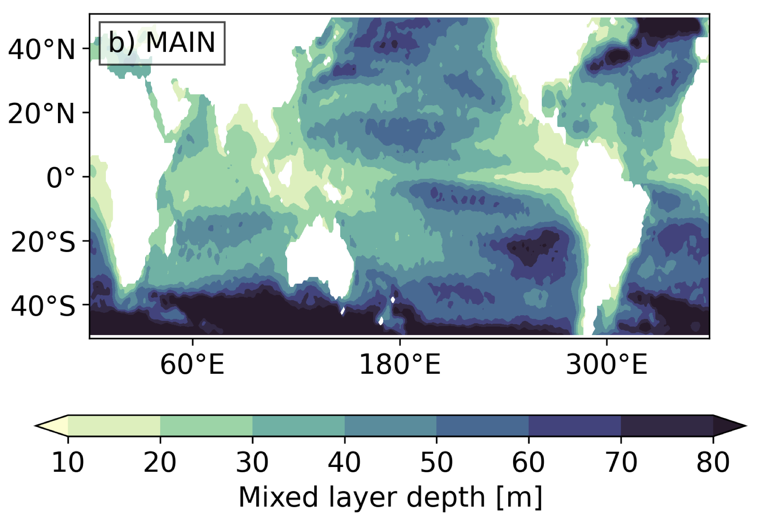
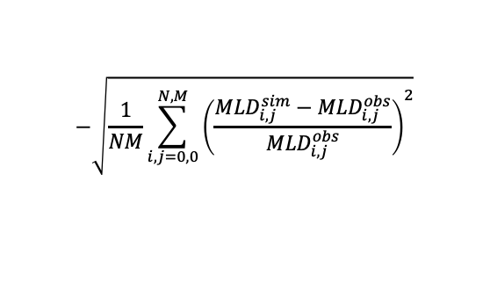
MLD optimization
Model:
Veros 1ºx1º
60 vertical layers
2.5m surface resolution
Forced by ECMWF reanalysis winds (ie observations assimilated into numerical model
$$−\sqrt{\frac{1}{NM}\sum_{i,j=0,0}^{N,M}{{\left(\frac{{MLD}_{i,j}^{sim}−{MLD}_{i,j}^{obs}}{{MLD}_{i,j}^{obs}}\right)}^{2}}}$$
Objective function:
Setup:
Duration of simulation: 30 years
Initial points: 10
Bayes points: 30
Evaluations per step: 2
ERA-Interim: Dee et al. (2011); Ifremer MLD: De Boyer Montégut et al. (2022)

Slide 32
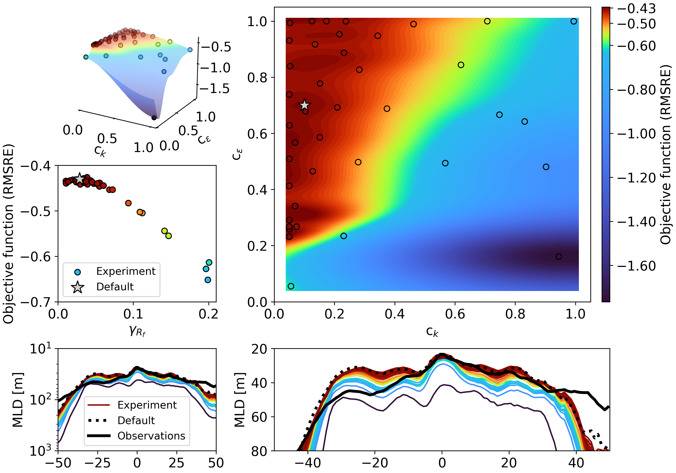
Optimization results
The default TKE parameterization lays within the parameter space region where the MLD bias is minimized.

Slide 33
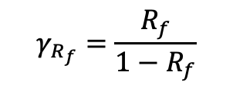
Optimization results
The default TKE parameterization lays within the parameter space region where the MLD bias is minimized.
$$γ_{R_{f}}=\frac{R_{f}}{1−R_{f}}$$
(lab experiments suggest 0.05-0.2),
Ie the amount of energy converted
To potential energy and not heat)

Slide 34

Why use Bayesian optimization?
The method is transparent (not a black box)
Does not rely on gradients
Relatively few objective function evaluations are needed
Easy to build with Python packages such as PyTorch
Has just last week been ported to LUMI to optimize a 9-d parameter space …
… on 1000 GPUs!

Slide 35
Thank you for your attention!
Supported by EU project NextGEMS, the LUMI consortium and the Danish Center of Climate Computing at KU

