Slide 1


AI for Magnetic Confinement Fusion
A. Agnello for the Fusion Computing Lab
HAMLET-Physics, Aug.19th-21st 2024

Slide 2
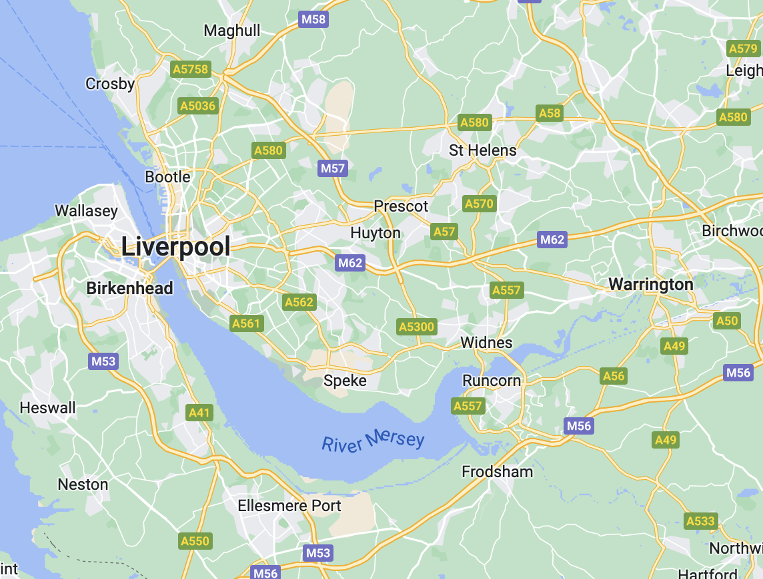
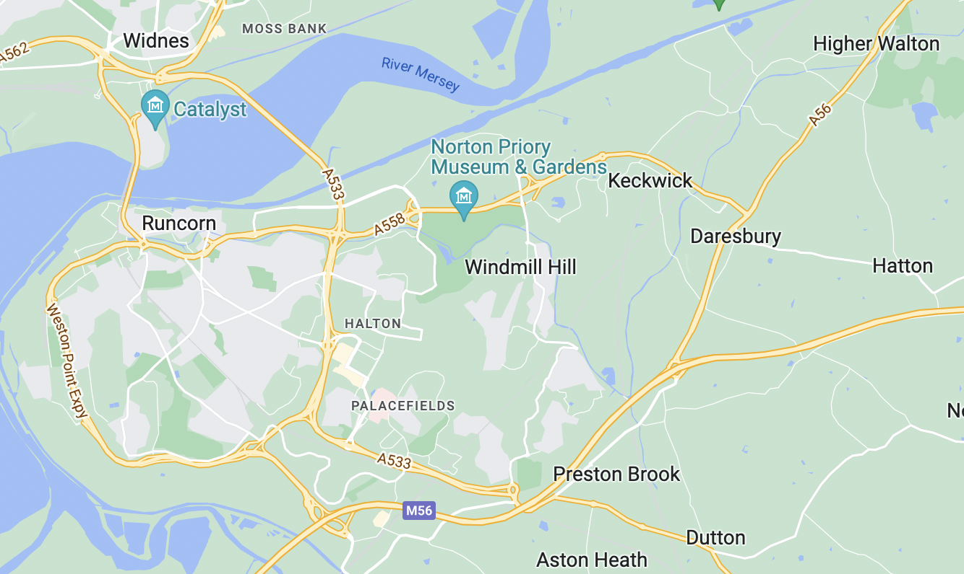
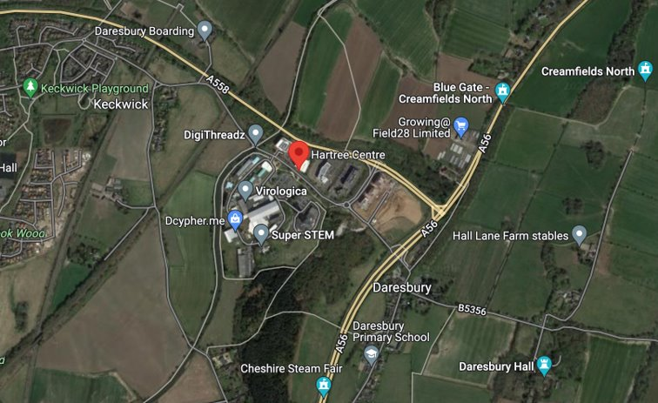
The STFC Hartree Centre
High-performance computing, data analytics and artificial intelligence research facility located at the Sci-Tech Daresbury research and innovation campus

Slide 3
AI activities at the Hartree Centre

Slide 4
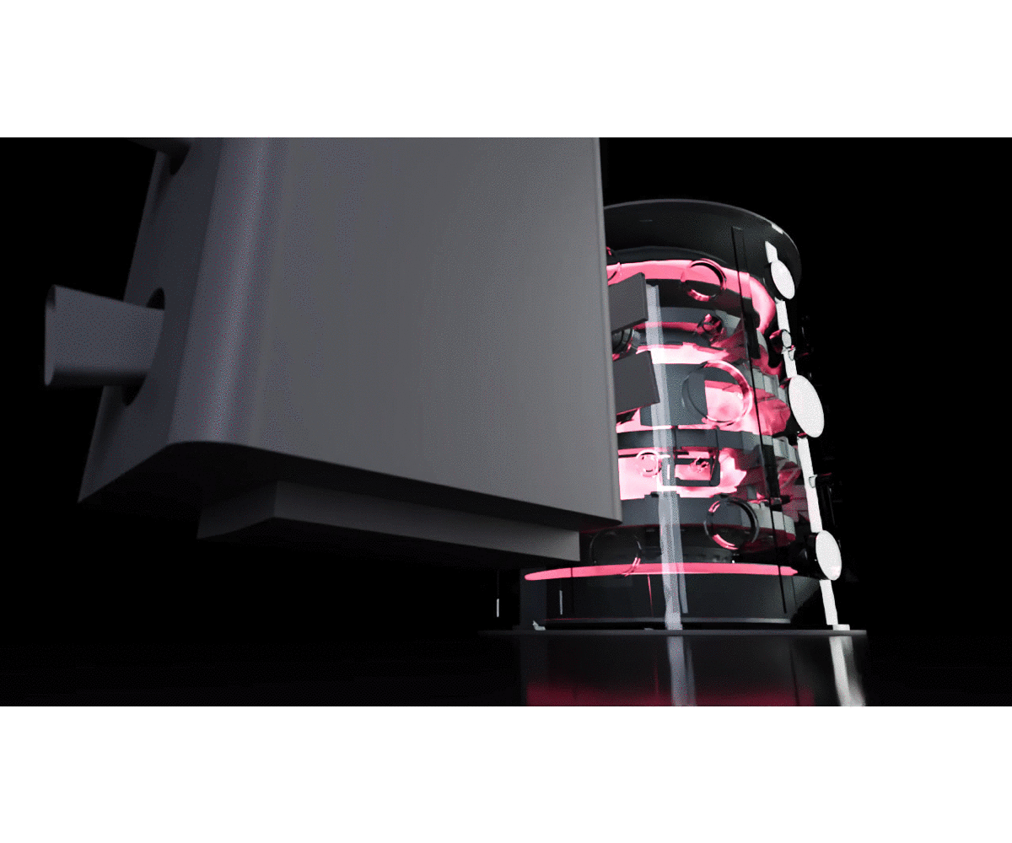


The Fusion Computing Lab
A collaboration with digiLab and the UKAEA
How to design
the fusion power plant of the future?
Iterative cycle
design – build – improve
is unfeasible
Can we get a full in silico replica
of a nuclear fusion reactor?

Slide 5



Fusion Computing Lab
4-year collaborative agreement, aiming to continue beyond 2027
Around 60 individuals (mostly researchers + operational support, communications, etc.),
Evenly split between STFC and UKAEA
Secondments of UKAEA researchers at Hartree
Aim: to explore and implement advanced computing methods in nuclear fusion research, and workflows towards the development of a reactor digital twin
Agreements also with academic institutions (incl Univ. Manchester and University College London), US National Labs (ESCAPE Project), and SMEs

Slide 6
Fusion Computing Lab
WS-2:
Fast and Actionable Emulators
using AI to replace expensive simulations with accurate surrogate models,
and to optimize the simulations to be run
Five
“Work Streams”
WS-3:
Plasma Real-Time Control
AI-powered algorithms
to keep the plasma confined and safeguard the surrounding structures
WS-1:
Digital Thread co-integration
bringing it all together to build a digital twin
WS-4:
Platform Architecture Exploitation
high-performance computing SW and HW solutions
WS-5:
Uncertainty Quantification
guarantee safe operations and understand sensitivity to design changes
WS-0:
Project Coordination, Training, Communication

Slide 7
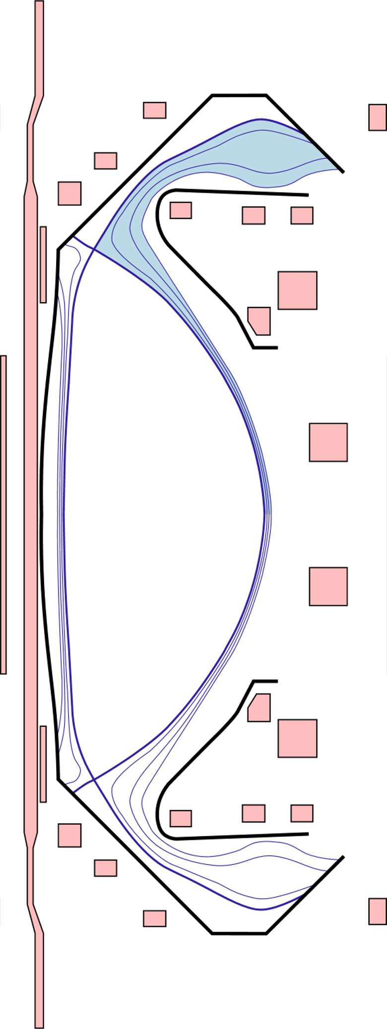
AI for Magnetic Confinement Fusion
Plasma shape control
How do we keep the plasma where we want it to be?
Disruptions
Can we predict/avoid/mitigate plasma instabilities?
Core Turbulence and Gyrokinetics
How much energy is transported inside the “burning” plasma?
Scrape-off Layer
How much energy is transported away from the “burning” plasma?
Divertor Detachment
How do we cool the exhausts so not to damage the tokamak?

Slide 8
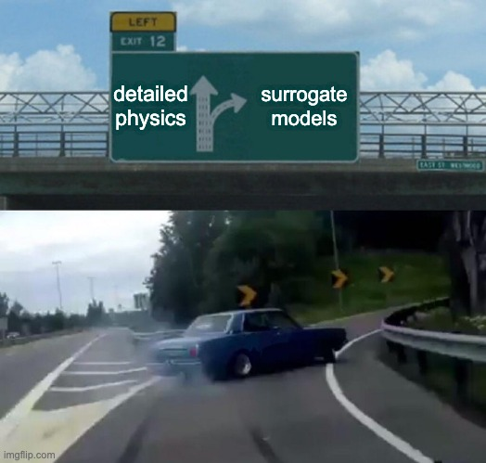
Surrogate Modeling

Slide 9
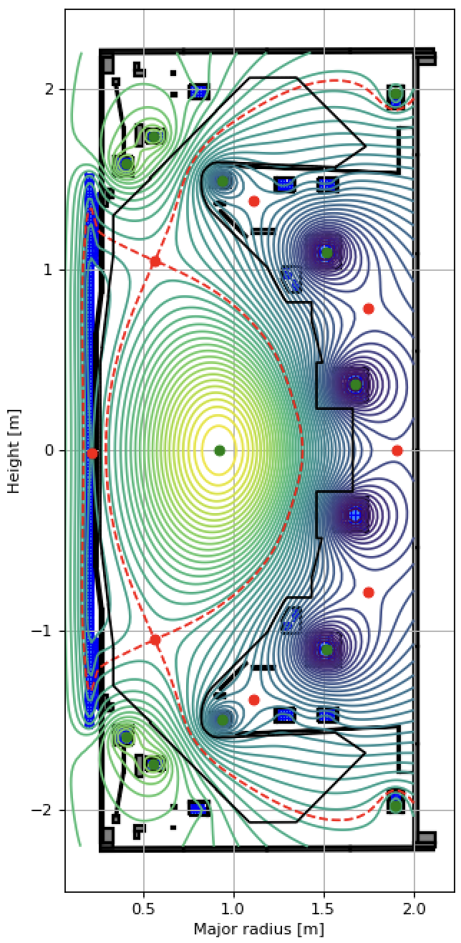
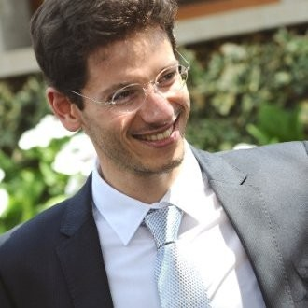
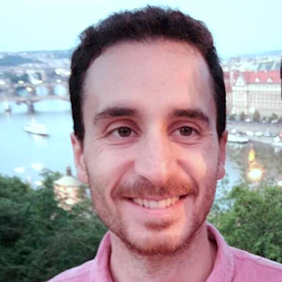
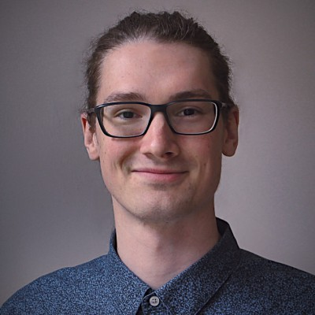
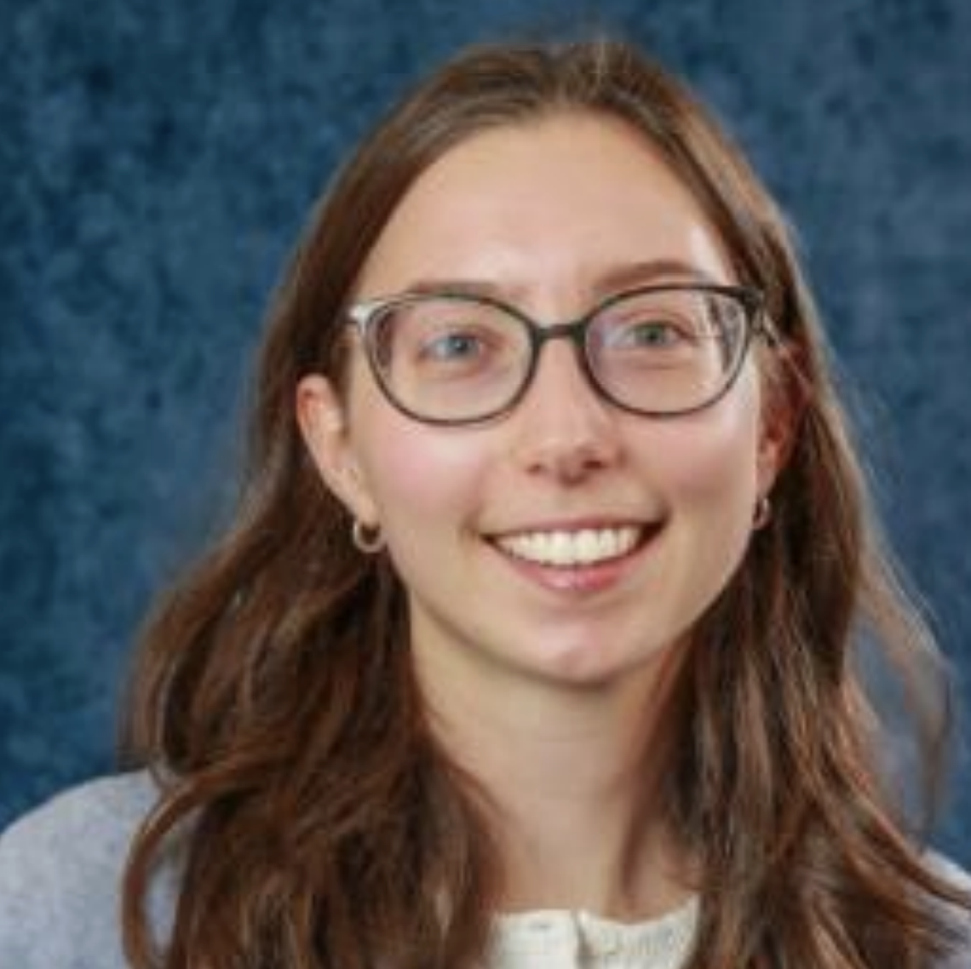
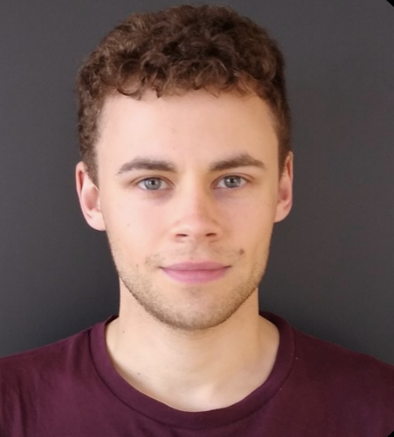
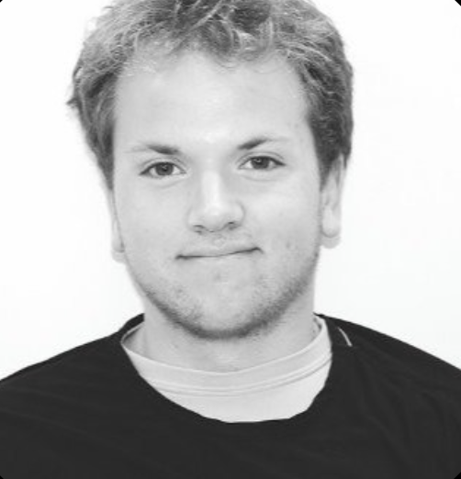
Plasma Shape Control
example MAST-U equilibrium
Real time magnetic control of 2D shape of plasma in the poloidal plane.
High frequency control of actuator coil currents magnetically coupled to the plasma.
Generally tackled using linear control techniques.
Hartree AI researchers:
Nicola Amorisco, Adriano Agnello, George Holt, Abbie Keats, Alasdair Ross, Aran Garrod
UKAEA Collaborators:
Stan Pamela, James Buchanan, Graham McArdle, Charlie Vincent,
Kamran Pentland, etc.

Slide 10
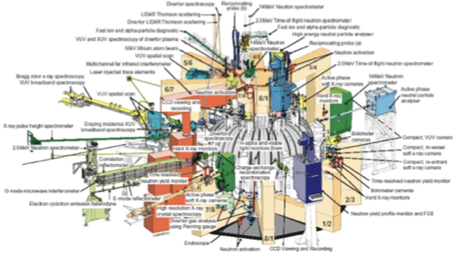
(Ohmic) Plasma Shape Control
MAST-U equilibrium
The plasma is confined by currents in the coils and in the plasma itself.
The "solenoid sweep" and other drives are preprogrammed to keep the plasma current up, but they can also alter its shape.
Probes around the tokamak give us noisy and incomplete information on the plasma. Is it departing from what we designed? And, how do we bring it back where it should be?
Inner & outer midplane points
X-point
Strike point

Slide 11



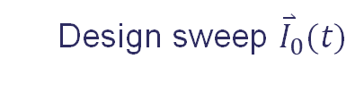

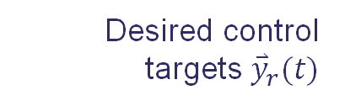



‘Classical’ Plasma Shape Control
Design sweep ${\overset{⃑}{I}}_{0}(t)$
Shape matrix
Desired control targets ${\overset{⃑}{y}}_{r}(t)$
$${\overset{⃑}{I}}_{c,r}={\overset{⃑}{I}}_{0}\left(t\right)+ {\overset{⃡}{S}}_{vc} ({\overset{⃑}{y}}_{r}\left(t\right)−{\overset{⃑}{y}}_{o}(t))$$
Observed state ${\overset{⃑}{y}}_{o}(t)$
$${\overset{⃑}{V}}_{c,r}=PID({\overset{⃑}{I}}_{c,r}−{\overset{⃑}{I}}_{c,o})$$
Real-time reconstruction
Coil currents${\overset{⃑}{I}}_{c,o}(t)$
$${\overset{⃑}{V}}_{c,out}=Safety({\overset{⃑}{V}}_{c,r} ,{\overset{⃑}{I}}_{c,r})$$
Probe measurements
$${\overset{⃑}{V}}_{c,power}=Supplies({\overset{⃑}{V}}_{c,out})$$
with the Shape matrix pre-calculated along the desired scenario.

Slide 12
AI-supported Plasma Shape Control
MAST-U equilibrium
Dynamic
Wall/Passive currents are neglected
Wall/Passive currents are NOT neglected
Inner & outer midplane points
‘Classical control’
Current framework
AI / ML supported control
Shape matrix
emulation
Reinforcement Learning
X-point
- GS surrogate: shape target emulator
- Accurate Shape matrices at any point in the experiment
- Ensemble averages
Strike point
Agnello et al. (2024), Phys.Plasmas, doi:10.1063/5.0187822 Amorisco et al. (2023), ICDDPS-4 and IAEA-FEC23

Slide 13
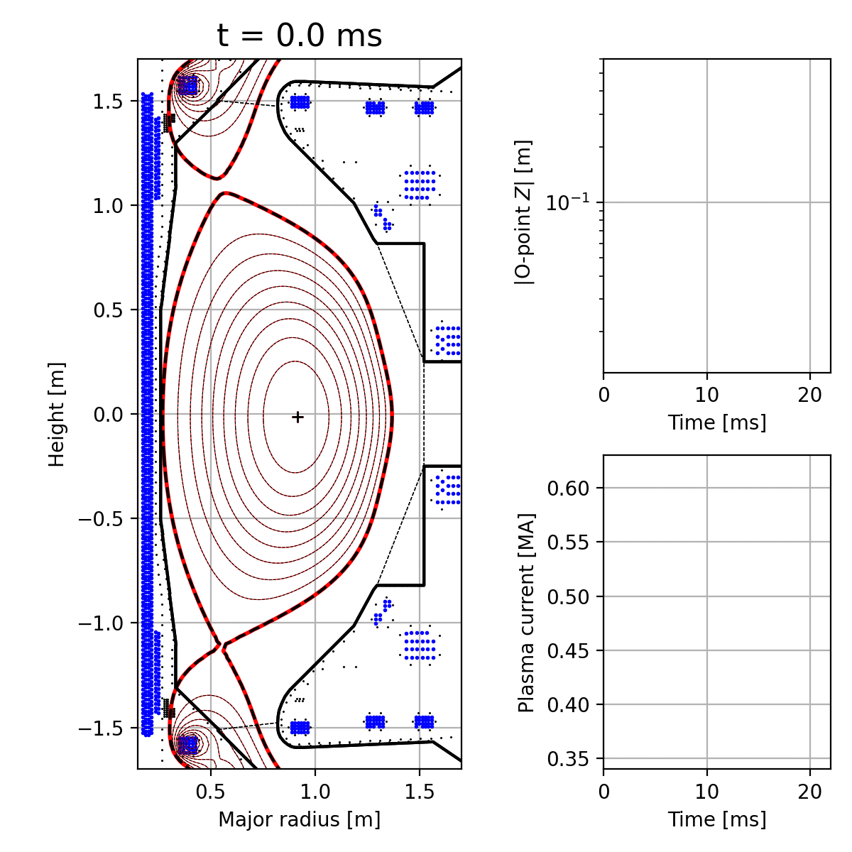
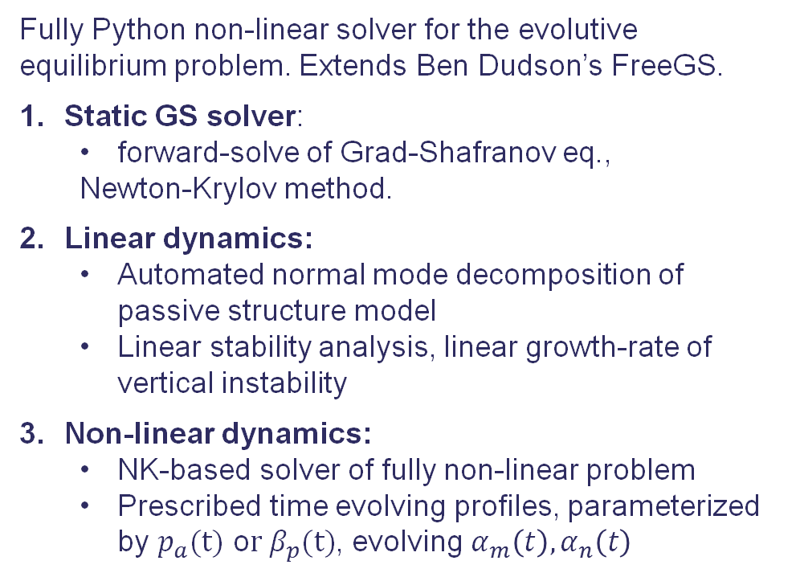
FreeGSNKE: FreeGS Newton-Krylov Evolutive
Fully Python non-linear solver for the evolutive equilibrium problem. Extends Ben Dudson’s FreeGS.
Static GS solver:
forward-solve of Grad-Shafranov eq.,
Newton-Krylov method.
Linear dynamics:
Automated normal mode decomposition of passive structure model
Linear stability analysis, linear growth-rate of vertical instability
Non-linear dynamics:
NK-based solver of fully non-linear problem
Prescribed time evolving profiles, parameterized by $p_{a}(t)$ o$r β_{p}(t)$, evolving $α_{m}\left(t\right), α_{n}\left(t\right)$
linearized
MAST-U VDE
nonlinear
FreeGSNKE-RL library for RL experiments and training.
Amorisco et al. (2024), Phys.Plasmas,
doi:10.1063/5.0188467

Slide 14
Divertor Detachment
Hartree: George Holt, Abbie Keats Collaborators: Stan Pamela¹, Mike Kryjak², Ben Dudson³, Lorenzo Zanisi¹
¹UKAEA, ²Univ. York, ³LLNL
Background
Tokamak plasma exhaust is extremely energetic
There are no materials that would withstand unmitigated deposition of the exhaust
Advanced divertor configurations are being designed and tested to reduce the energy load on exhaust components
Problems we are addressing
Scrape-off layer and divertor simulation is computationally expensive but can be massively sped up with machine learning
Current control policies are based on linear theory but can potentially be improved with nonlinear policy development
Led by Hartree Centre and UKAEA, contributions from Lawrence Livermore National Laboratory and University of York
Scrape-off layer
Central solenoid
Plasma-facing walls
Control coils
Divertor region
G. K. Holt, et al, ICDDPS-4 (2023) G. K. Holt, et al., IAEA-FEC (2023)
A. Keats, et al., ICDDPS-5 (2024) G. K. Holt, et al., under review (2024)
Quarter cross-section of the MAST-U tokamak

Slide 15
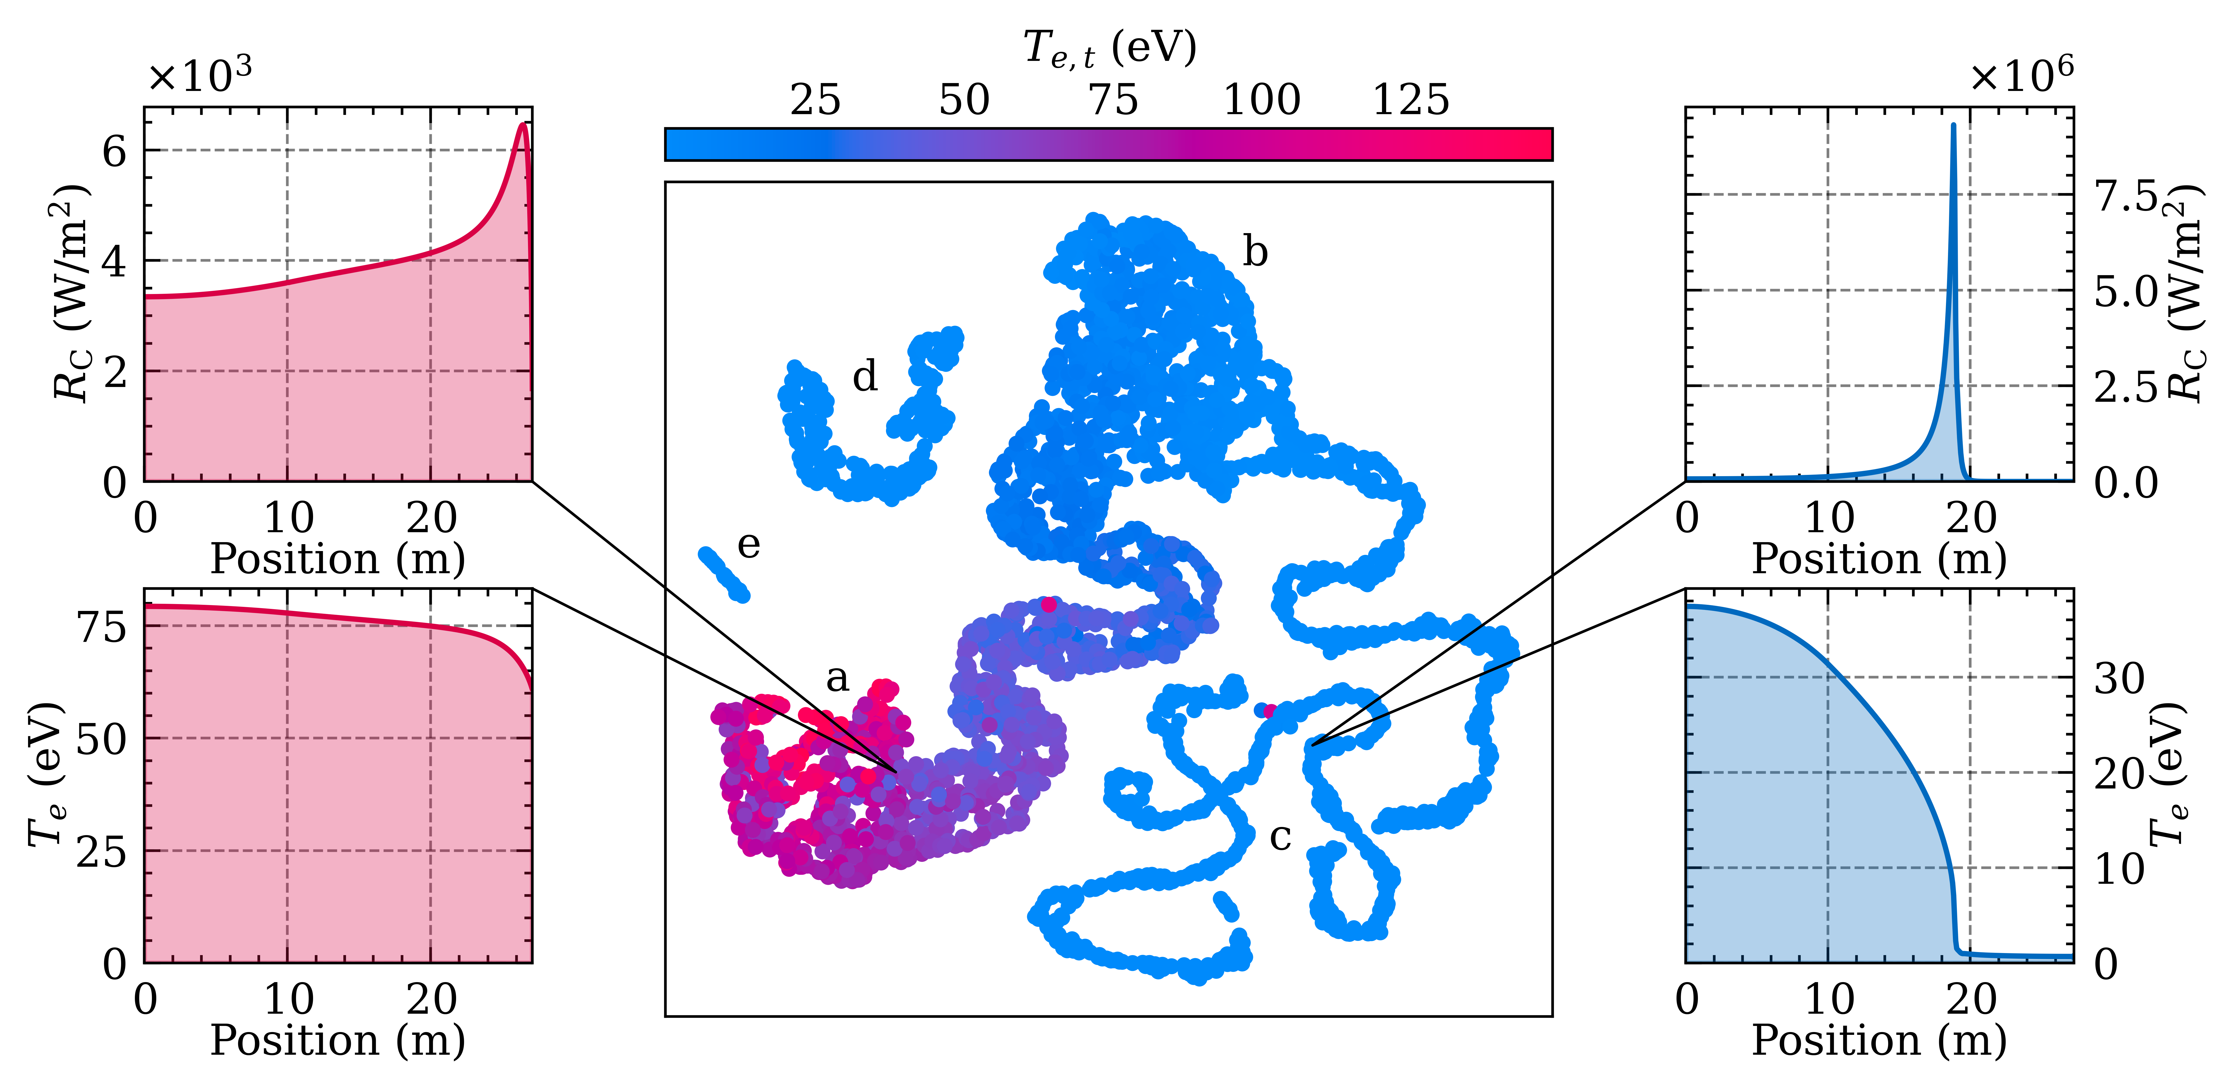













Divertor Detachment
Data set creation
Automation → scaling → HPC exploitation
Automation
Simulation input generation
Convergence testing
Diagnostic cleanup
Scaling
Trade-off between efficiency and wall time is problem dependent
HPC exploitation
Search space initialisation
Simulation batching
Array jobs
Top: UMAP target visualisation. Bottom-left: job placement diagram. Bottom-right: search space initialization schematic.
Pool of $S$ simulations,
$J=S/k$ array jobs
$$0$$
$$n_{D^{+},u} \left({\text{m}}^{−3}\right)$$
$$1$$
Supercomputer with $N$ nodes
$$1$$
$$P_{u} \text{(}\text{W}/{\text{m}}^{2})$$
G. K. Holt, et al, ICDDPS-4 (2023) G. K. Holt, et al., IAEA-FEC (2023)
A. Keats, et al., ICDDPS-5 (2024) G. K. Holt, et al., under review (2024)
Array job $J$
$$0$$
$$\tilde{X}$$
Array job $J−1$

Slide 16
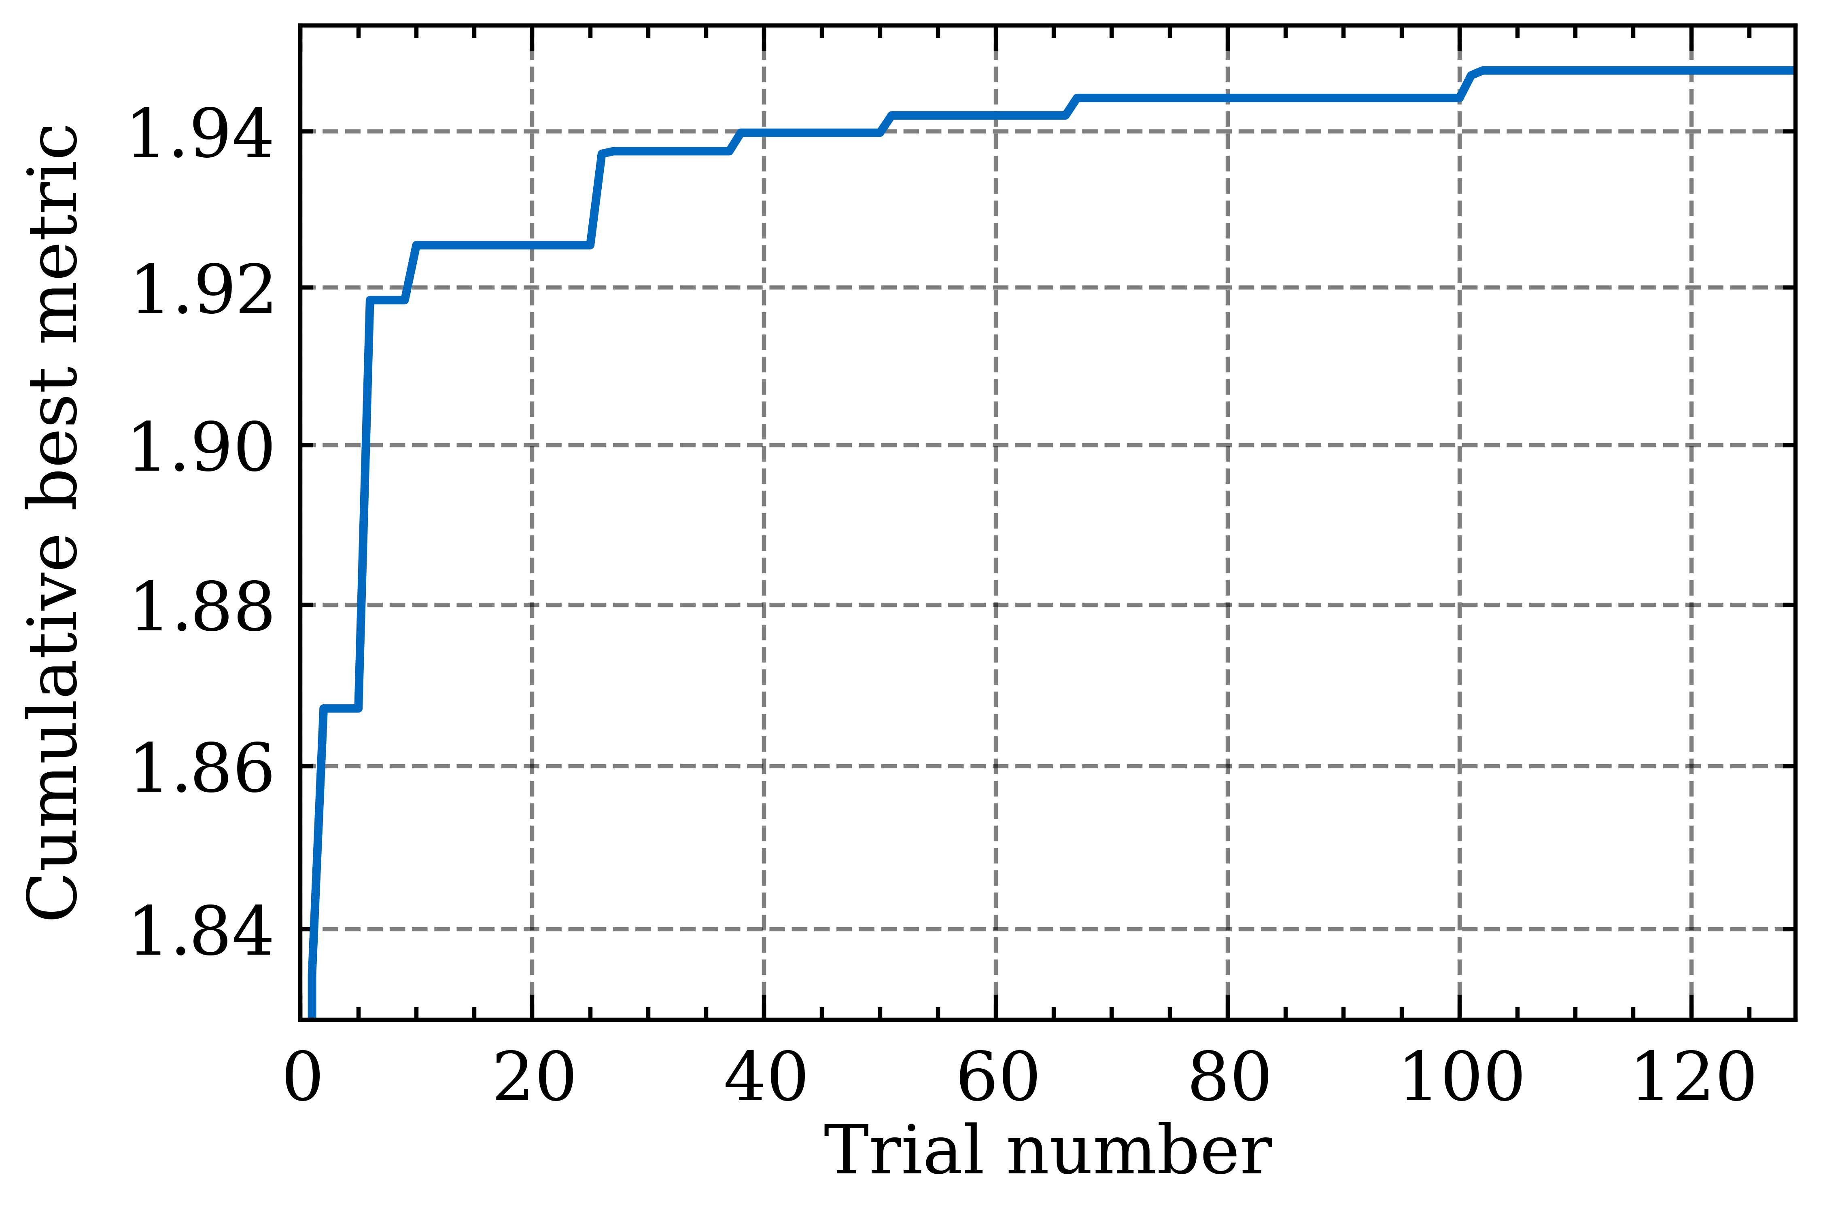
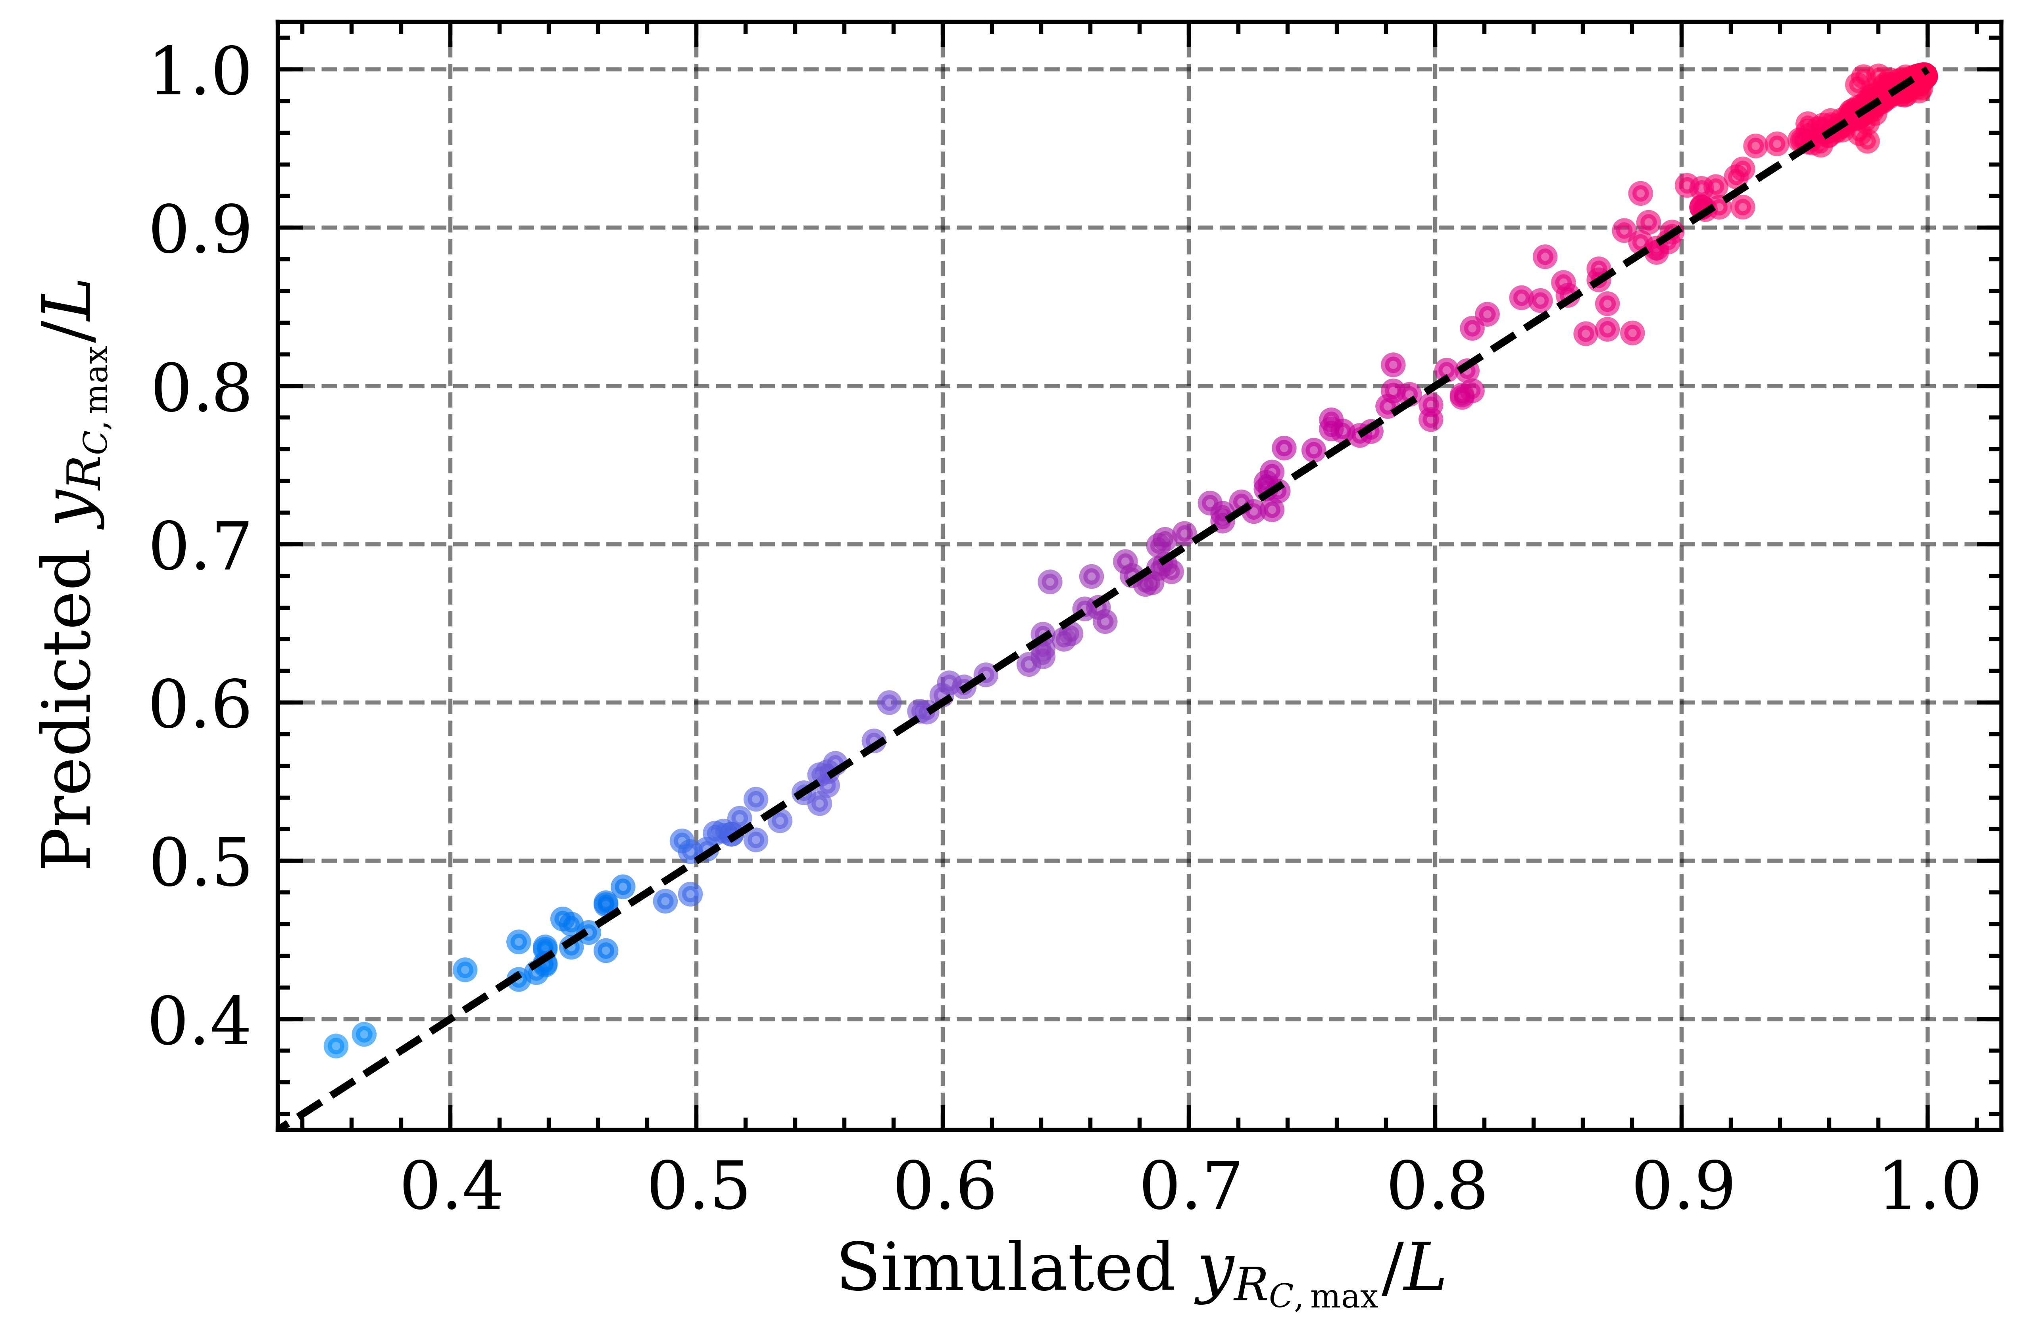
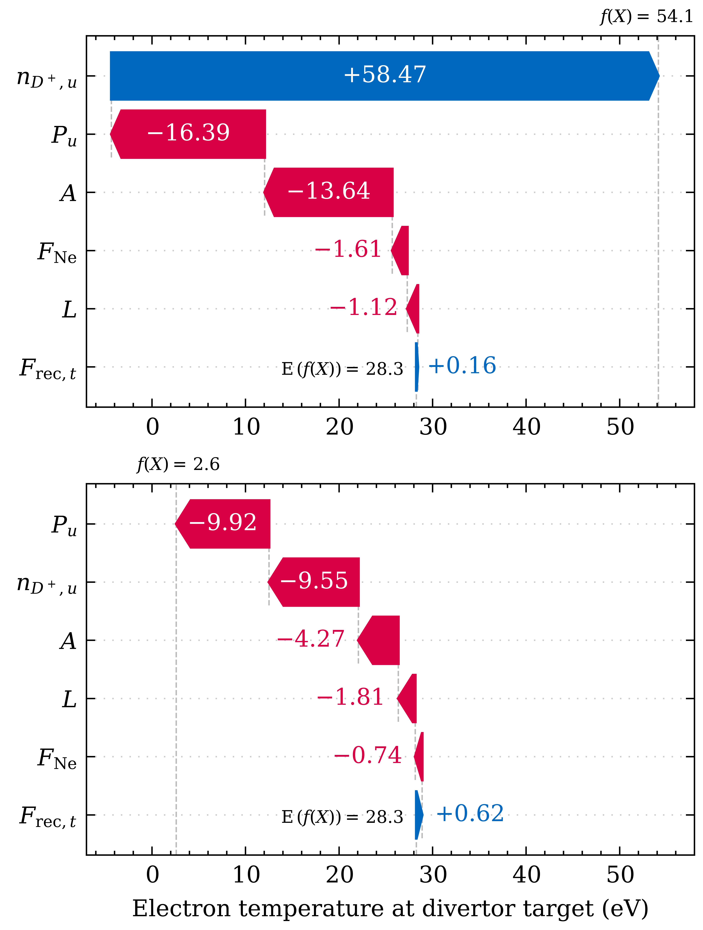
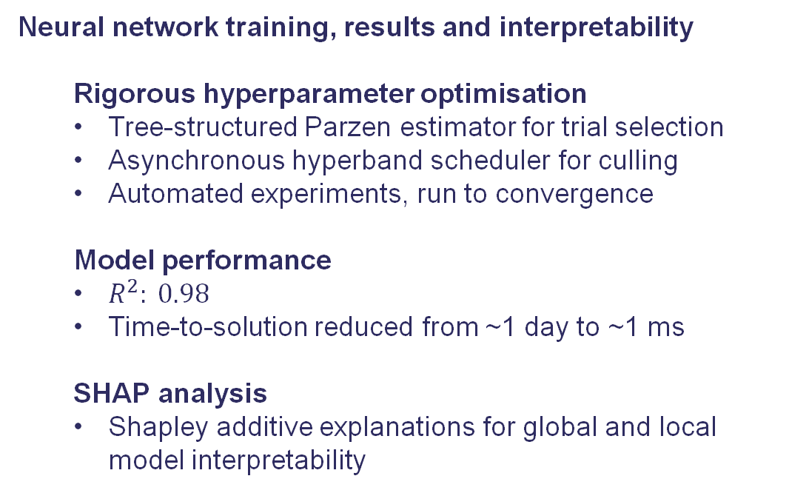
Divertor Detachment
Neural network training, results and interpretability
Rigorous hyperparameter optimisation
Tree-structured Parzen estimator for trial selection
Asynchronous hyperband scheduler for culling
Automated experiments, run to convergence
Model performance
$R^{2}: 0.98$
Time-to-solution reduced from ~1 day to ~1 ms
SHAP analysis
Shapley additive explanations for global and local model interpretability
Top-left: hyperparameter tuning experiment progress. Top-right: trained model calibration plot. Right: Local SHAP interpretations. Bottom: Global SHAP interpretations.
G. K. Holt, et al, ICDDPS-4 (2023) G. K. Holt, et al., IAEA-FEC (2023)
A. Keats, et al., ICDDPS-5 (2024) G. K. Holt, et al., under review (2024)

Slide 17
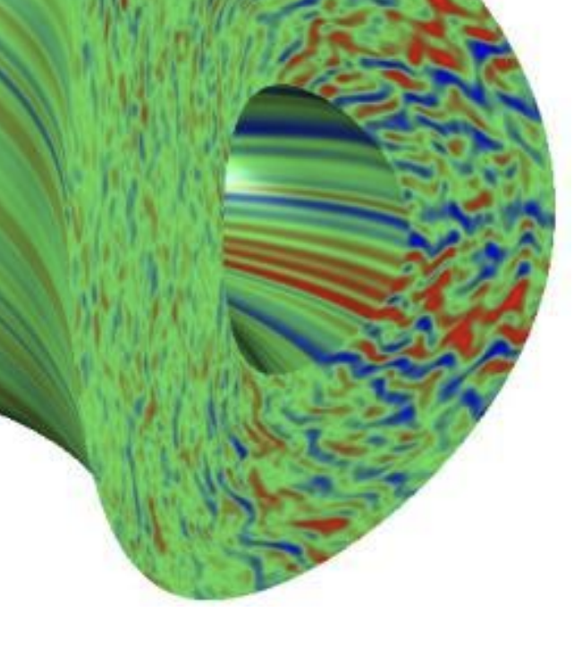
Accelerating Gyrokinetic simulations
Transport in a plasma is governed by the phase space distribution f(x,v) of particles
Focus on slab ITG turbulence.
Model: | Difficulty: | Caveats:
Fluid | easy 🙂 | No info on f(x,v) 😞
(quasi)linear gyrokinetic | Hard, but doable 🤨 | Can miss important physics 😞
Nonlinear gyrokinetic | Very hard, expensive 😞 | Provides f(x,v) info 🙂 But: how do we sample the parameter space fast and efficiently? 🤨
(Candy & Waltz, GA 2003)

Slide 18
Accelerating Gyrokinetic simulations
Closures for nonlinear slab ITG turbulence: higher-order velocity moments as simple functions of lower-order moments.
Simpler than full-geometry problem, but gives good insight.
It also shows some behaviour that was not caught in “paper and pen” linear-Landau closures.
Hartree: Adriano Agnello Collaborators: JT Parker^{1,2}, James Buchanan¹, William Hornsby¹,
¹,Irish Centre for HE Computing, ²UKAEA
https://github.com/JosephThomasParker/SpectroGK

Slide 19
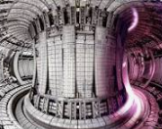
Active Learning on JET
QuaLiKiz
JET
Surrogate uncertainty
Simulation database
JET experimental 15D historical data
Fixed design space
Quasi-linear simulations
Surrogate
Zanisi et al. (2024)

Slide 20
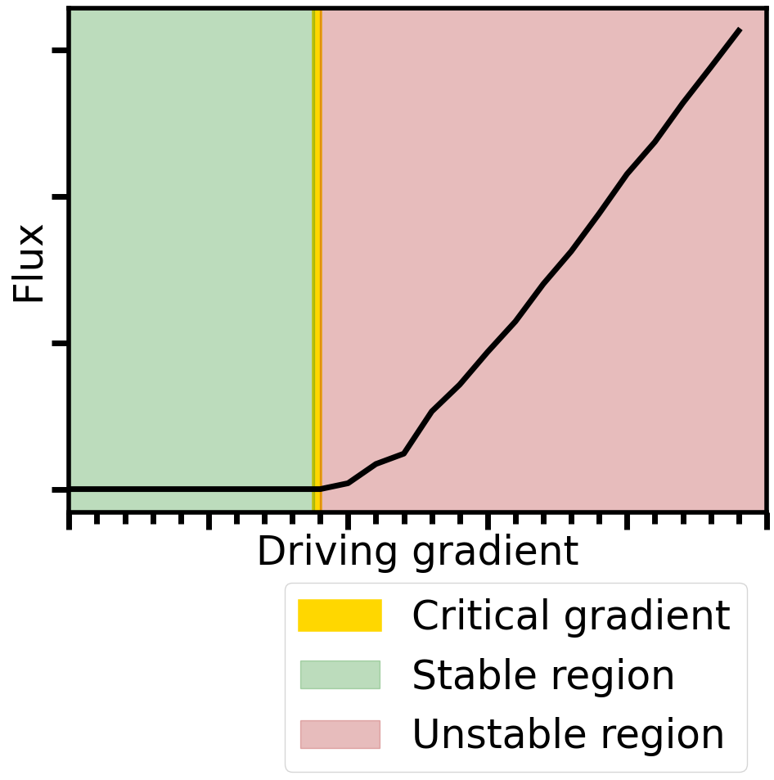
Active Deep Ensembles for Plasma Turbulence
Two Deep Ensembles
(Lakshminarayanan et al. 2017)
Classification
Critical gradient estimation
Prevents sampling in stable region
Regression
ITG turbulence flux estimation
QuaLiKiz
Surrogate uncertainty
Simulation database
Surrogate
Zanisi et al. 2024

Slide 21
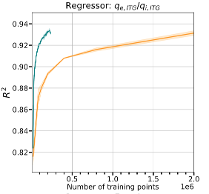
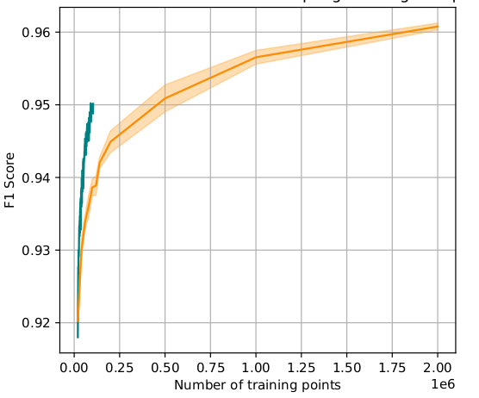

ADEPT Results on JET
Regressor performance
(ion particle flux)
Classifier performance
R2
F1
10x less data
4x less data
Number of training examples
Number of training examples
Zanisi et al. (2024) Nuclear Fusion doi:10.1088/1741-4326/ad240d
Siddle et al. in prep.

Slide 22
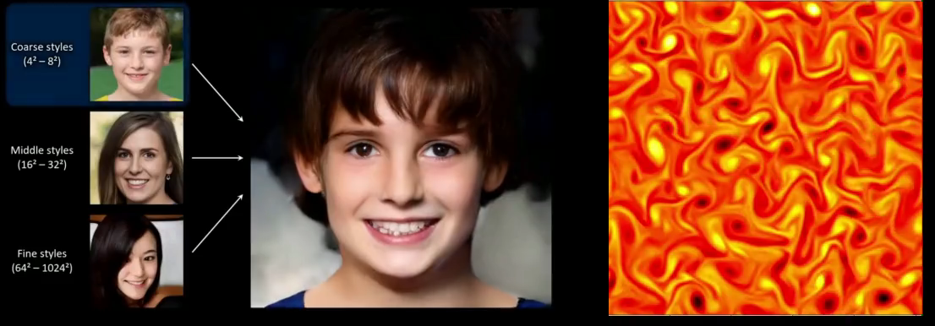
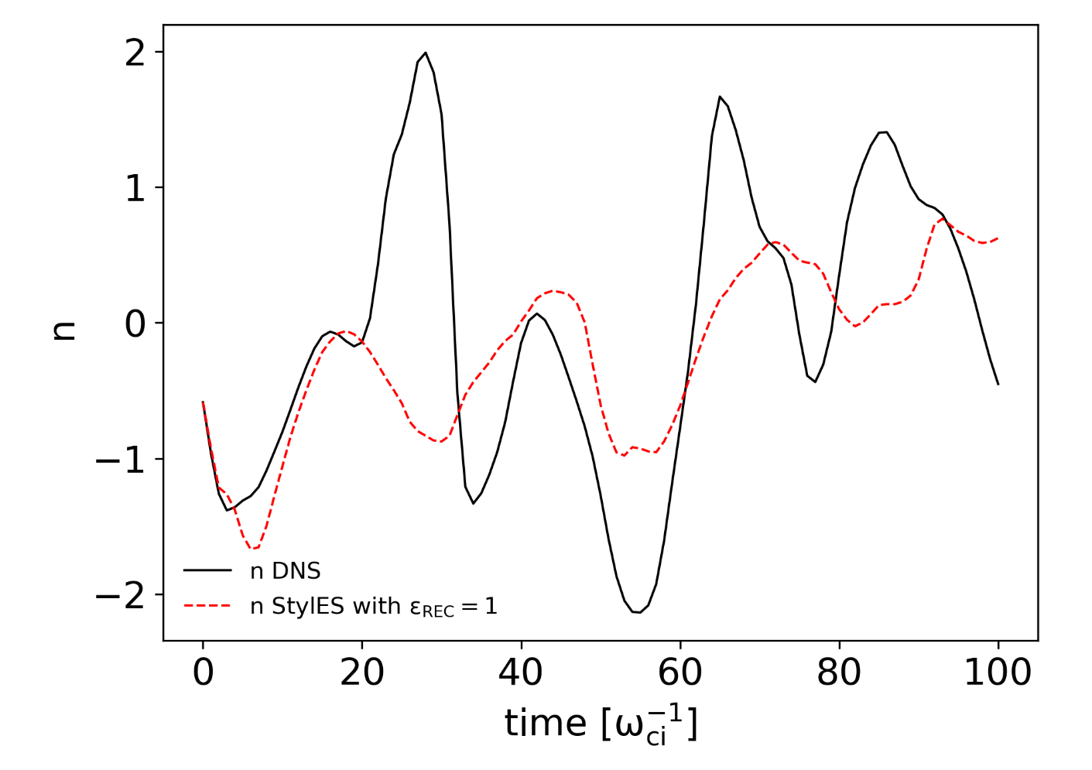
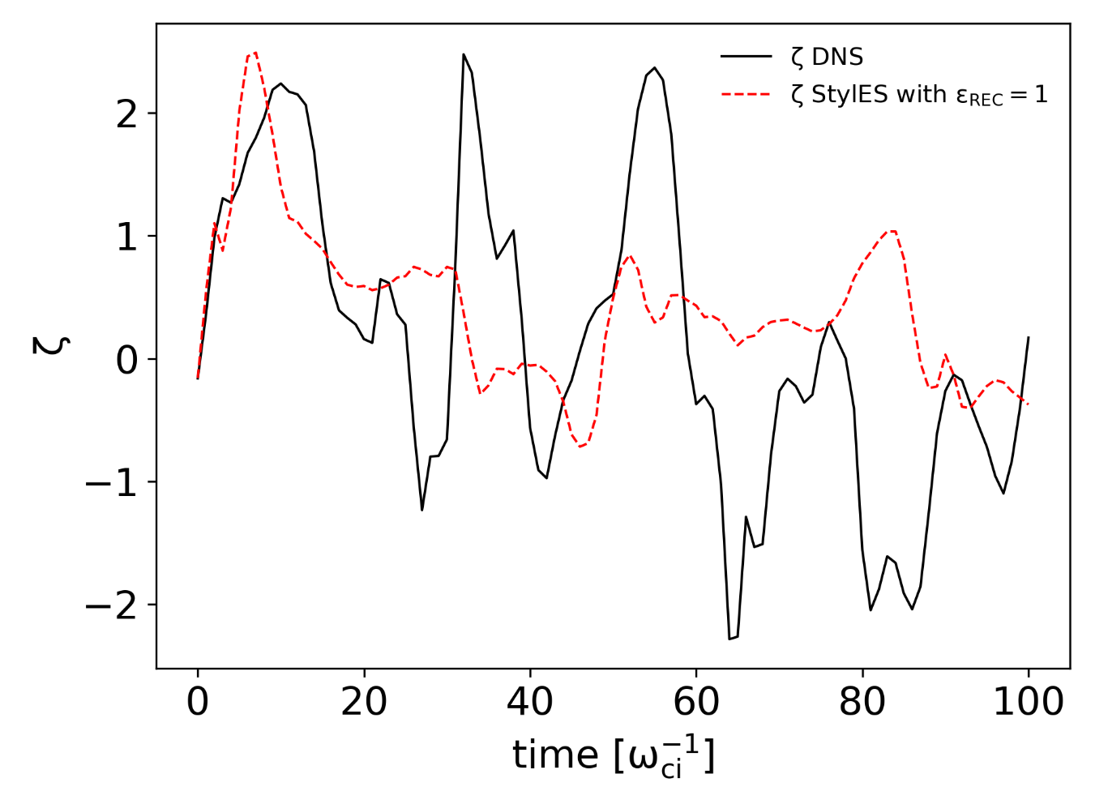
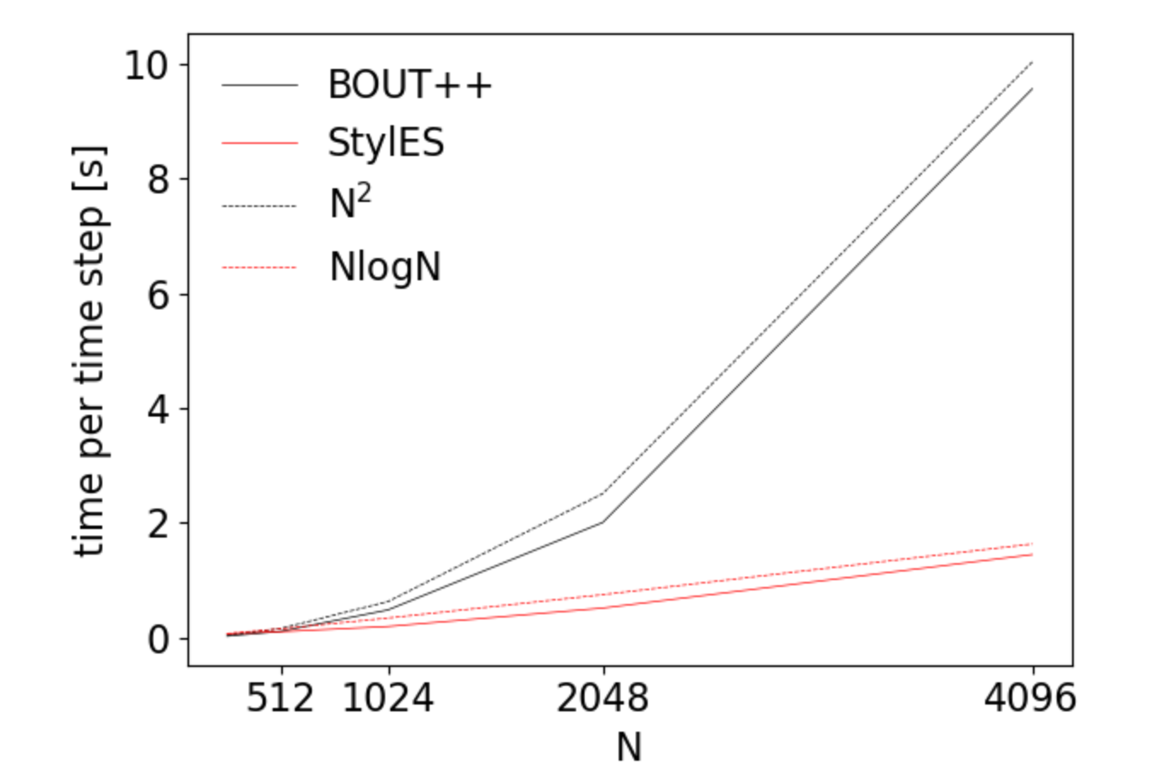
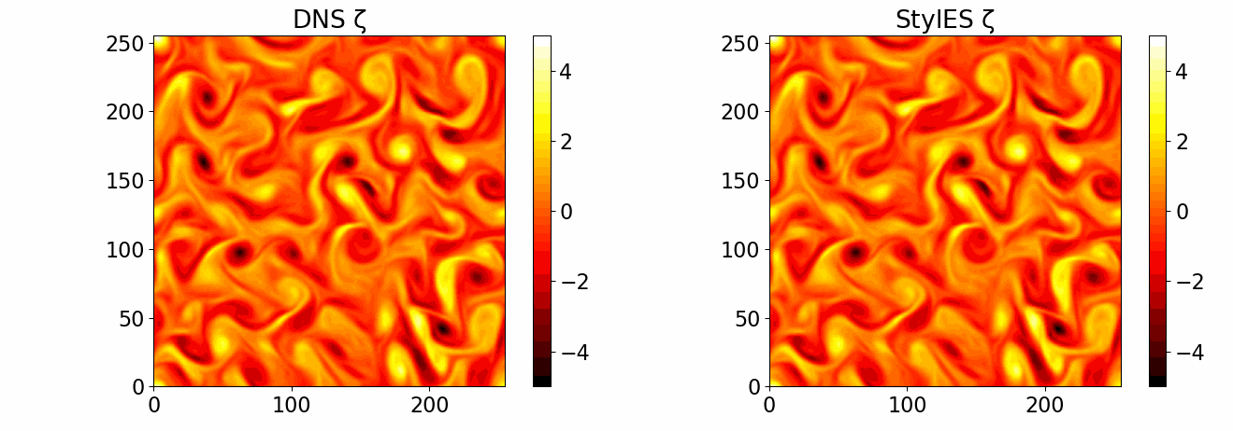
StyleGAN for SOL Turbulence
Using Generative Adversarial Networks as deconvolution operator for Large Eddy Simulations
Speedup ~10x and complexity NlogN vs N² of BOUT++
Castagna et al. (2024), doi:10.1063/5.0189945 Physics of Plasmas

Slide 23
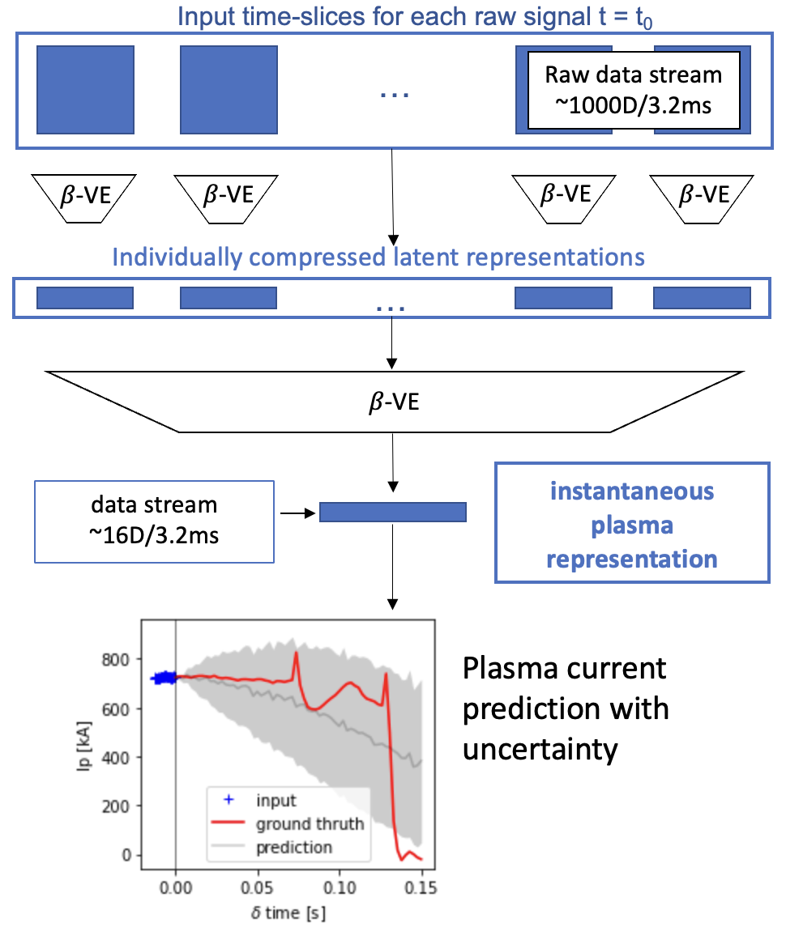
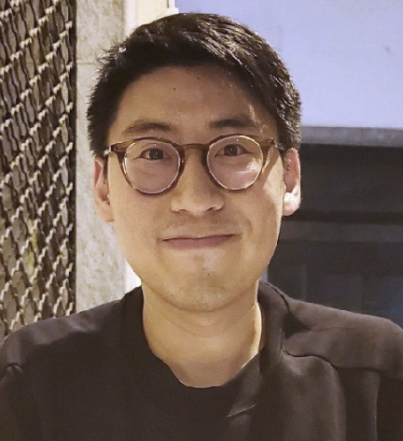
Unsupervised Disruption prediction
Predict impending plasma disruptions based on plant diagnostics in MAST database
Unsupervised approach vs literature work based on manually labelled data
Uncertainty-aware prediction for robust inference and advance warnings for mitigation
Unsupervised pre-training based on 𝛽-Variational Auto-Encoders
RNN
Training tailored to ensure robustness to missing data
RNN baseline prediction and customised transformers underway
Hartree: N. Amorisco, Wonny Lee UKAEA: Stan Pamela

Slide 24
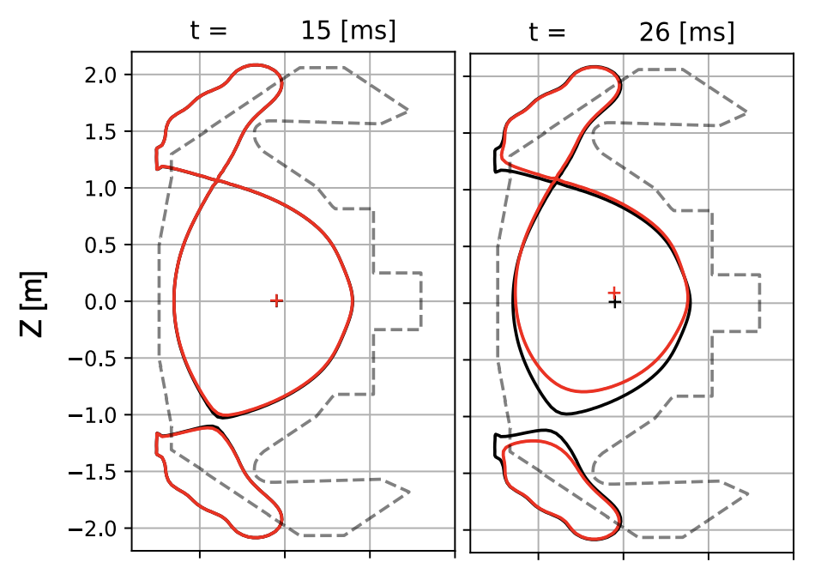
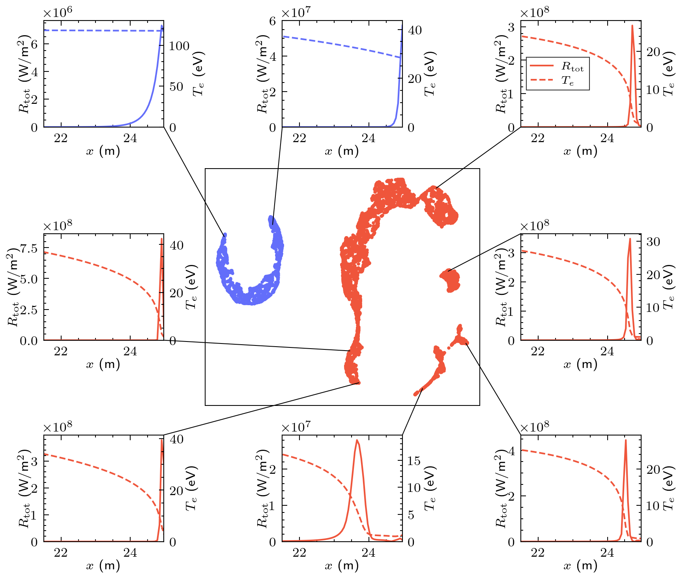
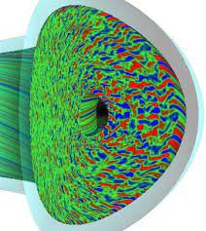
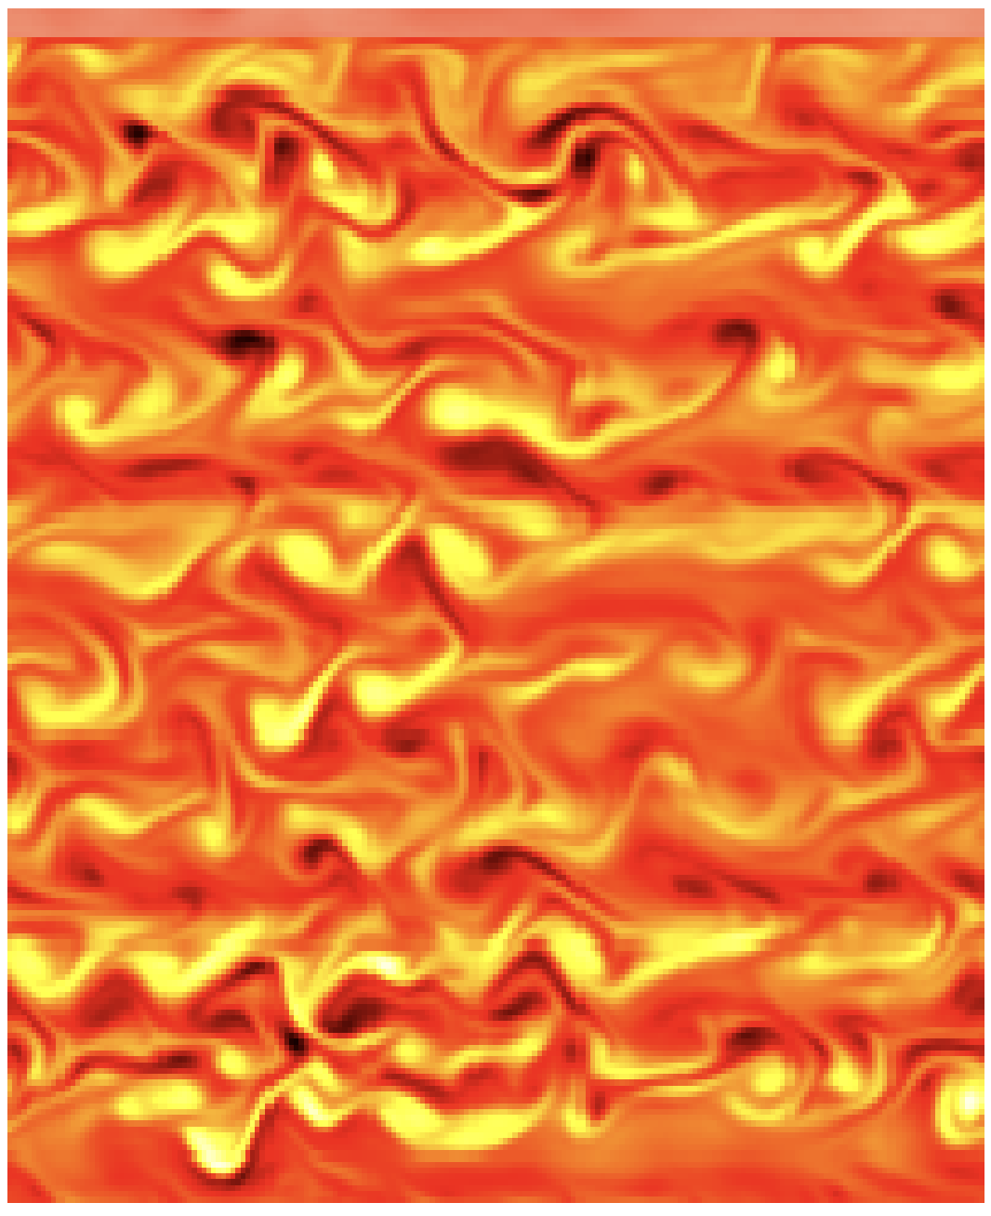
AI for magnetic confinement fusion
Plasma shape control
Detachment control
Gyrokinetics
Disruption prediction
SOL Turbulence
MAST 8203
--- Past plasma current
--- Future plasma current
--- Prediction with uncertainty
Evolutive Grad-Shafranov solver
Shape matrix emulation
Reinforcement learning for control
GPU support with JAX
Emulators of Hermes-3 & SD1D
Efficiency with active learning
Interpretability with SHAP
Reinforcement learning for control
Nonlinear slab gyrokinetic simulations of ITG turbulence
Data-driven closures discovery
Efficiency with active learning
Unsupervised approach eliminates need for manual labeling
Stack of VAEs for pre-training
Uncertainty-aware prediction
StyleGAN as deconvolution operator for large eddy simulations
Integrated into BOUT++

