Slide 1
Identifying dwarf AGN candidates through novel machine learning techniques
Mikkel Theiss Kristensen
Post doc
University of Southern Denmark (SDU)
mtkr@sdu.dk

Slide 2
Agenda
Why is this research interesting?
What are active galactic nuclei?
How are they usually identified?
Why are dwarf galaxies troublesome?
How to bypass this?
Novel approach to bypass this - ML

Slide 3
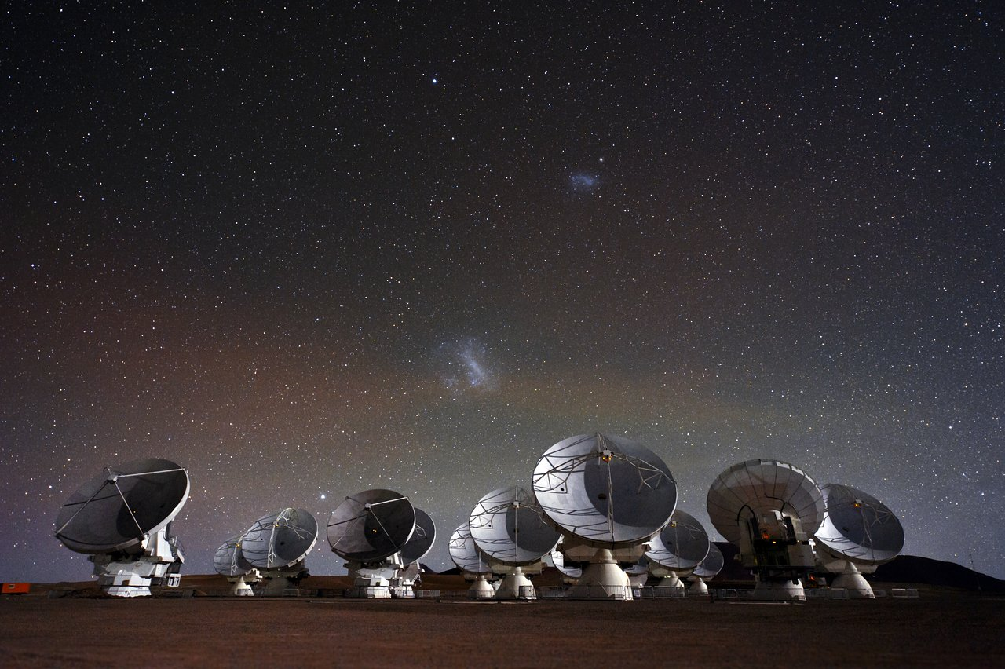
Dwarf galaxies
Credit: ESO/C. Malin

Slide 4
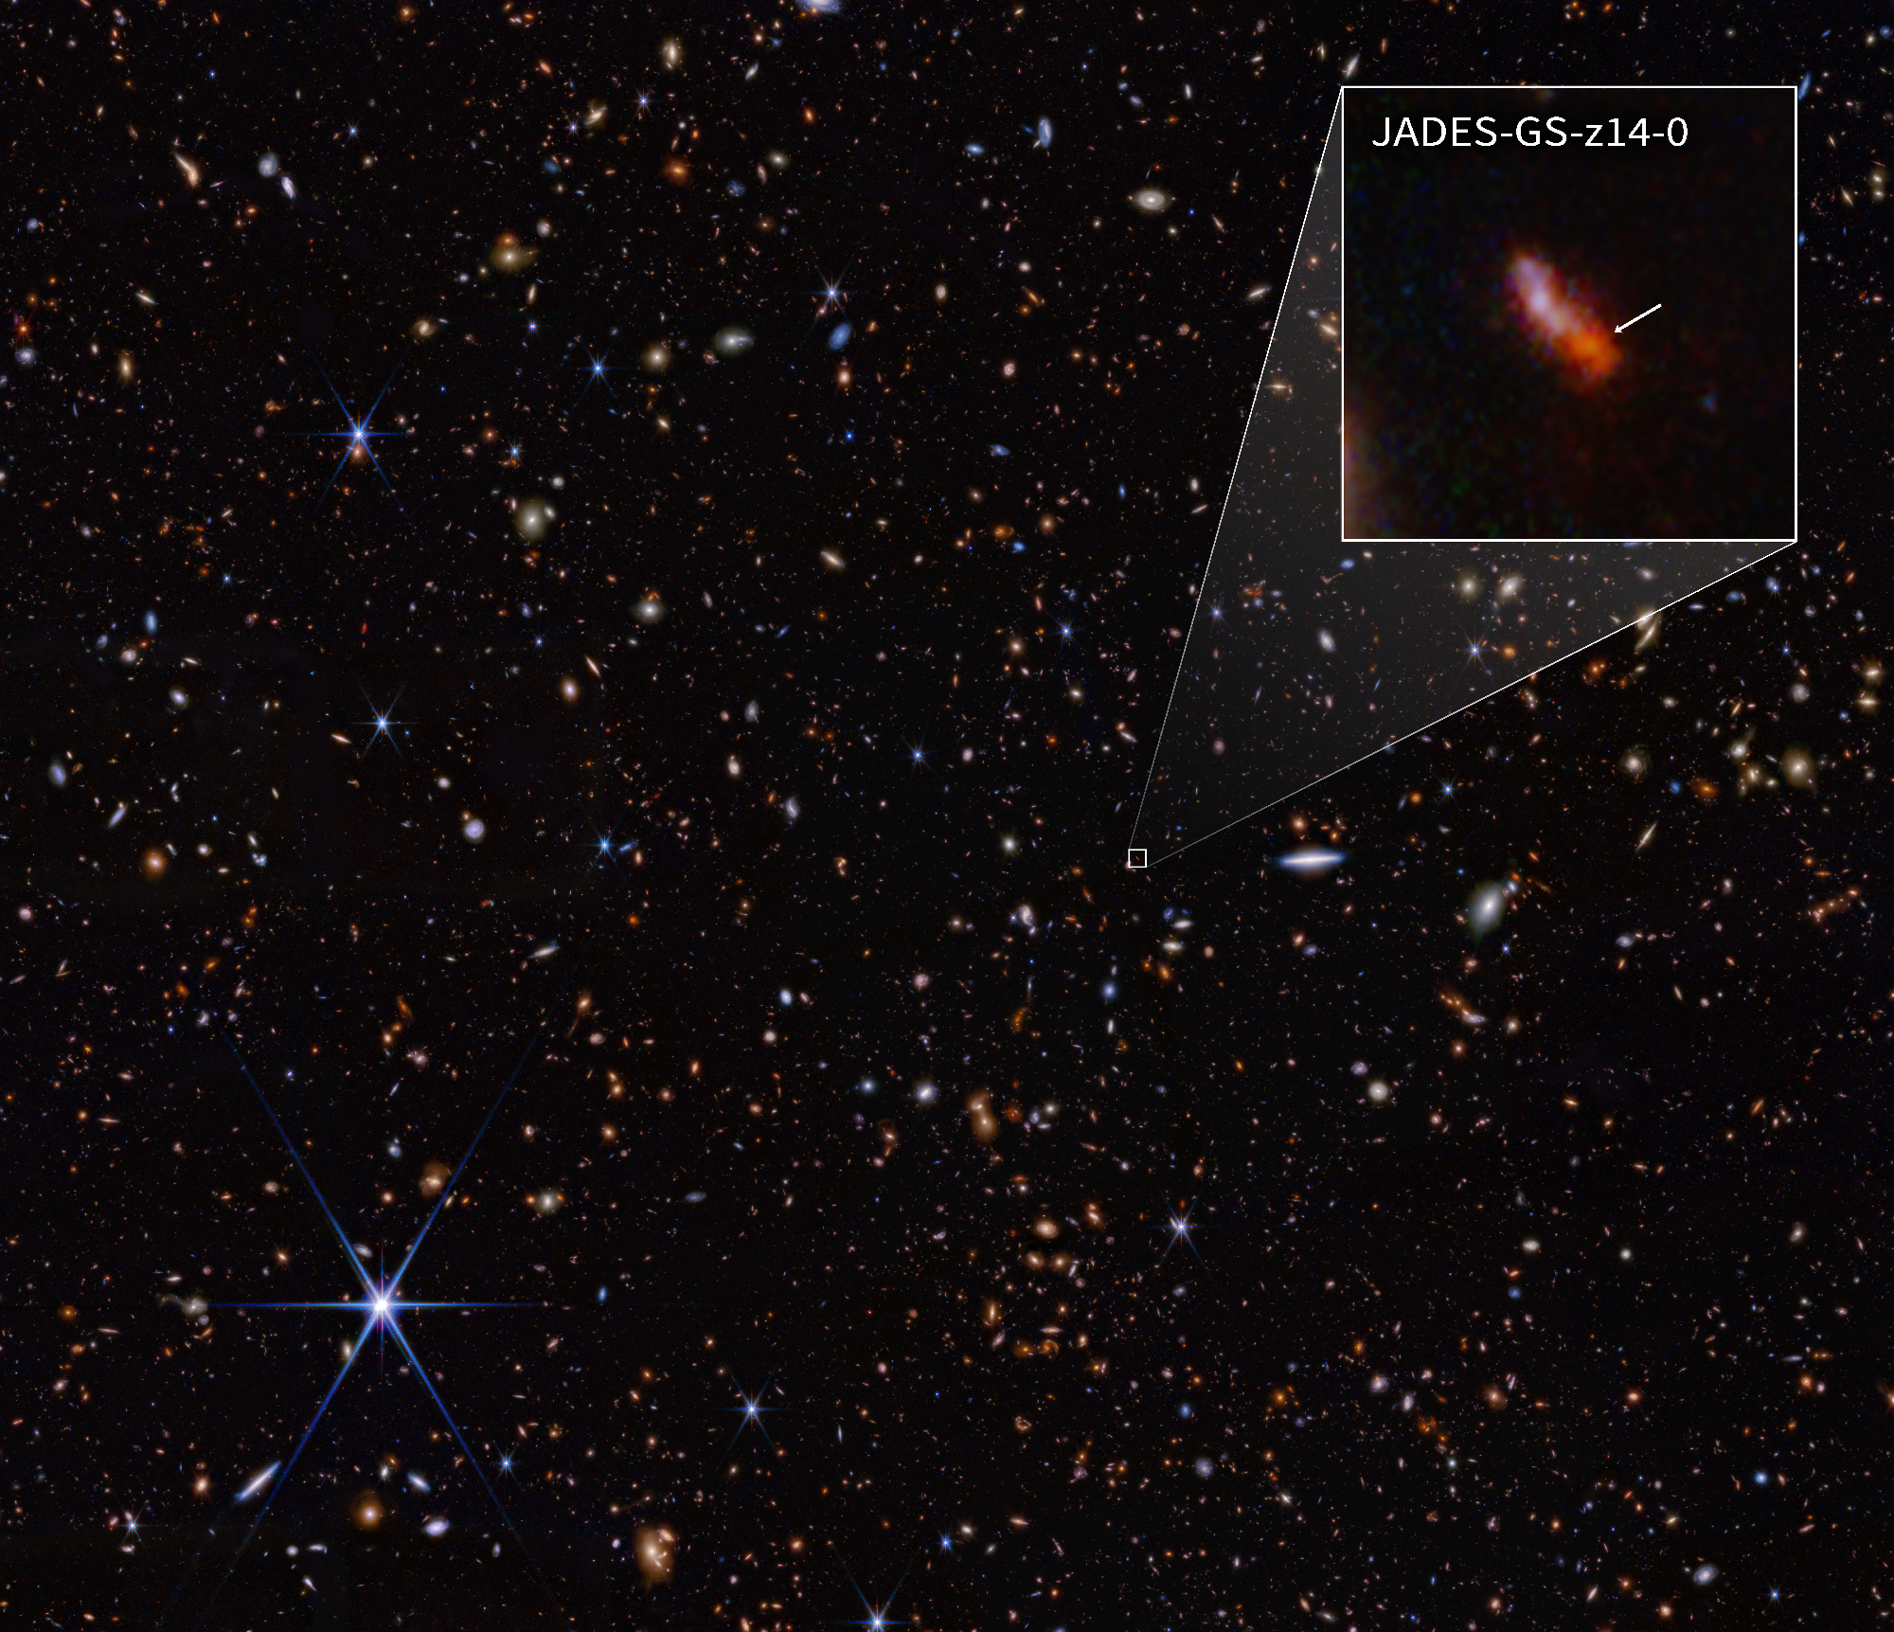
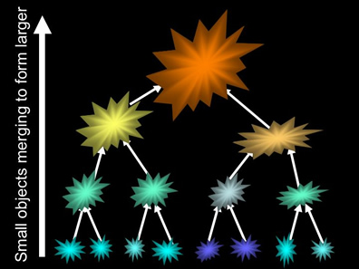
Early galaxies
Dwarf galaxies are the first in the chain!

Slide 5
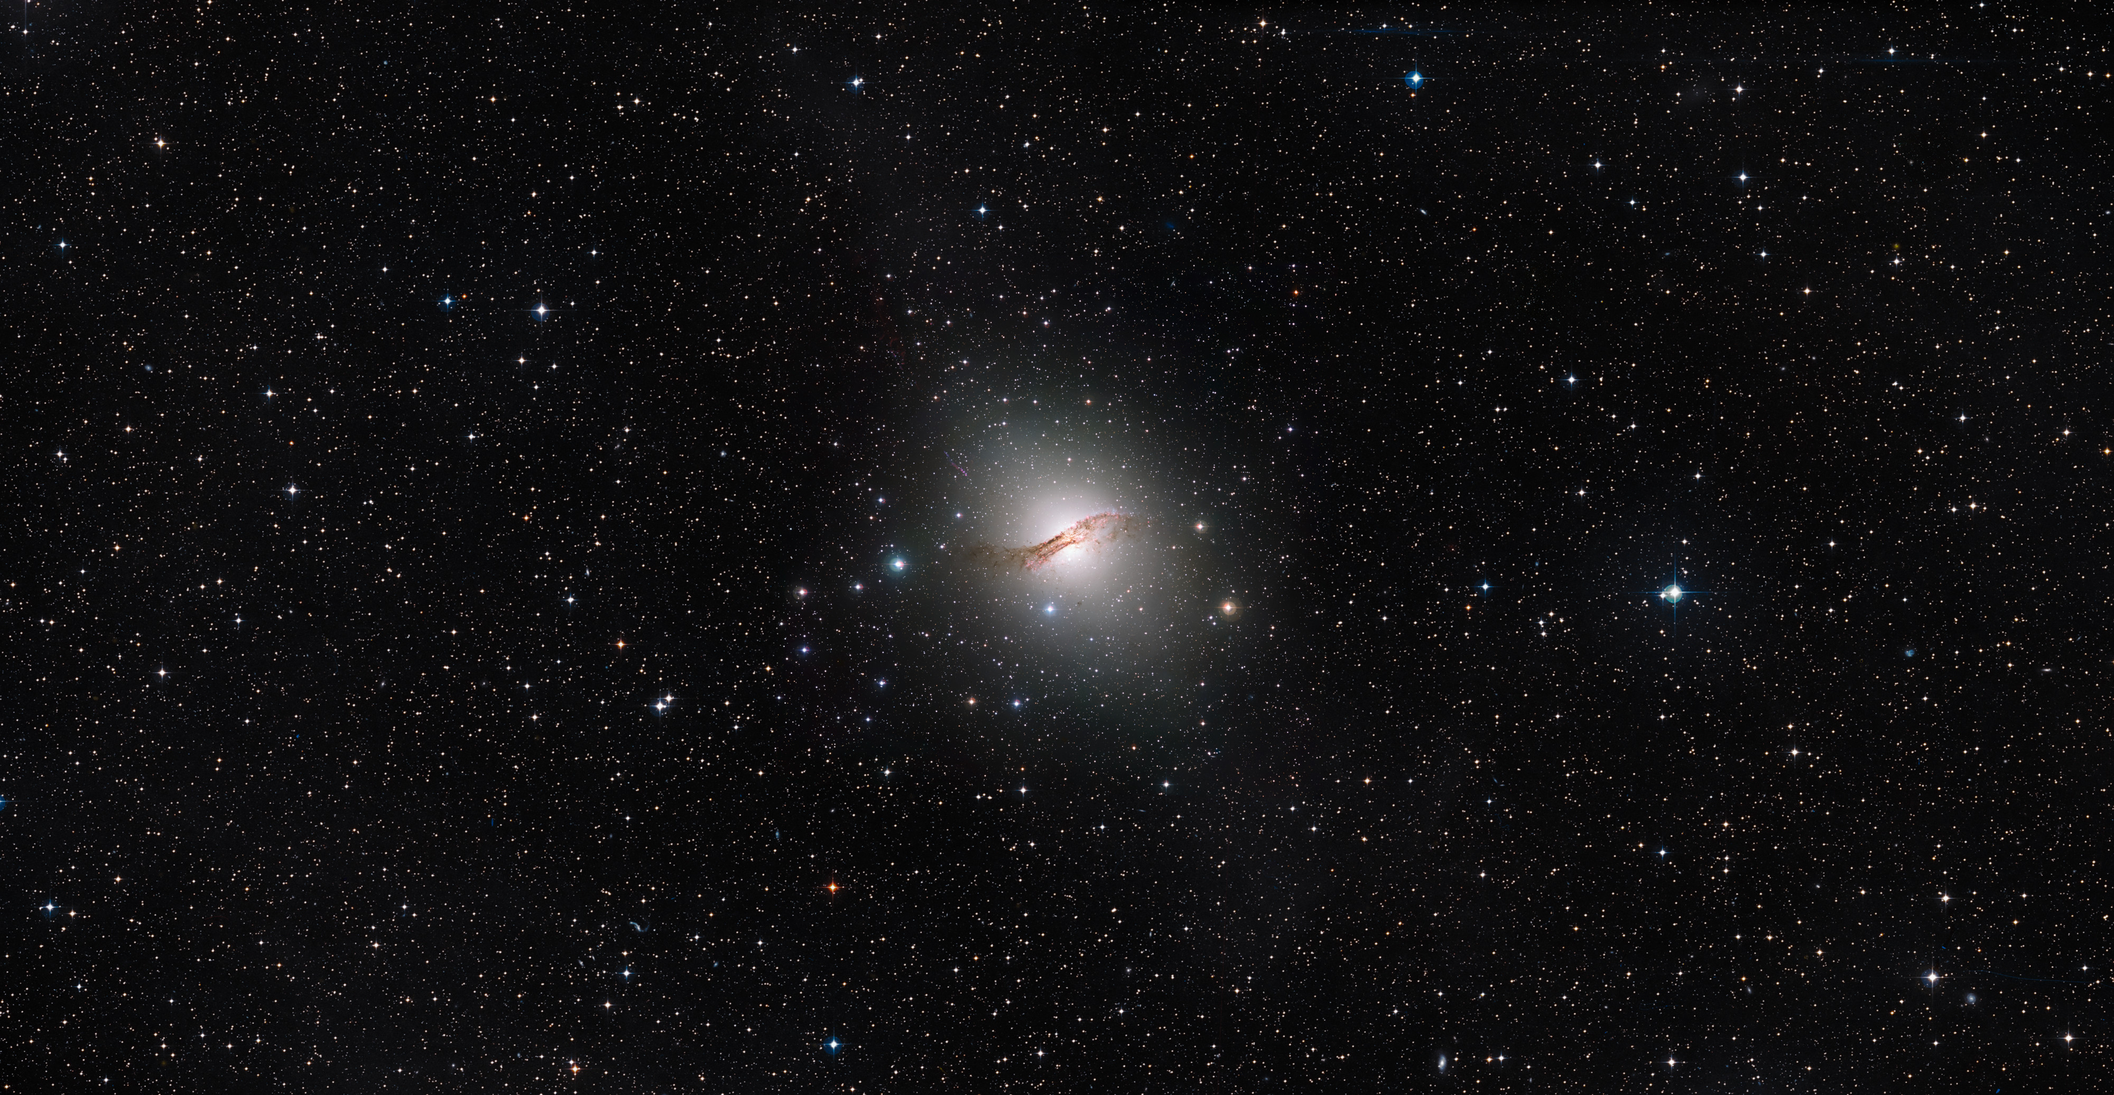
Active galactic nuclei (AGN) Centaurus A – closest active galaxy
Credit: ESO,ESA/Hubble, NASA. Digitized Sky Survey. Acknowledgement: Davide de Martin

Slide 6
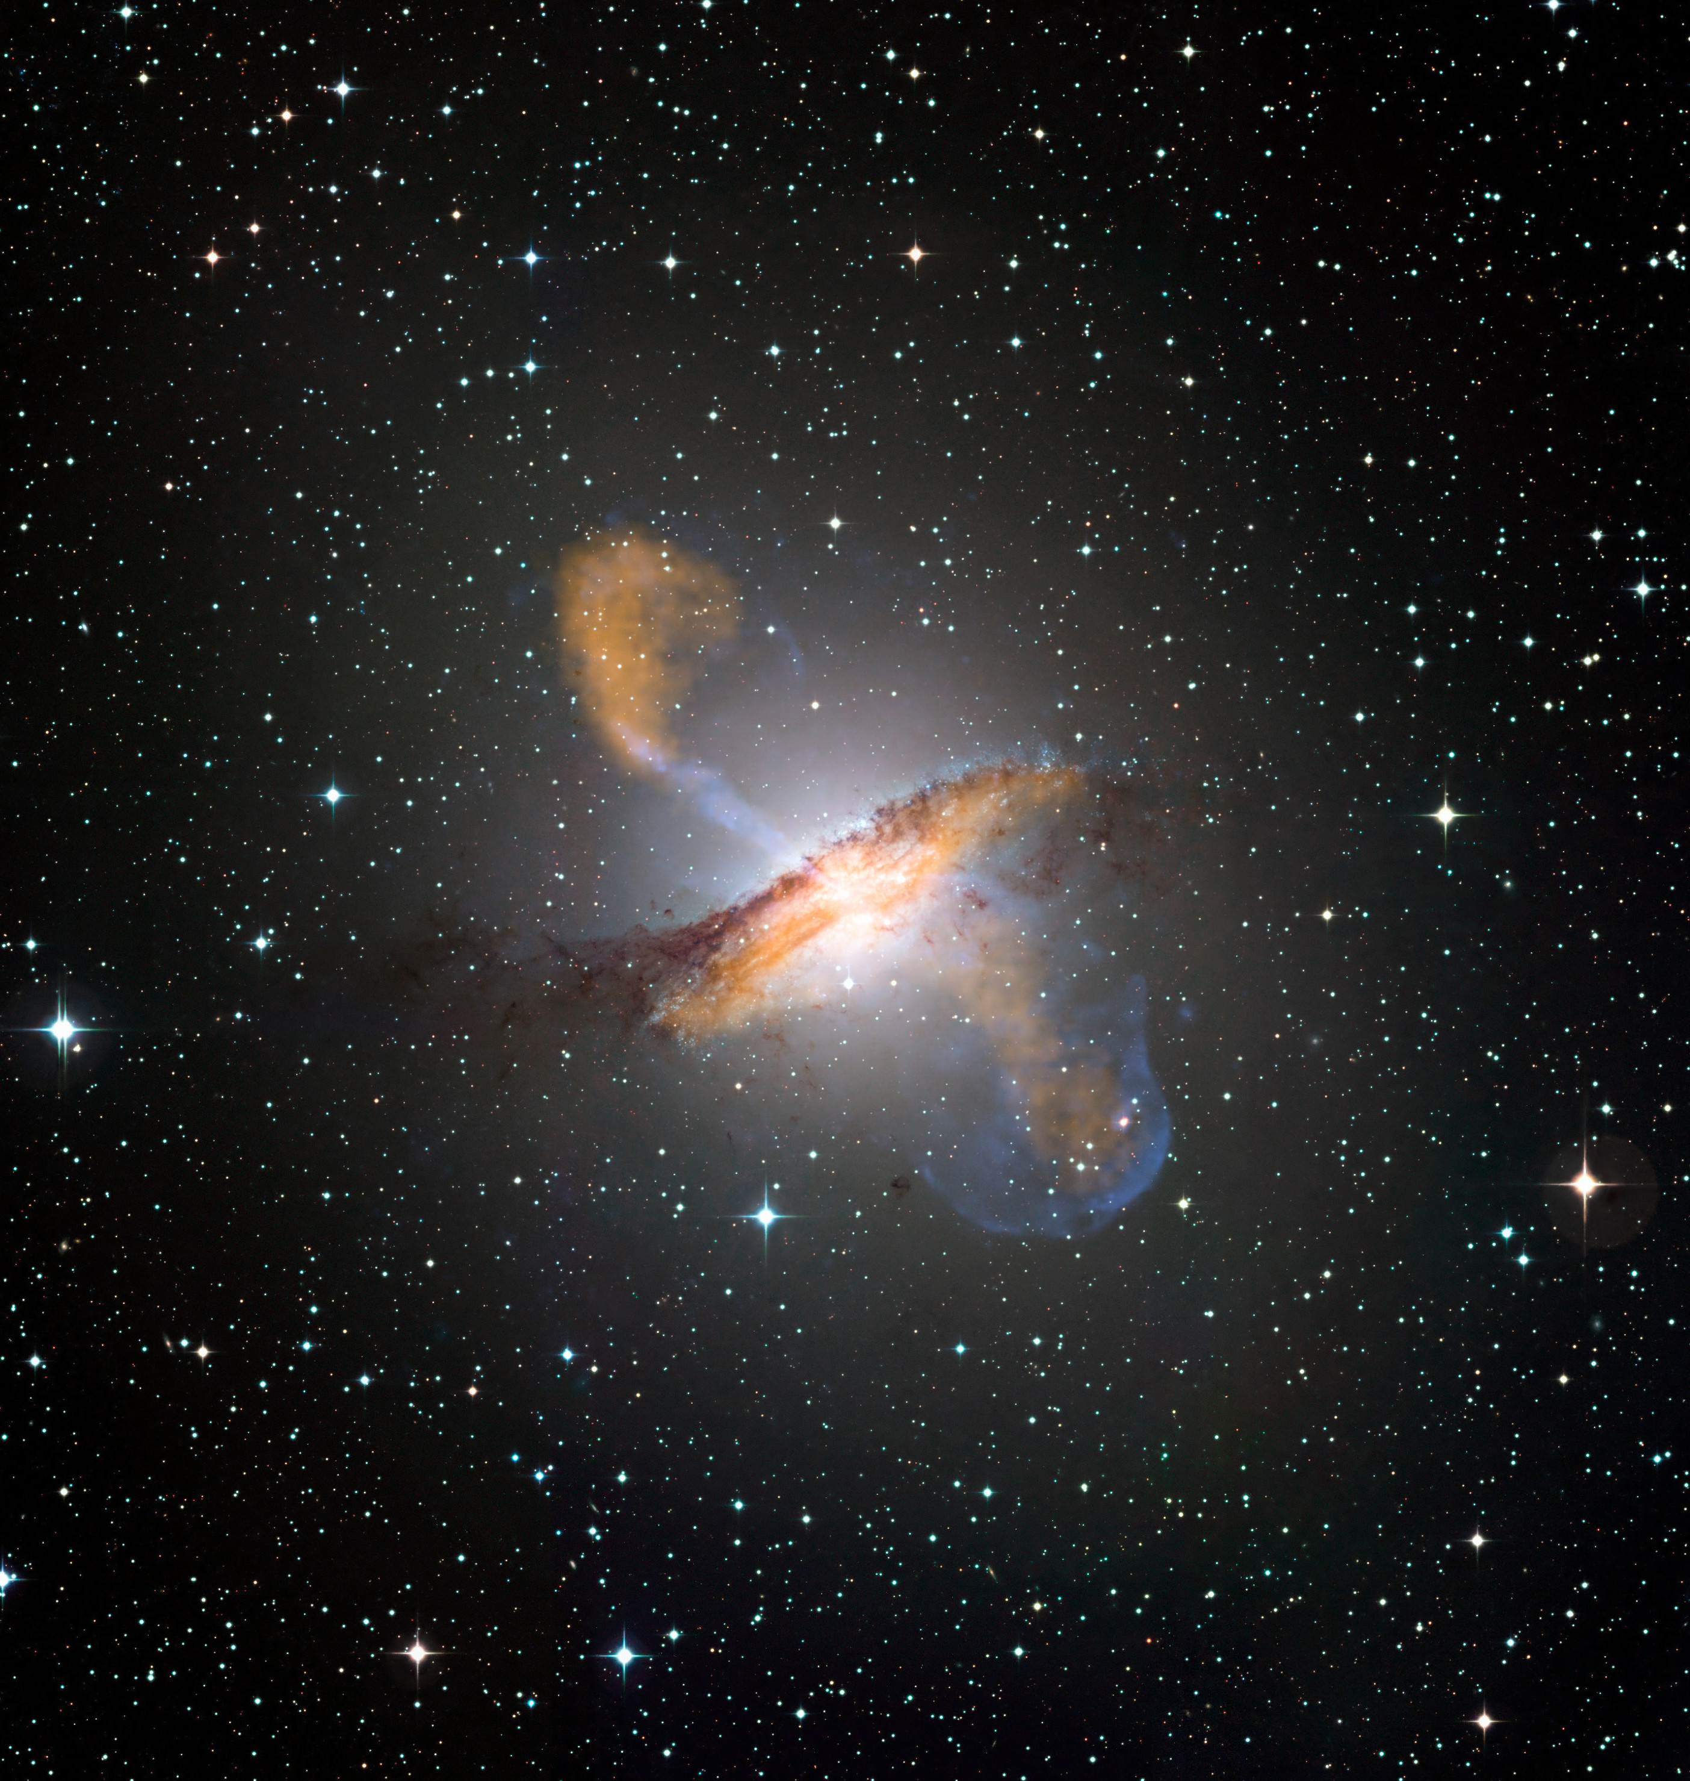
AGN jets
Credit: ESO,ESA/Hubble, NASA. Digitized Sky Survey. Acknowledgement: Davide de Martin

Slide 7
Zoom in
Credit: ESO/WFI (Optical); MPIfR/ESO/APEX/A.Weiss et al. (Submillimetre); NASA/CXC/CfA/R.Kraft et al. (X-ray)

Slide 8
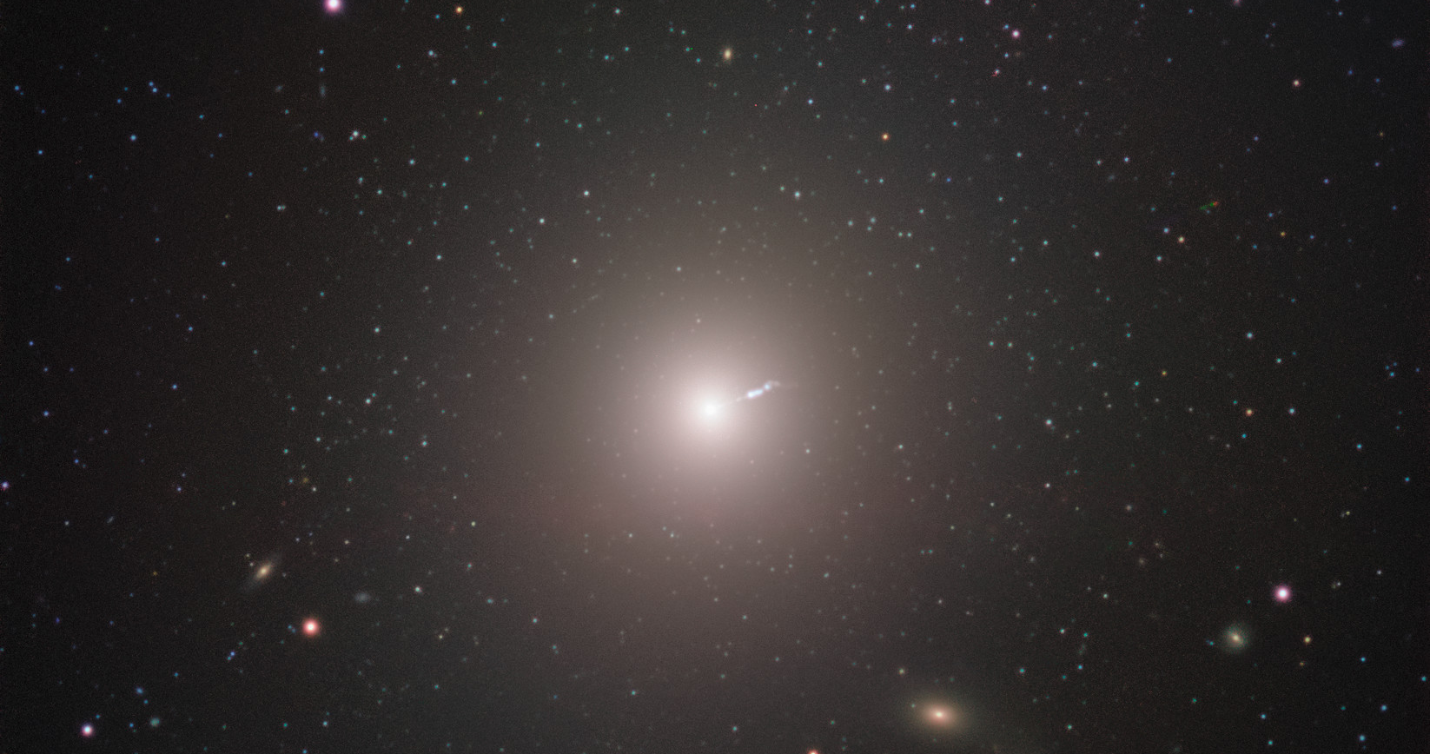
M87 Another well-known active galaxy

Slide 9
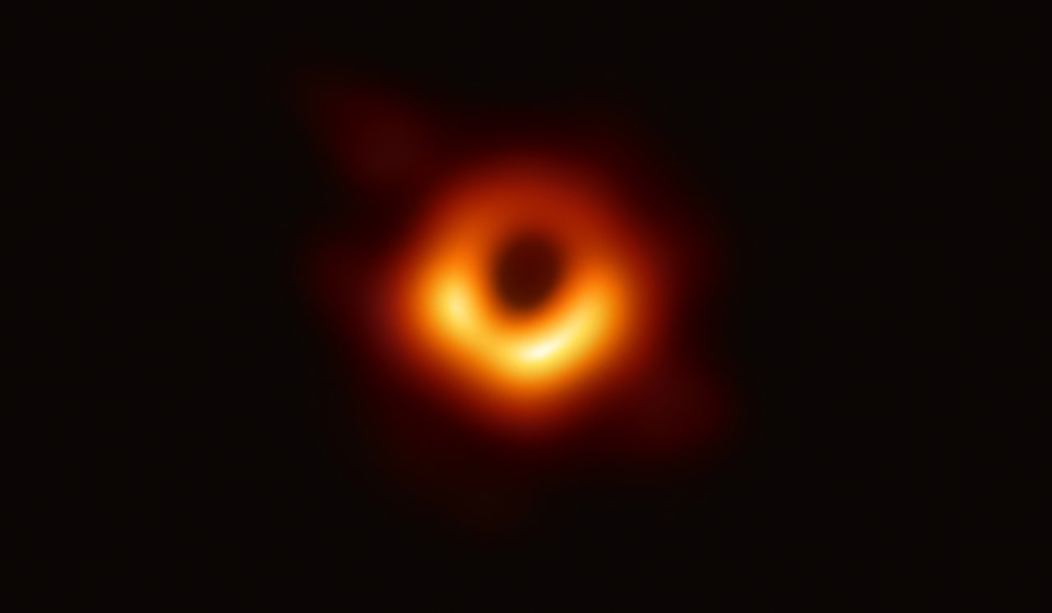
First image of a black hole M87*

Slide 10
Sense of scale
The Sun
Proxima Centauri
Crescent diameter: 45 mas
Distance: 16.8 Mpc

Slide 11
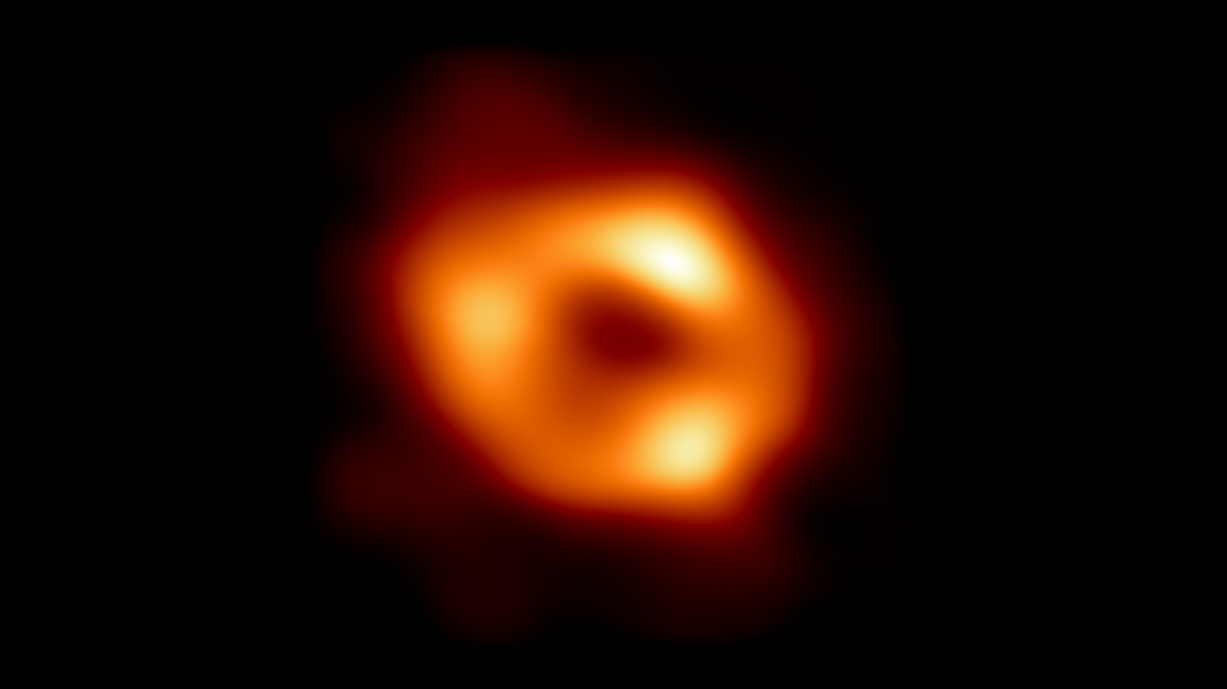
Our black hole Sgr A*

Slide 12
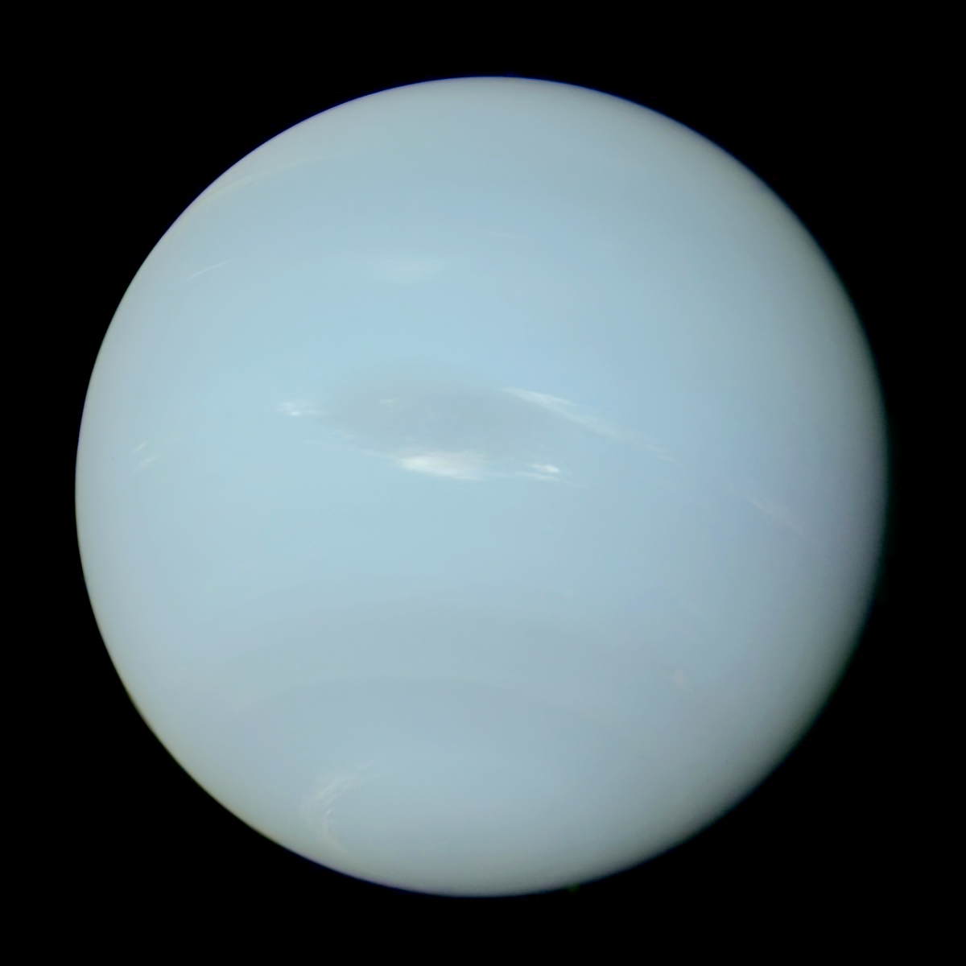
Slightly smaller
The Sun
Neptune
Crescent diameter: 50 mas
Distance: 8 kpc

Slide 13
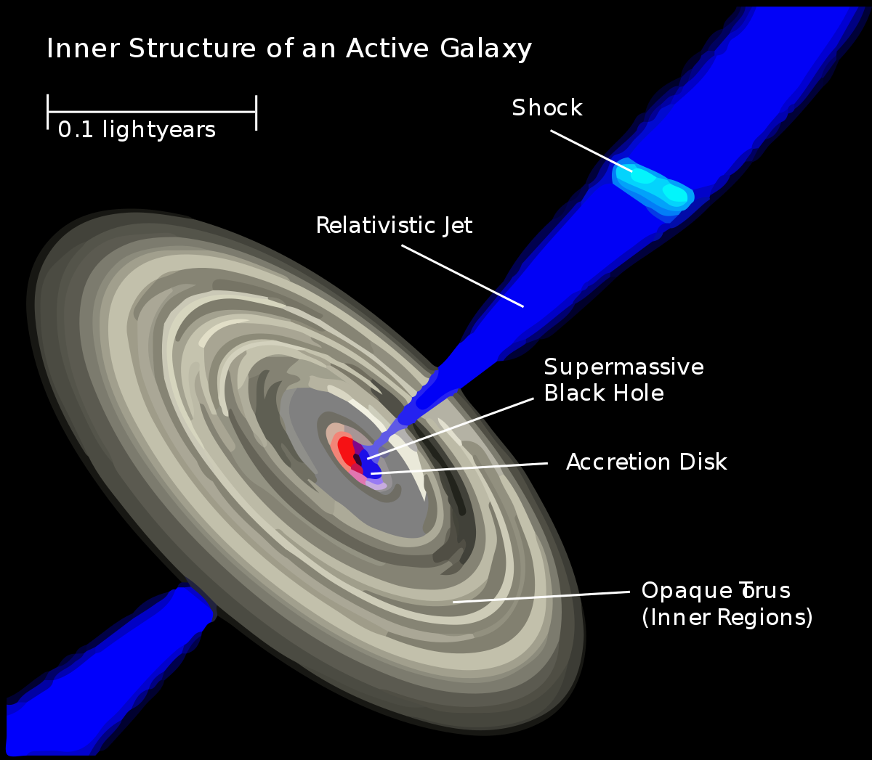
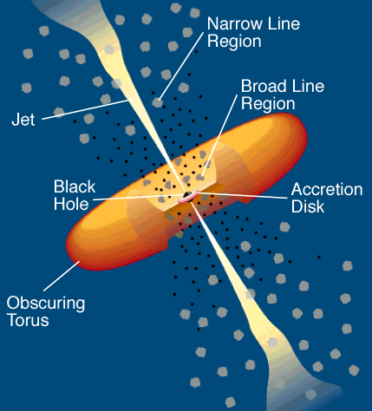
Schematic of AGN

Slide 14
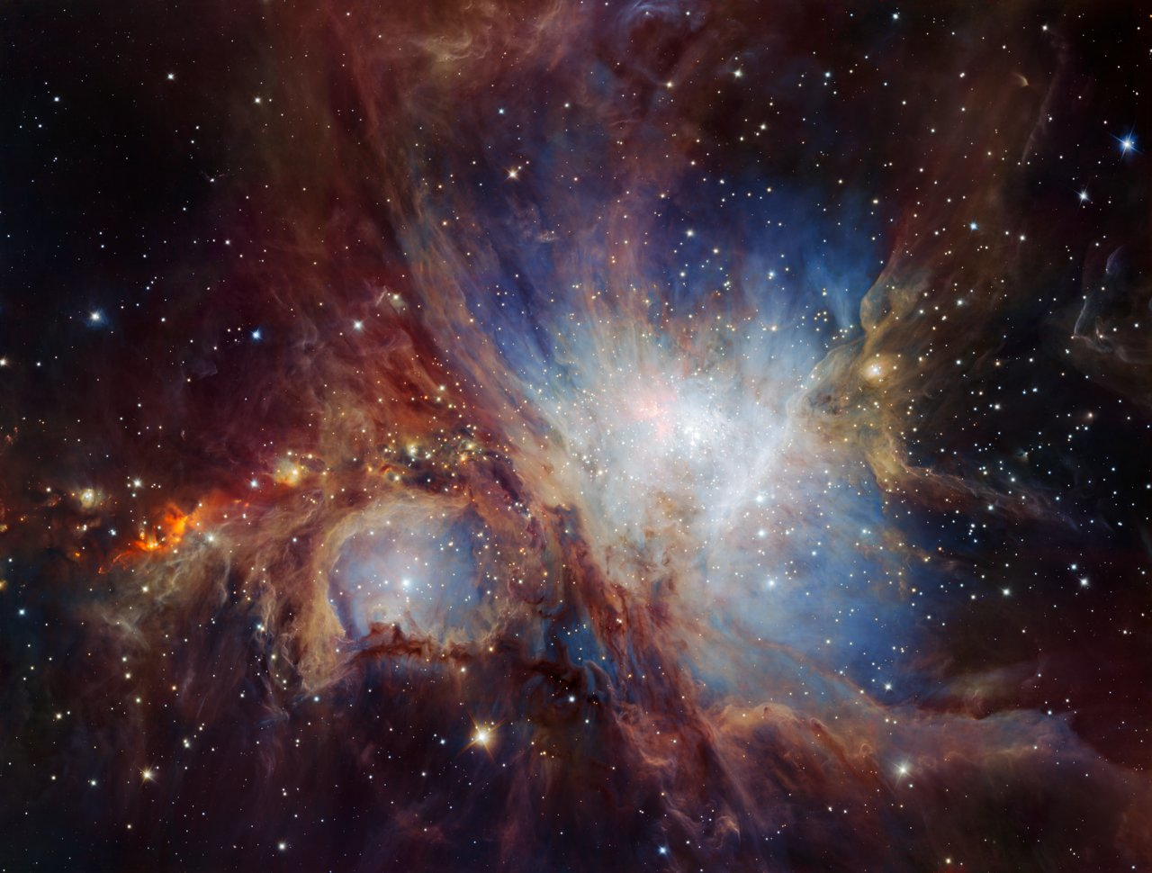
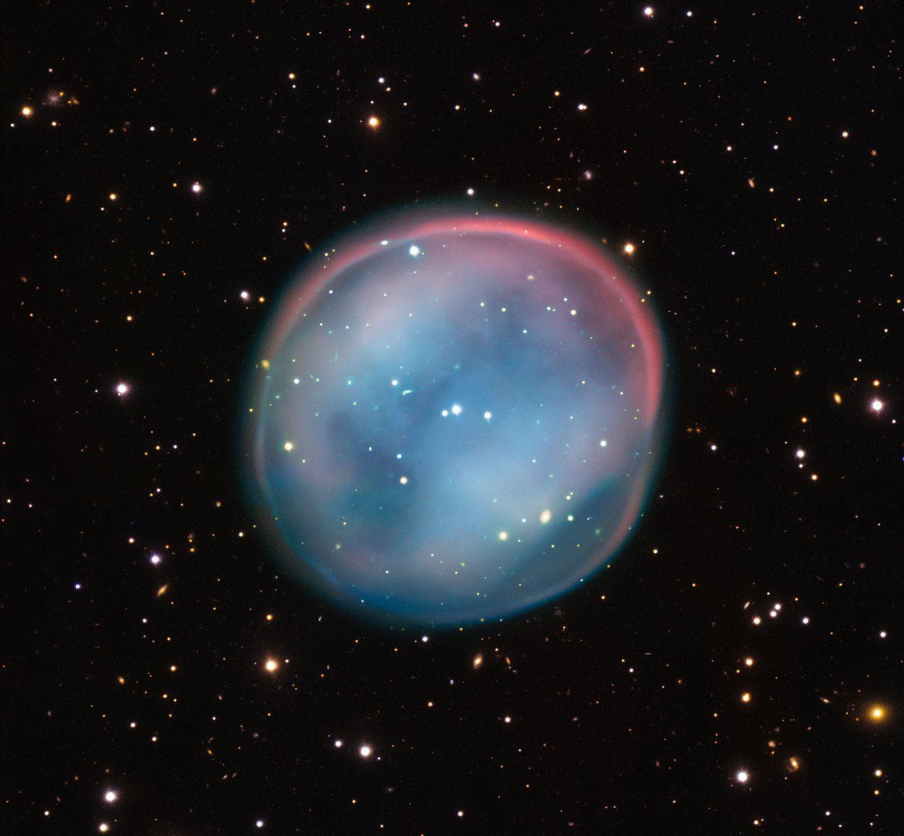
How to distinguish ionisation?

Slide 15
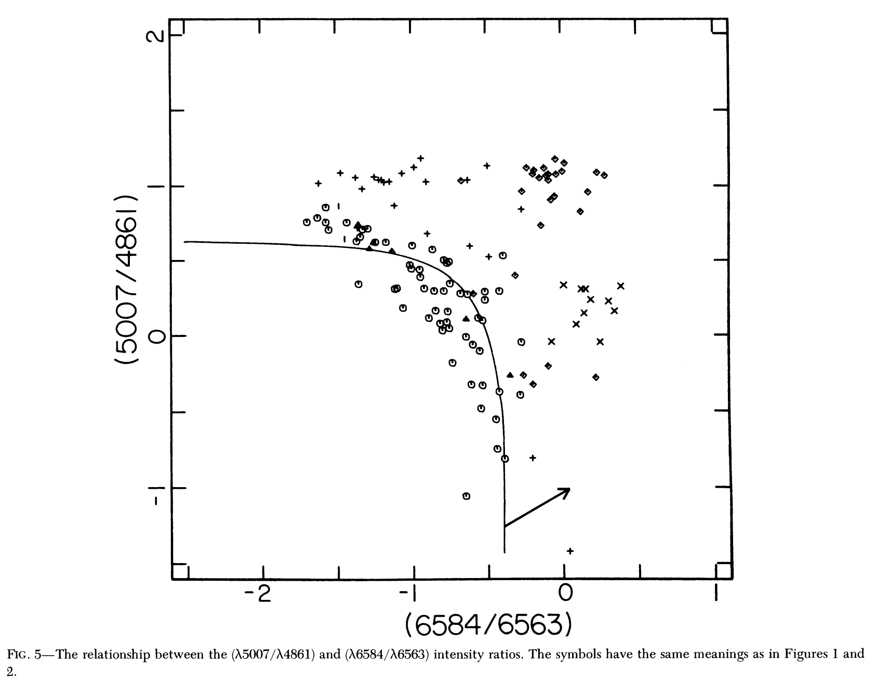
Optical diagnostic Baldwin-Phillips-Terlevich (BPT) diagram
From 1981
DOI: 10.1086/130766

Slide 16
Optical diagnostic Baldwin-Phillips-Terlevich (BPT) diagram
Hα λ6563
Hβ λ4861
[N ΙΙ] λ6584
[O ΙΙΙ] λ5007

Slide 17
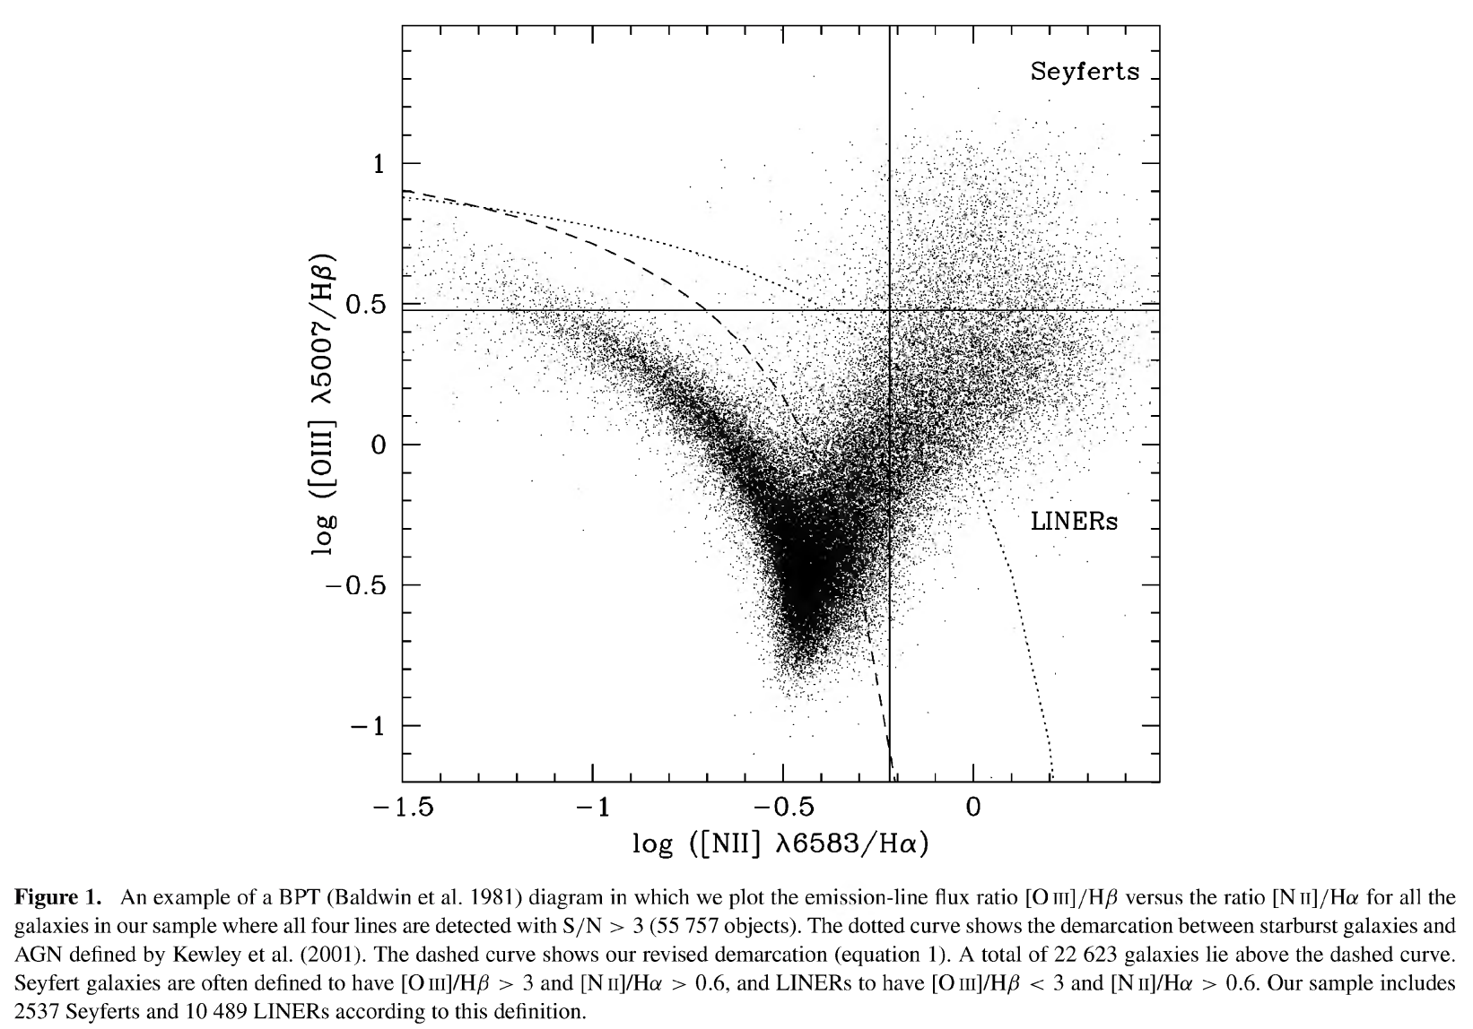
Improved since then
Kewley et al 2001
Kauffmann et al 2003

Slide 18
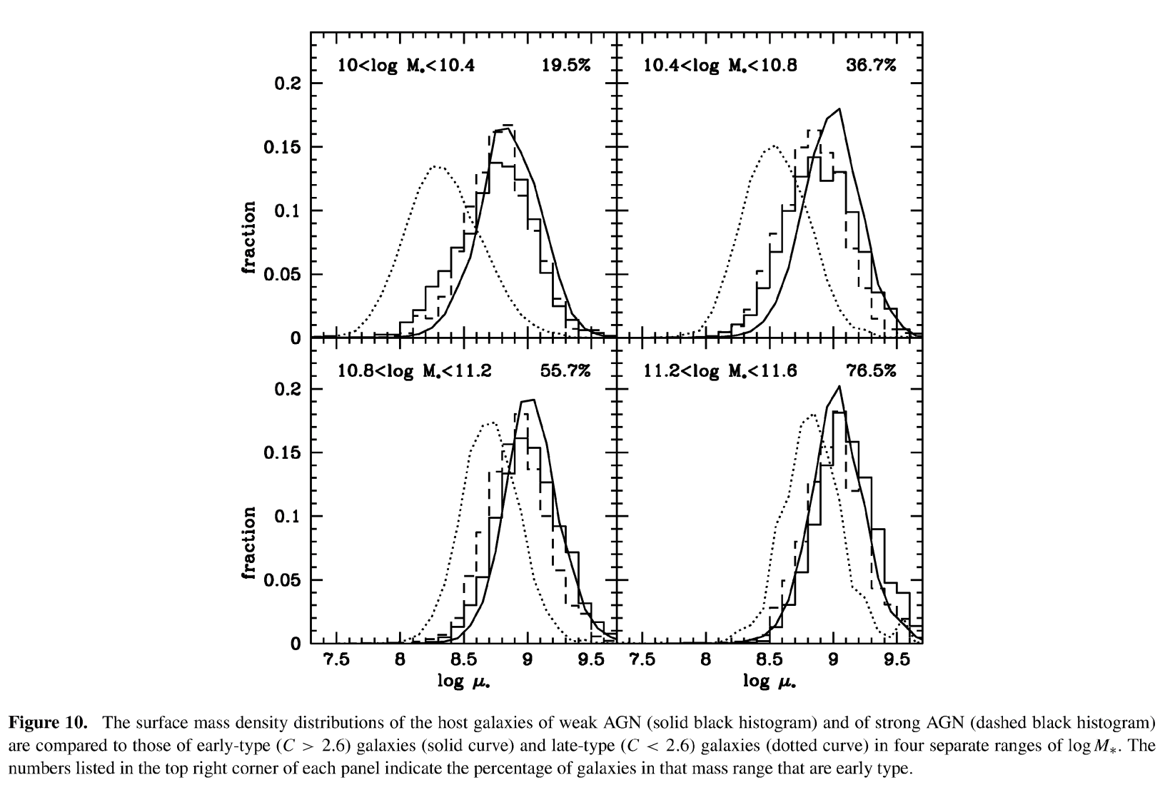
With a few buts
Kewly et al 2001
Kauffmann et al 2003

Slide 19
Other noteworthy methods
WHAN diagram (relies on equivalent width rather than Ο ΙΙΙ/Ηβ, so a bit more robust but less precise, Cid Fernandes et al. 2011)
WISE colours (infrared colours, so less resolution but parallel channel for identification, Stern et al. 2005, 2012)
JWST identification, although not sure of status
XMM-Newton (x-ray sources are almost unambigously AGN, Mateos et al. 2012 (but x-ray binaries contaminate a lot))
Variability (UV-IR wavebands, long- and short term, e.g Peterson et al. 2005)

Slide 20
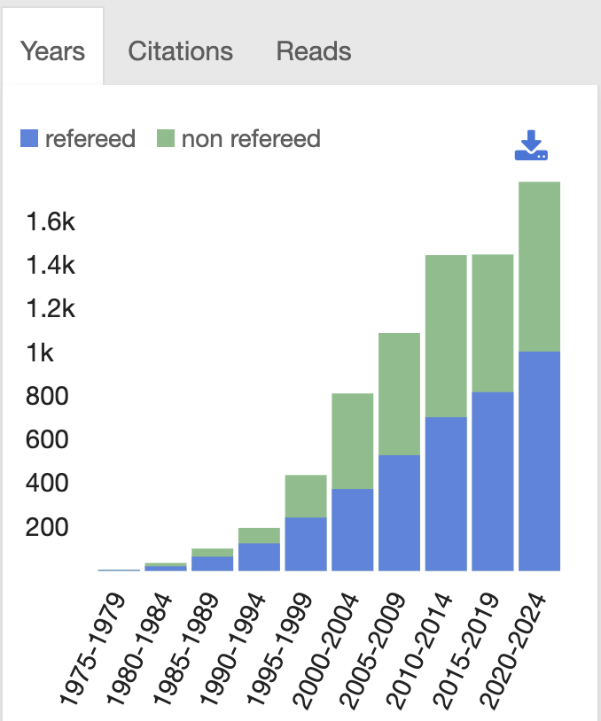
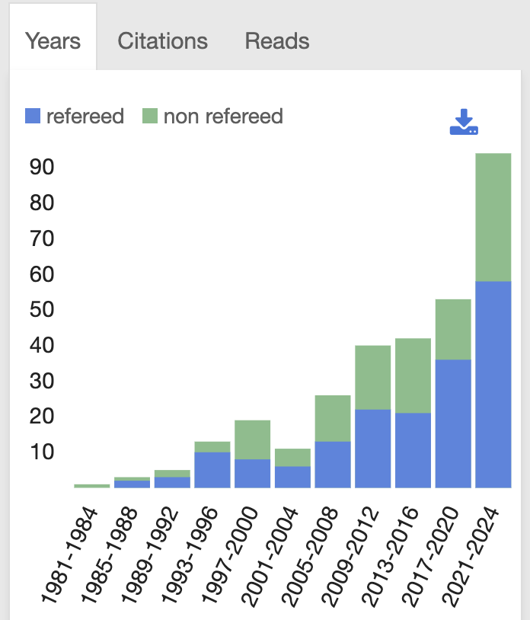
agn identification
dwarf agn identification

Slide 21
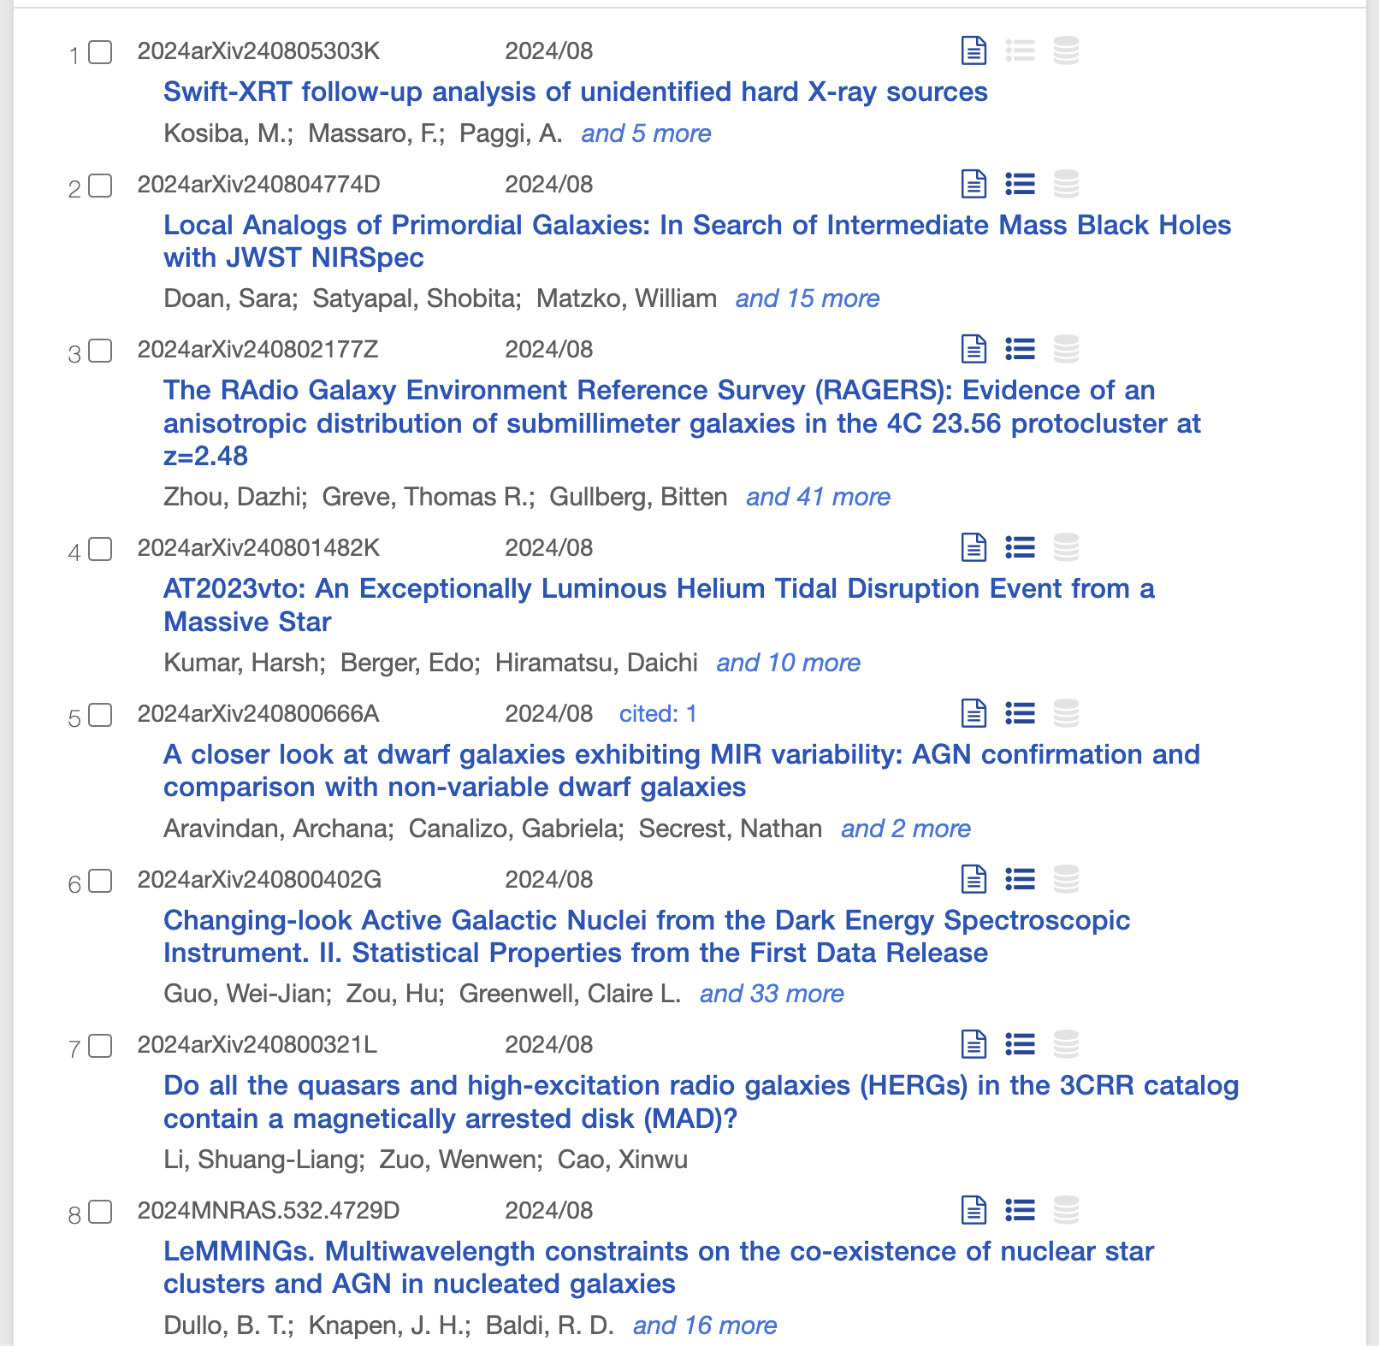
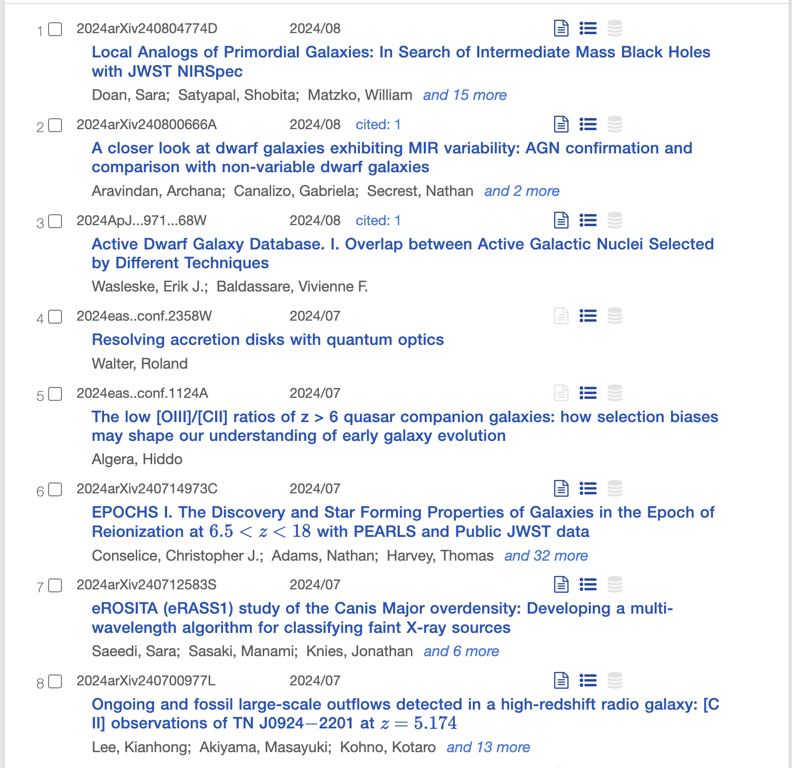
agn identification
dwarf agn identification

Slide 22
Problems with dwarf galaxies
Generally more star forming in SDSS spectroscopic surveys due to observation threshold (drowns out AGN signal)
Shallow potential wells make them susceptible to feedback processes
Low luminosity requires longer integration time to provide robust signal
Trump et al. 2015 ”demonstrate that “star formation (SF) dilution” by H ii regions causes a significant bias against AGN selection in low-mass, blue, star-forming, disk-dominated galaxies. ”

Slide 23
Solutions
Multiwavelength surveys
Multiple selection methods
Improve current selection methods
Develop new selection methods

Slide 24
My solution!
Random forest classification
AGN or not
AGN classification
Training
Prediction
BPT (N2 + S2)
Inner properties (11)
Sample
Low
WISE
Label
AGN
Spatial data (MaNGA)
Stellar age gradient
Ratio of ratios between inner/outer parts
XMM
Features
In, out, all
Spectral and photometric data (MaNGA+WISE+XMM)
WISE colours
Metallicity
3 training samples
- Int 1, Int 2, High
4 labels
- BPT N2, BPT S2, WISE, XMM
3 featurelists
Inner, outer, all
= 36 models
Stellar mass
Outer properties (12)
Low (1,149)
$$M_{∗} ≤3 × {10}^{9} M_{⊙}$$
High (2,439)
$$M_{∗}≥8 × {10}^{10} M_{⊙}$$
Environmental data (SDSS)
Distance to {1-10}th nearest neighbours
Distance gradient
Intermediate 1+2 (6,516)
$$3 ×{ 10}^{9}{ M}_{⊙}≤M_{∗} ≤8 ×{10}^{10} M_{⊙}$$

Slide 25
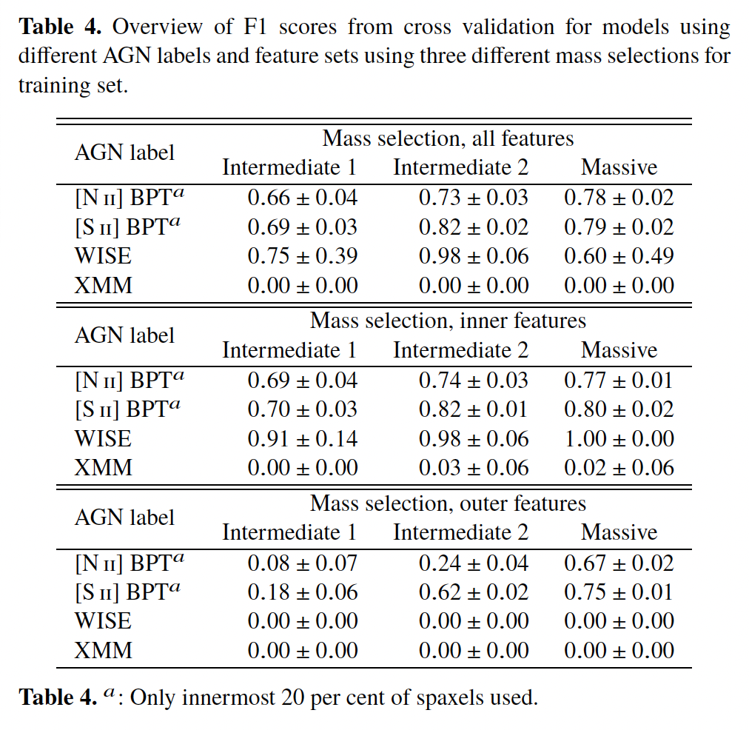
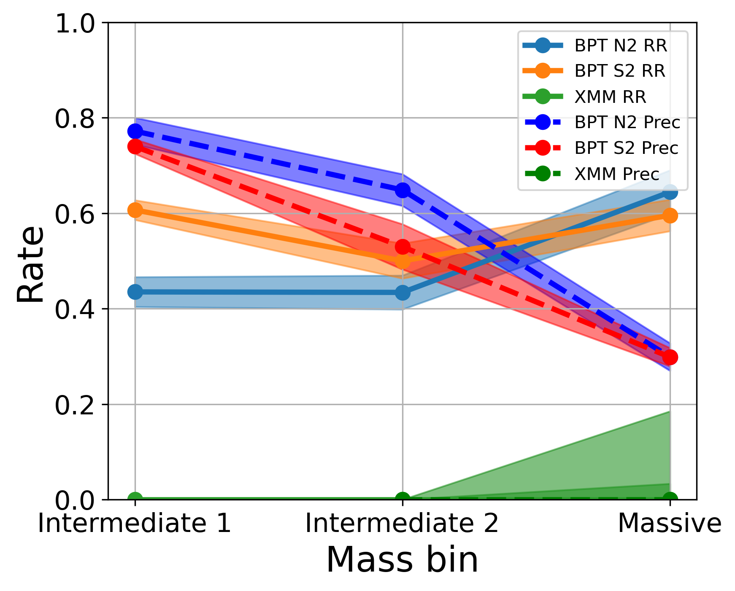
Cross validation scores

Slide 26
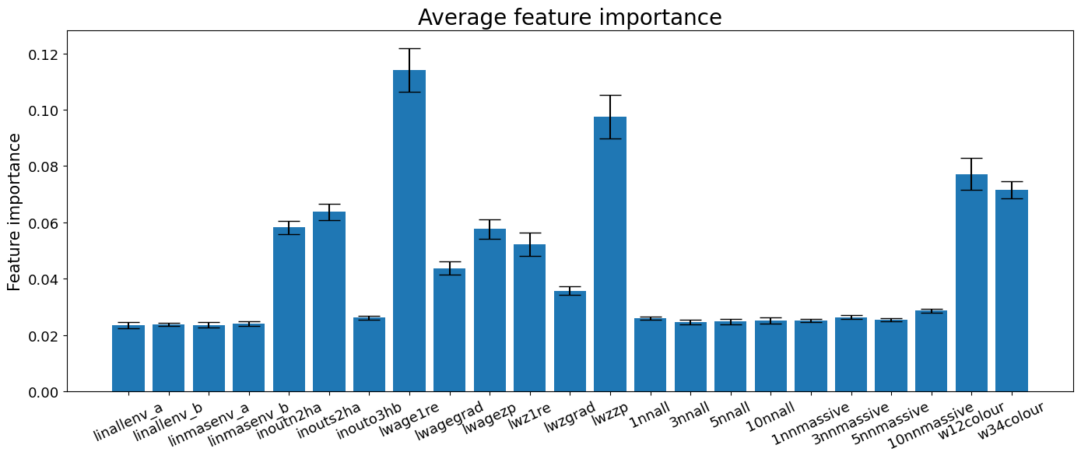
Feature importance Intermediate 2 as training set

Slide 27
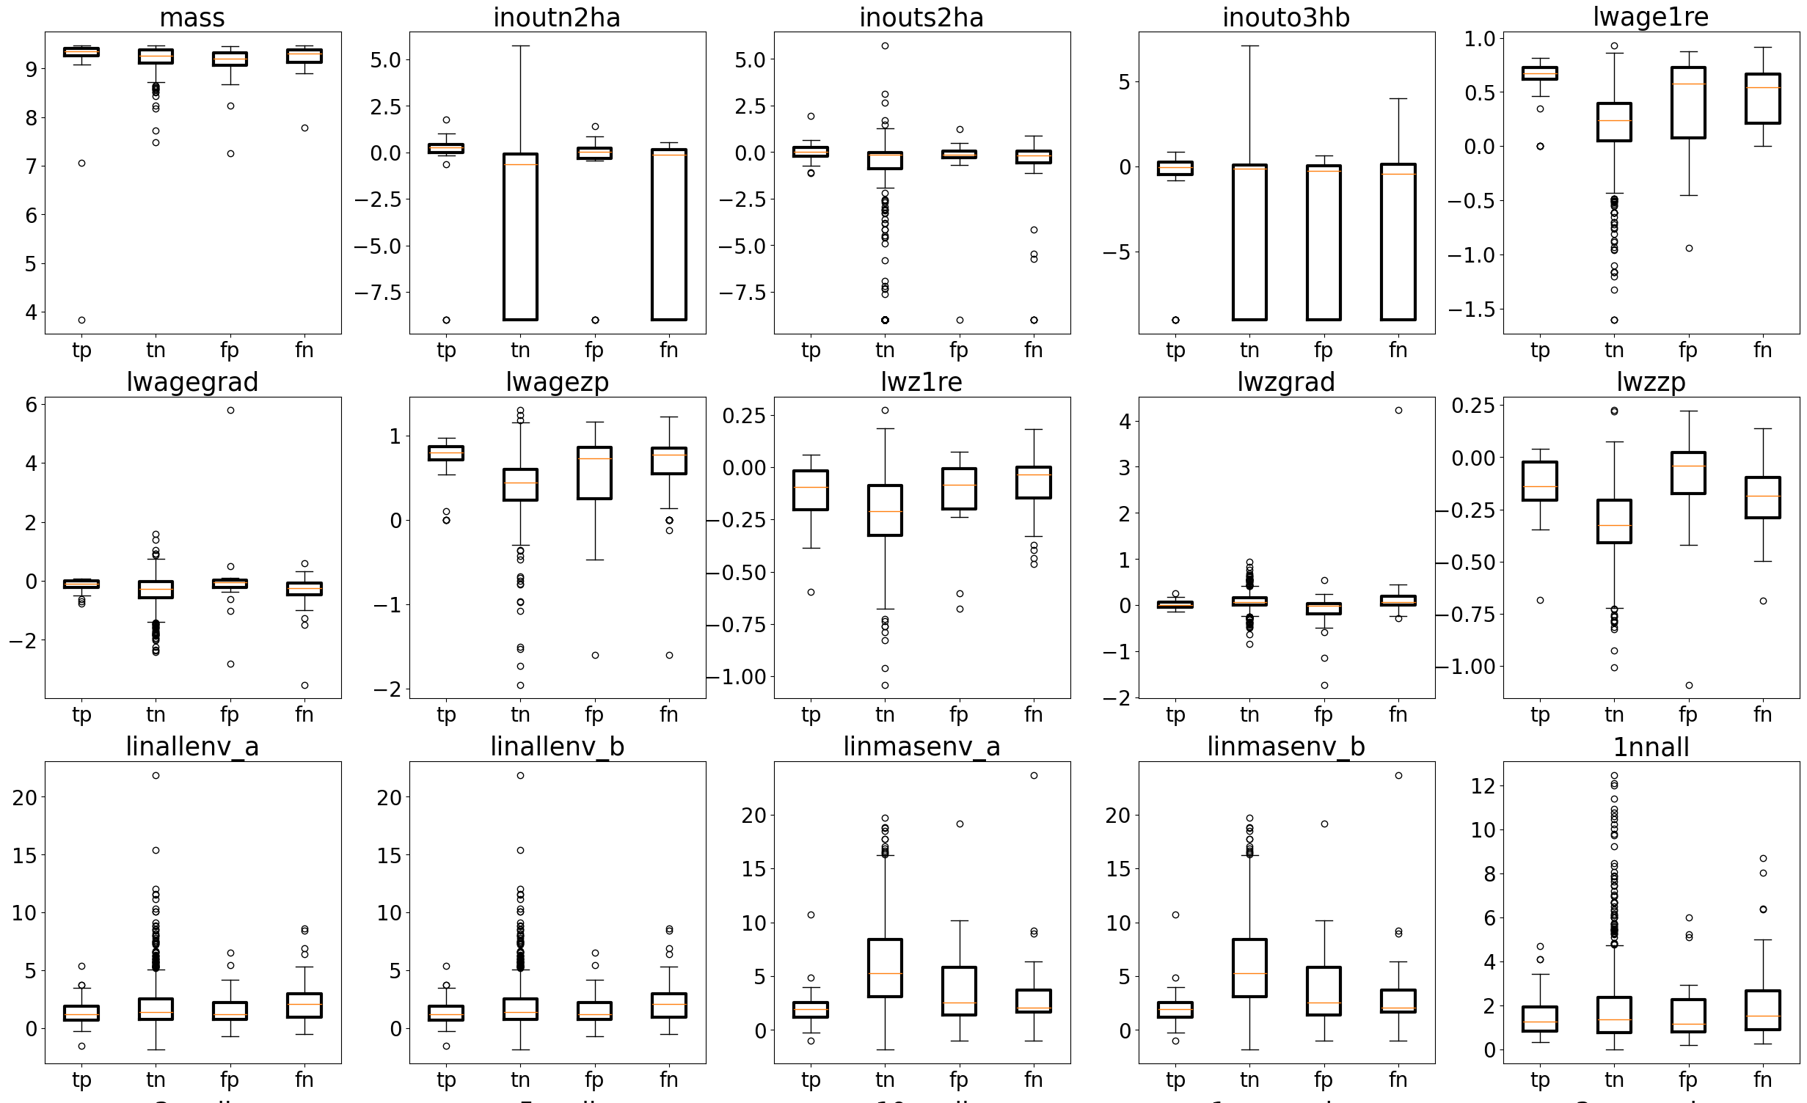
Characterisation matrix Intermediate 2 as training set, prediction on dwarfs

Slide 28
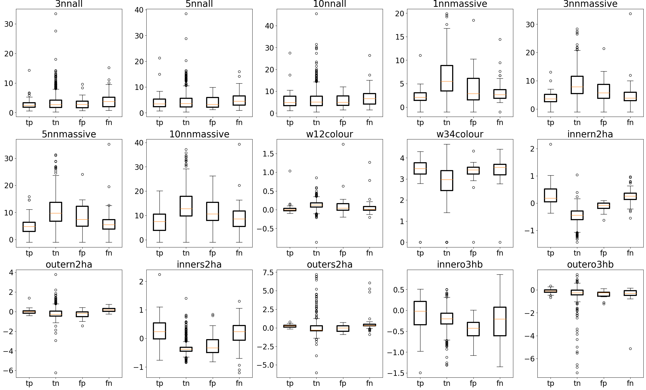
Characterisation matrix Intermediate 2 as training set, prediction on dwarfs

Slide 29
Summary
Environmental features are poor predictors of AGN activity, even when used in combination with internal features. However, dwarf N2 and S2 BPT AGN that are identified as AGN in both RF and MaNGA data are on average closer to a massive galaxy than non-AGN.
The more massive galaxies used for training, the better model, if going by F1 score alone. Going by score alone, though, washes out nuances such as class balance and feature importance. More massive galaxy models rely on fewer parameters that are more directly related to AGN activity. Specifically, [S ii] BPT ranks the [S ii]/H𝛼 ratio between inner and outer regions the highest – a feature that [N ii] BPT also rank highly but with a more flat feature importance distribution in general (i.e close to equal weighing of all features)
Average stellar age within 1 effective radius is weighed the highest using lower mass galaxies as training sets but decreases in importance towards higher masses. For [N ii] BPT, metallicity, infrared colours, and [N ii]/H𝛼 inner/outer ratio are also ranked highly, while for [S ii] BPT, metallicity is less important and feature importance is ultimately dominated by [S ii]/H𝛼 inner/outer ratio.
Predictions of dwarf galaxy classification from lower mass training sets yields results that most accurately resemble the observations, but the AGN occupation fraction is lower. As such, this training set alone is a poor choice for classifying AGN but can be used to find otherwise hidden AGN
Conversely, higher mass training sets yield a high number of AGN that observations do not predict and generally disagrees the most with observations out of all models – despite their good CV scores. The question is then whether the predicted dwarf AGN actually are AGN.
Since this study has been a preliminary approach, there are several improvements to the method that can be implemented for future work. Highest on the list is improving feature optimisation and inclusion. This includes reducing the number of features that are degenerate (e.g certain environmental parameters) while also including more relevant features (such as multi-wavelength data and colours).
Further exploration of the different true/false postive/negative subcategories of dwarf AGN are similarly a venue for improving the validity of the method, but it can also be to adjust regular AGN selection methods such as the BPT diagram to better fit the dwarf mass regime.

