Slide 1
Prospects for detecting quark star features with IceCube
María Durán de las Heras
Uppsala University Msc student
Supervisors: Erin O’Sullivan & Jakob Beise
Notes:
Hello everyone! I’m María Durán and today Im going to present my master tesis Project on the Prospects for detecting quark star features with Icecube, supervised by Erin O’Sullivan and Jakob Beise.

Slide 2
Introduction
Aim: study the capability of IceCube to detect sharp features from the hadron-quark phase transition present in the formation of a quark star
But, what is a quark star?
→Compact object: remnant of a star that has burn all its
nuclear fuel
→Composed by deconfined quark matter
*We can use neutrinos to identify the quark deconfinment!
Neutron star
Quark star
Notes:
So the main objective of this Project was to assess the capability of IceCube and IceCube gen2 to detect Sharp neutrino features from the hadron to quarks phase transition present in the formation of a quark star.
But what is a qs? It is a theoretical type of compact object, so a remanant of a star that has burn all its nuclear fuel.
But instead of being composed by hadronic matter, like neutron star, it is composed by deconfined quark matter.
We could use neutrinos to identify such an object during its formation

Slide 3
Phase transition driven Core-collapse SNe
In a nutshell
Notes:
Which can happen in a phase transition driven core collapse supernova

Slide 4
υ
υ
υ
υ
υ
υ
υ
υ
υ
υ
υ
υ
υ
υ
υ
υ
υ
$$\overline{υ}$$
υ
$${\overline{υ}}_{e}$$
$${\overline{υ}}_{e}$$
$$\overline{υ}$$
υ
$${\overline{υ}}_{e}$$
υ
$${\overline{υ}}_{e}$$
$${\overline{υ}}_{e}$$
$${\overline{υ}}_{e}$$
Notes:
Stars with a main-sequence mass over 10 solar masses produce extended iron cores, where photodisintegration of heavy nuclei and electron captures reduce the radiative pressure, breaking its equilibrium with gravity.
This triggers gravitational collapse, making the core contract. Neutrinos from the nuclear reactions get trapped due to the high densities
If we zoom into the core, we see that the collapse triggers an outward-going shockwave that reduces the density in the outer layers of the core (called neutrinospheres), opening a window for neutrinos to escape—emitting a first neutrino burst.
At this stage, the final fate of the star is not decided. Depending on the progenitor mass, it could end up as a black hole, or we could have what is called a proto-neutron star, formed by neutrons—each composed of two down quarks and one up quark.
If the progenitor is massive enough, the density in the PNS can overcome the neutron degeneracy pressure, triggering a phase transition from hadronic to deconfined quark matter.
This phase transition will lead to a secondary gravitational collapse, which generates a second shockwave, enabling the release of a second neutrino burst, dominated by electron antineutrinos.

Slide 5
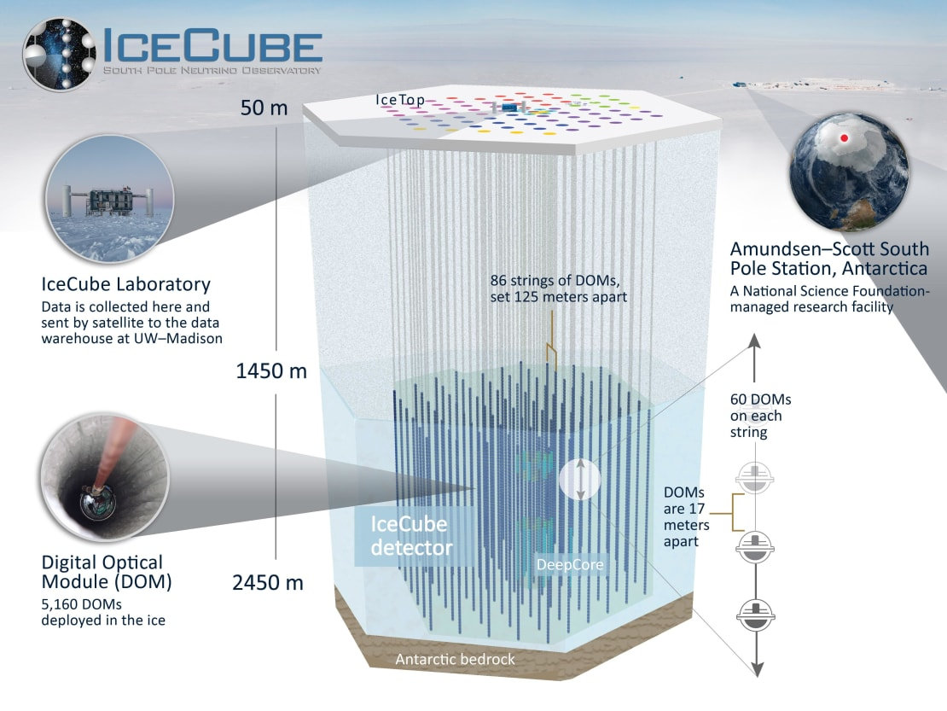
IceCube: neutrino detection
IceCube: neutrino observatory in Antarctica
1km³
5160 Digital Optical Modules (DOMs)
Detection of the neutrino-induced Cherenkov radiation
Notes:
IceCube is a 1 cubic kilometer neutrino obsertvatory in antartica, composed by 86 strings with five thousand sixty digital optical modules. It detects the cherenkov radiation thanks to he photomultipliers in the optical modules

Slide 6
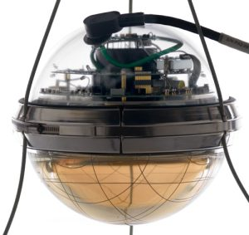
Observable features
We would observe a second peak on the emission signal:
→from the second shock wave (PNS collapse due to phase-transition)
Burst of electron antineutrinos:
Detectable via inverse beta decay
(10 MeV range)
$$+ p→e^{+}+n$$
Cherenkov light
$${\overline{ν}}_{e}$$
DOM
Notes:
We expect two peaks in the neutrino signal from the core collapse supernova:
-a first peak from the first collapse and a
-second peak triggered by the second shockwave from the quark phase transition.
IceCube is particularly sensitive to electron antineutrinos, which interact via inverse beta decay, producing a positron and a neutron. The positron emits Cherenkov light, which our optical modules detect.

Slide 7
Simulation set up and results
Notes:
Lets now dive into the simulations and analysis

Slide 8
Simulation setup
GR1D: simulate the CCSNe (flexible EoS module to include quark and hadron matter)
DD2F (hadron) + RDF (quark)
ASTERIA: simulate IceCube and IceCube Gen2 response to the ${\overline{\text{υ}}}_{e}$ signal
Notes:
In this work, Evan used GR1D to simulate the the phase-transition supernova taking into account the equations of state for hadronic and quark matter
I focused the analysis on two stellar models:
A 40-solar-mass star that forms a black hole after the phase transition.
A 30-solar-mass star that leaves behind a quark star remnant. The using the ASTERIA simulation framework, I calculated the expected detector response for:
Current IceCube
IceCube-Gen2
Gen2 + wavelength shifters
And I used the hit rate formula that depends on luminosity, neutrino energy, detector efficiency, and distance squared.

Slide 9
MODEL RDF-1.2 (s30a28)
Explosion model: quark star remnant
Notes:
Now lets see what we get when we look at the quark star remnant model (with a 30sm progenitor)

Slide 10
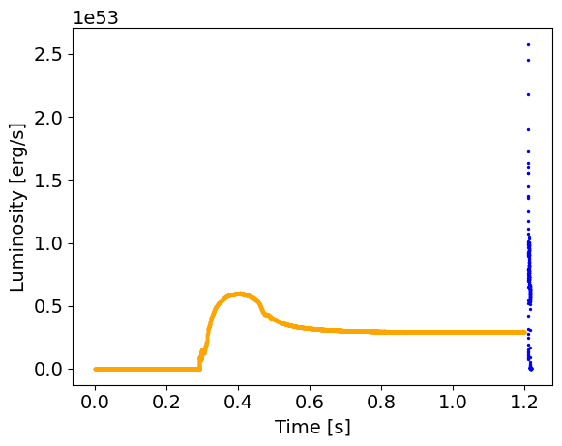
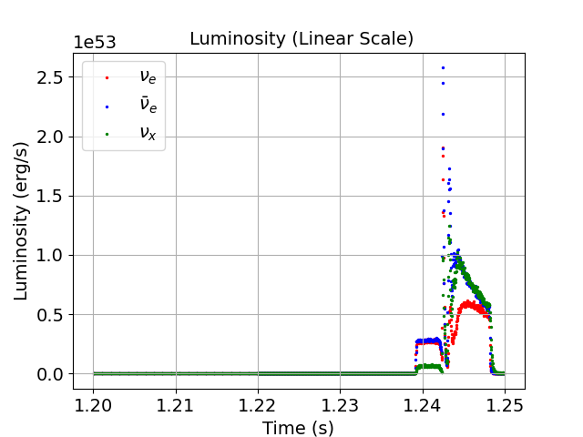
Simulations: quark star remnant
Neutrino emission in a phase transition driven supernovae
-First collapse emission
-Phase transition emission
Notes:
Here’s I plot the simulated electron antineutrino emission light curve.
We have
In orange:
-first collapse burst
-accretion phase
In blue:
-second collapse (way sharper and brighter) almost 1 order of magnitude, much higher luminosity than the bh model

Slide 11
ASTERIA: detection simulation
SIGNAL HYPOTHESIS
OUR MODEL
TS_H1= p(TS| H1)
NULL HYPOTHESIS
NO PT CCSN
TS_H0= p(TS| H0)
Notes:
I simulate the detection of this signal using the energies and luminosities of the model and the hit rate per sensor equation, creating a signal hypothesis (orange)
Then, the null hypothesis, was calculated using a fourier transformation of the signal to cut the peak of he signal mimicking a CCSNe with no PT feature

Slide 12
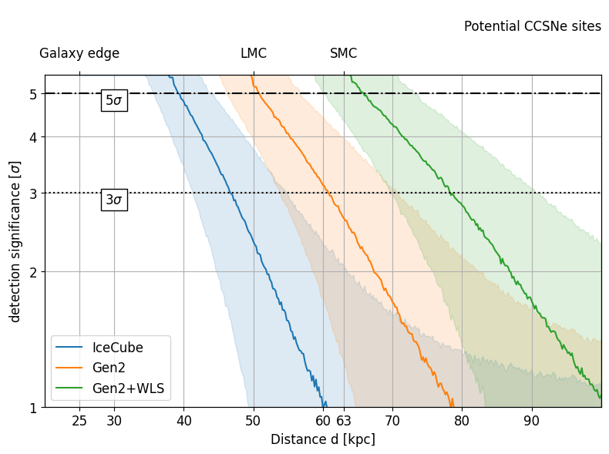
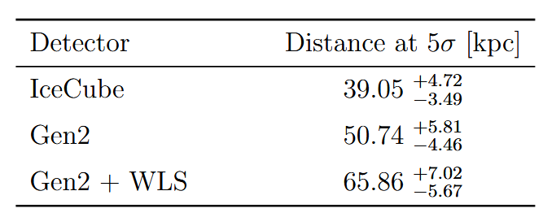
Detection significance
Notes:
Finally I calculated the detection significance transforming the previous p value in a Z score: how many standard deviations a value is from the mean under the null hypothesis.
In this plot the bands are the 16, 50 and 84 % confidence levels, and in blue we have icecube, orange gen2 and green gen2 wls
The main takeaway of this plot: 50 to 95 percent of the galaxy
Top x-axis: galaxy edge, large and small magellanic clouds

Slide 13
Conclusions
We could see such an event even at high distances
However, the likelihood for a SN is not that high, we expect 1 every 100 years within the Milky Way
Only SN1987A
Next generation detectors would enhance our detection of sharp features
Insights for the QCD phase-diagram + sate of matter at the early universe
…one day we could discover quark stars!

Slide 14
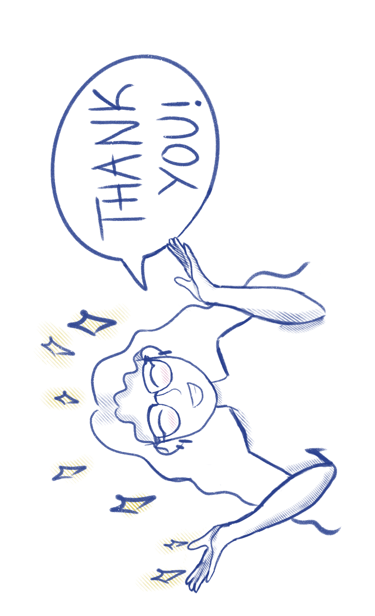
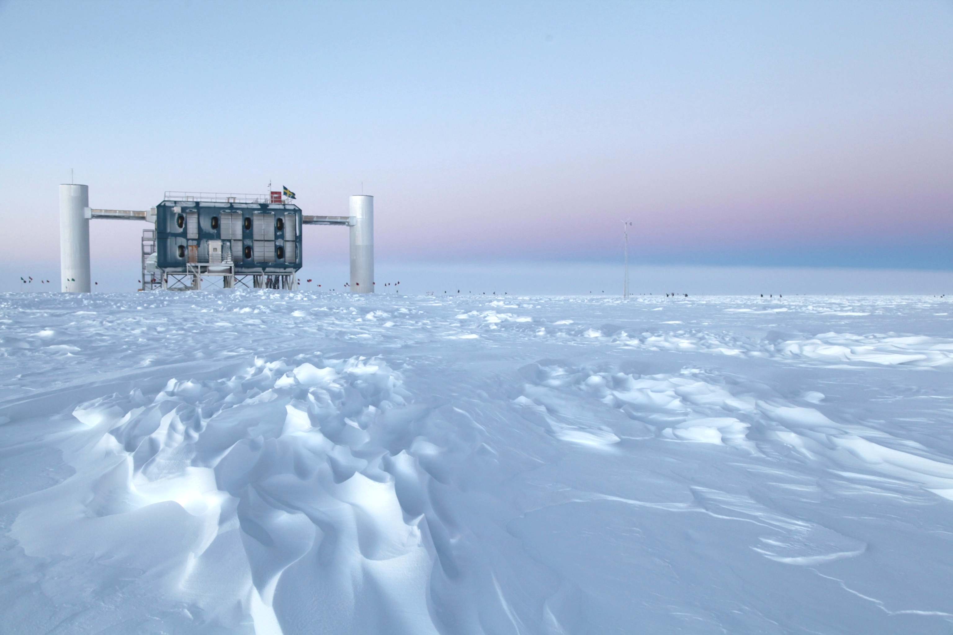

Slide 15
Backup slides
Notes:
Lets now dive into the simulations and analysis

Slide 16
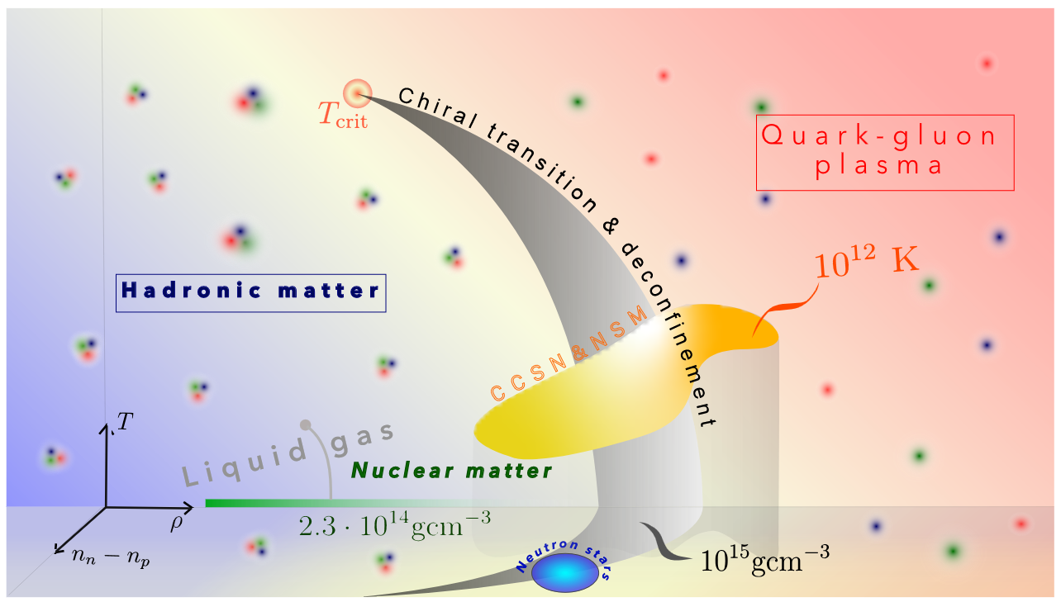
QCD phase diagram

Slide 17
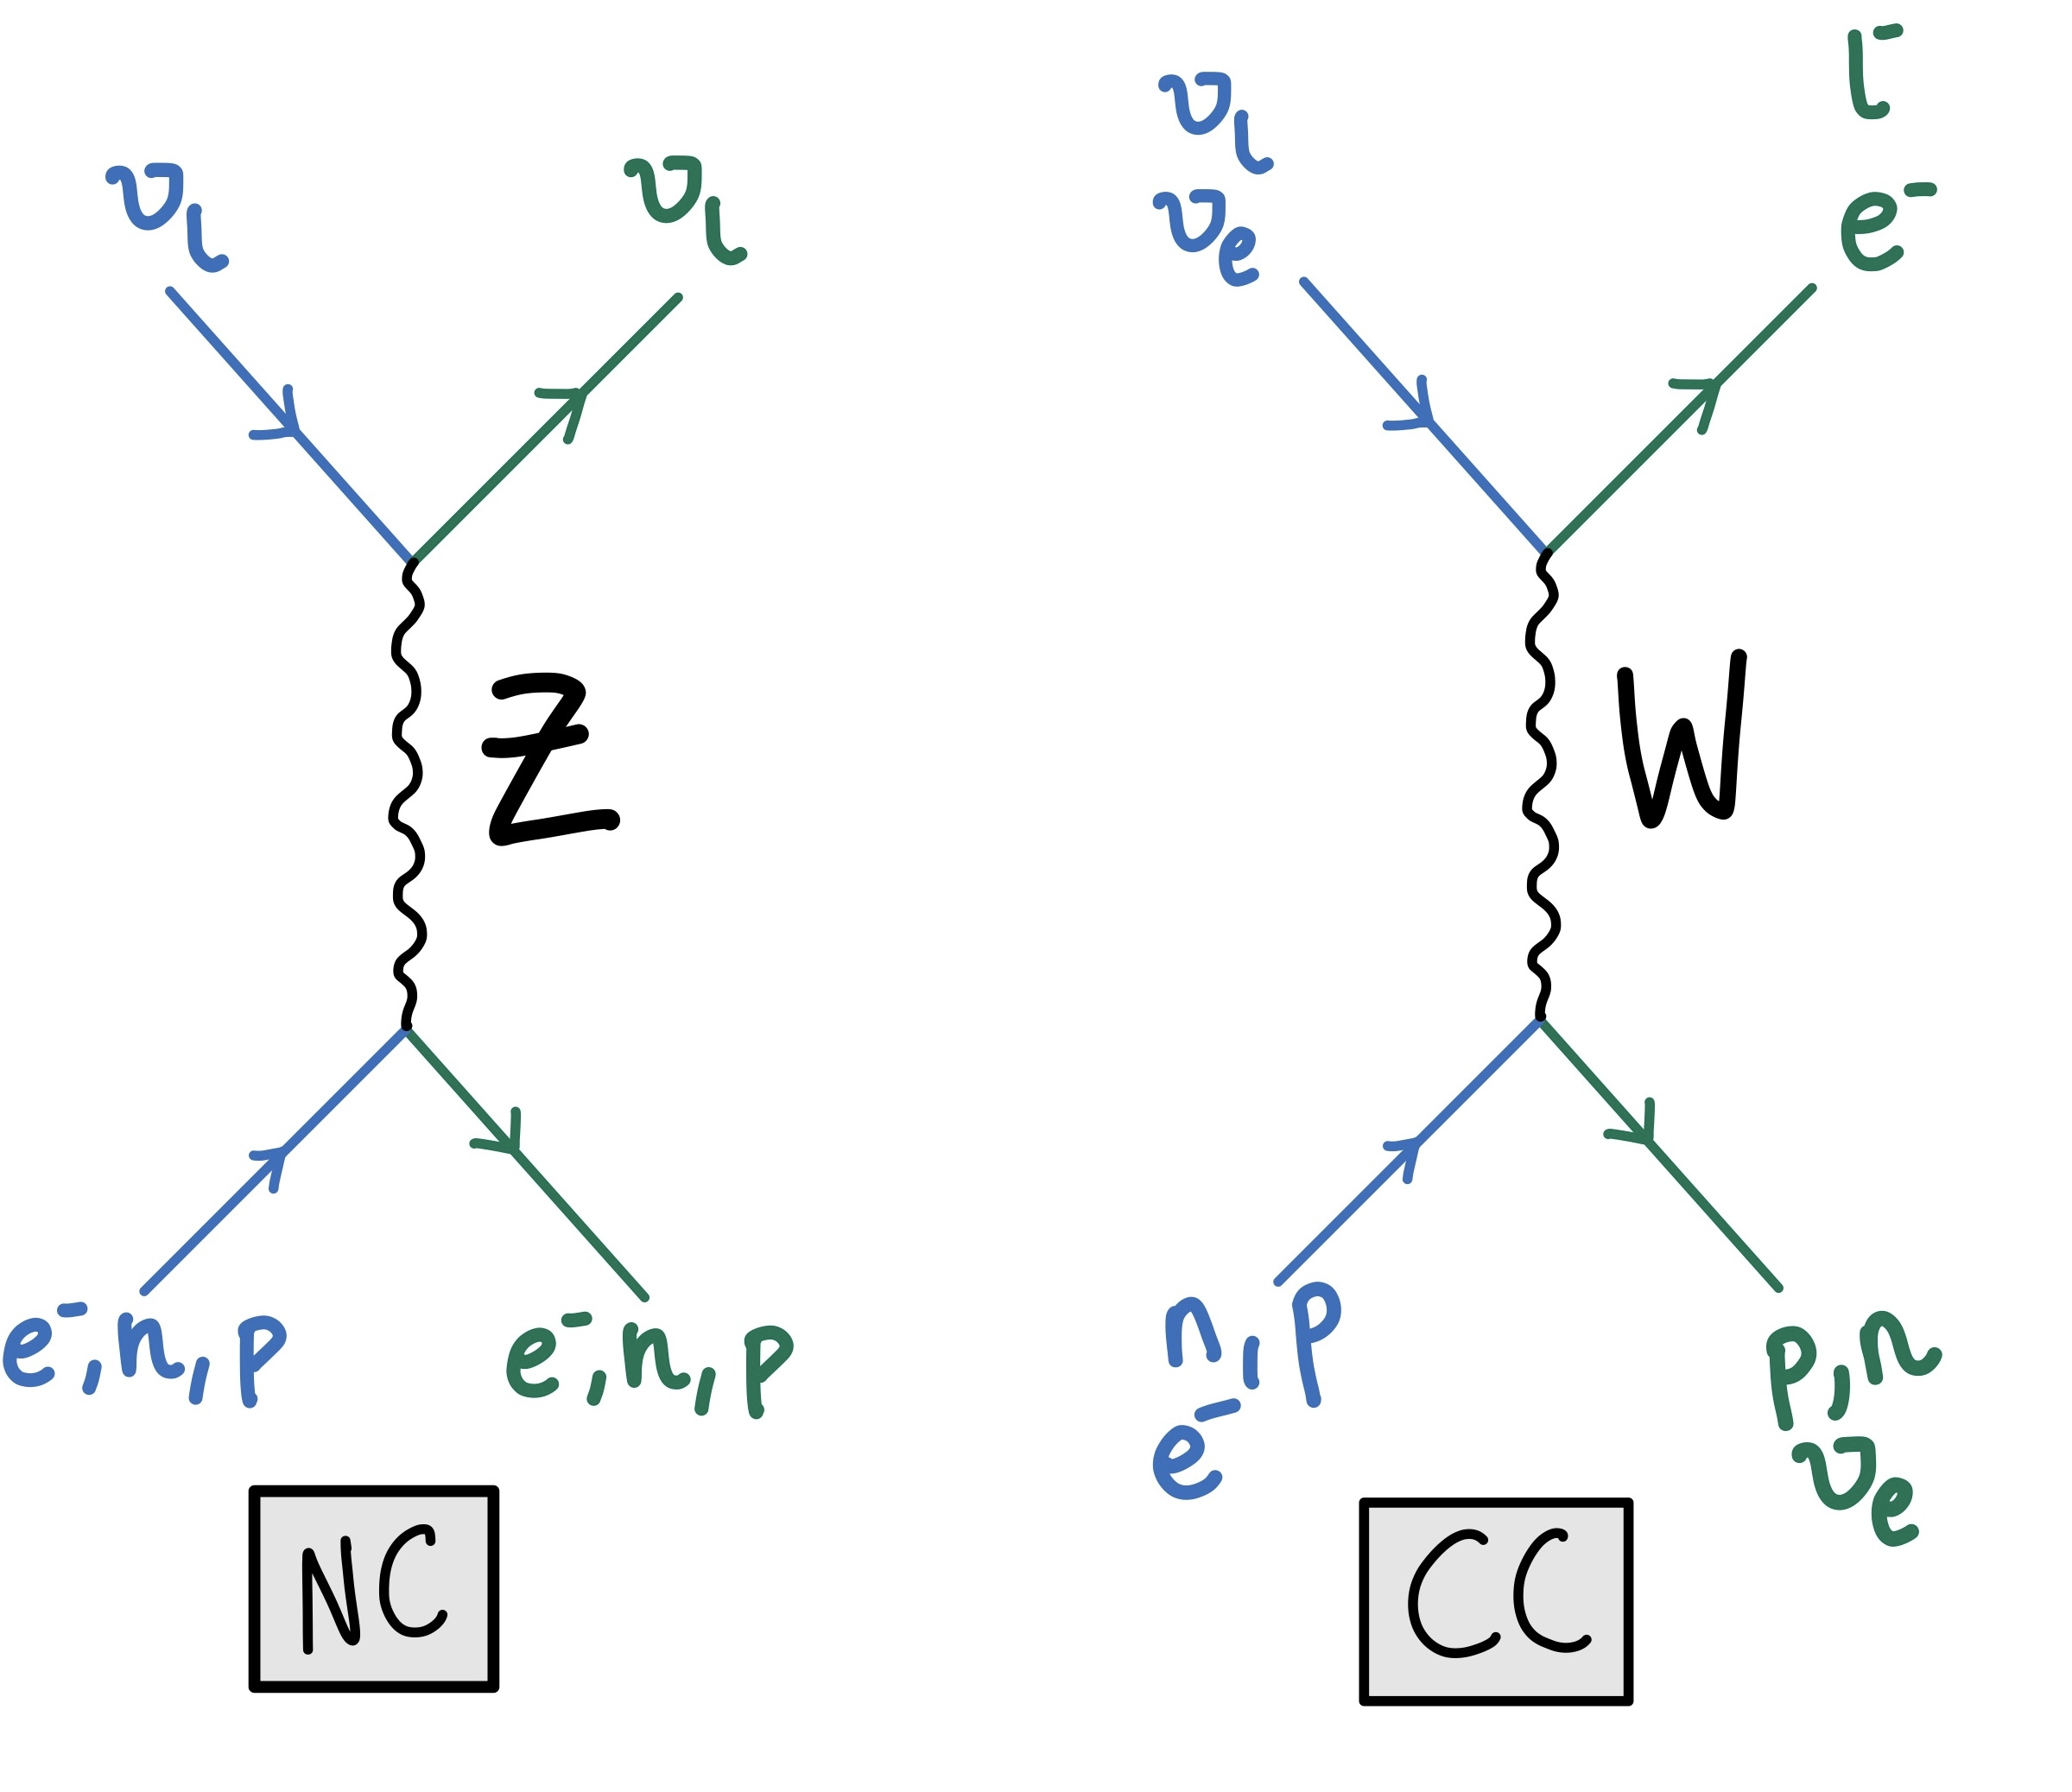
Ghostly messengers
Ghostly messengers
→Weakly interacting particles
They travel trough space without interacting, we cannot observe them directly
NC
CC
We observe the product of their interaction with matter
Notes:
We call neutrinos the ghostly messengers because they interact via the weak force, through the neutral current and charged current channels.
-we can’t observe them directly.
-We observe the product of their interactions with matter
Now you might be wondering where do quark stars come from and how do we connect them with neutrinos?

Slide 18
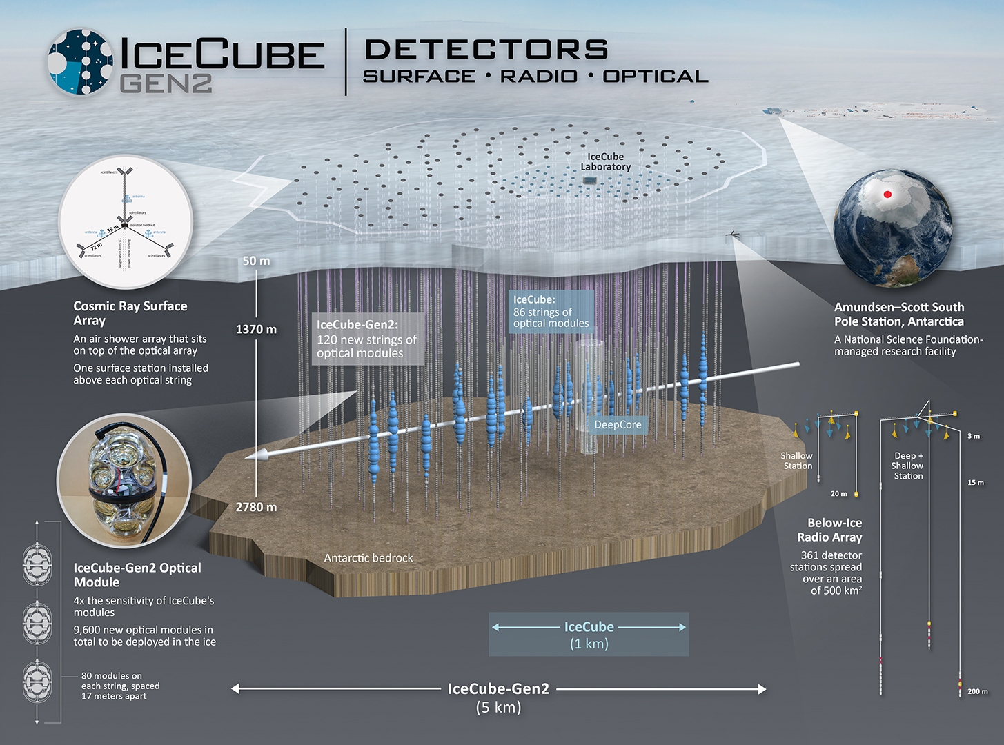

Slide 19
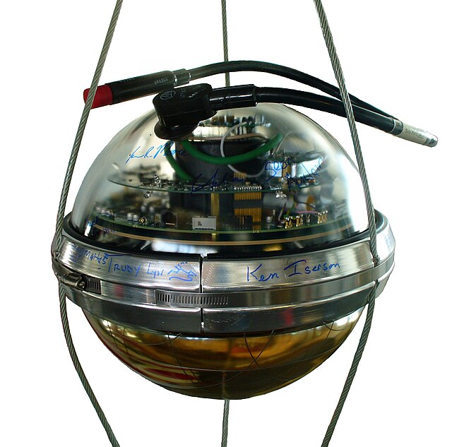
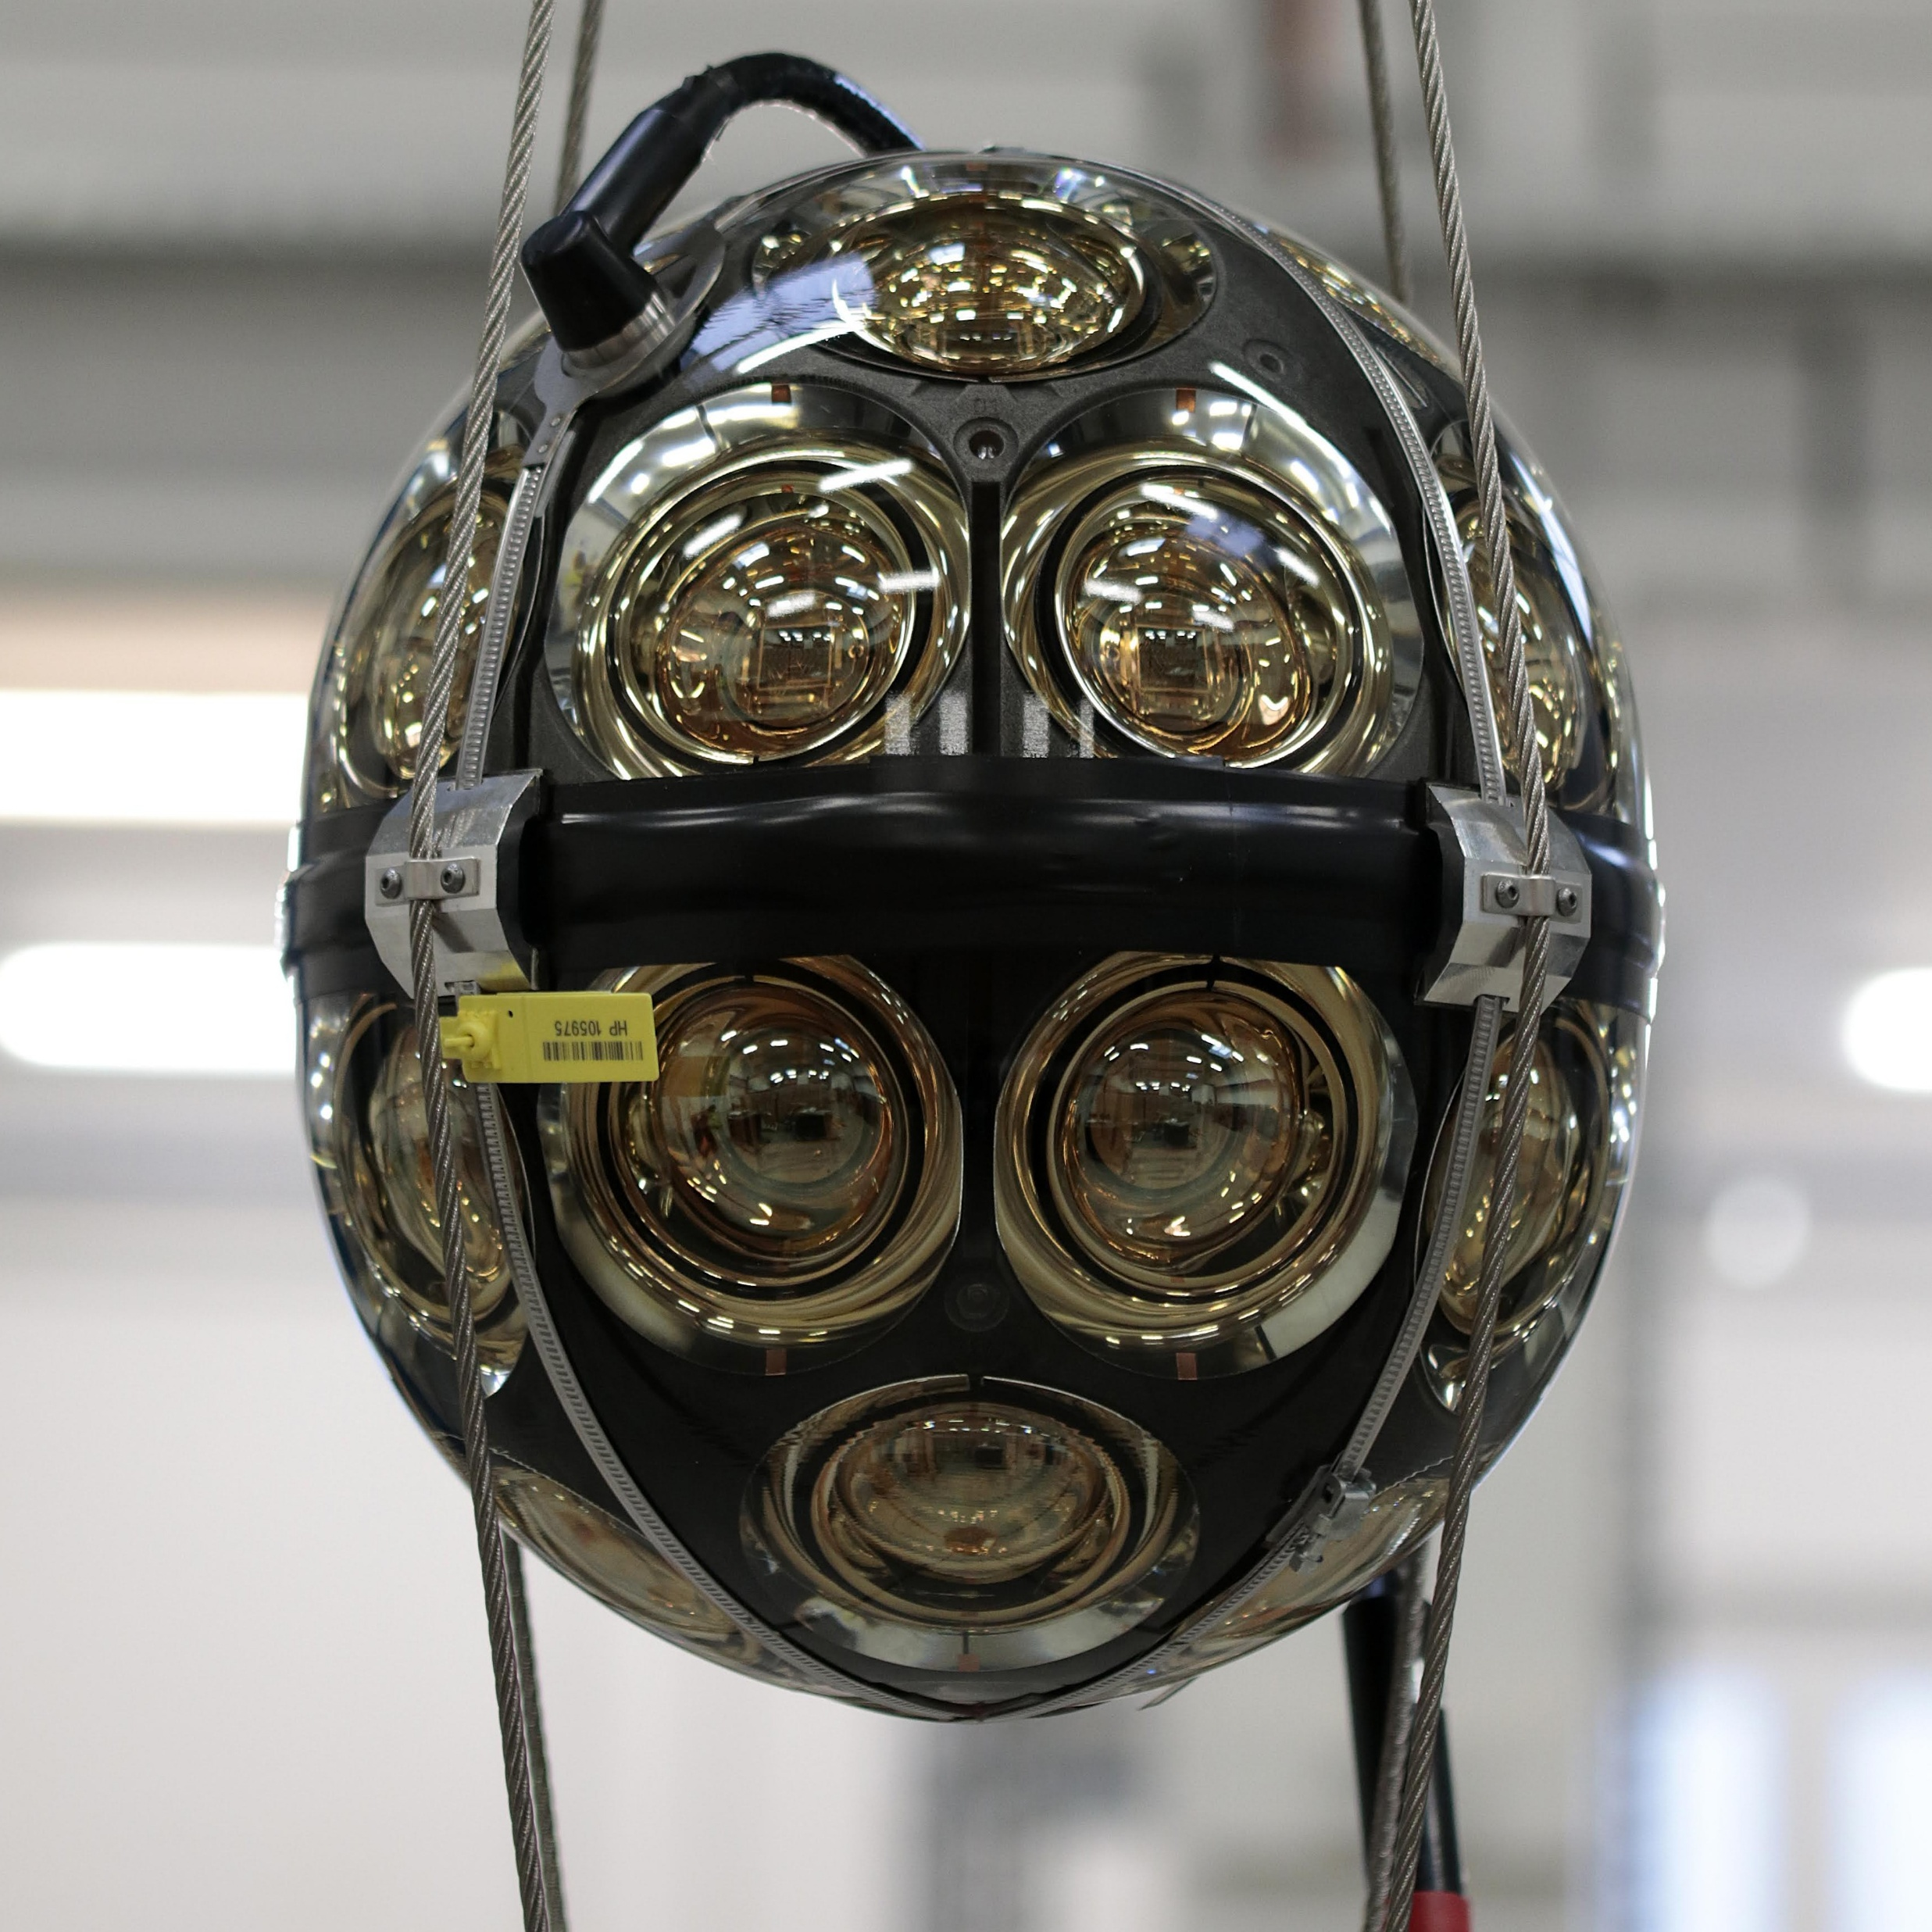
IceCube: Optical modules
DOM
mDOM
IceCube Gen2
Notes:
It’s important to understand the types of optical modules:
DOMs each contain a single photomultiplier tube (PMT).
mDOMs, planned for IceCube-Gen2, contain multiple PMTs—improving angular resolution and detection efficiency.
Some future designs may also include wavelength shifters, which further enhance light collection.

Slide 20
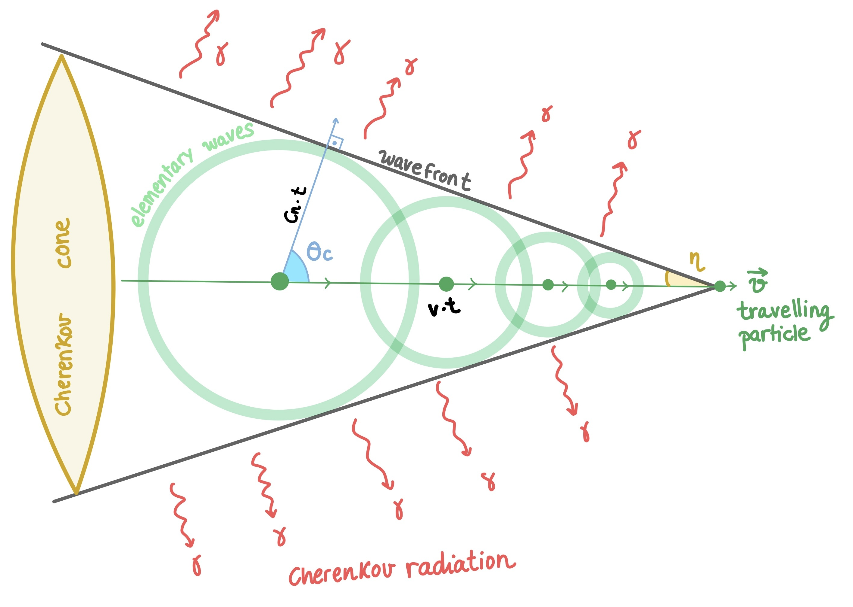
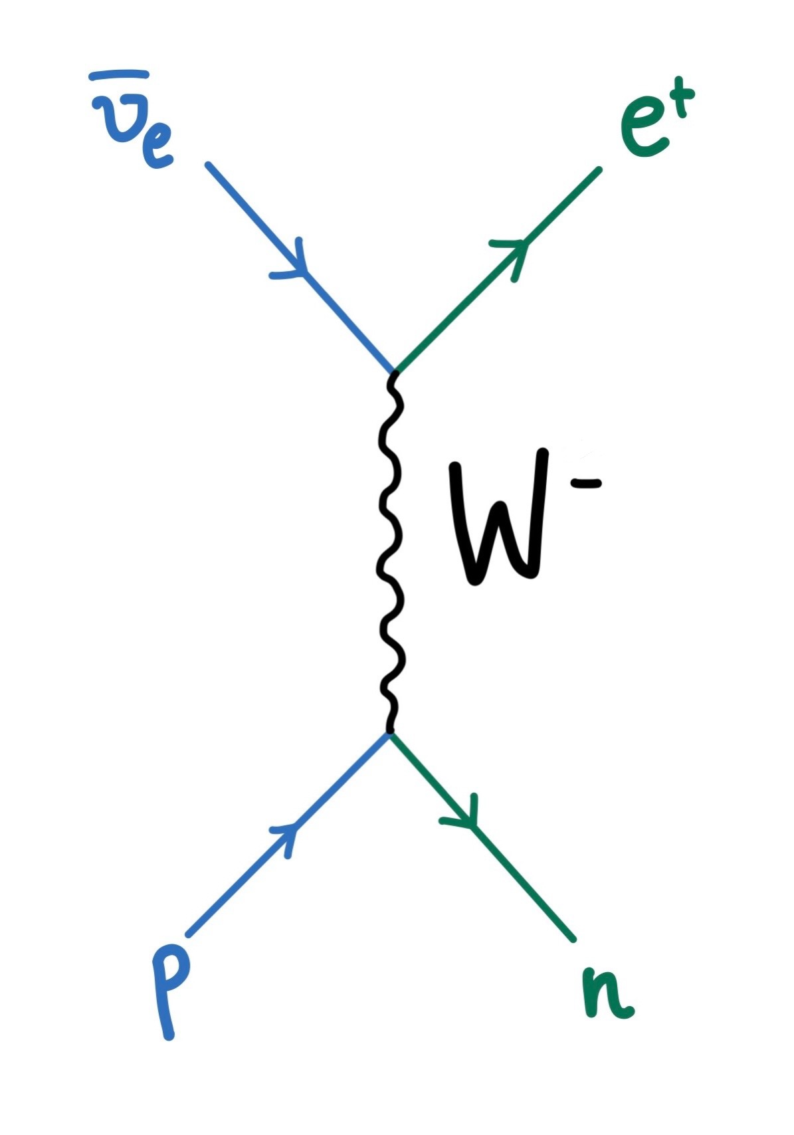
Cherenkov radiation

Slide 21
Analysis method:
Calculate a signal and null hypothesis (cutting the peak)
Evaluate a TS:
TS=max signal
TS_H0= p(TS| H0)
TS_H1= p(TS| H1)
→Probability of TS to be in the H0 / H1 hypotheses
Find detection significance as a function of the distance
→Transform the p-value in a Z-score
(how many standard deviations a value is from the mean
under the null hypothesis)
INCLUDING 10⁸ BACKGROUND TRIALS (ENHANCE STATISTICS)

Slide 22
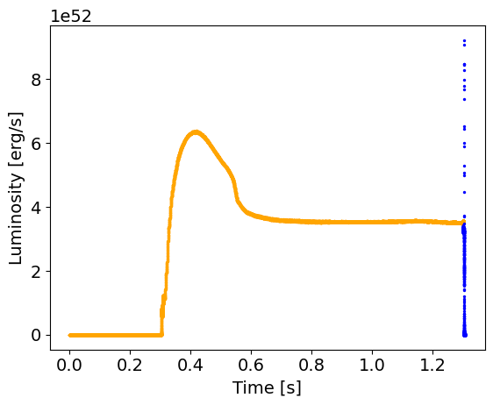
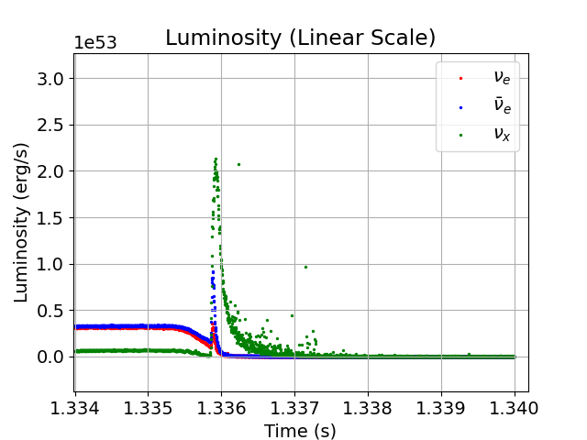
Simulations: delayed black hole
Neutrino emission in the phase transition driven supernovae
-First collapse emission
-Phase transition emission
Notes:
Here’s I plot the simulated electron antineutrino emission light curve.
We have
In orange:
-first collapse burst
-accretion phase
In blue:
-second collapse (way sharper and brighter)

Slide 23
MODEL RDF-1.7 (s40a28)
Delayed black hole
Notes:
Let’s look at the first model—the 40-solar-mass progenitor, which forms a delayed black hole.

Slide 24
ASTERIA: detection simulation
SIGNAL HYPOTHESIS
OUR MODEL
TS_H1= p(TS| H1)
NULL HYPOTHESIS
NO PT CCSN
TS_H0= p(TS| H0)
Notes:
I simulate the detection of this signal using the energies and luminosities of the model and the hit rate per sensor equation, creating a signal hypothesis (orange)
Then, the null hypothesis, was calculated using a fourier transformation of the signal to cut the peak of he signal mimicking a CCSNe with no PT feature

Slide 25
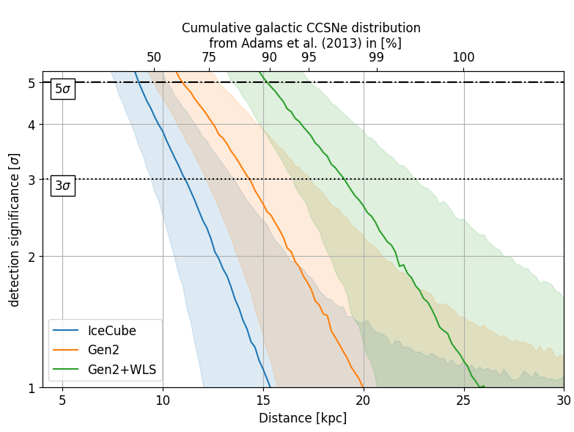
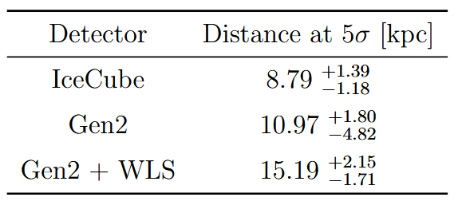
Detection significance
Notes:
Finally I calculated the detection significance transforming the previous p value in a Z score: how many standard deviations a value is from the mean under the null hypothesis.
In this plot the bands are the 16, 50 and 84 % confidence levels, and in blue we have icecube, orange gen2 and green gen2 wls
The main takeaway of this plot: 50 to 95 percent of the galaxy
Top x-axis: cumulative galatic ccsne distribution

