Slide 1
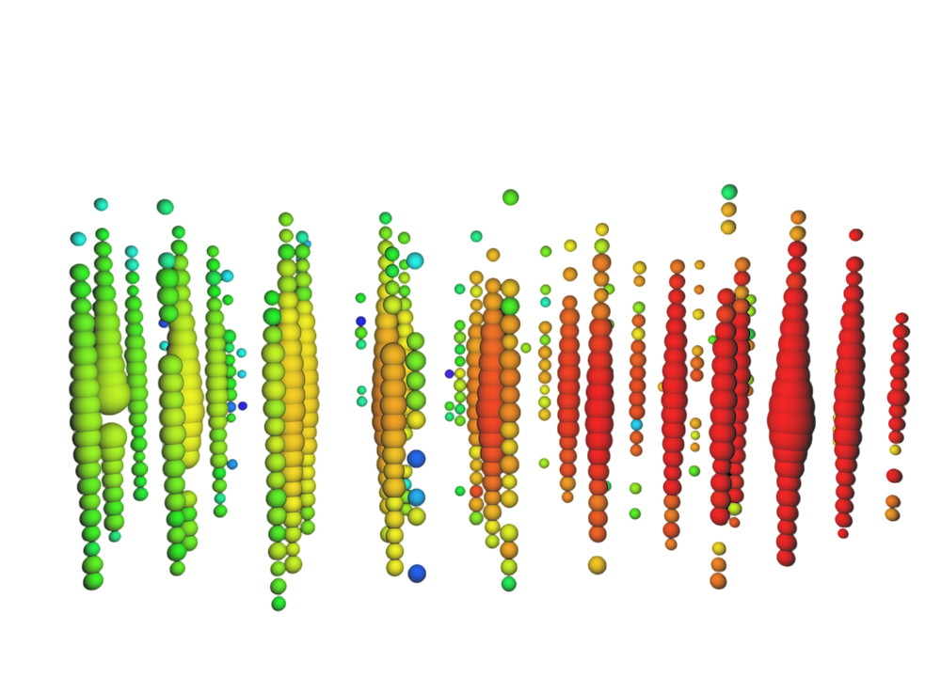
IV PHD Neutrinos Summer School on
Neutrinos Here, There & everywhere
July 10, 2025
Studying Muon Bundles for Improved EHE Neutrino Identification in IceCube
T.Delmeulle*, on behalf of the IceCube Collaboration
Université Libre de Bruxelles - IIHE
(*e-mail: tdelmeul@icecube.wisc.edu)

Slide 2
Table of Contents
1
Neutrino Astronomy with IceCube
2
Extremely High Energy (EHE) Neutrinos
Detection
Atmospheric background: Muon bundles
3
Muon bundles characteristics
4
Devil’s Tower model
1

Slide 3
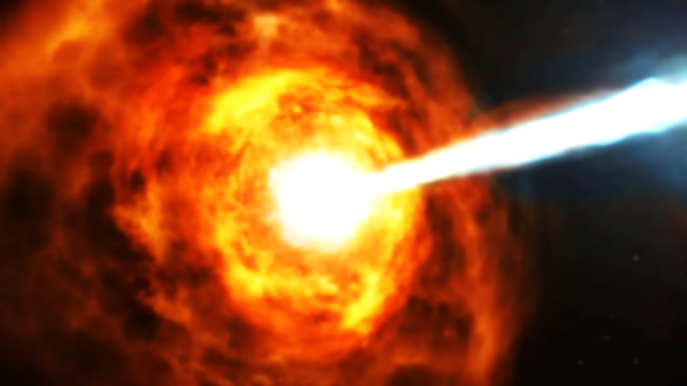
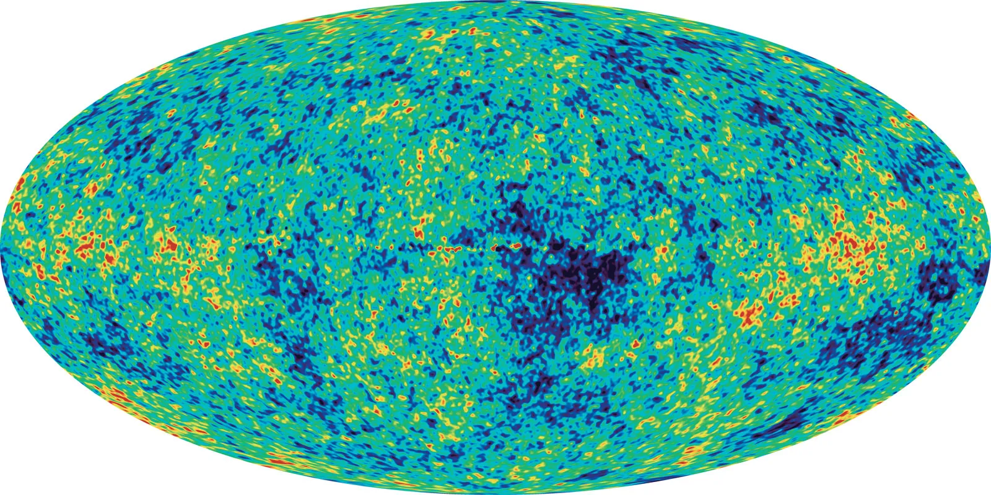
Astrophysical Goals
IceCube detector — EHE neutrinos — Muon Bundles Characteristics — Devil’s tower
EHE neutrino = neutrino with energy > 10 PeV
Produced directly in point-like sources
AGN, GRBs, …
Produced via UHECR–CMB/EBL interactions (GZK process)
$$p+γ → Δ^{+}→n+ π^{+}$$
Astrophysical neutrinos
> 10 PeV
Cosmogenic neutrinos
> EeV
Study astrophysical sources
Production mechanism
Acceleration process
Source distribution
Trace the origin of UHECRs
composition (protons vs nuclei)
spectrum
source distribution
Constrain astrophysical models
Test fundamental physics at energies not accessible at Earth
2

Slide 4
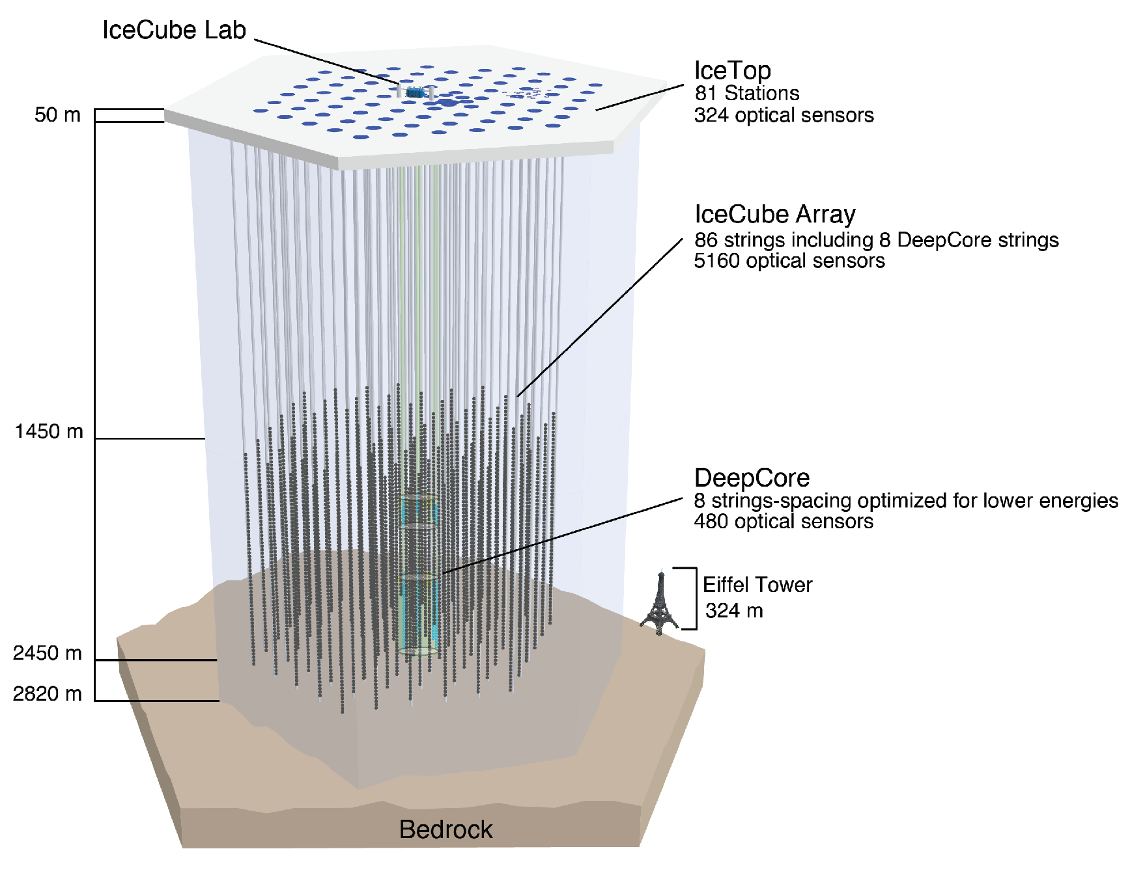
IceCube Detector
IceCube detector — EHE neutrinos — Muon Bundles Characteristics — Devil’s tower
Detection principle:
Detection of Cherenkov light produced by charged particles resulting from neutrino’s deep inelastic scattering interaction with nucleon of the ice.
Main Target:
Neutrinos from Northern sky
(Earth = shield against atmospheric background)
Optimized Energy Range (In-Ice):
Main Detector: 100 GeV to 1 PeV
Deep-core: down to 10 GeV
[Yu, 2023]
Possibility to probe higher energies: 1 PeV → 1EeV even if detected events are rare.
3

Slide 5
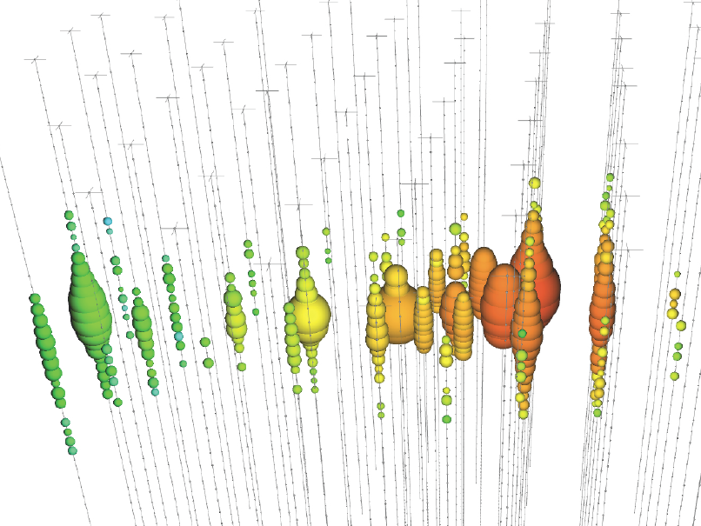
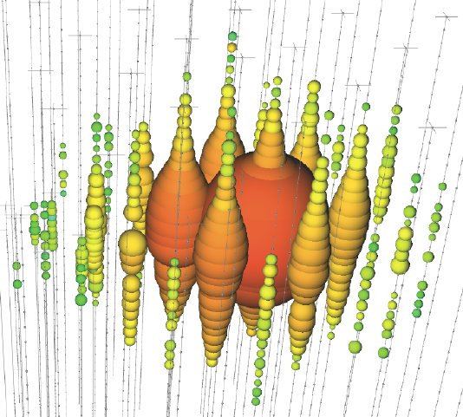
In-ice neutrino signatures
IceCube detector — EHE neutrinos — Muon Bundles Characteristics — Devil’s tower
Events signature: total charge collected per DOM and photons arrival time create characteristic shapes in the detector.
Angular resolution:
0.1° – 1°
Vertex can be outside detector:
increased effective volume
Muon Track
Deposited energy resolution: ≈ 15%
Angular resolution:
≈ 10° ($E_{ν}$ > 100 TeV)
Cascade
4
[IceCube Collaboration, 2024]
[IceCube Masterclass, 2024]

Slide 6
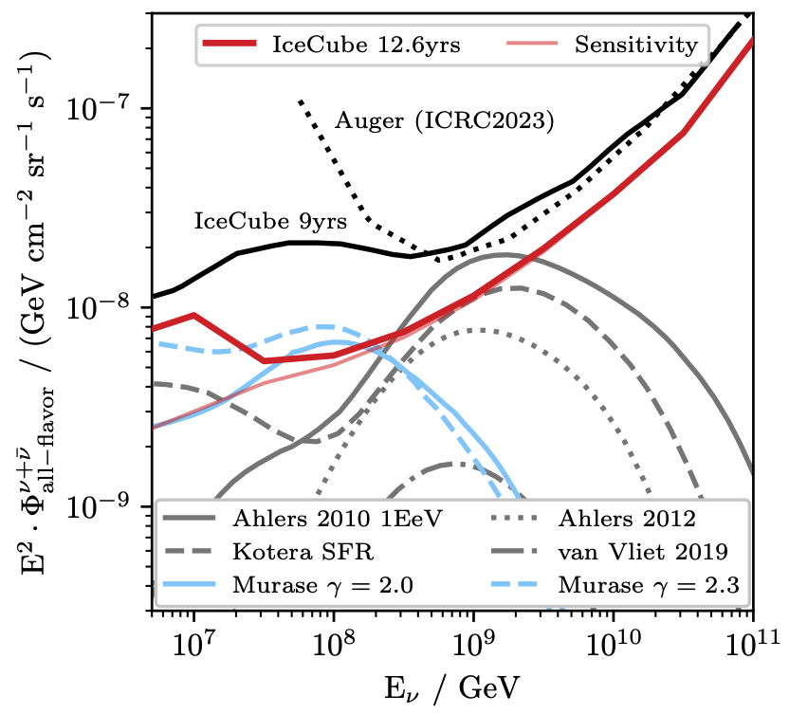
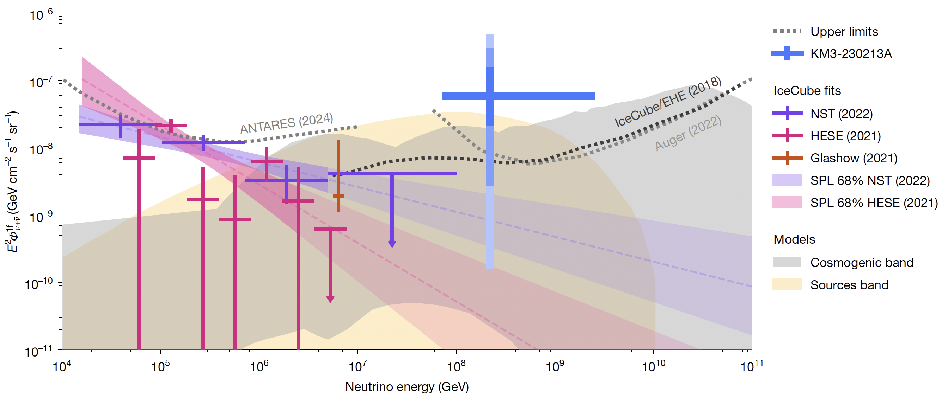
Extremely High Energy (EHE) Neutrinos
IceCube detector — EHE neutrinos — Muon Bundles Characteristics — Devil’s tower
IceCube detector
KM3Net
KM3-230213A Event
[KM3NeT Collaboration, 2025]
[Meier et al., 2025]
Muon: $E_{μ}={120}_{−60}^{+110}PeV$
Flux dropping and no event beyond 10 PeV
Estimated neutrino energy: $E_{ν}≈220 PeV$
5

Slide 7
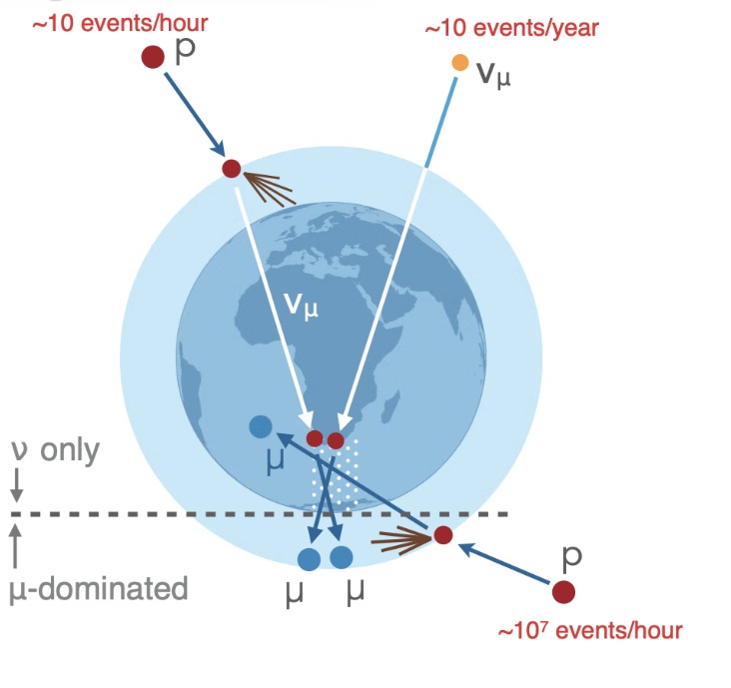
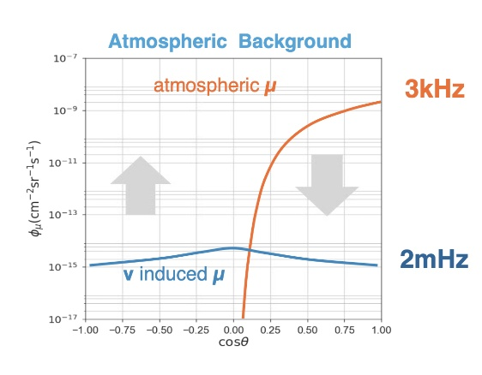
Atmospheric background
IceCube detector — EHE neutrinos — Muon Bundles Characteristics — Devil’s tower
EHE increasing
interaction cross-section
Focus on horizontal and down-going events
NO Earth shield
Earth becomes opaque
to neutrinos
Atmospheric background
omnipresent
Up-going events
Down-going events
-
6
Credit: J.A. Aguilar

Slide 8
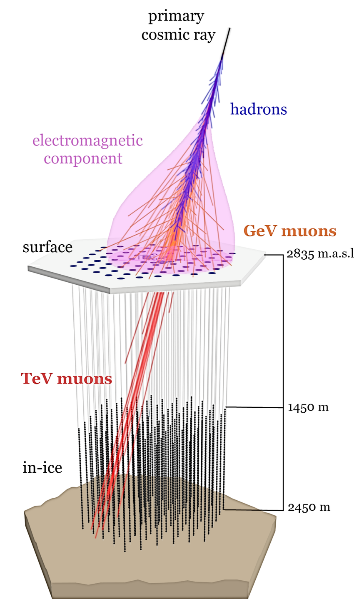
Muon Bundles
IceCube detector — EHE neutrinos — Muon Bundles Characteristics — Devil’s tower
Signal: Muon tracks from EHE neutrinos
Main background: Muon bundles
Muon groups from a single air shower caused by cosmic ray interactions in the atmosphere.
Mimic the signal of a single muon
Difficult to identify the signal
Research goal
Identify features that distinguish muon bundles from single muons to train a machine learning model and improve event selection.
Simulations: charged current $ν_{μ}$ interactions, only for throughgoing events
7
[IceCube Collaboration, 2021]

Slide 9
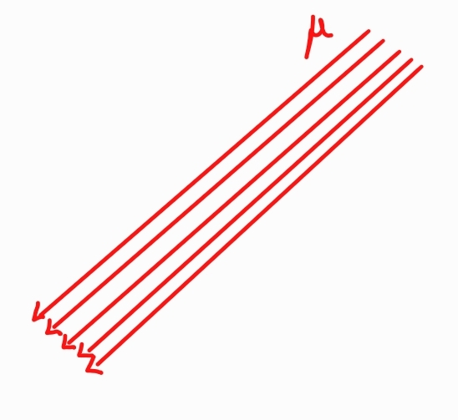
Muon Bundles Characteristics
IceCube detector — EHE neutrinos — Muon Bundles Characteristics — Devil’s tower
Bundle Multiplicity: Number of secondary muons passing through the detector volume.
Lateral extension (at the detector level)
Radius of a cylinder along the track that contains a defined percentage of the collected light.
8

Slide 10
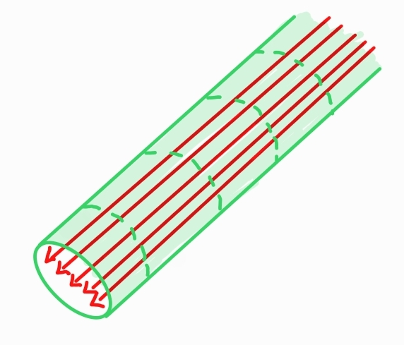
Muon Bundles Characteristics
IceCube detector — EHE neutrinos — Muon Bundles Characteristics — Devil’s tower
Bundle Multiplicity: Number of secondary muons passing through the detector volume.
Lateral extension (at the detector level)
Radius of a cylinder along the track that contains a defined percentage of the collected light.
8

Slide 11
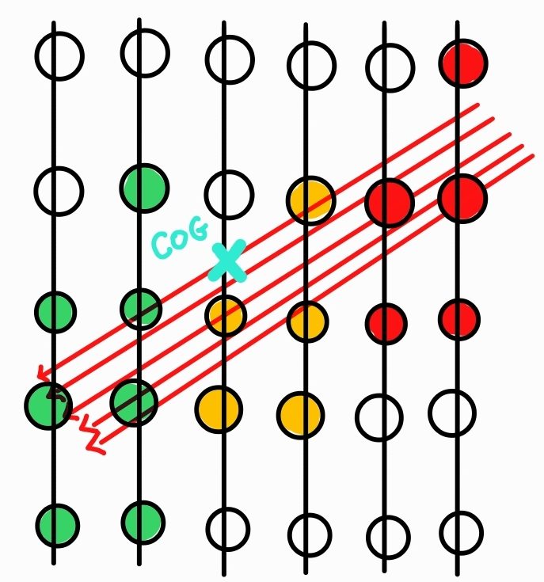
Muon Bundles Characteristics
IceCube detector — EHE neutrinos — Muon Bundles Characteristics — Devil’s tower
Bundle Multiplicity: Number of secondary muons passing through the detector volume.
Lateral extension (at the detector level)
Radius of a cylinder along the track that contains a defined percentage of the collected light.
1. Compute the center of gravity (COG) of the light distribution
8

Slide 12
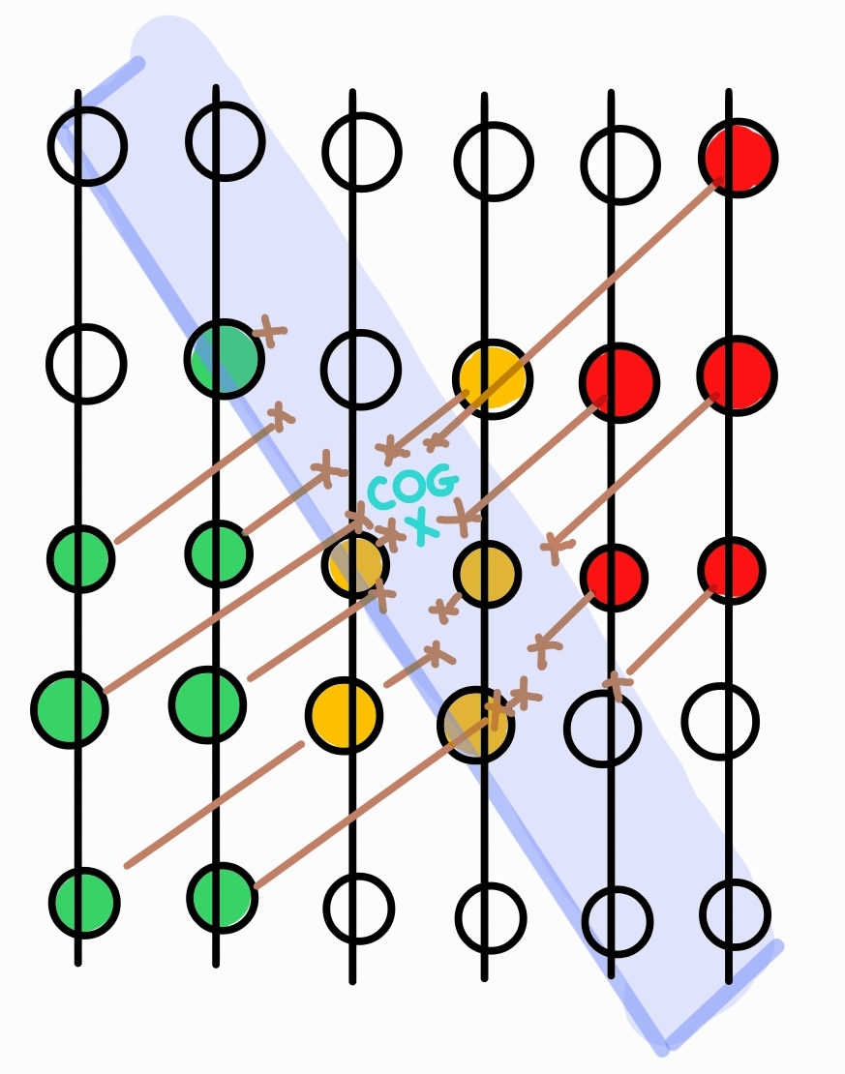
Muon Bundles Characteristics
IceCube detector — EHE neutrinos — Muon Bundles Characteristics — Devil’s tower
Bundle Multiplicity: Number of secondary muons passing through the detector volume.
Lateral extension (at the detector level)
Radius of a cylinder along the track that contains a defined percentage of the collected light.
1. Compute the center of gravity (COG) of the light distribution
2. Project DOM charges into the plane perpendicular to the track at the COG
8

Slide 13
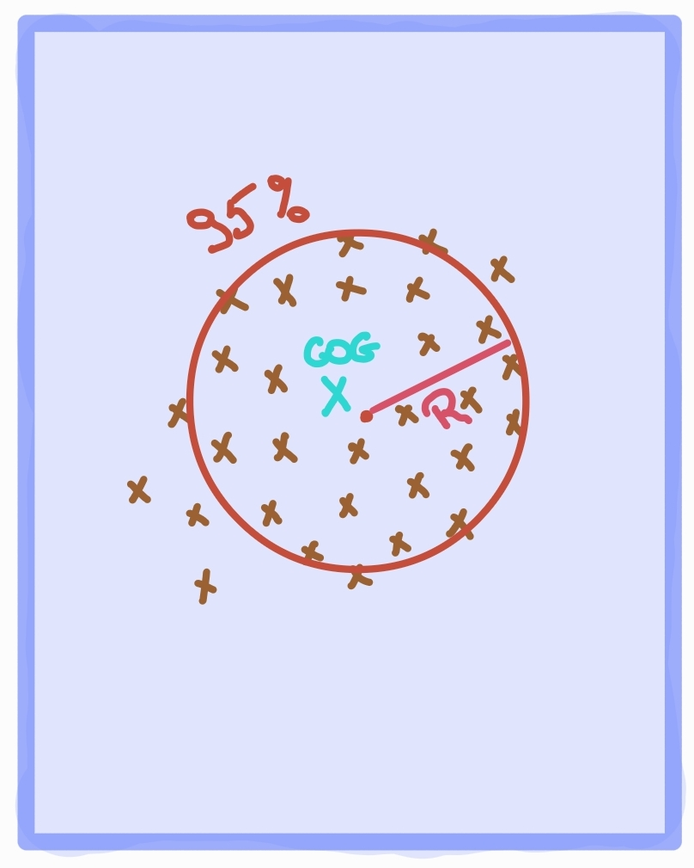
Muon Bundles Characteristics
IceCube detector — EHE neutrinos — Muon Bundles Characteristics — Devil’s tower
Bundle Multiplicity: Number of secondary muons passing through the detector volume.
Lateral extension (at the detector level)
Radius of a cylinder along the track that contains a defined percentage of the collected light.
1. Compute the center of gravity (COG) of the light distribution
2. Project DOM charges into the plane perpendicular to the track at the COG
3. Draw a circle containing 95% of the total projected charge
8

Slide 14
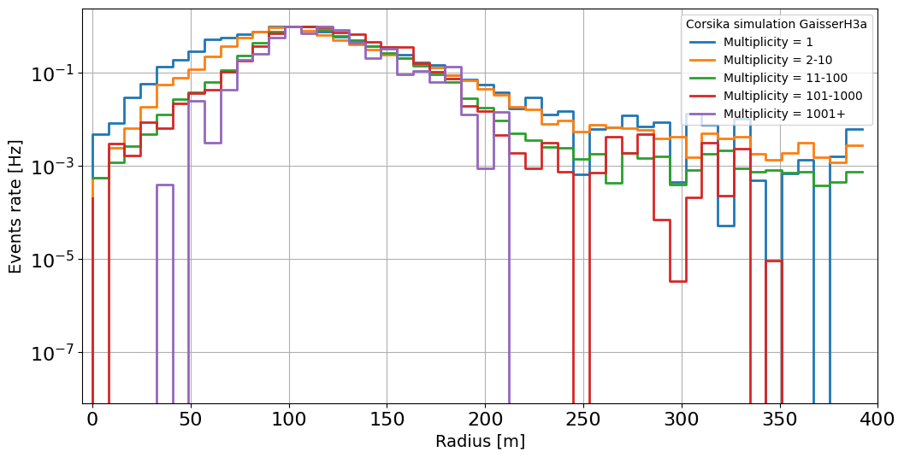
Muon Bundles Characteristics
IceCube detector — EHE neutrinos — Muon Bundles Characteristics — Devil’s tower
Bundle Multiplicity: Number of secondary muons passing through the detector volume.
Lateral extension (at the detector level)
Radius of a cylinder along the track that contains a defined percentage of the collected light.
1. Compute the center of gravity (COG) of the light distribution
2. Project DOM charges into the plane perpendicular to the track at the COG
3. Draw a circle containing 95% of the total projected charge
8

Slide 15
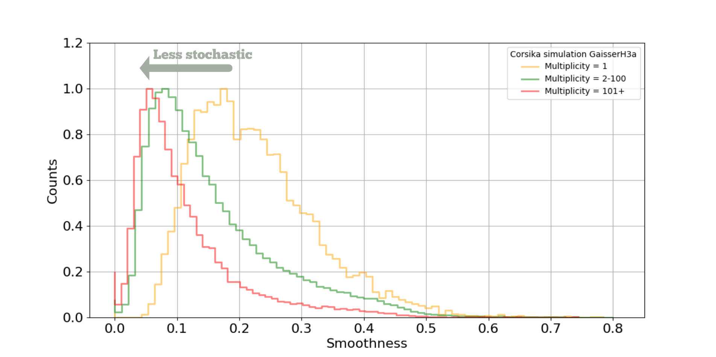
Muon Bundles Characteristics
IceCube detector — EHE neutrinos — Muon Bundles Characteristics — Devil’s tower
Stochastic losses
Smoothness
Sudden energy deposits along a muon's track
Variable S that characterizes the difference between the observed energy distribution and a uniform one (S=0).
Causing localized high energy deposition in the detector.
Due to interactions like bremsstrahlung or pair production
9
[IceCube Masterclass, 2024]

Slide 16
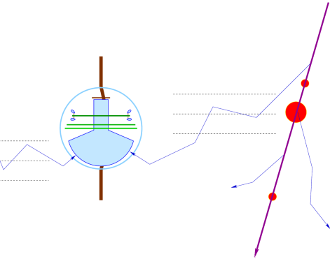
Muon Bundles Characteristics
IceCube detector — EHE neutrinos — Muon Bundles Characteristics — Devil’s tower
$$t_{0}$$
Residual time
$$t_{geo}$$
Difference between a photon's arrival time at the DOM and its expected arrival time assuming a direct, unscattered path.
$$t_{hit}$$
$$t_{res}= t_{hit}−t_{geo}−t_{0}$$
[Adapted from: Schwanekamp et al., 2022]
10
@M. Nakos display

Slide 17
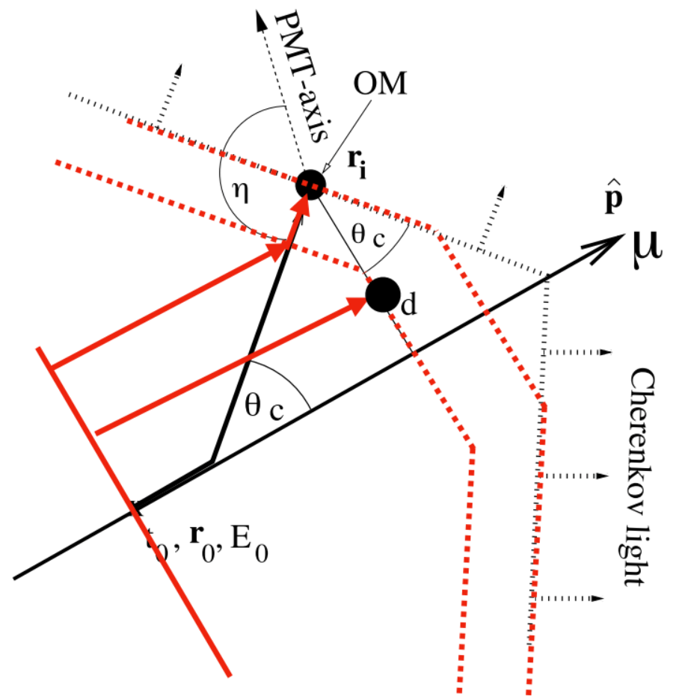
Devil’s Tower Model
IceCube detector — EHE neutrinos — Muon Bundles Characteristics — Devil’s tower
Single muon = only one track
$$\cos{θ}=\frac{1}{nβ}$$
Cherenkov cone
Muon bundle = multiple tracks
Contained in a cylindrical volume around the track direction
Devils tower idea:
Truncate the Cherenkov cone to use a planewave to simulate the front of the bundle (developed by K. Rawlins)
Ligth emission depends on DOM position:
Inside the cylinder: planewave Cherenkov emission
Outside the cylinder: Cherenkov cone emission
11
[Rawlins, 2023]

Slide 18
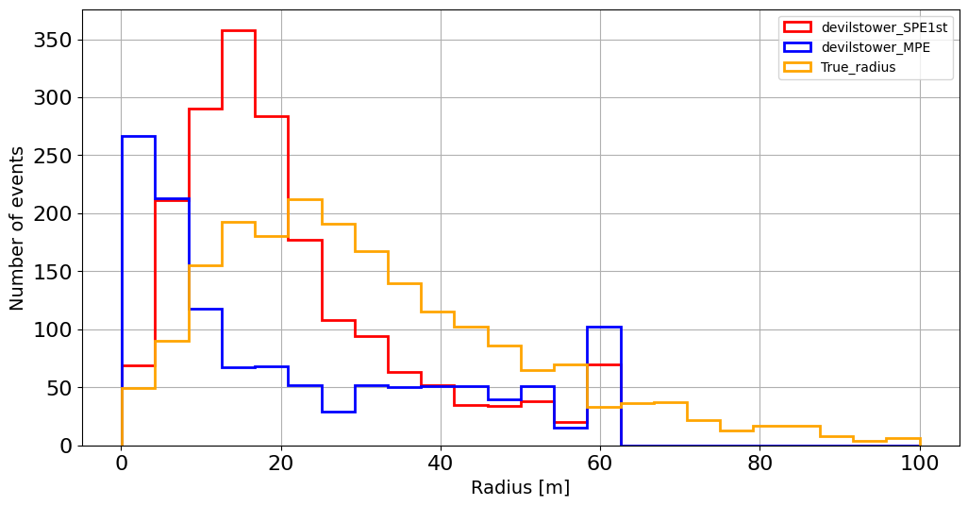
Devil’s Tower first result
IceCube detector — EHE neutrinos — Muon Bundles Characteristics — Devil’s tower
Bundle radius
True bundle: estimated from the set of simulated muons intersecting the detector
Different reconstruction method:
Multiple PhotoElectron (MPE)
Single PhotoElectron (SPE)
12

Slide 19
Conclusion and Outlook
Research Goal
Study muon bundles to improve the identification of Extremely High Energy (EHE) neutrinos in IceCube
Muon bundle characterization lateral extension, residual time, smoothness
Devil’s Tower Geometry Development of the new Event reconstruction model to refine track analysis
Outlook
Use these features to train a machine learning model (e.g., Graph Neural Network) for better event classification
13

Slide 20
Thank you

Slide 21
Smoothness
List of the projected position of the hit DOMS:
$$S=0.1$$
1.
$distAlongTrack({DOM}_{i}, Track)=$projected position of the $i^{th}$ DOM on the line of the configured track
where $i ∈\left[1, N_{hit}\right]$
$N_{hit}$ = the total number of hits
$$S=0.39$$
$$domDistList:=\{distAlongTrack({DOM}_{i}, Track)\}$$
2.
The « distance » list is rated in ascending order
$$ascDOMDistList := ascending Sort(domDistList)$$
3.
$l_{i}$ is the lenght of the track to the $i^{th}$ pulse in regard to the first pulse in sorted distance list
$$S=− 0.34$$
$j$ is the pulse with: $max \left(\left|\frac{j}{n}− \left.\frac{l_{j}}{l_{n}}\right|\right.\right)$
4.
Smoothness: $S=\frac{j}{n}−\frac{l_{j}}{l_{n}}$ where $S ∈\left[−1, 1\right]$
5.

