Slide 1
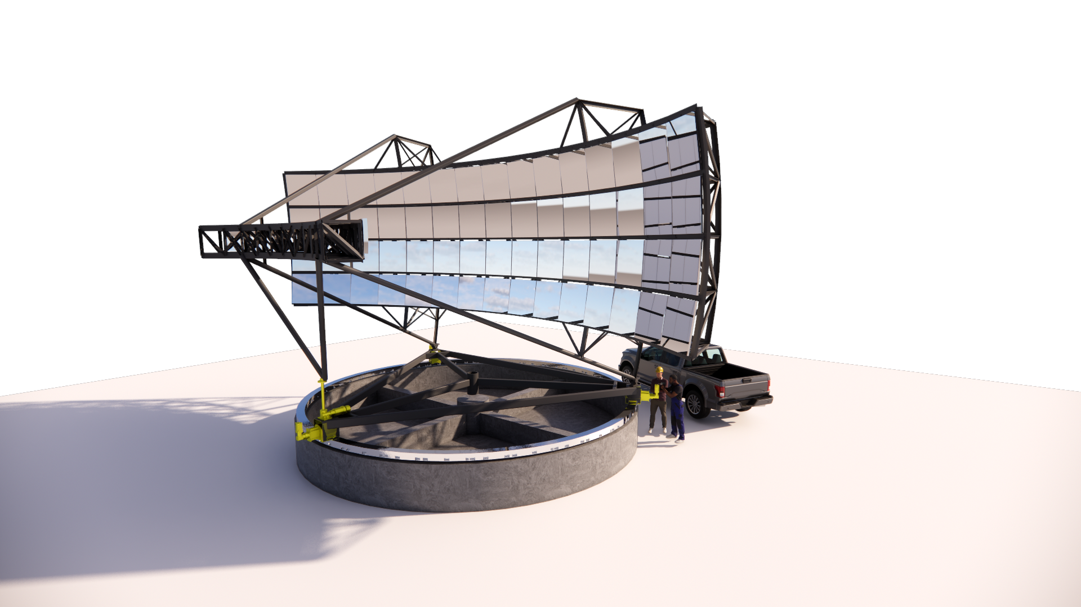
Neutrino Detection Forecasts: Estimates for the Trinity Observatory
David A. Raudales O. for the Trinity Collaboration
School of Physics and Center for Relativistic Astrophysics, Georgia Institute of Technology
trinity-observatory.org

Slide 2
How does Trinity detect neutrinos?
How can Trinity contribute to GRB physics?
What makes Trinity different from other neutrino telescopes?
Could Trinity observe blazar flares?
What is the past, present and future of Trinity?
What is Trinity’s detection capability?

Slide 3
How does Trinity detect neutrinos?
How can Trinity contribute to GRB physics?
What makes Trinity different from other neutrino telescopes?
Could Trinity observe blazar flares?
What is the past, present and future of Trinity?
What is Trinity’s detection capability?

Slide 4
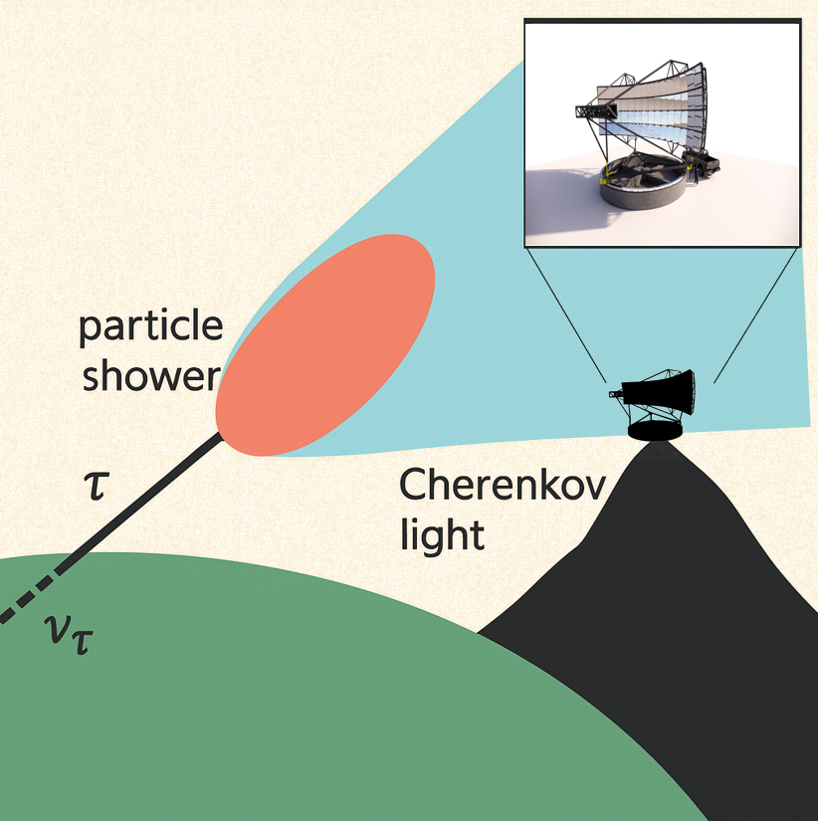
How does Trinity detect neutrinos?
Earth-skimming neutrino detection technique with an air shower imaging telescope.
Imaging technique well proven by the gamma-ray community.

Slide 5
How does Trinity detect neutrinos?
How can Trinity contribute to GRB physics?
What makes Trinity different from other neutrino telescopes?
Could Trinity observe blazar flares?
What is the past, present and future of Trinity?
What is Trinity’s detection capability?

Slide 6
How does Trinity detect neutrinos?
How can Trinity contribute to GRB physics?
What makes Trinity different from other neutrino telescopes?
Could Trinity observe blazar flares?
What is the past, present and future of Trinity?
What is Trinity’s detection capability?

Slide 7
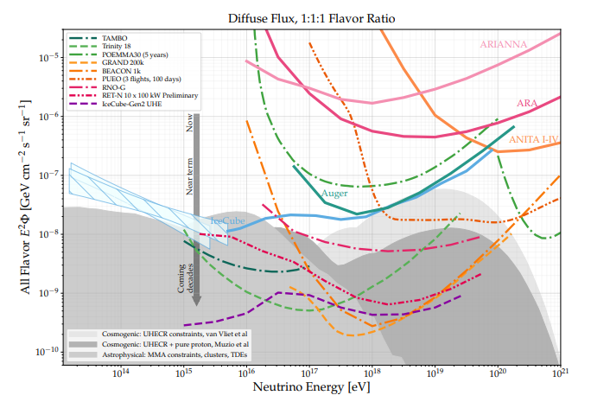
What makes Trinity different from other neutrino telescopes?
Snowmass 2022

Slide 8
What makes Trinity different from other neutrino telescopes?
RADIO
Snowmass 2022

Slide 9
What makes Trinity different from other neutrino telescopes?
RADIO
ICE/WATER
Snowmass 2022

Slide 10
What makes Trinity different from other neutrino telescopes?
Closes the gap between ice/water Cherenkov telescopes and radio detectors
RADIO
ICE/WATER
Snowmass 2022

Slide 11
What makes Trinity different from other neutrino telescopes?
RADIO
Closes the gap between ice/water Cherenkov telescopes and radio detectors
Overlap with IceCube ensures neutrino detection.
ICE/WATER
Snowmass 2022

Slide 12
What makes Trinity different from other neutrino telescopes?
RADIO
Expect no background.
ICE/WATER

Slide 13
What makes Trinity different from other neutrino telescopes?
RADIO
Expect no background.
Camera yields 0.3° angular resolution.
ICE/WATER
Snowmass 2022

Slide 14
What makes Trinity different from other neutrino telescopes?
RADIO
Expect no background.
Camera yields 0.3° angular resolution.
Deep point source sensitivity.
ICE/WATER
Snowmass 2022

Slide 15
What makes Trinity different from other neutrino telescopes?
RADIO
Expect no background.
Camera yields 0.3° angular resolution.
Deep point source sensitivity.
Proves the imaging technique as a valid method for UHE neutrino searches
ICE/WATER
Snowmass 2022

Slide 16
How does Trinity detect neutrinos?
How can Trinity contribute to GRB physics?
What makes Trinity different from other neutrino telescopes?
Could Trinity observe blazar flares?
What is the past, present and future of Trinity?
What is Trinity’s detection capability?

Slide 17
How does Trinity detect neutrinos?
How can Trinity contribute to GRB physics?
What makes Trinity different from other neutrino telescopes?
Could Trinity observe blazar flares?
What is the past, present and future of Trinity?
What is Trinity’s detection capability?

Slide 18
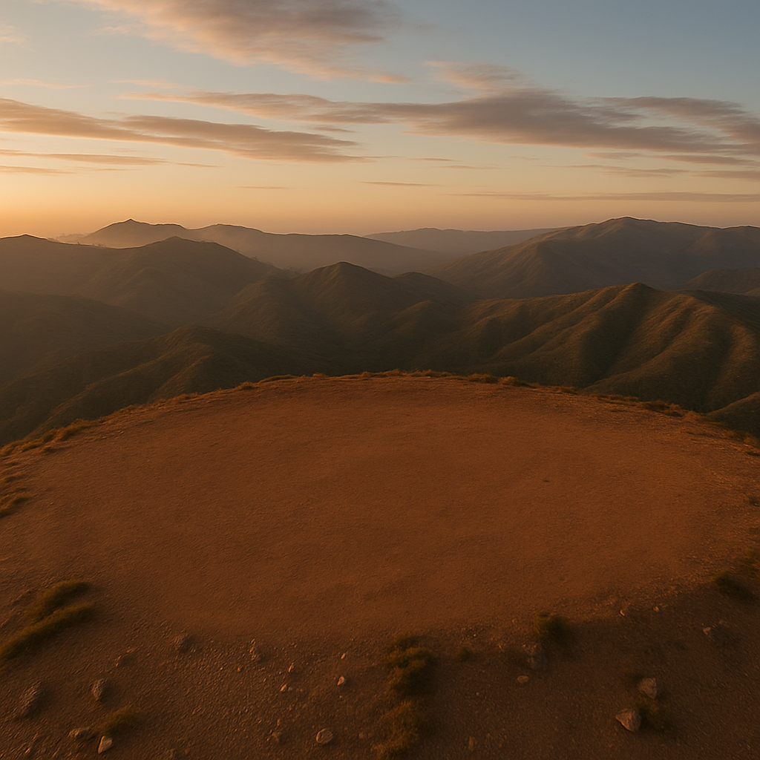
What is the past, present and future of Trinity?
Area -> 1 sq meter
Field of View -> 3.87°x3.87°
Resolution -> 0.24 °
2021 Demonstrator Funding
2023 Data Taking
Demonstrator

Slide 19
What is the past, present and future of Trinity?
Area -> 1 sq meter
Field of View -> 3.87°x3.87°
Resolution -> 0.24 °
Area -> 16 sq meter
Field of View -> 60°x5°
Resolution -> 0.3 °
2021 Demonstrator Funding
2026 Trinity One Funding (?)
2023 Data Taking
Demonstrator
Trinity One

Slide 20
What is the past, present and future of Trinity?
Area -> 1 sq meter
Field of View -> 3.87°x3.87°
Resolution -> 0.24 °
Area -> 16 sq meter
Field of View -> 60°x5°
Resolution -> 0.3 °
3 sites
6 telescopes per site
2021 Demonstrator Funding
2026 Trinity One Funding (?)
2031 Trinity Observatory Funding (?)
2023 Data Taking
Demonstrator
Trinity One
Trinity Observatory

Slide 21
How does Trinity detect neutrinos?
How can Trinity contribute to GRB physics?
What makes Trinity different from other neutrino telescopes?
Could Trinity observe blazar flares?
What is the past, present and future of Trinity?
What is Trinity’s detection capability?

Slide 22
How does Trinity detect neutrinos?
How can Trinity contribute to GRB physics?
What makes Trinity different from other neutrino telescopes?
Could Trinity observe blazar flares?
What is the past, present and future of Trinity?
What is Trinity’s detection capability?

Slide 23
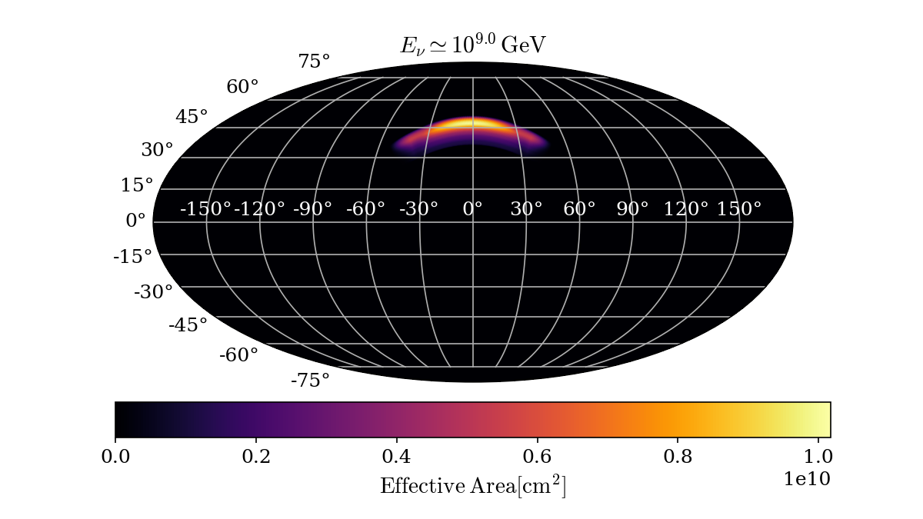
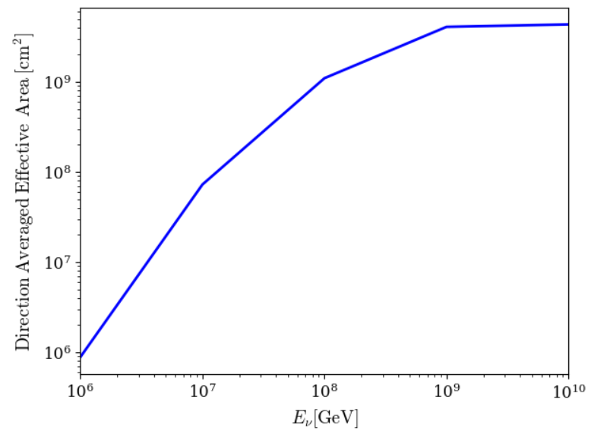
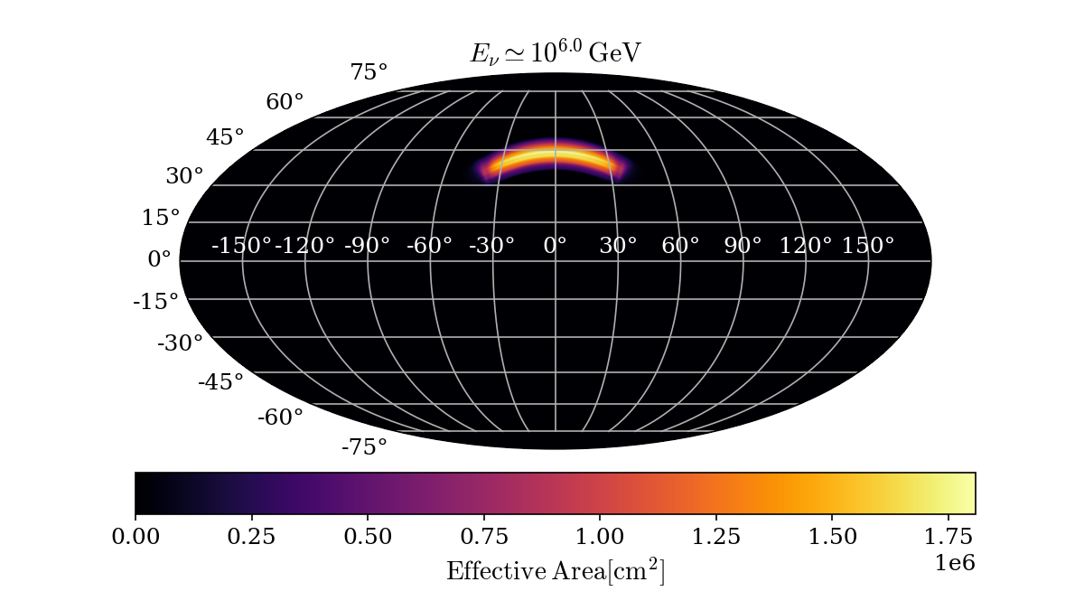
What is Trinity’s detection capability?
Simulations with Corsika and NuTauSim

Slide 24
What is Trinity’s detection capability?

Slide 25
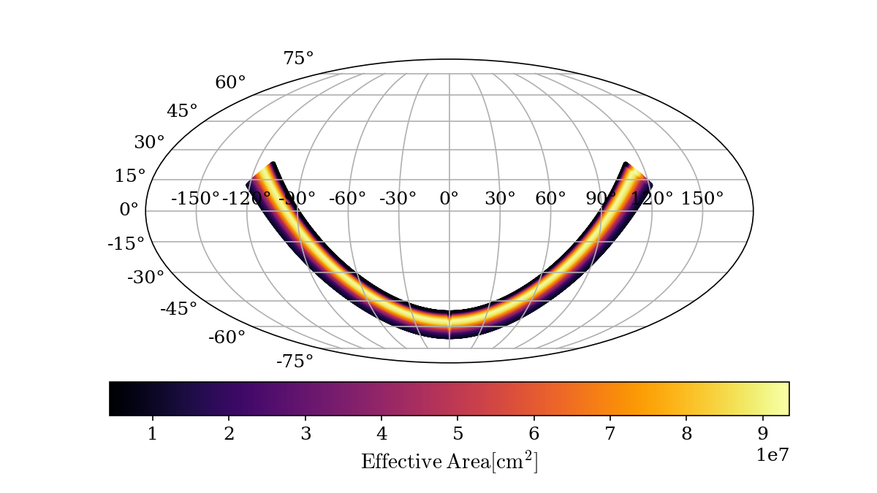
What is Trinity’s detection capability?
Accesible sky with repointing

Slide 26
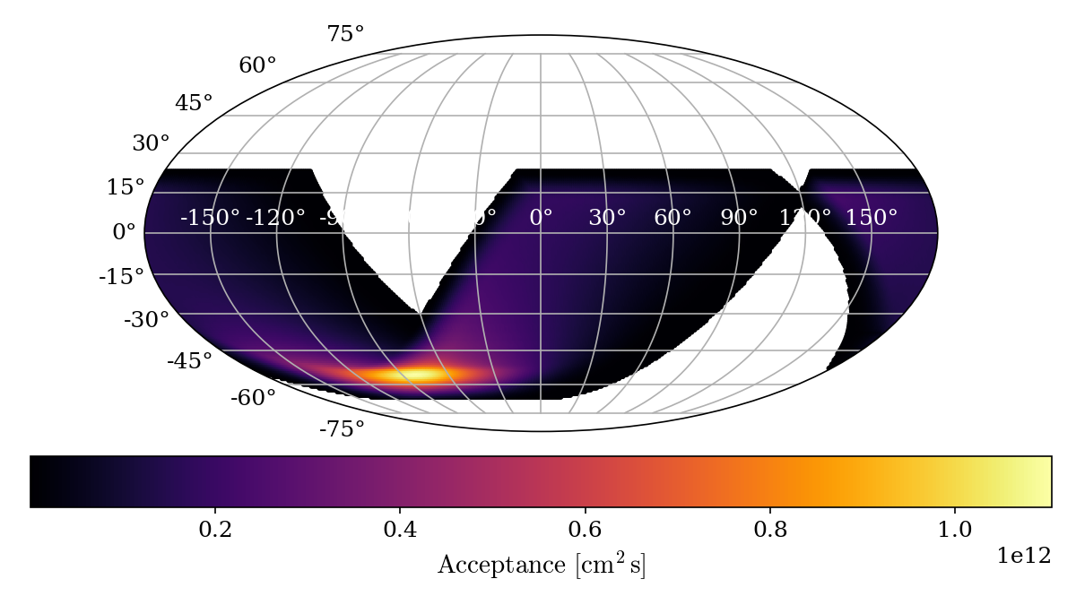
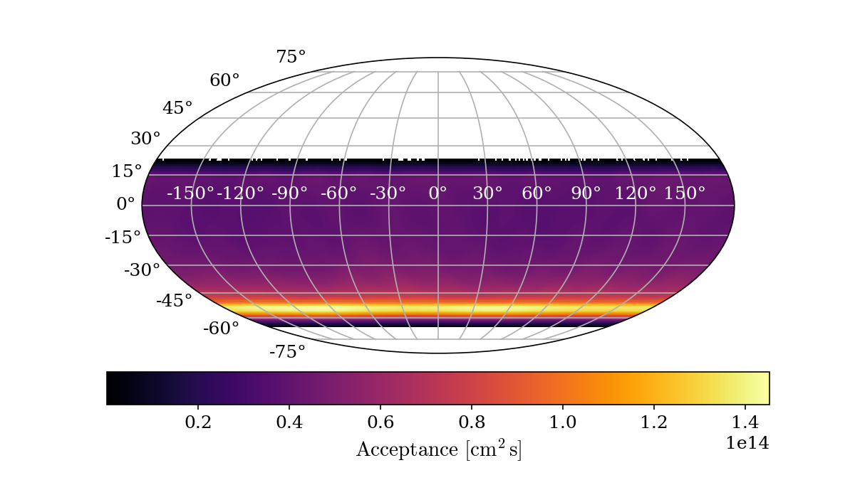
What is Trinity’s detection capability?
Instantaneous
One day
One year

Slide 27
What is Trinity’s detection capability?
Instantaneous
One day
One year
20% duty cycle

Slide 28
How does Trinity detect neutrinos?
How can Trinity contribute to GRB physics?
What makes Trinity different from other neutrino telescopes?
Could Trinity observe blazar flares?
What is the past, present and future of Trinity?
What is Trinity’s detection capability?

Slide 29
How does Trinity detect neutrinos?
How can Trinity contribute to GRB physics?
What makes Trinity different from other neutrino telescopes?
Could Trinity observe blazar flares?
What is the past, present and future of Trinity?
What is Trinity’s detection capability?

Slide 30
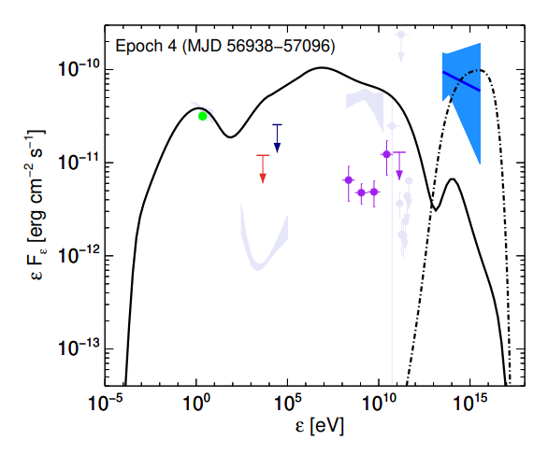
Could Trinity observe blazar flares?
TXS 0506 2014-2015 Flare
Petropoulou, M. et al. Astrophys.J. 891 (2020) 115

Slide 31
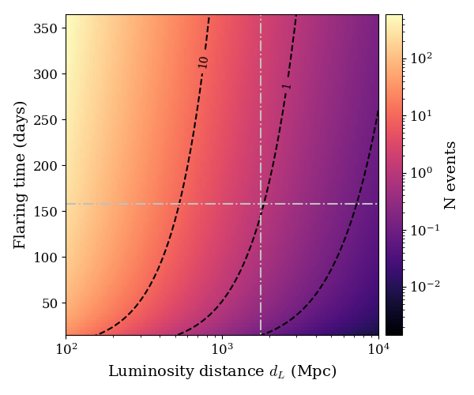
Could Trinity observe blazar flares?
Petropoulou, M. et al. Astrophys.J. 891 (2020) 115

Slide 32
How does Trinity detect neutrinos?
How can Trinity contribute to GRB physics?
What makes Trinity different from other neutrino telescopes?
Could Trinity observe blazar flares?
What is the past, present and future of Trinity?
What is Trinity’s detection capability?

Slide 33
How does Trinity detect neutrinos?
How can Trinity contribute to GRB physics?
What makes Trinity different from other neutrino telescopes?
Could Trinity observe blazar flares?
What is the past, present and future of Trinity?
What is Trinity’s detection capability?

Slide 34
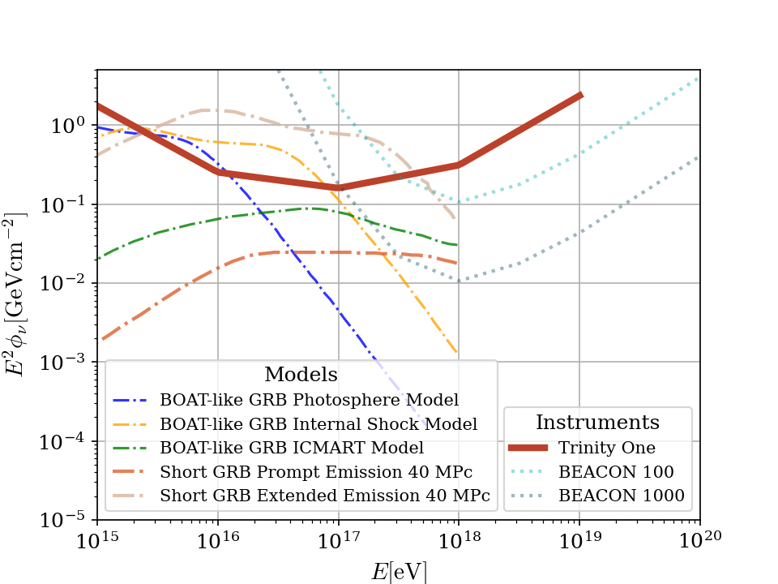
How can Trinity contribute to GRB physics?
Comparable sensitivity to radio counterparts with a single telescope
Ideal energy range for GRB model constrain

Slide 35
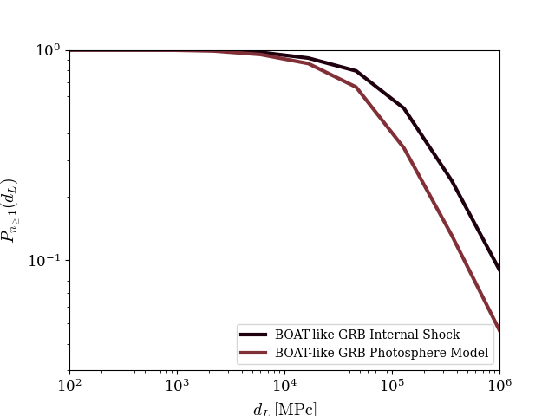
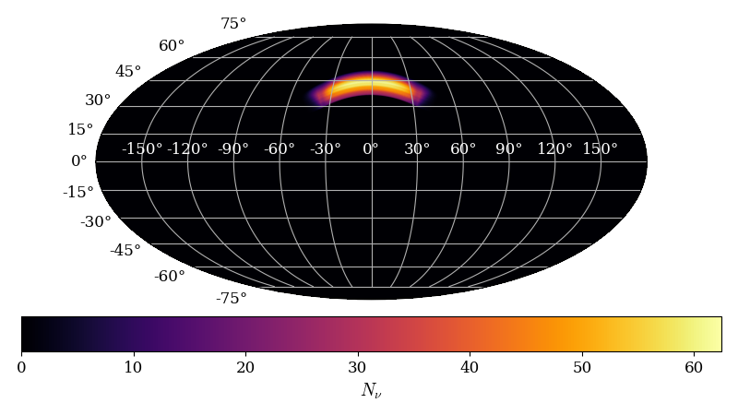
How can Trinity contribute to GRB physics?
BOAT-like GRB IS Model 10 GPc

Slide 36
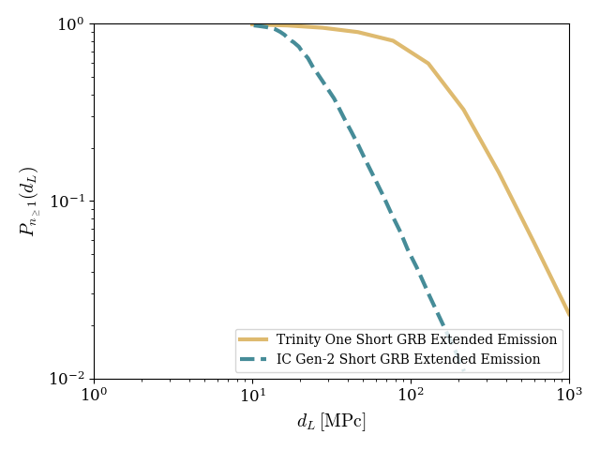
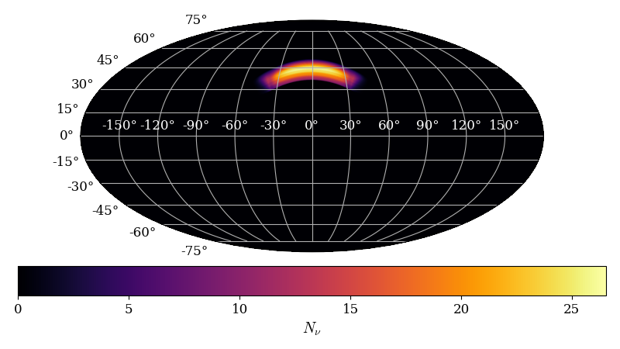
How can Trinity contribute to GRB physics?
sGRB Extended Emission 40 MPc

Slide 37
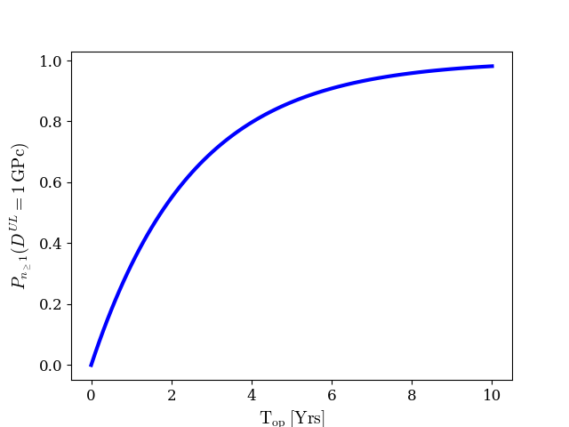
How can Trinity contribute to GRB physics?
1 GPc Upper Limit
Follow ups from gravitational waves observatories expected

Slide 38
Summary
Demonstrate Earth-skimming as a UHE neutrino detection method.
Leverage high sensitivity and sharp angular resolution for point-source studies.
Use azimuthal rotation to boost neutrino detection rates.
Work in progress, stay tuned…
Going to ICRC next week? Check out our poster on Trinity One
Right after some of our first data analysis run from the Trinity Demonstrator!

Slide 39
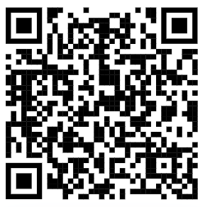
Questions?
I appreciate your feedback!
draudales@gatech.edu
The speaker acknowledges support from Georgia Tech’s Center for Relativistic Astrophysics Student Travel Award and the American Astronomical Society International Travel Grant.

