Slide 1
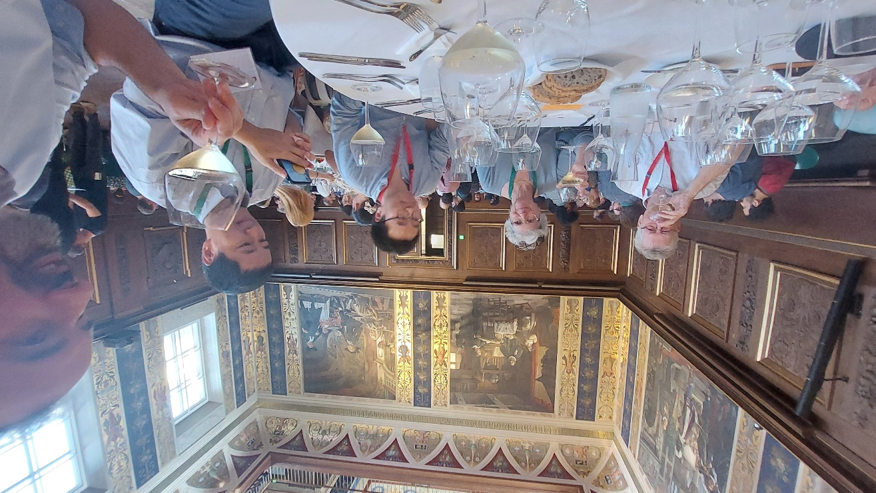
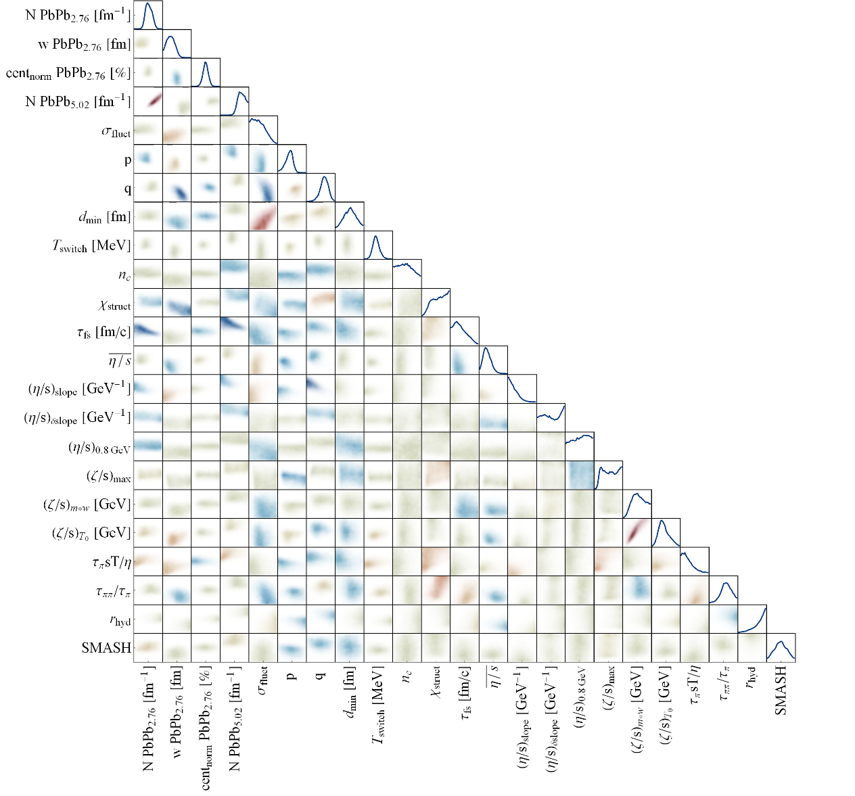
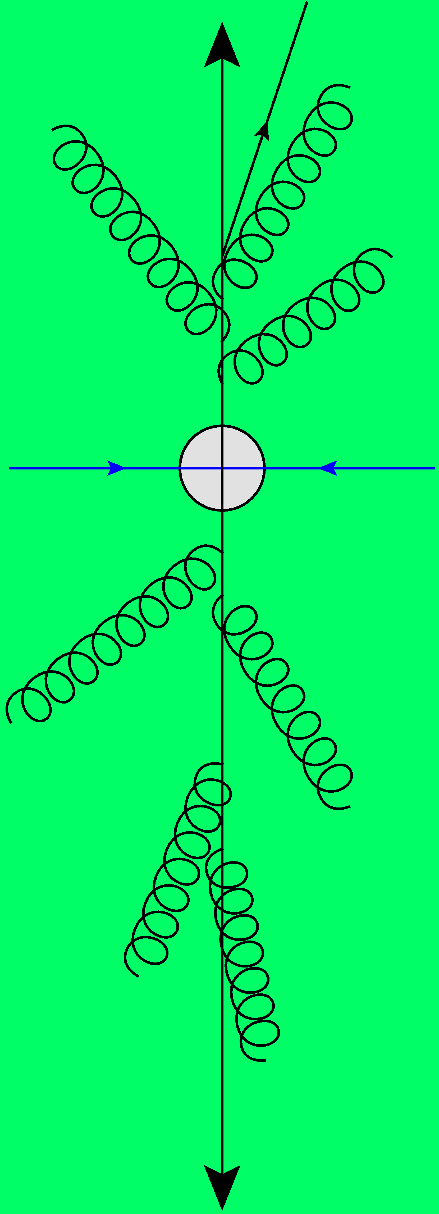
Global analyses of ultrarelativistic heavy ions in the LHC era
Towards a precision analysis of heavy ion collisions
Work mostly with Govert Nijs and Giuliano Giacalone
Wilke van der Schee
NBI heavy ion seminar
29 November 2024

Slide 2
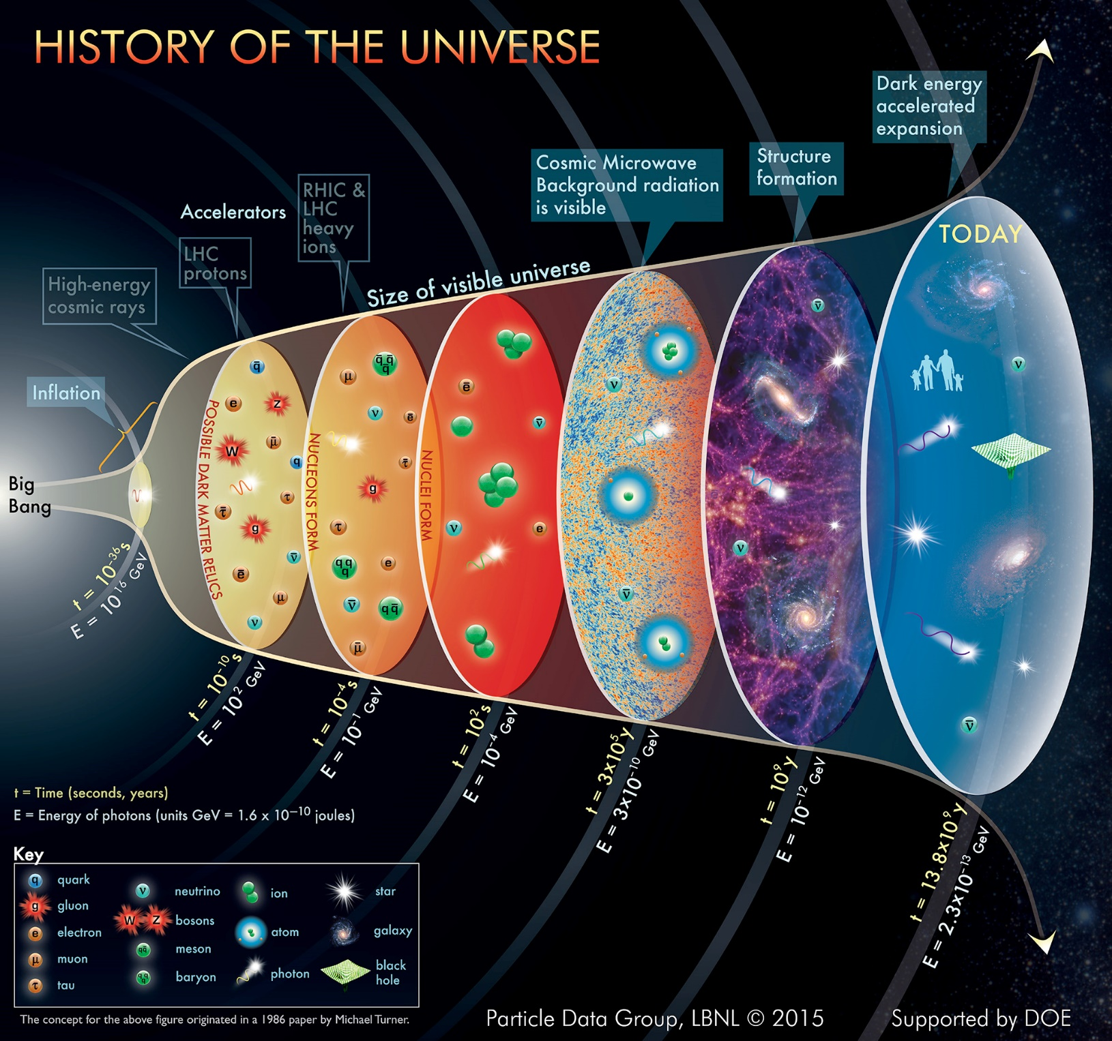
Quark-gluon plasma (QGP)
Wilke van der Schee, CERN/Utrecht
Quantum-Chromodynamics (QCD)
Recreating the big bang
At age 1 μs the entire universe was QGP!
QGP turns out interesting
Strongly coupled quantum matter
A fundamental force of nature
Notes:
QGP is perhaps simplest interesting fluid in nature
Elementary particles, cosmology
Not a free gas: strongly interacting quantum matter
Theoretical perspective: strong and QCD point of view
Experimental data

Slide 3
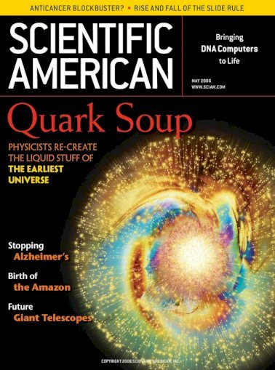
How to create QGP
Wilke van der Schee, CERN/Utrecht
16 fm
Colliding heavy nuclei (Pb) at high energies
Lorentz gamma factor up to 2500
Hottest fluid:
10¹² K
Smallest fluid:
~ 2 fm living 10⁻²³ s
Most perfect/strange:
η/s ~ 0.08
Most vortical fluid:
ω ~ 10²²/s

Slide 4
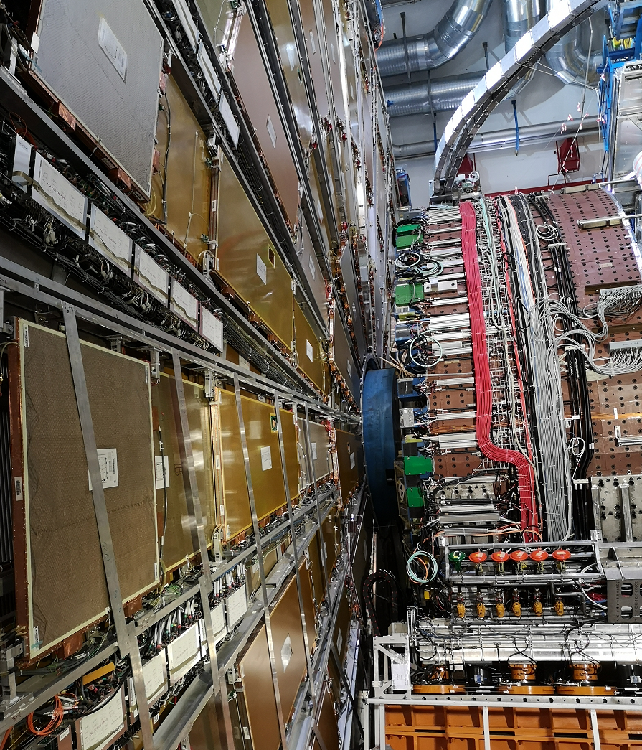
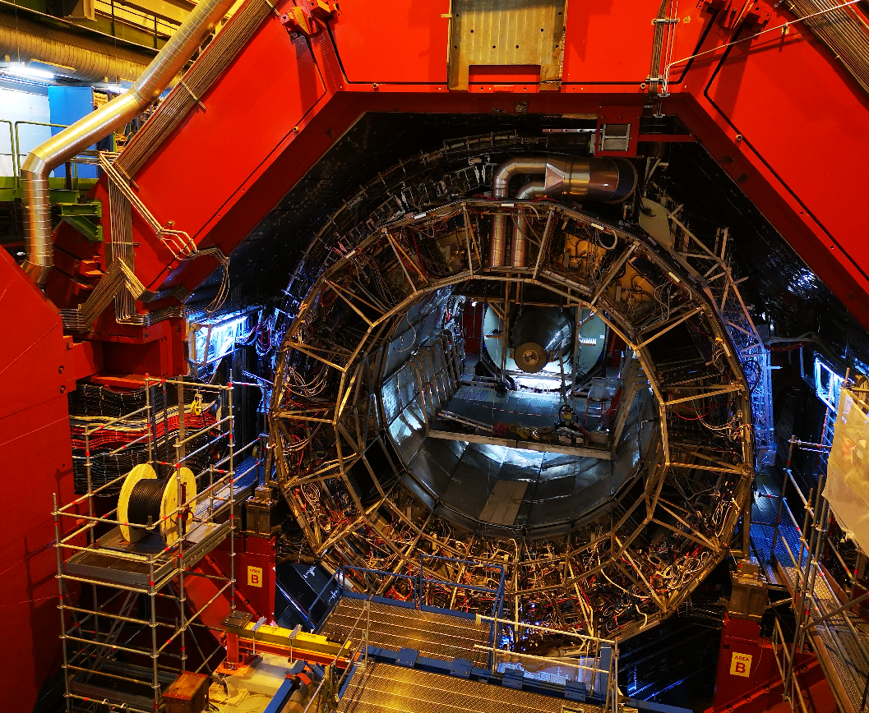
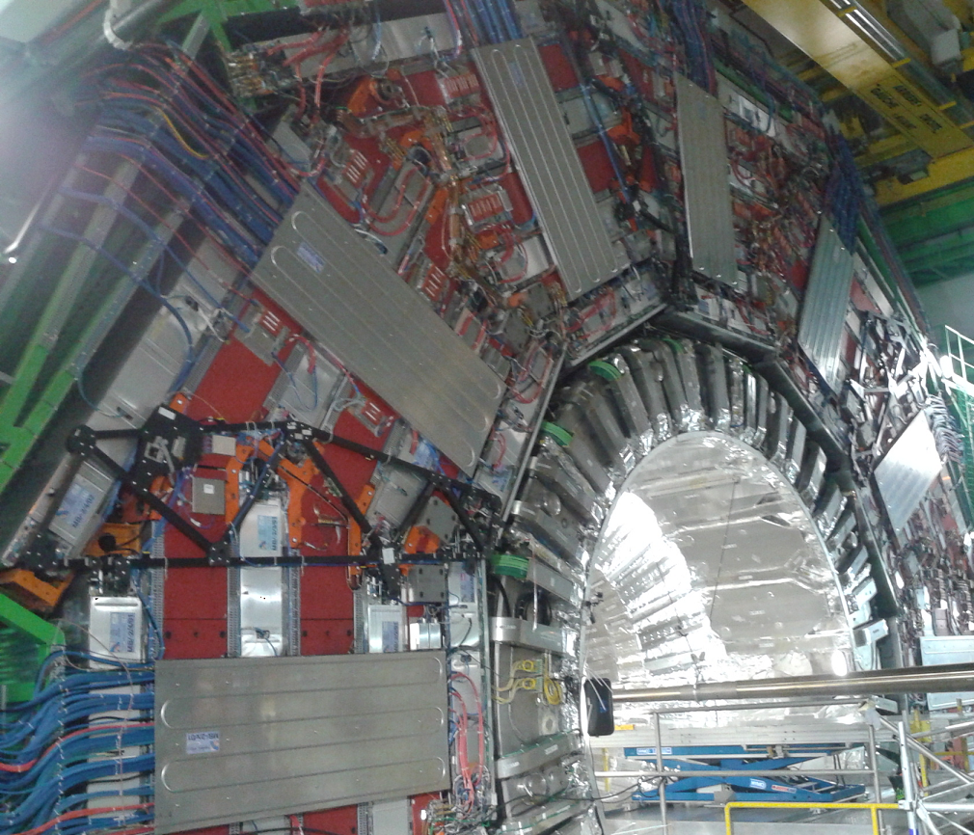
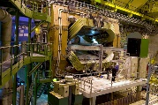
Wilke van der Schee, CERN/Utrecht
CERN accelerator complex
Le reculet/Jura
ATLAS/TH
ALICE
Rhône
SPS/Prévessin
CMS
LHCb
Lac Léman/Lake Geneva
Notes:
QGP created at hadron colliders
Contribution Utrecht to ALICE
Contributions from all experiments

Slide 5
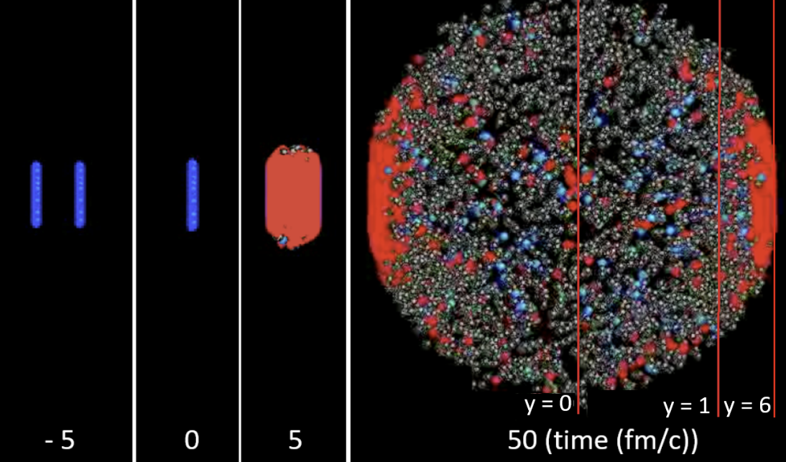
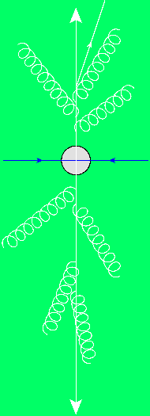
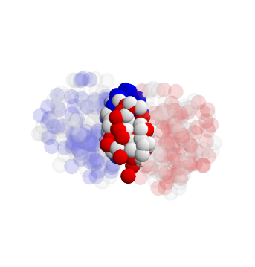
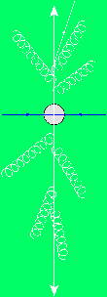
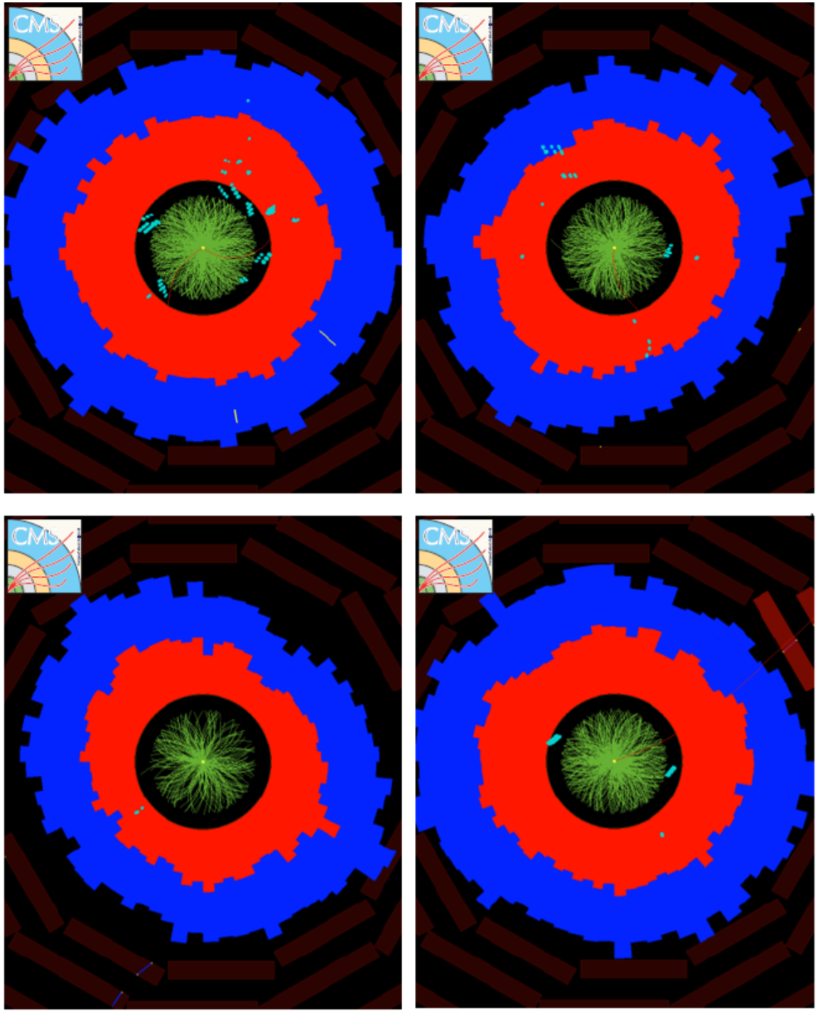
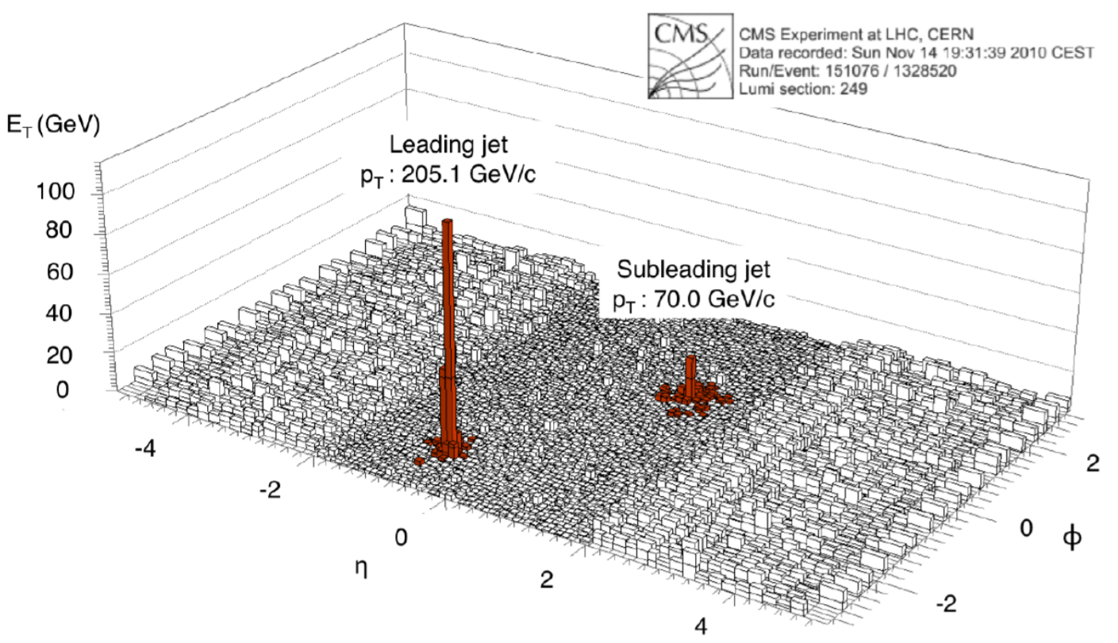
Quark-gluon plasma is strongly coupled
Wilke van der Schee, CERN
Initial stage - QGP - hadronic phase
Anisotropic flow (small viscosity)
Jet energy loss in dijet pair
Wit Busza, Krishna Rajagopal and WS, Heavy Ion Collisions: The Big Picture, and the Big Questions (2018)
Notes:
Historically: Weak coupling: slow thermalization and larger viscosity
Review: spectra at RHIC and LHC → fast QGP

Slide 6
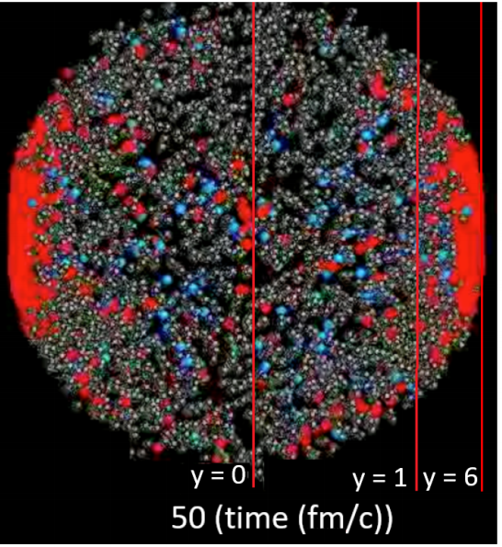
Standard model of heavy ion collisions
Wilke van der Schee, CERN/Utrecht
(# parameters)
Initial stage (13)
Viscous hydrodynamics (10)
Cascade of hadrons (2)
SMASH
Subnucleonic structure? (8)
Non-thermal flow? (2) with hydrodynamised initial stage
Fluctuations? (1)
Shape (2)
Shear viscosity (4)
Bulk viscosity (3)
Second order transports: 2
EOS: 1
Jonah Bernhard, Scott Moreland and Steffen Bass, Bayesian estimation of the specific shear and bulk viscosity of quark–gluon plasma (2019)
Govert Nijs, WS, Umut Gursoy and Raimond Snellings, A Bayesian analysis of Heavy Ion Collisions with Trajectum (2020)

Slide 7
Trajectum
Quite straightforward to use (see param file, right)
Includes analyse routine
Parallelised: can analyse unlimited number of events
http://sites.google.com/view/govertnijs/trajectum
http://wilkevanderschee.nl/trajectum

Slide 8
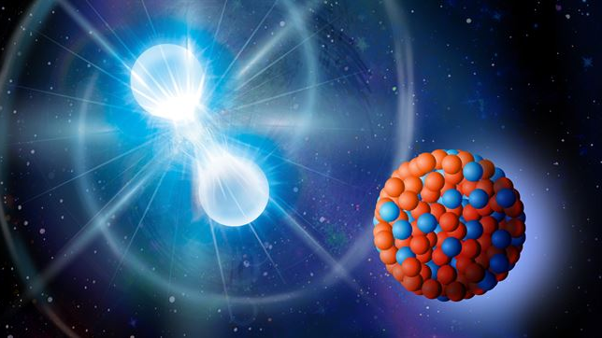
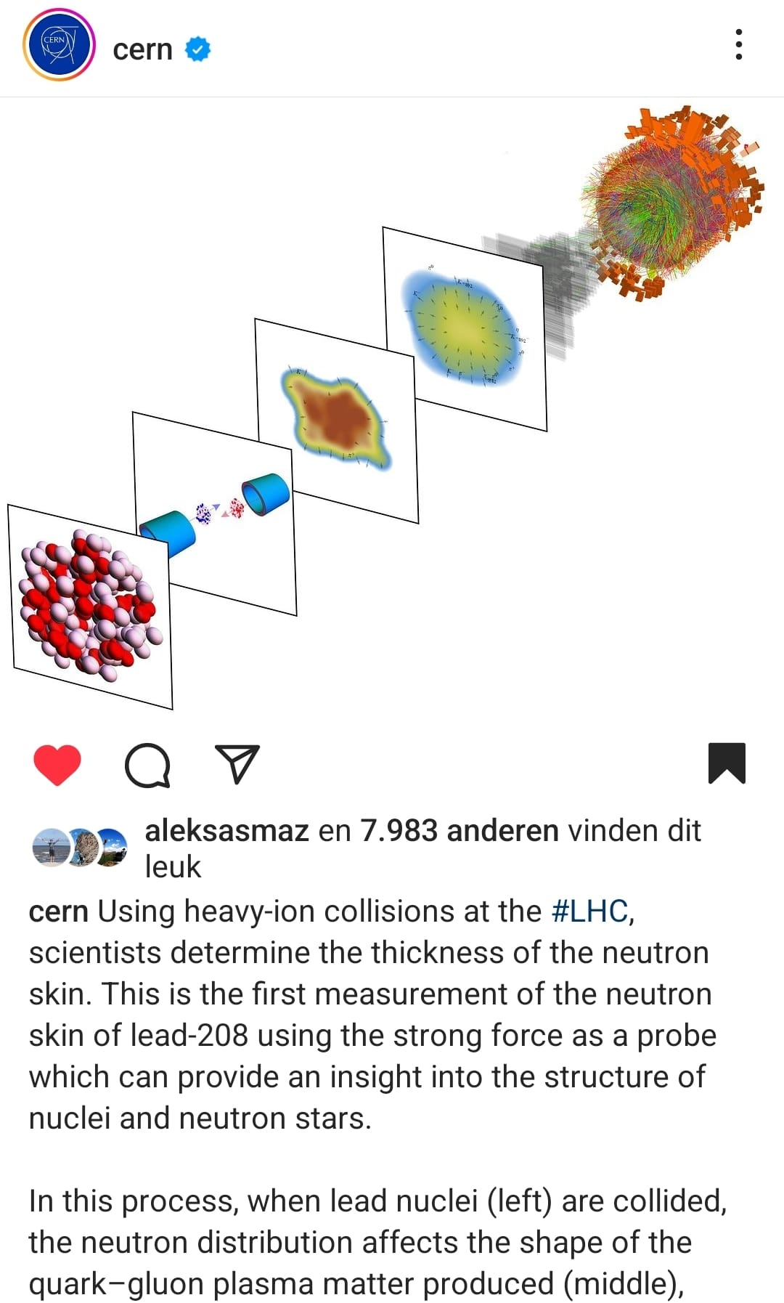
Neutron skin
With a short intro on Bayesian analysis

Slide 9
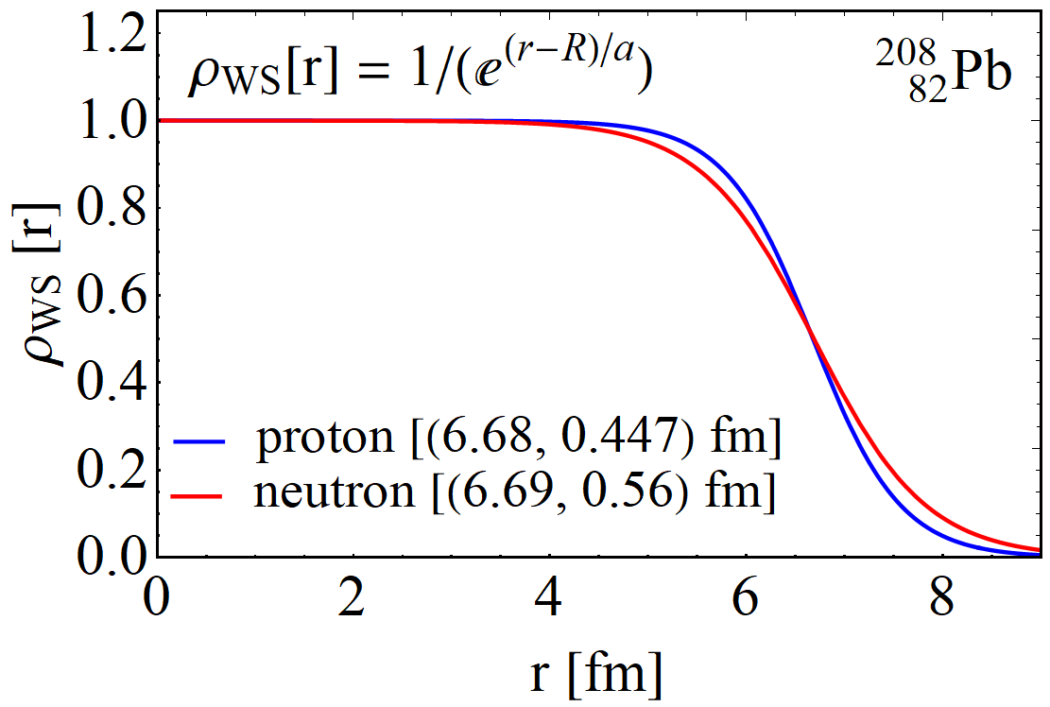
The neutron skin
Trento:
Nucleus charge profile can be measured very accurately
Much more uncertainty in the profile of the neutrons
Relevant to understand cold QCD: EOS for neutron stars
Can we make progress using heavy ion collisions?
Isospin symmetry makes distinction neutron/proton difficult
Leverage accurate proton knowledge and obtain profile of nucleus?
How to obtain the profile of a nucleus?
Wood-Saxon + MC-Glauber + (model like Trento) → dynamics
Currently state-of-the-art …
Profile influences many observables
Interplay with bulk viscosity, Trento model etc
Likely need a full global analysis
Constantin Loizides, Jason Kamin and David d'Enterria, Improved Monte Carlo Glauber predictions at present and future nuclear colliders (2017)

Slide 10
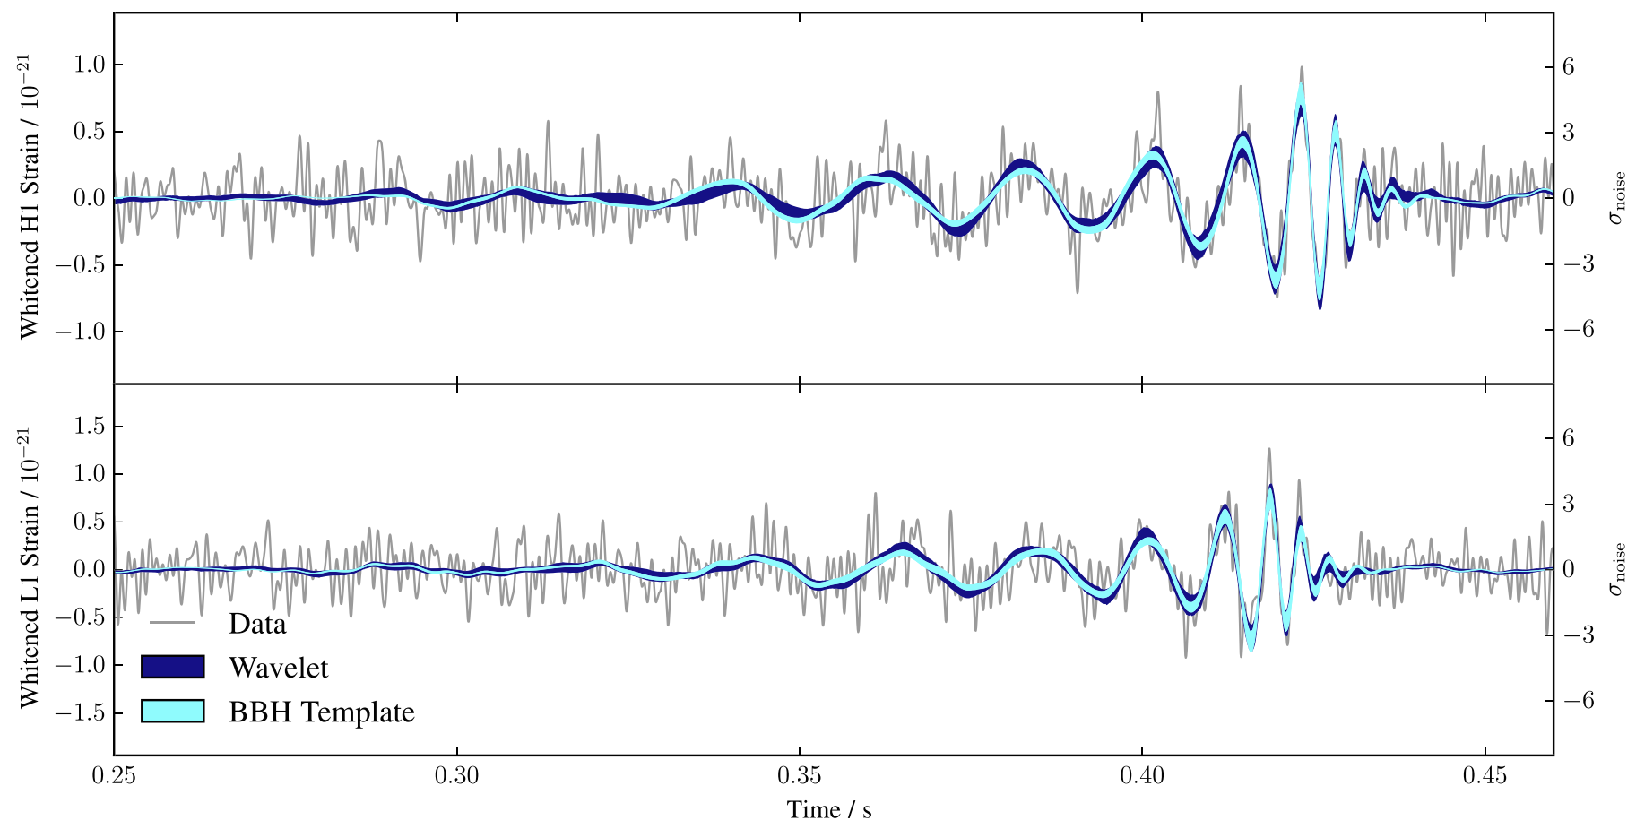
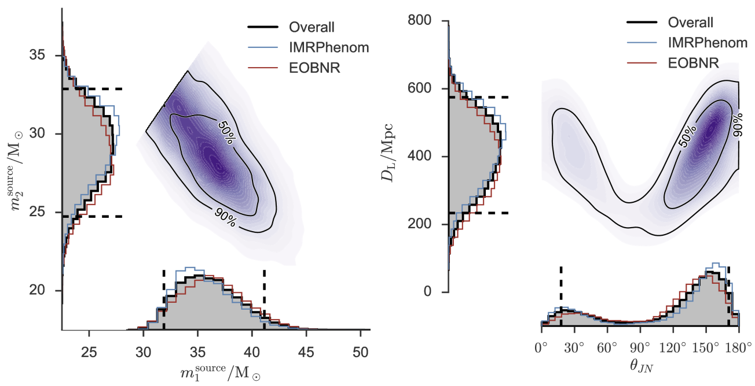
Performing a global analysis
Wilke van der Schee, CERN/Utrecht
Bayes theorem:
Same technique: gravitational waves
Model depends on parameters non-linearly
Run model on 3000 `design’ points
Use an emulator for any point in parameter space (GP)
Markov Chain Monte Carlo
653 data points
Obtain posterior probability density of parameters
Compare posterior with data
Can include high statistics run
LIGO, Properties of the Binary Black Hole Merger GW150914 (2016)
Notes:
Parameters influence observables in complex and non-linear way
Global analysis needed
Run on design points + emulate
MCMC with Bayes theorem and over 500 datapoints
Verify that high probability parameter set works well with other observables
Similar to gravitational waves with for instance waveform determines correlation between distance and inclination

Slide 11
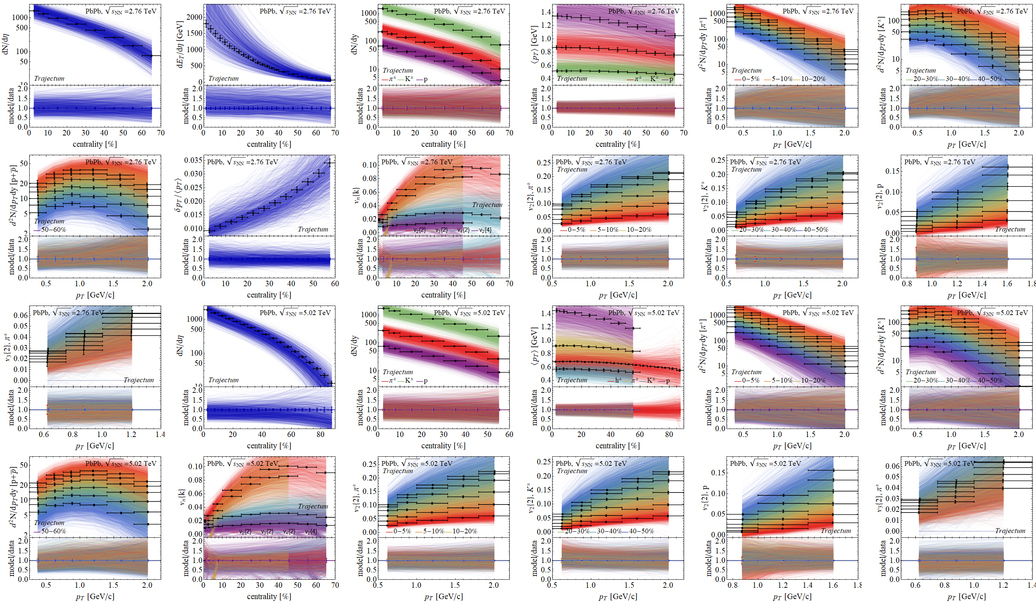
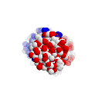
Experimental observables: a wealth of data
Prior

Slide 12
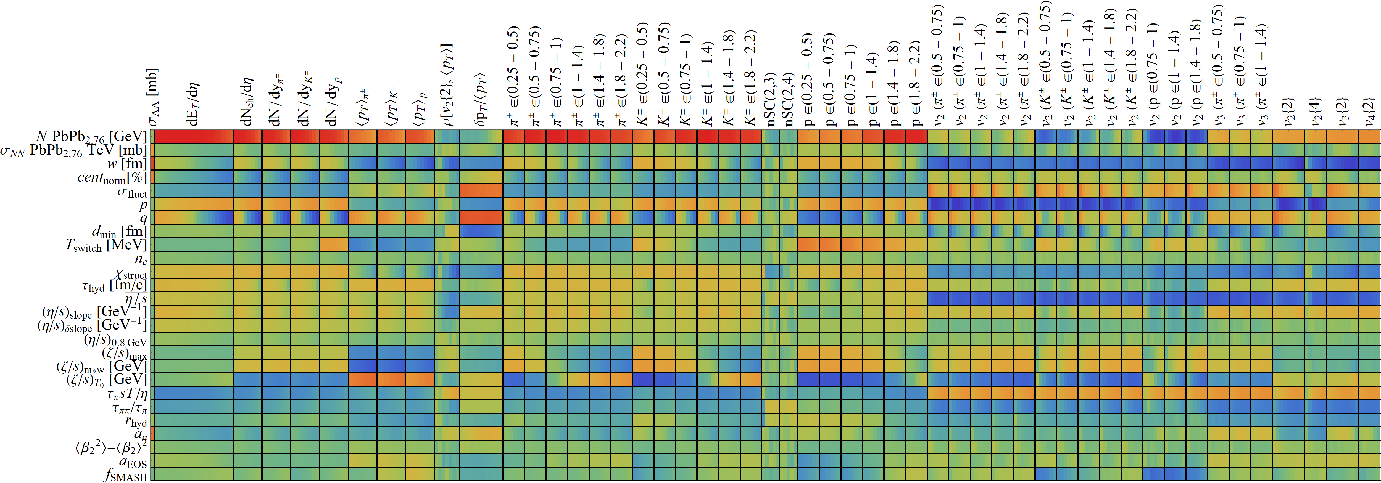
Design parameter-observable correlations:
Wilke van der Schee, CERN/Utrecht

Slide 13
Experimental observables: a wealth of data
Prior

Slide 14
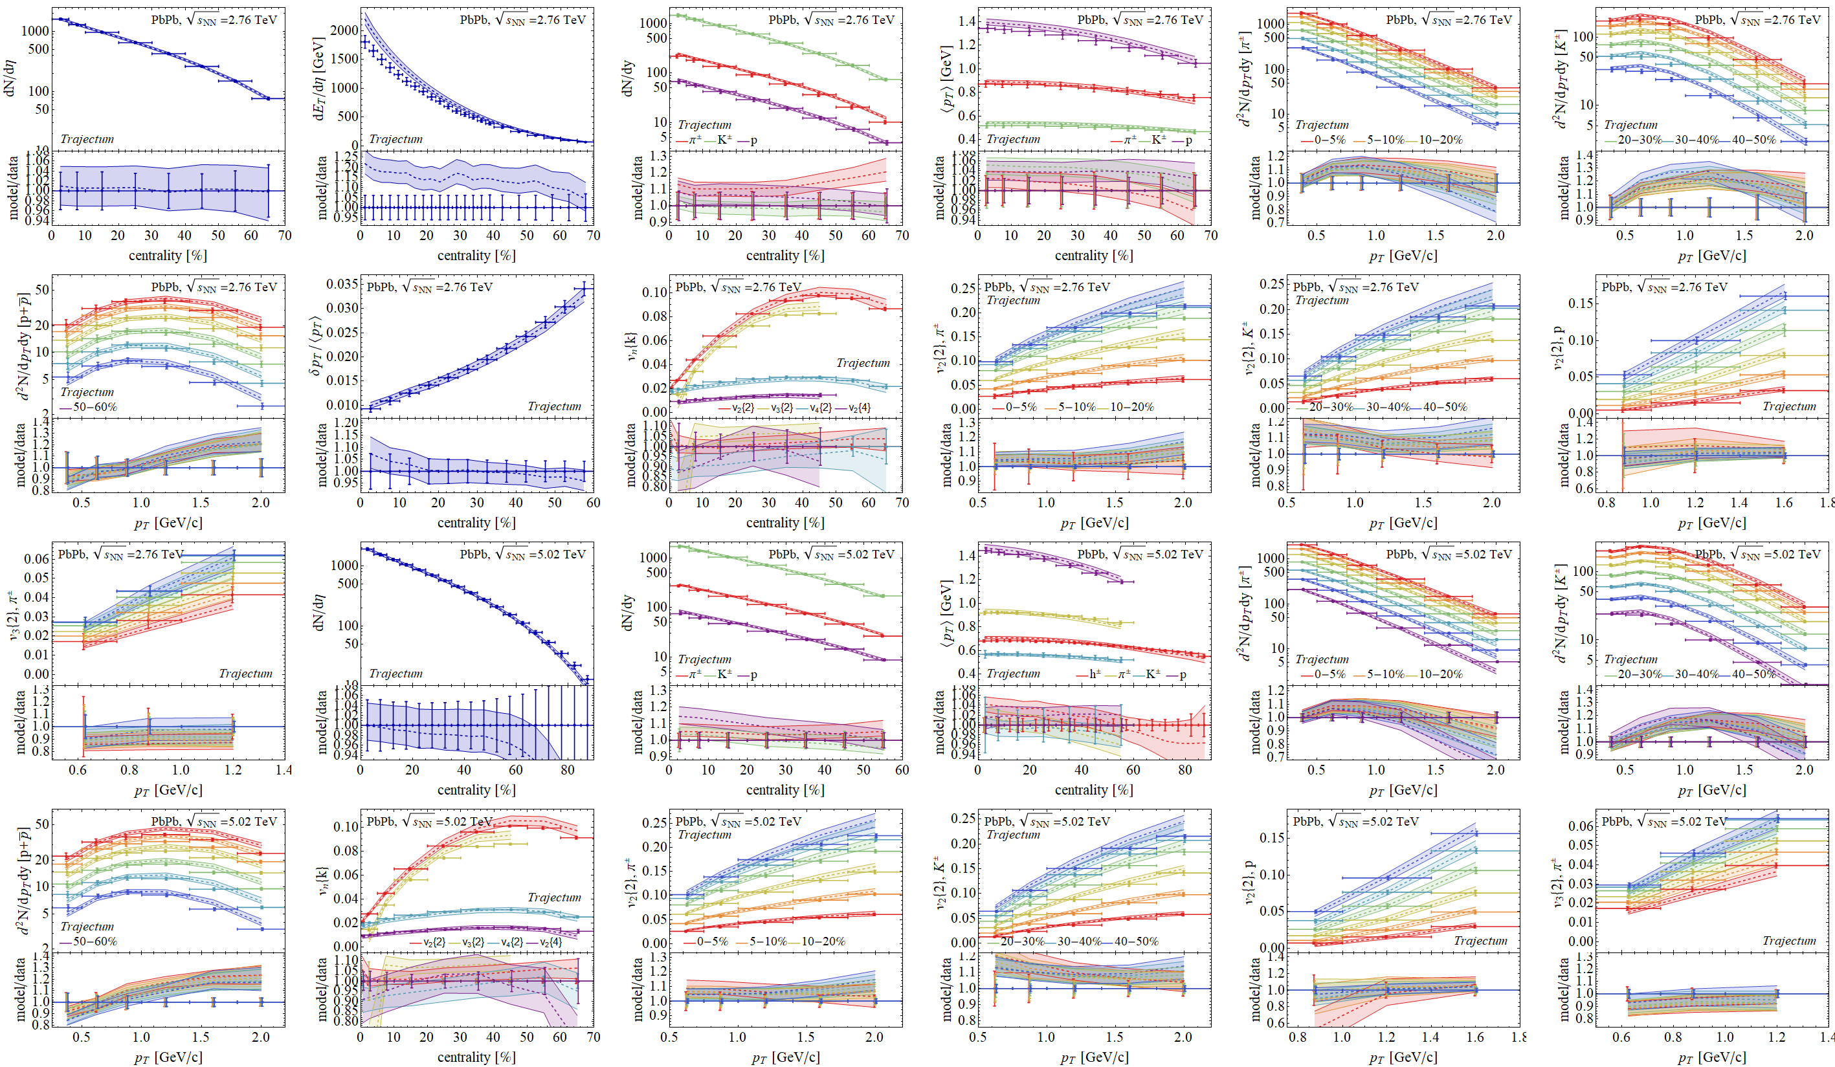
Experimental observables: a wealth of data
Posterior

Slide 15
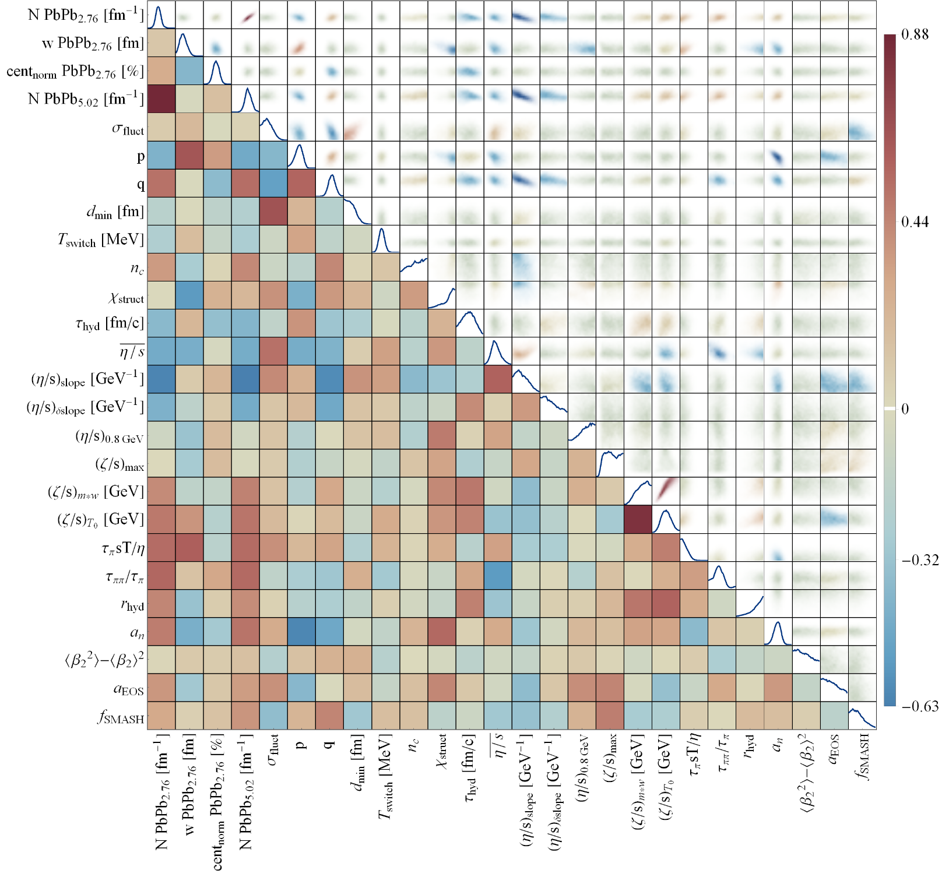
Full posterior distributions
Wilke van der Schee, CERN/Utrecht
Some parameters better constrained than others
Correlations add important information, e.g. width constrained much more accurately if p parameter is known

Slide 16
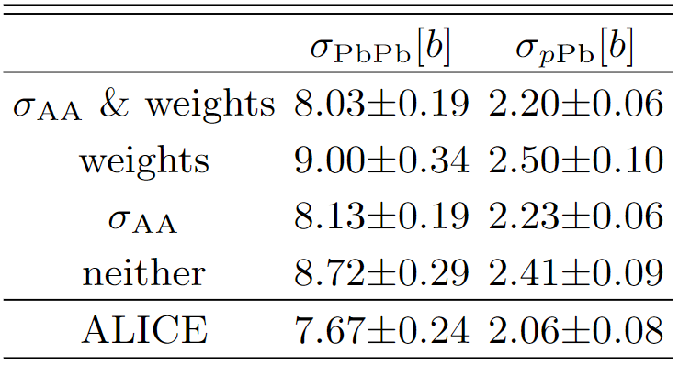
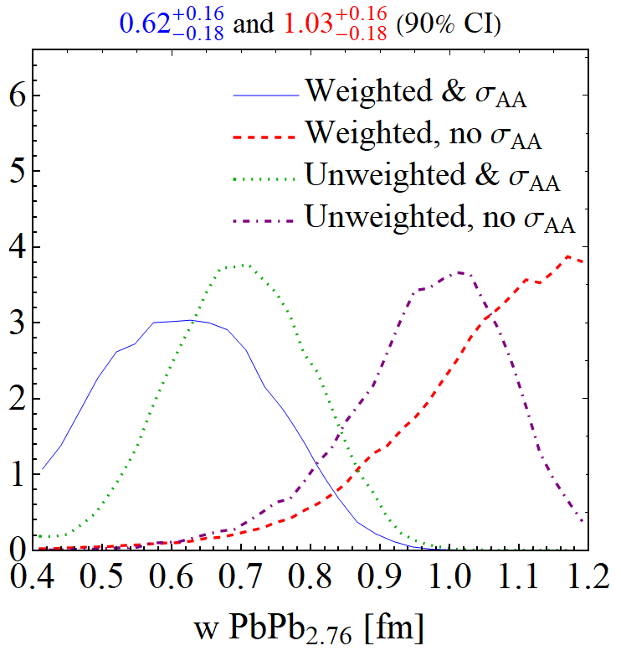
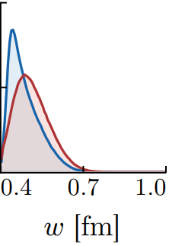
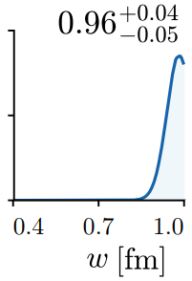
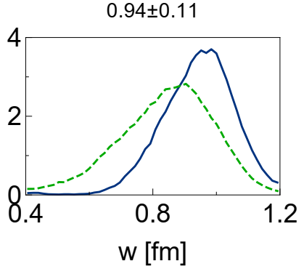
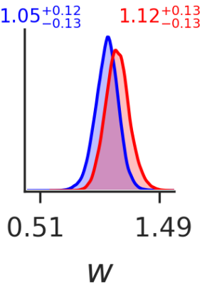
The nucleon width from Bayesian scans Nucleons grow with collision energy, but by how much?
Trajectum, 2022
Trajectum, 2020
JETSCAPE, 2020
Duke + OSU, 2016
Duke nature physics, 2018
Nucleon width increased in 2018 (very significantly)
Includes initial stage (free streaming)
Inconsistent with total hadronic cross section
Measured only 2022 (!)
Much smaller width (~0.62 fm)
Initial stage gives more radial flow, which is countered by larger width
w is Gaussian width: nucleons would have ~5 fm diameter
Such large nucleons are unlikely: cut off prior at 1 fm
PhD thesis Jonah Bernhard (p157)
Govert Nijs, WS, Hadronic Nucleus-Nucleus Cross Section and the Nucleon Size (2022)
Initially, this disparity seems contradictory, but the shift occurred because the previous model lacked pre-equilibrium free streaming, which generally increases radial flow; smaller nucleons compensated by creating steep initial pressure gradients, thereby driving similar radial flow. As for the apparent truncation: It reflects our prior that w < 1.0 fm, which is perhaps justified. After all, w is the width of a Gaussian, not a hard radius, so w = 1 fm implies very large nucleons of diameter ∼4–6 fm. If, based on physical considerations, we believe such large nucleons are unlikely, we could choose a prior with continuously decreasing probability as w → 1.0 fm (instead of a sudden cutoff), and the posterior distribution would smoothly drop to zero.

Slide 17
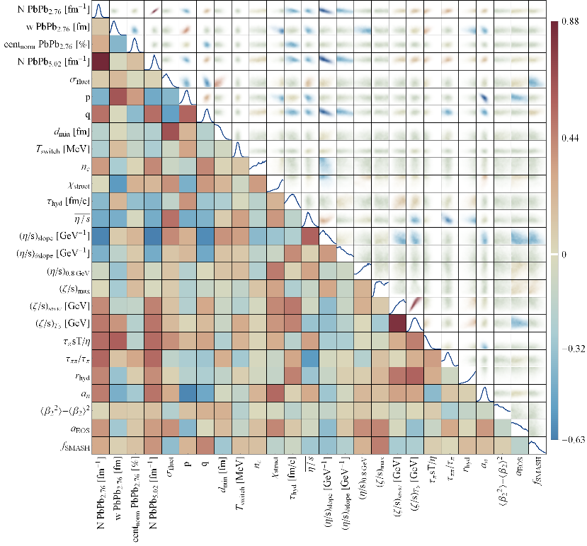
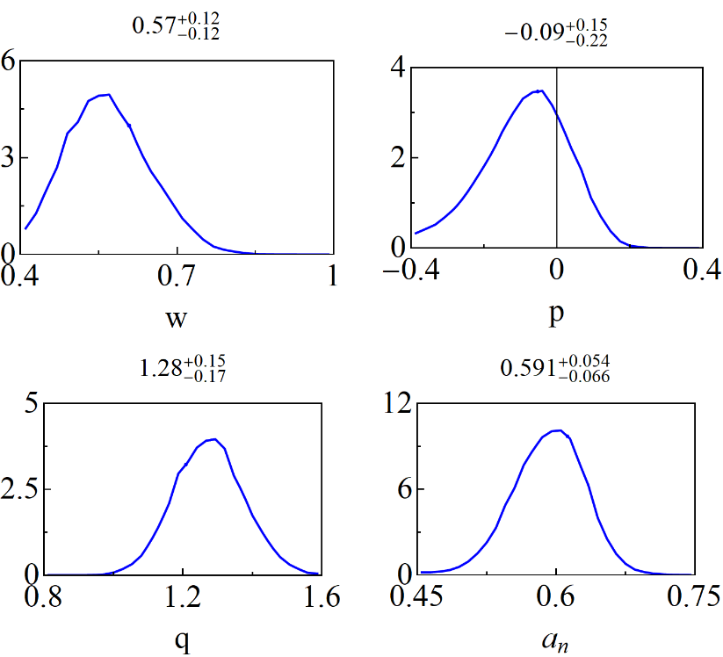
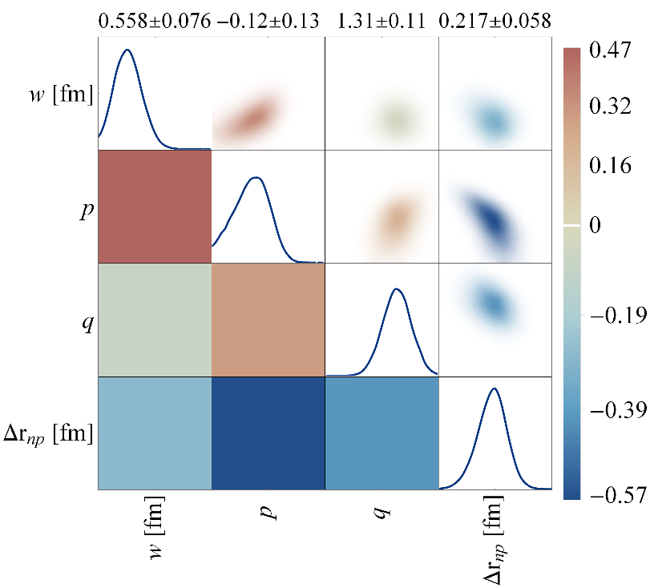
The neutron skin - posterior
Trento:
Three parameters are most sensitive to the neutron skin:
The nucleon width and the Trento parameters p and q
Small correlation with width (cross section is highly sensitive to w)
Very strong anticorrelation with p; centrality dependence is important

Slide 18
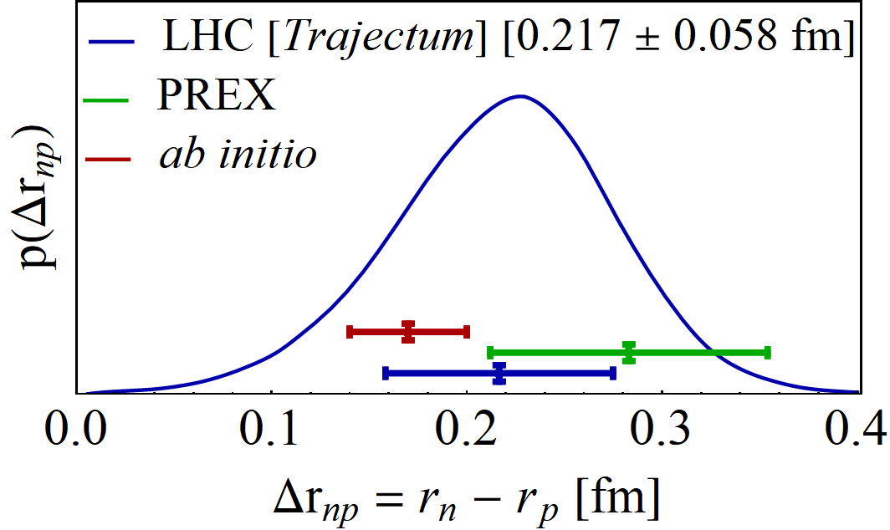
The neutron skin – final result
Transform to neutron radius minus proton radius
Final result consistent but smaller than PREX II
Uncertainty is about 20% smaller than PREX II
Cross section is crucially important, but also centrality dependence
Important to vary Trento parameters in particular
PREX II, Accurate Determination of the Neutron Skin Thickness of ²⁰⁸Pb through Parity-Violation in Electron Scattering (2022)
Baishan Hu et al, Ab initio predictions link the neutron skin of 208Pb to nuclear forces (2021)

Slide 19
A prediction: extremely ultracentral collisions

Slide 20
A true prediction using hydrodynamics (rare these days…)
Non-trivial curve; non-monotonicity was unexpected
Extremely precise (<0.1%) due to uncertainty cancellations in the ratio (theory & experiment (!))
Fernando G. Gardim, Giuliano Giacalone and Jean-Yves Ollitrault, The mean transverse momentum of ultracentral heavy-ion collisions: A new probe of hydrodynamics (2019)
Govert Nijs and WS, Predictions and postdictions for relativistic lead and oxygen collisions with the computational simulation code Trajectum (2021)
Austin Baty, Overview of Recent CMS results, https://indico.cern.ch/event/1139644/contributions/5343932/ (see also Cesar Bernardes)

Slide 21
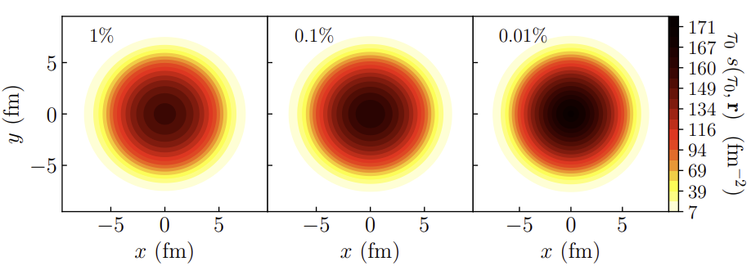
What is happening?
(Extremely) ultracentral collisions are not driven by impact parameter
Size does not extend beyond radius Lead nucleus
(Local) fluctuations drive up multiplicity
Average temperature can still increase
A simplified picture:
Entropy increase → multiplicity increases
Temperature increases → mean pt increases (assuming ideal hydro + constant `work’ done in rapidity direction)
Slope: sensitive to speed of sound (solely ?!):
Fernando G. Gardim, Giuliano Giacalone and Jean-Yves Ollitrault, The mean transverse momentum of ultracentral heavy-ion collisions: A new probe of hydrodynamics (2019)

Slide 22
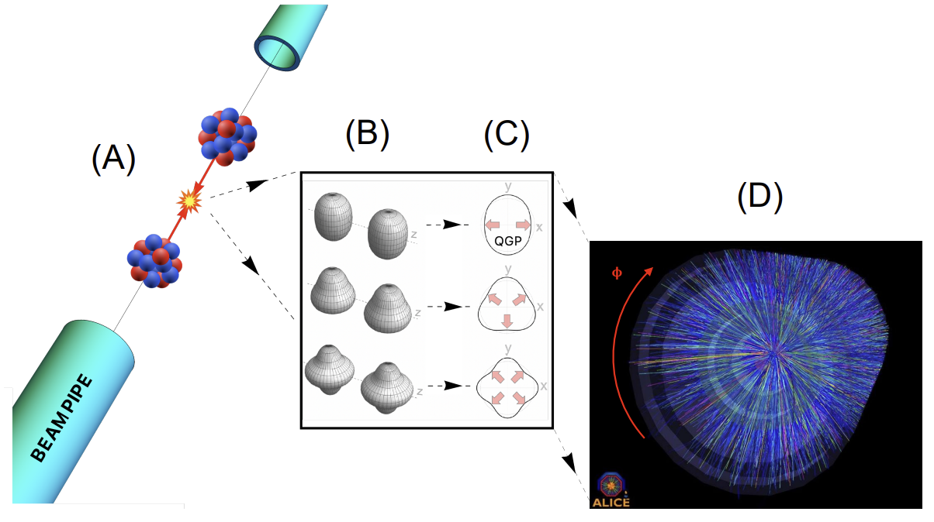
The shape of nuclei
Benjamin Bally, James Daniel Brandenburg, Giuliano Giacalone, Ulrich Heinz, Shengli Huang, Jiangoyng Jia, Dean Lee, Yen-Jie Lee, Wei Li, Constantin Loizides, Matthew Luzum, Govert Nijs, Jacquelyn Noronha-Hostler, Mateusz Ploskon, WS, Bjoern Schenke, Chun Shen, Vittorio Somà, Anthony Timmins, Zhangbu Xu and You Zhou
Imaging the initial condition of heavy-ion collisions and nuclear structure across the nuclide chart (2022)

Slide 23
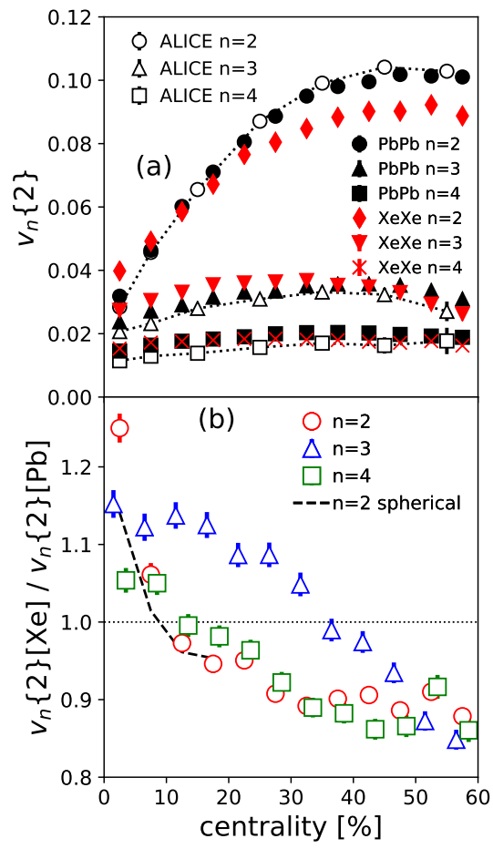
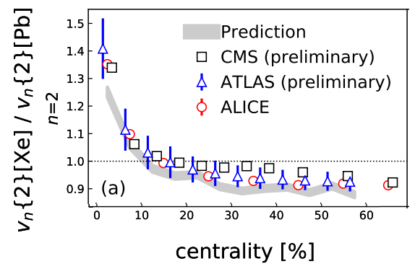
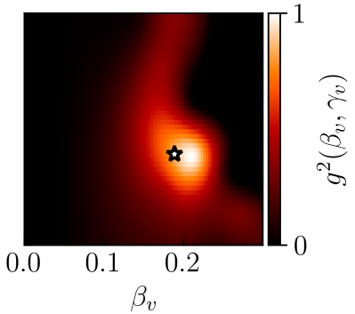
Prediction
Experiment
Xenon-129: a deformed nucleus
Elliptic deformation (β₂):
Was known from nuclear structure (0.16)
Prediction (MSc thesis Giacalone)
Xenon 6 (!) hour run: slightly bigger effect
Sophisticated nuclear structure (PGCM) confirms slightly larger β₂ (0.19)
Improved theory
Giuliano Giacalone, Jacquelyn Noronha-Hostler, Matthew Luzum and Jean-Yves Ollitrault, Hydrodynamic predictions for 5.44 TeV Xe+Xe collisions (2017)
Giuliano Giacalone, Jacquelyn Noronha-Hostler, Matthew Luzum, Jean-Yves Ollitrault, Confronting hydrodynamic predictions with Xe-Xe data (2018) Benjamin Bally, Michael Bender, Giuliano Giacalone and Vittorio Soma, Evidence of the triaxial structure of ¹²⁹Xe at the Large Hadron Collider (2021)

Slide 24
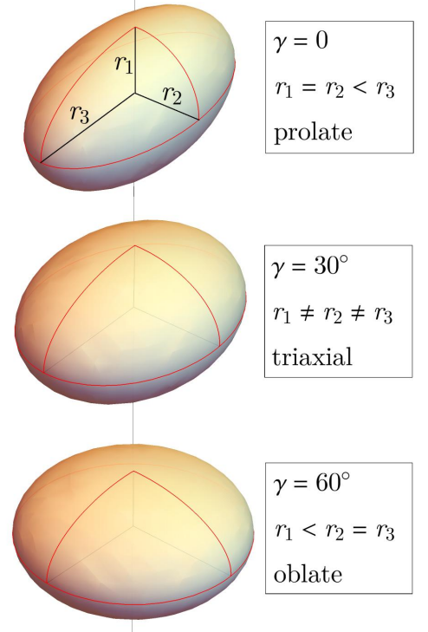
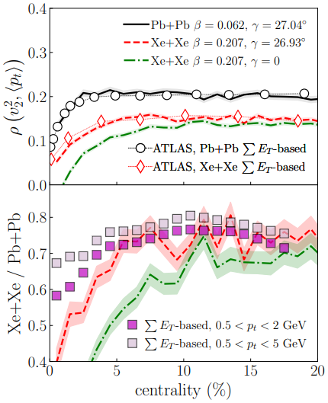
Xenon-129: a triaxial nucleus
Elliptic deformation (β₂):
Prolate or oblate: still has symmetry axis
Triaxial: all axis are independent
Curiously (?) especially ρ₂ observable sensitive
Measures correlation between elliptic flow and mean pt
What’s happening?
Benjamin Bally, Michael Bender, Giuliano Giacalone and Vittorio Soma, Evidence of the triaxial structure of ¹²⁹Xe at the Large Hadron Collider (2021)

Slide 25
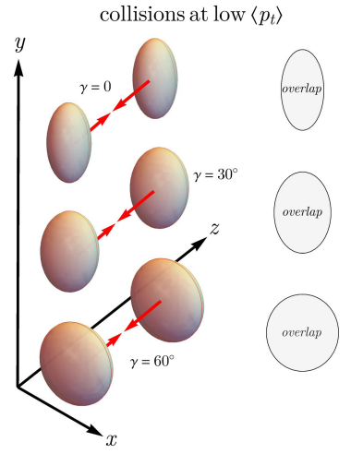
Xenon-129: a triaxial nucleus: what’s happening
Smart trick: two selections
Central and large (full overlap, low p_{T}) Prolate: large v₂ (negative ρ₂) Oblate: small v₂ (positive ρ₂) Conclusion ρ₂ determines γ
Alternatively:
Central and spherical (full overlap, low v₂) Prolate: small area, high p_{T} (negative ρ₂) Oblate: large area , low p_{T} (positive ρ₂) Conclusion ρ₂ determines γ
Note: just v₂ doesn’t work, β₂ gives v₂ in both cases (!)
Benjamin Bally, Michael Bender, Giuliano Giacalone and Vittorio Soma, Evidence of the triaxial structure of ¹²⁹Xe at the Large Hadron Collider (2021)

Slide 26
Xenon-129: a global analysis
The big picture again:
With Govert and Giuliano

Slide 27
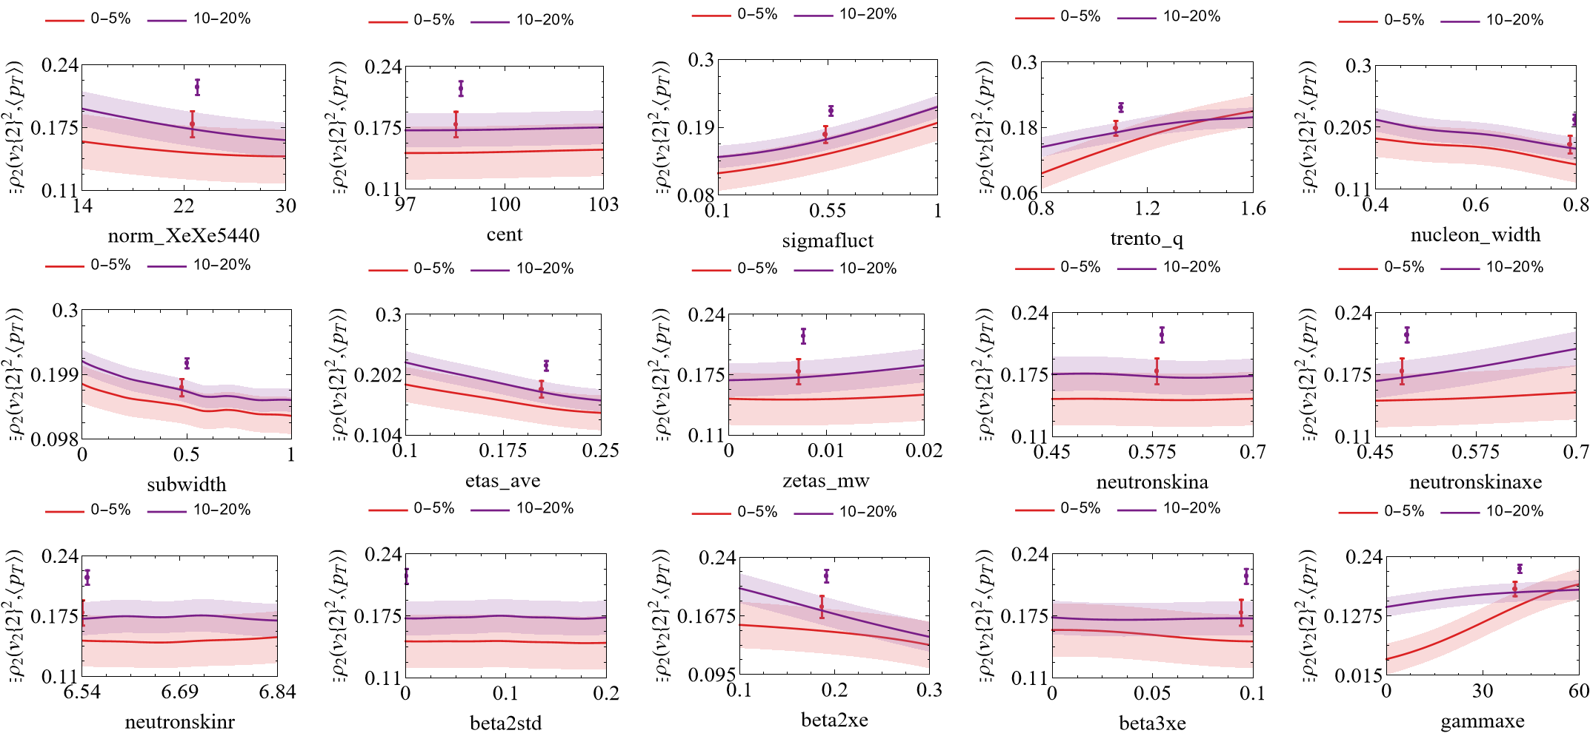
Xenon-129: a global analysis
A bit more precise: (emulated) parameter dependence at MAP:
With Govert and Giuliano

Slide 28
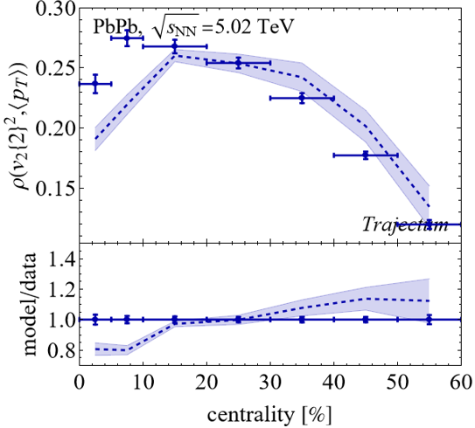
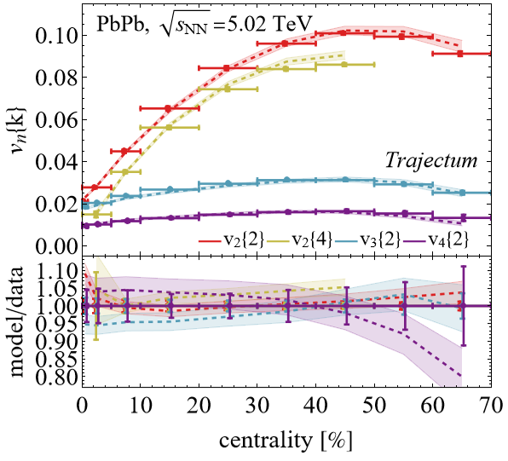
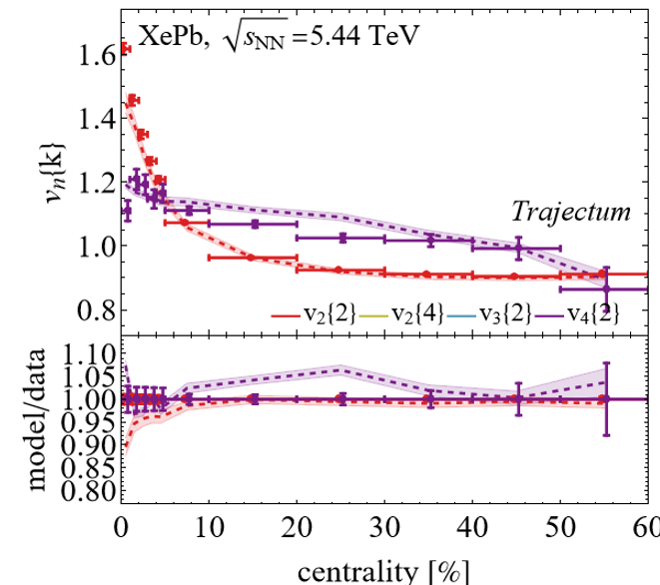
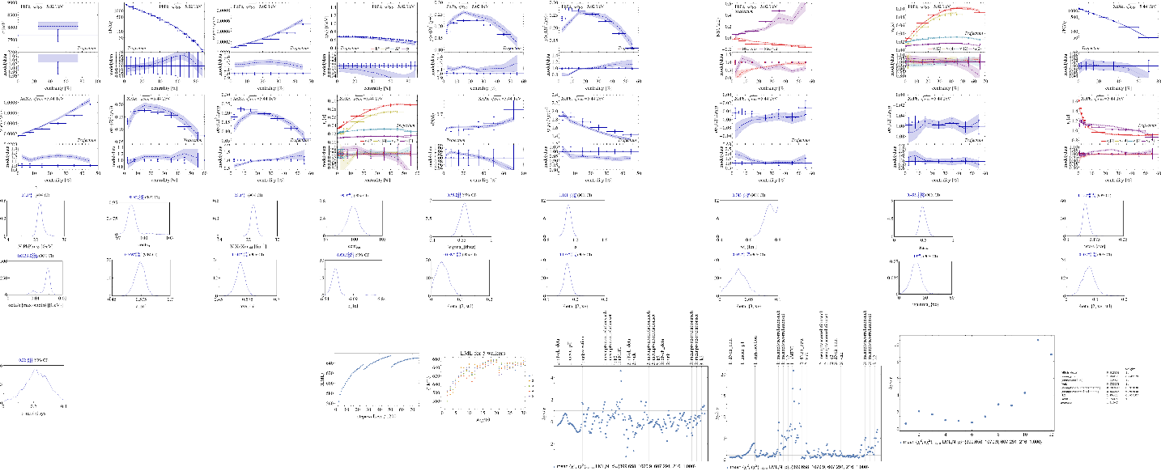
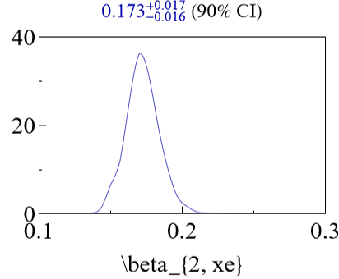
Very preliminary results (and are still changing…)
Beta2 is very robust, gamma more difficult, but hopeful we can get meaningful constraints
With Govert and Giuliano

Slide 29
Alphas from nuclear structure
Two big surprises (at least to me ☺)
¹⁶O alphas do not form a regular tetrahedron (!) → more like two coupled rods Similar results in NLEFT
²⁰Ne alphas do not form a bipyramid (!) → seemingly randomly placed on top… (was a challenge to find due to breaking of symmetry, credit to Benjamin Bally)
Of course the intuition of alphas as point particles with interaction energy is really quite naïve…
Giuliano Giacalone, Benjamin Bally, Govert Nijs, Shihang Shen et al,The unexpected uses of a bowling pin: exploiting 20Ne isotopes for precision characterizations of collectivity in small systems (2024)

Slide 30
Discussion
Exciting progress using global analyses
Heavy ion collisions towards percent level precision
Ultracentral prediction non-trivially verified by CMS experiment
Nuclear structure becoming relevant and interesting
First study for neutron skin, many improvements possible
A fun understanding of Xenon-129 collisisions
Oxygen collisions to be performed at the LHC summer 2025!

Slide 31
¹⁶Oxygen and ²⁰Neon nuclear structure
Do we understand and/or need to understand the shape of O and Ne?
Seems so, need precision understanding of anisotropic flow
Interesting by itself: combination of 4 or 5 alpha particles
Studied using two complementary nuclear structure methods:
State-of-the-art Projected Generator Coordinate Method (PGCM)
`Pinhole’ configurations from Nuclear Lattice Effective Field Theory (NLEFT)
Giuliano Giacalone, Benjamin Bally, Govert Nijs, Shihang Shen et al,The unexpected uses of a bowling pin: exploiting 20Ne isotopes for precision characterizations of collectivity in small systems (2024)

Slide 32
Anisotropic flow in light ions and nuclear structure
What are the theoretical systematic uncertainties?
Parameters such as viscosities are highly correlated
Take random sample of `probable’ parameter settings
Compute one standard deviation systematic uncertainty
Heavy ion and nuclear structure have comparable syst. unc.
Characteristic difference between O and Ne
Many systematics cancel when studying difference
Giuliano Giacalone, Benjamin Bally, Govert Nijs, Shihang Shen et al,The unexpected uses of a bowling pin: exploiting 20Ne isotopes for precision characterizations of collectivity in small systems (2024)

Slide 33
Back-up

Slide 34
Why was the width overestimated?
Without cross section width is large, about 1.0 fm
With the cross section width is smaller, about 0.7 fm
Still tension with cross section: other data pushes width higher
Need to capture `trust’ in observables: weighting
Weight unity: cross section + integrated & unidentified
Weight ½: integrated identified observables
Weight ¼: p_{T}-differential identified observables
Reduced weight: p_{T} > 1.5 GeV (π+K) and centrality > 50%
With weighting cross section comes out correctly
Broader uncertainties: reflect less `trust’ due to weighting
Also: description of data not much worse with smaller width
Important that Bayes factor is an addition of many (correlated!) data points

Slide 35
Experimental observables: a wealth of data
With σ_{PbPb}

Slide 36
Experimental observables: a wealth of data
No σ_{PbPb}

Slide 37
Bonus: mean p_{T} and v₂ or v₃ correlations
Wilke van der Schee, CERN/Utrecht
A Bayesian MAP check: unfitted data:
Triple differential observables:
Correlation p_{T} and v_{n}
Anticipated by (simpler) Trento analysis:
Giuliano Giacalone, Bjorn Schenke and Chun Shen, Constraining the nucleon size with relativistic nuclear collisions (2021)
ALICE, Characterizing the initial conditions of heavy-ion collisions at the LHC with mean transverse momentum and anisotropic flow correlations (2021)

Slide 38
The neutron skin - emulator
Plan is to vary a for neutrons and see if HIC can constrain it
a determines the neutron radius (approx. linear for RMS radius)
First step: what does the emulator say?
Using a precise global analysis (26 parameters, 3000 design points)
Main change: cross section
Measures ‘size’ of nucleus
Both multiplicity and mean pT change
Mainly for peripheral (‘skin effect’)
Small changes for other observables

Slide 39
The PbPb cross section and the centrality normalisation
Cross section follows from
Luminosity (van der Meer scan, dominates uncertainty)
The number of collisions
First measured in April 2022 (!)
ALICE can accurately measure collisions in 0-90% region
90-100% is estimated from NBD Glauber fit
Trajectum defines 100% by having at least one nucleon-nucleon interaction
Now also a parameter, perhaps as a check, or to address experimental uncertainty
We take a Gaussian prior of width 1%
Centrality normalisation trivially correlates all observables by shifting classes
Probably best to marginalise over in MCMC Bayesian analysis
Means ALICE should quote this uncertainty separately
Important even for some central observables (v₂{2})
ALICE , Centrality determination of Pb-Pb collisions at √s_{NN} = 2.76 TeV (2013)
ALICE luminosity determination for Pb-−Pb collisions at √s_{NN} = 5.02 TeV (2022)

Slide 40
The PLB insight
Temperature fluctuations drive both multiplicity and mean p_{T}
Even more cancellation for multiplicity than for centrality:
Fernando G. Gardim, Giuliano Giacalone and Jean-Yves Ollitrault,
The mean transverse momentum of ultracentral heavy-ion collisions:
A new probe of hydrodynamics (2019)

Slide 41
What then determines the slope?
Centrality cuts are very important..; boost invariant, self-correlation, computationally expensive for |η|>1.5
`Trajectum’
`V0’
`CMS FCAL’
`other theory’
‘ITS’

