Slide 1
Transformers and foundation models
Malte Algren
Between Models and Reality

Slide 2
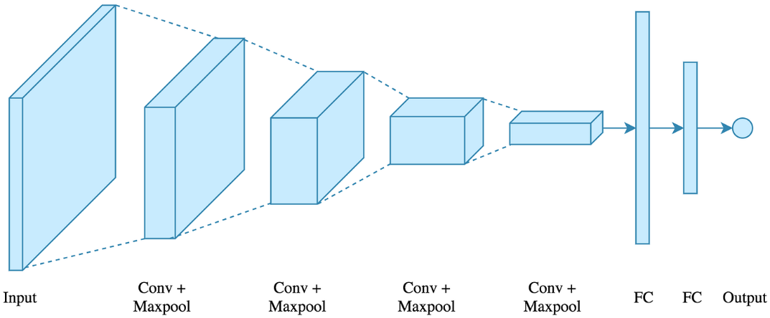
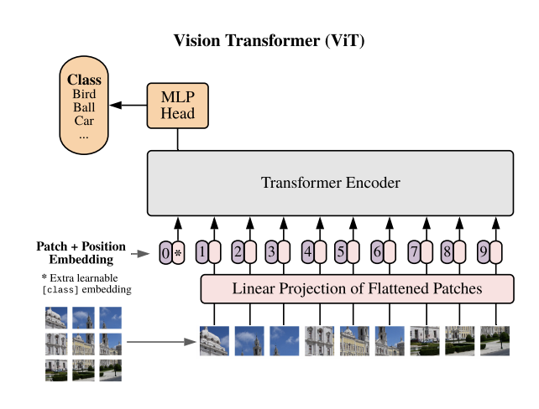
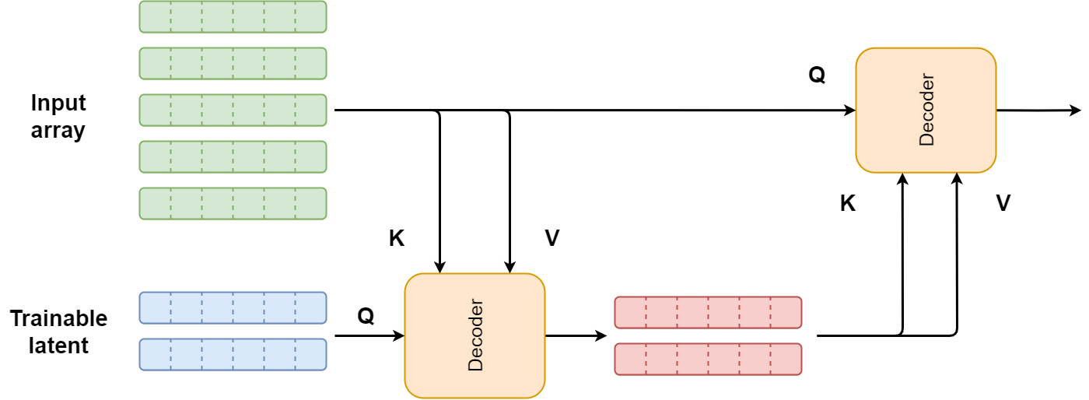
Transformers
Set-to-set mapping
A transformer takes in a set and returns a set.
Classification/regression: vector or scalar
Add trainable latent space
Return that point at the end
Class token
Vision transformer
Notes:
Dall-e: VAE+GPT+CLIP

Slide 3
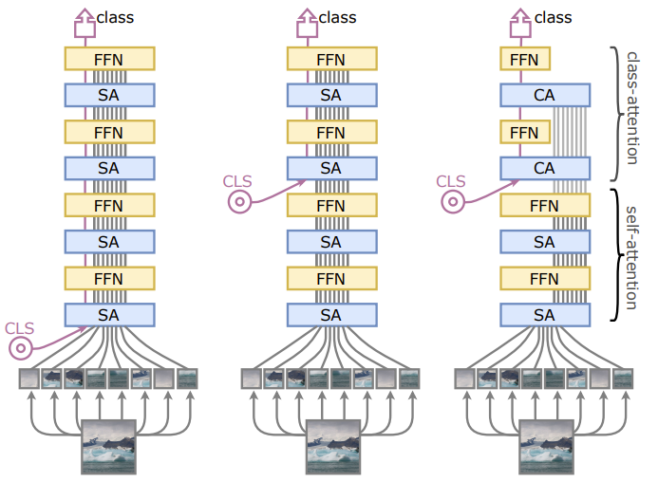
Transformers
Set-to-set mapping
A transformer takes in a set and returns a set.
Classification/regression: vector or scalar
Add trainable latent space
Return that point at the end
Class token
Going deeper with transformers
Notes:
Dall-e: VAE+GPT+CLIP

Slide 4
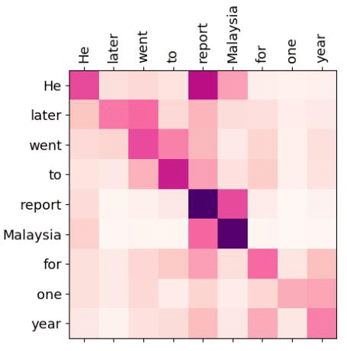
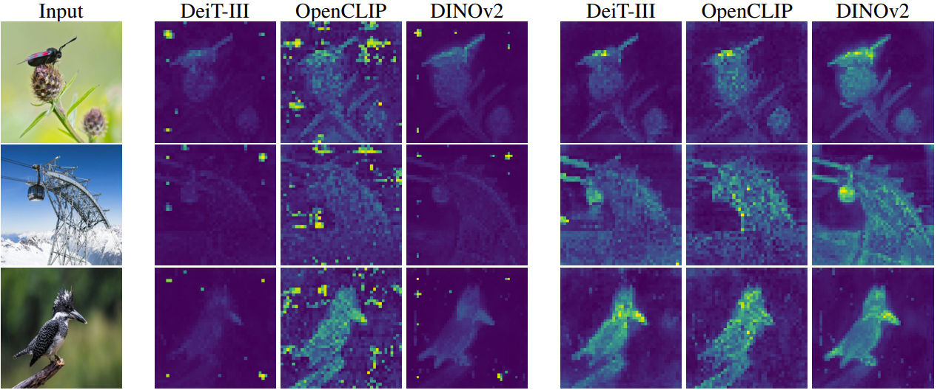
Transformers
Set-to-set mapping
Full self attention also create a lot of junk
Where to send the junk?
Notes:
Dall-e: VAE+GPT+CLIP

Slide 5
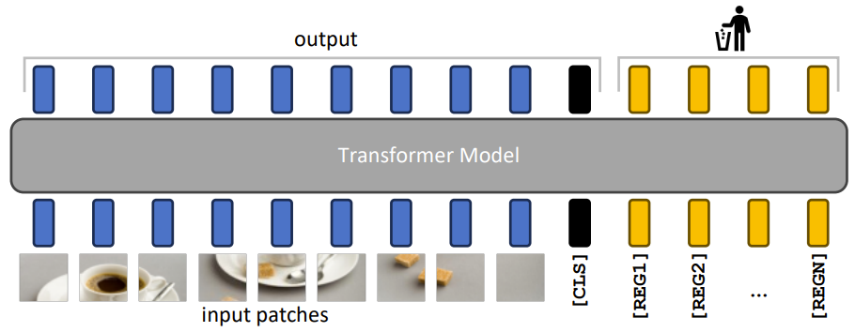
Transformers
Set-to-set mapping
Full self attention also create a lot of junk
Where to send the junk?
Garbage collectors
Notes:
Dall-e: VAE+GPT+CLIP

Slide 6
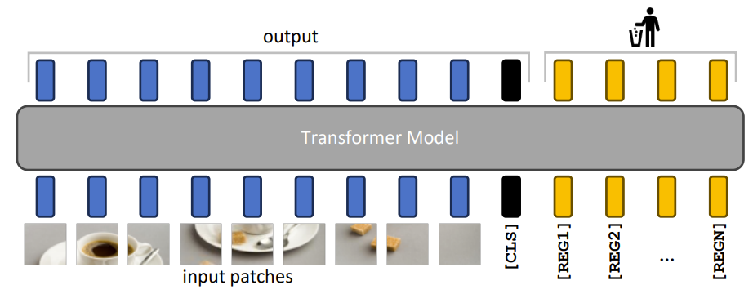
Transformers
Set-to-set mapping
Full self attention also create a lot of junk
Where to send the junk?
Adding trainable token that will be discarded afterwards
Questions?
Notes:
Dall-e: VAE+GPT+CLIP

Slide 7
Foundation models
How to make pretraining sound sexy
Malte Algren
Between Models and Reality

Slide 8
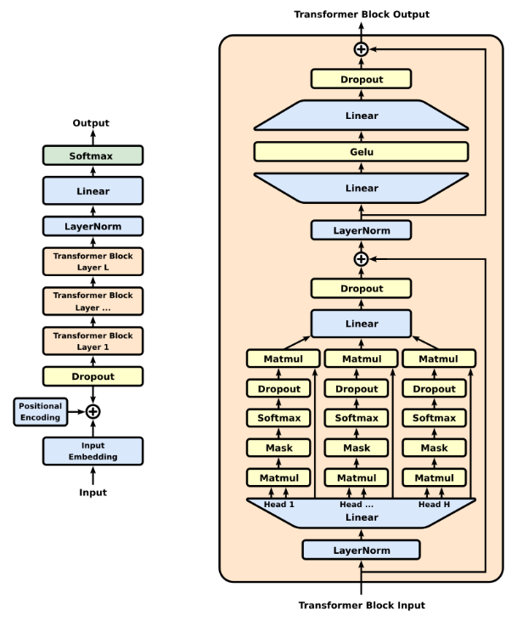
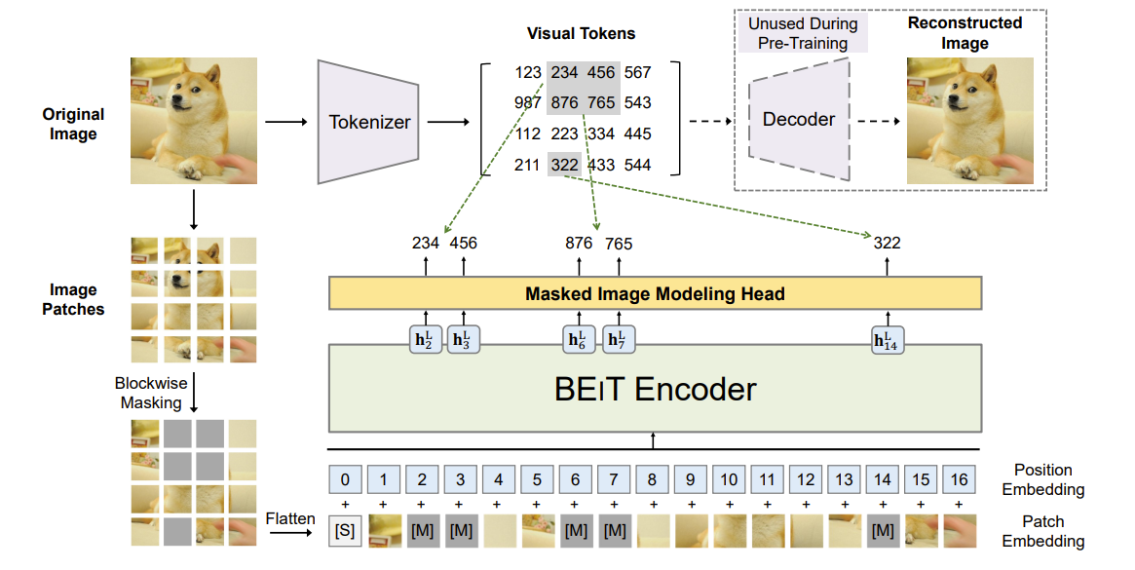
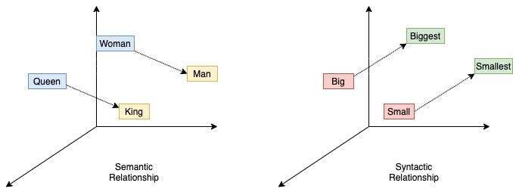
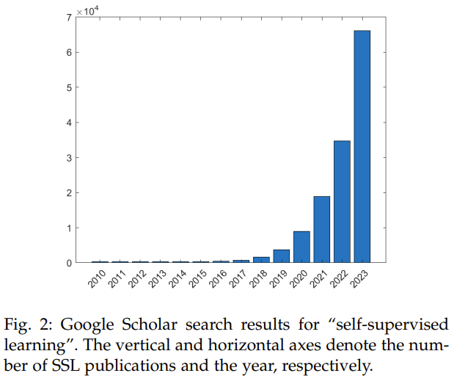
Zoo of foundation models
Google trends on “Foundation model” since 2020:
Word2vec & GloVe (2013)
GPT (2018)
BERT/BEiT (2018)
DALL-E (2021)
A Survey on Self-supervised Learning (2023)
Notes:
Dall-e: VAE+GPT+CLIP

Slide 9
Zoo of foundation models
Google trends on “Foundation model” since 2020:
Word2vec & GloVe (2013)
GPT (2018)
BERT/BEiT (2018)
DALL-E (2021)
A Survey on Self-supervised Learning (2023)
These concepts connects nicely with what we talked about Wednesday
Notes:
Dall-e: VAE+GPT+CLIP

Slide 10
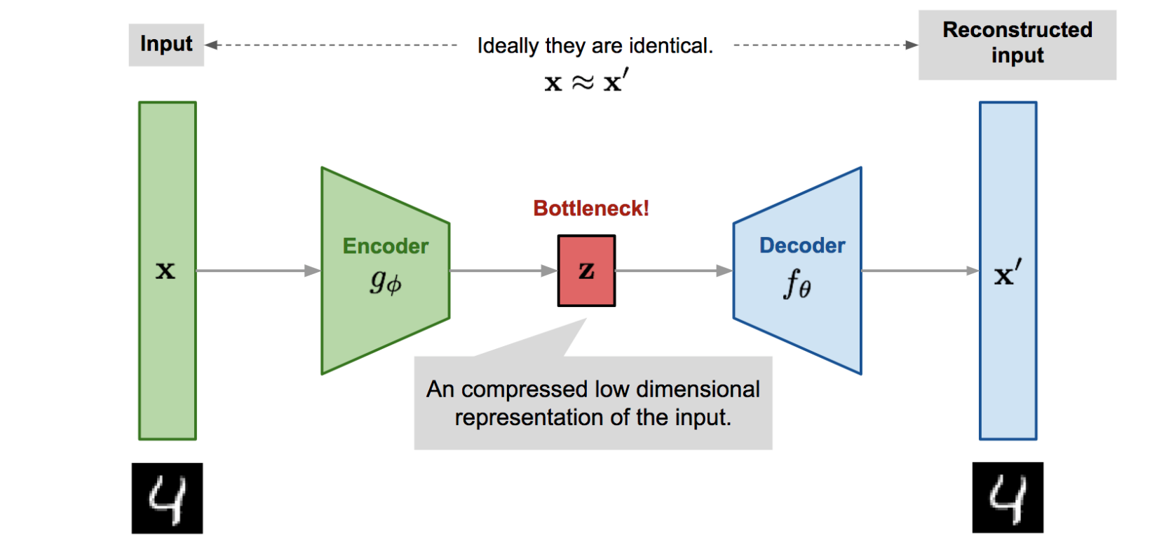
Notation and definitions
Need to define some notation and language for foundation models
Backbone (encoder)
g$\left(x\right)=z=⇒f\left(z\right)=y^{′}$
Latent representation
Representation: $z$
Learning objective
Supervised: $ℒ(f\left(z\right),y)$
Self-supervised: $ℒ(f\left(z\right),x)$
(V)AE (1990s)

Slide 11
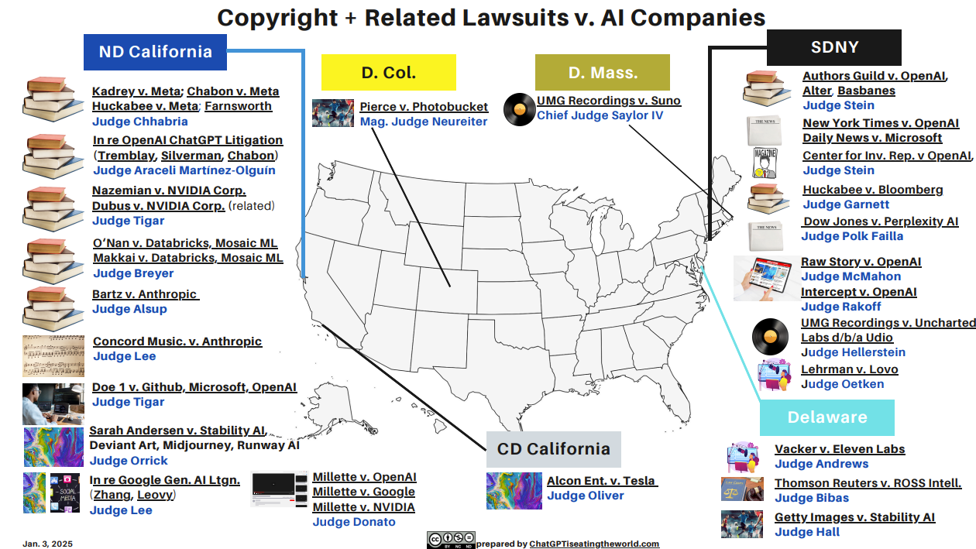
Notation and definitions
Need to define some notation and language for foundation models
Backbone (encoder)
g$\left(x\right)=z=⇒f\left(z\right)=y^{′}$
Latent representation
Representation: $z$
Learning objective
Supervised: $ℒ(f\left(z\right),y)$
Self-supervised: $ℒ(f\left(z\right),x)$
Scale (The world biggest heist)
Downstream tasks $T_{n}(z)$
Subset of the lawsuits

Slide 12
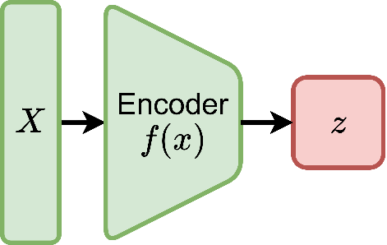
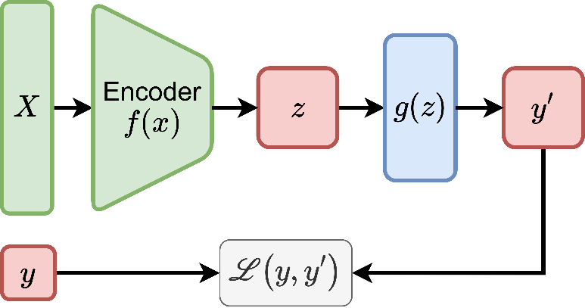
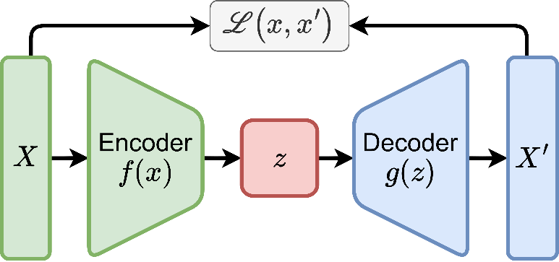
Pretraining method
What does pretrain mean?
Constructing a pretrain model to solve tasks $T_{n}(z)$
What is the object of a pretrained model?
$T(z)≈p\left(y\right)$
$T(z)≈p\left(x\right)$
$T(z)≠p\left(x\right)∨p\left(y\right)$
$T(z)≠≠≠≠≠p\left(x\right)∨p\left(y\right)$
Often $T(z)$ is unknown but assume $T(z)≈p\left(x\right)$

Slide 13
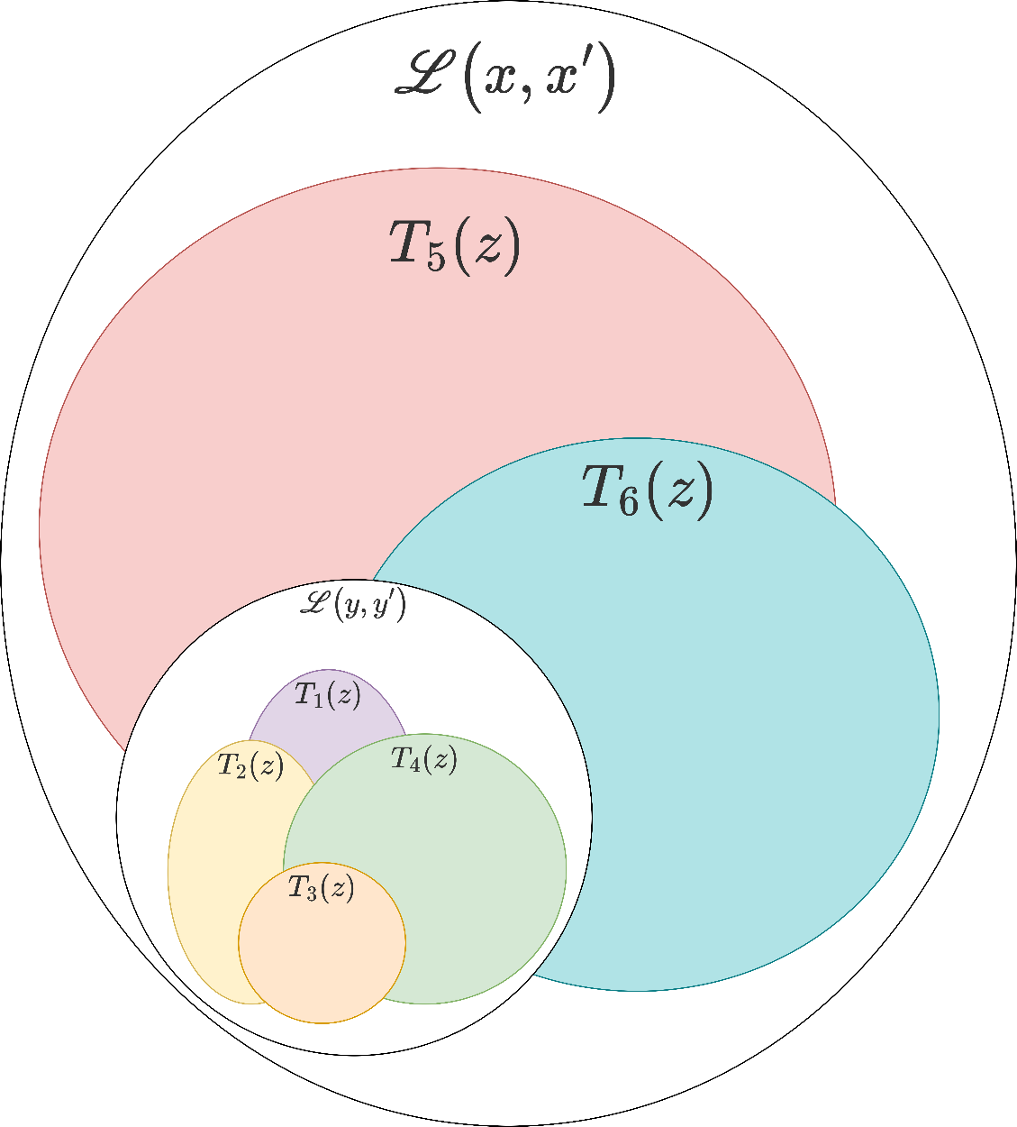
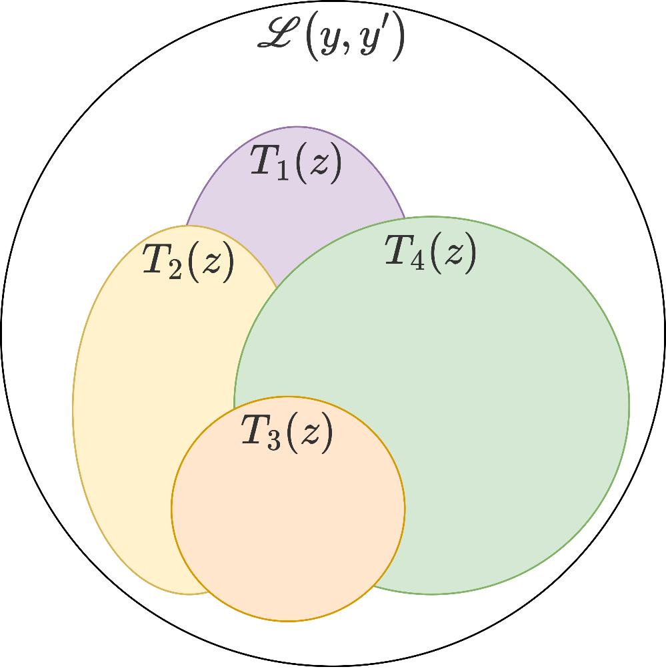
Pretraining method
Constructing a pretrain model to solve tasks $T_{n}(z)$

Slide 14
Pretraining method
Constructing a pretrain model to solve tasks $T_{n}(z)$
Supervised learning $T(z)≈p\left(y\right)$
MSE, BCE, CE, etc.
Multi-task learning with $σ$
Self-supervised $T(z)≈p\left(x\right)$
Semi-supervised $T(z)≈p\left(x,y\right)$
Joint supervised and self-supervised
Final step: Finetuning

Slide 15
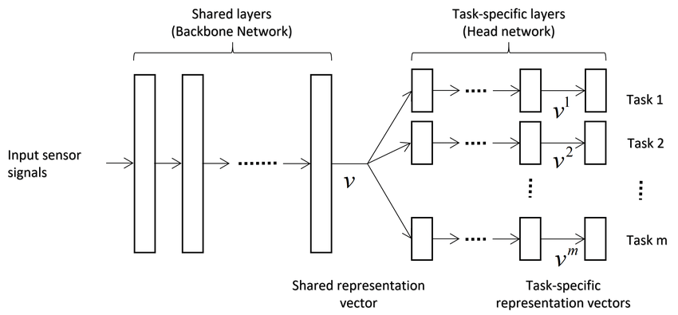
Supervised learning
If you have an idea about our downstream tasks
Use x to model y – access to y
Multiple downstream task that are orthogonal
Board support in the phase space
Construct your representation z using $T_{n}(z)$
z

Slide 16
Self-supervised learning
You don’t have any y. You have access to x
No specific $T_{n}(z)$ in mind
Board support in the phase space
Always similar encoder/decoder setup
In physics we have a lot of record data but no labels

Slide 17
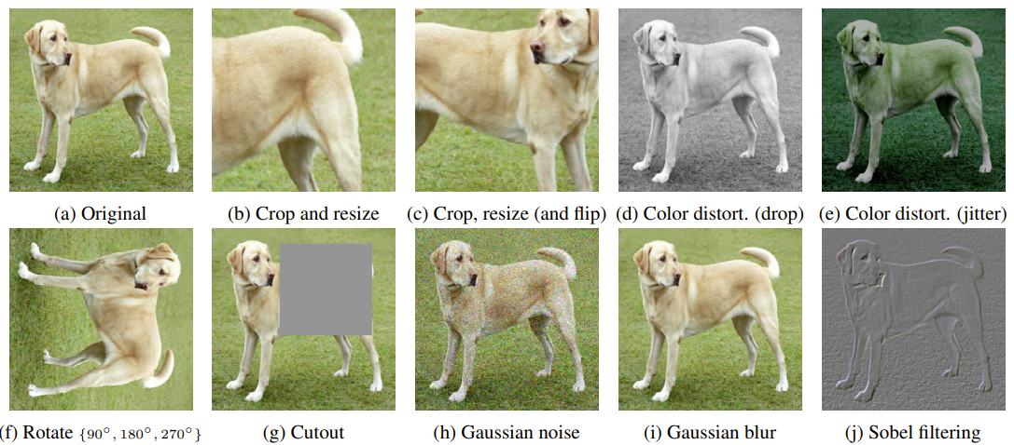
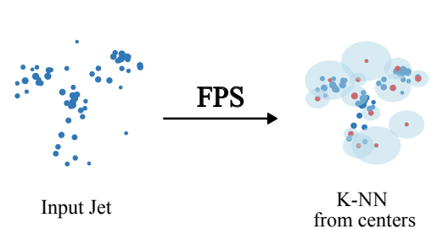
Self-supervised learning
Constructing a task from samples X
Augmentations is the name of the game
$A\left(x\right)=x_{a}⇒\underset{θ}{argmin}{ℒ(f\left(x_{a}\right),x)}$
Masking
Cropping/cutout
Rotation
Other invariances
Many of them are domain specific

Slide 18
Self-supervised learning
Constructing a task from samples X
Augmentations is the name of the game
Masking (general)
Cropping (image)
Generative
Masked autoencoder MAE
Diffusion MAE
Joint embedding - CLR
SimCLR
BYOL
I-JEPA
Compression or not?
What do we want?
Representation learning vs
pretraining

Slide 19
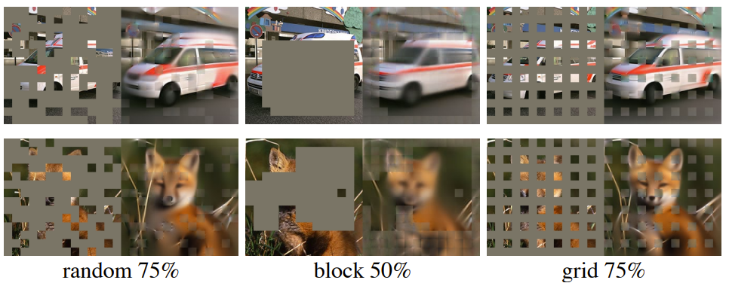
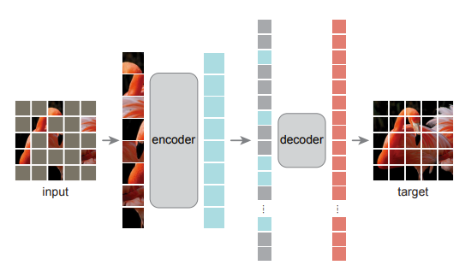
Self-supervised learning: Generative
Without Compression
Masked autoencoder (wo/ compression)
Apply masking to input and reconstruct it
$A\left(x\right)=x_{input},A^{−1}\left(x\right)=x_{target}$
$\underset{θ}{argmin}{ℒ(g_{θ}(f_{θ}\left(x_{input}\right)),x_{target})}$
Masking strategies and amount:
Without Compression

Slide 20
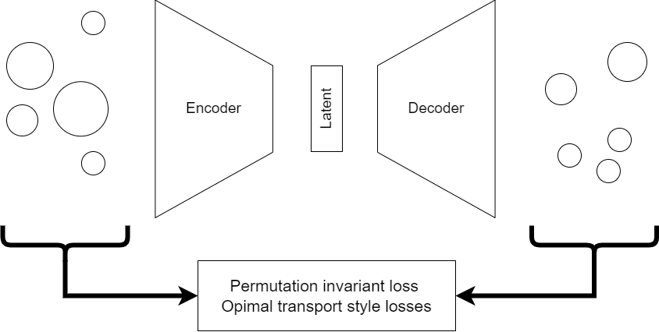
Self-supervised learning: Generative
Without Compression
Masked autoencoder (wo/ compression)
Apply masking to input and reconstruct it
$A\left(x\right)=x_{input},A^{−1}\left(x\right)=x_{target}$
$\underset{θ}{argmin}{ℒ(g_{θ}(f_{θ}\left(x_{input}\right)),x_{target})}$
Do you remember the issue with VAE?

Slide 21
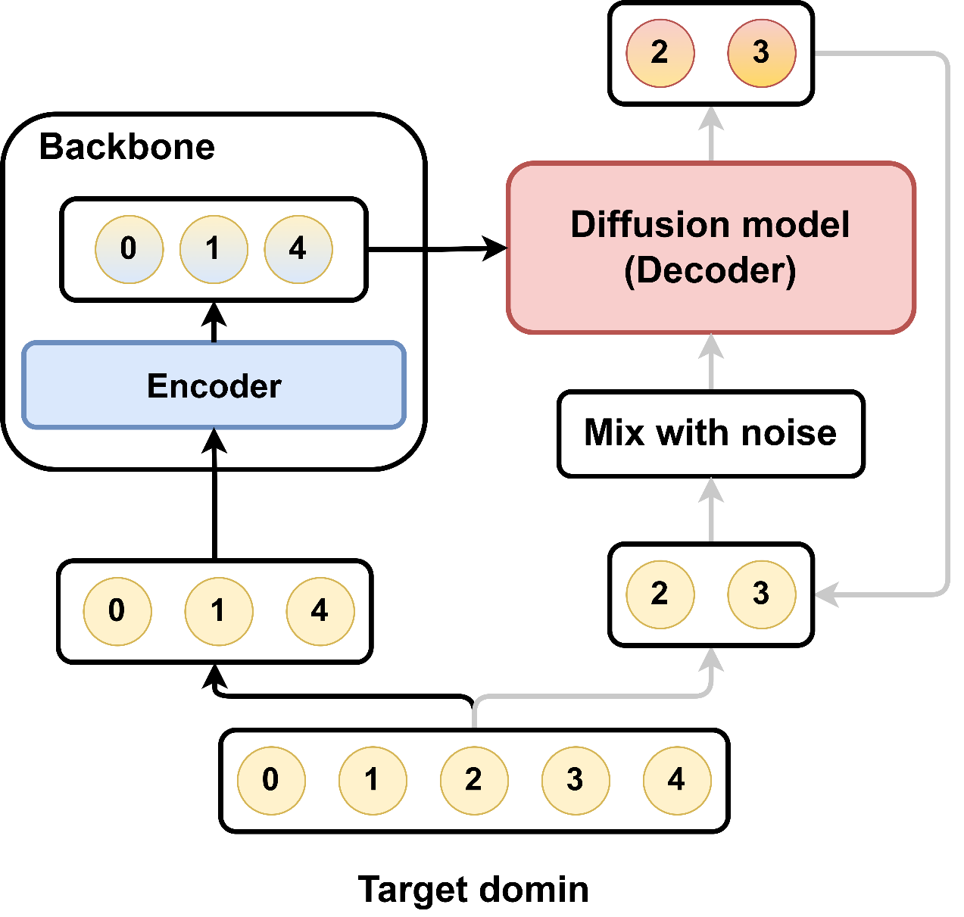
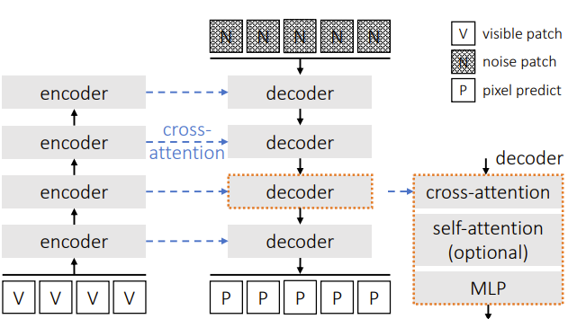
Self-supervised learning: Generative
Diffusion Models as Masked Autoencoders
Apply masking to input and reconstruct it
$A\left(x\right)=x_{input},A^{−1}\left(x\right)=x_{target}$
$\underset{θ}{argmin}{ℒ(g_{θ}(f_{θ}\left(x_{input}\right)),x_{target})}$
Swap the decoder with a diffusion model
Same setup as MAE
Still no compression between $f_{θ}\left(x_{input}\right)$
But now compression can be introduced
DiffMAE
MAE

Slide 22
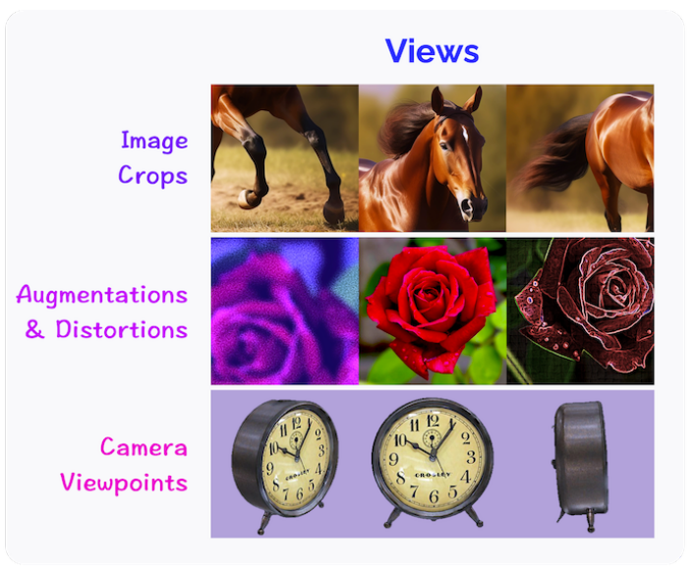
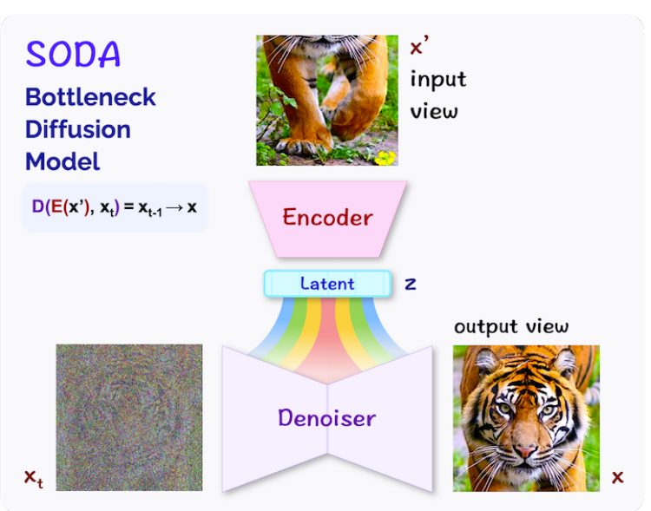
Self-supervised learning: Generative
Bottleneck Diffusion Models for Representation Learning
$A\left(x\right)=x_{input},A^{−1}\left(x\right)=x_{target}$
A is different representations of the image
Diffusion autoencoder
Continuous latent representation
Allow for interpolation in the latent
SODA

Slide 23
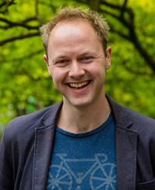
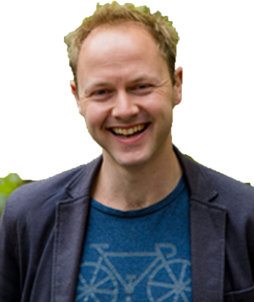
Self-supervised learning: Generative
Back to Masked AutoEncoders
Drawbacks?
How do we ensure that the information we reconstruct is relevant?
MAE
Apply masking

Slide 24
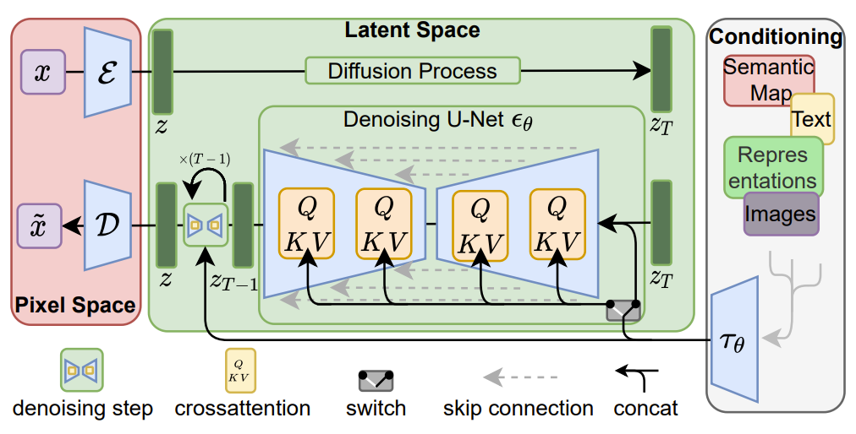
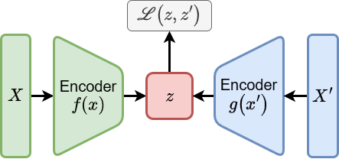
Self-supervised learning: Generative
Back to Masked autoencoders
Drawbacks?
How do we ensure that the information we reconstruct is relevant?
For image generation (VQ)-VAE are used to compress image
Then generate the image in the latent space

Slide 25
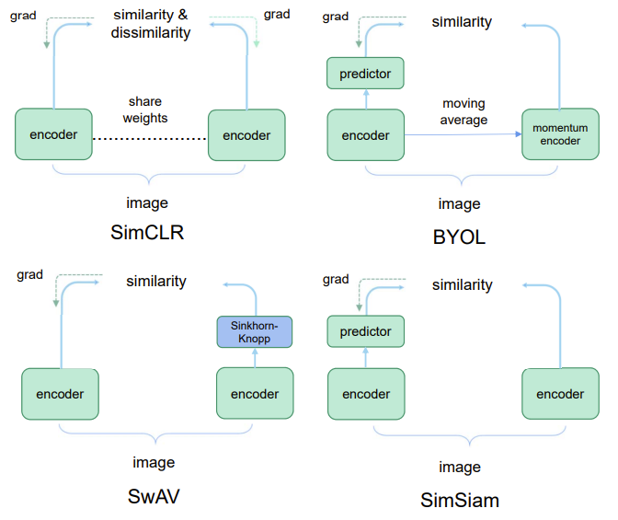
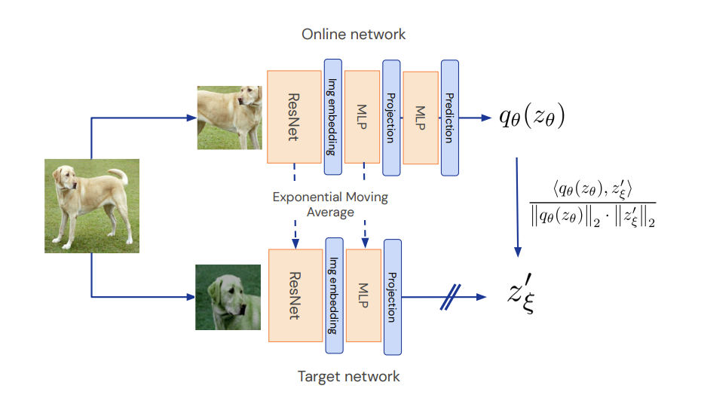
Self-supervised learning: Joint embedding
Compare features in the latent space
Augmentation in x to make x1 & x2
Encoder into latent space: z1 & z2
Similarity comparison
Less redundant information in z1 & z2
A lot of research in CL
SimCLR
BYOL
…

Slide 26
Self-supervised learning: Joint embedding
Compare features in the latent space
Augmentation in x to make x1 & x2
Encoder into latent space: z1 & z2
Similarity comparison
Joint-Embedding Predictive Architecture

Slide 27
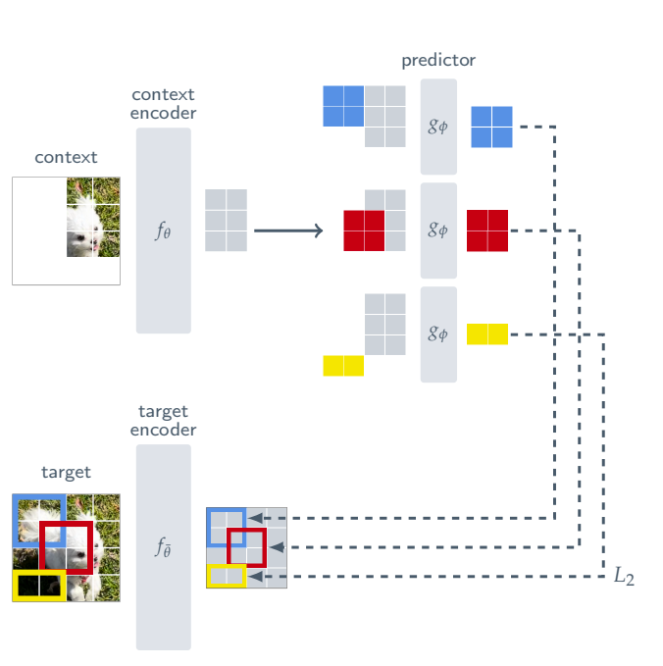
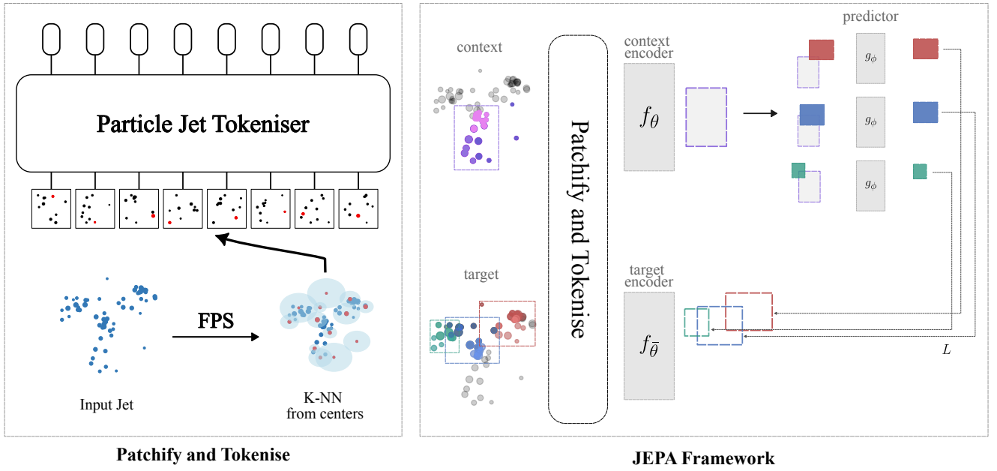
Self-supervised learning: Joint embedding
Compare features in the latent space
Augmentation in x to make x1 & x2
Encoder into latent space: z1 & z2
Similarity comparison
Joint-Embedding Predictive Architecture
Extend to point clouds

Slide 28
Self-supervised learning: Comparisons
Generative
Masked autoencoder MAE
Diffusion MAE
Properties
Loss/reconstruction in x
Work very well
Stable
Have been sort of left by the by CS
Joint embedding
SimCLR
BYOL
I-JEPA
Properties
Loss/reconstruction in z
Very active when it comes to research
Do also work well
Can have model collapse

Slide 29
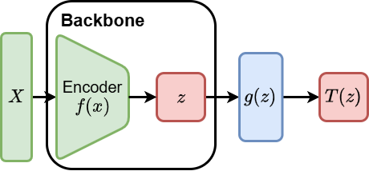
Quick points on finetuning
Now you have a pretrained model
How to finetune it for a task?
You have access to $f\left(x\right)=z$
1. Size of model
Can you even backpropagate through the model?
2. Domain shift
ssl in data, finetune on simulation
Thanks for listening! Questions?

