Slide 1
Statistics and Measurements
Kristjan Gulbrandsen ALICE Masterclass
18 March 2025

Slide 2
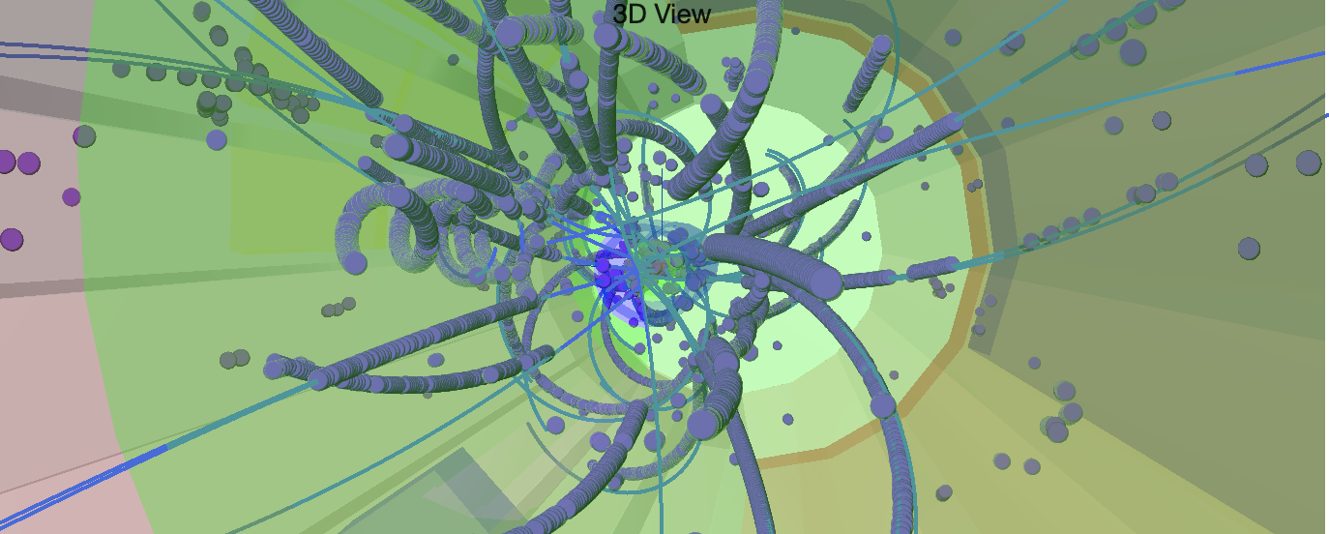
The Detector
Data is collected by the detector
Little points are left in the detector where the particle deposited energy (only charged particles)
An algorithm is used to reconstruct a “track”
The bending of the track with the time of flight or the exact amount of energy lost can be used to identify the particle (mass, momentum, charge)

Slide 3
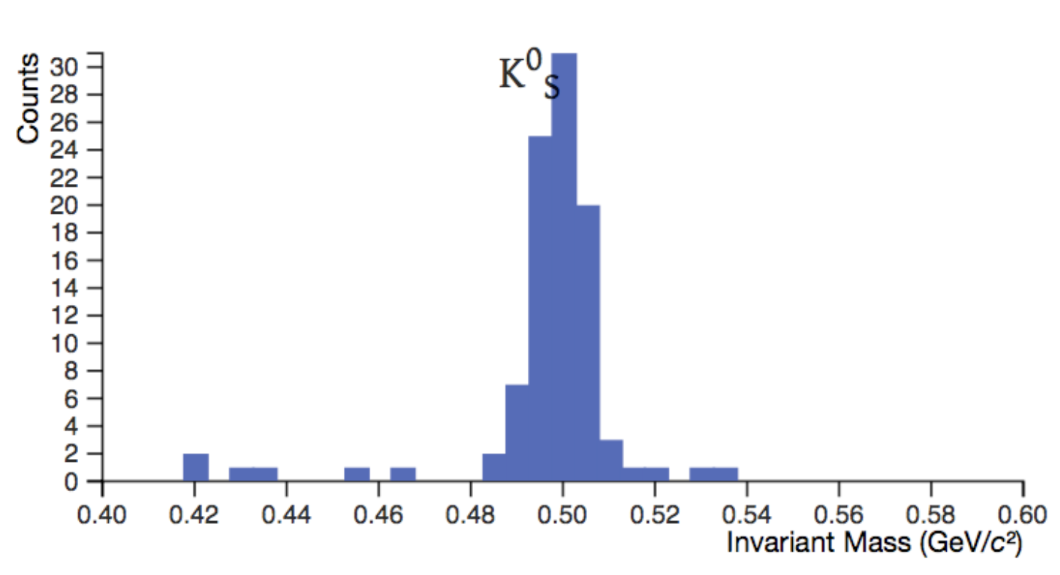
Identifying V0s
The specific decay chain can be used to identify candidate decaying particles
Decay products must originate close to each other
Through energy and momentum conservation one can reconstruct which kind of particle this could be

Slide 4
Counting how many particles
We want to know how many particles were created in the collision
How can we do that?
Are all of the particles actually from decays?

Slide 5
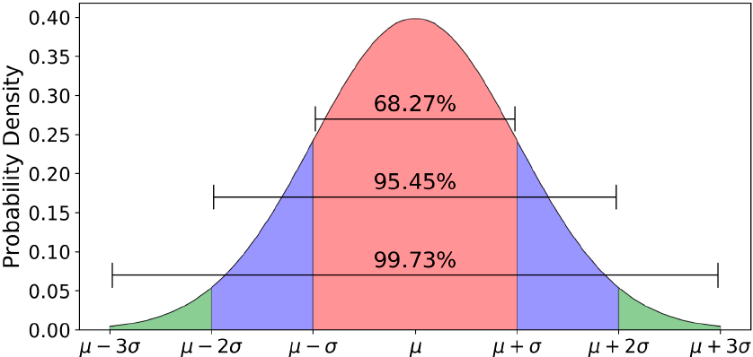
Normal distribution
There can be a background of “fake” particles
We expect, from quite general principles, that the actual signal should have a normal distribution
which has 2 parameters when normalized to an area of 1.

Slide 6
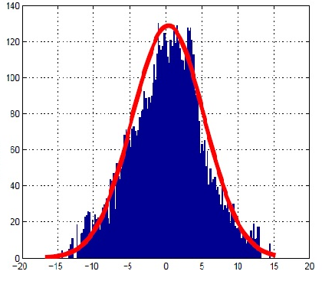
Fitting to a normal distribution
One can fit the signal to a normal distribution
Fitting finds the parameters that reduces the sum of the square of the distance of the function to the data points
a_{1,}…,a_{m} are parameters
y_{i} is the value of a data point
σ_{i} is the uncertainty of each data point

Slide 7
A heavy-ion event
When lead ions are collided, many more particles are created
For a central collision (head on hit) more than 20000 particles are created
This give a high chance of matching particles that were not from a decay
“Spectators”
Impact
Parameter
“b”
“Participants”
“Spectators”

Slide 8
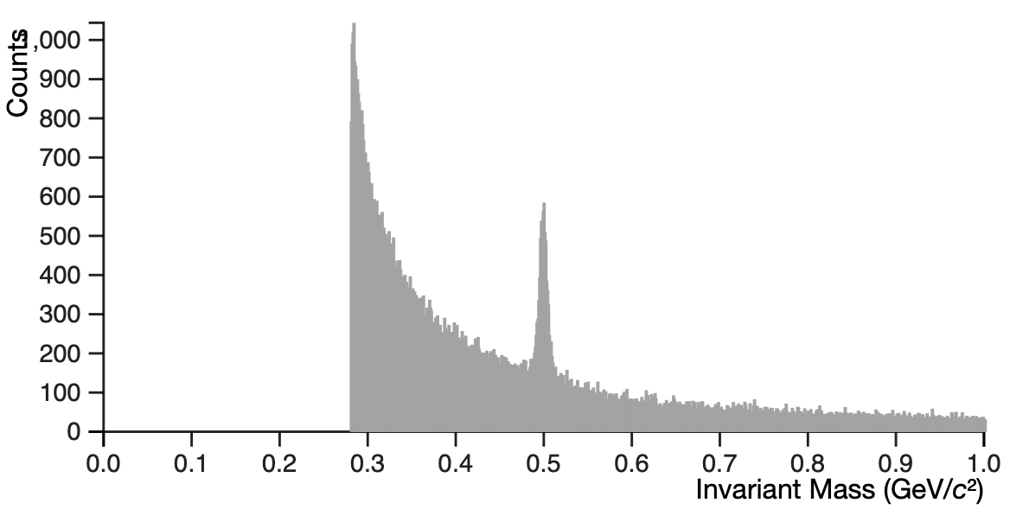
Invariant mass distribution
Invariant mass distribution for kaons looks like the following
Why?
How can we count the particles now?

Slide 9
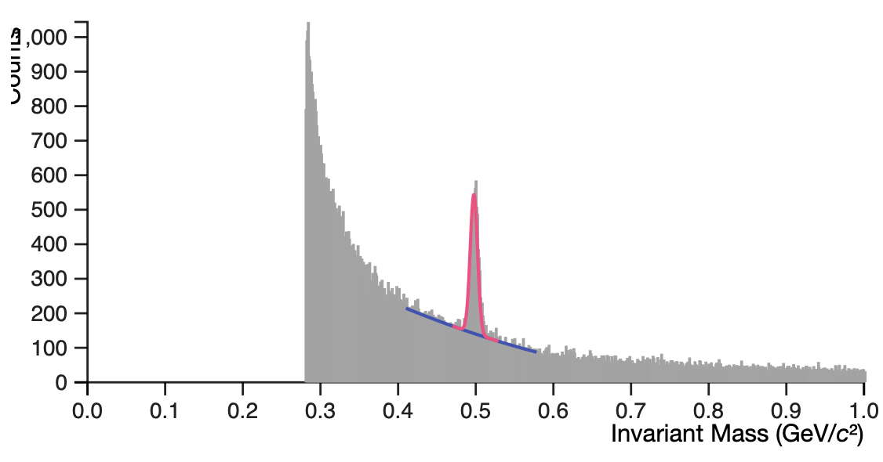
How to count
Fit both the signal and background together
Use the signal fit to compute the number of particles
This requires the background to be some smooth function underneath the signal
In the exercise a second order polynomial is used: y=ax²+bx+c

