Slide 1




The Quantum Technology ecosystem: a data driven analysis
Simon Goorney
Dep. of Management, Aarhus University
and Niels Bohr Insitute, Department of Physics
Head of Operations at DigiQ
Digitally Enhanced Quantum Technology Master
And the European Quantum Readiness Center (EQRC)
https://quantumready.eu
simon.goorney@mgmt.au.dk

Slide 2
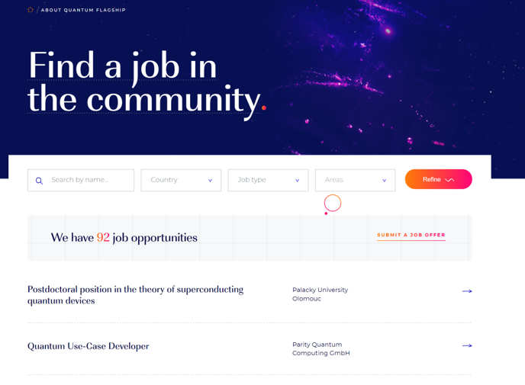

When I first started: the problem
Job opportunities
  There are more jobs than there are applicants on qt.eu!!!
simon.goorney@mgmt.au.dk

Slide 3
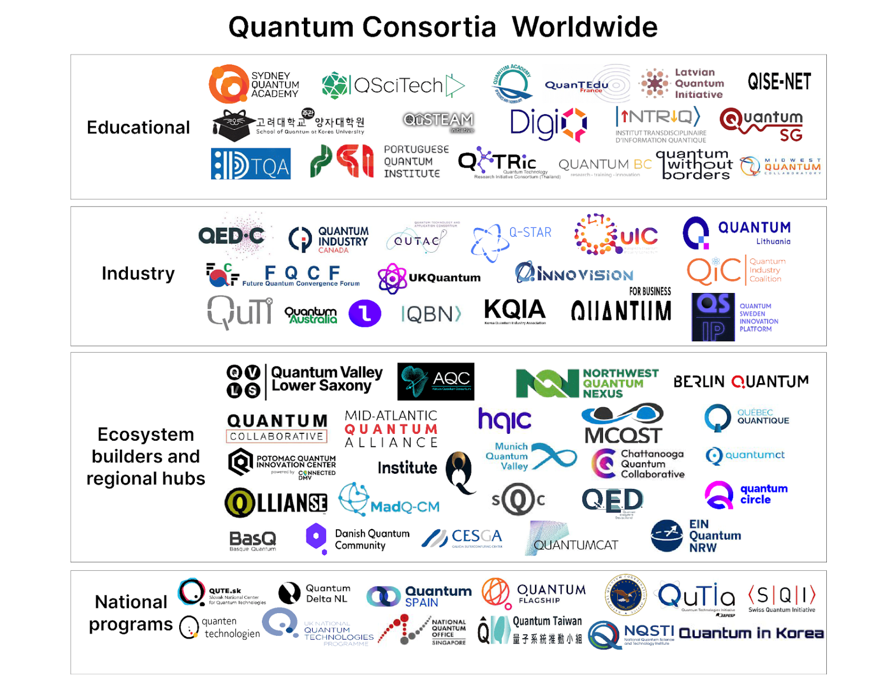


To best develop the workforce, we need to understand what we are training FOR? What does the quantum ecosystem look like now and in the future?
2016
2020-2030

Slide 4
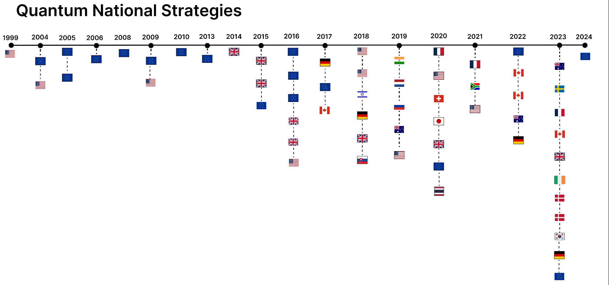
62 Quantum Strategic Documents (QSDs)
-Key criterion: Authored by the government or commissioned and endorsed by the government.

Slide 5
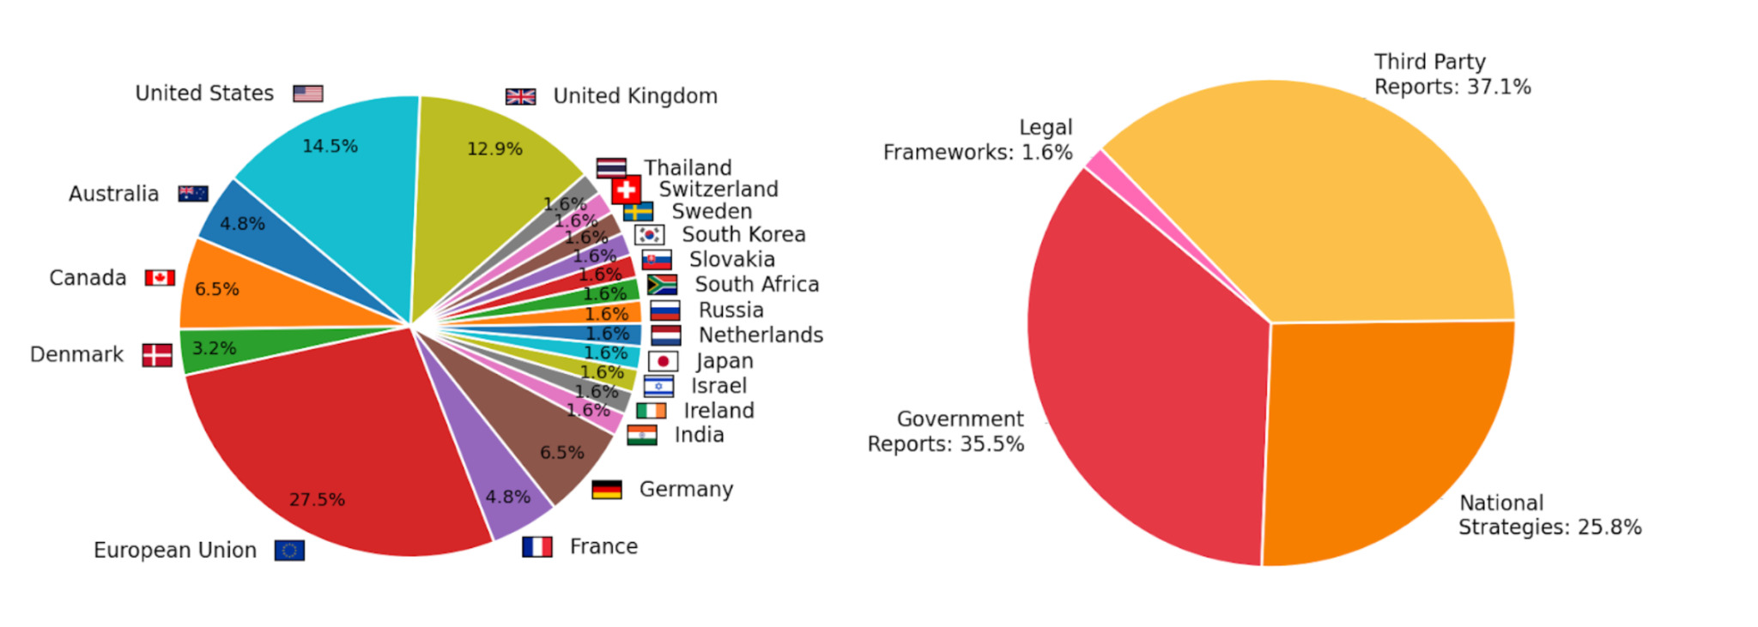
-62 documents, from 20 countries
-12,728 paragraphs extracted
-Clustered to 11 topics

Slide 6
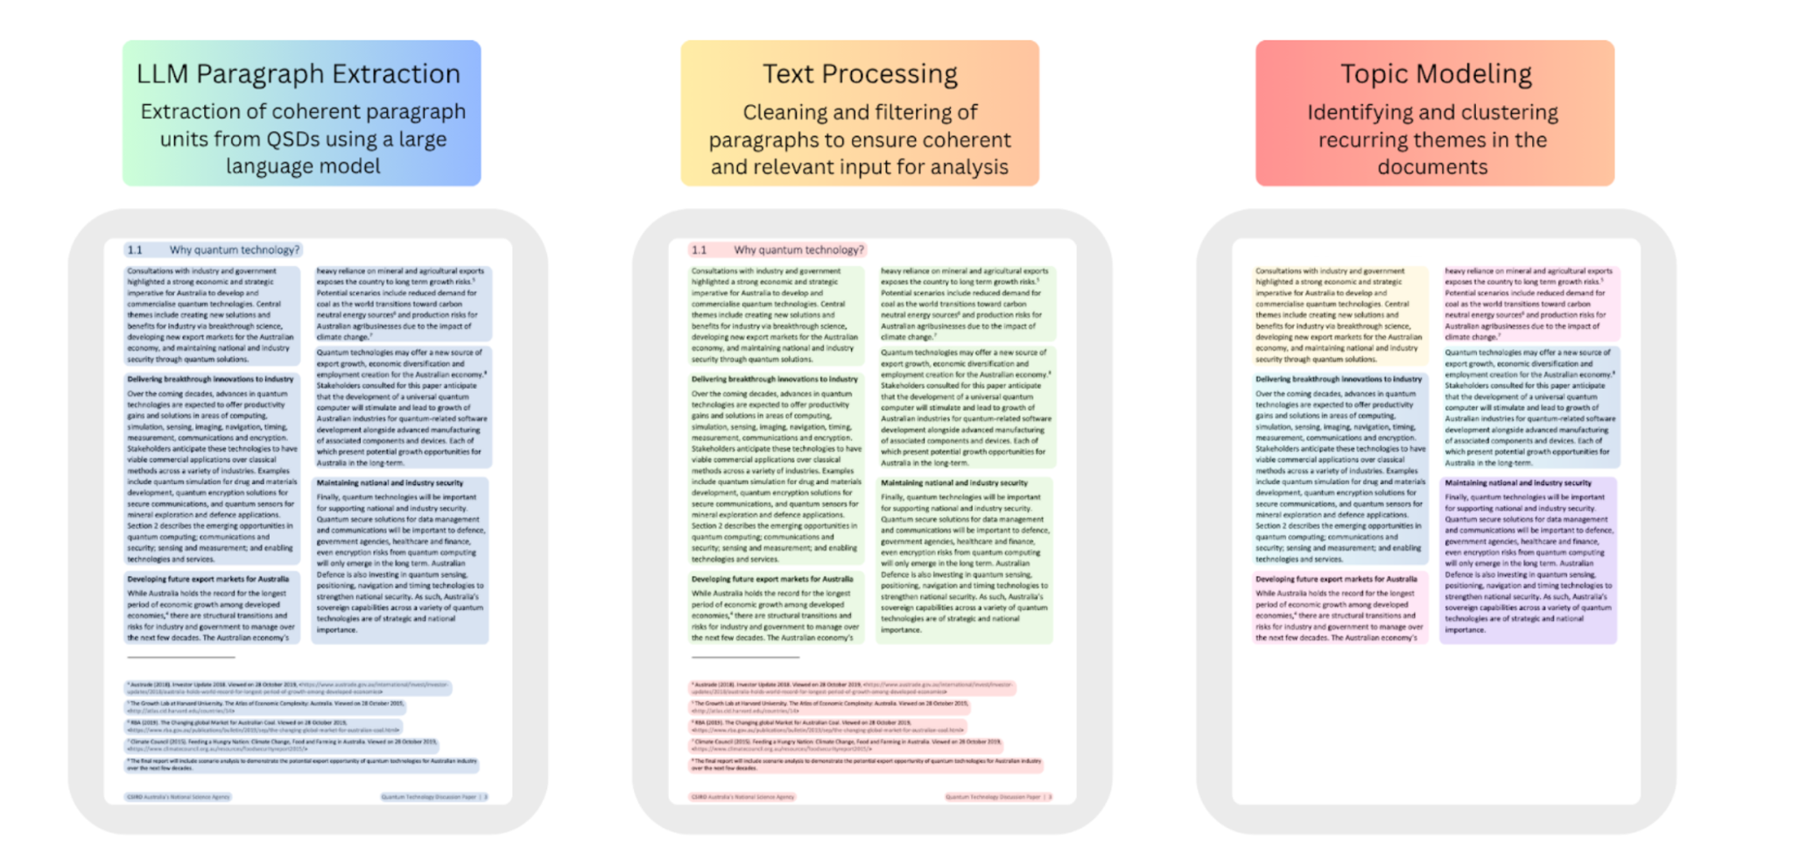
Data Processing
Filtering included removal of paragraphs relating to the past or to work being done in other nations

Slide 7
Top Keywords | Coverage | Topic Name
technology, research, industry, development, innovation, investment, company, support, new, national | 16.5% | Quantum Technology: Innovation, Industry, and Investment
photon, optical, source, light, system, use, single, photonic, detector, state | 10.2% | Photonics and Optical Systems
entanglement, state, information, theory, physic, classical, system, one, entangle, science | 9.2% | Quantum Physics and Information Theory
compute, technology, development, computer, software, system, application, hardware, develop, research | 7.8% | Quantum Computing Hardware, Software, and Applications
national, government, program, project, technology, committee, research, support, programme, activity | 7.2% | Government and National Quantum Programs
sensor, measurement, use, image, technology, application, field, magnetic, sense, clock | 6.7% | Quantum Sensing and Applications
communication, security, cryptography, secure, key, network, qkd, use, cryptographic, protocol | 6.7% | Quantum Communication, Networks, and Cryptography
research, collaboration, science, international, technology, researcher, university, national, support, project | 6.4% | National and International Research Collaboration
atom, ion, trap, atomic, optical, clock, spin, state, lattice, single | 6.3% | Quantum Platforms
qubits, qubit, gate, state, operation, control, error, computer, system, spin | 6.2% | Qubits and Error Correction in Quantum Computing
computer, problem, classical, simulation, algorithm, system, compute, simulator, model, computation | 6.0% | Quantum Algorithms and Simulation
phys, state, spin, system, et, lett, nature, control, phase, energy | 5.3% | Spin and State Control
education, technology, student, training, skill, industry, talent, train, workforce, need | 4.8% | Quantum Education and Workforce Development

Slide 8
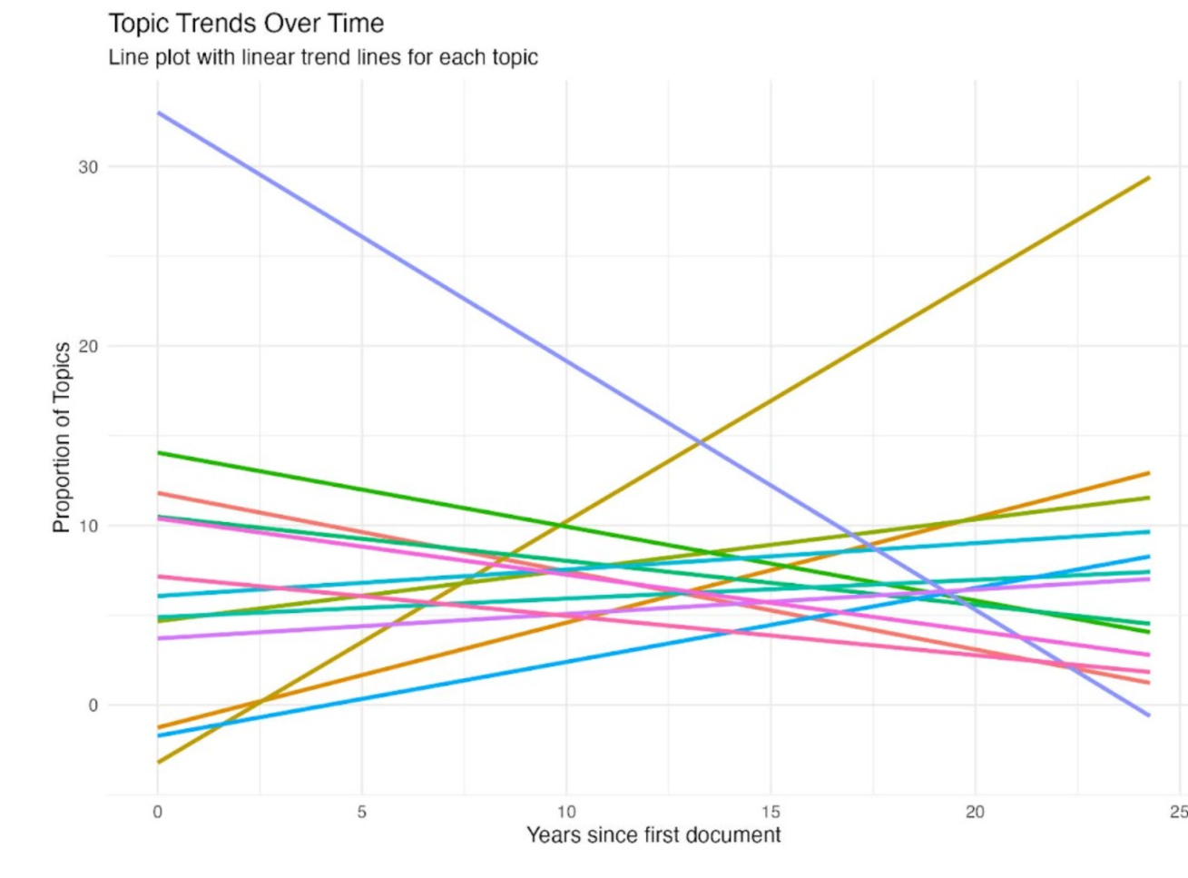
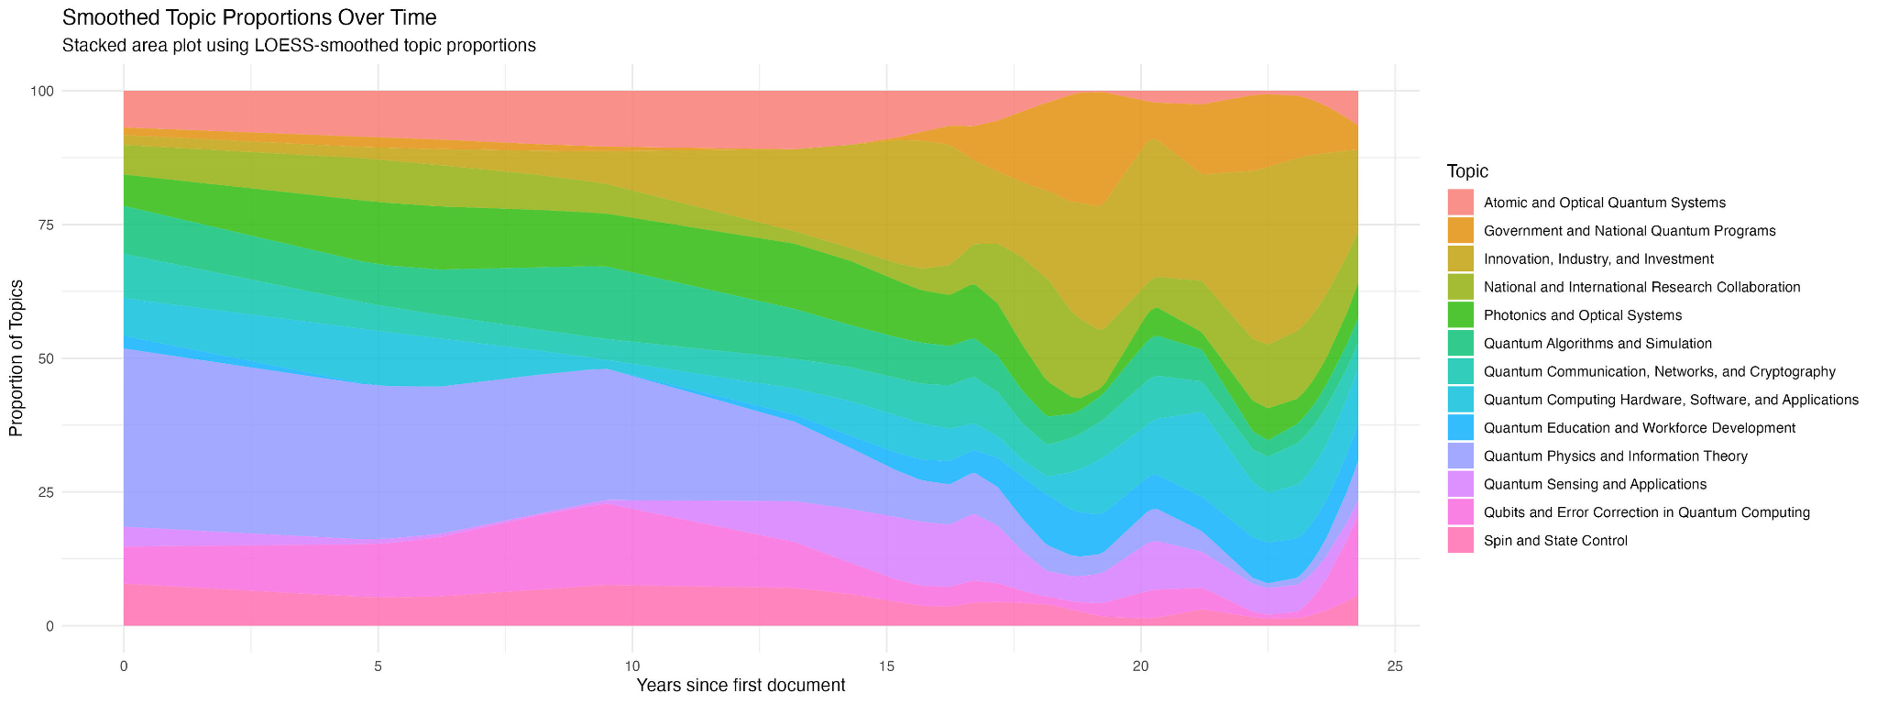
Topic | Slope | Intercept | P_Value | Significance
Atomic and Optical Quantum Systems (Platforms) | -0.436 | 11.805 | 0.04 | ***
Quantum Technology: Innovation, Industry, and Investment | 1.344 | -3.222 | 0.04 | ***
Quantum Education and Workforce Development | 0.412 | -1.723 | 0.02 | ***
Quantum Physics and Information Theory | -1.386 | 33.01 | 0.01 | ***

Slide 9
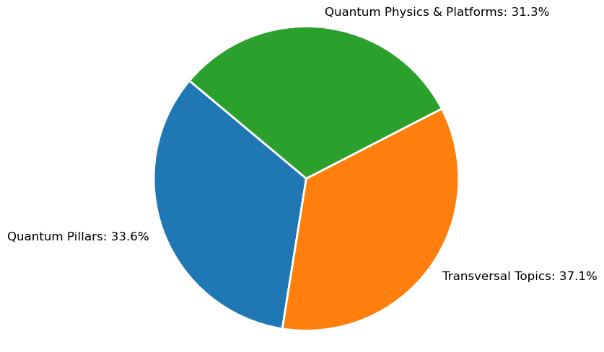
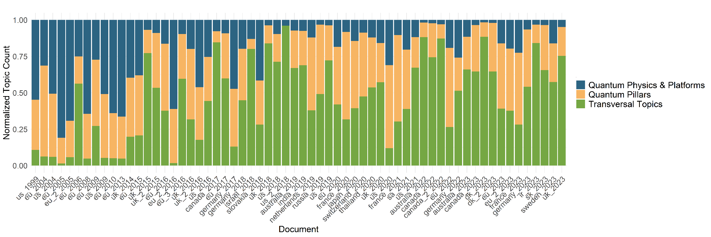
What about meta-topics?
-Governance, education, commercialisation, and other transversal topics are increasing in prevalence
-Quantum pillars (applications of QT) are increasing in prevalence
-Foundational topics (theory and platforms) are decreasing in prevalence.
QUESTION: Are these changes reaching the job marketplace???

Slide 10




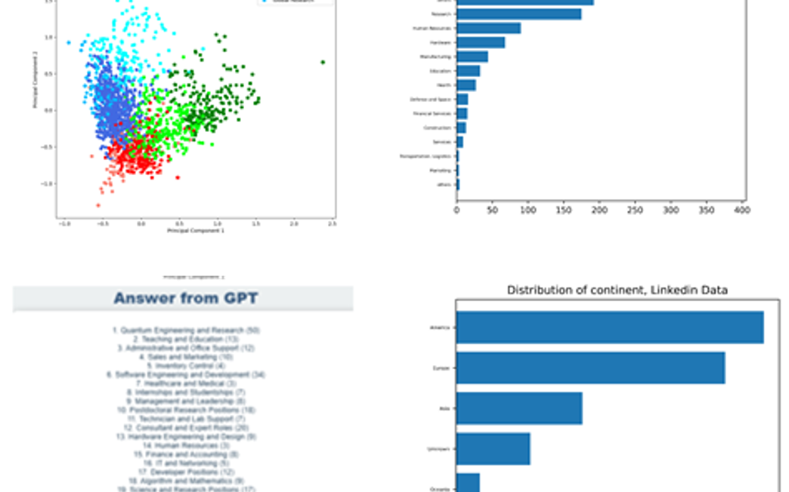


The Quantum Technology Job Market: Data Driven Analysis of 3641 Job Posts
Finding job Offers
Scraping Algorithms
Cleaning and Filtering
Analysis
Daily search for "Quantum" online and find the job title and company names of all offers displayer.
For each offer our algorithm scrapes the job details in the post, and all data available about the company such as location, description, industry domain.
The database is then filtered and cleaned to ensure only Quantum offers and clean data remains.
Clustering and/or Plots and Statistics

Slide 11
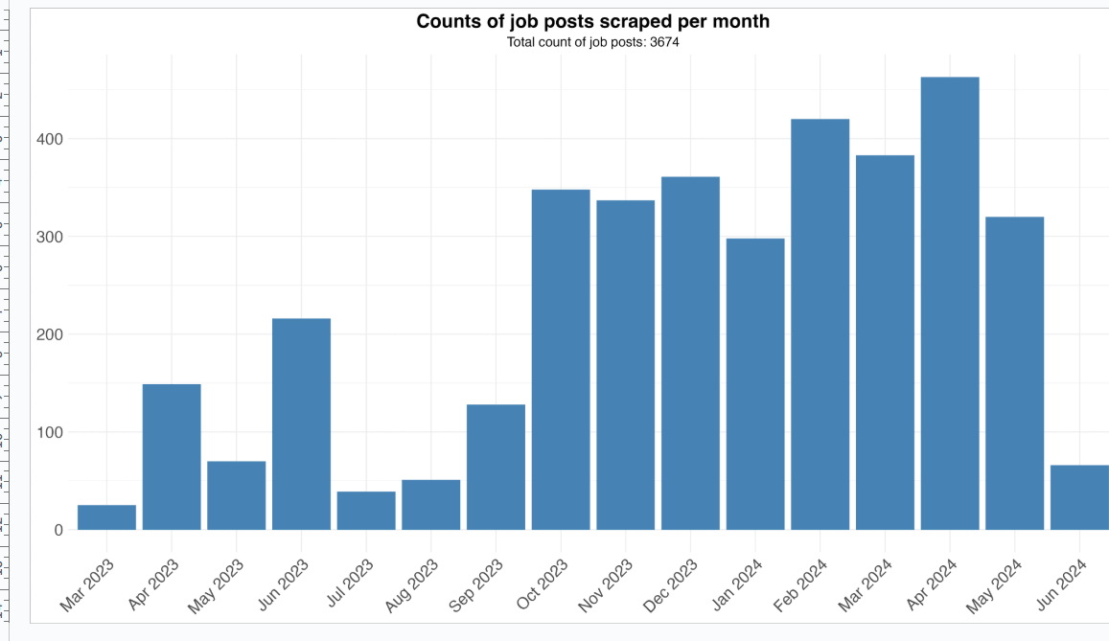
QT Jobs are scraped from a large online job database every month.

Slide 12
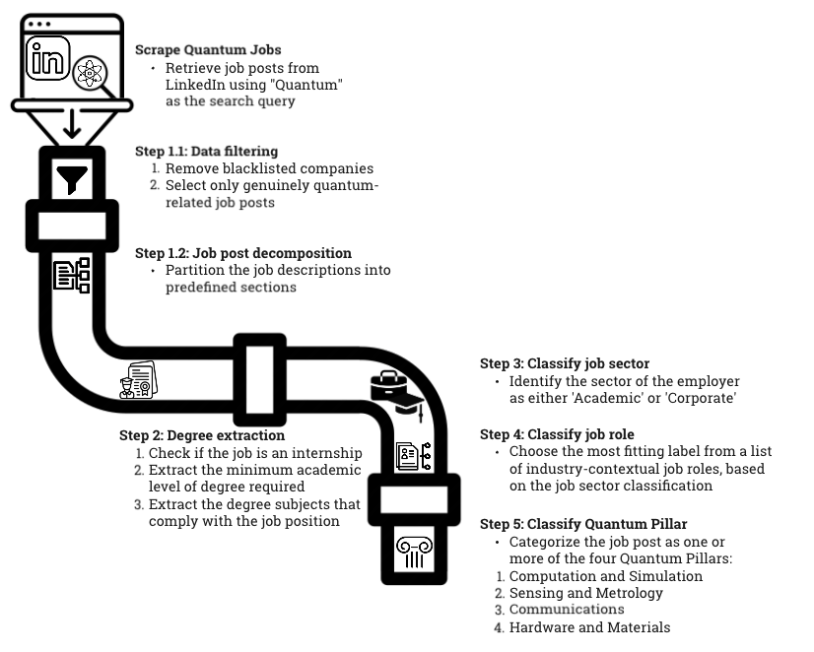
Methodology
The Quantum Technology Job Market: Data Driven Analysis of 3641 Job Posts
Simon Goorney et al.

Slide 13
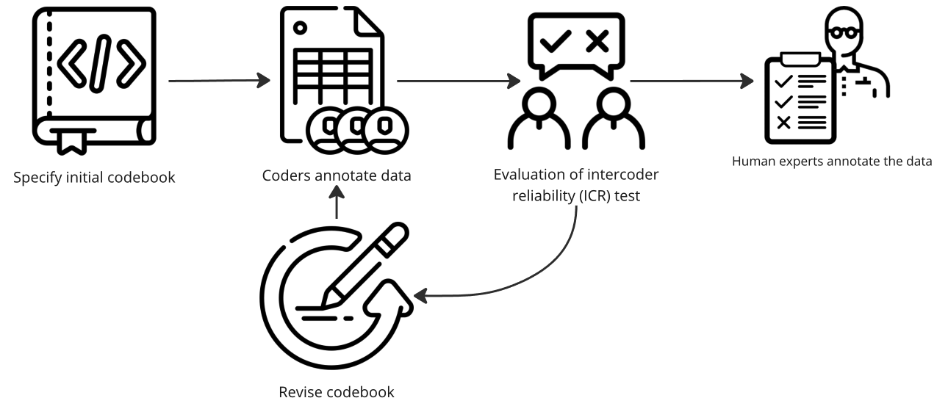
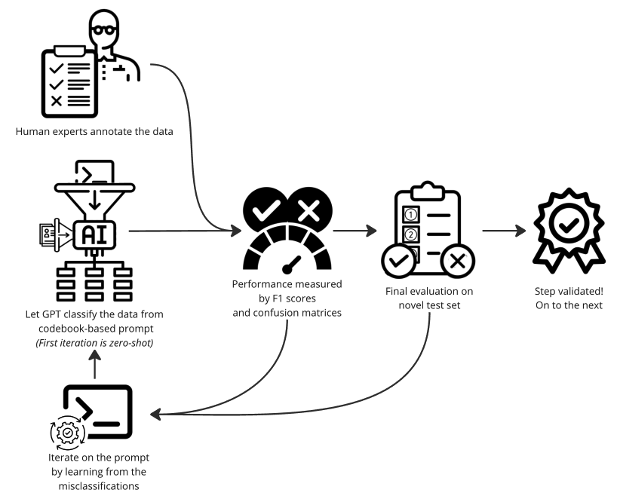
-GPT-classification with a “human in the loop”
-Data labelled and codebook generated by humans, revised through multiple iterations w/ GPT labelling and human verification.
-Total F1 score of >89% for all steps in final dataset.

Slide 14
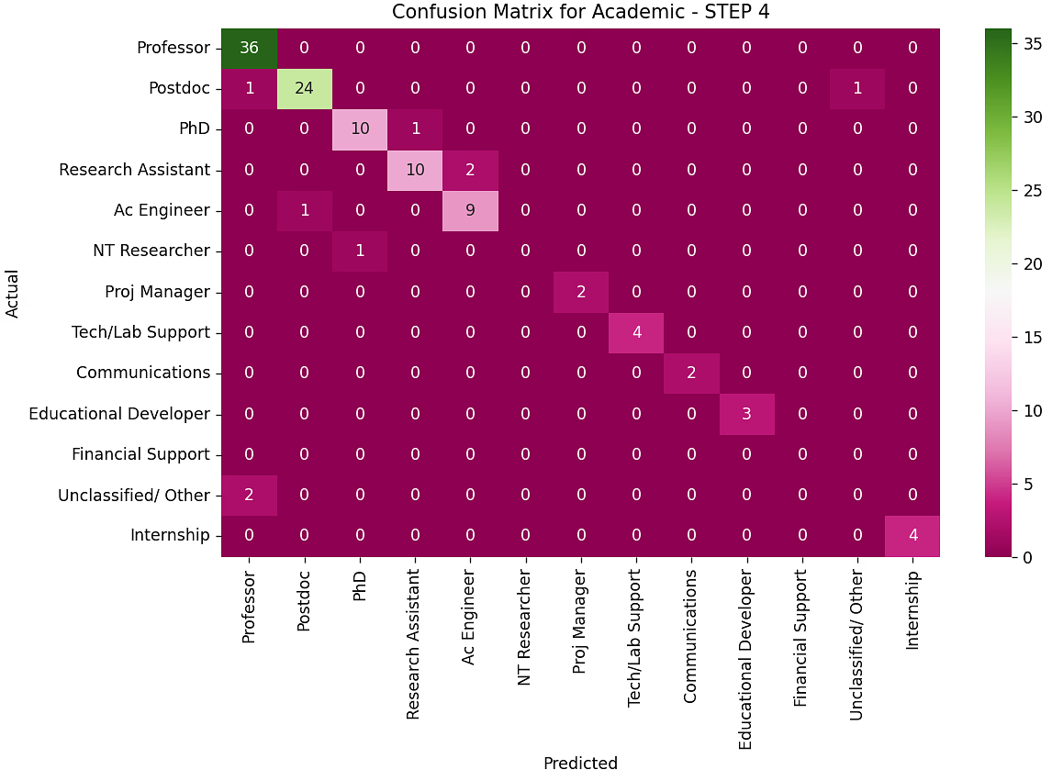
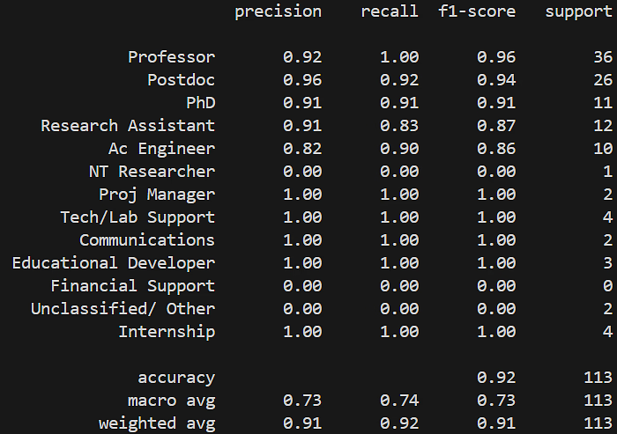
Data validation method - ca 200 job posts fully labelled by QT experts
Classification accuracy is at 89% or higher for all classification steps
Mapping the Quantum Workforce: Insights into the Worldwide Job Landscape
Simon Goorney, Jacob Sherson, et al. In preparation
Preliminary data

Slide 15
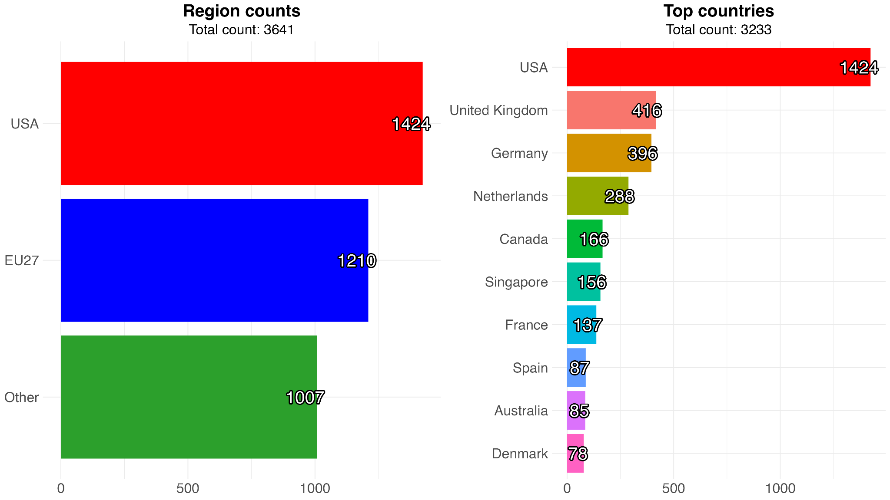
Mapping the Quantum Workforce: Insights into the Worldwide Job Landscape
Simon Goorney, Jacob Sherson, et al. In preparation
Findings from job analysis
USA Leads by a significant margin over any individual country.
EU-27 is pretty much neck and neck though!
N.B China is almost entirely not represented on online job boards accessible in English…

Slide 16
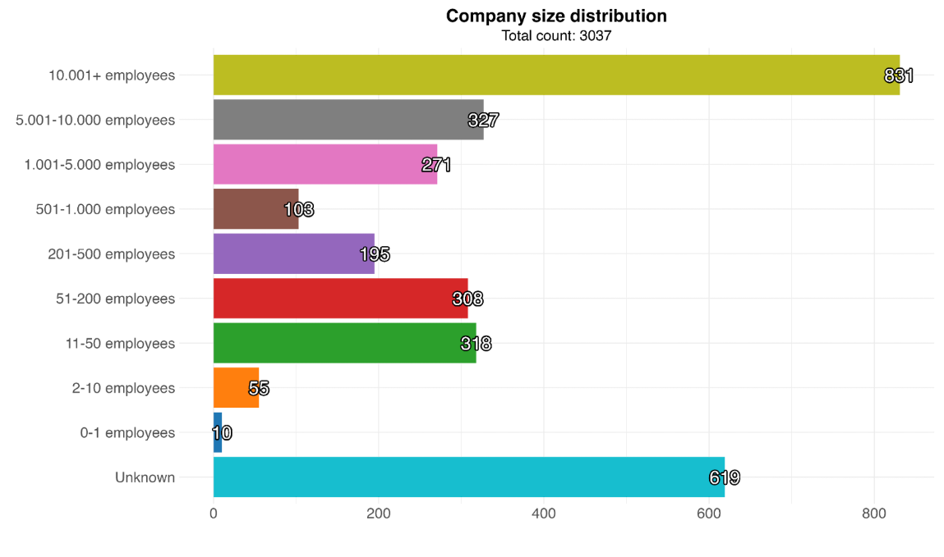
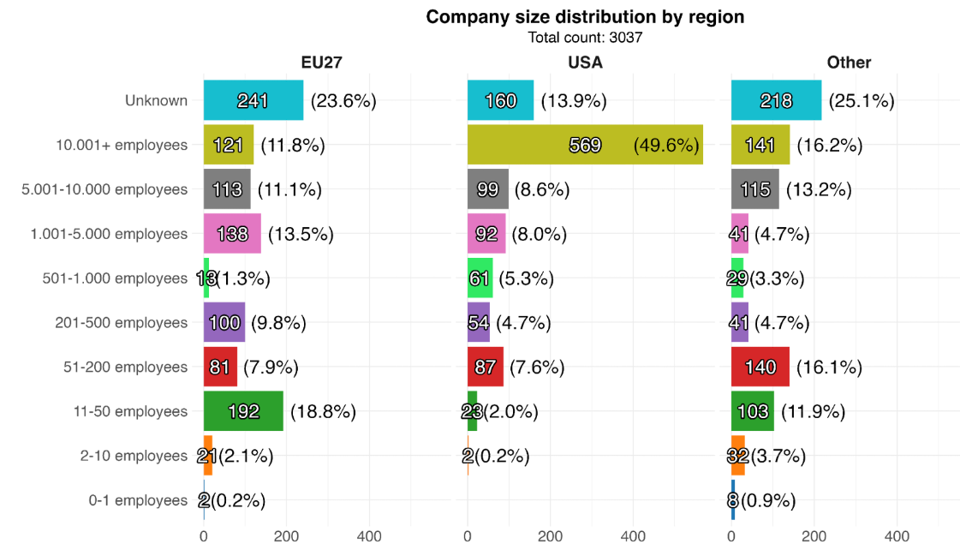
Company Size distribution
676
High hiring practices in large companies
USA “tech giants”
USA is hiring in large companies
EU-27 is hiring in small- intermediate size companies

Slide 17
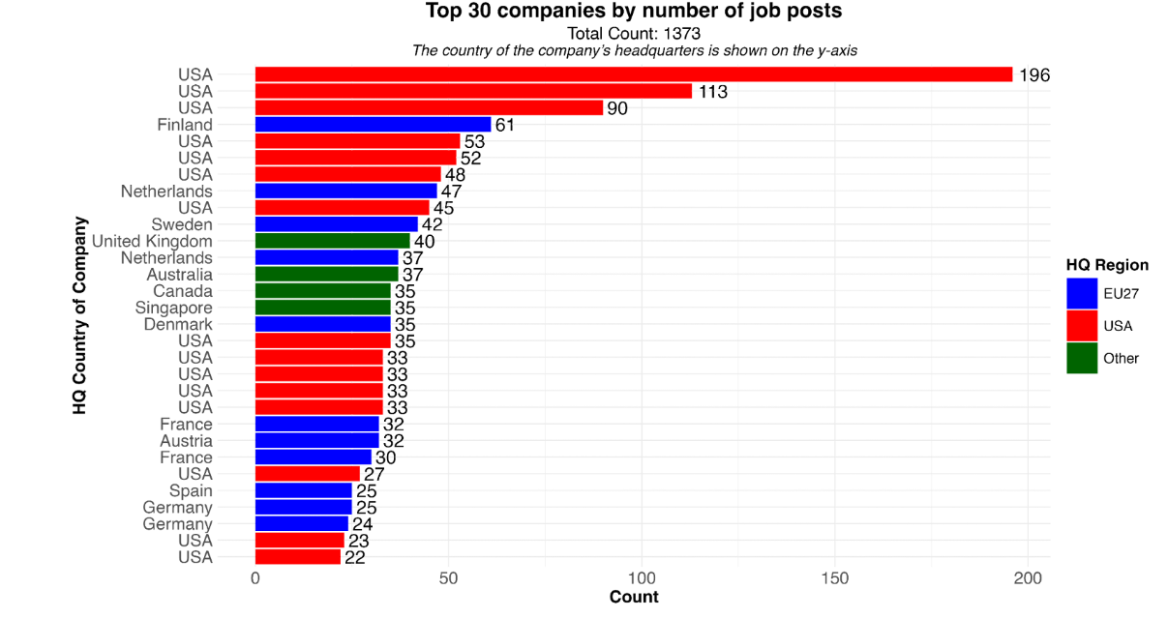
Company Size
distribution
676
High hiring practices in large companies
USA “tech giants”
Over 1/3 of the dataset is in the top 30 biggest companies.

Slide 18
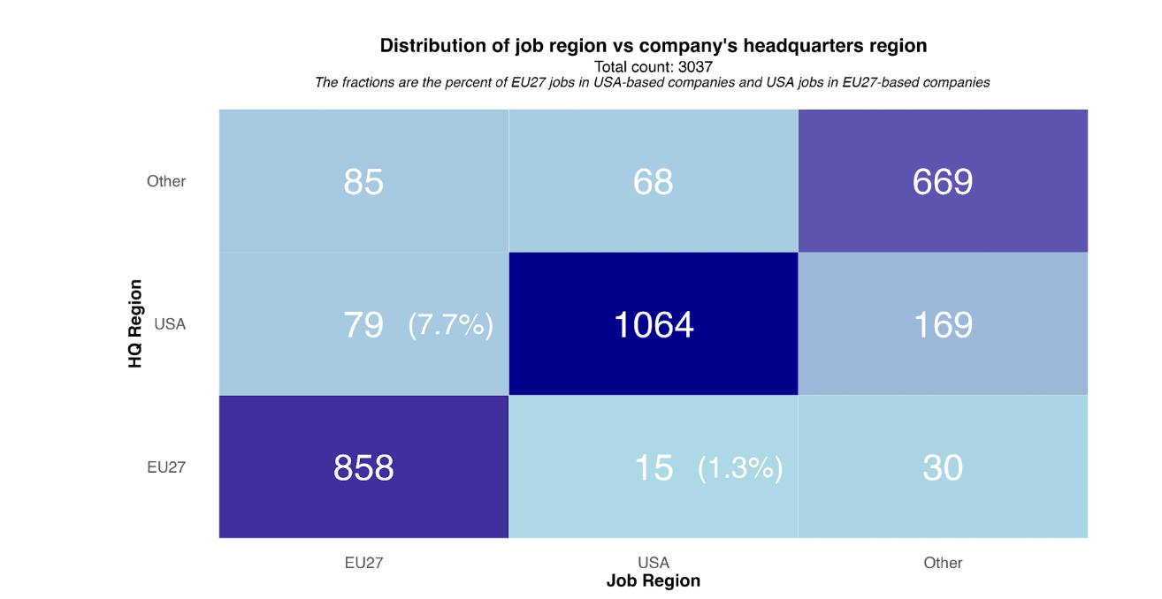
7.7% of EU27 jobs are from USA companies.
1.3% of USA jobs are from EU27 companies. A 6x difference!

Slide 19
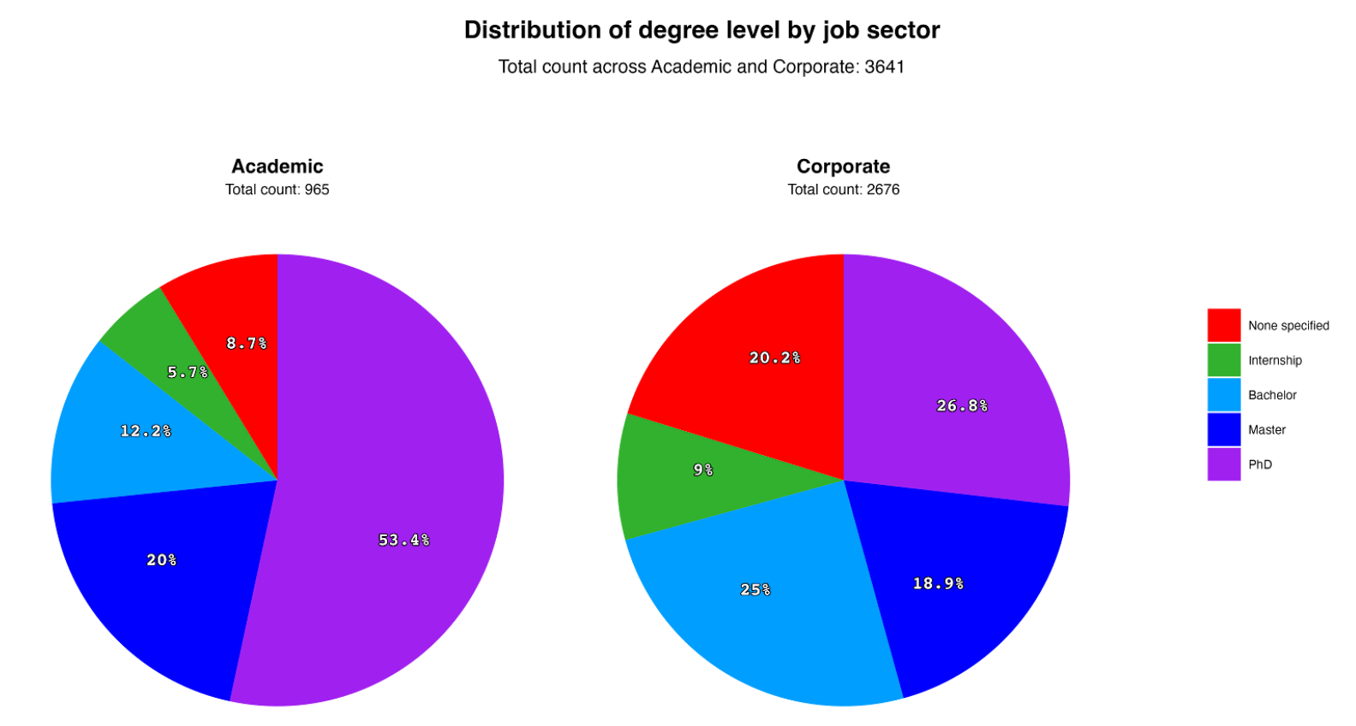
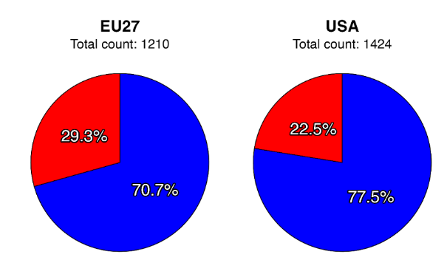
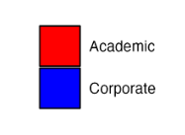
Academia/Corporate jobs comparison
Primarily postdoc and higher positions advertised on job boards
Substantial fraction of internship opportunities in both academia and companies - look into it!
EU-27 hiring somewhat more in academia than USA
Corporate sector more varied in hiring practices
Role for the qualification profiles in structuring job posts?
Mapping the Quantum Workforce: Insights into the Worldwide Job Landscape
Simon Goorney, Jacob Sherson, et al. In preparation

Slide 20
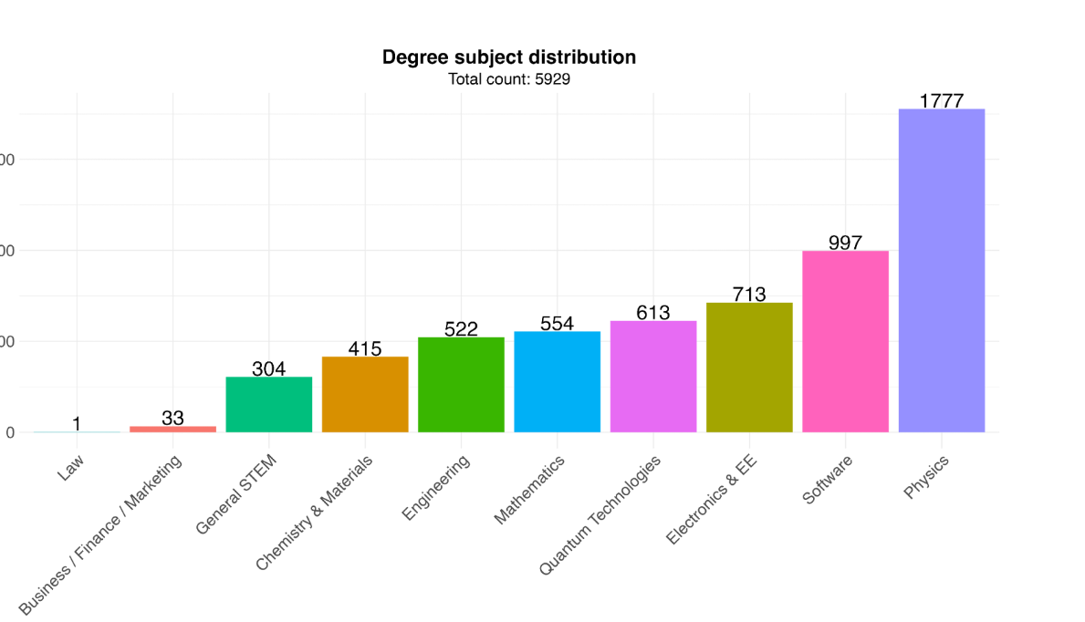
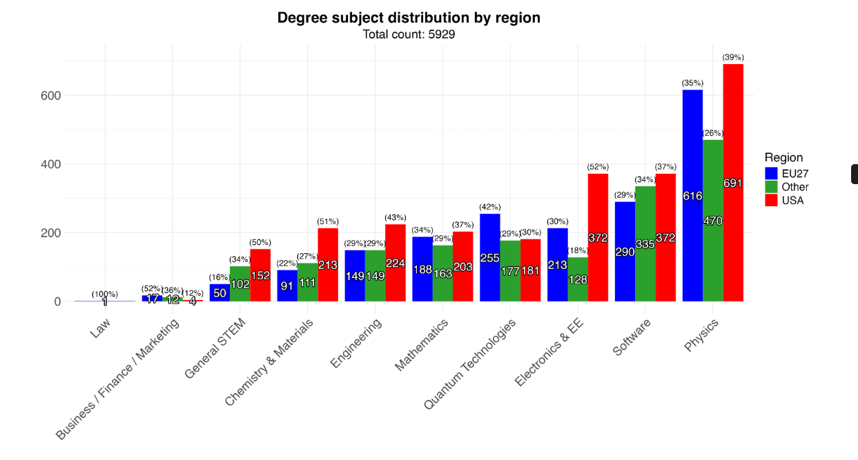
The Quantum Technology Job Market: Data Driven Analysis of 3641 Job Posts
Simon Goorney, Jacob Sherson, et al.
Degree subject distribution
The United States hires more engineering
Strong presence of physics but also a growing demand of interdisciplinary profiles
Demand for specific degrees in “QT” higher in Europe

Slide 21
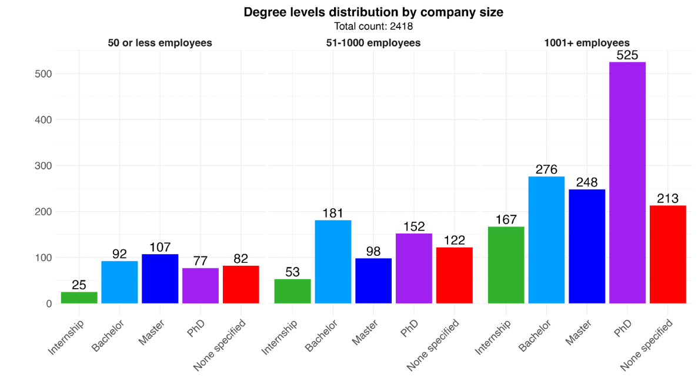
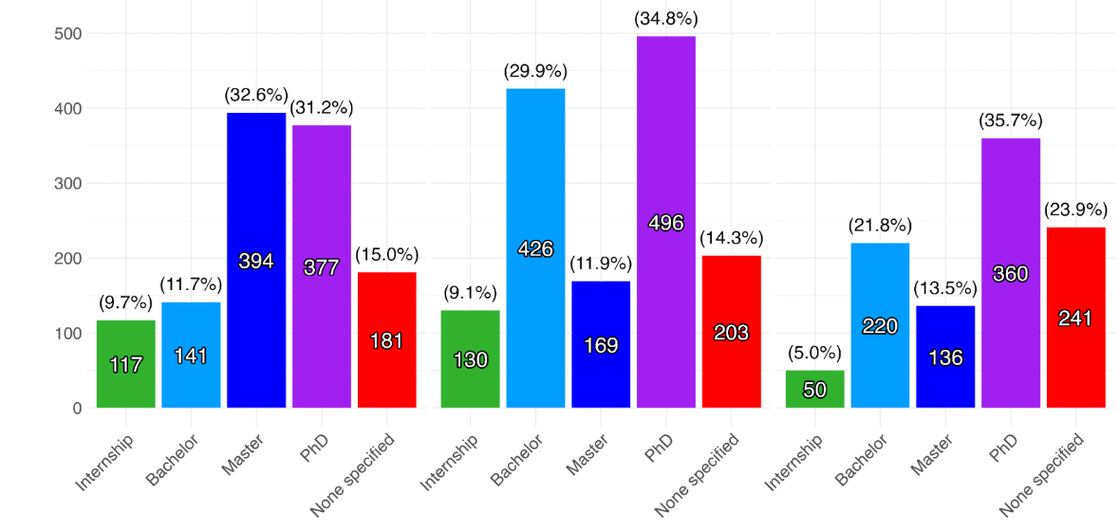
Degree level distribution
Larger companies hiring more PhD graduates, as they fulfill very technical roles
Larger companies may offer more internships as part of their strategy to attract and develop talent
The Quantum Technology Job Market: Data Driven Analysis of 3641 Job Posts
Simon Goorney, Jacob Sherson, et al.

Slide 22
Outlook
-The national strategies demonstrate a clearly increasing focus on commercialisation and applications of QT.
-But the job marketplace shows signs that we are still in fairly early stages.
-If you speak to industry professionals, many of them say that they find it hard to fill technical roles in QT. How can we address that?
-Education programs?

Slide 23
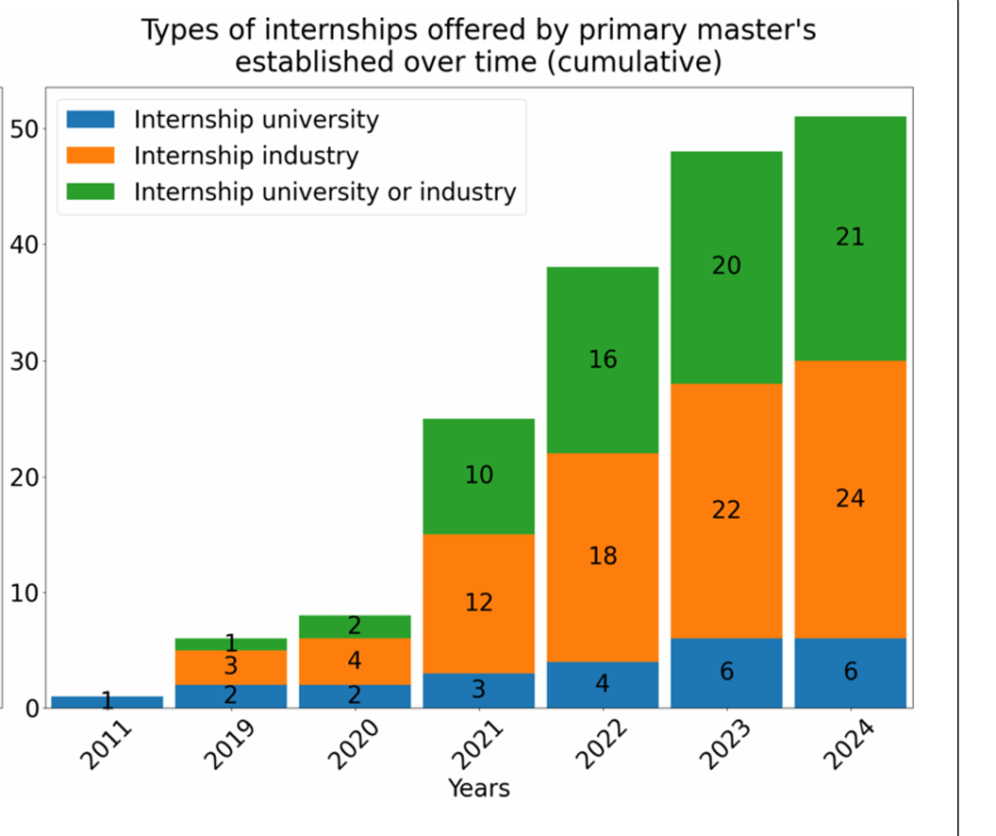
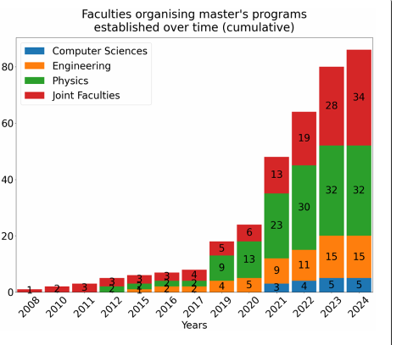
What about education opportunities?
Education programs are becoming more interdisciplinary and offering more hands-on experience.
Goorney et al Quantum Technology Masters’s: A shortcut to the quantum industry?
The Quantum Technology Job Market: Data Driven Analysis of 3641 Job Posts
Simon Goorney, Jacob Sherson, et al.

Slide 24
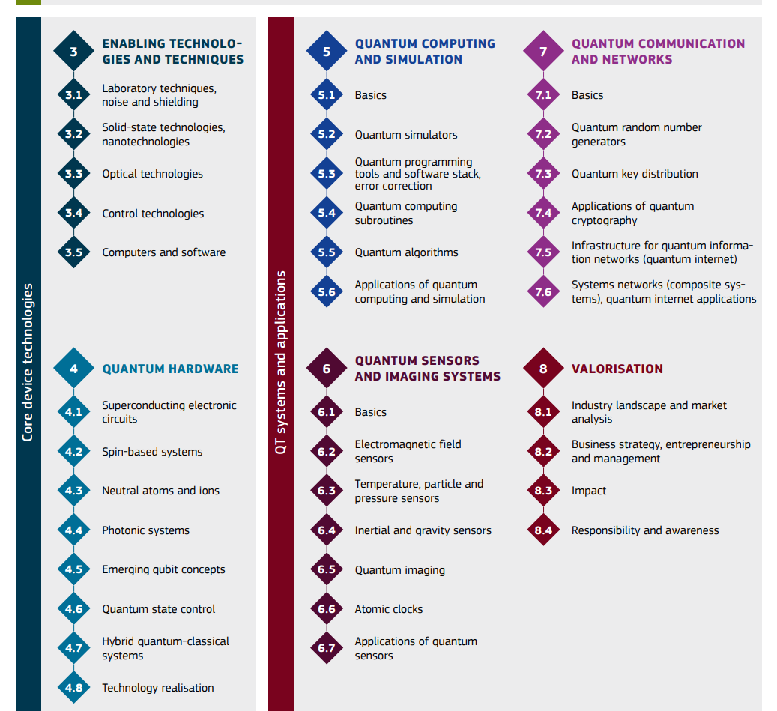
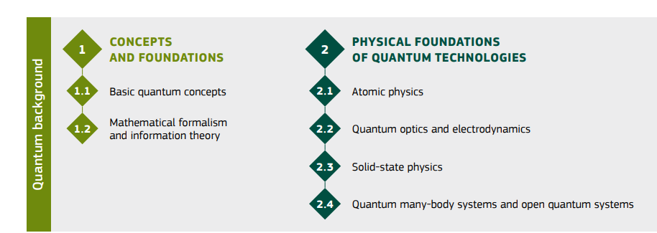
Perhaps we should not be too hasty. What do graduates actually need to know?
Competence Framework for QT
Building a common language for curricula and skills
simon.goorney@mgmt.au.dk

Slide 25

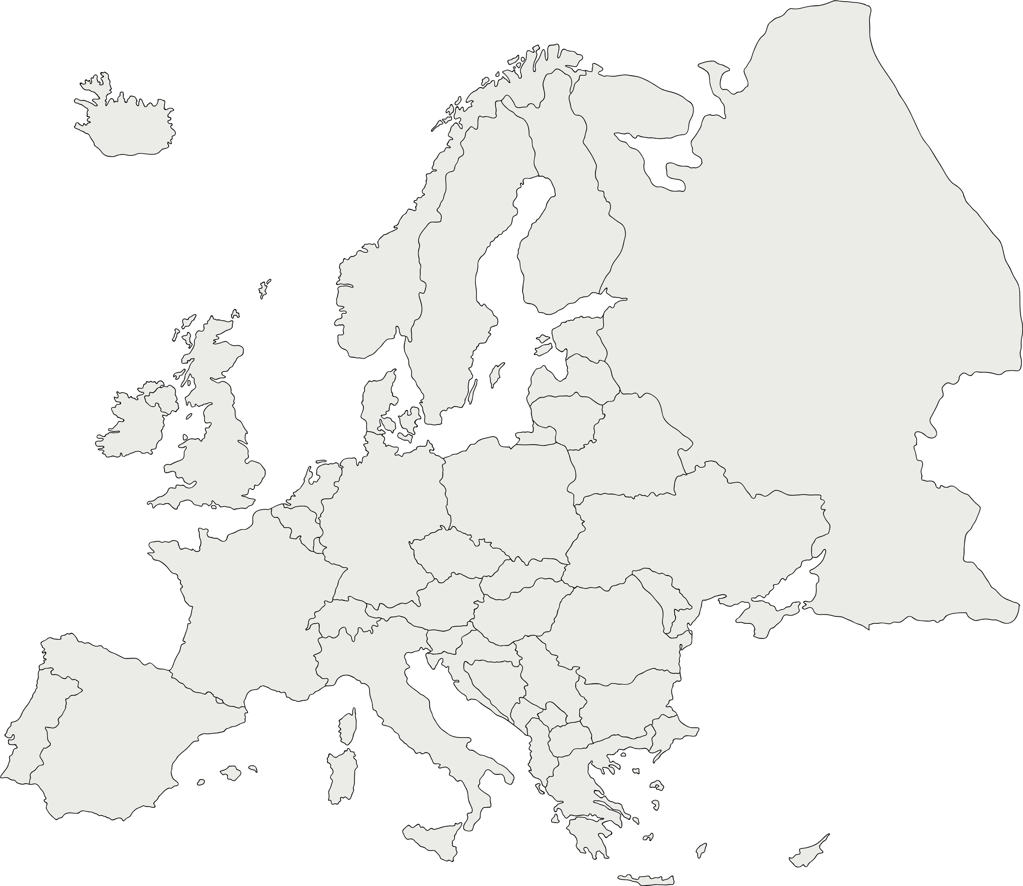
























  16 Quantum Master Programs across Europe
  30 Innovative education modules
  50+ Specialist courses for ECTS
  4 Pan-European networks
  A comprehensive internship program

Slide 26
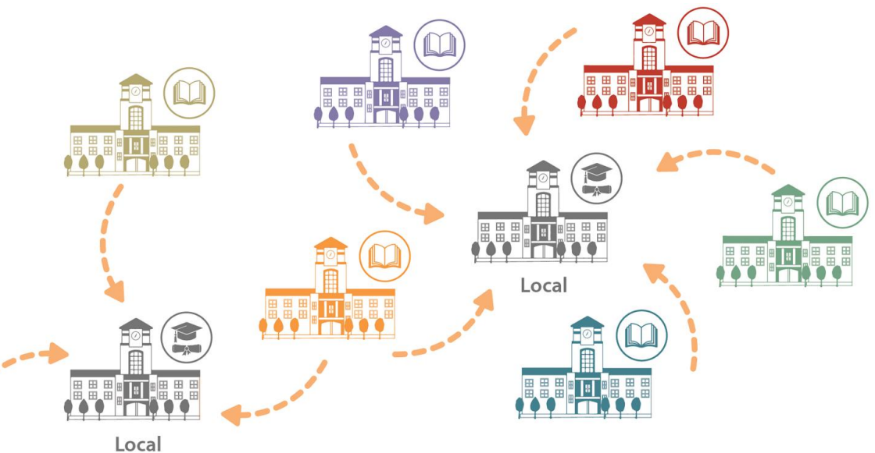
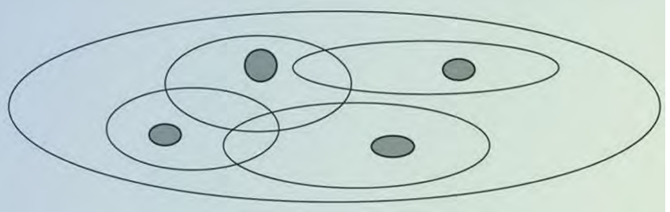
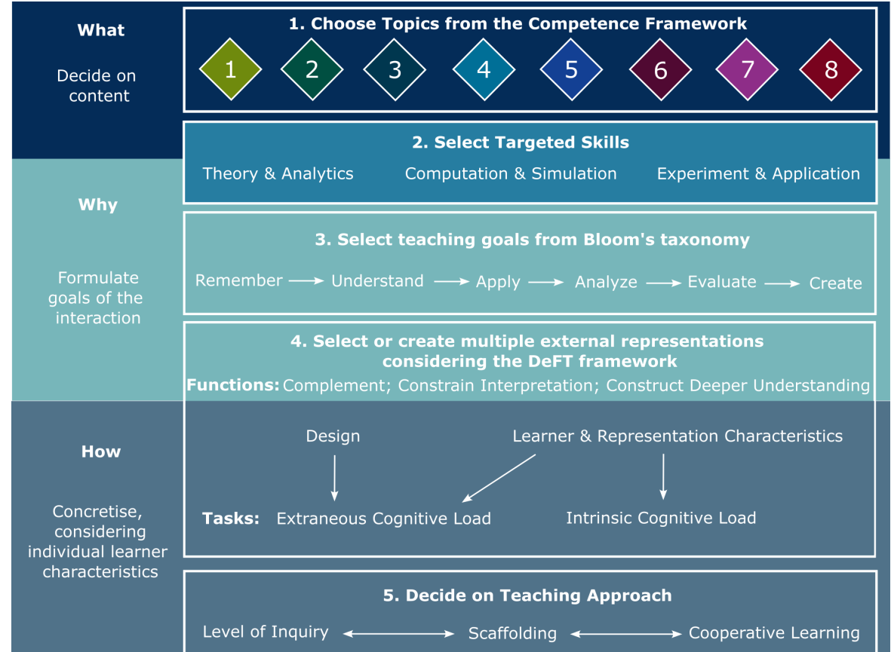
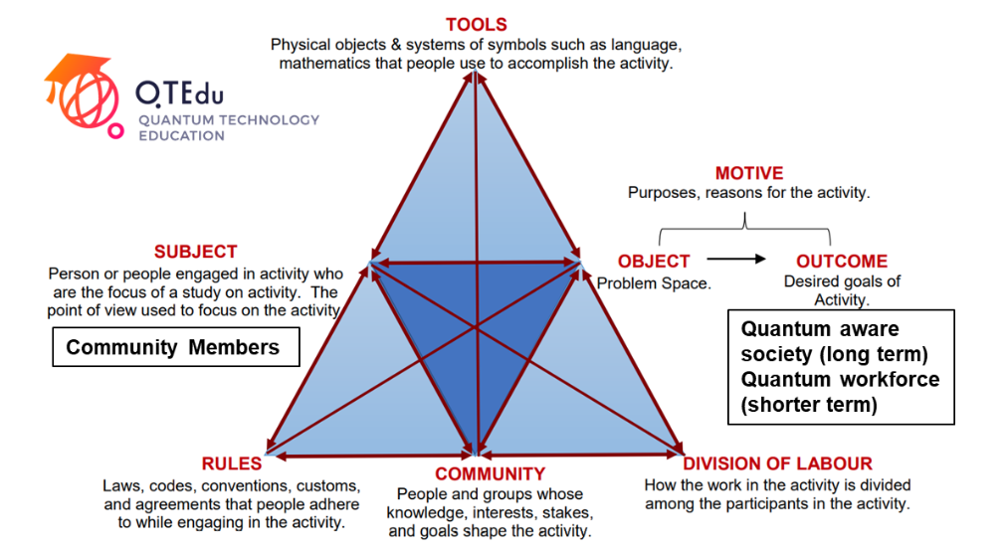
Other research into the Quantum Workforce
simon.goorney@mgmt.au.dk
Building a Quantum Technology Open Master:
Laying the foundation for a Pan-European program
Educating to the "Culture" of Quantum Technologies: A Survey Study on Concepts for Public Awareness
key ideas for QT outreach
The Quantum Curriculum Transformation Framework
For developing curricula in Quantum Technologies
Activity-theoretic analysis of the QTEdu community

Slide 27
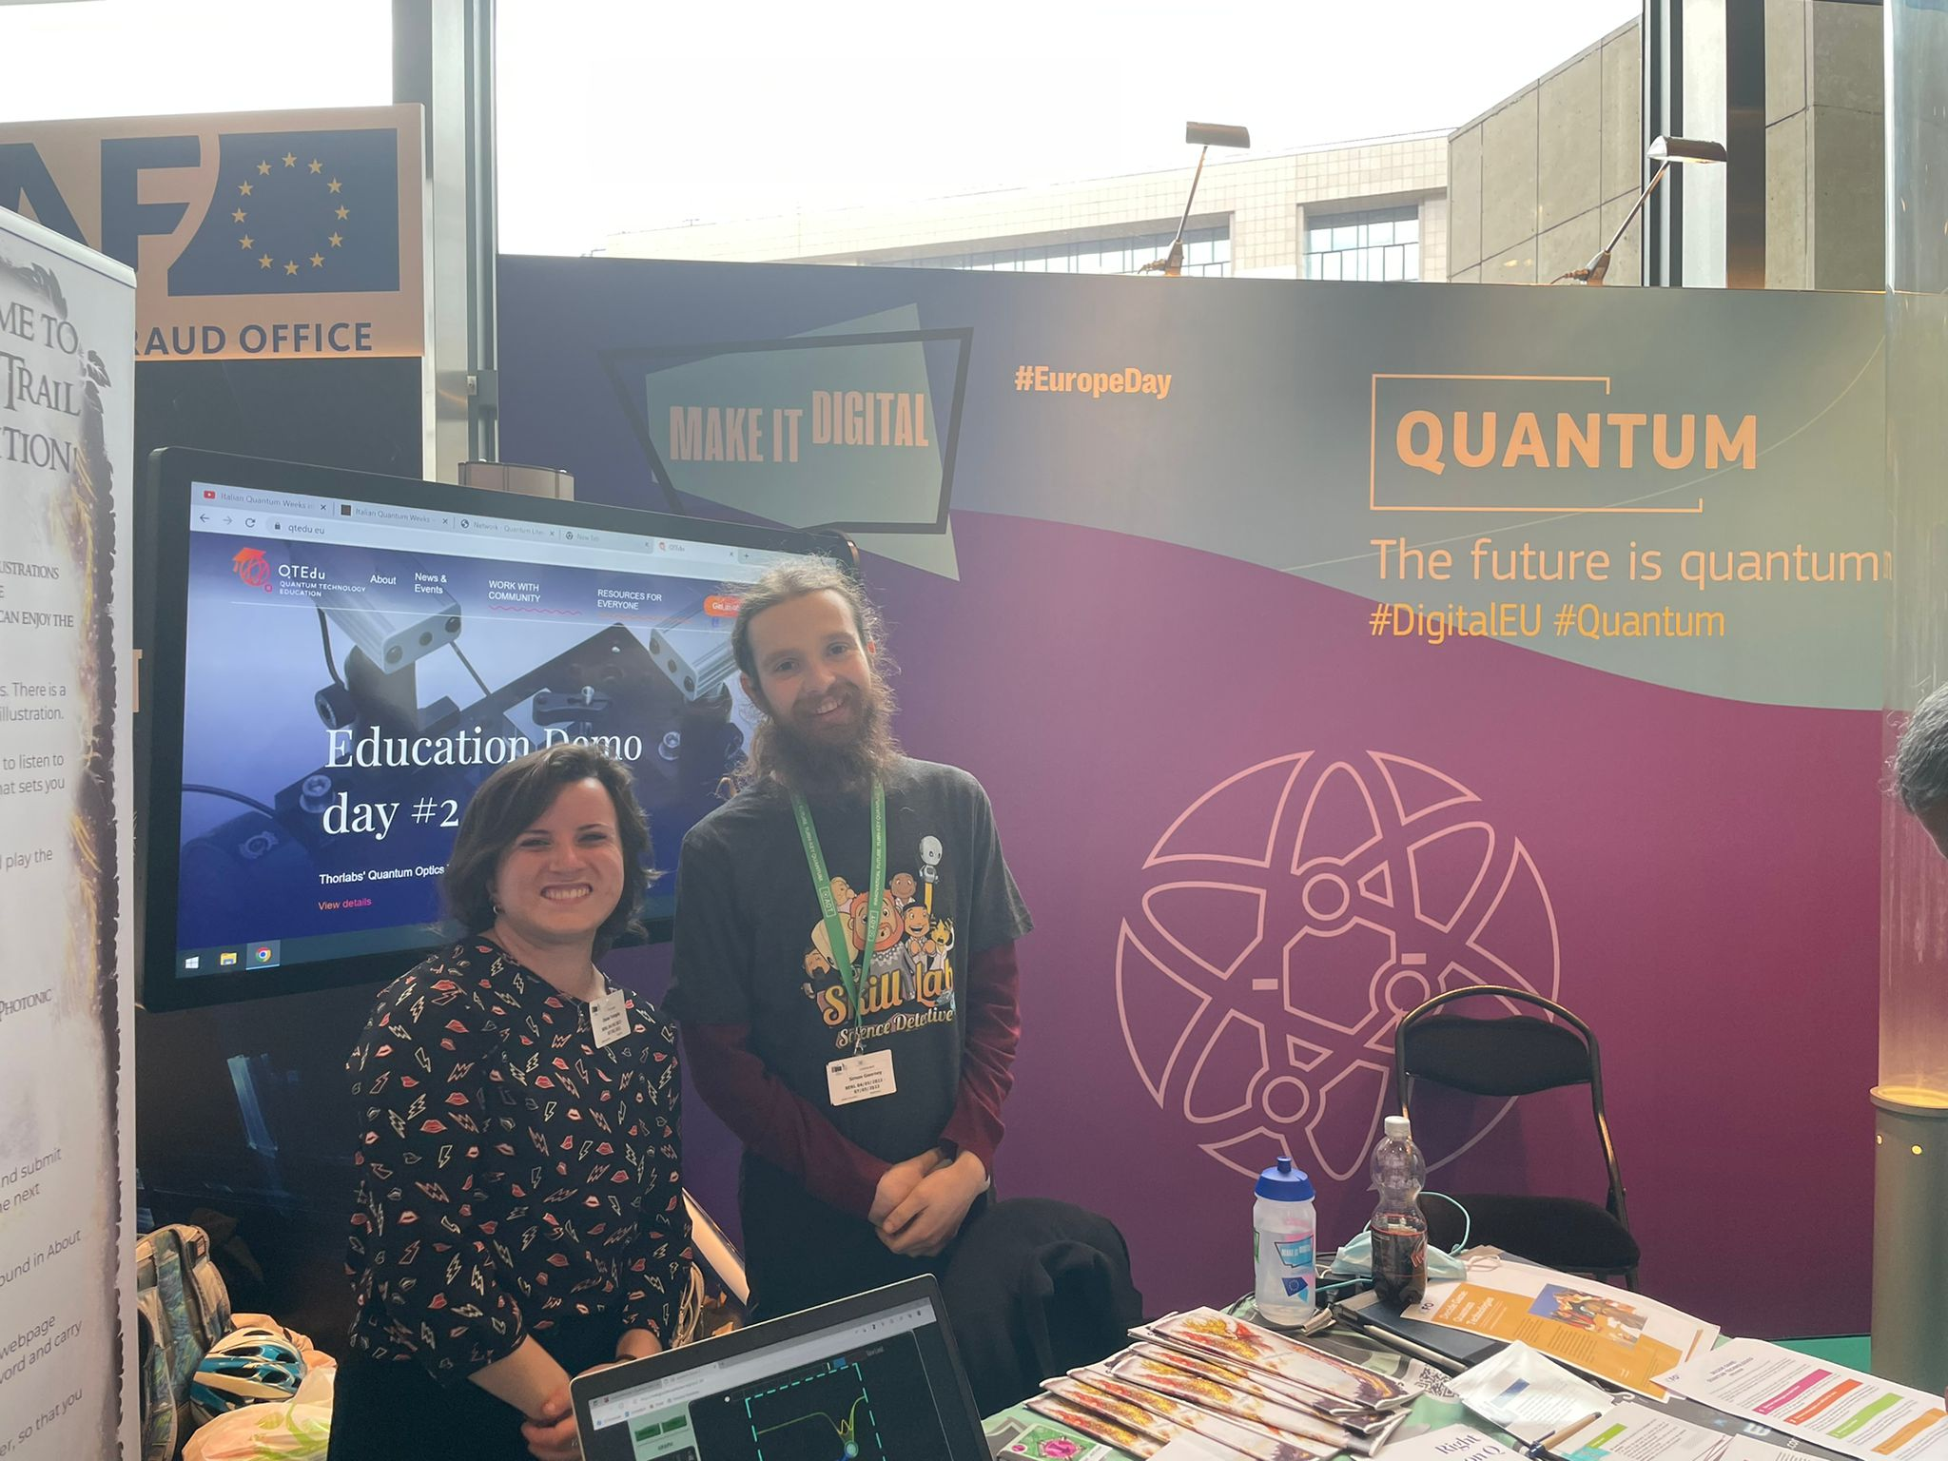
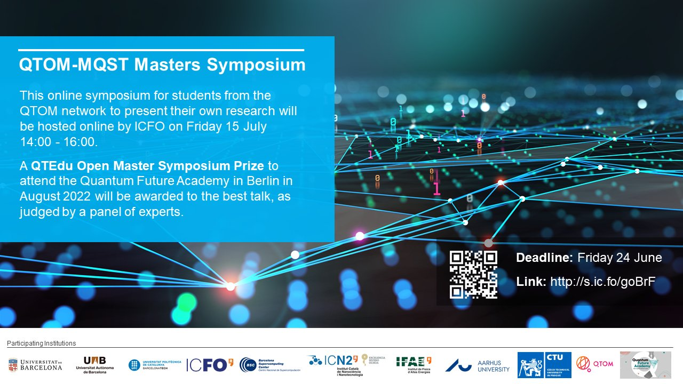
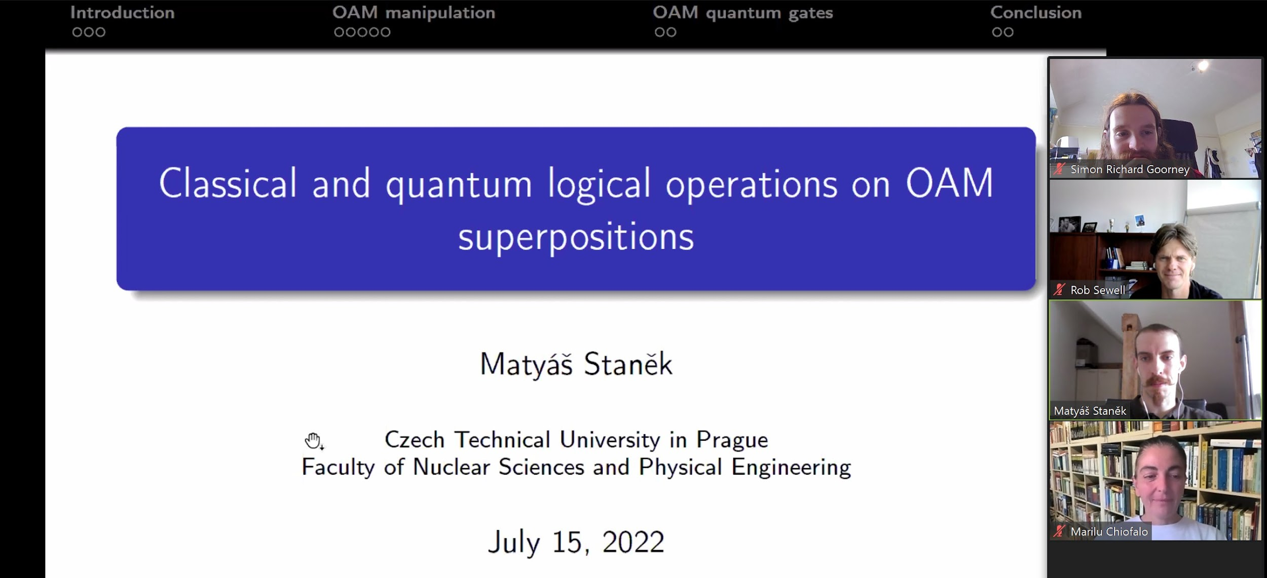
Thank you for listening!
Join the community:
https://qtedu.eu
https://quantumready.eu
https://digiq.eu
Simon.goorney@mgmt.au.dk

