Slide 1


Neural Networks as Trace-Preserving Quasi-Inverse Quantum Channels
Sameen Aziz and Muhammad Faryad*
Department of Physics, School of Science and Engineering
Lahore University of Management Sciences, Lahore, Pakistan
muhammad.faryad@lums.edu.pk

Slide 2
Motivation & Context
Quantum channels model noise in quantum systems.
Noise is a very important challenge for quantum computing, communication, and error mitigation.
Quantum channel inverse, in general, not possible.
Analytical results for quasi-inverse are available only in a restricted space of parameters.
Can neural network act as quantum channel (CPTP map)?

Slide 3
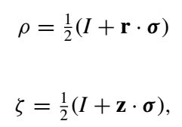




Quantum Channels describe physically realizable quantum processes
Map density matrices to density matrices.
Can be described by affine transformation: r → r’ = M r + c.
Channel can be thought of as a density matrix transformation or a Bloch vector transformation
Channel can be represented using Kraus operators
as

Slide 4



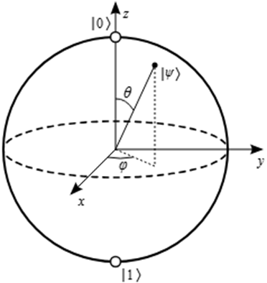

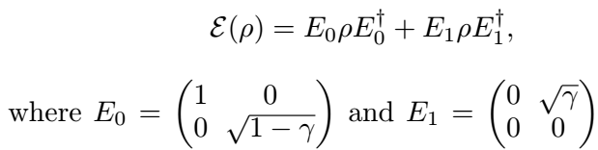
Quantum channels generally change the purity of quantum state, i.e., change the length of the Bloch vector
Pauli operators
Bit-flip
Phase-flip
Bit-phase-flip
Amplitude-damping

Slide 5
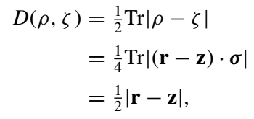


Trace Distance D is one of the measure of the dissimilarity of two quantum states
MSTD: Mean Square Trace Distance averaged over Bloch ball.
Allows adaptation to neural-network loss function for mixed states.

Slide 6
Quantum channels cannot be inverted, in general. Only quasi-inverse is possible.
A quantum channel rotates and shrinks the Bloch vector of a quantum state
A quasi-inverse can only undo the rotation by counter-rotation, but cannot increase the length of the Bloch vector (it would be un-physical)
So, quasi-inverse is a unitary operator.
Analytical results for quasi-inverse are available only when the error rate is very high, that too for qubit channels only.
For bit, phase, phase-flip channels, analytical results for quasi-inverse exist only for p>0.5

Slide 7
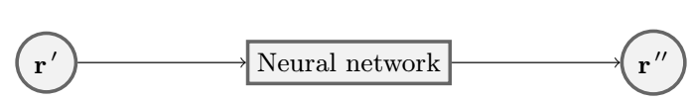


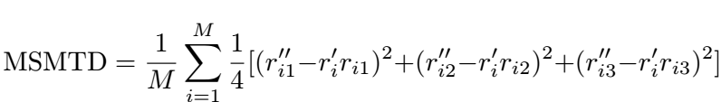
Neural networks can act as physically realizable quasi-inverse quantum channels if loss appropriately defined
Input: Bloch vector after passing through noisy channel.
Output: Approximate original Bloch vector.
Error function: Square of the Modified Trace Distance
Loss function: Mean of the SMTD

Slide 8
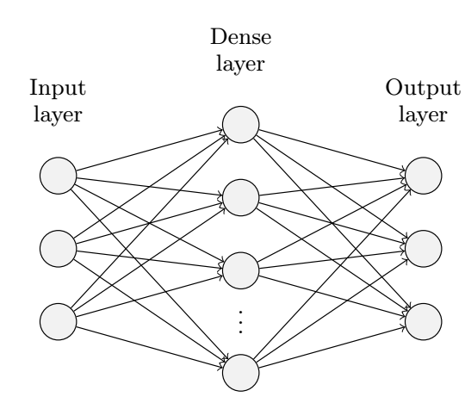
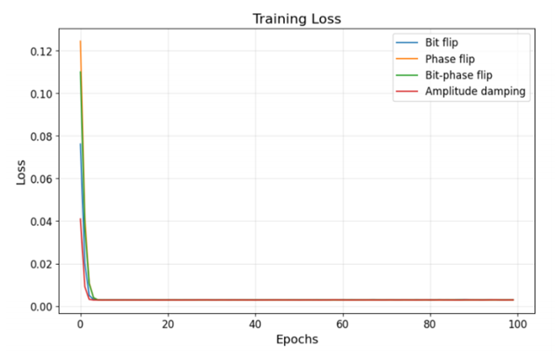
Neural network architecture and training
One fully connected hidden layer with 64 neurons
1000 input density matrices (r) generated randomly to uniformly span the whole Bloch ball
Passed through the original channel to get transformed density matrices (r’)
Trained neural network with r’ input and r’’ output
Used constrained loss function to incorporate the physics

Slide 9
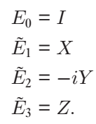
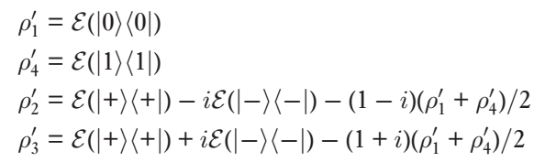



Trained neural network can be thought of as a physical quantum process, tomography can the be used to get the mathematical model
Quantum process tomography characterizes a quantum process
A basis is chosen
Output density matrices for specific inputs are “measured”
The quantum map can then be obtained in terms of the chosen basis

Slide 10
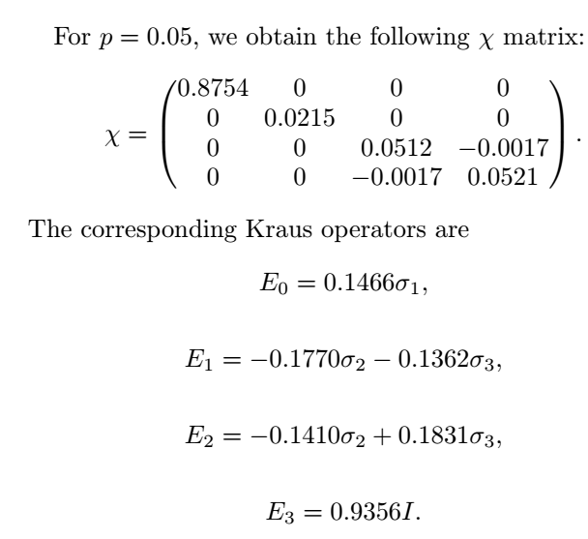
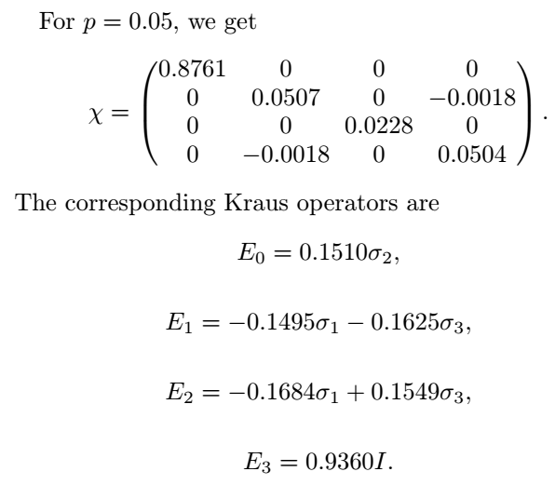
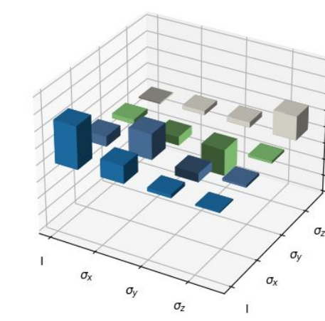

Noise channels can be quasi-inverted with physically realizable quantum channels
Bit-phase flip channel inverse
Bit flip channel inverse

Slide 11
Conclusions: Trained neural network can represent quantum processes
Successfully approximated quasi-inverse for bit flip, phase flip, bit-phase flip, and amplitude damping channels using neural networks for arbitrary value of error probability.
Kraus operators consistent with physical CPTP maps were obtained that can be directly implemented on physical systems.
The method is general and can be used to discover more general quantum processes by performing quantum process tomography on physically constrained neural networks

