Slide 1
Enhancing Detector Alignment with ML
Ștefan Crețu, M.Sc. student (Lund University, Sweden)
HAMLET Conference, 19th of August, 2026

Slide 2
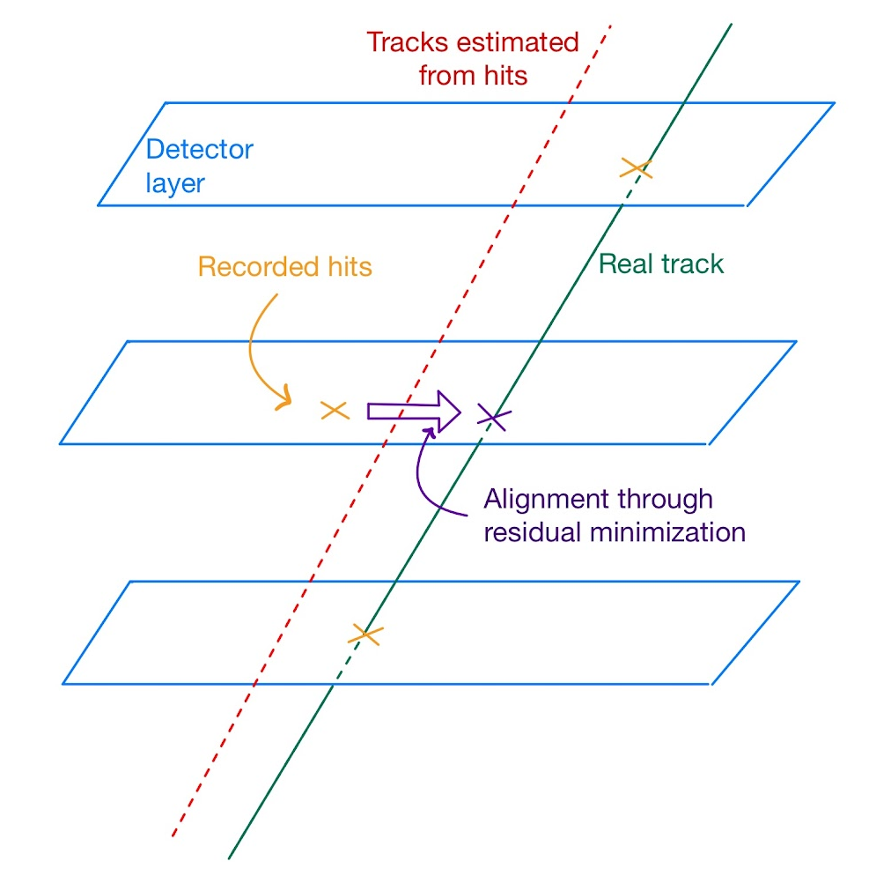
Detector alignment
Use “marker” particle tracks as references
Estimated track constructed from recorded hits
Alignment is done through minimizing the residuals
Problem:
Can get computationally heavy for large fits (~100.000s parameters)
Can we narrow the simulated area down?

Slide 3
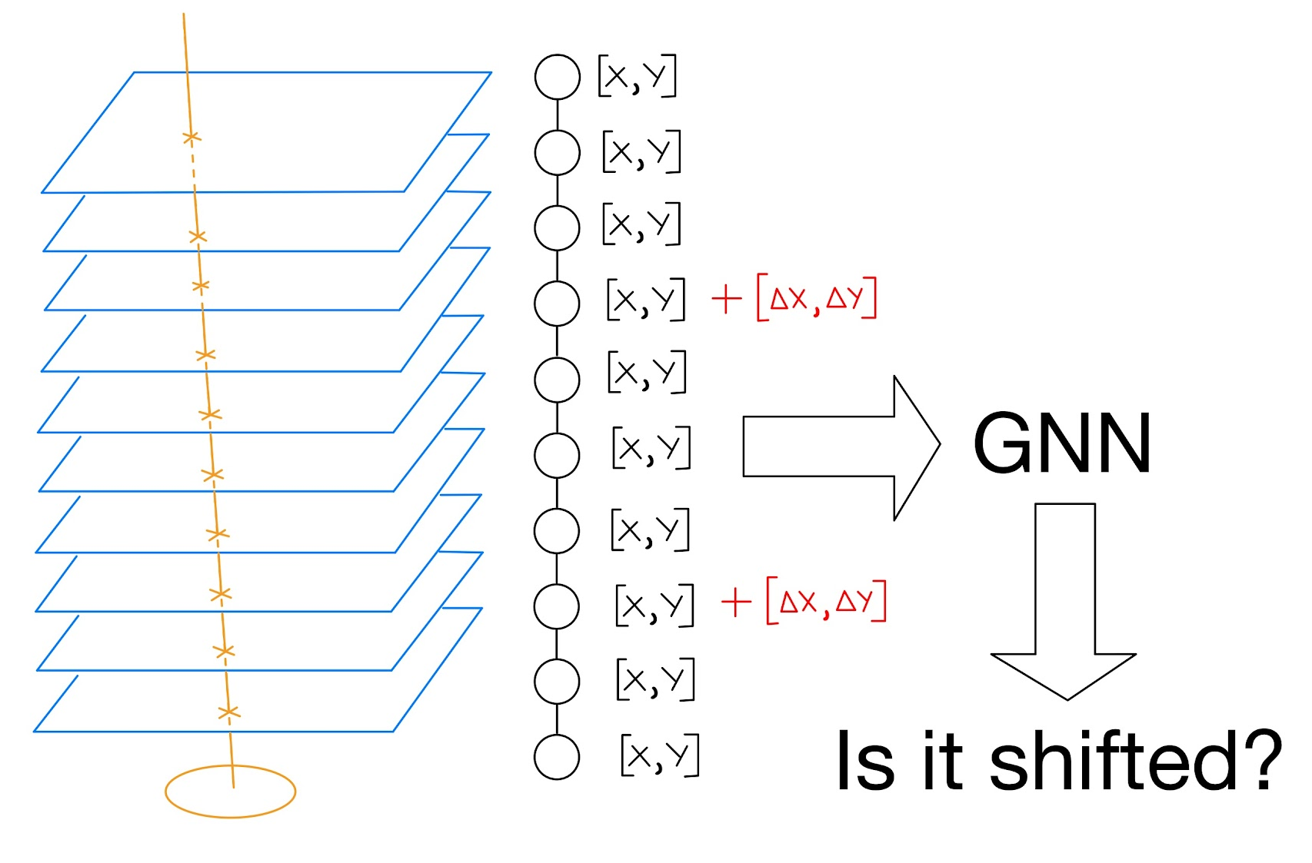
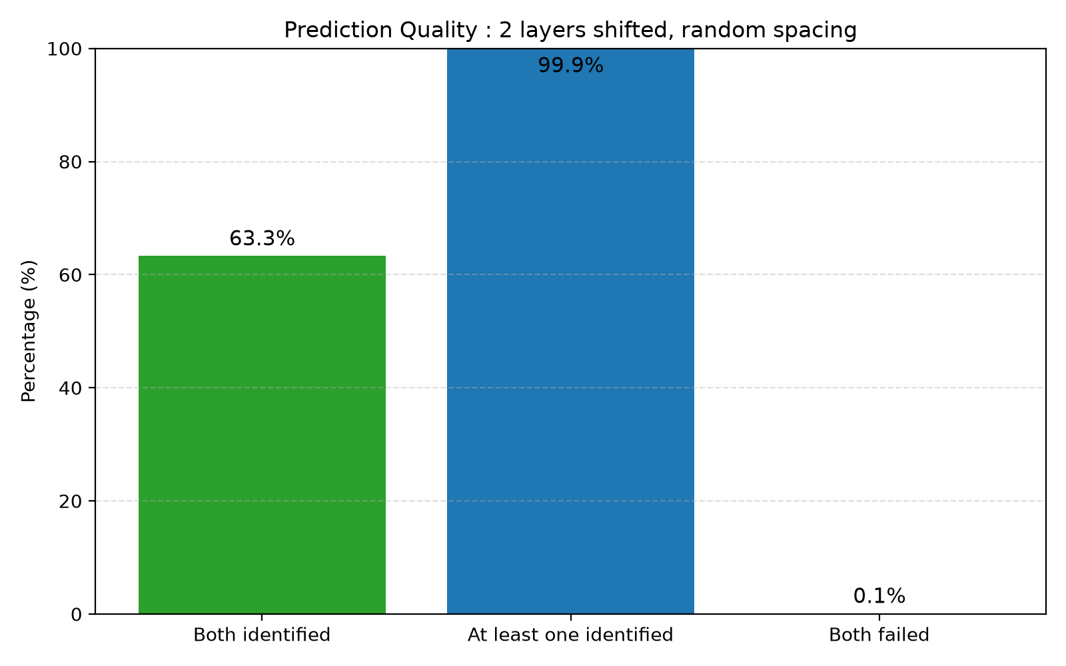

Our idea + proof-of-concept
Reasonable results for a simple proof-of-concept exercise.

Slide 4
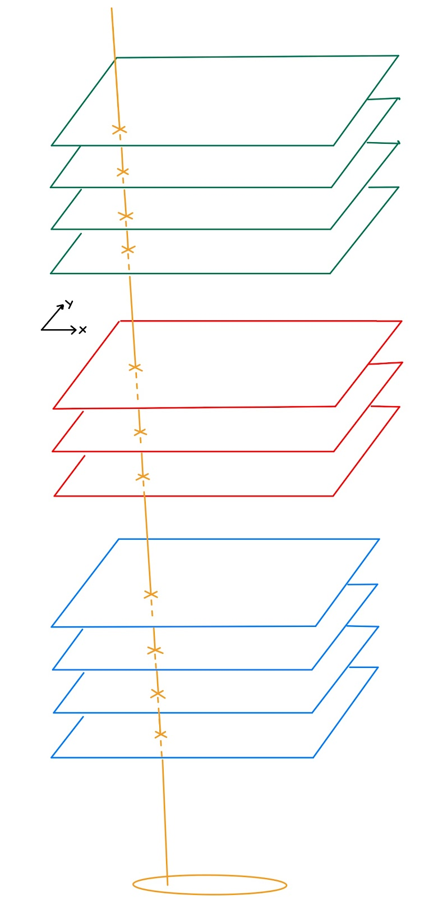
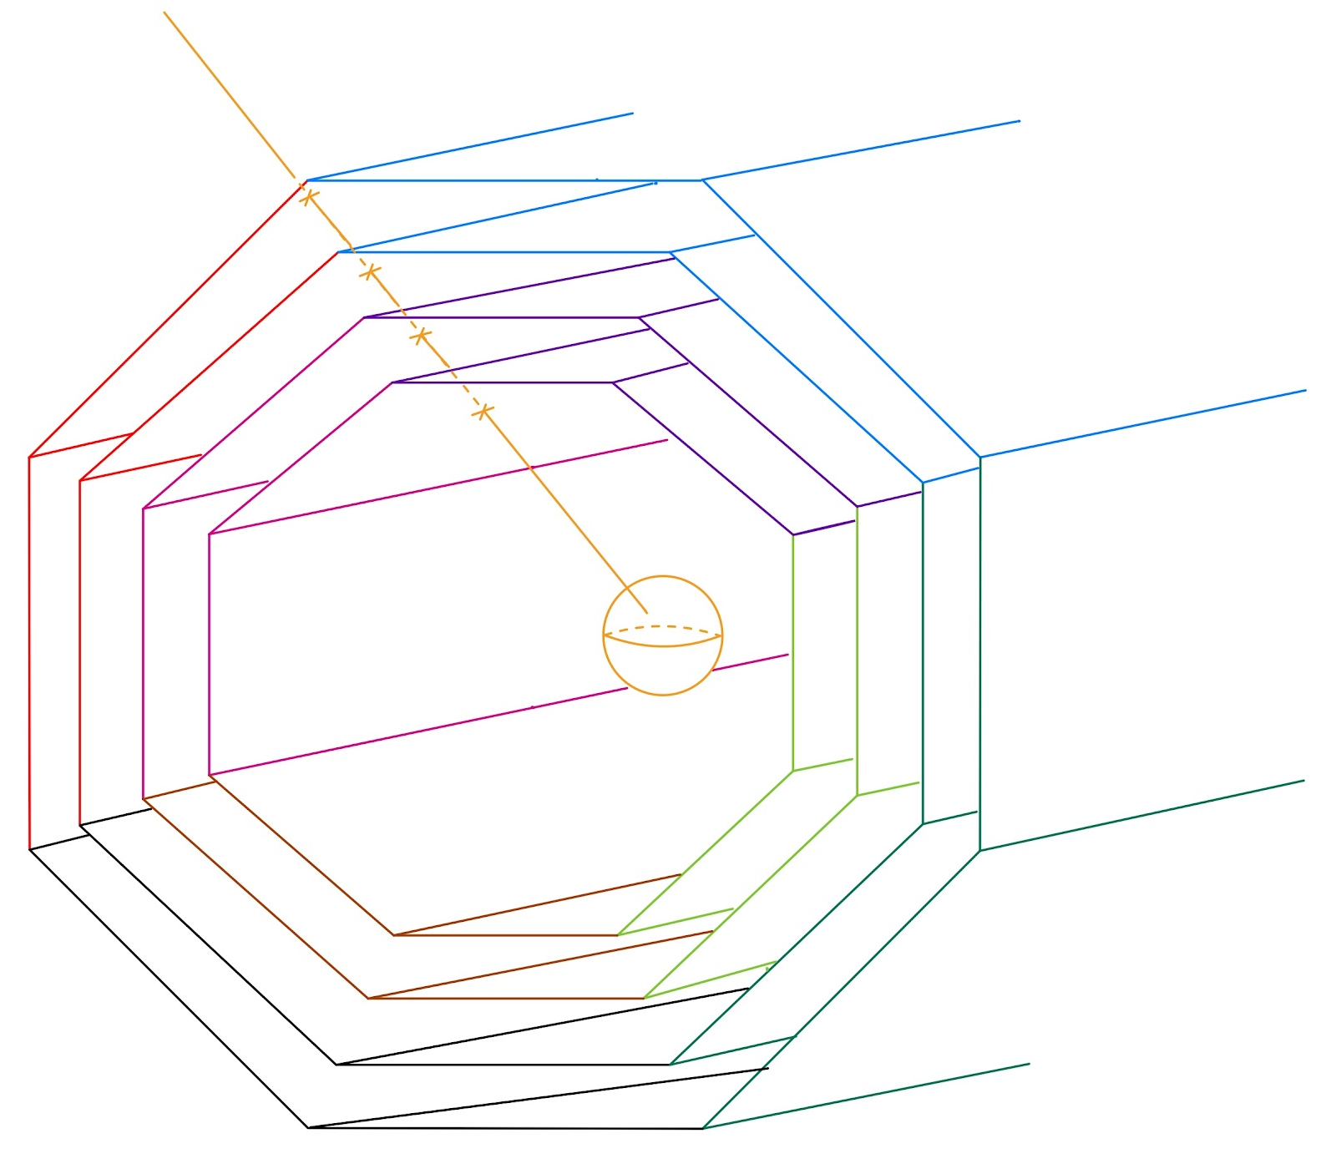
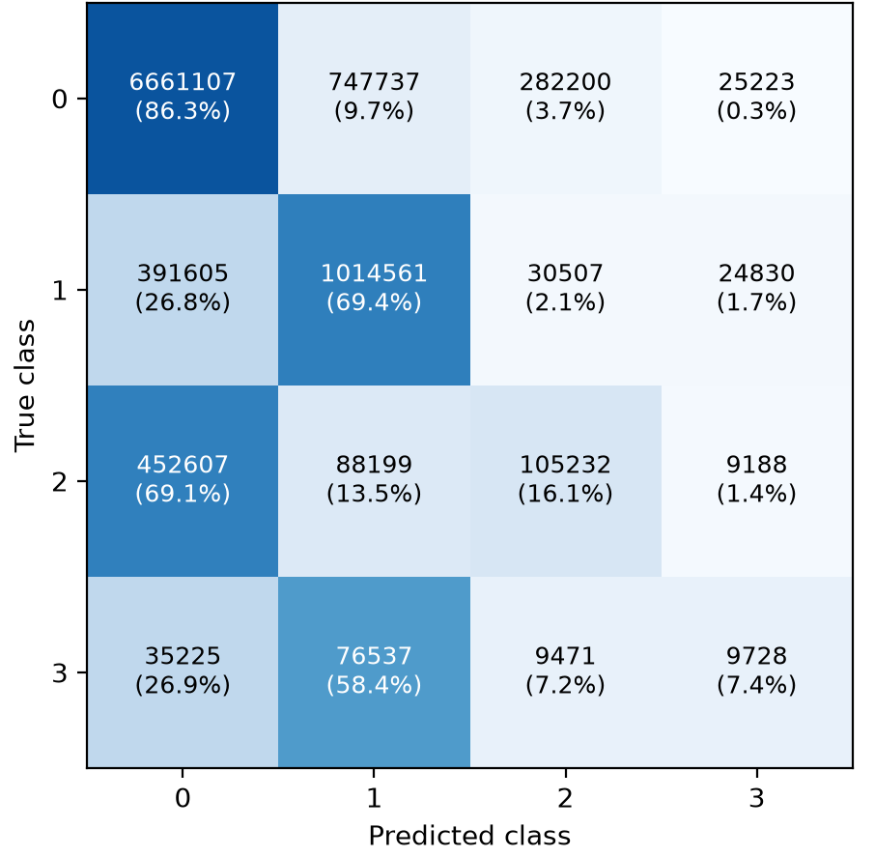
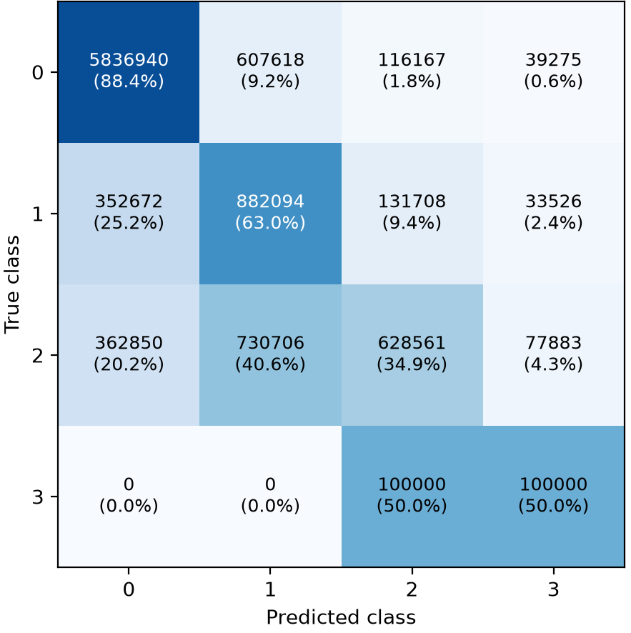
Towards more complex geometries
BLOCKS!

Slide 5
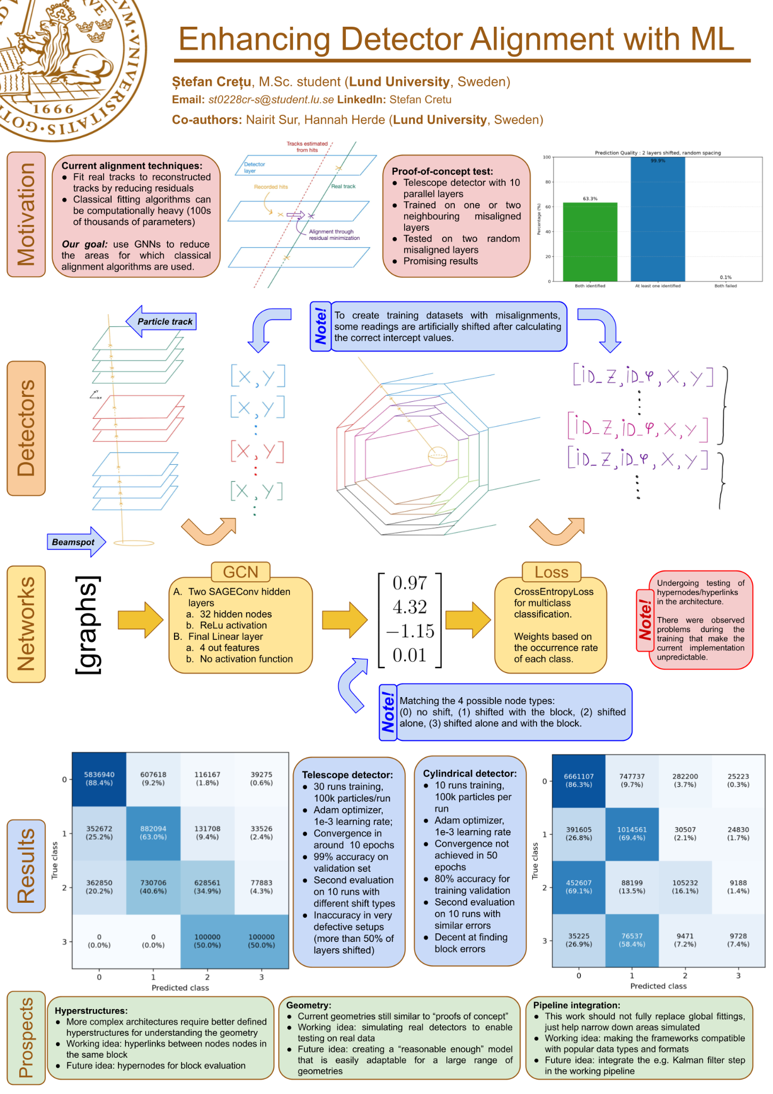
Poster!

