Slide 1
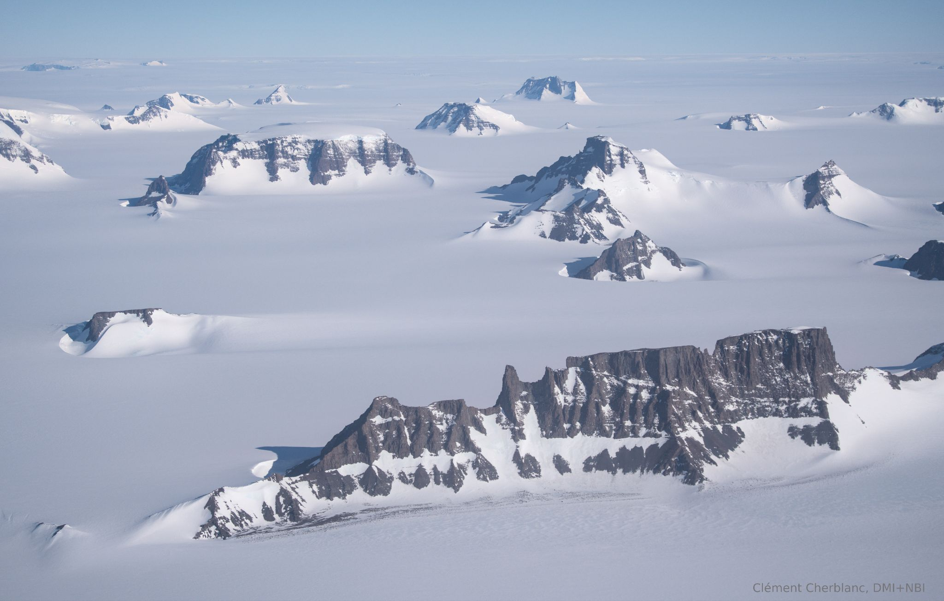
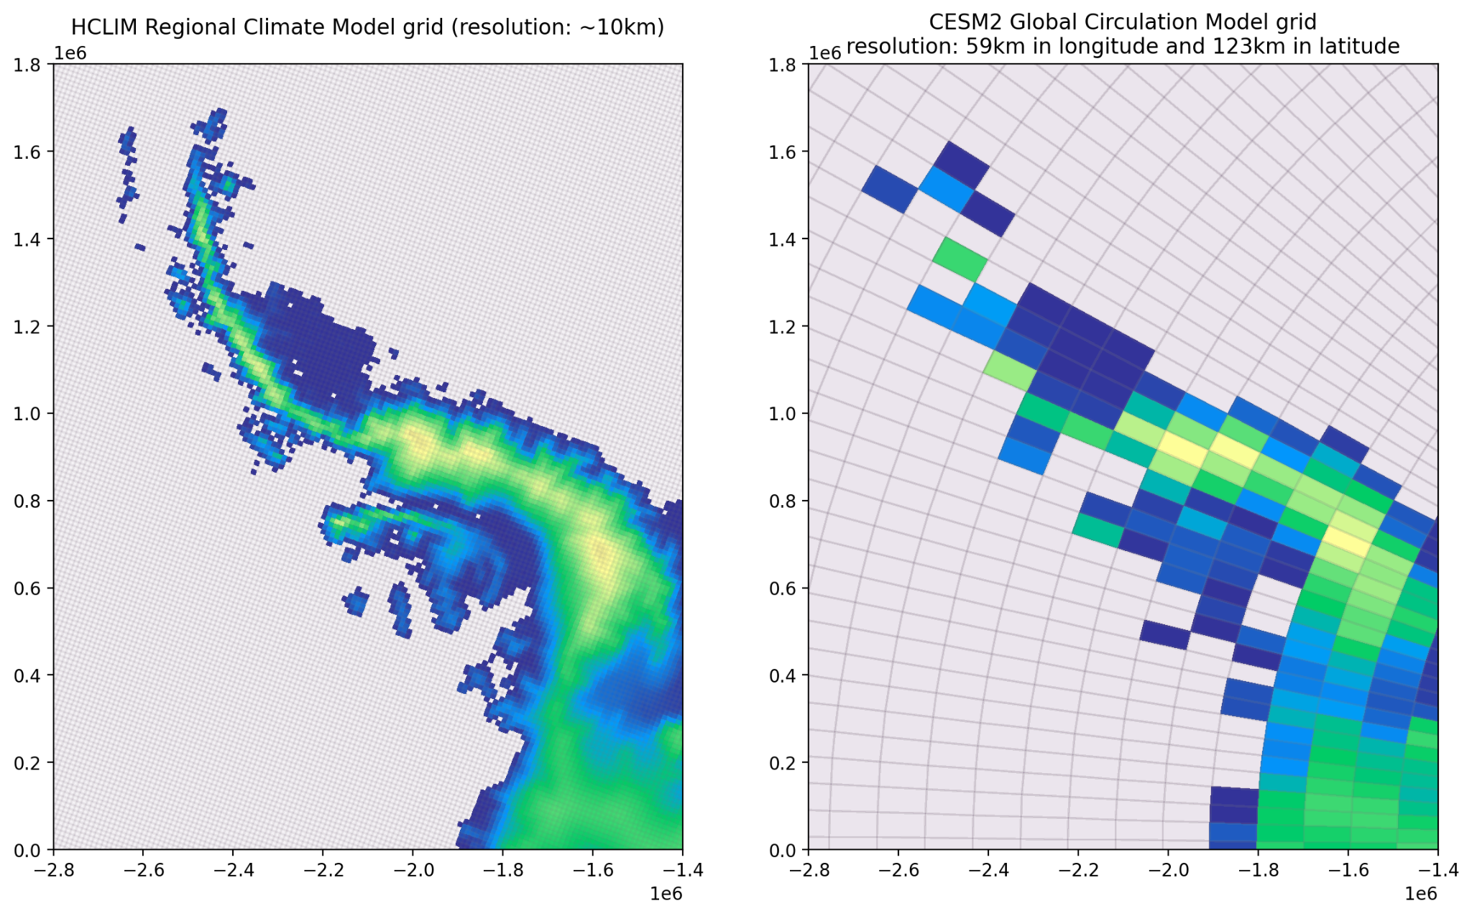



Emulation of Regional Climate Models
Clément Cherblanc¹ ², Emma Zirkel³, Nicolaj Hansen¹, Ruth Mottram¹ ⁴, Christine Schøtt Hvidberg², José Abraham Torres Alavez¹,
1: Danish Meteorological Institute, 2: Niels Bohr Institute, 3: KU Leuven, 4: University of Aarhus
Contact: clc@dmi.dk

Slide 2
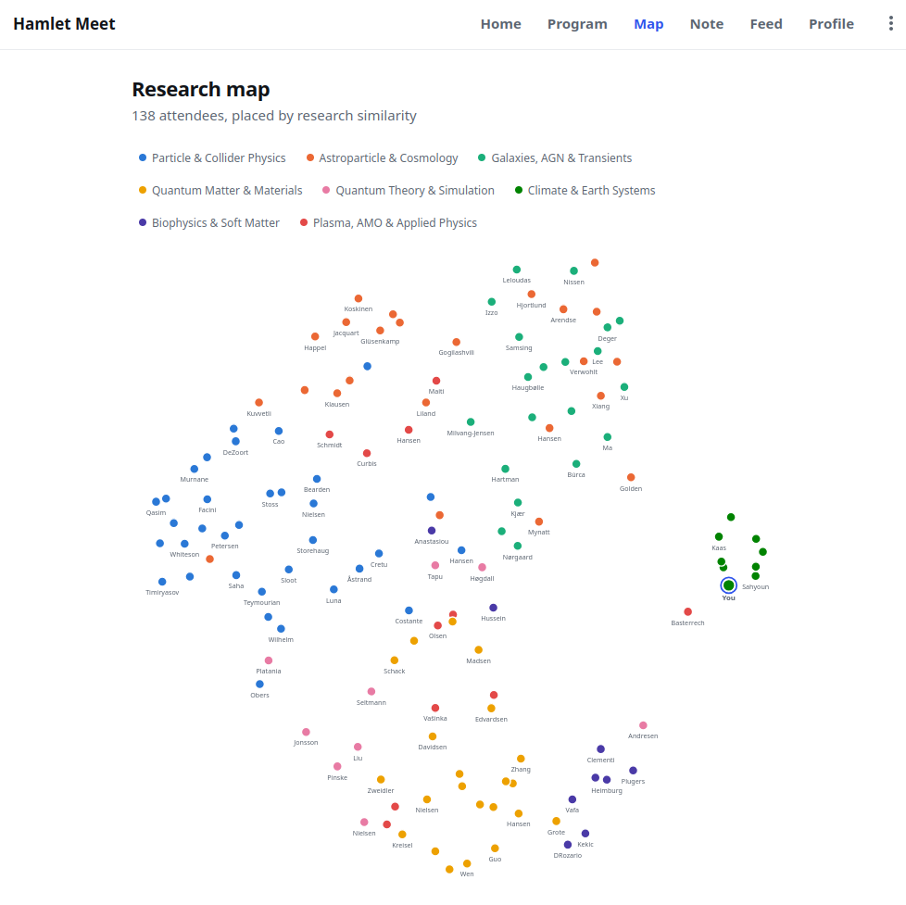

Slide 3
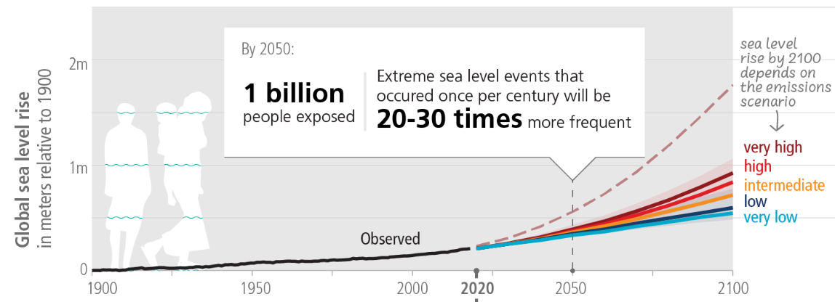
adapted from: IPCC AR6

Slide 4
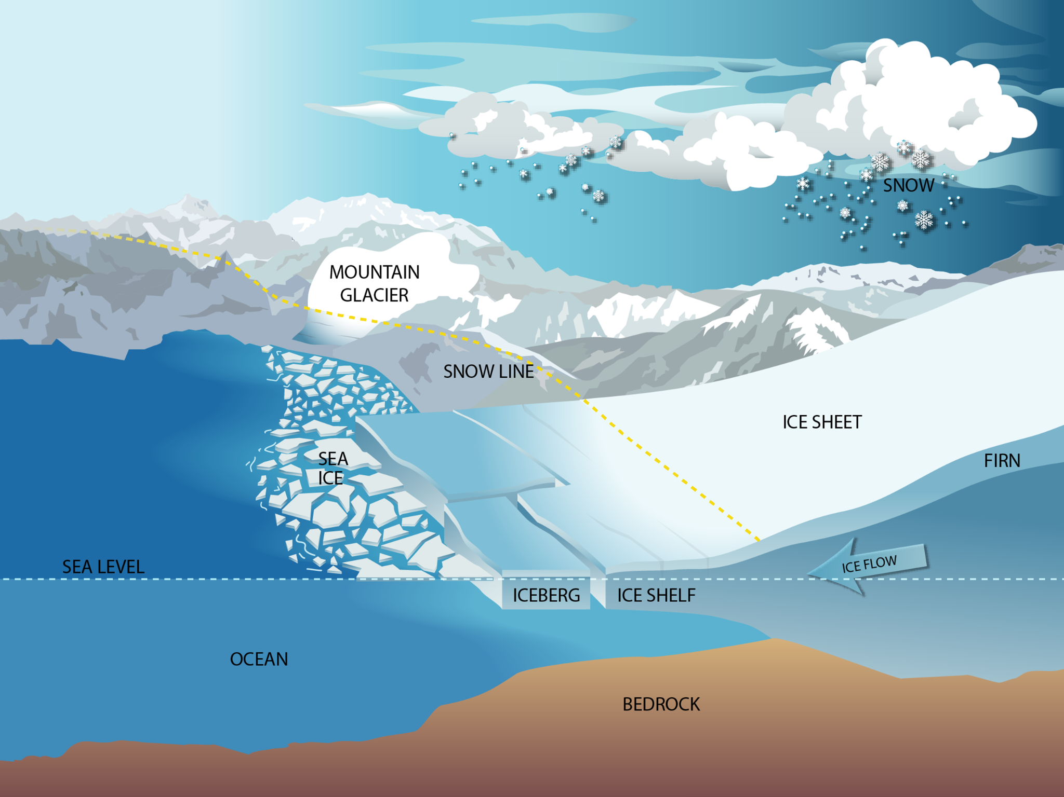
Ice sheet mass balance
⇔
Bank account balance
Some inputs and some outputs
NASA
Notes:
https://sealevel.nasa.gov/understanding-sea-level/regional-sea-level/ice-sheets/

Slide 5
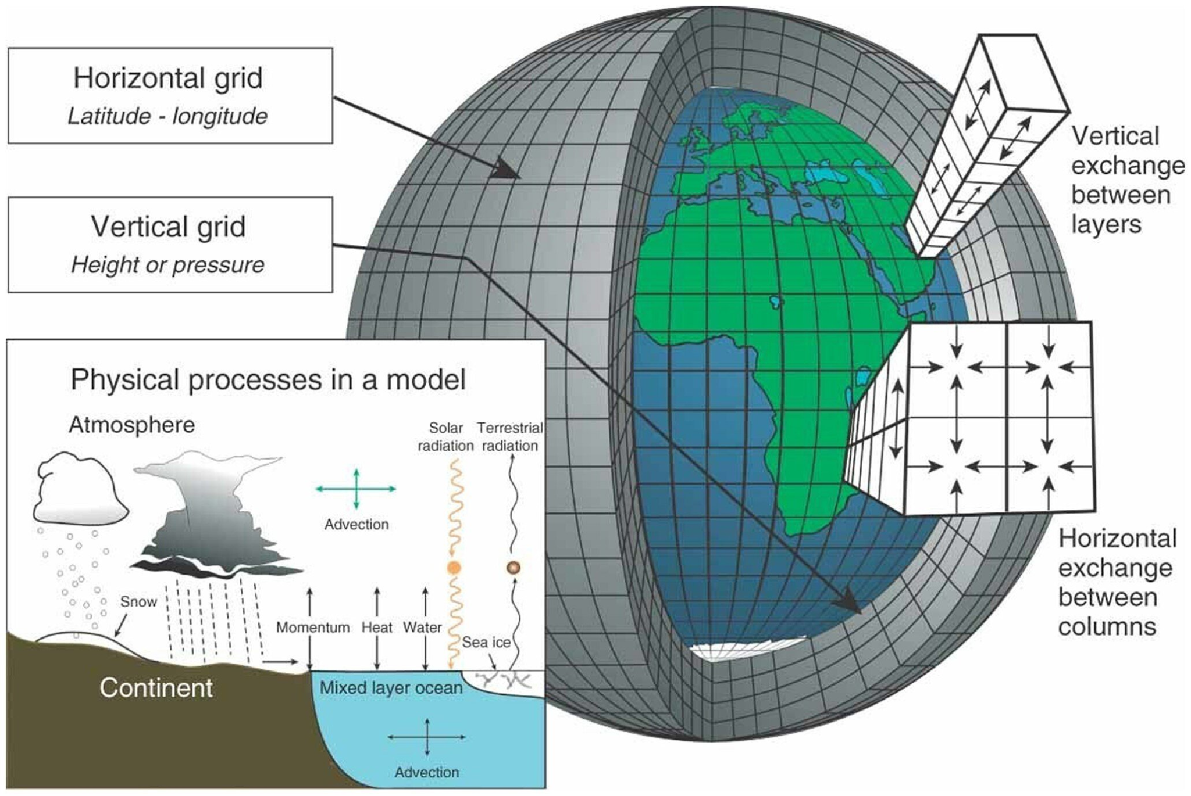
Climate Models:
An oracle into the future?
adapted from: https://www.dataforchildrencollaborative.com/news/future-climate-model-predictions

Slide 6
Earth System Model (ESM, ~100 km grid) Regional Climate Model (RCM, 11km grid)
“Forcing”, or “driving” a RCM with an ESM
But this is a computationally expensive step!

Slide 7
Earth System Model (ESM, ~100 km grid) Regional Climate Model (RCM, 11km grid)
Problem statement:
RCMs improve modelling of snowfall, but they are too computationally expensive, can AI emulators reproduce the output of RCMs with good enough fidelity and realism? In what set-up do they fail to do so and why?
“Forcing”, or “driving” a RCM with an ESM
But this is a computationally expensive step!

Slide 8
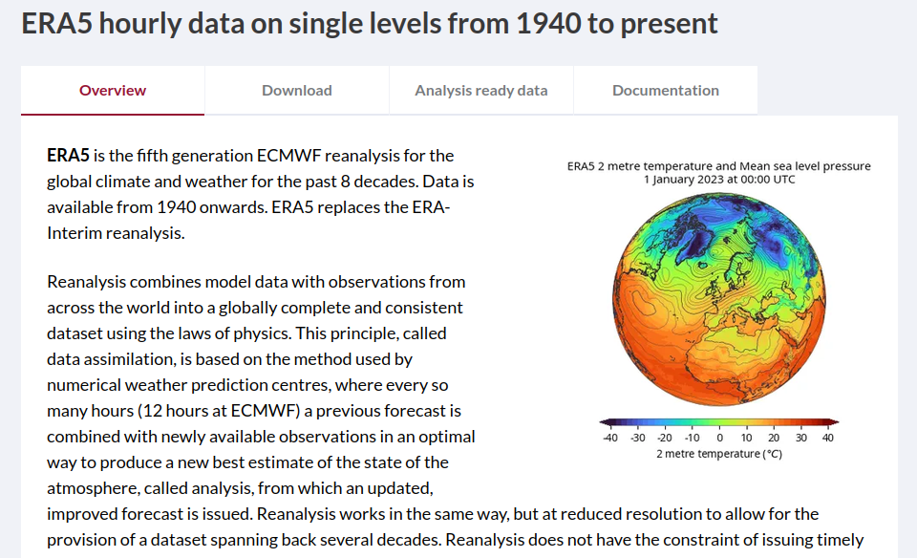
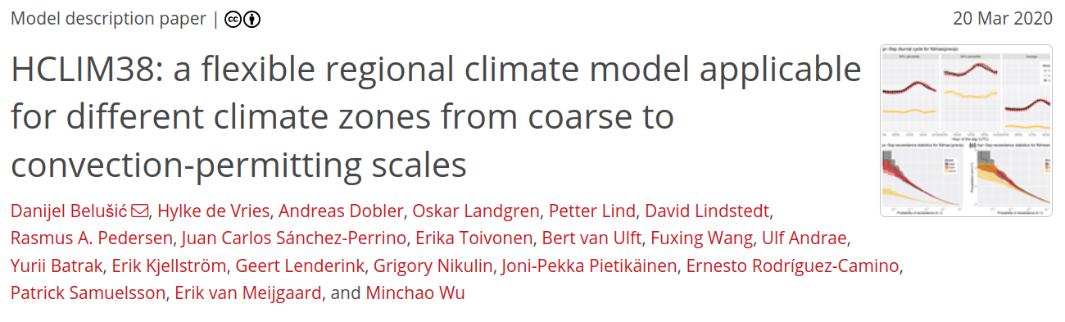
Pick a driver and Regional Model pair: already downscaled by colleagues at DMI
Global model (the predicting variable): the ERA5 reanalysis ~30 km resolution
Regional Climate Model: HCLIM

Slide 9
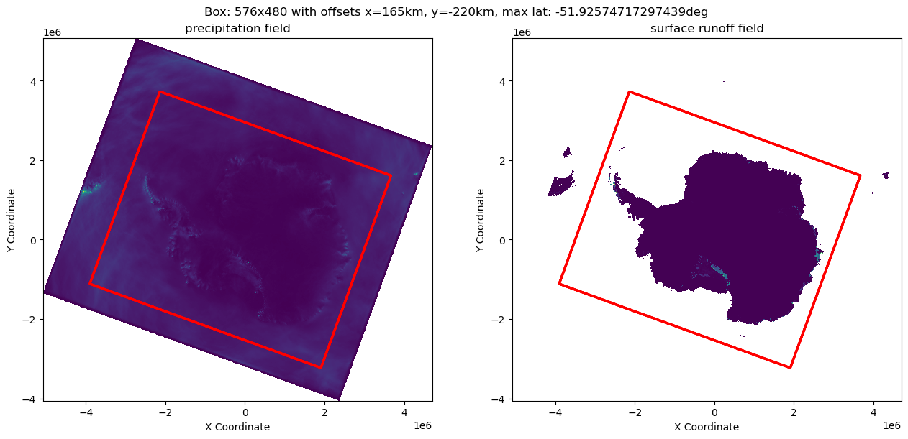
Pick a domain:

Slide 10
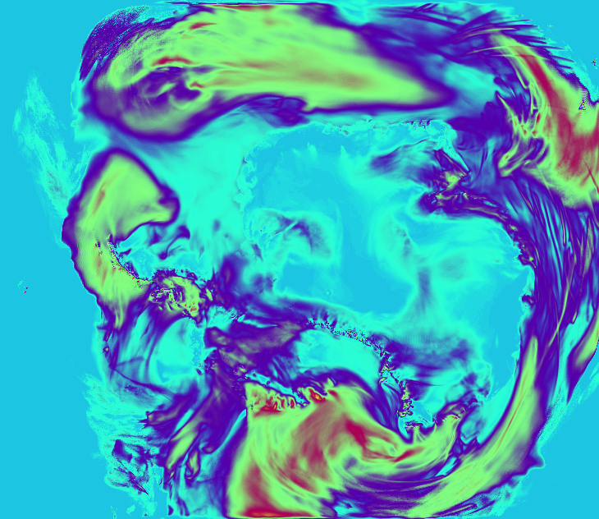
Data description:
8 variables from the ESM/RCM:
temperature
precipitation
evaporation
surface pressure
10m wind speed
surface shortwave down
surface longwave down
surface latent heat flux
8 channels
8 channels
480
~40
~300
Low resolution
576
High resolution
Daily maps, 1985 to 2023 →39 years x ~365 = 14244 time steps / samples

Slide 11
Data description: predicting the differentials
Prediction is not done on the regular RCM output, the predictand variable is:
target - input
RCM - ESM
So the emulator only learns what the RCM has changed.
8 channels
8 channels
480
~40
~300
Low resolution
576
High resolution

Slide 12
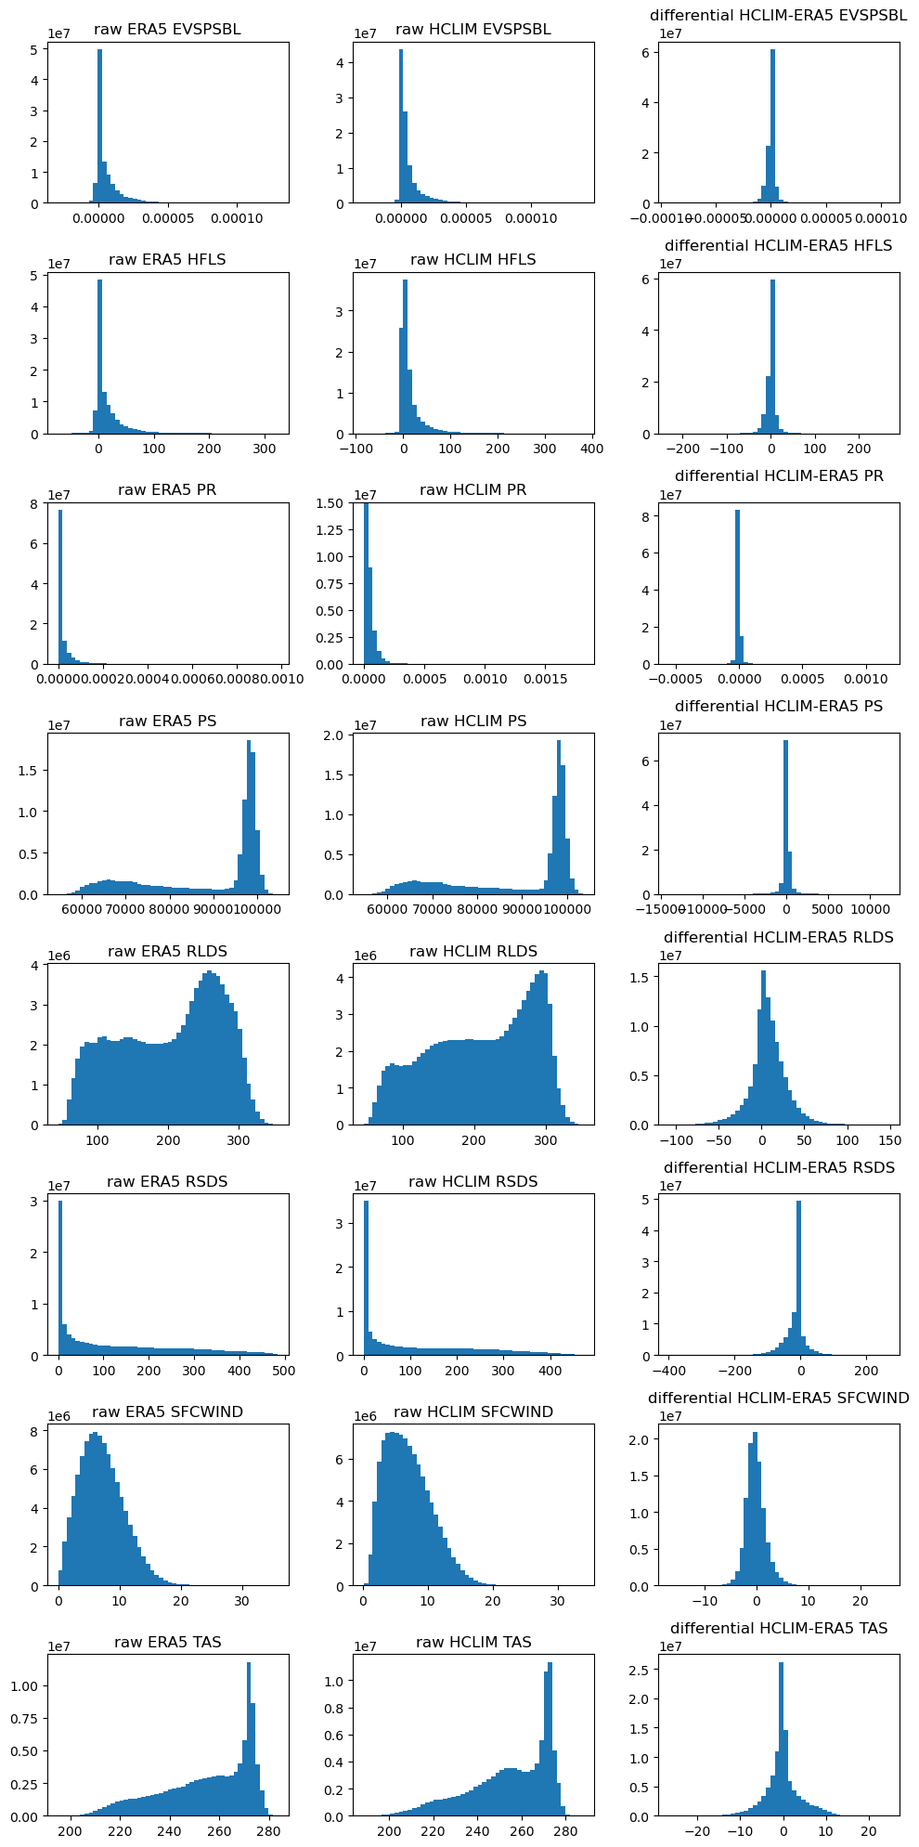
Differentials: reduced skewness in the data: example with all values from 1985 (365 samples)
Predicting predictand diff
8 variables / channels

Slide 13
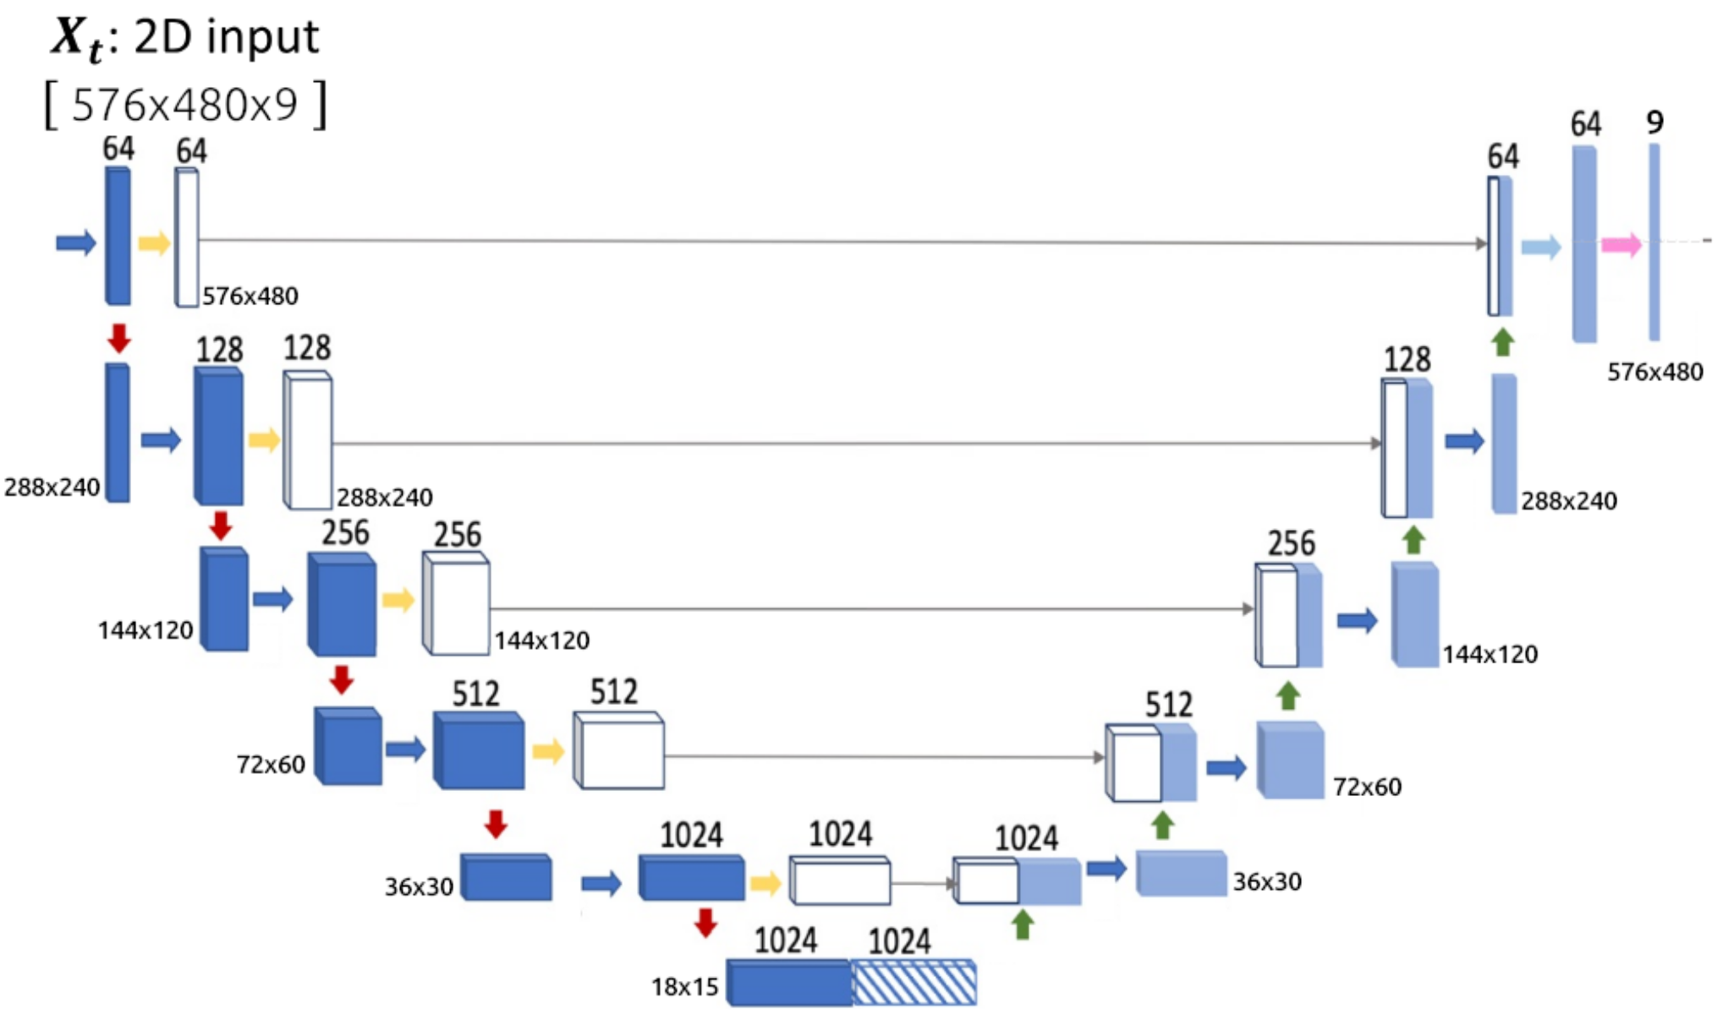
First model: UNet
8
8
8 channels
~40
480
8 channels
~300
Low resolution
576
High resolution
adapted from Van de Meer et al. 2023

Slide 14
Optimization?
8
8
8 channels
~40
480
8 channels
~300
Low resolution
576
High resolution
adapted from Van de Meer et al. 2023

Slide 15
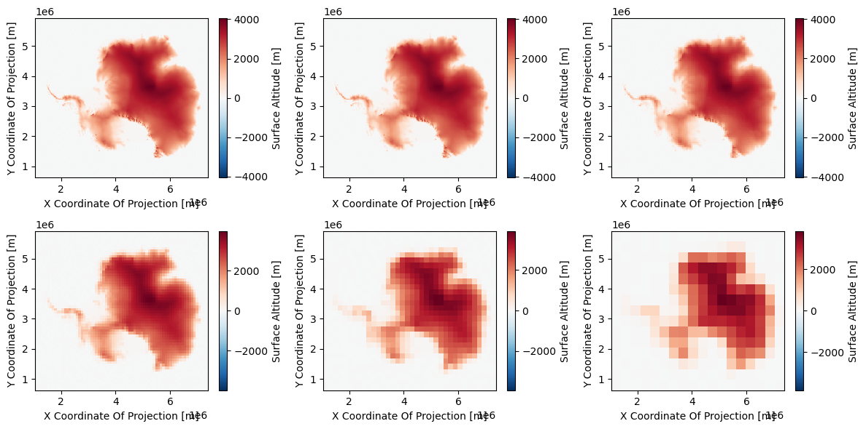
Optimization?
8
8
8 channels
~40
480
8 channels
~300
Low resolution
576
High resolution
adapted from Van de Meer et al. 2023

Slide 16
Train-val-test split and normalization strategy
To start with: this applies to the predicting variables, and the predictand
training: years 1985 to 2004
val: 2005 - 2013
test: 2014 - 2024
Compute the mean 𝛍train and standard deviation σtrain
Normalize all datasets with 𝛍train and σtrain
This method retains the information of whether it was a cold or warm year, a wet or dry year, etc.
This may fail if extrapolating to never-seen-before values

Slide 17
Model choices?
It will depend on the application:
reasonably good output to drive snow models: UNet
make the emulator compatible between ESMs (different input grids): GCNN
Understanding the spatial patterns and transcend scales: neural operators
ensembles of values: generative (mainly)
realistic output: generative
etc.
Realism
worse performance
improved “physics”
much more realistic patterns
Super-resolution
Good R and RMSE
smoothed output
UNet
GCNN
Neural Operators
Flow Matching
Physics-informed Loss

Slide 18
A first look at the results

Slide 19
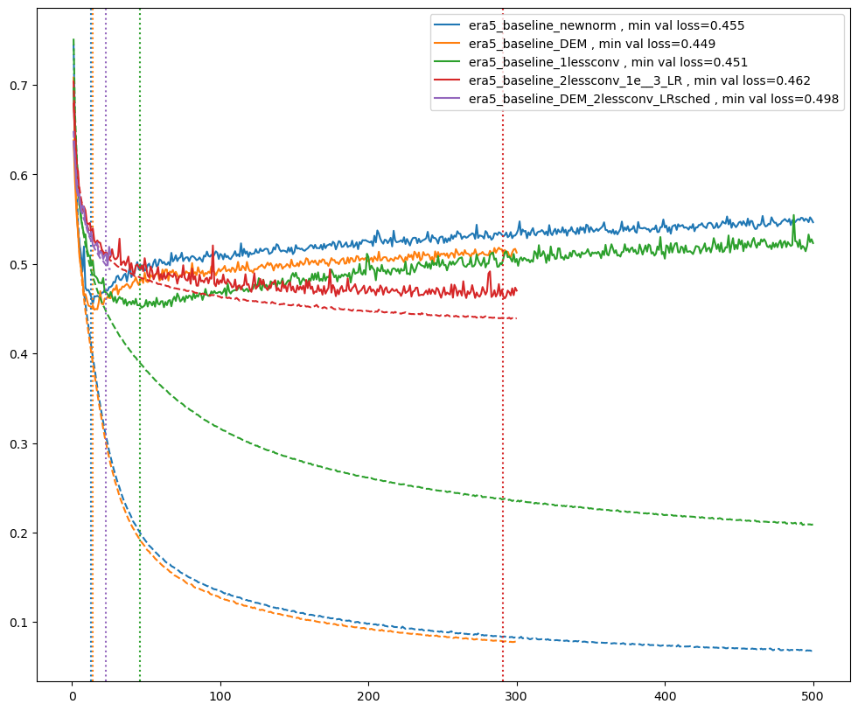
Very preliminary UNet model
Hyper parameter and model optimization to get a robust baseline
Analyze output from a physical perspective

Slide 20
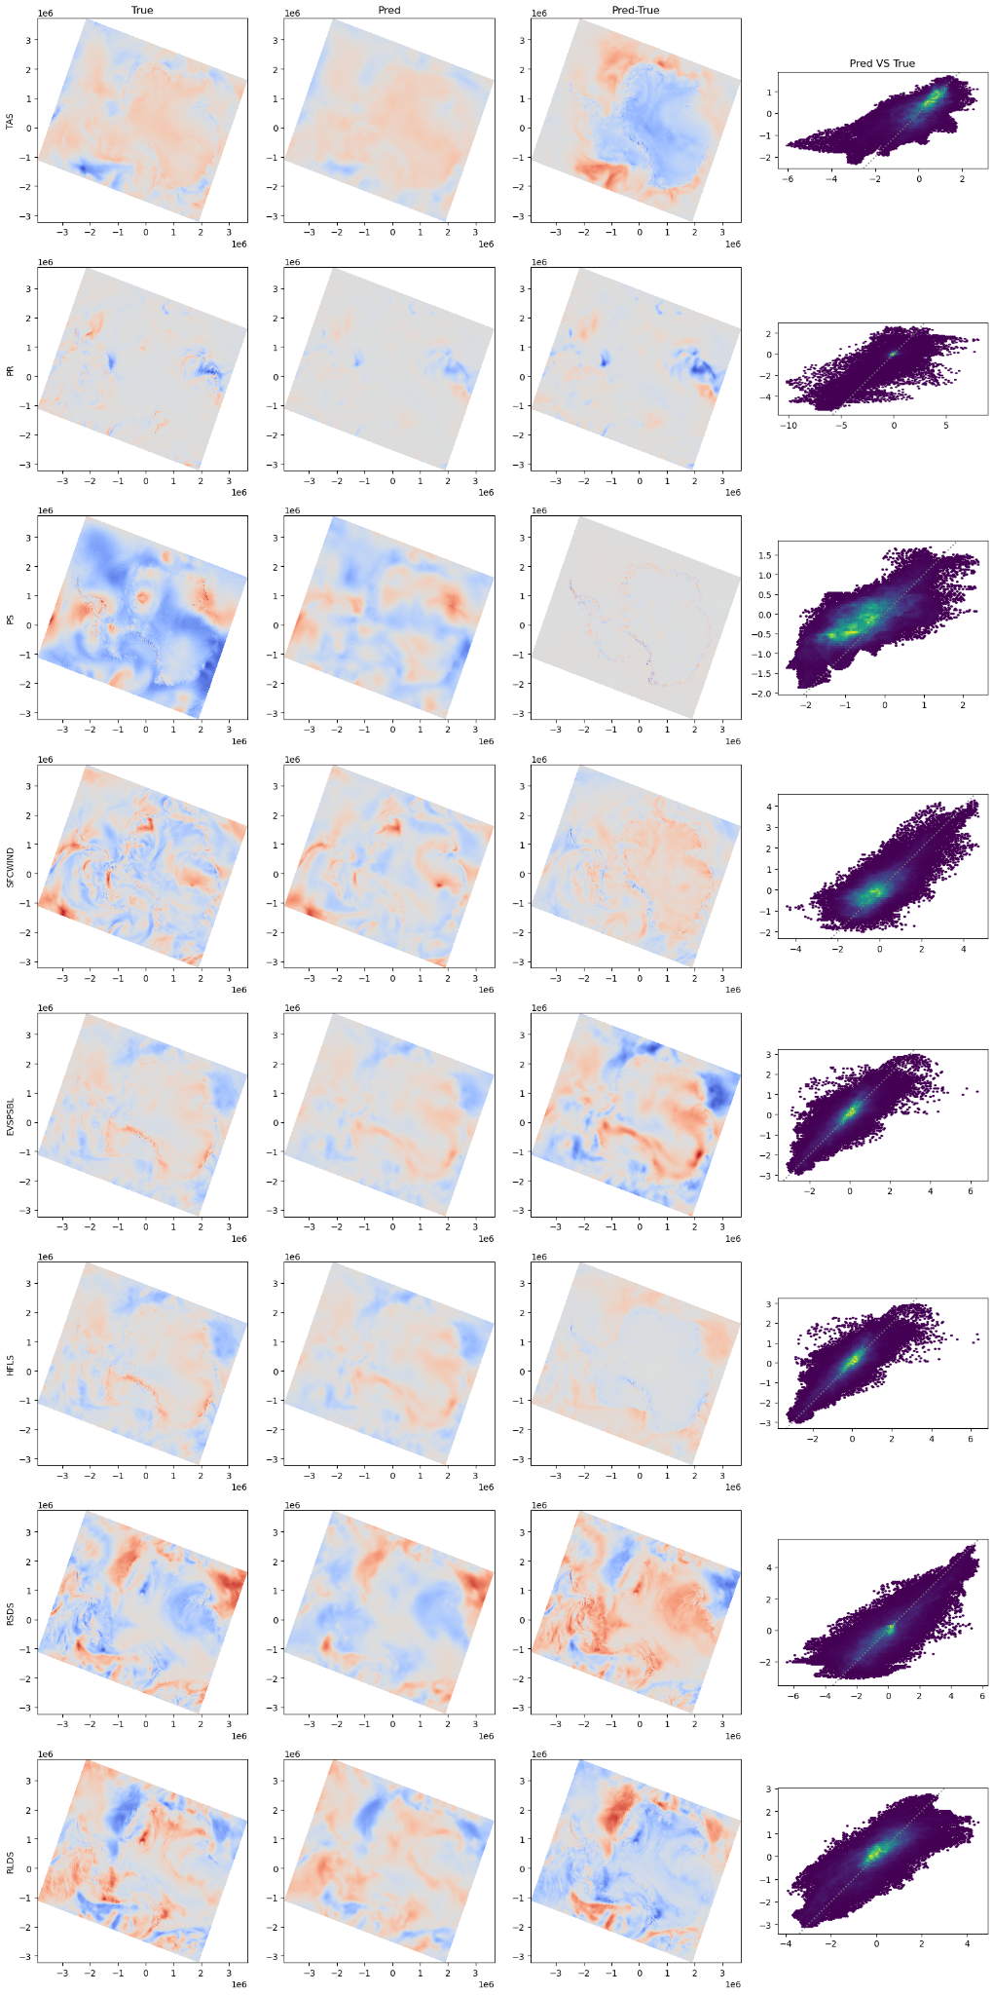
True Pred diff pred VS true
8 variables / channels
Output is too smooth, with some regional biases

Slide 21
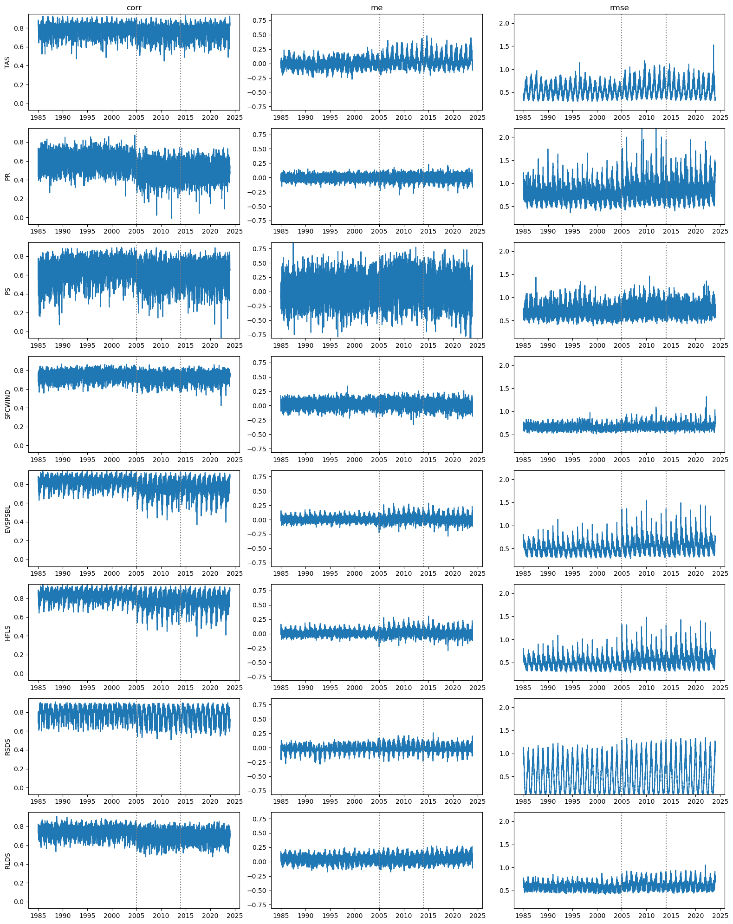
Correlation mean error RMSE
training data val. testing
8 variables / channels
Only a “small” decline in performance on the test set. 6% drop in R, 9% increase in RMSE
The test performance is still better than the interpolation baseline, and this is not the fine-tuned model yet.

Slide 22
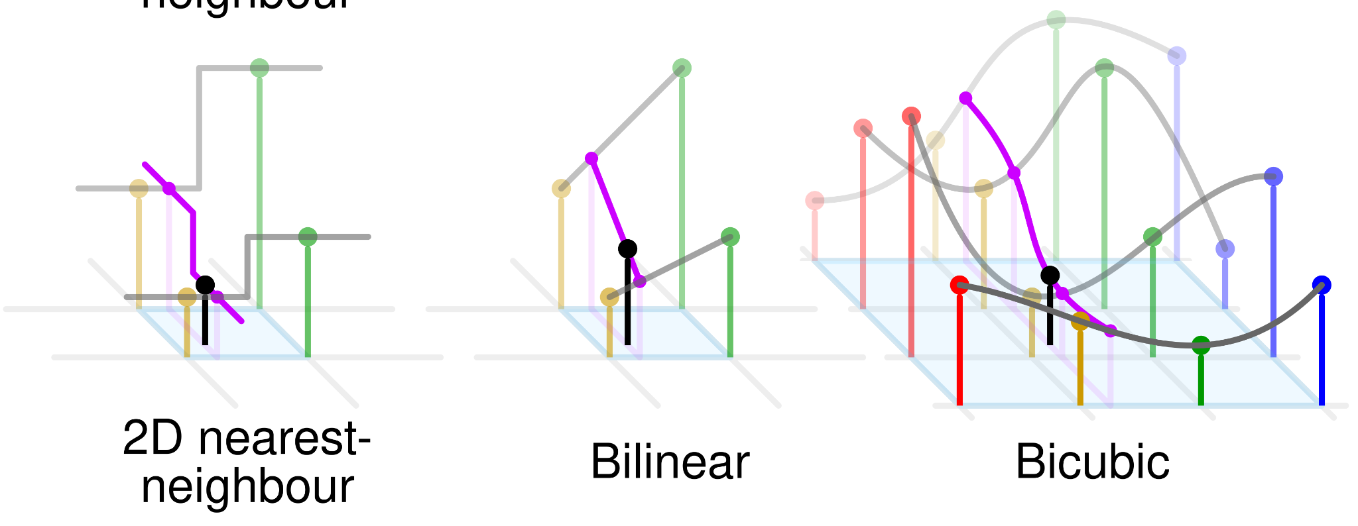
About baseline: how does interpolation compare?
Adapted from https://en.wikipedia.org/wiki/Linear_interpolation#/media/File:Comparison_of_1D_and_2D_interpolation.svg

Slide 23
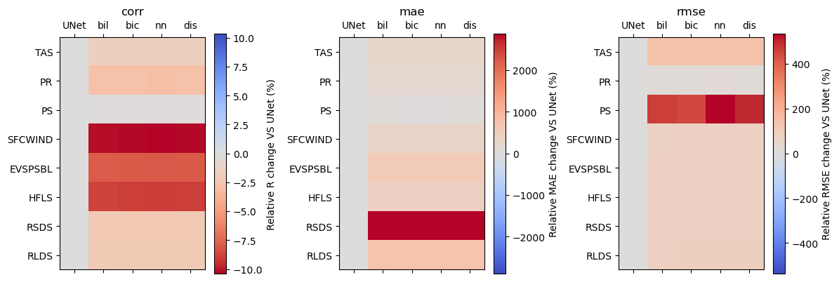
Preliminary results: red = the emulator predicts better than simple interpolation metrics
Great! Our preliminary emulator is useful already

Slide 24
Next steps
Finalize the UNet architecture
Flow Matching →more realistic patterns? Potential for a recurrent model?
Towards a universal emulator?
Realism
worse performance
improved “physics”
much more realistic patterns
Super-resolution
Good R and RMSE
smoothed output
UNet
GCNN
Neural Operators
Flow Matching
Physics-informed Loss

Slide 25
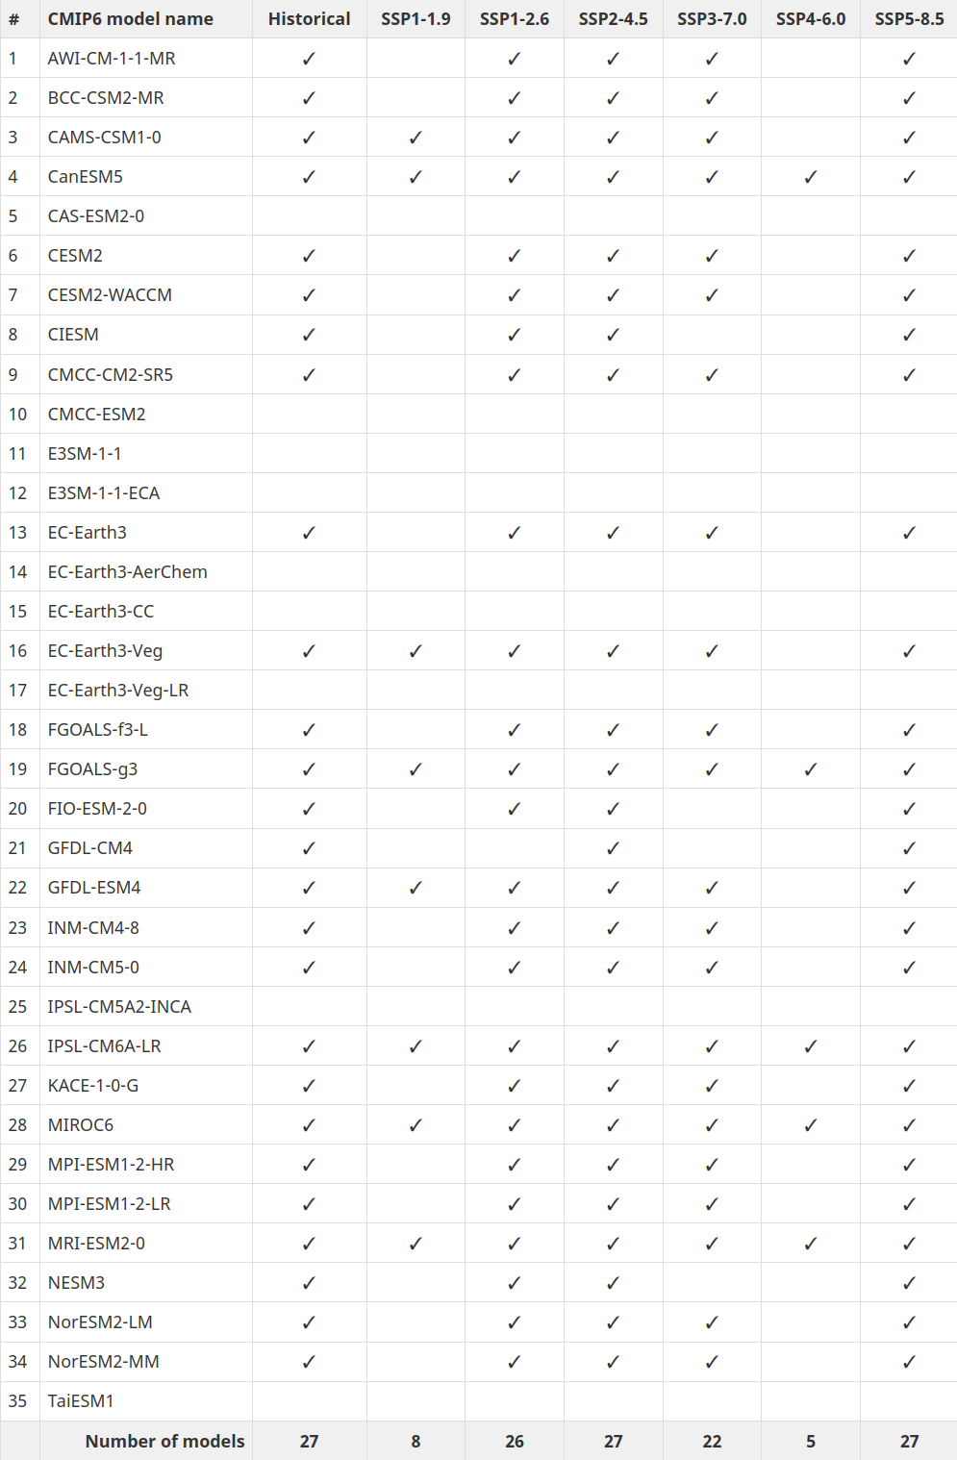
Towards a universal emulator?
So far we trained on ERA5, but there are many more coarse models available!
from: https://climate-scenarios.canada.ca/?page=cmip6-model-list

Slide 26
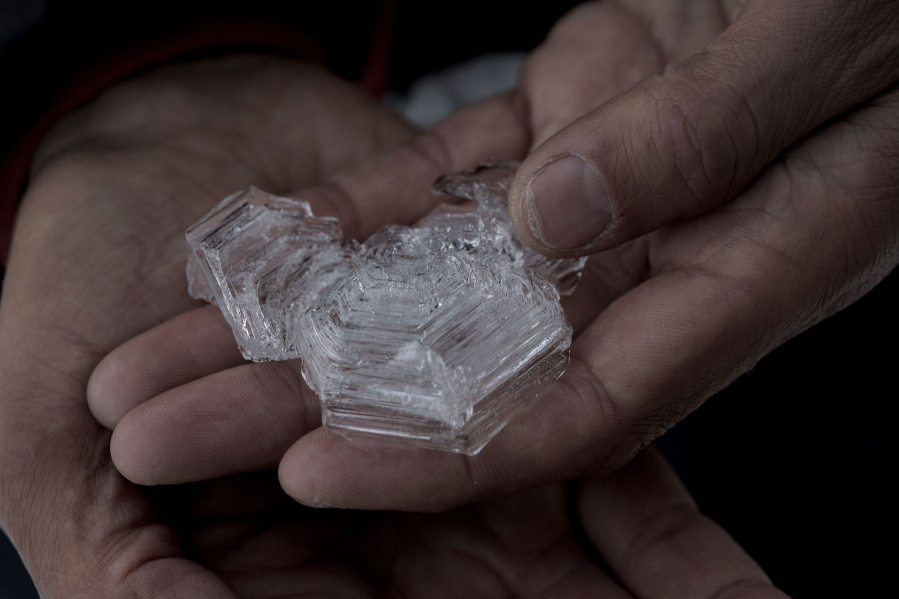
Any questions?
Feel free to email us at: clc@dmi.dk; rum@dmi.dk

