Slide 1



From Micro to Macro-World: Device-Agnostic Single-Emitter Super-Resolution Imaging using Deep Learning
IGA-PrF-2024-008
IGA-PrF-2025-010
Project Optical technologies
Reg. no. CZ.02.01.01/00/23_021/0008790
Programme Johannes Amos Comenius
IGA-PrF-2026-005
Dominik Vašinka
Department of Optics, Faculty of Science,
Palacký University Olomouc

Slide 2


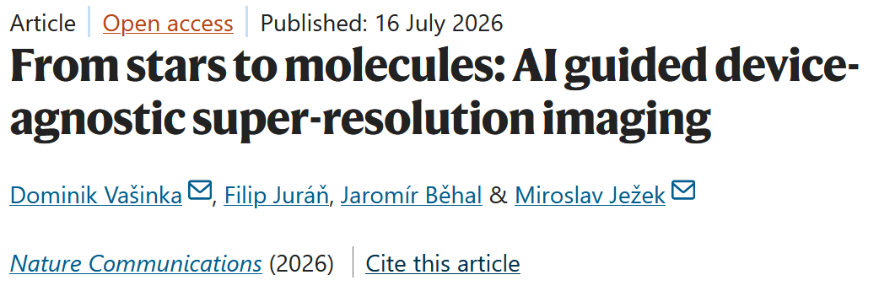
Super-resolution
Main benefits:
Device-agnostic & calibration-free
Single-pass reconstruction
Robust generalizability
From astronomy, to molecules and quantum dots
Art by Monika Tomanová

Slide 3
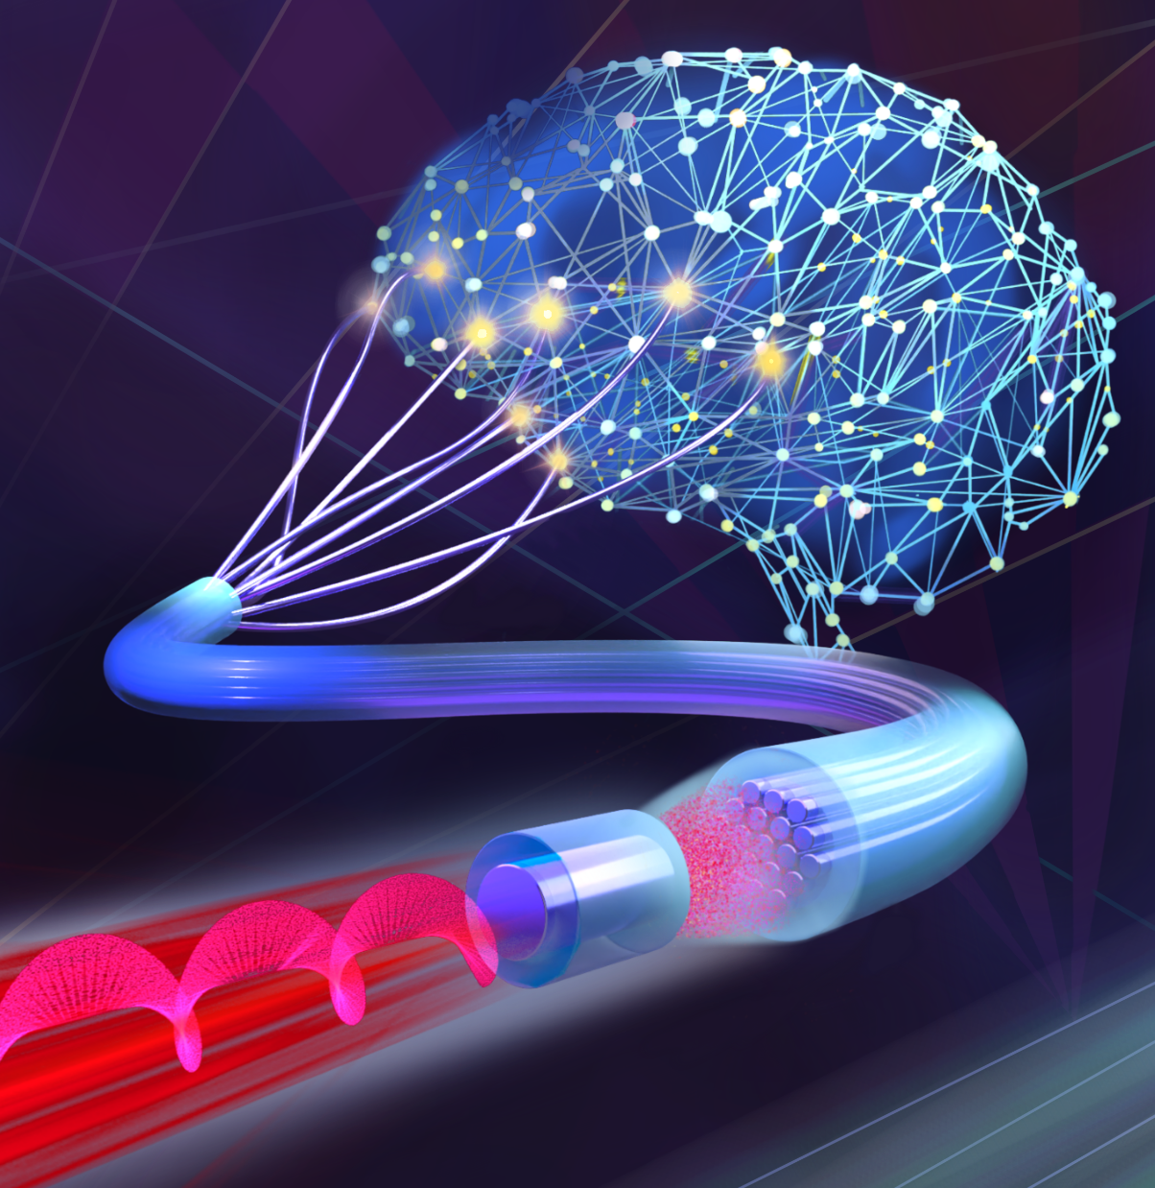
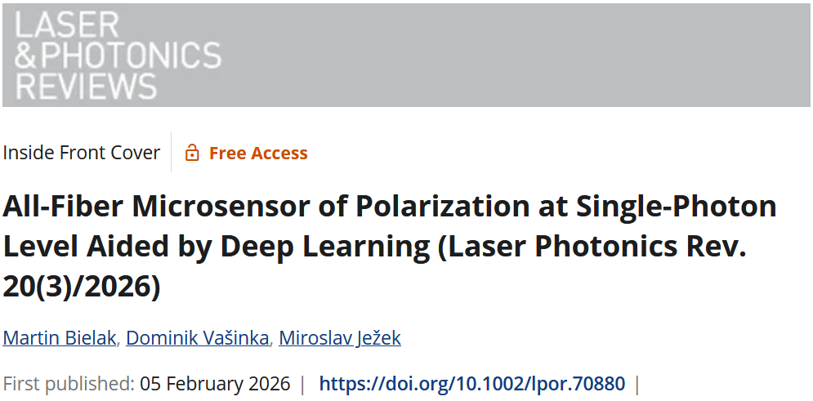
Polarization sensor
Main benefits:
Single-photon sensitivity
Single shot polarization measurement
Rapid speed
Feasible for constrained spaces
Long term stability
Art by Monika Tomanová

Slide 4
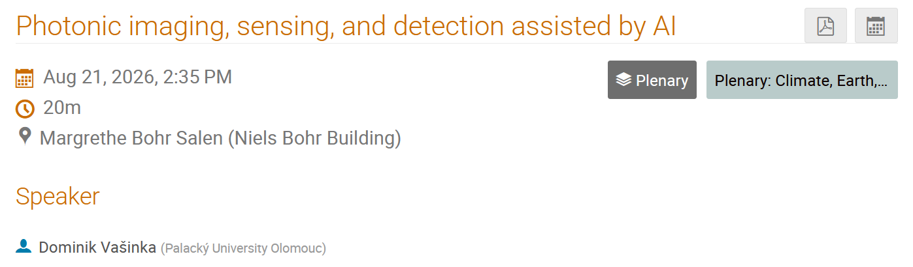

Thank you for your attention
and join me for the main talk

