Slide 1



Machine Learning and Data-Driven Discovery of the Atlantic Meridional Overturning Circulation
Qi-fan Wu, Dion Häfner, Roman Nuterman, Guido Vettoretti and Markus Jochum
Niels Bohr Institute Physics of Ice, Climate and Earth Section
University of Copenhagen

Slide 2
Outline of Talk
 A brief introduction to the research background and datasets
There is no analytical framework for deep ocean circulation, including the Atlantic Meridional Overturning Circulation (AMOC). Can we learn such a framework from data? Can its dynamics be reproduced using coupled equations?
● Further research: How can our method be applied in the real world?

Slide 3
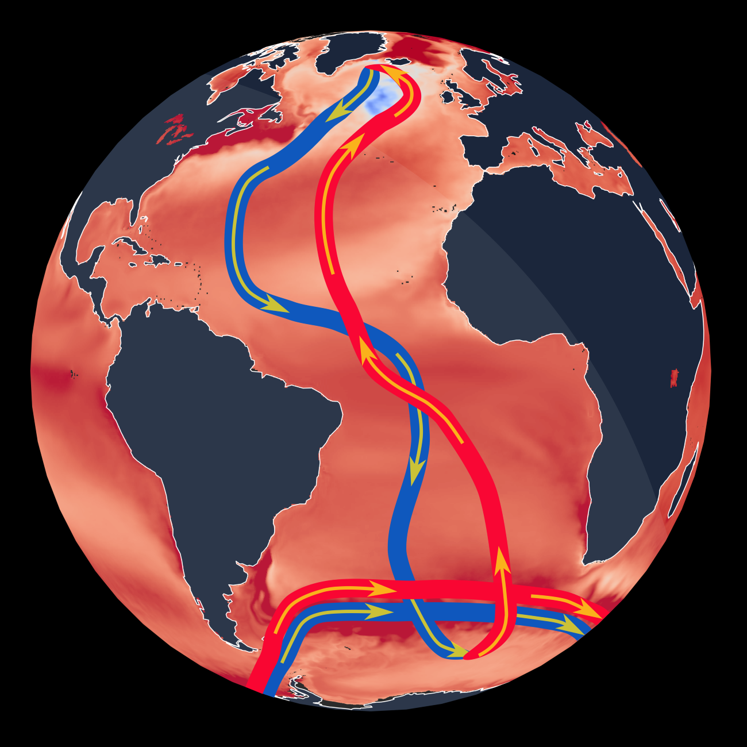
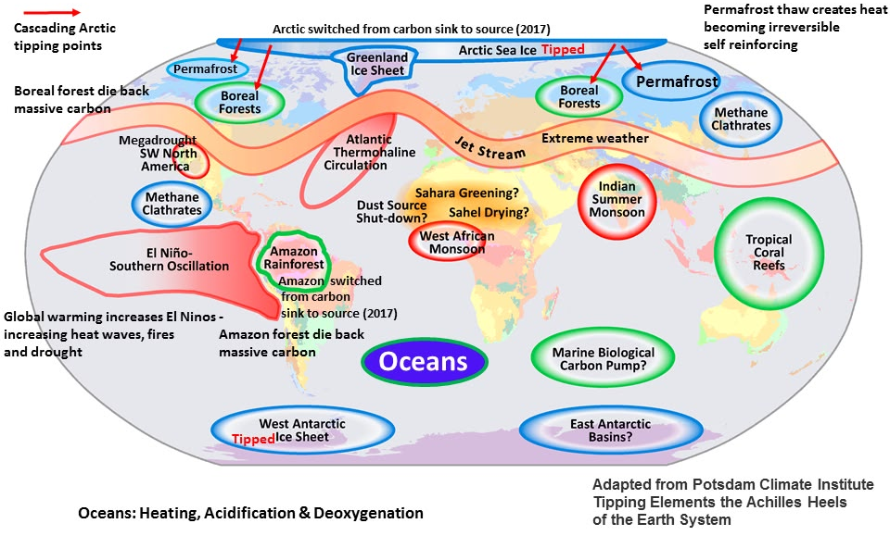
What is the AMOC?
Why is it important?
Current system in the Atlantic that transports heat and salt
AMOC plays a key role in shaping Earth's climate by moving heat, freshwater, and nutrients around the Atlantic Ocean. An AMOC collapse would likely cause widespread and rapid climate changes around the world.
There is no analytical framework for the AMOC, and a unifying theory that fully explains them is still lacking
Notes:
It's basically a huge system of ocean currents in the Atlantic that moves warm, salty water northward near the surface and returns colder, denser water southward deep below.
The meridional overturning circulation is a two-dimensional representation of a complex three-dimensional circulation that is derived by zonal integration from boundary to boundary. It includes components of the buoyance-driven and wind-driven circulations.

Slide 4
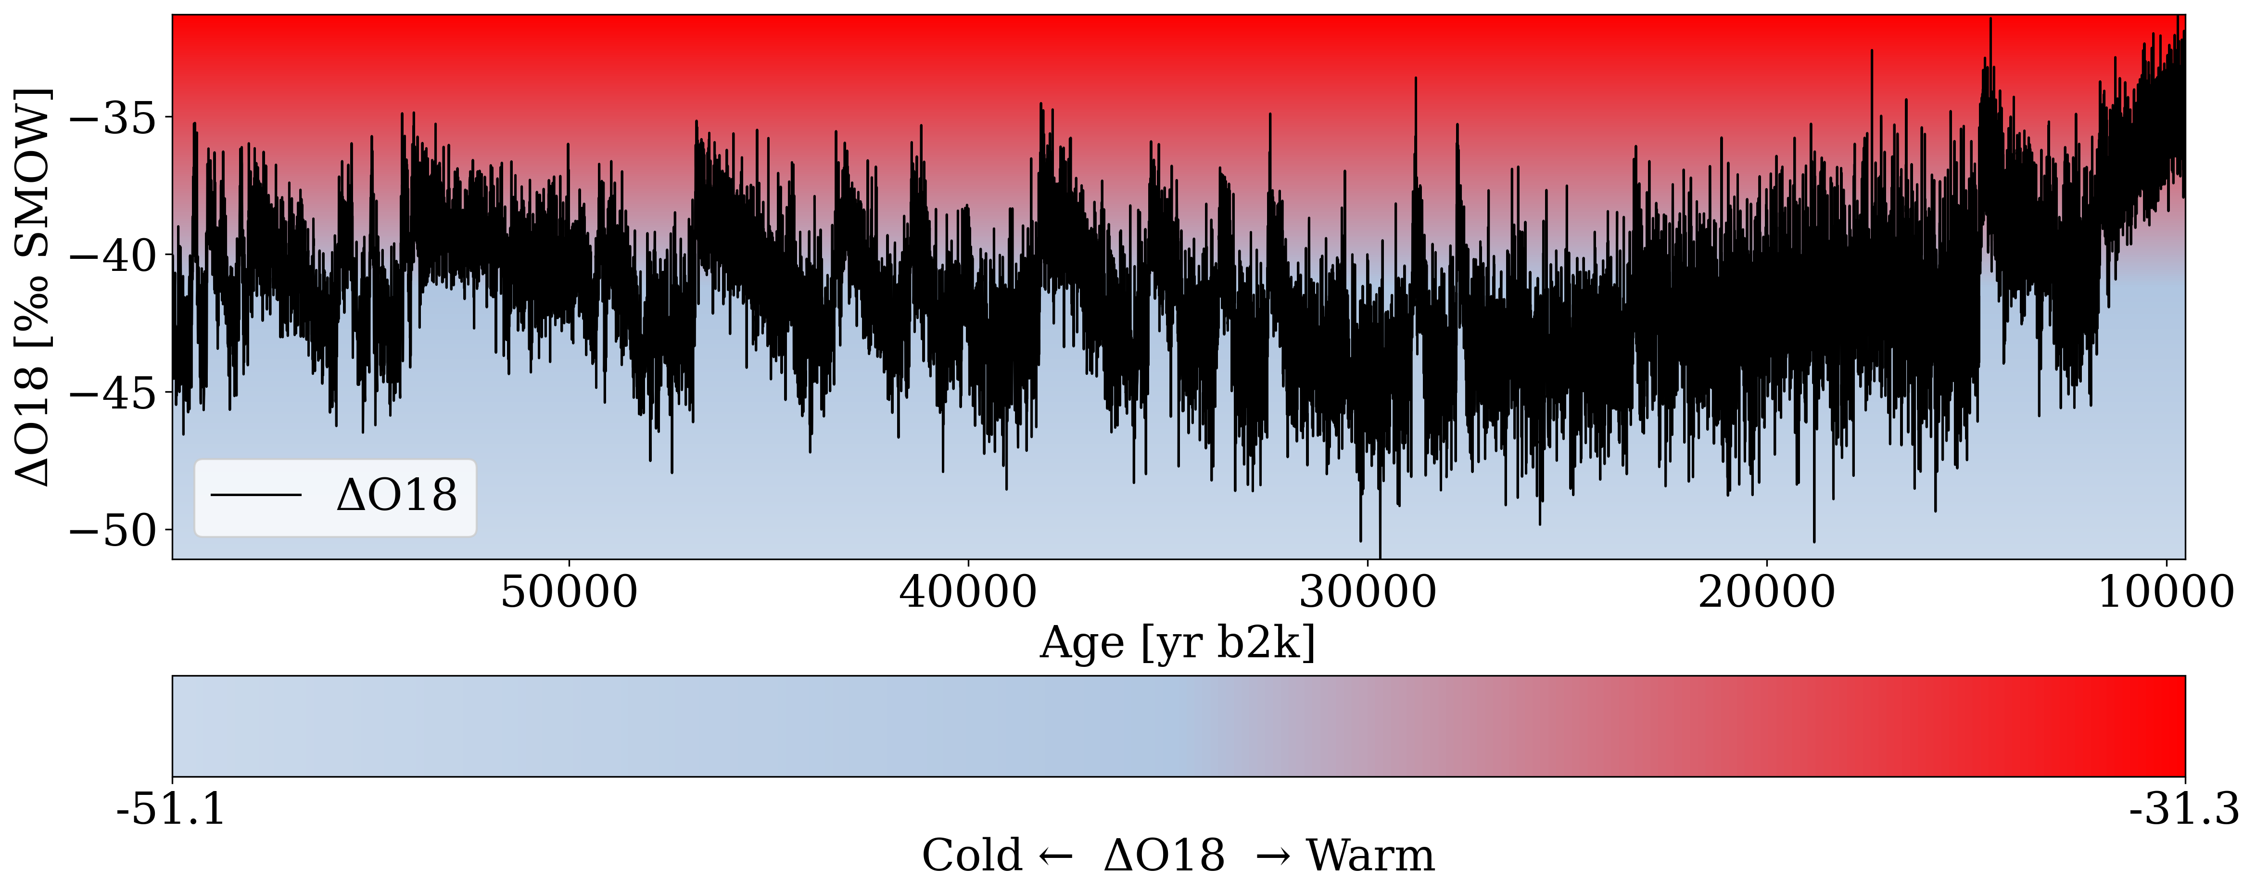
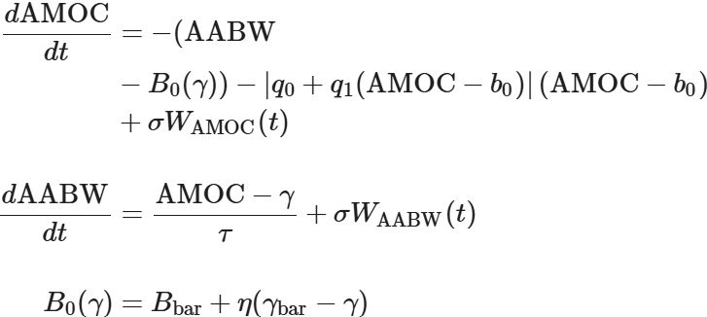
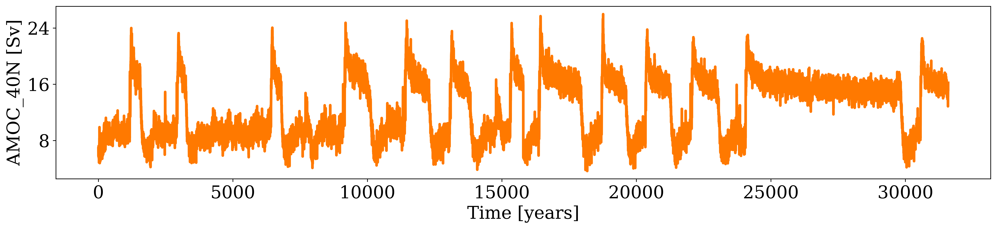
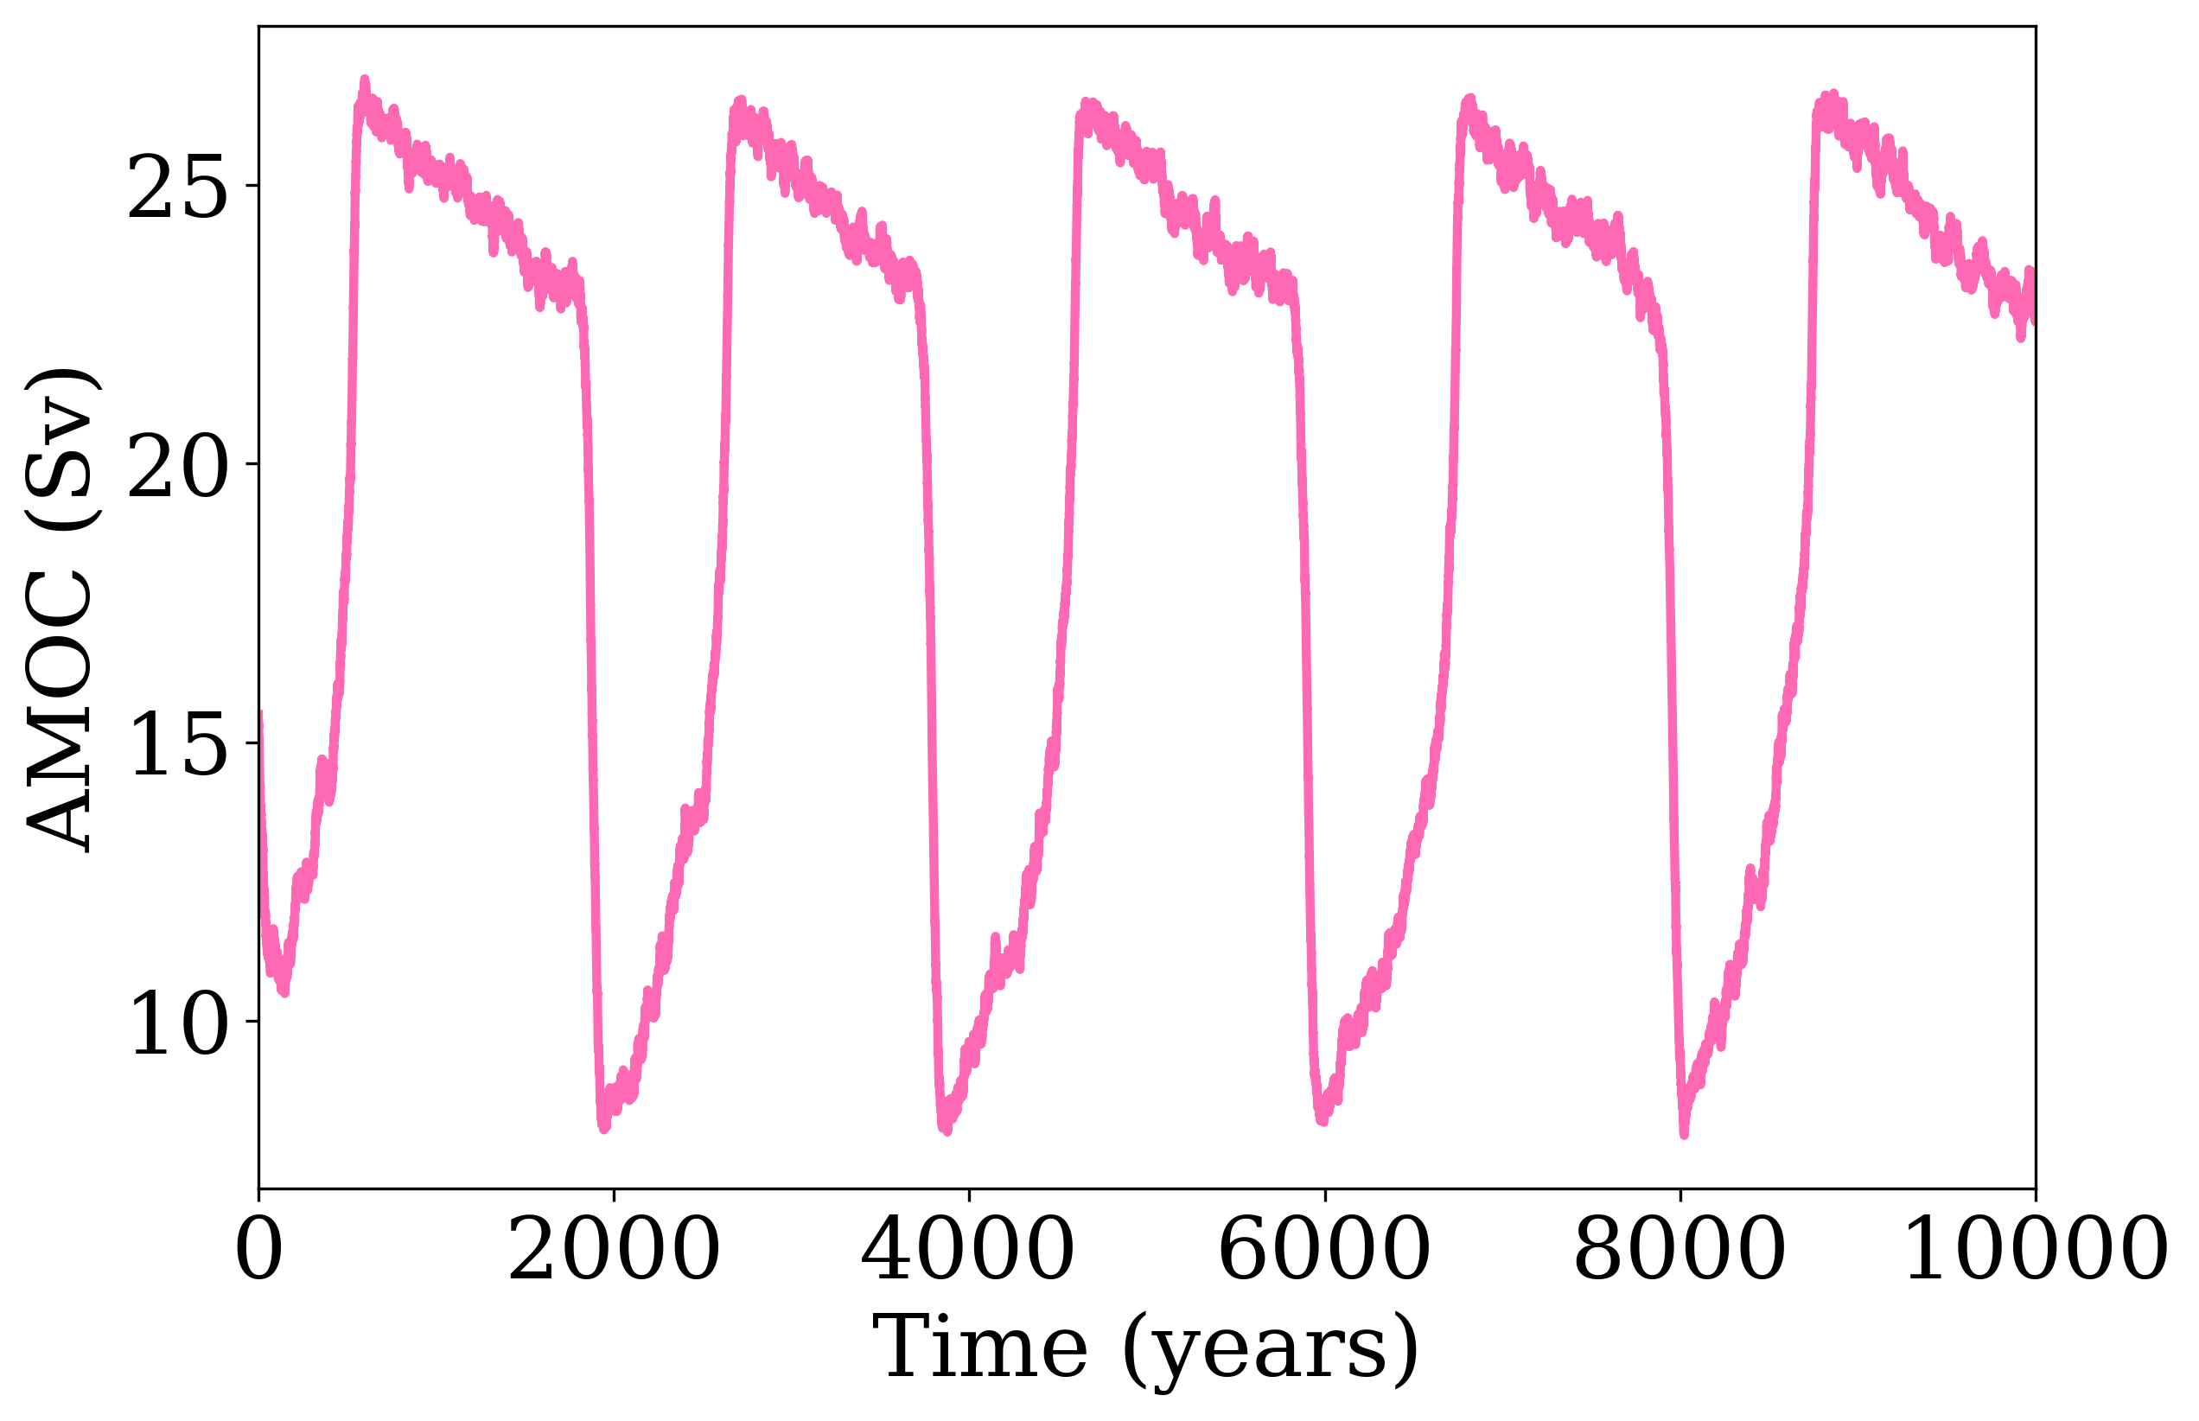
Introduction and Dataset
Data Source: Vettoretti et al., 2022
Dansgaard-Oeschger (D-O) Events reported in Greenland ice cores
Abrupt warming and gradual cooling
Proposed a set of stochastic differential equations (SDEs) as the simple model that emulate AMOC transitions based on the FitzHugh-Nagumo model
(Data Source: NGRIP)
The Community Earth System Model (CESM) is a computationally expensive climate model that can reproduce observations. Under glacial boundary conditions, CESM reproduces the observed structure of Dansgaard-Oeschger (D-O) events, which is closely linked to AMOC strength.
(Data Source: Vettoretti et al., Nature Geoscience, 2022)
Notes:
Earth system models (ESMs) integrate the interactions of atmosphere, ocean, land, ice, and biosphere to estimate the state of regional and global climate

Slide 5
Introduction and Dataset
Data Source: Vettoretti et al., 2022
Dansgaard-Oeschger (D-O) Events reported in Greenland ice cores
Abrupt warming and gradual cooling
Proposed a set of stochastic differential equations as the simple model that emulate AMOC transitions based on the FitzHugh-Nagumo model
CESM is a computationally expensive climate model that reproduces observations. We use CESM output to learn a set of SDEs directly from the data.
(Data Source: NGRIP)
The Community Earth System Model (CESM) is a computationally expensive climate model that can reproduce observations. Under glacial boundary conditions, CESM reproduces the observed structure of Dansgaard-Oeschger (D-O) events, which is closely linked to AMOC strength.
(Data Source: Vettoretti et al., Nature Geoscience, 2022)
Notes:
Earth system models (ESMs) integrate the interactions of atmosphere, ocean, land, ice, and biosphere to estimate the state of regional and global climate

Slide 6
Method
32,000 years of time-series data from CESM simulations, covering AMOC strength, surface freshwater flux (SFWF), and potential density at 200 m depth (PD_200m)
Data In
A coupled neural surrogate uses two variables to predict the third via a neural network and a sliding-window approach (using 50 years of historical data to predict the target 20 years ahead)
Model Out
The surrogate is run autoregressively, with and without perturbations, to generate deterministic and stochastic ensemble simulations for evaluating AMOC predictability

Slide 7
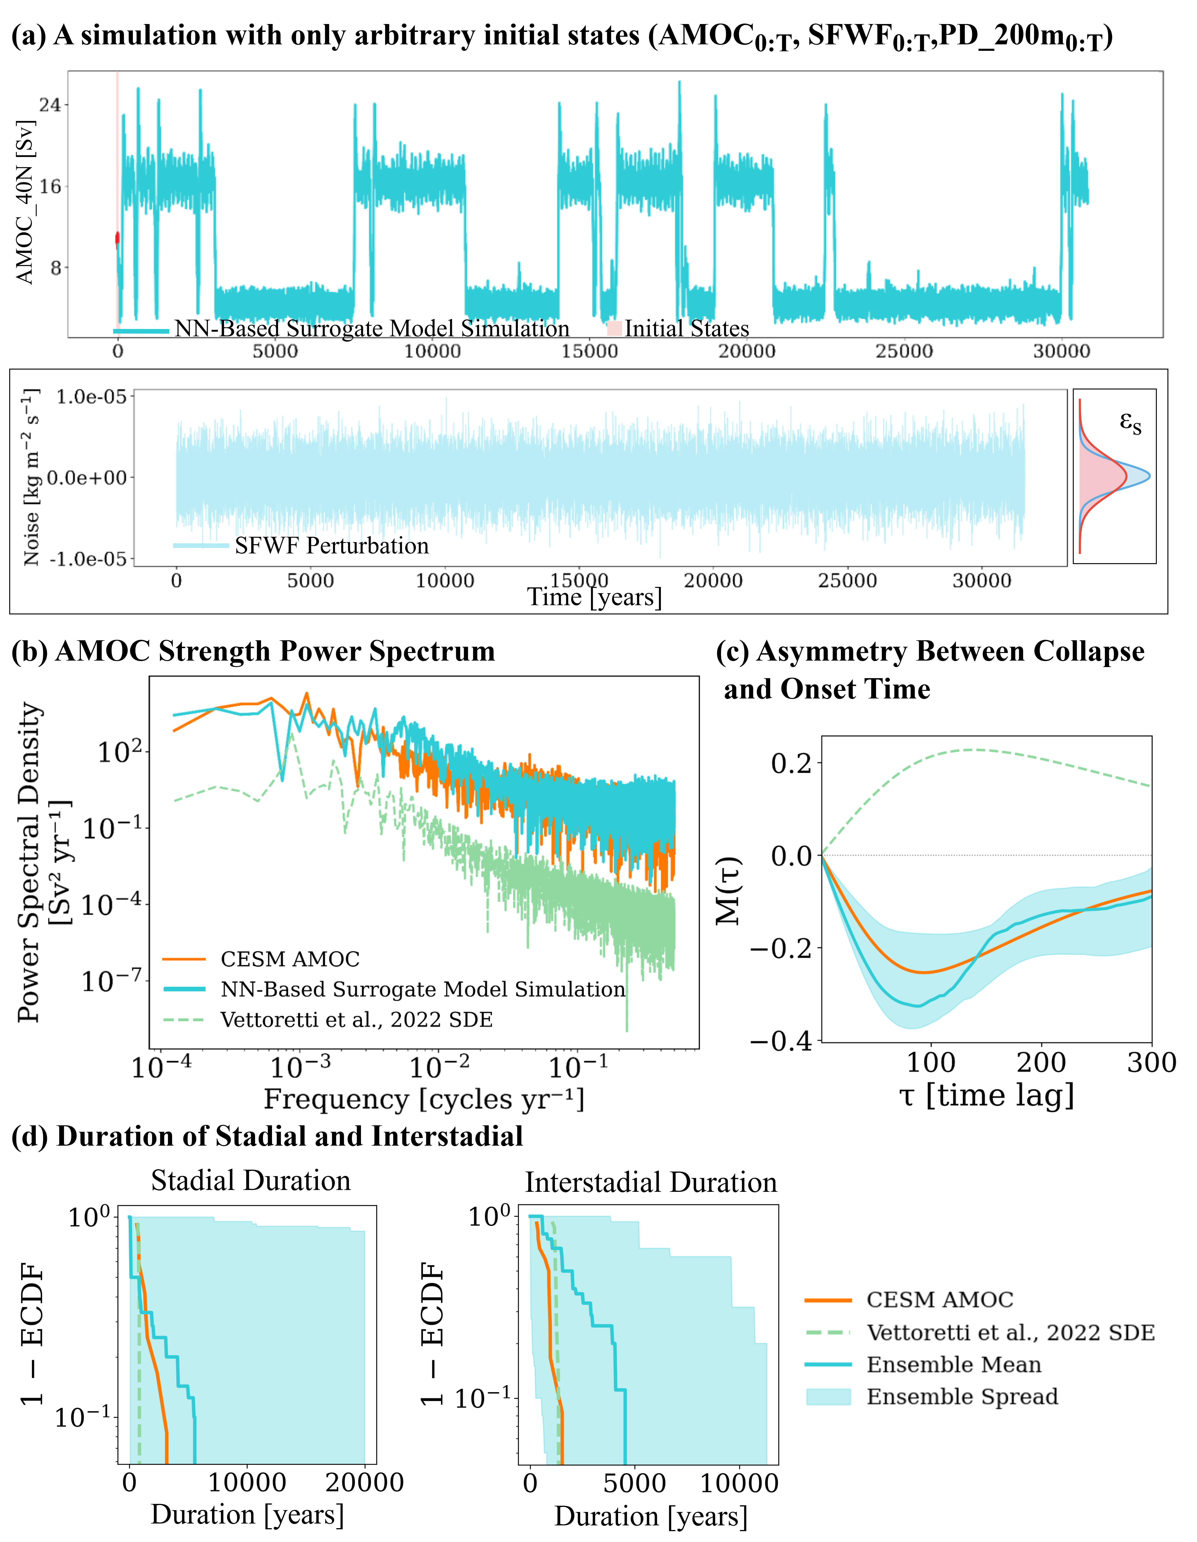
Validation
※ Continuous bounded solutions!
※ Initial Condition Problem

Slide 8
Initial Condition Problem
We will test the feasibility of predicting phase transitions across different initial conditions and climate regimes, and assess how far in advance such transitions can be predicted accurately

Slide 9
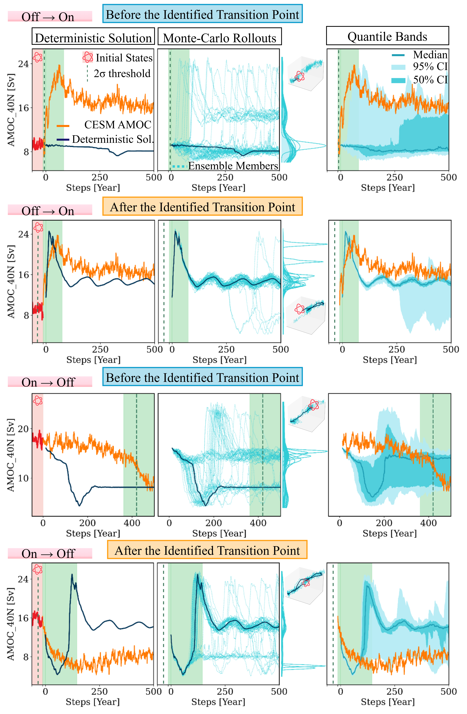
Initial Condition Problem
■ AMOC transitions depend on both noise and initial conditions.
■ Our model successfully reproduces the CESM transition regimes. The On - Off transitions are easier to be predicted ahead of time.

Slide 10
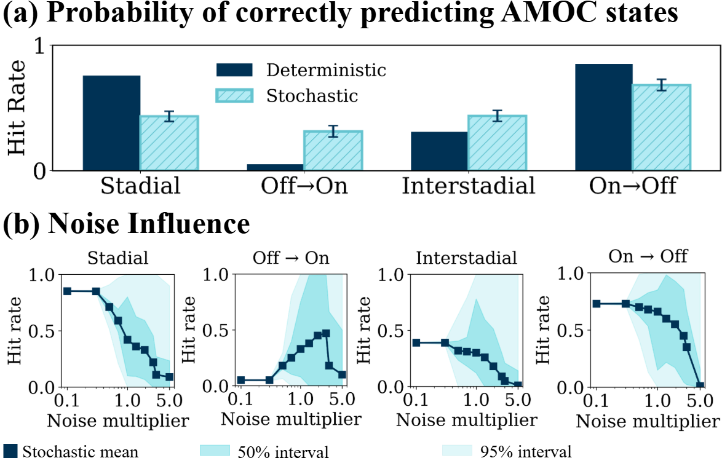
Deterministic Collapse and Stochastic Recovery
Statistical assessment: AMOC collapse is predominantly deterministic, whereas abrupt recovery is strongly influenced by stochastic forcing

Slide 11
Conclusion
・ Learned SDEs generates not only a bounded, but also realistic emulator of the underlying system.
・ The off-on transitions are caused by stochastic forcing, whereas on-off transitions are more predictable.

Slide 12
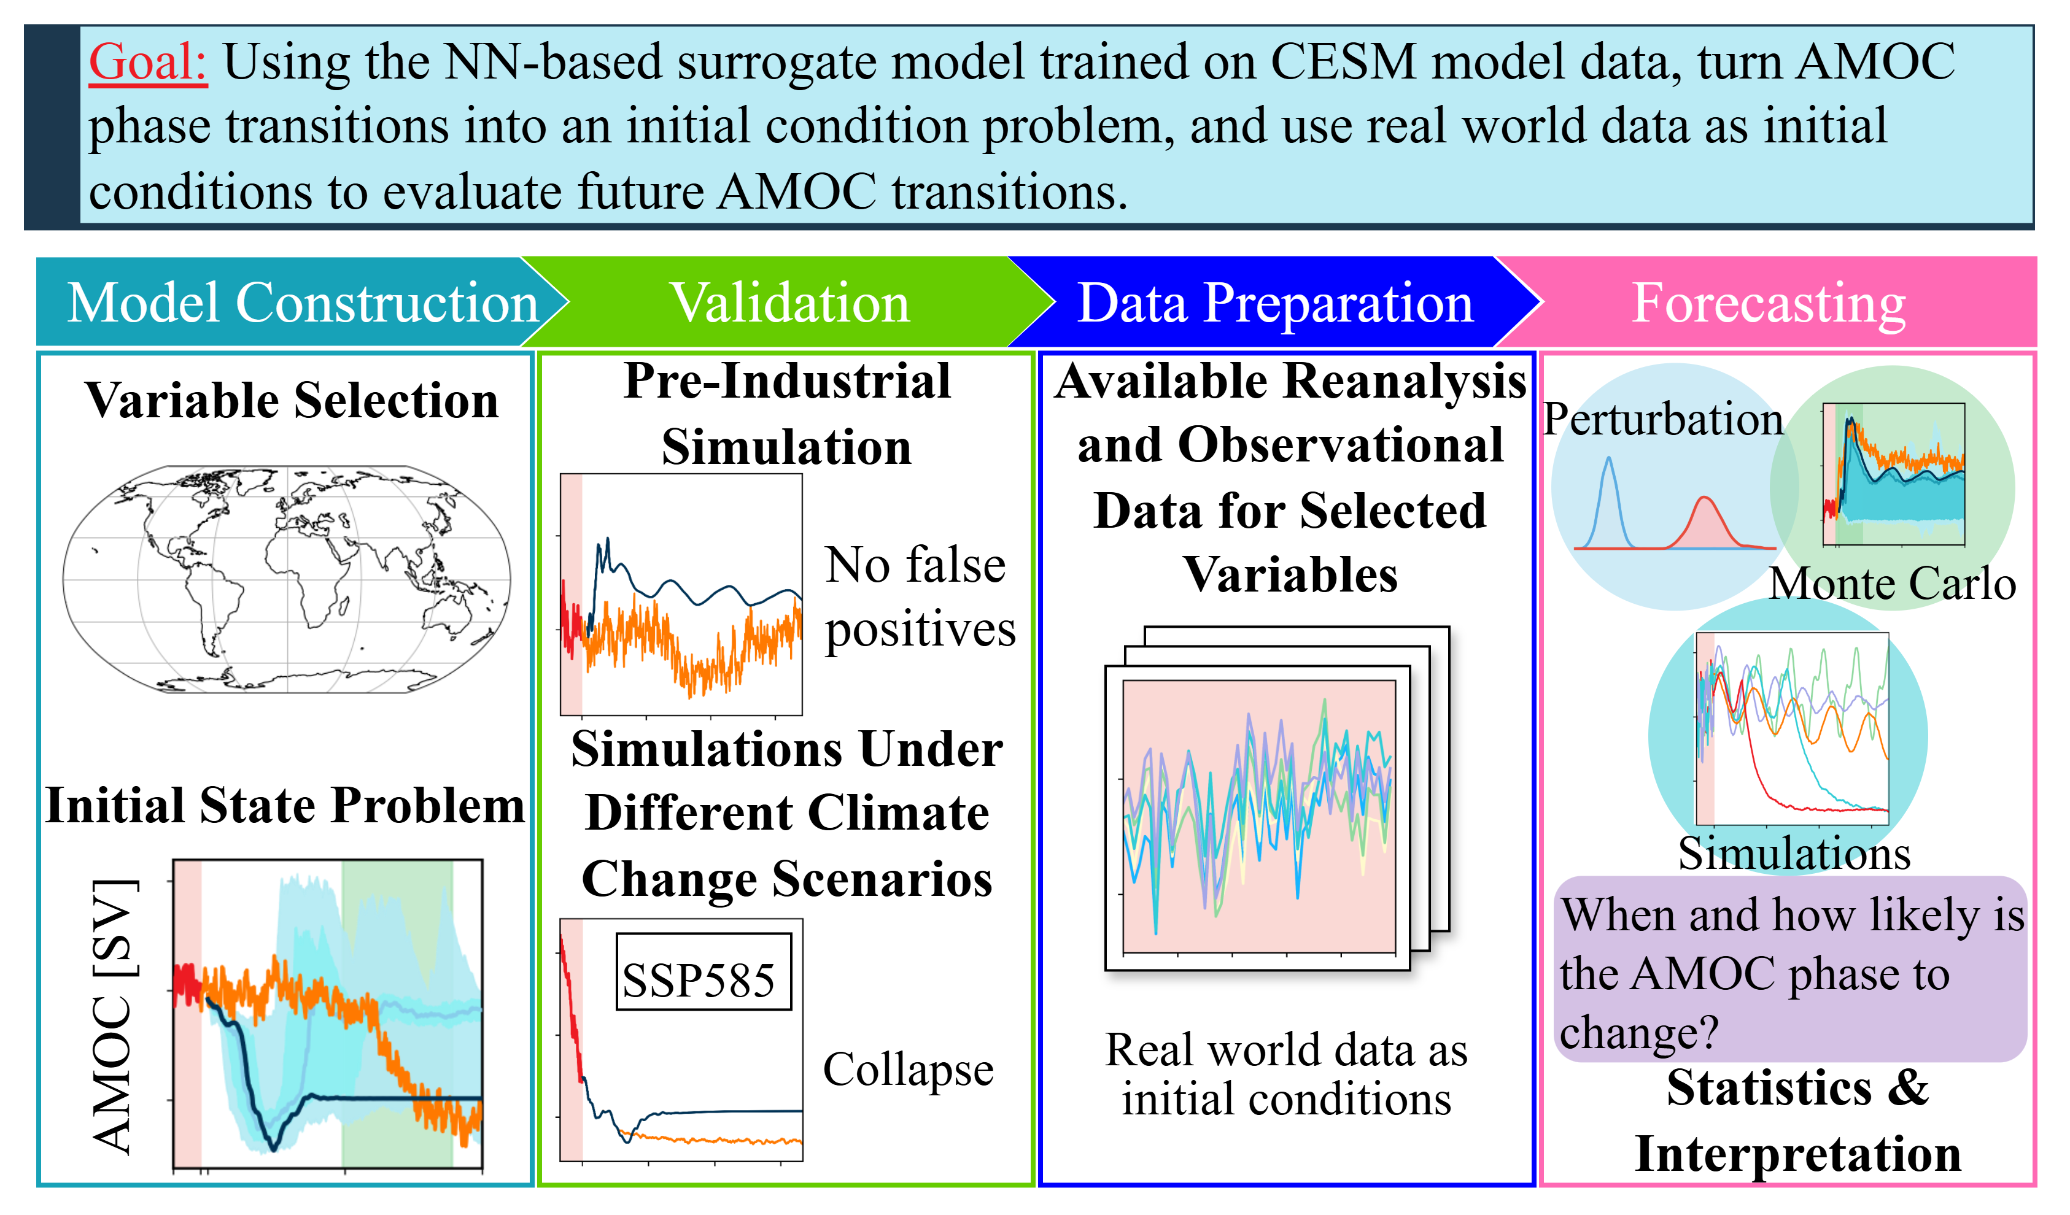
Further Research: Real-World Applications

Slide 13
More Slides

Slide 14
Just in Case: Detailed Workflow

Slide 15
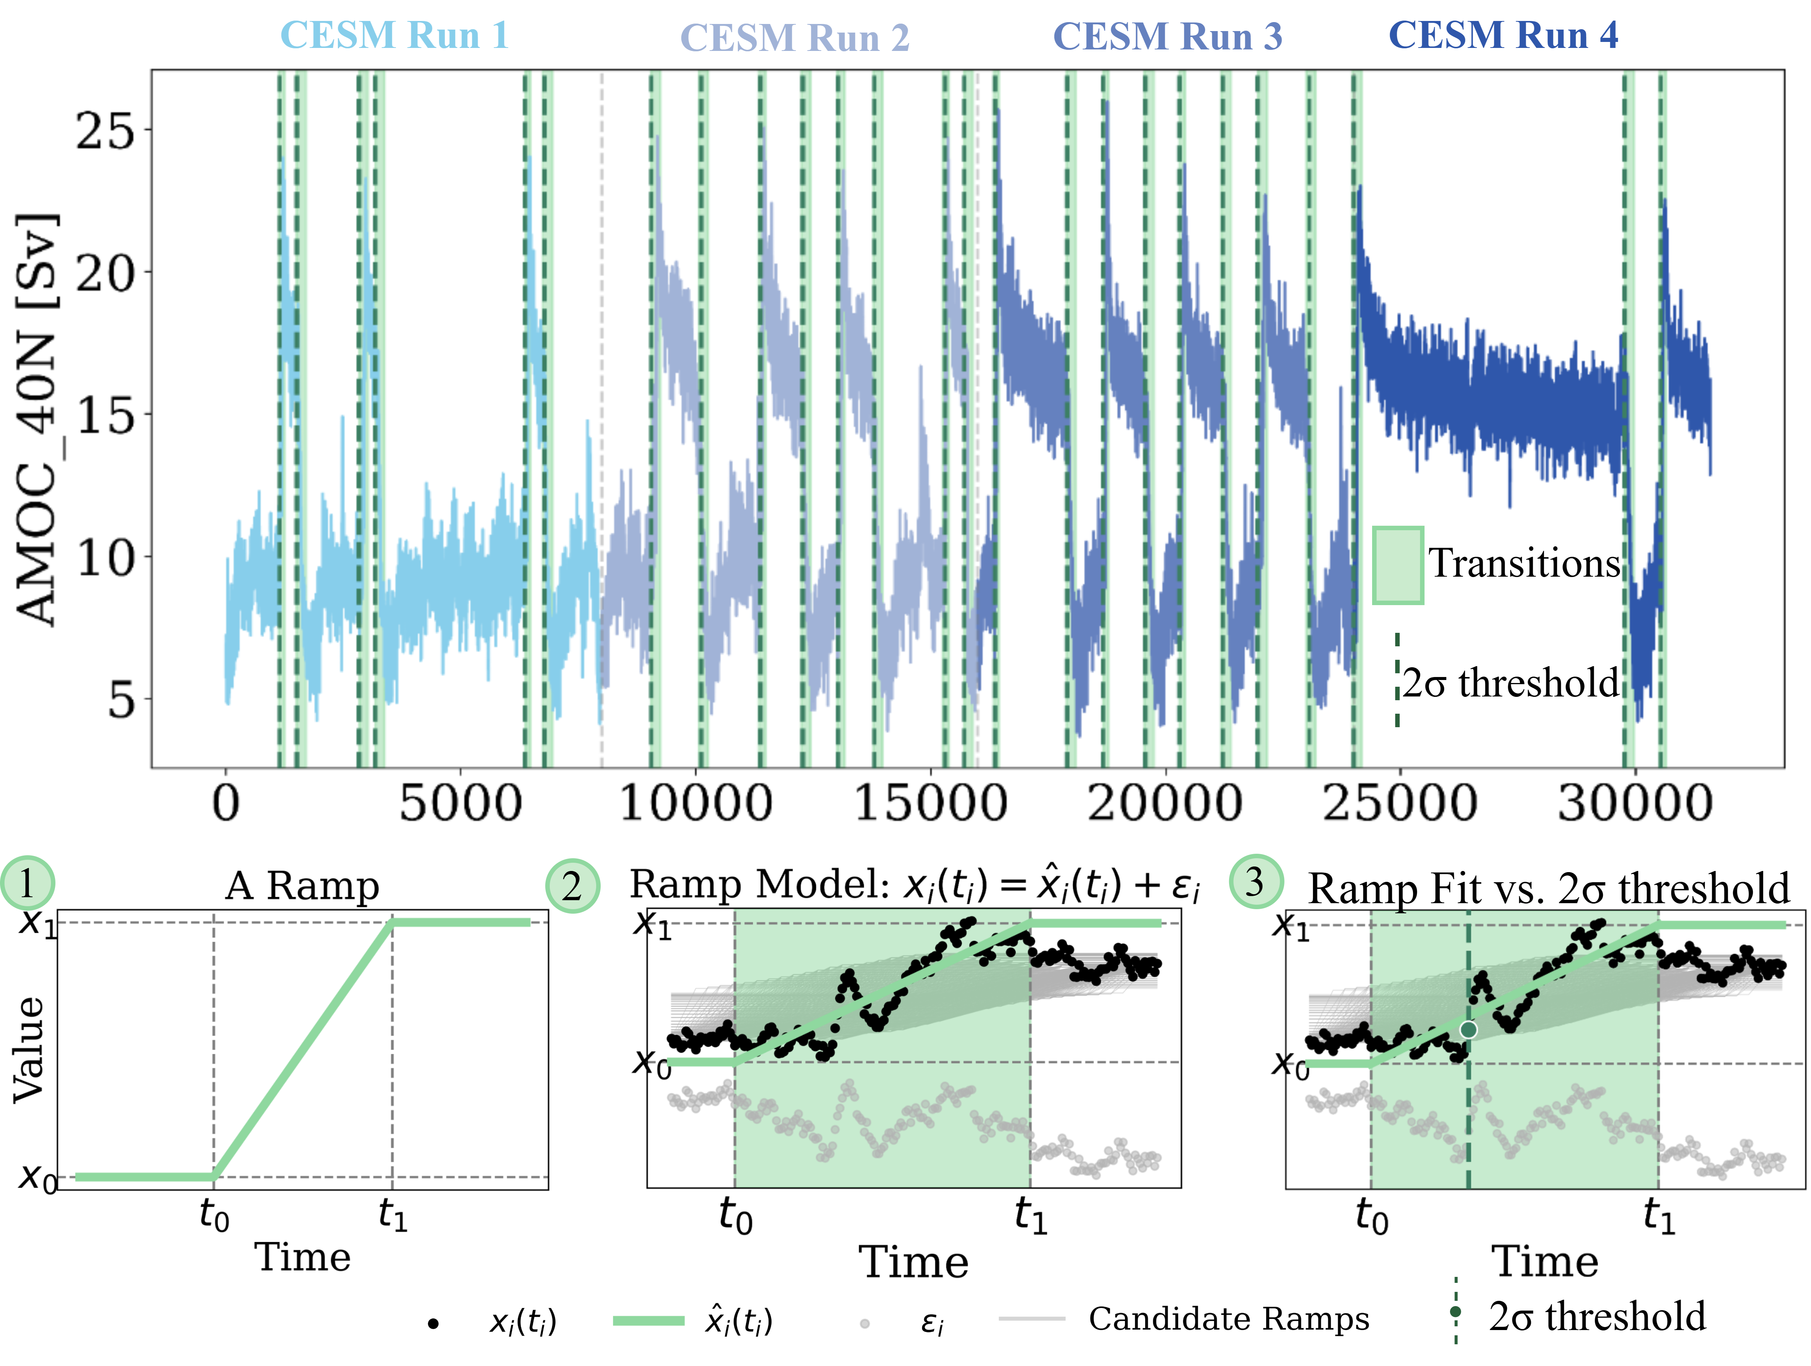
Just in Case: Ramp Fitting

Slide 16
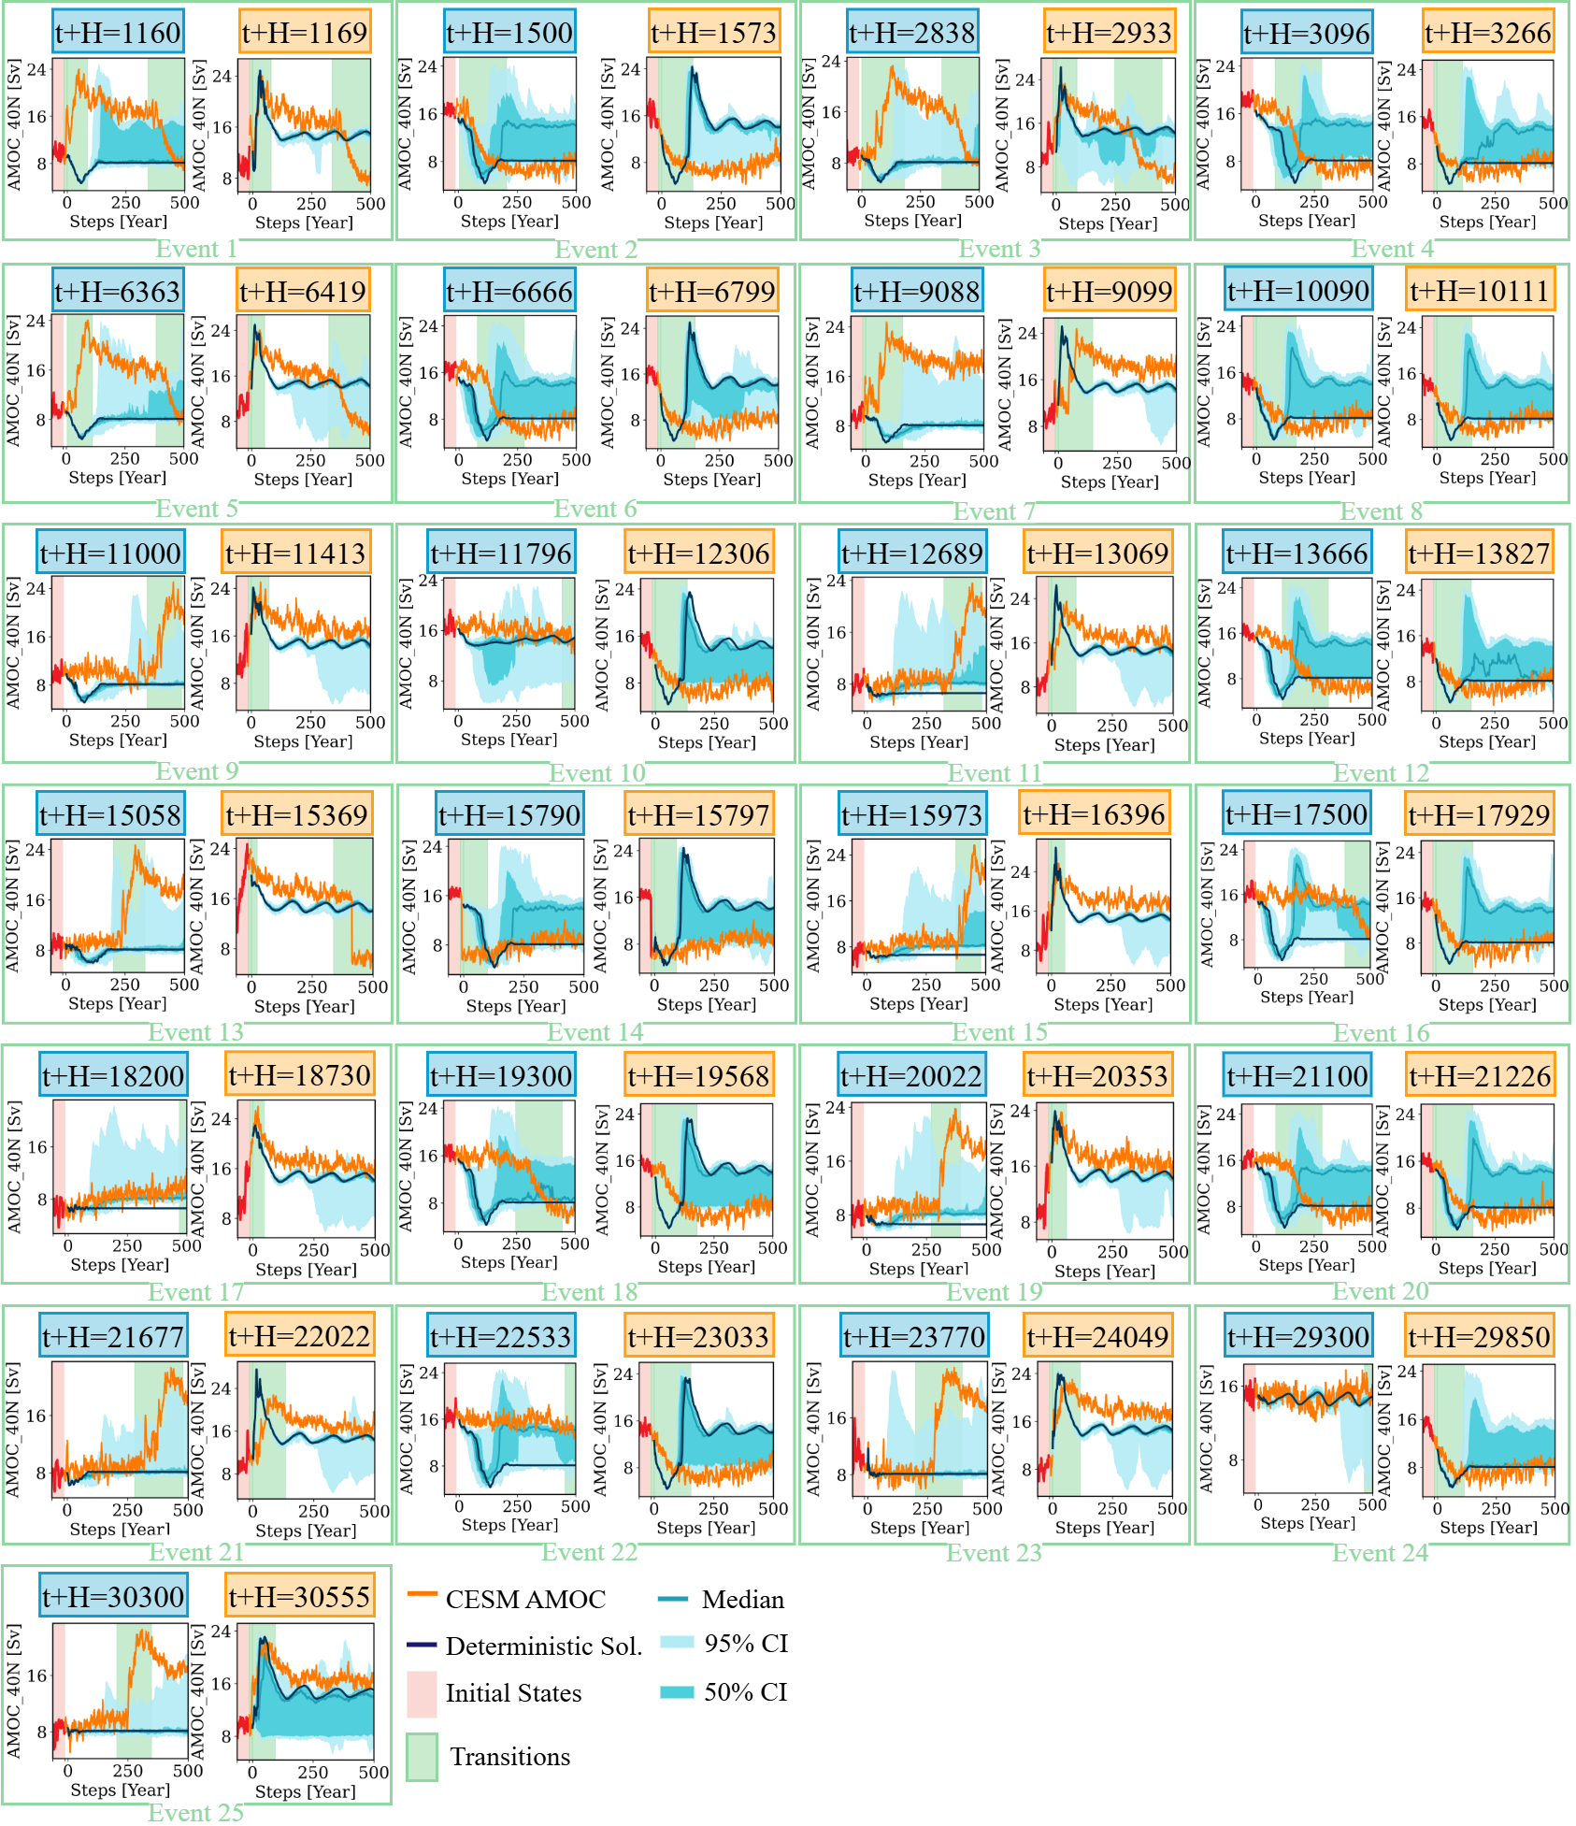
Just in Case: All Events

Slide 17
Just in Case: Polynomial Regression

Slide 18
Just in Case: Polynomial Regression

