Slide 1



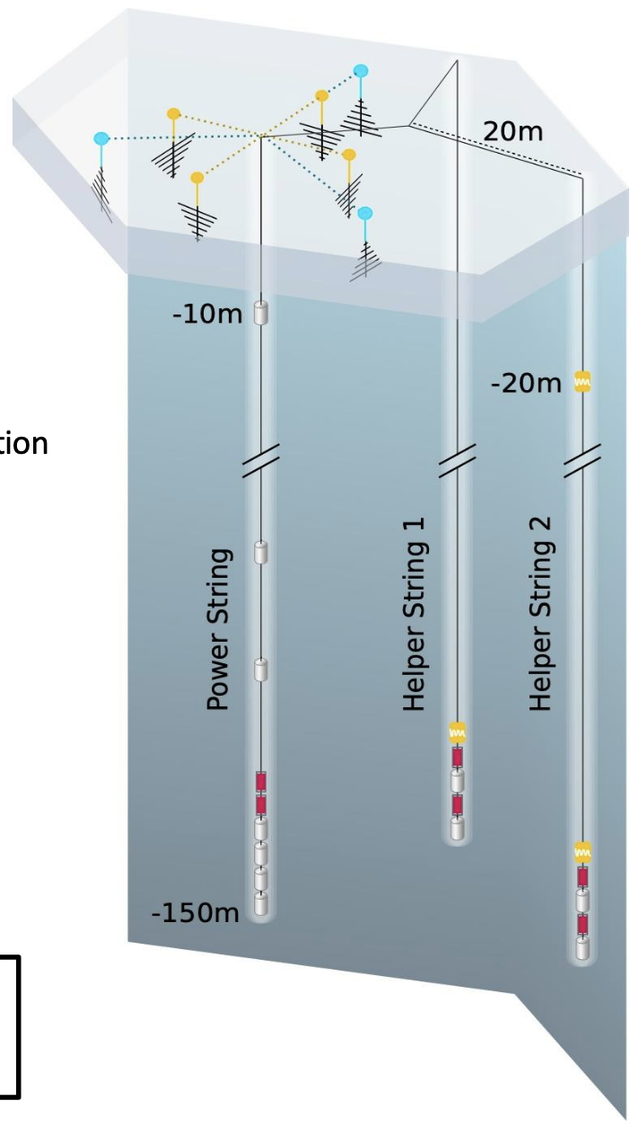


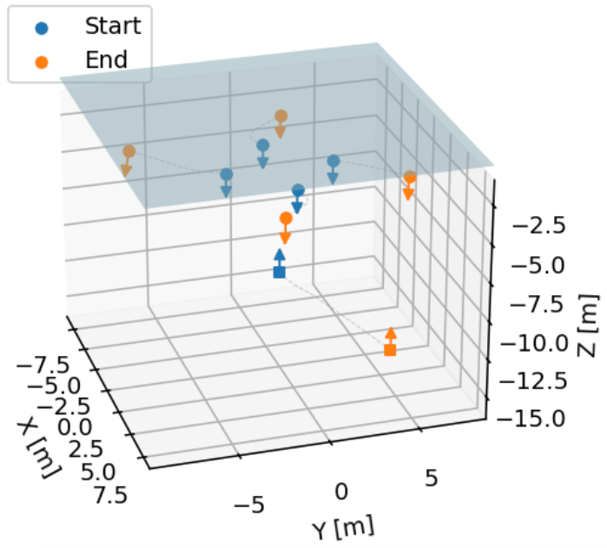
Differentiable end-to-end optimization of in-ice radio neutrino detectors
HAMLET-PHYSICS 2026
2026-08-21
Martin Langgård Ravn (martin.ravn@physics.uu.se), Nicolai Weitkemper, Christian Glaser

Slide 2
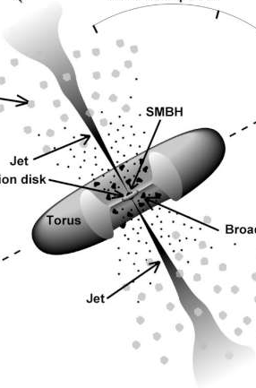
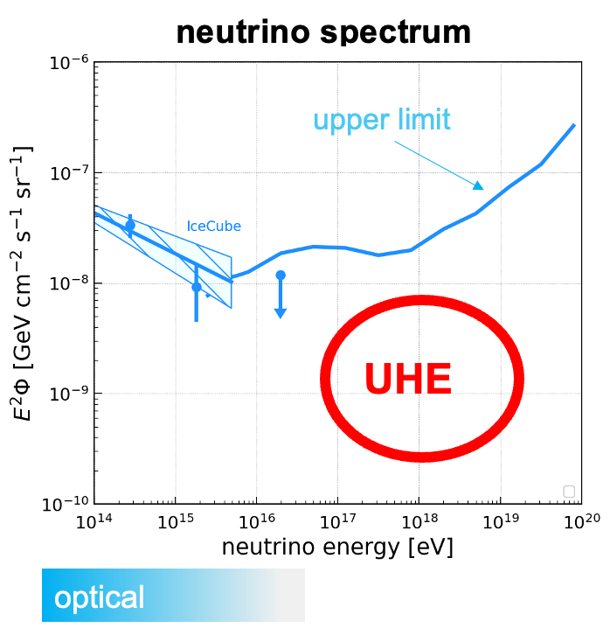
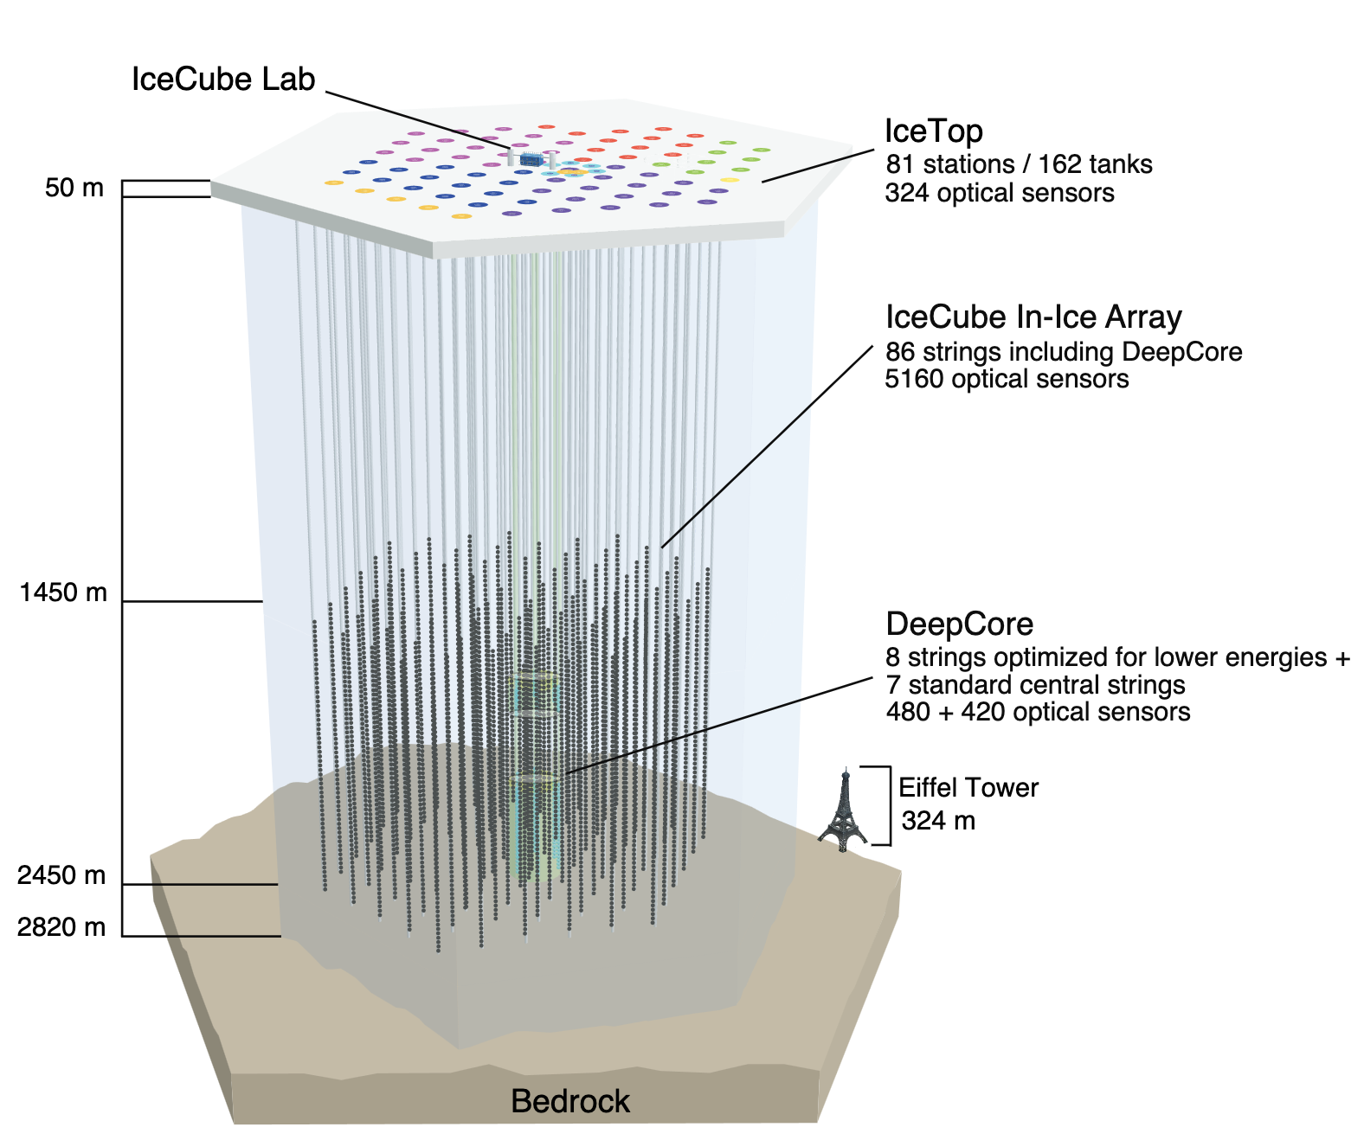
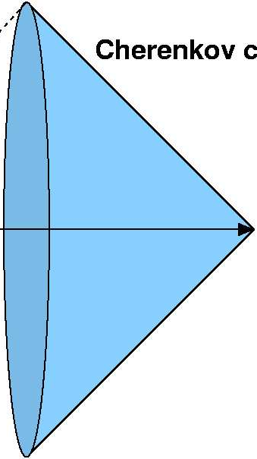

Astrophysical neutrino detection
$$ν$$
IceCube is the current leading astrophysical neutrino detector
Ultra-high energy (>PeV) neutrino flux is too faint
100 times the effective volume is needed
Interesting astrophysics:
Active galactic nuclei, gamma ray bursts, pulsars, blazars, cosmogenic neutrinos, etc.

Slide 3
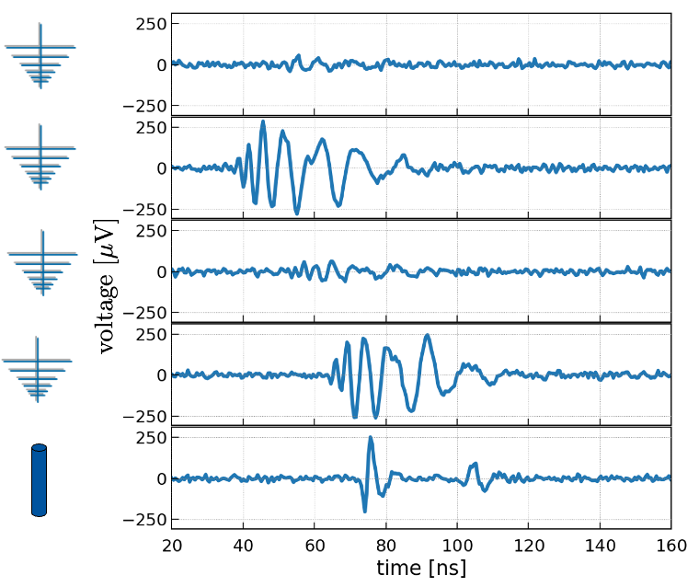
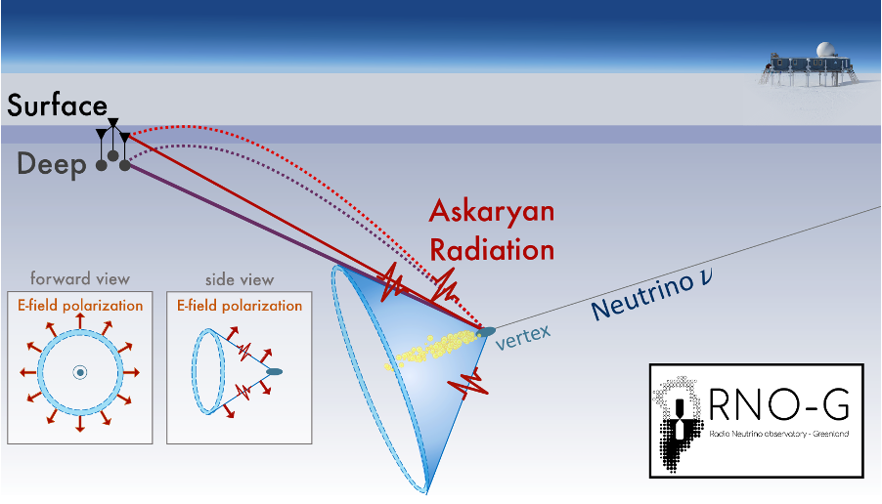
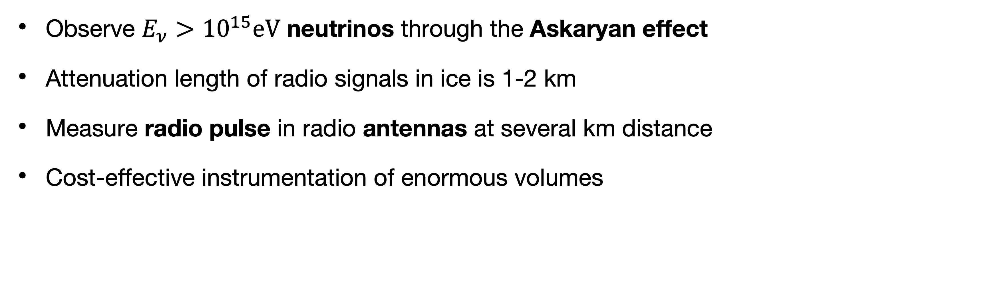
In-ice radio detection of neutrinos
Observe $E_{ν}>{10}^{15}\text{eV}$ neutrinos through the Askaryan effect
Attenuation length of radio signals in ice is 1-2 km
Measure radio pulse in radio antennas at several km distance
Cost-effective instrumentation of enormous volumes
Up to 5 km

Slide 4
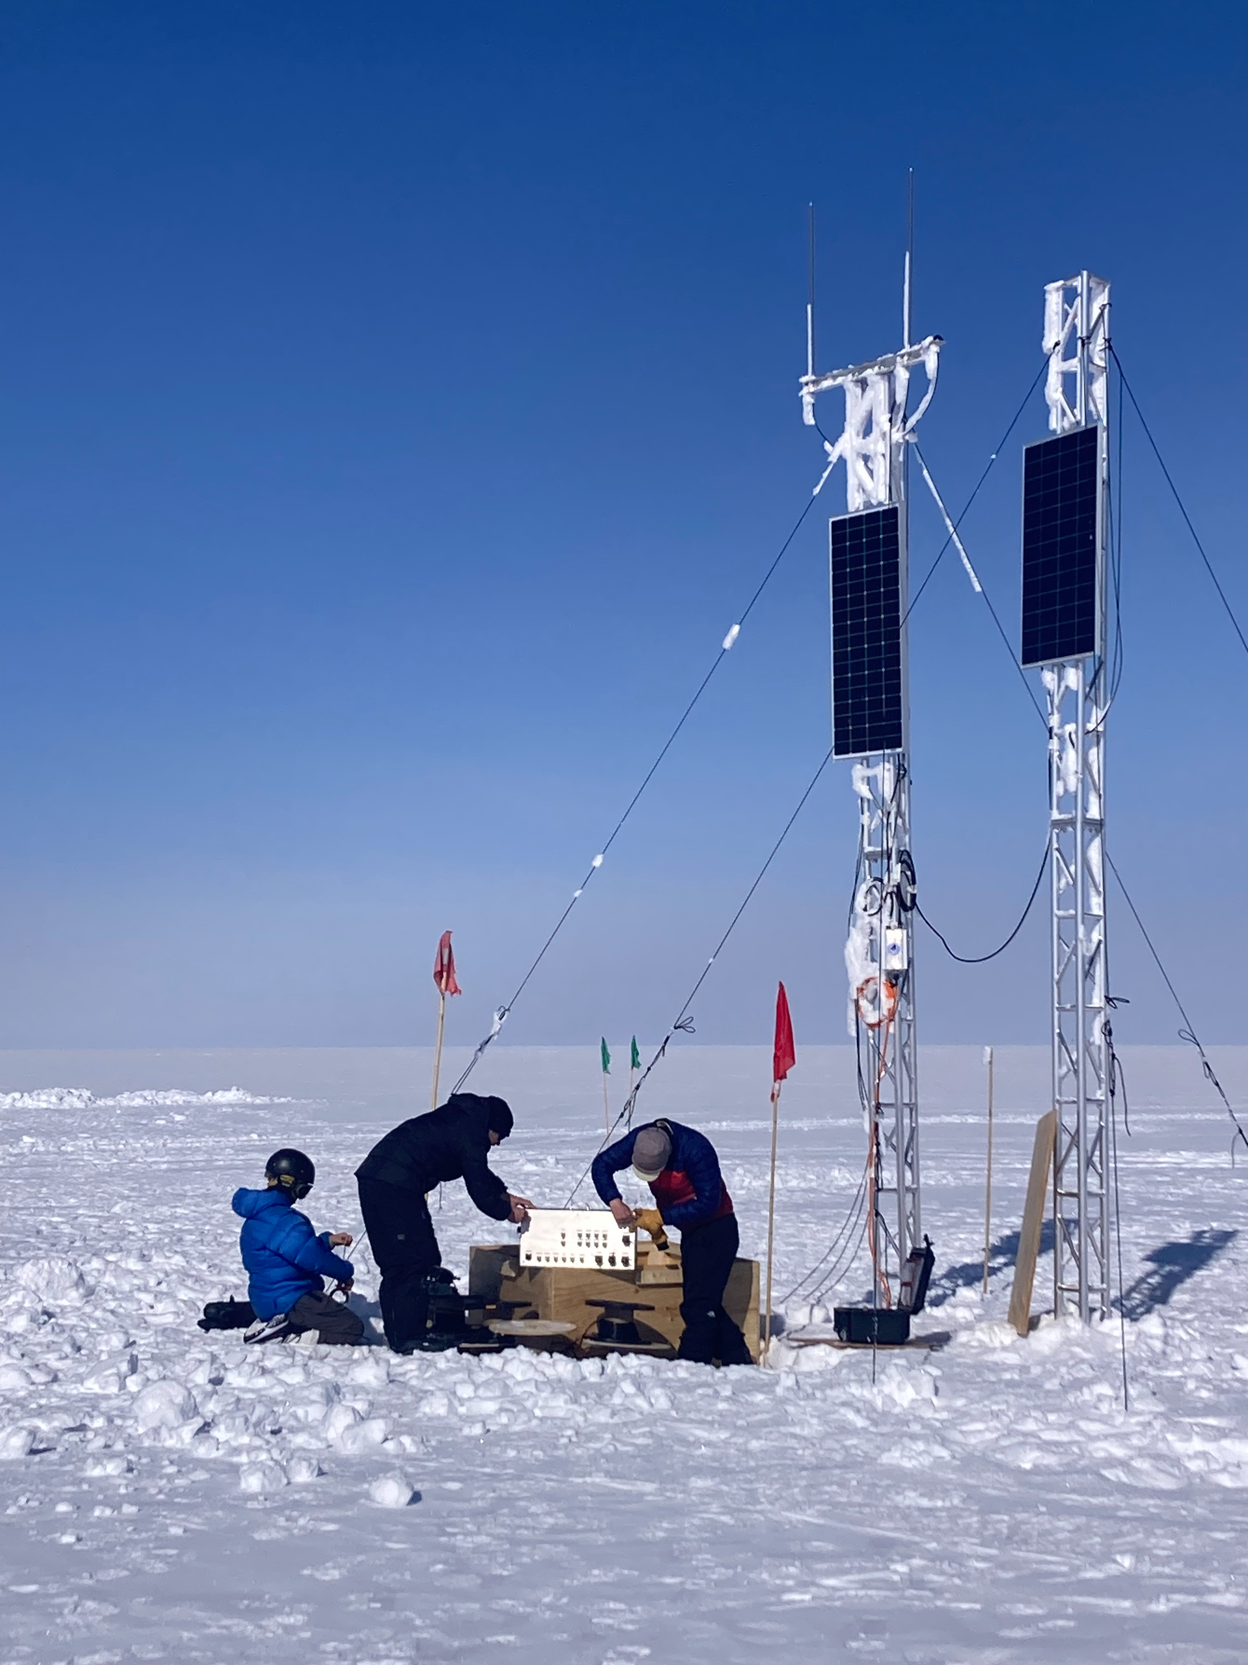
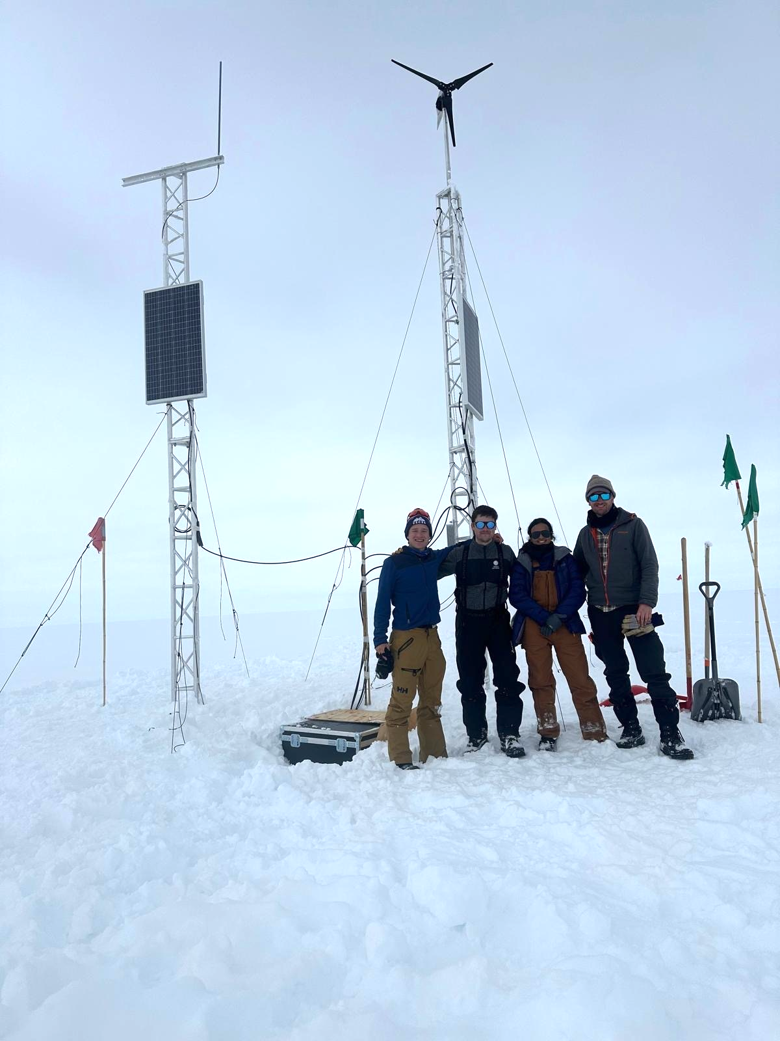
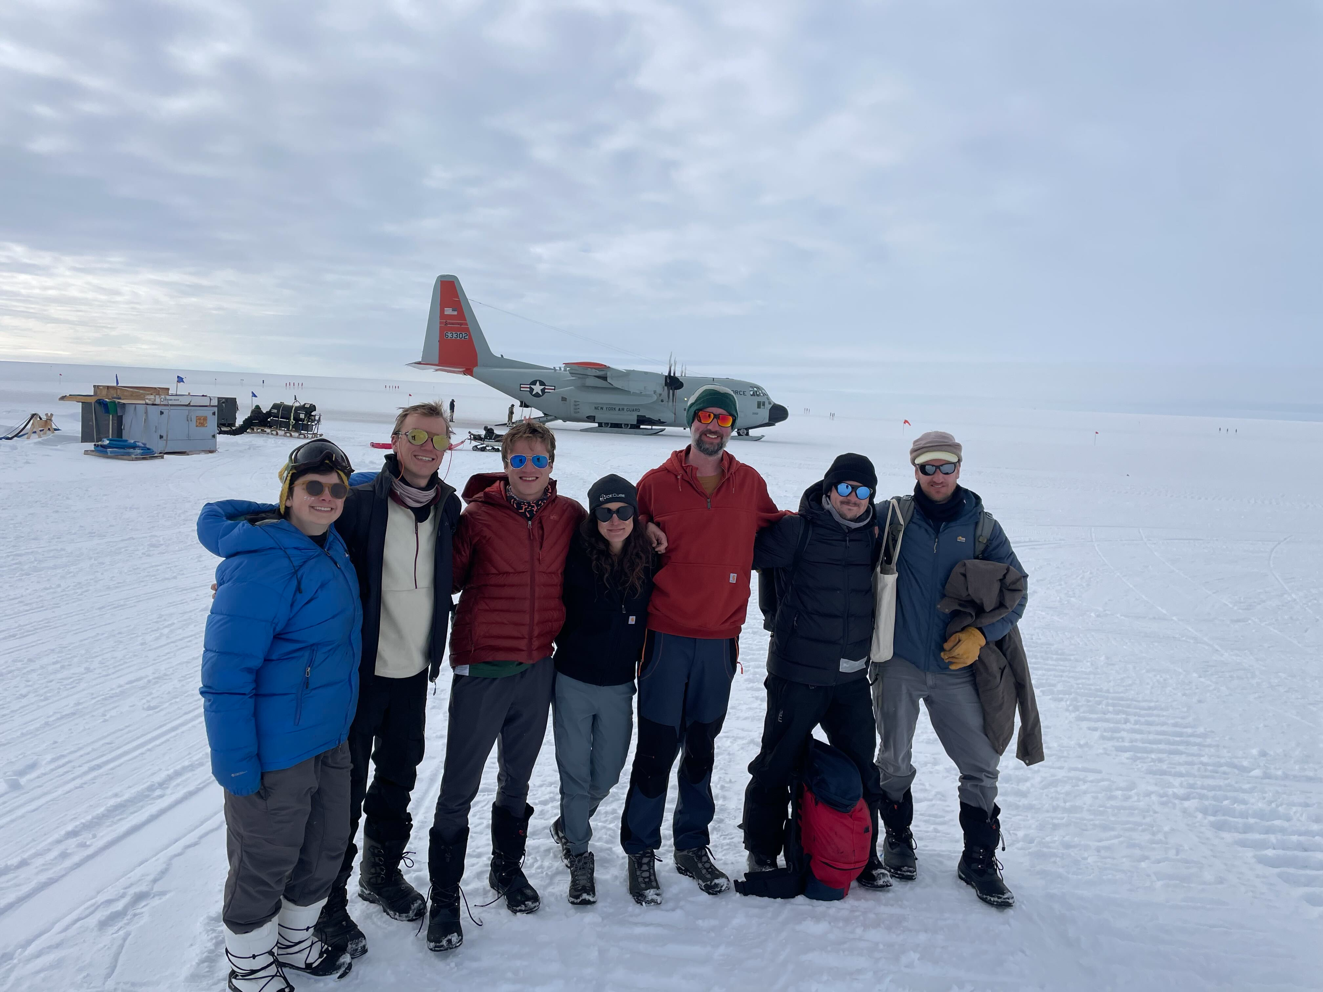
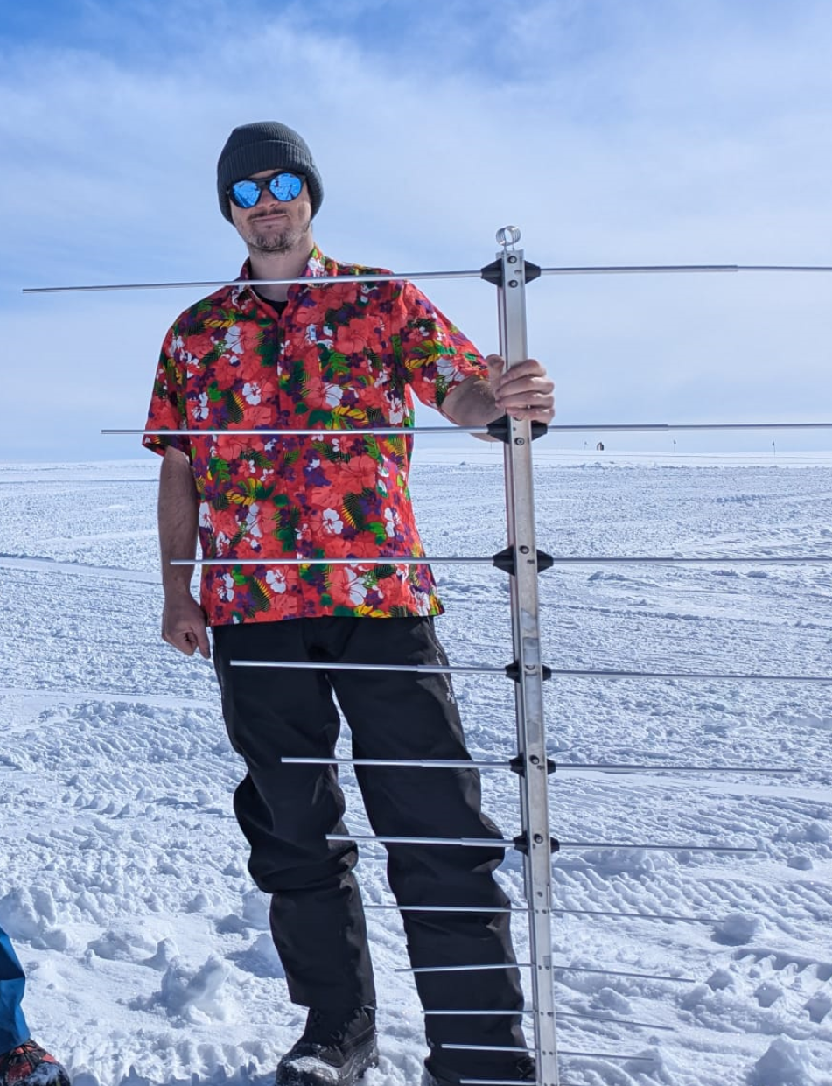
In-ice radio station:
Experimental landscape
In-ice radio neutrino detection:
  ARIANNA
  ARA
  Radio Neutrino Observatory in Greenland (RNO-G, Summit Station)
    12 out of 35 stations deployed
  Future: IceCube-Gen2 Radio (~350 stations)
Solar and wind-powered
Strong PhD student
Summit station in Greenland

Slide 5
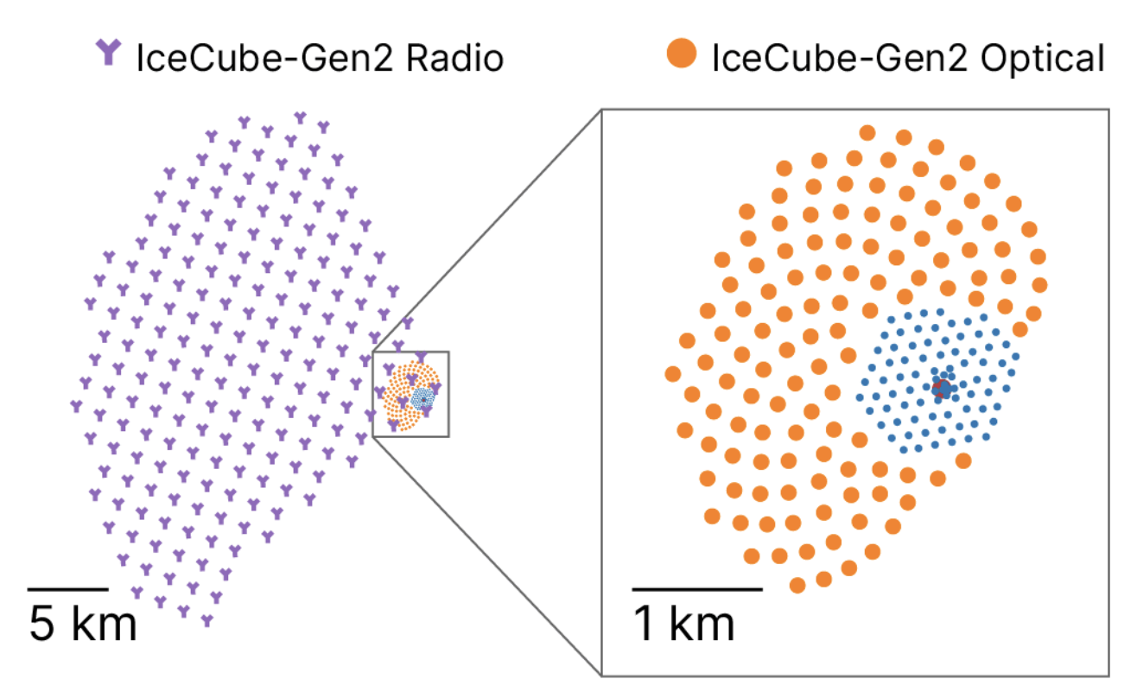
In-ice radio station:
Experimental landscape
In-ice radio neutrino detection:
  ARIANNA
  ARA
  Radio Neutrino Observatory in Greenland (RNO-G, Summit Station)
    12 out of 35 stations deployed
  Future: IceCube-Gen2 Radio (~350 stations)
Solar and wind-powered
Strong PhD student
Summit station in Greenland

Slide 6
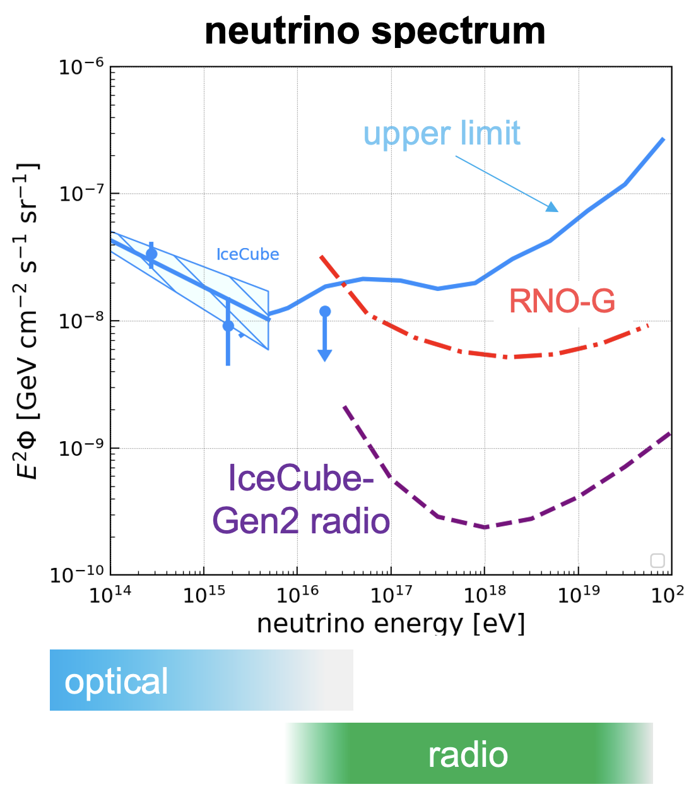
In-ice radio station:
Experimental landscape
In-ice radio neutrino detection:
  ARIANNA
  ARA
  Radio Neutrino Observatory in Greenland (RNO-G, Summit Station)
    12 out of 35 stations deployed
  Future: IceCube-Gen2 Radio (~350 stations)
Solar and wind-powered
Strong PhD student
Summit station in Greenland

Slide 7
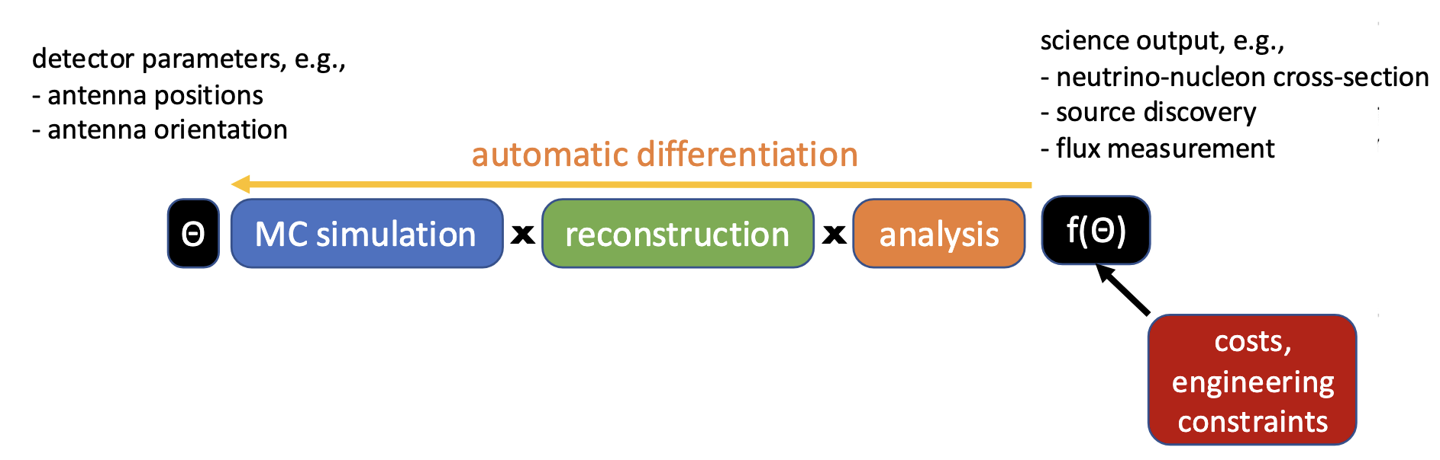
In-ice radio detector optimization
Traditional MC-based detector optimization is slow

Slide 8
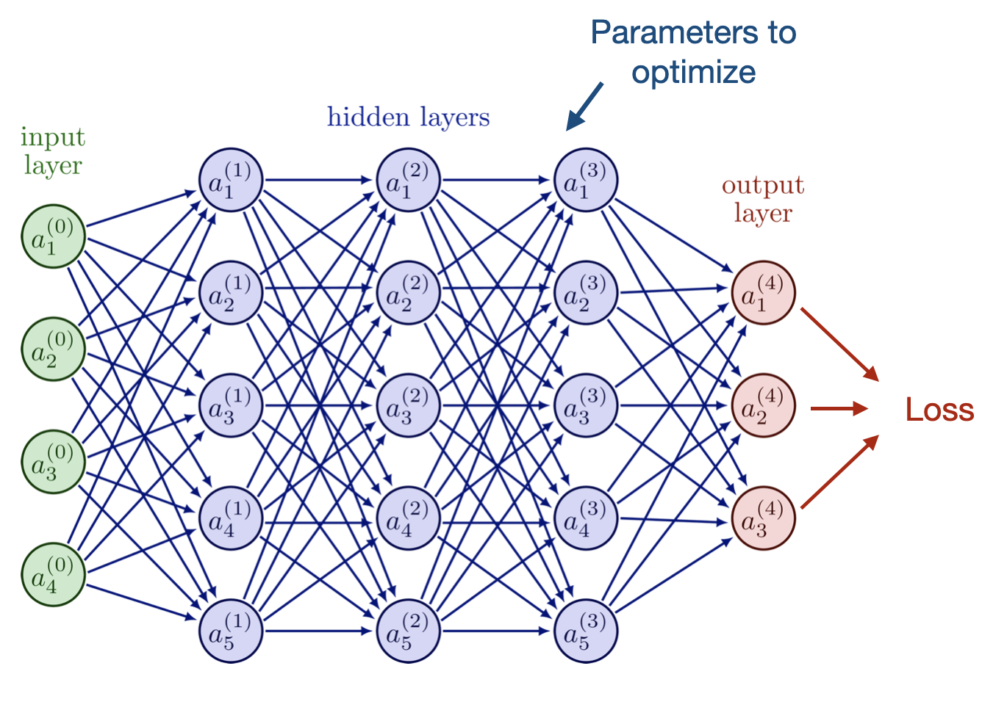
In-ice radio detector optimization
Traditional MC-based detector optimization is slow
Solution: Make pipeline differentiable using PyTorch
→ Gradient-based optimization
Train detector like a neural network

Slide 9
In-ice radio detector optimization
Traditional MC-based detector optimization is slow
Solution: Make pipeline differentiable using PyTorch
Differentiable pipeline implemented in PyTorch (see M. Ravn et al, 2025, PoS:491/031)
→ Gradient-based optimization
Port NuRadioMC to PyTorch
Proxy:
Fisher information matrix
Objective:
Neutrino direction uncertainty

Slide 10
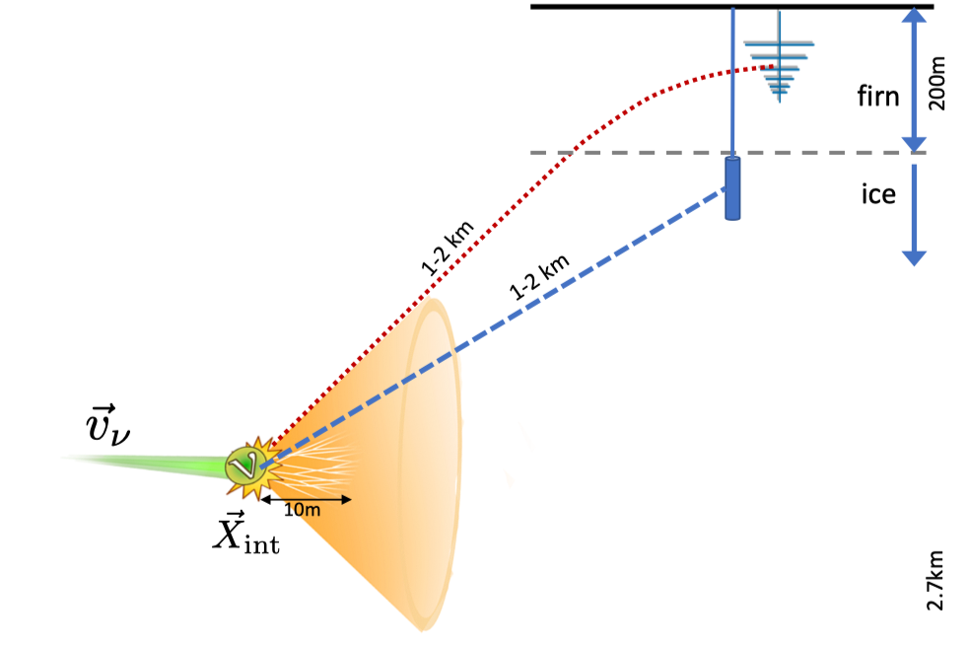
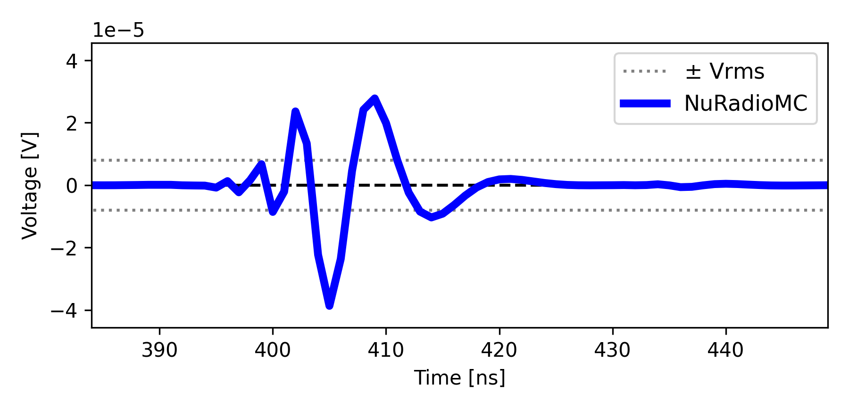
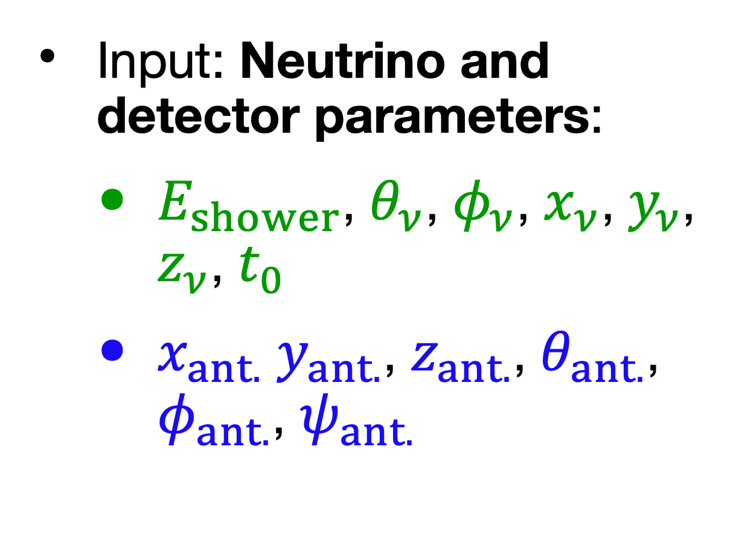
M. Ravn et al, 2025, PoS:491/031
Differentiable simulation pipeline
Traditional simulation: NuRadioMC
Input: Neutrino and detector parameters:
  $E_{shower}$, $θ_{ν}$, $φ_{ν}$, $x_{ν}$, $y_{ν}$, $z_{ν}$, $t_{0}$
  $x_{ant.}$ $y_{ant.}$, $z_{ant.}$, $θ_{ant.}$, $φ_{ant.}$, $ψ_{ant.}$
Output: Voltage trace
Simulation pipeline

Slide 11
M. Ravn et al, 2025, PoS:491/031
Differentiable simulation pipeline
Traditional simulation: NuRadioMC
Input: Neutrino and detector parameters:
  $E_{shower}$, $θ_{ν}$, $φ_{ν}$, $x_{ν}$, $y_{ν}$, $z_{ν}$, $t_{0}$
  $x_{ant.}$ $y_{ant.}$, $z_{ant.}$, $θ_{ant.}$, $φ_{ant.}$, $ψ_{ant.}$
Output: Voltage trace
Simulation pipeline
Ported to PyTorch
Analytic calculations:
  Directly portable to PyTorch
Stochastic processes, iterative calculations, non-analytic evaluations, discrete logic:
  Use deep learning surrogates, analytical approximation, and proxies

Slide 12
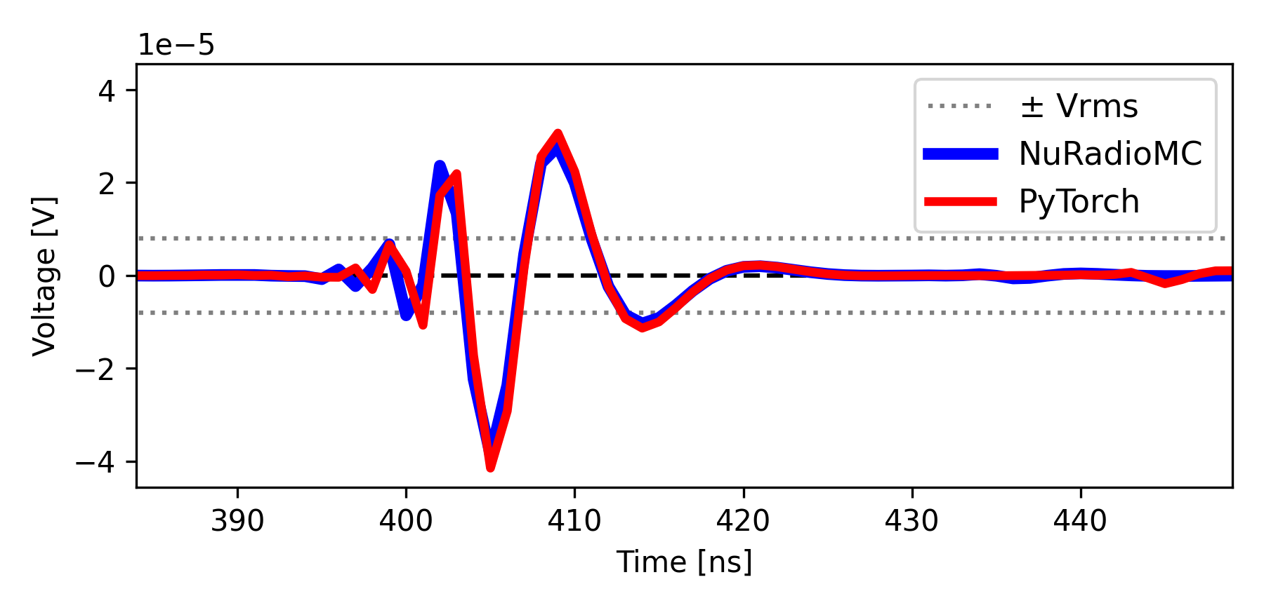

M. Ravn et al, 2025, PoS:491/031
Differentiable simulation pipeline
Traditional simulation: NuRadioMC
Input: Neutrino and detector parameters:
  $E_{shower}$, $θ_{ν}$, $φ_{ν}$, $x_{ν}$, $y_{ν}$, $z_{ν}$, $t_{0}$
  $x_{ant.}$ $y_{ant.}$, $z_{ant.}$, $θ_{ant.}$, $φ_{ant.}$, $ψ_{ant.}$
Output: Voltage trace
Simulations agree!
Simulation pipeline
Ported to PyTorch
Differentible simulation pipeline
Event generation:
  Fixed list of triggered events
Askaryan emission:
  Diffusion model by P. Pilar et al, 2026, Mach. Learn.: Sci. Technol. 7 025017
  Or Analytic approximation
Propagation:
  Neural network ray-tracing model
Detection:
  Analytic approx. of LPDA, VPol, Hpol
  Future: Symbolic regression
(NB: keep trigger antennas fixed)

Slide 13
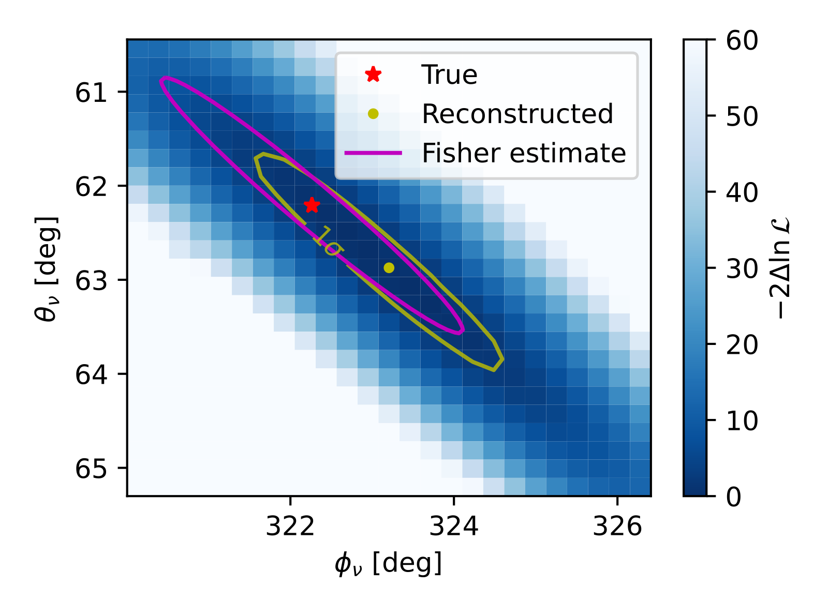
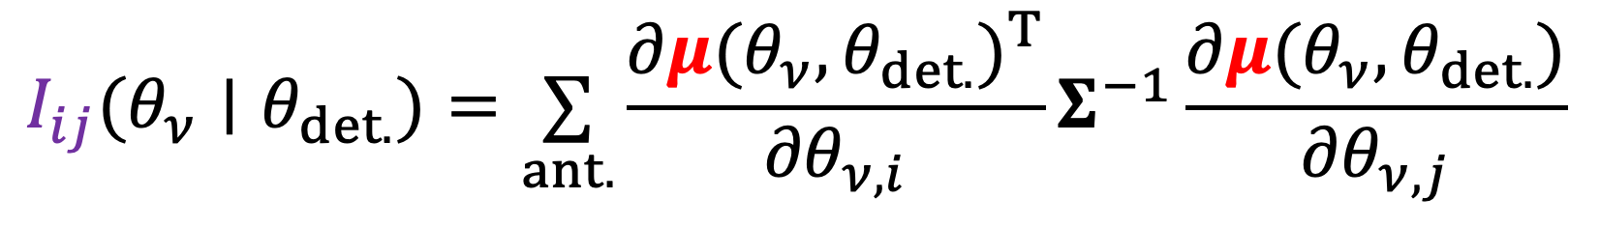
M. Ravn et al, 2025, PoS:491/031
Differentiable simulation pipeline
Traditional simulation: NuRadioMC
Convert to traces to reconstruction uncertainties through Fisher information:
Input: Neutrino and detector parameters:
  $E_{shower}$, $θ_{ν}$, $φ_{ν}$, $x_{ν}$, $y_{ν}$, $z_{ν}$, $t_{0}$
  $x_{ant.}$ $y_{ant.}$, $z_{ant.}$, $θ_{ant.}$, $φ_{ant.}$, $ψ_{ant.}$
Output: Voltage trace
$$I_{ij}(θ_{ν}∣θ_{det.})=\underset{ant.}{∑}\frac{∂μ(θ_{ν},θ_{det.})^{T}}{∂θ_{ν,i}}Σ^{−1}\frac{∂μ(θ_{ν},θ_{det.})}{∂θ_{ν,j}}$$
Simulations agree!
Simulation pipeline
Optimization objective:
Minimize area of ellipse
Ported to PyTorch
Differentible simulation pipeline
Gradients w.r.t. antenna positions and orientations are known
Event generation:
  Fixed list of triggered events
Askaryan emission:
  Diffusion model by P. Pilar et al, 2026, Mach. Learn.: Sci. Technol. 7 025017
  Or Alvarez2009
Propagation:
  Neural network ray-tracing model
Detection:
  Analytic approx. of LPDA, VPol, Hpol
  Future: Symbolic regression
M. Ravn et al, 2026, Phys. Rev. D 114, 043025

Slide 14
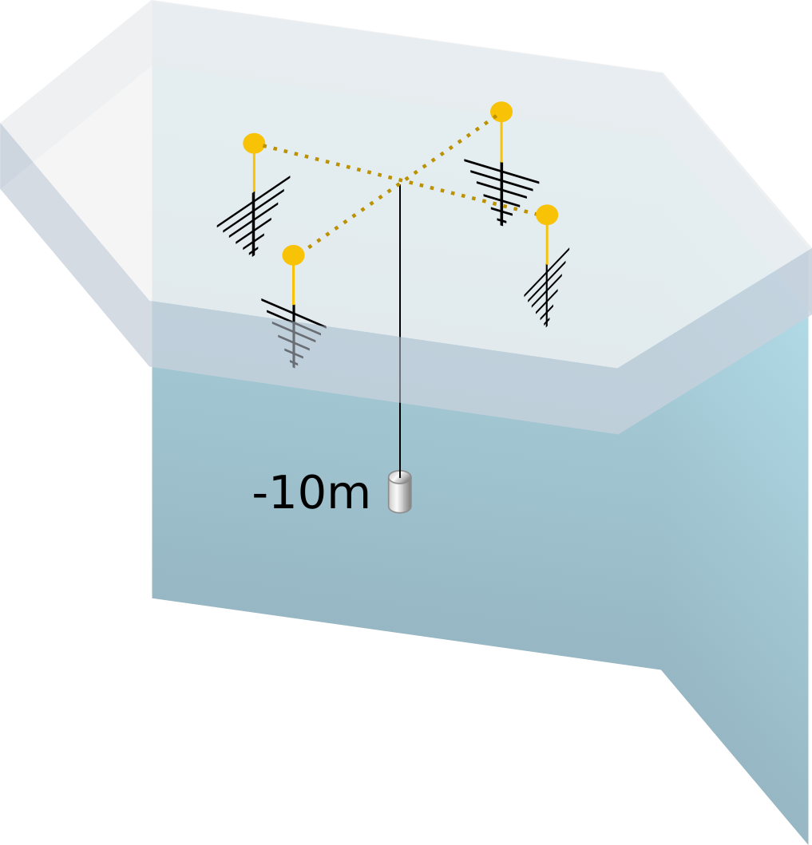
IceCube-Gen2 shallow station:
IceCube-Gen2 shallow station optimization
Optimize all antenna positions and orientations in shallow station
  Optimization details:
Dataset: 100,000 triggered neutrino events
Loss: log10(area of Neutrino direction uncertainty contour)
Batch size: 512 events
Optimizer: Adam (lr = 1e-3)
Training time: ~1 hour on GPU

Slide 15
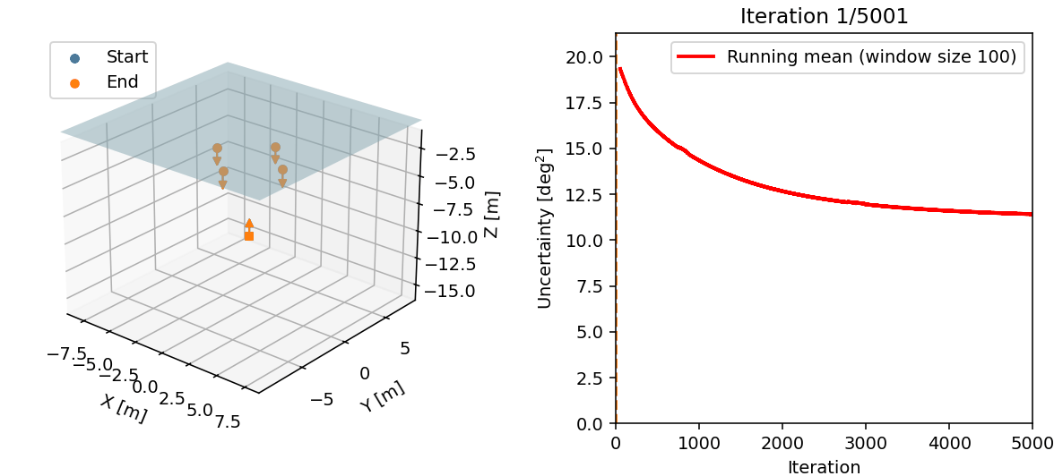
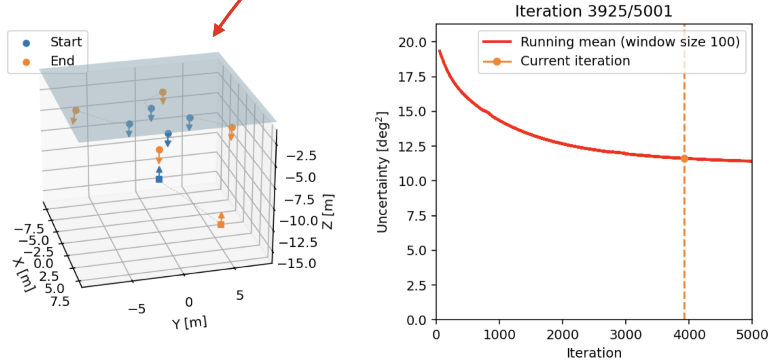
IceCube-Gen2 shallow station:
IceCube-Gen2 shallow station optimization
Optimize all antenna positions and orientations in shallow station
Substantial improvement with:
  Outward-facing antennas
  Larger detector
Physically motivated results!
  Optimization details:
Dataset: 100,000 triggered neutrino events
Loss: log10(area of Neutrino direction uncertainty contour)
Batch size: 512 events
Optimizer: Adam (lr = 1e-3)
Training time: ~1 hour on GPU

Slide 16
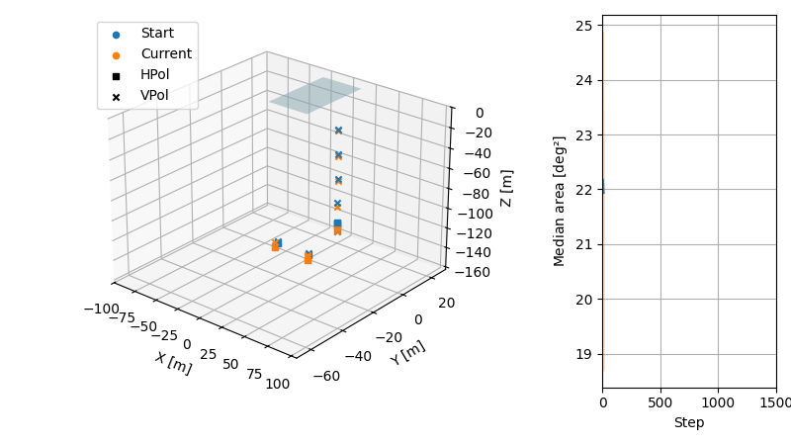
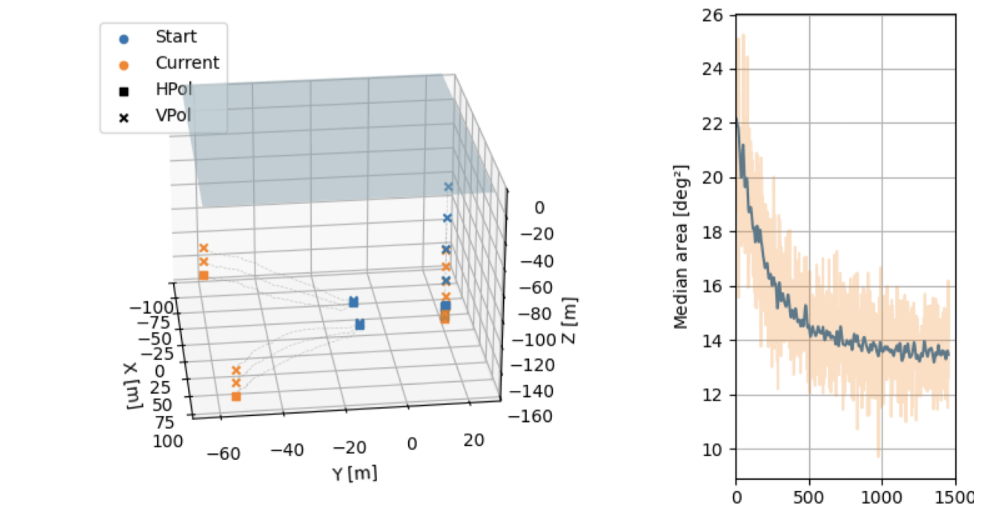
IceCube-Gen2
radio station:
IceCube-Gen2 deep station optimization
Optimize deep station layout with cost penalty below 150 m
Optimization proceeds as previous studies
Optimization finds substantial improvement with larger detector

Slide 17
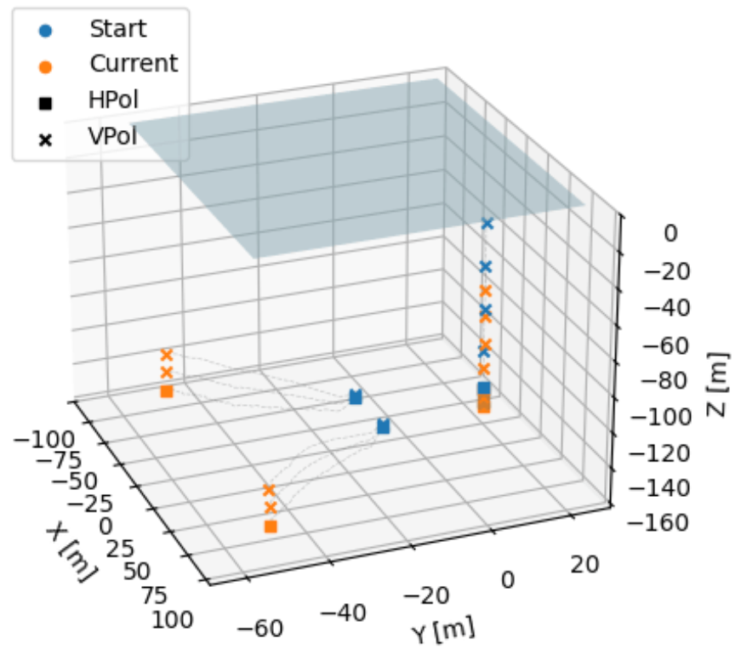

Conclusion
Differentiable programming enables efficient optimization of detector designs
End-to-end pipeline for in-ice radio detectors developed
Initial studies demonstrate successful gradient-based optimization
Next steps:
  Add cost and engineering constraints, optimize for specific science analyses, validate designs, test layouts in real experimental settings
Potential to significantly improve the scientific performance of the IceCube-Gen2 radio array
For more differentiable detector optimization, see the MODE collaboration and workshop:
  https://mode-collaboration.github.io/

Slide 18
Extra slides

Slide 19
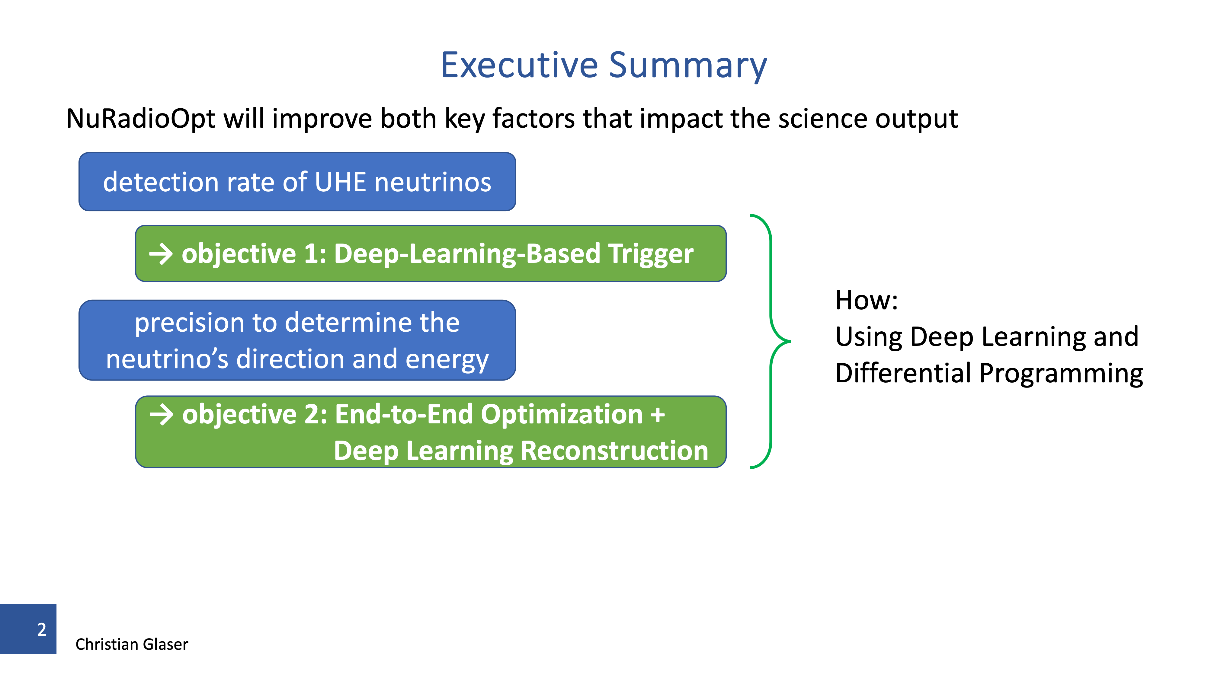


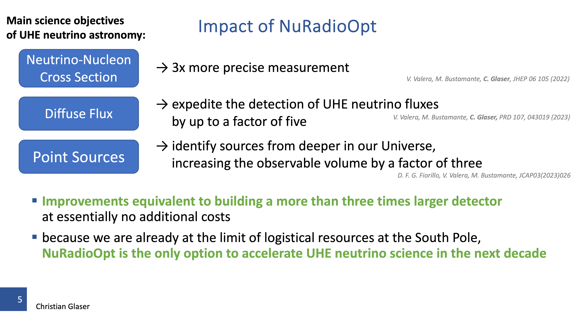
This talk

Slide 20
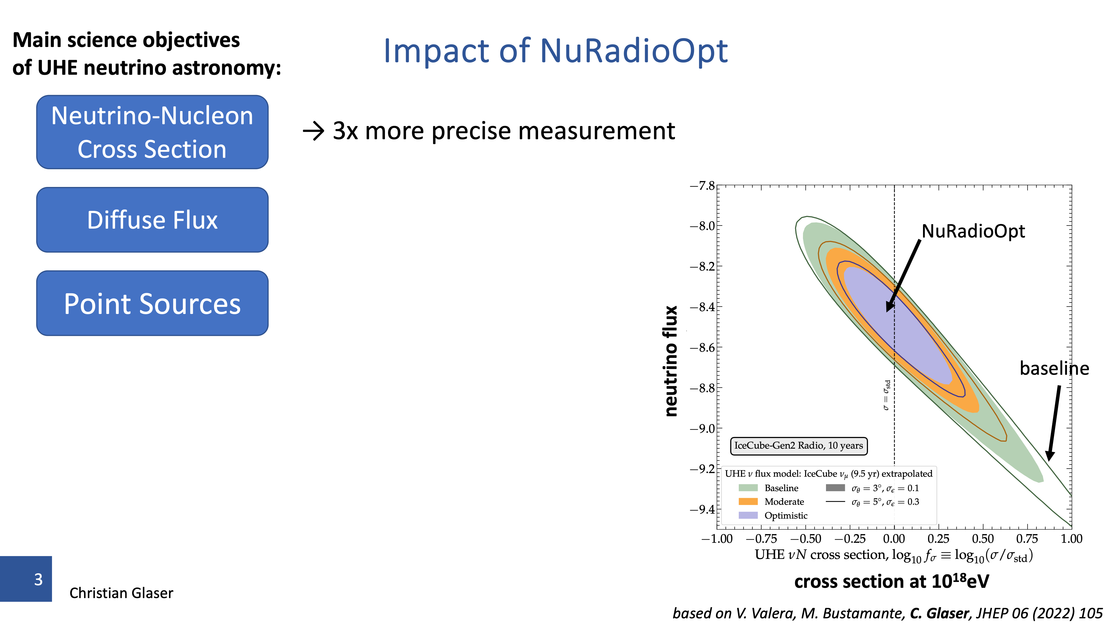


Slide 22
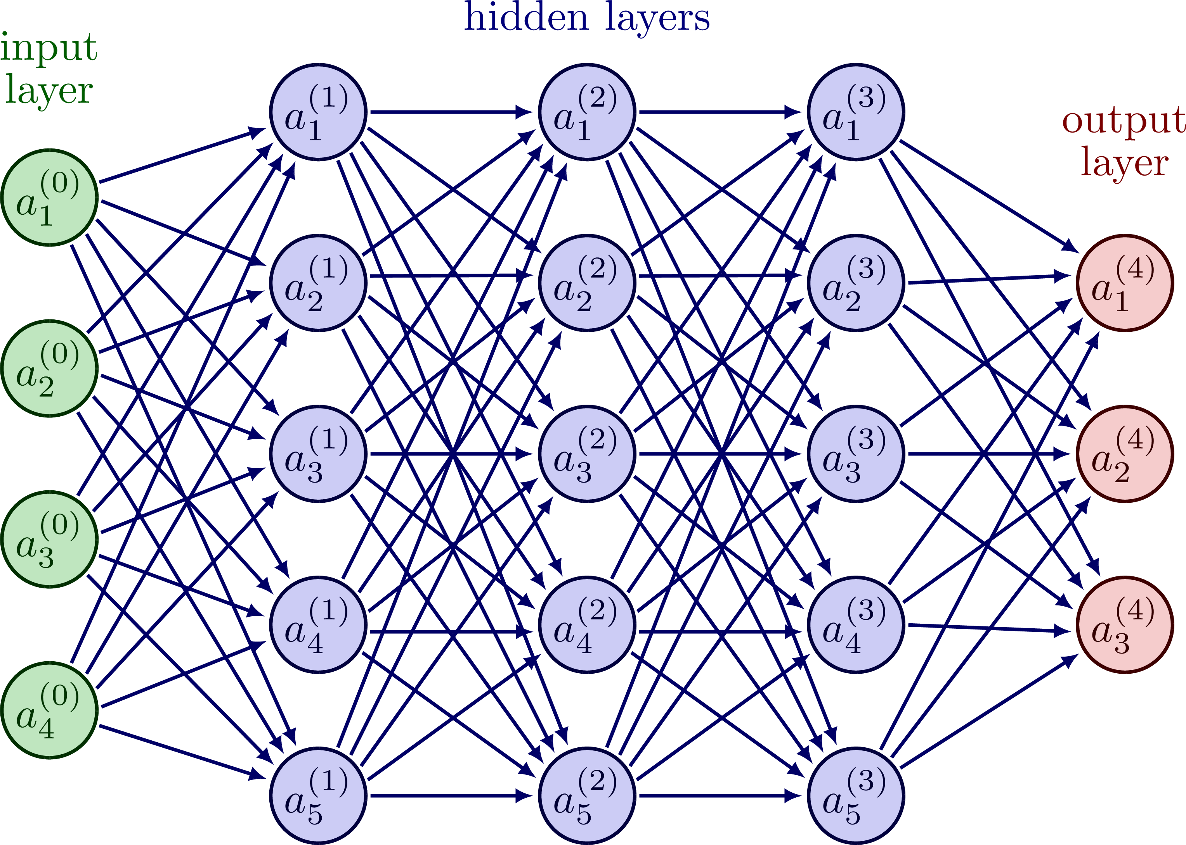
Differentiable programming
Central concept in machine learning
Automatically calculate and save derivatives of output w.r.t. parameters in forward pass
Calculate gradient of loss w.r.t. parameters in backpropagation (chain rule)
Take step opposite gradient to optimize network
Use for detector optimization:
  Network is simulation pipeline
  Input is neutrino parameters
  Parameters are detector parameters
  Loss is neutrino reconstruction uncertainty
We can utilize differential programming frameworks to optimize detector layouts
Parameters to optimize
Loss

Slide 23
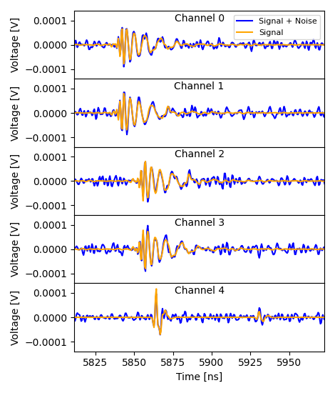
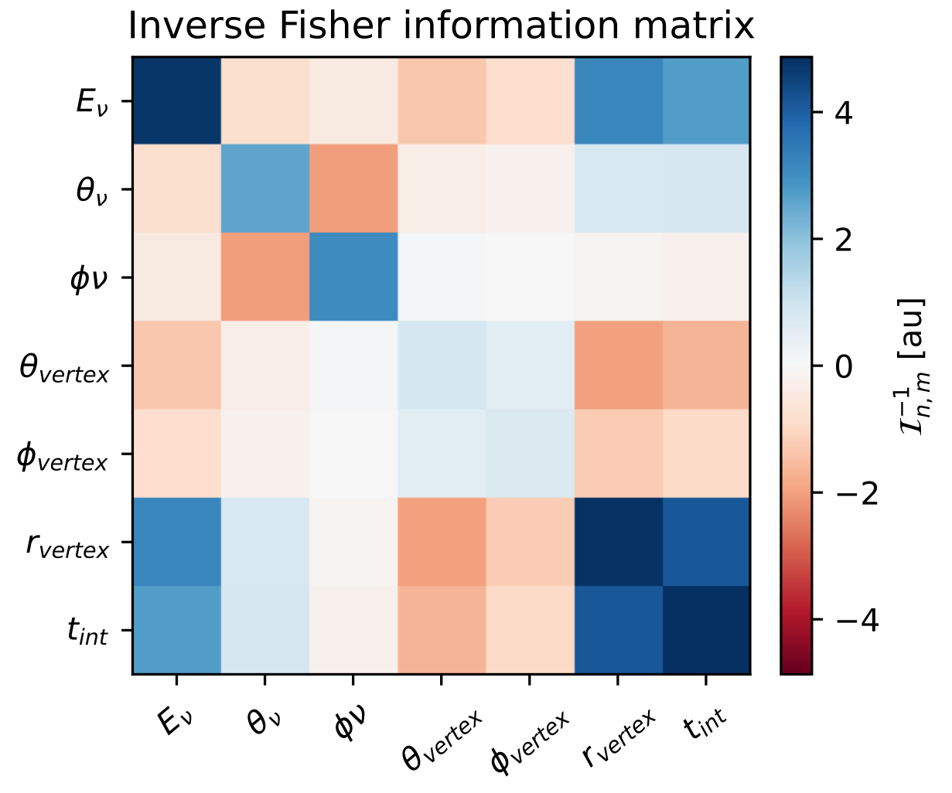

M. Ravn et al, 2025, arXiv:2510.21925
Reconstruction uncertainty estimation
Traditional reconstruction: Maximum likelihood fit
Fit signal signal to data:
Calculate area of ellipse
Gradients of uncertainty automatically calculated!
Cramér-Rao bound
Differentiable uncertainty estimate:
  Fisher information:
$$I_{ij}(θ_{ν}∣θ_{det.})=\underset{ant.}{∑}\frac{∂μ(θ_{ν},θ_{det.})^{T}}{∂θ_{ν,i}}Σ^{−1}\frac{∂μ(θ_{ν},θ_{det.})}{∂θ_{ν,j}}$$
Simple equation evaluation!

Slide 24
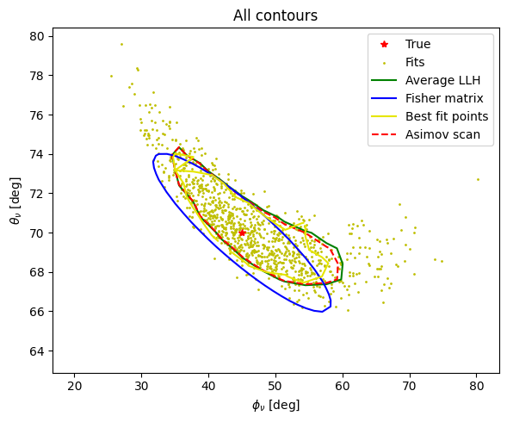
Fisher information matrix contour
Four different ways of estimating uncertainties

Slide 25
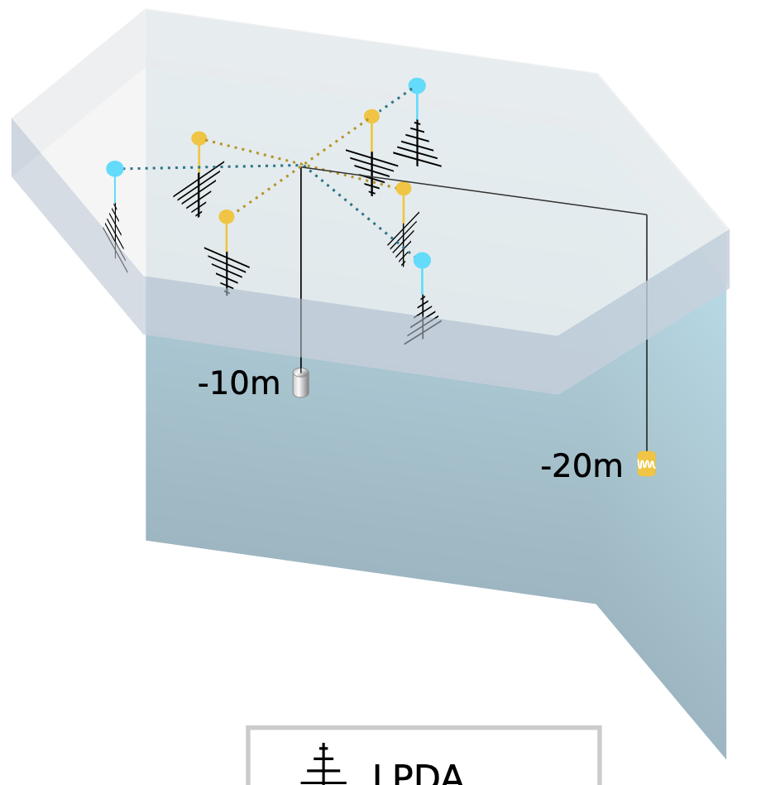
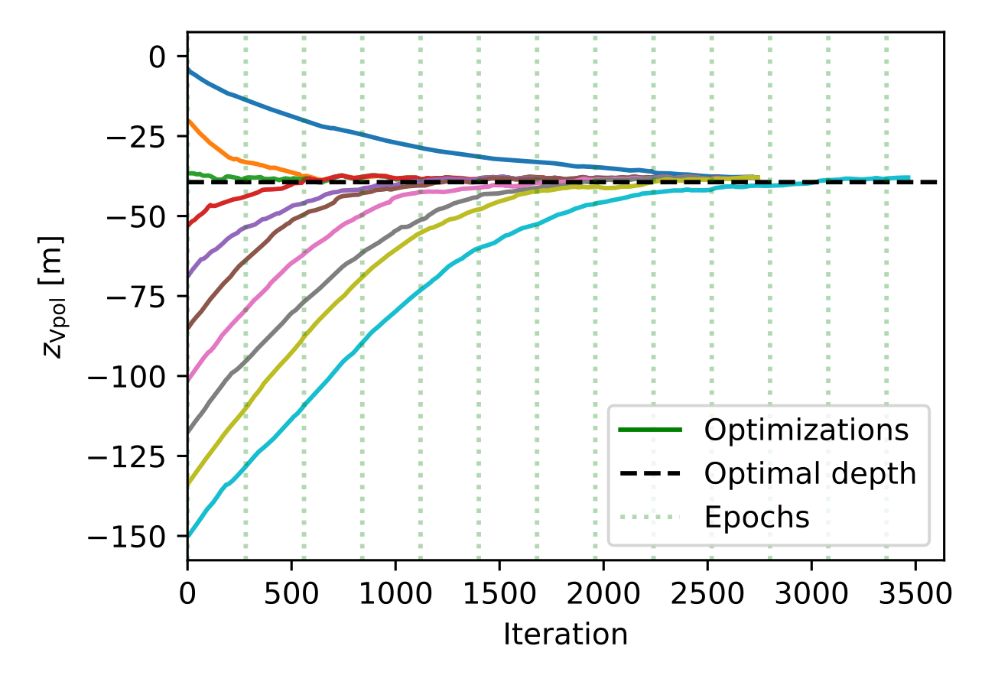
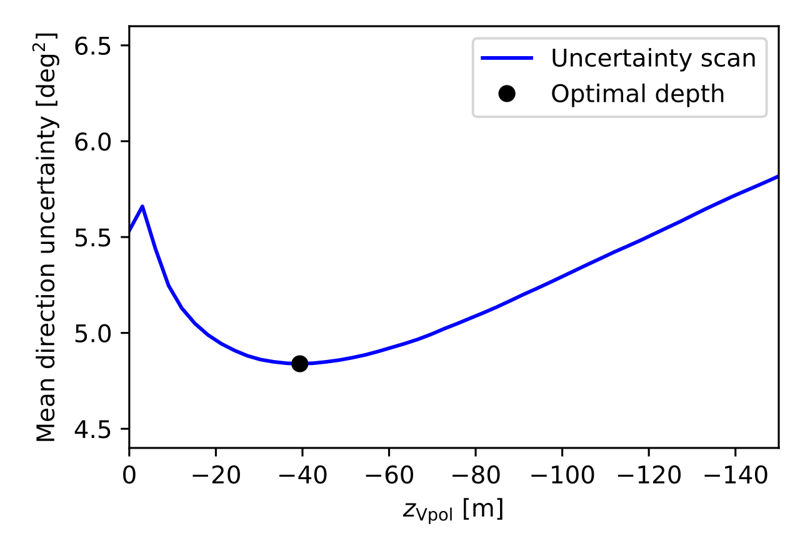
IceCube-Gen2 shallow station:
Proof of concept optimization 1: VPol depth
Goal: demonstrate stable convergence
Optimize depth of VPol antenna
Dataset: 100,000 triggered events
Batch: 512 neutrino events
Run simulation + reconstruction pipeline
Loss: Neutrino direction reconstruction uncertainty
Optimize like neural network
Simple optimization is stable!
10 optimizations:
1D scan:
(area of ellipse)
T. Dorigo et al, 2026, arXiv:2603.26613

