Slide 1


What Shapes the UV Beta Slope of Early Galaxies? Disentangling Physical Drivers with Machine Learning
Davey A. Plugers, Zhen Xiang, Romeel Davé

Slide 2
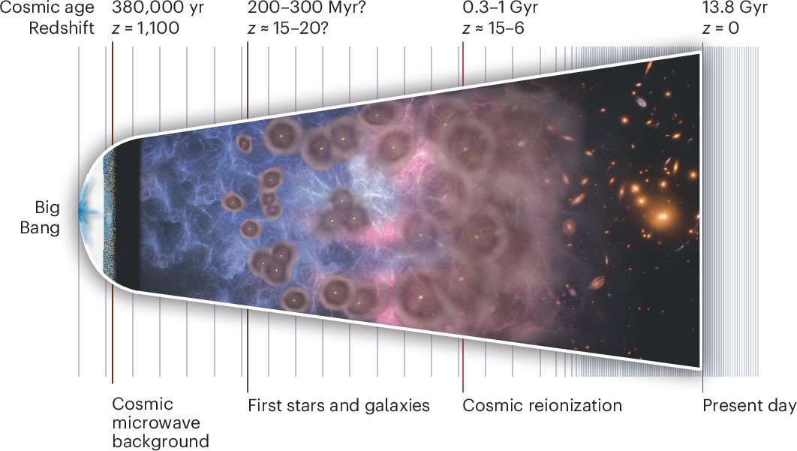
Universe history – Cosmic dawn
Cosmic Dawn: first stars and galaxies began to form.
Early galaxies were small, young, and rapidly forming stars.
JWST detects their redshifted infrared light, probing the earliest galaxies.
Image Courtesy to Delphi Project

Slide 3
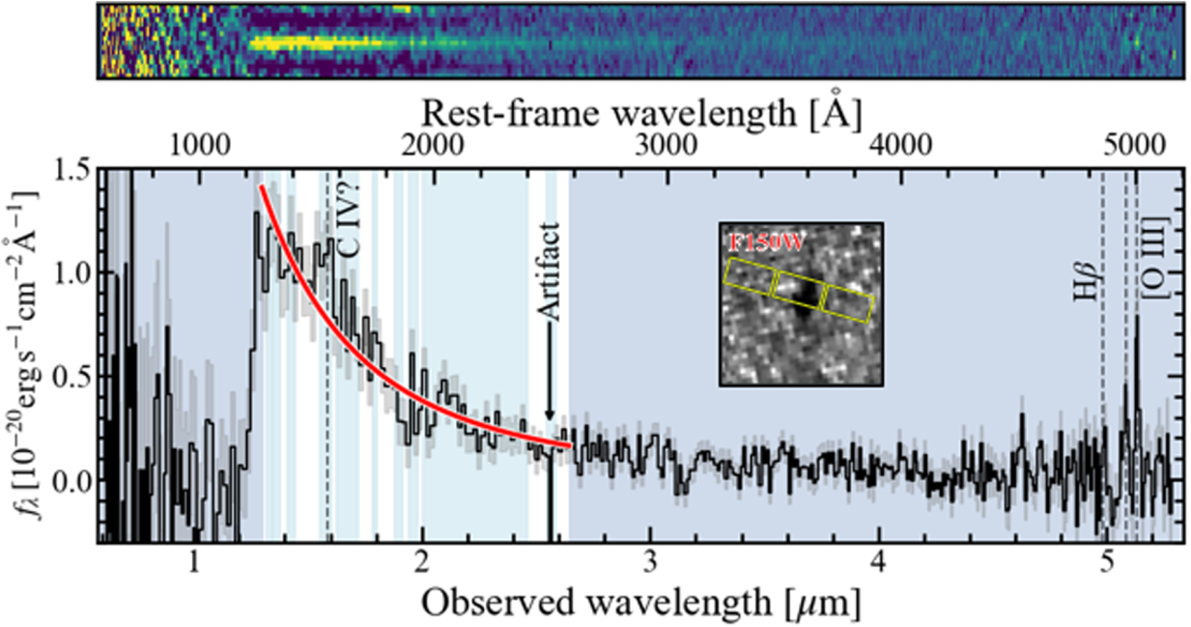
Galaxy spectra – UV Beta Slope
UV slope β describes the shape of the rest-frame UV continuum: fλ​∝λ^{β}. Typically measured over the rest-frame UV, ~1250–2600 Å.
Bluer (more negative) β generally indicates young, dust-poor stellar populations.
β helps constrain dust attenuation and stellar populations in early galaxies.
(Yanagisawa et al. 2025)
Typical high-redshift galaxies have β ≈ −2 to −2.5
β ≈ −3: extremely blue, young, dust-poor populations
β ≳ −1.5: redder, often indicating more dust and/or older stars

Slide 4
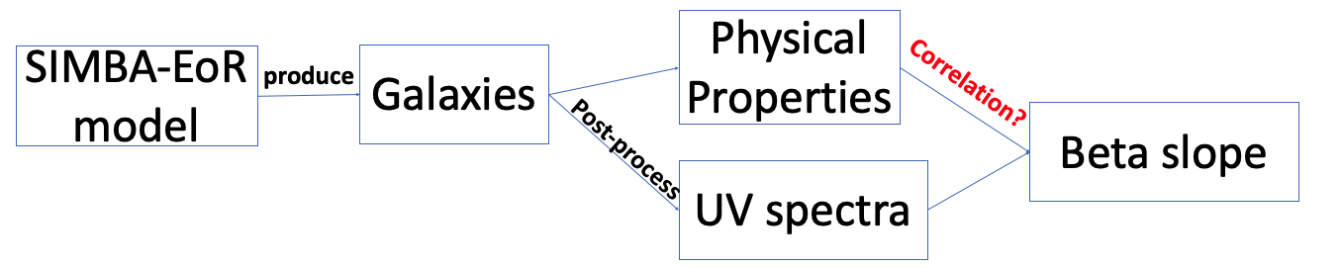
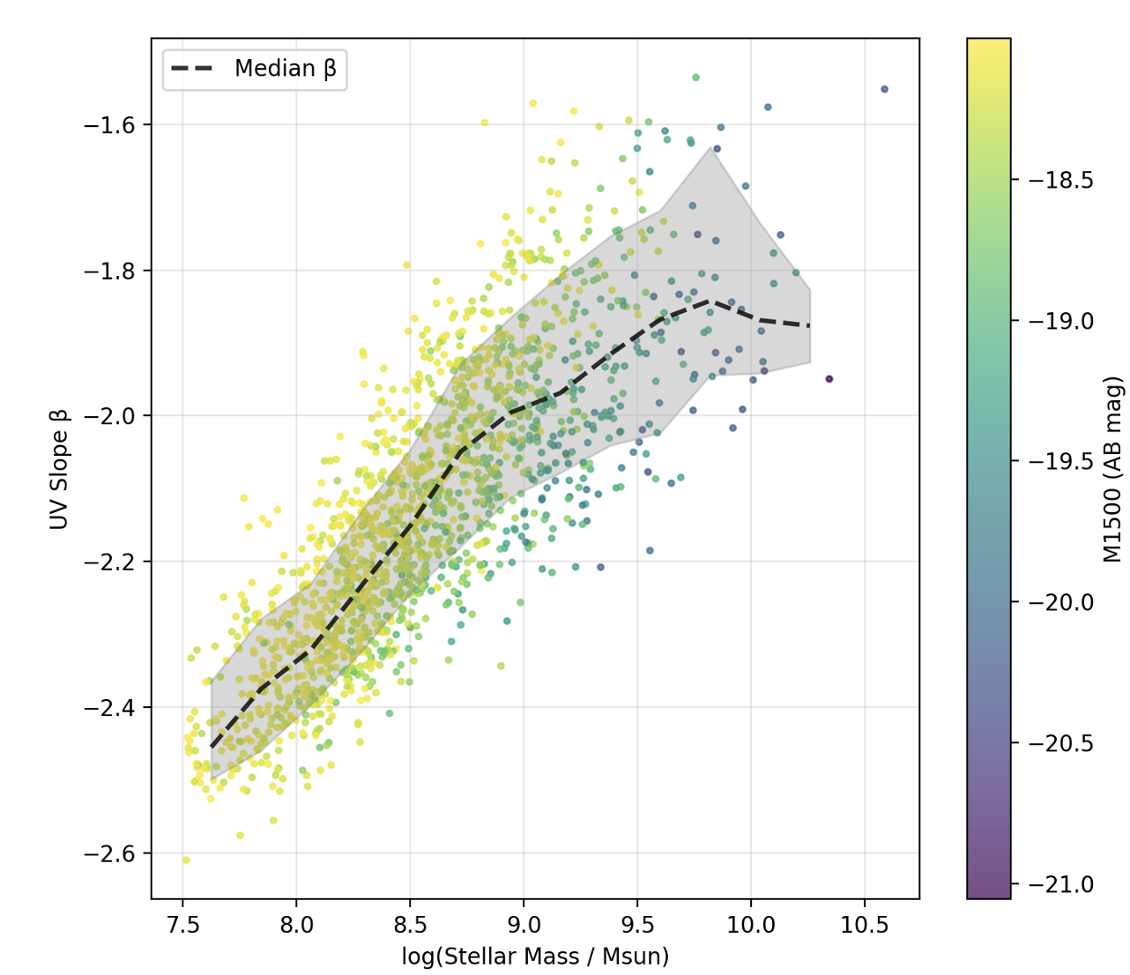
Cosmological simulation study on UV beta slope
Cosmological simulations provide self-consistent galaxy properties across large galaxy samples.
Stellar mass, SFR, metallicity, and dust mass are strongly correlated with one another.
β also correlates with these properties, e.g. the stellar mass–β relation.
These correlations make it difficult to determine which physical parameter is the best predictor of β.

Slide 5
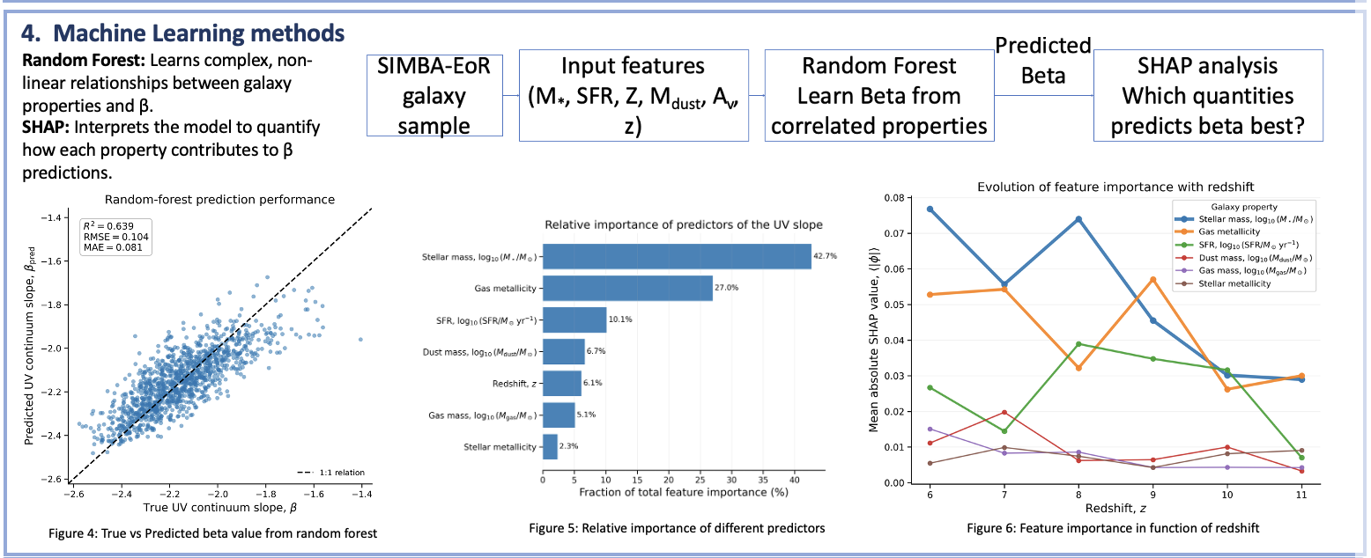
Machine Learning – Beta Predictor

