Slide 1
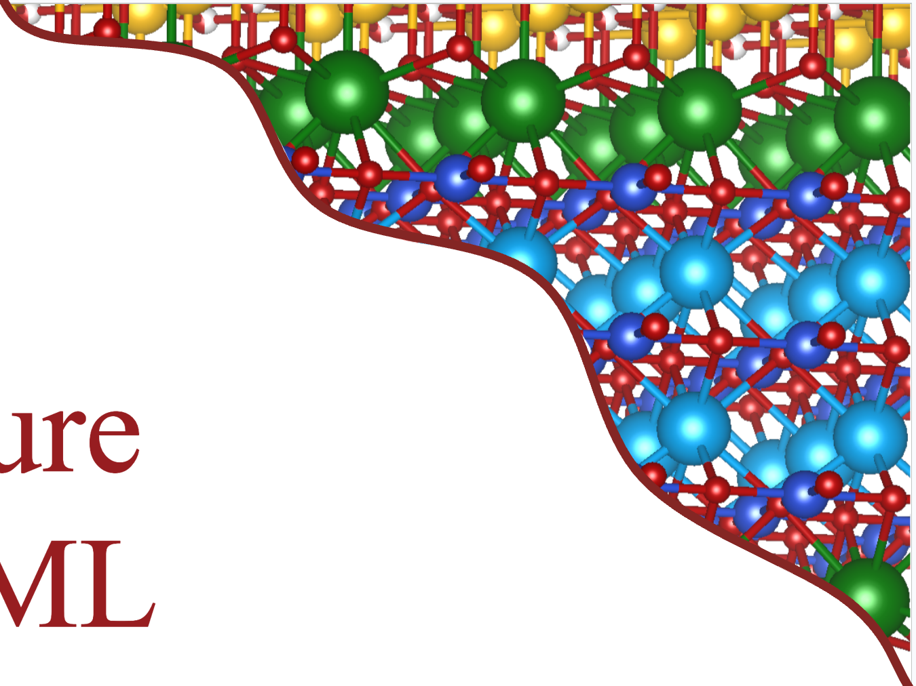
Predicting superconductivity
using Machine Learning
Amalie F. Davidsen, Rasmus B. Madsen, Frida B. Nielsen, Silas B. Schack and Hugo Schreckenberg
Hamlet conference August 2026
Ba₂Ca₂Cu₃HgO₈
T_{C}=134 K

Slide 2
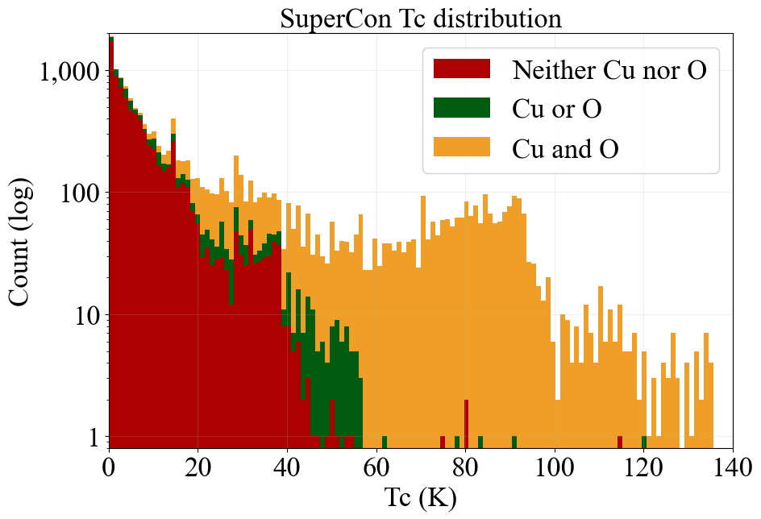
Collecting datasets: SuperCon
SuperCon
15 758 SC
3 854 non-SC
With T_{c}
Materialsproject
153k materials
Both SC and non-SC

Slide 3
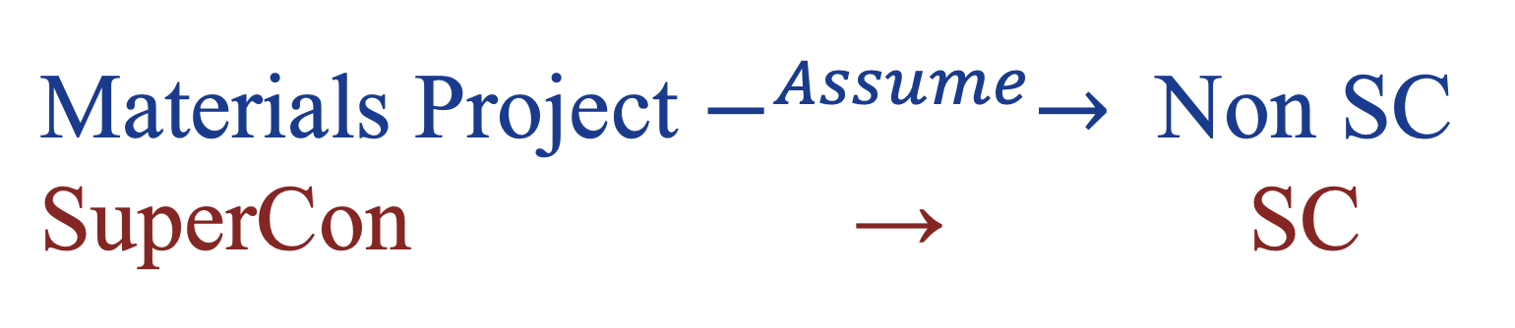
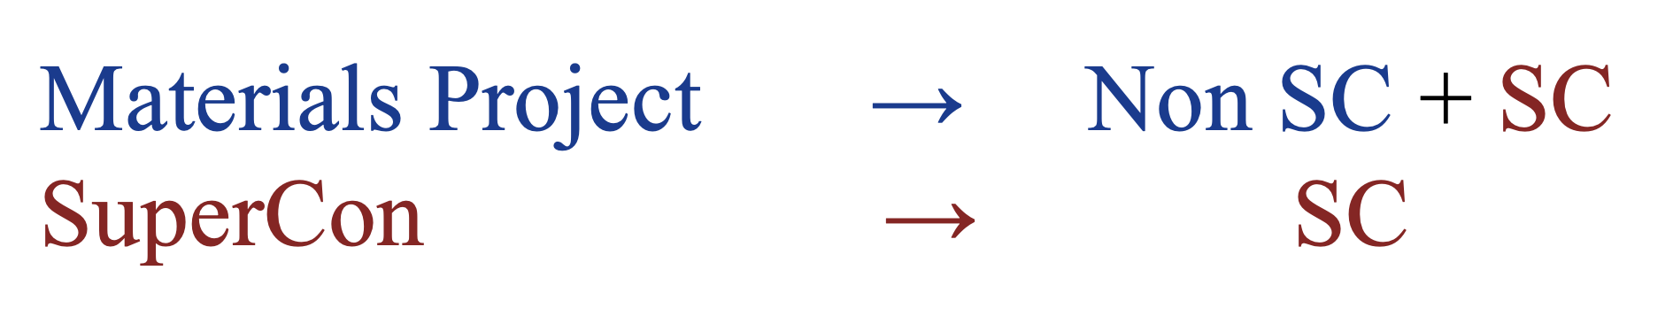
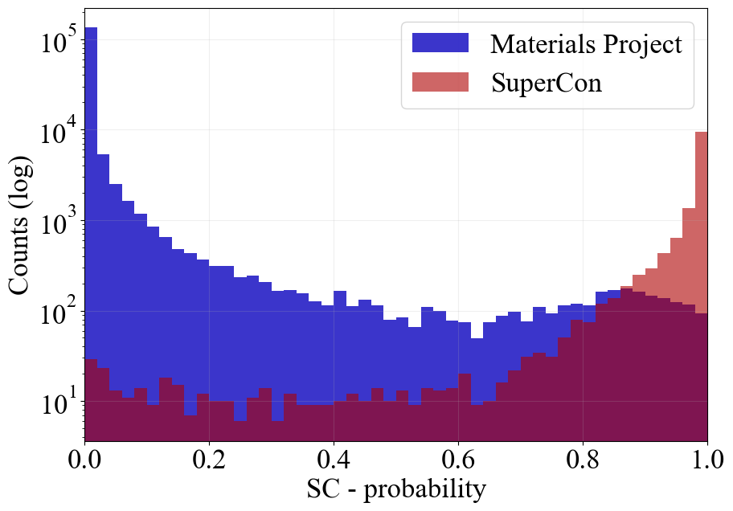
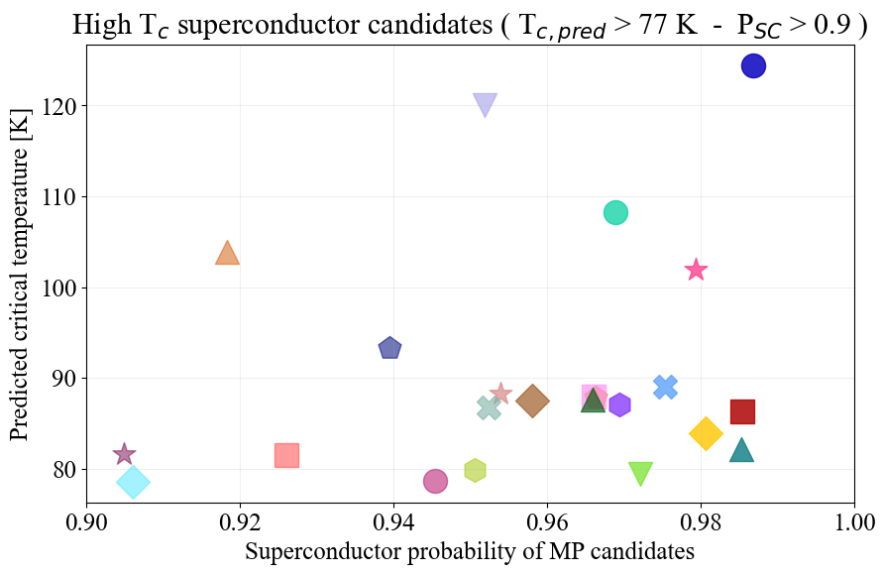
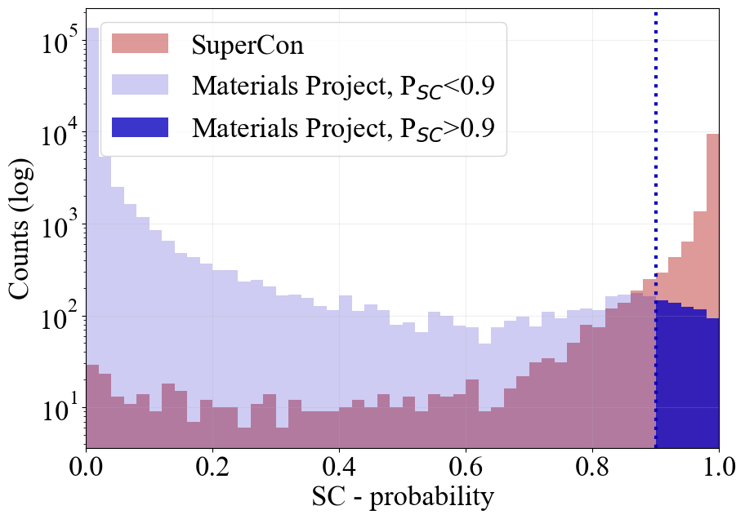
Predicting superconductors
Which ‘Non-SC’ have the highest probability of being SC?
Only
T_{c}>77 K
Notes:
SC (1): 7.6% | MP+sc0 (0): 92.4%

Slide 4
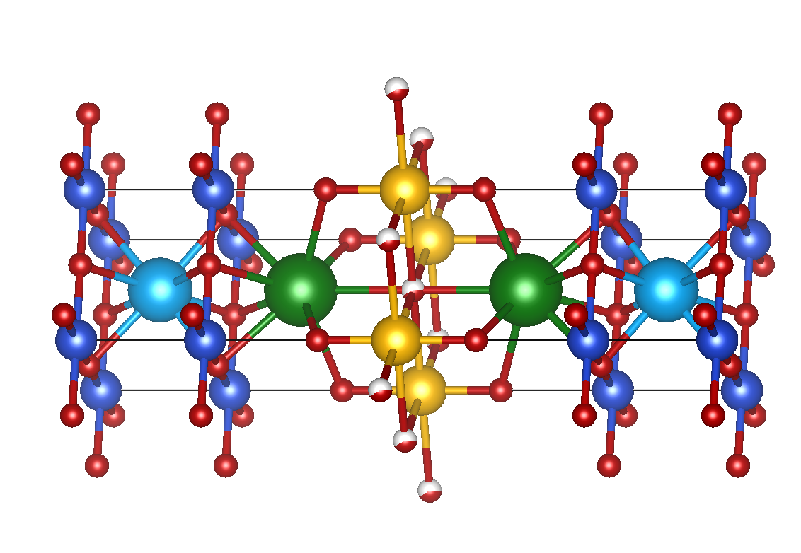
Combining datasets
Exact
match
SuperCon
15 758 SC
3 854 non-SC
With T_{c}
Materials
Project
139 000 calculated
crystal structures
5 759 crystals
5 773 crystals
Tc and structure
“Artificial doping”
Exact
match
ICSD
196 317 experimental crystal structures
9 150 crystals
75 850 crystals
Tc and structure
“Artificial doping”
T_{C}
T_{C} +
Data augmentation

Slide 5
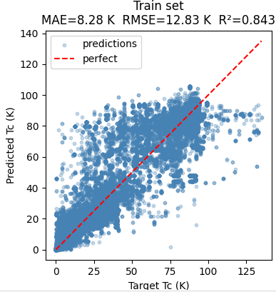
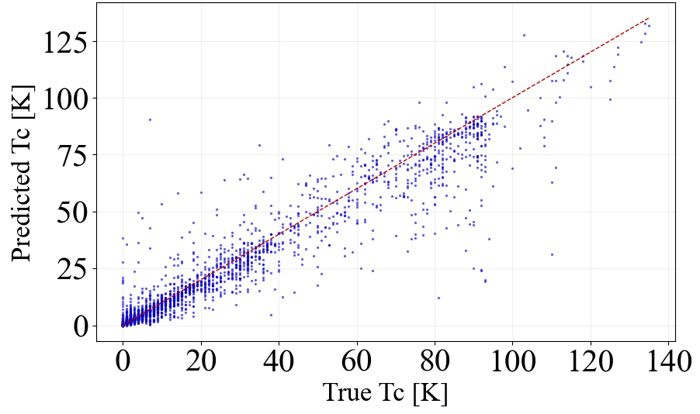
Tree based models
Graph based models
RMSE=8.90 K, R²=0.91,

Slide 6
High-Tc
Superconductor candidates
Regression/
Classification
VAE

