Slide 1
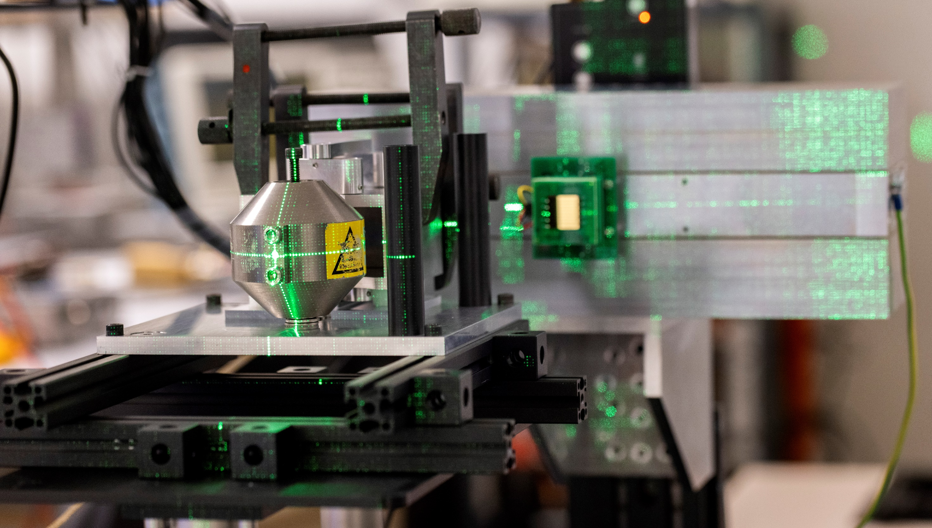

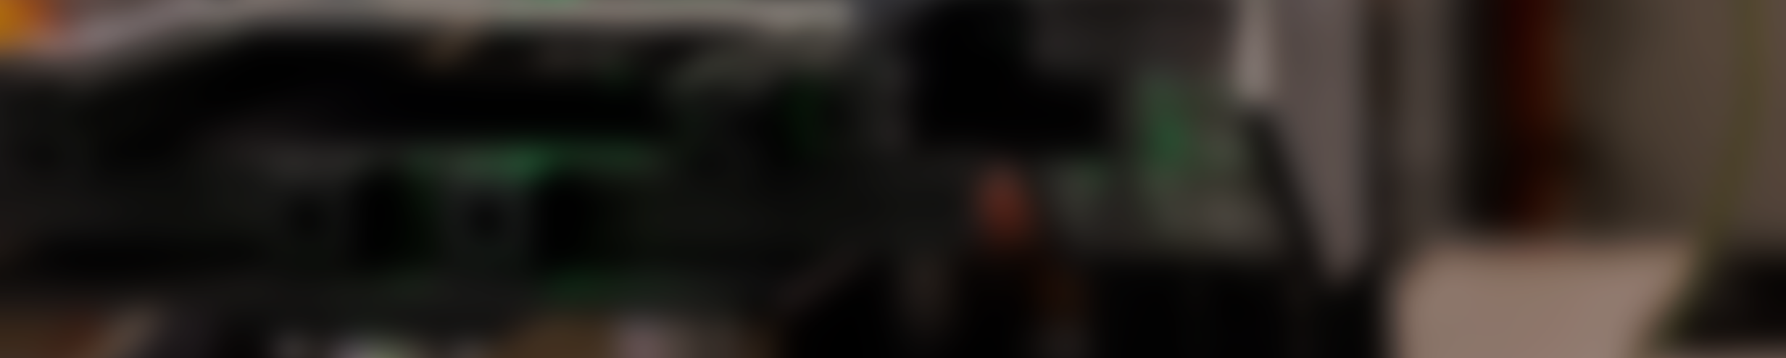
Detector simulation for neural network position reconstruction in the i-RASE system†
S. R. H. Owe, M. Kossakowski, R. S. Klausen, A. Cherlin, A. Valverde Mahou, G. Arvanitidis, S. Hauberg,
D. Tcherniak, C. Budtz-Jørgensen, and I. Kuvvetli
† S. R. H. Owe, M. Kossakowski, R. S. Klausen, et al. "Detector simulation for neural network position reconstruction in the i-RASE system",
Proc. SPIE 14146, Space Telescopes and Instrumentation 2026: Ultraviolet to Gamma Ray https://doi.org/10.1117/12.3102775

Slide 2
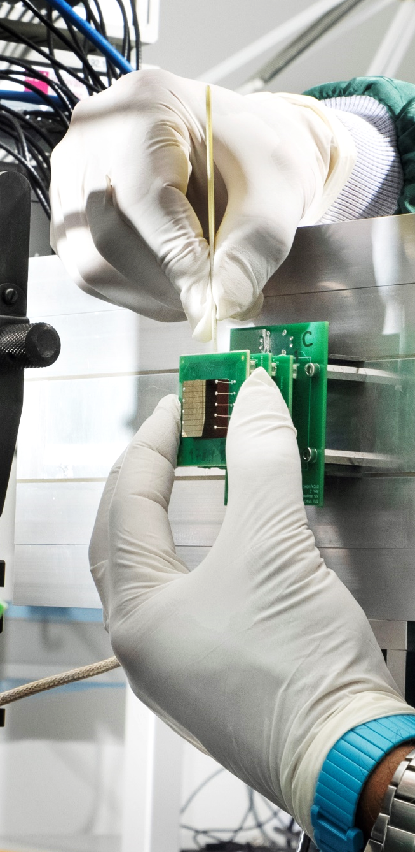
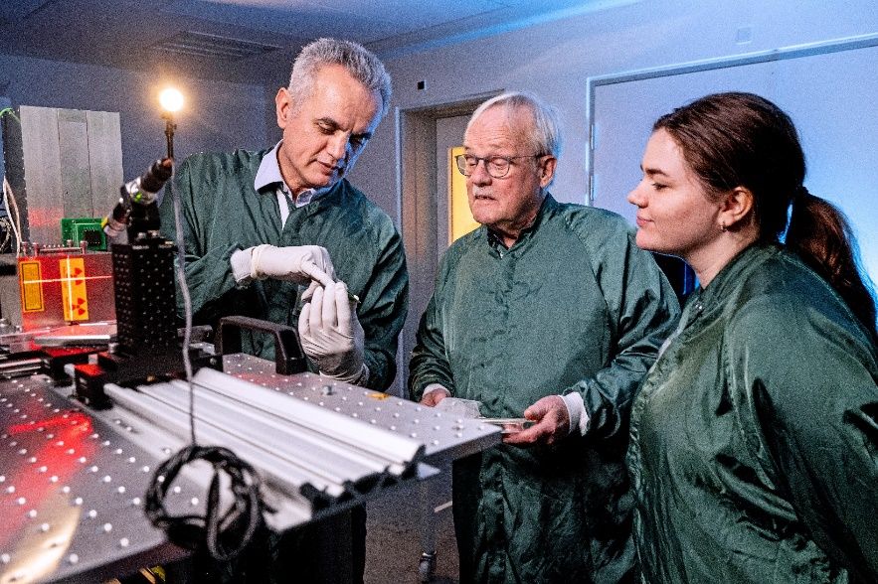
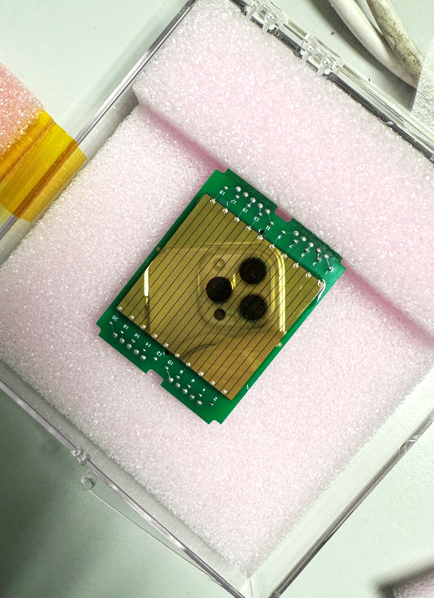
DTU Space Detector Laboratory
Detector technology development
Detector material research
Advanced detector modelling
Applications
Heritage
Notes:
Material research, detector tech research, advanced modelling
Heritage like ASIM, JEM-X on INTEGRAL

Slide 3
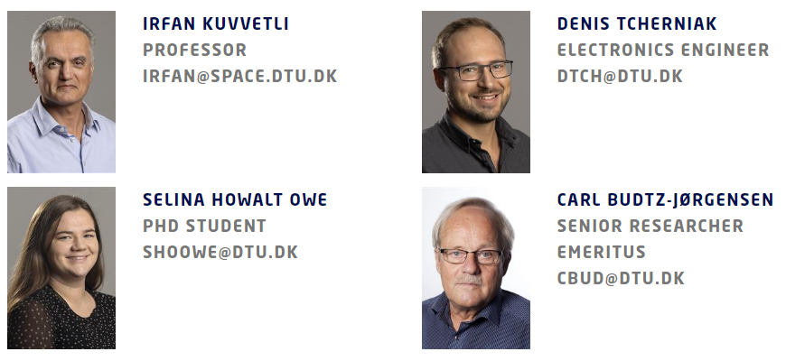


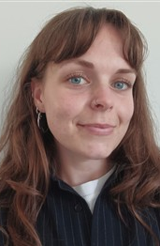
DTU Space Detector Group
Irfan Kuvvetli
Professor
irku@dtu.dk
Selina R. H. Owe
Postdoc
shoowe@dtu.dk
Ajay RaTheeSH
Postdoc
AJRAT@dtu.dk
Carl Budtz-Jørgensen
Senior researcher emeritus
cbud@dtu.dk
Michał Kossakowski
Phd Student
mmako@dtu.dk
Rikke Stougaard klausen
Research Assistant
rstkl@dtu.dk
Denis Tcherniak
Electronics Engineer
dtch@dtu.dk

Slide 4
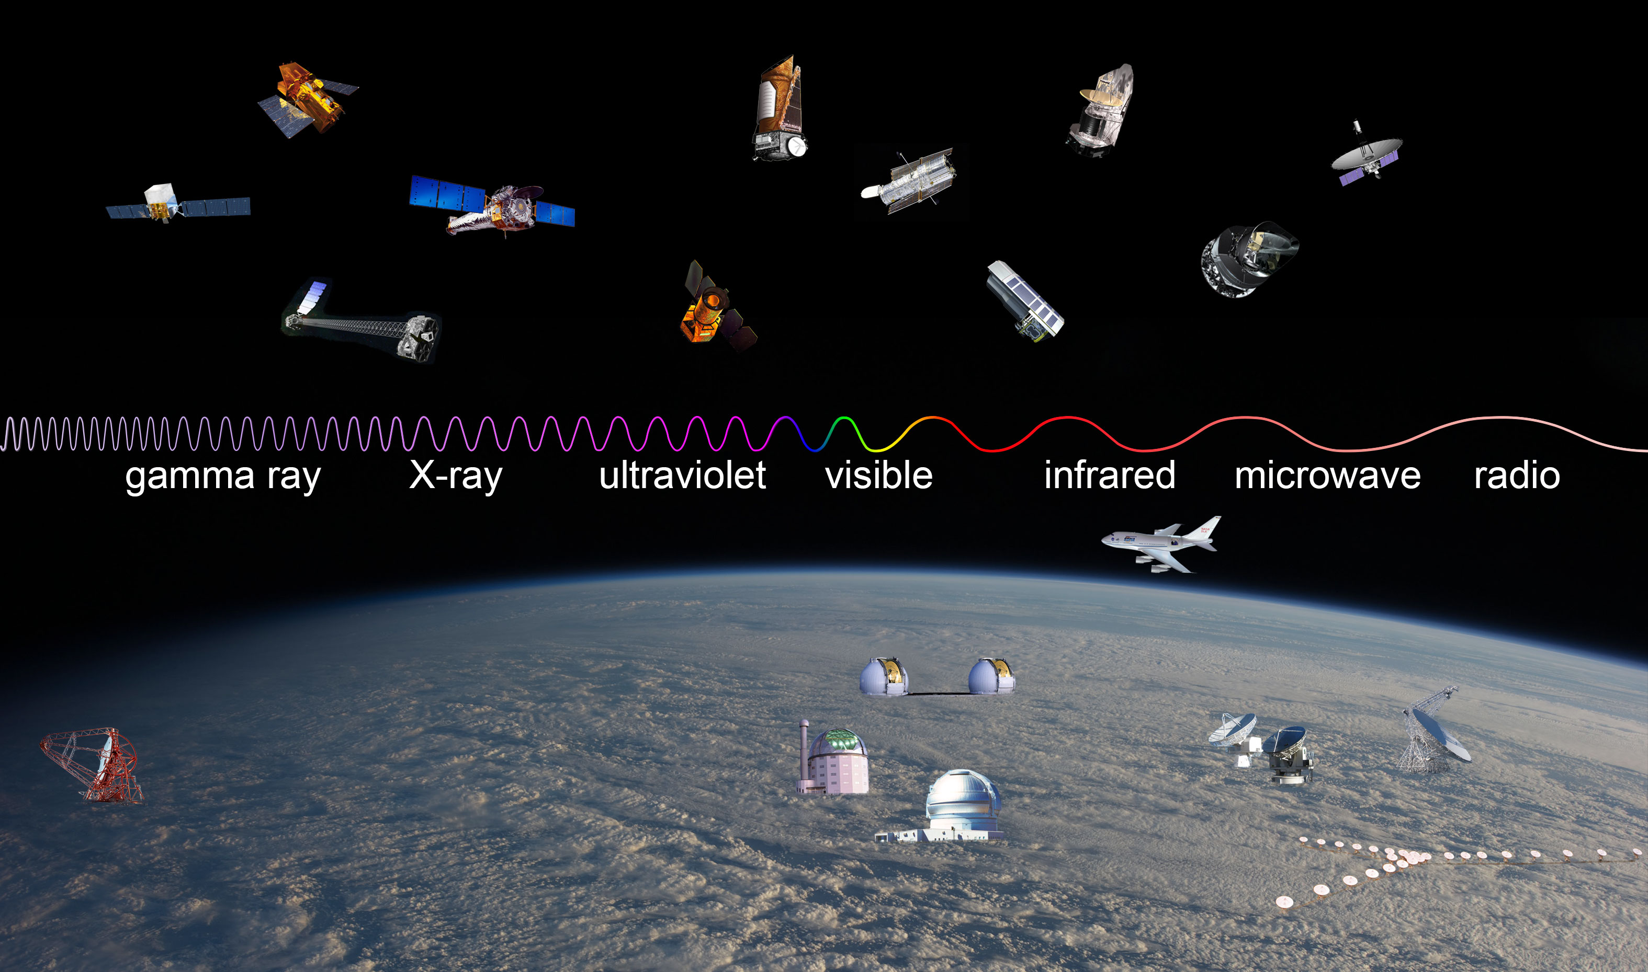
Credit: Observatory images from NASA, ESA (Herschel and Planck), Lavochkin Association (Specktr-R), HESS Collaboration (HESS), Salt Foundation (SALT), Rick Peterson/WMKO (Keck), Germini Observatory/AURA (Gemini), CARMA team (CARMA), and NRAO/AUI (Greenbank and VLA); background image from NASA)
Notes:
We are interested observational astrophysics and instrumentation

Slide 5
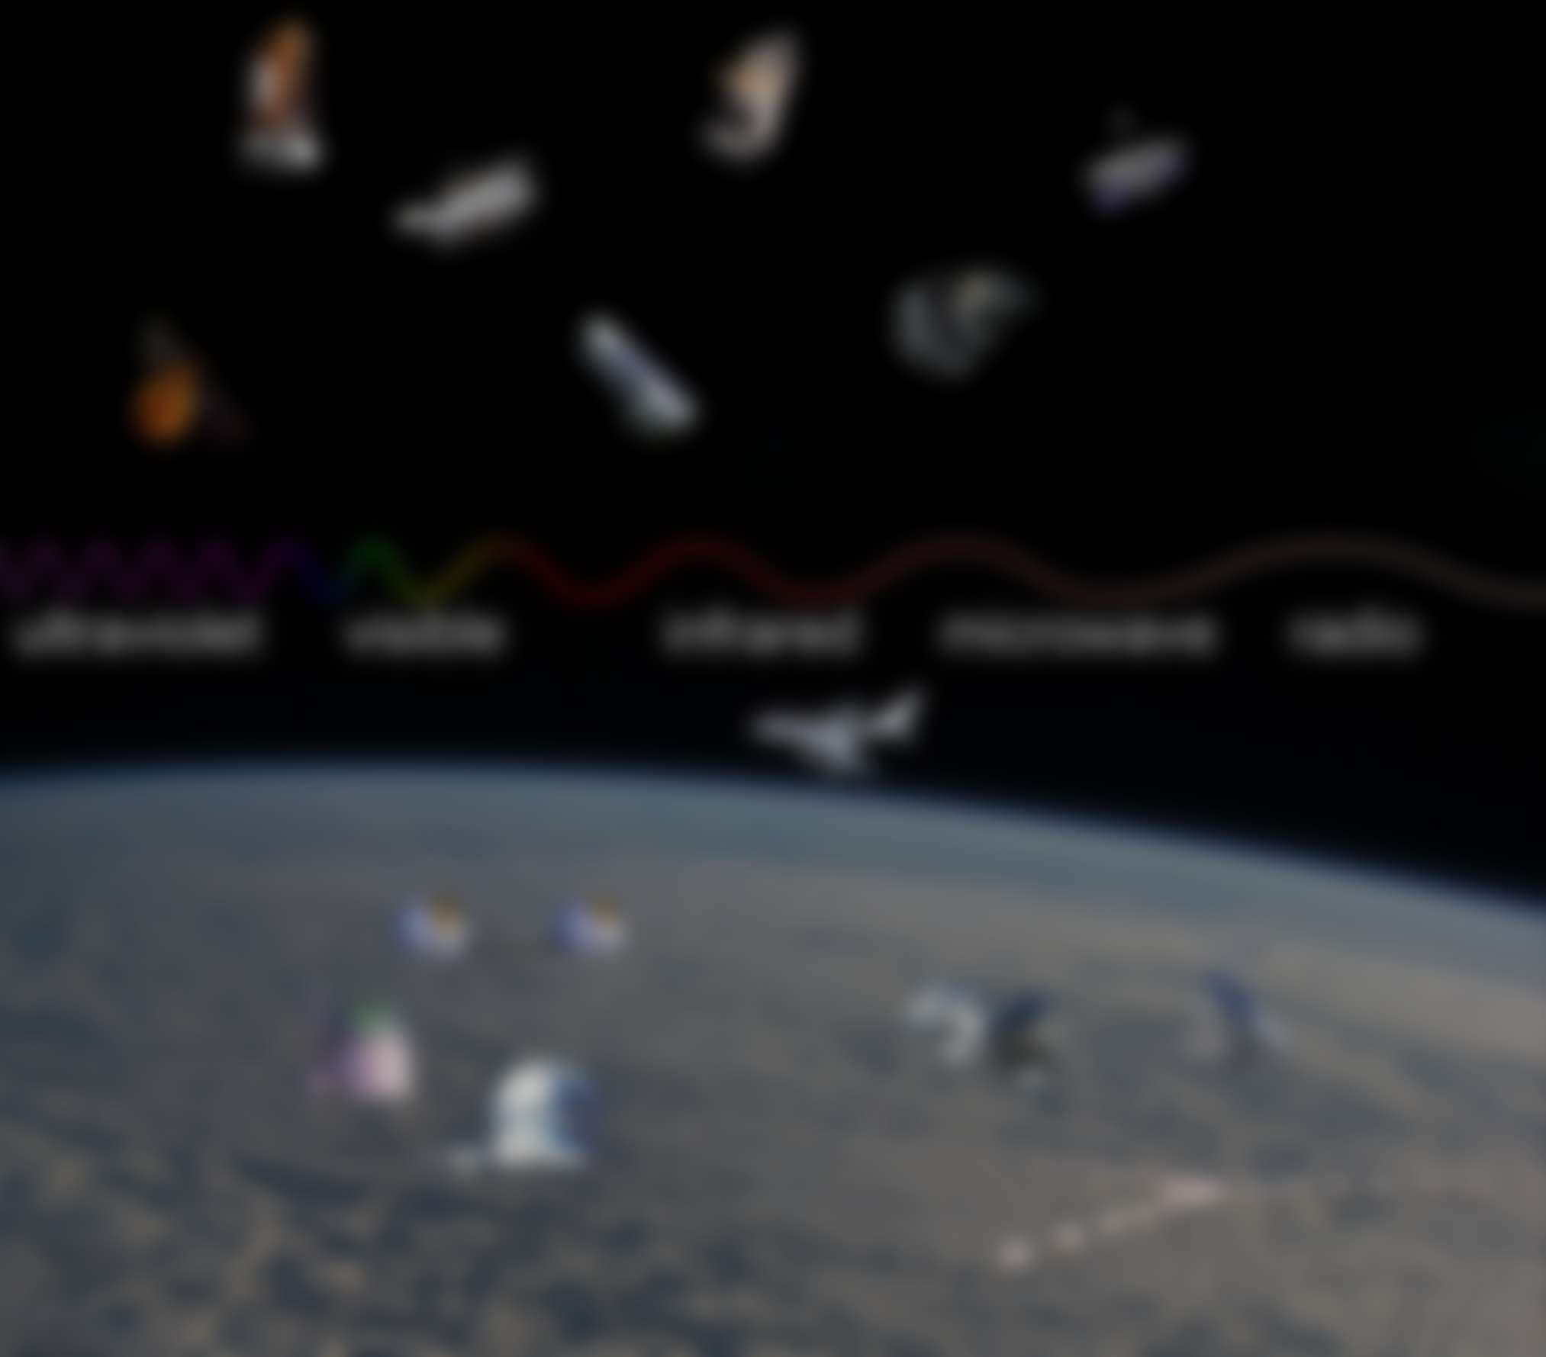
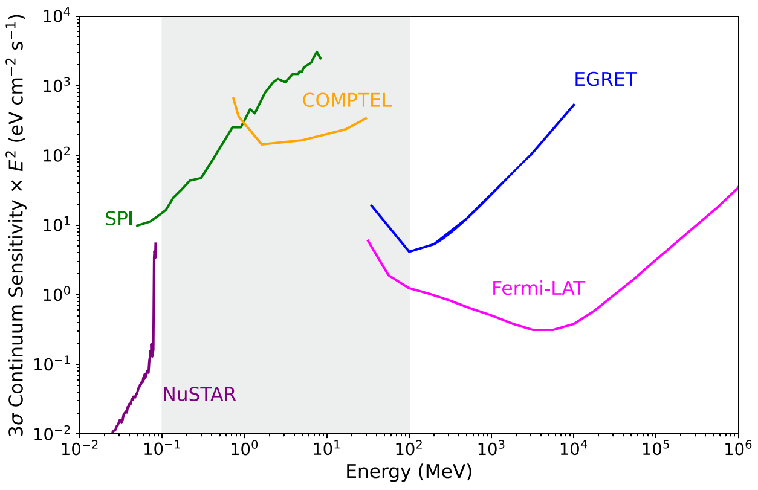
Image: Michela Negro et al. 2022
MeV
Gap
TeV- GeV
High energy
gamma
MeV
Low-medium energy
gamma
keV
High energy
x-ray
High energy
x-ray
Low-medium energy
gamma
High energy
gamma
Notes:
Higher energy
There is a gap in sensitivity in the MeV domain of the spectrum and it the least explored. We want to address this gap

Slide 6
The MeV gap
Image: Michela Negro et al. 2022
Difficulties of observing this domain is due to
Three energy-loss processes
Low interaction cross-sections
Inherent difficulty of imaging
High instrumental and atmospheric background
MeV
Gap
Notes:
It is difficult to observe in this domain for several reasons, but -

Slide 7
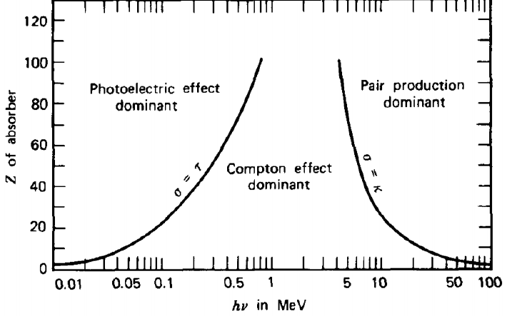
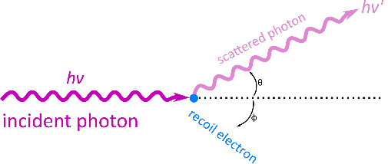
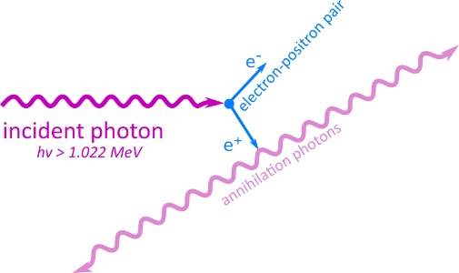
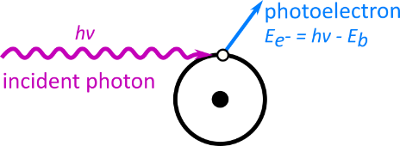
The MeV gap
Image: (Knoll, 1997)
Difficulties of observing this domain is due to
Three energy-loss processes
Low interaction cross-sections
Inherent difficulty of imaging
High instrumental and atmospheric background
Notes:
The main difficulty is the three types of energy losses in this energy range.
Photon electric absorption, Compton scattering and pair production. We need extremely good detectors that can distinguish the interactions.

Slide 8
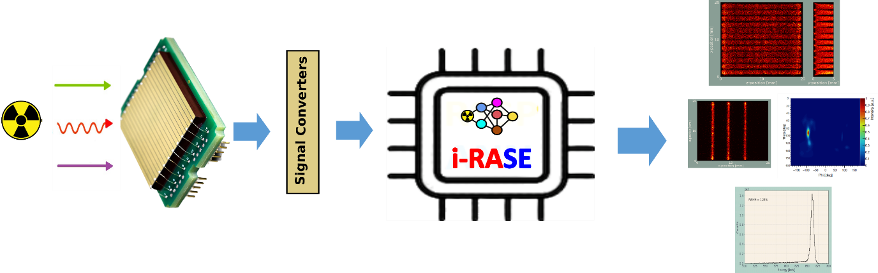
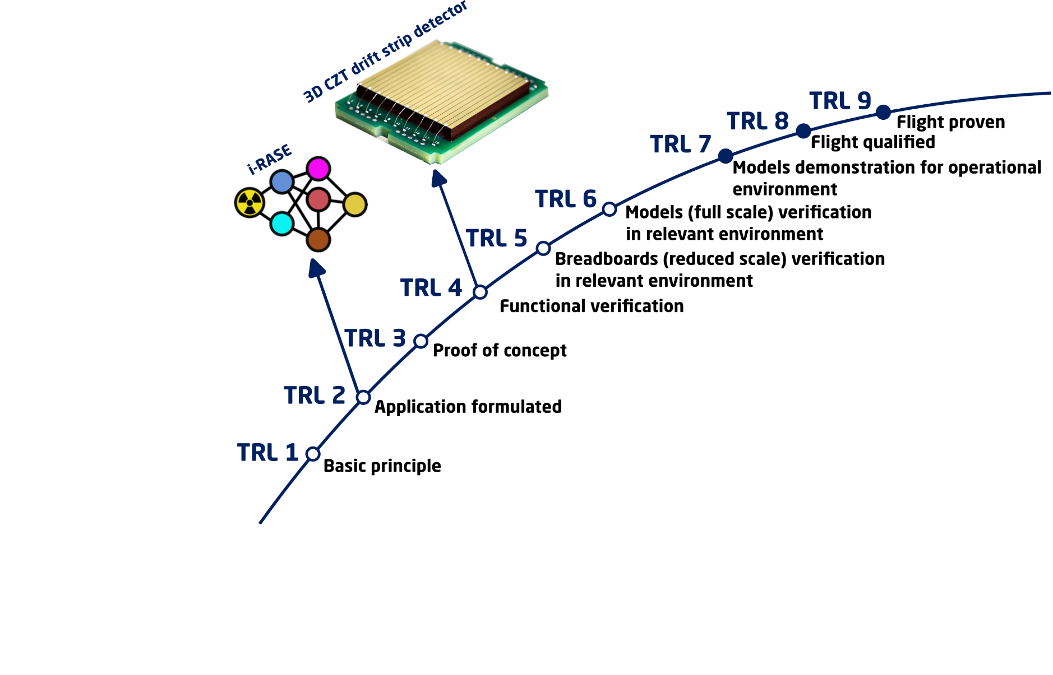
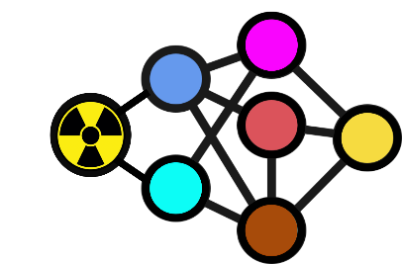










i-RASE – Intelligent Radiation Sensor
Readout Systems
HE EIC - i-RASE – 101130550
KO: March 01, 2024, Duration: 48 months
Real-time radiation measurement via physics-inspired neural networks​​
Space (PI)
&
Compute
Notes:
This is where the i-RASE project comes in. We and our partners are trying to design, build, test and implement the 1st on-the-fly photon-by-photon radiation detector.
We want to put a neutral network on a chip for real-time measurement.
In 2023, to gether with 4 Eropean partners, including leading industrial partners in detector material Kromek,UK and and electronics IDEAS, NO and POLIMI, IT and TUBINGEN University DE, we have aplied and approved for 4 years development project, i-RASE in ordet to develop a new generation readout electronics prototype, based on DTU patented “ANN-based radiation readout electronics”.
i-RASE Intelligent Radiation Sensor Readout Systems is the next-gen AI-powered sensor readout technology directly using detector specific trained Artificial Neural Networks (ANNs) for radiation detectors and signal processing​.
During i-RASE, we will build an intelligent radiation sensor readout system specific for the 3DCZT drift detectors, with signal and event characterization based on real-time radiation measurement with physics-inspired neural networks.
We would like to acknowledge funding form Horizon – EU program from European Innovation Consul to support our reseach activity for the i-RASE project for 4 years.

Slide 9
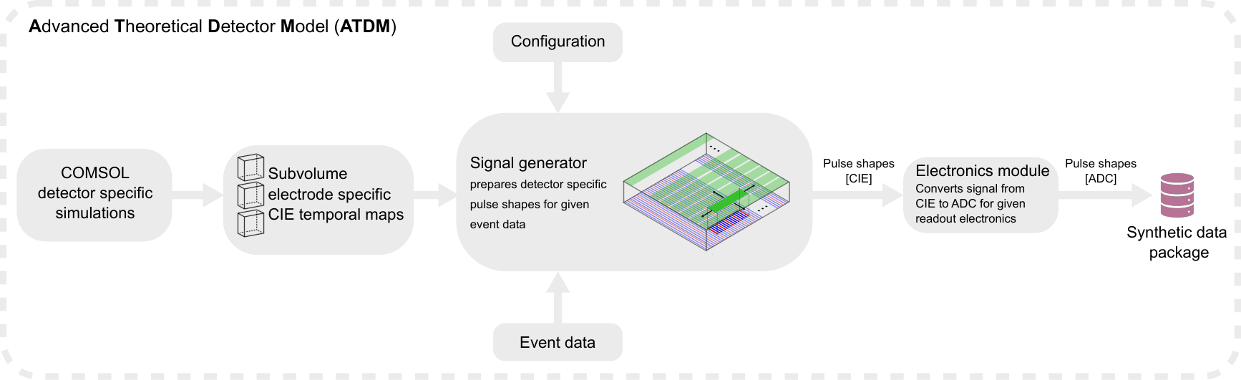
Advanced Theoretical Detector Model
(ATDM) framework
Notes:
Our role in the i-RASE project is everything detector oriented. We designed the detector, and we are also working on an Advanced Theoretical Detector Model framework.
In order to train a NN with ground truth labels we need a good detector simulation to understand the detector and event data, so how does the fingerprint of an interaction look like in the detector.
In order to get to a synthetic data package for training, we built a frame work that from detector specific simulations can generate signals.

Slide 10

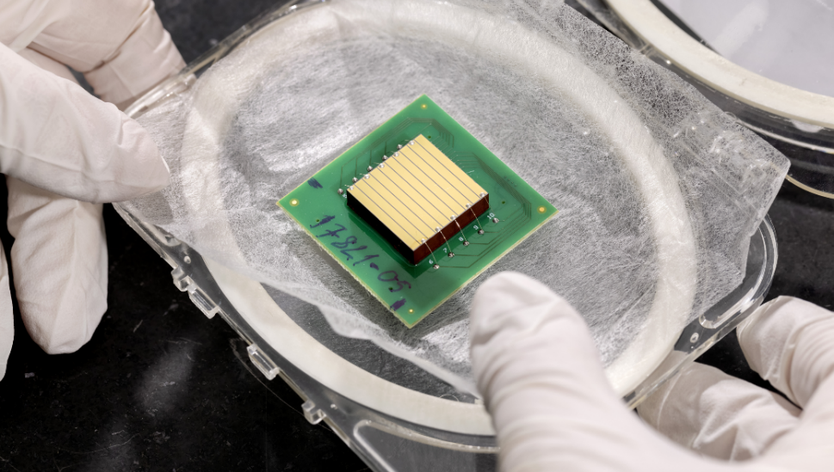
The 3D CZT Drift Strip Detector
Semiconductor detector (CdZnTe) | Electron only device | Room temperature operation | Energy resolution ~1% @661.6 keV | 3D position capability (0.4 mm in 3D @661.6 keV)
Notes:
The detector itself is..

Slide 11
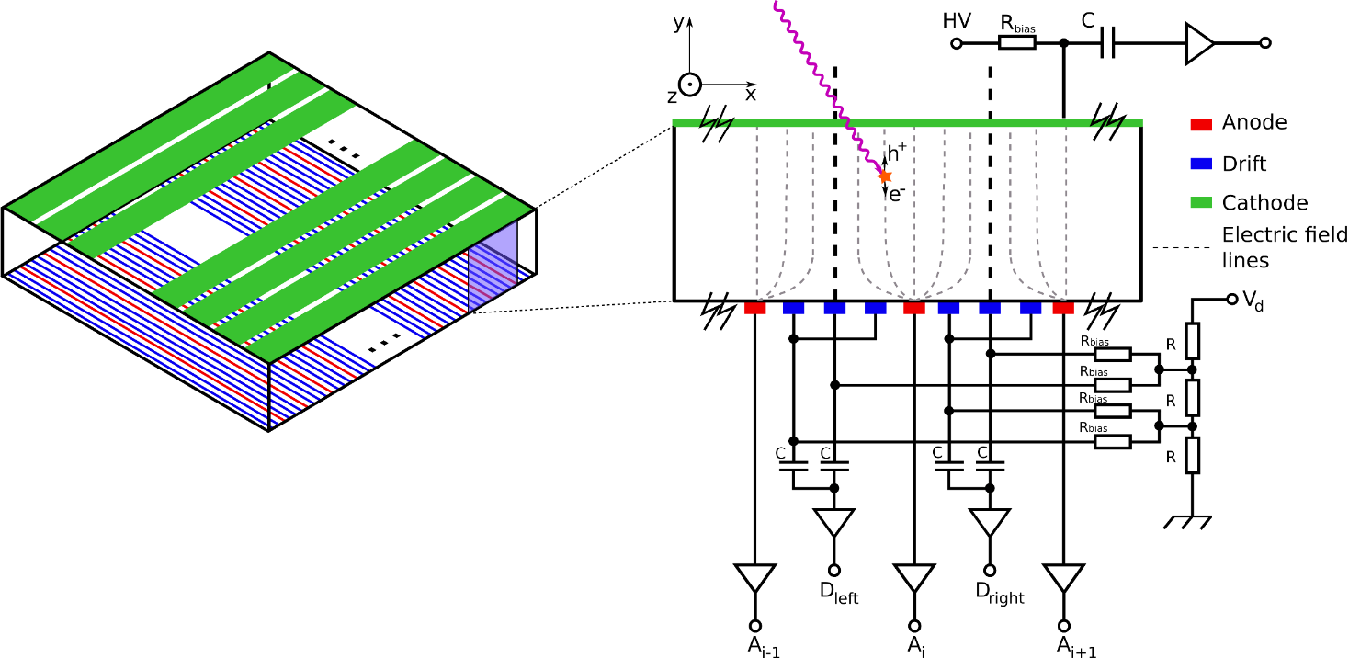
The 3D CZT drift strip detector
Electrode configuration
Notes:
The concept of the detector..
The electrodes are strips on the top and bottom of the semiconductor material.
The biasing and geometry of the electrodes determine the electric field inside the bulk.
When a photon interacts within the detector electron-hole pairs are created and the electrons are guided towards an anode for collection.

Slide 12
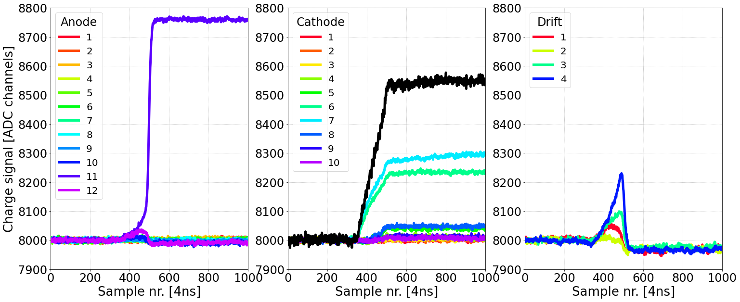
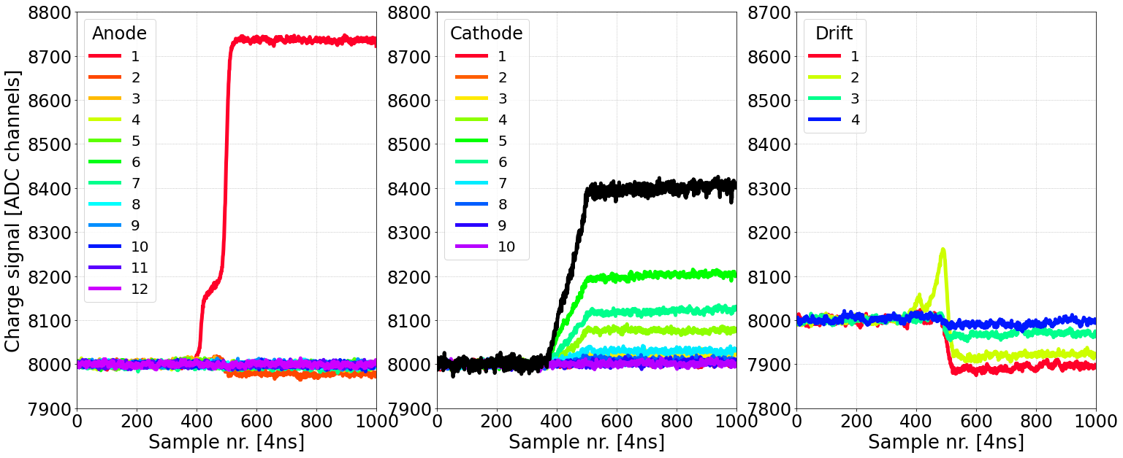
The 3D CZT drift strip detector
Electrode configuration and signal analysis
Summed cathode signal provide information of
Electron drift time
Activated anode number and pulse shapes reveal
event (interaction) type
Anode, cathode, and drift strip signals all provide information of
3D interaction position
Anode pulse height provide information of
Deposited energy
Notes:
The fingerprint of an event are pulse shapes – we see how the charge cloud travels/drifts through the detector.
There are two sets of pulse shapes
The activated anode tells us which kind of interaction took place, left is a photoelectric absorption and right is a Compton event (it has a little bump)
We use all of the output to get the 3D position of the event.
The pulse height of the anode is related to the deposited energy
The cathode sum provides us the information about the electron drift time.

Slide 13
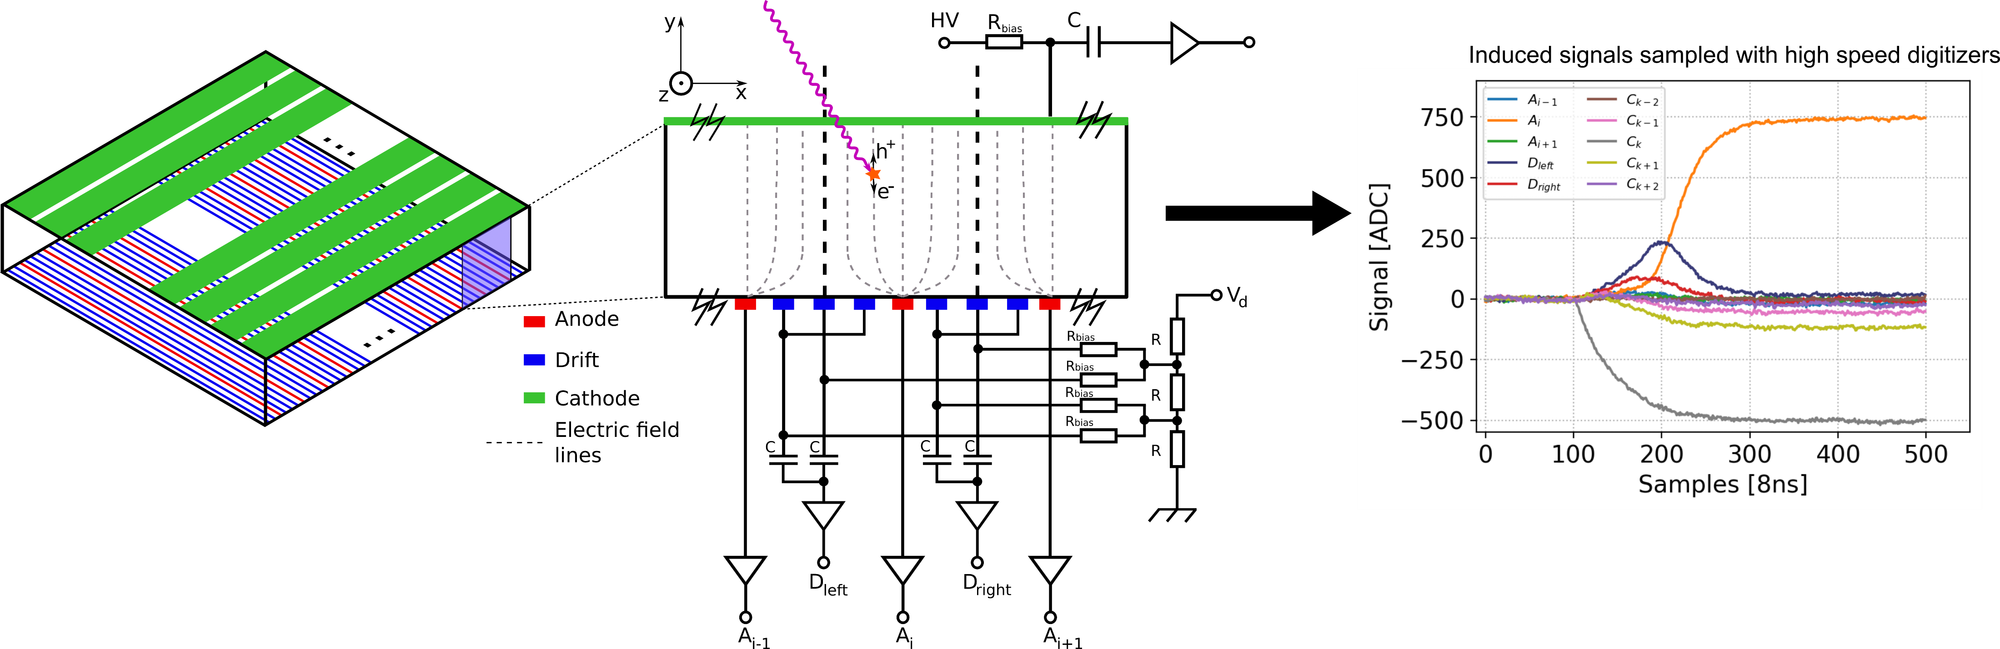
DTU Space Detector Development
DSD performance @ 662 keV:
1% FWHM energy resolution, electronic noise dominant
0.5 mm FWHM 3D position resolution
Interaction type identification
40x5x40 mm³ 3D CZT Drift Strip Detector (3D CZT DSD)^{[1]}
69 readout channels (24 anodes, 25 drift strip sections, 20 cathodes)
Segmented cathode is biased to -350V and drifts -150V
  Central drift receives 2/3 of the drift bias
  Two outer drift receives 1/3 of the drift bias
  Anodes are at ground potential
Successful concept:
Low-Dose Molecular Breast Imaging (LDMBI) ^{[2]}
MeV Astrophysics ^{[3,4]}
Compton Camera ^{[5]}
[1] Kuvvetli, ˙I., Budtz-Jørgensen, C., Zappettini, A., Zambelli, N., Benassi, G., Kalemci, E., Caroli, E., Stephen,J., and Auricchio, N., “A 3d czt high resolution detector for x-and gamma-ray astronomy,” in [High energy,optical, and infrared detectors for astronomy VI], 9154, 272–281, SPIE (2014).
[2] Owe, S., Kuvvetli, I., Cherlin, A., Harris, B., Tomita, H., Baistow, I., Tcherniak, D., and Budtz-Jørgensen,C., “Evaluation of czt drift strip detectors for use in 3-d molecular breast imaging,” IEEE Transactions onRadiation and Plasma Medical Sciences 7(2), 113–123 (2022).
[3] Owe, S. H., “Development of 3d imaging detectors for high energy astronomy instrumentation,” (2023).
[4] Hauptmann, B. N., Owe, S. R., Kuvvetli, I., Tcherniak, D., Budtz-Jørgensen, C., Baistow, I., Harris, B.,Cherlin, A., and Cantwell, B., “Performance evaluation of large area three-dimensional cdznte drift stripdetectors,” Journal of Astronomical Telescopes, Instruments, and Systems 11(2), 026001–026001 (2025).
[5] Owe, S. H., Kuvvetli, I., Budtz-Jørgensen, C., and Zoglauer, A., “Evaluation of a compton camera concept using the 3d cdznte drift strip detectors,” Journal of Instrumentation 14(01), C01020–C01020 (2019)

Slide 14
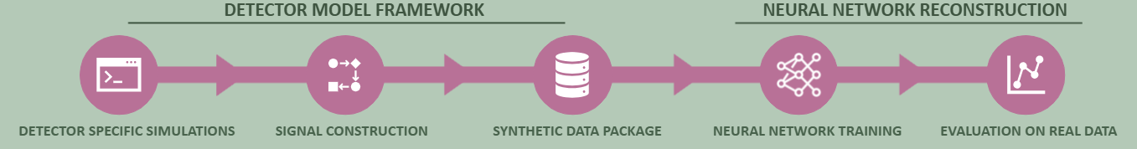

Slide 15
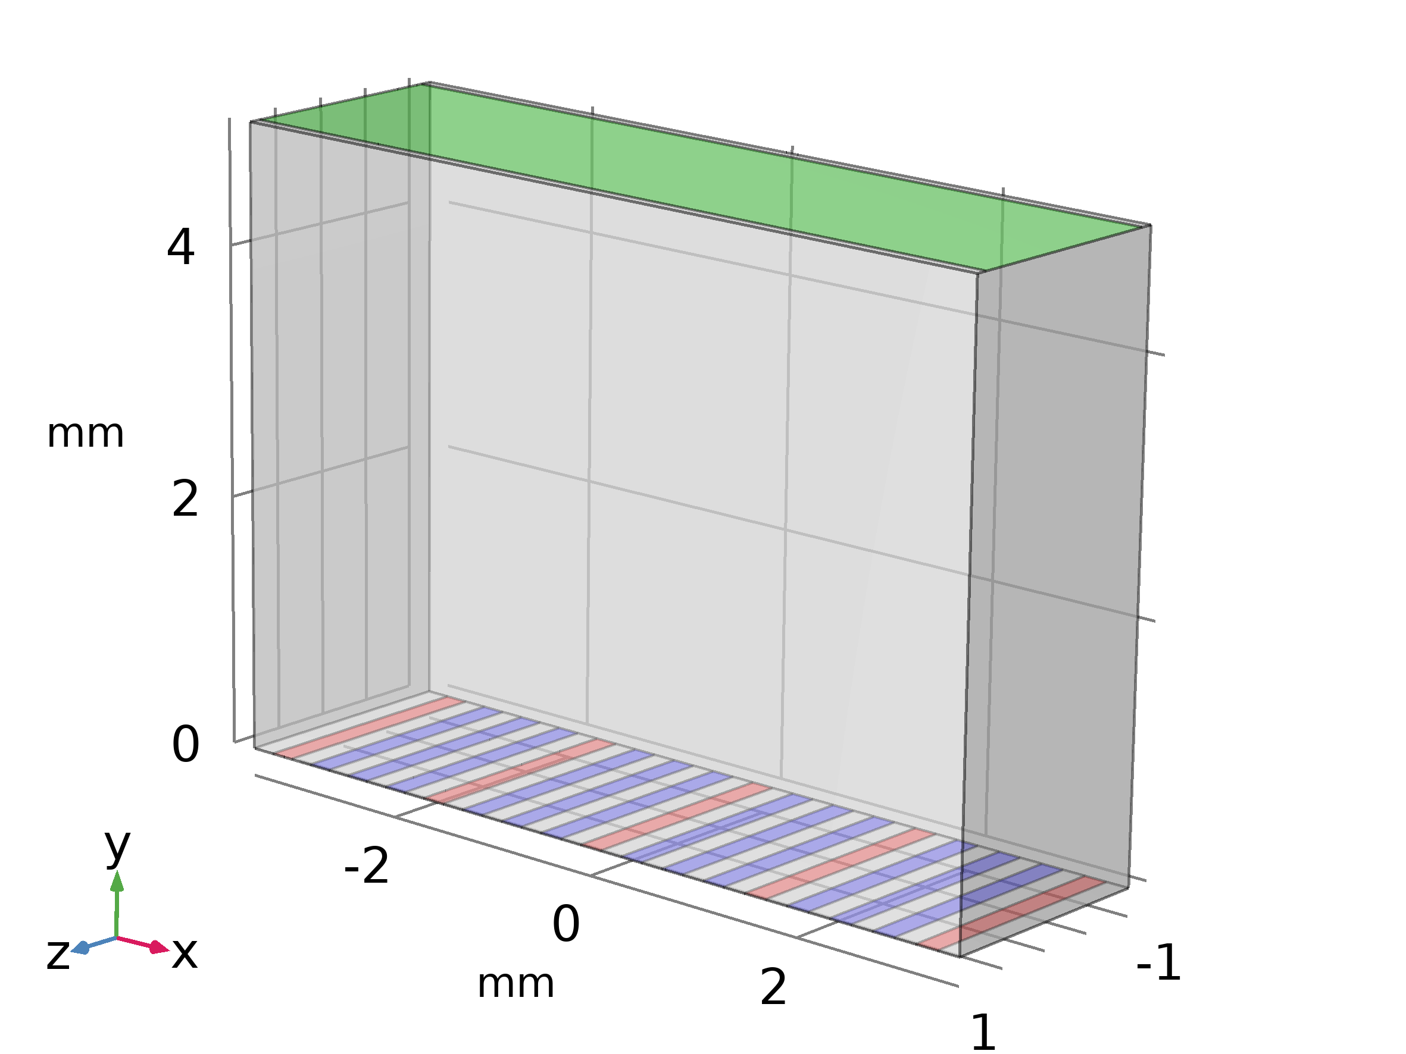
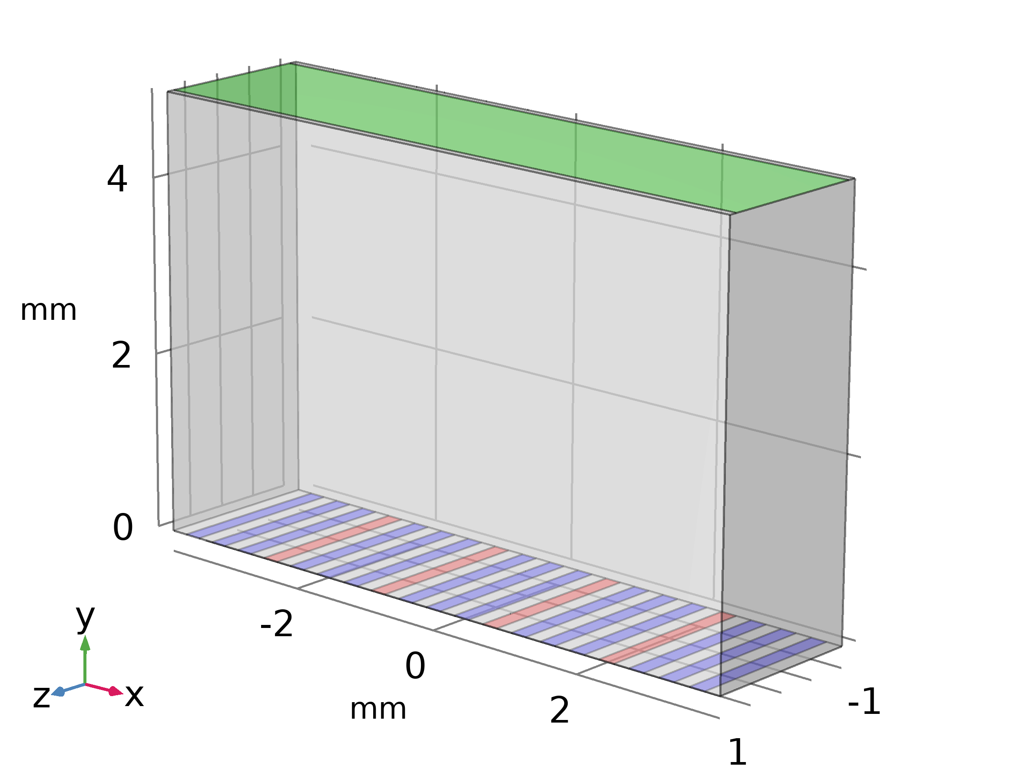
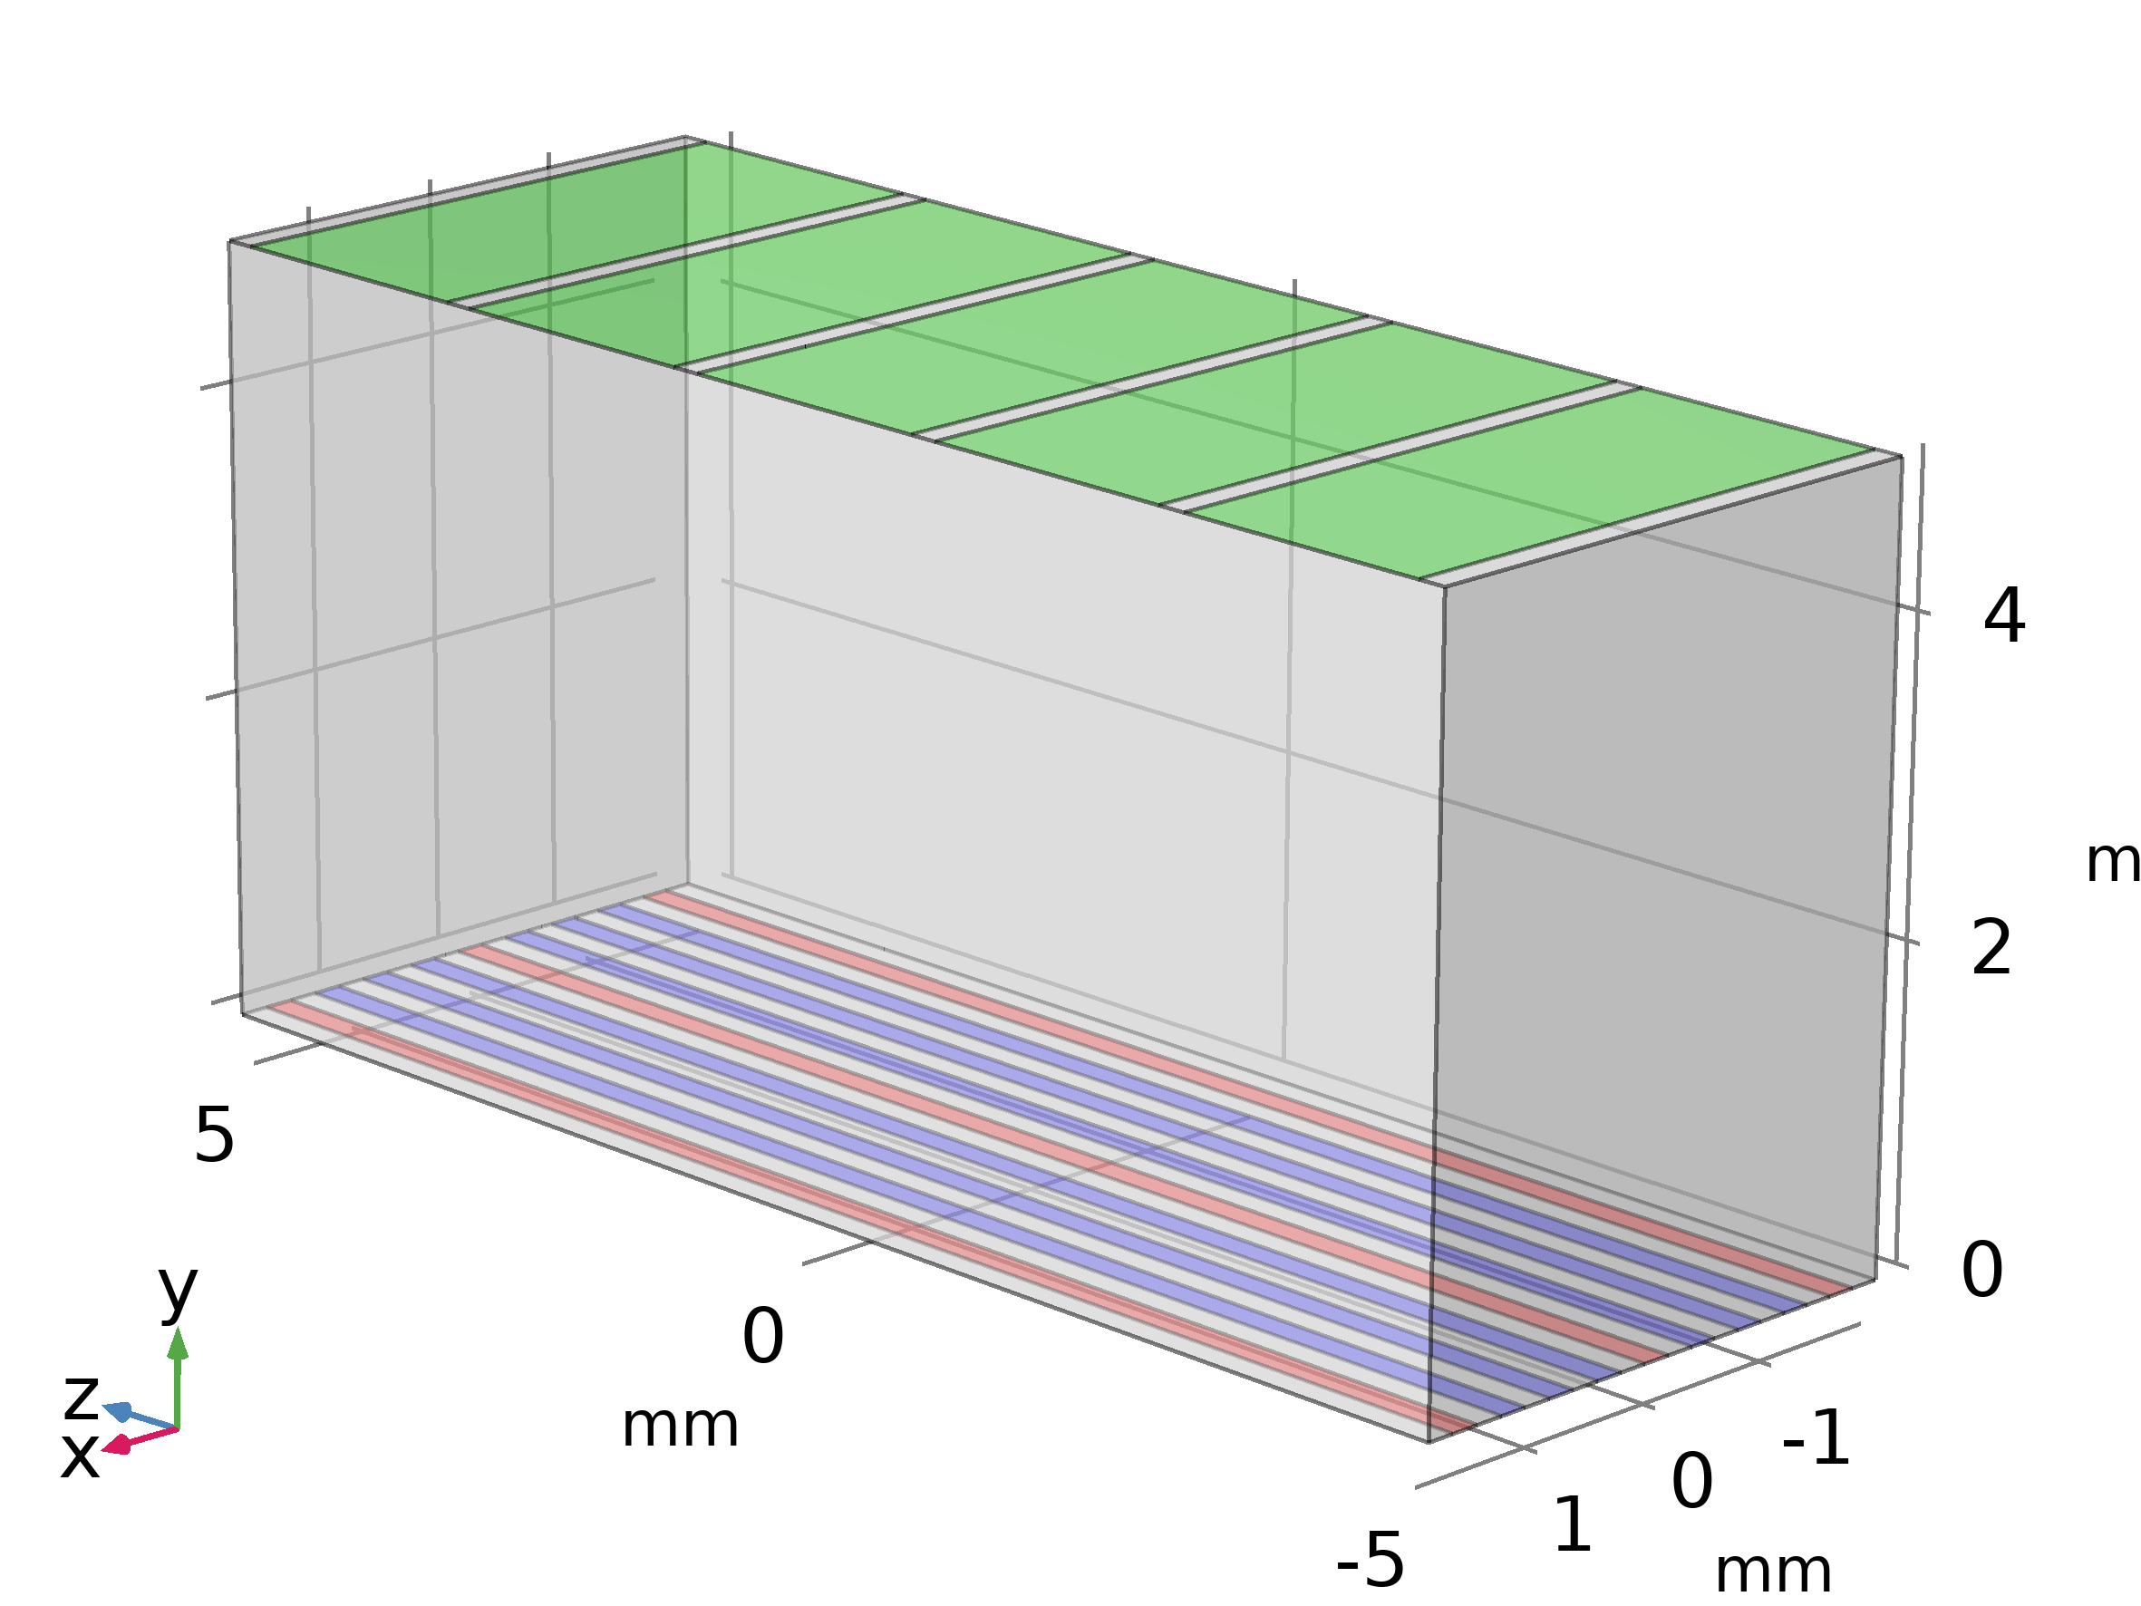
Sub-volume simulations
A)Anode @ center
B) Drift @ center
C) Cathode @ center
Notes:
How do we simulate the detector?
We use COMSOL multiphysics and we cant simulate the full detector volume due to memory, computation time and storage, so we only simulate sub-volumes.
We utilize the symmetry of the detector and we only have to simulate the center electrode type and edges.

Slide 16
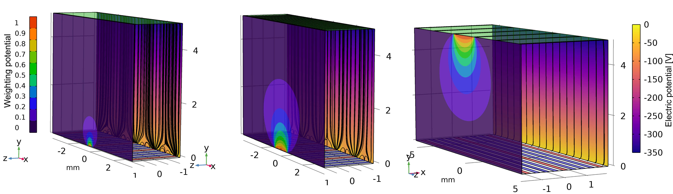
Sub-volume simulations
  Electrostatic solutions
  Weighting potentials for each electrode
  Electric fields determined by electrode geometry and biasing
Notes:
We simulate the weighting potentials – so how does each of the electrode type ”see” charge, and the electric field lines.

Slide 17
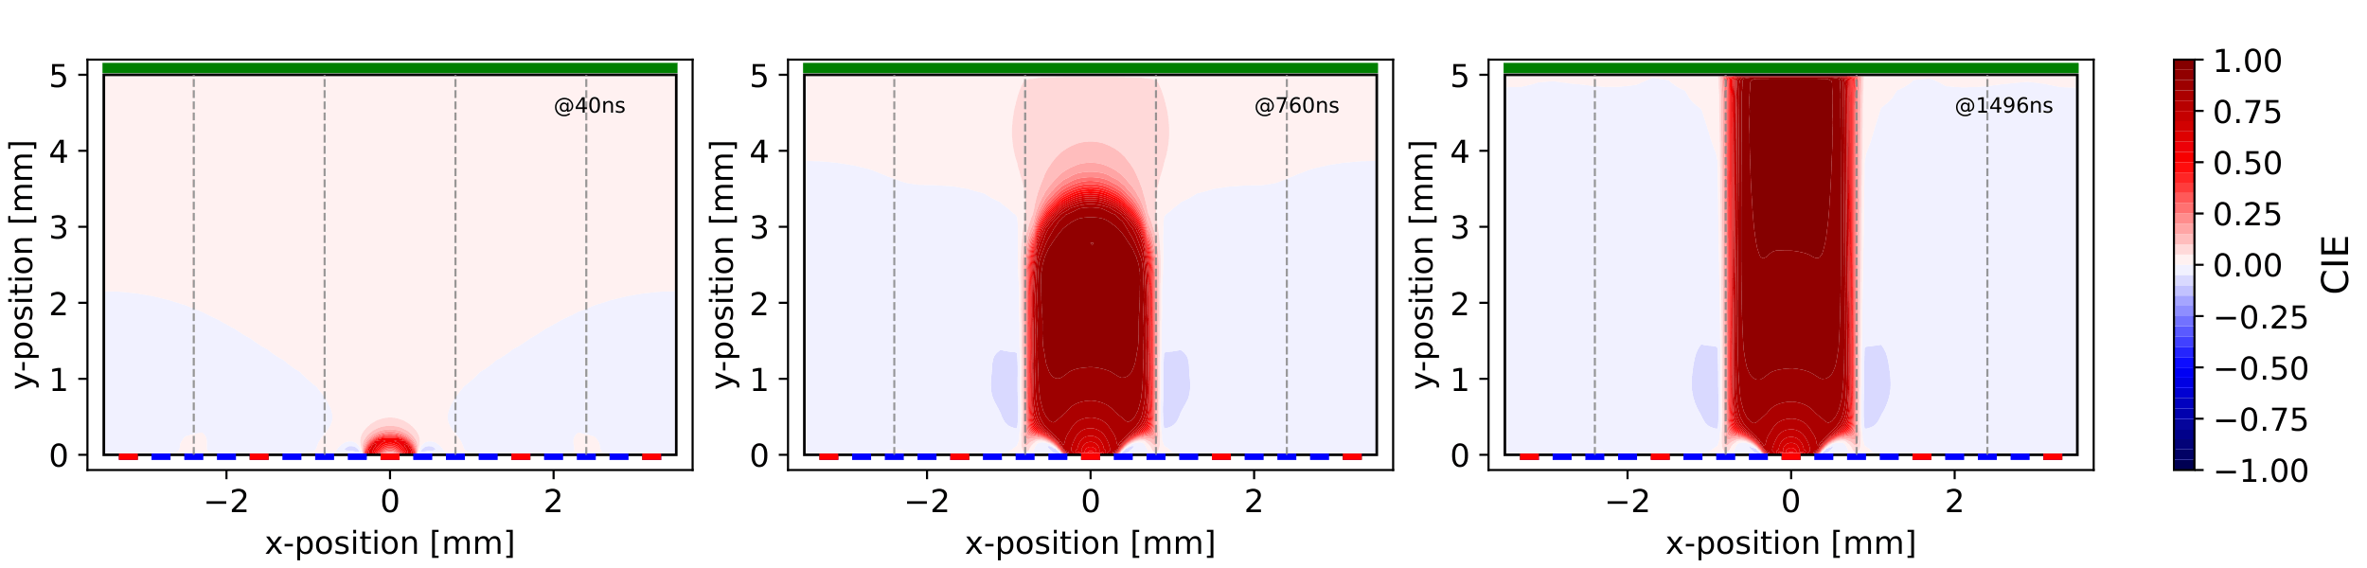
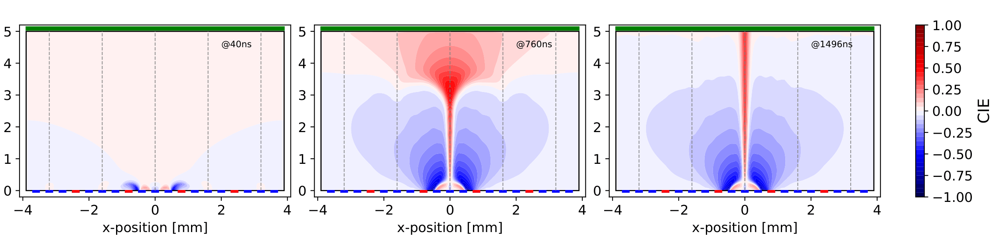
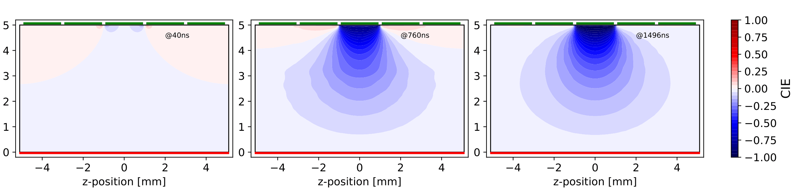
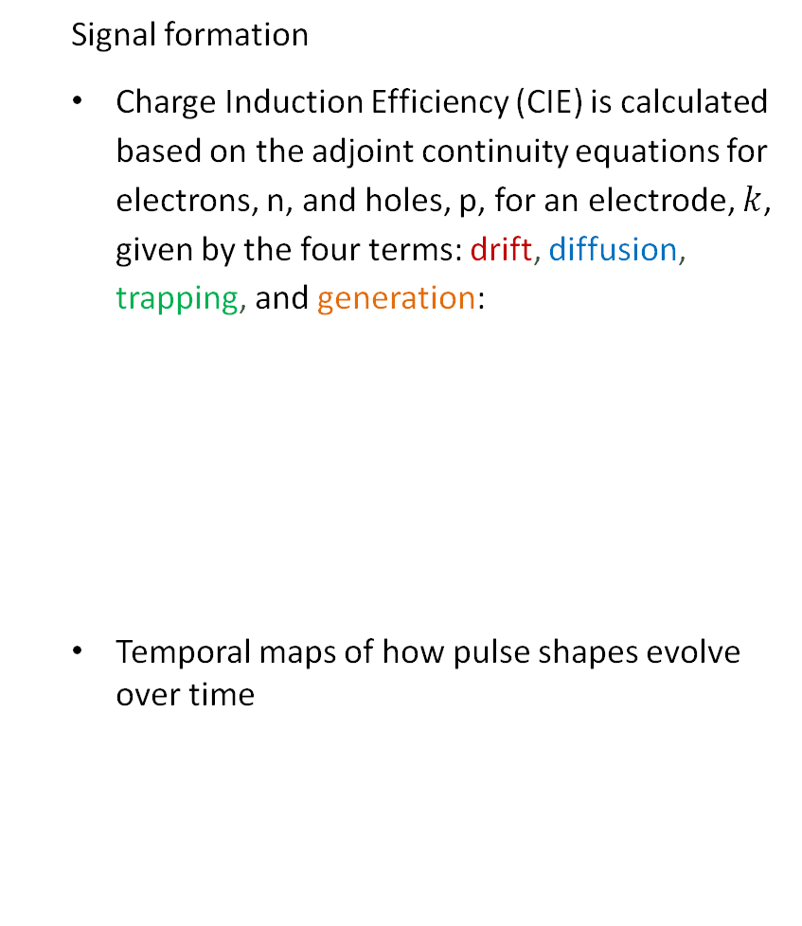

Sub-volume simulations
  Signal formation
  Charge Induction Efficiency (CIE) is calculated based on the adjoint continuity equations for electrons, n, and holes, p, for an electrode, $k$, given by the four terms: drift, diffusion, trapping, and generation:
  Temporal maps of how pulse shapes evolve over time
Electron
concentration
Weighting
potential
Mobility
$$\frac{∂n^{+}}{∂t}=μ_{n}∇φ⋅n^{+}+∇⋅\left(D_{n}∇n^{+}\right)−\frac{n^{+}}{τ_{n}}+μ_{n}∇φ⋅∇ψ_{k}$$
Applied bias
Diffusion
Lifetime
Notes:
From the static solutions, we also simulate the CIE:
How the charge density change over time depending on material properties, experimental bias, diffusion
We get a time dependent solution for how the signals (pulse shapes) evolve over time depending on interaction site

Slide 18
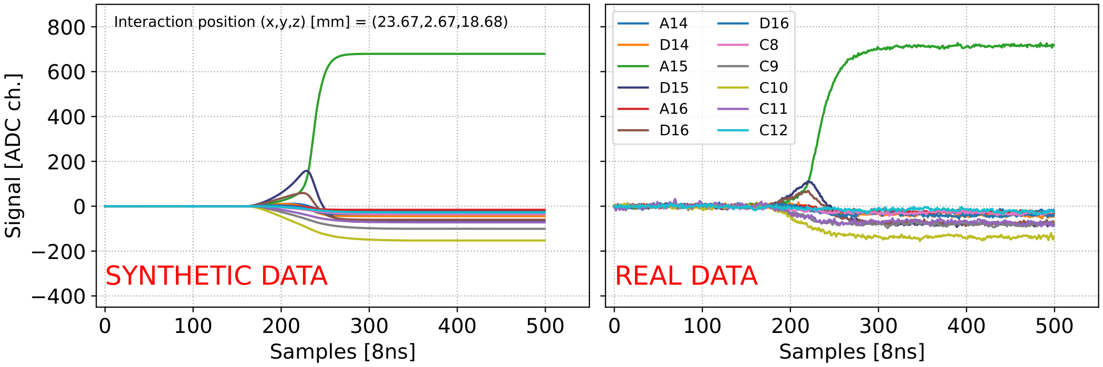
Signal generation for a synthetic data package
Notes:
From the CIE we can extract pulse shapes, and here we have synthetic data along site real data – and they agree very well.
So, I just went through the detector model framework – how we simulate the detector itself and extract signals for NN training.

Slide 19
Outline
Can we reconstruct position from synthetic detector signals?
Brief NN setup.
On synthetic data: extremely accurate
RMSE 0.018 mm.
But simulation-to-simulation is not the real test
Transition to experiment.
On real data: synthetic training transfers
0.51 mm x, 0.80 mm z.
Where the simulator is wrong, the NN is wrong too
Dead cathode / diagonal slit artifact.
Takeaway: ML can also diagnose the simulator
Return to the quote.

Slide 20
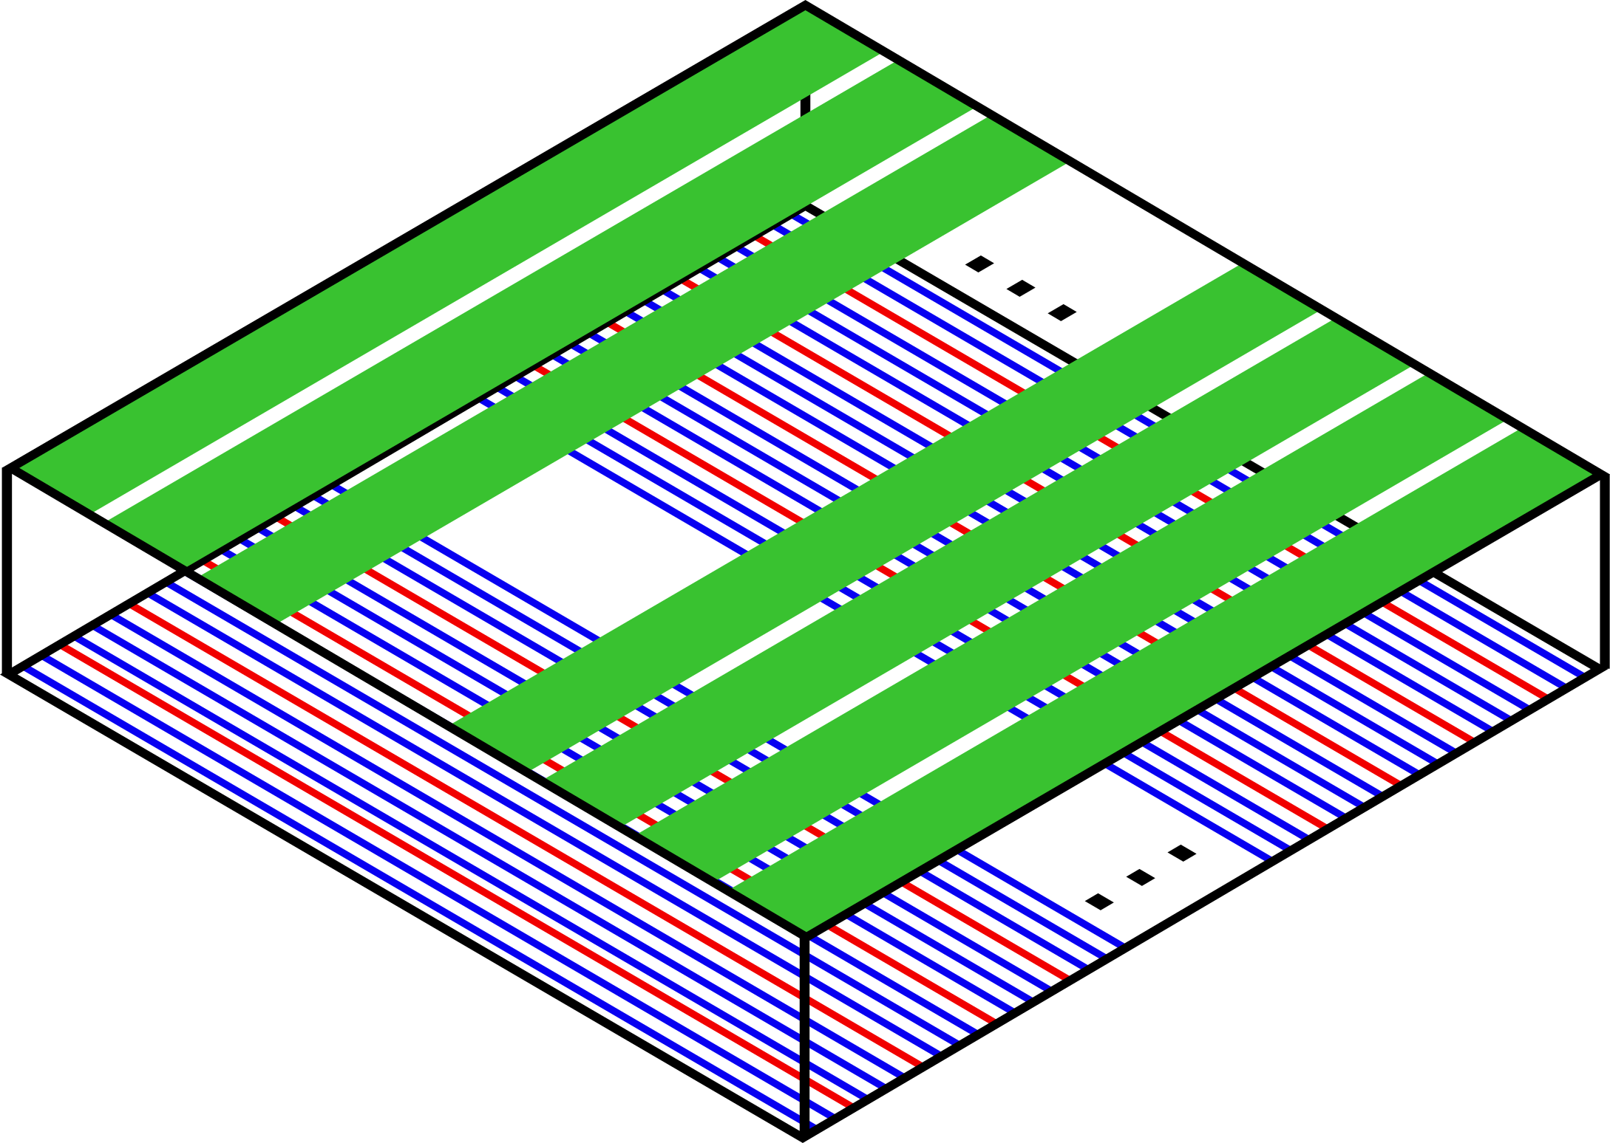


Neural Network position reconstruction
(69 channels x 500 time steps)
ATDM framework as forward model
Neural Network as inverse model
$$(x, y, z)$$
ATDM
Neural Network
$$(\hat{x}, \hat{y}, \hat{z})$$
Feed-Forward Neural Network
(3 hidden layers x 500 hidden units)
Notes:
NN is reconstructing the position of interaction events within the detector from signals of size (69 x 500)
We use a Feed-Forward NN model with 3 hidden layers and 500 hidden units in each layer

Slide 21
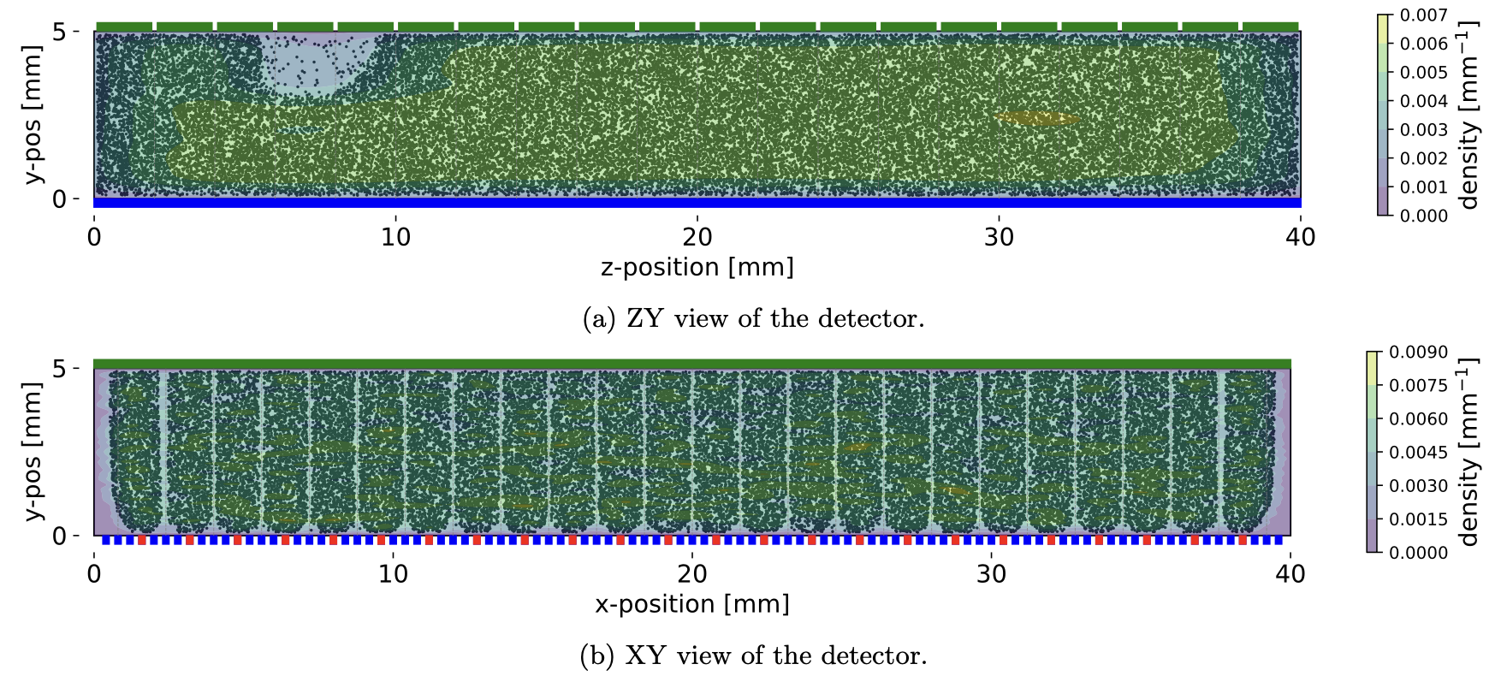

Detector physics shape training data
Sim
Initially ~50 000 positions uniformly distributed
Uniform sampling ≠ uniform training data
dead cathode
detector blind spot
Notes:
The training distribution itself already contains detector physics and experimental constraints.

Slide 22
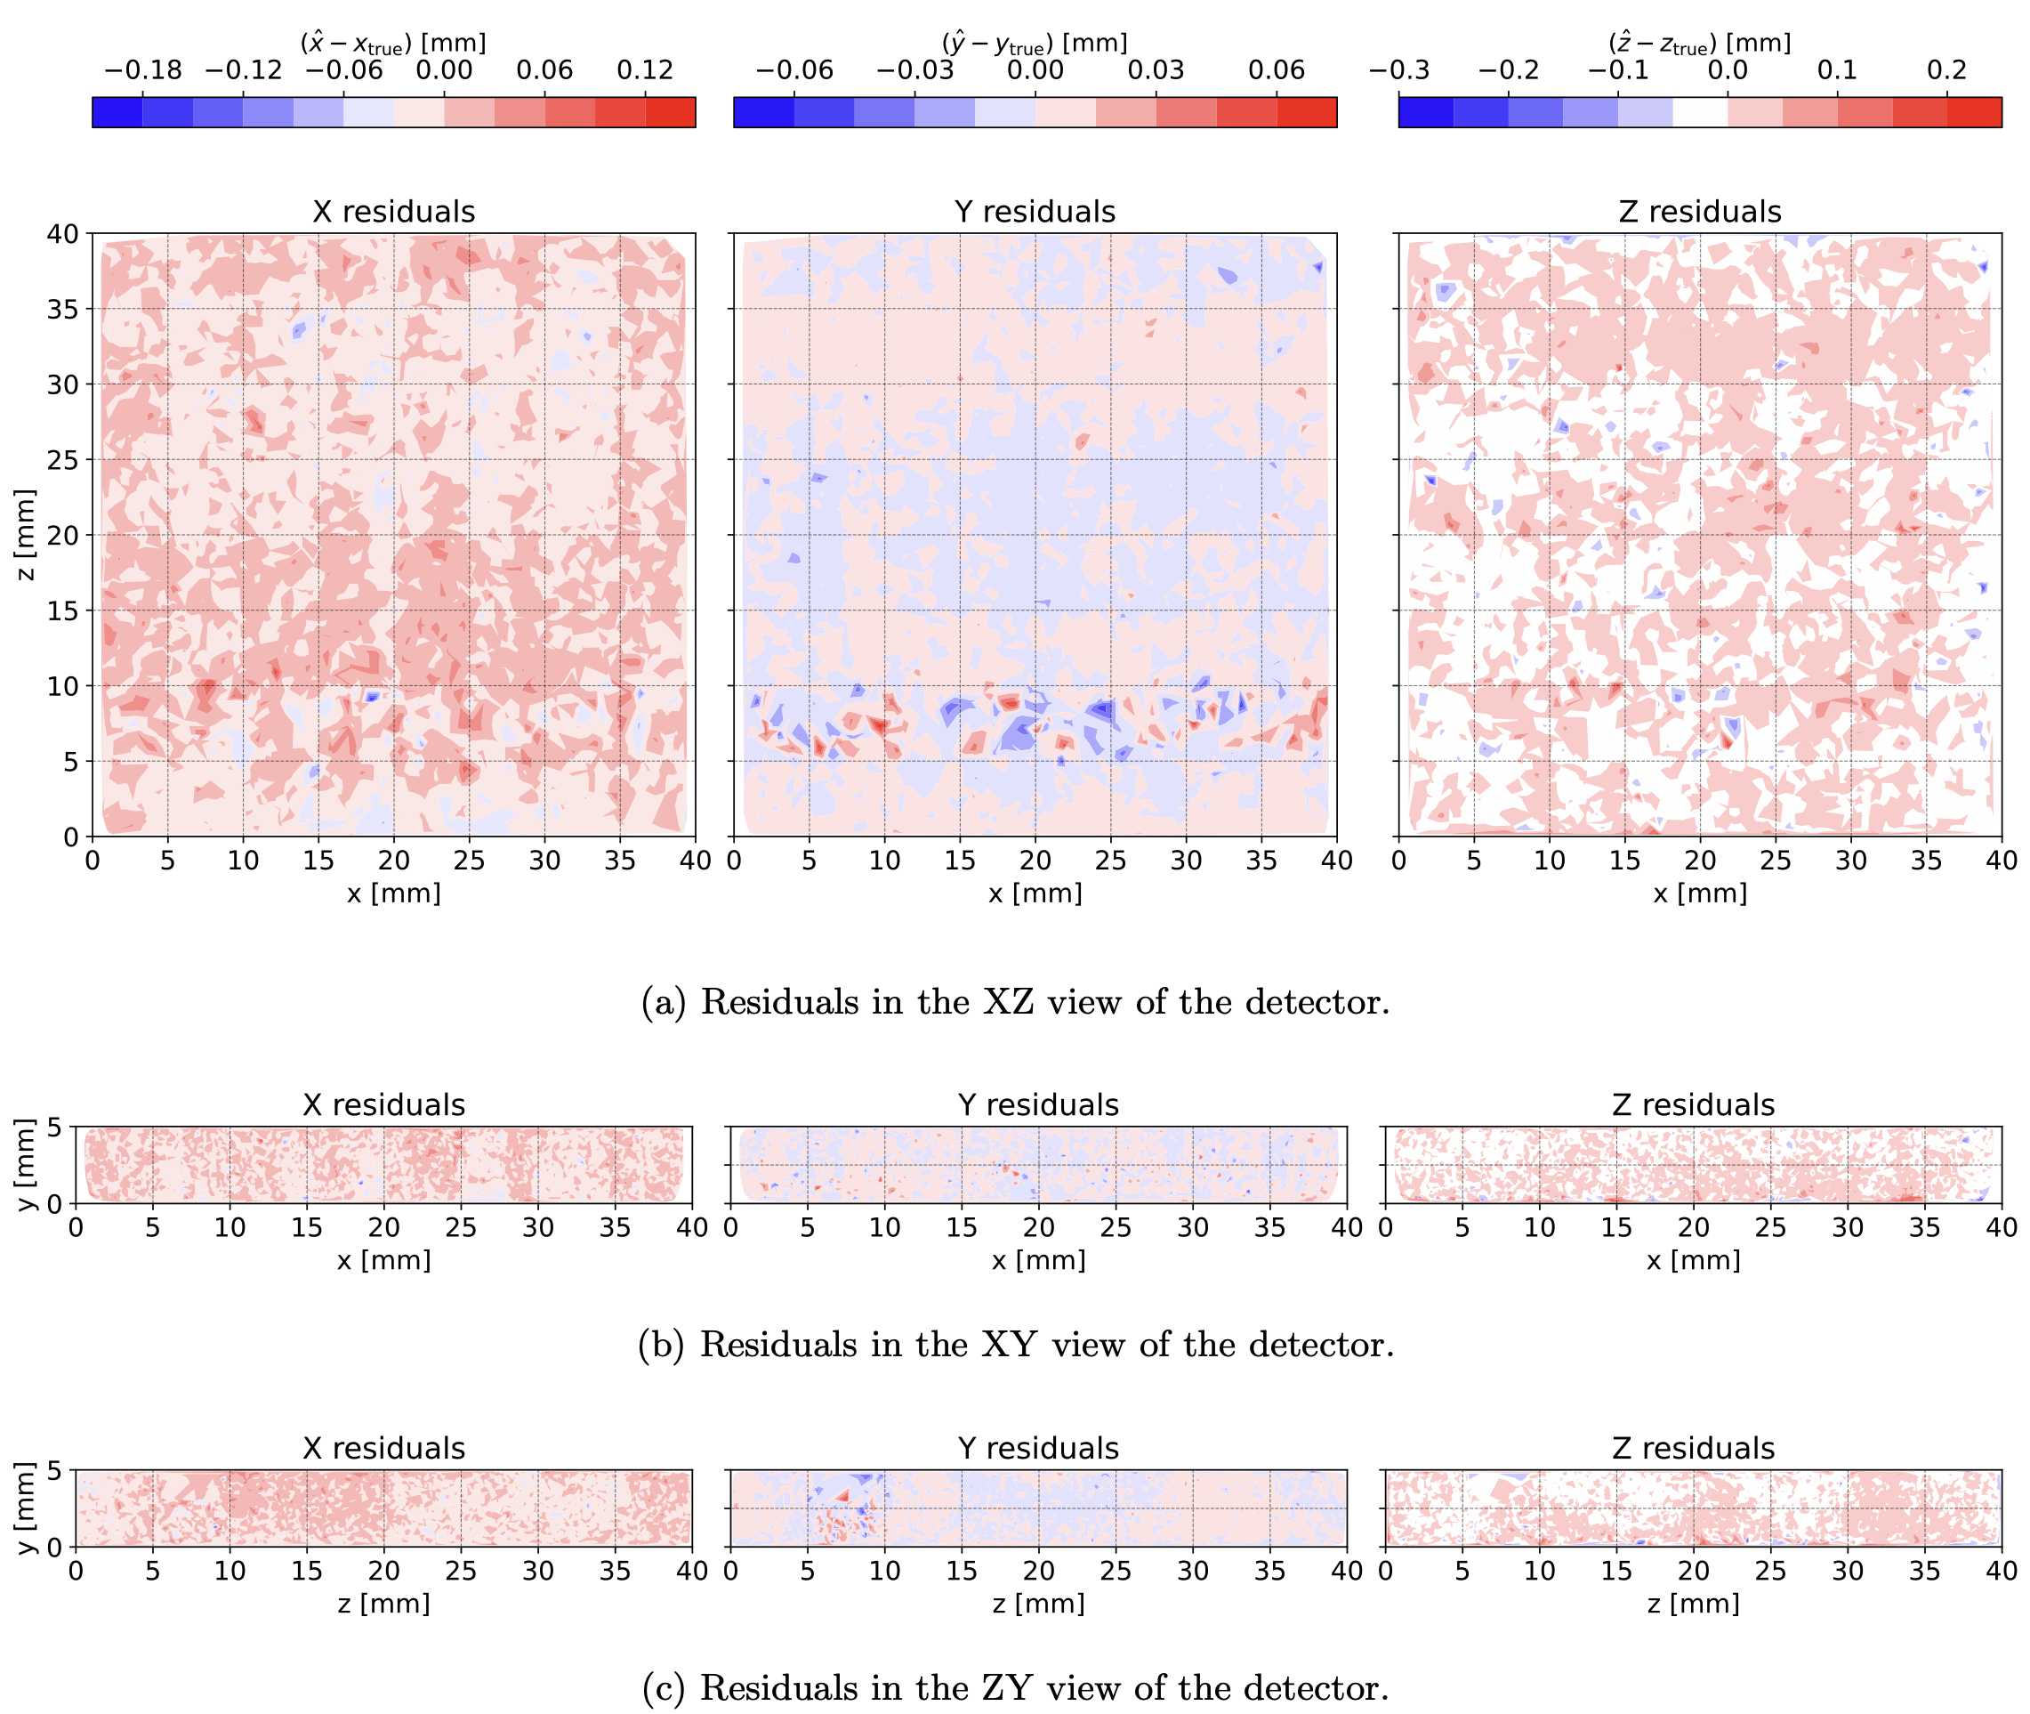
On simulation, it’s learnable
Sim
Average RMSE_{test} = 0.018 mm
$σ_{y}$ = 0.008 mm
$σ_{x}$ = 0.019 mm
$σ_{z}$ = 0.028 mm
Notes:
These numbers look extremely good, but this is simulation-to-simulation. The scientifically interesting test is whether this survives the domain shift to real detector signals.

Slide 23
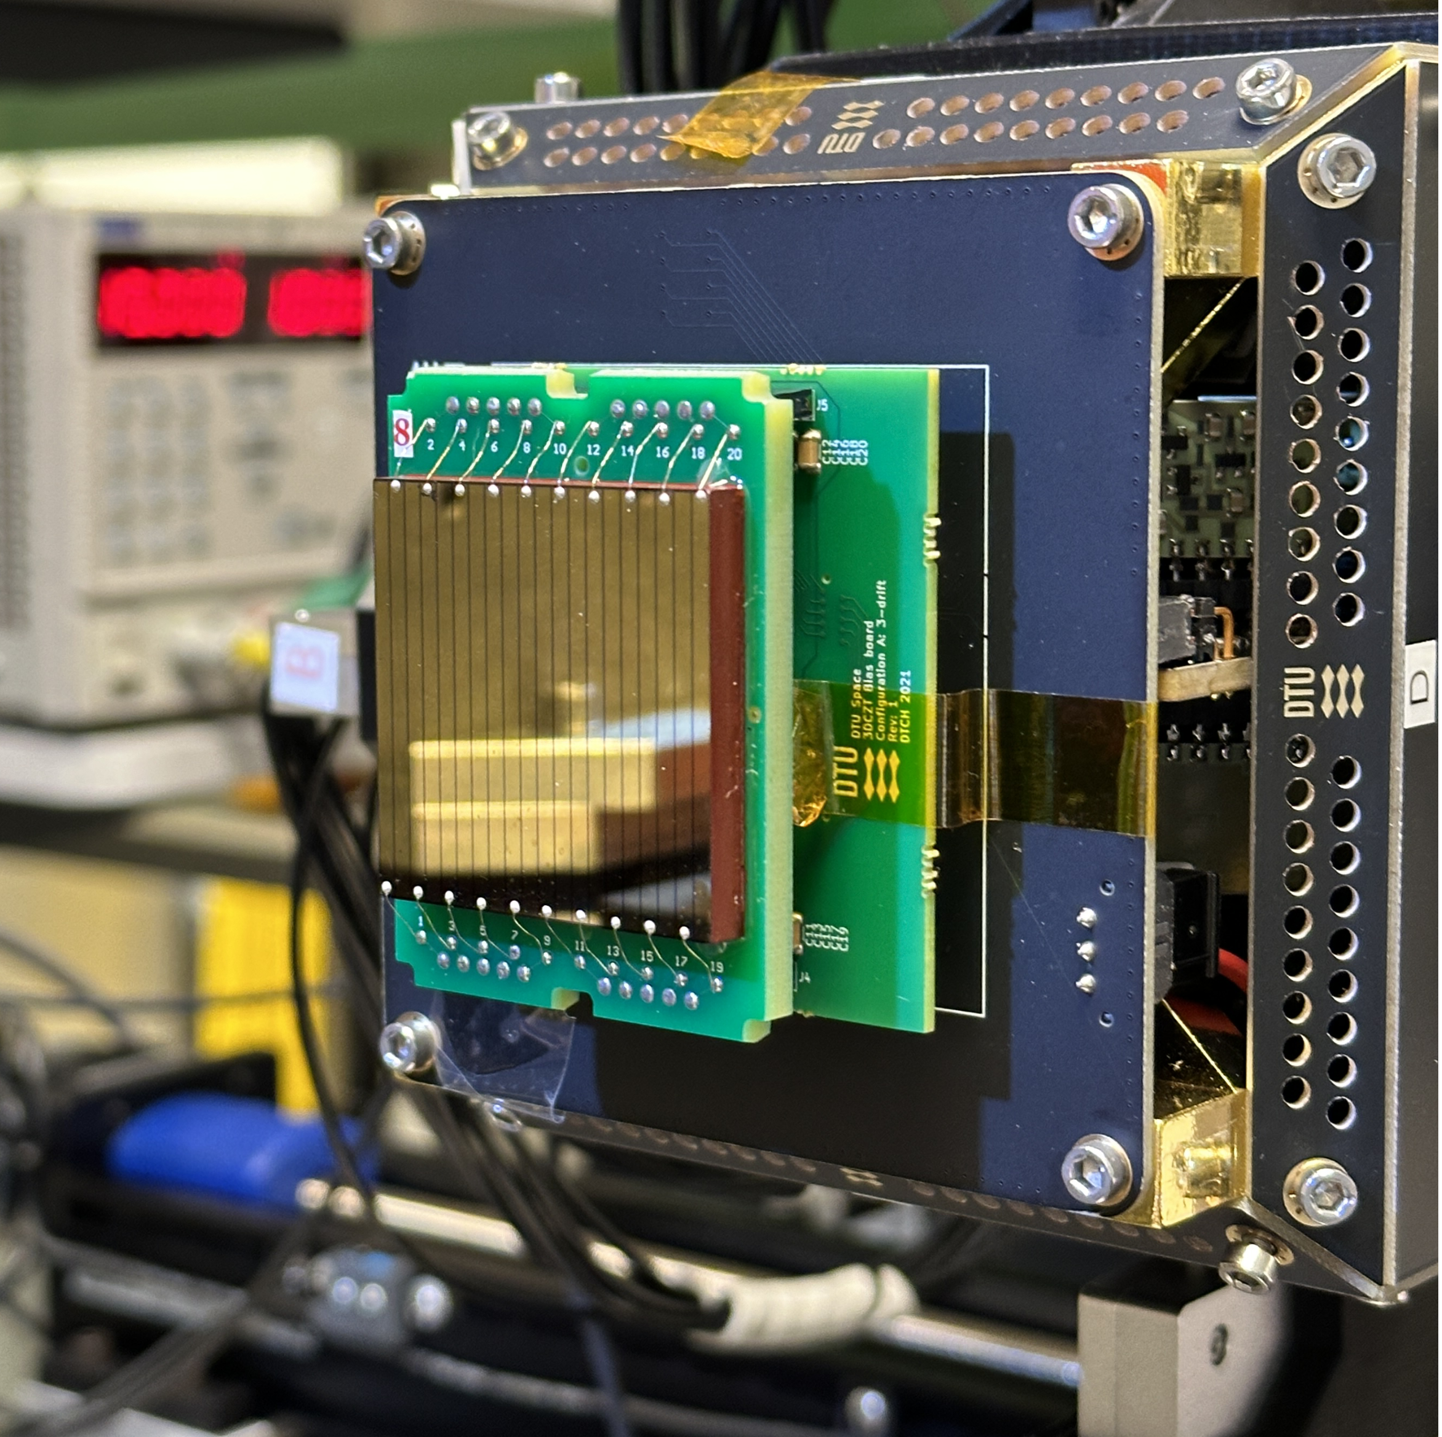
Does it work on real data?
Real data is obtained from measurements in the DTU Space Detector Laboratory
The NN transfers from simulation to experimental signals,
  only bridge to real data was random signal noise injected during training
  no detector or setup-specific calibration was applied
v
s
Notes:
This is the important test, because good performance on synthetic test data only shows that the inverse mapping is learnable within the simulator.
Real data was collected using the modeled setup in the DTU Space Detector Laboratory.
The NN transfers its simulation-based knowledge onto experimental signals…
The only bridge…
Otherwise, no model or data calibration was applied

Slide 24
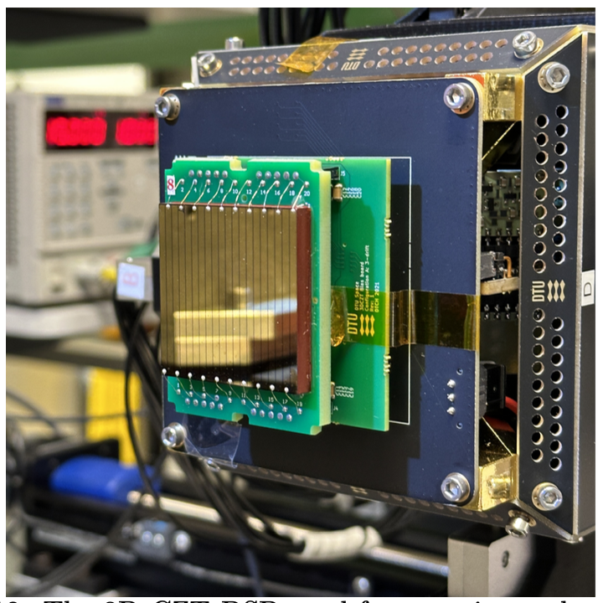
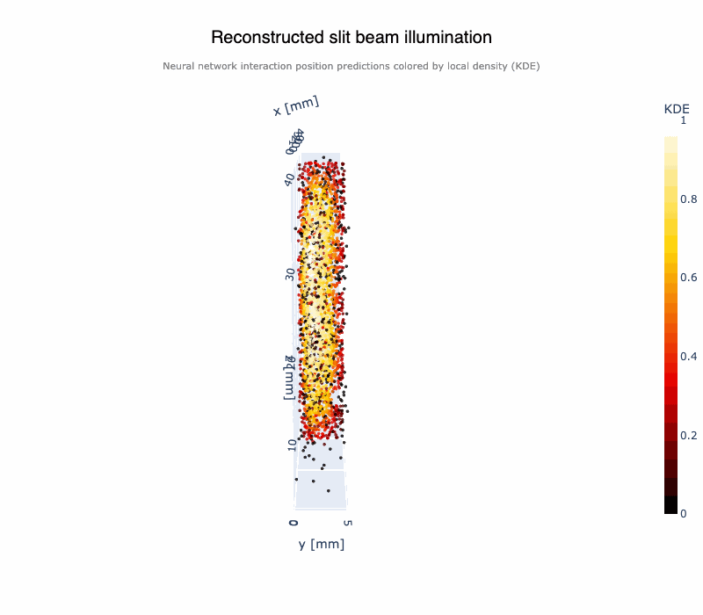
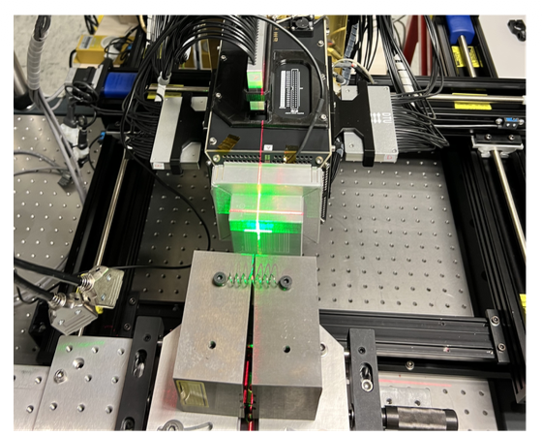
Forming an expected distribution
Slit-beam illumination
using Cs¹³⁷ (662 keV)
Notes:
Evaluating on real data is not that simple, since the true interaction position is hidden to us.
We therefore use so-called slit beam illumination measurements that confine the interaction positions to a known distribution. As shown on the reconstruction on the right.

Slide 25

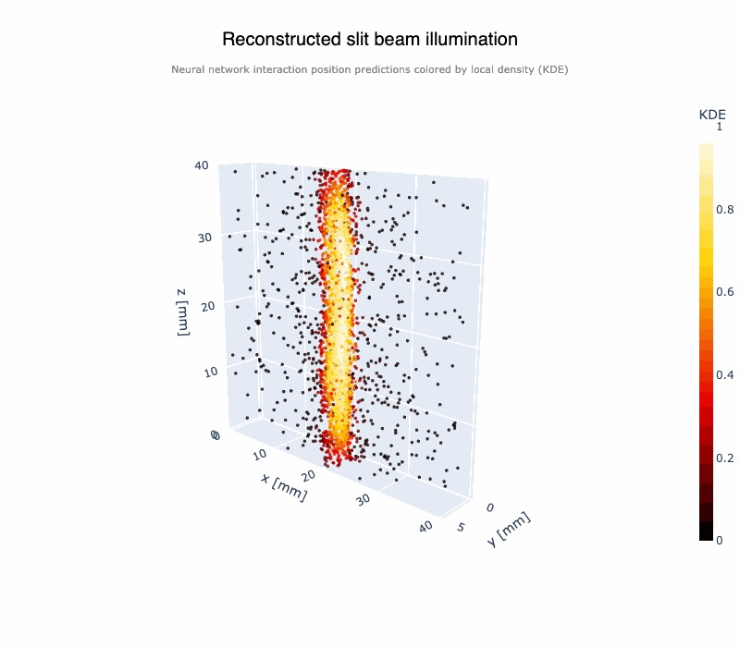
So… Does it work on real data?
Real
x-dimension illumination
z-dimension illumination
as seen from here
Notes:
Projecting the reconstruction onto an appropriate dimension results in a normal distribution.
We can then measure the width of that distribution by fitting a Gaussian to it.
First, we apply this procedure to our conventional pulse shape analysis, which is an analytical solution to the inverse problem (feature-based).
We then, run our NNs on the same data and notice the performance increase. The distribution is much more narrow, which points towards a successful and improved reconstruction.
Notice how the NN retains its resolution throughout the depth of the illumination. This is particularly important as it shows that the simulation-based approach provides robustness to worse signal to noise ration near the bottom of the detector.
Performance is mostly limited by the sim-to-real gap and lab measurements.

Slide 26
Where does the NN help?
Real
A flood-field measurement comparison (side view)
Notes:
Conventional reconstruction is based on handcrafted signal features; the NN learns directly from the complete pulse shapes.
Learning from the full signal recovers information lost by handcrafted reconstruction.

Slide 27
Failures are informative
Real
Good simulator physics → successful sim-to-real transfer
Missing simulator physics → structured ML failure
Model bias
or detector physics?
Dead cathode
Notes:
So when we see structured behavior in the reconstruction, the interesting question becomes: is the network discovering detector physics, or reproducing bias from its simulated training data?
Where we expect the reconstruction to follow a line, we see a bump due to simulator limitations. This works as a diagnostic whether this region is correctly represented by the ATDM.

Slide 28


Future work
Advanced Theoretical Detector Model
Decrease subvolume size → higher simulator resolution → better NN performance
Introduce more advanced interaction physics (charge clouds, event types)
Setup-specific calibration to decrease sim-to-real gap
  non-linear electrode responses
  3D material property distribution
Machine Learning
Uncertainty quantification (UQ) via ensembles and Bayesian Machine
Learning
A learnable (differentiable) simulator* to learn to model physics directly from
real data
$→$ UQ may fail in practice, but still reveal noise and signal ambiguity
*work of Alejandro Valverde Mahou (PhD student @ DTU Compute) pheithar.github.io
Notes:
ATDM
ML
- UQ to better understand where our NN reconstruction fails due to high noise level or signal ambiguity,

Slide 29
Final thought
“Much of [AI4Science] progress runs through simulators — mechanistic models hand-crafted by domain experts and fit to data — that encode our scientific theories and underpin prediction. […] an ML method coupled to a simulator is only as good as that simulator.”
(Sim2Science, EurIPS 2026 Workshop)
Thank you ☺

Slide 30
References
Kuvvetli, ˙I., Budtz-Jørgensen, C., Zappettini, A., Zambelli, N., Benassi, G., Kalemci, E., Caroli, E., Stephen,J., and Auricchio, N., “A 3d czt high resolution detector for x-and gamma-ray astronomy,” in [High energy,optical, and infrared detectors for astronomy VI], 9154, 272–281, SPIE (2014).
Owe, S., Kuvvetli, I., Cherlin, A., Harris, B., Tomita, H., Baistow, I., Tcherniak, D., and Budtz-Jørgensen,C., “Evaluation of czt drift strip detectors for use in 3-d molecular breast imaging,” IEEE Transactions onRadiation and Plasma Medical Sciences 7(2), 113–123 (2022).
Owe, S. H., “Development of 3d imaging detectors for high energy astronomy instrumentation,” (2023).
Hauptmann, B. N., Owe, S. R., Kuvvetli, I., Tcherniak, D., Budtz-Jørgensen, C., Baistow, I., Harris, B.,Cherlin, A., and Cantwell, B., “Performance evaluation of large area three-dimensional cdznte drift stripdetectors,” Journal of Astronomical Telescopes, Instruments, and Systems 11(2), 026001–026001 (2025).
Owe, S. H., Kuvvetli, I., Budtz-Jørgensen, C., and Zoglauer, A., “Evaluation of a compton camera concept using the 3d cdznte drift strip detectors,” Journal of Instrumentation 14(01), C01020–C01020 (2019)

Slide 31
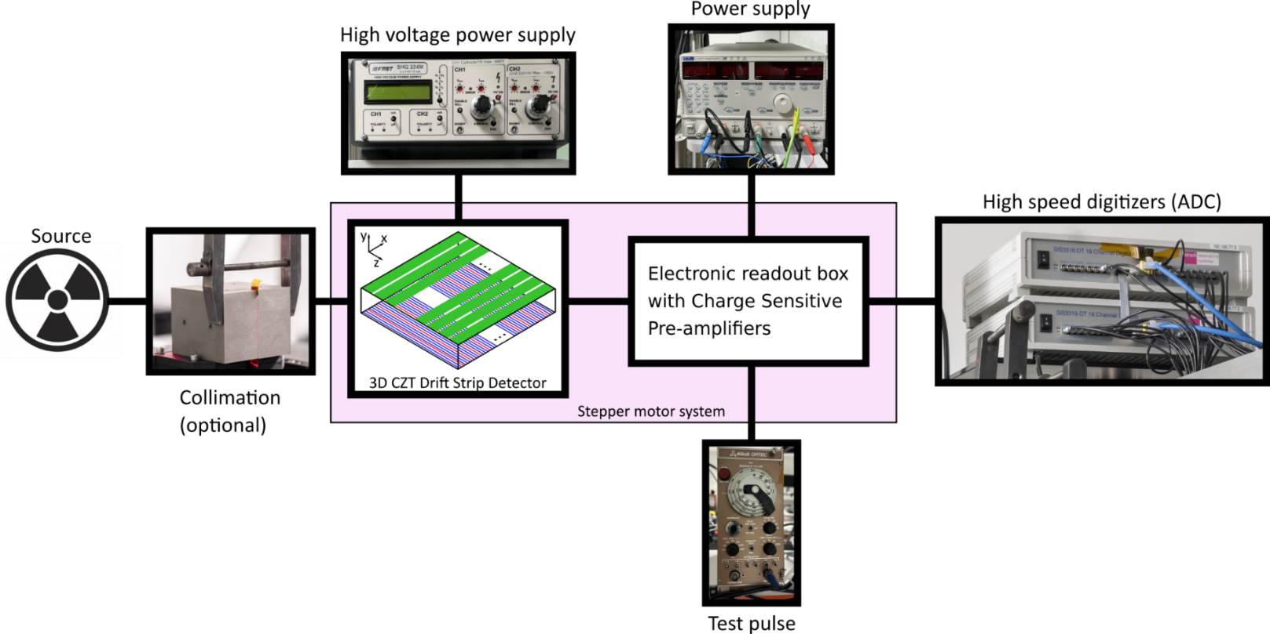
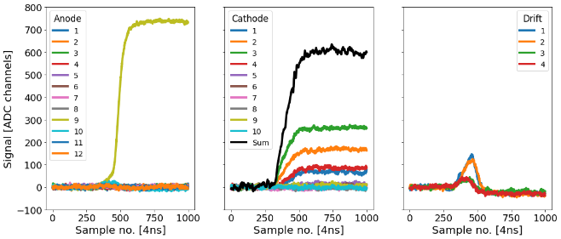
The 3D CZT drift strip detector
Detector lab
Data to be analysed

Slide 32

On simulation, the inverse problem is easy
Average test RMSE = 0.018 mm
$σ_{x}$ = 0.019 mm
$σ_{y}$ = 0.008 mm
$σ_{z}$ = 0.028 mm
Notes:
These numbers look extremely good, but this is simulation-to-simulation. The scientifically interesting test is whether this survives the domain shift to real detector signals.

Slide 33
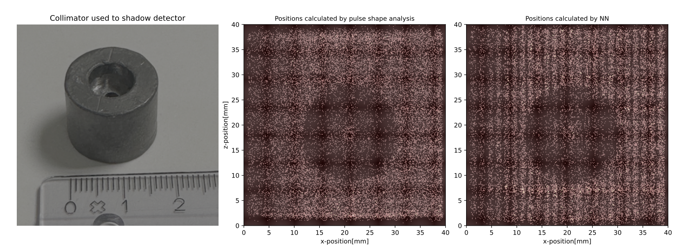
Limitations of using NNs
Data-driven approach is heavily sensitive to simulator limitations - artifacts

Slide 34
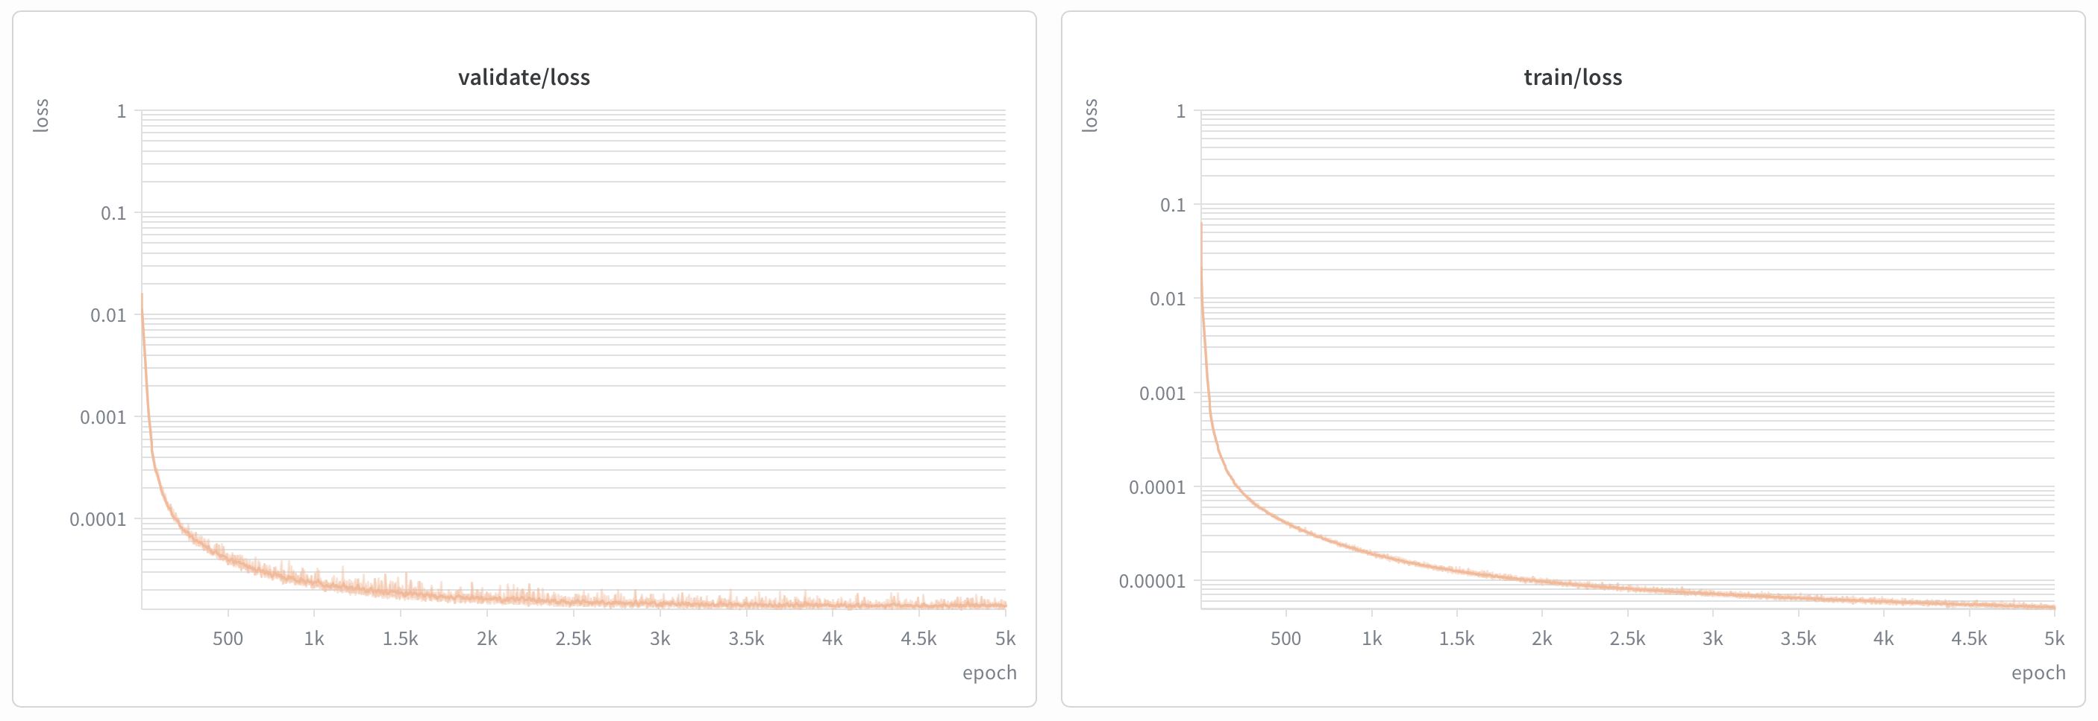
NN model
"model": {
"value": {
"fnn": {
"hidden_units": 500,
"hidden_layers": 3
},
"type": "FNN",
"output": {
"dim": 3,
"units": "norm",
"structure": ["x", "y", "z"]
},
"activation": "tanh",
"dropout_rate": 0,
"signal_length": 500,
"output_activation": "tanh",
"input_normalization": true
}

