Slide 1
Magnetic tuning of chiral light-matter interactions with on-chip spin control
Shikai Liu

Slide 2
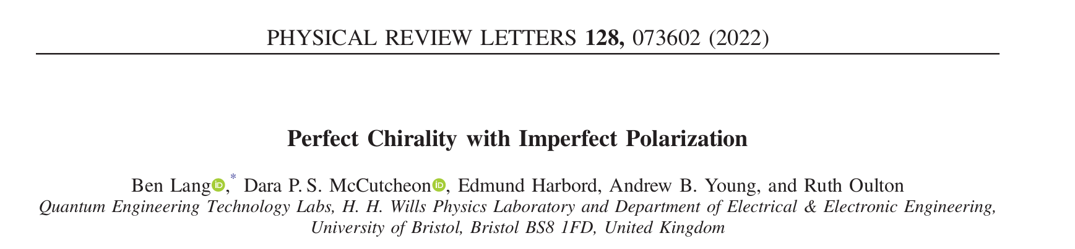
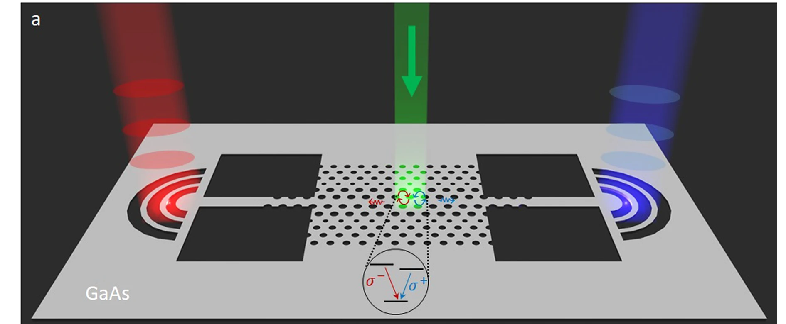
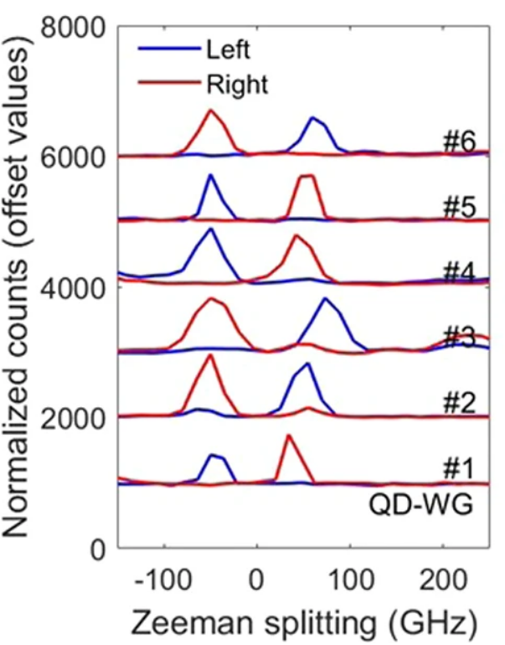
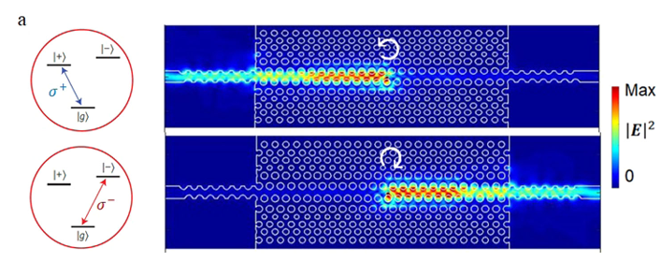
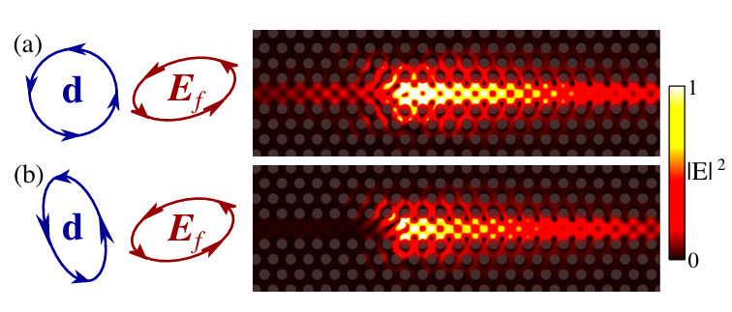
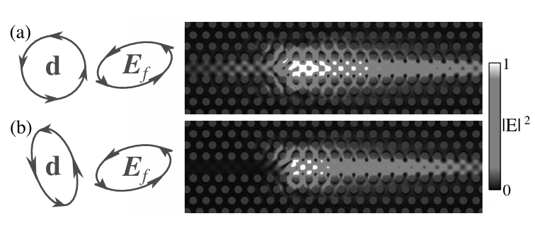
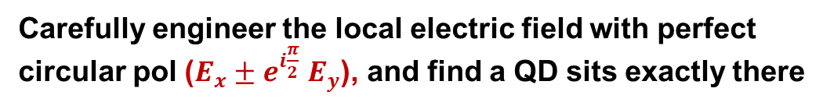
Chiral quantum optics (QD +chiral WG)
Near-unity directionality (neutral exciton)
Engineer the emitter’s dipole polarization
npj Quantum Inf 9, 15 (2023).
Carefully engineer the local electric field with perfect circular pol ($E_{x}±e^{i\frac{π}{2}}$ $E_{y}$), and find a QD sits exactly there
Phys. Rev. Lett. 128, 073602 (2022).
Notes:
A very typical setting for chiral quantum optics is for example, here, using QD as the active material coupled to a chiral waveguide as the nanophotonic structure. This platform has been very successful in demostrating near-unity directional emission. It means that the polarization of the emitted light is locked to its propagation direction, leading to spin-momentum locking.
So here the approach is done by engineering ……………
Alternatively, a theoretical PRL work shows even with this imperfect circularly polarized electric field at the emitter position; it can still achieve perfect chirality by engineering the dipole polarization to elliptical and make it orthogonal with the electric field.
An important point here is that Perfect chiral points don’t necessarily provide the highest Purcell enhancement, but elliptical electric field does.

Slide 3
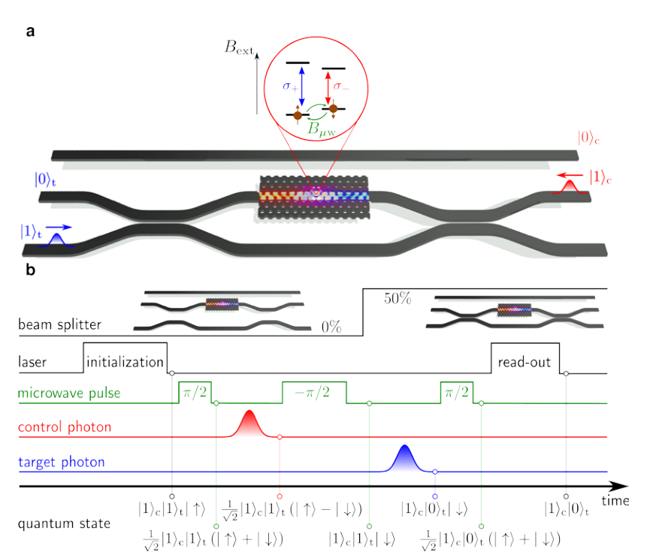
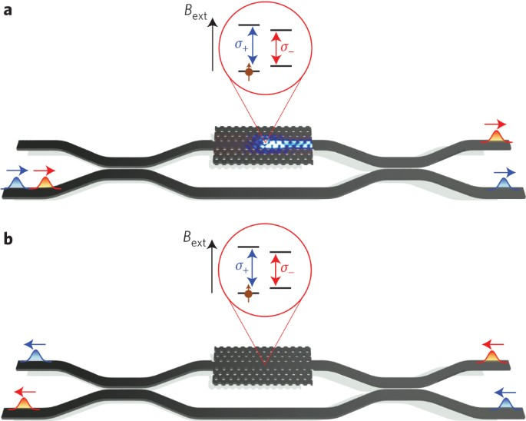
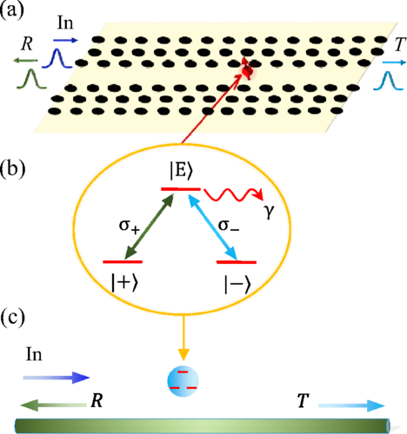
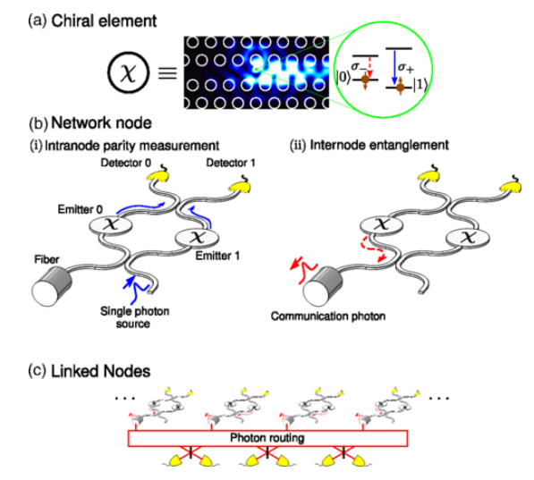
Chiral quantum optics (QD +chiral WG)
Protocols require both chirality and an optical addressable spin qubit with coherent control.
After device fabrication, the chirality is hard to tune for a given QD–device
C-NOT gate for photons
Non-reciprocal photon transport
Quantum memory
Quantum Networks
PRA 97, 062318 (2018)
Nat. Nanotech. 10, 775 (2015).
npj Quantum Inf 9, 15 (2023).
PRL 117, 240501 (2016)
Notes:
Many quantum information protocols require both chirality and an optical addressable spin for initialization, readout, and coherent manipulation of its quantum state, including quantum gates, non-reciprocal photon transport, quantum memory, and quantum networking.
Beyond that, another research gap is the chirality is also very difficult to tune after choosing a specific QD and a device after the fabrication is done.
Later one, I will show you how we tackle these two challenges.

Slide 4
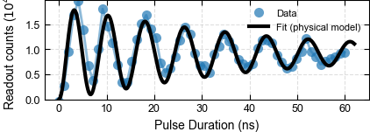
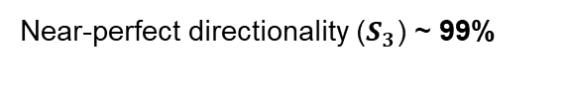

Tunable chiral spin-photon interface: ${ X}^{−}$ elliptically coupled to a W1 PCW
a
b
c
Faraday
Oblique
Voigt
d
e
f
Near-perfect directionality ($S_{3}$) ~ 99%
WG-mediated spin control
Directionality ($S_{3}$) ~ 69%
Direction-resolved cyclicity (branching ratio) ~ 134
WG-induced cyclicity ~ 6
Dipole
Engineer the dipole polarization
Circular
Elliptical
Linear
WG spin control
Rabi frequency
Shikai Liu, et al. In preparation
Notes:
Here, using the same quantum dot embedded in the same device, we demonstrate a magnetic-field controlled multi-functional chiral spin photon interface.
The first row shows you the magnetic field settings from Faraday, a mix in between and Voigt. The second row shows the corresponding functionalities. For example, in the faraday configuration, we achieved imperfect directionality between the other transitions due to the optical selection rules. The impaction comes from that the electric field where the QD is coupled is not perfectly circular.
However, by going to the Mix magnetic field, we are able to tune the chiral coupling by engineering the dipole polarization. Here we achieve perfect directionality between the inner transitions. In addition, we realized chiral cyclicity. This is done by fully suppressed the orange photon to the left port and only looking at the decay rate on the right port. Which is between red and orange. Now we can also tune the chiral coupling to achieve a very high cyclicity.
Further rotate the magnetic field to Voigt, we achieved WG-mediate spin control, which means we shine the Raman laser from the grating remotely and use the natural in-plane waveguide mode to drive the spin ground state rotation.
From faraday to Voight, you can also see the dipole changes from circular to elliptical and eventually linear. thereby modifying their coupling to the guided mode.
For the WG spin control， the effective spin Rabi frequency increase to the maximum at Voigt configuration.

Slide 5
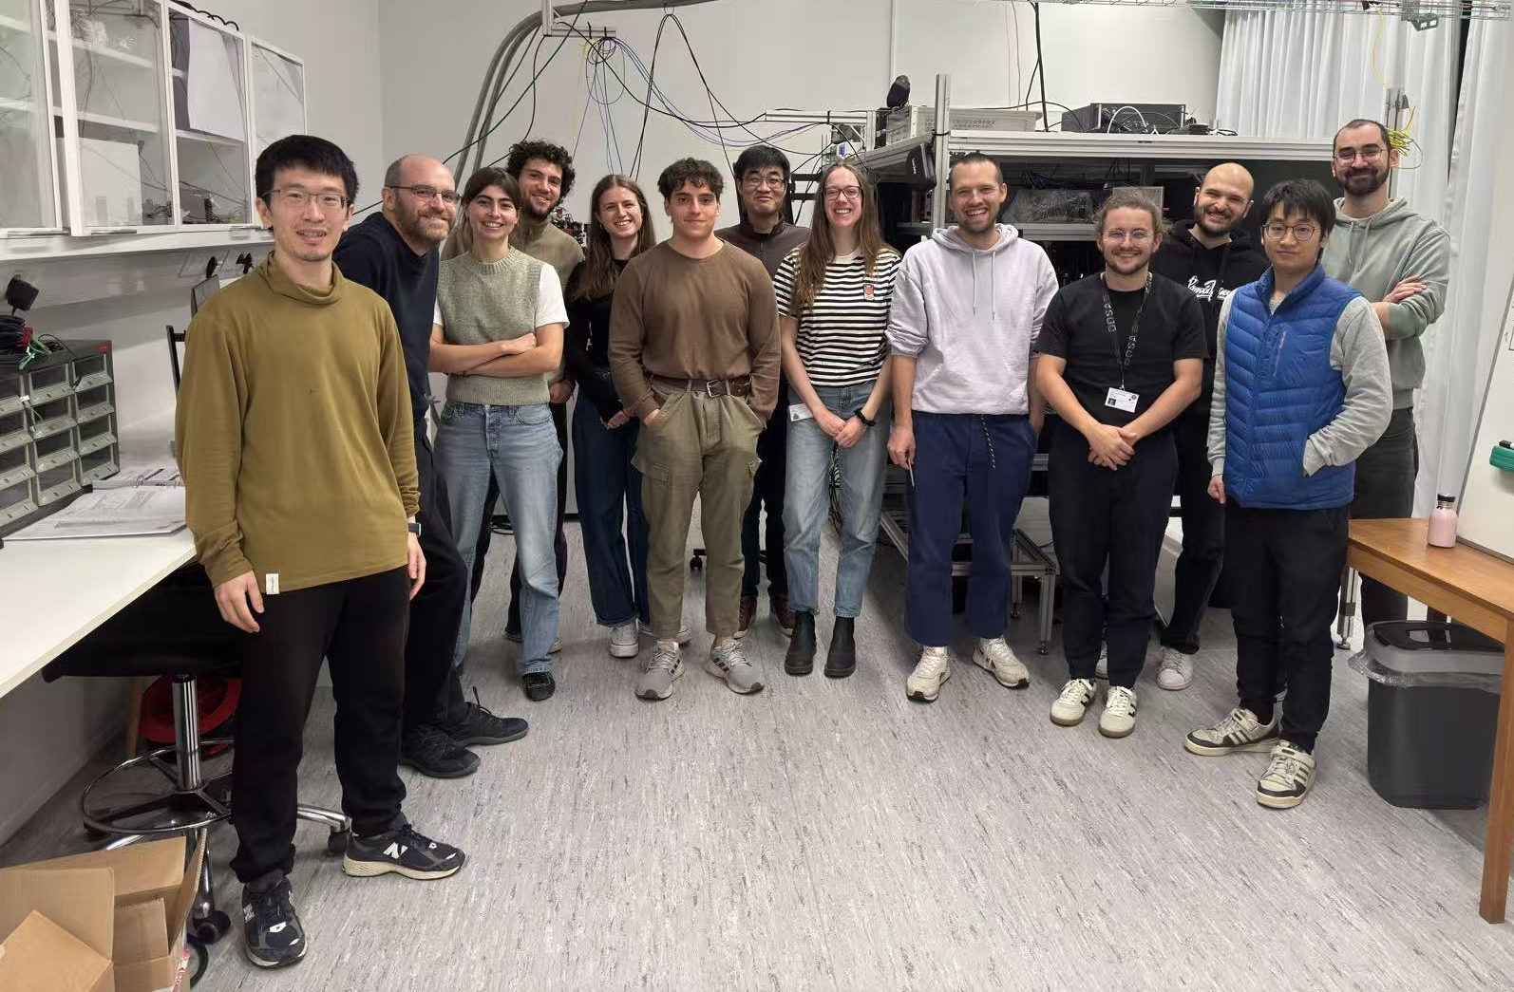


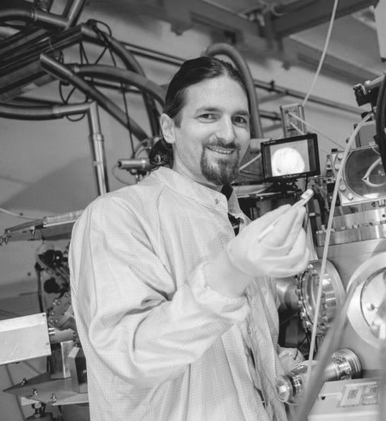




Acknowledgements
Team (Niels Bohr Institute)
Collaborators
20/08/2026
5
Anders Sørensen
Joan Alba
Arne Ludwig
Funding
Thank you for your attention

Slide 8
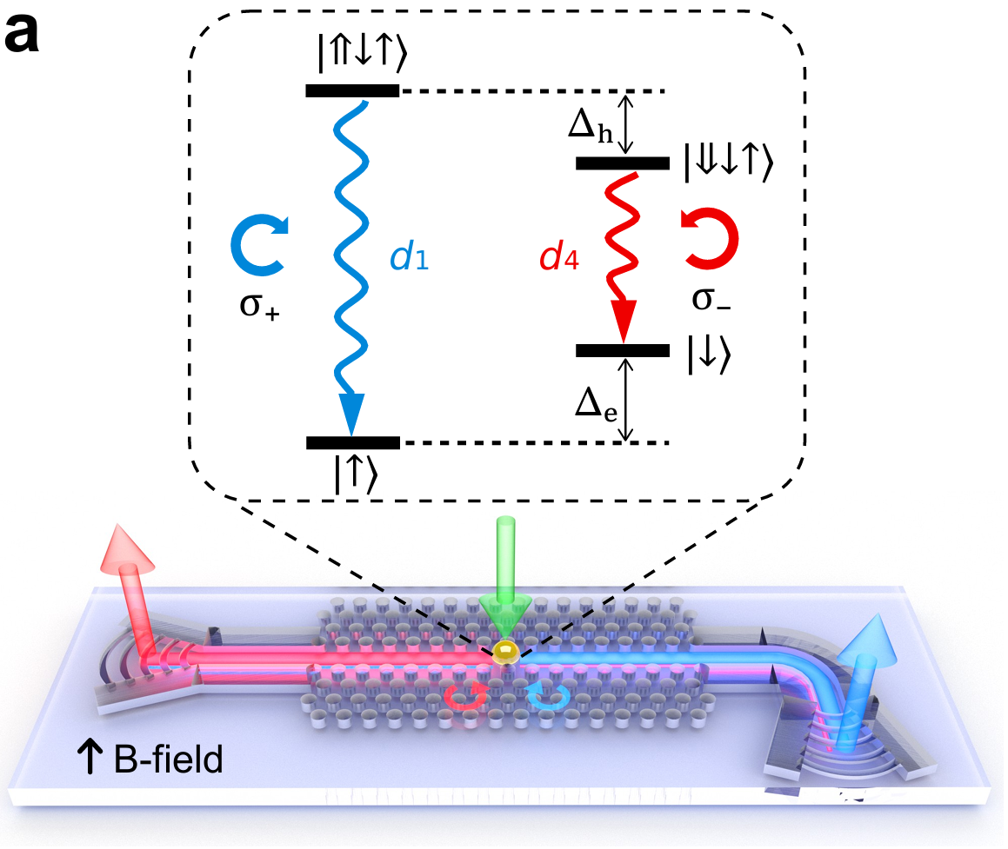
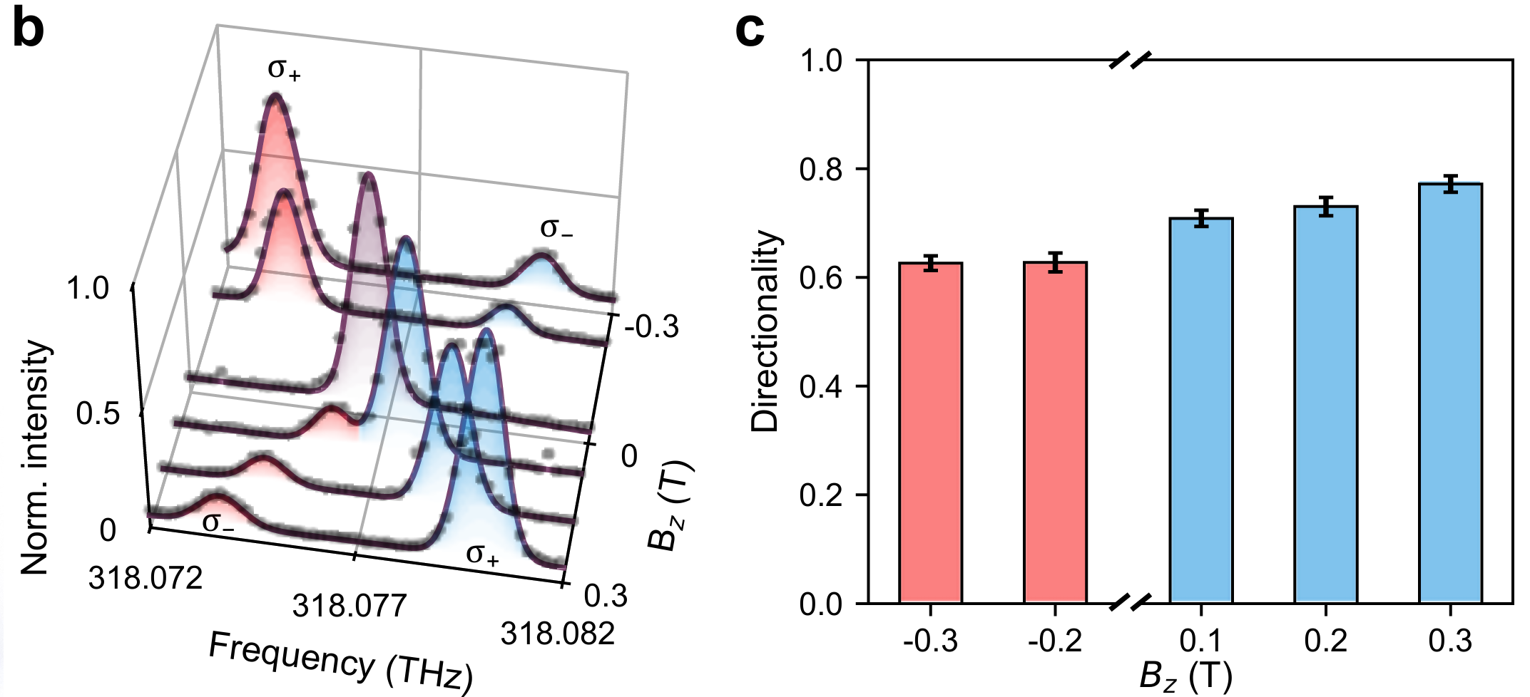
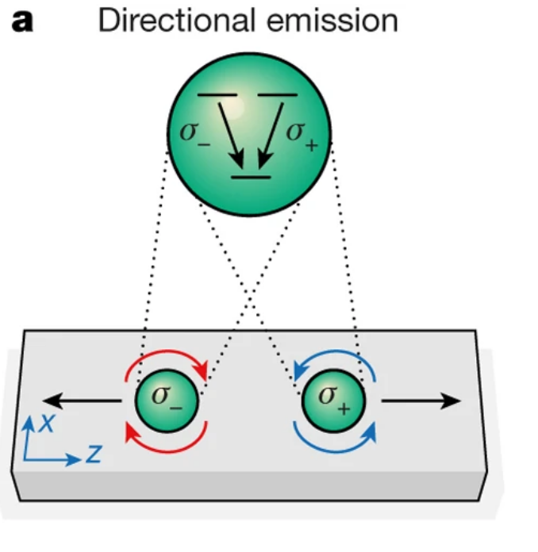


1) imperfect directionality in Faraday config
p-shell spectrum
Directionality ($S_{3}$)~69%
Port A
Port B (collection)
quantum memory
Nature 541, 473–480 (2017)
Shikai Liu, et al. In preparation
Notes:
The first is the imperfect directionality in Faraday config. Here the p-shell excitation which is the green arrow, is used to locally drive the quantum dot. Due to the chiral coupling, the sigma+ and sigma- will propagate into a different direction. Here we only collect the emission from port B. Compared with the previous neutral exciton work, which use a three-level system, here the polarization of the emitted photon is not only linked to the two excited state, but also the long-lived ground state, which is important for quantum memory

Slide 9
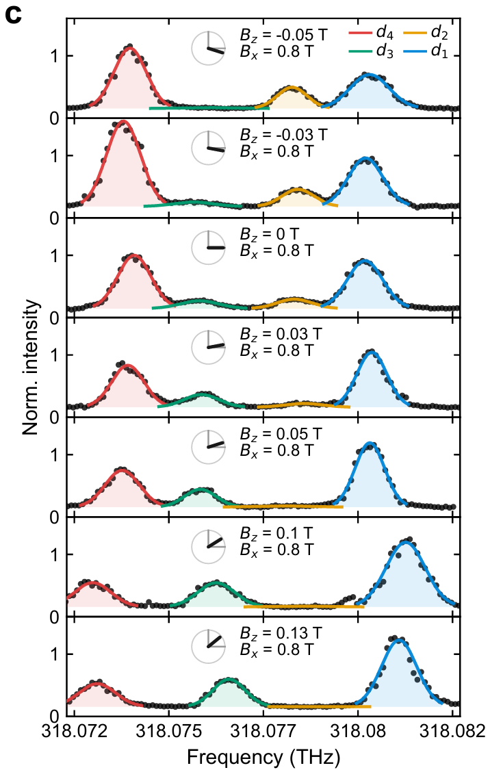
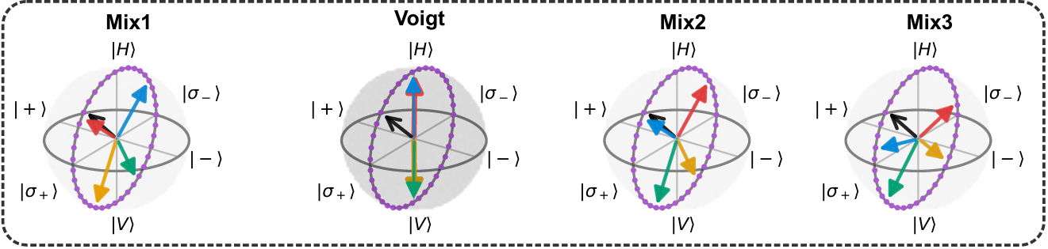
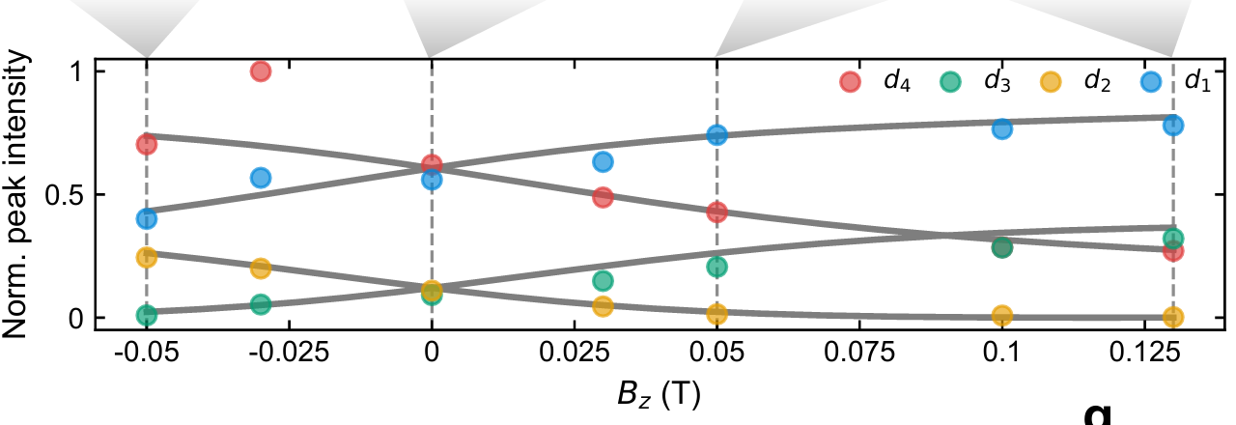
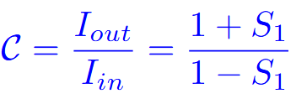

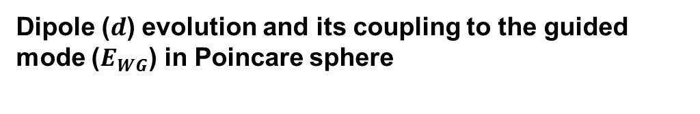
Engineer dipoles by rotating B-field angle (oblique)
P-shell excitation $→$cavity-assisted spectroscopy
Dipole ($d$) evolution and its coupling to the guided mode ($E_{WG}$) in Poincare sphere
Mix -
Pure Voigt
Mix +
Mix ++
Pure Voigt
Shikai Liu, et al. under preparation
Notes:
Add a Faraday field on top of a fixed Voigt field

Slide 10
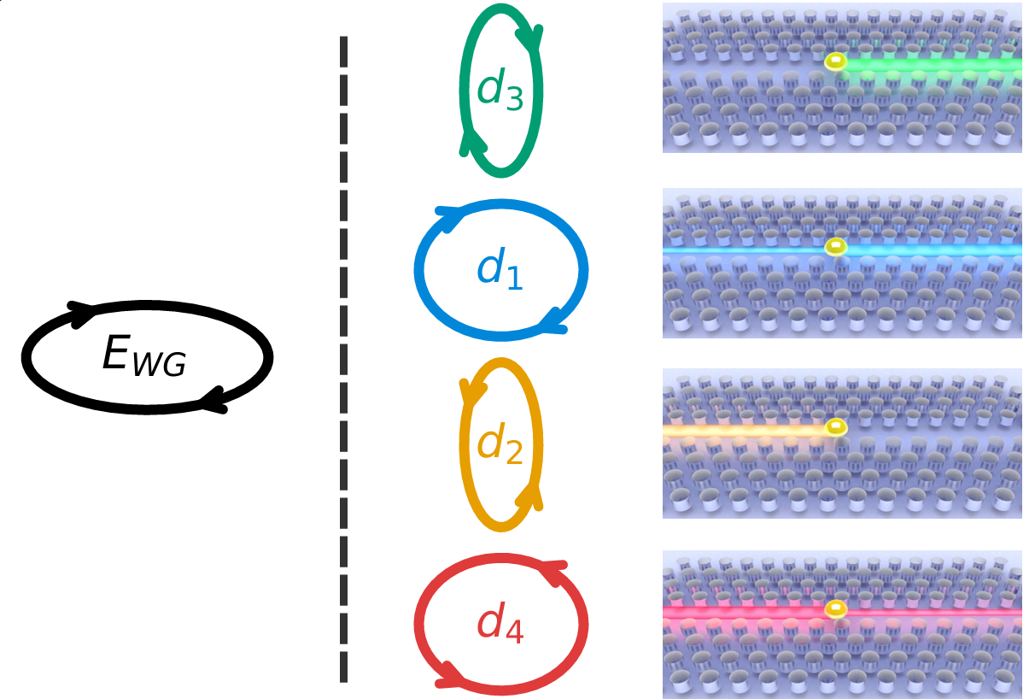
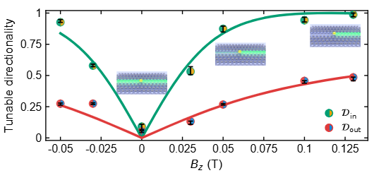
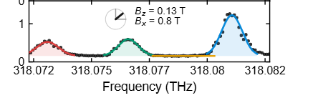
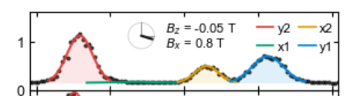

2) perfect directionality in oblique config
using appropriately oriented elliptical dipoles (d), even the electric field (E_{WG}) is not perfectly circular.
dipole • electric field
$𝓓\sim$69% $→$ 99%
Mix -
Voigt
Mix +
Mix ++
p-shell spectrum
Shikai Liu, et al. In preparation
Notes:
One can always find a dipole that gives perfect chirality except linear polarization

Slide 11
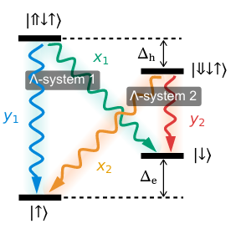
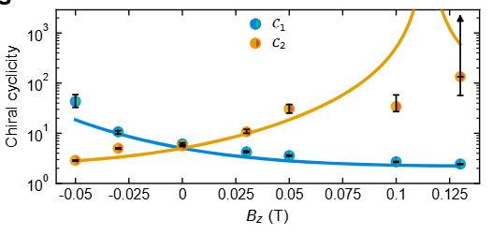
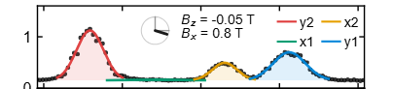
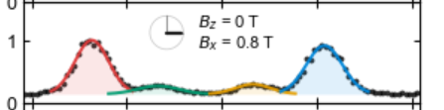
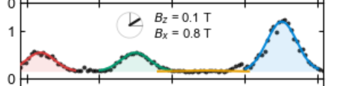

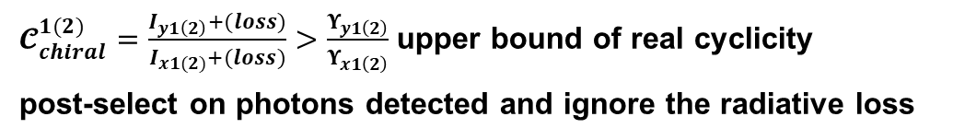

3) chiral cyclicity between 2 $Λ−$systems
$𝓒_{chiral}^{1(2)}=\frac{I_{y1\left(2\right)}+(loss)}{I_{x1(2)}+(loss)}>\frac{Υ_{y1\left(2\right)}}{Υ_{x1\left(2\right)}}$ upper bound of real cyclicity
post-select on photons detected and ignore the radiative loss
Vital for achieving high-fidelity spin-photon entanglement
Mix (-）
Pure Voigt
Mix (+）
Mix (++）
identical
6$⟶$134
Complementary
Shikai Liu, et al. In preparation
Notes:
teal

Slide 12
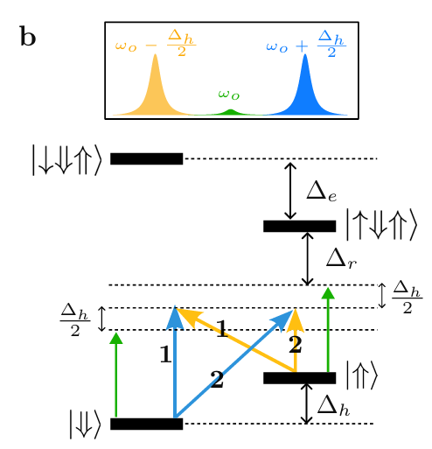
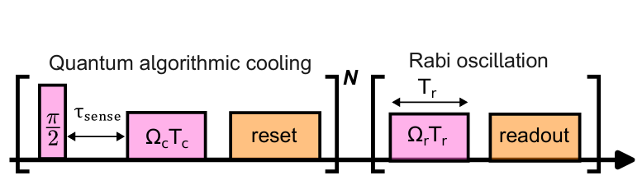
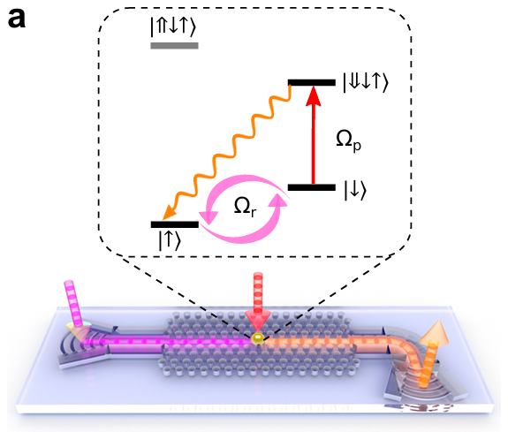

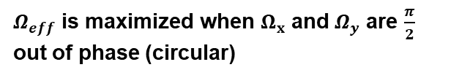
4) On-chip spin control via WG-transmitted Raman
Optical Raman scheme
A red-detuned bichromatic laser
Circular polarization
Laser freq. splitting matches ground state splitting of spin
Pulse sequence
Rabi oscillation
Raman
readout
$Ω_{eff}$ is maximized when $Ω_{x}$ and $Ω_{y}$ are $\frac{π}{2}$ out of phase (circular)
advantage of remote spin control
Lower excitation power → reduced laser-induced spin-flip rate(κ)
More robust → less sensitive to laser polarization and alignment
Shikai Liu, et al. In preparation

