Slide 1
Next token prediction for arbitrary particle physics tasks
Daniel Murnane
Niels Bohr Institute, University of Copenhagen

Slide 2
Can language help us with physics?

Slide 3
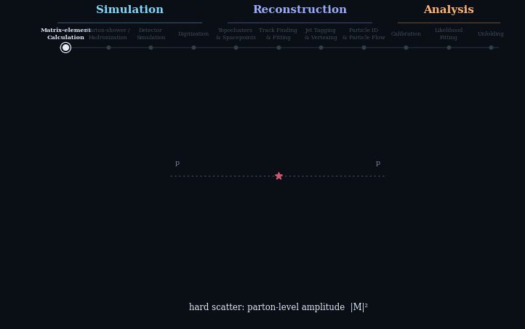
A day in the life of an experimental particle physicist
Particle physics has LOTS of tasks
They need to be calibrated and interpreted, cannot simply be a black box
We don’t want to train O(NM) models (for N inputs, M outputs)
We may not even want to train with truth labels (e.g. for calibration or simulation purposes)
Simulation
Reconstruction
Analysis
Matrix-element Calculation
Parton-shower / Hadronization
Detector
Simulation
Digitization
Topoclusters
& Spacepoints
Track Finding
& Fitting
Jet Tagging
& Vertexing
Particle ID
& Particle Flow
Calibration
Likelihood Fitting
Unfolding
Numerical
Integration
Markov Chain
Monte Carlo
Topological clustering
Kalman Filtering
& Fitting
Conformal Fits
& Hough Transform
Statistical Techniques, Bayesian Inference

Slide 4
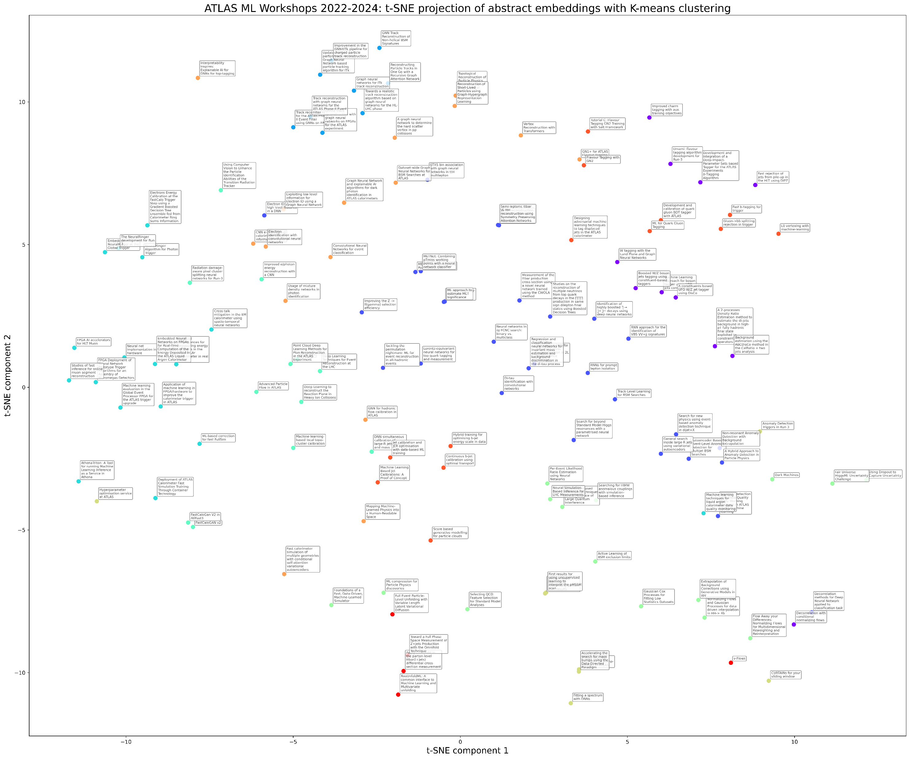
What does mL in the atlas experiment “Look like”?
Tracking
Flavor Tagging
Vertexing & ID
Calorimetry
W/Z tagging
Trigger
Specific Channel Searches
Particle Flow
Anomaly Detection
Embed every talk in the ATLAS ML Workshop (135 talks) from the last 3 years
Calibration
Infrastructure
Simulation-based Inference
Open Data
DQ
Simulation
Unfolding
Flows, Fits & Bumps

Slide 5
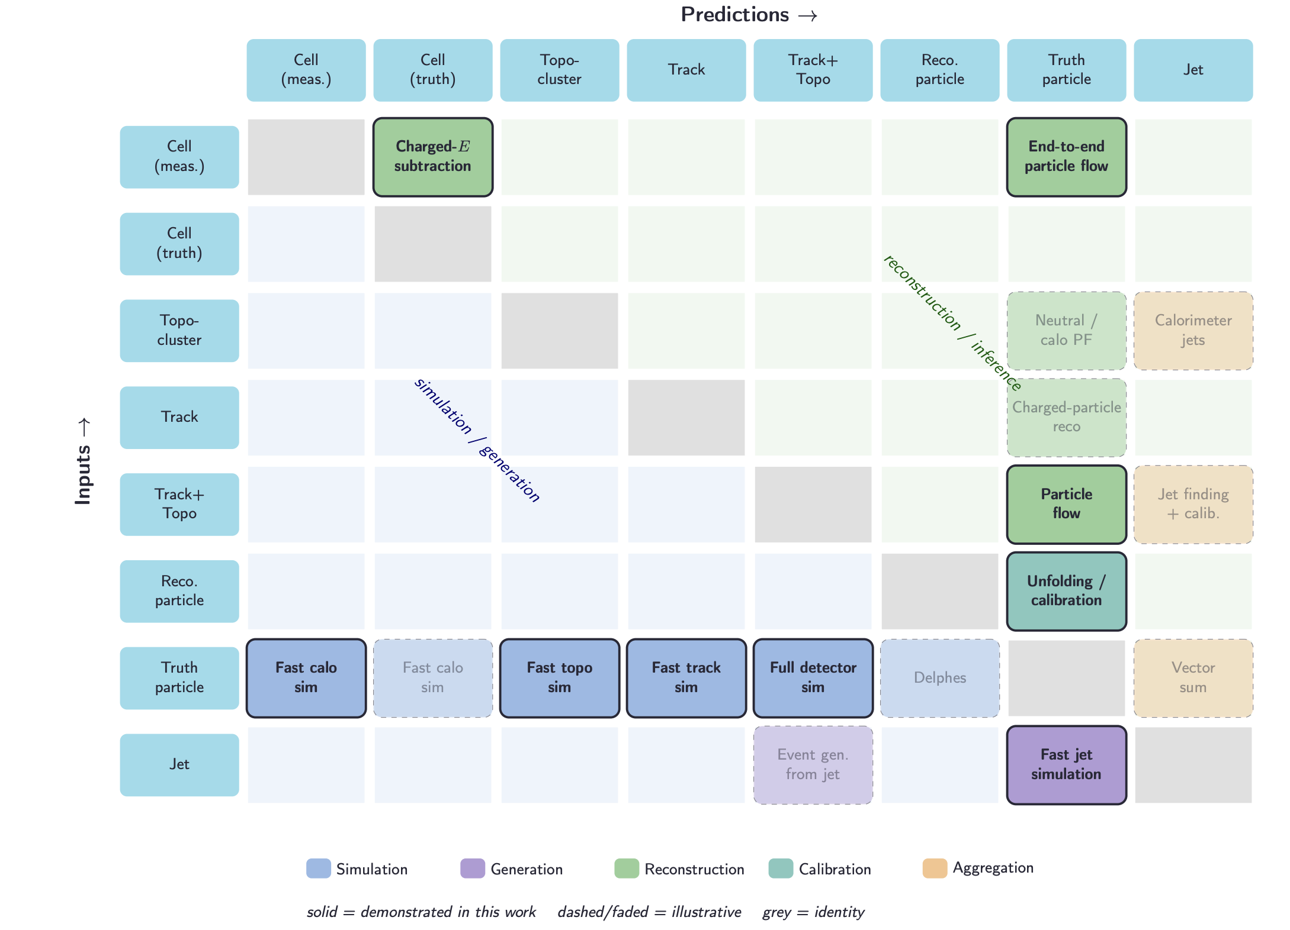
Tasks can be captured by inputs and outputs

Slide 6
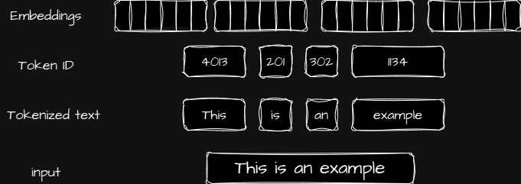
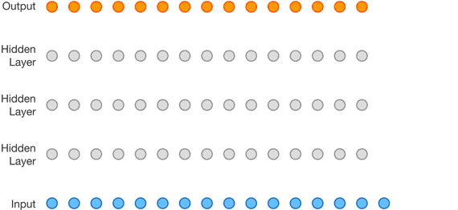
How do large language models solve this?
Tokens & Autoregression
Every object that can be represented by language is converted to a common form = “token”
English, Chinese, numbers, emojis → one big one-hot vector
The question of defining a task is then simply presenting a sequence of previous tokens = “prompt”
Switching between input and output, different tasks or modalities, can be done with special tokens. E.g. “EOS” tells the model to stop generating

Slide 7
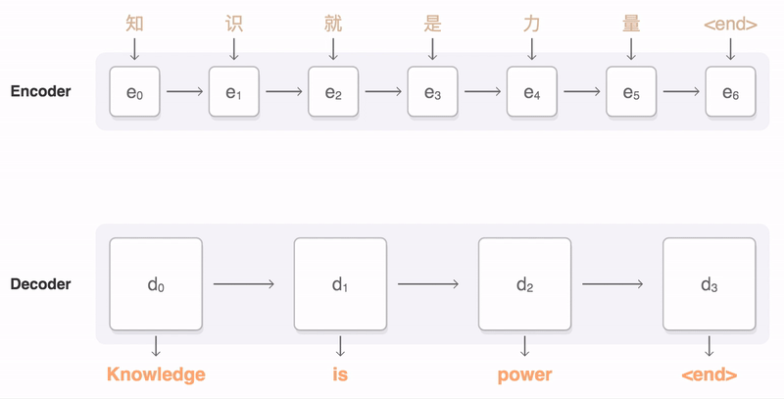
How do large language models solve this?
Some industry tricks…
Some small extra points:
  Teacher forcing
  KV caching
  Causal attention

Slide 8
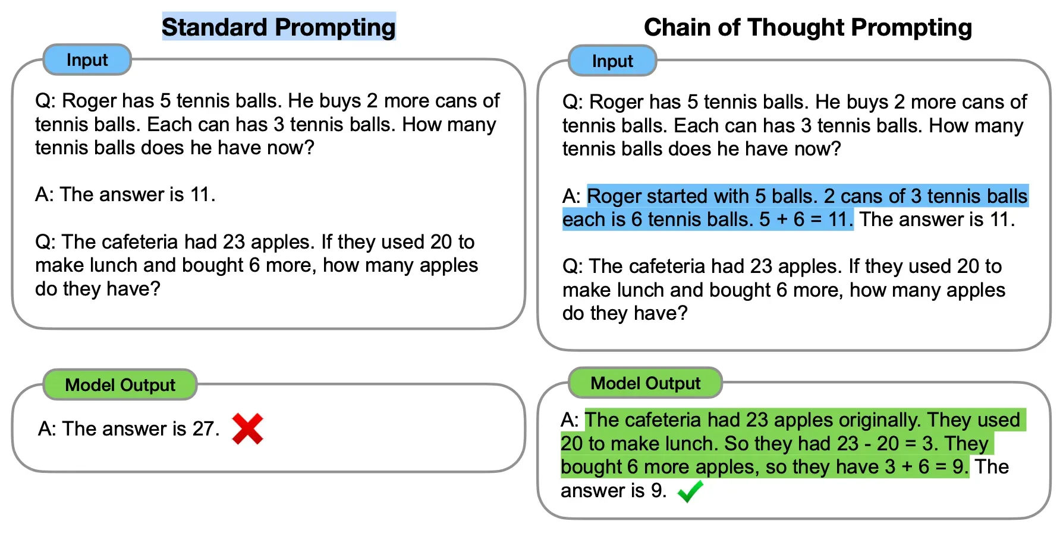
How do large language models solve this?
Emergent behaviour
From only this training task, we seem to get “emergent” behavior:
Some level of generalizability across tasks
The ability to improve performance by “thinking” (version 1 = chain of thought, version 2 = reasoning)
In-context learning (new tasks given as examples)

Slide 9
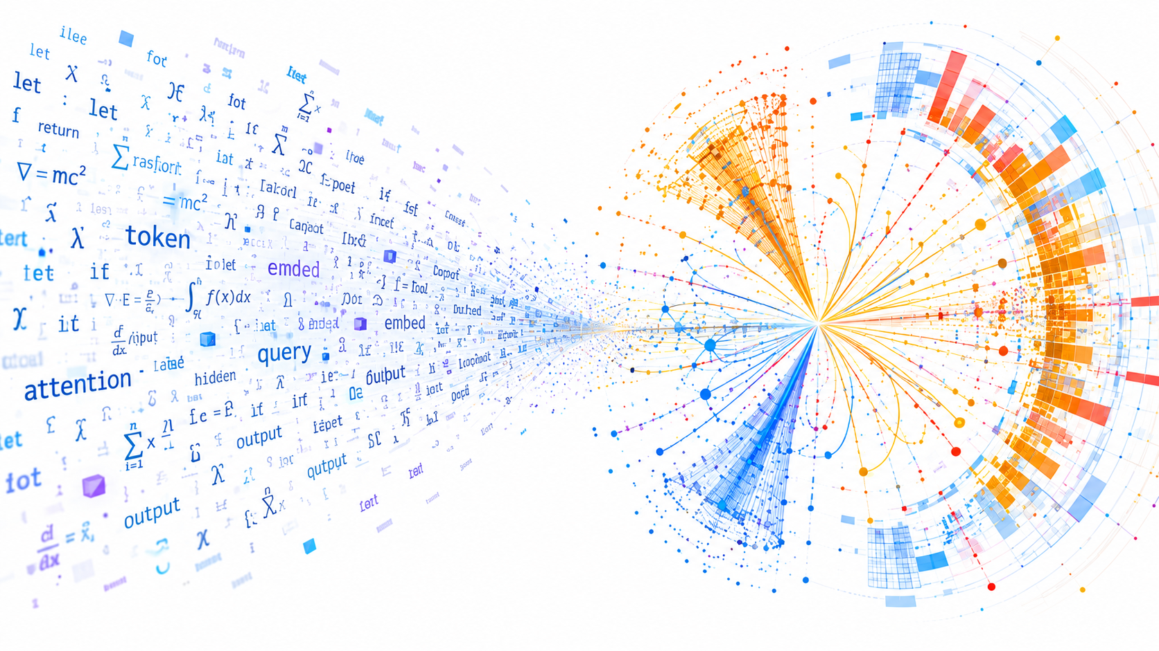
Is natural language similar to (particle) physics?
  This is a huge and open question. Our approach, rather than approaching from first principles, was instead to build some models that borrow from large vision and large language models, and see how they behave!

Slide 10
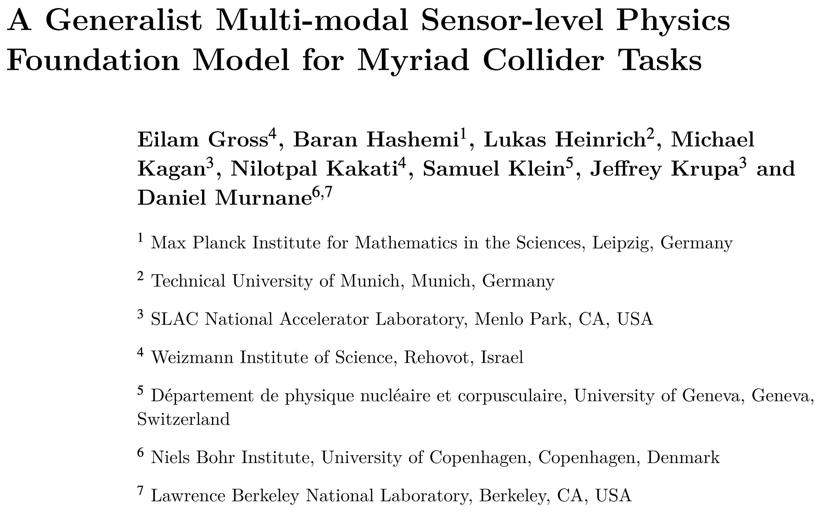
Building a generalist physics model
Work based on upcoming pre-print →

Slide 11
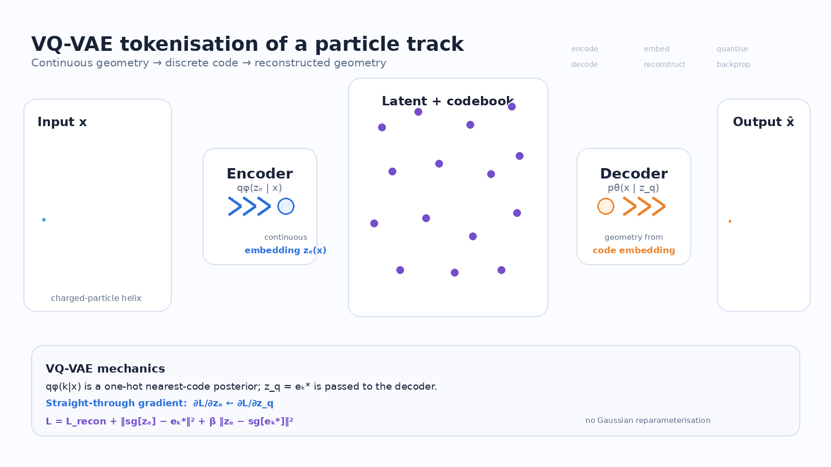
Data & Tokenisation
Data is simulated in the simplified COCOA detector geometry (calorimeter full sim, tracker fast sim)
100M jets
7 modalities: tracks, topoclusters, truth particles, reco particles (from HGPFlow), cell energies, jet-level features, reconstructed cells (for calibration)
Tokenise with RVQ-VAE

Slide 12
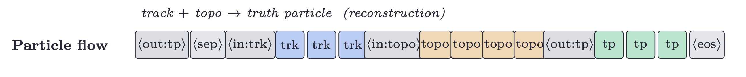
Defining tasks
We propose two ways to define tasks, which depend on how we decode and sample a sequence…
We can decode and sample in parallel: All tokens produced at the same time. In that case, we have a ”cardinality” (length) head to predict how many of each modality should be produced first, then we decode that many of each
We can decode and sample autoregressively: Produce one token at a time, conditioned on all previous input and output tokens. In that case, learn when to switch modalities, and finish the task, with dedicated modality and EOS tokens
A header then “prompts” the model for the modalities we want to receive

Slide 13
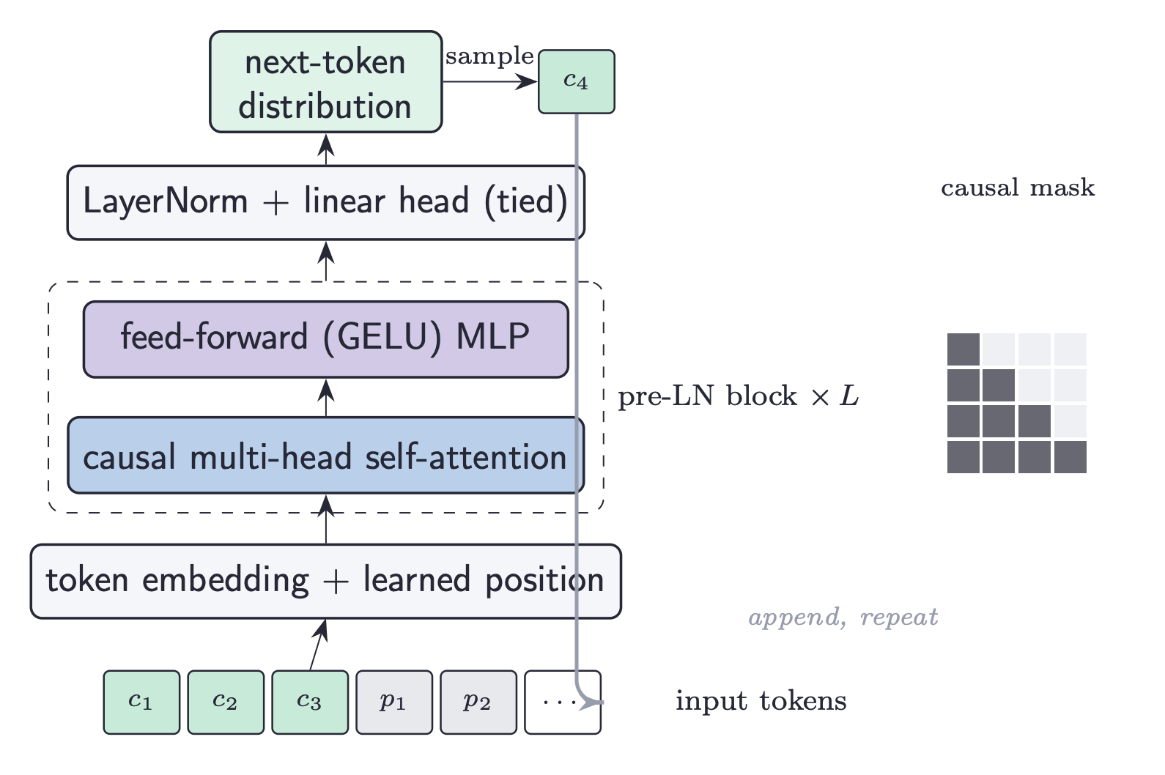
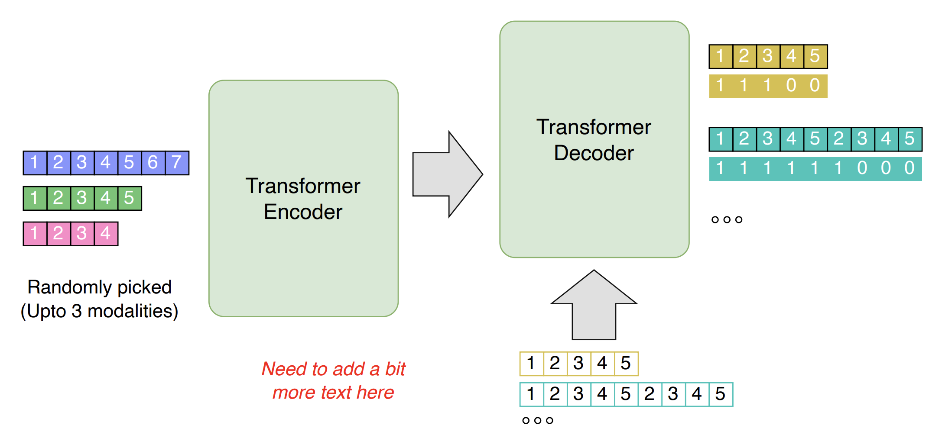
Choosing an architecture
Parallel architecture based on 4M model from Apple AI Research group (call it HEP4M)
Autoregressive architecture based on nanoGPT (call it nanoHEP)

Slide 14
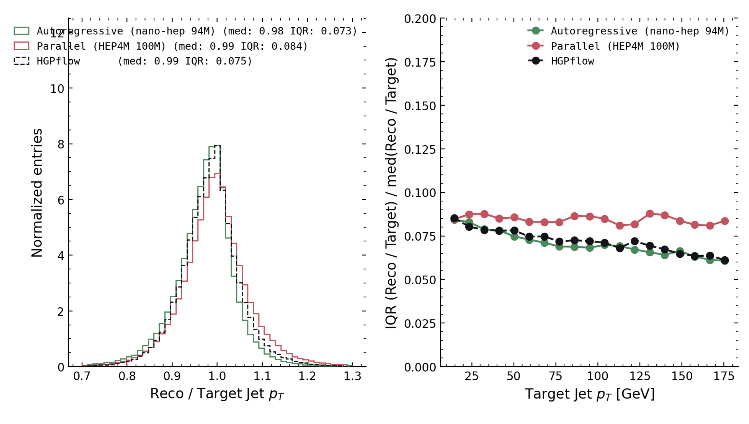
Sample tasks
Particle Flow Reconstruction
Particle flow is a nice task: High impact, well-defined, low-cardinality, with great baseline model
HGPFlow is a current contender for pflow inside ATLAS – current state-of-the-art
Contains several physics-based heuristics (e.g. conservation of energy)
HEP4M is competitive
NanoHEP outperforms
Both are simply “filling in the blank”

Slide 15
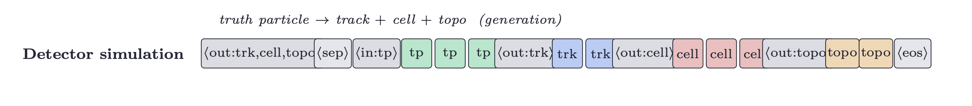
Sample tasks
Detector Simulation
Can easily define the task of detector simulation:
But how should we evaluate output?

Slide 16
Evaluating Foundation Model behaviour

Slide 17
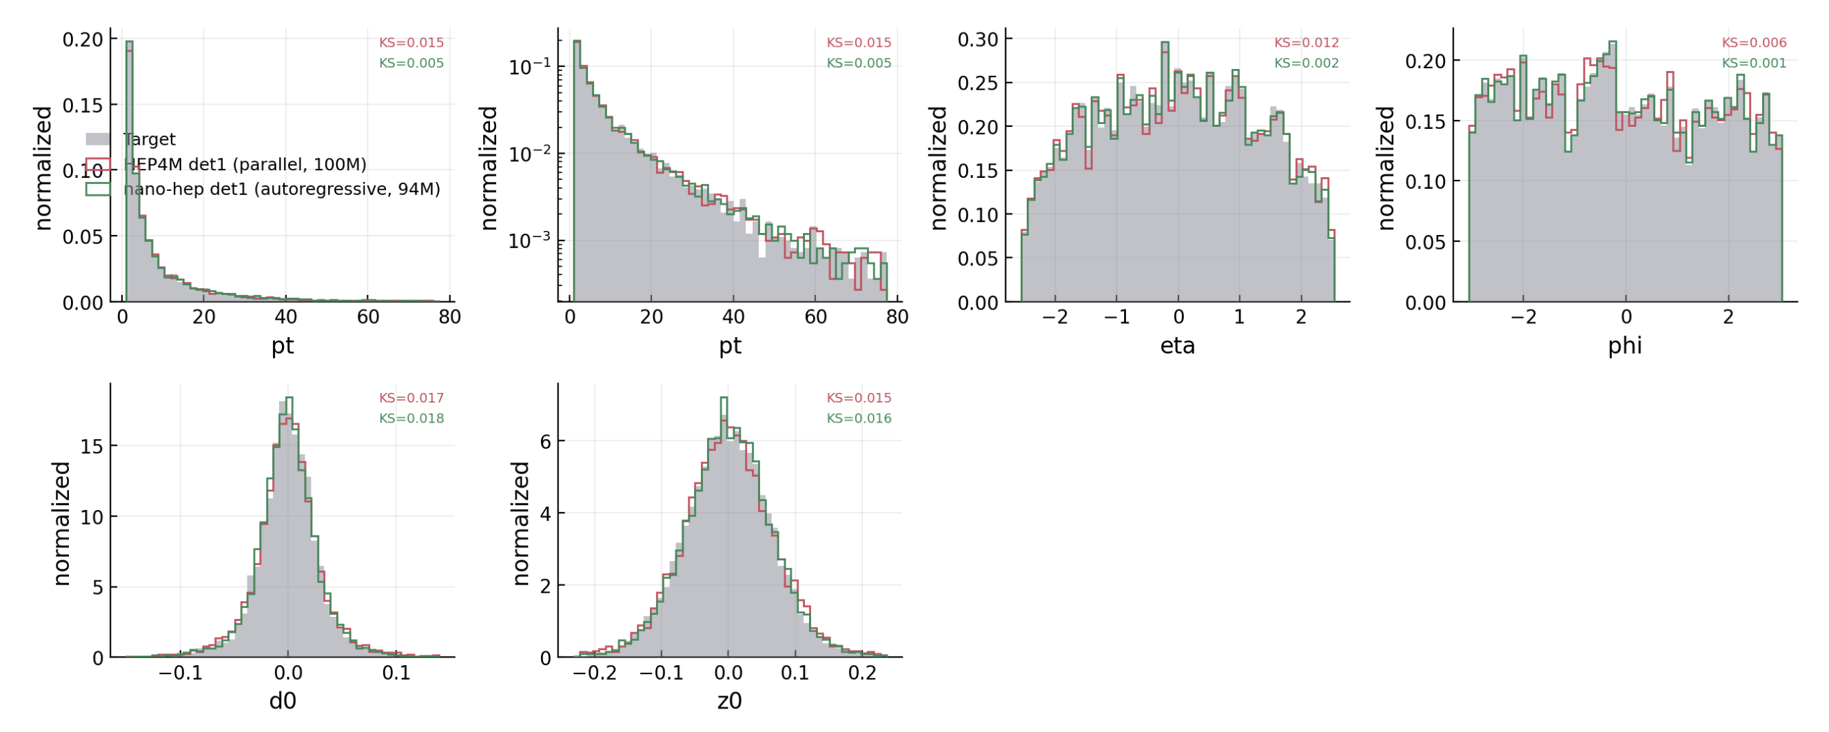
Evaluation standard approaches
We can inspect the marginal distributions of a generative model, and we would expect that the generator and training sample should be similar (can quantify with Kolmogorov-Smirnov = KS)
Indeed, good match for both here!
Hard to interpret this, and it doesn’t tell us how each event looks

Slide 18
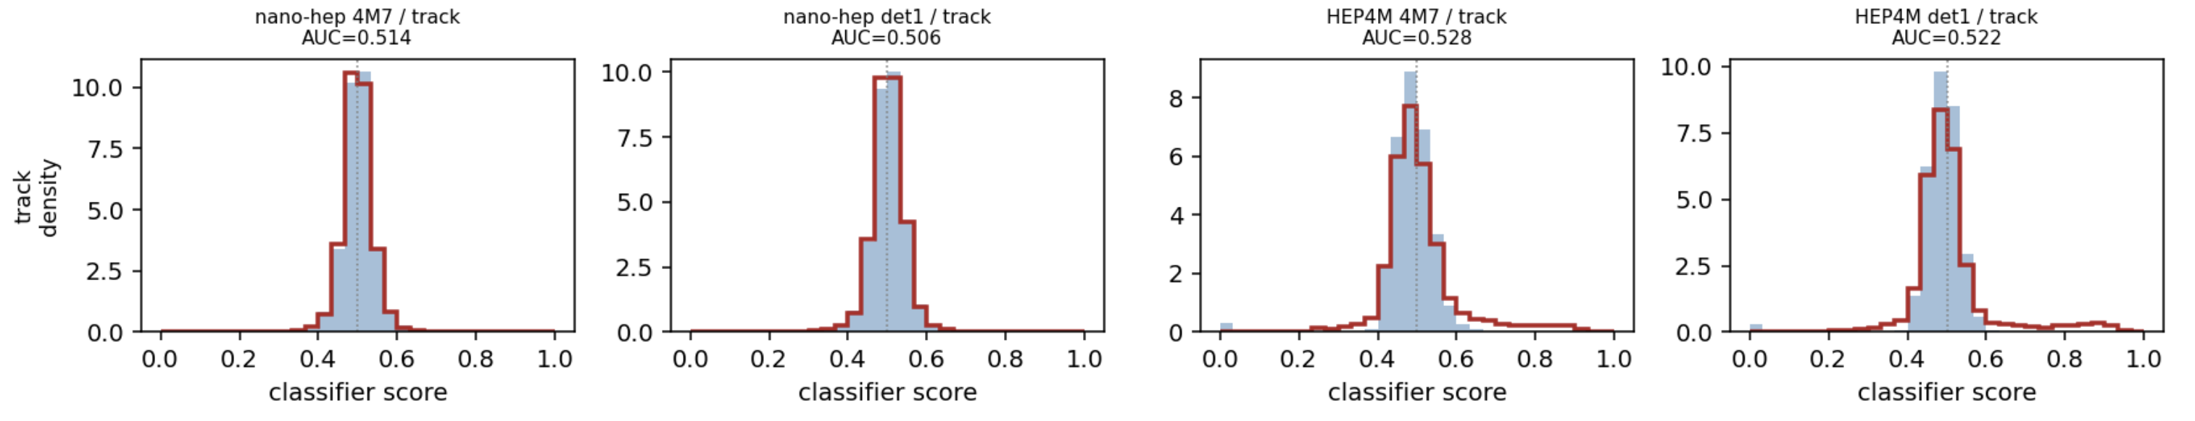
Evaluation model-as-a-judge
We can try to define per-event quality by training a classifier to distinguish generated events from “real” (Geant4) events
Even better: Let’s give the classifier the FULL sequence. That is, we want the generator to not only generate realistic events, but they should match the input conditions
Nano-hep subtly better here than HEP4M

Slide 19
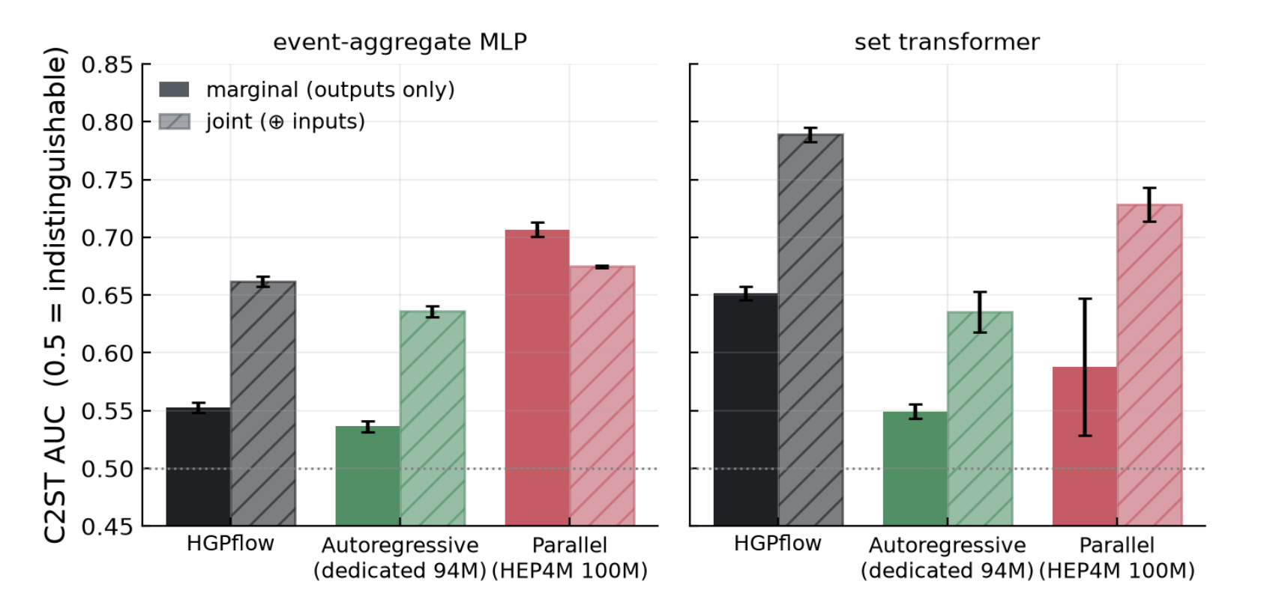
Evaluation model-as-a-judge
Nano-hep really shines when we look back at particle flow
Interestingly, HGPflow looked so good with jet-level residuals
But a classifier can tell its reconstruction apart from truth!
NanoHEP reconstructs much closer to truth objects
HEP4M in between

Slide 20
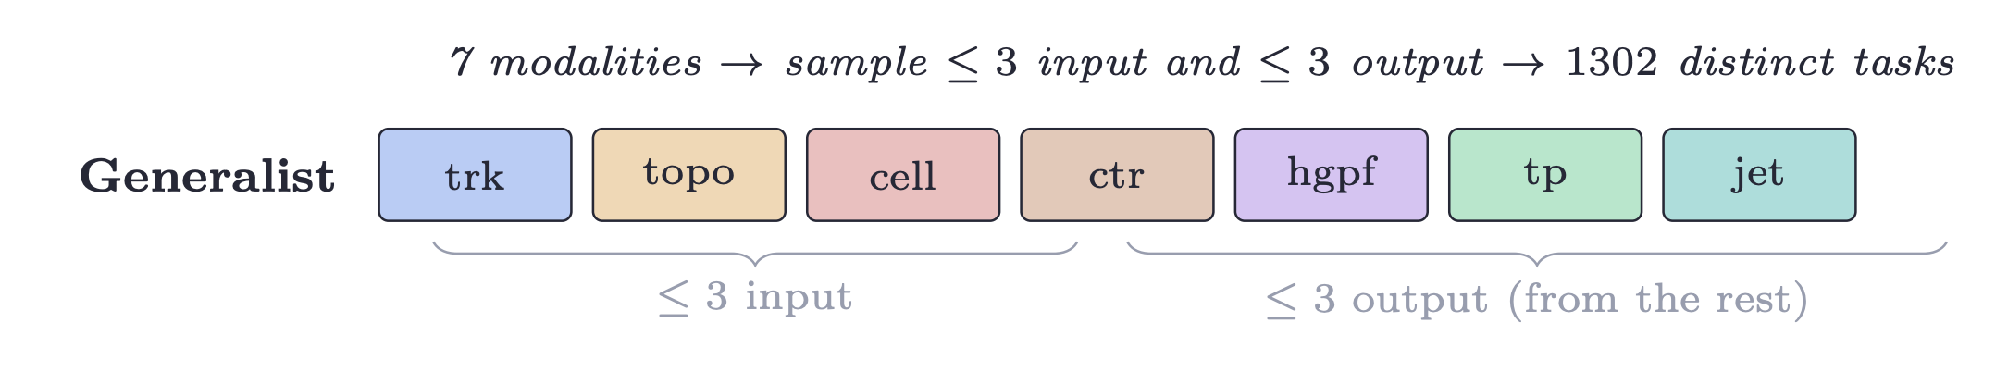
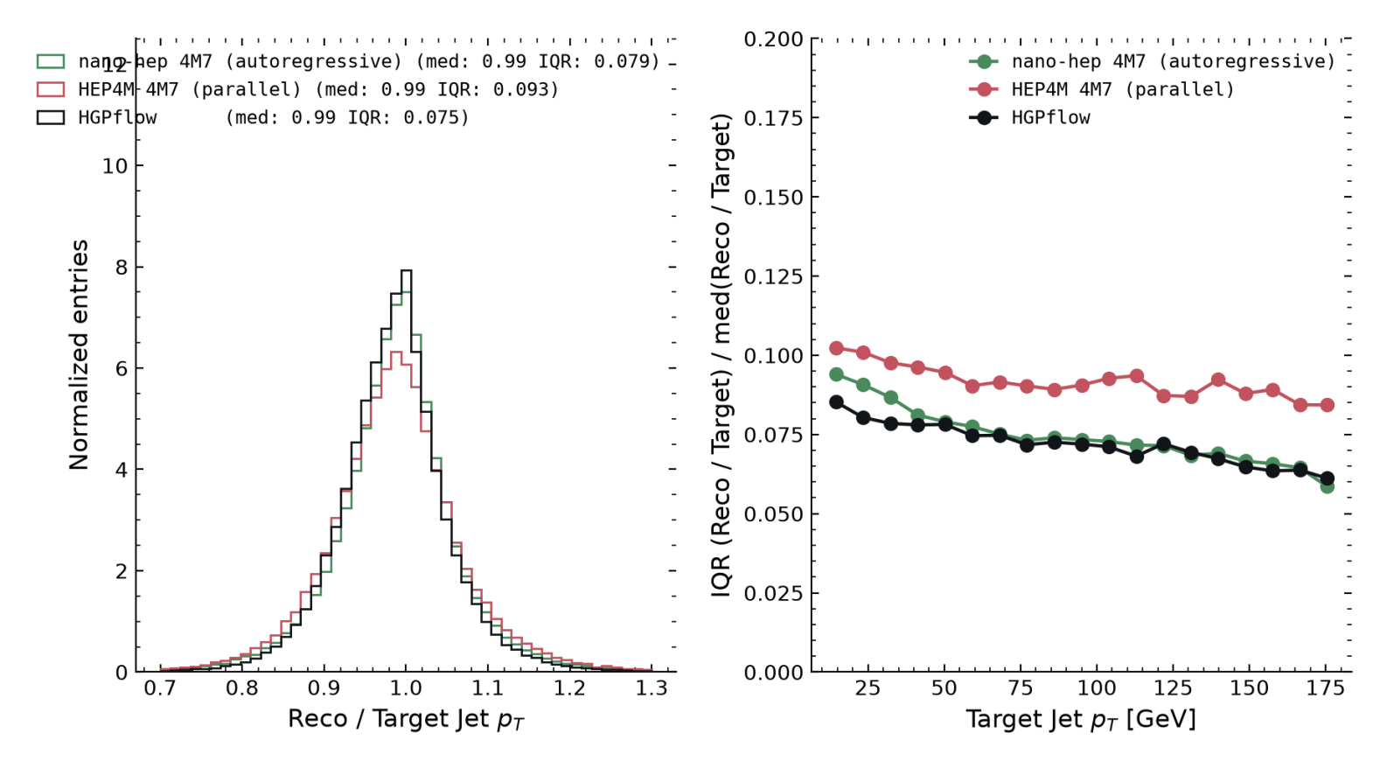
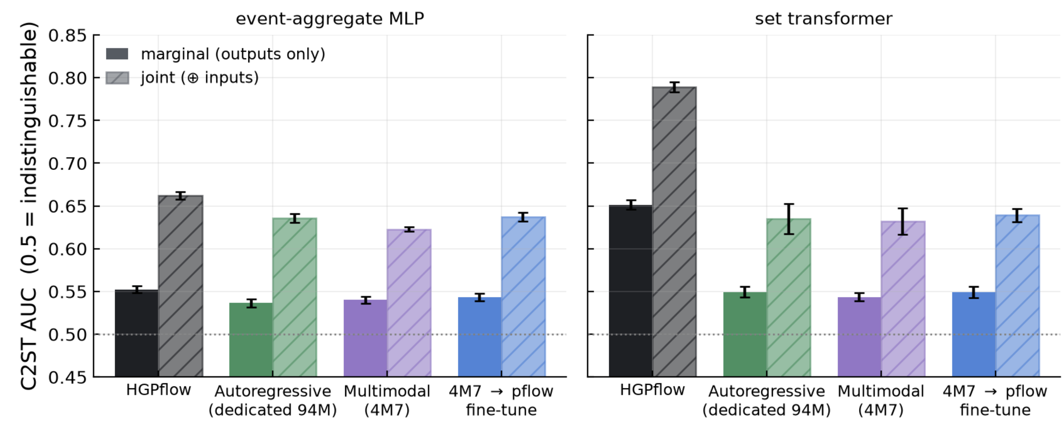
Generalist training & Examples
Finally, show the main result: Train on all 1302 distinct tasks (7 choose up to 3 x remaining 4 choose up to 3)
How does it do? Look again at the particle flow task (only one of the 1302 tasks) – competitive with HGPflow state-of-the-art

Slide 21
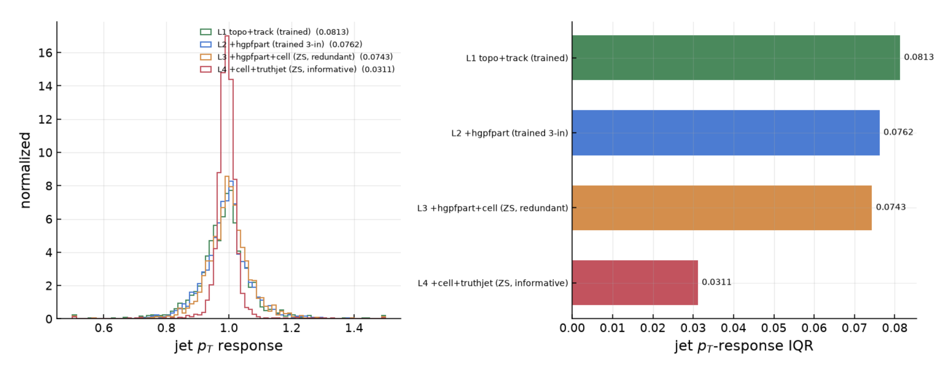
Generalisability
Out-of-distribution tasks
The model had only ever seen up to three modalities as input. L1 is standard Pflow (2 input modalities) as before
L2 gives the model HGPFlow particles as a hint – now it outperforms HGPFlow
L3 gives a fourth modality, out-of-distribution, but it actually improves performance significantly

Slide 22
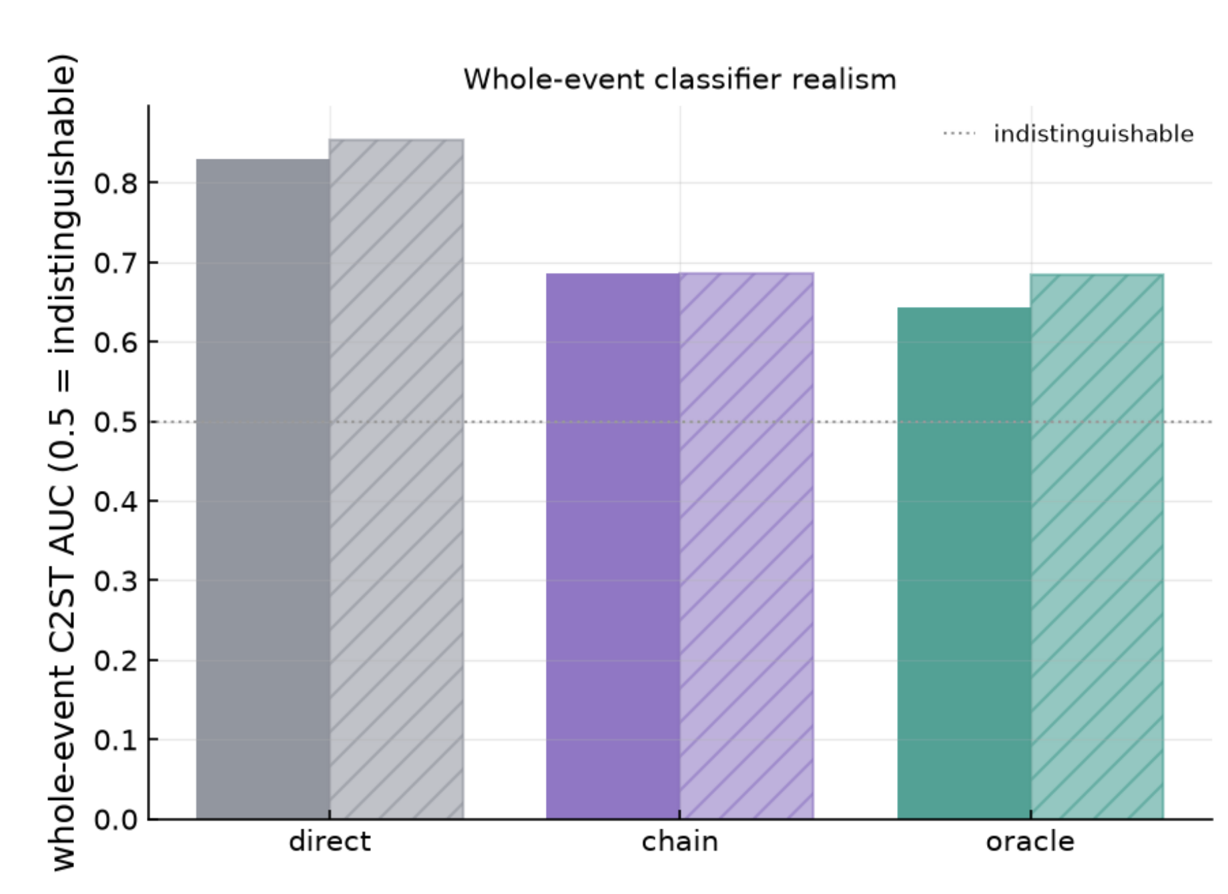
Generalisability chain-of-physics
Generating calorimeter showers is notoriously difficult
The holy grail would be providing particles and receiving calorimeter cell energy deposits – nanoHEP is not very good at this: a classifier can tell its showers apart with an AUC of 0.8
But ask nanoHEP to generate tracks first from particles, then tracks+particles → topoclusters, then tracks+particles+topoclusters → cells, and it significantly improves
This is a kind of proto-chain of thought, motivated by physics heuristics

Slide 23
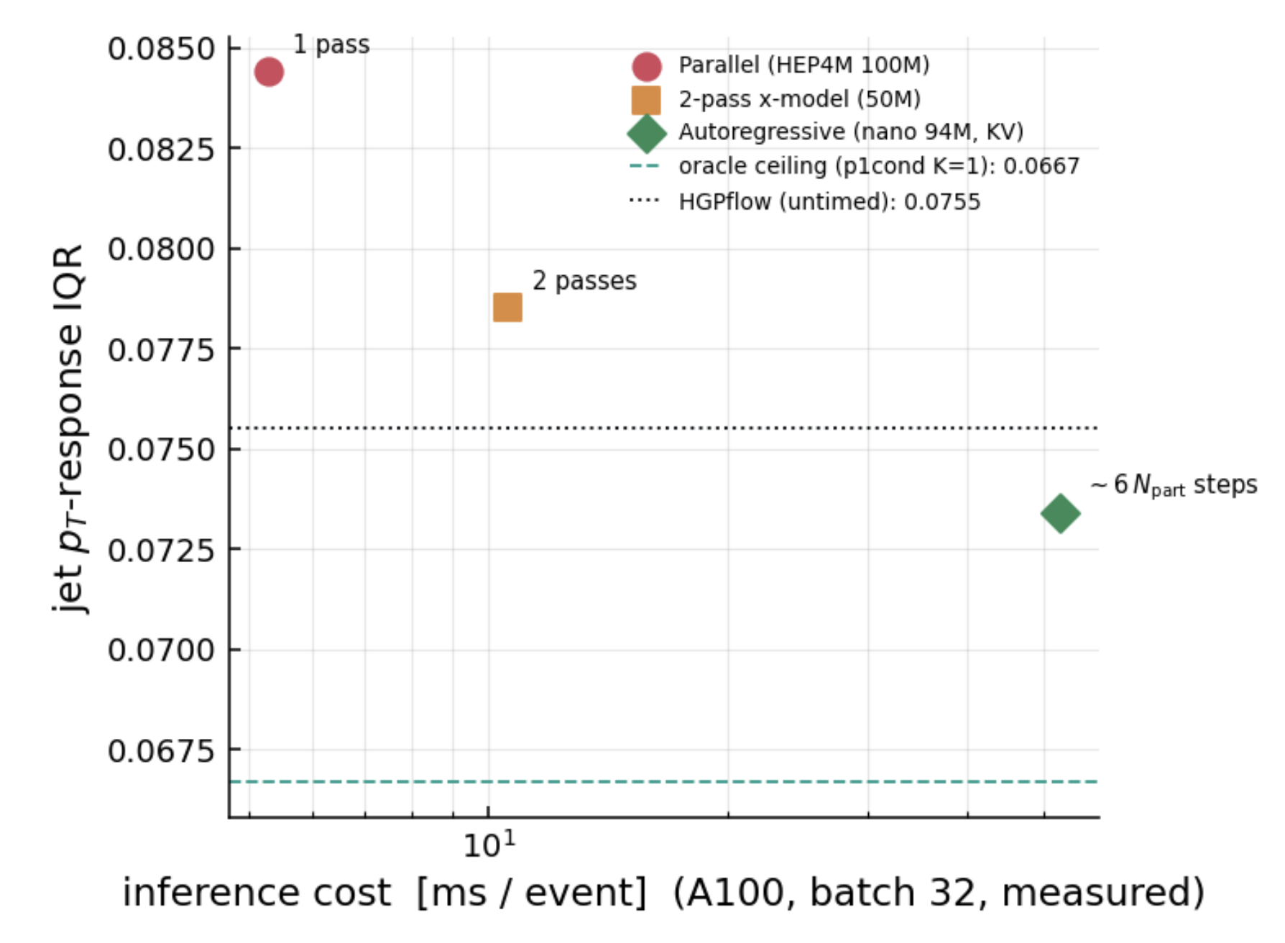
Conclusion
Simple fill-in-the-blank allows us to define a generalist particle physics model
HEP4M (parallel) is already competitive with state of the art pflow, and is very quick
NanoHEP (autoregressive) scales very well with model and dataset size and outperforms state of the art
However, it comes at a cost, which needs to be given some thought…

