Slide 1

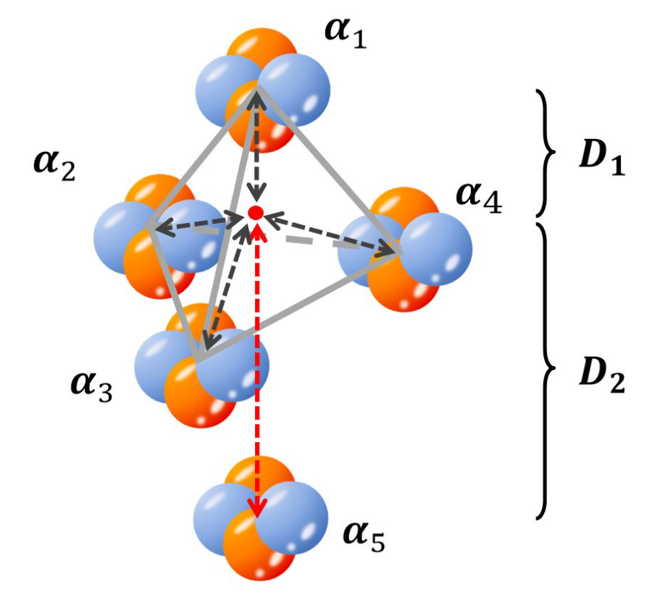
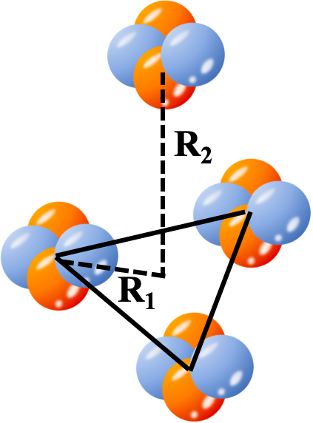
Nuclear Imaging of Competing
Geometric Cluster at the LHC
speaker: Pei Li (李沛), Fudan University
coauthor: Guo-liang Ma (马国亮), Bo Zhou (周波)
Match 9, 2026

Slide 2
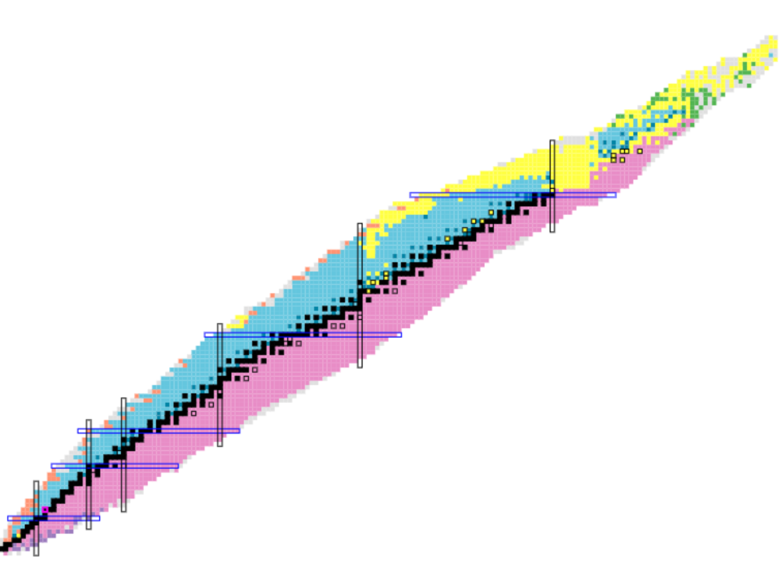
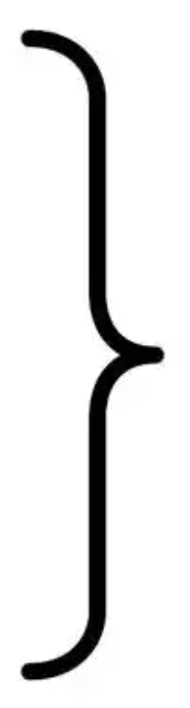
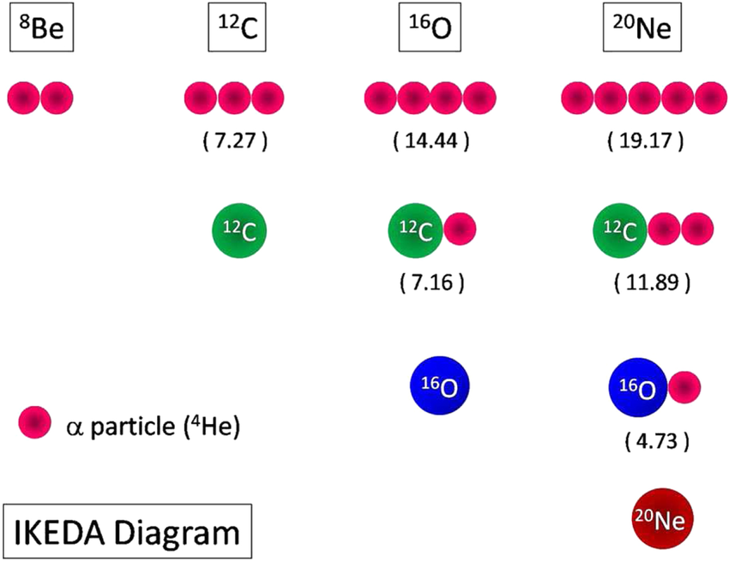
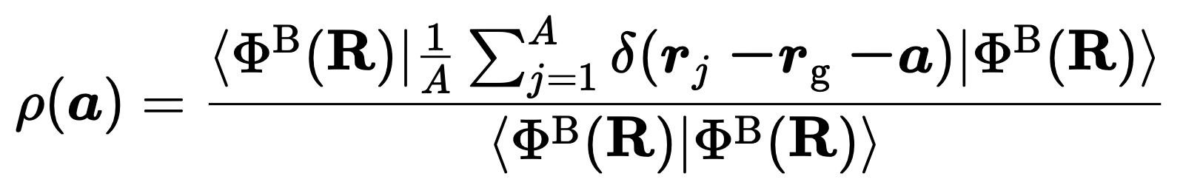

Nuclear shape
Large system
Woods
Saxon
²³⁸U+²³⁸U
²⁰⁸Pb+²⁰⁸Pb
¹⁹⁷Au+¹⁹⁷Au
¹²⁹Xe+¹²⁹Xe
Deformation is collective correlation at mean-field level.
Cluster is collective behavior beyond mean field
Alpha cluster structure in light ion
medium-size system
¹⁶O+¹⁶O
²⁰Ne+²⁰Ne
high degrees of freedom
complicated cluster structure
1
Match 9, 2026

Slide 3
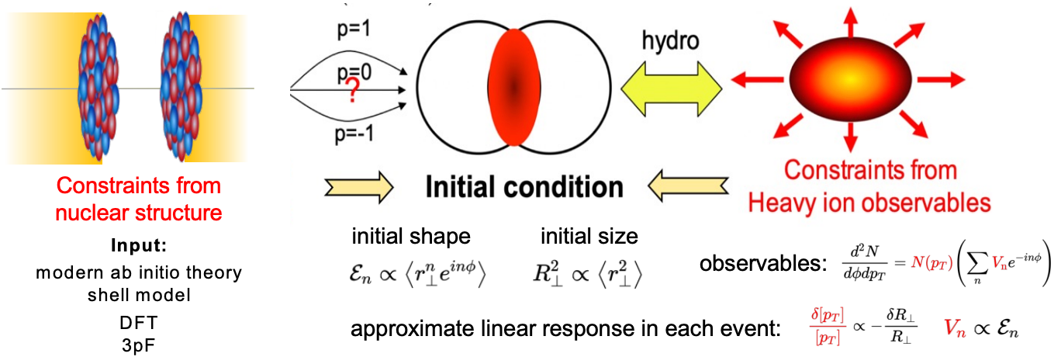


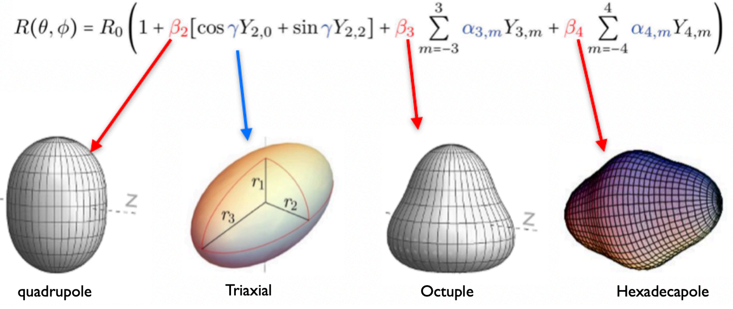
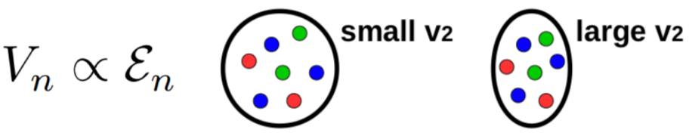
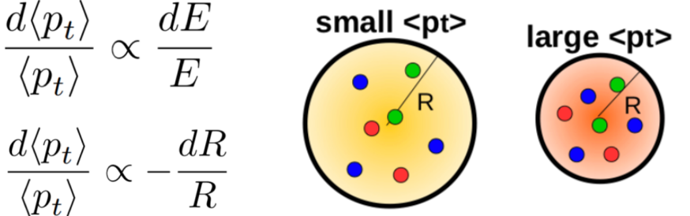
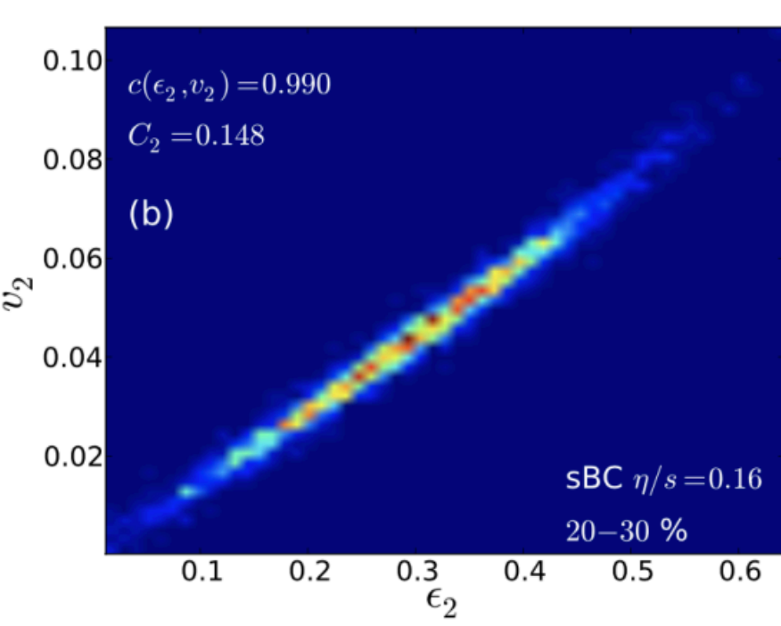
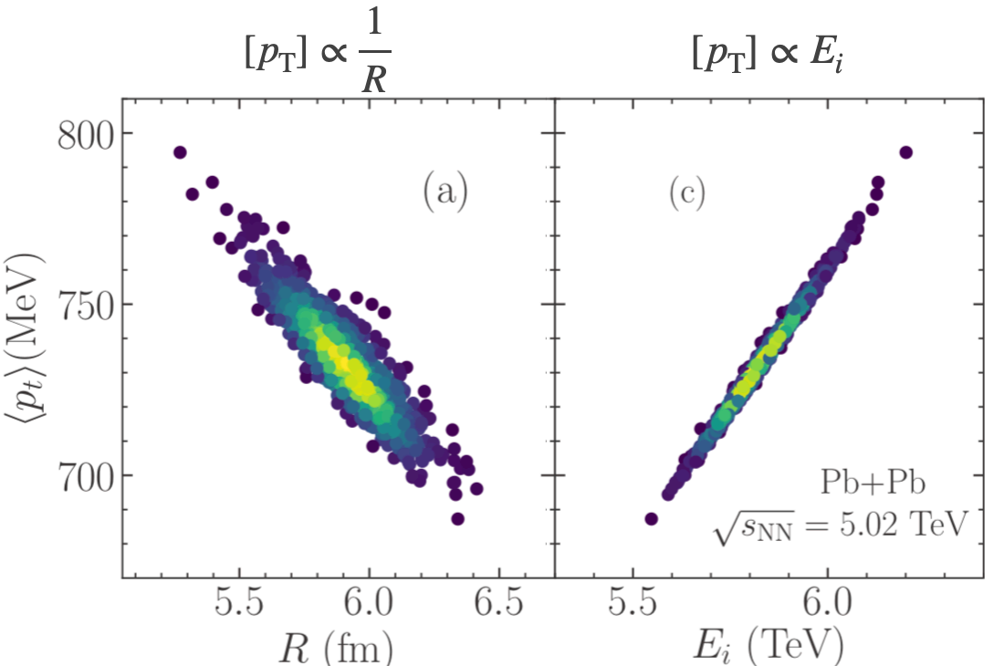
Heavy-ion collisions
Deformation
10⁻²⁵ s << rotational time scale 10⁻²¹ s
Shape
Anisotropic flow
Size
Transvers momentum
Cluster
PRC103 (2021) 2, 024909
PRC 87 (2013) 5, 054901
2
Match 9, 2026

Slide 4
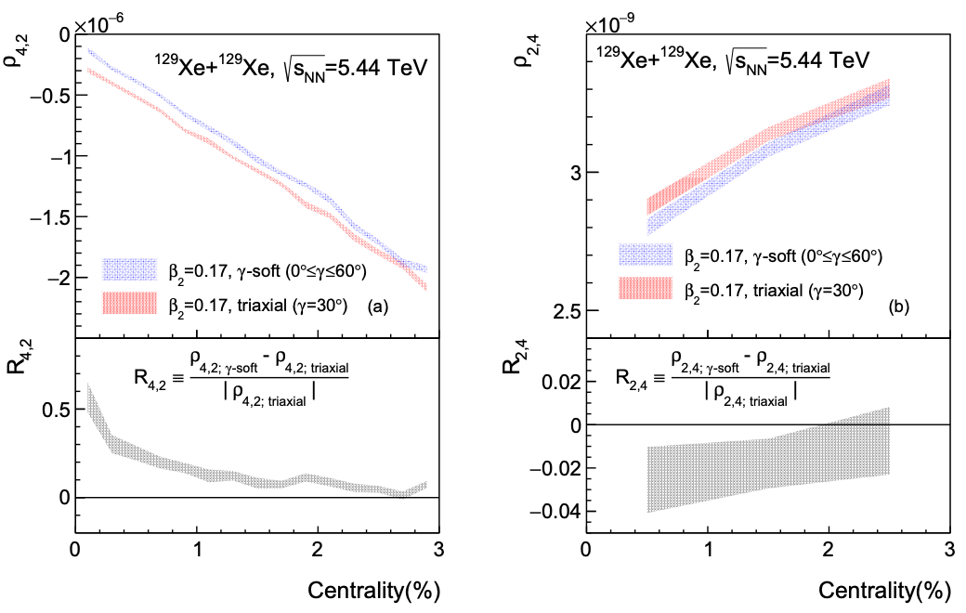
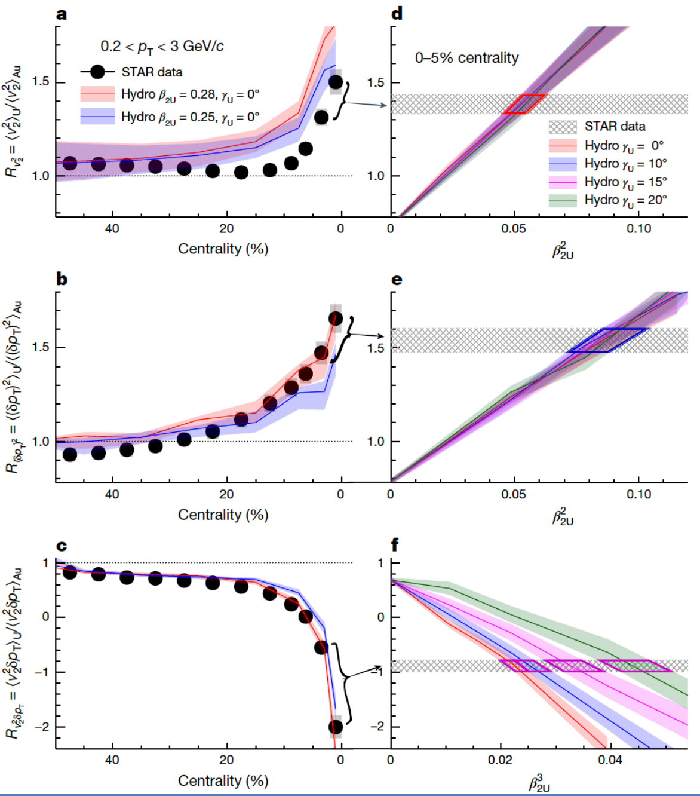
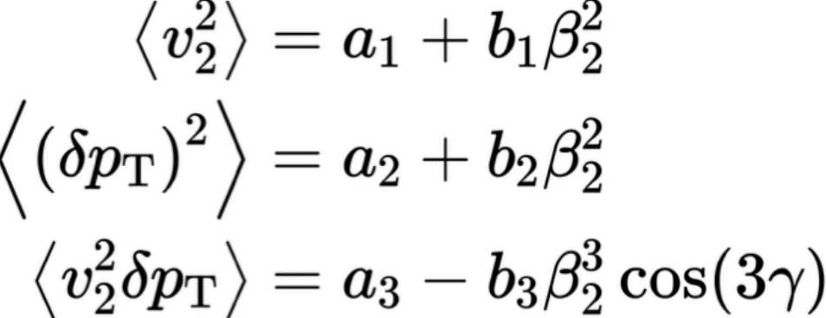
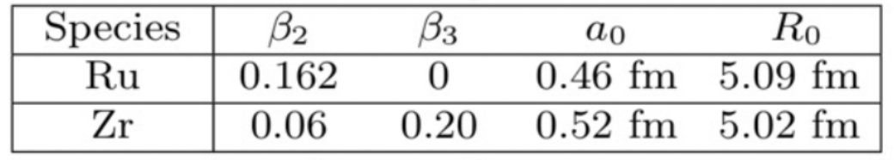
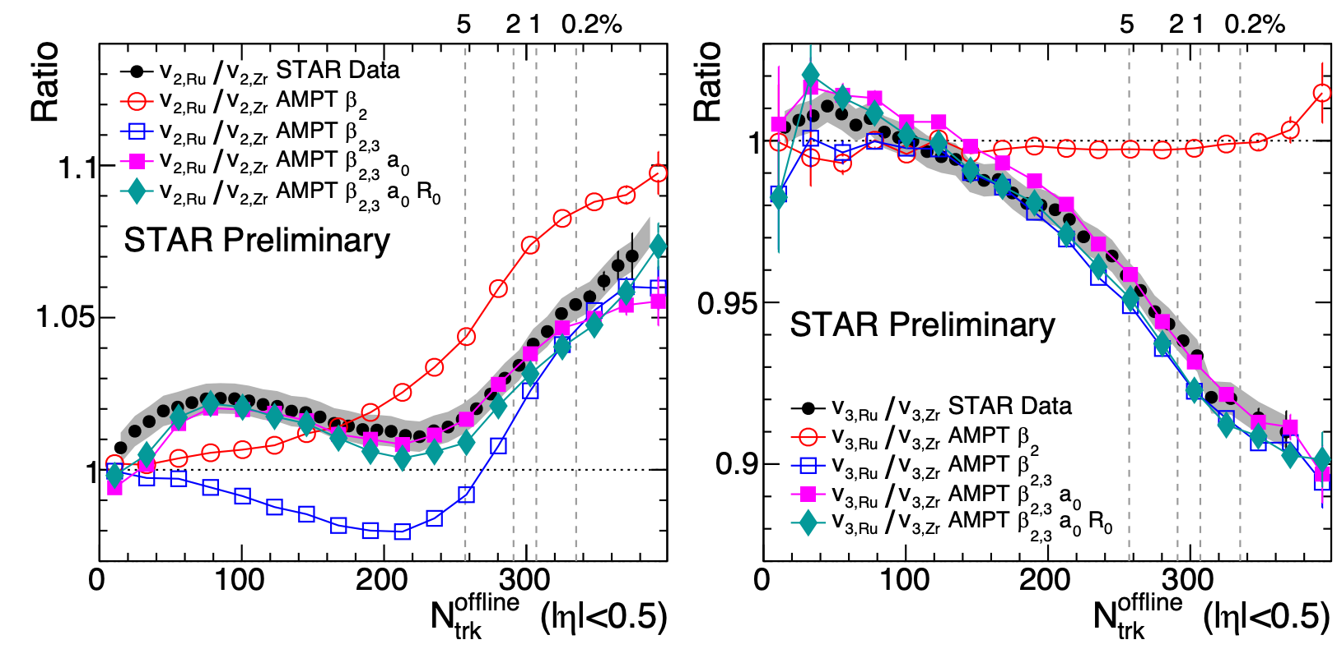
Deformation
²³⁸U+²³⁸U/¹⁹⁷Au+¹⁹⁷Au:
¹²⁹Xe+¹²⁹Xe/²⁰⁸Pb+²⁰⁸Pb:
Nature, 635, 67–72 (2024)
Phys.Rev.Lett. 133 (2024) 192301
⁹⁶Ru+⁹⁶Ru/⁹⁶Zr+⁹⁶Zr:
PRL128, 022301(2022);
3
Match 9, 2026

Slide 5
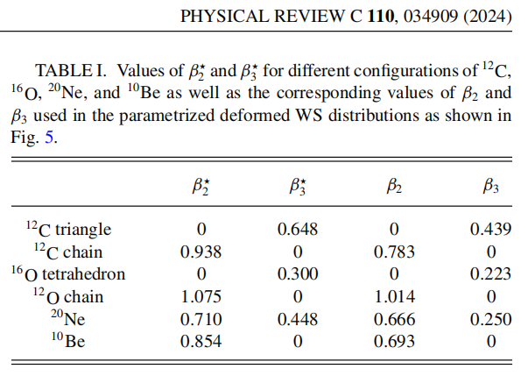
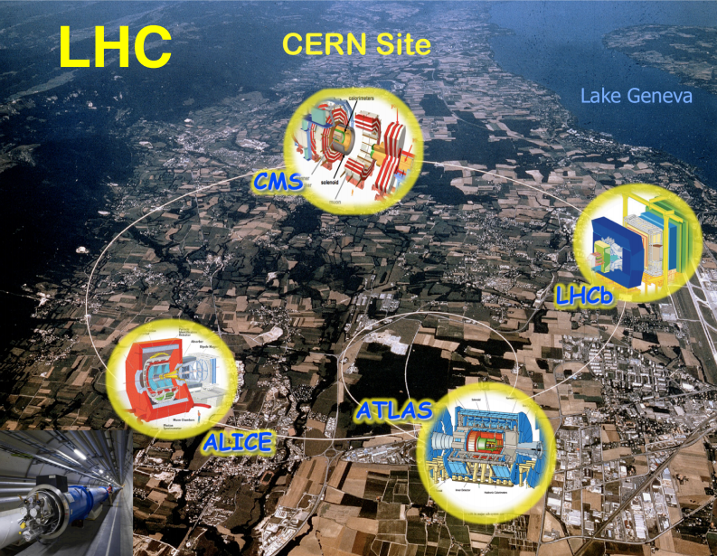
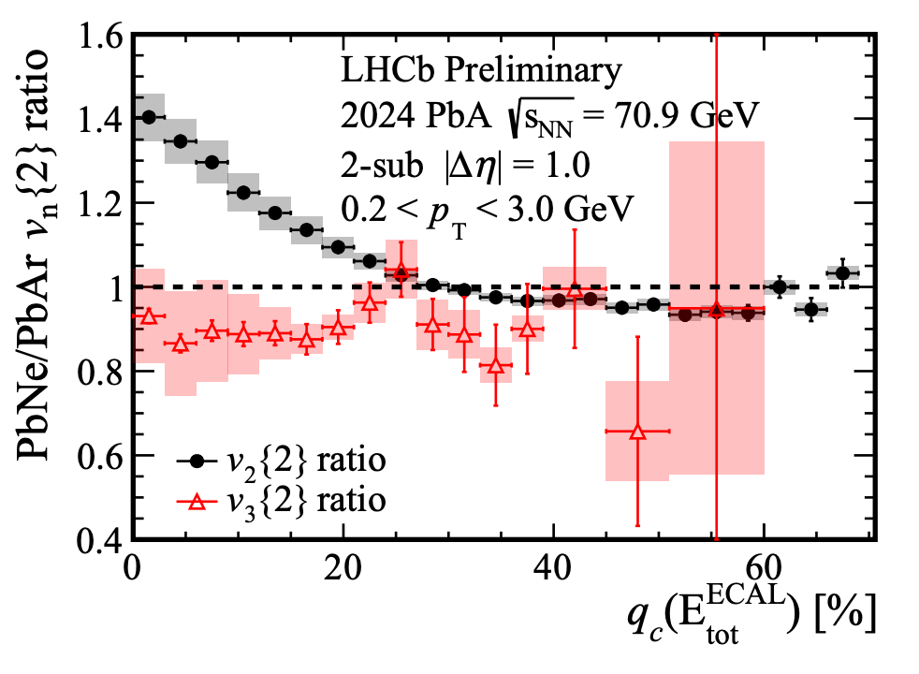
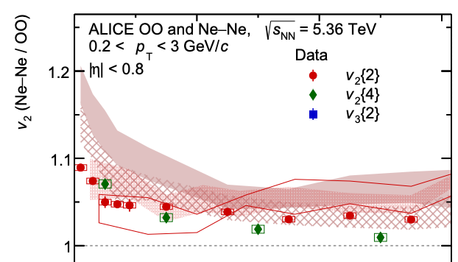
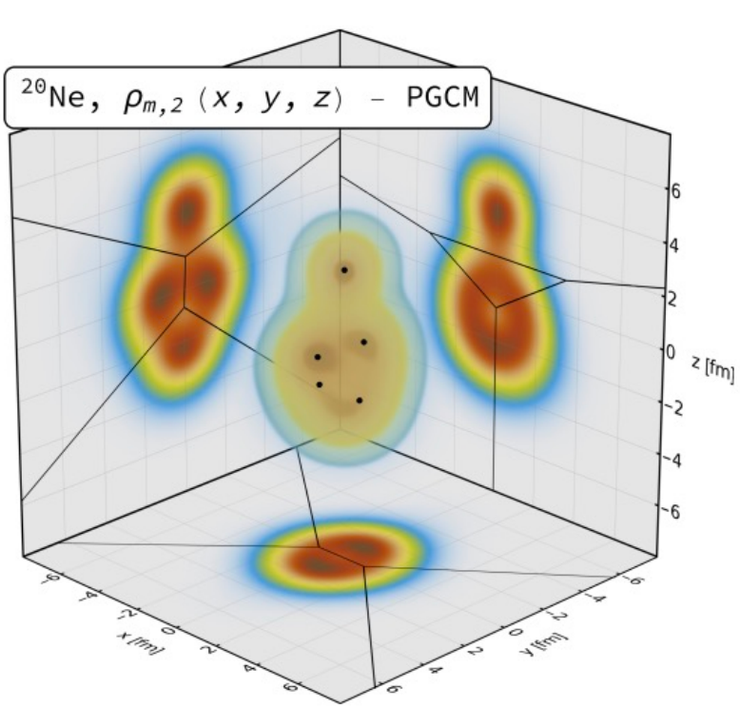

Light-ion collisions
²⁰Ne large deformation
or significant cluster structure
2509.06428, 2509.05171, 2510.02580
LHCb： Pb+Ne/Pb+Ar
arXiv: 2509.12399
ALICE/ATLAS/CMS： Ne+Ne/O+O
40%
10%
Phys.Rev.Lett. 135 (2025) 1, 012302
Evidence for Bowling-Pin structure of the Ne nucleus.
Just the general shape！More details ?
4
Match 9, 2026

Slide 6
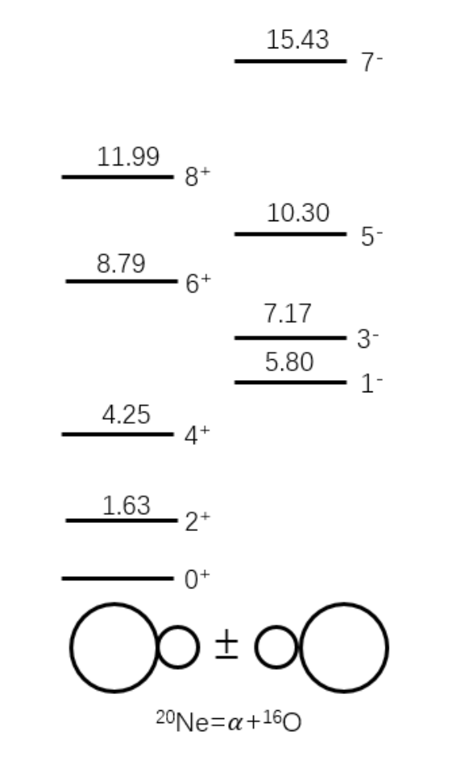
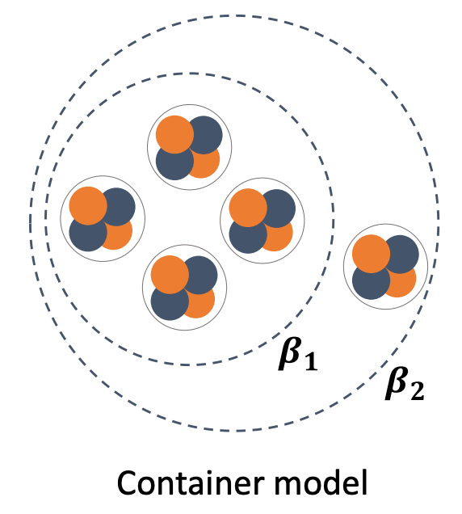
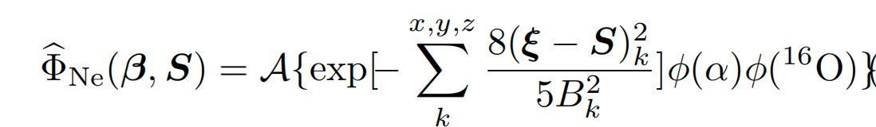

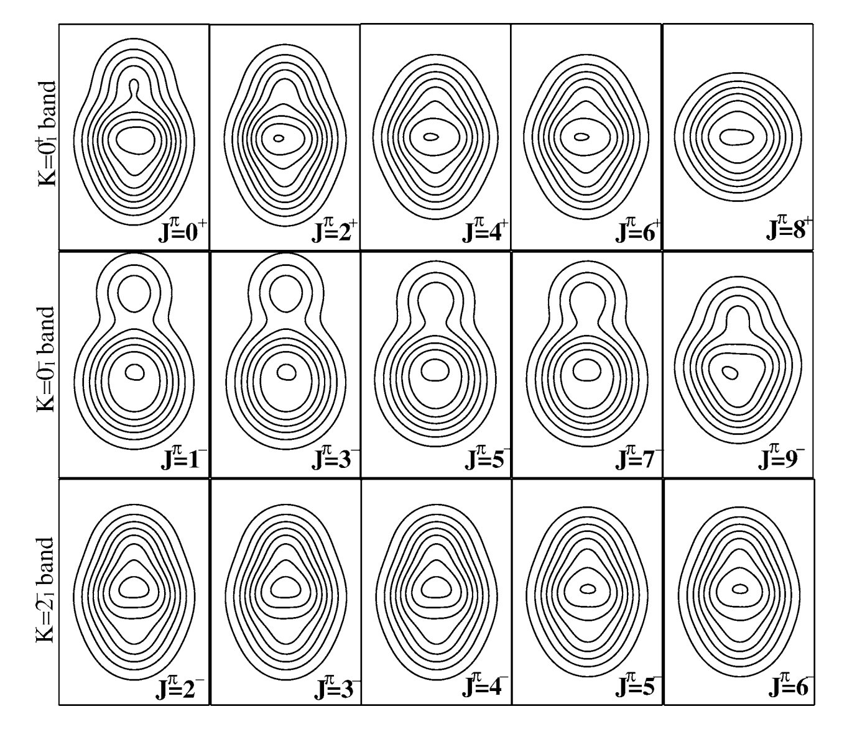
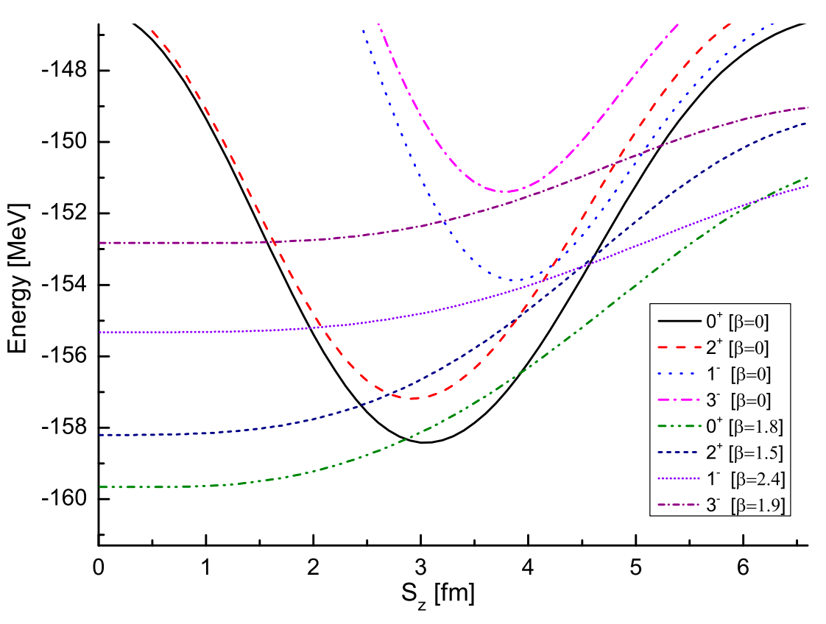
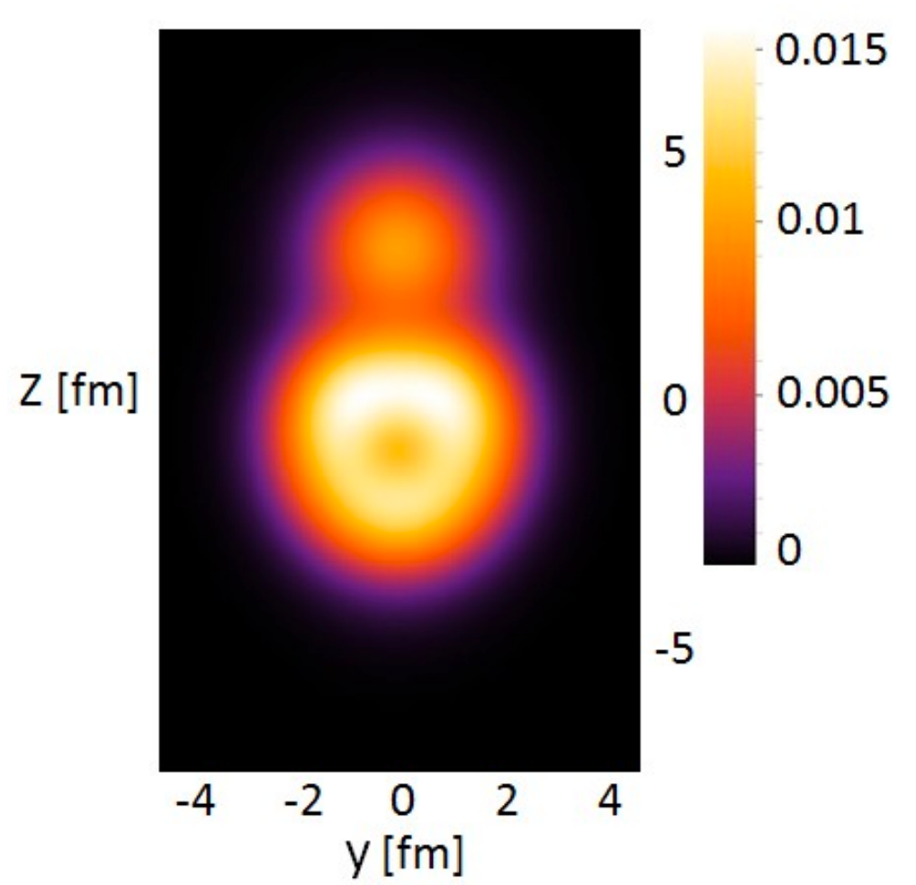
Clusters in ²⁰Ne
²⁰Ne large deformation
or significant cluster structure
Nonlocalized THSR model
Front.Phys. 15 (2020) 14401
Prog. Theor. Phys. 40, 277 (1968)
Antisymmetrized Molecular Dynamics Model (AMD)
Nature Commun. 14 (2023) 1, 8206
Cluster
J↑
Shell
Pauli repulsion
²⁰Ne with localized cluster with a+¹⁶O
Or with nonlocalized cluster with 5-alpha
5
Match 9, 2026

Slide 7
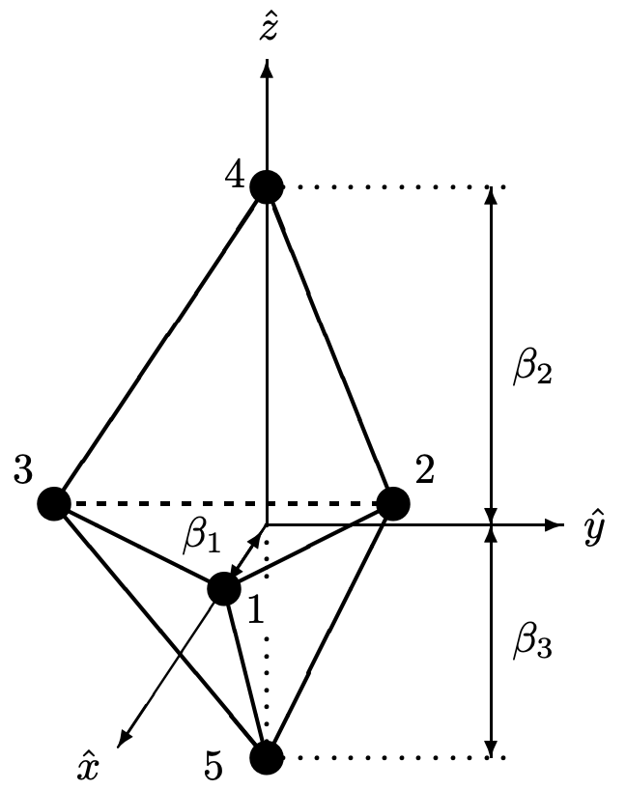
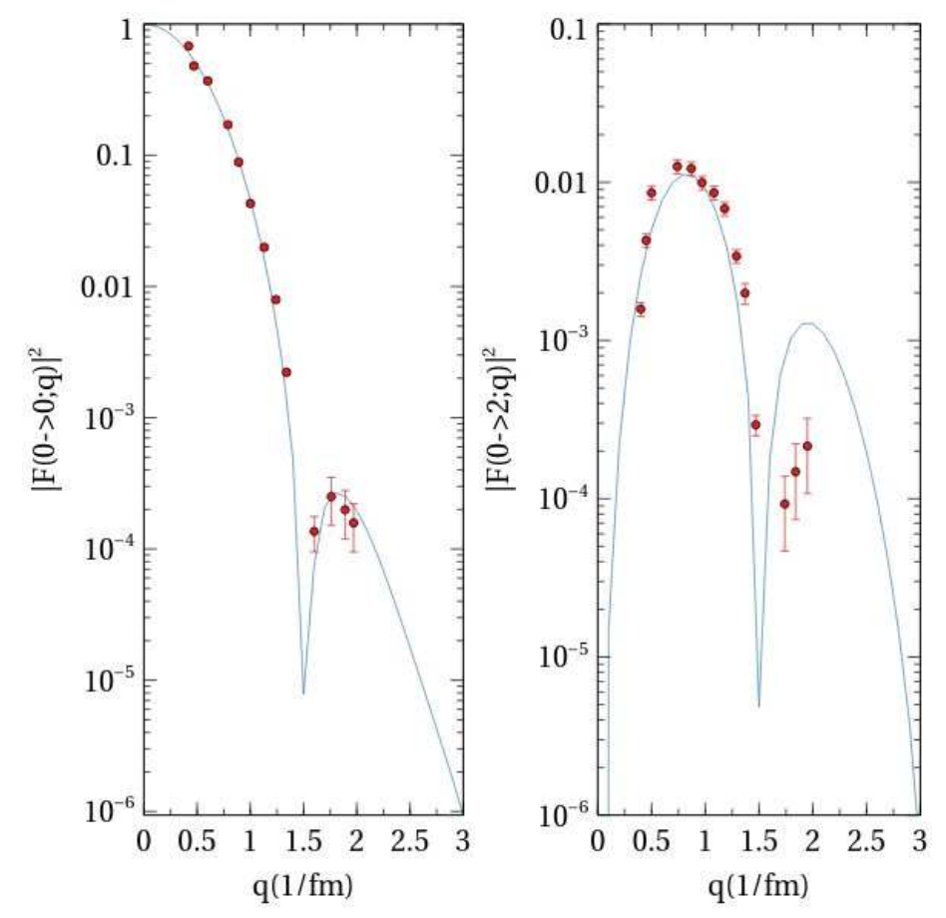
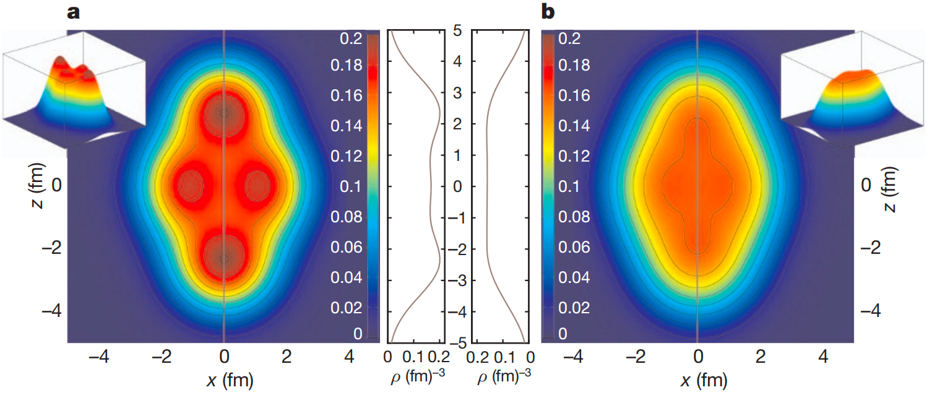
Clusters in ²⁰Ne
²⁰Ne large deformation
or significant cluster structure
Nucl.Phys.A 1006 (2021) 122077
Algebraic Collective Model (ACM)
Energy-density functionals
Nature 487 (2012) 341-344
J↑
relativistic functional DD-ME2
non-relativistic Skyrme SLy4
Cluster
Evidence of ²⁰Ne with D_{3h} symmtery
6
Match 9, 2026

Slide 8
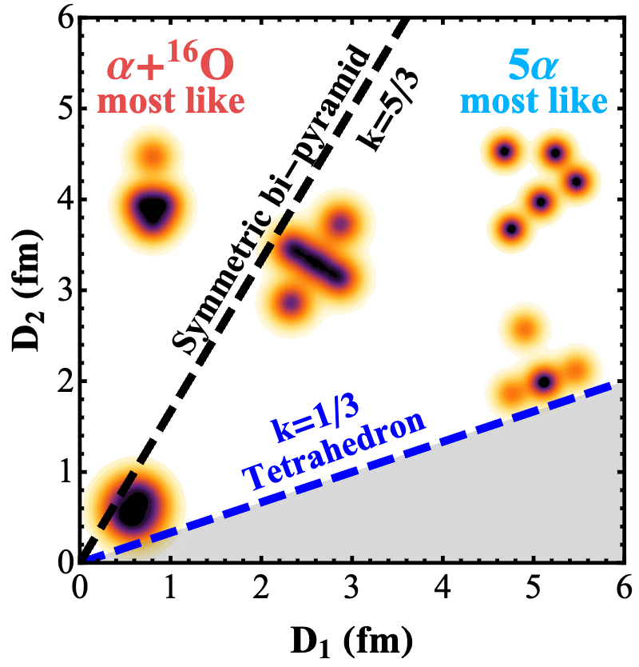
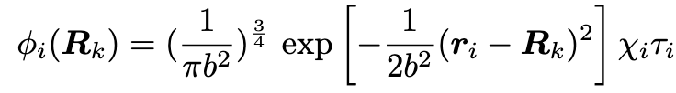

Clusters in ²⁰Ne
Nucl. Phys. A 1006, 122077 (2021)
Front.Phys. 15 (2020) 14401
Two parameters: D₁ and D₂
Loose and nonlocalized-like
(D₂>D₁/3)
Clusters with
D_{3h} symmtry
frozen $α$ + core (tetrahedron)
Prog. Theor. Phys. 40, 277 (1968)
AMD model
(localized
two-cluster)
D₁->0
D₁->0
D₁->0
D₂->0
Shell model
(Spherical)
❌
Pauli repulsion
How to estimate the systematic error of the theoretical model？
all parameters : D₁ D₂(local structural parameters) and b (harmonic oscillator size parameter)
7
Match 9, 2026

Slide 9
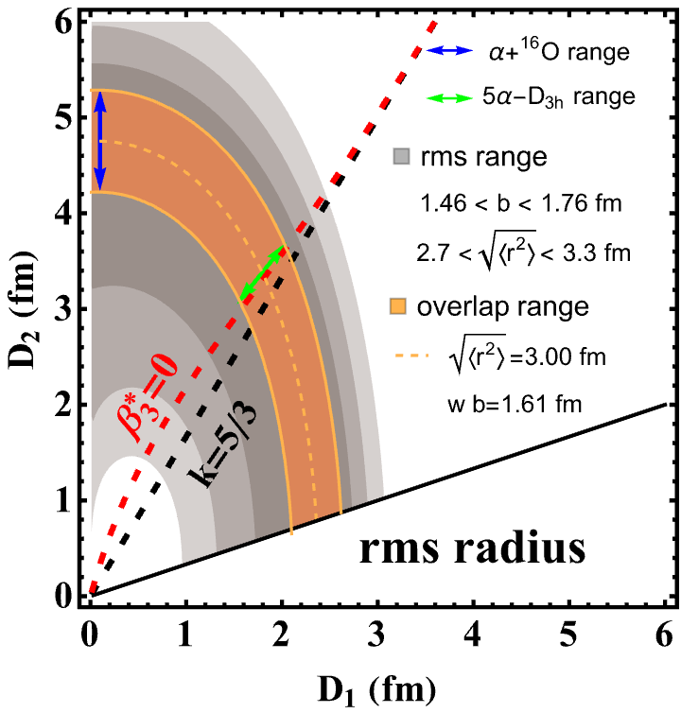

Clusters in ²⁰Ne
Nucl. Phys. A 1006, 122077 (2021)
Front.Phys. 15 (2020) 14401
Two parameters: D₁ and D₂
Loose and nonlocalized-like
(D₂>D₁/3)
Clusters with
D_{3h} symmtry
frozen $α$ + core (tetrahedron)
Prog. Theor. Phys. 40, 277 (1968)
AMD model
(localized
two-cluster)
rms radius
(3.0$±$10%)fm
b$∈$(1.46, 1.76)fm
D₁ D₂ range
Shell model
(Spherical)
How to estimate the systematic error of the theoretical model？
all parameters : D₁ D₂(local structural parameters) and b (harmonic oscillator size parameter)
8
Match 9, 2026

Slide 10


Clusters in ²⁰Ne
Two parameters: D₁ and D₂
How to consider shape mixing ?
(D₂>D₁/3)
frozen $α$ + core (tetrahedron)
All parameters fluctuate
b
b
D₂
D₂
rms radius
(3.0$±$10%)fm
b$∈$(1.46, 1.76)fm
D₁
two-clusters
5a-clusters
D₁ D₂ range
They are different
P
T
How to estimate the systematic error of the theoretical model？
all parameters : D₁ D₂(local structural parameters) and b (harmonic oscillator size parameter)
9
Match 9, 2026

Slide 11

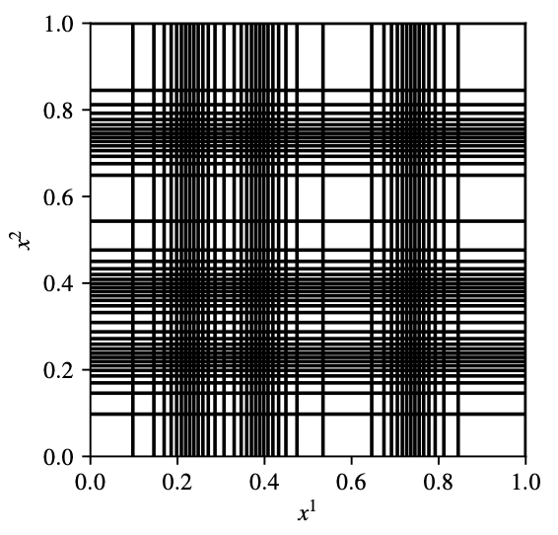
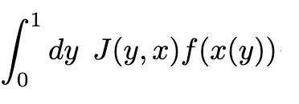
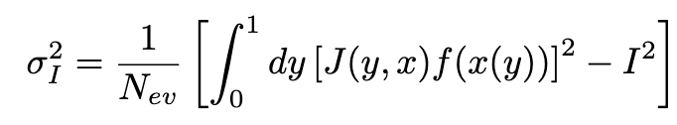
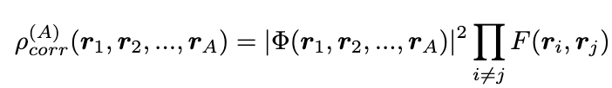
Adaptive monte carlo sampling
A novel Monte Carlo method inspired by VEGAS
--Adaptive Monte Carlo sample
transformation
Density with
high-dimensional
(48d for ¹⁶O, 624d for ²⁰⁸Pb)
strongly coupled A-body
complex structure
iteration
adjust
grid
with Integral error：
sampling with wave function
(cluster model/Shell model):
Sample from simple functions g(y)
compared with MCMC
Inverse transformation
Quantifiable！
Accurate！
Samples of complex distribution f(x)
High efficiency！
arXiv: 2511.23293
10
Match 9, 2026

Slide 12
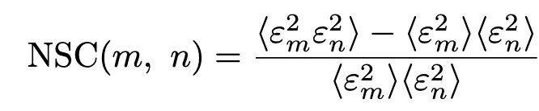
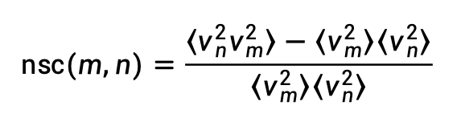
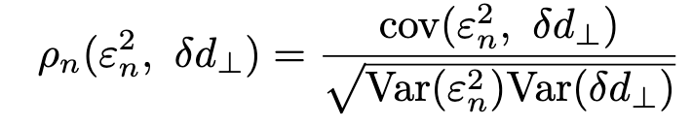
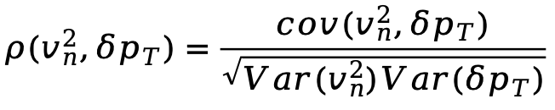
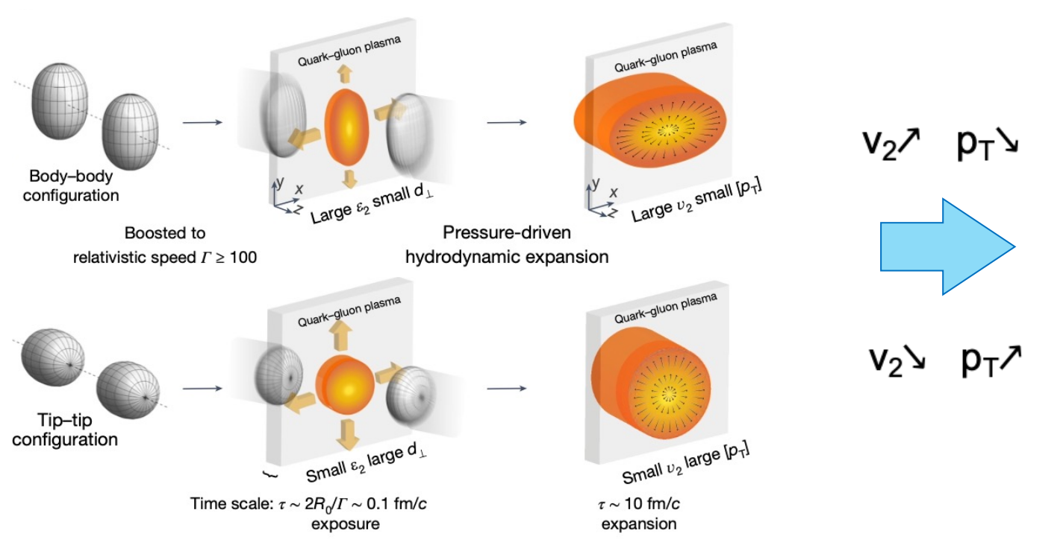
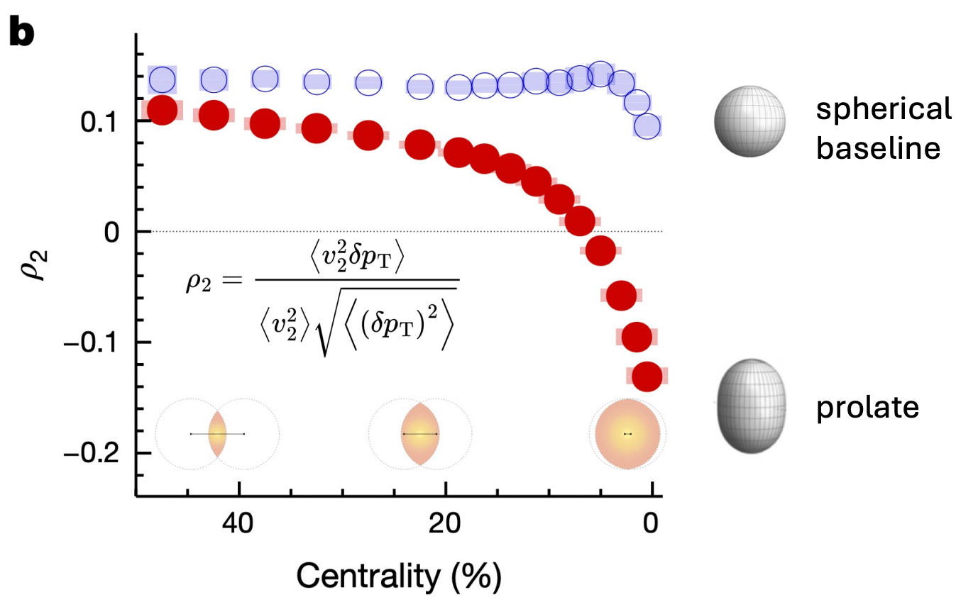



Correlation observables
How to explore more detailed structural effects：
Correlation between different $ε_{n}$
Correlation between different $v_{n}$
Correlation between $ε_{n}$ (shape) and $δd_{⊥}$ (size)
Correlation between $v_{n}$ and $δp_{T}$
different sign !
11
Match 9, 2026

Slide 13
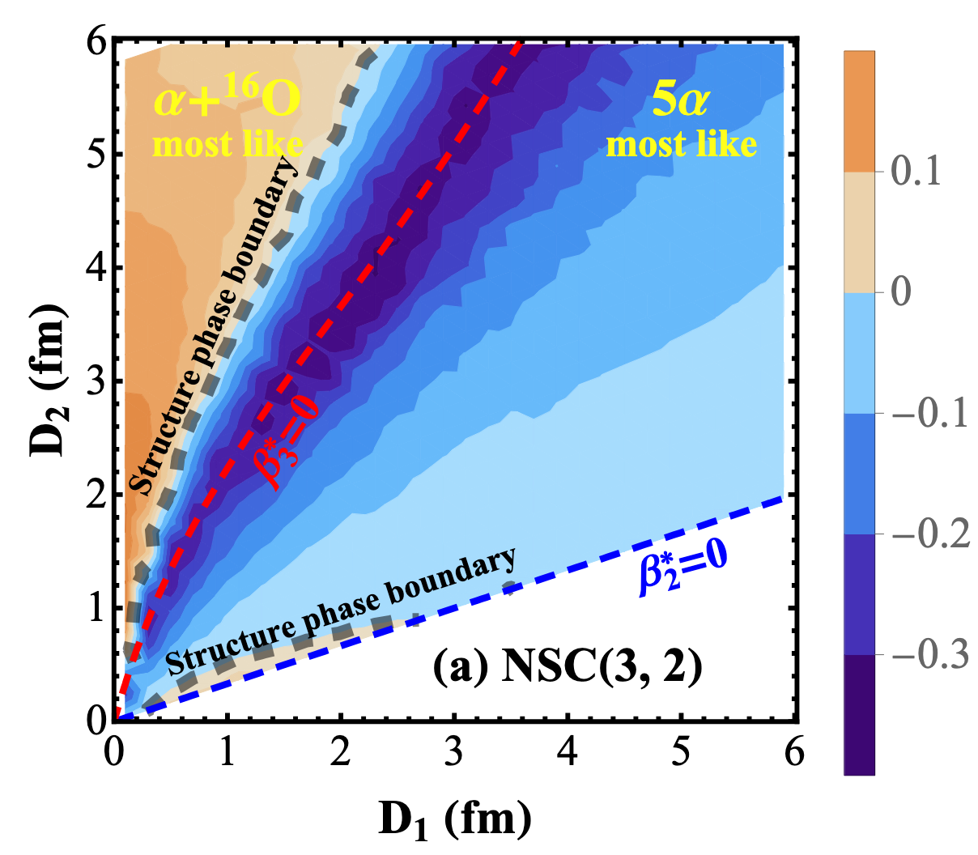
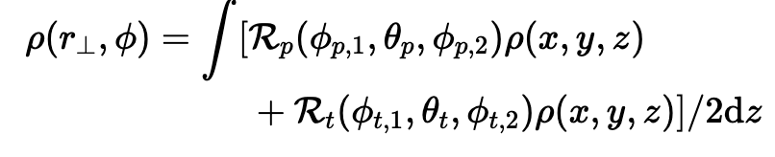
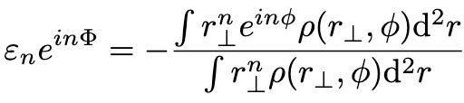
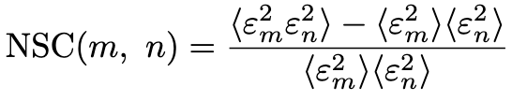
Symmetric cumulant NSC(n, m)
Analytical results w/o fluctuation
only geometry effect!
The shape of ²⁰Ne can be determined by the positive or negative NSC(2, 3) value.
Correlation strength NSC(2, 3) $∝$k = D₂/D_{1.}
12
Match 9, 2026

Slide 14
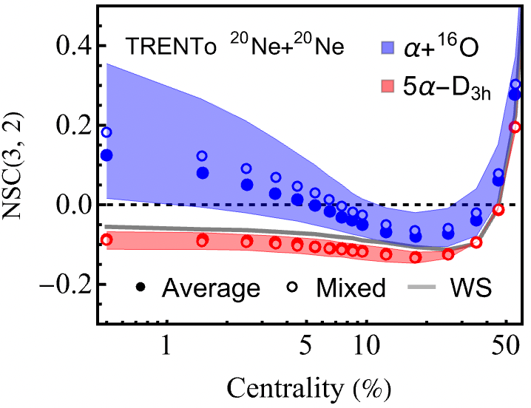

Symmetric cumulant NSC(n, m)
TRENTo results w initial fluctuation
Hydro results w all fluctuations
hydro
evolution
The shape of ²⁰Ne can be determined by the positive or negative NSC(2, 3) value.
Shape mixing does not affect the sign of NSC(2, 3).
The fluctuations of initial and final state do not affect the sign of NSC(2, 3).
13
Match 9, 2026

Slide 15



Pearson correlation $v_{n}−p_{T}$
Analytical results w/o fluctuation
only geometry effect!
$$ρ_{2}<0$$
The shape of ²⁰Ne can be determined by the positive or negative $ρ_{3}$value
Correlation strength $ρ(ε_{3}^{2},{δd}_{⊥})$ $∝$k = D₂/D₁
14
Match 9, 2026

Slide 16





Pearson correlation $v_{n}−p_{T}$
TRENTo with initial fluctuation
Hydro with all fluctuations
$ρ_{2}$ change
$$ρ_{2}<0$$
hydro
evolution
$ρ_{3}$ change
The sign of $ρ_{2}$ changes due to the initial position fluctuations.
The sign of $ρ_{3}$ changes due to the final hydro fluctuations.
Fortunately, the shape of ²⁰Ne can be determined by the positive or negative $ρ_{2}$value.
15
Match 9, 2026

Slide 17






Ne+Ne vs. Ne+Pb
Ne+Ne
vs.
Ne+Pb
0-5%
0-20%
The correlation strength of Ne+Pb increases compared to Ne+Ne.
The distinguishable range of centrality of Ne+Pb increases compared to Ne+Ne.
(0-20%)
(0-5%)
Ne+Pb study in pipeline.
16
Match 9, 2026

Slide 18


Summary
PRL 136, 082302 (2026)
1. The Analytical method we developed can isolate the initial-state fluctuations,
thus clarifying pure clsuter geometry effect.
2. NSC(2,3) and $ρ_{2}$(v₂², [p_{T}]) are very good observables to probe
the cluster structure of ²⁰Ne and distinguish a+¹⁶O and 5a
directly with positive and negative value.
3. The fixed-target experiment Ne+Pb has better theoretical
superiority than the collider experiment Ne+Ne.
——an opportunity to cross-validate the theory
We look forward to working together and the answer of the experiment!
Thanks for attention!
11
October 26, 2025, QPT 2025, Guilin, China

Slide 19











Backup
by FUNAKI, Yasuro (船木 靖郎)
3-dim. H.O. w.f. in xyz coordinate
$N=2\left(n−1\right)+l=n_{x}+n_{y}+$ $n_{z}$
$$φ_{\left(n_{x},n_{y},n_{z}\right)}\left(r\right)=φ_{n_{x}}\left(x\right)φ_{n_{y}}\left(y\right)φ_{n_{z}}\left(z\right)$$
$$φ_{0}\left(z\right)={\left(\frac{2ν}{π}\right)}^{3/4}e^{−νz^{2}}$$
By taking R in a z-direction,
$${\left(000\right)}^{′}=φ_{\left(000\right)}\left(r−\frac{1}{2}R\right)=φ_{0}\left(x\right)φ_{0}\left(y\right)φ_{0}\left(z−\frac{R}{2}\right)$$
$$φ_{1}\left(z\right)=2\sqrt{ν}zφ_{0}\left(z\right)$$
$$φ_{2}\left(z\right)=\frac{1}{\sqrt{2}}\left(1−4νz^{2}\right)φ_{0}\left(z\right)$$
$$\left(000\right)=φ_{\left(000\right)}\left(r+\frac{1}{2}R\right)=φ_{0}\left(x\right)φ_{0}\left(y\right)φ_{0}\left(z+\frac{R}{2}\right)$$
Expansion of (000)’ with the completeness relation,
$$\sum_{n_{x},n_{y},n_{z}}{|\left.\left(n_{x}n_{y}n_{z}\right)\right\rangle \left\langle \left(n_{x}n_{y}n_{z}\right)\right.|}=1$$
$$\left\langle \left(000\right) | {\left(000\right)}^{′}\right\rangle =\int{φ_{0}\left(z+R/2\right)φ_{0}\left(z−R/2\right)dz}=e^{−\frac{ν}{2}R^{2}}$$
$$\left\langle \left(001\right) | {\left(000\right)}^{′}\right\rangle =\int{φ_{1}\left(z+R/2\right)φ_{0}\left(z−R/2\right)dz}=\sqrt{ν}Re^{−\frac{ν}{2}R^{2}}$$
$${\left(000\right)}^{′}=\sum_{n_{x},n_{y},n_{z}}{\left(n_{x}n_{y}n_{z}\right)\left\langle \left(n_{x}n_{y}n_{z}\right) | {\left(000\right)}^{′}\right\rangle }$$
$$\left\langle \left(001\right) | {\left(000\right)}^{′}\right\rangle =\int{φ_{1}\left(z+R/2\right)φ_{0}\left(z−R/2\right)dz}=−\frac{ν}{\sqrt{2}}R^{2}e^{−\frac{ν}{2}R^{2}}$$
$$=\sum_{ n_{z}}{\left(00n_{z}\right)\left\langle \left(00n_{z}\right) | {\left(000\right)}^{′}\right\rangle }=e^{−\frac{ν}{2}R^{2}}\left\{\left(000\right)+\sqrt{ν}R\left(001\right)−\frac{ν}{\sqrt{2}}R^{2}\left(002\right)+⋯\right\}$$

Slide 20


Backup
²⁰Ne (α-¹⁶O): Brink w.f.
$$Ψ\left(α−{}_{}^{16}{\text{O}\text{, }}R\right)=n_{0}𝒜\left[ψ\left(α,\frac{4}{5}R\right)ψ\left({}_{}^{16}O,−\frac{1}{5}R\right)\right] \\ =\frac{n_{0}}{\sqrt{4!16!}}\text{det}\left[φ_{\left(\text{000}\right)}\left(r_{1}−\frac{4}{5}R\right)n_{p↑}\left(1\right)⋯φ_{\left(\text{000}\right)}\left(r_{4}−\frac{4}{5}R\right)n_{n↓}\left(4\right)φ_{\left(\text{000}\right)}\left(r_{5}+\frac{1}{5}R\right)n_{p↑}\left(5\right)⋯φ_{\left(\text{001}\right)}\left(r_{20}+\frac{1}{5}R\right)n_{n↓}\left(20\right)\right] \\ =\frac{n_{0}}{\sqrt{4!16!}}\text{det}\left[{{\left(\text{000}\right)}^{′}}^{4}{\left(\text{000}\right)}^{4}{\left(\text{100}\right)}^{4}{\left(\text{010}\right)}^{4}{\left(\text{001}\right)}^{4}\right]$$
By taking R in a z-direction,
$${\left(000\right)}^{′}=φ_{\left(000\right)}\left(r−\frac{4}{5}R\hat{z}\right)=\sum_{n_{z}}{\left(00n_{z}\right)\left\langle \left(00n_{z}\right) | {\left(000\right)}^{′}\right\rangle }=e^{−\frac{ν}{2}R^{2}}\left\{\left(000\right)+\sqrt{ν}R\left(001\right)−\frac{ν}{\sqrt{2}}R^{2}\left(002\right)+⋯\right\}$$
When R → 0
$$Ψ\left(α−16O,R\right)∝\text{det}\left[{\left(\text{000}\right)}^{4}{\left(\text{100}\right)}^{4}{\left(\text{010}\right)}^{4}{\left(\text{001}\right)}^{4}{\left(\text{002}\right)}^{4}\right]$$

Slide 21


Backup
v_{n}{2} compared to ALICE data

Slide 22










Adaptive monte carlo sampling
Step 1
A novel Monte Carlo method inspired by VEGAS
Step 2
Adaptive Monte Carlo sample
Density with
high-dimensional
(48d for ¹⁶O, 624d for ²⁰⁸Pb)
strongly coupled
A-body coupled
complex correlated
Spherical
²⁰Ne
with wave function (cluster model/Shell model):
cluster
with single nucleon density (WS):
Density for any shape and any size with any correlations
arXiv: 2511.23293
October 26, 2025, QPT 2025, Guilin, China

