Slide 1
Aarhus University
We create value through knowledge, new insight and collaboration
Notes:
HUSK AT ”AKTIVERE INDHOLD” I DIALOGBOKSEN DER KOMMER NÅR PRÆSENTATIONEN STARTER (GUL BJÆLKE)

Slide 2

Facts about
Aarhus University

Slide 3

Rooted in a broad palette
of strong disciplines
5
faculties
37,000
students
12,300
employees
1,900
PhD students
Notes:
[Photo: The arches at Solgården (‘The Sun Courtyard’)]
Aarhus University is a strong university that is internationally recognised for the high quality of its research, research-based degree programmes and public sector government consultancy, in addition to value-creating collaboration with private businesses, public sector institutions and civil society.
Aarhus University’s academic portfolio is broad-ranging, from the classic university disciplines of the humanities, natural sciences, social sciences, health sciences and theology to business and engineering, educational theory and practice and the environmental and agricultural sciences. This breadth gives the university a unique opportunity to combine strong disciplines in the creation of research breakthroughs, and to establish close collaboration with many sectors to the benefit of society as a whole.

Slide 4
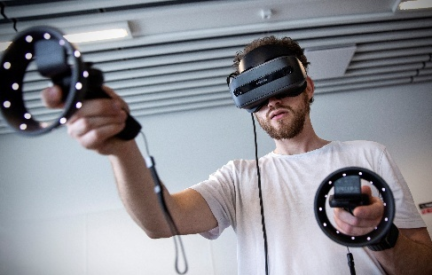
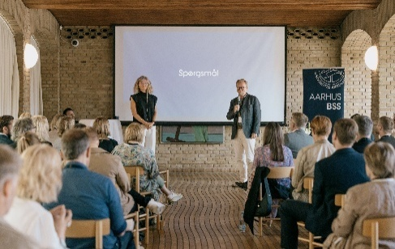

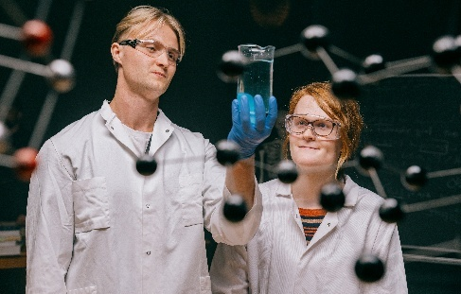
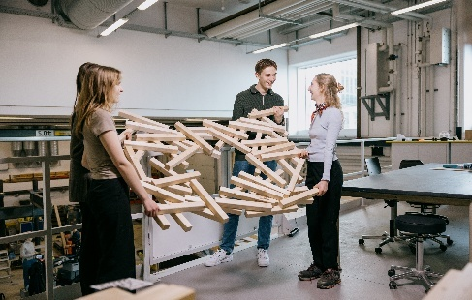
Research-intensive
and a full breadth of disciplines
Faculty of Arts
Aarhus BSS
Health
Faculty of Natural Sciences
Faculty of Technical Sciences
Humanities, theology, educational theory and
education
15%
Business and social sciences
16%
Health sciences
28%
Natural sciences
16%
Agricultural and environmental
sciences and engineering
25%
Notes:
The table shows the percentage of staff employed at each of the five faculties.
Arts: 15%
BSS: 16%
HE: 28%
NAT: 16%
TECH: 25%
Sum = 100%
Source: https://galleri.au.dk/ (Nat: JHS_23063_13-11-2024-Enhanced-NR copy; Tech: JHS_26658_09-01-2025 copy; Arts: VR_lab_LK_861

Slide 5
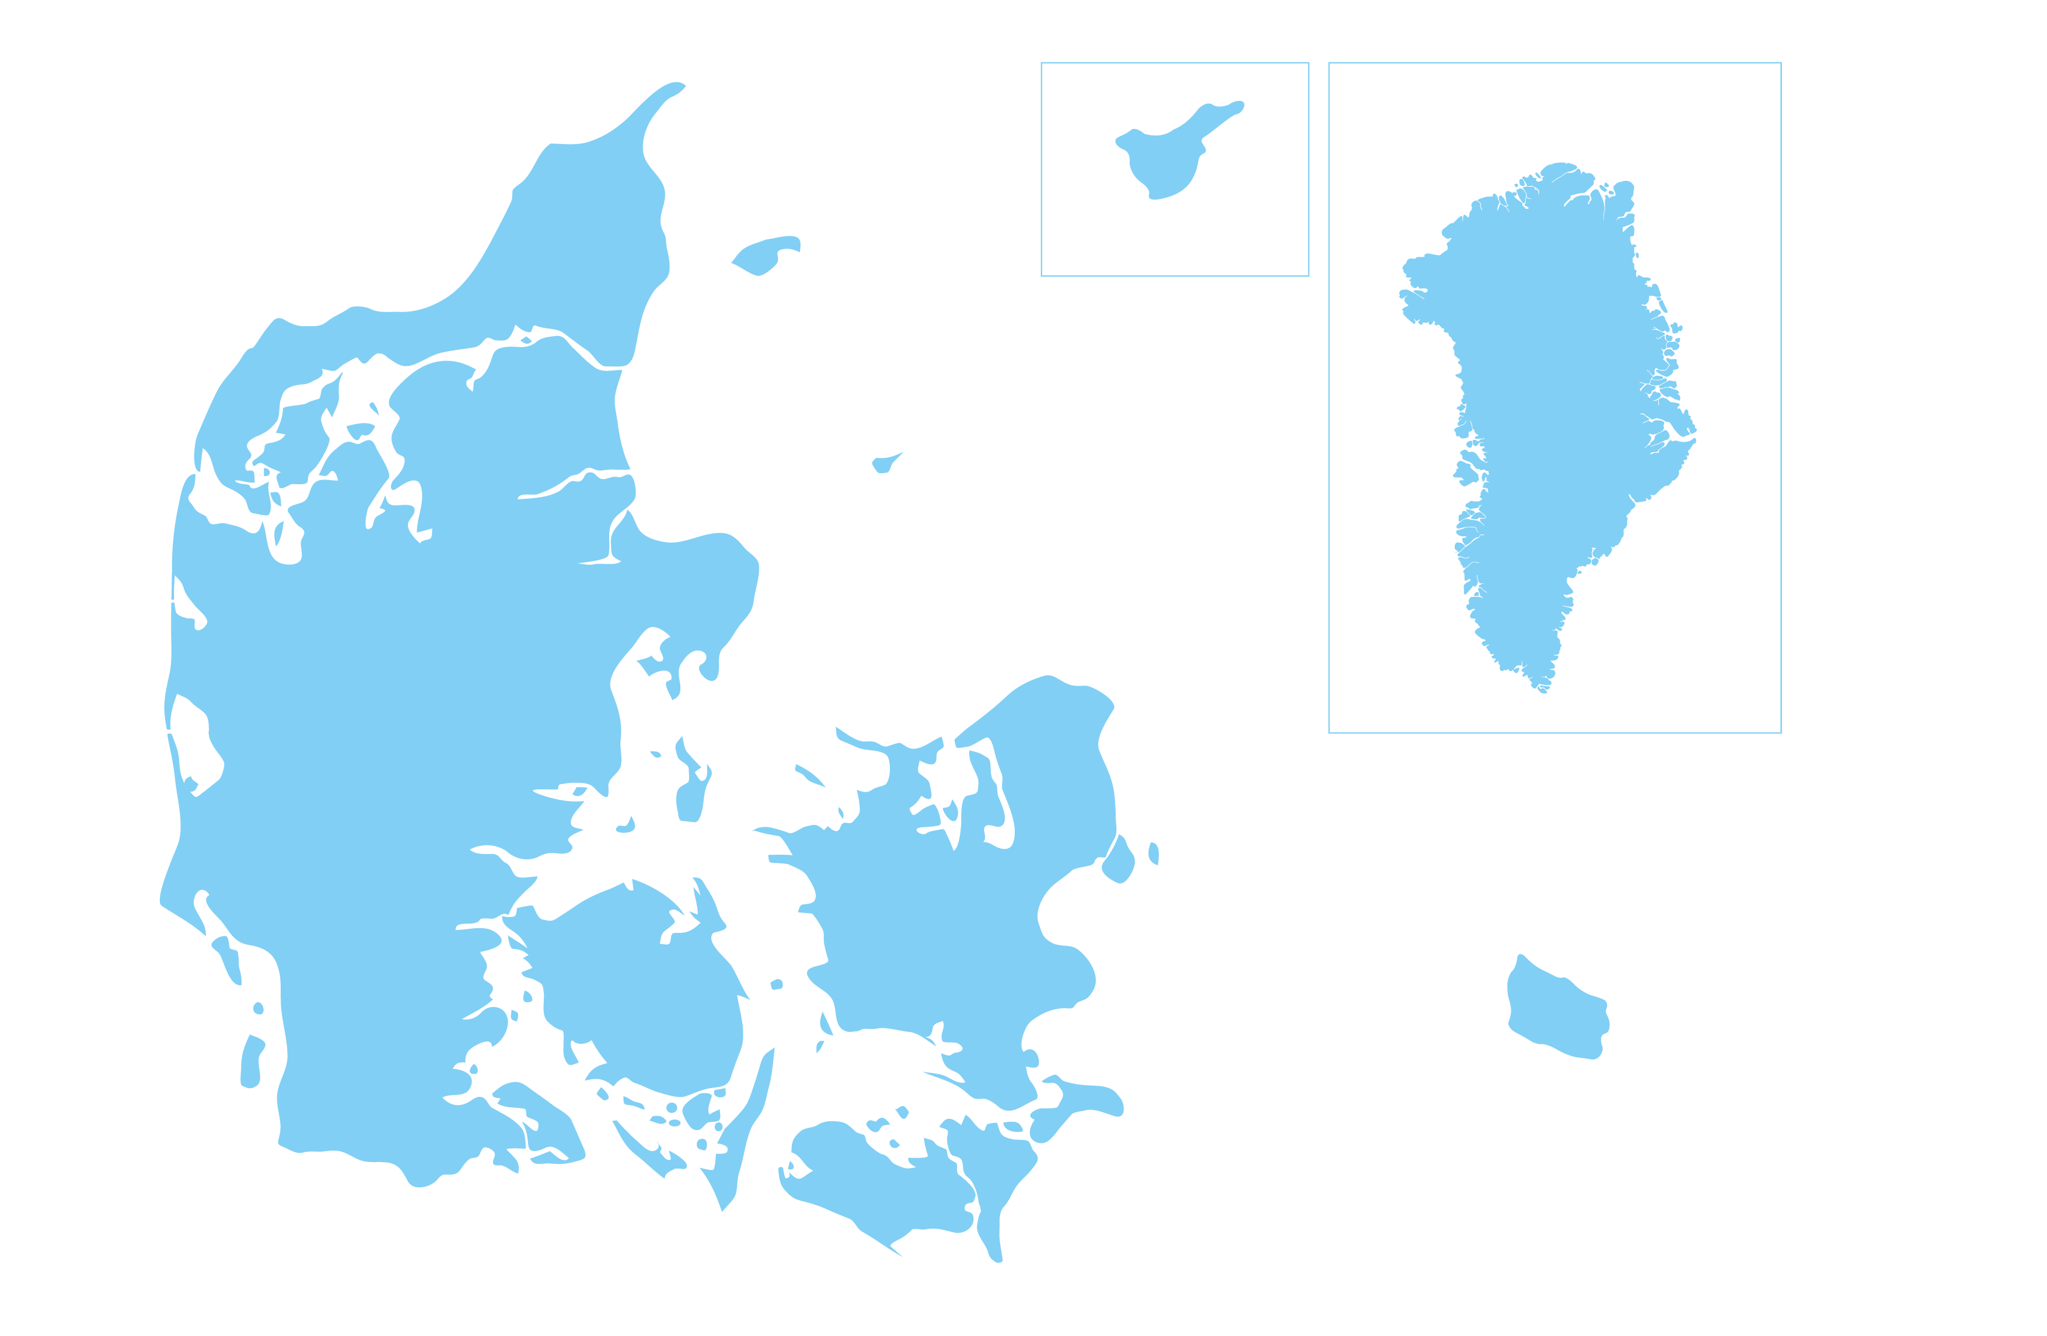
A national university
VILLUM
TENERIFE
ZACKENBERG
GREENLAND
VIBORG
AUNING
NUUK
HERNING
AARHUS
RISØ
EMDRUP
ASKOV
RESEARCH AND EDUCATION
FLAKKEBJERG
RESEARCH ACTIVITIES AND OTHERS
Notes:
From its early days as a local university, Aarhus University has developed into a globally recognised university, with international standing and impact, to the benefit of both the individual and Danish society.
The map shows where AU has research and/or educational activities:
Aarhus
Emdrup
Viborg (Foulum)
Flakkebjerg, Sydsjælland
Askov, Sønderjylland
Risø, v. Roskilde
Herning
Auning, Norddjursland
Grønland (Nord: Villum Research Station, Midt: Zackenberg Research Station, Syd: Nuuk / AU Arctic Research Centre)
Tenerife
[The map is updated in May 2023]

Slide 6
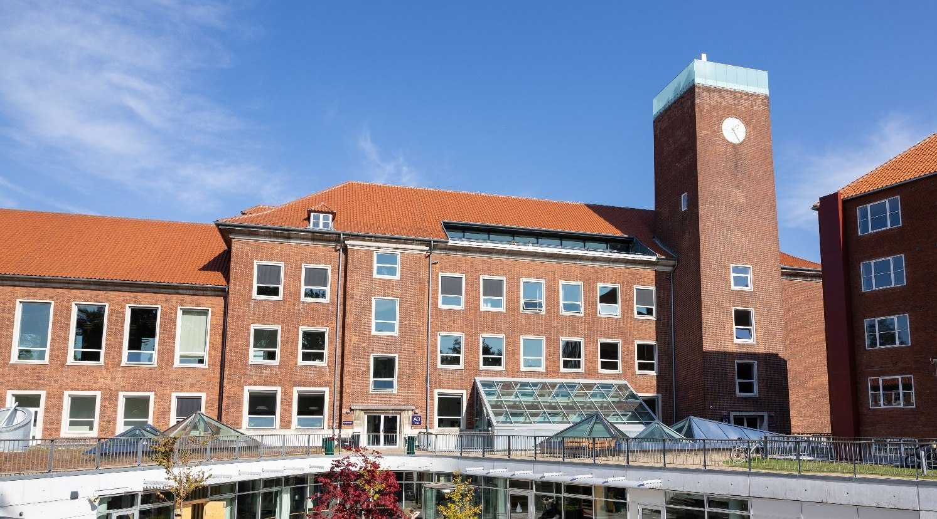
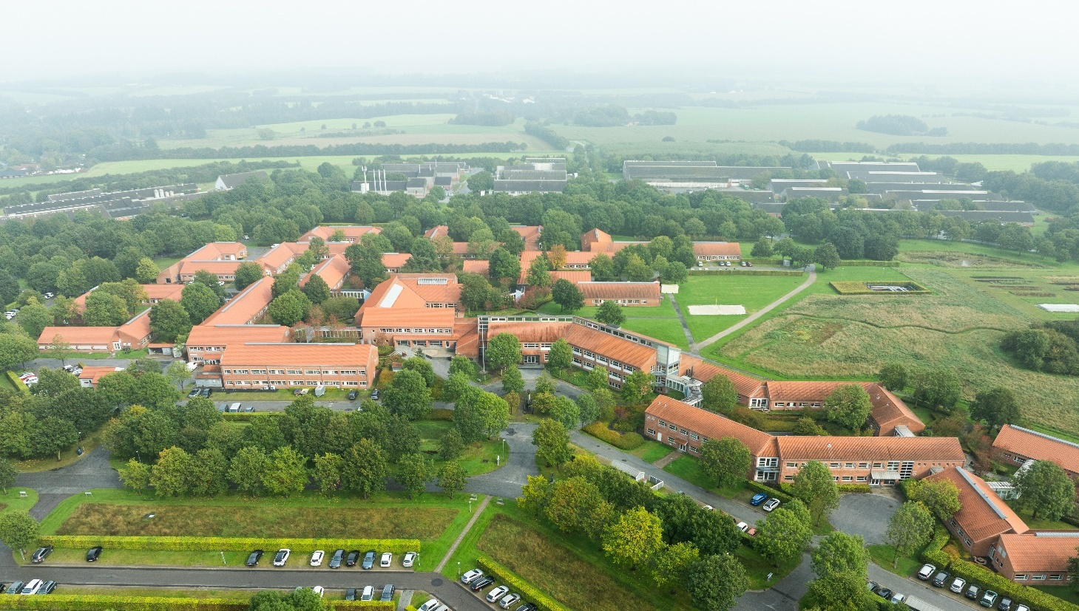
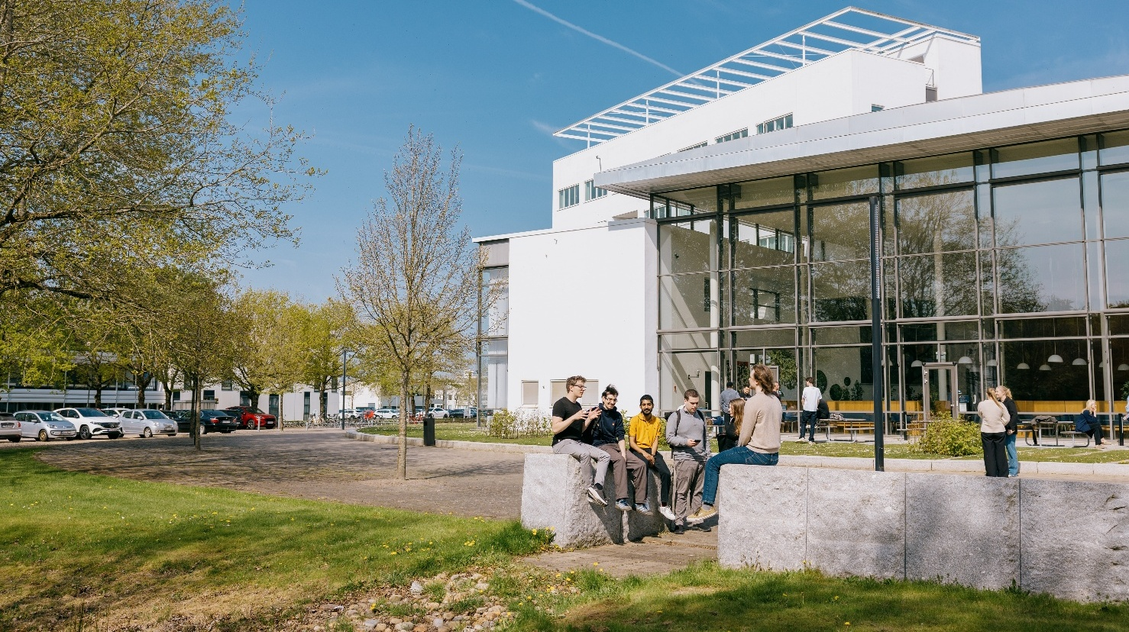
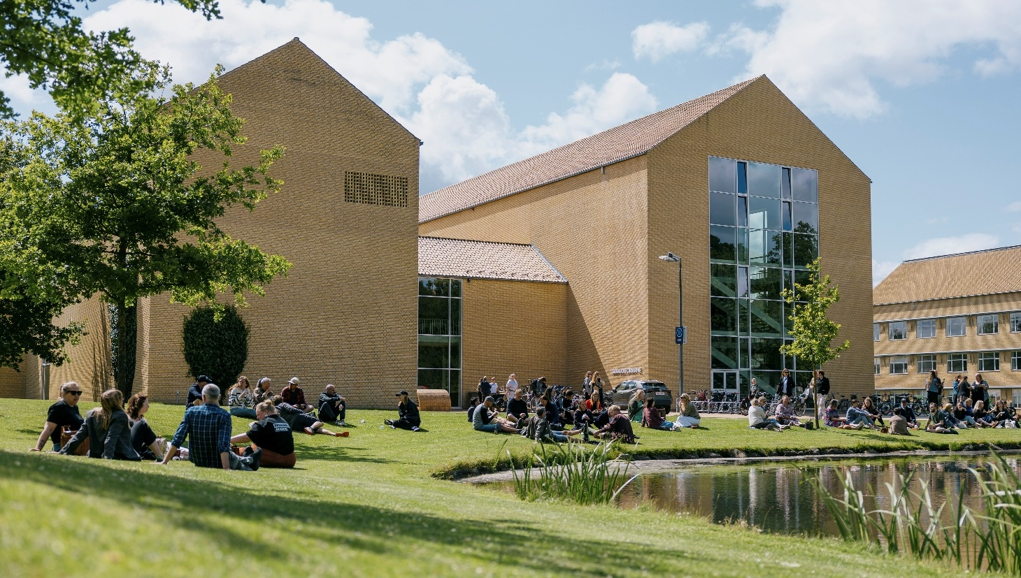
One university –
four campuses
Emdrup
Viborg
Herning
Aarhus
Notes:
[The pictures show Campus Emdrup, AU Viborg (Foulum), AU Herning og campus Aarhus (the back of the Lakeside Lecture Theatres)]
Source: https://galleri.au.dk/ (Emdrup: 24_09_26_Emdrup-5; Viborg: 24_09_26_Viborg-19; Herning: JHS_35340_30-04-2025 copy; Aarhus: 2025-06-19_søauditorierne_AL_11603 copy)
Aarhus University has campuses in Emdrup, Herning and Aarhus, and soon Foulum (2024).

Slide 7



International collaborations
As a member of international alliances and networks,
AU contributes to the global exchange of knowledge and talents.
Notes:
The need to work together to find solutions to global societal challenges is greater than ever before. We contribute to an increased global exchange of knowledge and talents through AU’s international collaboration.
Membership in international alliances and networks for research, education and collaboration helps to strengthen AU'S global position and connections.
Circle U. is a strong alliance of seven major European universities. The alliance works to facilitate internationalisation and create new connections between research, teaching and innovation. Circle U. is part of the EU’s European Universities Initiative.
https://medarbejdere.au.dk/strategi/internationale-alliancer/circle-u
The Guild
Founded in 2016, The Guild comprises twenty-three of Europe’s most distinguished research-intensive universities in sixteen countries, and is dedicated to enhancing the voice of academic institutions, their researchers and their students. The Guild is committed to the pursuit of excellence, the importance of truth-seeking and trust-building as the foundation of public life, and the creation of new knowledge for the benefit of society, culture, and economic growth. https://www.the-guild.eu/about/
Coimbra Group
Founded in 1985 and formally constituted by Charter in 1987, the Coimbra Group is an association of long-established European multidisciplinary universities of high international standard. The Coimbra Group is committed to creating special academic and cultural ties in order to promote, for the benefit of its members,
internationalisation, academic collaboration, excellence in learning and research, and service to society. It is also the purpose of the Group to influence European educational and research policy and to develop best practice through mutual exchange of experience. https://www.coimbra-group.eu/

Slide 8






International recognition
AU is among the 25 best universities in the EU
– and is ranked in the top 100 and top 150 by several world rankings
Notes:
AU in the rankings
A number of internationally recognised world rankings evaluate the world’s universities in relation to each other. Among more than 17,000 universities worldwide, Aarhus University is ranked in the top 100 and 150 in several rankings, and AU is in the top 25 of all universities in the EU.
AU scores particularly high on research quality and education. With regard to internationalisation, AU also ranks among the best of the world's universities, with a position as no. 59 on the Most International Universities in the World ranking.
Aarhus University is particularly focused on six of the leading world rankings. This is due to these rankings’ transparent, rigorous methods, as well as the relevance of the indicators they use. The rankings assess parameters including the quality of research, the quality of the degree programmes and the reputation of the universities. The indicators and methods used by the different rankings vary.
https://www.au.dk/om/profil/ranking

Slide 9
Research at
Aarhus University

Slide 10
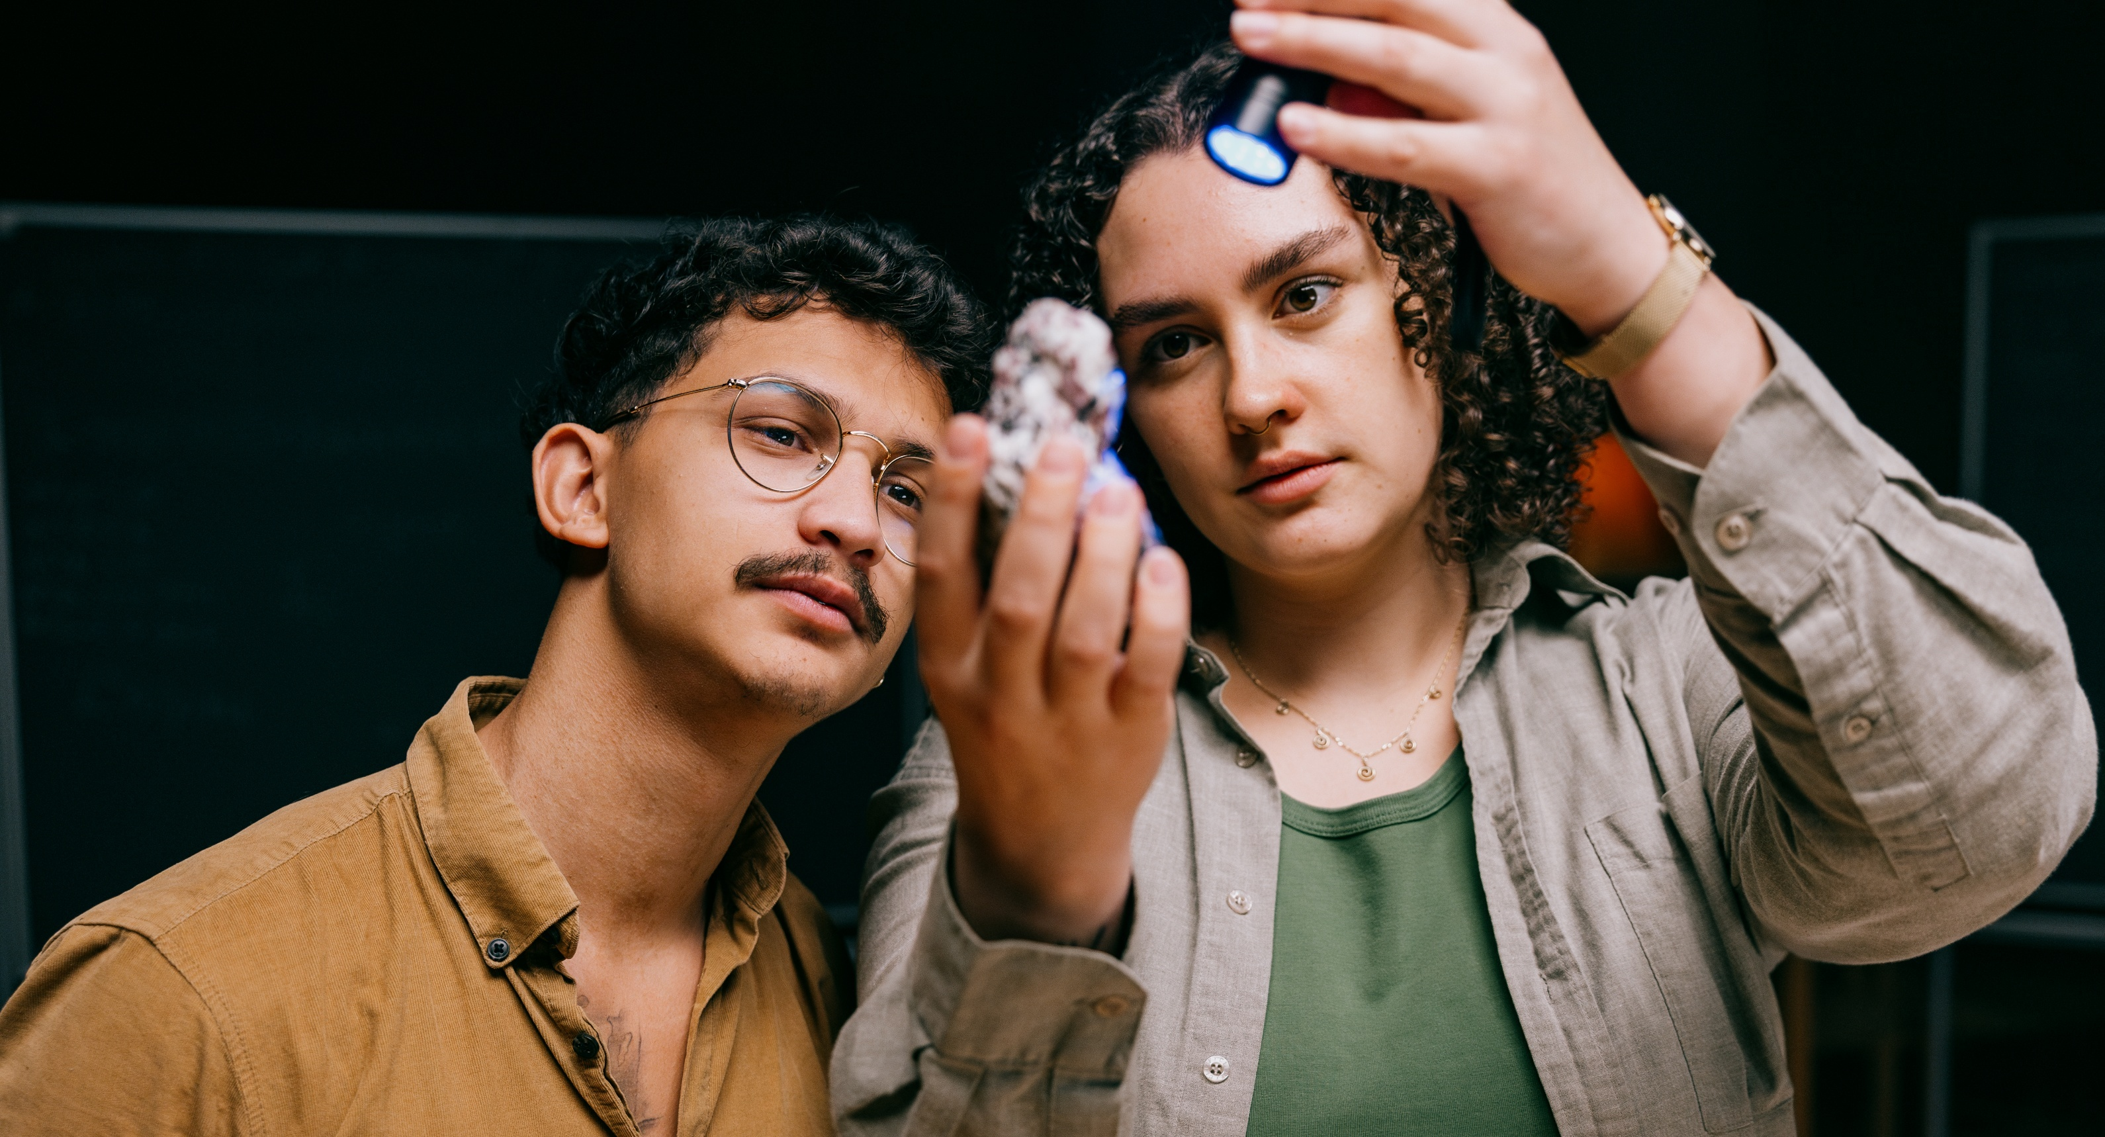
We create insight and knowledge
100 research centres at five faculties
12,000 publications annually
Five exceptional graduate schools with 1,900 PhD students
AIAS – excellence in basic research and talent development
Two Nobel Prizes
Notes:
[This picture shows two students examining a piece of geological material]
Source: https://galleri.au.dk/ (JHS_22754_13-11-2024-Enhanced-NR copy)
AIAS: Independent, curiosity-driven research carried out by top researchers from all disciplines characterises Aarhus Institute of Advanced Studies. AIAS focuses exclusively on research expertise and cultivating research talents.https://aias.au.dk/
Nobel Prizes:
A Nobel Prize was awarded to an AU researcher for the first time in 1997. The recipient was Professor Jens Christian Skou, now deceased, and he received the prize for his work on the sodium-potassium pump.
In 2010, Niels Bohr Professor Dale T. Mortensen (b. 2 February 1939 - d. 9 January 2014) was awarded the Nobel Prize in Economics together with Christopher A. Pissarides and Peter A. Diamond.

Slide 11
Education at
Aarhus University

Slide 12

In-depth knowledge and an engaging learning environment
Approx. 6,600
new bachelor
students every year
200+
degree programmes
Approx. 4,300
courses
Notes:
[The picture shows students at a lecture]
Source: https://galleri.au.dk/ (JHS_28562_09-12-2024 copy)
It is crucial that AU’s degree programmes are characterised by disciplinary excellence as well as an engaging learning environment. Our graduates make important contributions to society. By offering degree programmes at the highest international level, we want to help our graduates develop themselves both academically and personally and to acquire the skills associated with a formative university education. We want our graduates to become responsible citizens of society, who, with their knowledge, independence, curiosity, drive and reflection are able to excel professionally, create attractive jobs and contribute to an enlightened society.
Aarhus University's policy for educational quality assurance: https://medarbejdere.au.dk/strategi/kvalitetspolitik
https://bachelor.au.dk/
Source of data
New bachelor students is calculated by the average admissions til Bachelor’s dregree programmes 2021-2024 (AU Key Statistics, table B3)
4296 courses (2025)
204 degree programmes (when both Master’s degree programmes and Master’s degree programme for working professionals are counted as one) 226 degree programmes (When the total degree programmes is calculated; Master’s degree programmes and Master’s degree programme for working professionals count as separate programmes)
The figures include standard programmes/courses as well as programmes/courses offered as continuing and further education

Slide 13
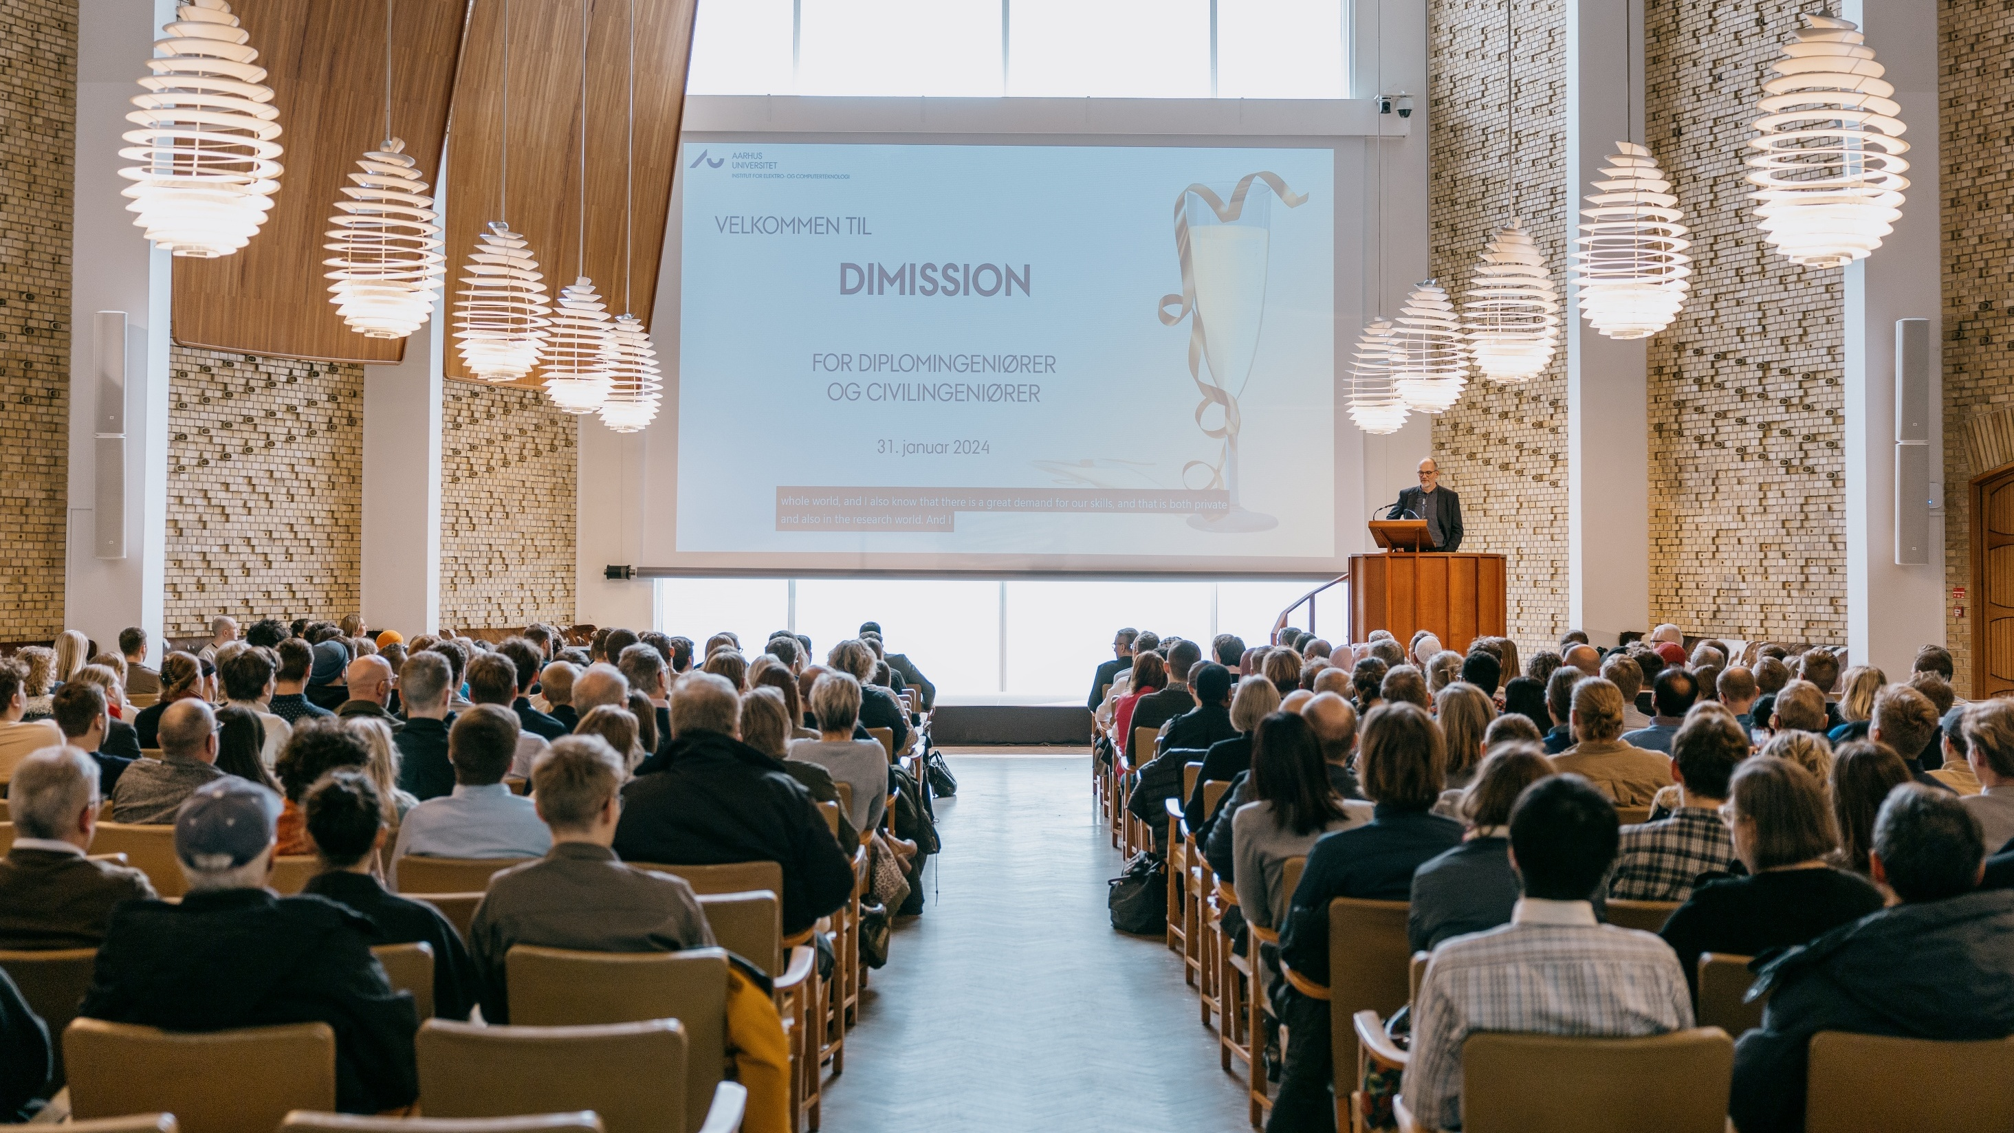
Graduates are our most important contribution to society
5.700
no. of graduates
per year
More than
9 out of 10
are employed within two years of graduation
92%
of surveyed companies are satisfied with their collaboration with students from AU
Notes:
[This picture shows the graduation ceremony for Bachelor of Engineering and Master of Science in Engineering graduates in the Aula, January 2024]
Total number of graduates of Master’s degree programmes and professional Bachelor’s degree programmes from Aarhus University 2024: 5699
The total number of graduates includes graduates of Master’s degree programmes and professional Bachelor’s degree programmes, the two groups of graduates with a well-defined job market.
Total number graduates of Master’s degree programmes and professional Bachelor’s degree programmes from Aarhus University 2024: 1591 (Arts) + 2021 (Aarhus BSS) + 708 (Health) + 464 (NAT) + 915 (TECH) = 5.699
_______________________________________________
92% of surveyed companies are satisfied with their collaboration with students from AU (https://medarbejdere.au.dk/fileadmin/www.medarbejdere.au.dk/Strategi_og_ledelse/Uddannelsesudvalget/Epinionsrapport_om_studenterrelaterede_projekter.pdf)
88% of respondents 'Strongly agree' or 'Agree' that the quality of their degree programme is generally high (study environment survey 2023: https://studerende.au.dk/en/student-survey/previous-surveys)
__________________________________________________________________
More than 9 out of 10 grads are employed within two years of graduation
Figures for unemployment are collected from PowerBI

Slide 14
Student life at
Aarhus University

Slide 15
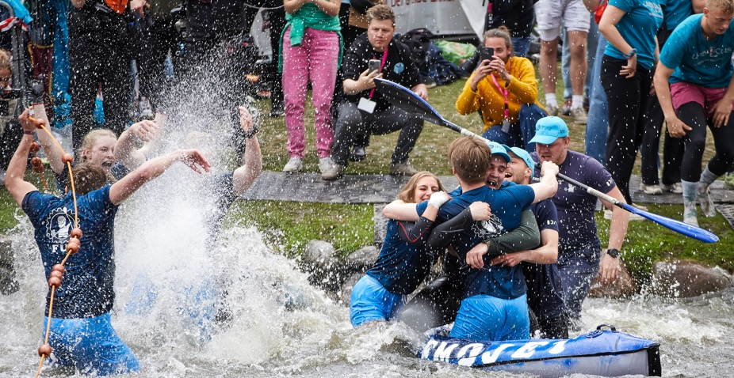
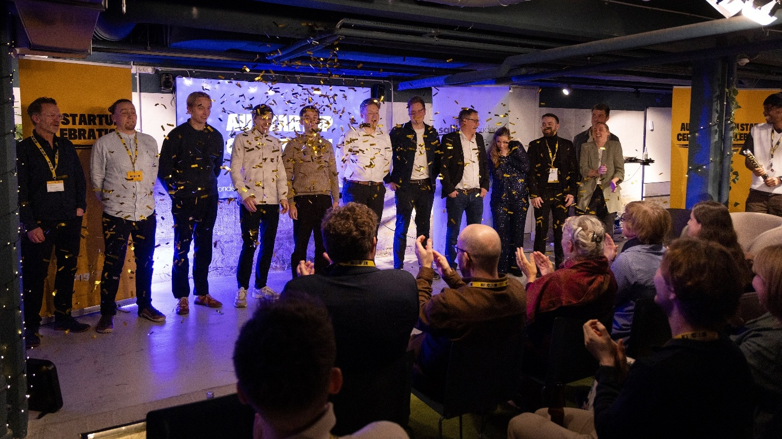
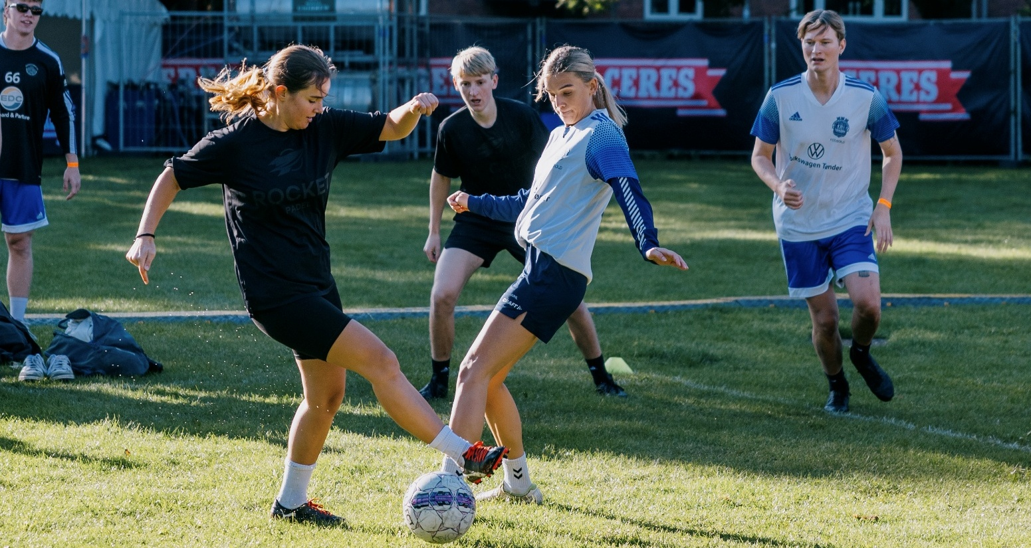
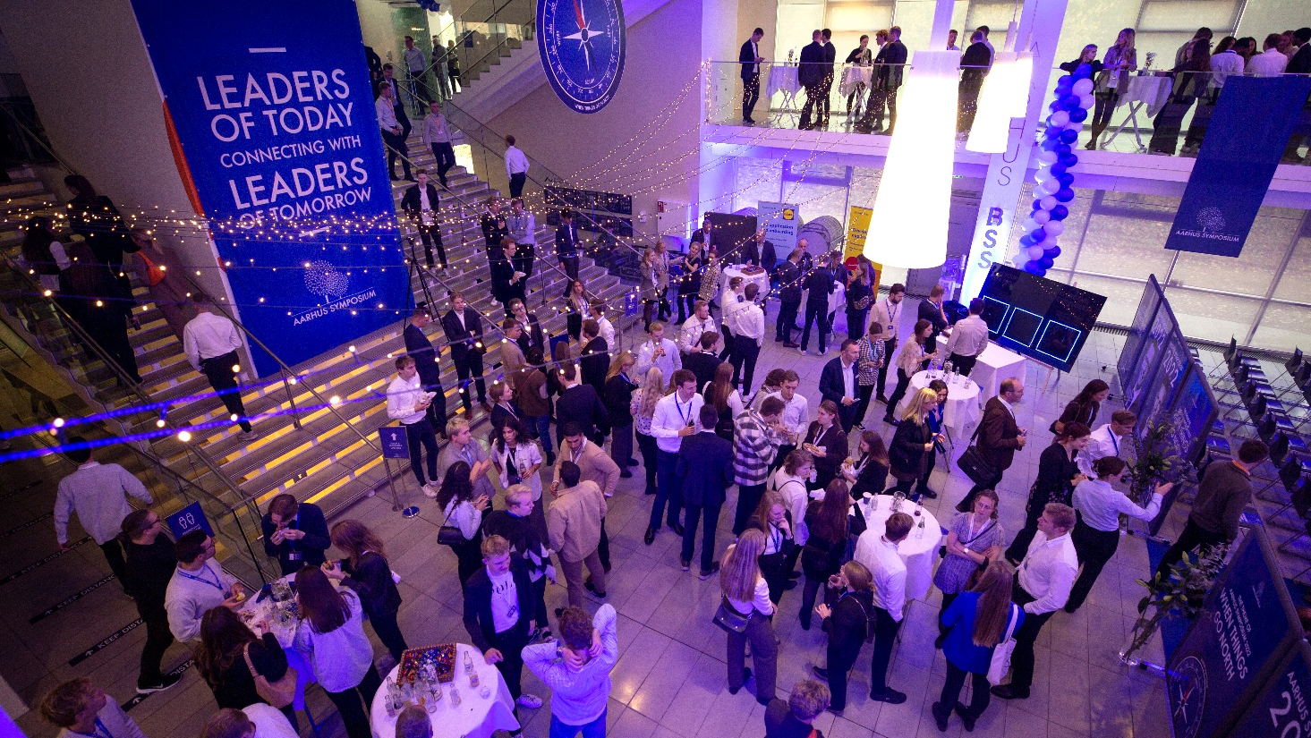
Aarhus named Denmark’s second-best university town
The Regatta
Entrepreneurship
Sports Day
Aarhus Symposium
Notes:
STUDENT LIFE AT AARHUS UNIVERSITY
Aarhus University’s campuses invite and foster student life, both socially and academically. We are currently expanding our main campus. Centrally located in Aarhus, it is a hub for vibrant student life and offers excellent facilities that integrate teaching and research and promote a modern, flexible environment for learning. There is room for students to grow and explore – first and foremost academically, but also in the many volunteer associations, entrepreneurship and student-organised events, as well as getting to know fellow students from Denmark and abroad and engaging with society.
____________________________________________
After 3 years in a row as Denmark's best student town, Aarhus is voted second best after Copenhagen in 2024 (source: https://www.studentum.dk/aarets-studieby/). This title is awarded based on eight criteria:
Good career opportunities
Academic excellence
Sense of security
Cheap housing
Student jobs
Good transportation system
Cultural, athletic and recreational activities
Quality of life
_______________________________
The Regatta
This annual event, at which different student associations from AU and other educational institutions in Aarhus compete for ‘the Golden Bedpan’, is probably northern Europe's largest student event.
The event takes place in the University Park and attracts thousands of students from all over the region.
Aarhus Symposium
At the student-organised Aarhus Symposium in November, students have ample opportunities to engage in debate and discussion on the year’s theme and network with representatives from a wide variety of Danish and international companies.
Entrepreneurship
At Aarhus University, knowledge is transformed into value. Through the entrepreneurial hub The Kitchen, students and researchers gain access to mentoring, networks, and investors, enabling ideas to develop into businesses. Since 2008, more than 2,300 new companies have been created by AU students and researchers – spanning fields from health and green transition to IT and culture.
Denmark’s biggest Friday bar and sports day
Every year at the beginning of the autumn semester, ‘Denmark’s biggest Friday bar and sports day’ brings the University Park alive with sporting events, parties and live music.
The day starts with various tournaments, from volleyball to handball and chess and fencing – and ends with concerts and parties.

Slide 16
Aarhus Campus

Slide 17
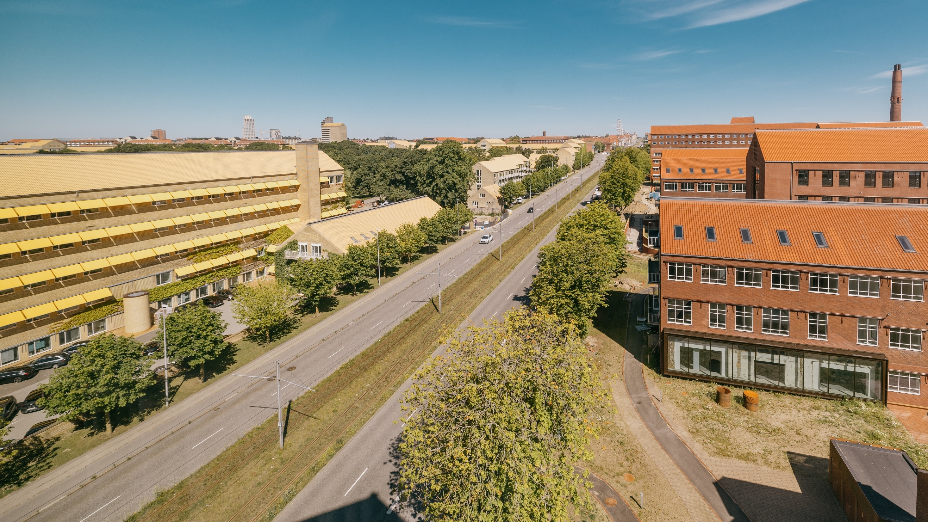
We are continually developing our main campus
Notes:
[The picture shows University City on the right side of Nørrebrogade and the Bartholin Building, as well as part of the dormitories in Universitetsparken on the left side.]
Source: https://galleri.au.dk/ (JHS_39252_01-07-2025 copy
The overall vision for AU’s campus in Aarhus is to develop and strengthen it by consolidating it around the University Park, the University City and Katrinebjerg. Meanwhile, the framework for AU activities outside of Aarhus will continue to be developed , particularly in Foulum, Herning and Emdrup.
The physical development of AU’s campus will ensure that the university can continue to provide an attractive environment for work and study that attracts talented and committed students and staff.
Ten principles for AU’s campus development
Based on the vision, ten overall principles have been developed. The principles will guide the strategic development of the university's campuses in the coming years.
Aarhus University’s campuses must:
promote integration of research and education
promote interdisciplinary research, education and innovation
promote future forms of teaching
be a flexible study environment with many places for study
be an international campus
be able to offer housing to students and researchers
promote collaboration with the business community and the local community
be enhanced by non-university activities
be a car-free area
be developed sustainably.

Slide 18
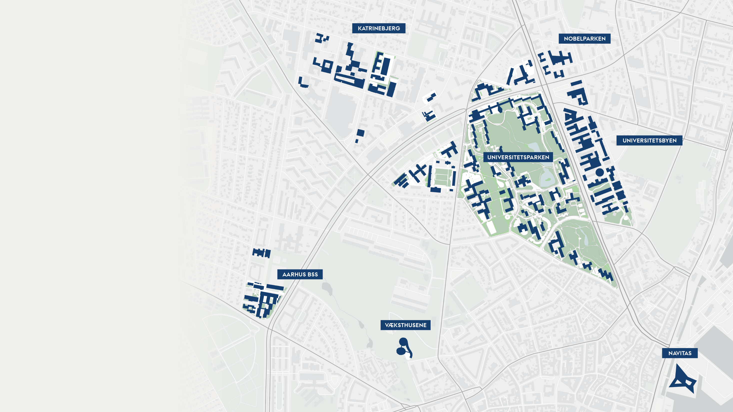
Unified AU spans a large area
Notes:
The map shows most of the Aarhus campus as it is distributed around the big roads Nordre Ringgade and Nørrebrogade.

Slide 19
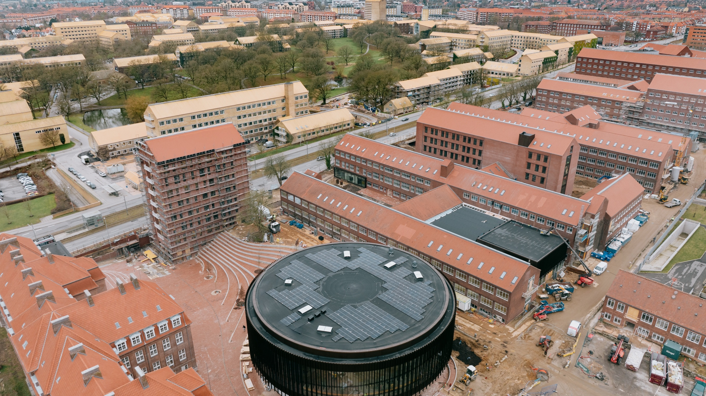
University City
Notes:
[The image shows University City with the “Runde Auditorium” in the foreground and the University Park in the background, February 2025]
Source: https://galleri.au.dk/ (JHS_29351_26-02-2025 copy)
Almost 100 years old – and still developing.
Further information about the construction of Universitetsbyen can be found here:
https://www.au.dk/om/campusudvikling

Slide 20

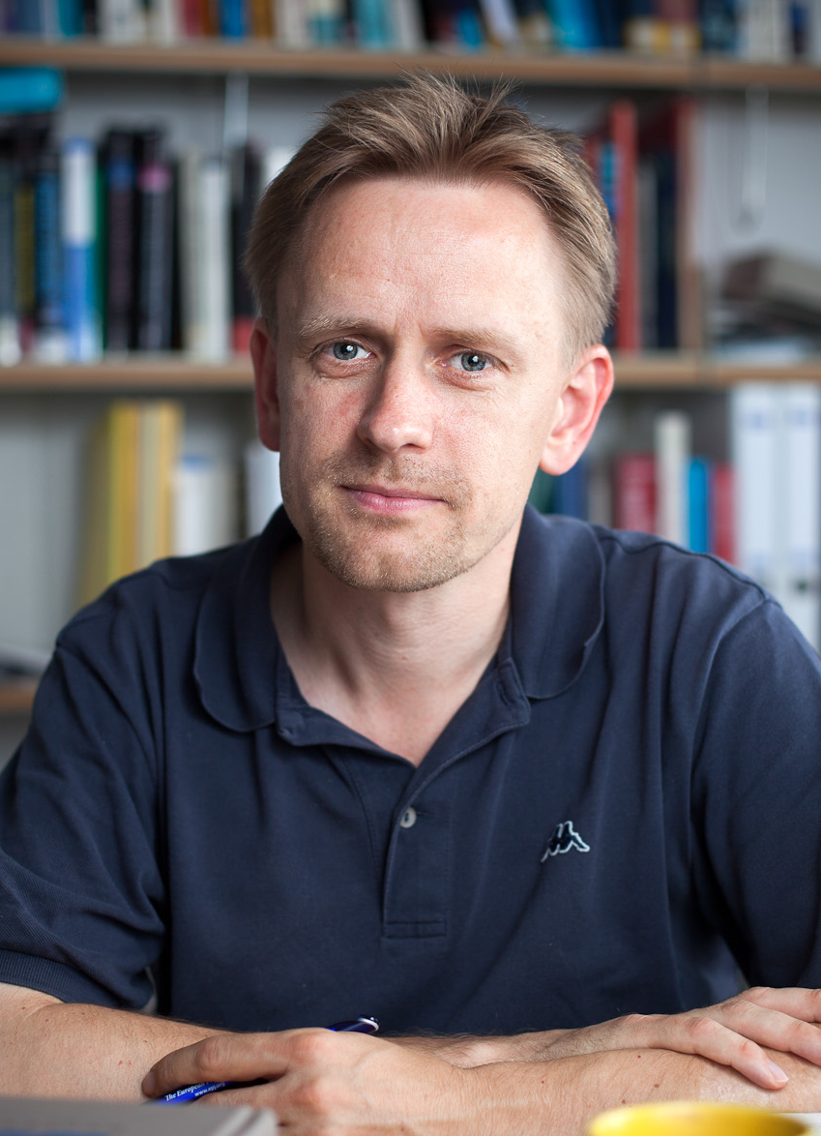
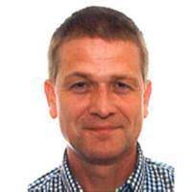
ISOLDE at CERN
On behalf of Danish ISOLDE users
Karsten Riisager, AU
Hans Fynbo, AU
Lars Hemmingsen, KU

Slide 21
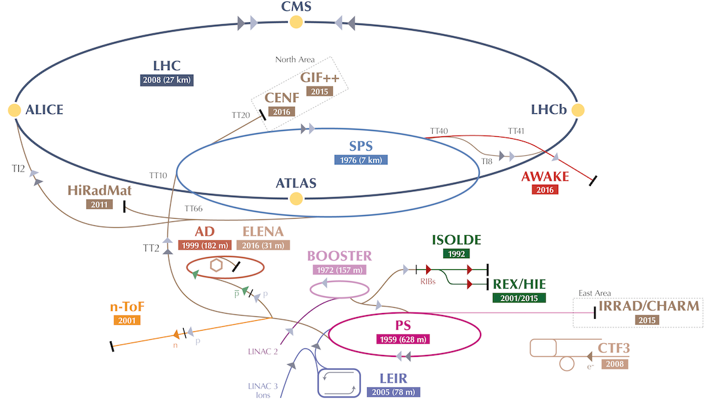
ISOLDE @ CERN

Slide 22
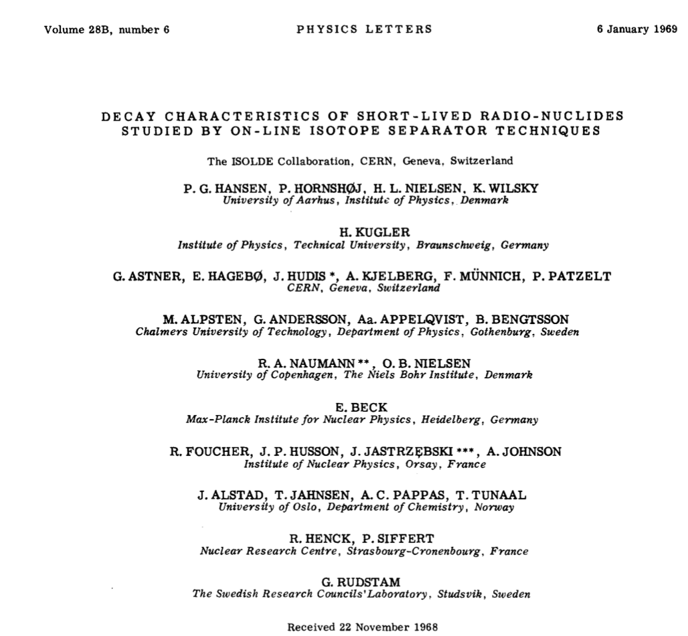
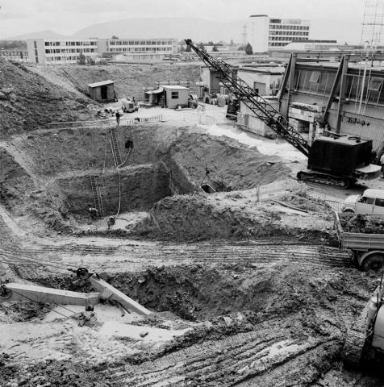
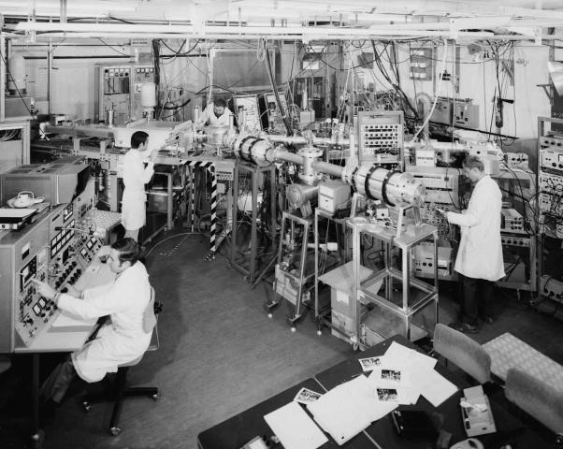
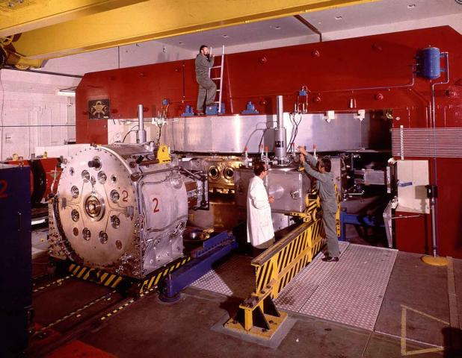
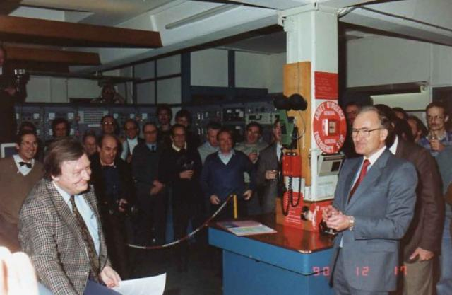
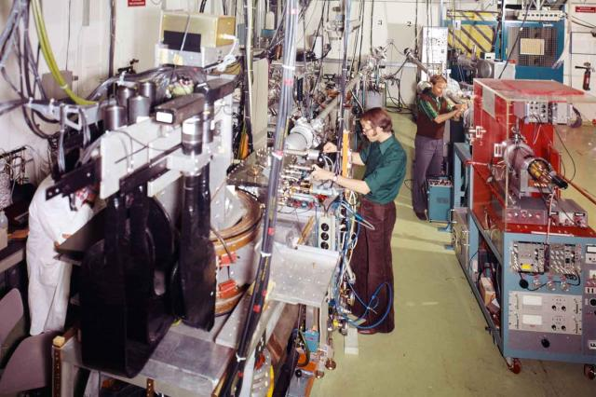
ISOLDE @ CERN
Dec 1964: CERN approves
the online separator project
May 1966: Synchro-Cyclotron
shuts down for ISOLDE construction
Oct 1967: First proton
beams at ISOLDE
Dec 1990: The Synchrocyclotron beam end
New ISOLDE facility → Online in 1992@PSB
June 1983: ISOLDE III approved –
two-stage high resolution separation
using two magnets
1972:
SC Improvement Program – doubles the intensity
22
Notes:
[Indsæt historie på billede]

Slide 23

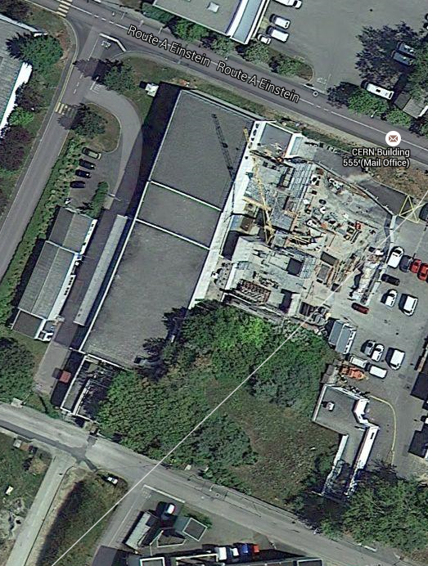
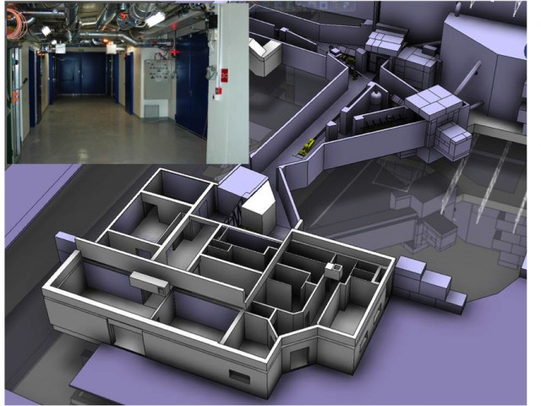
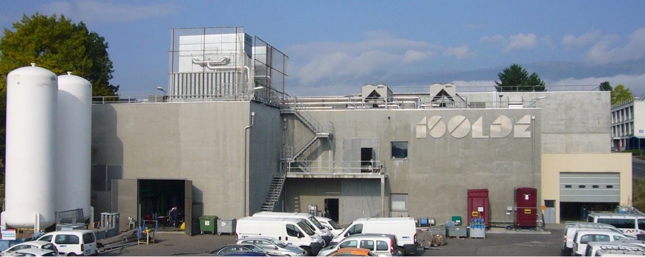
Isolde expansion 1992 -
2004
2007
1999
2012
Class A radioactive laboratory
2015
1992
2004
HIE ISOLDE on line 2015

Slide 24
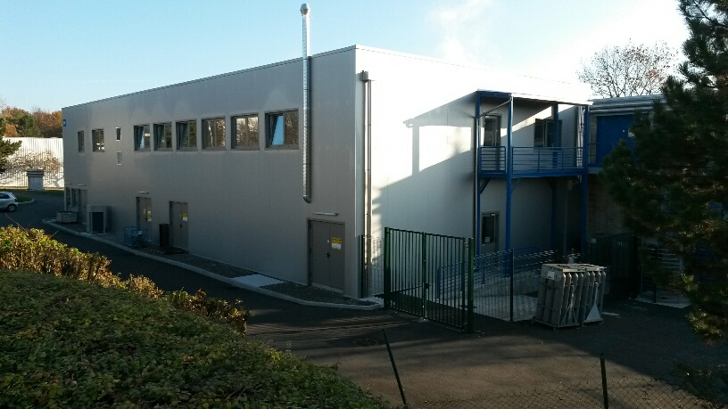
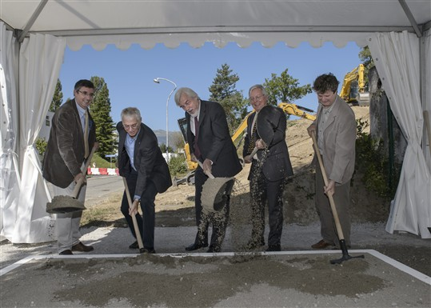
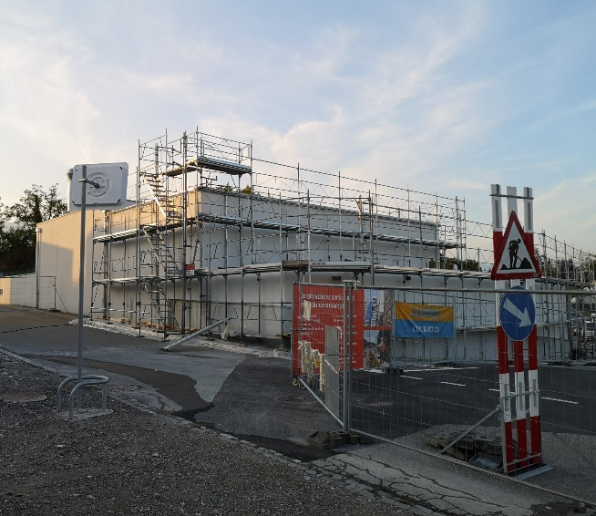
Isolde expansion 1992 -
2014
2007
1999
2014
User and Operations facility building
2012
2013
2020
1992
2004
2020
2014
Groundbreaking MEDICIS
building
NANO-lab building

Slide 25
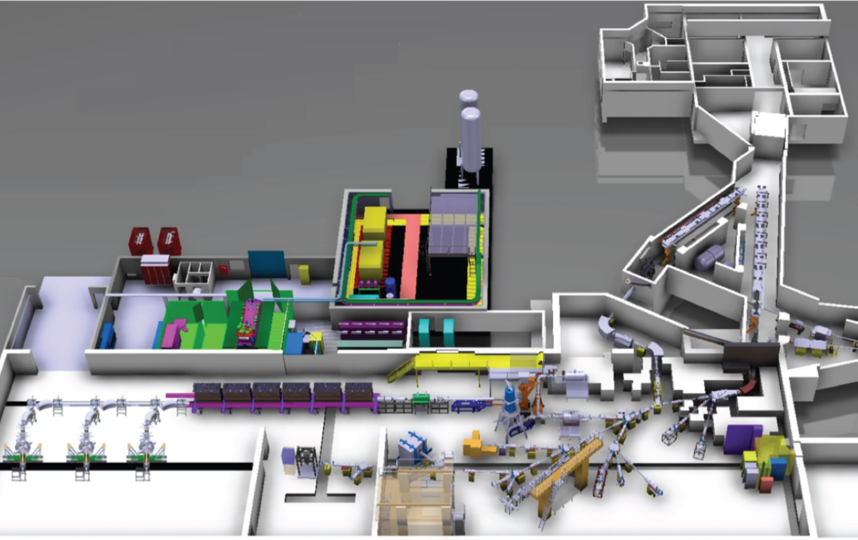
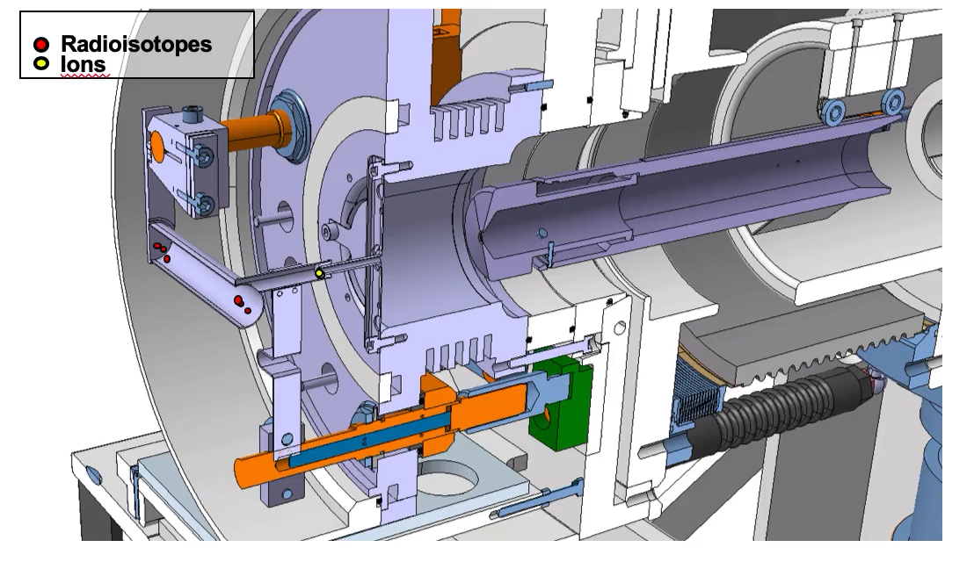
ISOLDE @ CERN
Targets
Front-ends

Slide 26
Research
At ISOLDE
With Danish Involvement

Slide 27
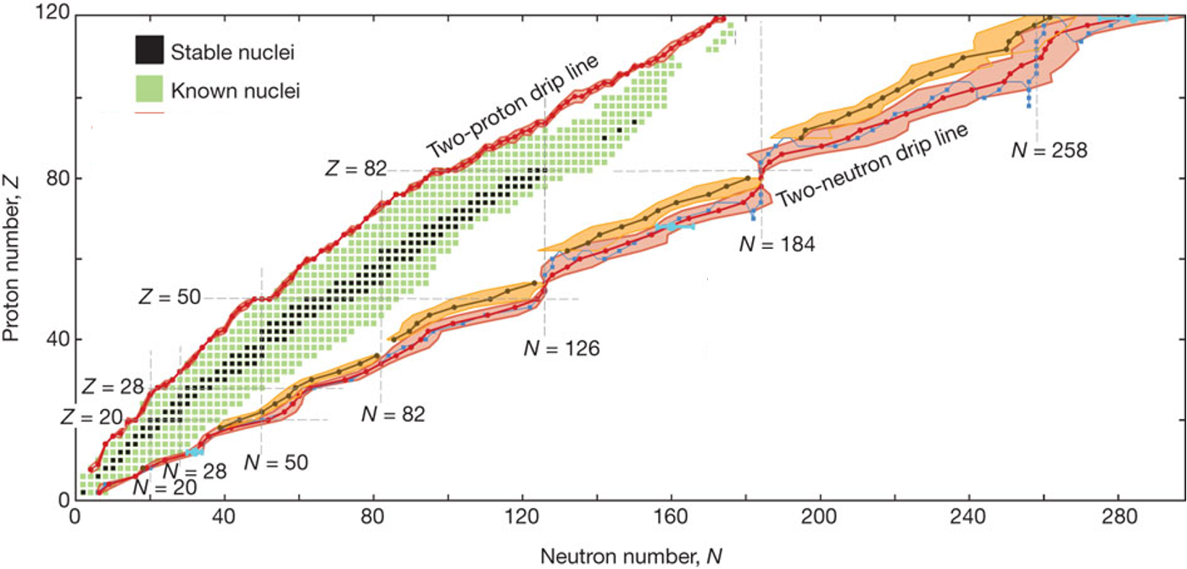
The nuclear world
How does nuclei emerge from fundamental interactions?
Where are the limits of stability and what is the heaviest element?
How does nuclear structure evolve with N and Z? Which shapes are possible?
”We predict that 6900 nuclei with Z<120 are
bound to proton and neutron emission”

Slide 28
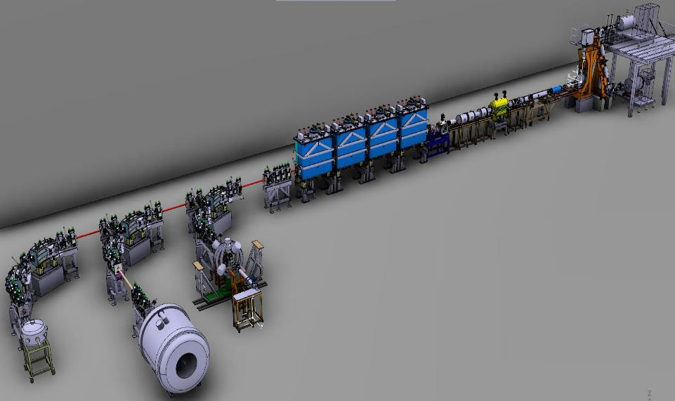
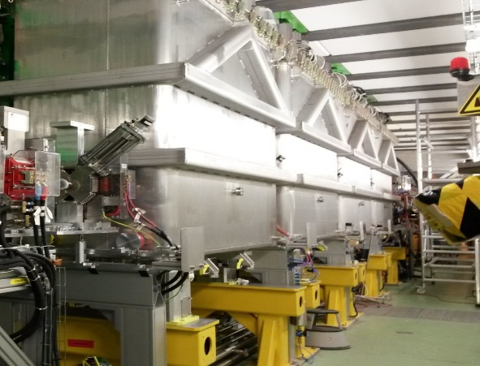
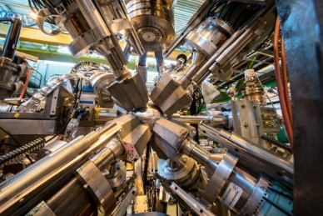
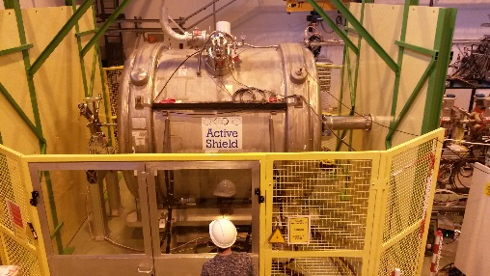
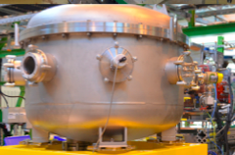

Post-accelerated beams
REX (2001) – gradual upgrade to 3 MeV/u
HIE (2010-18) – reaching 10 MeV/u
XT01
XT02
XT03
Miniball
Coulomb excitation, lifetimes (Miniball, plunger)
Transfer reactions (Miniball+Trex, ISS, ..)
Multipurpose scattering chamber
Scattering chamber
ISOLDE Solenoid Spectrometer (ISS)

Slide 29
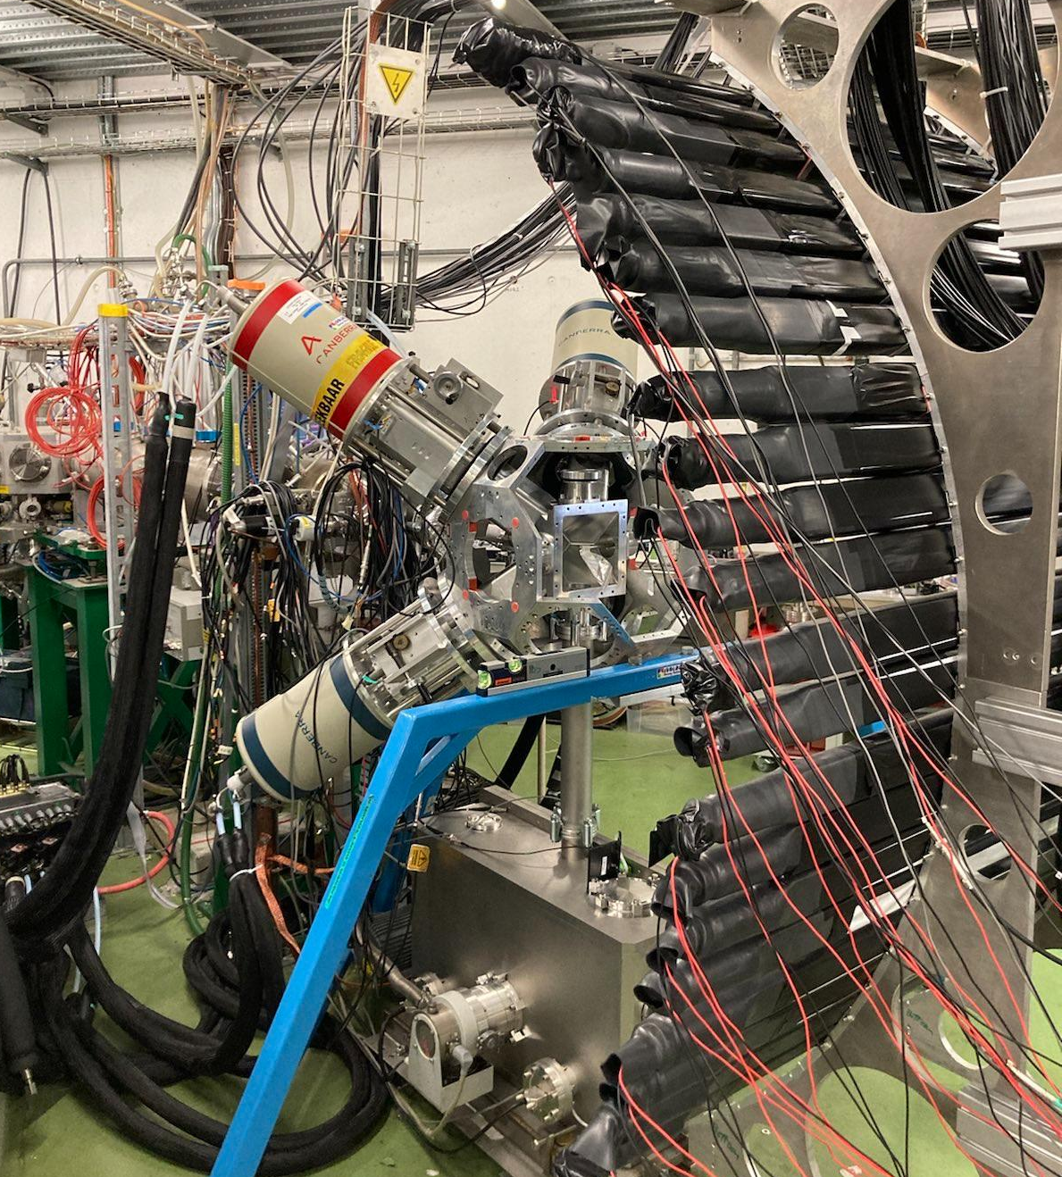
Decays and reactions with radioactive beams
Focus on light nuclei and isotopes close to or at driplines
Explore exotic nuclear structure and decay. modes
Recent or planned decay studies at CERN:
                ⁸B for weak interaction and nuclear structure
                ⁸He and ⁹Li for neutrino physics and decay modes
                ¹¹Li for nuclear structure and decay modes
                Recent or planned decay studies at FRIB:
                ²²Al and ²⁶P for nuclear structure and decay modes - see next slide
                Recent or planned reaction studies at CERN:
⁹Li on triton target – two-neutron transfer reaction for nuclear structure
Occasionally, activities at local VdG-accelerator in Aarhus, CMAM Madrid, Krakow, and elsewhere.
ISOLDE decay station at CERN: neutron, gamma-ray and
charged particle detectors

Slide 30
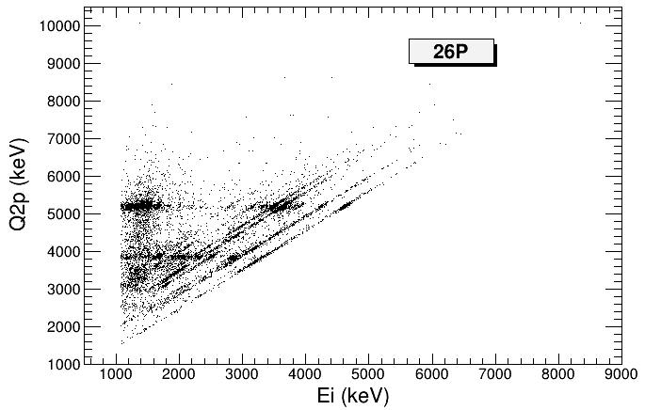
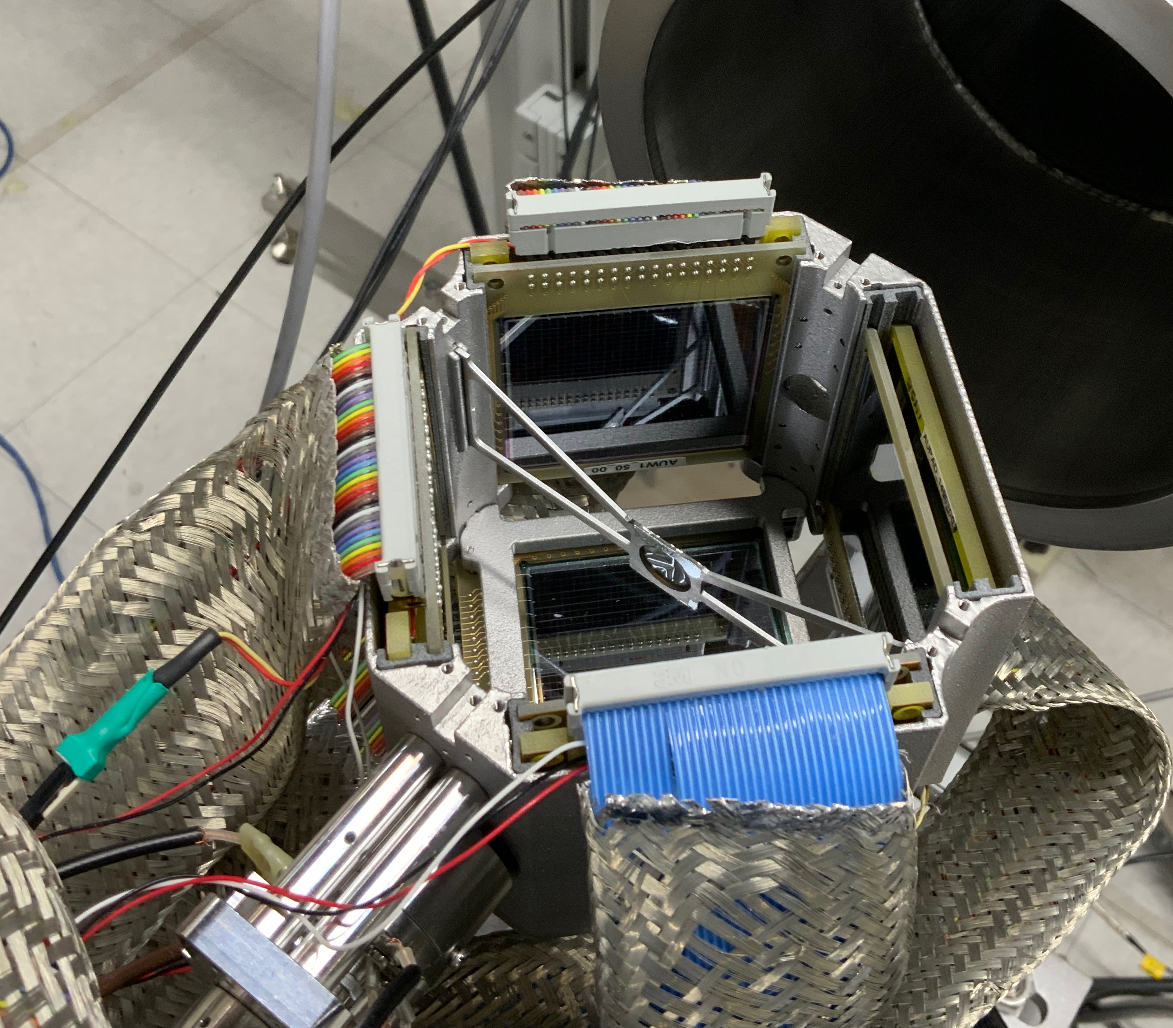
Decay studies of dripline isotopes ²²Al and ²⁶P
Two-proton coincidences reveal dynamics of two-proton emission
beam
Diagonal lines
from intermediate
resonances
Horizontal lines from two-proton emitting
resonances
Array of Si-strip detectors for study of decay modes
Two-proton emission from drip-line nucleus ²⁶P
Notes:
The goal of the experiment was to measure two-proton coincidences from the decays of 22Al and 26P to reveal the dynamics of the two-proton emission in the decay of these two dripline isotopes. The scatter plot shows on the x-axis the energy of the two individual protons (two dots on each line), and the y-axis shows the calculated Q-value of the two-proton transition, which is the energy difference between the initial two-proton emitting state and the final state of two-protons and the two-proton daughter.
Uniqueness: The excellent beam optical quality from the gas cell makes it possible to combine the powerful exotic beam production at FRIB with a sensitive setup including particle identification capabilities and fine grained angular resolution.

Slide 32
Nuclear power in Denmark
1953-1985, 2040-?

Slide 33
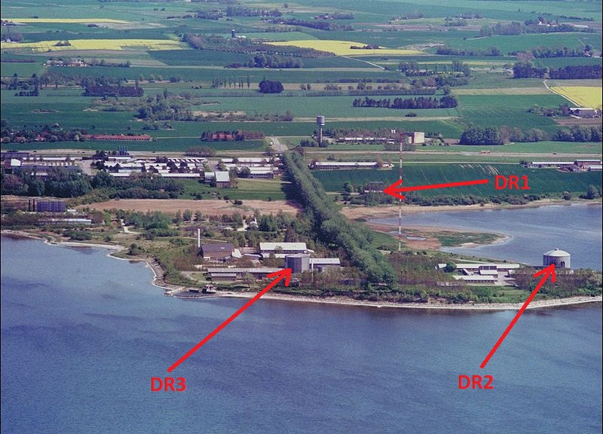
Risø
State owned research center Risø at Roskilde fjord
Opened june 6 1958
Had threw research reactors (DR1, DR2 og DR3)
Purpose: ”Furhering of the pieceful exploitation of nuclear energy for the benefit of society.”

Slide 34
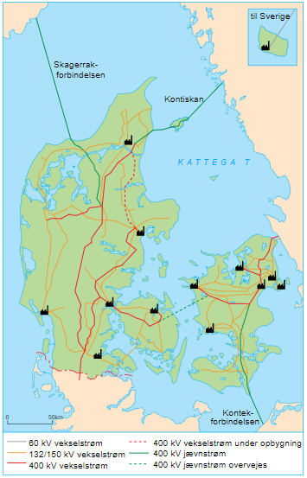
Nuclear power?
Denmark split in two : East - West
  East of Storebælt: Kraftimport
  West of Storebælt: Elsam
  First cabel under Storebælt came in 2010
Kraftimport:
  Reluctant on nuclear power.
  Contracted to buy power from Swedish Barsebäck
Elsam:
  Primary driver for nuclear power in Danmark
  Wanted control of when and where Denmark’s first nuclear power plant should be built

Slide 35

Organisation til Oplysning om Atomkraft (OOA)
NGO Founded january 31 1974
Initialy motivated to inform population
Quickly become a voice against nuclear power.
Desolved maj 31 2000 because no longer any debate on nuclear power.

Slide 36
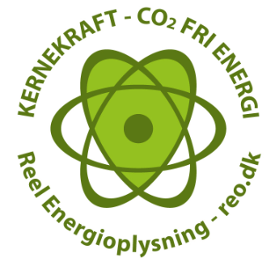
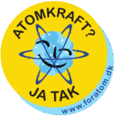
Organisation til Oplysning om Atomkraft (OOA)
Four political goals
  Politisk moratorium 3 yrs before danish nuclear power (delay)
  Calculations to analyse if nuclear power was economically viable
  Plan for handling the spent fuel
  Population should be included in decision (referendum)
Arranged nuclear marches / demonstrastions

Slide 37
Later developments, 1985-
Climate concerns -> Paris agreement. Use of coal now nearly removed from utilities. Replaced by biomass.
Acadamic field of ”energy planning” strongly biased for WWS-only.
Focus on electrification of non-electricity energy usage (transport, heat/cooling, industry).
Strong wind power industry and supply chain. Lobbies for massive build out of wind and no nuclear.
After Uraine war started 2022+Trump2, focus on economic competetiveness and security of supply (Mario Draghi report etc.).
Two Danish startups on MSR (CphAtomics + Saltfoss)
Energy agency analysis on possible role of SMR. Foregone conclusion.
Nuclear power alliance will release independent analysis.

Slide 38
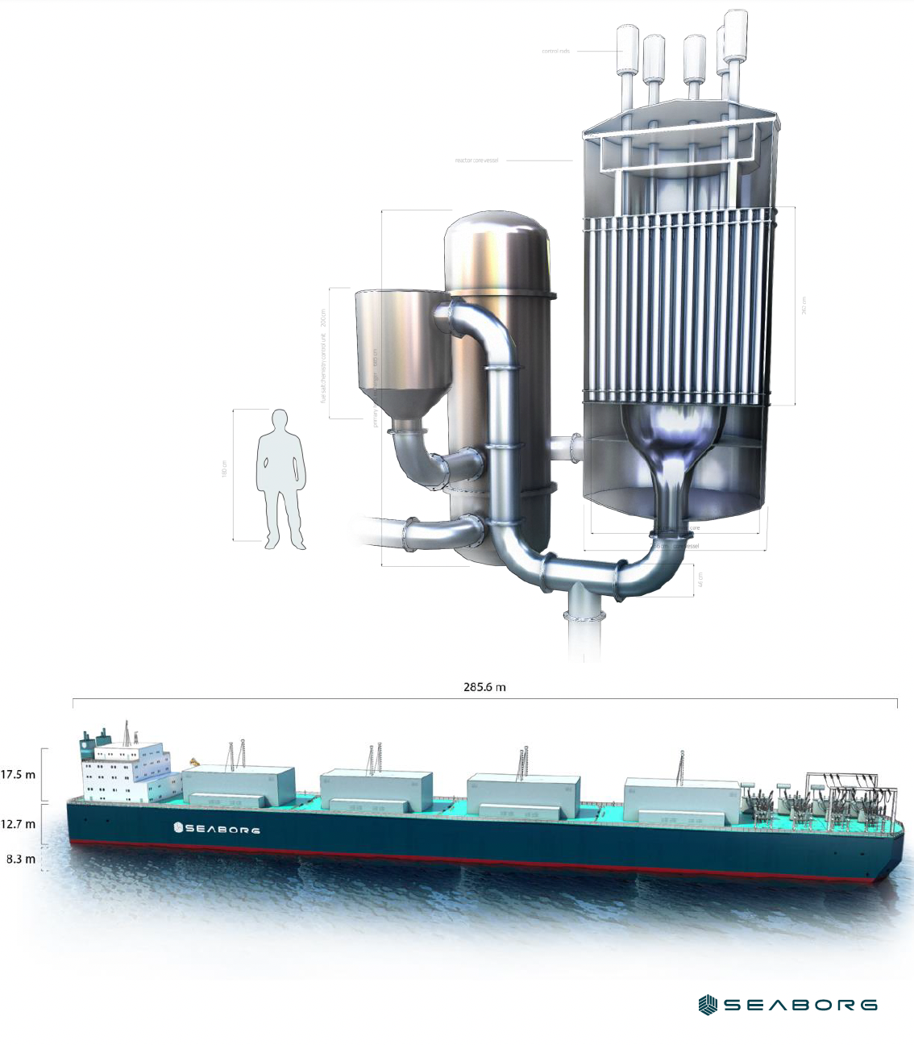
Saltfoss Technologies

Slide 39
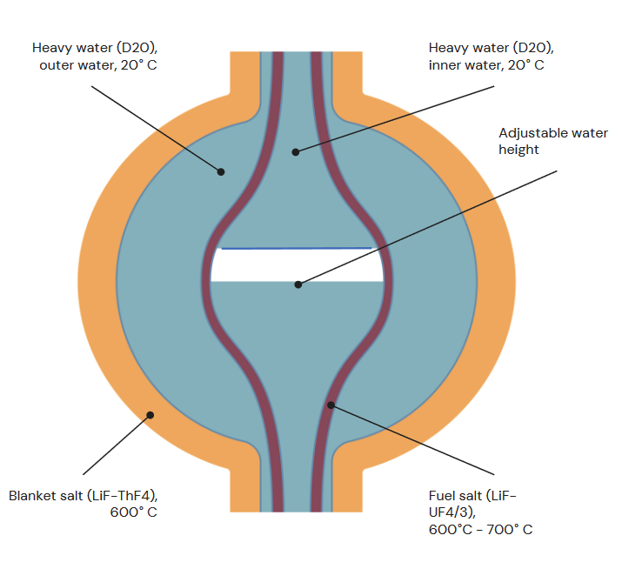


Copenhagen
Atomics

Slide 40


Copenhagen Atomics

Slide 41


Dansk Reaktor 1 (DR1)
Mini research reactor
Bought in USA
First criticality 15. august 1957
Power up to 2 kW
Used for teaching
Closed in 2001. Decomisioned.

Slide 42

Dansk Reaktor 1 (DR1)
Homogenous core in steel tank
Liquid fuel
  20 % enriched uranium (uranylsulfat) desolved in destilled water
4 control rods (B₄C)
  2 for power regulation
  2 for safety/shutdown

Slide 43

Dansk Reaktor 2 (DR2)
Research reactor
Gift from USA
First criticality december 19 1958
Power 5 MW
Used for neutron irradiation
Closed october 1975

Slide 44


Dansk Reaktor 2 (DR2)
Light water
Open pool type
  Core under 6 meters water
Fuel 90% enriched uranium

Slide 45


Dansk Reaktor 3 (DR3)
Research reactor
Bought in England
First criticality january 16 1960
Power 10 MW
Stopped april 15 2000 due to political pressure
Closed 2001

Slide 46

Dansk Reaktor 3 (DR3)
PHWR DIDO design
Fuel
  First 90 % enriched uranium
  After 1990 19,75 % enriched uranium
Heat used for buildings or rooled in the fjord.

Slide 47
Some projects
Nuclear Astrophysics (stellar burning, stellar explosions)
Structure of light nuclei (halo structures, cluster structures)
Deviations from classical shell structure
Mechanisms behind (beta-delayed) particle emission
Isospin purity
Applications in bio-chemistry

Slide 48

⁸He, ⁸⁻¹¹Li, ^{7,9,11,12,14}Be, ^{8,12}B, ^{9,12}C, ^{12,16, 18}N, ²⁰F, ¹⁷Ne, ²⁰Na, ^{20,21,26,30}Mg, ²³Al, ³¹Cl, ³¹⁻³⁵Ar, ⁴⁸Ca, ⁷²Ni, ^{70,72,74-78}Cu, ⁶¹Ga, ⁹⁴⁻⁹⁹Kr, ⁷⁴Rb, ⁷⁵Sr, ¹¹¹Cd, ^{129,132,135-137}Sn, ¹⁴²⁻¹⁴⁷Xe, ^{199m,208}Hg, ^{186,207,208}Tl, ²²¹Fr, ²⁰⁸At, ²²⁹Th, ...
Caption

Slide 49







¹⁶N decay and ¹²C(α,γ)¹⁶O
KVI : Refsgaard et al. PLB 752, 296
CERN: Kirsebom et al., PRL 121, 142701

Slide 50
Ex: ²¹Mg – beta-delayed particles give
Info on levels, spin etc (interest for astrophys., structure…)
Decay mechanism
Rare decay modes
Isospin purity

Slide 51


From nuclear physics to molecular properties
Intracellular control of metal ion concentration by metallosensor proteins – CueR senses Cu(I):
But does not respond to divalent metal ions, potentially because a secondary metal site provides auxiliary ligands – a ^{199m}Hg Perturbed angular correlation of γ-rays (PAC) study.
Balogh et al. Chem. Eur. J. 2019, 25, 15030 – 15035
From molecular properties to nuclear physics
The first gas phase PAC experiments combined with state of the art (CCSD(T)) electronic structure calculations (project lead by H. Haas, CERN)
provided most accurate determination of excited state nuclear quadrupole moments of ¹⁹⁹Hg and ¹¹¹Cd:
Q(¹⁹⁹Hg, 5/2⁻) = +0.674(17) b and Q(¹¹¹Cd, 5/2⁺) = +0.664(7) b.
Haas et al., Phys. Rev. Lett. 126, 103001 (2021)
ISOLDE/CERN
Uni of Copenhagen
Uni of Szeged
Biological Research Centre of the Hungarian Academy of Sciences
ISOLDE/CERN
Uni of Copenhagen
Uni of Bonn
Uni of Duisburg-Essen
Uni of Aveiro
Uni of Lisbon
CdHal₂ is:
CdCl₂
CdBr₂
CdI₂

Slide 52

Developments in the debate
1953 – 1974
  Question was ”when” not ”if”
  Elsam against nationalisation, hesitant
  Little initiative. Focus on oil.
  Hardly any debate
  Atomic marches against nuclear weapons
    Not opposition against power.

Slide 53

Developments in the debate
1974 – 1976:
Elsam presents concrete plans for Danish nuclear power
Politically, the following were lacking
  Specific requirements for Danish nuclear power plants
  A procedure for safety approval
  A proper political debate on nuclear power
The nuclear power law is split into two
  Part 1: Compensation in case of accidents at nuclear power plants – quickly adopted
  Part 2: Should Denmark have nuclear power – major political disagreement
In 1976, the decision on Danish nuclear power is postponed until
  there is a concrete application from a power company
  There is a “solution” to the waste problem

Slide 54

Developments in the debate
1976 – 1985:
Minimal debate in the Danish Parliament
Public opposition to nuclear power increases
Political opposition also increases
Elsam decides that the first Danish nuclear power plant will be built at Gylling Næs near Horsens
The Three Mile Island accident on March 28, 1979
Coal, Renewable energy and oil and gas from the North Sea become the Danish alternative
In 1985, nuclear power is removed/prohibited from Danish energy planning

