Slide 1
Semiclassical correlation functions in holography
Kostya Zarembo
K.Z.,1008.1059
“Strings, Gauge Theory and the LHC”, Copenhagen, 23.08.11

Slide 2
AdS/CFT correspondence
Yang-Mills theory with
N=4 supersymmetry
Maldacena’97
String theory on
AdS₅xS⁵ background

Slide 3
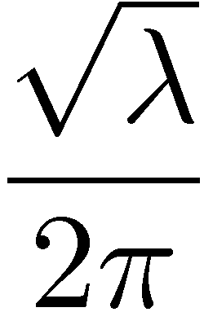
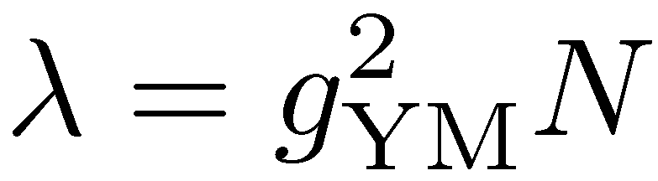
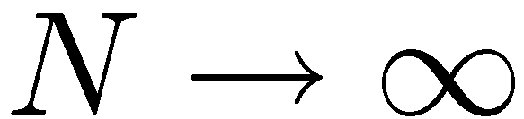
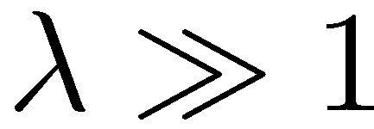
‘t Hooft coupling
string tension
planar / no quantum gravity
string theory - classical

Slide 4
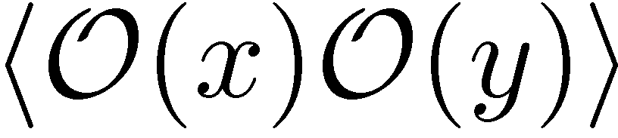


z
0
Gubser,Klebanov,Polyakov’98
Witten’98

Slide 5
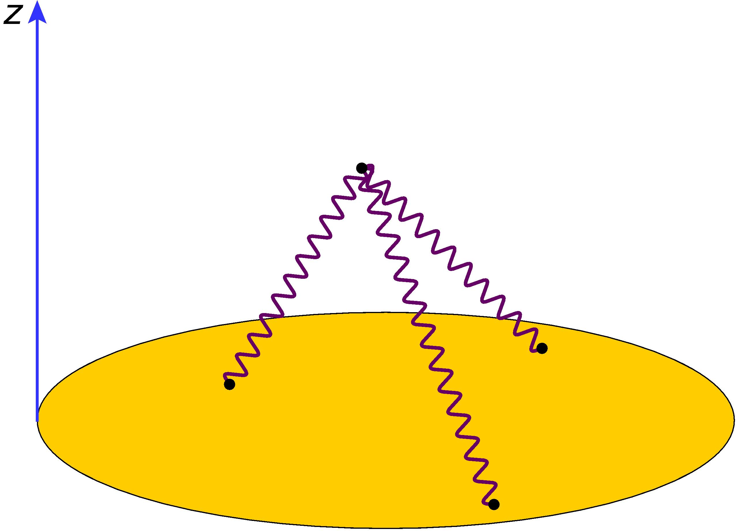
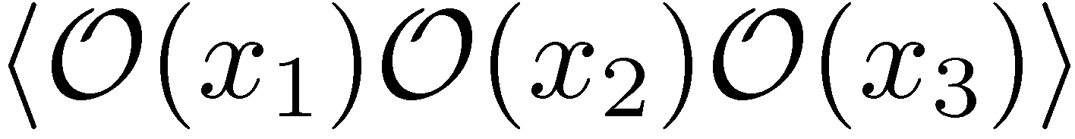
Witten diagrams

Slide 6

z
0

Slide 7
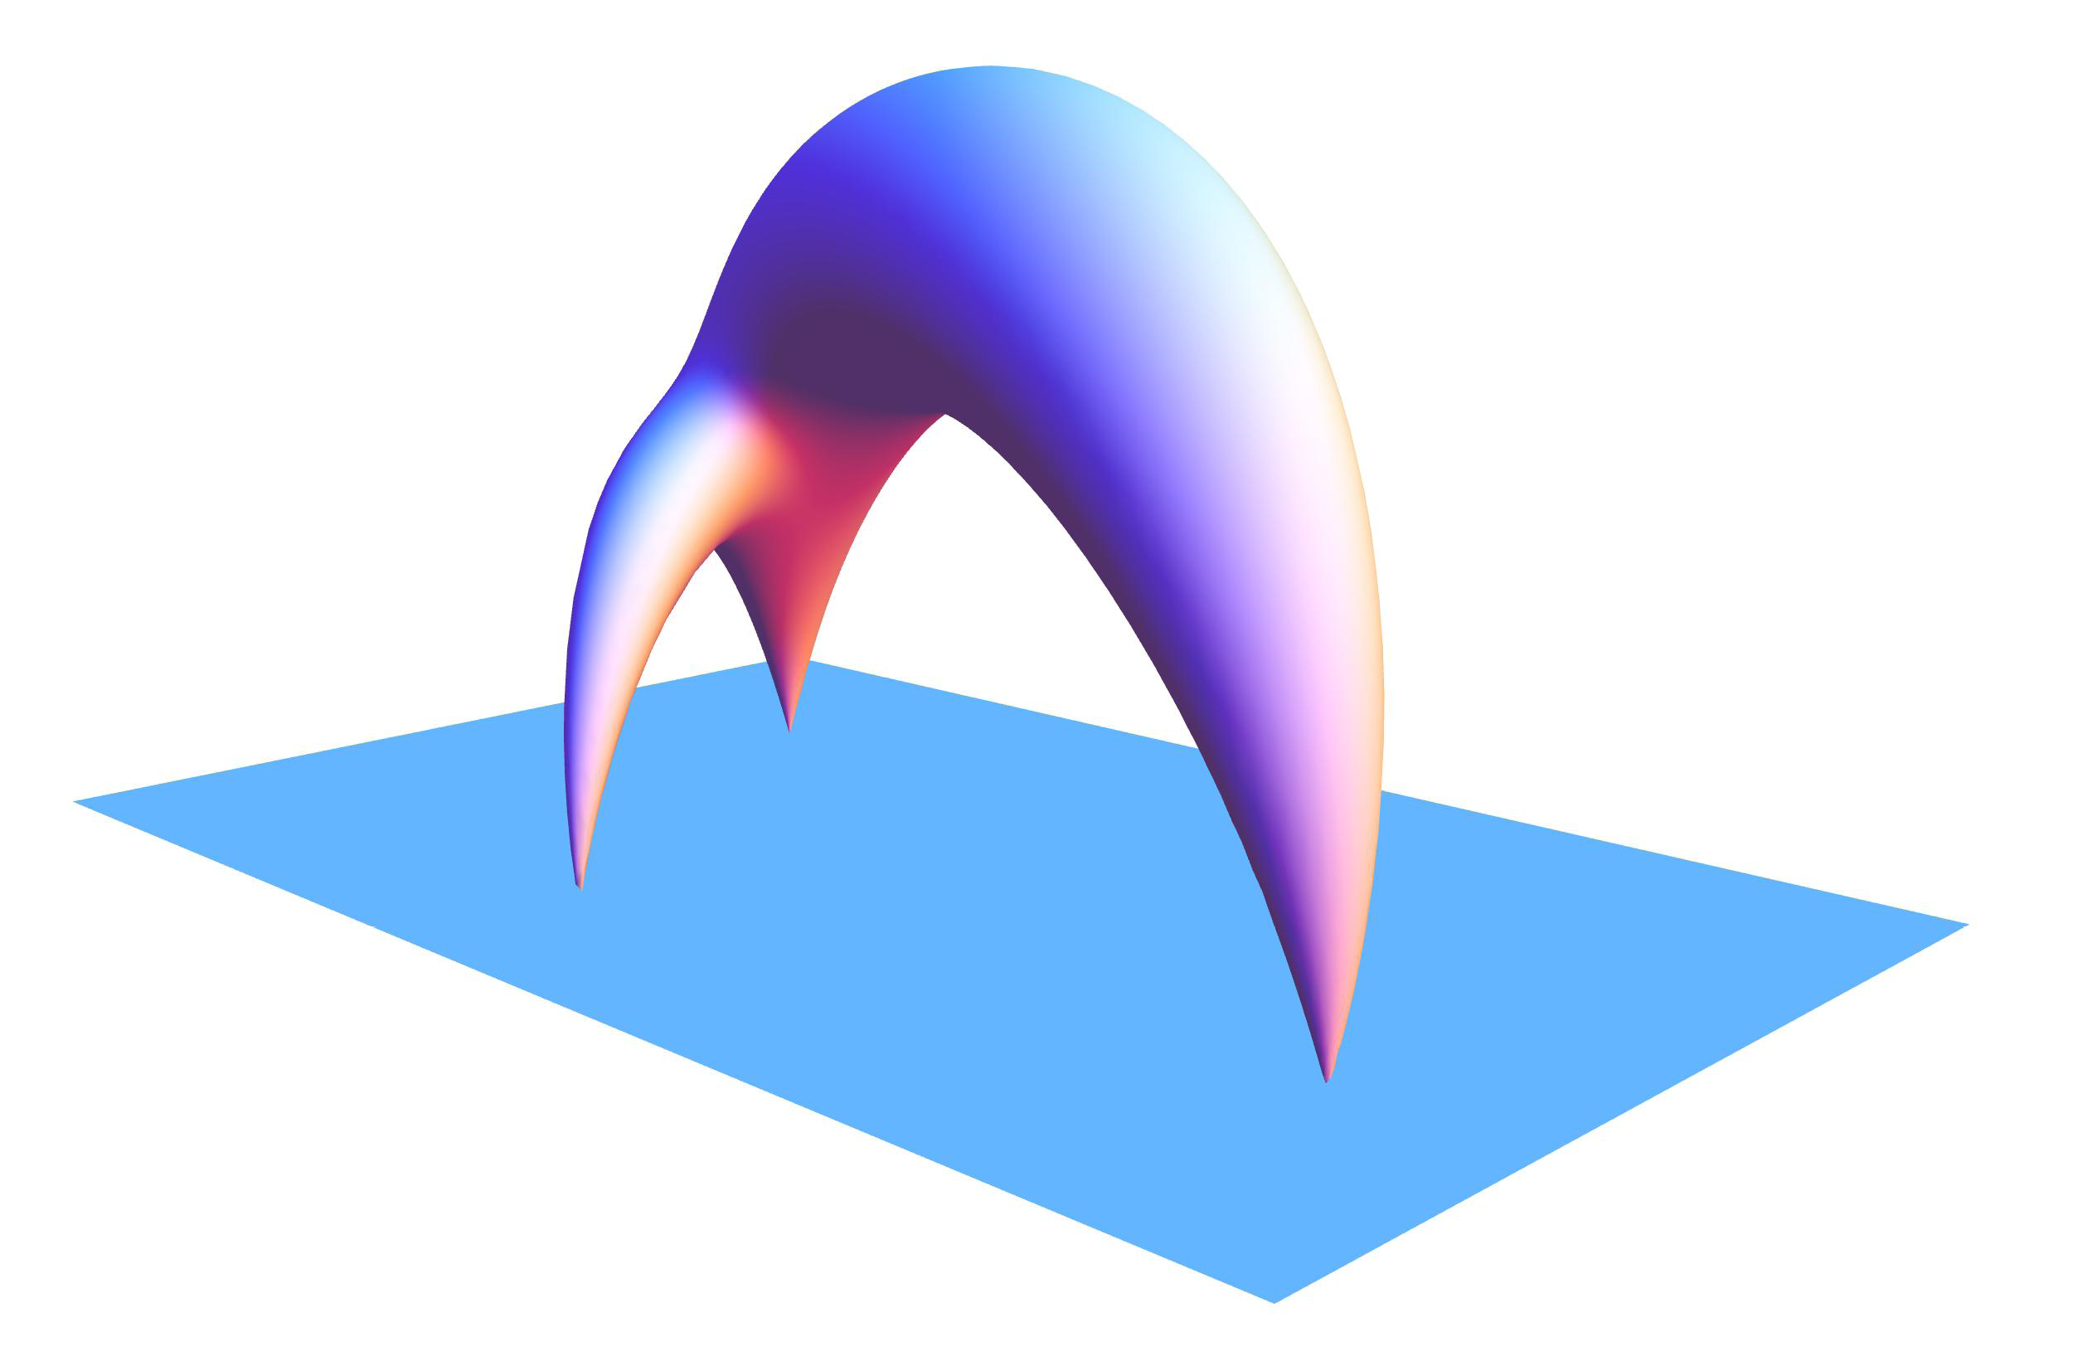

Slide 8
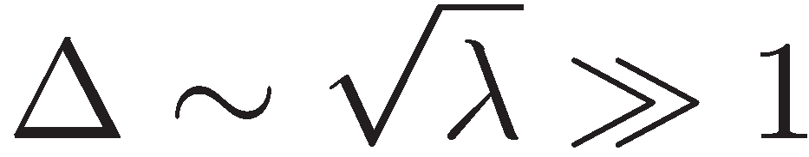
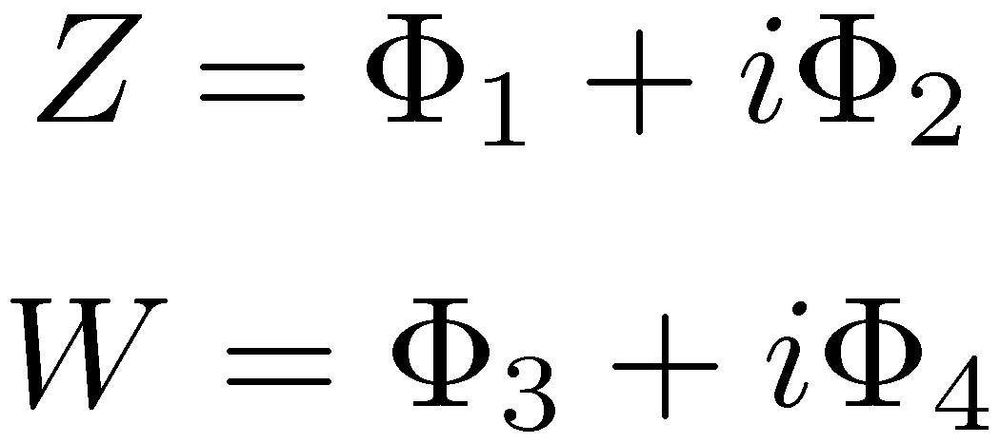
Semiclassical operators:
Berenstein,Maldacena,Nastase’02
Gubser,Klebanov,Polyakov’02
described by classical strings
Ex: long “spin-chain” operators

Slide 9
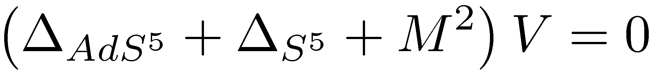
Correlation functions in string theory
Vertex operators:
(1,1) operators in the sigma-model
Semiclassically:
Callan,Gan’86

Slide 10
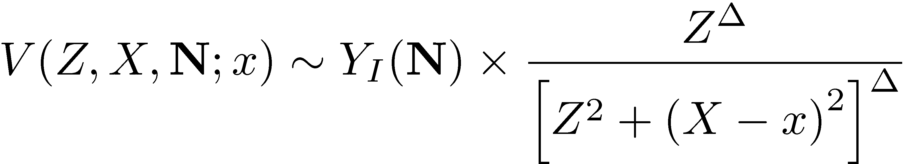

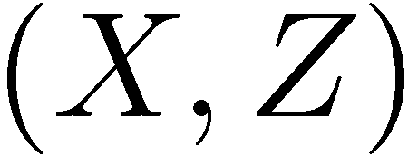

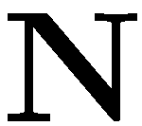
Vertex operators in AdS₅xS⁵
Polyakov’01
Tseytlin’03
Spherical functions
S⁵
AdS₅

Slide 11
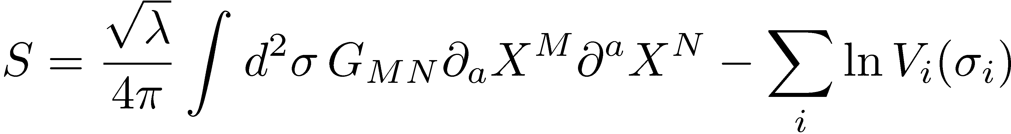
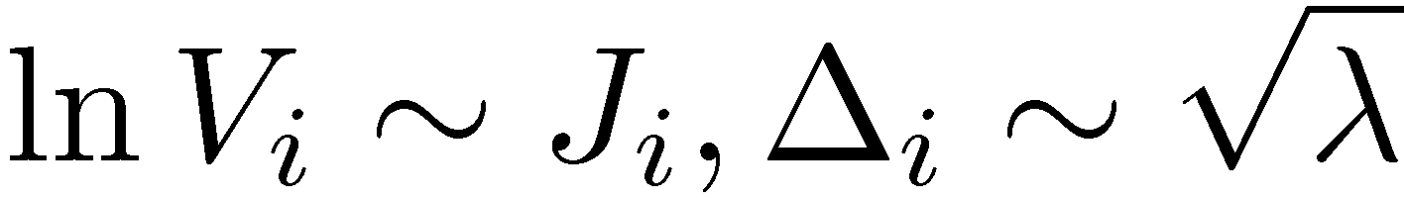
Semiclassical limit
Semiclassical states:
Sources in classical equations of motion:

Slide 12

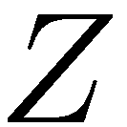

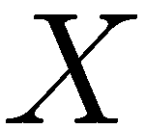
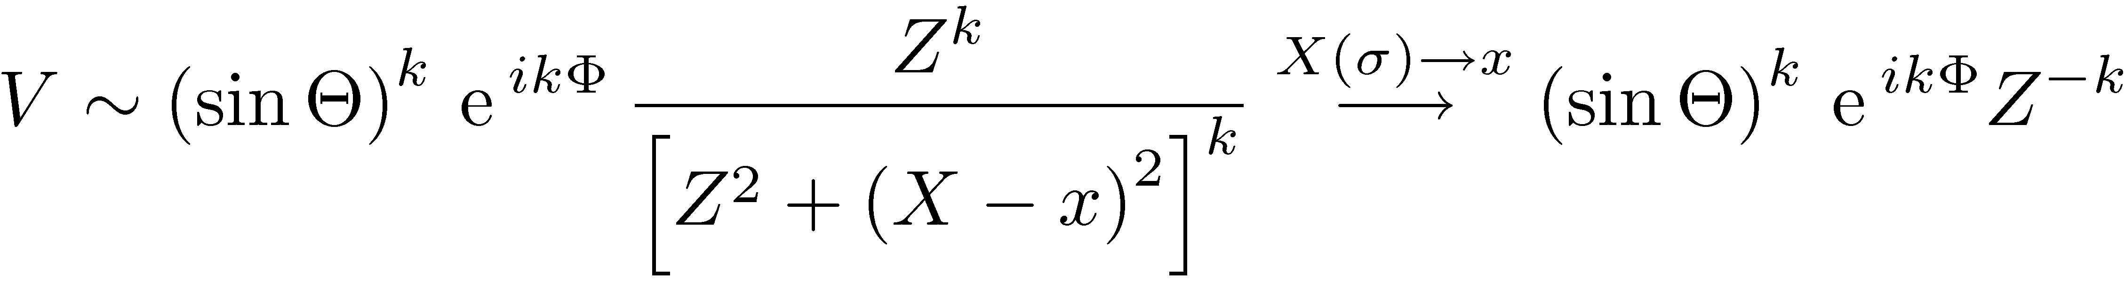
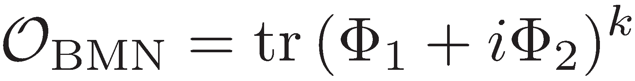
Example:
Dual to (same quantum numbers!):

Slide 13
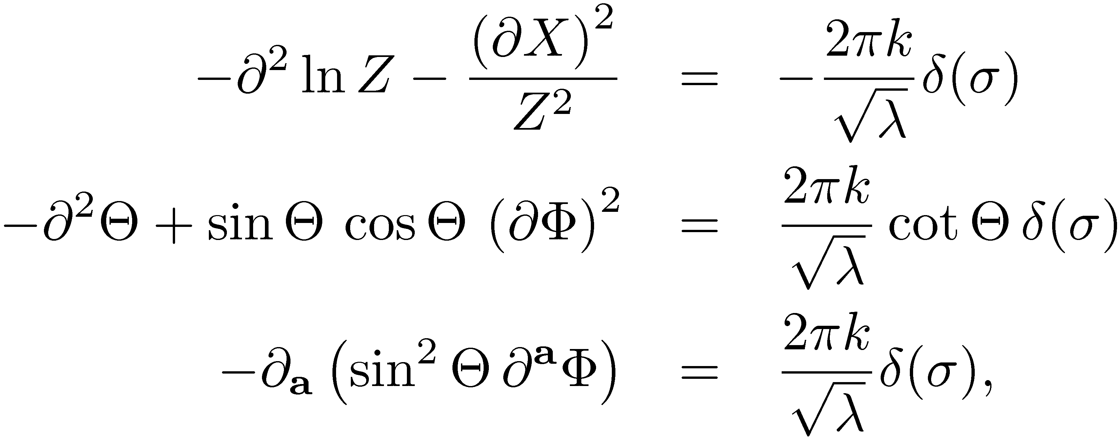
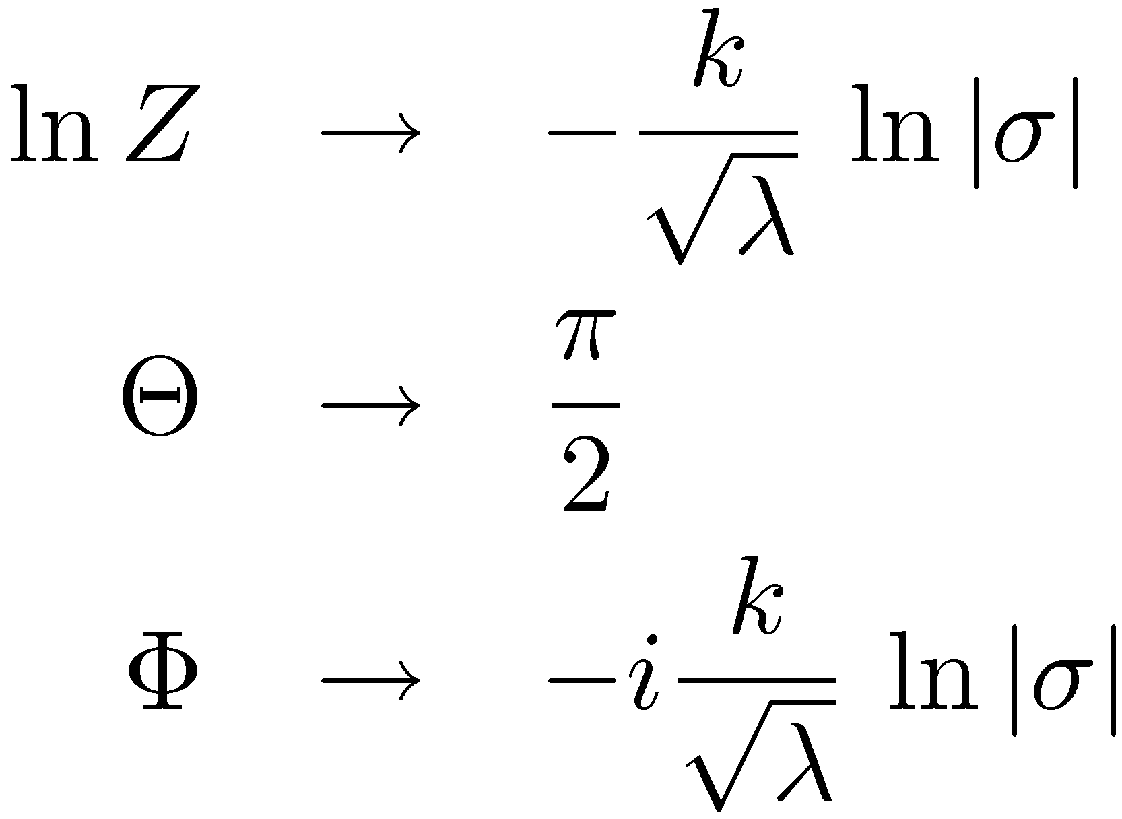
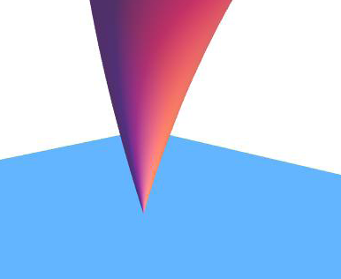
Boundary conditions:
de Boer,Ooguri,Robins,Tannenhauser’98

Slide 14
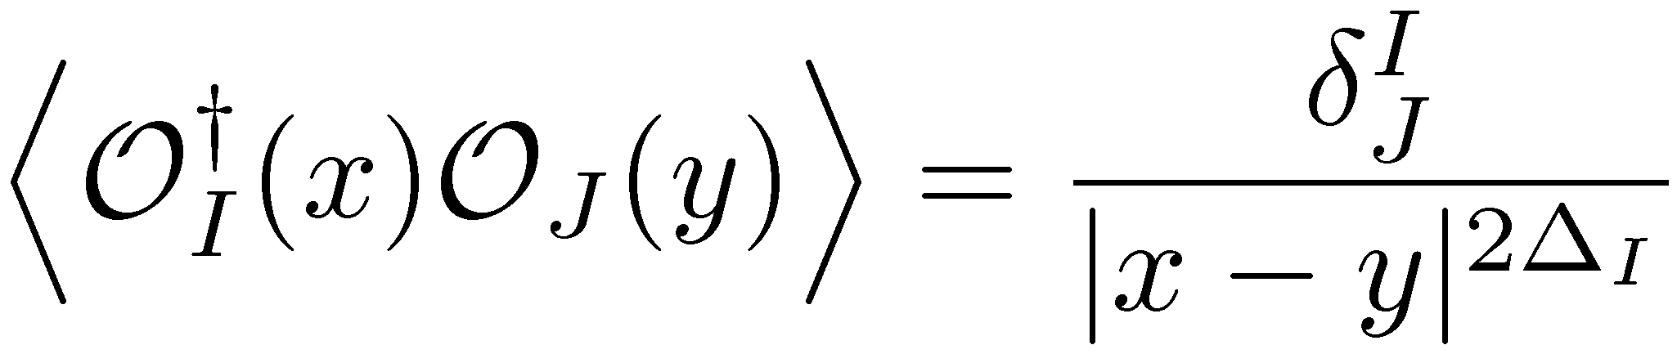
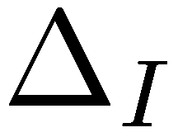
Two-point functions
Spectrum:
Known from integrability
exactly at large-N
Bombardelli,Fioravanti,Tateo’09
Gromov,Kazakov,Vieira’09
Arutyunov,Frolov’09

Slide 15

Holographic two-point functions
Buchbinder’10
Janik,Surowka,Wereszczynski’10
Buchbinder,Tseytlin’10
Two-point functions ↔ Spectrum ↔ Periodic solutions in global AdS
start with time-periodic (finite-gap) solution in global AdS
Wick-rotate
transform to Poincaré patch
generates solutions with correct boundary conditions
classical string action produces the correct - -dependence of the correlator
solutions are in general complex

Slide 16
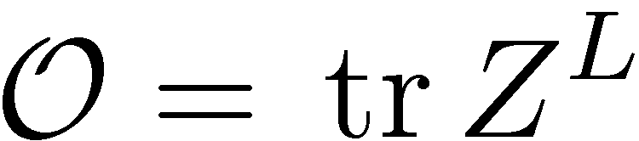
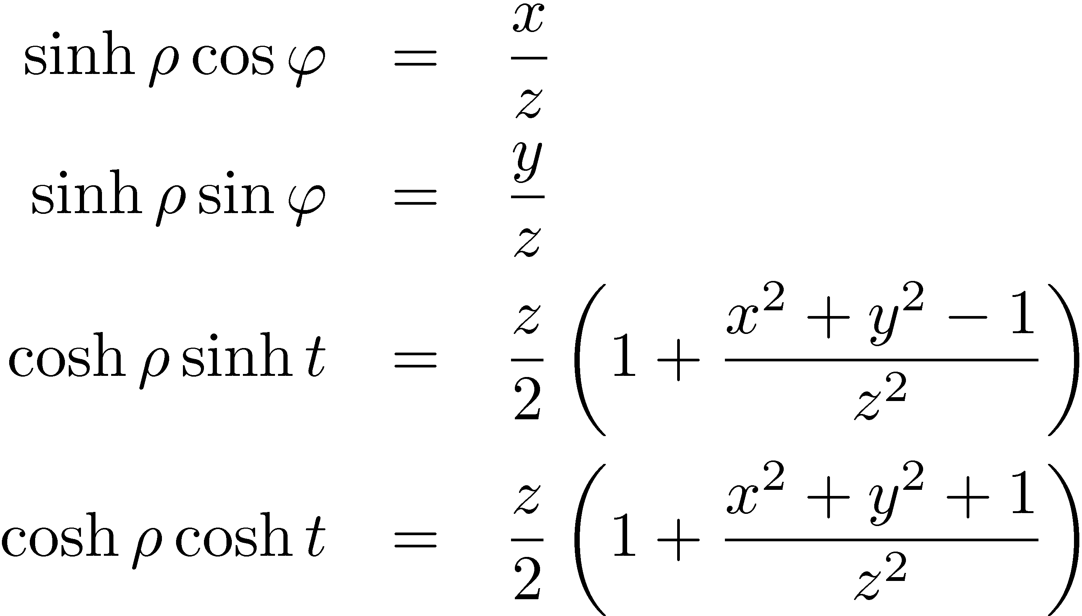
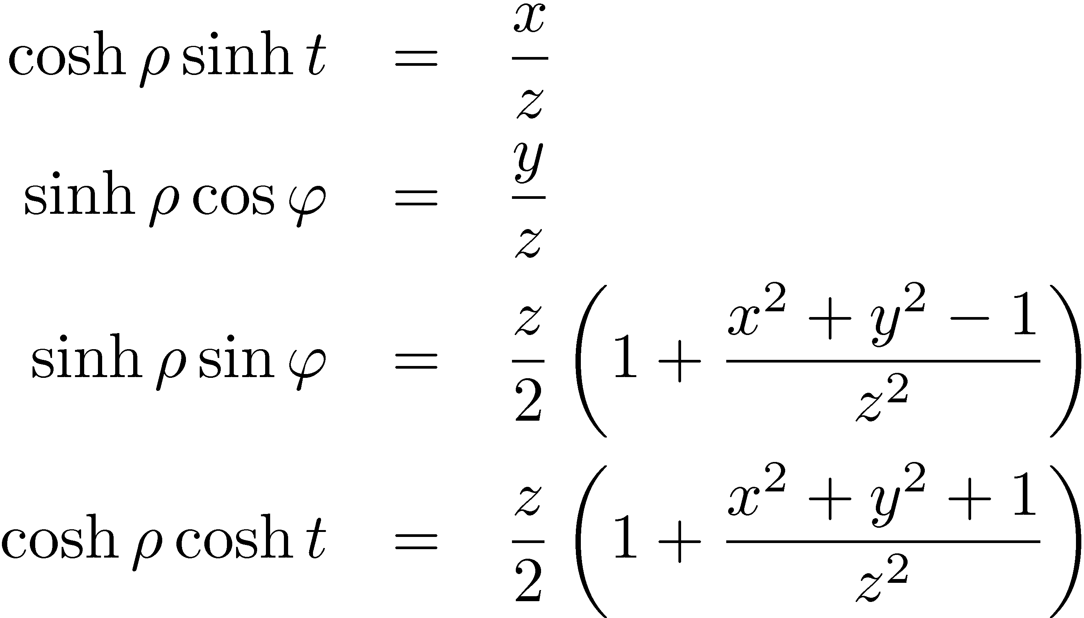
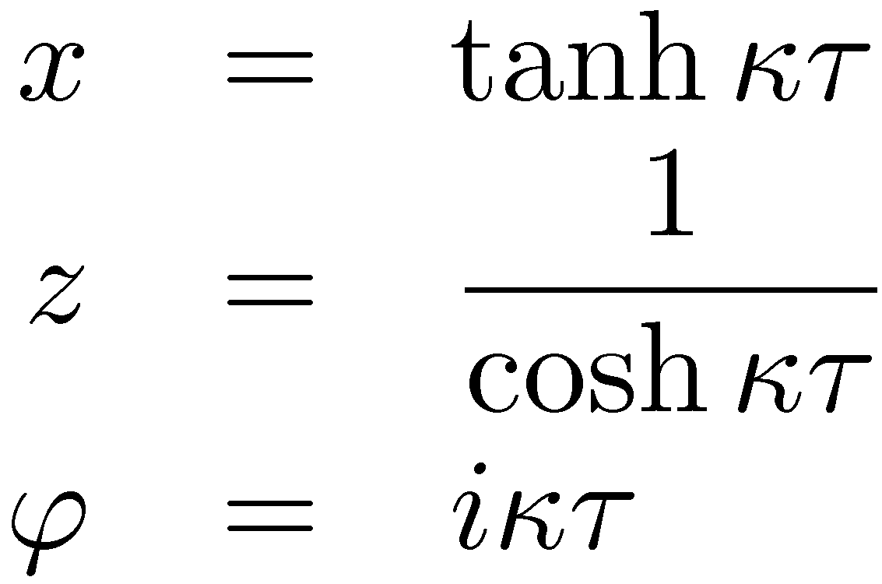
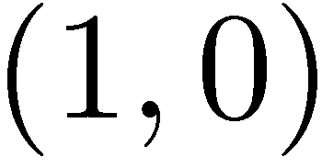
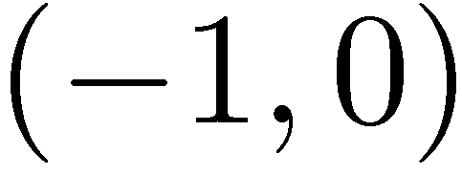
Example:
BMN string:
Standard global-Poincaré map (AdS₃):
Twisted map:
Cartesian coordinates on R^{3,1}
Tsuji’06
Janik,Surowka,Wereszczynski’10

Slide 17
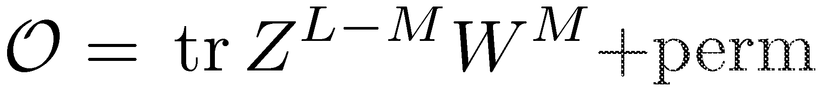
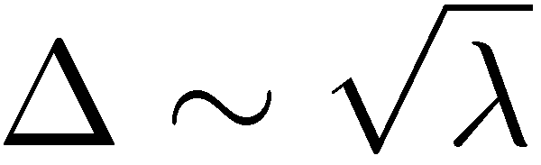
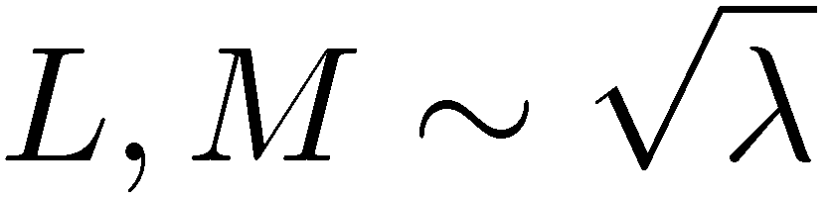
More general semiclassical states
Gubser,Klebanov,Polyakov’02
Frolov,Tseytlin’03
…
S⁵
global AdS₅
Periodic solutions in sigma-model ↔ Long operators in SYM
Energy:
Angular momenta:
…

Slide 18
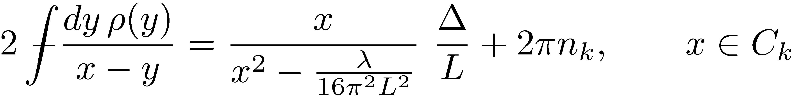
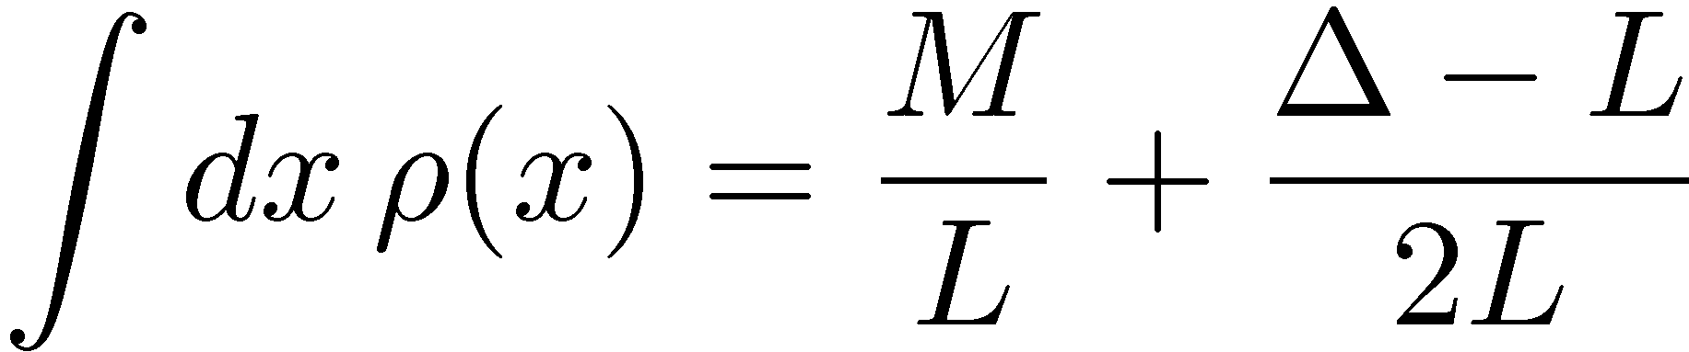
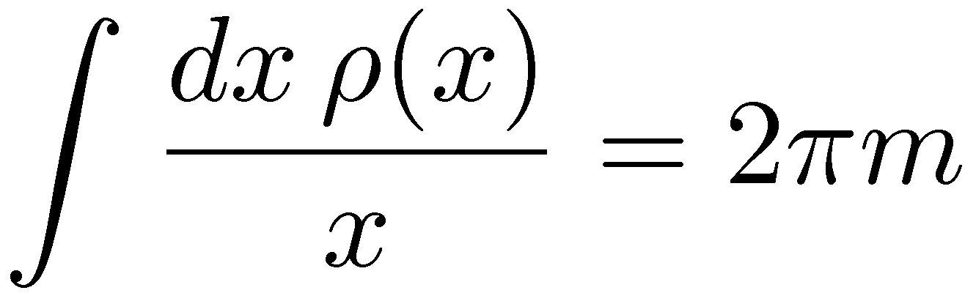
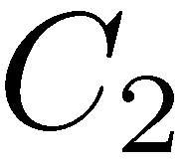
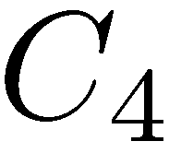
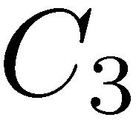
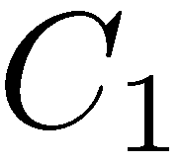
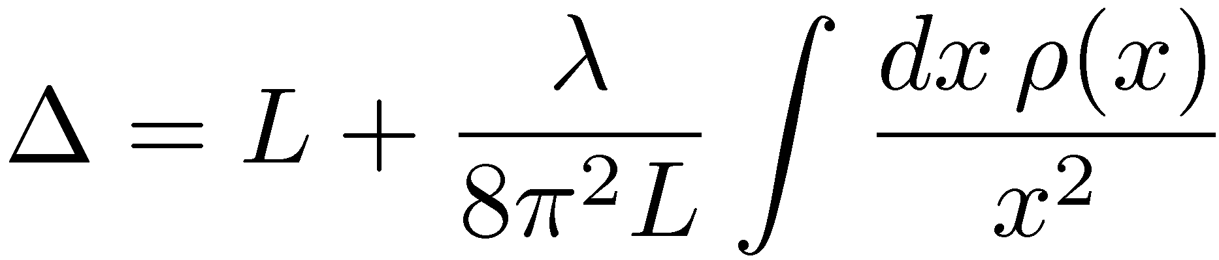
Finite-gap solutions
Kazakov,Marshakov,Minahan,Z.’04
Normalization:
Level matching:
Scaling dimension:

Slide 19
vertex operators
↔
finite-gap solutions
(?)

Slide 20
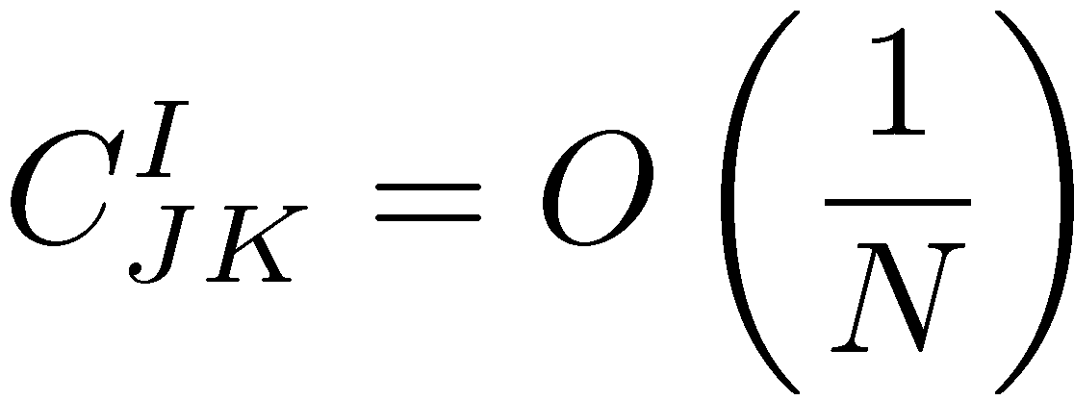
Three-point functions
OPE coefficients:
Simplest 1/N observables:

Slide 21
Three-point functions
No solutions known

Slide 22

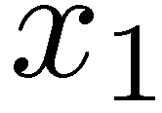
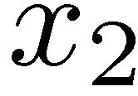
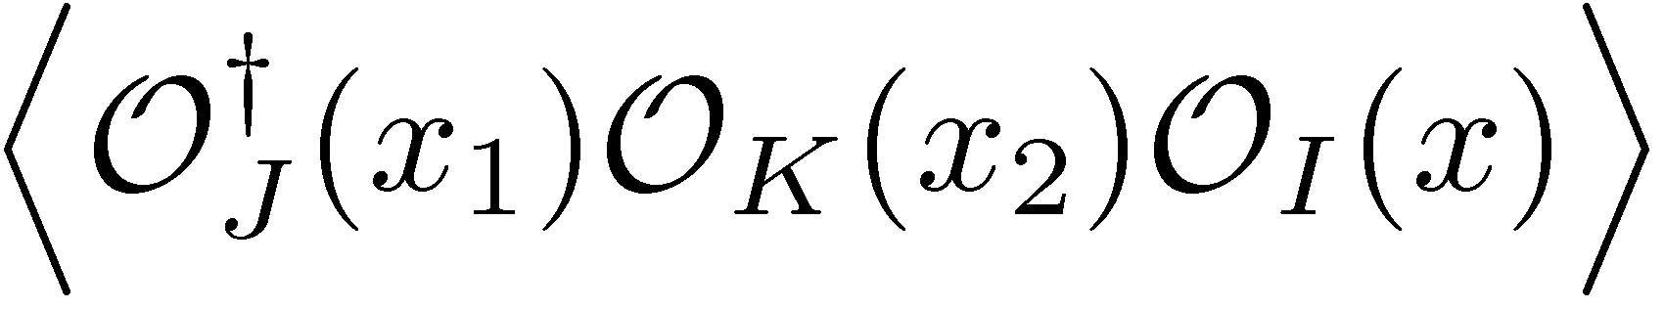
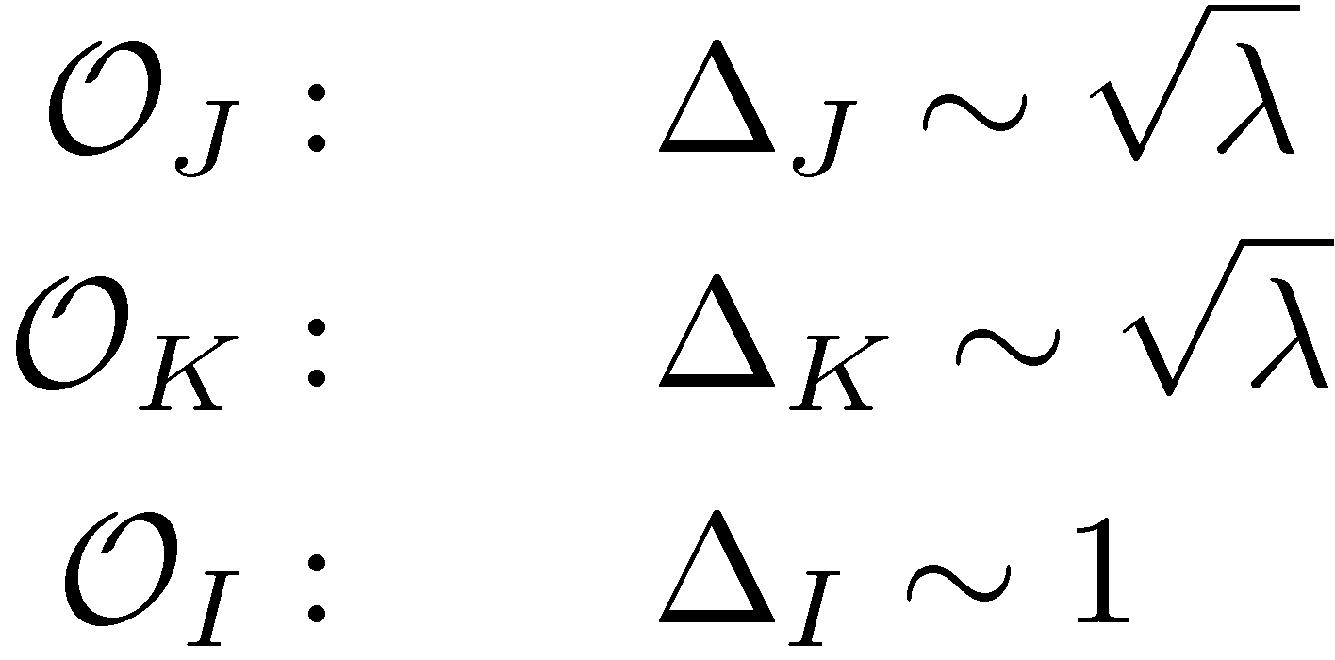
Z.’10
Costa,Monteiro,Santos,Zoakos’10
Roiban,Tseytlin’10
Hernandez’10
Arnaudov,Rashkov’10
Georgiou’10
Lee,Park’10,11
Buchbinder,Tseytlin’10
Bak,Chen,Wu’11
Bissi,Kristjansen,Young,Zoubos’11
Arnaudov,Rashkov,Vetsov’11
Bai,Lee,Park’11
Alday,Tseytlin’11
Ahn,Bozhilov’11
Bozholov’11
...
Simpler problem:
create fat string
creates slim string

Slide 23
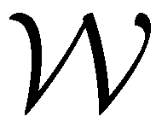
General formalism
big non-local operator that creates classical string
Berenstein,Corrado,Fischler,Maldacena’98

Slide 24
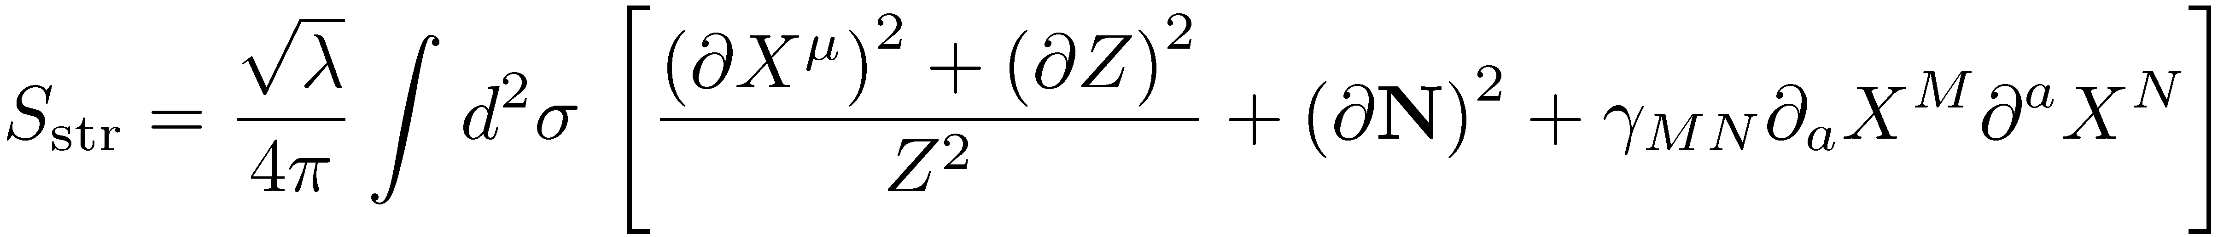
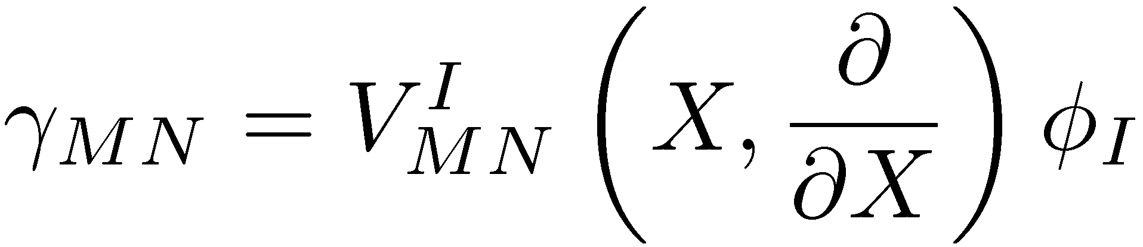

metric perturbation
due to operator insertion
vertex operator
OPE coefficient:

Slide 25


Chiral Primary Operators
symmetric traceless tensor of SO(6)
Dual to scalar supergravity mode on S⁵
Wavefunction on S⁵:
(spherical function of SO(6))

Slide 26


Kaluza-Klein reduction
Kim,Romans,van Nieuwenhuizen’85
Lee,Minwalla,Rangamani,Seiberg‘98
Vertex operator:

Slide 27




Correlator of three chiral primaries
Superconformal highest weight:
@
Spherical function:

Slide 28




Classical solution:
OPE coefficient:
Exact OPE coefficient of three CPO’s:
Agree at J>>k
Lee,Minwalla,Rangamani,Seiberg‘98

Slide 29





Spinning string on S⁵
Frolov,Tseytlin’03
Elliptic modulus:
Conserved charges:

Slide 30

Dual to
The concrete operator can be identified by comparing
the finite-gap curve to Bethe ansatz
Beisert,Minahan,Staudacher,Z.’03

Slide 31


OPE coefficient:
What happens when k becomes large?

Slide 32




Saddle-point approximation
to ∞
Saddle-point equations:
fixed
point

Slide 33




Overlapping regime of validity:

Slide 34





Exact solution with a spike:
Z.’02
Describes
for circular Wilson loop
Solution for ?

Slide 35




Boundary conditions at the spike

Slide 36

Fine structure of the spike
Regular solution
without the spike

Slide 37




Solution on S⁵:
Virasoro constraints:
limit:
Determine the position
on the worldsheet, where
the spike can be attached.
The same as the saddle-point equation for the vertex operator!

Slide 38
Factorization
Roiban,Tseytlin’10
Integration over σ_{i} independent:

Slide 39

Integrability
∞ number
of conservation laws
Bookeeping of
conserved charges:

Slide 40
Integrability in 3-point functions?
conserved
charges
(known)
Algebraic curves for external states + branching?

Slide 41
Weak coupling
Escobedo,Gromov,Sever,Vieira’10
Caetano,Escobedo’11
Overlap of three spin chain states
Certain resemblance to string field theory vertex
Can be efficiently computed using ABA
Still not enough to take the large-charge limit to compare to strong coupling
Okuyama,Tseng’04
Escobedo,Gromov,Sever,Vieira’10

Slide 42
Questions
Possible to compute the <LH…H> correlation functions (H – heavy semiclassical states, L – light supergravity state)
How to calculate <HHH>?
Can give a clue to exact solution…
How to use integrability?
Vertex operators ↔ Classical Solutions ↔ Bethe ansatz
Boundary conditions for generic vertex operators
Z.’10
Costa,Monteiro,Santos,Zoakos’10
Roiban,Tseytlin’10
Hernandez’10
Buchbinder,Tseytlin’10
?

