Slide 1
Data Analysis
Wouter Verkerke (NIKHEF)

Slide 2
HEP and data analysis
General introduction

Slide 3
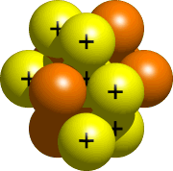
Particle physics
Bestudeert de natuur op afstanden < 10⁻¹⁵ m
10⁻¹⁵ m
atom nucleus
Looking at the smallest constituents of matter → Building a consistent theory that describe matter and elementary forces

Slide 4
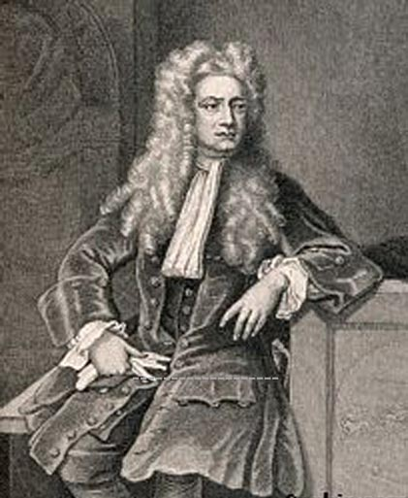
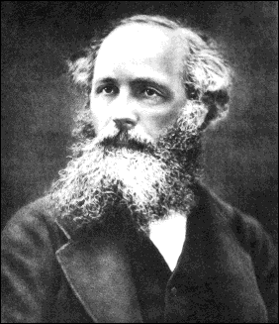
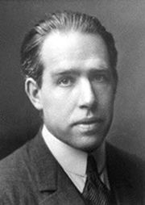
Zwaartekracht en Electromagnetisme “zelfde krachten … nieuwe modellen”
Theory of Relativity
Newton
Einstein
Quantum Mechanics
Maxwell
Bohr

Slide 5
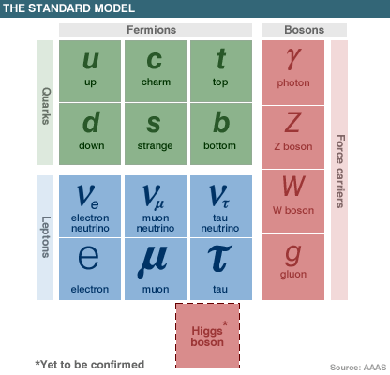
High Energy Physics
Working model: ‘the Standard Model’ (a Quantum Field Theory)
Describes constituents of matter, 3 out of 4 fundamental forces

Slide 6
The standard model has many open issues

Slide 7
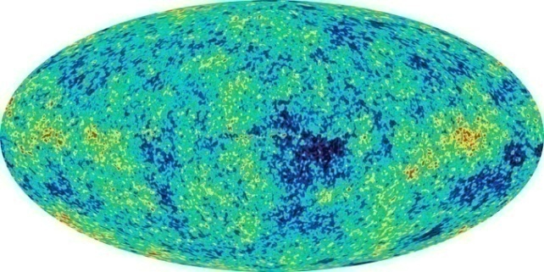
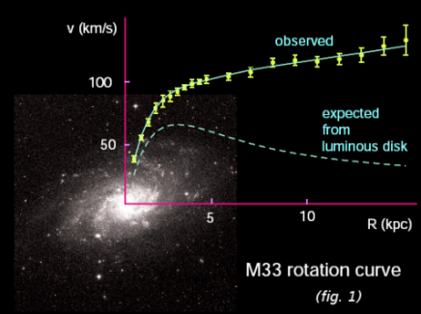
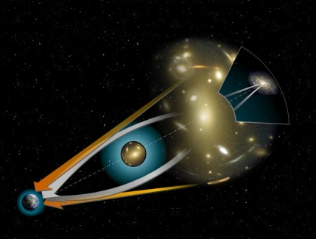
Link with Astrophysics
Temperature fluctuations in Cosmic Microwave Background
Rotation Curves
Gravitational Lensing
What is dark matter?

Slide 8
Particle Physic today – Large Machines

Slide 9
Detail of Large Hadron Collider

Slide 10
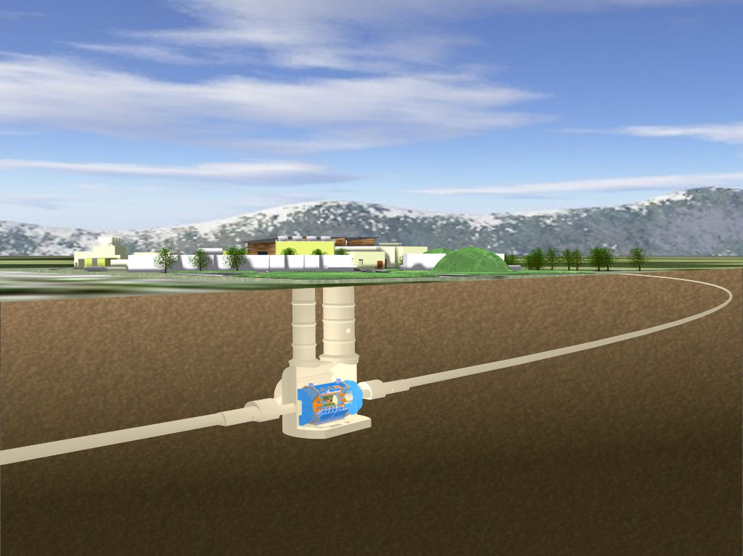
And large experiments underground

Slide 11
One of the 4 LHC experiments – ATLAS

Slide 12
View of ATLAS during construction

Slide 13
Collecting data at the LHC

Slide 14
Data reduction, processing and storage are big issues

Slide 15
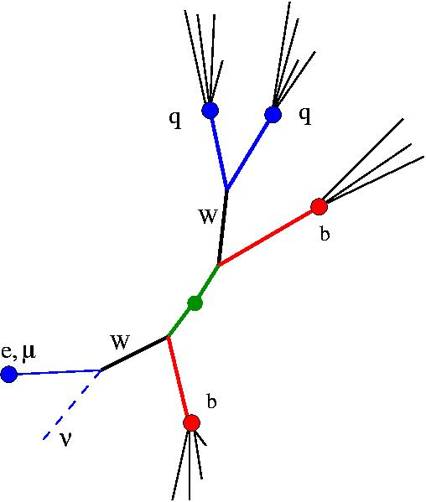
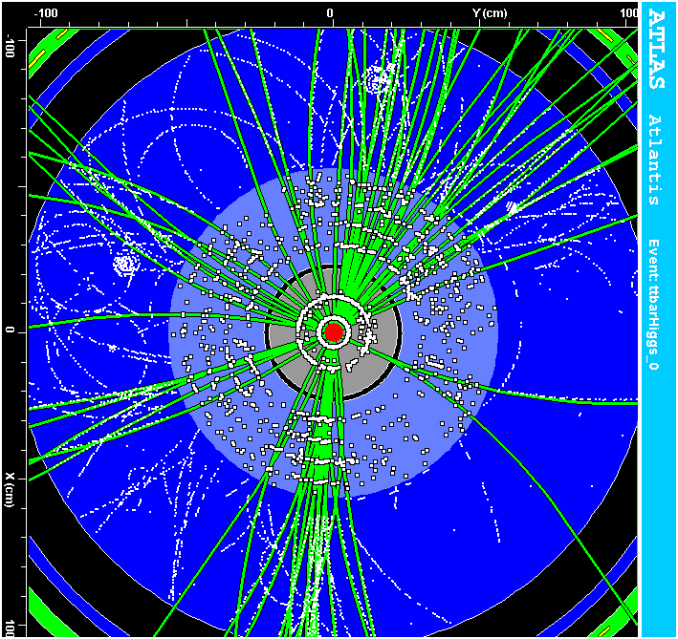
Analyzing the data – The goal
What we see in the detector
Fundamental physics picture
proton
proton
Extremely difficult (and not possible on an event-by-event basis anyway due to QM)

Slide 16
Analyzing the data – in practice
event reconstruction data analysis
detector simulation
Physics simulation
ATLAS
detector
?
The LHC

Slide 17
‘Easy stuff’

Slide 18
‘Difficult stuff’

Slide 19
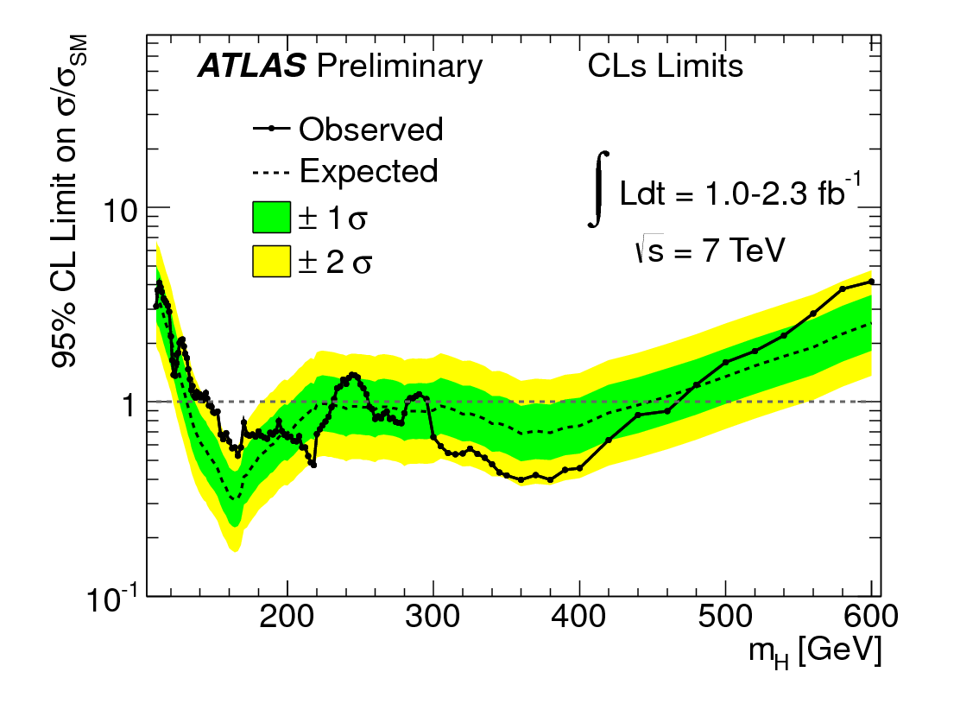
Quantify what we observe and what we expect to see
Methods and details are important – for certain physics we only expect a handful of events after years of data taking

Slide 20
Tools for data analysis in HEP
Nearly all HEP data analysis happens in a single platform
ROOT (1995-now)
And before that PAW (1985-1995)
Large project with many developers, contributors, workshops

Slide 21
Choice of working environment R vs. ROOT
ROOT has become de facto HEP standard analysis environment
Available and actively used for analyses in running experiments (Tevatron, B factories etc..)
ROOT is integrated LHC experimental software releases
Data format of LHC experiments is (indirectly) based on ROOT → Several experiments have/are working on summary data format directly usable in ROOT
Ability to handle very large amounts of data
ROOT brings together a lot of the ingredients needed for (statistical) data analysis
C++ command line, publication quality graphics
Many standard mathematics, physics classes: Vectors, Matrices, Lorentz Vectors Physics constants…
Line between ‘ROOT’ and ‘external’ software not very sharp
Lot of software developed elsewhere, distributed with ROOT (TMVA, RooFit)
Or thin interface layer provided to be able to work with external library (GSL, FFTW)
Still not quite as nice & automated as ‘R’ package concept

Slide 22
(Statistical) software repositories
ROOT functions as moderated repository for statistical & data analysis tools
Examples TMVA, RooFit
Several HEP repository initiatives, some contain statistical software
PhyStat.org (StatPatternRecognition, TMVA,LepStats4LHC)
HepForge (mostly physics MC generators),
FreeHep
Excellent summary of non-HEP statistical repositories on Jim Linnemans statistical resources web page
From Phystat 2005
http://www.pa.msu.edu/people/linnemann/stat_resources.html

Slide 23
Roadmap for this course
In this course I aim to follow the ‘HEP workflow’ to organize the discussion of statistics issues
My experience is that this most intuitive for HEP Phd students
HEP Introduction & Basics
A short overview of HEP
Distributions, the Central Limit Theorem
Event classification
Hypothesis testing
Machine learning
Parameter estimation
Estimators: Maximum Likelihood and Chi-squared
Mathematical tools for model building
Practical issues arising with minimization
Confidence intervals, limits, significance
Hypothesis testing (again), Bayes Theorem
Frequentist statistics, Likelihood-based intervals
Likelihood principle and conditioning
Discovery, exclusion and nuisance parameters
Formulating discovery and exclusion
Systematic uncertainties as nuisance parameters
Treatment of nuisance parameters in statistical inference

Slide 24
Basic Statistics
Mean, Variance, Standard Deviation
Gaussian Standard Deviation
Covariance, correlations
Basic distributions – Binomial, Poisson, Gaussian
Central Limit Theorem
Error propagation

Slide 25
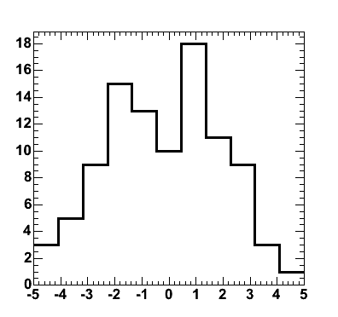
Describing your data – the Average
Given a set of unbinned data (measurements) { x₁, x₂, …, x_{N}} then the mean value of x is
For binned data
where n_{i} is bin count and x_{i} is bin center
Unbinned average more accurate due to rounding
x
n_{i}
x_{i}

Slide 26
Describing your data – Spread
Variance V(x) of x expresses how much x is liable to vary from its mean value x
Standard deviation

Slide 27
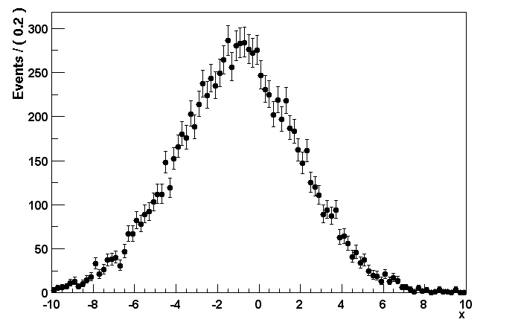
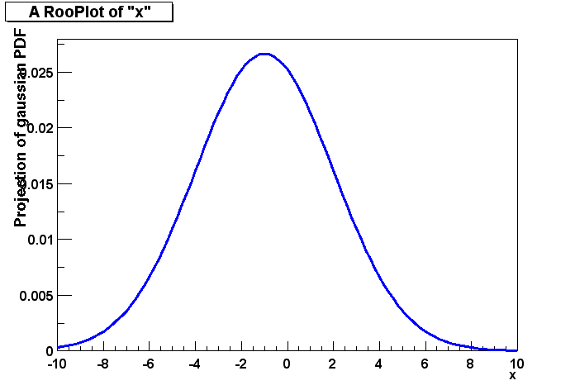
Different definitions of the Standard Deviation
is the S.D. of the data sample
Presumably our data was taken from a parent distributions which has mean μ and S.F. σ
Data Sample
Parent Distribution (from which data sample was drawn)
σ
σ
x
μ
x – mean of our sample
μ – mean of our parent dist
σ – S.D. of our sample
σ – S.D. of our parent dist
Beware Notational Confusion!

Slide 28
Different definitions of the Standard Deviation
Which definition of σ you use, σ_{data} or σ_{parent}, is matter of preference, but be clear which one you mean!
In addition, you can get an unbiased estimate of σ_{parent} from a given data sample using
Data Sample
Parent Distribution (from which data sample was drawn)
σ_{data}
σ_{parent}
x
μ

Slide 29
More than one variable
Given 2 variables x,y and a dataset consisting of pairs of numbers { (x₁,y₁), (x₂,y₂), … (x_{N},y_{N}) }
Definition of x, y, σ_{x}, σ_{y} as usual
In addition, any dependence between x,y described by the covariance
The dimensionless correlation coefficient is defined as
(has dimension D(x)D(y))

Slide 30
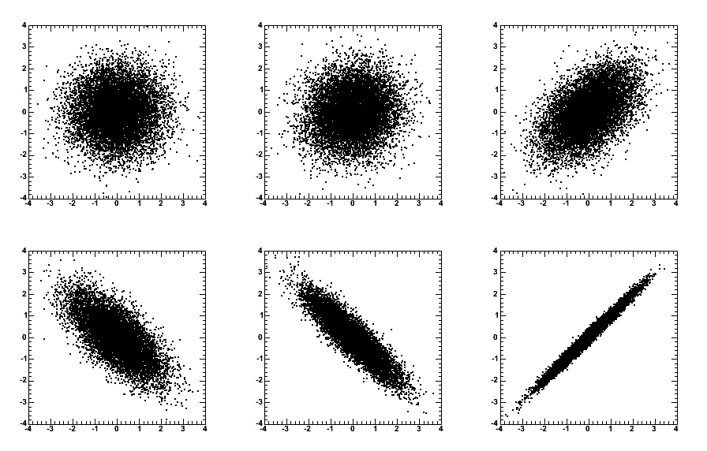
Visualization of correlation
ρ = 0
ρ = 0.1
ρ = 0.5
ρ = -0.7
ρ = -0.9
ρ = 0.99

Slide 31
Correlation & covariance in >2 variables
Concept of covariance, correlation is easily extended to arbitrary number of variables
so that takes the form of a n x n symmetric matrix
This is called the covariance matrix, or error matrix
Similarly the correlation matrix becomes

Slide 32
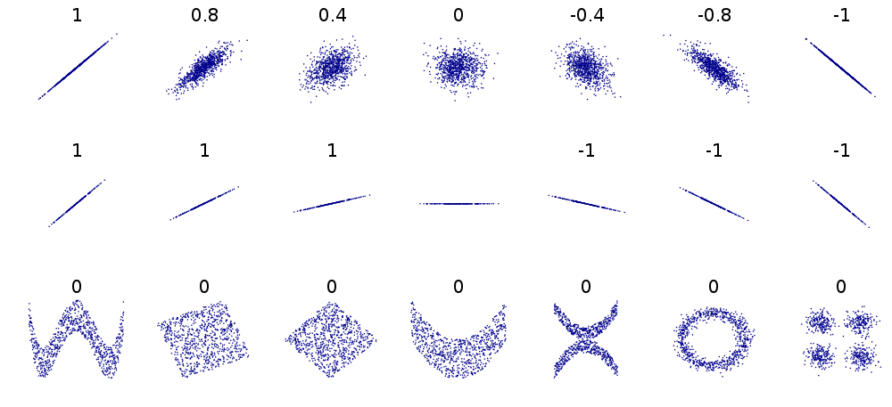
Linear vs non-linear correlations
Correlation coeffients used here are (linear) Pearson product-moment correlation coefficient
Data can have more subtle (non-linear correlations) that expressed in these coefficient

Slide 33
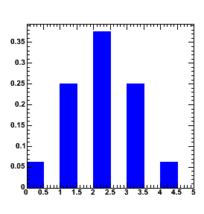
Basic Distributions – The binomial distribution
Simple experiment – Drawing marbles from a bowl
Bowl with marbles, fraction p are black, others are white
Draw N marbles from bowl, put marble back after each drawing
Distribution of R black marbles in drawn sample:
Probability of a specific outcome e.g. ‘BBBWBWW’
Number of equivalent permutations for that outcome
p=0.5 N=4
Binomial distribution
P(R;0.5,4)
R

Slide 34
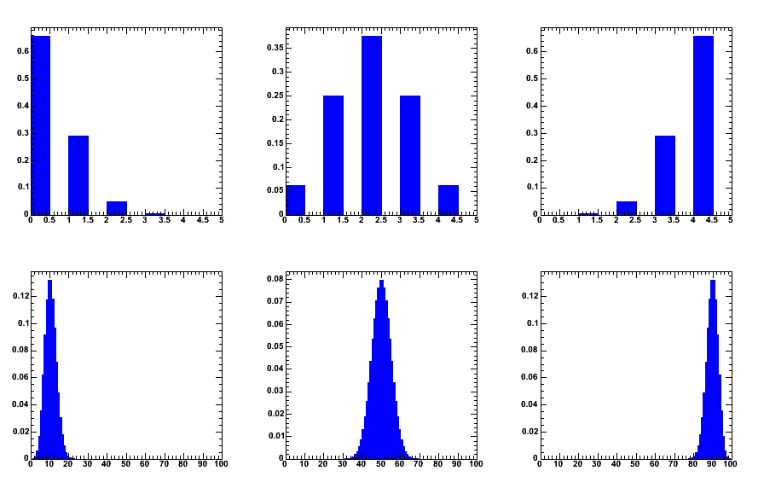
Properties of the binomial distribution
Mean:
Variance:
p=0.1, N=4
p=0.5, N=4
p=0.9, N=4
p=0.1, N=1000
p=0.5, N=1000
p=0.9, N=1000

Slide 35
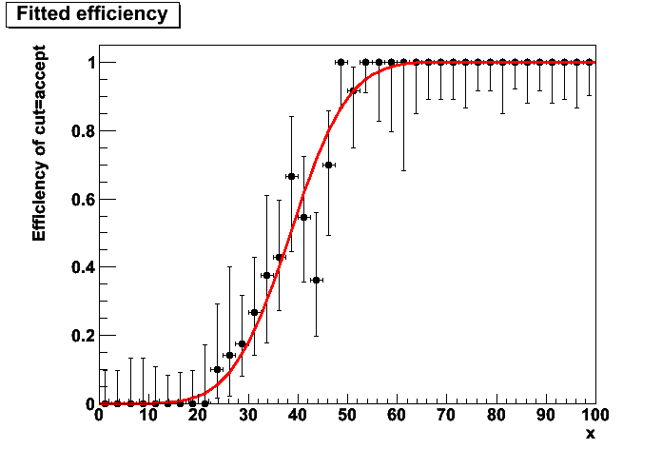
HEP example – Efficiency measurement
Example: trigger efficiency
Usually done on simulated data so that also untriggered events are available

Slide 36
Basic Distributions – the Poisson distribution
Sometimes we don’t know the equivalent of the number of drawings
Example: Geiger counter
Sharp events occurring in a (time) continuum
What distribution to we expect in measurement over fixed amount of time?
Divide time interval λ in n finite chunks,
Take binomial formula with p=λ/n and let n→∞
Poisson distribution

Slide 37
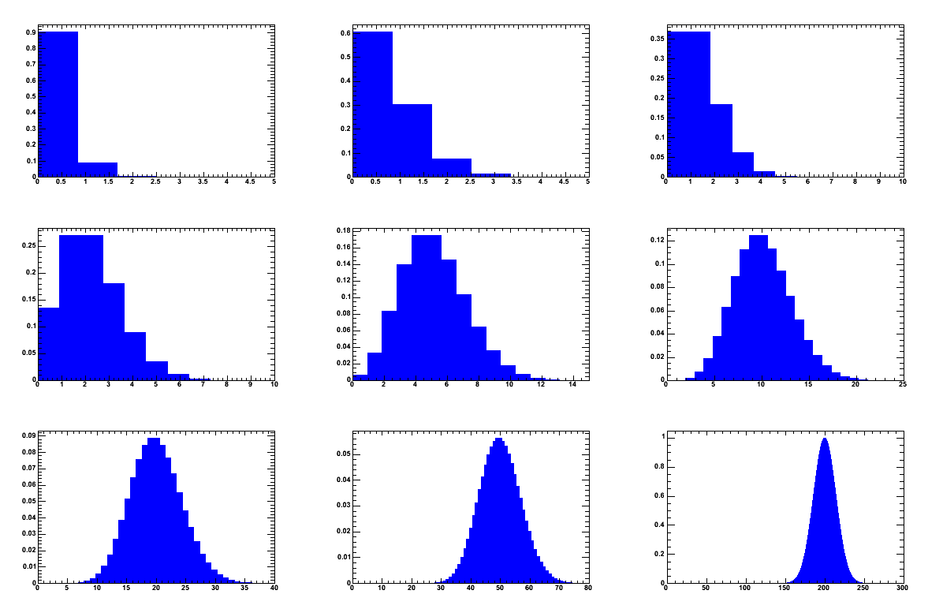
Properties of the Poisson distribution
λ=0.1
λ=0.5
λ=1
λ=2
λ=5
λ=10
λ=20
λ=50
λ=200

Slide 38
More properties of the Poisson distribution
Mean, variance:
Convolution of 2 Poisson distributions is also a Poisson distribution with λ_{ab}=λ_{a}+λ_{b}

Slide 39
HEP example – counting experiment
Any distribution plotted on data (particularly in case of low statistics

Slide 40
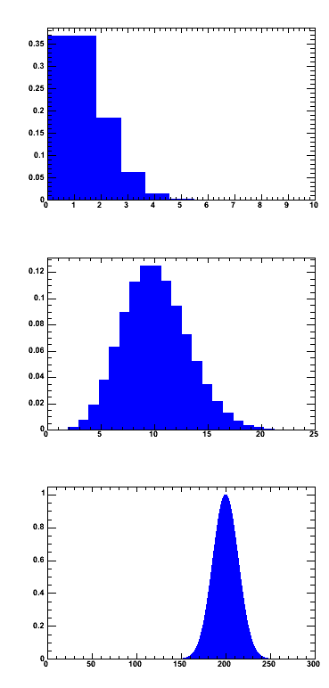
Basic Distributions – The Gaussian distribution
Look at Poisson distribution in limit of large N
λ=1
Take log, substitute, r = λ + x, and use
λ=10
λ=200
Take exp
Familiar Gaussian distribution, (approximation reasonable for N>10)

Slide 41
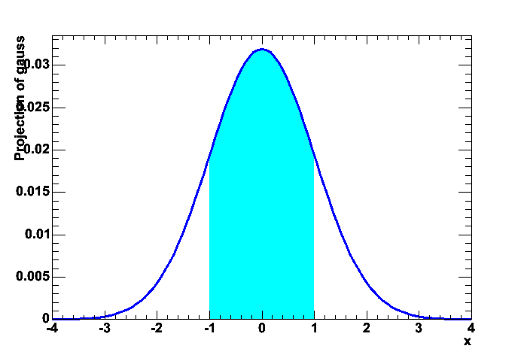
Properties of the Gaussian distribution
Mean and Variance
Integrals of Gaussian
68.27% within 1σ | 90% → 1.645σ
95.43% within 2σ | 95% → 1.96σ
99.73% within 3σ | 99% → 2.58σ
 | 99.9% → 3.29σ

Slide 42
HEP example – high statistics counting expt
High statistics distributions from data

Slide 43
Errors
Doing an experiment → making measurements
Measurements not perfect → imperfection quantified in resolution or error
Common language to quote errors
Gaussian standard deviation = sqrt(V(x))
68% probability that true values is within quoted errors [NB: 68% interpretation relies strictly on Gaussian sampling distribution, which is not always the case, more on this later]
Errors are usually Gaussian if they quantify a result that is based on many independent measurements

Slide 44
The Gaussian as ‘Normal distribution’
Why are errors usually Gaussian?
The Central Limit Theorem says
If you take the sum X of N independent measurements x_{i}, each taken from a distribution of mean m_{i}, a variance V_{i}=σ_{i}², the distribution for x (a) has expectation value (b) has variance (c ) becomes Gaussian as N → ∞
Small print: tails converge very slowly in CLT, be careful in assuming Gaussian shape beyond 2σ

Slide 45
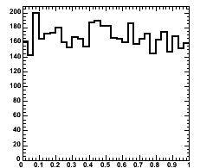
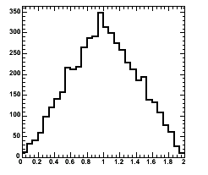
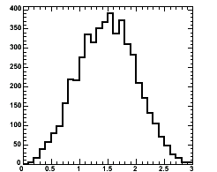
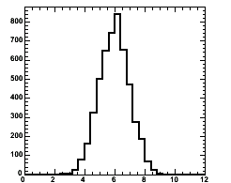
Demonstration of Central Limit Theorem
5000 numbers taken at random from a uniform distribution between [0,1].
Mean = ¹/₂, Variance = ¹/₁₂
5000 numbers, each the sum of 2 random numbers, i.e. X = x₁+x₂.
Triangular shape
Same for 3 numbers, X = x₁ + x₂ + x₃
Same for 12 numbers, overlaid curve is exact Gaussian distribution
N=1
N=2
N=3
N=12

Slide 46
Central Limit Theorem – repeated measurements
Common case 1 : Repeated identical measurements i.e. μ_{i} = μ, σ_{i} = σ for all i
C.L.T
⬅ Famous sqrt(N) law

Slide 47
Central Limit Theorem – repeated measurements
Common case 2 : Repeated measurements with identical means but different errors (i.e weighted measurements, μ_{i} = μ)
Weighted average
‘Sum-of-weights’ formula for error on weighted measurements

Slide 48
Error propagation – one variable
Suppose we have
How do you calculate V(f) from V(x)?
More general:
But only valid if linear approximation is good in range of error
← i.e. σ_{f} = |a|σ_{x}

Slide 49
Error Propagation – Summing 2 variables
Consider
More general
Familiar ‘add errors in quadrature’
only valid in absence of correlations, i.e. cov(x,y)=0
But only valid if linear approximation is good in range of error
The correlation coefficient ρ [-1,+1] is 0 if x,y uncorrelated

Slide 50
Error propagation – multiplying, dividing 2 variables
Now consider
Result similar for
Other useful formulas
(math omitted)
Relative error on x,1/x is the same
Error on log is just fractional error

Slide 51
Coffee break

