Slide 1
Parameter estimation
χ² and likelihood
Introduction to estimation
Properties of χ², ML estimators
Measuring and interpreting Goodness-Of-Fit
Numerical issues in fitting
Understanding MINUIT
Mitigating fit stability problems
Bounding fit parameters
Simultaneous fitting
Multidimensional fitting
Fit validation studies
  Fit validity issues at low statistics
Toy Monte Carlo techniques

Slide 2
Parameter estimation – Introduction
Probability
Theory
Data
Calculus
Given the theoretical distribution parameters p, what can we say about the data
Need a procedure to estimate p from D
Data
Theory
Statistical
inference

Slide 3
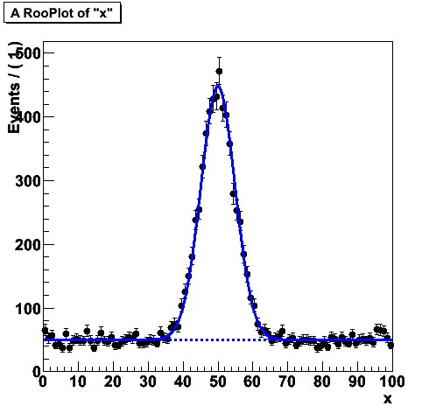
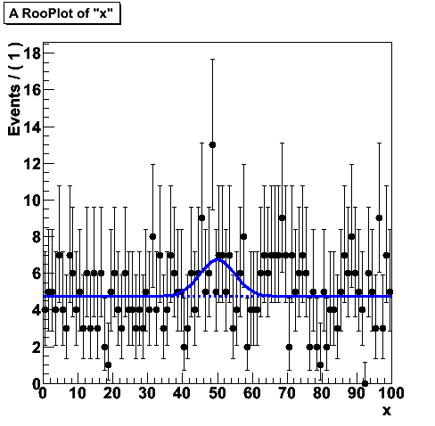
Multiple methods
Many ways to infer information on model (parameter) from data
  χ² fit → p = 5.2 ± 0.3
  Likelihood fit → p = 4.7 ± 0.4
  Bayesian interval → p ∈ [ 4.5 – 5.9 ] at 68% credibility
  Frequentist interval → p ∈ [ 4.4 – 5.8 ] at 68% confidence level
When data is abundant, methods usually give consistent answers
Issues and differences between methods arise when experimental result contains little information
‘Easy’
‘Difficult’

Slide 4
Multiple methods
Many ways to infer information on model (parameter) from data
  χ² fit → p = 5.2 ± 0.3
  Likelihood fit → p = 4.7 ± 0.4
  Bayesian interval → p ∈ [ 4.5 – 5.9 ] at 68% credibility
  Frequentist interval → p ∈ [ 4.4 – 5.8 ] at 68% confidence level
Will first focus χ² and likelihood estimation procedures
  Well known, often used
  Explore assumptions, limitations
Later we focus on interpreting experiments with little information content

Slide 5
Basics – What is an estimator?
An estimator is a procedure giving a value for a parameter or a property of a distribution as a function of the actual data values, i.e.
A perfect estimator is
  Consistent:
  Unbiased – With finite statistics you get the right answer on average
  Efficient
  There are no perfect estimators for most problems
← Estimator of the mean
← Estimator of the variance
This is called the
Minimum Variance Bound

Slide 6
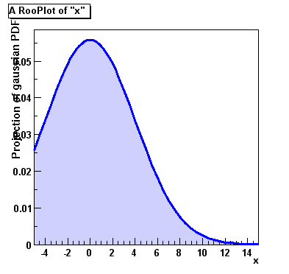
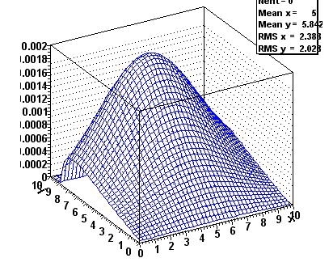
How to model your data
Approach in χ² fit very empirical – Function f(x,y) can be any arbitrary function
Many techniques (Likelihood, Bayesian, Frequentist) require a more formal approach to data modeling through probability density functions
We can characterize data distributions with probability density functions F(x;p)
  x = observables (measured quantities)
  p = parameters (model/theory parameters)
Properties
  Normalized to unity with respect to observable(s) x
  Positive definite – F(x;p)>=0 for all (x,p)

Slide 7
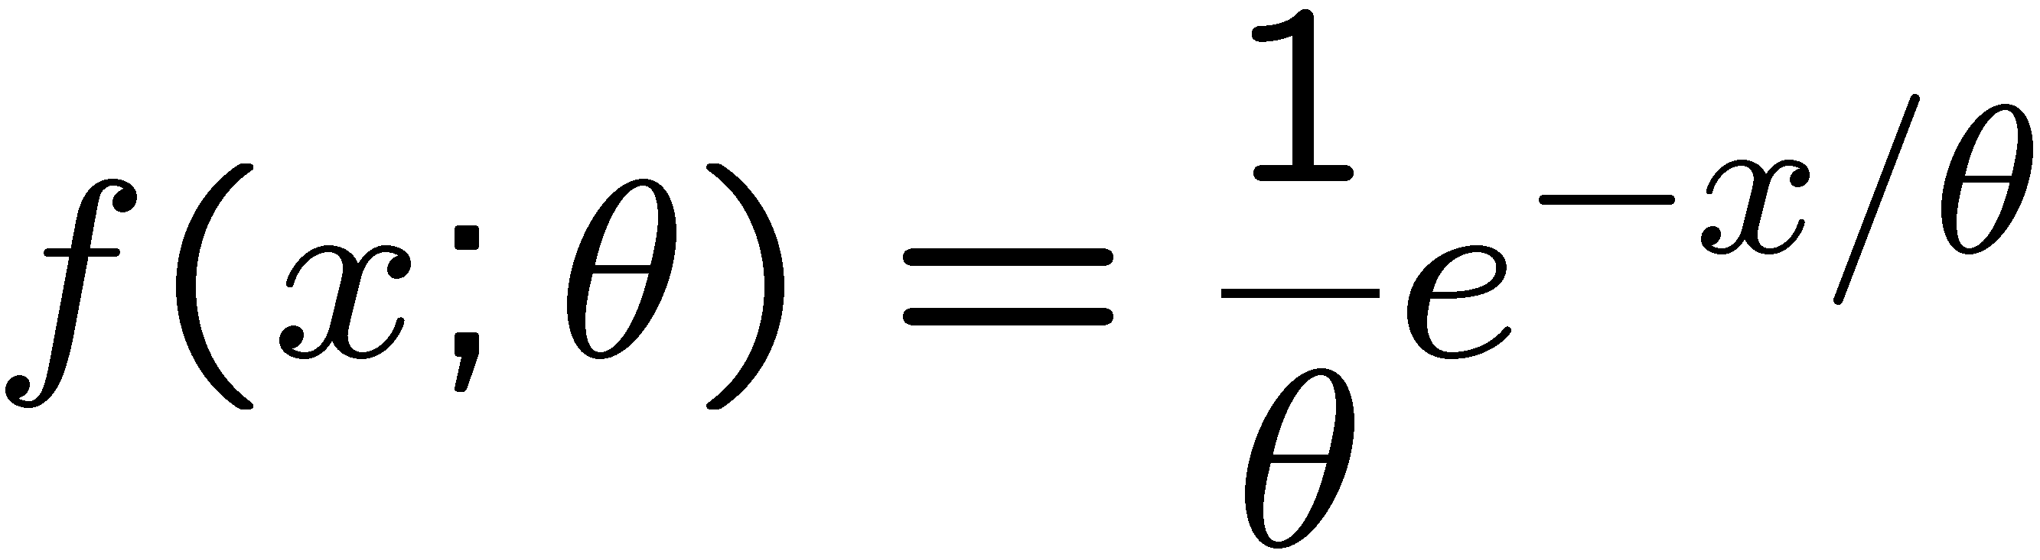
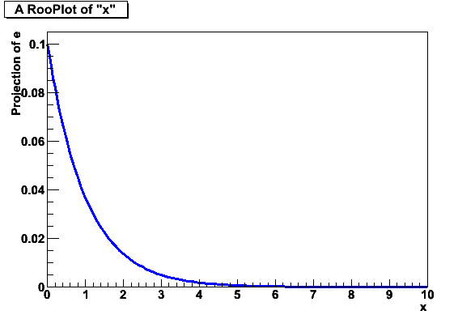
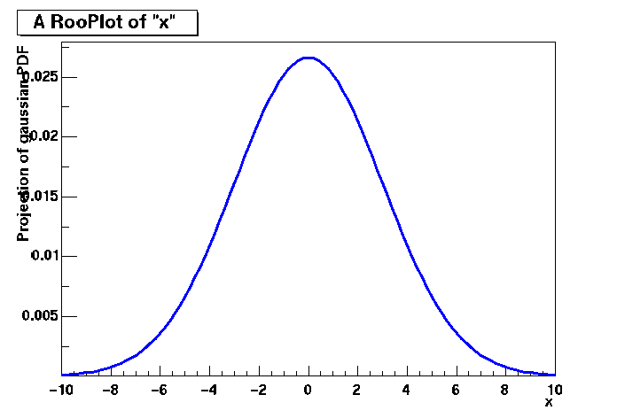
Probability density functions
Properties
  Parameters can be physics quantities of interest (life time, mass)
  Vehicle to infer physics parameters from data distributions
Invariant mass distribution
observable x (inv. mass)
parameter m (physics mass)
parameter σ (decay width)
Decay time distribution
observable x (decay time)
parameter θ (lifetime)

Slide 8
Likelihood
The likelihood is the value of a probability density function evaluated at the measured value of the observable(s)
  Note that likelihood is only function of parameters, not of observables
For a dataset that consists of multiple data points, the product is taken

Slide 9
Probability, Probability Density, and Likelihood
For discrete observables we have probabilities instead of probability densities
  Unit Normalization requirement still applies
Poisson probability P(n|μ) = μ^{n} exp(-μ)/n!
Gaussian probability density function (pdf) p(x|μ,σ): p(x|μ,σ)dx is differential of probability dP.
In Poisson case, suppose n=3 is observed.
Substituting n=3 into P(n|μ) yields the
likelihood function L(μ) = μ³exp(-μ)/3!
  Key point is that L(μ) is not a probability density in μ. (It is not a density!)
  Area under L is meaningless. That’s why a new word, “likelihood”, was invented for this function of the parameter(s), to distinguish from a pdf in the observable(s)! Many people nevertheless talk about ‘integrating the likelihood’ → confusion about what is done in Bayesian interval (more later)
  Likelihood Ratios L(μ1) /L(μ2) are useful and frequently used.

Slide 10
Change of variable x, change of parameter θ
For pdf p(x|θ) and (1-to-1) change of variable from x to y(x):
p(y(x)|θ) = p(x|θ) / |dy/dx|.
Jacobian modifies probability density, guarantees that
P( y(x1)< y < y(x2) ) = P(x1< x < x2), i.e., that
Probabilities are invariant under change of variable x.
  Mode of probability density is not invariant (so, e.g., criterion of maximum probability density is ill-defined).
  Likelihood ratio is invariant under change of variable x. (Jacobian in denominator cancels that in numerator).
For likelihood L(θ) and
reparametrization from θ to u(θ): L(θ) = L(u(θ)) (!).
  Likelihood L(θ) is invariant under reparametrization of parameter θ (reinforcing fact that L is not a pdf in θ).

Slide 11
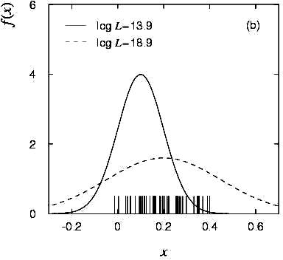
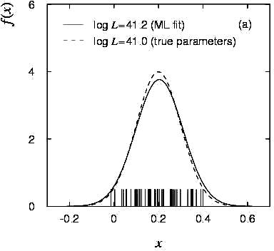
Parameter estimation using Maximum Likelihood
Likelihood is high for values of p that result in distribution similar to data
Define the maximum likelihood (ML) estimator(s) to be the parameter value(s) for which the likelihood is maximum.

Slide 12
Parameter estimation – Maximum likelihood
Computational issues
  For convenience the negative log of the Likelihood is often used
  as addition is numerically easier than multiplication
  Maximizing L(p) equivalent to minimizing –log L(p)
In practice, find point where derivative is zero

Slide 13
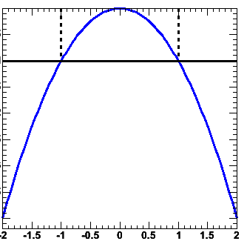
Variance on ML parameter estimates
The ML estimator for the parameter variance is
  I.e. variance is estimated from
  2nd derivative of –log(L) at minimum
  Valid if estimator is
  efficient and unbiased!
Visual interpretation of variance estimate
  Taylor expand –log(L) around minimum
From Rao-Cramer-Frechet
inequality
b = bias as function of p,
inequality becomes equality
in limit of efficient estimator
0.5
-log(L)
p

Slide 14
Properties of Maximum Likelihood estimators
In general, Maximum Likelihood estimators are
  Consistent (gives right answer for N→∞)
  Mostly unbiased (bias ∝1/N, may need to worry at small N)
  Efficient for large N (you get the smallest possible error)
  Invariant: (a transformation of parameters
  will Not change your answer, e.g
MLE efficiency theorem: the MLE will be unbiased and efficient if an unbiased efficient estimator exists
  Proof not discussed here
  Of course this does not guarantee that any MLE is unbiased and efficient for any given problem
Use of 2nd derivative of –log(L)
for variance estimate is usually OK

Slide 15
More about maximum likelihood estimation
It’s not ‘right’ it is just sensible
It does not give you the ‘most likely value of p’ –
it gives you the value of p for which this data is most likely
Numeric methods are often needed to find
the maximum of ln(L)
  Especially difficult if there is >1 parameter
  Standard tool in HEP: MINUIT (more about this later)
Max. Likelihood does not give you a goodness-of-fit measure
  If assumed F(x;p) is not capable of describing your data for any p,
  the procedure will not complain
  The absolute value of L tells you nothing!

Slide 16
Relation between Likelihood and χ² estimators
Properties of χ² estimator follow from properties of ML estimator using Gaussian probability density functions
The χ² estimator follows from ML estimator, i.e it is
  Efficient, consistent, bias 1/N, invariant,
  But only in the limit that the error on x_{i} is truly Gaussian
  i.e. need n_{i} > 10 if y_{i} follows a Poisson distribution
Bonus: Goodness-of-fit measure – χ² ≈ 1 per d.o.f
Probability Density Function
in p for single data point x_{i}(σ_{i})
and function f(x_{i};p)
Take log,
Sum over all points (x_{i} ,y_{i} ,σ_{i})
The Likelihood function in p
for given points x_{i}(σ_{i})
and function f(x_{i};p)

Slide 17
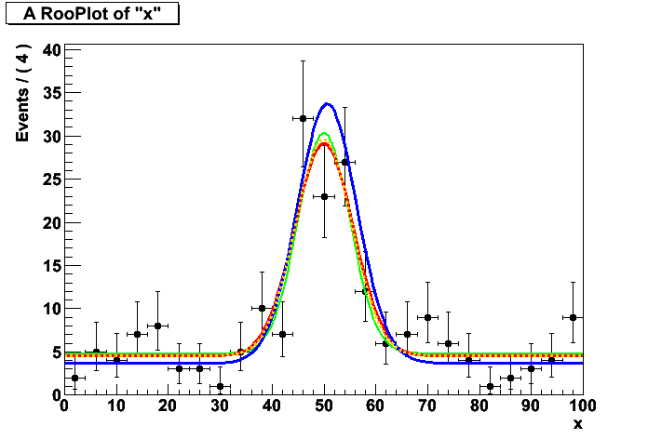
Example of χ² vs ML fit
Example with many low statistics bins
true distribution
χ² fit
unbinned ML fit
binned ML fit

Slide 18
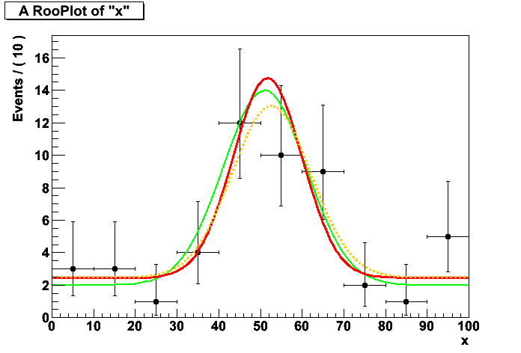
Example of binned vs unbinned ML fit
Lowering number of bins and number of events…
Proper way to study bias, precision is with toy MC study
→ at the end of this module
true distribution
unbinned ML fit
binned ML fit

Slide 19
Maximum Likelihood or χ² – What should you use?
χ² fit is fastest, easiest
  Works fine at high statistics
  Gives absolute goodness-of-fit indication
  Make (incorrect) Gaussian error assumption on low statistics bins
  Has bias proportional to 1/N
  Misses information with feature size < bin size
Full Maximum Likelihood estimators most robust
  No Gaussian assumption made at low statistics
  No information lost due to binning
  Gives best error of all methods (especially at low statistics)
  No intrinsic goodness-of-fit measure, i.e. no way to tell if ‘best’ is actually ‘pretty bad’
  Has bias proportional to 1/N
  Can be computationally expensive for large N
Binned Maximum Likelihood in between
  Much faster than full Maximum Likihood
  Correct Poisson treatment of low statistics bins
  Misses information with feature size < bin size
  Has bias proportional to 1/N

Slide 20
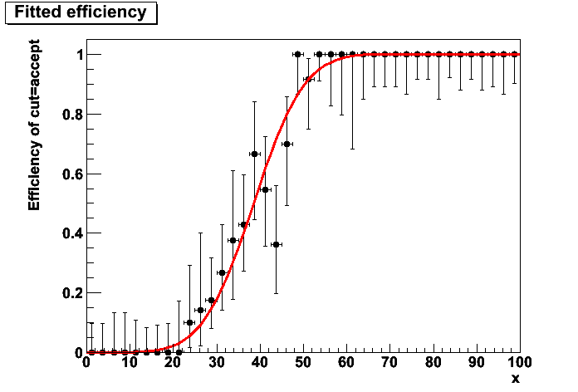
You can (almost) always avoid χ² fits
Case study: Fit for efficiency function
  Have some simulation sample:
  need to parameterize which fraction
  of events passes as function of
  observable x
‘Traditional χ² approach’
  Make histogram of Npassed/Ntotal
  Fit parameterized efficiency function to histogram
  Tricky question: what errors to use? √N is wrong.
  Can use binomial errors
  However still quite approximate: true errors will be asymmetric
  (i.e. no upward error on bin with Npass=10, Ntotal=10)

Slide 21
You can (almost) always avoid χ² fits
MLE approach
  Realize that your dataset has two observables (x,c), where c is a discrete observable with states ‘accept’ and ‘reject’
  Corresponding probability density function:
  Clearly unit-normalized over c for each value of (x,p)
  (ε must be between 0 and 1 for all (x,p))
  Write –log(L) as usual, using above p.d.f. and minimize
  Result: estimation of e(x,p) using correct binomial/poisson assumption on distribution of observables.
  Fit can also be performed unbinned

Slide 22
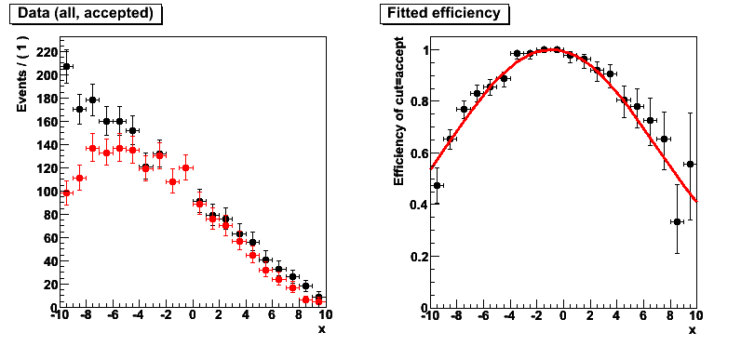
You can (almost) always avoid χ² fits
Example of unbinned MLE fit for efficiency

Slide 23
Weighted data
Sometimes input data is weighted
Examples:
  Certain Next-to-leading order event generator for LHC physics produce simulated events with weights +1 and -1.
  You’ve subtracted a distribution of background events from a sideband in data (also results in events with weight +1 and -1)
  You work with reweighted data samples for a variety of reasons
  (e.g. not enough data was available for one background sample, rescale available events with some non-unit weight to match available amounts of other samples)
How to deal with event weights in χ², MLE parameter estimation
χ² fit of histograms with weighted data are straightforward
  NB: You may no longer be able to interpret as a Gaussian error (i.e. 68% contained in 1σ)
From C.L.T
From C.L.T

Slide 24
Weighted data – χ² vs MLE
Adding event weights to –log(L) straightforward, but does not yield correct estimates on parameter variance
  Variance estimate on parameters will be proportional to
  If errors will be too small, if errors will be too large!
No clean solution available that retains all good properties of MLE, but it is possible to perform sum-of-weights-like correction to covariance matrix to correct for effect of on-unit weights
  where V is the cov. matrix calculated from a –log(L) with event weights w,
  and C is the cov. matrix calculated from a –log(L) with event weights w²
  It is easy to see that in the case of 1 parameter this is equivalent to
Event weight

Slide 25
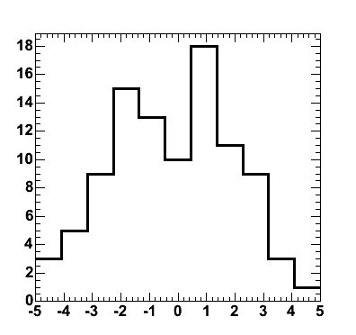
Hypothesis testing – Goodness of fit
Hypothesis testing and goodness-of-fit
  Reminder:
  classical hypothesis test compares data to two hypothesis H₀ and H₁ (e.g background-only vs signal+background).
  Type-I error = claiming signal when you should not have
  Type-II error = not claiming signal when you should have
  If there is no alternate (H0) hypothesis, hypothesis test is called ‘goodness-of-fit’ test. NB: Can only quantify Type-I error thus question “which g.o.f. test is best” (e.g. χ², Kolmogorov) is ill posed
‘Not a good fit’

Slide 26
Estimating and interpreting Goodness-Of-Fit
Most common test: the χ² test
  If f(x) describes data then χ² ≈ N, if χ² >> N something is wrong
How to quantify meaning of ‘large χ²’?
  What you really want to know: the probability that a function which does genuinely describe the data on N points would give a χ² probability as large or larger than the one you already have.
  For large N, sqrt(2χ²) has a Gaussian distribution
  with mean sqrt(2N-1) and σ=1 → ‘Easy’
  How to make a well calibrated statement for intermediate N

Slide 27
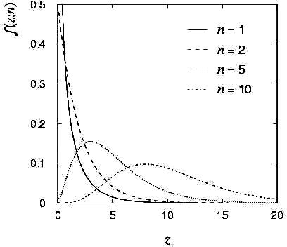
How to quantify meaning of ‘large χ²’
Probability distr. for χ² is given by
Good news: Integral of χ² pdf is analytically calculable!
Observed χ²
for n=10
P = integral over shaded area

Slide 28
Goodness-of-fit – χ²
Example for χ² probability
  Suppose you have a function f(x;p) which gives a χ² of 20 for 5 points (histogram bins).
  Not impossible that f(x;p) describes data correctly, just unlikely
  How unlikely?
Note: If function has been fitted to the data
  Then you need to account for the fact that parameters have been adjusted to describe the data
Practical tips
  To calculate the probability in ROOT ‘TMath::Prob(chi2,ndf)’

Slide 29
Practical estimation – Numeric χ² and -log(L) minimization
For most data analysis problems minimization of χ² or –log(L) cannot be performed analytically
  Need to rely on numeric/computational methods
  In >1 dimension generally a difficult problem!
But no need to worry – Software exists to solve this problem for you:
  Function minimization workhorse in HEP many years: MINUIT
  MINUIT does function minimization and error analysis
  It is used in the PAW,ROOT fitting interfaces behind the scenes
  It produces a lot of useful information, that is sometimes overlooked
  Will look in a bit more detail into MINUIT output and functionality next

Slide 30
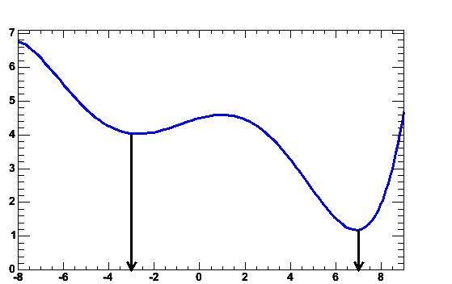
Numeric χ²/-log(L) minimization – Proper starting values
For all but the most trivial scenarios it is not possible to automatically find reasonable starting values of parameters
  This may come as a disappointment to some…
  So you need to supply good starting values for your parameters
  Supplying good initial uncertainties on your parameters helps too
  Reason: Too large error will result in MINUIT coarsely scanning a wide region of parameter space. It may accidentally find a far away local minimum
Reason: There may exist
multiple (local) minima
in the likelihood or χ²
-log(L)
Local
minimum
True minimum
p

Slide 31
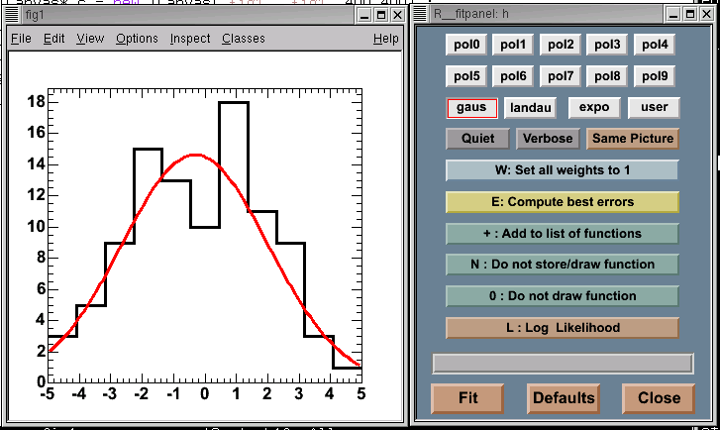
Example of interactive fit in ROOT
What happens in MINUIT behind the scenes
  Find minimum in –log(L) or χ² – MINUIT function MIGRAD
  Calculate errors on parameters – MINUIT function HESSE
  Optionally do more robust error estimate – MINUIT function MINOS

Slide 32
Minuit function MIGRAD
Purpose: find minimum
Progress information,
watch for errors here
**********
** 13 **MIGRAD 1000 1
**********
(some output omitted)
MIGRAD MINIMIZATION HAS CONVERGED.
MIGRAD WILL VERIFY CONVERGENCE AND ERROR MATRIX.
COVARIANCE MATRIX CALCULATED SUCCESSFULLY
FCN=257.304 FROM MIGRAD STATUS=CONVERGED 31 CALLS 32 TOTAL
EDM=2.36773e-06 STRATEGY= 1 ERROR MATRIX ACCURATE
EXT PARAMETER STEP FIRST
NO. NAME VALUE ERROR SIZE DERIVATIVE
1 mean 8.84225e-02 3.23862e-01 3.58344e-04 -2.24755e-02
2 sigma 3.20763e+00 2.39540e-01 2.78628e-04 -5.34724e-02
ERR DEF= 0.5
EXTERNAL ERROR MATRIX. NDIM= 25 NPAR= 2 ERR DEF=0.5
1.049e-01 3.338e-04
3.338e-04 5.739e-02
PARAMETER CORRELATION COEFFICIENTS
NO. GLOBAL 1 2
1 0.00430 1.000 0.004
2 0.00430 0.004 1.000
Parameter values and approximate errors reported by MINUIT
Error definition (in this case 0.5 for a likelihood fit)

Slide 33
Minuit function MIGRAD
Purpose: find minimum
Value of χ² or likelihood at minimum
(NB: χ² values are not divided by N_{d.o.f})
**********
** 13 **MIGRAD 1000 1
**********
(some output omitted)
MIGRAD MINIMIZATION HAS CONVERGED.
MIGRAD WILL VERIFY CONVERGENCE AND ERROR MATRIX.
COVARIANCE MATRIX CALCULATED SUCCESSFULLY
FCN=257.304 FROM MIGRAD STATUS=CONVERGED 31 CALLS 32 TOTAL
EDM=2.36773e-06 STRATEGY= 1 ERROR MATRIX ACCURATE
EXT PARAMETER STEP FIRST
NO. NAME VALUE ERROR SIZE DERIVATIVE
1 mean 8.84225e-02 3.23862e-01 3.58344e-04 -2.24755e-02
2 sigma 3.20763e+00 2.39540e-01 2.78628e-04 -5.34724e-02
ERR DEF= 0.5
EXTERNAL ERROR MATRIX. NDIM= 25 NPAR= 2 ERR DEF=0.5
1.049e-01 3.338e-04
3.338e-04 5.739e-02
PARAMETER CORRELATION COEFFICIENTS
NO. GLOBAL 1 2
1 0.00430 1.000 0.004
2 0.00430 0.004 1.000
Approximate
Error matrix
And covariance matrix

Slide 34
Minuit function MIGRAD
Status:
Should be ‘converged’ but can be ‘failed’
Estimated Distance to Minimum
should be small O(10⁻⁶)
Error Matrix Quality
should be ‘accurate’, but can be ‘approximate’ in case of trouble
Purpose: find minimum
**********
** 13 **MIGRAD 1000 1
**********
(some output omitted)
MIGRAD MINIMIZATION HAS CONVERGED.
MIGRAD WILL VERIFY CONVERGENCE AND ERROR MATRIX.
COVARIANCE MATRIX CALCULATED SUCCESSFULLY
FCN=257.304 FROM MIGRAD STATUS=CONVERGED 31 CALLS 32 TOTAL
EDM=2.36773e-06 STRATEGY= 1 ERROR MATRIX ACCURATE
EXT PARAMETER STEP FIRST
NO. NAME VALUE ERROR SIZE DERIVATIVE
1 mean 8.84225e-02 3.23862e-01 3.58344e-04 -2.24755e-02
2 sigma 3.20763e+00 2.39540e-01 2.78628e-04 -5.34724e-02
ERR DEF= 0.5
EXTERNAL ERROR MATRIX. NDIM= 25 NPAR= 2 ERR DEF=0.5
1.049e-01 3.338e-04
3.338e-04 5.739e-02
PARAMETER CORRELATION COEFFICIENTS
NO. GLOBAL 1 2
1 0.00430 1.000 0.004
2 0.00430 0.004 1.000

Slide 35
Minuit function MINOS
MINOS errors are calculated by ‘hill climbing algorithm’.
  In one dimension find points where ΔL=+0.5.
  In >1 dimension find contour with ΔL=+0.5. Errors are defined by bounding box of contour.
  In >>1 dimension very time consuming, but more in general more robust.
Optional – activated by option “E” in ROOT or PAW
**********
** 23 **MINOS 1000
**********
FCN=257.304 FROM MINOS STATUS=SUCCESSFUL 52 CALLS 94 TOTAL
EDM=2.36534e-06 STRATEGY= 1 ERROR MATRIX ACCURATE
EXT PARAMETER PARABOLIC MINOS ERRORS
NO. NAME VALUE ERROR NEGATIVE POSITIVE
1 mean 8.84225e-02 3.23861e-01 -3.24688e-01 3.25391e-01
2 sigma 3.20763e+00 2.39539e-01 -2.23321e-01 2.58893e-01
ERR DEF= 0.5
Symmetric error
(repeated result from HESSE)
MINOS error
Can be asymmetric
(in this example the ‘sigma’ error is slightly asymmetric)

Slide 36
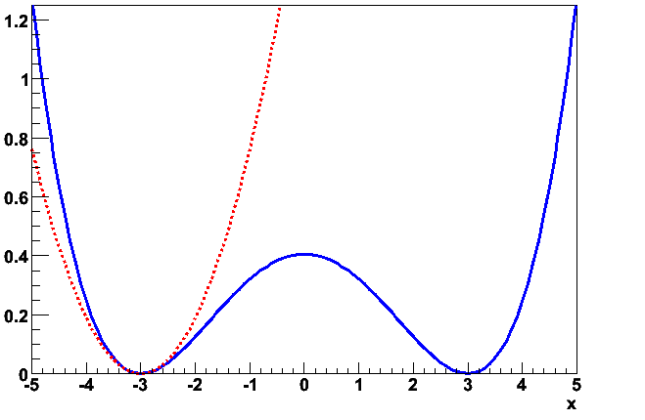
Illustration of difference between HESSE and MINOS errors
‘Pathological’ example likelihood with multiple minima and non-parabolic behavior
MINOS error
-logL(p)
Extrapolation
of parabolic
approximation
at minimum
Parameter
HESSE error

Slide 37
Practical estimation – Fit converge problems
Sometimes fits don’t converge because, e.g.
  MIGRAD unable to find minimum
  HESSE finds negative second derivatives
  (which would imply negative errors)
Reason is usually numerical precision and stability problems, but
  The underlying cause of fit stability problems is usually
  by highly correlated parameters in fit
HESSE correlation matrix in primary investigative tool
  In limit of 100% correlation, the usual point solution becomes a line solution (or surface solution) in parameter space.
  Minimization problem is no longer well defined
PARAMETER CORRELATION COEFFICIENTS
NO. GLOBAL 1 2
1 0.99835 1.000 0.998
2 0.99835 0.998 1.000
Signs of trouble…

Slide 38
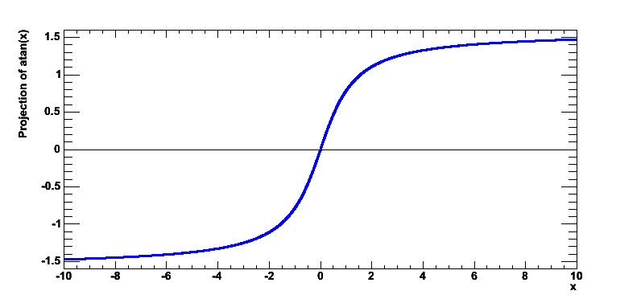
Practical estimation – Bounding fit parameters
Sometimes is it desirable to bound the allowed range of parameters in a fit
  Example: a fraction parameter is only defined in the range [0,1]
  MINUIT option ‘B’ maps finite range parameter to an internal infinite range using an arcsin(x) transformation:
Bounded Parameter space
External Error
MINUIT internal parameter space (-∞,+∞)
Internal Error

Slide 39
Practical estimation – Bounding fit parameters
If fitted parameter values is close to boundary, errors will become asymmetric (and possible incorrect)
So be careful with bounds!
  If boundaries are imposed to avoid region of instability, look into other parameterizations that naturally avoid that region
  If boundaries are imposed to avoid ‘unphysical’, but statistically valid results, consider not imposing the limit and dealing with the ‘unphysical’ interpretation in a later stage
Bounded Parameter space
External error
MINUIT internal parameter space (-∞,+∞)
Internal error

Slide 40
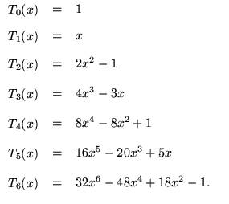
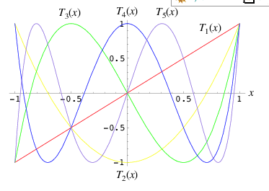
Mitigating fit stability problems -- Polynomials
Warning: Regular parameterization of polynomials a₀+a₁x+a₂x²+a₃x³ nearly always results in strong correlations between the coefficients a_{i}.
  Fit stability problems, inability to find right solution common at higher orders
Solution: Use existing parameterizations of polynomials that have (mostly) uncorrelated variables
  Example: Chebychev polynomials

Slide 41
Extending models to more than one dimension
If you have data with many observables,
there are two common approaches
  Compactify information with test statistic (see previous section)
  Describe full N-dimensional distribution with a p.d.f.
Choice of approach largely correlated with understanding of correlation between observables and amount of information contained in correlations
  No correlation between observables →
  ‘Big fit’ and ‘Compactification’ work equally well.
  Important correlations that are poorly understood → Compactification preferred. Approach:
    Compactify all-but-one observable (ideally uncorrelated with the compactified observables)
    Cut on compactification test statistic to reduce backgrounds
    Fit remaining observable → Estimate from data remaining amount of background
    (smallest systematic uncertainty due to poor understanding of test statistic and its inputs)
  Important correlations that are well understood → Big fit preferred

Slide 42
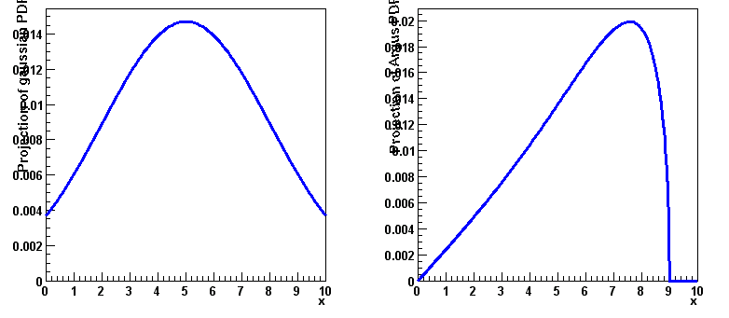
Extending models to more than one dimension
Bottom line: N-dim models used when either no correlations or well understood correlations
Constructing multi-dimensional models without correlations is easy
  Just multiply N 1-dimensional p.d.f.s.
  No complex issues with p.d.f. normalization: if 1-dim p.d.f.s are normalized then product is also by construction
*
=

Slide 43
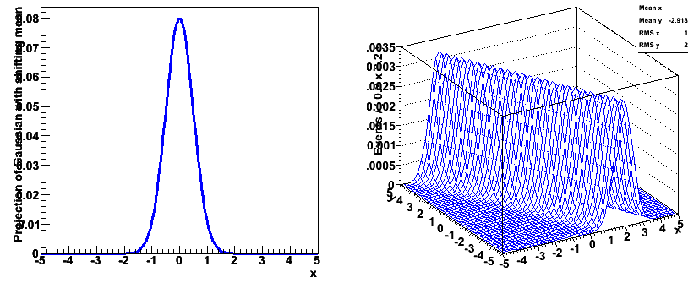
Writing multi-dimensional models with correlations
Formulating N-dim models with correlations may seem daunting, but it really isn’t so difficult.
  Simplest approach: start with one-dimensional model, replace one parameter p with a function p’(y) of another observable
  Yields correction distribution of x for every given value of y
  NB: Distribution of y probably not correct…
F(x,m,s)
F’(x,[a₀+a₁y],s)

Slide 44
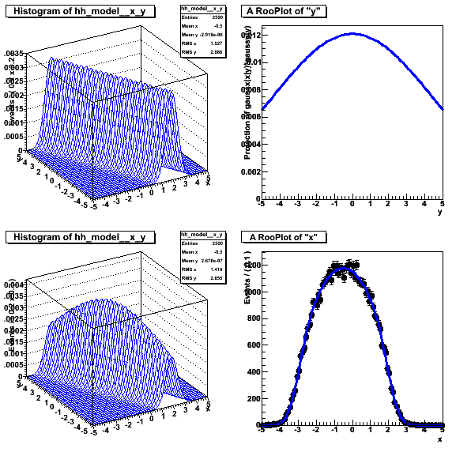
Writing multi-dimensional models with correlations
Solution: see F’(x,y,p) as a conditional p.d.f. F’(x|y)
  Difference is in normalization
  Then multiply with a separate p.d.f describing distribution in y
Almost all modeling issues with correlations can be treated this way
for each value of y
F’(x|y)
*
G(y)
=
M(x,y)

Slide 45
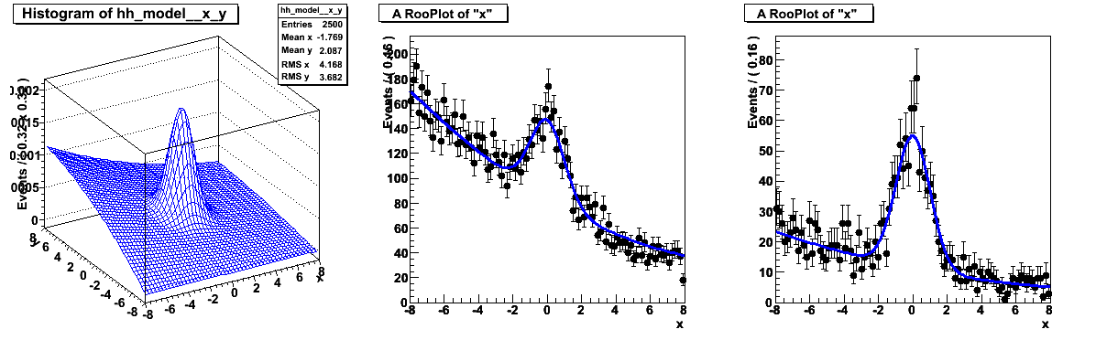
Visualization of multi-dimensional models
Visualization of multi-dimensional models presents some additional challenges w.r.t. 1-D
Can show 2D,3D distribution
  Graphically appealing, but not so useful as you cannot overlay model on data and judge goodness-of-fit
  Prefer to project on one dimension (there will be multiple choices)
  But plain projection discards a lot of information contained in both model and data
Significance of signal
less apparent
  Reason: Discriminating information in
  y observable in both data and model is ignored

Slide 46
Visualizing signal projections of N-dim models
Simplest solution, only show model and data in
“signal range” of observable y
  Significance shown in “range projection” much more in line with
  that of 2D distribution
Easy to define a “signal range” simple model above.
How about 6-dimensional model with non-trivial shape?
  Need generic algorithm → Likelihood ratio plot
y∈[-10,10]
y∈[-2,2]

Slide 47
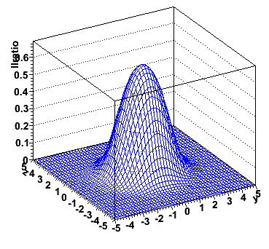
Likelihood ratio plots
Idea: use information on S/(S+B) ratio in projected observables to define a cut
Example: generalize previous toy model
to 3 dimensions
Express information on S/(S+B) ratio of model in terms of integrals over model components
Integrate over x
Plot LR vs (y,z)

Slide 48
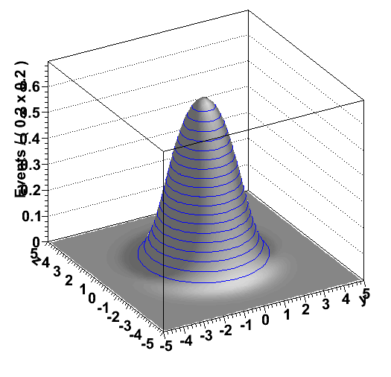
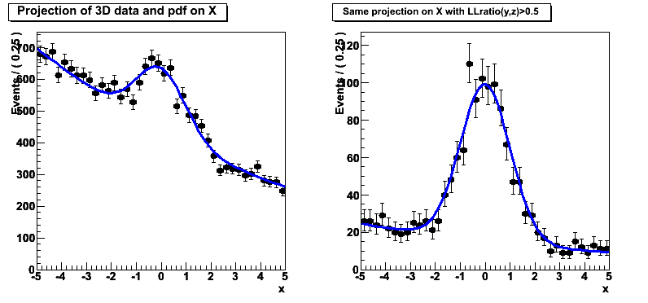
Likelihood ratio plots
Decide on s/(s+b) purity
contour of LR(y,z)
  Example s/(s+b) > 50%
Plot both data and model
with corresponding cut.
  For data: calculate LR(y,z) for each event, plot only event with LR>0.5
  For model: using Monte Carlo integration technique:
Dataset with values of (y,z)
sampled from p.d.f and
filtered for events that meet
LR(y,z)>0.5
All events
Only LR(y,z)>0.5

Slide 49
Multidimensional fits – Goodness-of-fit determination
Goodness-of-fit determination of >1 D models is difficult
  Standard χ² test does not work very will in N-dim because of natural occurrence of large number of empty bins
  Simple equivalent of (unbinned) Kolmogorov test in >1-D does not exist
This area is still very much a work in progress
  Several new ideas proposed but sometimes difficult to calculate, or not universally suitable
  Some examples
    Cramer-von Mises (close to Kolmogorov in concept)
    Anderson-Darling
    ‘Energy’ tests
  No magic bullet here, “best” generally an ill-posed question
  Some references to recent progress:
    PHYSTAT2001/2003/2005

Slide 50
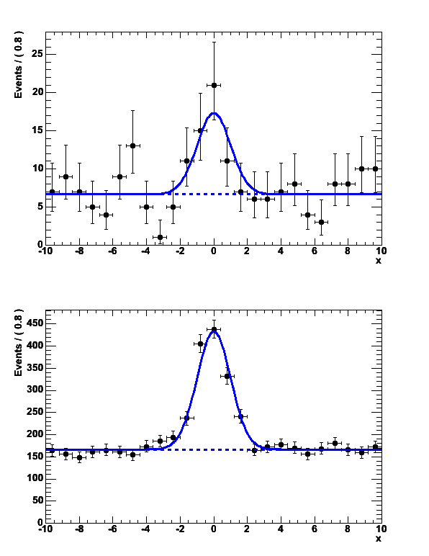
Practical fitting – Error propagation between samples
Common situation: you want to fit
a small signal in a large sample
  Problem: small statistics does not
  constrain shape of your signal very well
  Result: errors are large
Idea: Constrain shape of your signal
from a fit to a control sample
  Larger/cleaner data or MC sample with
  similar properties
Needed: a way to propagate the information from the control sample fit (parameter values and errors) to your signal fit

Slide 51
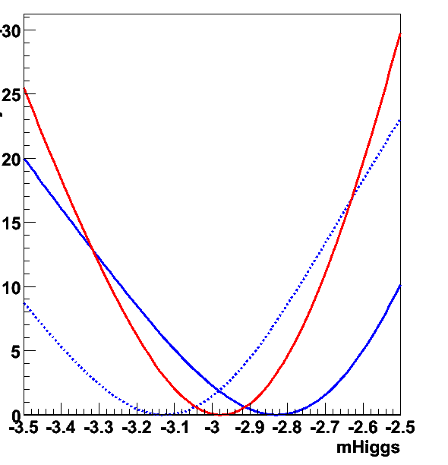
Practical fitting – Simultaneous fit technique
given data D_{sig}(x) and model F_{sig}(x;a,b) and
data D_{ctl}(x) and model F_{ctl}(x;b,c)
  Construct –log[L_{sig}(a,b)] and –log[L_{ctl}(b,c)] and
Minimize -logL(a,b,c)= -logL(a,b)+ -logL(b,c)
  Errors, correlations on common param. b automatically propagated
Likelihood view
D_{sig}(x), F_{sig}(x;a,b)
D_{ctl}(x), F_{ctl}(x;b,c)
-log(L)
Combined
‘SIG’
‘CTL’
b

Slide 52
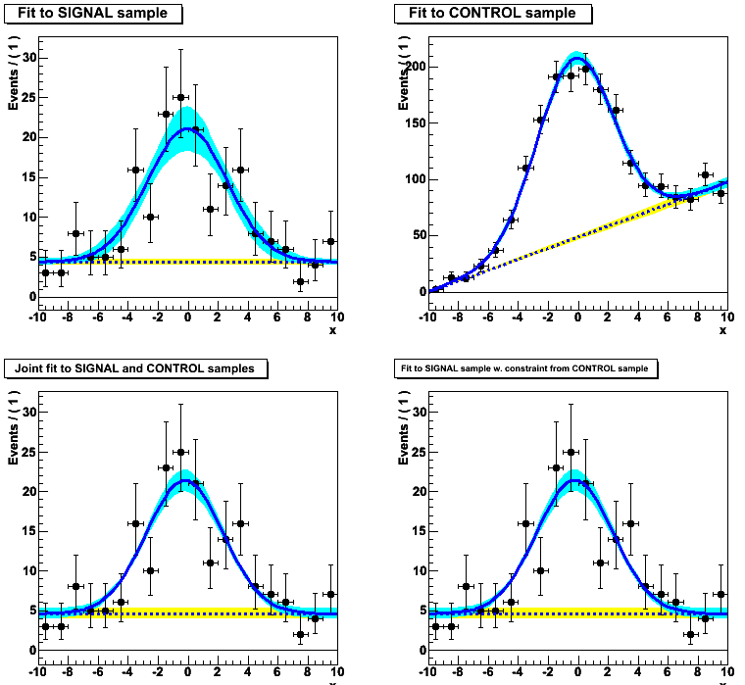
Practical fitting – Simultaneous fit technique
Simultaneous fit with visualization of error

Slide 53
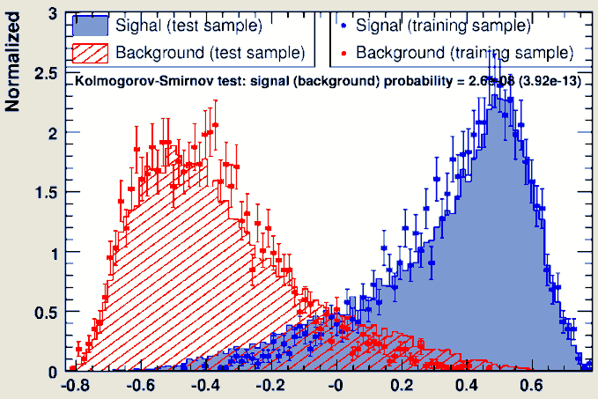
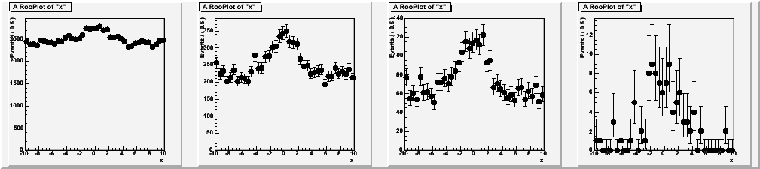
Another application of simultaneous fits
You can also use simultaneous fits to samples of the same type (“signal samples”) with different purity
Go back to example of NN with one observable left out
  Fit x after cut on N(x)
  But instead of just fitting data with
  N(x)>α, slice data in bins of N(x)
  and fit each bin.
  Now you exploit all data instead
  of just most pure data. Still no
  uncontrolled systematic uncertainty
  as purity is measured from data in
  each slide
  Combine information of all slices in
  simultaneous fit
  a

Slide 54
Practical Estimation – Verifying the validity of your fit
How to validate your fit? – You want to demonstrate that
  Your fit procedure gives on average the correct answer ‘no bias’
  The uncertainty quoted by your fit is an accurate measure for the statistical spread in your measurement ‘correct error’
Validation is important for low statistics fits
  Correct behavior not obvious a priori due to intrinsic ML bias proportional to 1/N
Basic validation strategy – A simulation study
  Obtain a large sample of simulated events
  Divide your simulated events in O(100-1000) samples with the same size as the problem under study
  Repeat fit procedure for each data-sized simulated sample
  Compare average value of fitted parameter values with generated value → Demonstrates (absence of) bias
  Compare spread in fitted parameters values with quoted parameter error → Demonstrates (in)correctness of error

Slide 55
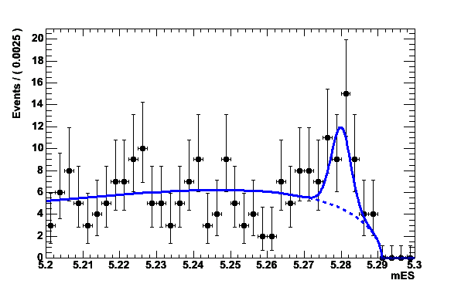
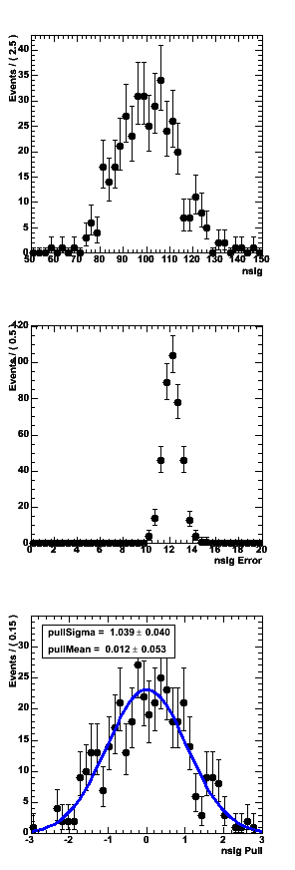
Fit Validation Study – Practical example
Example fit model in 1-D (B mass)
  Signal component is Gaussian
  centered at B mass
  Background component is
  Argus function (models phase
  space near kinematic limit)
Fit parameter under study: N_{sig}
  Results of simulation study:
  1000 experiments
  with N_{SIG}(gen)=100, N_{BKG}(gen)=200
  Distribution of N_{sig}(fit)
  This particular fit looks unbiased…
N_{sig}(generated)
N_{sig}(fit)

Slide 56
Fit Validation Study – The pull distribution
What about the validity of the error?
  Distribution of error from simulated
  experiments is difficult to interpret…
  We don’t have equivalent of
  N_{sig}(generated) for the error
Solution: look at the pull distribution
  Definition:
  Properties of pull:
    Mean is 0 if there is no bias
    Width is 1 if error is correct
  In this example: no bias, correct error
  within statistical precision of study
σ(N_{sig})
pull(N_{sig})

Slide 57
Fit Validation Study – Low statistics example
Special care should be taken when fitting small data samples
  Also if fitting for small signal component in large sample
Possible causes of trouble
  χ² estimators may become approximate as Gaussian approximation of Poisson statistics becomes inaccurate
  ML estimators may no longer be efficient
  → error estimate from 2nd derivative may become inaccurate
  Bias term proportional to 1/N of ML and χ² estimators may
  no longer be small compared to 1/sqrt(N)
In general, absence of bias, correctness of error can not be assumed. How to proceed?
  Use unbinned ML fits only – most robust at low statistics
  Explicitly verify the validity of your fit

Slide 58
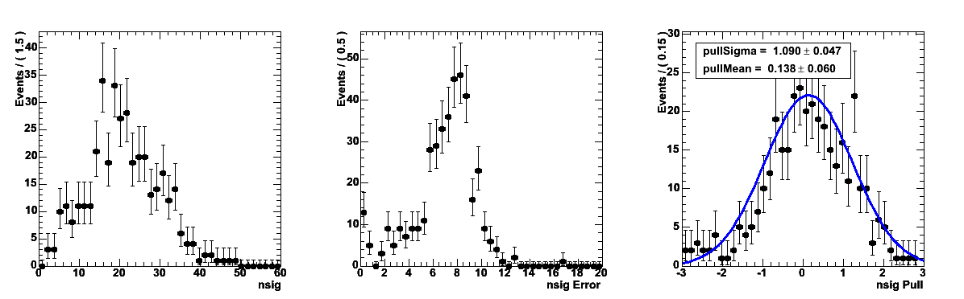
Demonstration of fit bias at low N – pull distributions
N_{SIG}(gen)=20
Low statistics example:
  Scenario as before but now with
  200 bkg events and
  only 20 signal events (instead of 100)
Results of simulation study
Absence of bias, correct error at low statistics not obvious!
  Small yields are typically overestimated
N_{BKG}(gen)=200
Distributions become
asymmetric at low statistics
→ Fit is positively biased!
N_{SIG}(gen)
N_{SIG}(fit)
σ(N_{SIG})
pull(N_{SIG})

Slide 59
Fit Validation Study – How to obtain 10.000.000 simulated events?
Practical issue: usually you need very large amounts of simulated events for a fit validation study
  Of order 1000x number of events in your fit, easily >1.000.000 events
  Using data generated through a full GEANT-based detector
  simulation can be prohibitively expensive
Solution: Use events sampled directly from your fit function
  Technique named ‘Toy Monte Carlo’ sampling
  Advantage: Easy to do and very fast
  Good to determine fit bias due to low statistics, choice of parameterization, boundary issues etc
  Cannot be used to test assumption that went into model
  (e.g. absence of certain correlations). Still need full GEANT-based simulation for that.

Slide 60
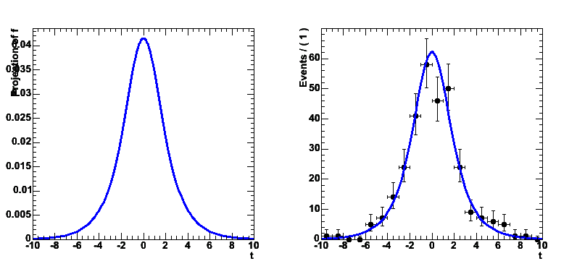
Toy MC generation – Accept/reject sampling
How to sample events directly from your fit function?
Simplest: accept/reject sampling
  Determine maximum of function f_{max}
  Throw random number x
  Throw another random number y
  If y<f(x)/f_{max} keep x,
  otherwise return to step 2)
  PRO: Easy, always works
  CON: It can be inefficient if function
  is strongly peaked.
  Finding maximum empirically
  through random sampling can
  be lengthy in >2 dimensions
f_{max}
y
x

Slide 61
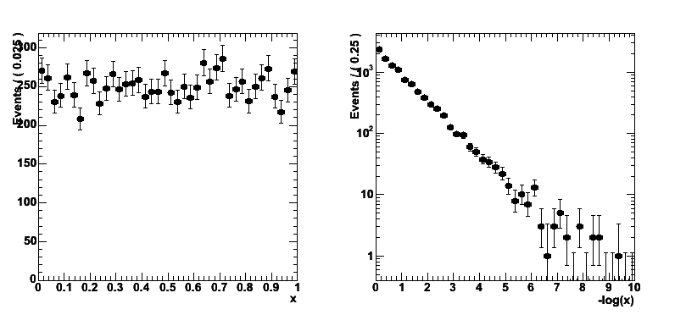
Toy MC generation – Inversion method
Fastest: function inversion
  Given f(x) find inverted function F(x)
  so that f( F(x) ) = x
  Throw uniform random number x
  Return F(x)
  PRO: Maximally efficient
  CON: Only works for invertible functions
x
Take –log(x)
Exponential
distribution
-ln(x)

Slide 62
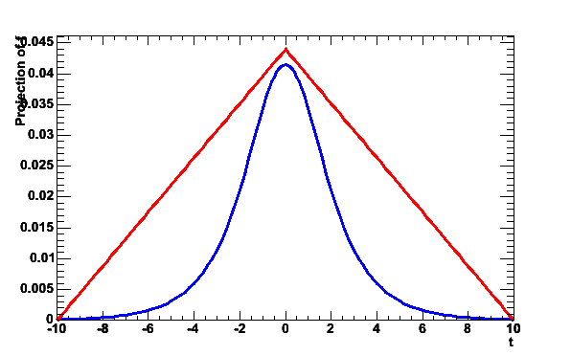
Toy MC Generation in a nutshell
Hybrid: Importance sampling
  Find ‘envelope function’ g(x)
  that is invertible into G(x)
  and that fulfills g(x)>=f(x)
  for all x
  Generate random number x
  from G using inversion method
  Throw random number ‘y’
  If y<f(x)/g(x) keep x,
  otherwise return to step 2
  PRO: Faster than plain accept/reject sampling
  Function does not need to be invertible
  CON: Must be able to find invertible envelope function
g(x)
y
f(x)
G(x)

Slide 63
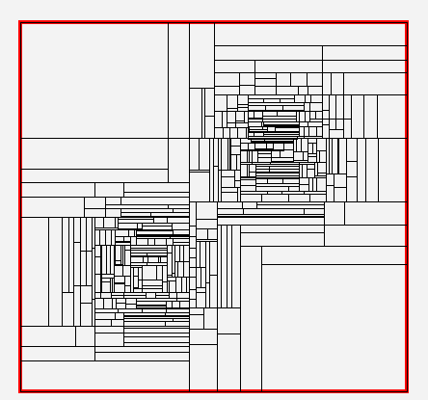
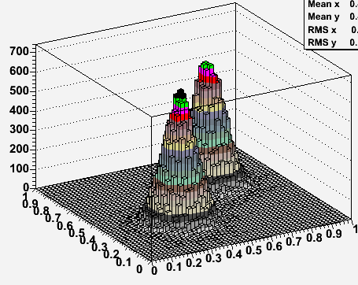
Toy MC Generation in a nutshell
General algorithms exists that can construct empirical envelope function
  Divide observable space recursively into smaller boxes and take uniform distribution in each box
  Example shown below from FOAM algorithm

