Slide 1
Discovery, exclusion, nuisance parameters
Formulating discovery, exclusion
Dealing with syst. uncertainties as nuisance parameters

Slide 2
Introduction
In the previous module extensive focus on fundamental statistics and the meaning of confidence interval and limits, i.e. what does a statement “We exclude SuperSymmetry at 95% C.L.” precisely mean
Today we explore other issues that are of crucial importance to be able to make such statement on real-life theories
Models can have uncertainties (in the form of unconstrained or weakly constrained parameters) → How do we incorporate that in our statement
Making statements about what we expect from both H0(SUSY+SM) and H1(SM) in addition to what we observe (especially relevant for theories with uncertainties we’ll generally expect a range of possibilities)
Incorporating p-value of the alternate hypothesis in the conclusion. Example: If your data says P(SM+SUSY)=0.001 we ‘exclude SUSY’ but if p(SM)=0.003 on that same data, should we believe our conclusion?

Slide 3
Theories with uncertainties - Nuisance parameters
Have so far considered problems with one model parameter
Hypothetical case for “SuperSymmetry” discovery
Simulation for SM – Predicts 3 events (Poisson, μ exactly known)
Simulation for SUSY – Predicts 6 events → 9 events in total
Observed event count in data: 8 events
How do you conclude (or not) that you’ve discovered supersymmetry?
You expect 9 events (with SUSY), you see 8, looks promising
Discussed three types of solution to above problem.
What do we do if background is not exactly known?
E.g. μ = 3.0 ± 1.0 (NB: this statement does not unique fix P(μ))

Slide 4
Nuisance parameters
In real life, background rate, shape of background model are usually not exactly known
Need procedure to incorporate uncertainty on these ‘nuisance parameters’ into account when setting limits etc.
For preceding problems (with precisely defined null hypotheses) procedures exist to calculate intervals and significances could be exactly
When dealing with nuisance parameters, this generally not possible anymore
Q: Is that a problem?
A: Yes. If your (approximate) calculation says Z=5, but it is really Z=3, there is a substantial chance your discovery is fake
If ATLAS and CMS use different methods one experiment may claim discovery of e.g. Higgs with only half the data of the other because of differences in significance calculation

Slide 5
Treatment of nuisance parameters
1 – Definition of nuisance parameters
A nuisance parameter is any parameter of the model that is not a parameter-of-interest (for physics).
Example: for Higgs discovery N(higgs) is of interest, everything else is nuisance
2 – Introduction of nuisance parameters in Likelihood
Sometimes nuisance parameter arise naturally in the likelihood.
Systematic uncertainties always introduce nuisance parameters, but explicit parameterization not always obvious (e.g. how to parameterize effect of Pythia-vs-Herwig?)
3 – Treatment of nuisance parameters in inference
Each of the three main classes of constructing intervals (Bayesian, likelihood ratio, Neyman confidence intervals) has a different way to incorporate the uncertainty on the nuisance parameters in the parameters of interest.

Slide 6
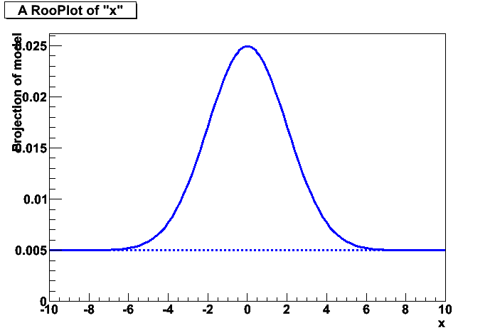
Likelihood fit – Definition of nuisance parameters
In ML fits, any floating fit parameter that is not the parameter of interest is a nuisance parameter
Model = Nsig*Gauss(x,m,s)+Nbkg*Uniform(x)
N_{sig} is parameter of interest
m,s,N_{bkg} are nuisance parameters, if not exactly known/fixed
Uncertainty on nuisance parameters will increase uncertainty on parameter of interest Nsig
In this example, the nuisance parameters can be constrained from the data along with the parameter of interest (given a sufficiently large dataset) → Even without any prior knowledge on m,s,N_{bkg} one is still capable of making a statement on Nsig

Slide 7
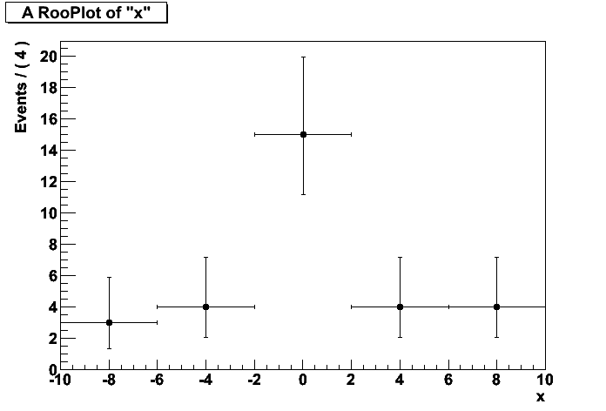
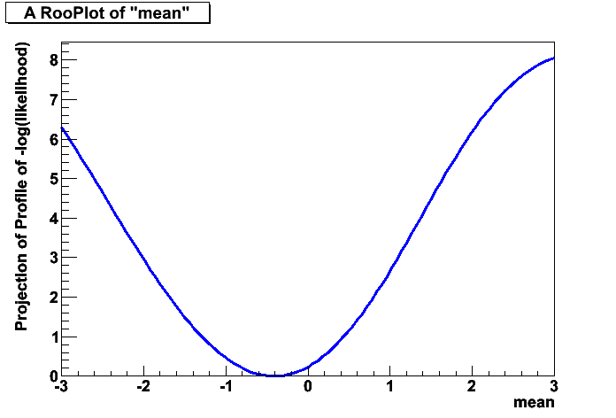
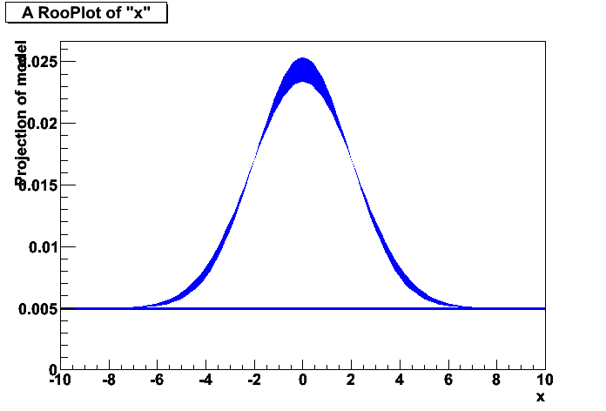
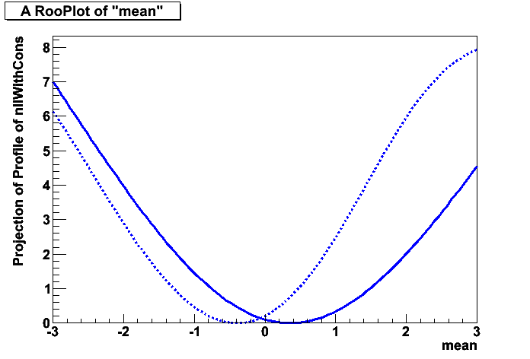
Adding uncertainties to a likelihood
Example 1 – Width known exactly
Example 2 – Gaussian uncertainty on width

Slide 8
Counting with sideband – Nuisance parameters
In other examples, a the nuisance parameter may not be constrainable from the data
An ‘auxiliary measurement/constraint’ term must be introduced to define the magnitude of the uncertainty of the NP so that a statement can be made on the POI.
Example: counting experiment with sideband: Poisson(N_{sig}|s+b)
Must have some external information on b to be able to do measurement
Example of external constraint on b:
We have a control region where we measure background only. Model: Poisson(N_{sig}|s+b)·Poisson(N_{ctl}|τ⋅b)
Measurement now consistent of two numbers: N_{sig},N_{ctl}
NB: Mathematically and conceptual identical to concept of ‘simultaneous measurements’ discussed earlier

Slide 9
Constraining nuisance parameters
Also in cases where the nuisance parameters can be measured from the data, it is possible that external information exists that is more constraining the inference from the data sample
Can incorporate this in the same form as ‘auxiliary measurement’
Ex: Model = Nsig*Gauss(x,m,s)+Nbkg*Uniform(x)
→ -logL = (- Σ_{data} Model(x_{i},N_{sig},N_{bkg},m,s)) – log C(m,...)
Typical shape of C is Gaussian, or Poisson
Note notational convention difference in C(m) for Frequentist and Bayesian formalism
Freq: C = Gaussian(y,m,s) ‘auxiliary measurement in observable y’
Bayes: C = Gaussian(m,m₀,s) ‘prior on m’
Note that for a Gaussian shape both are mathematically equivalent as Gauss(x,m,s) = Gauss(m,x,s), but this is not necessarily true for other shapes

Slide 10
Shape of auxiliary measurement likelihood
Shape of auxiliary measurements requires some careful thought – especially when evaluating high Z limits
Option A: Rescaled Poisson: Poisson(N|τ⋅b)
Most suitable if uncertainty on B is dominated by statistical uncertainty from a sideband or control region
(It is the exact solution for a counting measurement in a sideband)
Option B: Gaussian: Gauss(b,b₀,σ_{b}) or Gauss(b₀,b,σ_{b})
Usually chosen if source information is known in form b₀ ± σ_{b}
Also often chosen if true shape is unknown (e.g. ‘theory uncertainty’)
Central Limit Theorem → Sum of many uncertainties is asymptotically Gaussian
But beware of relatively large Gaussian uncertainties → These can result in optimistically biased significance calculations

Slide 11
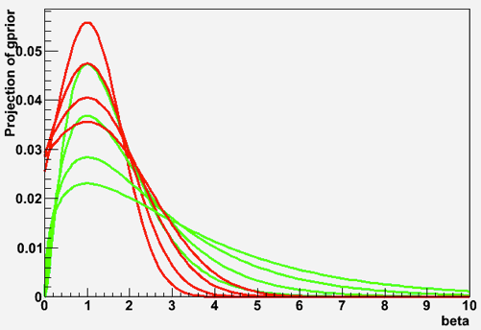

Shape of auxiliary measurement likelihood
Option B: Gaussian: Gauss(b,b₀,σ_{b}) [ continued]
Illustration of danger of large Gaussian uncertainties
Model = Poisson(N_{sig}|s+b) ⋅ Gaussian(b,b₀,σ_{b}) with b₀ = 3, σ_{b} = 1 (33%) If we look at 5σ fluctuations we in principle allow the Gaussian term to move 5σ off its center → Allow downward fluctuation to b=-2 ! In reality b must be greater than zero → Significance of result will be optimistically biased
Option C: Gamma(b,b₀,σ_{b})
Longer positive tail than Gaussian
Better behavior at 0 than Gaussian
Asymptotically Gaussian
Good ‘alternate model’ for systematics

Slide 12
Turning all uncertainties into nuisance parameters
For ‘simple’ measurements systematic uncertainties are traditionally included ‘a posteriori’ with error propagation
E.g. measure cross-section using Herwig, then again using Pythia and use the difference in these cross-section values for the fragmentation uncertainty on the cross-section (and add all such systematic uncertainties in quadrature)
For fundamental techniques (e.g. Bayesian, Likelihood ratio) techniques these sources must be incorporated in the likelihood
No accurate ‘a posteriori’ prescription exists to include these
Inclusion ensures consistent treatment of these systematics as nuisance parameters in inference analysis (limit or confidence interval)
But certain types of systematics are difficult to parameterize...

Slide 13
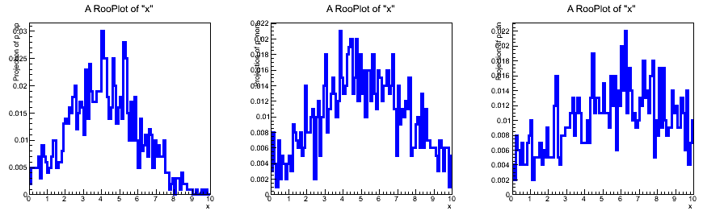
Parameterized template pdfs
In many LHC analyses (e.g. Higgs searches, top cross-section), shapes are defined by histograms rather than analytical functions. While these shapes are fixed (no parameters), nuisance parameters can be introduced a posteriori through ‘morphing techniques’
Original (fixed) shape for e.g. the signal in an observable x → Histogram defines shape of probability density function
But this distribution, obtained from simulation has many systematic uncertainties associated with it (originating from the simulation → How do you turn these into nuisance parameters
F(x)

Slide 14
Parameterized template pdfs
First quantify effect by regenerating histogram from the source (e.g. full simulation) with a source of systematic uncertainty set to a shifted value
Example: Jet Energy scale up / down by X%
distribution
for JES at -1σ
nominal distribution
distribution
for JES at +1σ
F₋(x)
F₀(x)
F₊(x)

Slide 15
Parameterized template pdfs
Final step is to make a pdf that interpolates (bin-by-bin) between the histograms introducing a newly introduced nuisance parameter
Constrain size of systematic by introducing ‘constraint’ on a in likelihood
F₊(x)
F₀(x)
F₋(x)
F(x,a=1)
F(x,a=0)
F(x,a)
F(x,a=-1)

Slide 16
Parameterized template pdfs
Final step is to multiply likelihood with constraint that defines magnitude of uncertainty as ‘one sigma’
-logL = (- Σ_{data} F(x_{i},a)) – log Gauss(a,0,1)
Can repeat this procedure for any number of systematic uncertainties
-logL = (- Σ_{data} F(x_{i},a,b,...)) – log G(a,0,1) G(b,0,1)...
Note that data may also constrain magnitude of NP
In such cases the uncertainty on a,b will be less than 1

Slide 17
Treatment of nuisance parameters
Effort so far has been to incorporate systematic uncertainties as explicit nuisance parameters in model
In analytical pdfs, the free parameters of these models are the nuisance parameters
In template-based pdfs, parameters can be introduced by morphing/interpolation techniques
In either case the magnitude of the uncertainty represented by the NP can be constraint with an ‘auxiliary measurement’ type of constraint in the likelihood “L(s,b) = Poisson(N_{sig}|s+b) ⋅ Gaussian(b,b₀,σ_{b})”
The next step is to include the effect of all these nuisance parameters on the statistical inference on the parameter-of-interest
Will first discuss procedure in each of the three ‘fundamental’ approaches

Slide 18
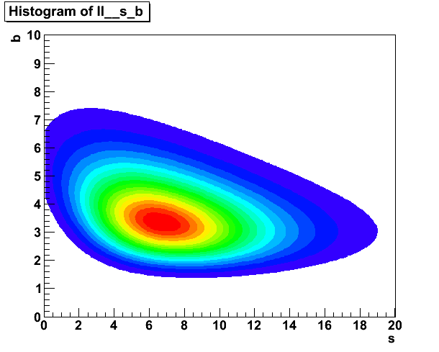
Counting with sideband – Nuisance parameters
Model: Poisson(N_{sig}|s+b)Poisson(N_{ctl}|τ⋅b), τ=3 (exact)
Visualization of Likelihood
Nsig=10, Nctl=10
We know how to set interval on s given a fixed b Now need to incorporate uncertainty on b…

Slide 19
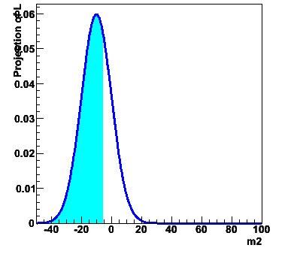
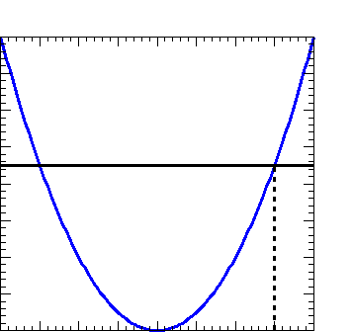
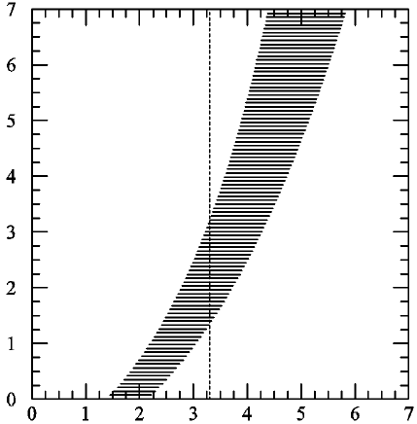
Reminder: intervals defined ways
Bayesian interval at 90% credibility: find μu such that posterior probability p(μ>μu) = 0.1.
Likelihood ratio method for approximate 90% C.L. U.L.: find μu such that L(μu) / L(3) has prescribed value.
Asymptotically identical to Frequentist interval (Wilks theorem)
Equivalent to MINOS errors
Frequentist one-sided 90% C.L. upper limit: find μu such that P(n≤3 | μu) = 0.1.

Slide 20
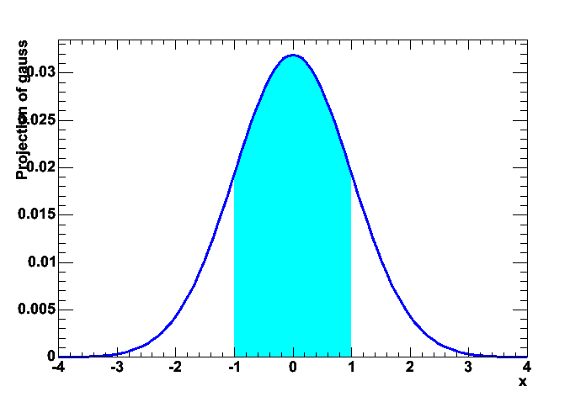
Dealing with nuisance parameters in Bayesian intervals
Reminder: definition of Bayesian intervals
p(μ|x₀) ∝ L(x₀|μ) p(μ),
where:
p(μ|x₀) = posterior pdf for μ, given the results of this experiment
L(x₀|μ) = Likelihood function of μ from the experiment
p(μ) = prior pdf for μ,
If you have nuisance parameters a, equation becomes
p(μ,a|x₀) ∝ L(x₀|μ,a) p(μ) p(a)
p(μ|x₀)
Area that integrates X% of posterior

Slide 21
Dealing with nuisance parameters in Bayesian intervals
Elimination of nuisance parameters in Bayesian interval: Integrate over the full subspace of all nuisance parameters;
You are left with the posterior pdf for the parameter of interest.

Slide 22
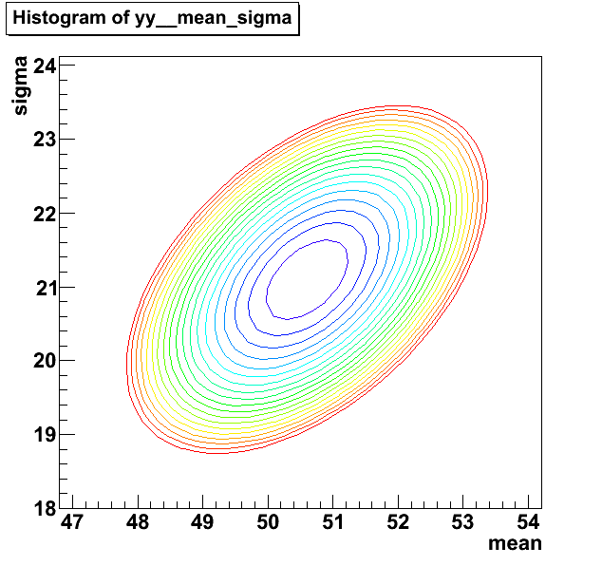
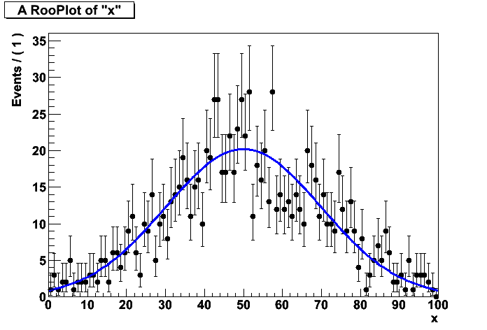
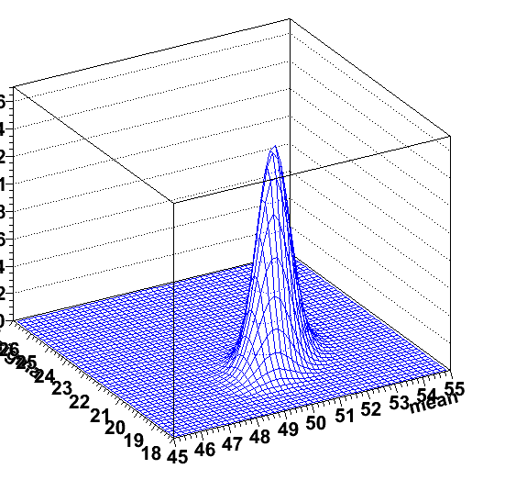
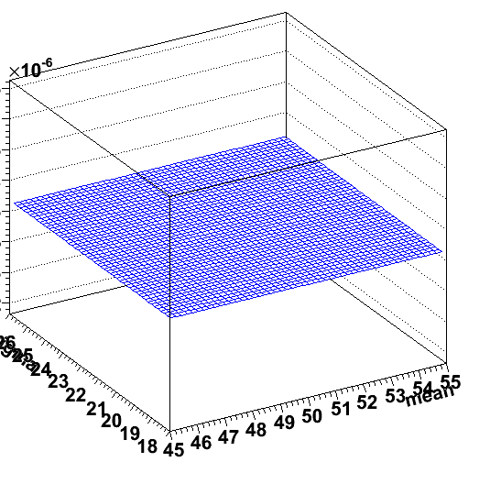
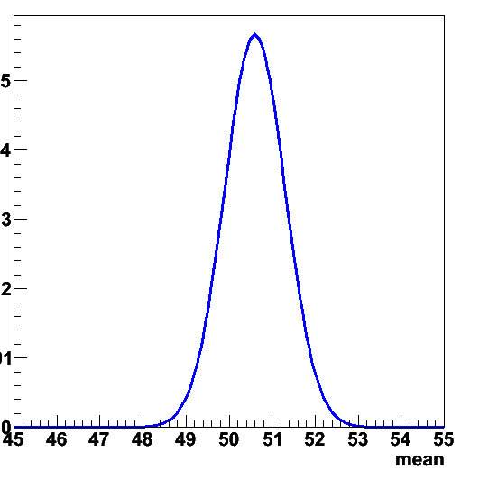
Illustration of nuisance parameters in Bayesian intervals
Example: data with Gaussian model (mean,sigma)
-logLR(mean,sigma)
MLE fit fit data
∫
×
=
LR(mean,sigma)
prior(mean,sigma)
posterior(mean)

Slide 23
Dealing with nuisance parameters in Bayesian intervals
Issues
The multi-D prior pdf is a problem for both subjective and non-subjective priors.
In HEP there is almost no use of the favored non-subjective priors (reference priors of Bernardo and Berger), so we do not know how well they work for our problems.
In case of many nuisance parameters, the high-dimensional numeric integral can be a technical problem (use of Markov Chain Monte Carlo can help)

Slide 24
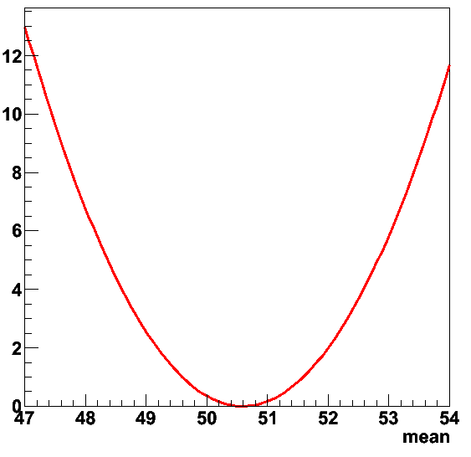
Dealing with nuisance parameters in Likelihood ratio intervals
Likelihood ratio intervals with one parameter
With nuisance parameters – modify definition of the likelihood ratio
^
μ is MLE estimate of μ σ is MLE estimate of σ
σ(μ) is MLE estimate of s conditional on given value of μ
^
^
^

Slide 25
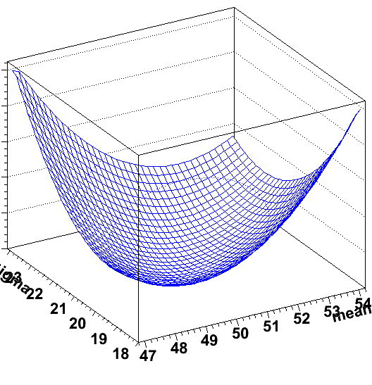
Dealing with nuisance parameters in Likelihood ratio intervals
Construct ‘profile likelihood’
For each value of the parameter of interest, search the full subspace of nuisance parameters for the point at which the likelihood is maximized.
-logLR(mean,sigma)
-logLR(mean,sigma)
-logPLR(mean)
MLE fit fit data
max L for any given value of μ
max L

Slide 26
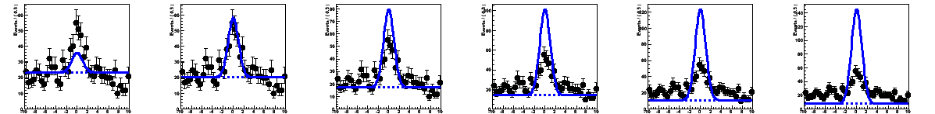
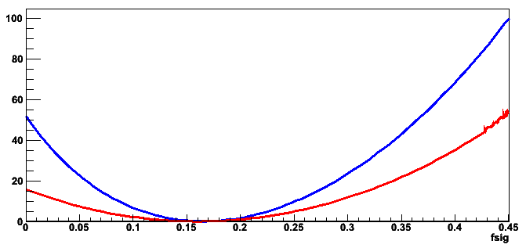
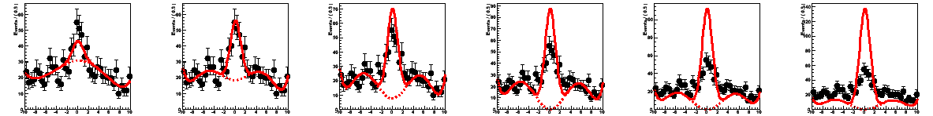
Dealing with nuisance parameters in Likelihood ratio intervals
Likelihood Ratio
Profile Likelihood Ratio
Minimizes –log(L) for each value of f_{sig} by changing bkg shape params (a 6th order Chebychev Pol)

Slide 27
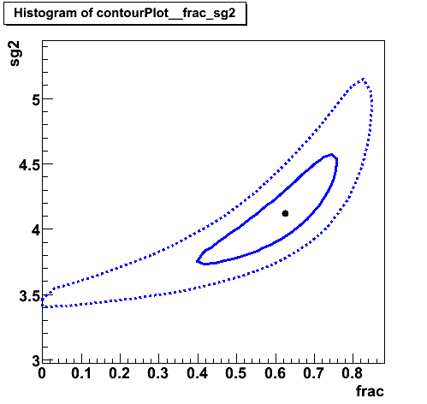
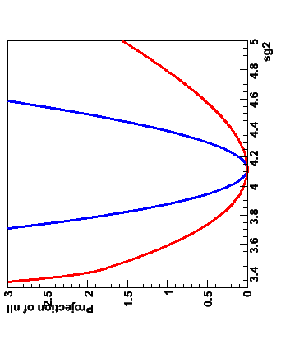
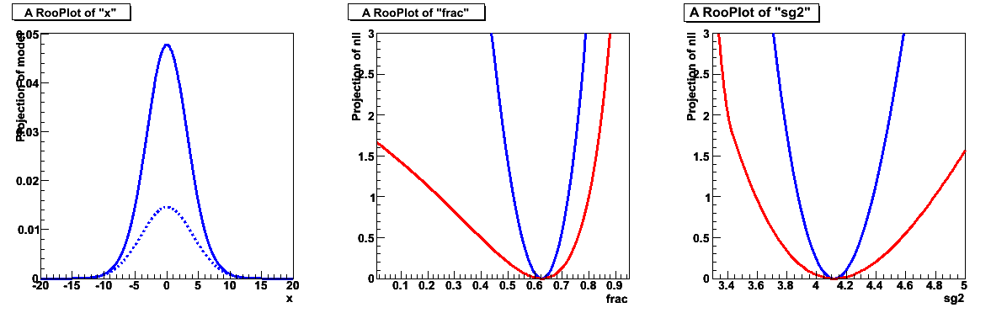
Link between MINOS errors and profile likelihood
Parameter of interest
Note that MINOS algorithm in MINUIT gives same errors as Profile Likelihood Ratio
MINOS errors is bounding box around λ(s) contour
Profile Likelihood = Likelihood minimized w.r.t. all nuisance parameters
Nuisance parameter

Slide 28
Dealing with nuisance parameters in Likelihood ratio intervals
Profile likelihood ratio intervals asymptotically equivalent to frequentist intervals
Just like plain LR intervals asymptotically equivalent to frequentist intervals
Issues with Profile Likelihood
Has a reputation of underestimating the true uncertainties.
In Poisson problems, this is partially compensated by effect due to discreteness of n, and profile likelihood (MINUIT MINOS) gives good performance in many problems.
NB: Computationally Profile Likelihood is quite manageable, even with a large number of nuisance parameters
Minimize likelihood w.r.t. 20 parameters quite doable
Especially compared to numeric integration over 20 parameters, or constructing confidence belt in 20 dimensions…
But beware of finding the wrong minimum, General problem with algorithmic minimization
But in profile likelihoods many minimizations are performed with incrementally different starting points → How to choose starting point?

Slide 29
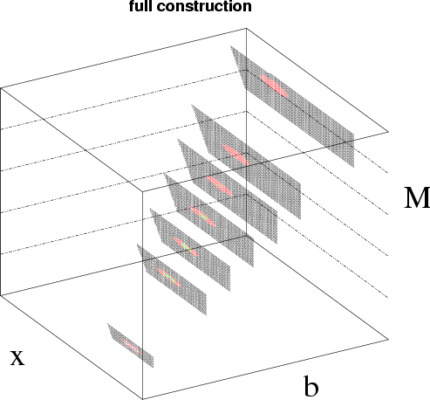
Dealing with nuisance parameters in Frequentist intervals
Incorporating nuisance parameters in the Neyman construction of the confidence belt makes the belt multi-dimensional
The goal is that the parameter of interest should be covered at the stated confidence for every value of the nuisance parameter
if there is any value of the nuisance parameter which makes the data consistent with the parameter of interest, that parameter point should be considered: eg. don’t claim discovery if any background scenario is compatible with data
But: technically very challenging and significant problems with over-coverage → Practical approach: absorb nuisance parameters in profile likelihood then make confidence belt on PLR and POI

Slide 30
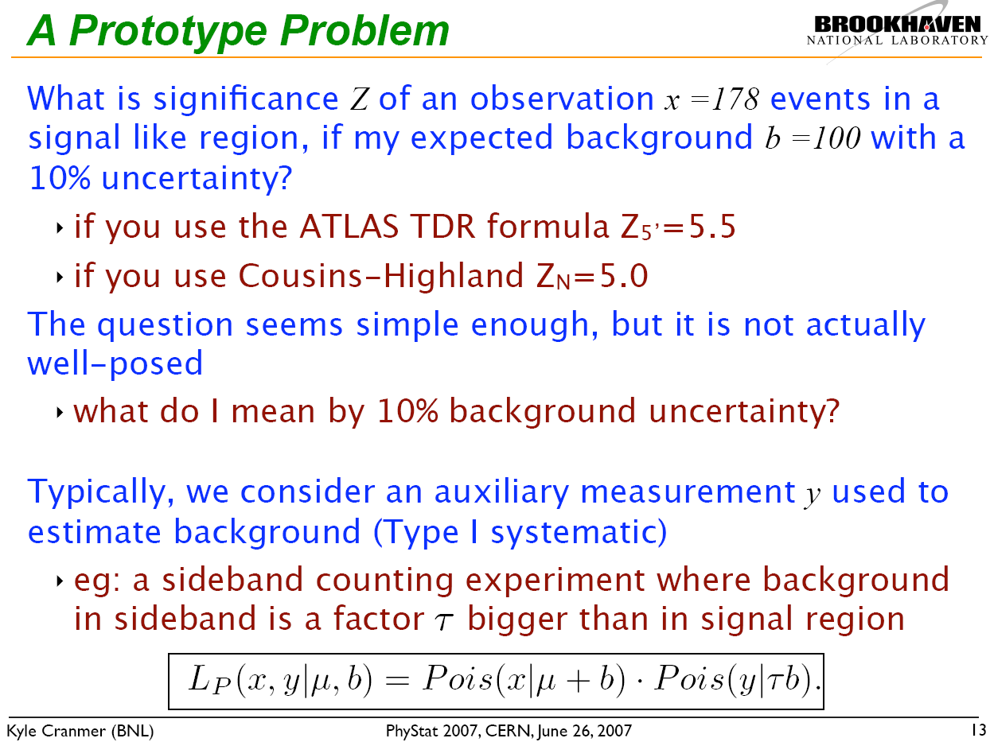
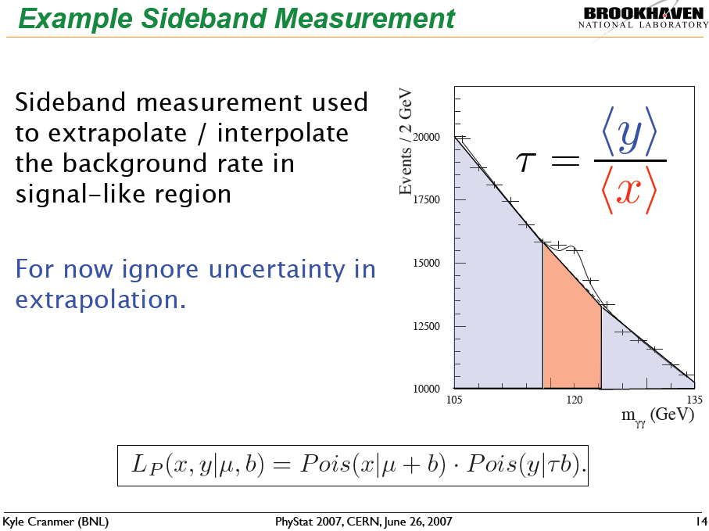
How much do answers differ between methods?
These slide discuss the earlier shown problem: Poisson(N_{sig}|s+b) ⋅ Poisson(N_{ctl}|τ⋅b)
NB: This is one of the very few problems with nuisance parameters with can be exactly calculation

Slide 31
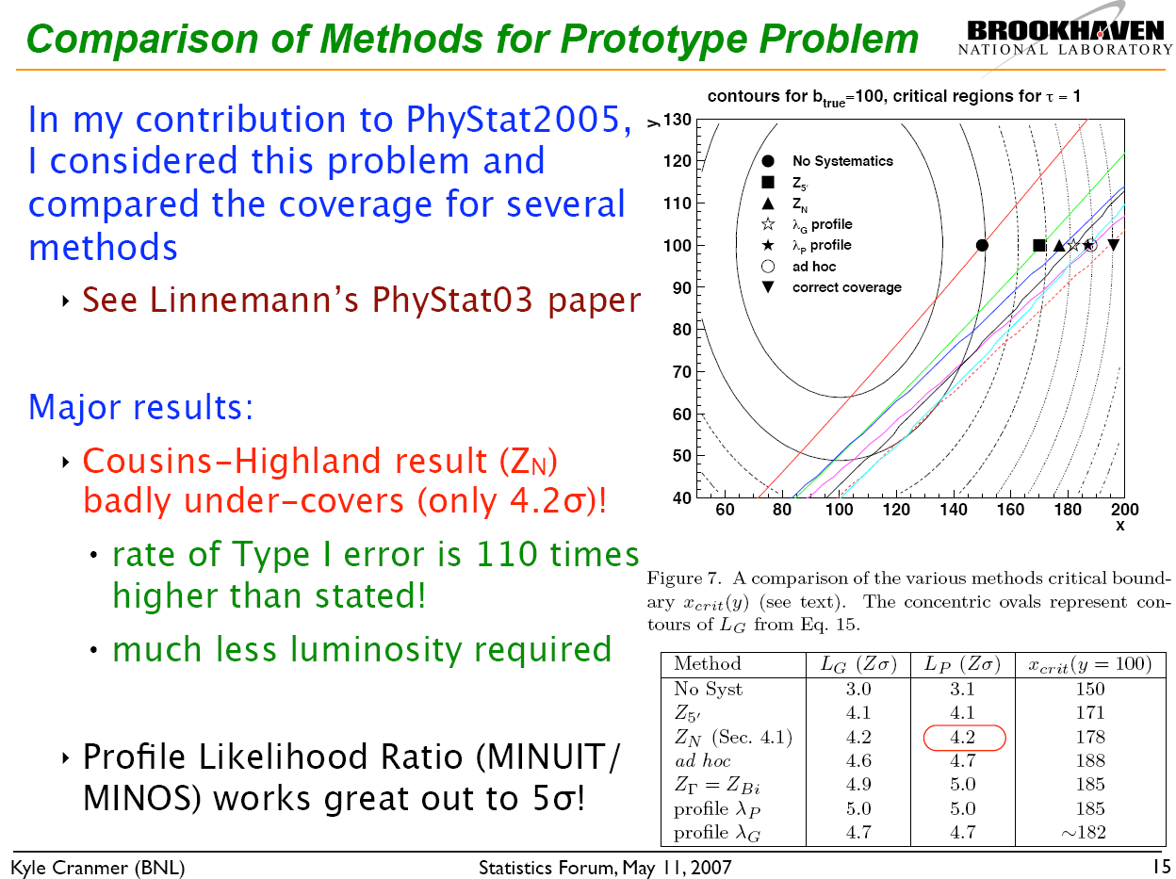
Recent comparisons results from PhyStat 2007
Exact solution

Slide 32
Summary on incorporating nuisance parameters
1 – Definition of nuisance parameters
A nuisance parameter is any parameter of the model that is not a parameter-of-interest (for physics).
Example: for Higgs discovery N(higgs) is of interest, everything else is nuisance
2 – Introduction of nuisance parameters in Likelihood
Sometimes nuisance parameter arise naturally in the likelihood.
In other cases they can be introduces with techniques like template morphing to parameterize underlying systematic uncertaintis
For proper treatment of systematic uncertainties in fundamental methods all uncertainties must be described as nuisance parameters (i.e. no ad-hoc solutions allows as can be done for ‘simple’ measurements)
3 – Treatment of nuisance parameters in inference
Each of the three main classes of constructing intervals (Bayesian, likelihood ratio, Neyman confidence intervals) has a way to incorporate the uncertainty on the nuisance parameters in the parameters of interest. Answers can differ sizable – even for simple problems. This remains a subject of frontier statistics research.

Slide 33
Discovery, exclusion – expectation and observation
Now that we have discussed techniques on how formulate model uncertainties in likelihood and how to incorporate these in the statements on the p-value of models (or correspondingly on intervals)
How to we use those models to make sensible physics conclusions, e.g.
Did we discover the Higgs?
Can we exclude Supersymmetry?
First need to decided on formulating answer as discovery or exclusion
Discovery: Make statement based on p-value of background only hypothesis (i.e. data is inconsistent with SM). Low p-value means data is inconsistent with SM only, we’ve discovered ‘something’ in the data
Exclusion: Make statement based on p-value of background + new physics hypothesis (p_{s+b}). Low p-value means new physics is excluded at some C.L.
While to first order discover and exclusion amount to swapping H₀ and H₁ we treat these scenarios in practice somewhat asymmetrically

Slide 34
Discovery, exclusion – expectation and observation
Discovery (this scenario has not been exercised much yet at the LHC unfortunately)
Canonically aim for ‘5 sigma’ → p-value (SM resulting in excess seed on data or better) of 1.2 · 10⁻⁷
Can (and should) in principle also make a statement on p-value of ‘SM+new physics’ scenario to quantify to which extent the observed result is consistent with the alternate hypothesis, but this is quite complicated in practice → models have usually several free parameters, so what precisely you want to compare to.
So, can publish exclusion of SM first, and follow up later what it means precisely
Exclusion (this scenario has been exercised much already!)
Canonically aim for 95% → p-value of (SM+NewPhysics) of 5%
Explicitly look at p-value of SM-only of the data also. Did you expect to be able to exclude this point?

Slide 35
Exclusion statements – in a bit more detail
Simple example again – counting experiment, no nuisance parameters
N_{exp}(SM+NewPhys) = 20
N_{exp}(SM only) = 10
N_{obs} = 10
p-value (SM+NewPhys) =
p-value (SM) =
New physics scenario predicting 10 additional events is clearly excluded at high C.L. (p=0.005).

Slide 36
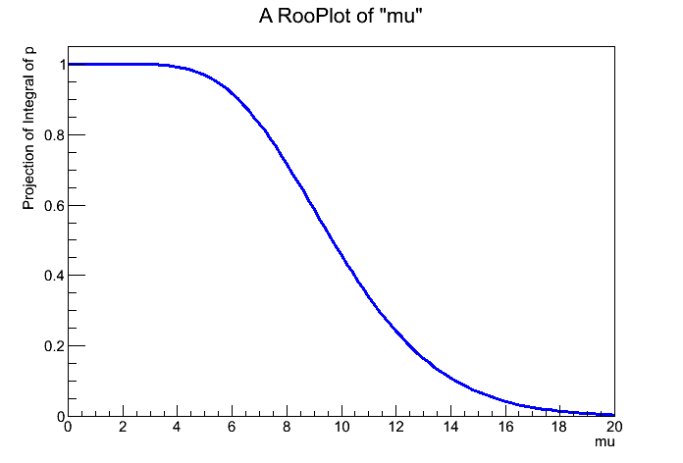
Exclusion statements – in a bit more detail
Usually reframe this statement: rather than excluding a fixed N_{sig} at some C.L, fix C.L. at 95% and find Nsig that is just excluded at that C.L.
Plot p-value for N_{obs}=10 vs mu=s+b
Can do this analytically for a Poisson counting exp w/o nuisance params
In this example: can exclude N(NewPhys) of ~6 events at 95% C.L.
5%
s+b

Slide 37
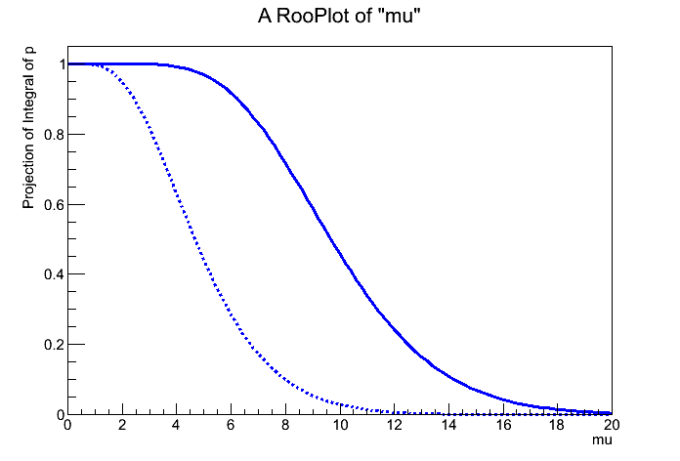
Exclusion statements – low fluctuations
What if we observe only 5 events (instead of 10?)
N_{exp}(SM+NewPhys) = 20, N_{exp}(SM only) = 10
N_{obs} = 5
We can exclude N_{sig}=0 at >95% C.L! Hmm....
But we don’t expect to have sensitivity to do that.
Also p(SM)≈6%
s+b

Slide 38
Exclusion statements – CLs
What should you do with such cases?
I.e. low stat fluctuation in observed data gives limit on signal that (far) exceeds expected sensitivity
HEP invented procedure do deal with such situations is a technique called ‘CL_{S}’
Instead of taking the p-value of S+B case p(S+B) = 7.2 · 10⁻⁵ (Nobs=5, Nexp=20) take the ratio of p-values of p(S+B)/p(B) p(S+B) = 7.2 · 10⁻⁵ (Nobs=5, Nexp=20) p(B) = 6.7 · 10⁻² (Nobs=5, Nexp=10) ‘CLs’ = 1.1 · 10⁻³ (Nobs=5)

Slide 39
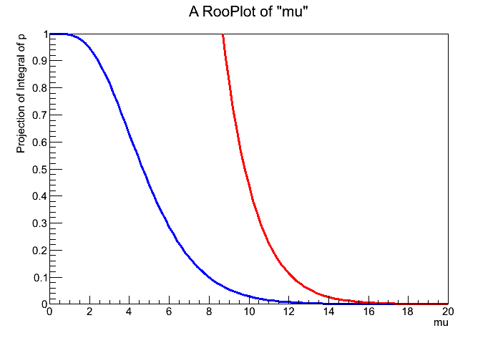
Exclusion statements – CLs
Effectively CLs prevents you from making exclusions in areas where you do not expect to have sensitivity
Example case with Nobs is 5, signal limit is now ~3.2 events at 95% C.L. (from excluding Nsig=0 at >95%C.L.)
s+b

Slide 40
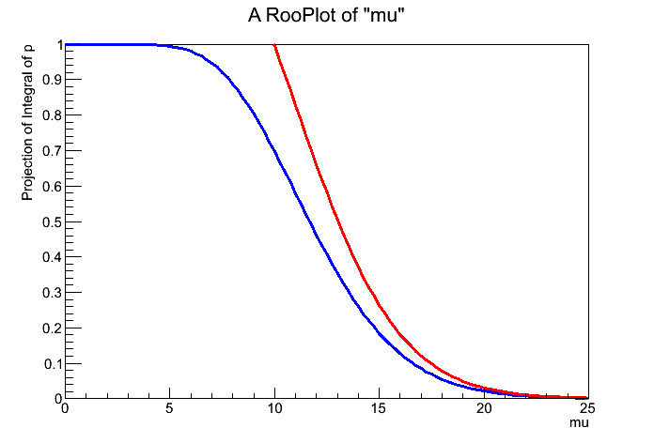
Exclusion statements – CLs
If you are in a region where there Nobs > Nexp(bkg) difference between CLs and p_{s+b} is small
CLs tends to overcover a bit when N_{obs} ~<= N_{exp}(bkg)

Slide 41
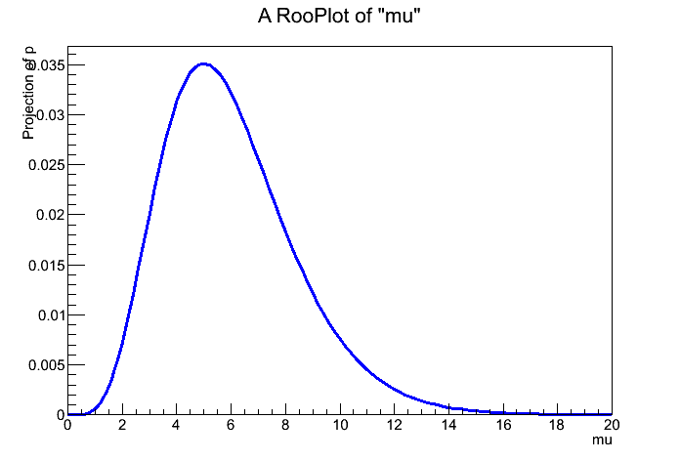
Poisson case: Bayes with flat prior vs CLs
Note that for the case of the simple Poisson counting experiment, the CL_{S} limit is identical the Bayesian limit assuming a flat prior for s>0 and zero prior for s<0
Area cut by prior
L(x=5|μ)
95% interval in posterior
s+b

Slide 42
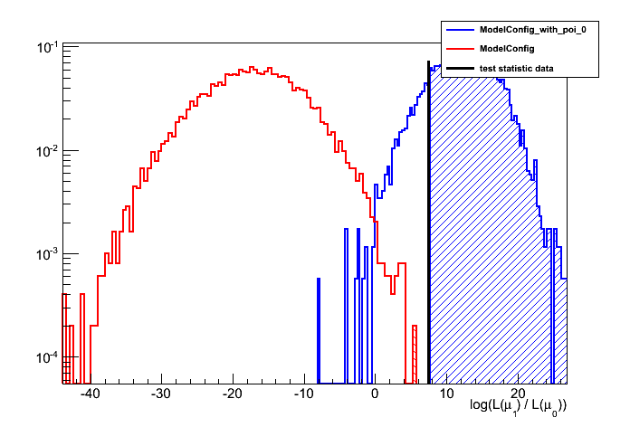
CLs on realistic analysis
On more complex analysis, distribution of p values for B and S+B cannot be calculated easily as was done here for Poisson number counting case
Solution: Obtain distributions from pseudo-experiments and then follow procedure as usual
But can take a lot of computing time...

Slide 43
Putting it all together – The Higgs search as example
The LHC search for the Higgs boson uses almost all of the techniques that we have discussed
The search for the Higgs is complicated: It’s mass is unknown, it can decay in many possible ways, and preferred decay modes depend on the mass
Strategy:
Search for Higgs boson in many decay channels.
Set exclusion limit as function of (unknown) Higgs mass, i.e. assume m_{H}=X, determine Higgs production cross-section that can be excluded assuming that mass, and then reiterate procedure for m_{H}=X+ΔX.
Goal for now: try to rule out range of Higgs mass. (If Higgs boson exist, exclusion will remain impossible in some region of Higgs mass.) Goal for later: switch from exclusion to discovery mode
Increase sensitivity by combining results from all channels in limit calculation
Increase sensitivity by combining results from ATLAS and CMS (should be public for the first time this week)

Slide 44
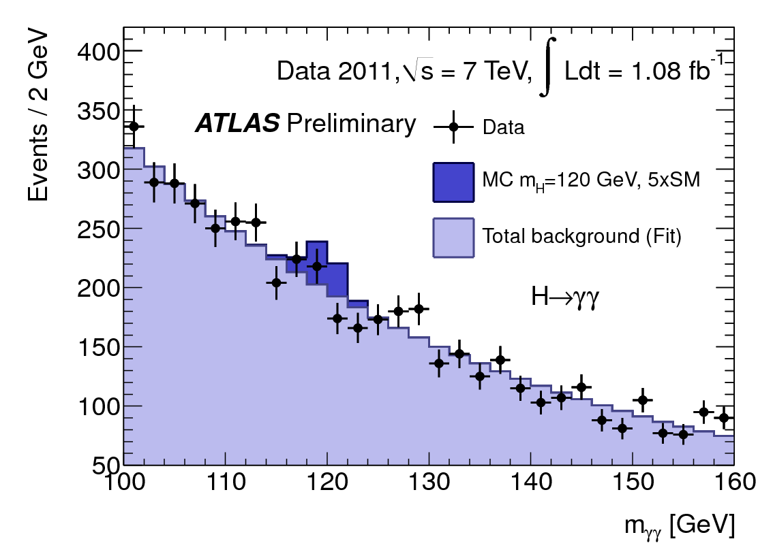
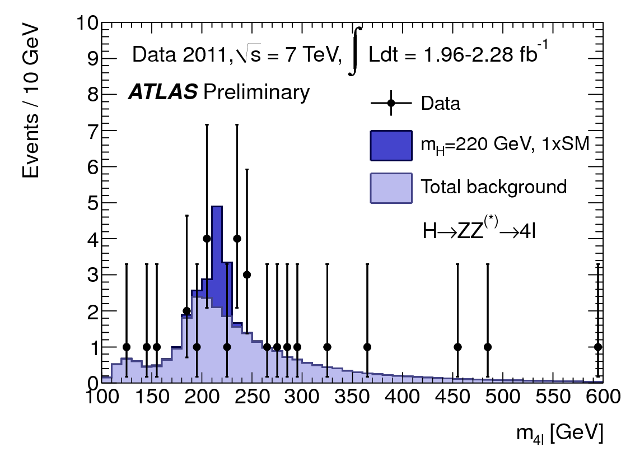
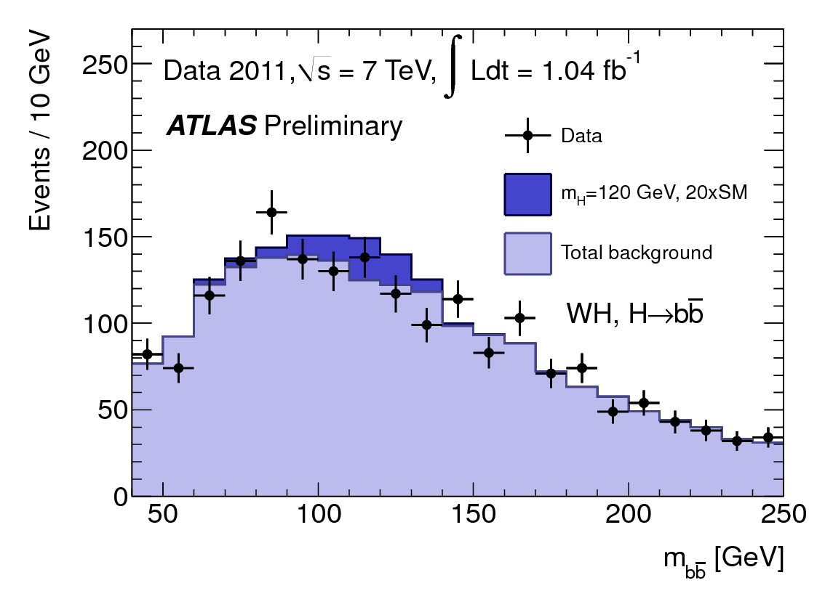
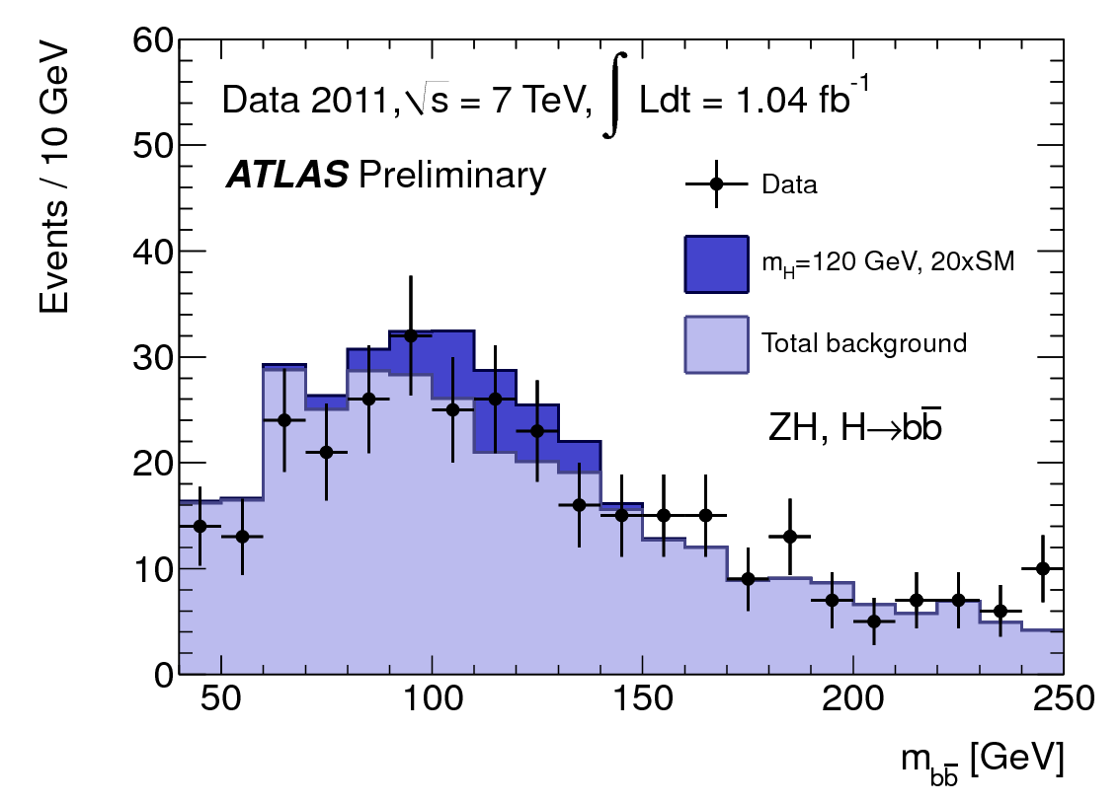
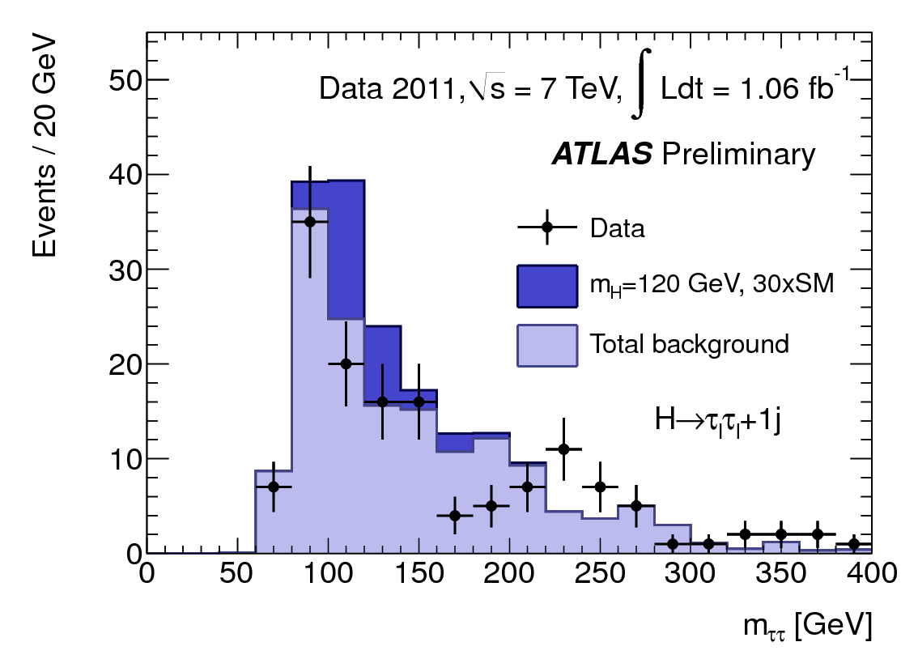
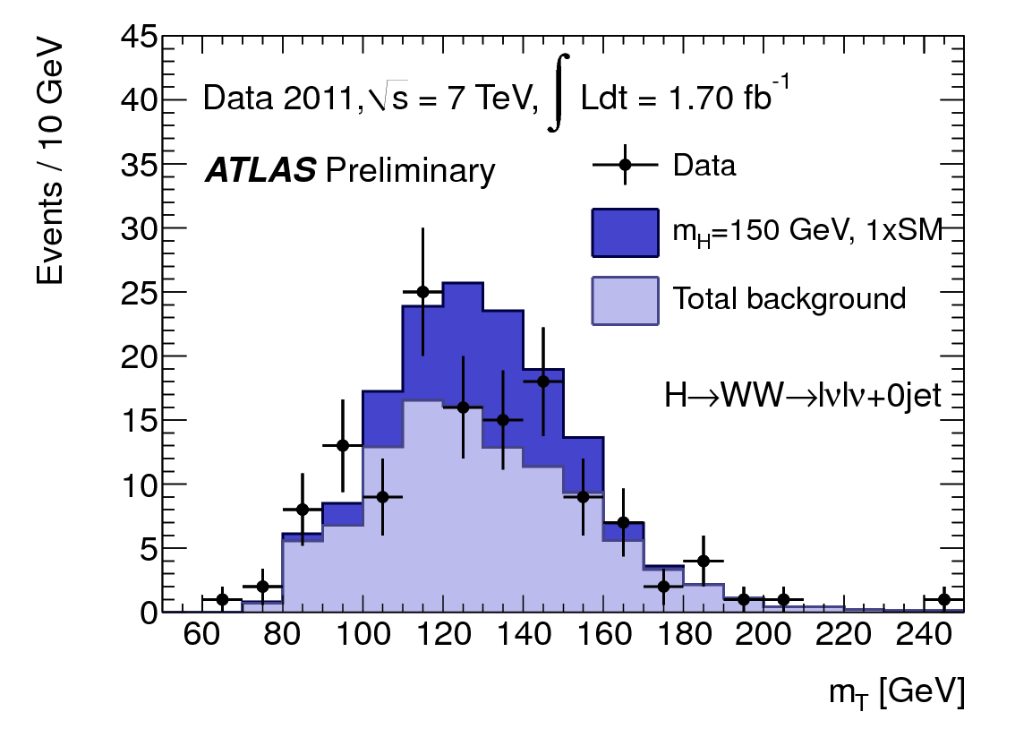
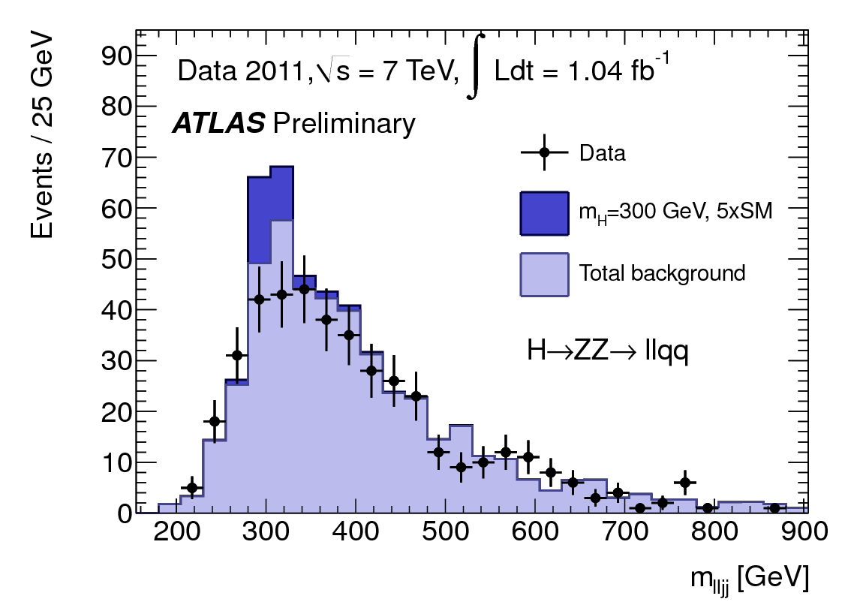
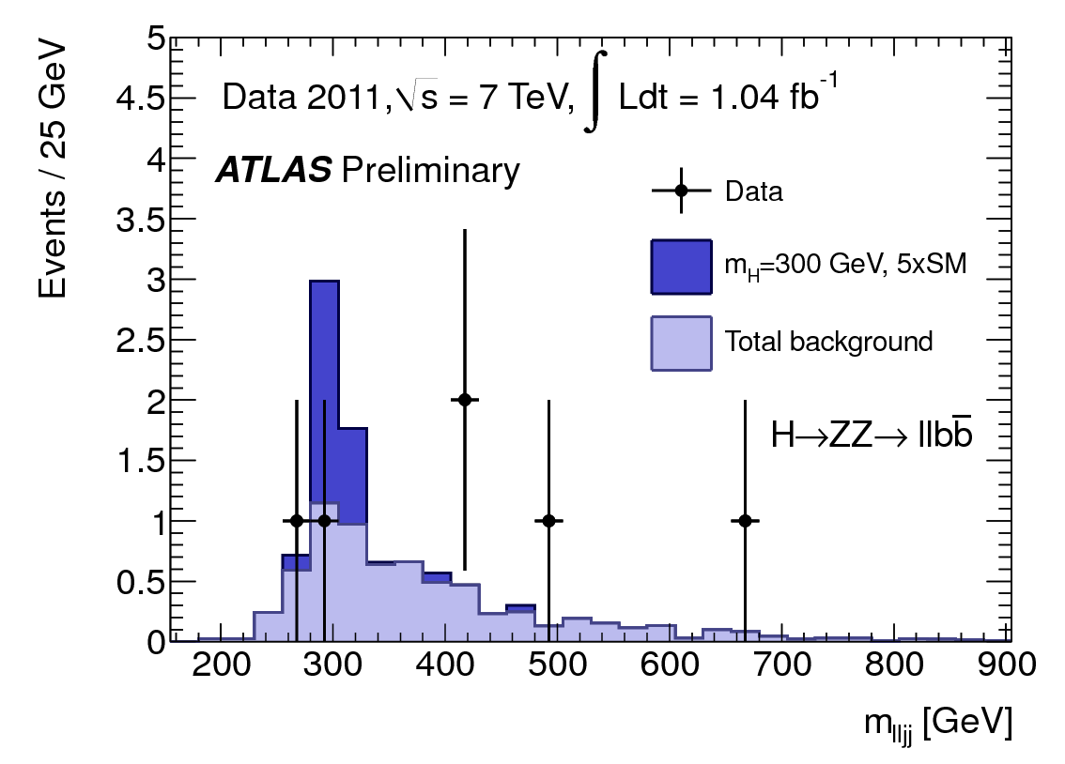
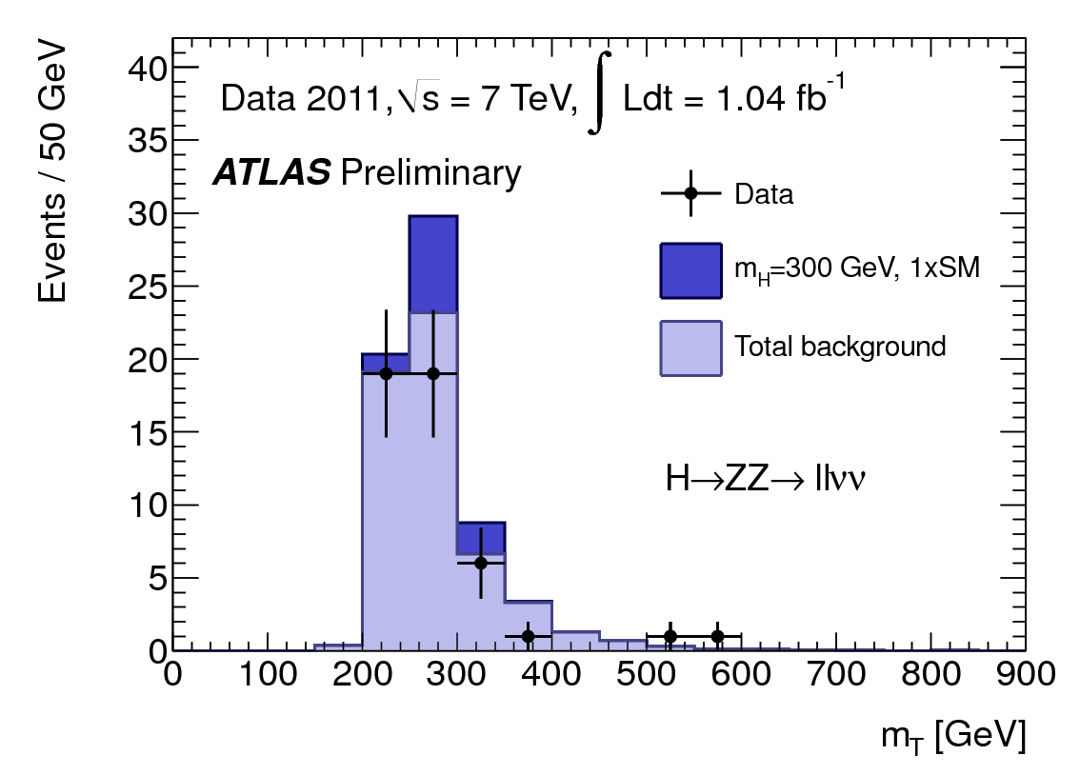
Putting it all together – The Higgs search as example
Step 1 – Event selection
Defined separately for each Higgs decay channel (gg,WW,ZZ,ττ)
Quantify SM and Higgs expected distributions for each channel (the latter for a large range of mHiggs hypotheses)
NB: This is a substantial effort for each channel

Slide 45
Putting it all together – The Higgs search as example
Step 2 – Statistical analysis of each channel
Use ‘profile likelihood ratio’ as test statistic, as input to CLs construction. For each channel and m(Higgs):
Generate distribution of expected values for test statistic in background only hypothesis and signal+background hypothesis
Calculated observed value of p(s+b), p(b) → observed CLs limit on Higgs→XX at m(Higgs)=YY GeV
Calculate expected CLs limit for each point too (central value of expectation and 1-sigma and 2-sigma intervals)

Slide 46
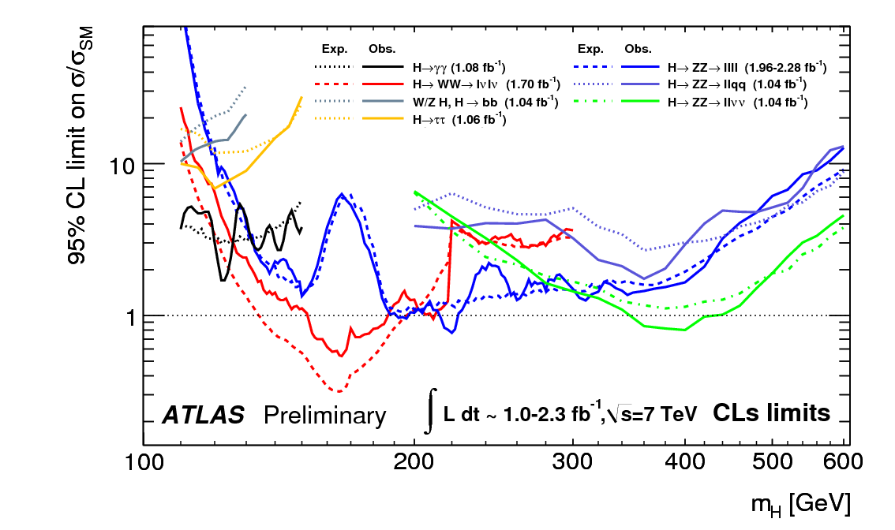
Putting it all together – The Higgs search as example
Exampe: this point means: H→gg analysis can exclude Higss production at ~5x the SM predicted rate at m_{H}=130 GeV

Slide 47
Putting it all together – The Higgs search as example
Step 3 – Combination effort
Construct joint likelihood of all channels (and/or experiments)
Take Lcomb = L_{gg}(m_{H},....)·L_{WW}(m_{H},...)·L_{ZZ}(m_{H},..)
Profile over all nuisance parameters (can be >100 parameters), ( amounts to minimizing the likihood with >100 parameters!)
Perform CLs construction (generate pseudo-data, minimize likelihood, iterate a few 100K times)
Need to this carefully about correlations between nuisance parameters from various channels
i.e. Jet Energy Scale uncertainty will be common in all channels, backgrounds rates are usually not etc etc
Repeat exercise for many values of m(Higgs)

Slide 48
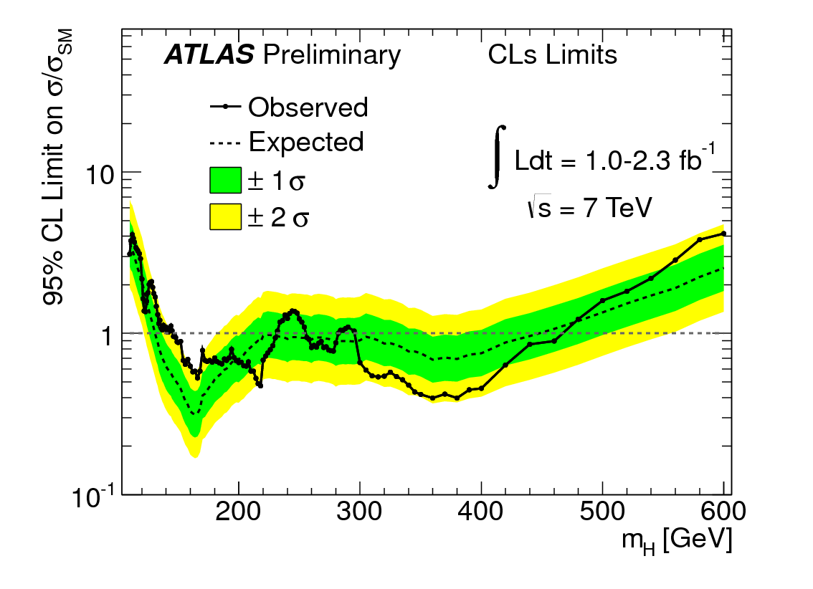
Putting it all together – The Higgs search as example

Slide 49
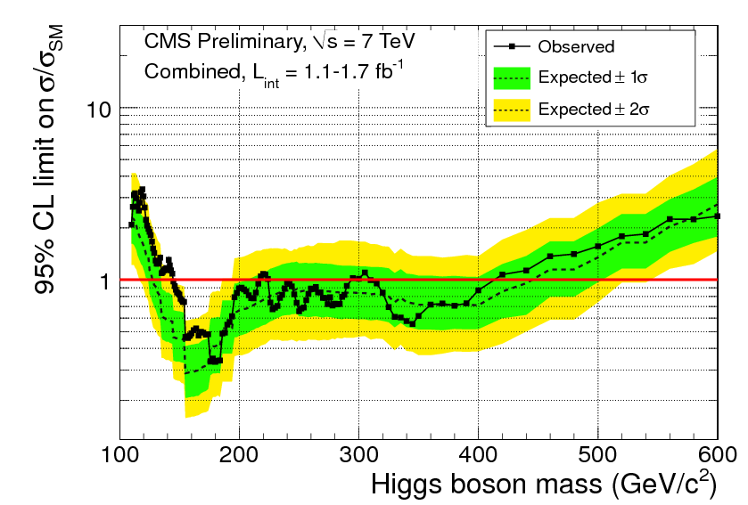
Coming (very) soon – LHC combination

Slide 50
Software for combinations and limit setting
A lot of software has been developed in the past years to simplify the technical implementation of likelihoods, combining of likelihoods and to perform limit calculations
Tools for modeling of pdfs already existed in some form (RooFit) → has been extended to make this models persistable → Can write actual likelihood to file
Combination effort consists then of picking up these files, constructing the joint likelihood and minimizing this
Technically easy (but still a lot of effort and thinking required)
Write a new series of ‘standard’ tools that perform Bayesian, Frequentist and Likelihood-based limit calculations on such models
Goal: each calculator can handle any model (very ambitious!)

Slide 51

ATLAS/CMS/ROOT Project: RooStats built on RooFit
Core developers:
K. Cranmer (ATLAS)
Gregory Schott (CMS)
Wouter Verkerke (RooFit)
Lorenzo Moneta (ROOT)
Open project, all welcome to contribute.
Included in ROOT production releases since v5.22, more soon to come
Example macros in $ROOTSYS/tutorials/roostats
RooFit extensively documented, RooStats manual catching up, code doc in ROOT.

Slide 52
B. Cousins: Goal for the LHC a Few Years Ago
Have in place tools to allow computation of results using a variety of recipes, for problems up to intermediate complexity:
Bayesian with analysis of sensitivity to prior
Frequentist construction with approximate treatment of nuisance parameters
Profile likelihood ratio (Minuit MINOS)
Other “favorites” such as LEP’s CLS(which is an HEP invention)
The community can then demand that a result shown with one’s preferred method also be shown with the other methods, and sampling properties studied.
When the methods all agree, we are in asymptotic regime.
When the methods disagree, we learn something!
The results are answers to different questions.
Bayesian methods can have poor frequentist properties
Frequentist methods can badly violate likelihood principle

Slide 53
RooStats Project – Example
Create a model - Example
Create workspace with above model (using factory)
RooWorkspace* w = new RooWorkspace(“w”); w->factory(“Poisson::P(obs[150,0,300], sum::n(s[50,0,120]*ratioSigEff[1.,0,2.], b[100,0,300]*ratioBkgEff[1.,0.,2.]))"); w->factory("PROD::PC(P, Gaussian::sigCon(ratioSigEff,1,0.05), Gaussian::bkgCon(ratioBkgEff,1,0.1))");
Contents of workspace from above operation
RooWorkspace(w) w contents
variables
---------
(b,obs,ratioBkgEff,ratioSigEff,s)
p.d.f.s
-------
RooProdPdf::PC[ P * sigCon * bkgCon ] = 0.0325554
RooPoisson::P[ x=obs mean=n ] = 0.0325554
RooAddition::n[ s * ratioSigEff + b * ratioBkgEff ] = 150
RooGaussian::sigCon[ x=ratioSigEff mean=1 sigma=0.05 ] = 1
RooGaussian::bkgCon[ x=ratioBkgEff mean=1 sigma=0.1 ] = 1

Slide 54
RooStats Project – Example
Confidence intervals calculated with model
Profile likelihood
Feldman Cousins
Bayesian (MCMC)
ProfileLikelihoodCalculator plc; plc.SetPdf(w::PC); plc.SetData(data); // contains [obs=160] plc.SetParameters(w::s); plc.SetTestSize(.1); ConfInterval* lrint = plc.GetInterval(); // that was easy.
FeldmanCousins fc;
fc.SetPdf(w::PC);
fc.SetData(data); fc.SetParameters(w::s); fc.UseAdaptiveSampling(true); fc.FluctuateNumDataEntries(false); fc.SetNBins(100); // number of points to test per parameter fc.SetTestSize(.1); ConfInterval* fcint = fc.GetInterval(); // that was easy.
UniformProposal up; MCMCCalculator mc; mc.SetPdf(w::PC); mc.SetData(data); mc.SetParameters(s); mc.SetProposalFunction(up); mc.SetNumIters(100000); // steps in the chain mc.SetTestSize(.1); // 90% CL mc.SetNumBins(50); // used in posterior histogram mc.SetNumBurnInSteps(40);
ConfInterval* mcmcint = mc.GetInterval();

Slide 55
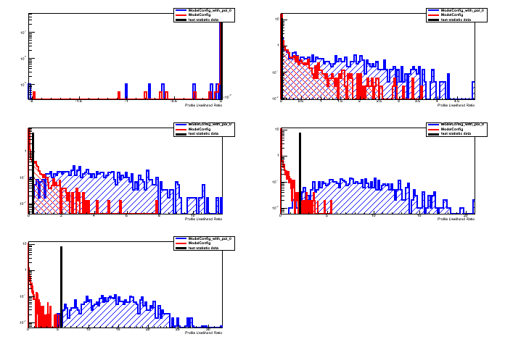
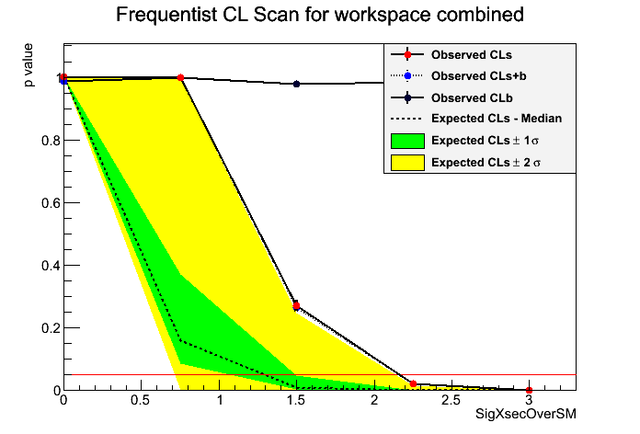
RooStats Project – Example
Retrieving and visualizing output

Slide 56
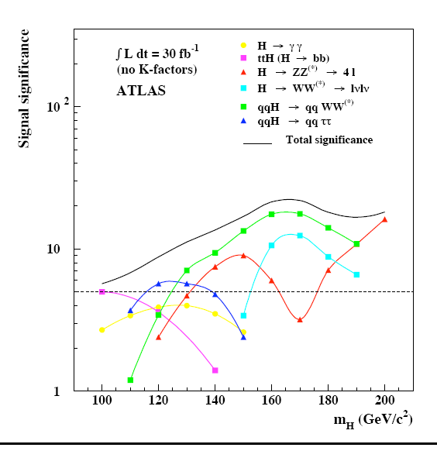
‘Digital’ publishing of results
A likelihood may be considered the ultimate publication of a measurement
Interesting to be able to digitally publish actual likelihood rather than
Parabolic version (i.e. you publish your measurement and an error)
Some parameterized form. Cumbersome in >1 dimension. No standard protocol for exchanging this time of information
This is trivially possible with RooFit/RooStats
Many applications, e.g. now used in combining of Higgs channels, sharing of models between ATLAS and CMS for combination effort

Slide 57


Using persisted p.d.f.s.
Using both model & p.d.f from file
Note that above code is independent of actual p.d.f in file → e.g. full Higgs combination would work with identical code
TFile f(“myresults.root”) ;
RooWorkspace* w = f.Get(“w”) ;
RooPlot* xframe = w::x.frame() ;
w::d.plotOn(xframe) ;
w::g.plotOn(xframe) ;
RooAbsReal* nll = w::g.createNLL(w::d)
RooAbsReal* pll = nll->createProfile(w::mean) ;
RooPlot* mframe = w::m.frame(-1,1) ;
pll->plotOn(mframe) ;
mframe->Draw()
Make plot of data and p.d.f
Construct likelihood & profile LH
Draw profile LH

Slide 58





The end – Recommended reading
Easy
R. Barlow, Statistics: A Guide to the Use of Statistical Methods in the Physical Sciences, Wiley, 1989
L. Lyons, Statistics for Nuclear and Particle Physics, Cambridge University Press
Philip R. Bevington and D.Keith Robinson, Data Reduction and Error Analysis for the Physical Sciences
Intermediate
Glen Cowan, Statistical Data Analysis (Solid foundation for HEP)
Frederick James, Statistical Methods in Experimental Physics, World Scientific, 2006. (This is the second edition of the influential 1971 book by Eadie et al., has more advanced theory, many examples)
Advanced
A. Stuart, K. Ord, S. Arnold, Kendall’s Advanced Theory of Statistics, Vol. 2A, 6th edition, 1999; and earlier editions of this “Kendall and Stuart” series. (Authoritative on classical frequentist statistics)
PhyStat conference series:
Beginning with Confidence Limits Workshops in 2000, links at http://phystat-lhc.web.cern.ch/phystat-lhc/ and http://www.physics.ox.ac.uk/phystat05/

