Slide 1
MINOS/NOvA and
Future LBNOE
Alfons Weber
University of Oxford
STFC/RAL
NExT Neutrino Meeting, Southampton
4-May-2011

Slide 2
Overview
The NuMI Project
  The Beam
  The detectors
    MINOS
      Muon Neutrino Disappearance
      Neutral Current Events
      Electron Neutrino Appearance
    NOvA
Other US projects:
  LBNE

Slide 3
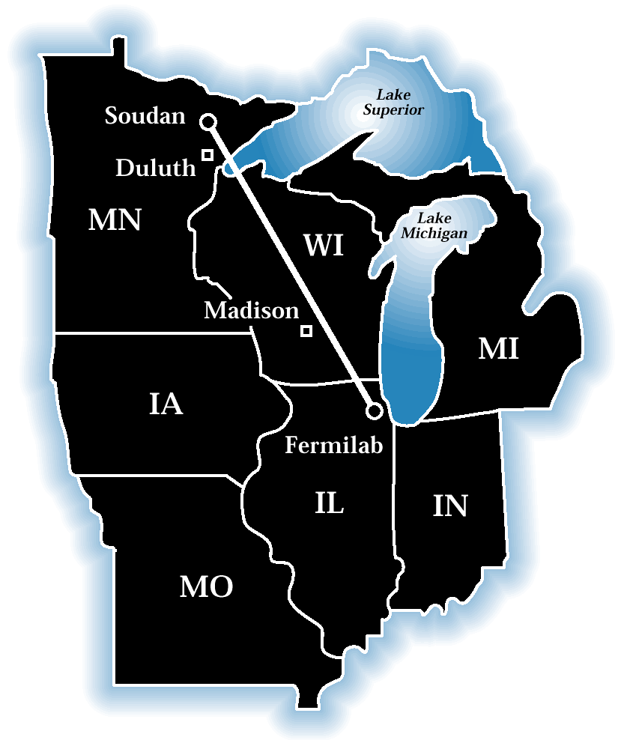
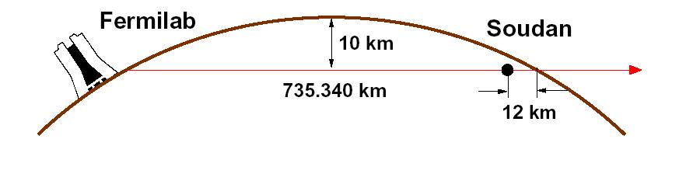

Experimental Setup
MINOS
(Main Injector Neutrino Oscillation Search)
  A long-baseline neutrino oscillation experiment
  Near Detector at Fermilab to measure the beam composition
  Far Detector deep underground in the Soudan Underground Lab, Minnesota, to search for evidence of oscillations
(12 km)
735 km

Slide 4
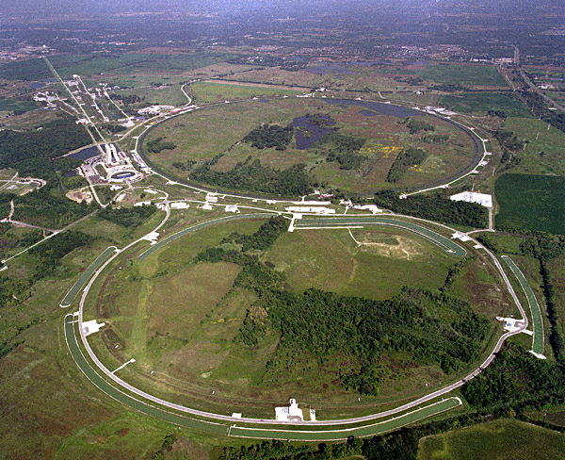
Making Neutrinos
ν_{μ}
π±
p

Slide 5
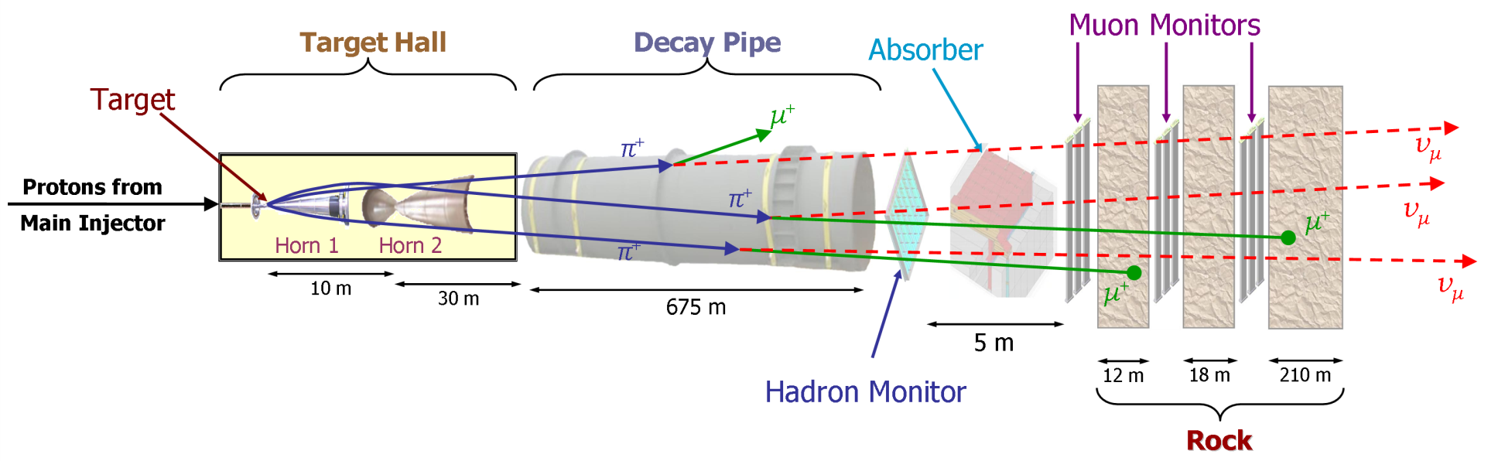
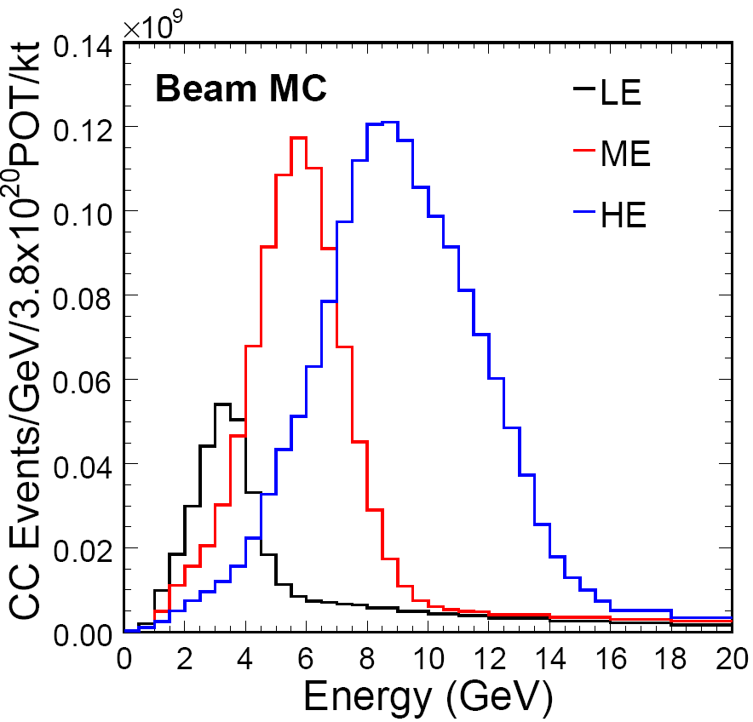
Making Neutrinos (II)
Neutrinos from the Main Injector (NuMI)
10 μs spill of 120 GeV protons every 2.2 s
300 kW typical beam power
3 10¹³ protons per pulse
Neutrino spectrum changes
with target position

Slide 6
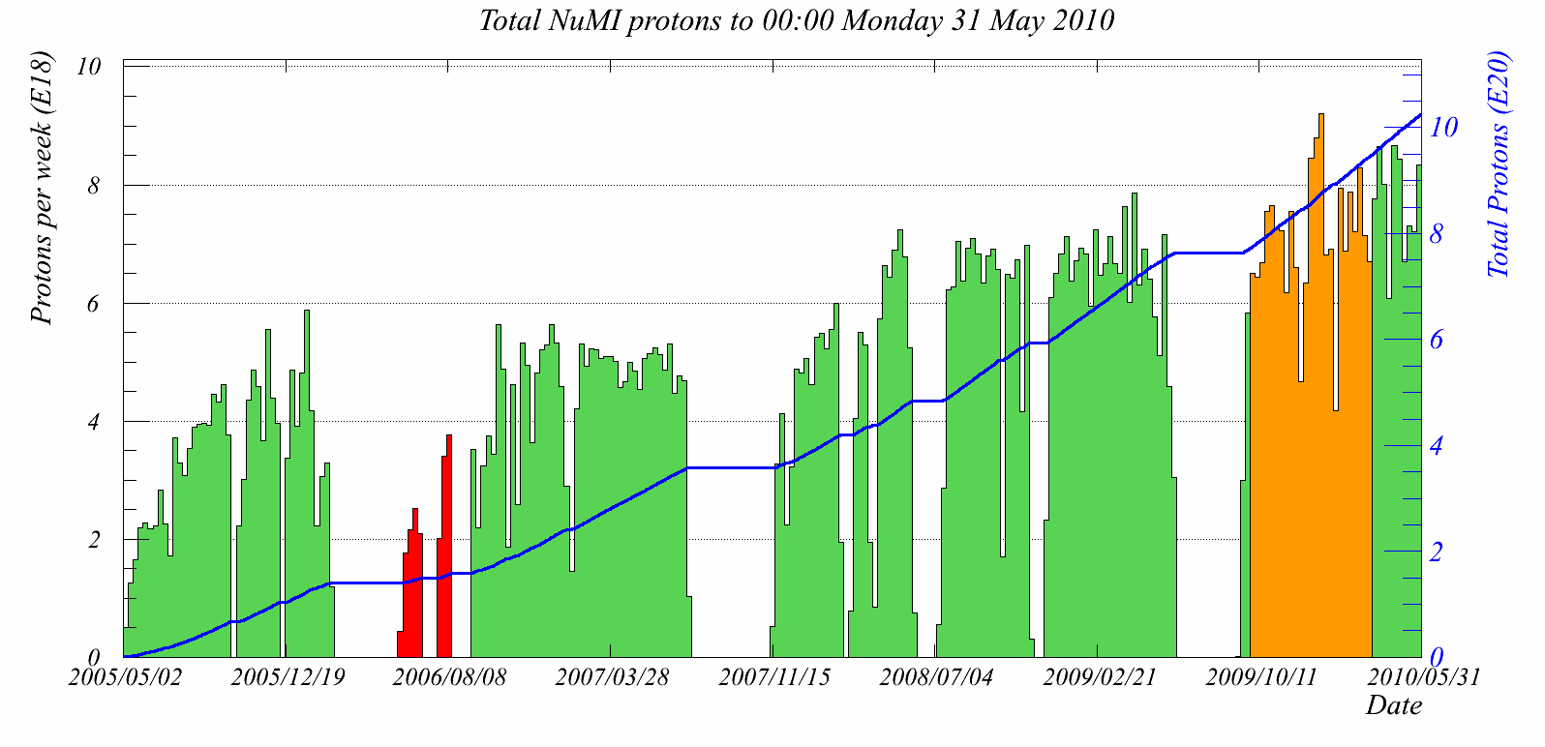
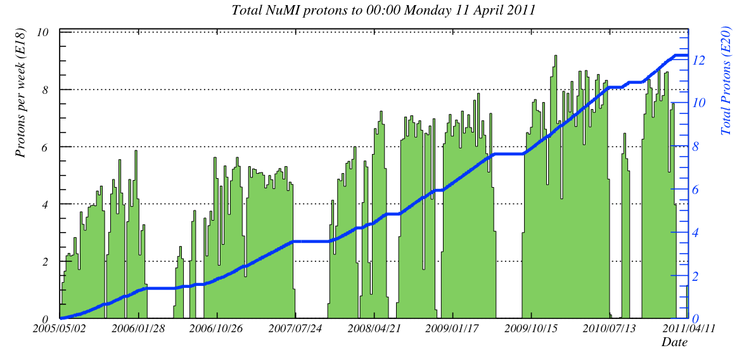
Beam Data Analyzed
Additonal
Anti-neutrino data
1.07x10²¹ POT total
through summer 2010
Exposures Analyzed (protons on target):
This talk (7.2x10²⁰ ν + 1.75x10²⁰ ν)
Previous analyses (>3x10²⁰)
HE beam: 0.15x10²⁰ POT
Anti-nu beam: 1.75x10²⁰ POT
Far Det
>98% live!

Slide 7
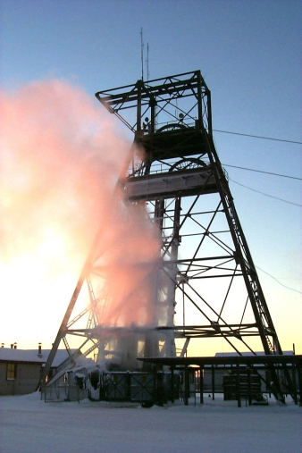
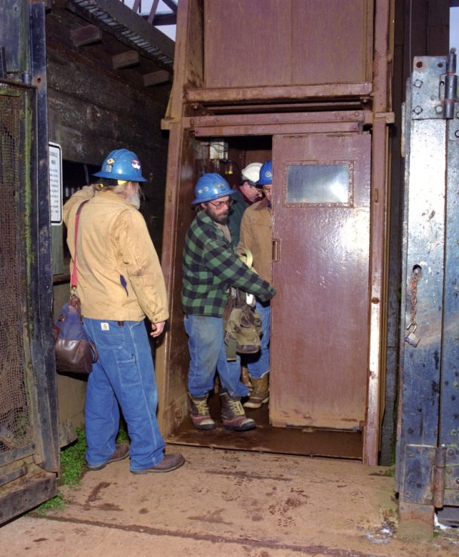
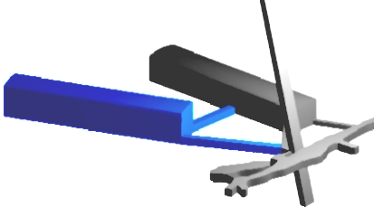
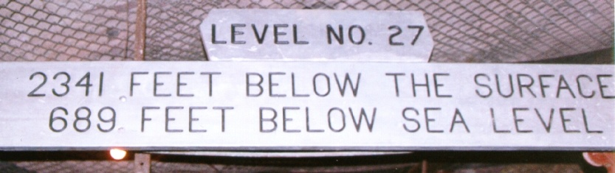
Soudan Underground Lab
former iron mine, now a state park, home of
  Soudan-1 & 2 , CDMS-II , and MINOS experiments

Slide 8
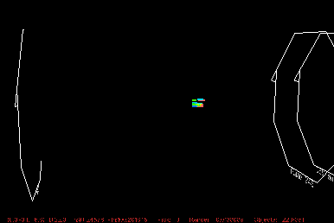
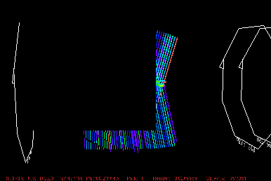
MINOS Far Detector
What it sees
What we reconstruct

Slide 9
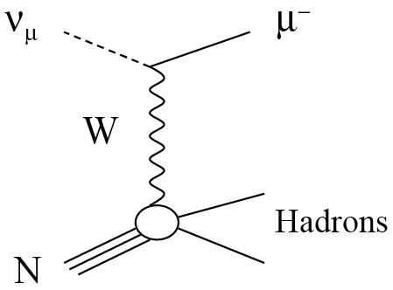
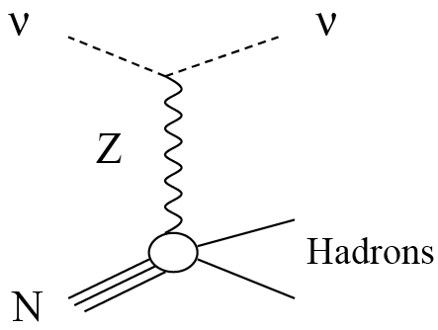
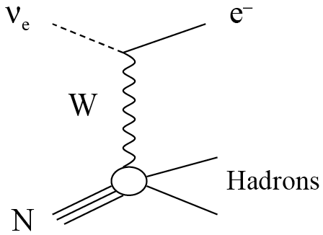
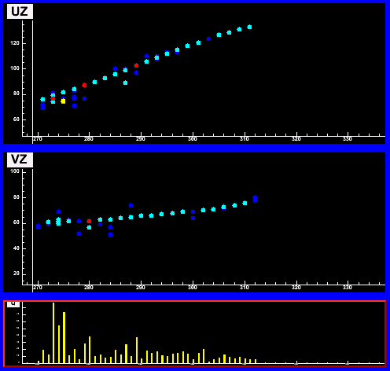
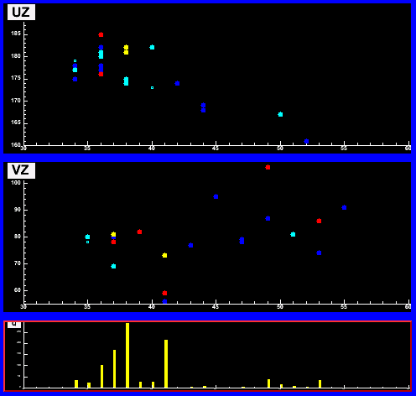
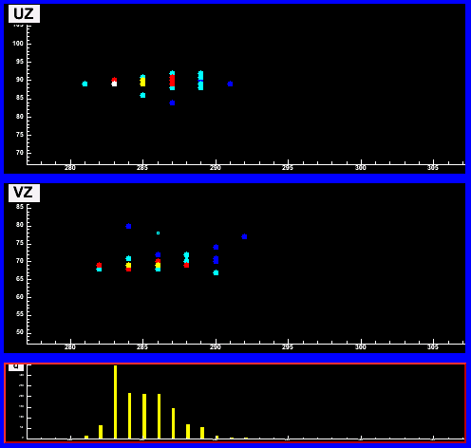
Event Topologies
Monte Carlo
ν_{μ} CC Event
NC Event
ν_{e} CC Event
UZ
VZ
3.5m
1.8m
2.3m
long μ track & hadronic activity at vertex
short event, often diffuse
short, with typical EM shower profile
E_{ν} = E_{shower} + p_{μ}
Energy resolution
  π±: 55%/√E(GeV)
  μ±: 6% range, 10% curvature

Slide 10
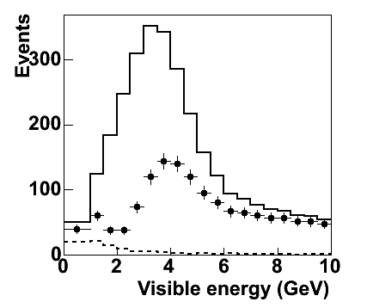
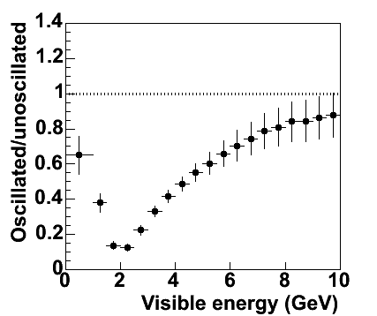
MINOS Oscillation Measurement
ν_{μ} spectrum
Spectrum ratio
Monte Carlo
Monte Carlo
Unoscillated
Oscillated
Use charge current events to measure neutrino energy spectrum

Slide 11
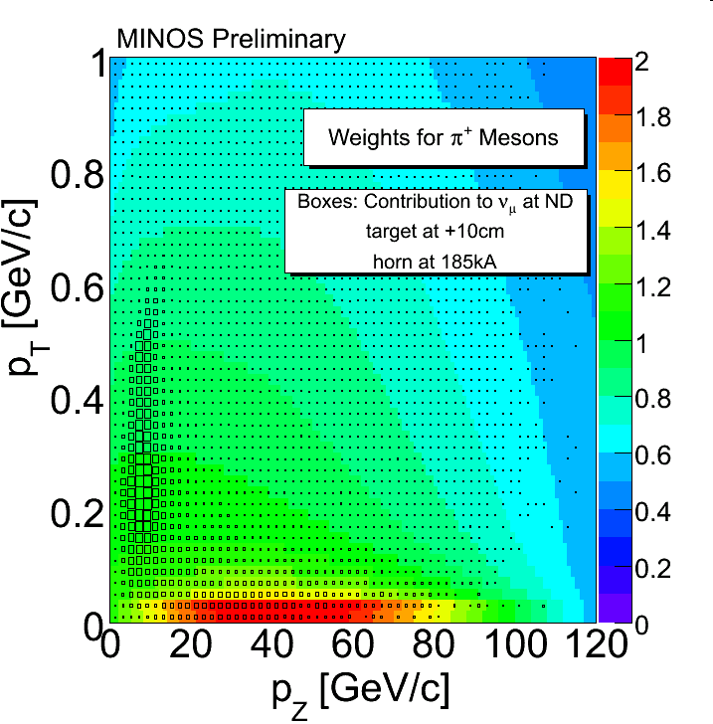
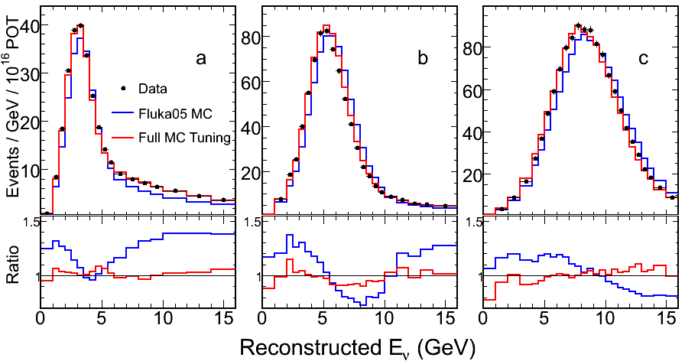
Hadron Production Tuning
Hadron production of proton target has big uncertainties
  neutrino flux unknown
Use Fluka2005 hadron production
  modify: re-weight as f(x_{F},p_{T})
include in fit
  Horn focusing, beam misalignments, neutrino energy scale, cross section, NC background
LE
ME
HE
Weights applied
vs p_{z} & p_{T}
low energy
beam region

Slide 12
Predicting the FD Spectrum
π⁺
p
Target
FD
Decay Pipe
ND

Slide 13
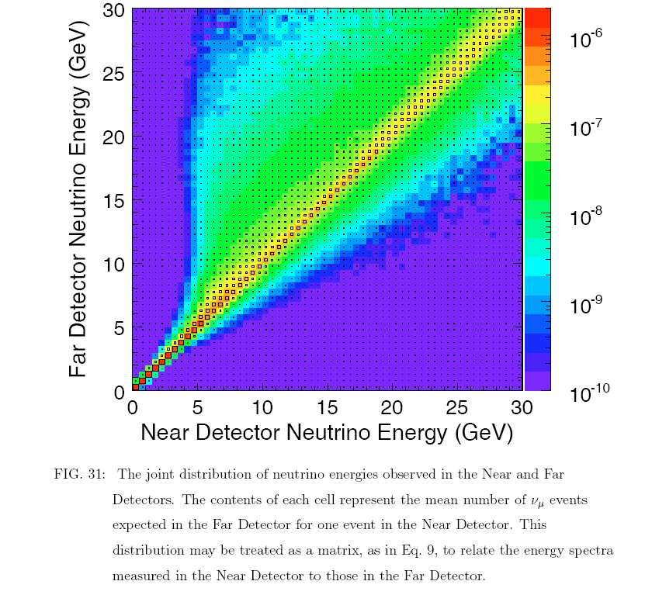
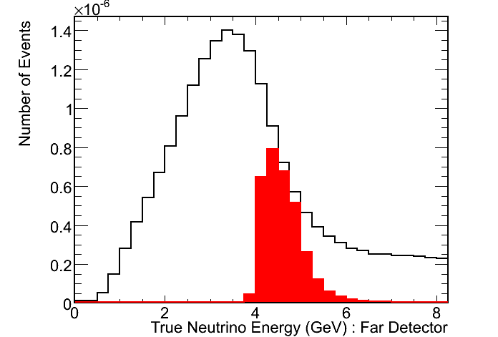
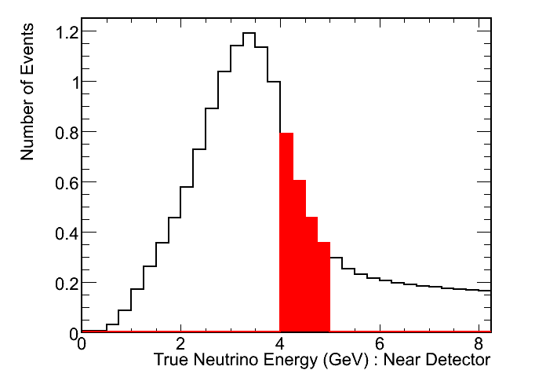
Near to Far Extrapolation
Pion/Kaon decay kinematics are encapsulated in matrix
Measured ND spectrum is transported to FD
Largely reduce systematics
  hadron production
  cross section

Slide 14
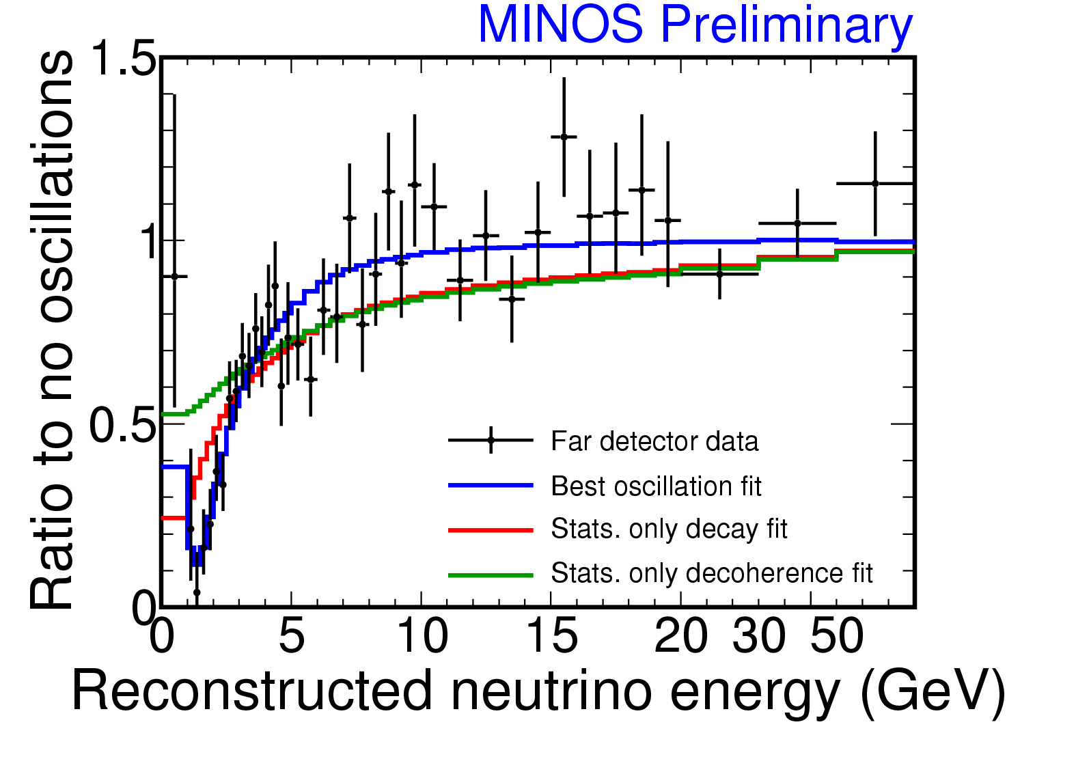
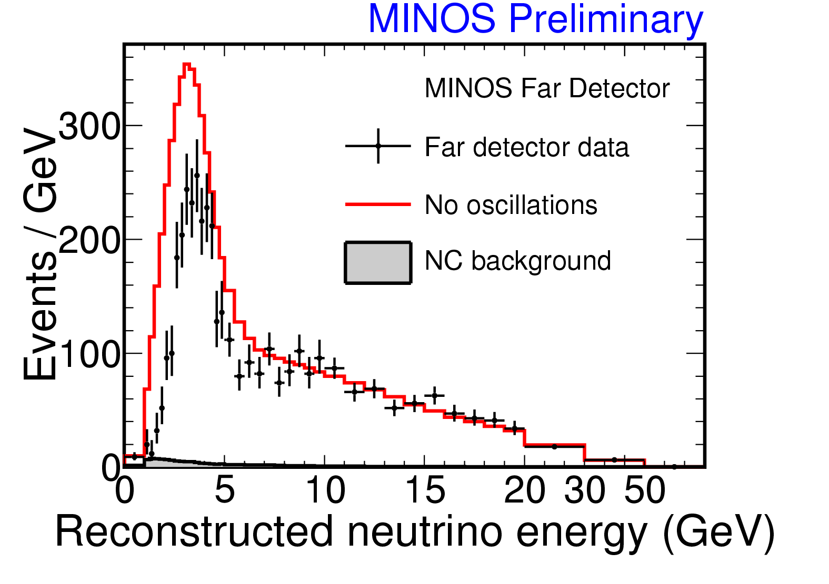
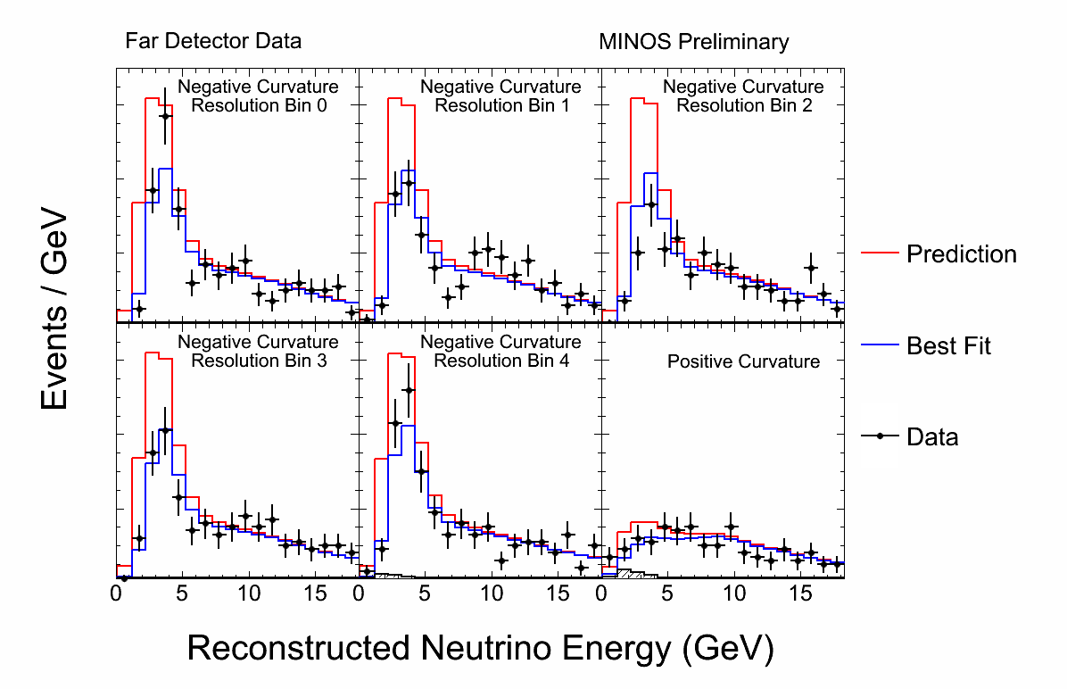
Spectrum
Split up sample into five bins by energy resolution, to let the best resolved events carry more weight (plus a sixth bin of wrong-sign events)
Fit everything simultaneously…
Expect 2451 without oscillations
includes ~1 CR μ, 8.1 rock μ, 41 NC, ~3 ν_{τ} BG
See only 1986 in the FD.

Slide 15
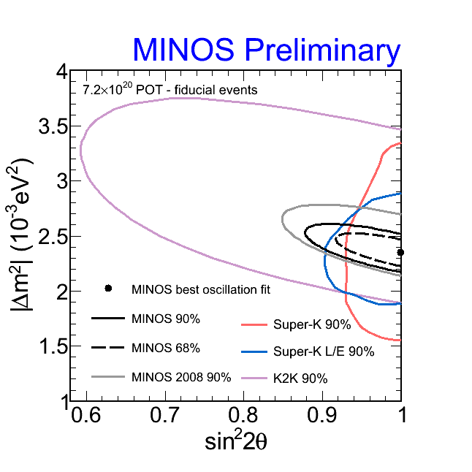
Allowed Region
Fit includes systematic penalty terms
Best physical fit:
|Δm|² = 2.35 x 10⁻³ eV²
sin²(2θ)=1.00
Unconstrained:
|Δm|² = 2.34 x 10⁻³ eV² sin²(2θ)=1.007
Earlier results are in:
Phys.Rev. Lett. 101:131802, 2010

Slide 16
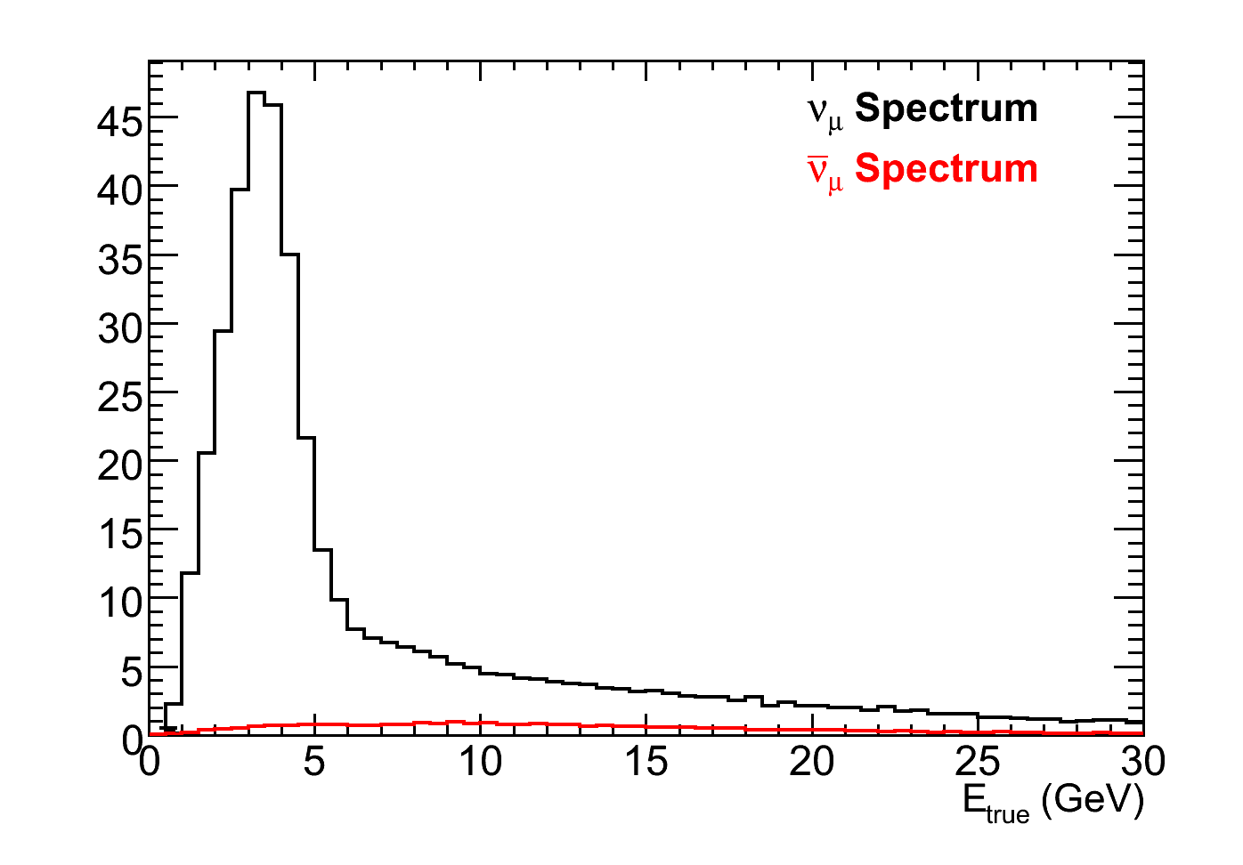
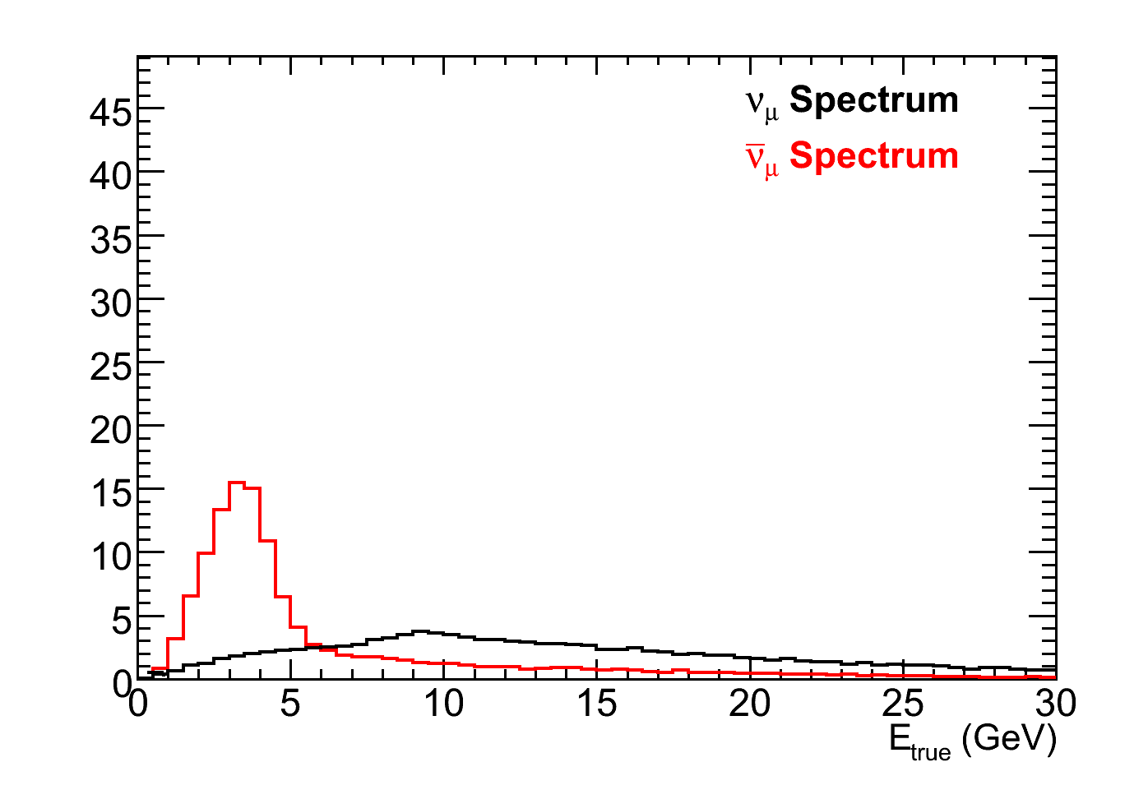

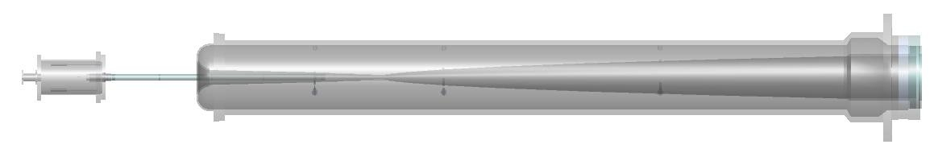
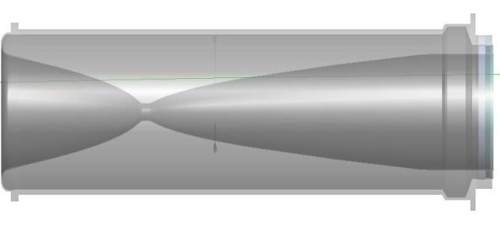
Anti-neutrino Mode
Neutrino mode
Horns focus π⁺, K⁺
Antineutrino mode
Horns focus π⁻, K⁻
Monte Carlo
Monte Carlo
Target
Focusing Horns
Decay Pipe
π⁺
2 m
ν_{μ}
120 GeV protons
ν_{μ}
π⁻
15 m
30 m
675 m

Slide 17
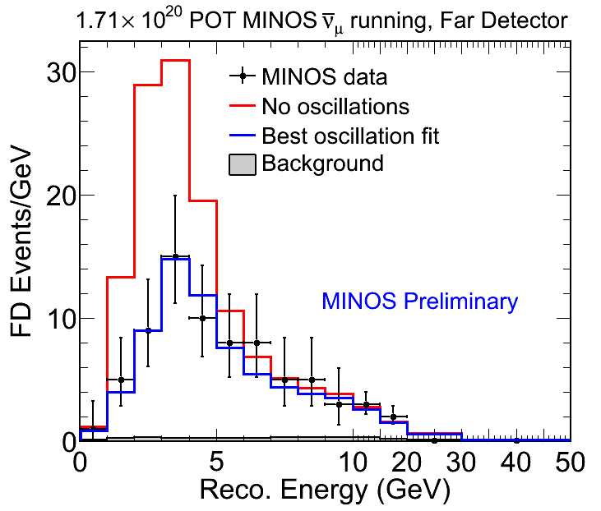
ν_{μ} Results
97 events seen, 155 expected (no osc)
No- oscillations scenario disfavored at 6.3σ
Same sort of
oscillation fit yields:
dominated by statistics
  Includes additional 30%
  uncertainty on the ν_{μ}
  background
Plan to double anti-nu
statistics after initial
Minerva run

Slide 18
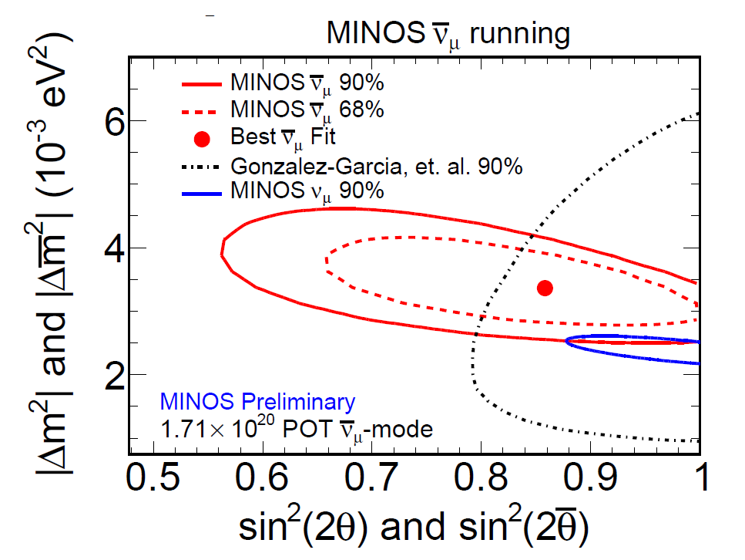
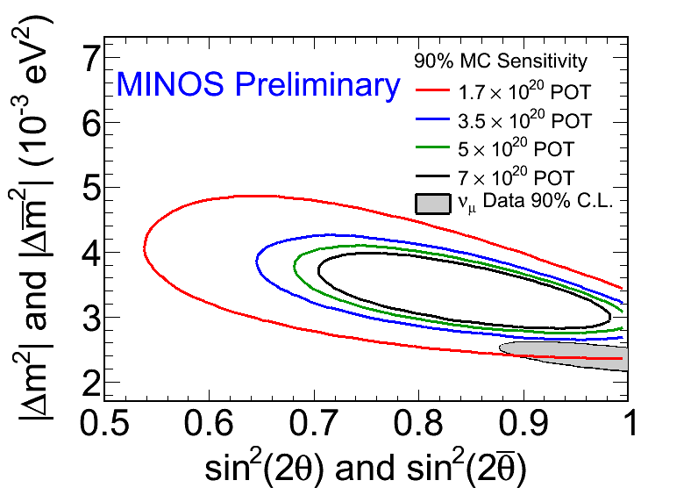
ν_{μ} Results
Interestingly, oscillation parameters differ from the ν_{μ} results at a not terribly significant level, ~2σ
MC Sensitivity studies show
doubling the data should better
resolve any differences:
Global fit from Gonzalez-Garcia & Maltoni,
Phys. Rept. 460 (2008), SK data dominates

Slide 19
So what are the ν_{μ} disappearing to?
For ν oscillations in this “atmospheric” sector, we like to blame ν_{μ} oscillating to ν_{τ},
  Most ν below τ production threshold
  Few τ that aren’t produce very messy decays which get rejected by our analysis
Some very well might be going to ν_{e} as well, depending on the currently unknown θ₁₃ (known to be less than 0.21 from Chooz)
A fourth, sterile neutrino could also be the culprit
  By definition, ν_{s} interact with nothing save gravity

Slide 20
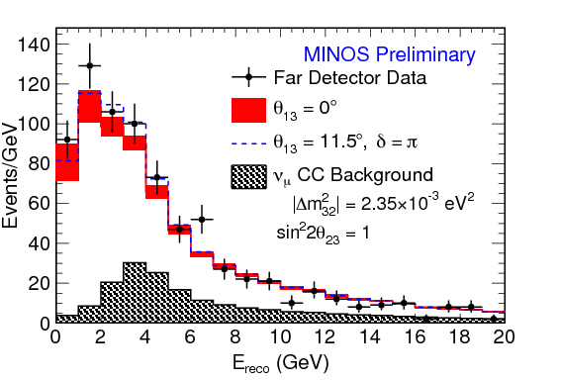
NC Analysis Results
FD NC energy spectrum for Data and oscillated MC predictions
  Form ratio R, data are consistent with no ν_{μ} disappearing to νs
Simultaneous fit to CC and NC energy spectra yields the fraction of ν_{μ} that could be oscillating to ν_{s}:
 | R ± stat ± syst
θ₁₃=0 | 1.09 ± 0.055 ± 0.053
θ₁₃=11.5° | 1.01 ± 0.055 ± 0.058
Earlier results are in:
Phys.Rev.D81:052004, 2010

Slide 21
ν_{e} Appearance
Are some of the disappearing ν_{μ} re-appearing as ν_{e}?
  P(ν_{μ}→ ν_{e}) ≈ sin²θ₂₃ sin²2θ₁₃ sin²(1.27Δm²₃₁L/E)
    Plus CP-violating δ and matter effects, included in fits
Need to select events with compact shower
  MINOS optimized for muon tracking, limited EM shower resolution
    Steel thickness 2.5 cm = 1.4 X₀
    Strip width 4.1cm ~ Molière radius (3.7cm)
  At CHOOZ limit, expect a ~2% effect
    Do blind analysis – establish all cuts, backgrounds, errors first
    Crosscheck in three sidebands
    Only then look at the data to see what pops out

Slide 22
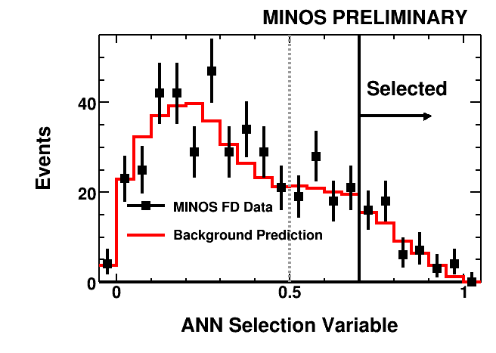
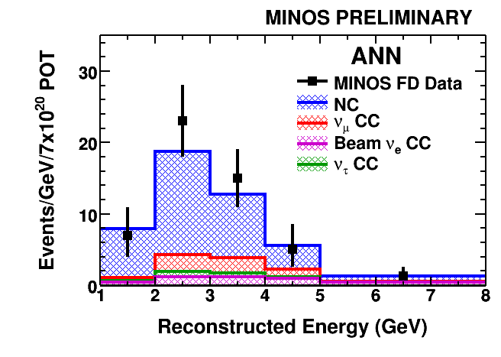
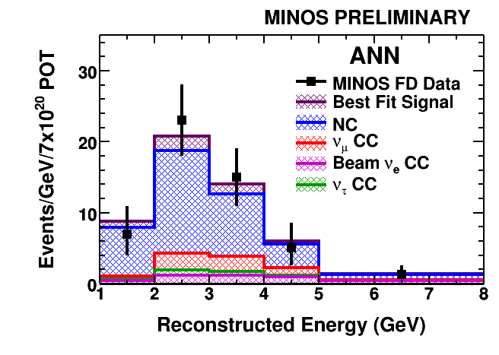
ν_{e} Appearance Results
FD background prediction:
  49.1±7(stat)±2.7(sys)
Observed:
  54 (0.7σ excess)

Slide 23
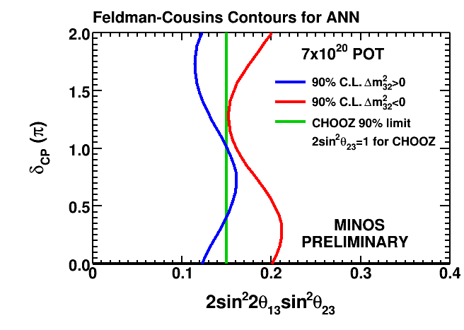
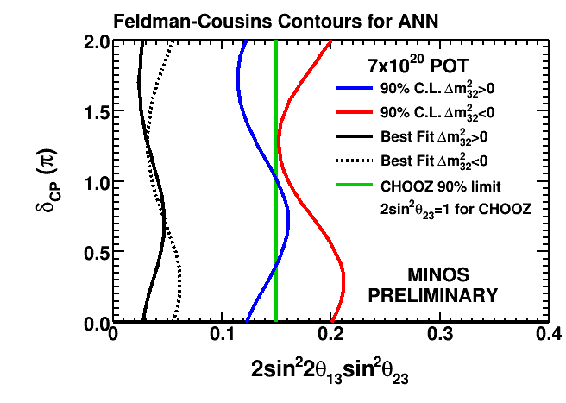
ν_{e} Appearance Results
No significant excess seen, find allowed upper limits using F-C approach
  For both Normal and Inverted mass hierarchies
  Normal hierarchy
  (δCP=0):
    sin²(2θ₁₃) < 0.12 (90% C.L.)
  Inverted hierarchy (δCP=0):
    sin²(2θ₁₃) < 0.29 (90% C.L.)
To be updated soon!
A paper about this:
arXiv:1006.0996 [hep-ex]

Slide 24
NOvA Experiment
MINOS
Uses NuMI beam
  Upgrade to 700 kW
same off-axis trick as T2K
Longest baseline possible while staying in US

Slide 25
Far Detector
Full-size Modules
The cells are made from 32-cell extrusions.
12 extrusion modules make up a plane.
The planes alternate horizontal
and vertical.
There are 1003 planes, for a total
mass of 15 kT. There is enough room in the building for 18 kT, which can be built if we can preserve half of our contingency.
The detector can start taking data as soon as blocks are filled and the electronics connected.
An admirer

Slide 26
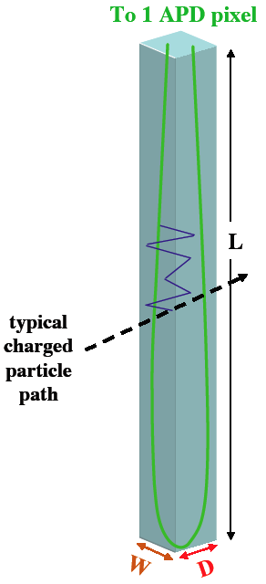
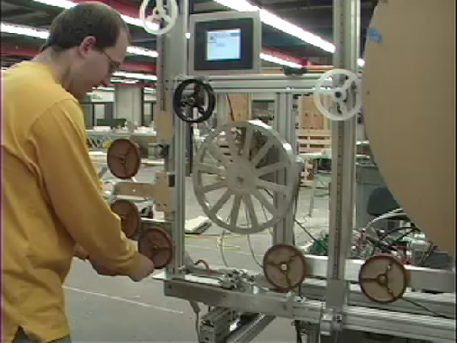
NOνA Basic Detector Element
Liquid scintillator in a 4 cm wide, 6 cm deep, 15.7 m long, highly reflective PVC cell.
Light is collected in a U-shaped 0.7 mm wavelength-shifting fiber, both ends of which terminate in a pixel of a 32-pixel avalanche
photodiode (APD).
The APD has peak quantum
efficiency of 85%. It will be run
at a gain of 100. It must be
cooled to -15ºC and requires
a very low noise amplifier.
Fiber Stringing Machine
32-cell APD

Slide 27
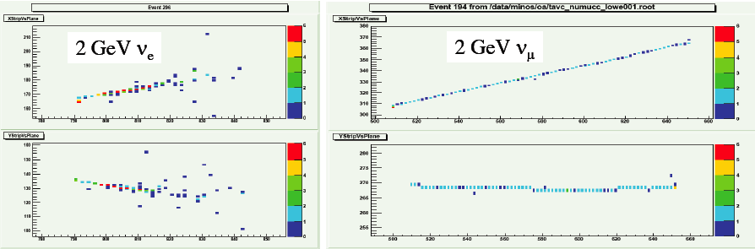
Event Quality
Longitudinal sampling is ~0.2 X₀, which gives excellent μ-e separation.
A 2-GeV muon is 60 planes long.

Slide 28
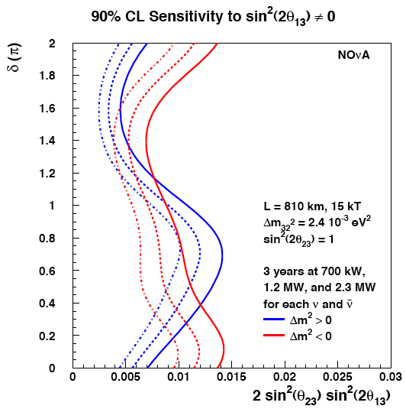
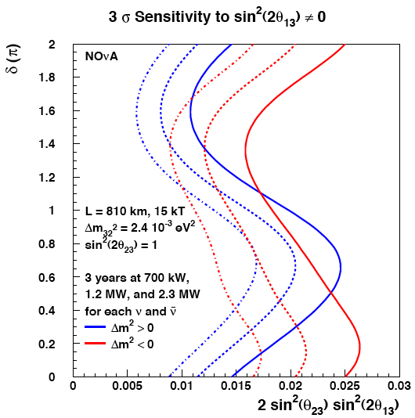
Sensitivity to sin²(2θ₁₃) ≠ 0

Slide 29
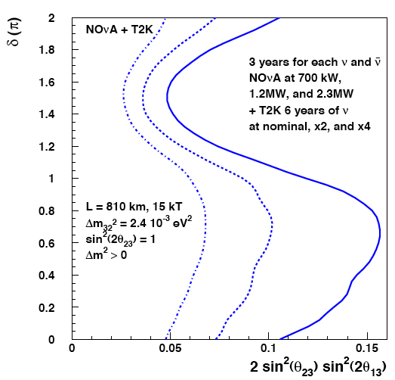
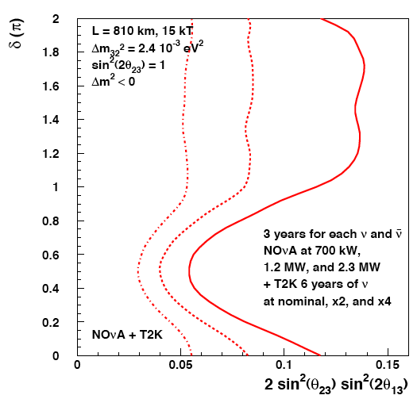
95% CL Resolution of the Mass ordering: NOνA Plus T2K
ν_{μ}➔ν_{e} transition depend on sign of Δm²
  Matter effects
Comparing neutrino and anti-neutrino
Normal Ordering
Inverted Ordering

Slide 30
Probable Schedule
Start of far detector assembly Sep 2011
Start of long shutdown for
NuMI upgrades Mar 2012
First 2.5 kT operational Jan 2012*
Full far detector operational May 2013*

Slide 31



LBNE
200 kT Fid.
Water
2 mods
4850 ft
34 kT LAr
2 mods 800 ft

Slide 32

2 Far Detector Options
200 kT water Cherenkov
34 kT liquid argon
Two 17 kT fiducial LAr detectors
To be located at a new drive-in
site at 800 foot level.
One 200 kT fiducial WC detector
Located at the 4850 foot level

Slide 33

Mass Hierarchy Determination
In ten years of running it will be possible to determine the mass ordering at the 95% c.l. for all values of sin²2θ₁₃ greater than 0.02
“Best” means statistics limited
WC and LAr give same sensitivity
Normal ordering shown here, inverted ordering is similar

Slide 34

CP Violation Measurement
In 10 years it is also possible to measure the CP violation parameter δ for all values of sin²2θ₁₃ greater than 0.01
Curve shows 90% c.l. bound on correlated parameters
oval shows an example of a measurement at the sensitivity limit

Slide 35

sin²2θ₁₃
While a very small value of θ₁₃ would limit mass ordering and CPV sensitivity, it’s scientifically fairly remarkable
Could neutrino mixing be an exact symmetry?
LBNE θ₁₃ sensitivity is limit by statistics
The 90% c.l. bound on sin²2θ₁₃ as a function
of exposure. “min/max” values indicate the
range of δ. Normal mass ordering is shown, but
sensitivity for inverted ordering is similar.

Slide 36
Summary
MINOS had a very successful running over the past years
  Precision measurement of neutrino-oscillation parameters
  Further anti-neutrino running has just started
NOvA is in full swing getting ready
  Near detector taking data in NuMI beam
  FD will start taking data next year
  Sensitivity order of magnitude better than MINOS
    Similar to T2K
LBNE active planning towards the next step
  LAr of Water-Cherenkov detector
  Another order of magnitude improvement possible

Slide 37

… and
May the 4th
be with you!

Slide 38


The MINOS Mural
Finding something in unexpected places

Slide 39

MINOS Construction Challenge

Slide 40






Detector Construction

