Slide 1
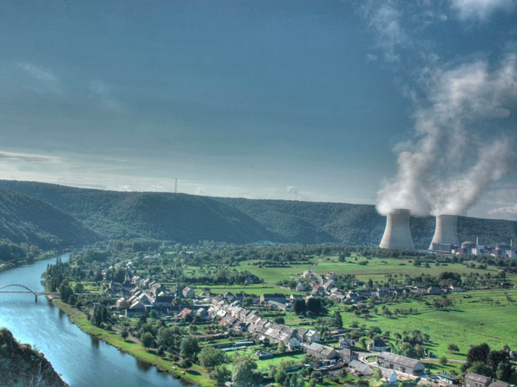
Reactor Neutrinos
Simon JM Peeters
NExT meeting, University of Southampton, 4th May 2011

Slide 2
Contents
Introduction
Current status of upcoming detectors
Reactor anomaly

Slide 3
introduction
Part I/III

Slide 4
Neutrino oscillations
δ
Normal hierarchy
Inverted hierarchy
δ
ν_{e}
ν₂
ν₃
ν_{τ}
ν_{μ}
Δm²₁₂
ν₁
Δm²₃₂
(mass)²
Δm²₃₂
ν₂
Θ₁₃: portal to
CP violation
Δm²₁₂
ν₁
ν₃
~Unknown
CP-violation
phase
“Atmospheric”
Well measured
“Solar”
Well measured
θ₂₃ = (45 ± 7)º
Δm²₃₂ = 2.4 ^{x} 10⁻³ eV²
θ₁₃ <~ 10º
Δm²₃₁ ~ Δm²₃₂
θ₁₂ = (34 ± 3)º
Δm²₁₂ = 7.6 ^{x} 10⁻⁵ eV²

Slide 5
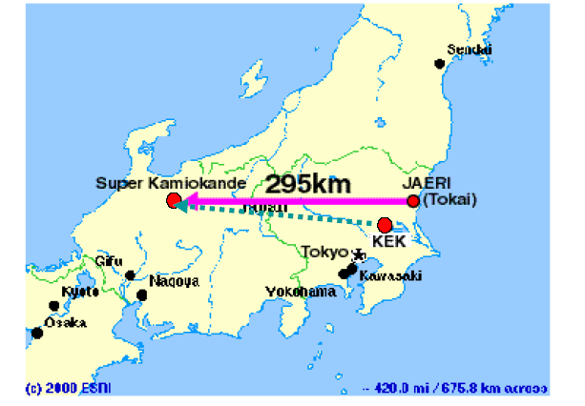
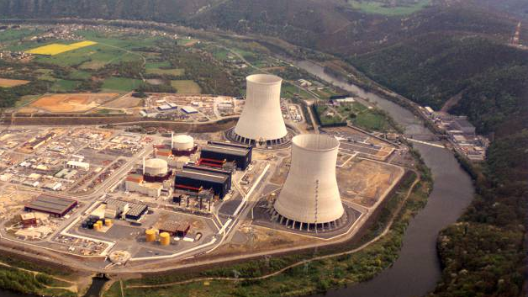
Two approaches
LBL accelerator experiments:
Look for appearance (ν_{μ} → ν_{e}) in pure ν_{μ} beam vs. L and E
Near detector to measure background ν_{e}s (beam + mis-id)
P (ν_{μ} → ν_{e}) = f (δ, sign(Δm₃₁²))
Reactor experiments:
Look for disappearance (ν_{e} → ν_{e}) as a fnc of L and E
Near detector to measure unoscillated flux
P (ν_{e} → ν_{e}) independent of δ; matter effects small
Combination of appearance and disappearance
very powerful if comparable sensitivity
ND
FD
T2K, MINOS, NOνA
Double Chooz, Daya Bay, RENO

Slide 6
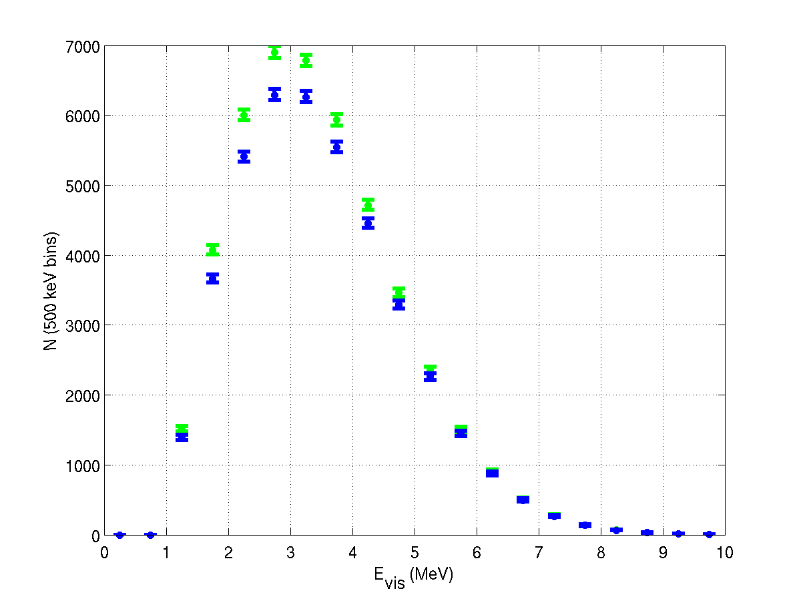
Reactor experiments
Spectral change:
only small difference
Double Chooz
3 yrs, sin² 2θ₁₃ = 0.1, Δm²=2.5x10⁻³
arXiv:hep-ex/0606025
No degeneracies
No matter effects
No correlations
6

Slide 7
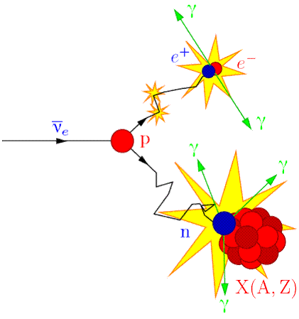
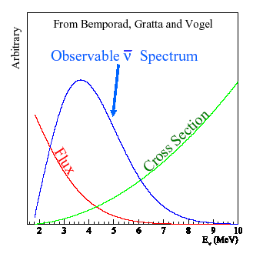
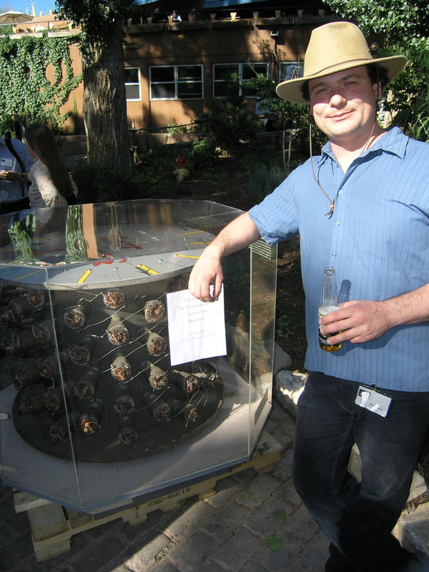
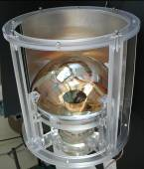
Reactor experiments
ν_{e}
Well understood*, isotropic source of electron anti-neutrinos
ν_{e}
Oscillations observed as disappearance of ν_{e}
ν_{e}
ν_{e}
ν_{e}
ν_{e}
R
E_{ν} ≤ 8 MeV
Gd-doped LS
Design concept over 50 yrs old
7

Slide 8
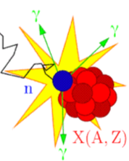
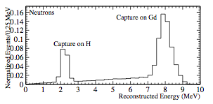
Detector design
μ
Keep geometry simple
(as simple as possible)
Light collection
(energy resolution)
Size matters:
counting vs shape measurement
Active muon shielding
Depth: reduce muon rate
Detect passing muons
Gamma catcher
  Catch escaping gammas
  from neutron captures
  on Gd: reduce tail
Backgrounds
  materials (Gd complex)
  (PMT, rock) shielding
LS + Gd
8

Slide 9
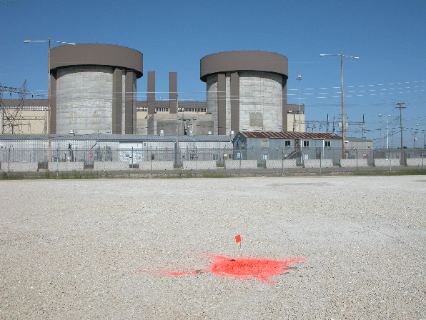
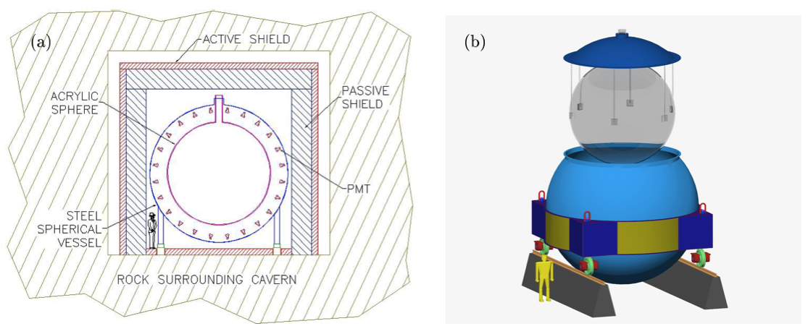
Detector design: ideal
braidwood.uchicago.edu

Slide 10
STATUS
Part II/III

Slide 11
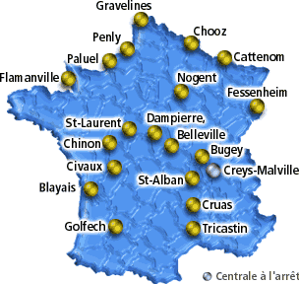

Les Ardennes, France
2 cores:
8.5 GW_{th}
Near detector:
|D| ~ 400 m
Overburden
~115 m.w.e.
(flat topology)
Far detector:
D ~ 1.05 km
Overburden ~300 m.w.e.
(hill topology)
Double Chooz overview
11
Existing (Chooz) pit at far detector

Slide 12
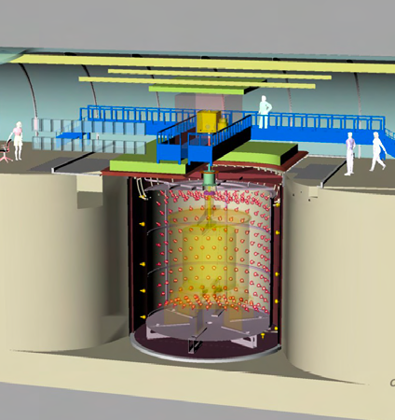
Detector design: Double Chooz
Outer Veto:
Plastic scintillator or RPCs
ν Target:
Liquid scintillator
doped with 0.1% Gd
γ Catcher:
Liquid scintillator (undoped)
Buffer:
Mineral oil; PMTs
Inner Veto:
Liquid scintillator or water; PMTs
Shielding:
Steel or water

Slide 13
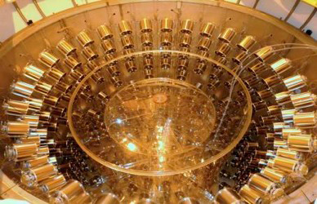
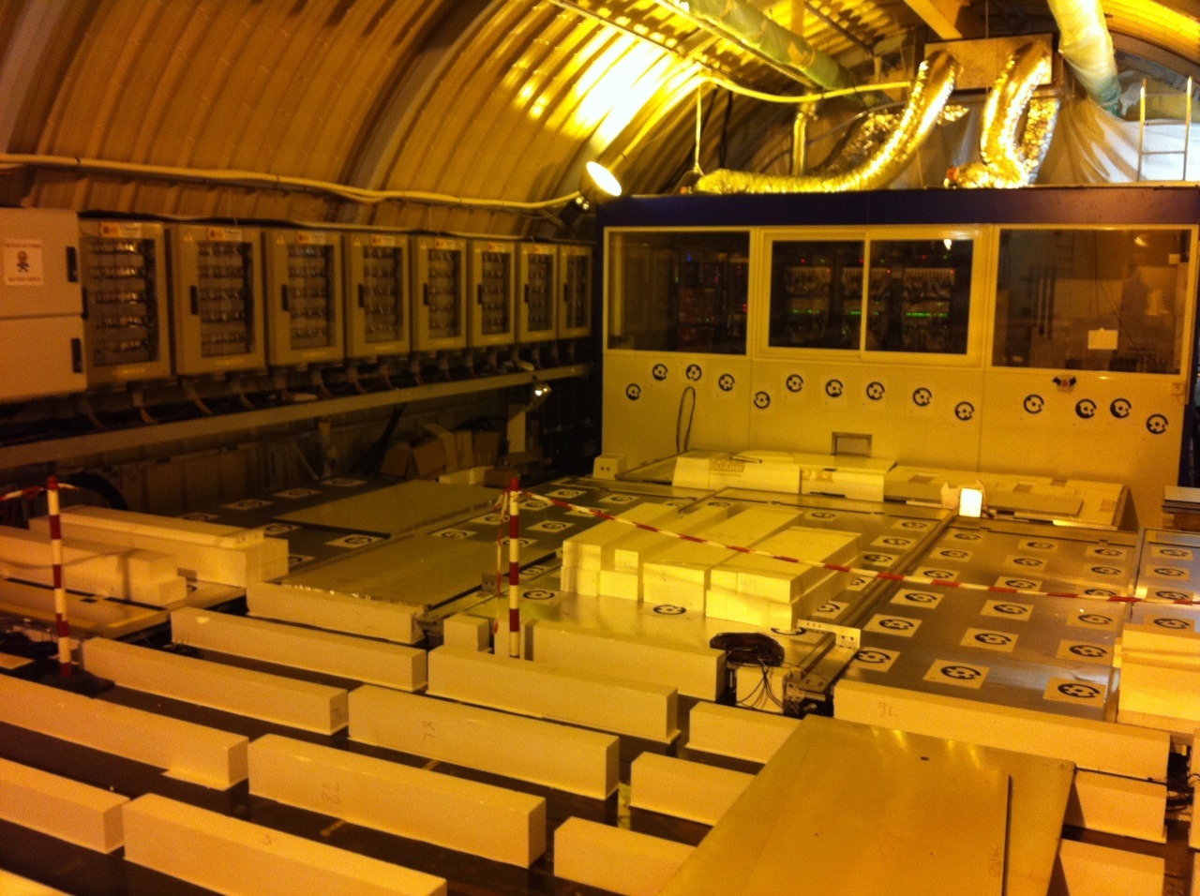
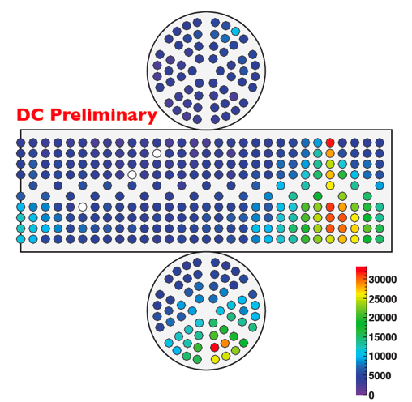
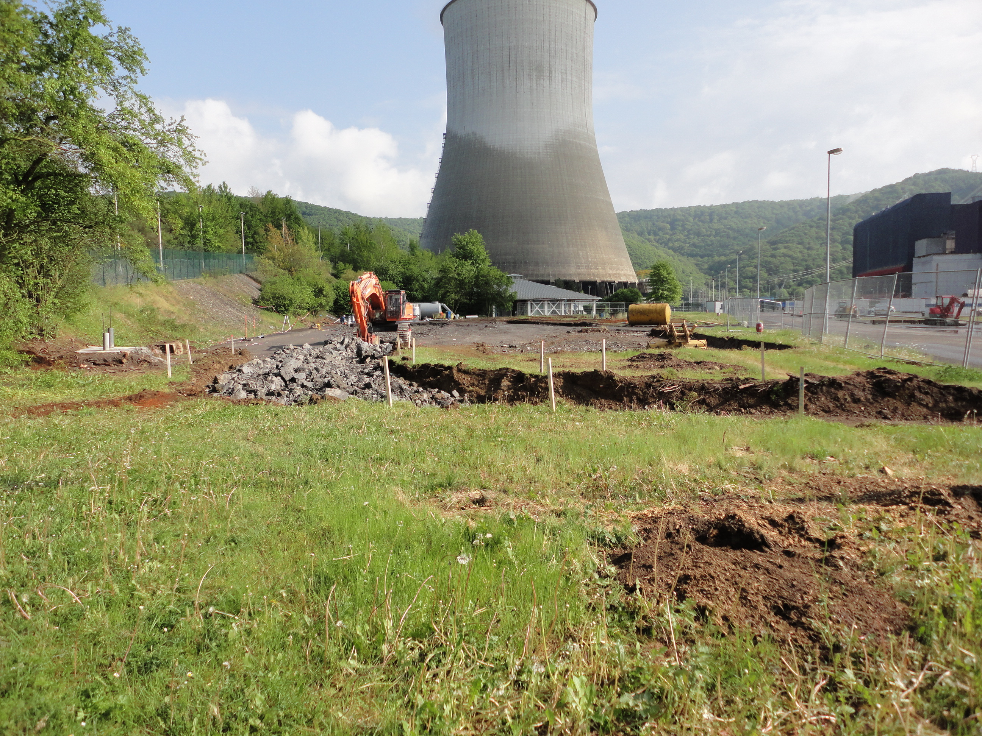
Double Chooz: status
veto being
installed
ground breaking near site:
29 April 2011
physics running
13 April 2011

Slide 14
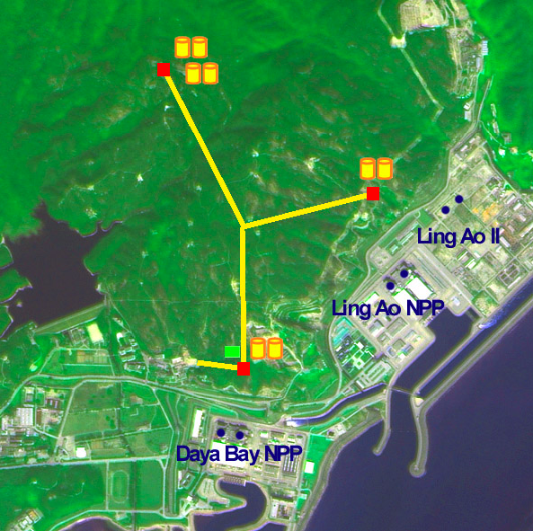
Daya Bay
This year:
6 reactors/17.4 GW
Far site
L = 1615 m/1985 m
350 m overburden
~90 events/day/detector
DB near site
L = 363 m/1145 m
98 m overburden
~930 events/day/detector
LA near site
L = 481 m/526 m
112 m overburden
~760 events/day/detector
Target mass 8 ^{X} 20 ton

Slide 15
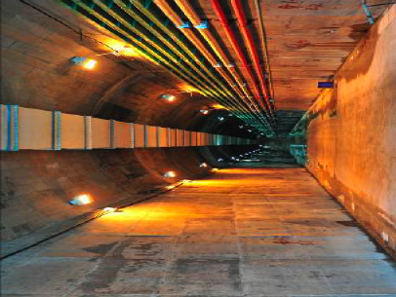
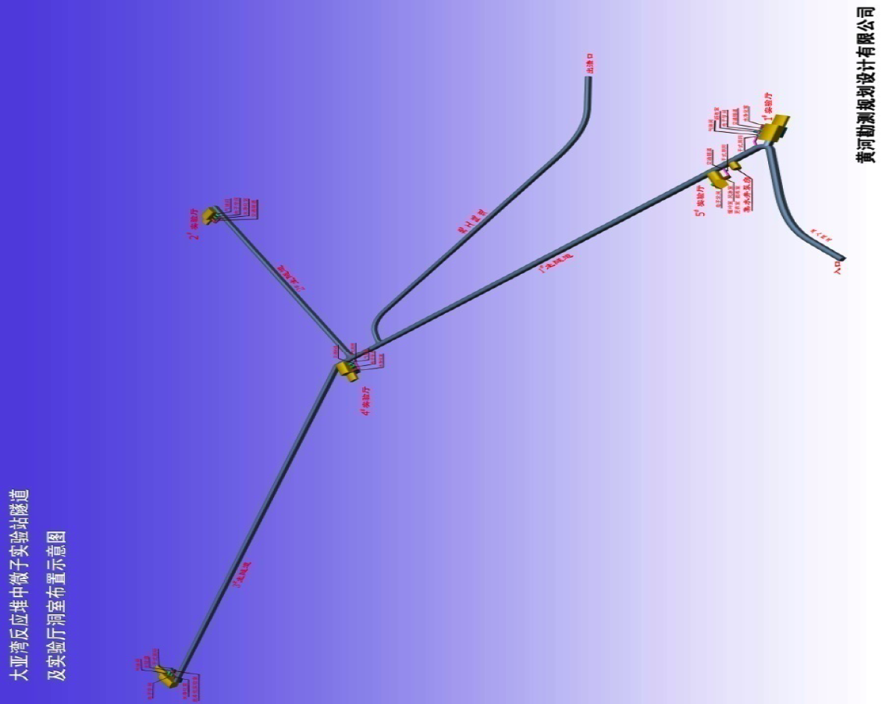
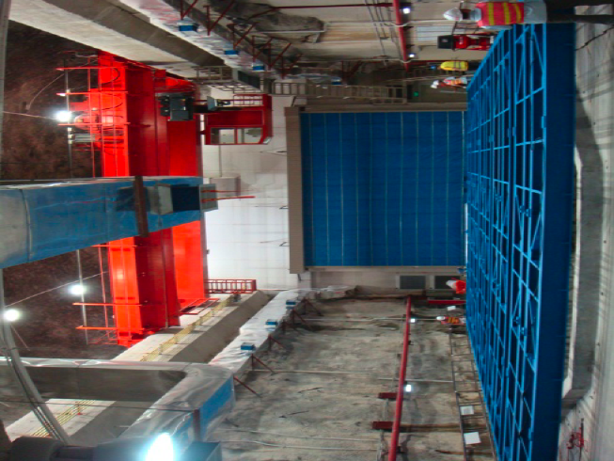
Daya Bay
3
2
4
5
1
Tunnels completed
All halls except no. 3 completed
Hall 3 to be completed this summer (2011)

Slide 16
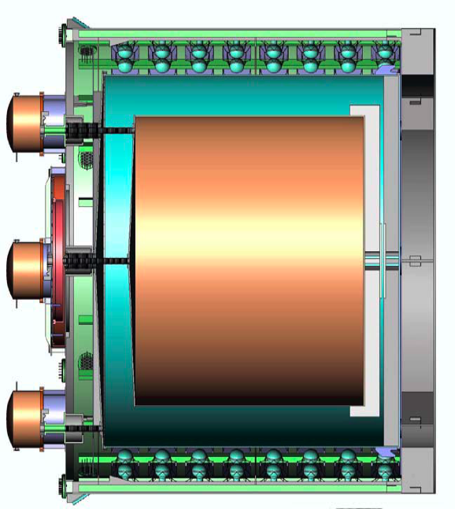
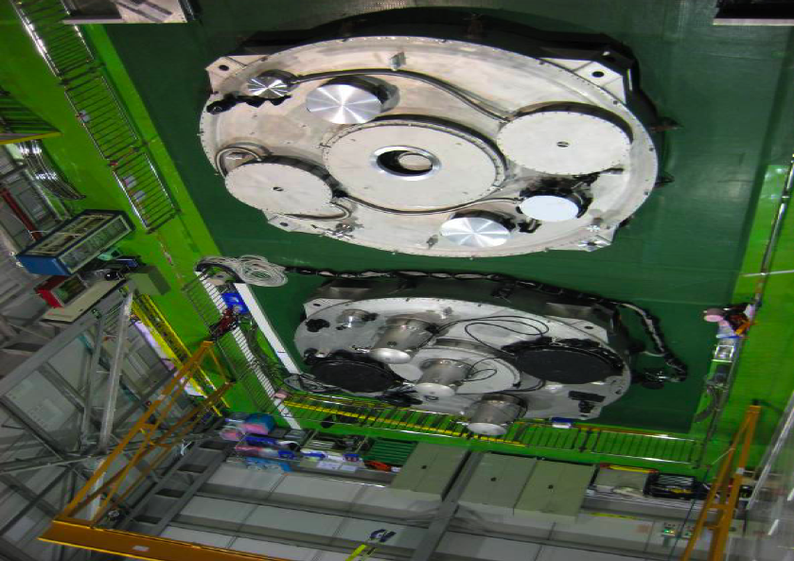
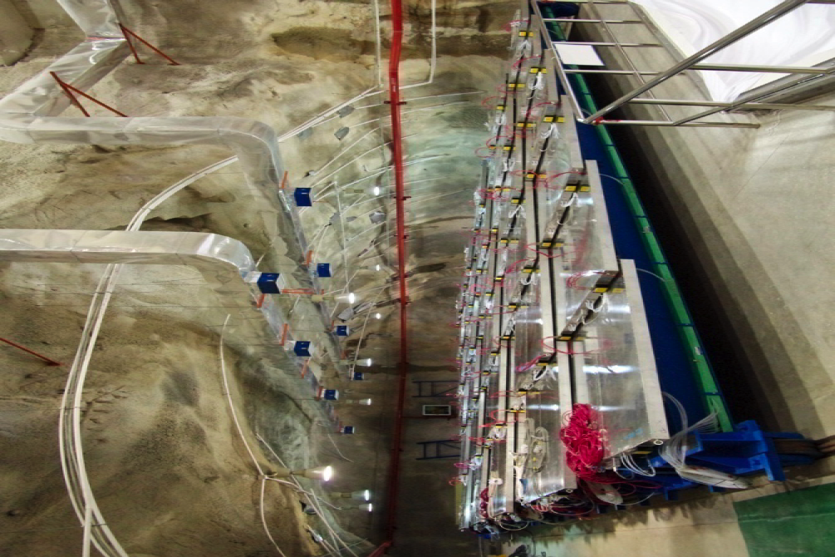
Daya Bay
Two detectors completed and dry-run tested
Remaining to be completed by next spring
Electronics, trigger, DAQ ready for Hall 1; RPC and water vetos nearly ready
Liquid scintillator filling of Hall 1 detectors to start this month
Two detectors completed
RPCs installed
18/04/11
E. Falk, U. of Sussex
16

Slide 17
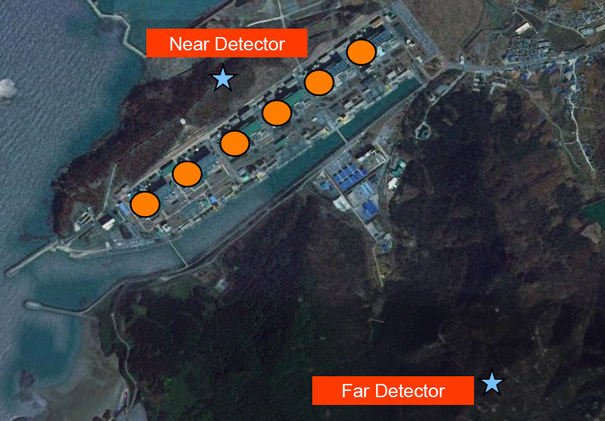
Reno
6 cores/16.4 GW
46 m overburden
16 t target mass
1280 events/day
292 m
1381 m
168 m overburden
16 t target mass
114 events/day

Slide 18
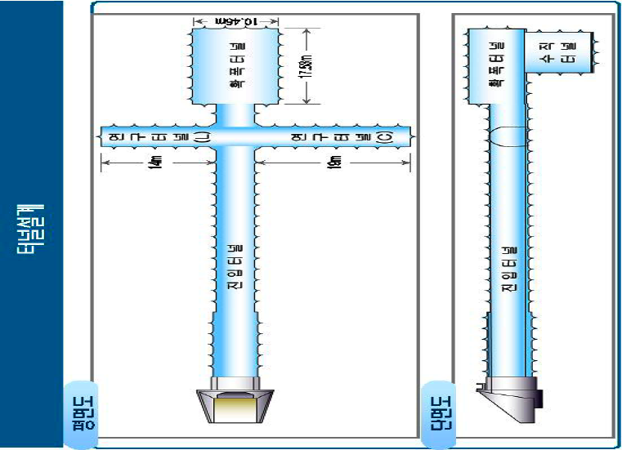
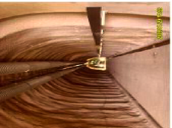
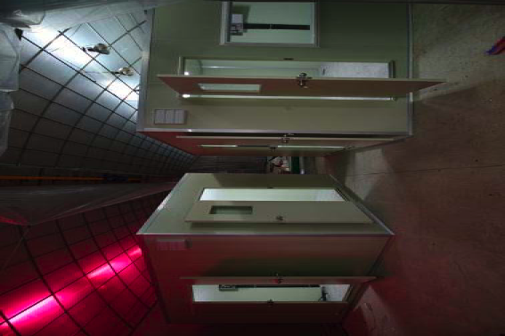
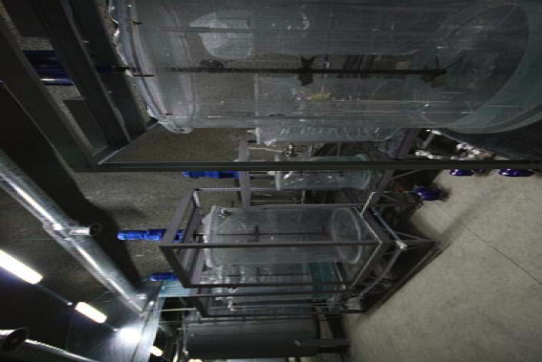
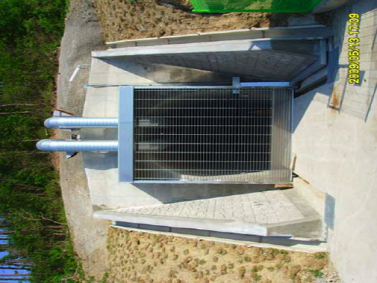
Reno
Tunnels, detector halls completed
Infrastructure in place: control room, liquid production system, offices
18/04/11
E. Falk, U. of Sussex
18

Slide 19
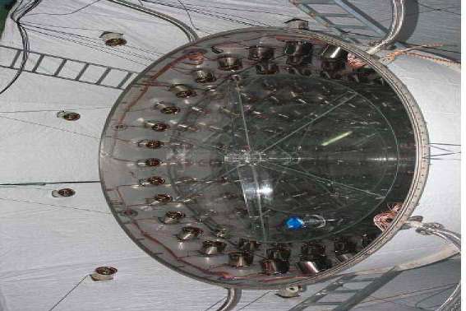
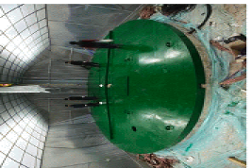
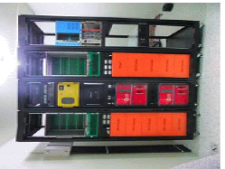
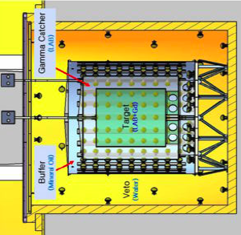
RENO
Both detectors completed
DAQ installed; dry runs under way
LS production + filling: May – June 2011
Data-taking: July 2011

Slide 20
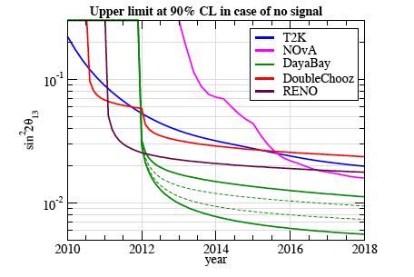
A comparison
M. Mettezzo and T. Schwetz, arXiv:1003.5800v1

Slide 21
reactor anomaly
Part III/III

Slide 22
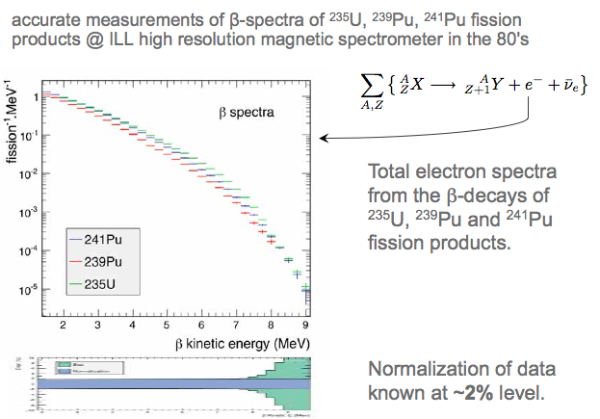
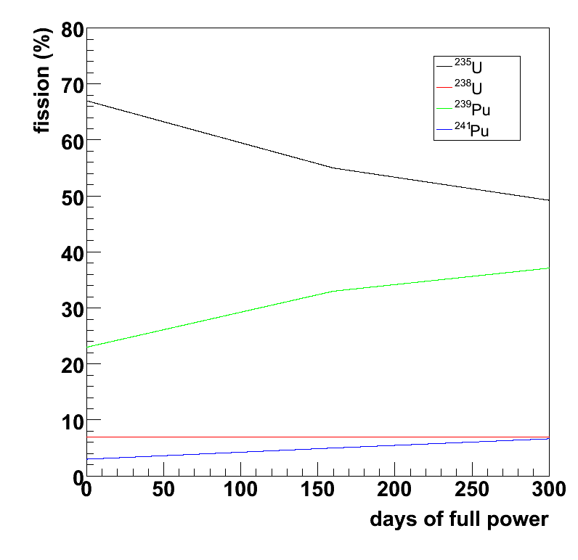
Flux calculation 101

Slide 23
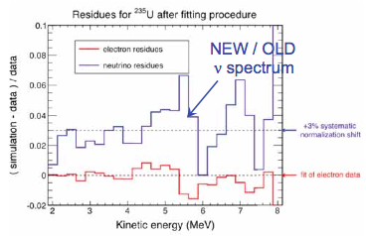
Recalculation of reactor fluxes
arXiv:1101.2663
Beta spectra measured @ ILL 1980s (²³⁵U)
Included more decays in ab initio calculations
…
Updated neutron lifetime (see next slide)
Long lived betas – taken better into account
Improved error/correlation propagation
same for other isotopes
(238U, 239/241Pu)

Slide 24
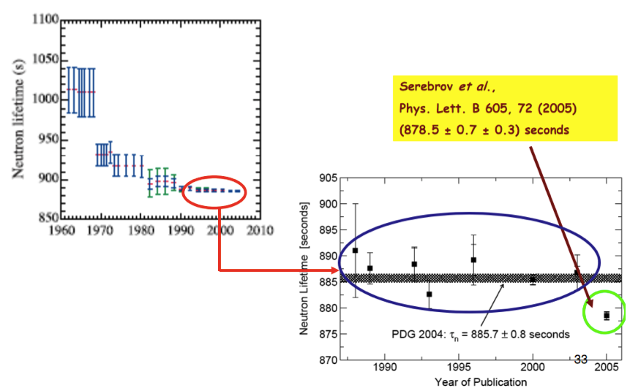
Neutron lifetime

Slide 25
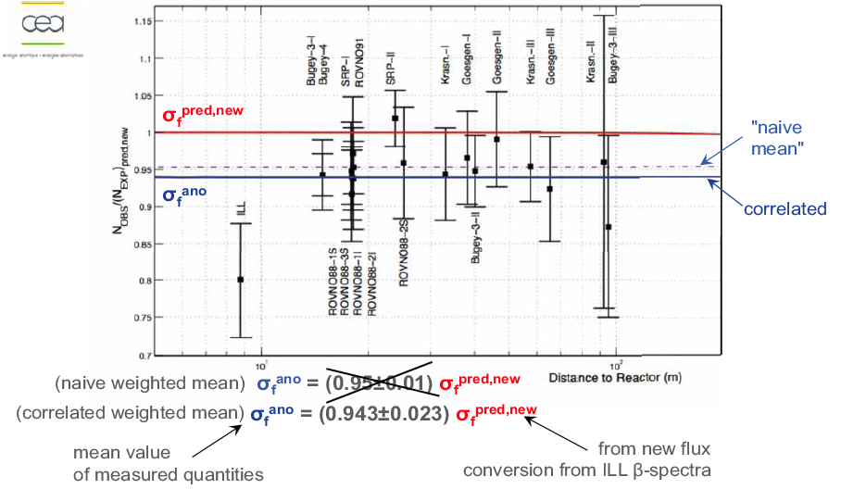
Consequences for short baseline experiments

Slide 26
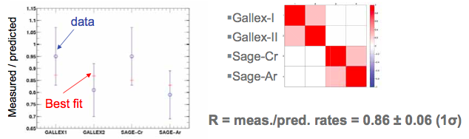
Consistent with Ga anamoly
Radiochemical neutrino experiments using Ga (SAGE/GALLEX) used MCi radioactive sources (⁵¹Cr and ³⁷Ar) for calibration purposes: observed lower rate than expected!!
Guinti, Lavender PRD82 053005 (2010)

Slide 27
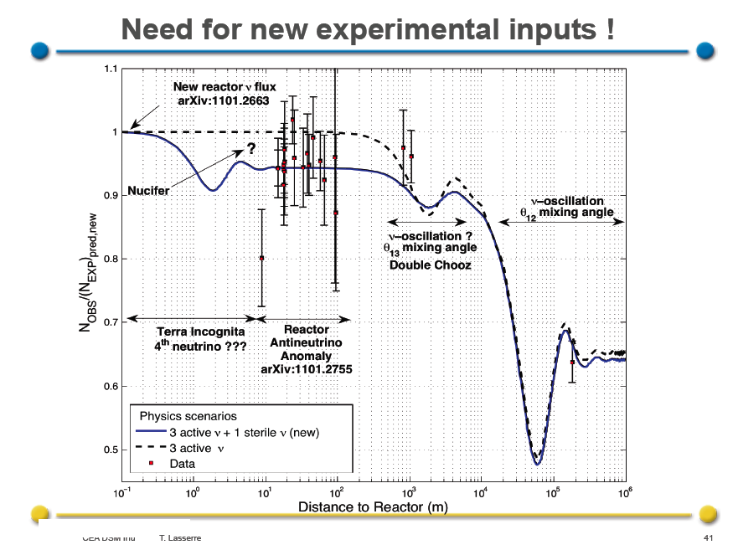
Interpretation
ArXiv:1101.2755

Slide 28
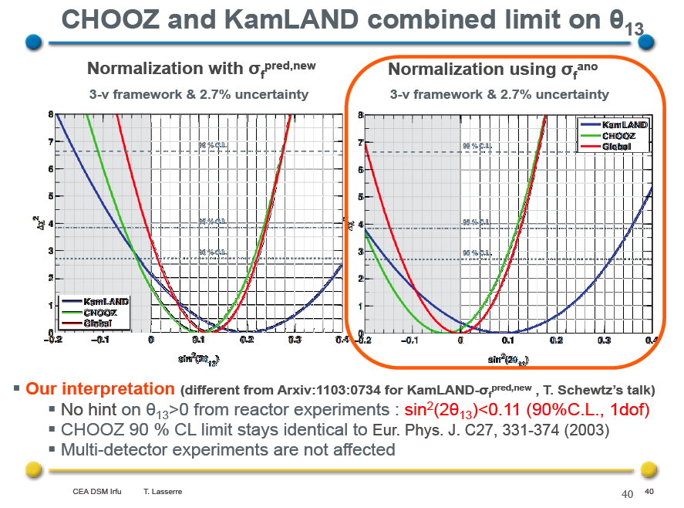

Slide 29
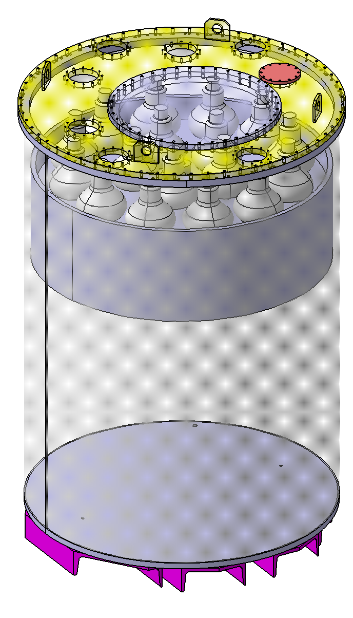
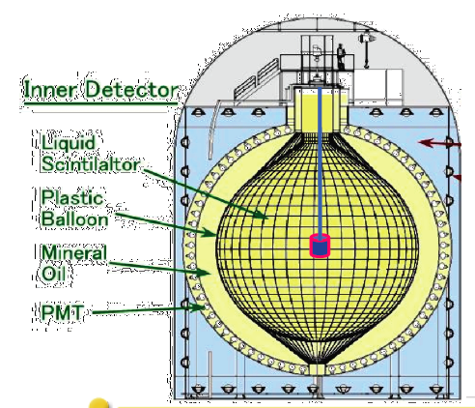
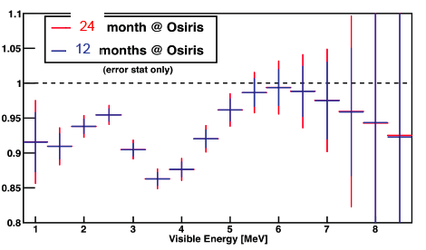
Possible checks
Nucifer
NUCIFER
  Non-proliferation experiment at Saclay
  Compact core 57 x 57 x 60 cm
  <L> = 7.0 m
MCi ν source in LS detector
  Position resolution ~20 cm
  KamLAND, SNO+, Borexino
ICARUS @ CERN PS ν beam…?

Slide 30
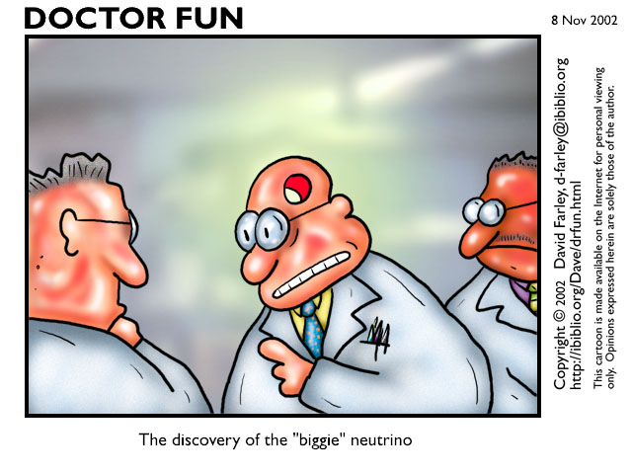
Conclusion
Exiting times ahead!

