Slide 1
https://indico.nbi.ku.dk/conferenceDisplay.py?confId=349
http://home.thep.lu.se/~torbjorn/ppp2011.html
Sponsored by Copenhagen University, NBIA, Discovery Center
Prof. Torbjorn Sjostrand (Lund University) : lecturer.
Dr. Alberto Guffanti, Dr. Stefania Xella : assistants.
Scheme for the week : lectures + exercises, morning and afternoon session.
See Indico agenda for details. Exam to be completed mid-november.
2 ECTS for active participation to the course. 5 ECTS upon completion of the exam.
Lectures / exercises :
All in auditorium A.
Be aware : doors cannot be locked during lunch or coffe breaks, mind your laptop.
Laptops can be charged during the lectures, at the table in front in aud A.

Slide 2
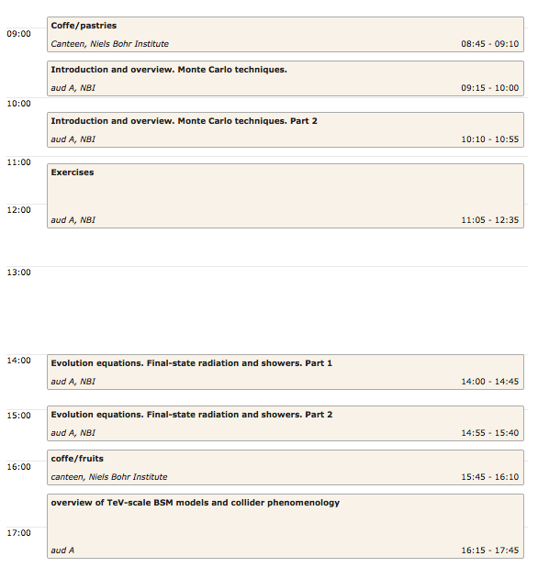
Monday
October 3
Just for today :
Prof. Maxim Perelstein
(Cornell University )
Usually this is
exercise
session

Slide 3
Schedule for the week is very tight, 9:15- 17:45 each day.
we tried to put a good, long lunch break, and a 25’ coffee break in the afternoon,
plus 10’ break between each item in the agenda.
We kindly ask you to respect the time table and be on time for restart of the lecture or
exercise session.
Exercises :
Some of them traditional, pen and paper.
Some of them using laptops (you should all have it), using Pythia 8 .
As recommended, please make sure you have Pythia 8 installed and working, before
the exercises start.
Group work is allowed, not more than 2-3 people in each group please.

Slide 4
For participants in the
course only
Every morning 8:45-9:10
Every afternoon 15:45 – 16:10
coffee/tea/cookies/fruits in NBI canteen (small room) – except Wednesday morning: in NBI canteen, big room
Lunch is on us (food only. There is water from cooler by the cashier) , in
NBI canteen. Tickets can be picked up in the auditorium desk, each morning.
Pick up one (only) each morning.
DINNER Tuesday evening 19:30 RizRaz restaurant (St.Kannikestraede 19).
See entry in indico agenda for details.
Buffet + 1 soda/beer per person. Sponsored by Discovery center.
Please sign the sheet here in front, when collecting you badge.
We need to know the exact count.

