Slide 1
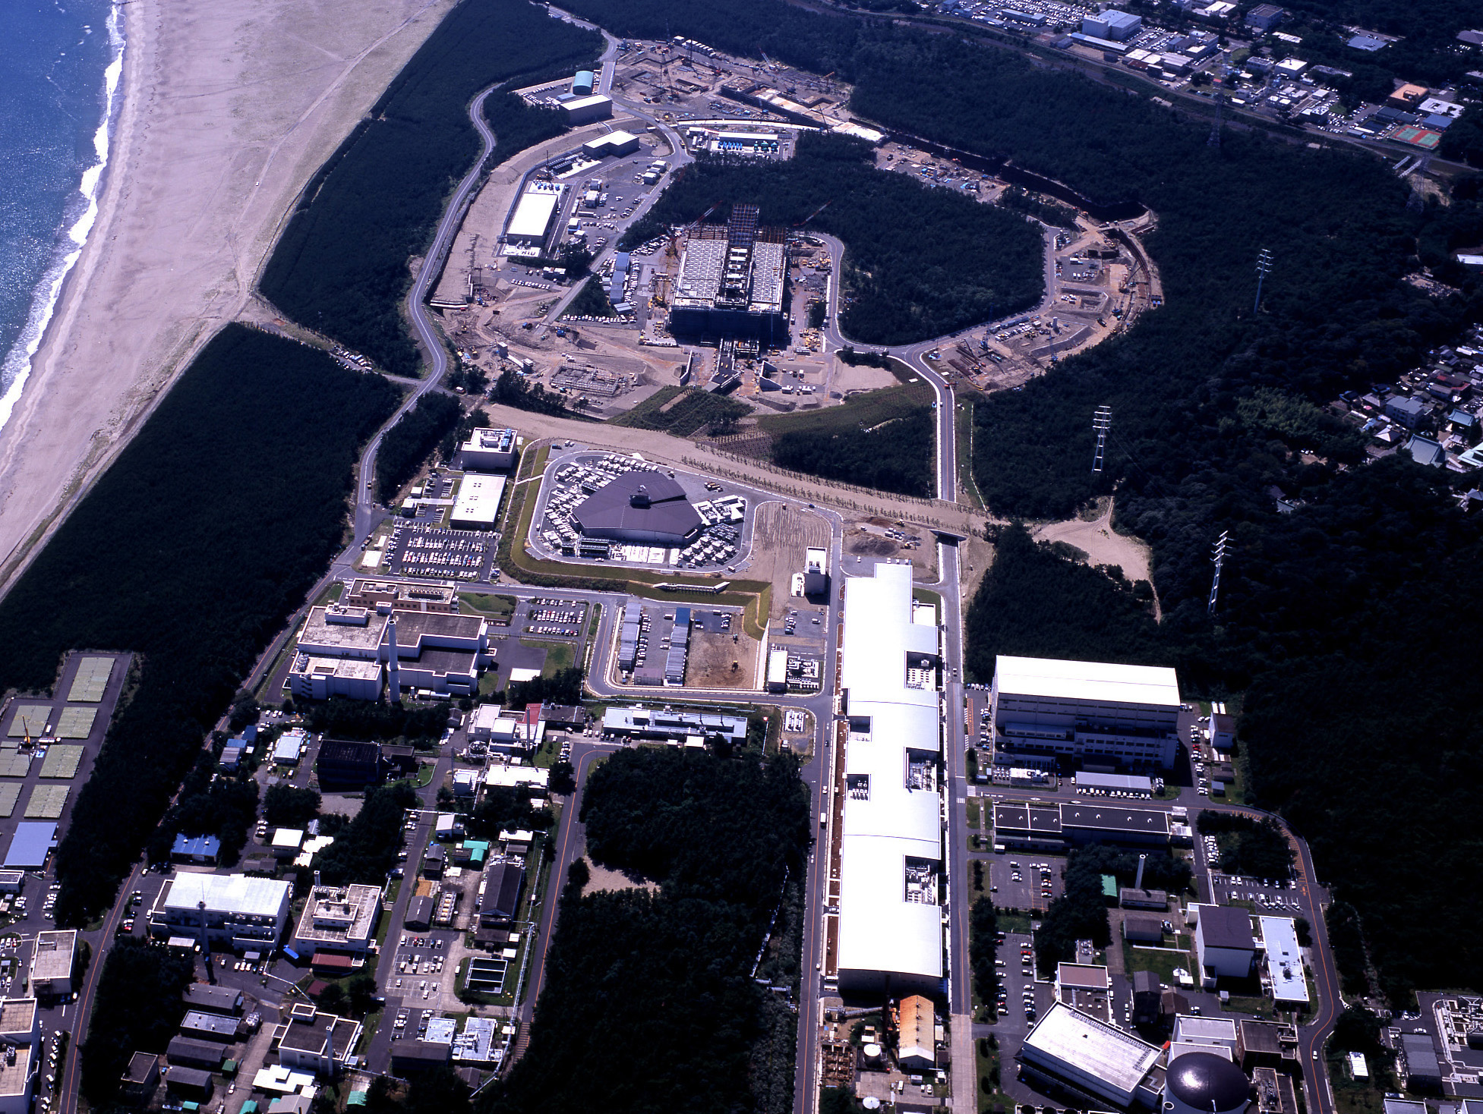


Neutrino Physics
Spaatind 2012
XX11 Nordic Conference on Particle Physics
Jan. 5/6, 2012
Dave Wark
Imperial/RAL

Slide 2
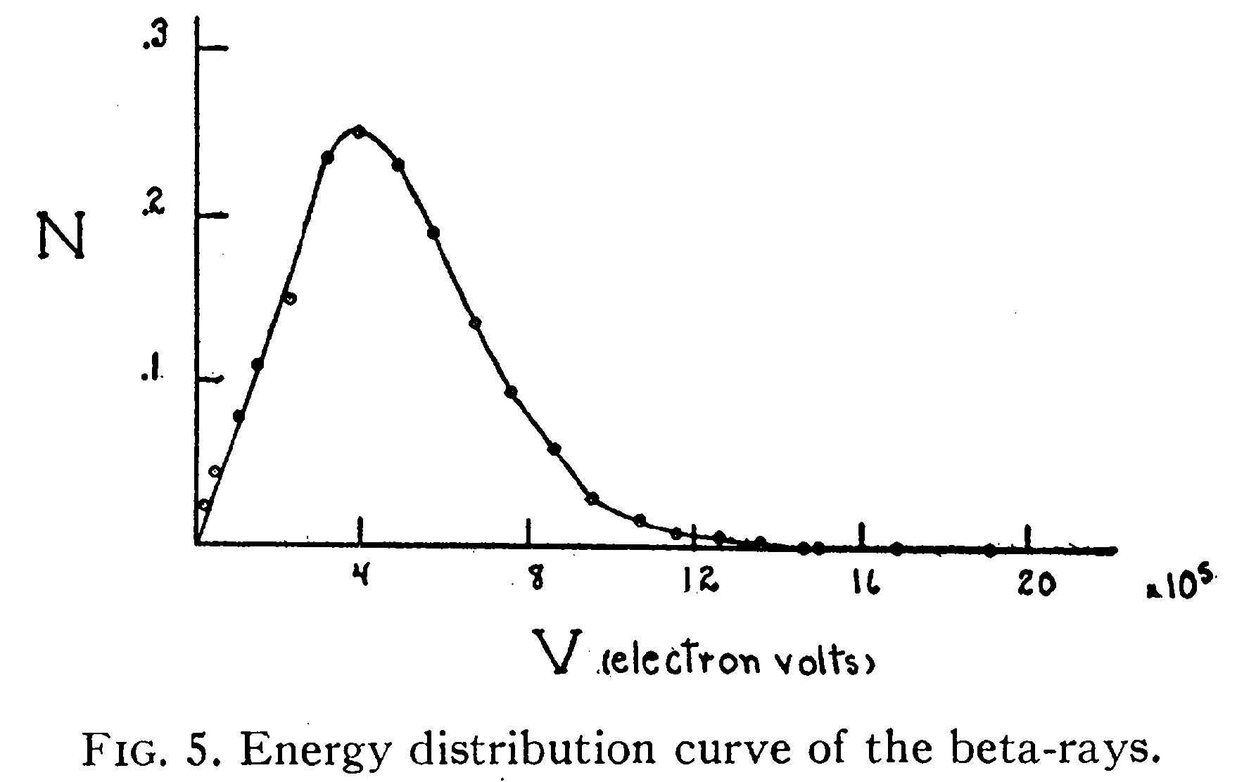
Where did the idea of the neutrino come from?
There were problems in the early days of β decay.
F. A. Scott, Phys. Rev. 48,
391 (1935)
β spectra were
continuous
Instead of
discrete
And the spins didn’t add up…
¹⁴C → ¹⁴N + e–
spin 0 spin 1 spin 1/2
Bohr: maybe energy/momentum not conserved in β decay?

Slide 3
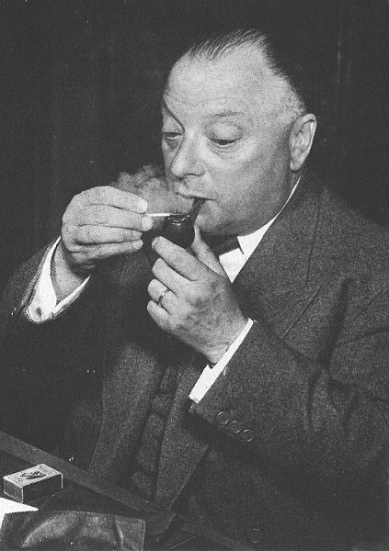
Pauli’s Solution…
Dear Radioactive Ladies and Gentlemen,
As the bearer of these lines, to whom I graciously ask you to listen, will explain to you in more detail, how because of the "wrong" statistics of the N and Li⁶ nuclei and the continuous beta spectrum, I have hit upon a desperate remedy to save the "exchange theorem" of statistics and the law of conservation of energy. Namely, the possibility that there could exist in the nuclei electrically neutral particles, that I wish to call neutrons, which have spin 1/2 and obey the exclusion principle and which further differ from light quanta in that they do not travel with the velocity of light. The mass of the neutrons should be of the same order of magnitude as the electron mass and in any event not larger than 0.01 proton masses. The continuous beta spectrum would then become understandable by the assumption that in beta decay a neutron is emitted in addition to the electron such that the sum of the energies of the neutron and the electron is constant...
I agree that my remedy could seem incredible because one should have seen those neutrons very earlier if they really exist. But only the one who dare can win and the difficult situation, due to the continuous structure of the beta spectrum, is lighted by a remark of my honoured predecessor, Mr Debye, who told me recently in Bruxelles: "Oh, It's well better not to think to this at all, like the new taxes". From now on, every solution to the issue must be discussed. Thus, dear radioactive people, look and judge. Unfortunately, I cannot appear in Tubingen personally since I am indispensable here in Zurich because of a ball on the night of 6/7 December. With my best regards to you, and also to Mr Back. Your humble servant . W. Pauli

Slide 4
How to detect them?
The detection of neutrinos was an extreme challenge for the experiments of the mid-twentieth century – Pauli, in fact, apologized for hypothesizing a particle that could not be detected.
In a Chalk River report in 1946, Bruno Pontecorvo pointed out the advantages of a radiochemical experiment based on ν_{e} + ³⁷Cl → ³⁷Ar + e⁻ (and even mentioned solar neutrino detection using this method).
However the first detection of neutrinos used another method…

Slide 5
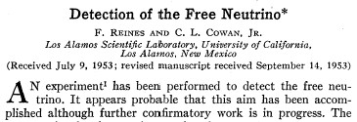
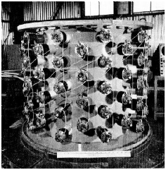
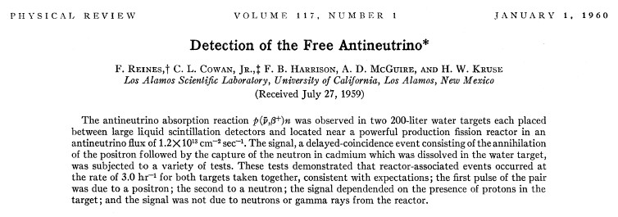
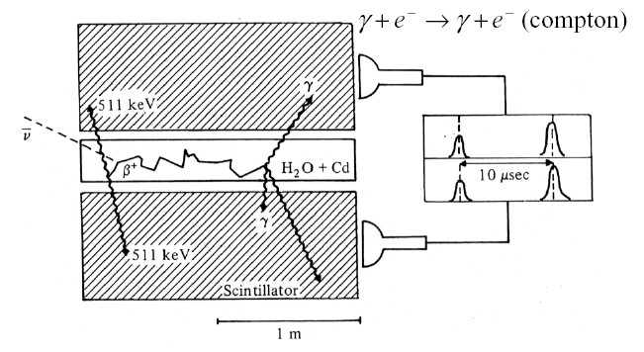
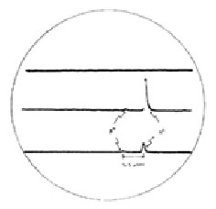

Slide 6
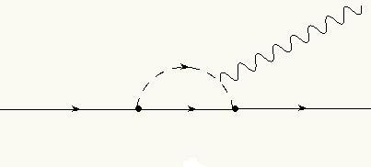
More Ancient History…
Question in the late 50’s: Are the neutrinos in these reactions the same thing?:
n → p + e + ν π → μ + ν μ → e + ν + ν
If so, why no μ → e + γ via diagrams like?:
IVB
γ
μ
ν
e

Slide 7
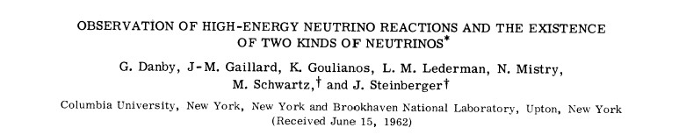
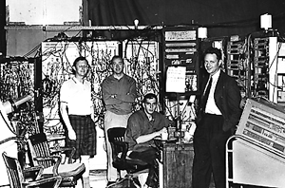
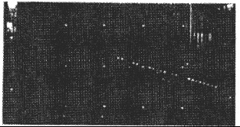
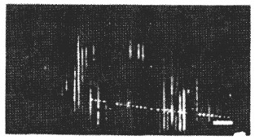
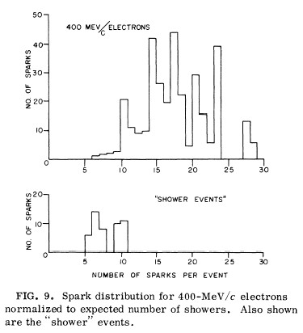
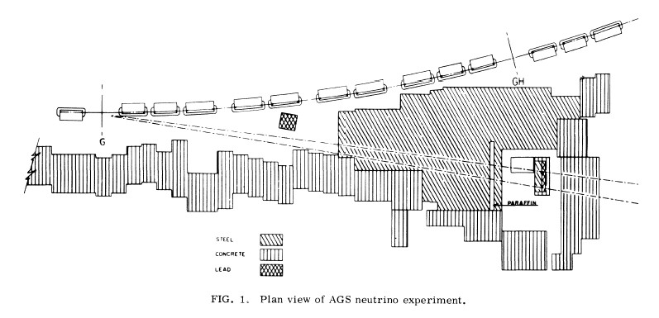
This year is the
50th anniversary!
μ event
e event

Slide 8
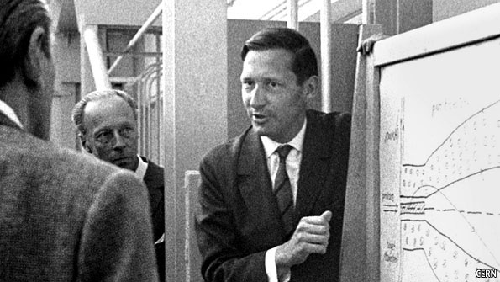
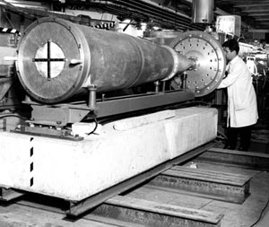
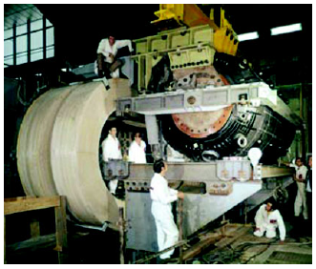
The Discovery of Neutral Currents
Simon van der Meer, 1925 - 2011
The 1st Neutrino Horn –
Van den Meer, CERN, 1961
The Gargamelle
CF₃Br Bubble Chamber

Slide 9
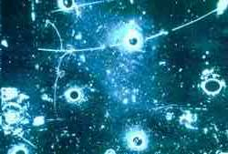
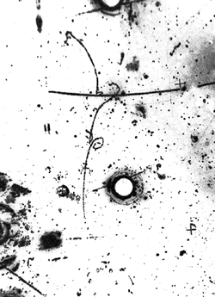
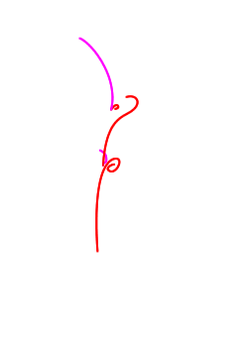
The Discovery of Neutral Currents
Most of the basic techniques were now in place, and since then we
have built them bigger/faster/more sensitive....

Slide 10
Why am I spending all this time talking about ancient experiments?
It’s fun…
I was told that students would be present.
I would like them to carefully note as I go through all the amazing, expensive, flashy new experiments to come that they are almost all just elaborations of these early ideas.
This is a beautiful demonstration of the most important single thing my advisor ever taught me:
“Three months in the laboratory will
save you three hours in the library”.

Slide 11

Neutrino Oscillations
If neutrinos have mass, then there are two distinct types of neutrino state we must consider – the eigenstates of the weak Hamiltonian ν_{l} = ν_{e}, ν_{μ}, ν_{τ}; and the eigenstates of the free particle Hamiltonian ν_{i} = ν₁, ν₂, ν₃.
There is absolutely no reason to believe that these are the same thing.
In general:

Slide 12
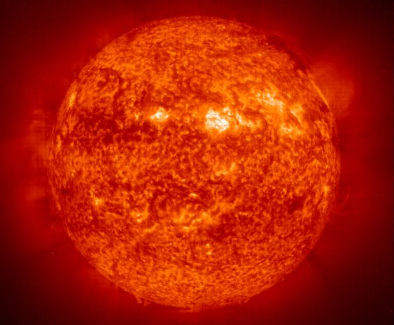
Solar Neutrinos

Slide 13
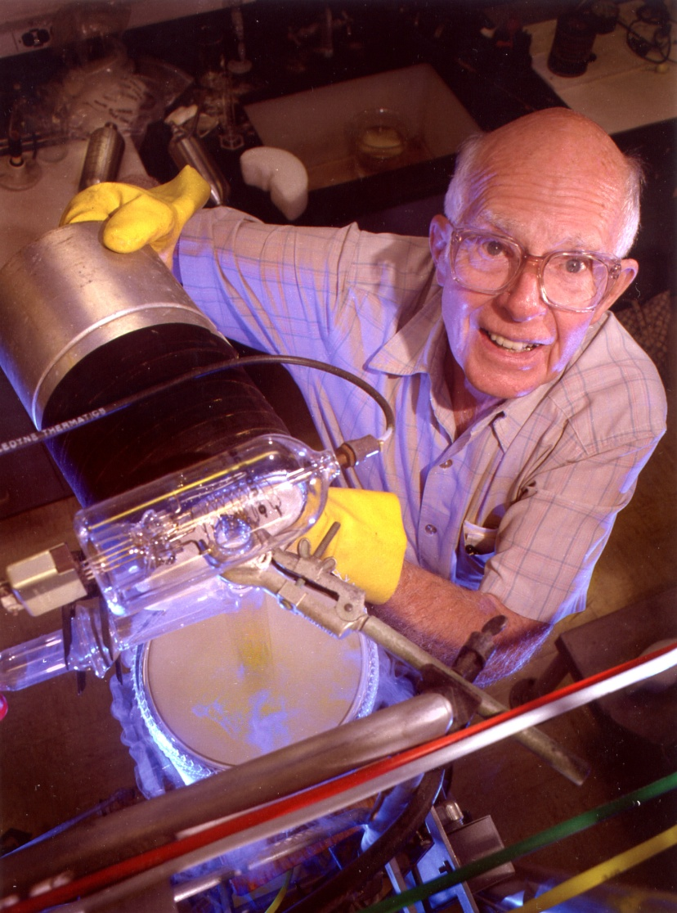
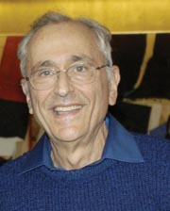
Ray Davis
John Bahcall

Slide 14
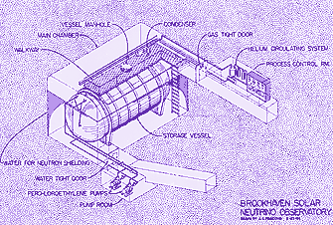
Where it all began – the Davis Experiment

Slide 15
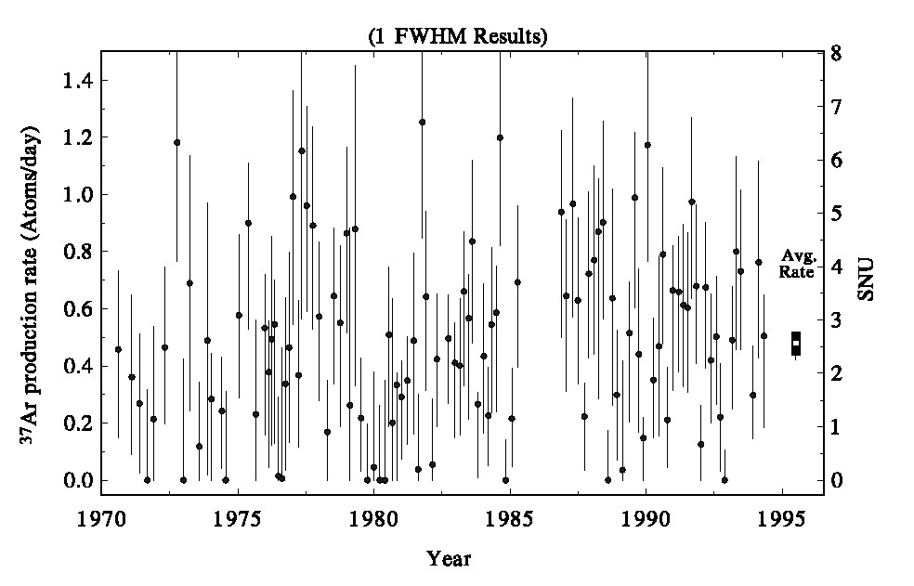
Where it all began – the Davis Experiment
SSM
Prediction!
•
Maybe the experiment is wrong…
Dave Wark
Imperial College/RAL

Slide 16
Theorists are always thinking….
1957 – Bruno Pontecorvo, wondering if there are any other particles which could undergo oscillations analogous to K⁰ ↔ K⁰ oscillations, hit upon the idea of neutrino ↔ anti-neutrino oscillations (more about this later).
1962 – Maki, Nakagawa, and Sakata (in the context of what looks today like a very odd model of nucleons) proposed that the weak neutrinos known at the time were superpositions of “true” neutrinos with definite masses, and that this could lead to transitions between the different weak neutrino states.
1967 – Pontecorvo then considered the effects of all different types of oscillations in light of what was then known, and pointed out before any results from the Davis experiment were known that the rate in that experiment could be expected to be reduced by a factor of two!
1972 – Pontecorvo is informed by John Bahcall that Davis does indeed see a reduced rate, and responds with a letter….
—

Slide 17
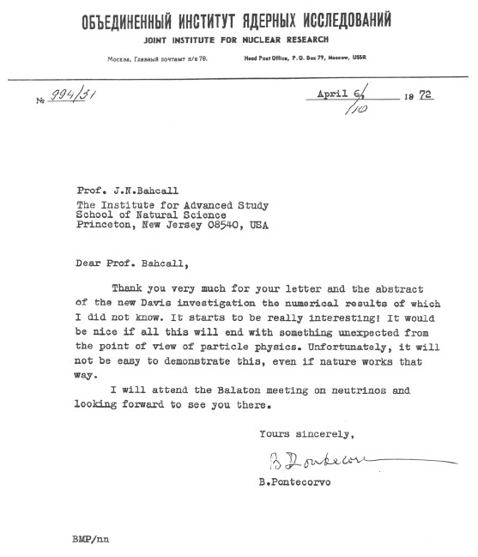
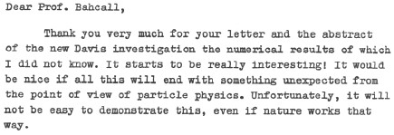

Slide 18
2ν Vacuum Oscillations
For two neutrino flavours in vacuum oscillations lead to the appearance of a new neutrino flavour:
With the corresponding disappearance of the original neutrino flavour, hence Davis result?
These oscillations can be significantly modified by the MSW effect when the neutrinos pass through matter…

Slide 19
Matter Effects – the MSW effect
In vacuum:

Slide 20

Matter Effects – the MSW effect
ν_{x}
ν_{x}
ν_{e}
e⁻
Z⁰
W
e⁻
e⁻
e⁻
ν_{e}

Slide 21
Matter Effects – the MSW effect
Including this effect gives a good
(if complicated) fit to all solar ν data....

Slide 22
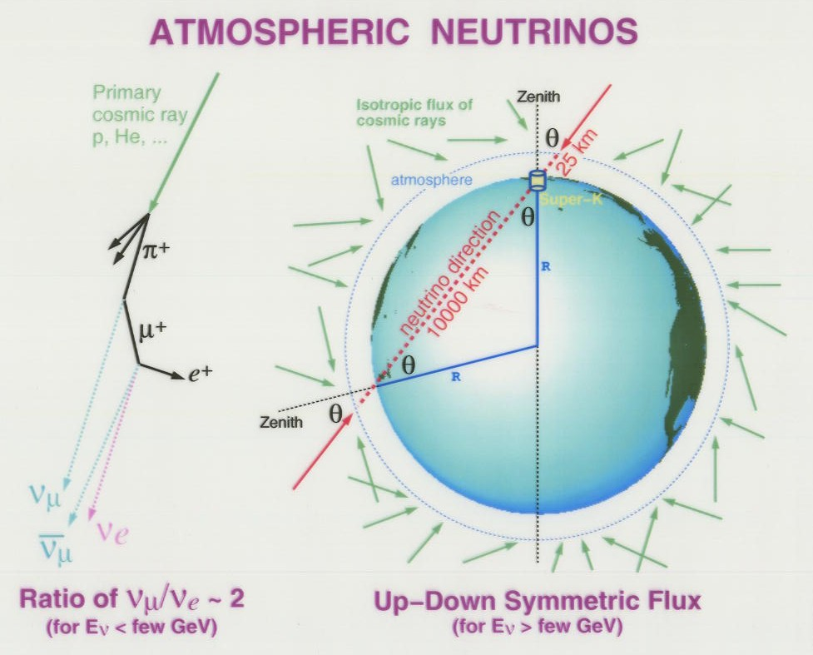

Slide 23
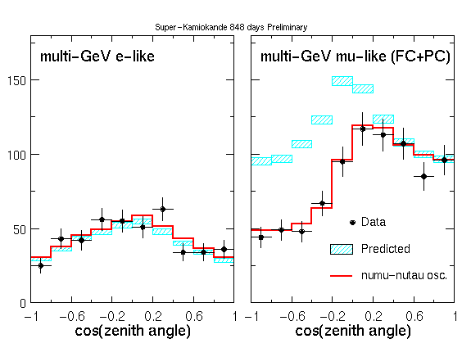
SK atmospheric ν data as a function of zenith angle

Slide 24
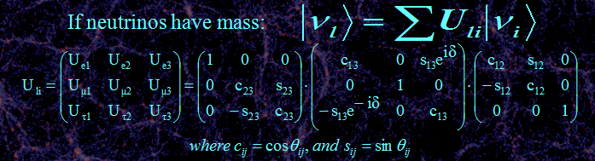
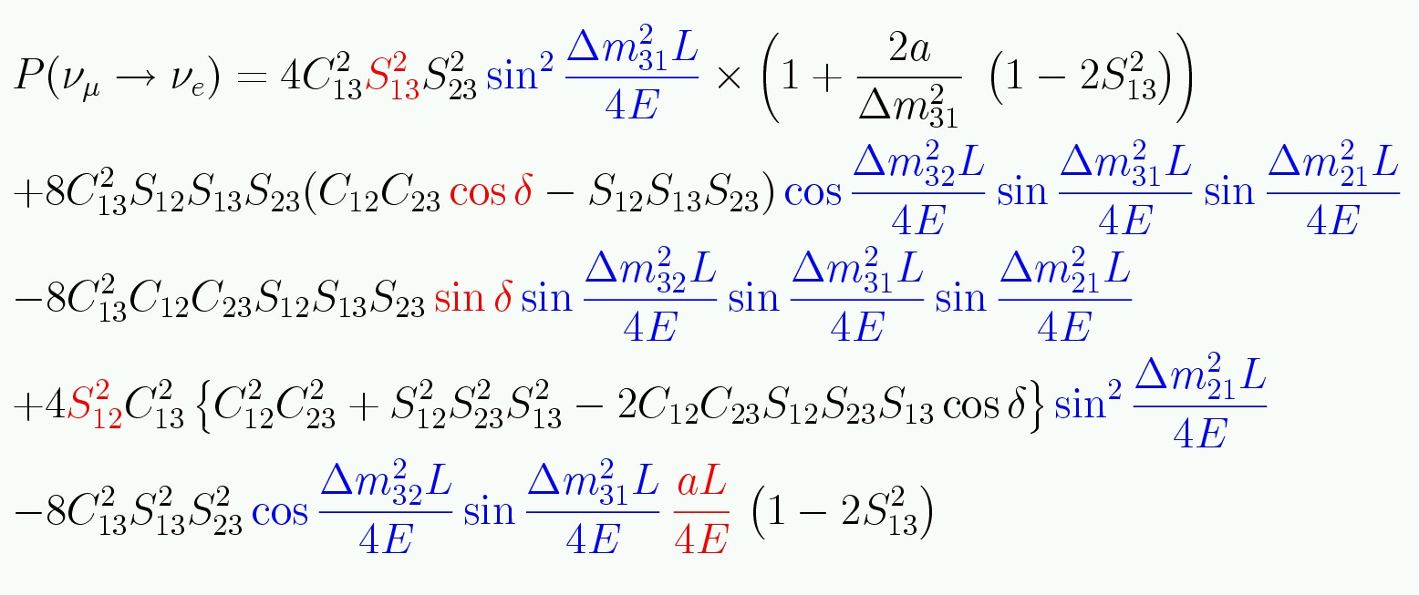
Three neutrino mixing.
Remember degeneracies
And covariances!

Slide 25
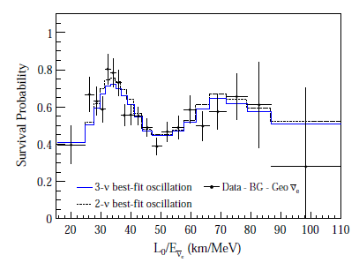
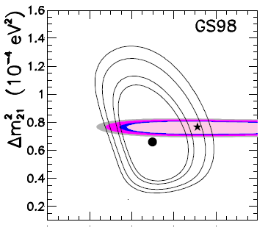

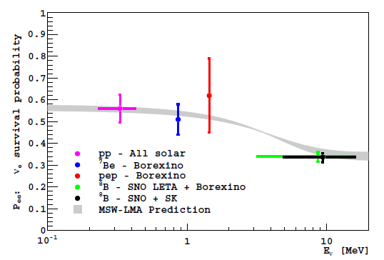

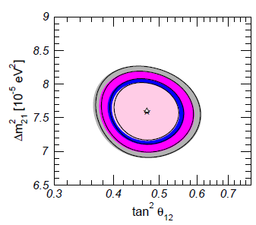
How well do we know θ₁₂?
Gonzalez-Garcia, Maltoni, Salvado

Slide 26
θ₂₃? – Back to SK’s atmospheric oscillations
This proves all by itself (well, including SR) that neutrinos have mass...How to check it on earth?

Slide 27
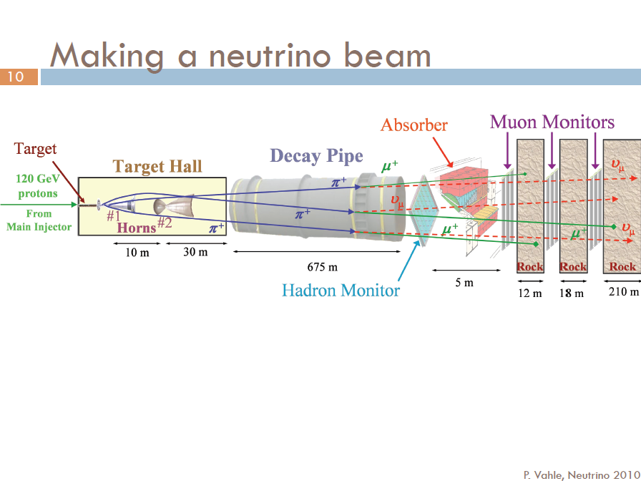
First successful demonstration of ν oscillations with such a beam was by K2K,
but in the interest of time let’s skip to MINOS...
From Patricia Vahle’s presentation at Neutrinos 2010

Slide 28

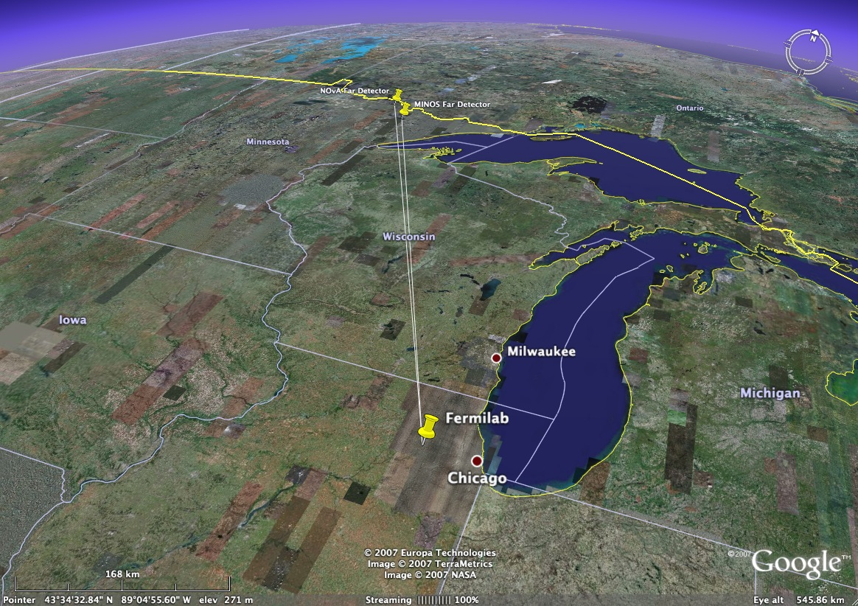
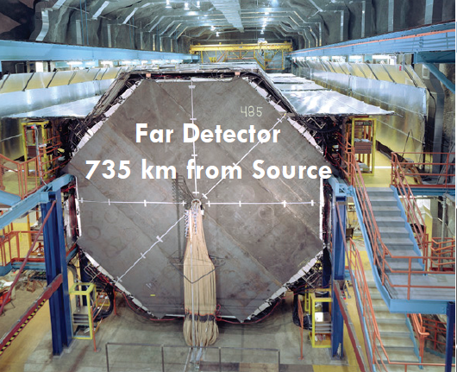
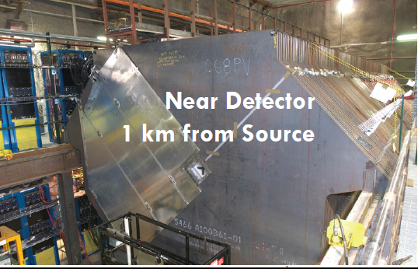
ICHEP talk by Justin Evans
735km
MINOS

Slide 29
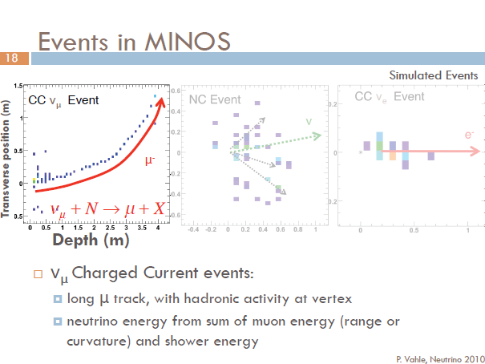

Slide 30
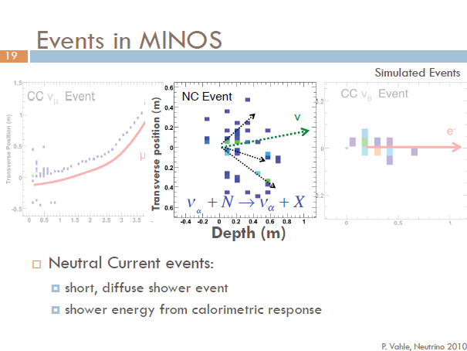

Slide 31
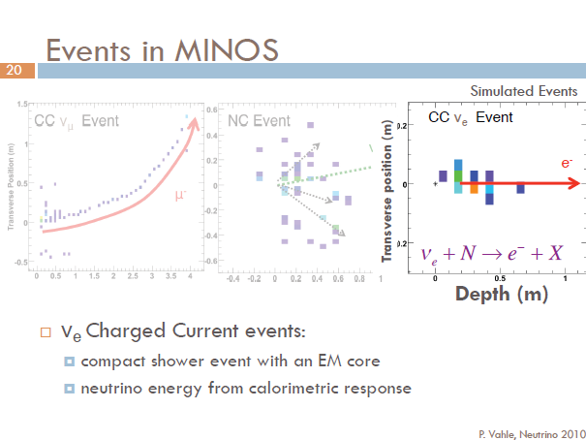
Cross-sections for all processes very poorly known!

Slide 32
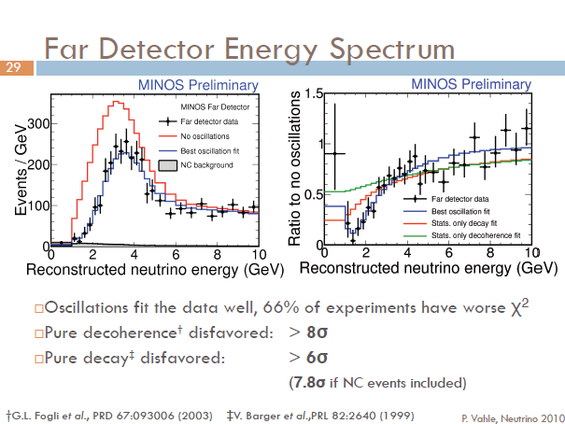

Slide 33

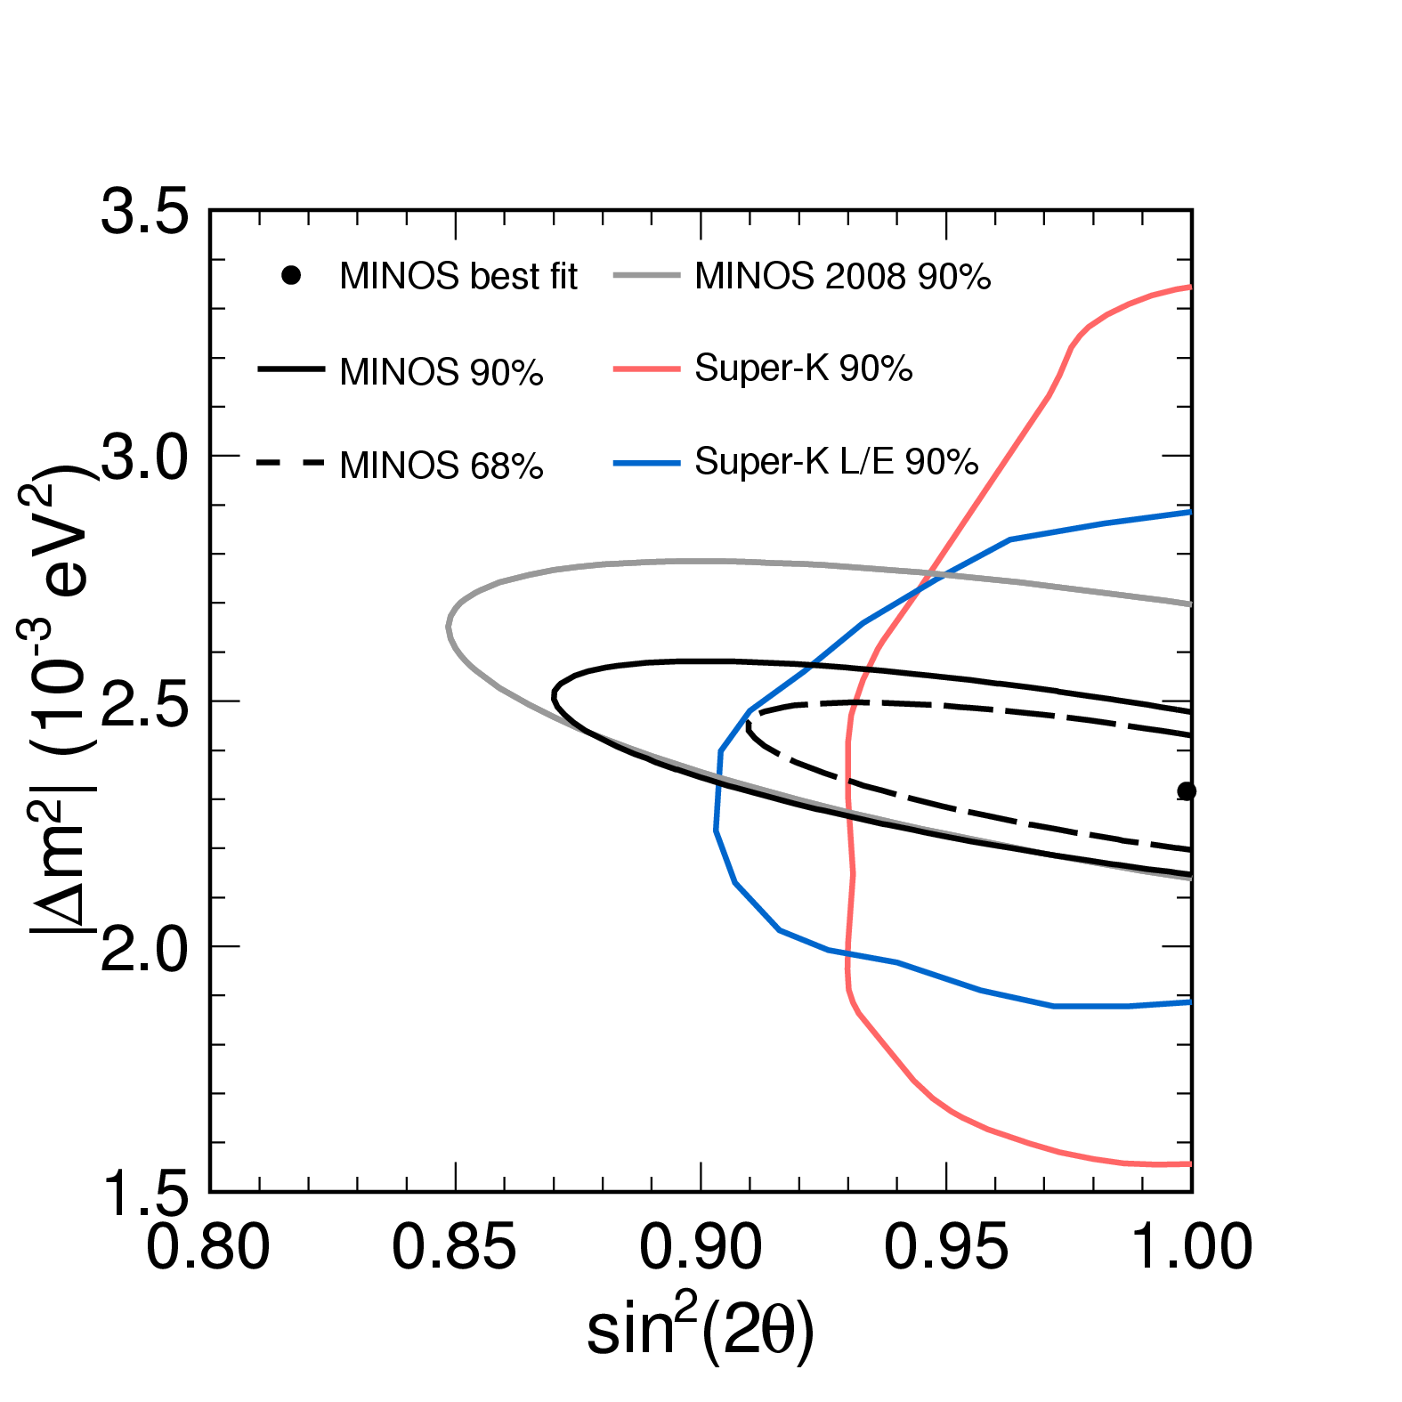
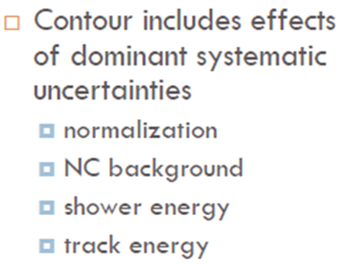

Slide 34

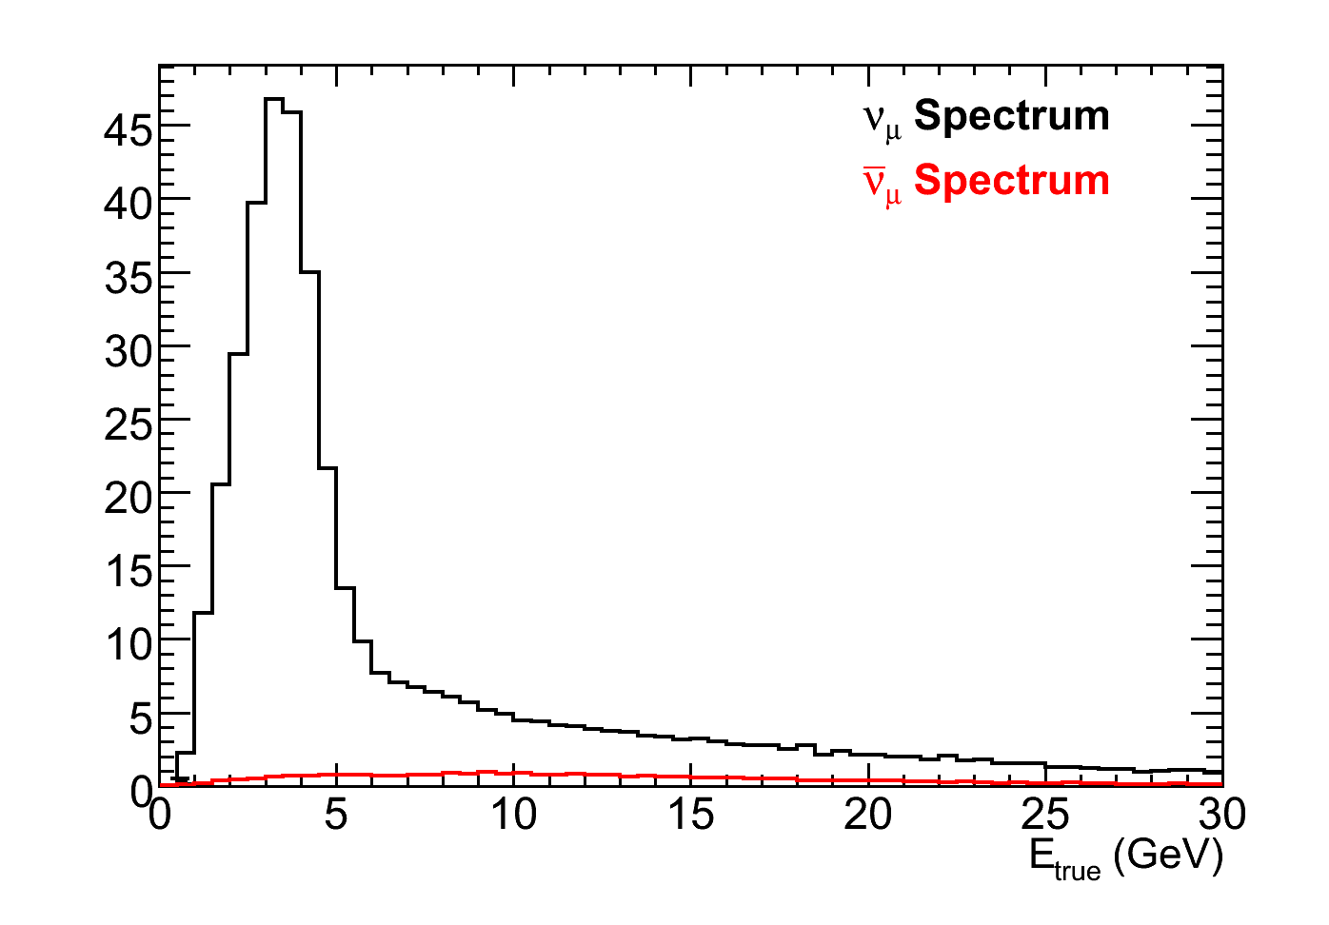
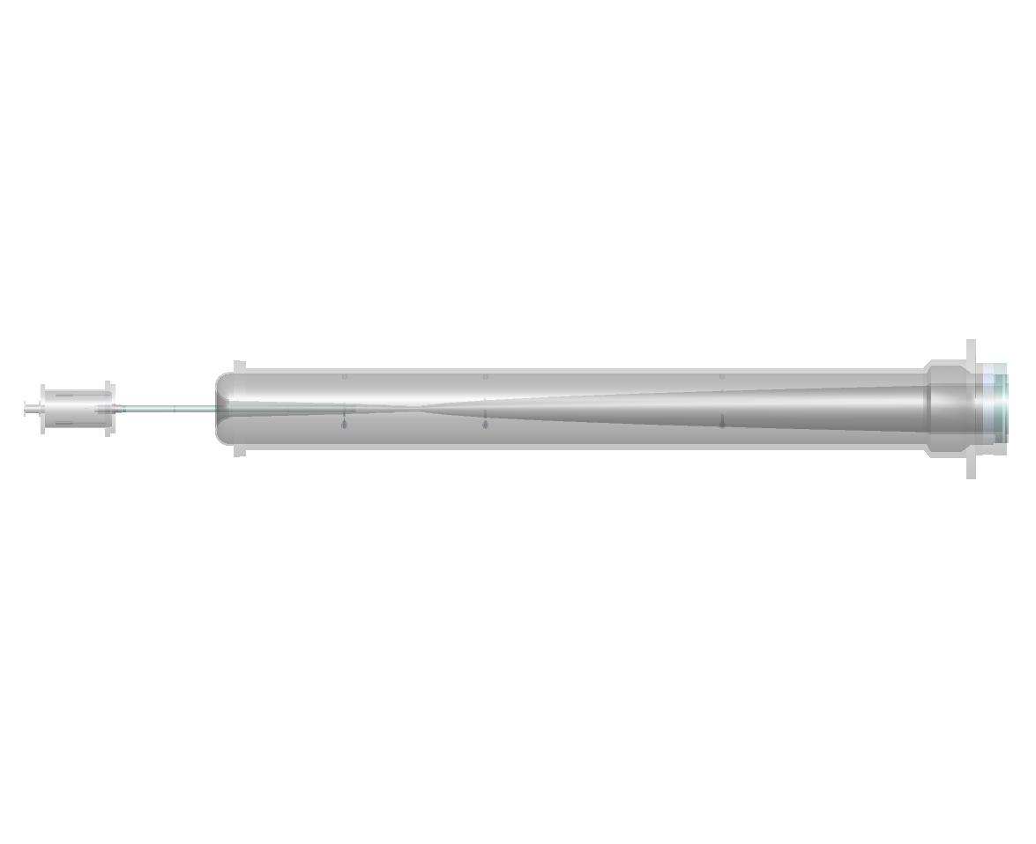
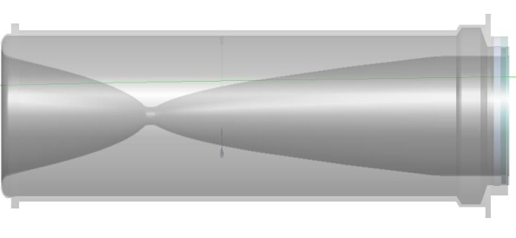
Making an antineutrino beam
Neutrino mode
Horns focus π⁺, K⁺
Events
ν_{μ}: 91.7%
ν_{μ}: 7.0%
ν_{e}+ν_{e} : 1.3%
Target
Focusing Horns
π⁻
2 m
ν_{μ}
120 GeV p’s from MI
ν_{μ}
π⁺
15 m
30 m
675 m

Slide 35
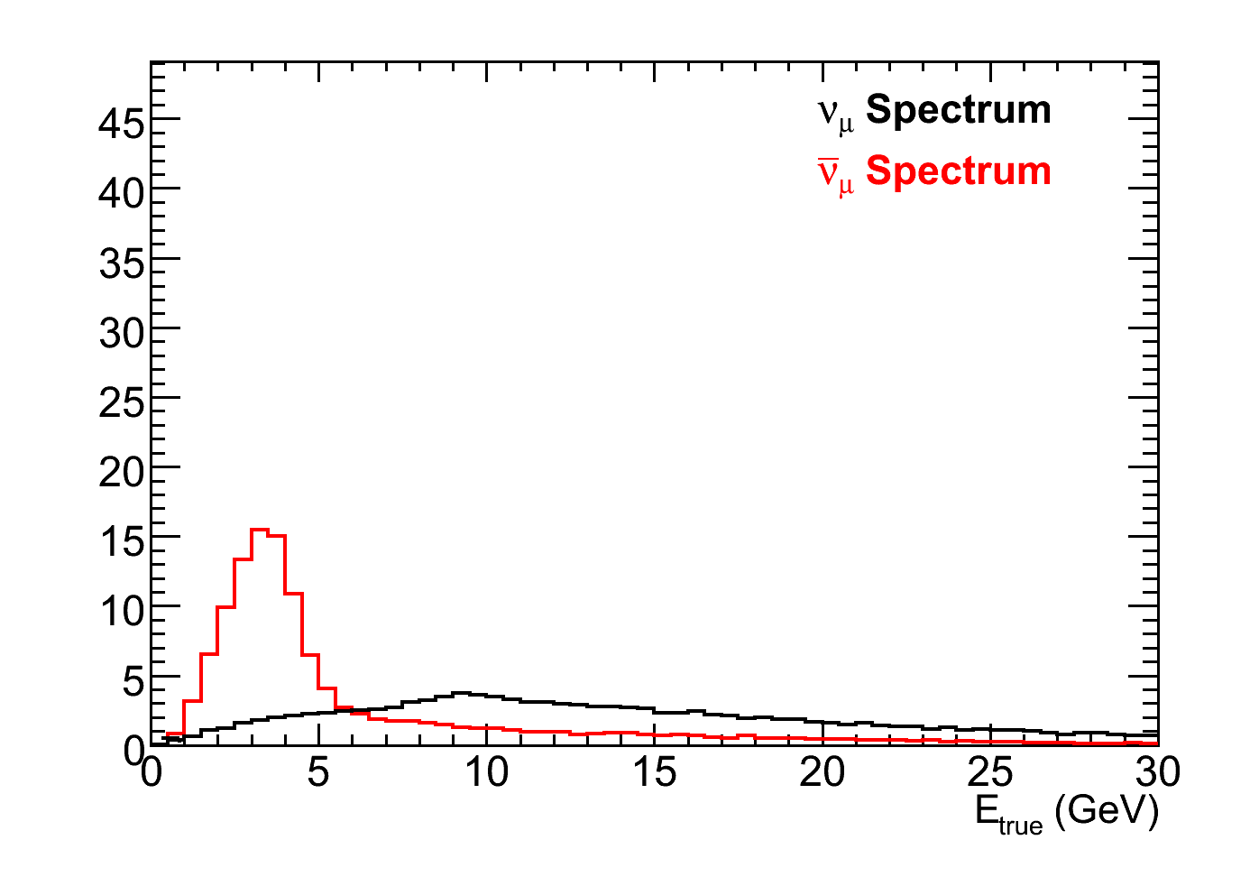
Making an antineutrino beam
Neutrino mode
Horns focus π⁺, K⁺
Anti-neutrino Mode
Horns focus π⁻, K⁻ enhancing the ν_{μ} flux
Events
Events
ν_{μ}: 91.7%
ν_{μ}: 7.0%
ν_{e}+ν_{e} : 1.3%
ν_{μ}: 39.9%
ν_{μ}: 58.1%
ν_{e}+ν_{e} : 2.0%
Target
Focusing Horns
π⁺
2 m
ν_{μ}
120 GeV p’s from MI
π⁻
ν_{μ}
15 m
30 m
675 m

Slide 36

ν_{μ} oscillation parameters
Contours include the effects of systematic uncertainties

Slide 37

How well do we know θ₂₃?
Gonzalez-Garcia, Maltoni, Salvado

Slide 38
What is the pattern of neutrino masses?
It “probably” looks
something like this
Log m²
m₃
Δm²₂₃ ~ 2.5 x 10⁻³ eV²
m₂
Δm²₁₂ ~ 7.5 x 10⁻⁵ eV²
m₁
ν_{e}
ν_{μ}
ν_{τ}

Slide 39
What is the pattern of neutrino masses?
But it could look like this
Log m²
m₃
m₂
m₁
m₂
m₁
m₃
Normal Heirarchy
Inverted Heirarchy
ν_{e}
ν_{μ}
ν_{τ}

Slide 40
This makes a factor of two difference in the
cosmological contribution, but a factor of two
on what?
Log m²
m₃
m₂
m₁
m₂
m₁
m₃
ν_{e}
ν_{μ}
ν_{τ}

Slide 41
Even more significant is the absolute scale.
Log m
1 eV
m₃
This?
m₂
m₁
Or this?
10⁻¹ eV
m₃
m₂
10⁻² eV
m₁
ν_{e}
ν_{μ}
ν_{τ}

Slide 42

Does this look natural?

Slide 43


_
How well do we know θ₂₃?
Gonzalez-Garcia, Maltoni, Salvado
But what about
θ₁₃?

Slide 44





#

Slide 45


Slide 46


Slide 47

What are we trying to measure?
ν_{μ} disappearance
No oscillation
sin²2θ₂₃
Δm²= 2.5 x10⁻³ eV²
Δm²= 2.0 x10⁻³ eV²
Δm₂₃²
Precision measurements

Slide 48
What are we trying to measure?
ν_{e} appearance
sin²2θ₁₃

Slide 49

Optimal Far Detector – Super Kamiokande

Slide 50
Background
from NC
interactions
e
ν_{μ}
disappearance
signal
π⁰
ν_{e}
appearance
signal
μ
In this energy range, Super Kamiokande well understood,
Excellent for separating
electrons, μ, π⁰

Slide 51

Critical σ’s poorly known in range 0.1-10 GeV.
Total ν_{μ} CC cross section
Data compiled by G.Zeller, hep-ex/0312061

Slide 52

Cross sections are poorly known in range 0.1-10 GeV
Data compiled by G.Zeller, hep-ex/0312061

Slide 53

Cross sections are poorly known in range 0.1-10 GeV
Data compiled by G.Zeller, hep-ex/0312061

Slide 54

Cross sections are poorly known in range 0.1-10 GeV
Data compiled by G.Zeller, hep-ex/0312061

Slide 55


Some are worse than others…
Data compiled by G.Zeller, hep-ex/0312061

Slide 56

And lets not even talk about ν…
_

Slide 57




Slide 58


Slide 59


Slide 60



Slide 61








Slide 62


Slide 63


Slide 64

Τ2Κ ν_{e} Appearance Data Reduction

Slide 65


Slide 66



Slide 67



Slide 68




Τ2Κ ν_{e} Appearance Data Reduction
All cuts optimized for low statistics
and fixed before data taken.

Slide 69





Check many distributions....
No excess outside FV or in OD,
but KS prob. for R² is ~3%

Slide 70


Slide 71



What about
θ₁₃?
T2K (2.5σ)
MINOS (1.7σ)
ν_{e} appearance, θ₁₃ > 0?
Interesting hints that
θ₁₃ > 0, but clearly
more data needed.

Slide 72




5/11, 14:46, all
Hell broke loose...
Despite considerable external damage at
the facility, damage to the actual apparatus
was not as serious as feared...

Slide 73



The good news: T2K is
running again already!
The bad news: The power
supply to the horn blew
up, so real neutrino data
will return in March.

Slide 74


Slide 75






Slide 76


First Double Chooz Results.
Slides from de Kerret’s talk at LowNu 11.

Slide 77


Slide 78



Slide 79



Slide 80


Slide 81



Slide 82

What will existing experiments yield?
Even some 90% CP violation sensitivity...
sin²2θ₁₃ = 0.1, NH
arXiv:0907.1896v1 [hep-ph] 10 Jul 2009

Slide 83


Slide 84


Slide 86
Three “conventional” beam proposals:
An upgrade of T2K based on reaching 1.6 MW beam power and a new far detector.
LBNE – a plan to build a new neutrino beam at Fermilab aimed at Homestake, where either a large water Cerenkov detector or a LAr tracking calorimeter would be built.
LAGUNA-LBNO – three different options for new long baseline in Europe.

Slide 87
Future Neutrino Oscillation Experiments
Another round of supererbeams?:
Water Cerenkov or Liquid Argon?
Upgrade of T2K
LBNE
LBNO
The further future?:
β beams
Neutrino Factory
Support Experiments...

Slide 88
Measuring absolute m_{ν}
Supernovae – Prodigious producers of neutrinos, and measuring time shifts can in principle measure neutrino masses, m_{ν} < ~30 eV.
Kinematic limits: If you believe the oscillation results, all Δm²≪1 eV, therefore only ν_{e} measurements have useful sensitivity → current best is Tritium Beta Decay, m_{ν} < 2.2 eV.
If neutrinos have Majorana masses, then zero-neutrino double-beta decay is allowed → observation of 0νββ decay would be direct evidence for neutrino mass, <m_{ν}> < ~1.3 eV.
Neutrinos are the second most numerous particle in the Universe → even a tiny neutrino mass could have astrophysical implications, Σm_{ν} < 0.28 eV(?)
Dave Wark
Imperial College/RAL

Slide 89
Other Neutrino Physics Topics
Opera, SN ν, and the Opera Time Anomaly
Sterile neutrinos
High-E neutrino astronomy

Slide 90

If oscillations
prove IH
If 0νββ decay
sets a limit here
Then neutrinos are Dirac...

Slide 91
Conclusions
ν oscillations are the first confirmed physics beyond the SM (well, other than the mass of the electron)!
Current indications are that sin²2θ₁₃ ≥ ~0.01, which could give existing experiments the first sensitivity to CP violation in the neutrino sector.
Do not assume we know everything that is going on – redundancy is essential!
There are three next-generation superbeam projects, and I think the physics will justify at least two.
The mine at Pyhäsalmi is potentially an extremely valuable resource for European neutrino physics due to its distance from CERN, but we should move fast if we are going to retain the option of using it in the future. Can we build a 10 kT LAr prototype?
In my opinion, a large LAr tracking calorimeter will be used in at least one experiment, making LAr development a high priority.
There will be many other opportunities for smaller-scale involvement in cross-section, hadron production, and perhaps short-baseline projects.
Dave Wark
Imperial College/RAL

Slide 92
More Conclusions
There are many other fascinating and important topics in neutrino physics other than in oscillations that will continue to generate significant experiments.
Neutrino physics has a guaranteed future – JOIN US!
Each generation of particle physicists has to fight and win the battle to convince governments that our science is important and that our experiments need to be funded and our theorists need support.
This fight has gotten, and will get, harder as public money is tighter and tighter.
To win the fight we need new ideas and new initiatives, and the young people are where they should come from.
The European strategy process that is starting up will have a bigger effect on your future than on mine – give us input and get involved!
Dave Wark
Imperial College/RAL

Slide 94

~kT scale LAr now a working technology
Must now work on scalability and cost
Must figure out how to analyze!

Slide 95

Also very significant efforts in the US in LBNE and MicroBooNE

Slide 96

Return ↑

Slide 97






Scenarios in Japan
Kamioka L=295km OA=2.5deg
J-PARC
→1.7MW
Okinoshima L=658km OA=0.78deg
Almost On-Axis

Slide 98

Return ↑

Slide 99




US: Long Baseline Neutrino Experiment
CD 0: January 2010
1300 km
Collaboration:
288 members from 54 institutions (India, Italy, Japan, UK, US)
Continue to grow!

Slide 100


LAr Slight cheaper but riskier – Marx Committee
Return ↑
Alternative is
34 kT of LAr
Technology choice underway ....

Slide 101




Possible synergy with a NF beam
Joint Japanese/European approach
Possible synergy with a β beam

Slide 102


Slide 103


LENA + DAEdALUS a
complementary way to measure CP violation in neutrino oscillations?

Slide 104

Exploring within LAGUNA-LBNO an LoI for a 10 kT LAr with a muon ranger combined with a new beam in the NA.
Return ↑

Slide 105


CERN Beta Beams, Synoptic
RCS
SPL
Linac4
Dotted lines: alternative layouts
Linac
ISOL target
Molten Salt Loop
Collection
PR
6He
18Ne
ν-Beam
8B/8Li
Baseline
6He/18Ne
ECR
RFQ
Linac 100 MeV
PS
DR
SPS
PS and SPS existing
RCS
Decay Ring: Bρ ~ 500 Tm, B = ~6 T, C = ~6900 m, L_{ss}= ~2500 m, γ = 100, all ions
Return ↑
105
Notes:
What is changing is mainly the production

Slide 106


Neutrino Factory Baseline
MICE
@RAL
Two Magnetised Iron Neutrino Detectors (MIND):
100 kton at 2500-5000 km
50 kton at 7000-8000 km
Baseline constantly under
review in light of new
physics results
Return ↑

Slide 108

Slide from Yvonne Wong’s talk at TAUP ‘11

Slide 109

Slide from Yvonne Wong’s talk at TAUP ‘11

Slide 110

Slide from Yvonne Wong’s talk at TAUP ‘11

Slide 111




If you are measuring a mass, you must QUANTIFY the systematics!

Slide 112
SNO Systematic Flux Uncertainties
Error Source
Energy scale
Energy resolution
Non-linearity
Vertex shift
Vertex resolution
Angular resolution
High Energy γ’s
Low energy background
Instrumental background
Trigger efficiency
Live time
Cut acceptance
Earth orbit eccentricity
¹⁷O, ¹⁸O
Experimental uncertainty
Cross-section
Solar Model
CC error (%)
-5.2, +6.1
±0.5
±0.5
±3.1
±0.7
±0.5
-0.8, +0.0
-0.2, +0.0
-0.2, +0.0
0.0
±0.1
-0.6, +0.7
±0.2
0.0
-6.2, +7.0
3.0
-16, +20
ES error (%)
-3.5, +5.4
±0.3
±0.4
±3.3
±0.4
±2.2
-1.9, +0.0
-0.2, +0.0
-0.6, +0.0
0.0
±0.1
-0.6, +0.7
±0.2
0.0
-5.7, +6.8
0.5
-16, +20
Unless a real error analysis is done
for astrophysical mass “limits” they
cannot really be considered
equivalent to laboratory limits.
In any case, using precious
cosmological data to
constrain m_{ν} would be like
using LEP as a tide gauge.
Return ↑

Slide 114



February 1984
March 8,1987
A supernova
converts
~ 1 M⊙ to ν

Slide 115

Limit from SN1987a is m_{νe} > 23 eV (PDG)
Best you can do is ~5-10 eV, which isn’t good enough
Light and neutrinos got here on the same day after travelling
for ~160k yrs, so |v_{ν}-c|/c < 2×10⁻⁹ at E_{ν} ~ 10 MeV
Return ↑

Slide 116






Dusini at EPS
OPERA τ appearance event....
.... has no friends yet. Expect 1.65±0.16

Slide 117





TOF_{c} - TOF_{ν}
|v_{ν}-c|/c =
(2.48±0.28±0.30)×10⁻⁵

Slide 118

This narrow beam structure will allow Borexino, ICARUS, and LVD to measure δt as well.

Slide 119

Return ↑

Slide 121





LSND Starts it all...
Short baselines
(L/E ~ 1)
and sterile ν.
MiniBooNE says....
No!
Yes?

Slide 122


Slide 123


Return ↑

Slide 125


In the systematics dominated era
support measurements are essential!
One slide on hadron production

Slide 126





Neutrino interaction properties must
also be measured...
But also need....
Near Detectors....
Return ↑

Slide 128
Dirac ν vs Majorana ν
C
P
T
Lorentz
Boost,
E, B
C
P
T
Dirac
Majorana

Slide 129

ββ decay and neutrino mass
35 isotopes in nature

Slide 130

0νββ: Peak at Q-value of nuclear transition
Sum energy spectrum of both electrons

Slide 131



Slide 132

Each is ±1 if CP conserved, but there
can still be cancellations

Slide 134

KKDC Claim
(best fit 0.32 eV)
Present Cuoricino result
GERDA Target
CUORE Target
With SuperNEMO, SNO+, MAJORANA, many others should reach here in ~ 7-10 yrs.
Return ↑
Need new ideas to reach < 10 meV, but kiloton
scale low background experiments are not impossible!

Slide 136




Tritium β-decay
Fermi theory of β-decay:
observable:
tritium as β emitter:
high specific activity (half-life: 12.3 years)
low endpoint energy E₀ (18.57 keV)
super-allowed

Slide 137



KATRIN experiment
(KArlsruhe TRItium Neutrino experiment, location: Forschungszentrum Karlsruhe)
70 m
electron transport
CMS at same scale
tritium decay
energy analysis
tritium retention
β-decay rate: 10¹¹ Hz
T₂ pressure: 10⁻⁶ mbar
background rate: 10⁻² Hz
T₂ pressure: 10⁻²⁰ mbar
about 14 orders of magnitude
adiabatic guiding of electrons on meV level

Slide 138

Return ↑

Slide 140


Slide 141


Slide 142


Slide 143


Slide 144


Slide 145

Return ↑

Slide 146
What is KM3NeT ?
Future cubic-kilometre scale neutrino telescope in the Mediterranean Sea
Exceeds Northern-hemisphere telescopes by factor ~50 in sensitivity
Exceeds IceCube sensitivity by substantial factor
Provides node for earth and marine sciences

Slide 147

Candidate Sites
Locations of the three pilot projects:
ANTARES: Toulon
NEMO: Capo Passero
NESTOR: Pylos
Long-term site characterisation measurements performed
Political and funding constraints
Possible solution: networked, distributed implementation

