Slide 1
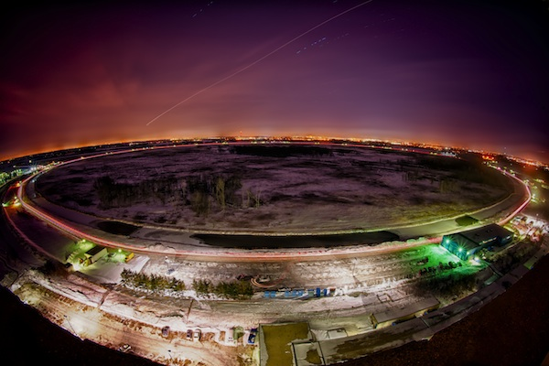
Higgs Searches at the Tevatron
Koji Sato
on behalf of CDF and D0 Collaborations
Standard Model @ LHC
HCΦ institute, Copenhagen
April 12, 2012

Slide 2
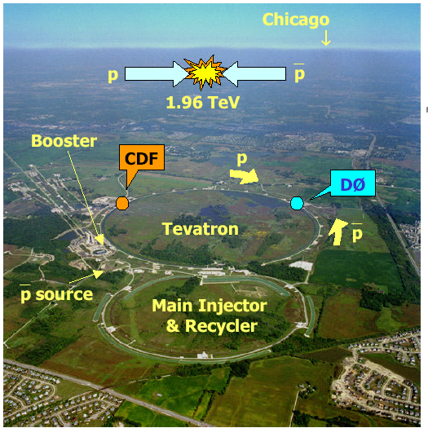
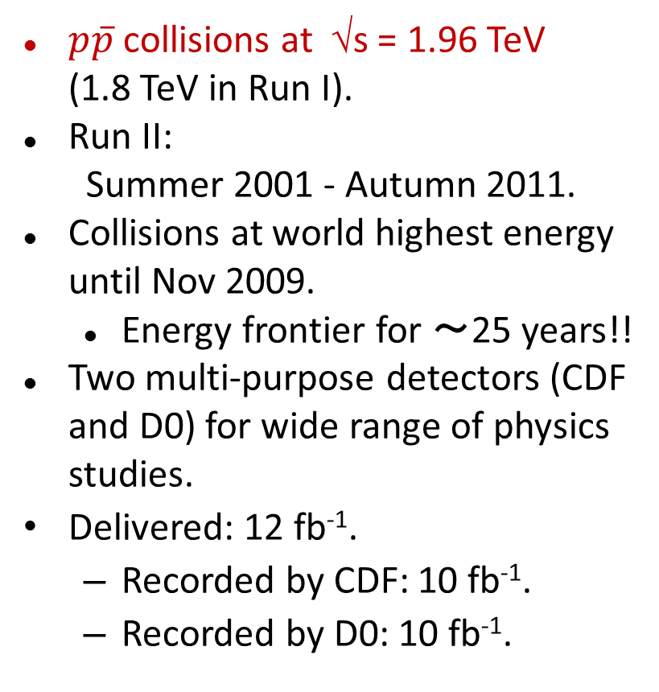
Tevatron Run II
$p\overline{p}$ collisions at √s = 1.96 TeV (1.8 TeV in Run I).
Run II:
Summer 2001 - Autumn 2011.
Collisions at world highest energy until Nov 2009.
  Energy frontier for ～25 years!!
Two multi-purpose detectors (CDF and D0) for wide range of physics studies.
Delivered: 12 fb⁻¹.
  Recorded by CDF: 10 fb⁻¹.
  Recorded by D0: 10 fb⁻¹.

Slide 3
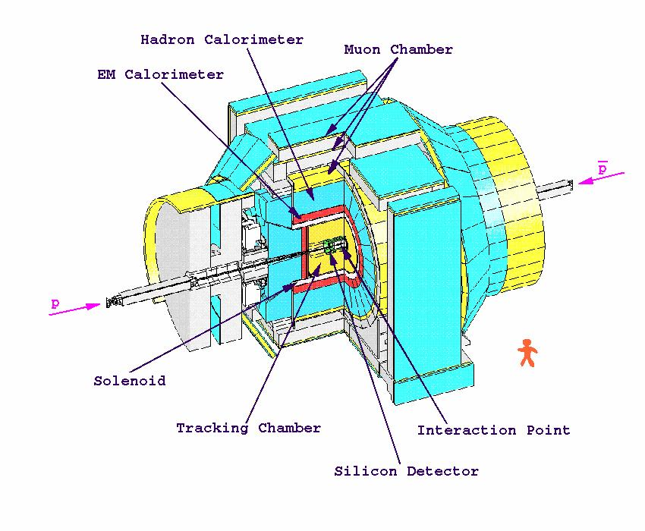
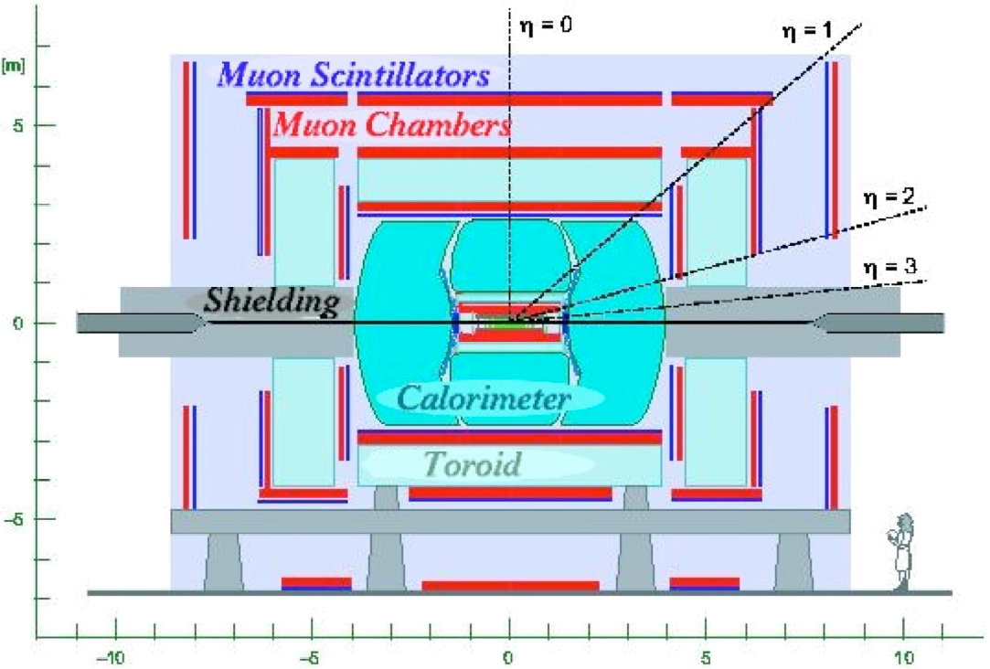
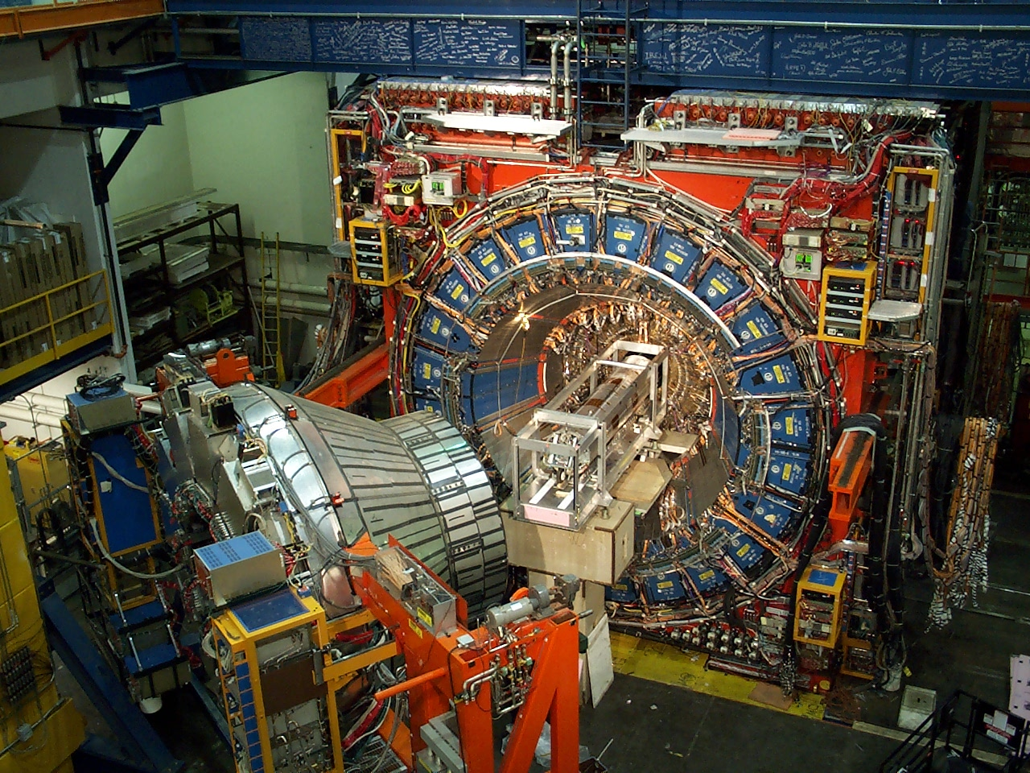

CDF and D0 Detectors
Both are multipurpose detectors:
  Top/EWK measurements, Searches for Higgs and New Phenomena, and B physics.
Precision tracking with Silicon in 1.5 (CDF)/1.8 T (D0) Solenoid field.
EM/Had calorimeters for e/γ/jet measurement.
Outer muon chambers.
CDF
D0

Slide 4
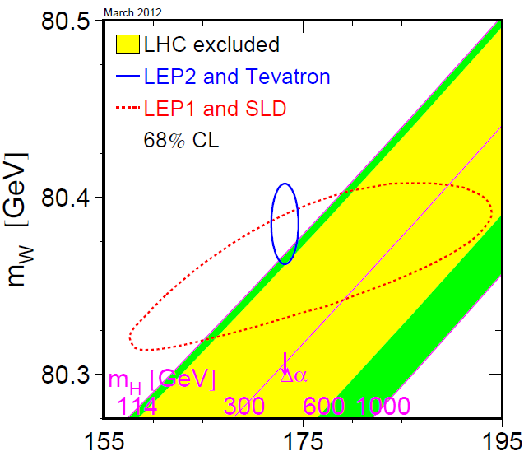
Constraint on Higgs Mass
Mass of W Boson (World Average):
  Before Tevatron Run II：
  m_{W}=80.426±0.034 GeV/c²
  With Tevatron Run II results：
  m_{W}=80.385±0.015 GeV/c²
Mass of Top Quark (World Average):
Tevatron Run I result：
m_{top} = 178.0 ± 4.3 GeV/c²
With Tevatron Run II results：
m_{top} = 173.2 ± 0.9 GeV/c²
Before Tevatron Run II results (Spring 2004)
m_{top} [GeV]
  M_{higgs} < 152 GeV/c² （95% CL) .
  ….was M_{higgs} < 251 GeV/c² (95% CL) in Spring 2004.

Slide 5
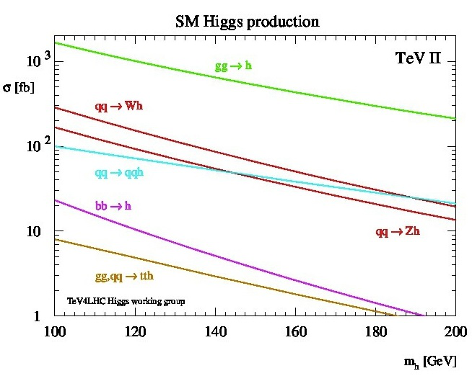
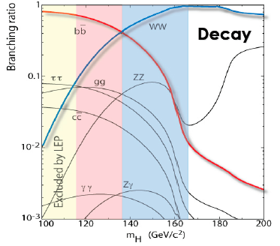
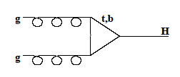

SM Higgs Properties at Tevatron
bb
WW
m_{H}<135 GeV (low mass):
  gg→H→bb is difficult to see.
  Look for WH/ZH with leptonic vector boson decays.
m_{H}>135 GeV (high mass):
  Easiest to look for H→WW→lνlν.

Slide 6
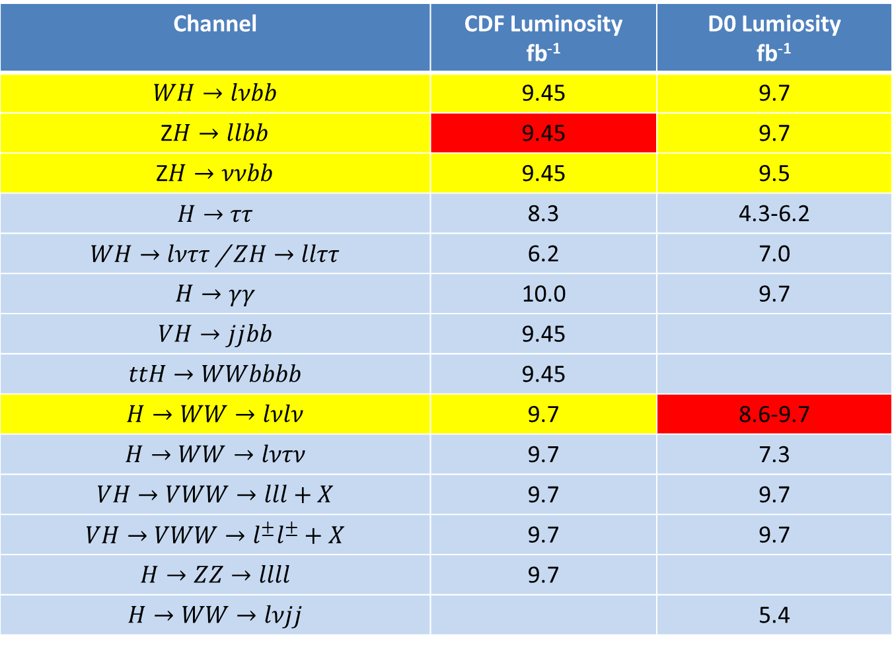
CDF and D0 analyses
Channel | CDF Luminosity fb⁻¹ | D0 Lumiosity fb⁻¹
$$WH→lνbb$$ | 9.45 | 9.7
Z$H→llbb$ | 9.45 | 9.7
Z$H→ννbb$ | 9.45 | 9.5
$$H→ττ$$ | 8.3 | 4.3-6.2
$WH→lνττ$ / $ZH→llττ$ | 6.2 | 7.0
$$H→γγ$$ | 10.0 | 9.7
$$VH→jjbb$$ | 9.45
$$ttH→WWbbbb$$ | 9.45
$$H→WW→lνlν$$ | 9.7 | 8.6-9.7
$$H→WW→lντν$$ | 9.7 | 7.3
$$VH→VWW→lll+X$$ | 9.7 | 9.7
$$VH→VWW→l^{±}l^{±}+X$$ | 9.7 | 9.7
$$H→ZZ→llll$$ | 9.7
$$H→WW→lνjj$$ |  | 5.4

Slide 7
General Strategy
Utilize Multivariate Algorithms (MVA) for better S/B separation.
  Neural Net, Boosted Decision Tree, Matrix Element, etc.
  Some analyses use MVA output into another MVA.
The main channels analyzed the full dataset in Winter 2012.
  Analysis of events through different triggers.
Improved b-jet energy scale measurement (low mass analyses)
  b-jet energy correction based on NN at CDF.
Improved b-tagging (low mass analyses)
  Algorithms based on MVA.
Divide analysis sample into high/low purity subsamples.
  Subdivision due to lepton and b-tag quality.

Slide 8
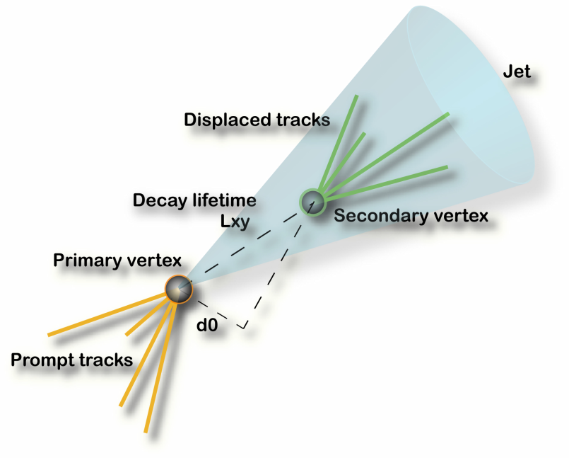
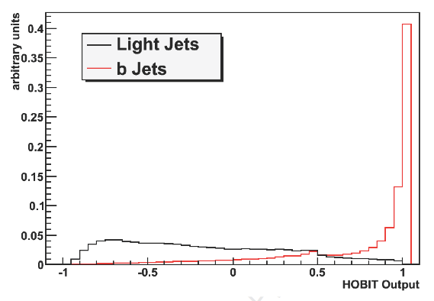
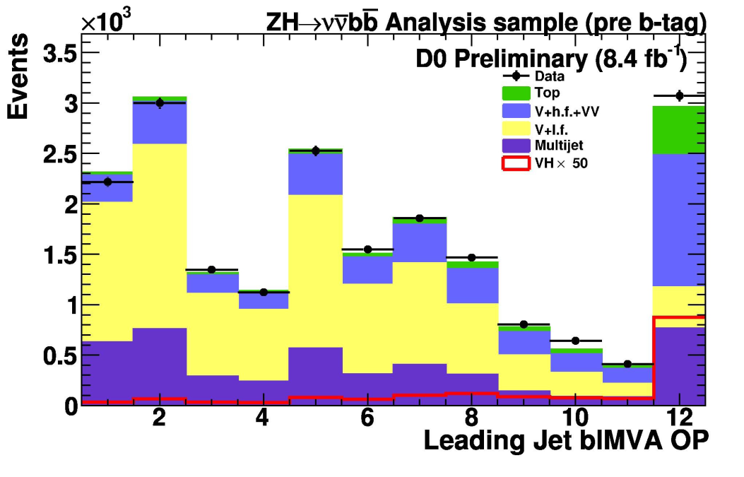
Improved b-tagging
Jet
Displaced Tracks
CDF and D0 combine information of secondary vertex and tracks within jet cone by MVA (NN and BDT).
Secondary Vertex
Primary Vertex
Light Flavor Eff. | HOBIT Eff. | SecVtx Eff. (old tagger)
1% | 54% | 39%
2% | 59% | 47%
Light Flavor Eff. | Lb Eff.
0.5% | 50%
4.5% | 70%

Slide 9
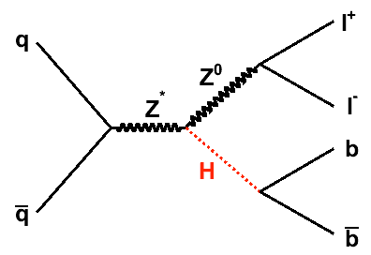
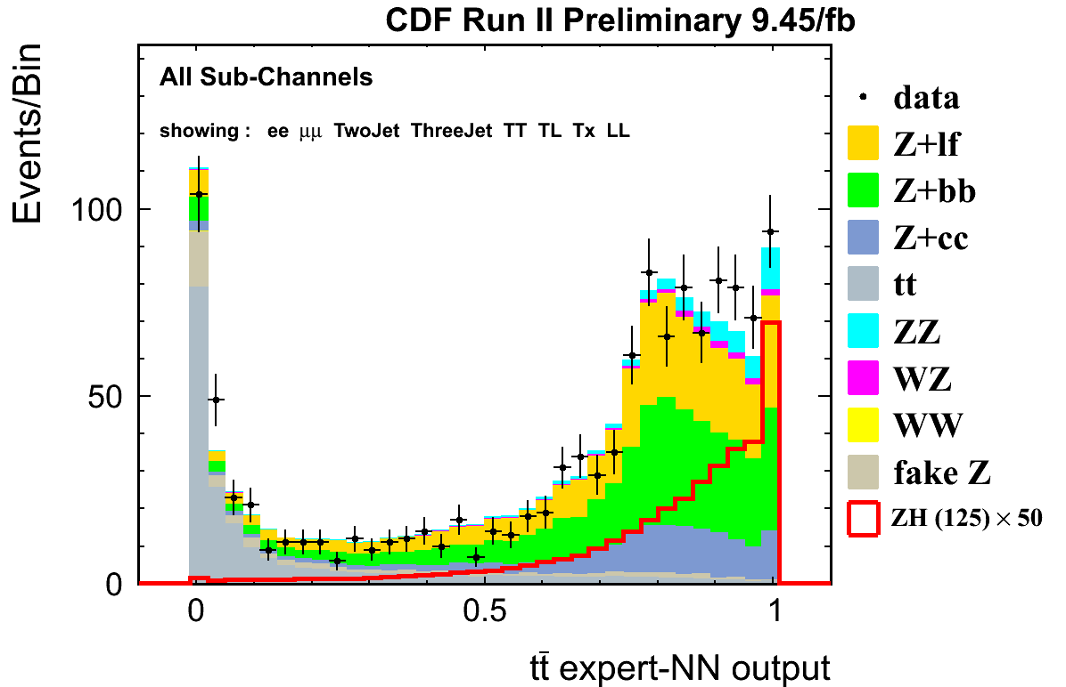
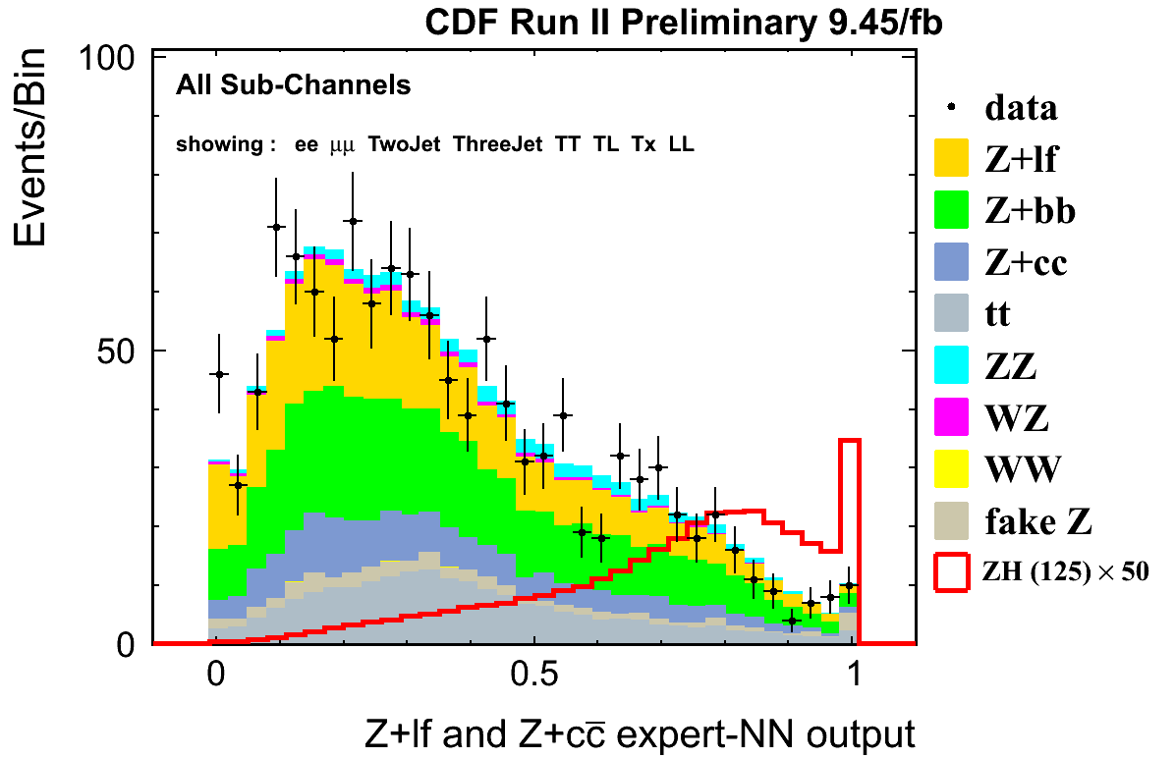
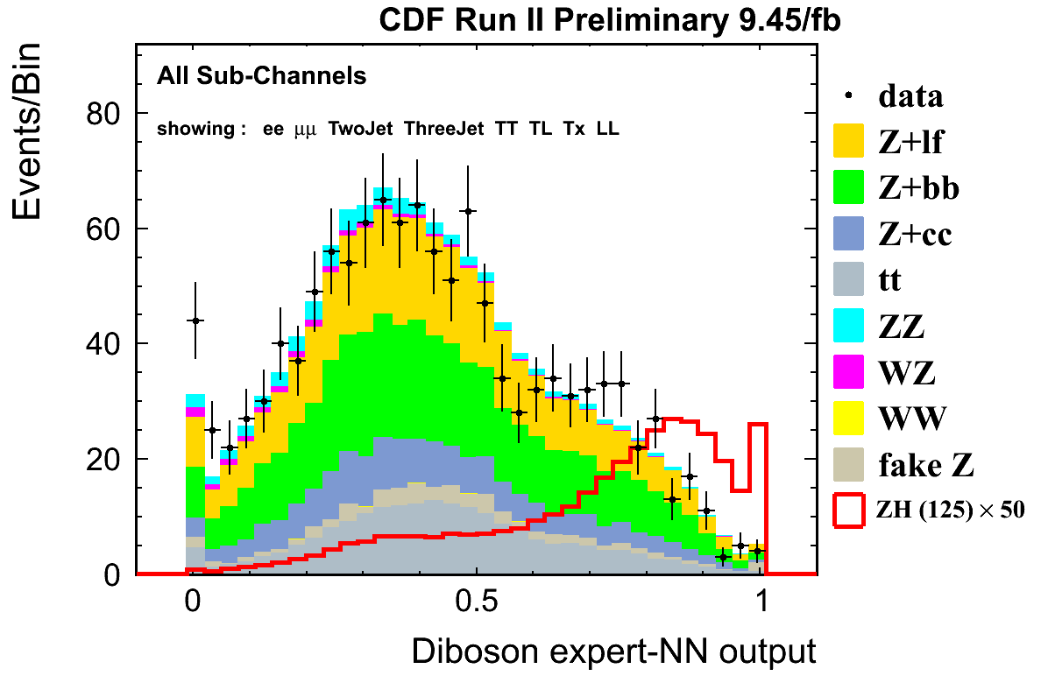

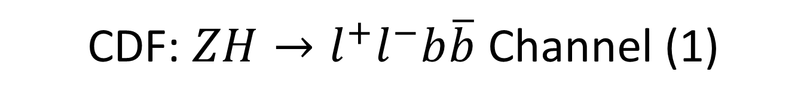
CDF: $ZH→l^{+}l^{−}b\overline{b}$ Channel (1)
Event Selection:
  $e^{+}e^{−}$ or $μ^{+}μ^{−}$ pair within Z mass window.
  2 or 3 jets with 1 or 2 b-tagged (4 tag categories).
Train NN for different background.
tt-like
other
Z+qq - like
other
WZ, ZZ - like
ZH - like

Slide 10
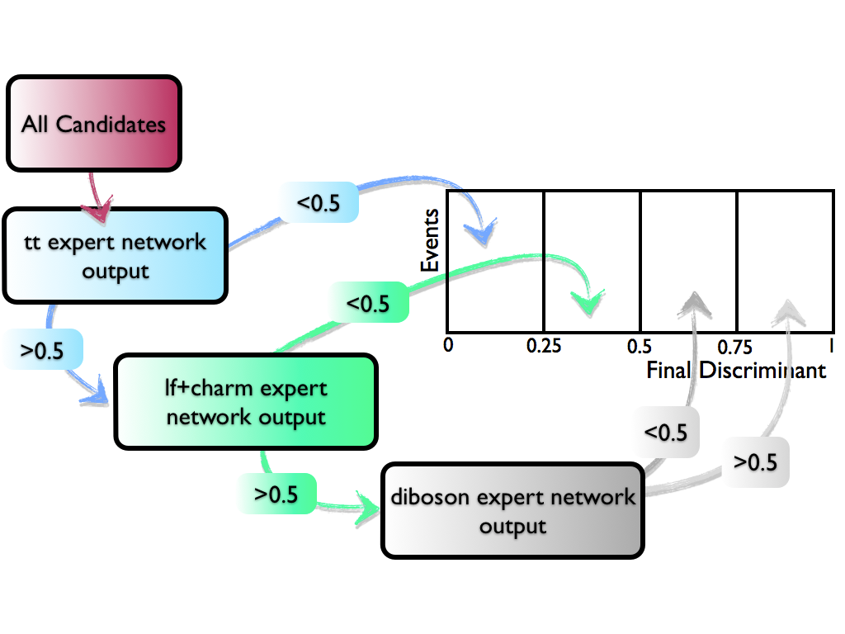
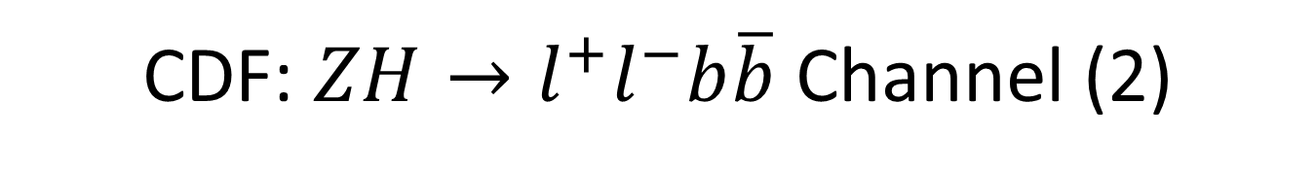
CDF: $ZH→l^{+}l^{−}b\overline{b}$ Channel (2)
Final Discriminant = separate Signal from all Bkgd.

Slide 11
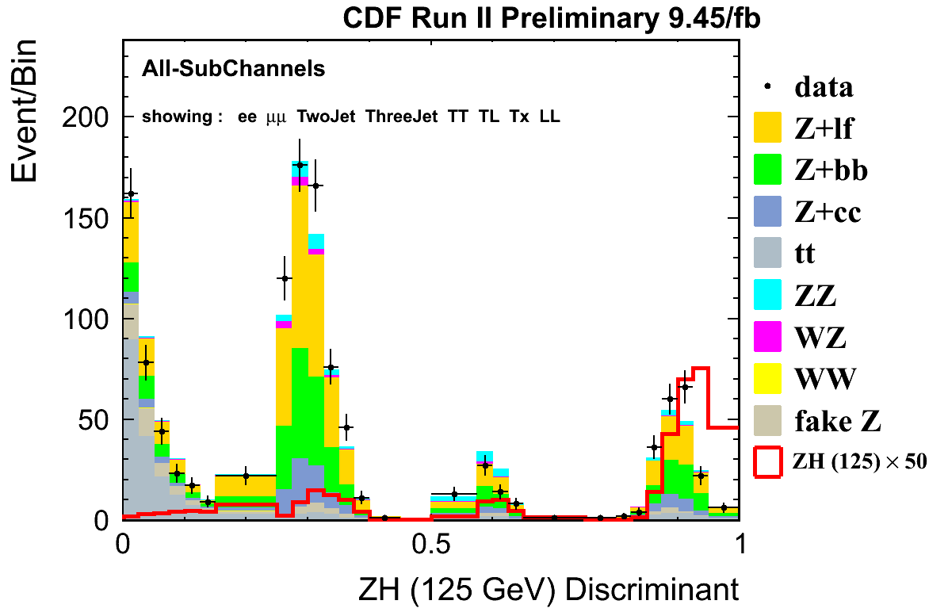
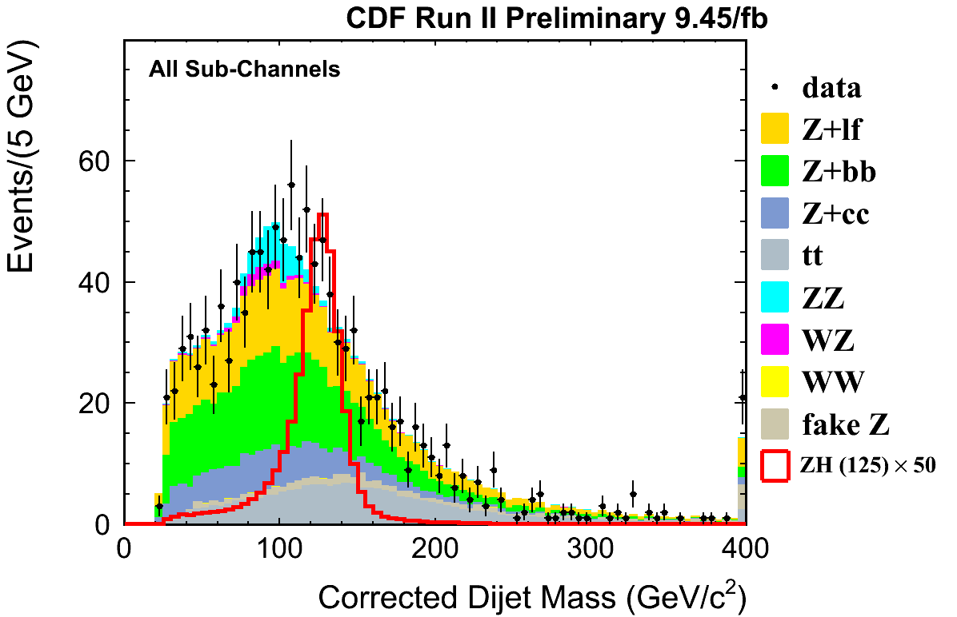
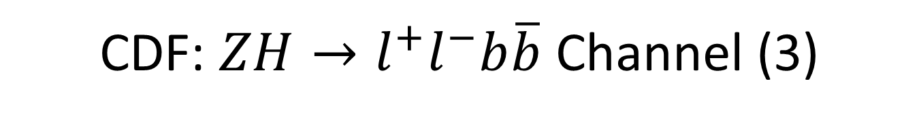
CDF: $ZH→l^{+}l^{−}b\overline{b}$ Channel (3)
tt
Z+
qq
WZ,
ZZ
ZH

Slide 12
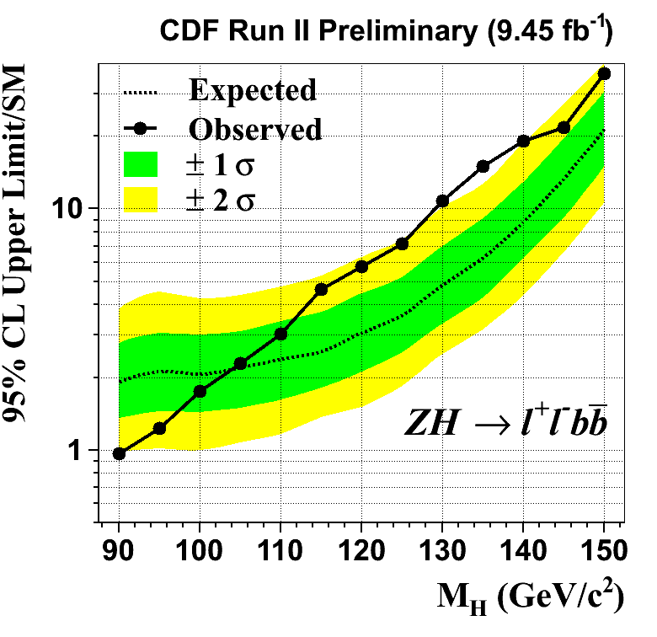
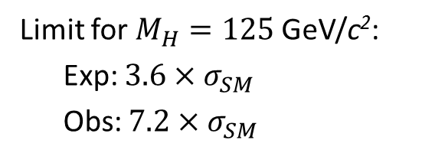
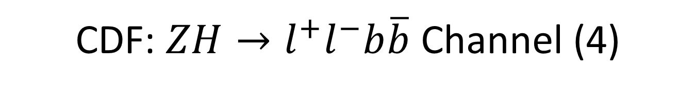
CDF: $ZH→l^{+}l^{−}b\overline{b}$ Channel (4)
Limit for $M_{H}=125$GeV/c²:
Exp: $3.6×σ_{SM}$
Obs: $7.2×σ_{SM}$

Slide 13
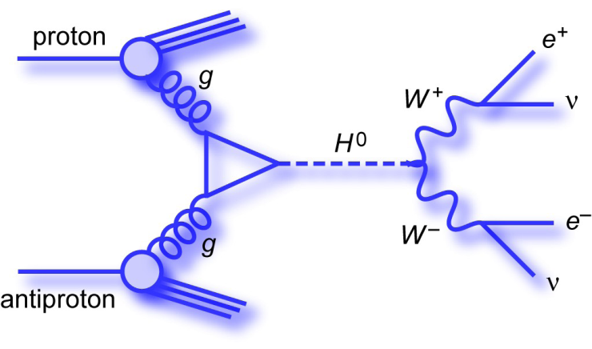
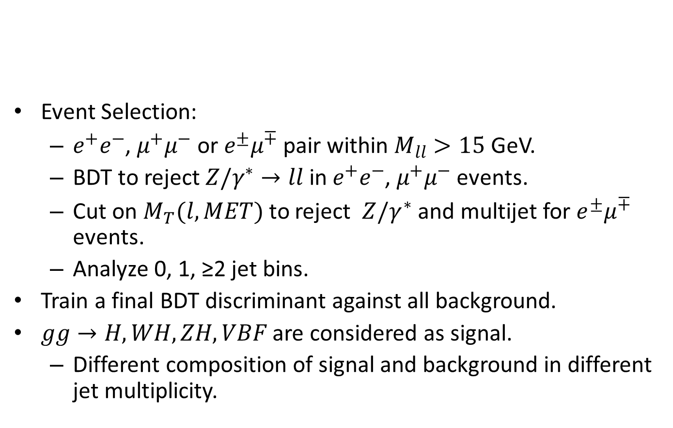

D0: $H→W^{+}W^{−}→l^{+}l^{−}+MET$ Channel (1)
Event Selection:
  $e^{+}e^{−}$, $μ^{+}μ^{−}$ or $e^{±}μ^{∓}$ pair within $M_{ll}>15$ GeV.
  BDT to reject $Z/γ^{∗}→ll$ in $e^{+}e^{−}$, $μ^{+}μ^{−}$events.
  Cut on $M_{T}(l,MET)$ to reject $Z/γ^{∗}$and multijet for $e^{±}μ^{∓}$ events.
  Analyze 0, 1, ≥2 jet bins.
Train a final BDT discriminant against all background.
$gg→H, WH, ZH, VBF$ are considered as signal.
  Different composition of signal and background in different jet multiplicity.

Slide 14
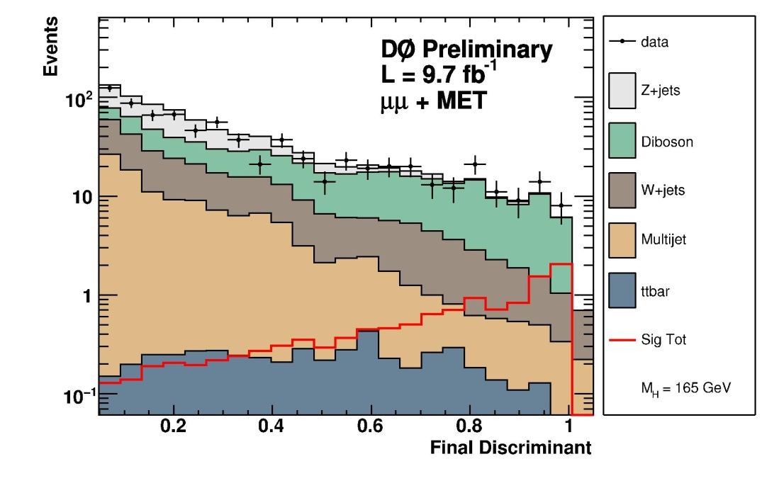
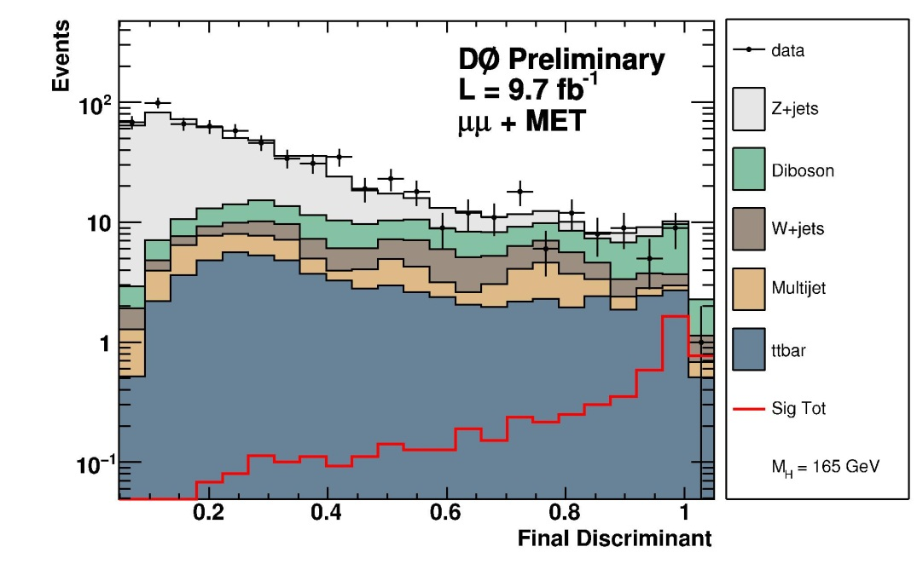
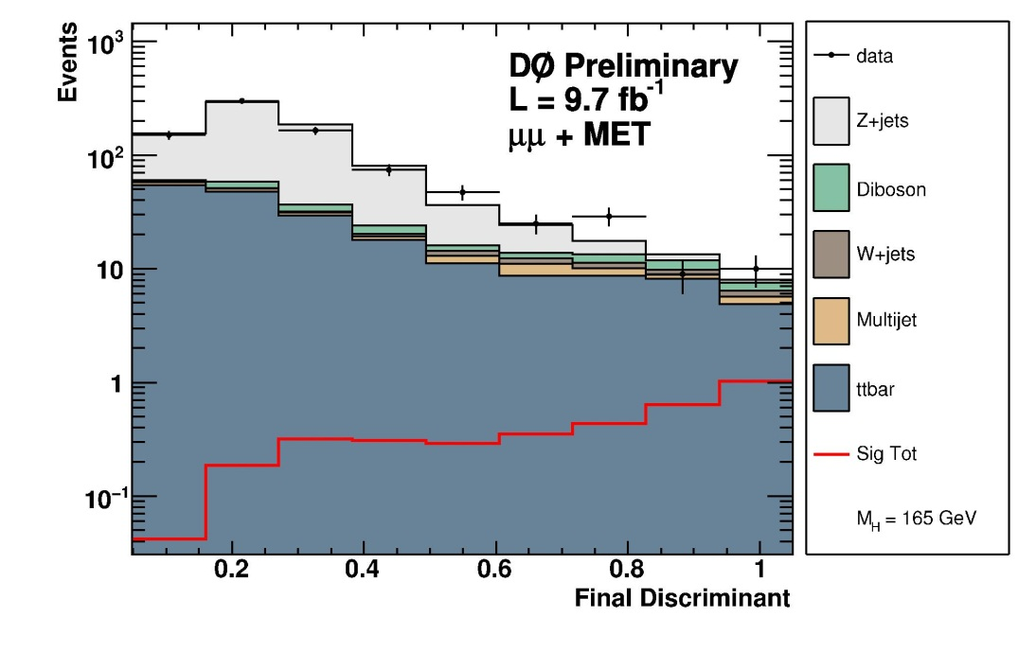

D0: $H→W^{+}W^{−}→l^{+}l^{−}+MET$ Channel (2)
Distributions of the Final discriminant:
0 jet
1 jet
≥2 jet

Slide 15
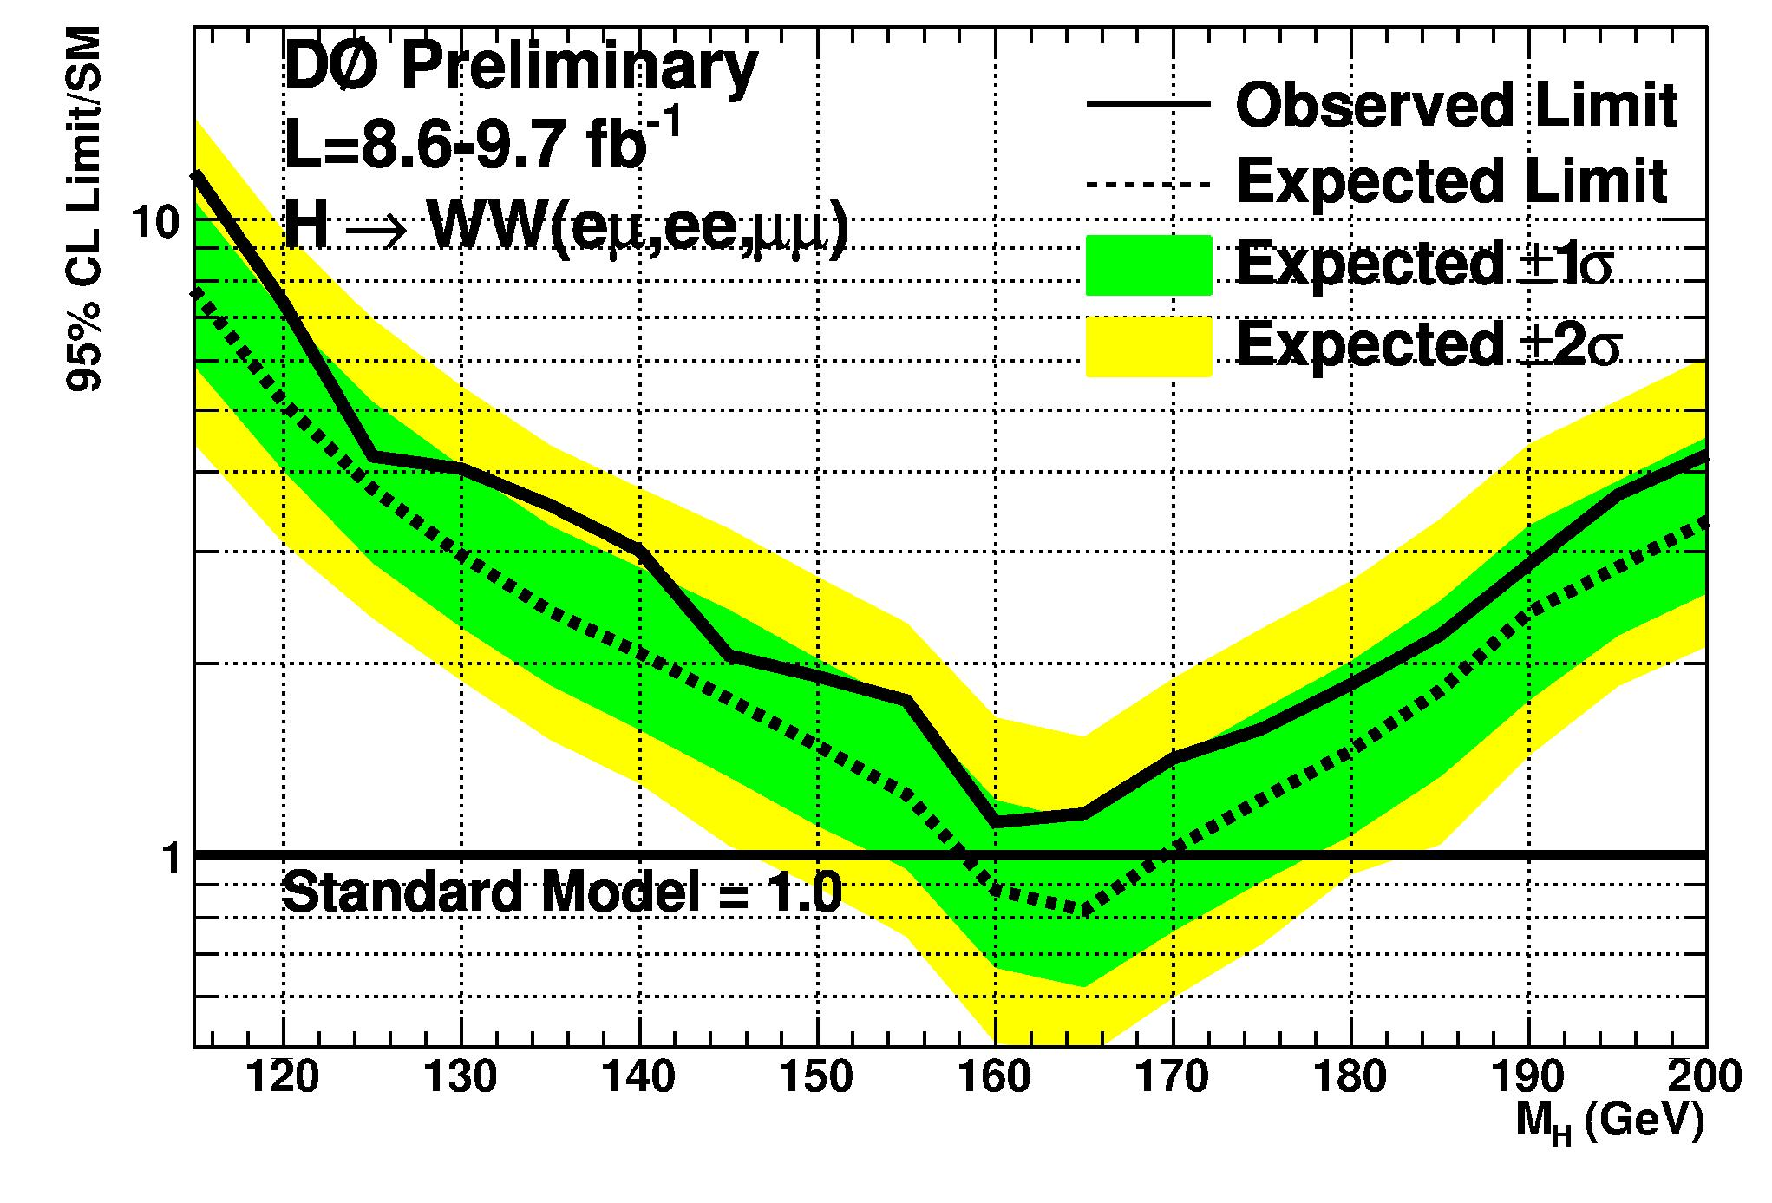


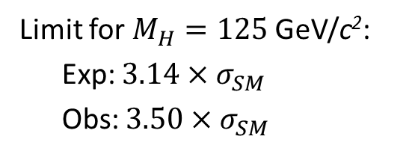
D0: $H→W^{+}W^{−}→l^{+}l^{−}+MET$ Channel (3)
$e^{+}e^{−}$, $μ^{+}μ^{−}{,e}^{±}μ^{∓}$ channels combined:
Limit for $M_{H}=125$GeV/c²:
Exp: $3.14×σ_{SM}$
Obs: $3.50×σ_{SM}$
Competitive with each individual $H→bb$ channel.

Slide 16
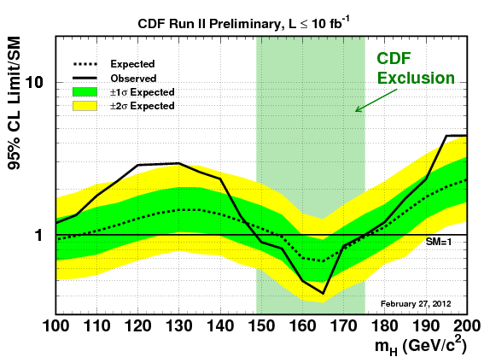
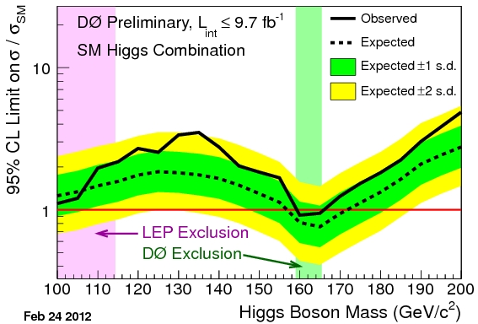
CDF and D0: Combined Limit
CDF excludes (95% C.L.):
148.8 < m_{H} < 175.2 GeV/c²
D0 excludes (95% C.L.):
159 < m_{H} < 166 GeV/c²

Slide 17
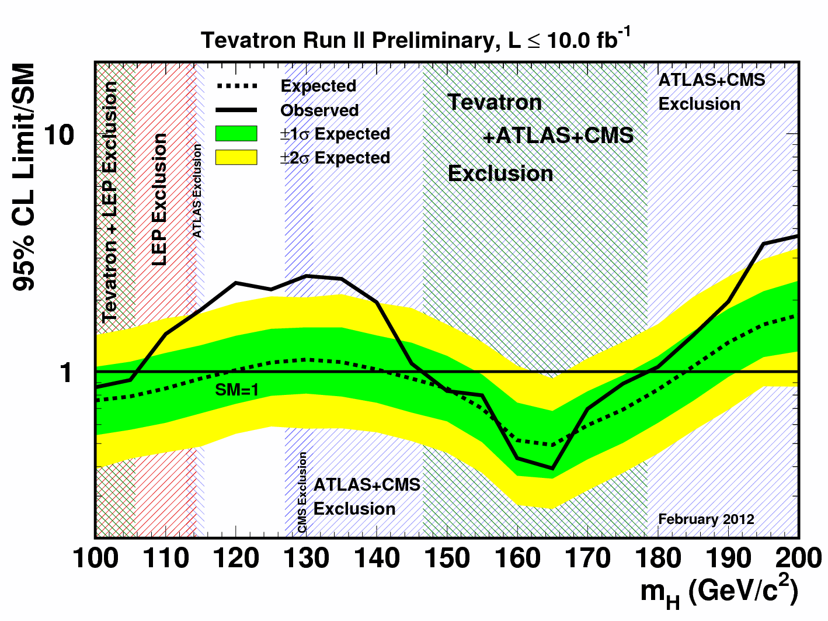
CDF+D0 Combined Limit
What’s this excess?
Expected exclusion: 100<m_{H}<119, 141<m_{H}< 184 GeV/c²
Observed exclusion: 100<m_{H}<106, 147<m_{H}< 179 GeV/c²

Slide 18
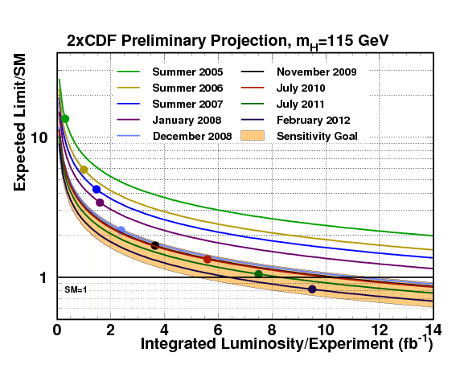
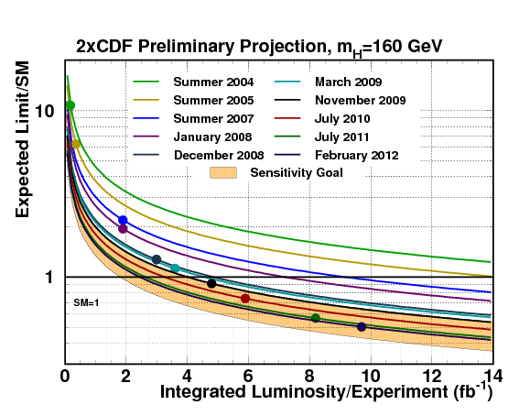
History of Analysis Improvement
Tevatron analyses have been constantly improved.
  Improvement far better than by the increase of dataset!!

Slide 19
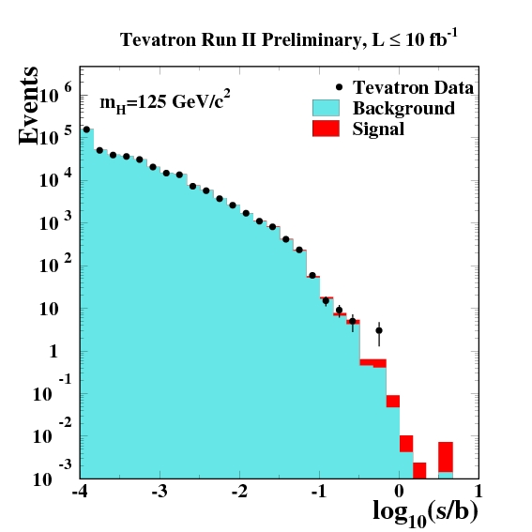
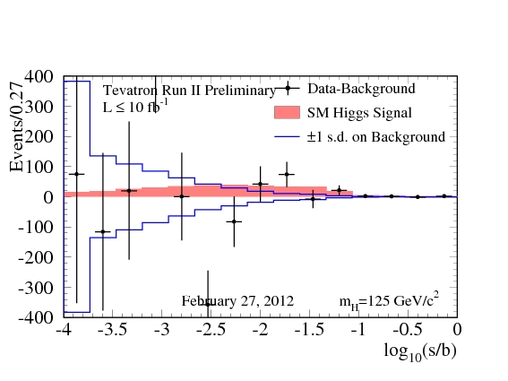
Distribution of the Candidate Events
Candidate events in the combined 16 analyses (~90 orthogonal subchannels):
Data - Background

Slide 20
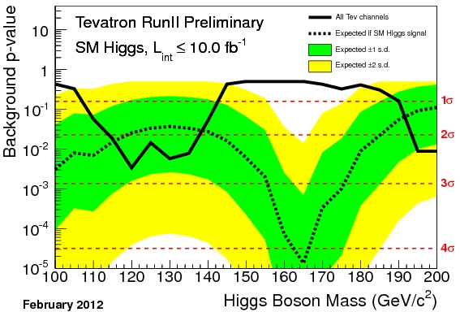
P-value of the Tevatron Combination

Slide 21
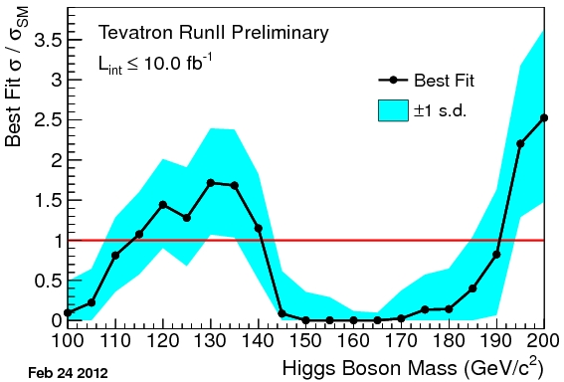
Signal Cross Section Best Fit
Assuming the SM Higgs branching ratio.
If real, excess around 115-135 GeV is consistent with the Standard Model.

Slide 22
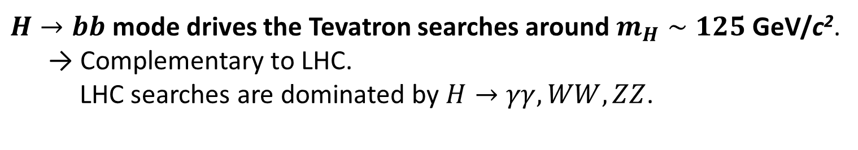
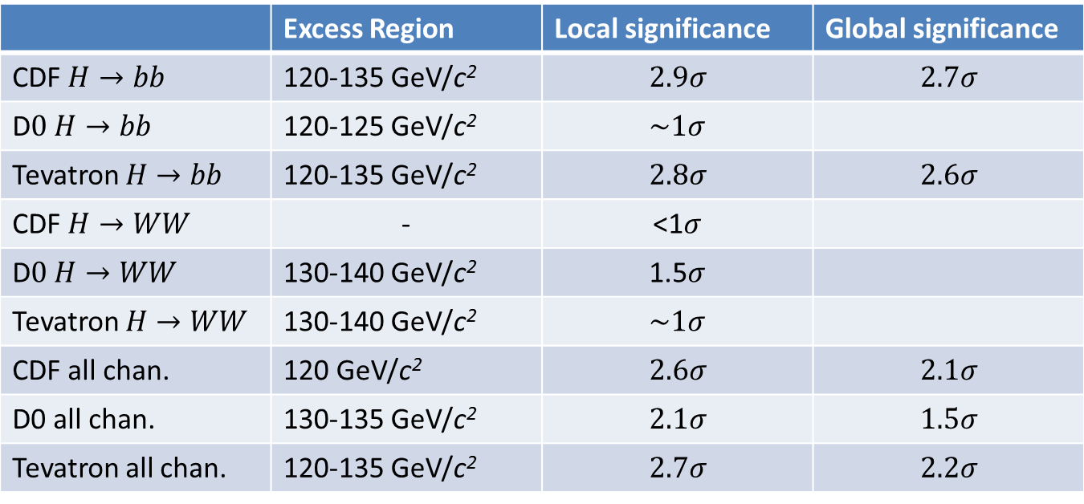
Summary of Significance
 | Excess Region | Local significance | Global significance
CDF $H→bb$ | 120-135 GeV/c² | $$2.9σ$$ | $$2.7σ$$
D$0 H→bb$ | 120-125 GeV/c² | $$\sim 1σ$$
Tevatron $H→bb$ | 120-135 GeV/c² | $$2.8σ$$ | $$2.6σ$$
CDF $H→WW$ | - | <1$σ$
D$0 H→WW$ | 130-140 GeV/c² | 1.5$σ$
Tevatron $H→WW$ | 130-140 GeV/c² | $$\sim 1σ$$
CDF all chan. | 120 GeV/c² | $$2.6σ$$ | $$2.1σ$$
D0 all chan. | 130-135 GeV/c² | $$2.1σ$$ | $$1.5σ$$
Tevatron all chan. | 120-135 GeV/c² | $$2.7σ$$ | $$2.2σ$$
$H→bb$ mode drives the Tevatron searches around $m_{H}∼125$ GeV/c².
→ Complementary to LHC.
LHC searches are dominated by $H→γγ, WW, ZZ$.

Slide 23
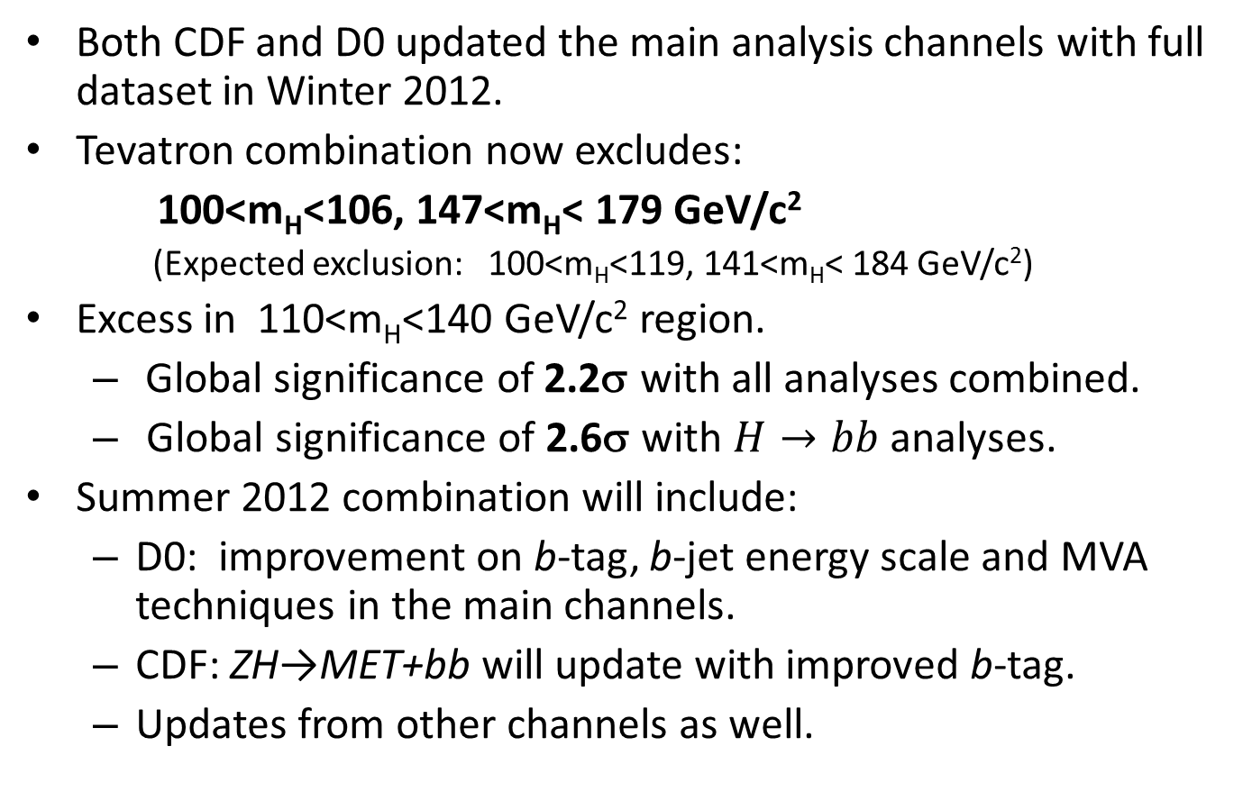
Summary
Both CDF and D0 updated the main analysis channels with full dataset in Winter 2012.
Tevatron combination now excludes:
100<m_{H}<106, 147<m_{H}< 179 GeV/c²
(Expected exclusion: 100<m_{H}<119, 141<m_{H}< 184 GeV/c²)
Excess in 110<m_{H}<140 GeV/c² region.
  Global significance of 2.2σ with all analyses combined.
  Global significance of 2.6σ with $H→bb$ analyses.
Summer 2012 combination will include:
  D0: improvement on b-tag, b-jet energy scale and MVA techniques in the main channels.
  CDF: ZH→MET+bb will update with improved b-tag.
  Updates from other channels as well.

Slide 24
Backup

Slide 25
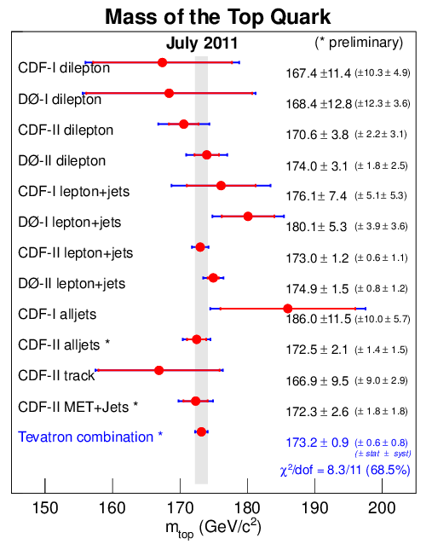
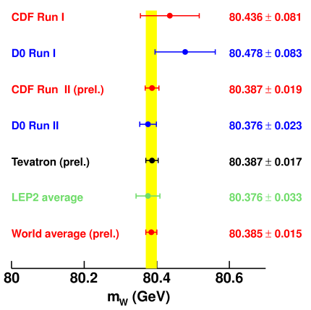
Constraints on Higgs Mass (1)
Mass of W Boson (World Average):
  Before Tevatron Run II：
  m_{W}=80.426±0.034 GeV/c²
  With Tevatron Run II results：
  m_{W}=80.385±0.015 GeV/c²
！
Mass of Top Quark (World Average):
Tevatron Run I result：
m_{top} = 178.0 ± 4.3 GeV/c²
With Tevatron Run II results：
m_{top} = 173.2 ± 0.9 GeV/c²
誤差が1/5になった！

Slide 26
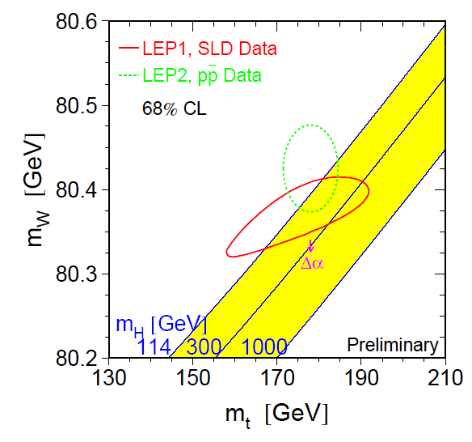
Constraint on Higgs Mass (2)
Spring 2004
  M_{higgs} < 152 GeV/c² （95% CL) .
  ….was M_{higgs} < 251 GeV/c² (95% CL) in Spring 2004.

Slide 27

CDF and D0 analyses

Slide 28

Sensitivity of Analysis Channels (CDF)

Slide 29


Neural Net b-jet energy correction (CDF)
A neural net was trained using b-jets in $H→bb$Monte Carlo events to return a scale factor for jet energy.

Slide 30


CDF: ZH→llbb
Electron channels
Here we observe a significant change
Summer 2011
Winter 2012

Slide 31


CDF: ZH→llbb
Examine top 20 events in both channels based on S/B of the discriminant bin in which it’s located
The electron channel contains 12 new candidates within this high score region, while muon channel has 5

Slide 32

CDF: ZH→llbb
To study the effect of high S/B events on our observed limits, we remove our best new and best two new events from the e⁺e⁻ channel and re-run the limits
Gives one sigma level changes in the limits at 120 GeV/c²

Slide 33





D0: $H→l^{+}l^{−}+MET$ Channel

Slide 34


LLR of Tevatron Combination
$$LLR=−2ln\frac{p\left(data;s+b\right)}{p(data;b)}$$

Slide 35


Tevatron: Signal Injection Study
With 125 GeV signal, we expect a broad excess over the entire mass region.
Consistent with SM signal plus background hypothesis over Higgs mass range from 110 to 140 GeV/c²

Slide 36






$H→bb$ Channel by Channel (CDF,D0)

Slide 37




By Decay Mode (CDF, D0)

Slide 38






CDF H->WW OS channels
Channels with oppositely charged dileptons.
0jet: 1jet 2jet

Slide 39




$H→bb$ (CDF+D0)

Slide 40

CDF H→bb Signal Injection study
Because our neural network discriminants are optimized for separation of signal and background rather than mass reconstruction, we expect to observe (in the presence signal) higher than expected observed limits over a broad mass range .

Slide 41




$H→WW$ (CDF+D0)

Slide 42




CDF combination plots

Slide 43


D0 combination plots

