Slide 1
Multi-jets, jet shapes, substructure and radiation between jets in ATLAS
Karina F. Loureiro on behalf of the ATLAS Collaboration
SM@LHC2012 - Copenhagen

Slide 2
Outline
Motivation
QCD jets
Multi-jets
Jet shapes
Jet substructure
Jet radiation
What has been achieved and what’s next… (application to physics analyses)
Conclusions
Ample room for discussion

Slide 3
Motivation
To ascertain how close LO and NLO pQCD calculations are to the real measurements
To find out how MC generators fare when compared to data
To explore jet properties to be able to:
  distinguish between two- and three- body particle decay from quark- and gluon- initiated jets
  take advantage of the fact that jets coming from boosted particles exhibit different properties than quark- and gluon- initiated jets

Slide 4
QCD Jets
General Issues

Slide 5
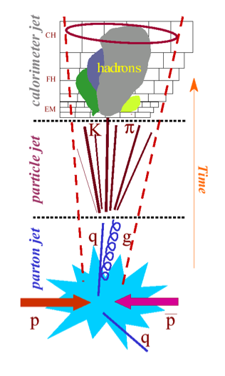
QCD Jets
What is a jet?
  As far as the analysis is concerned it is a complex object that represents a collection of final state particles
It is “classified” in 3 levels: partons (pQCD), hadrons (npQCD) and detector jets
In theory, we need npQCD but we stop here because it is the actual final state in nature so this will always be what we can measure
To our disappointment theory has trouble calculating it ☹
Notes:
Unfortunately we cannot go back to the parton level, it is not THERE experimentally so we need to devise ways of being able to peer into the structure of our final hadronic objects
We see clusters of energy in calo and tracks in ID
slide 5 bullet 2 & 3 I would say the point is that in the theory you need npQCD, but the reason we stop here is that this is the actual final state in nature, so it will always be what we can physically measure. The disappointment is that theory has trouble calculating it.

Slide 6
Multi-jets
Measurements: multi-jet cross-section, differential cross-section and σ(n)/σ(n-1) with 2.4 pb⁻¹

Slide 7
Multi-jets
Provide QCD testing @ hadron colliders
Are Background for many new particles and new interaction searches
  Systematic uncertainties contributing to multi-jet cross sections measurements carry over into searches
Allow us to evaluate robustness and validity of LO and NLO pQCD calculations
Notes:
LO pQCD: how robust are these calculations in representing the high jet multiplicity events. (events with up to 6 jets in the final state are studied)
NLO pQCD: comparison between three-jet events w.r.t. two-jet events, because there is no 4 jet NLO pQCD prediction at this moment available!!!!
2010 data but not enough

Slide 8
Multi-jets Measurements
Eur.Phys. J.C (2011) 71:1763
Total Inclusive Jet Cross Section
The MC simulation predictions agree with the measured results across the full inclusive multiplicity spectrum. The systematics are dominated by the JES uncertainty and range from 10-20% at low multiplicities and 30-40% at high ones.
Ratio σ(n)/σ(n-1)
This ratio reduces the impact of the systematic uncertainties (jet energy scale) since the uncertainty due to luminosity cancels out.
Differential Jet Cross Section
This measurement as a function of jet p_{T} serves as a characterization of the kinematic features. The comparison reveals significant differences between the LO calculations and the measurements.
Next
1
2
3
Notes:
Goal of the study: test the performance of the different LO MC simulations so that they can be used to estimate multi-jet backgrounds for new particle searches.
For these reason, the leading MC predictions are ALL normalized to the measured inclusive two-jet cross section and then used for shape comparisons.
Zoom version of the plots!!!
Out of all of the normalization factors used to match the MC to the inclusive two-jet cross section, SHERPA is the one closest to unity!!! (Page 10 of Eur. Phys. J.C (2011) 71:1763
Ratio: both the uncertainties in the data correction for efficiencies and resolutions and the jet energy scale contribute comparably to the total systematic uncertainty, whereas the statistical uncertainties are smaller than the systematic ones and negligible in most bins.

Slide 9
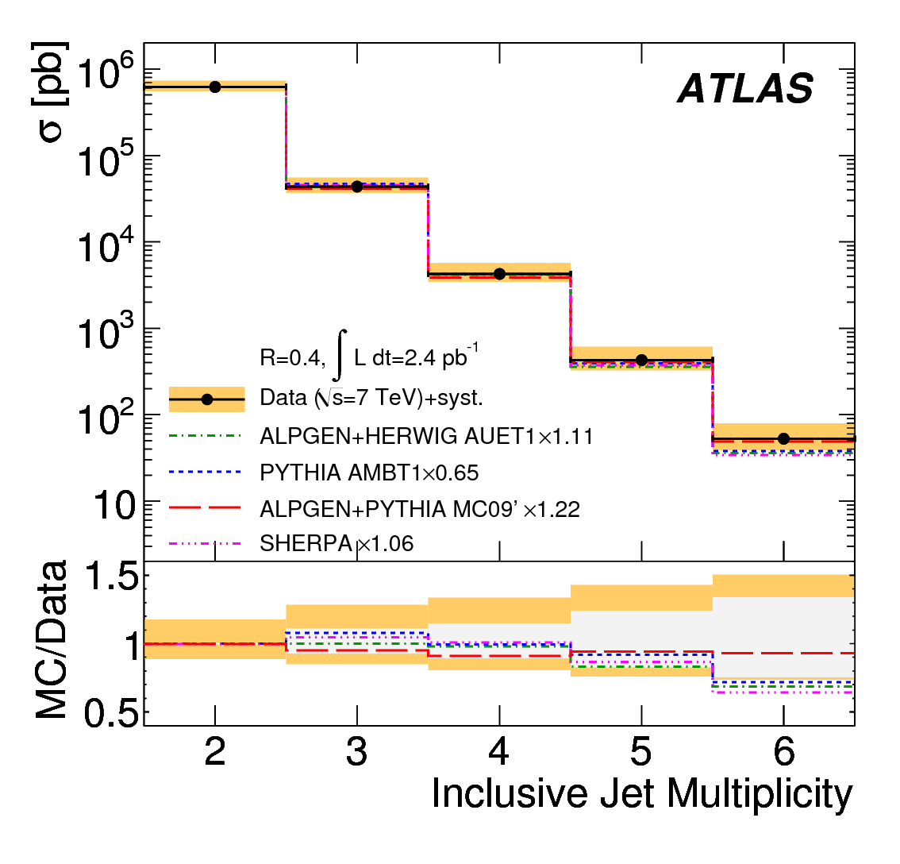
Total Inclusive Jet Cross-Section

Slide 10
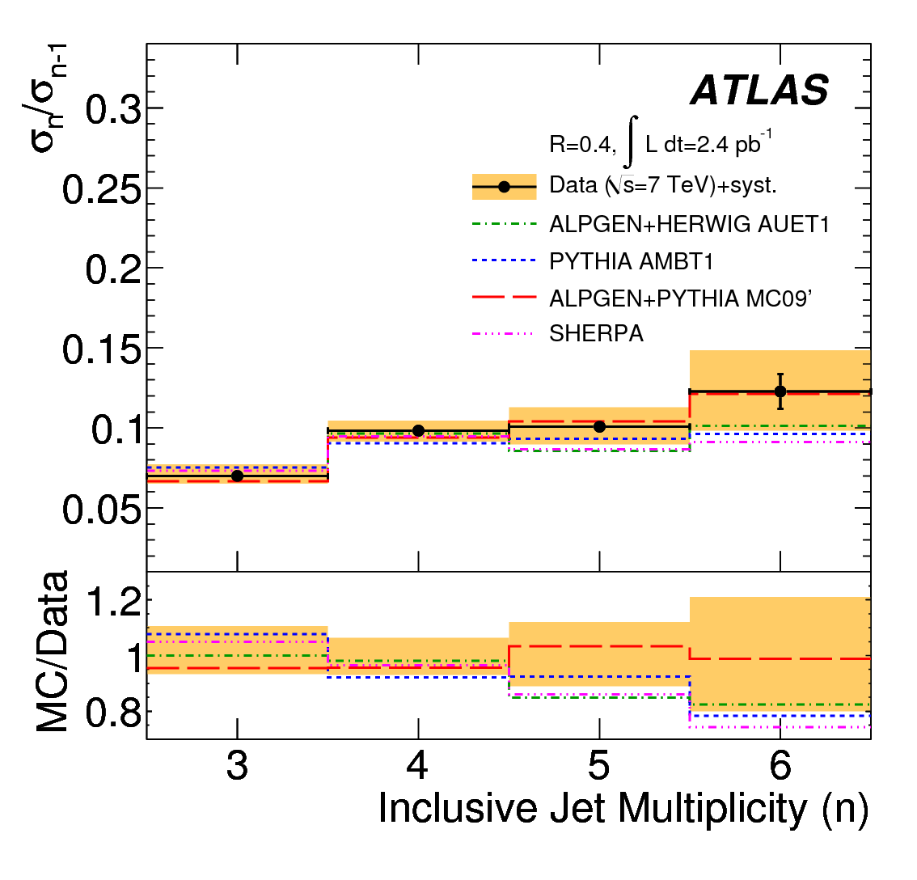
Ratio σ(n)/σ(n-1)

Slide 11
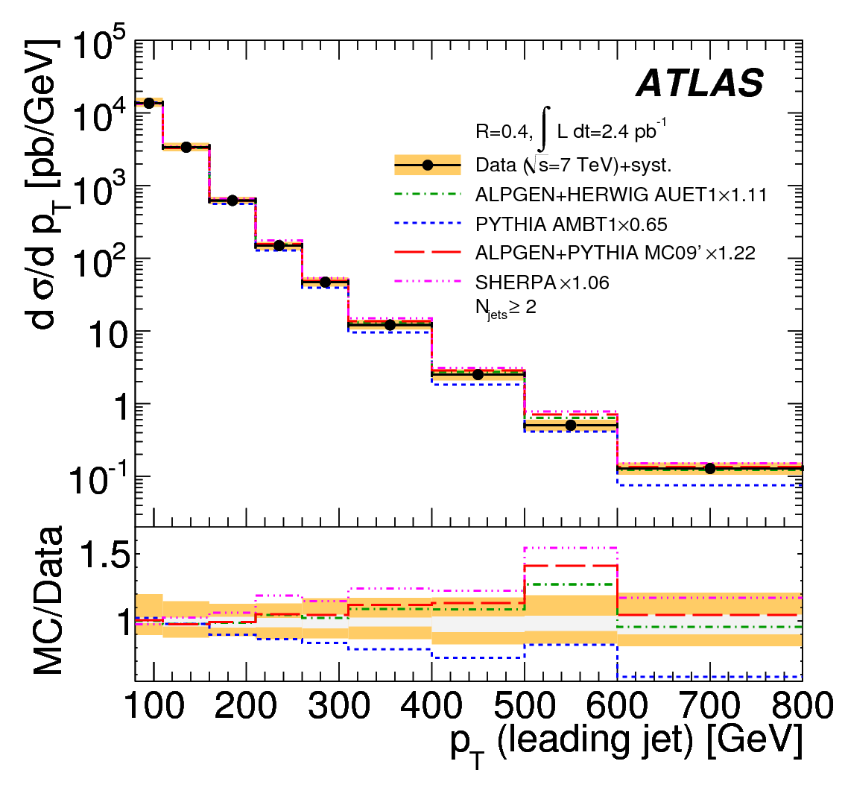
Differential Jet Cross -Section

Slide 12
Multi-jets: Uncertainties of the Measurement
Monte Carlo derived correction factors for efficiencies and resolution
Luminosity calculation
Jet energy scale - Dominant
  Evaluated on isolated jets – Largest component (between 5% at 60GeV and 2.5% at 1 TeV)
  Due to “Flavor response” – At most 3.5%
  Due to jets with nearby activity – At most 1.0%
Due to contamination from a nearby soft jet accounted within the offset correction.
Notes:
Monte Carlo derived…: the correction accounts for trigger inefficiencies, detector resolution and other detector effects that affect jet counting. It is performed in a single step using a bin-by-bin multiplicative factor calculated from the MC simulations. For each measured distribution, the corresponding MC simulation cross-section using truth jets is evaluated in the relevant bins, along with the same distributions obtained after detector simulation and cuts. The ratio of the true to the simulated distribution provides the multiplicative correction factor that is applied to the measured distributions. There is also an uncertainty in the correction factors and it is added in quadrature.
JES: it has been determined for jets within a dijet sample without nearby activity in the calorimeter. For a multi-jet analysis, additional systematic uncertainties on the scale need to be considered. These uncertainties arise from the difference in the calorimeter response to jets of different flavors as well as the impact of the presence of nearby activity in the calorimeter. CHECK JES FLAVOR – STEPHANIE ADOMEIT ???

Slide 13
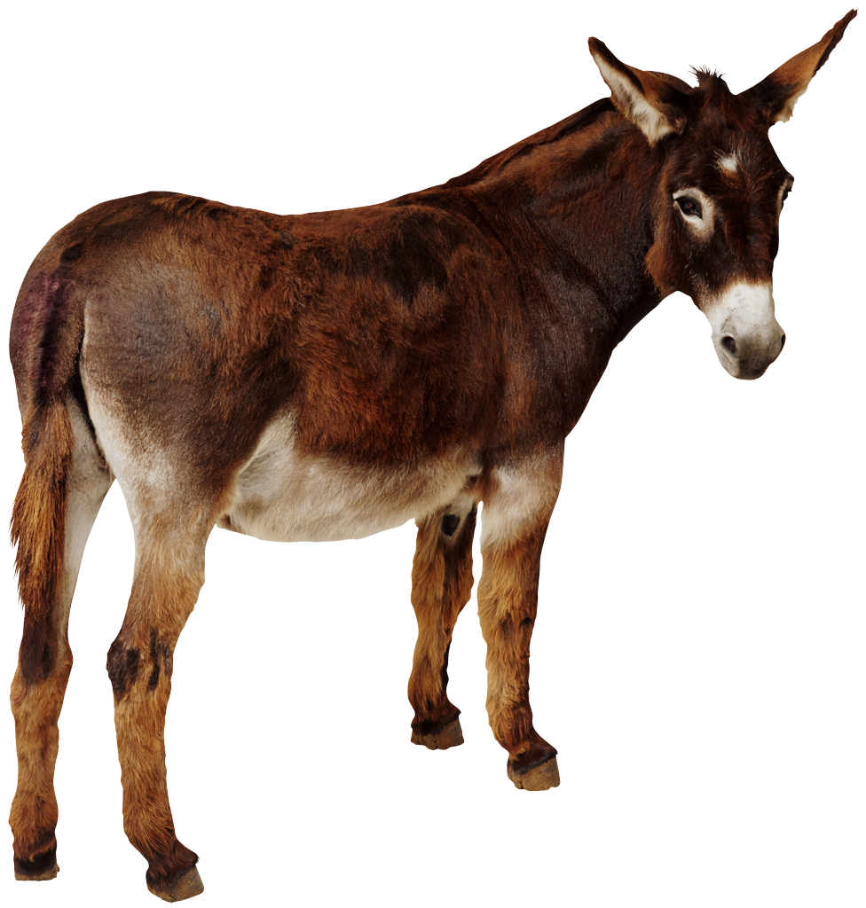




Multi-jets: Interim Summary
All MC simulations agree reasonable well with the data.
Most ALPGEN MC simulations predict an inclusive multi-jet cross section similar to the measured one
The normalization factor for SHERPA is the closest to unity
The n to n-1 cross section ratio as a function of the jet multiplicity reduces significantly the impact of the jet energy scale uncertainty
The three-to-two jet differential cross-section as a function of a well chosen variable (i.e. leading jet p_{T}) can be used since the systematic uncertainties on the measurement are small
To update the study manpower is needed

Slide 14
Jet Shapes
Measurement: differential and integrated jet shapes

Slide 15
Jet Shapes
Provide information about the details of the parton-to-jet fragmentation process by studying the internal structure of the jet
  The internal structure of sufficiently energetic jets is mainly dictated by the emission of multiple gluons from the primary parton
  The shape of the jet depends on the type of partons (quark or gluon) that give rise to jets in the final state
  The shape is sensitive to non perturbative fragmentation effects and underlying event contributions
Are useful tools for new physics searches with highly boosted particles in the final state decaying to multiple jets

Slide 16
Jet Shapes: Definition
Phys. Rev. D83, 052003 (2011)
Differential jet shape
Integrated jet shape
p_{T}(r₁,r₂) : summed p_{T} of the clusters in the annulus between radii r₁ and r₂
N^{jet} : number of jets
R = 0.6, Δr = 0.1,
Notes:
The same definitions apply to simulated calorimeter clusters and final-state particles in the MC generated events to define the differential and integrated jet shapes. The measurements are preformed in different regions of jet pt and rapidity and a minimum of 100 jets in data are required in each region to limit the statistical fluctuations of the measured values.
The points from the differential jet shap at different r values are correlated since by definition Sum (0,R) rho(r) DeltaR = 1
The study uses uncorrected energy clusters in the calorimeter associated with the jet!!!!
Average fraction of jet pt that lies within the annulus or the integrated surface!!!!

Slide 17
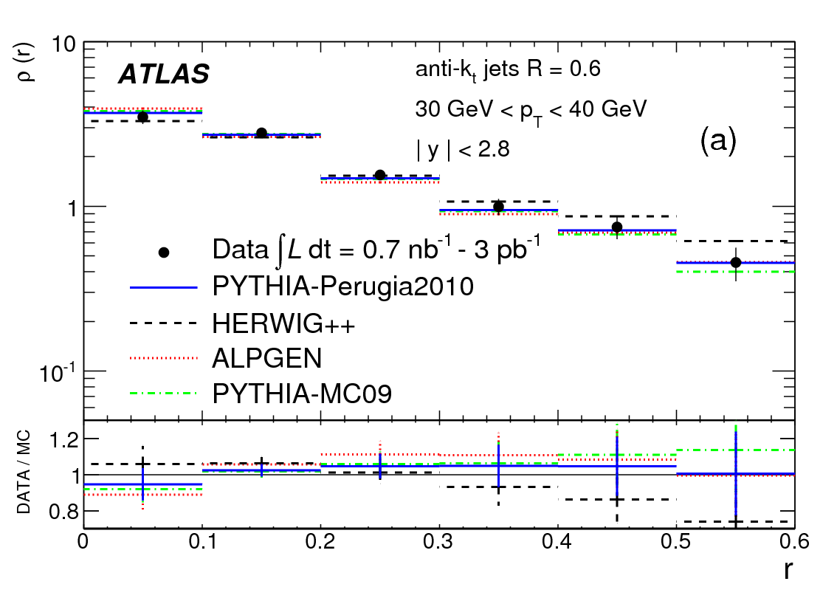
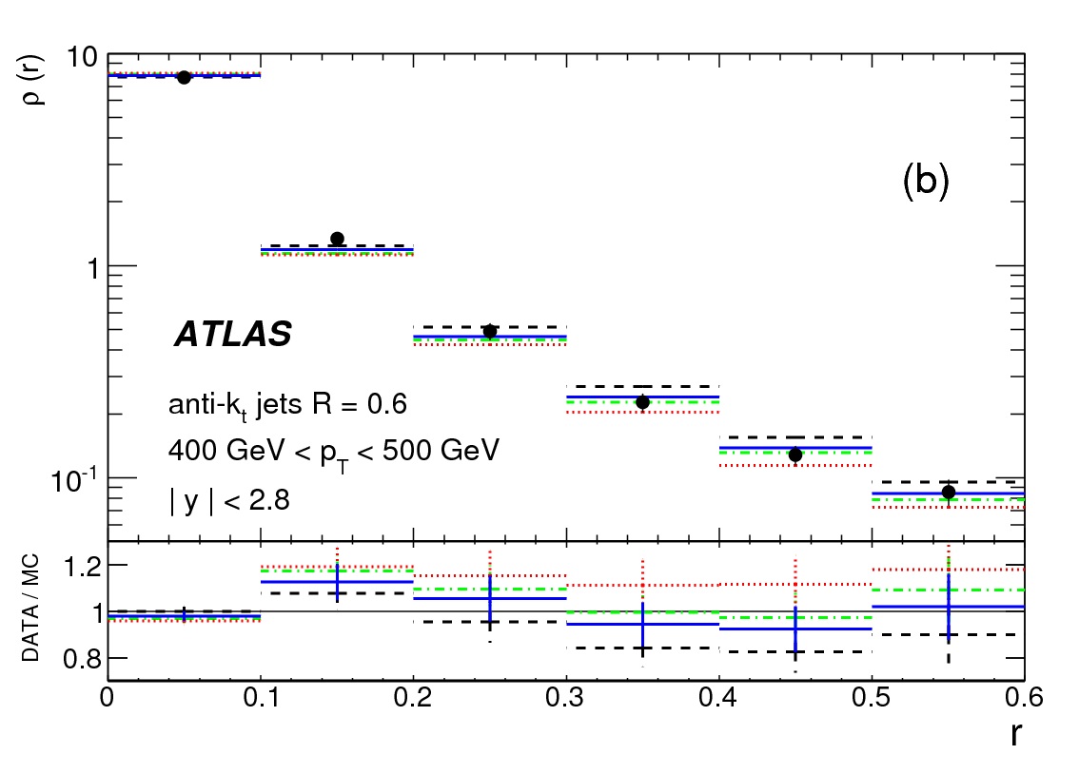
Jet Shapes Measurements : ρ(r)
Phys. Rev. D83, 052003 (2011)
ρ(r), 30 GeV < p_{T} < 40 GeV
ρ(r), 400 GeV < p_{T} < 500 GeV
Differential anti-k_{t} R=0.6 jet shape densities – per annulus – demonstrate clear jet-like structure (dense core and diffuse periphery)
Different Monte Carlo generators show varying levels of agreement
PYTHIA Perugia2010 tune describes the data very well
Notes:
The dominant peak at small r indicates that the majority of jet momentum is concentrated close to the jet axis. At low pT, more than 80% of the transverse momentum is contained within a cone of radius r = 0.3 around the jet direction. This fraction increases up to 95% at very high pT, showing that jets become narrower as pT increases.
This can also be seen on the next page, where the measured 1 – Psi(r=0.3) , the fraction of the jet transverse momentum outside a fixed radius r=0.3 decreases as a function of pT.

Slide 18
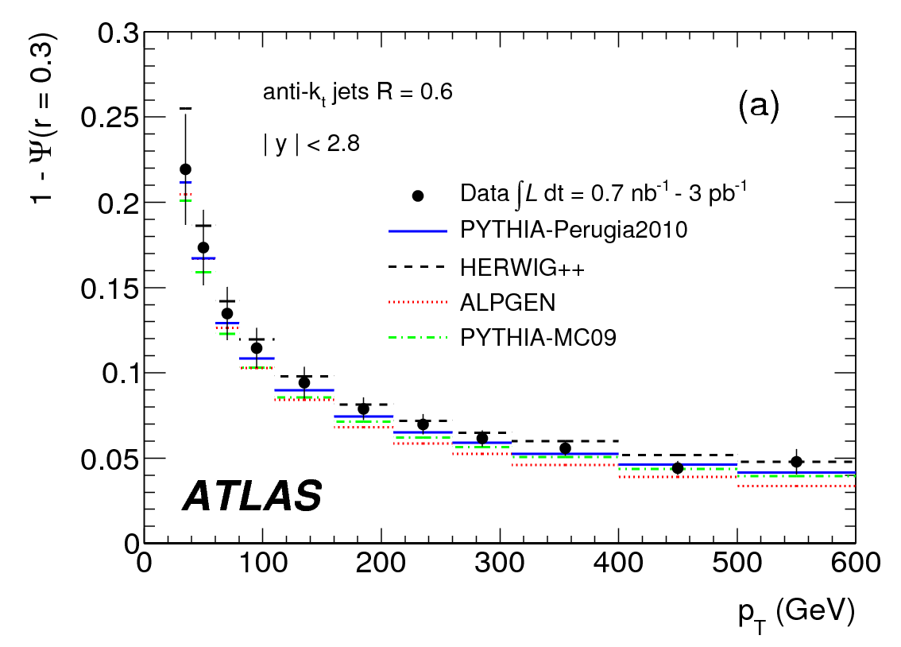
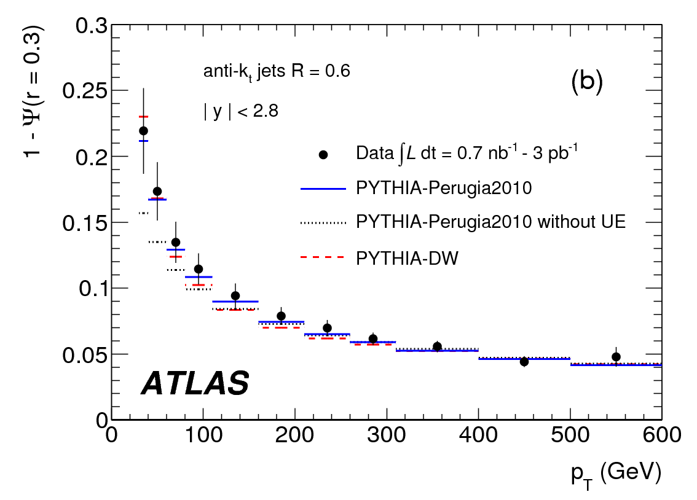
Jet Shapes: 1 - Ψ(r=0.3)
Phys. Rev. D83, 052003 (2011)
Data & MC comparisons with UE
Data & MC comparisons without UE
Ψ(r=r₀) represents the integrated energy within a given cone
1-Ψ(r=0.3) represents the energy outside the core of the jet
Consistently see that most standard MC tunes (ALPGEN, PYTHIA) underestimate the amount of soft, wide-angle contributions to the jet
The dominant uncertainty of the measurement is the absolute energy scale of the individual clusters belonging to the jet – 3% to 5% as r increases

Slide 19
Jet Shapes: Interim Summary
Measured jets become narrower as the jet transverse momentum and rapidity increase, showing a mild |y| dependence
PYTHIA-Perugia2010 describes de data reasonably well
PYTHIA-Perugia2010 with UE contribution and ALPGEN show largest discrepancies w.r.t. the data in the low p_{T} region (p_{T} < 160 GeV)
HERWIG++ predicts jets slightly broader than the data, while ALPGEN interfaced with HERWIG and JIMMY, PYTHIA-DW and PYTHIA-MC09 all predict jets narrower than the data
Jet shape measurements show the potential to constrain the current phenomenological models for soft gluon radiation, UE activity, and non-perturbative fragmentation processes in the final state

Slide 20
Jet Mass and Substructure
Measurement: jet mass, splitting scale, N-subjettiness, width, eccentricity, planar flow and angularity, cross section as function of observables

Slide 21
Jet Substructure
In addition to the jet mass, these variables allow for the exploration of the internal substructure of jets as composite objects
Given a sufficiently large boost, the resulting hadrons can be clustered into a single collimated jet
  Substructure studies offer a technique to disentangle these particular jets from the overall jet background (i.e. boosted object vs. quark- or gluon-initiated jet)
The largest systematic uncertainty is the modeling of the calorimeter response since the analysis uses jet algorithms with larger R-parameters

Slide 22
Jet Substructure: Elements
Jet algorithms
Jet splitting and filtering
Splitting scales
N-subjettiness
Jet mass, with, eccentricity, angularity, planar flow.
Notes:
More detail

Slide 23
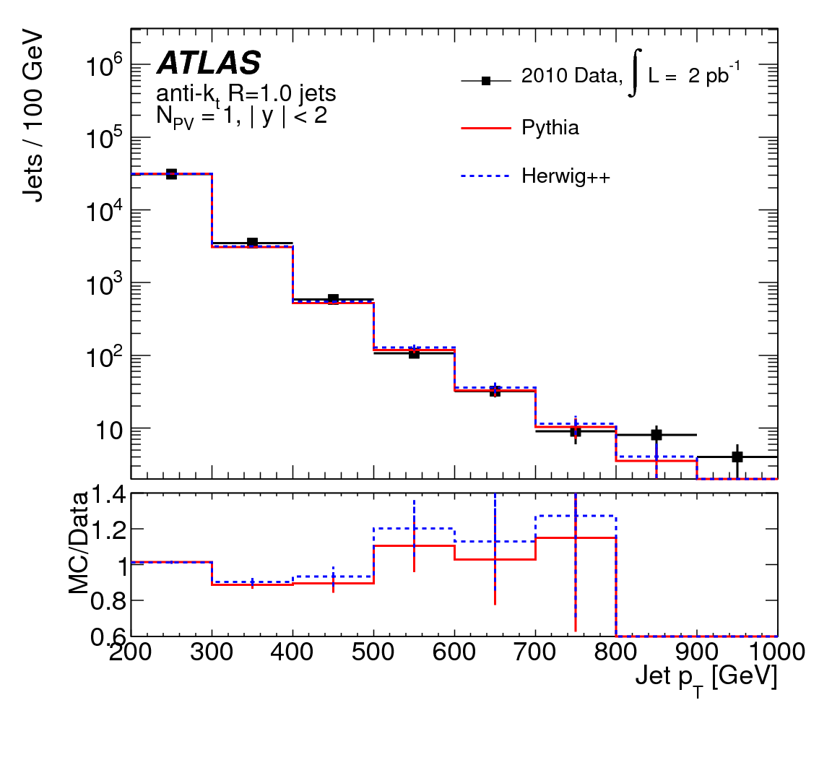
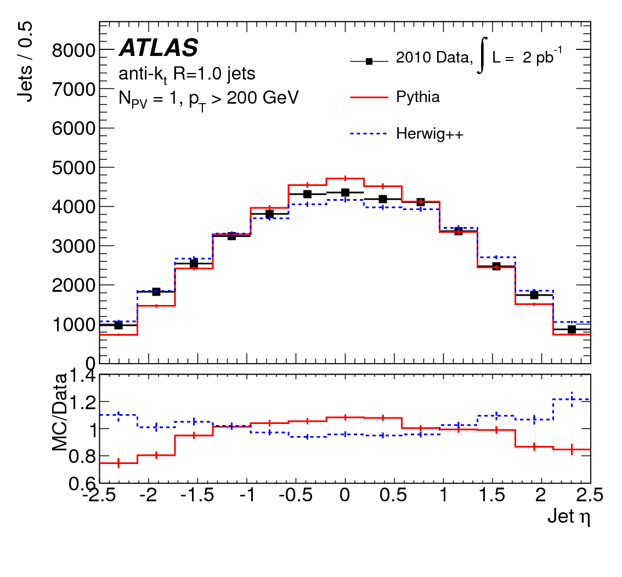
Jet Substructure: Jet Algorithms
CERN-PH-EP-2012-031
Anti-k_{t} (R= 1.0) and Cambridge-Aachen (R=1.2) are infrared and collinear safe
Anti k_{t} jet p_{T}
Anti k_{t} jet η
Notes:
The composition of jets is a recombination of constituents using four-vector addition. Jets in the real or simulated detector are constructed from clusters of energy deposited in the calorimeter. Jets in the “true” final state, or “hadron” level are defined as jets made from all particles with a proper lifetime longer than 10ps, including neutrinos.
Back up slide on algorithms
Before splitting and filtering!!! Differences in the high pt bins, but that is expected
Shape wise, ok

Slide 24
Jet Substructure: Splitting & Filtering
To identify relatively hard, symmetric splittings in a jet that contribute significantly to the jet’s invariant mass
To search for jets (j₁ and j₂: low mass objects) within a jet (j: more massive object) via an iterative process that splits the original jet into sub-jets whose four-momenta are added to redefine the new jet
  The splitting is controlled by two parameters of the iterative algorithm (μ= 0.67 and υ=0.09)
Notes:
The parameters of the procedure are tuned to maximize sensitivity to an SM Higgs boson decaying to bbbar, but it is suitable generally for two-body decay processes.
The mu cut attempts to identify a hard substructure in the distribution of energy in the jet, which would imply the decay of a heavy particle. The cut on nu further helps by suppressing very asymmetric decays of the type favoured by splittings of quarks and gluons.

Slide 25
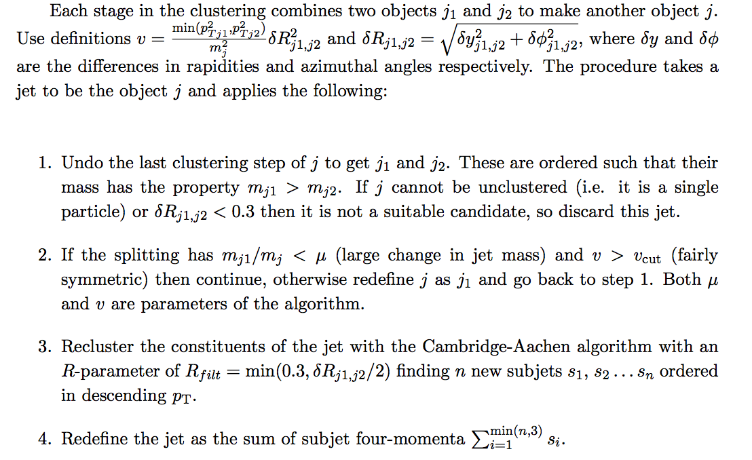
Jet Substructure: Splitting & Filtering (2)
CERN-PH-EP-2012-031
Notes:
There is a modification of the procedure where δRj1j2 cut is added, this cut is added because with current techniques the correction for detector resolution at angular scales below 0.3 is not well controlled.
Steps 3 and 4 filter out some of the particles in the candidate jet, the aim being to retain particles relevant to the hard process reducing the contributions from underlying event and pile-up.
The new jet from step 4 has a pt and mass less than or equal to those of the original jet.

Slide 26
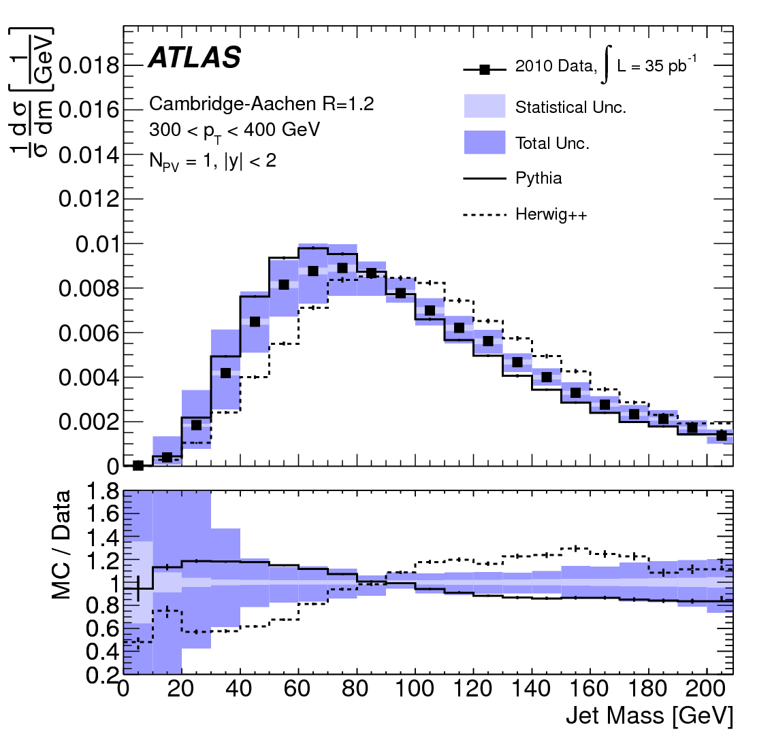
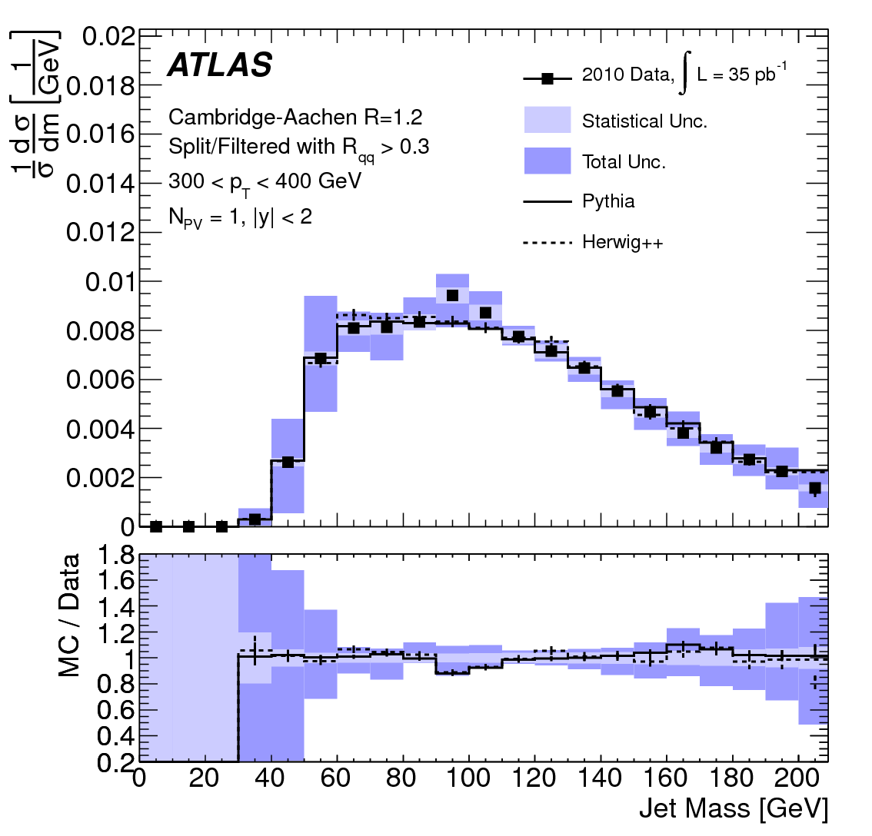
Jet Substructure: Differential Cross section after Splitting & Filtering
Before Splitting & Filtering
After Splitting & Filtering
Notes:
Even though there is a significant reduction on the statistics, the agreement is quite promising

Slide 27
Jet Substructure: k_{t} Splitting scales (Sqrt[d_{ij}])
The splitting scale represents the kinematic threshold at which a jet can be broken into sub-components. It is the level at which structure begins to form
The k_{t}-distance of the final clustering step is used to define the splitting scale variable:
Can be used to distinguish heavy particle decays (more symmetric ~ m/2) from asymmetric splittings of quarks and gluons (~ p_{T}/10)

Slide 28
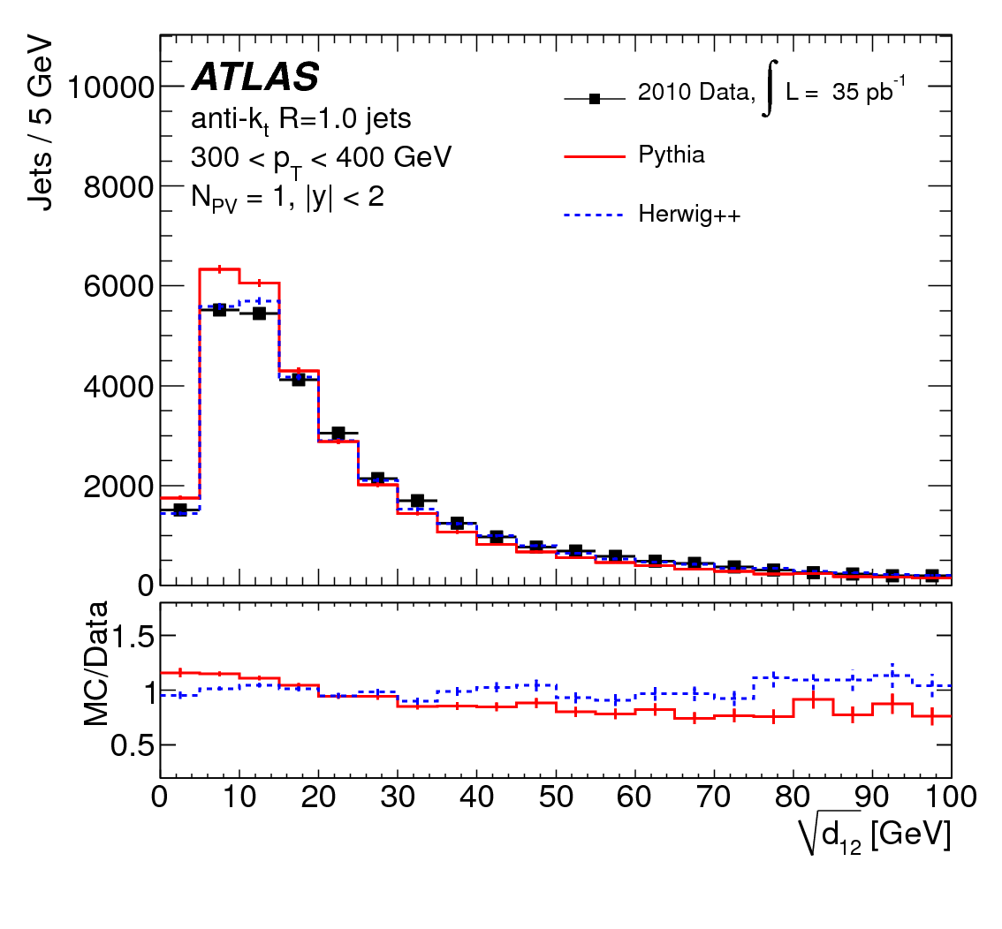
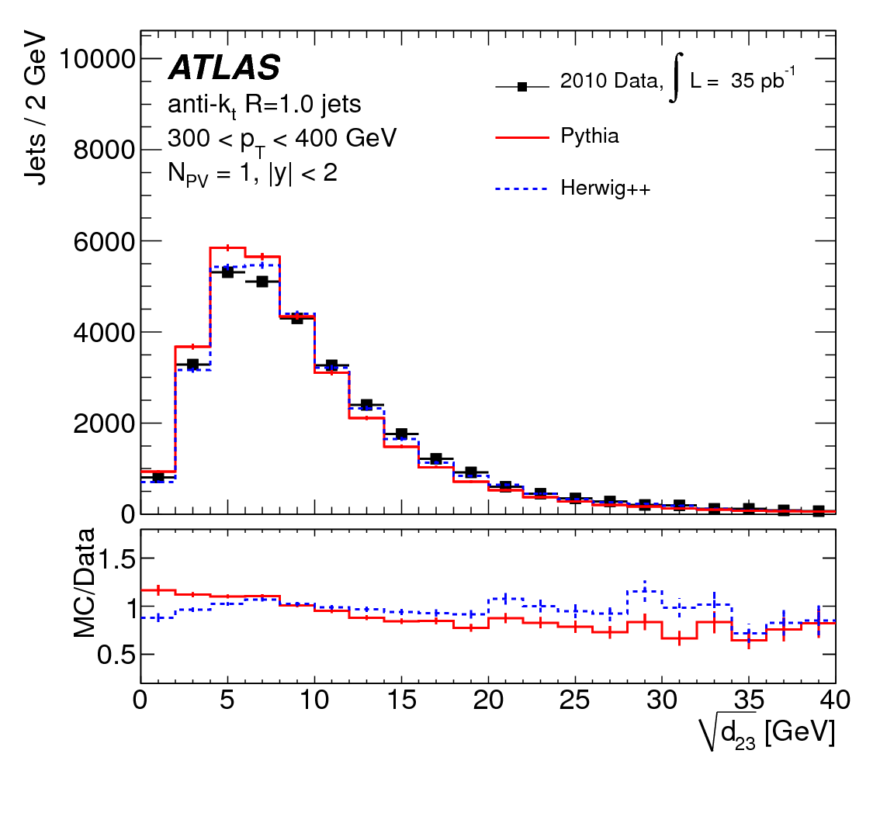
Jet Substructure: k_{t} Splitting Scale (2)
Corrected to the particle level for detector effects
Expected to be significantly different between signal and background for boosted objects
Fairly well described by MC and detector simulation
Notes:
????

Slide 29
Jet Substructure: N-subjettiness
Measures the degree to which radiation within a jet is aligned along the N candidate subjet axes
Estimates number of N different subjets within a given jet
The ratios τ₂₁ = τ₂/τ₁ and τ₃₂ = τ₃/τ₂ provide excellent discrimination for hadronic decays of W-bosons and boosted top quarks
Notes:
It is calculated by clustering the constituents for the jet with the kt algorithm an requiring that N subjets be found. The N subjets define axes within the jet around which the jet constituents are concentrated. For two to three body decays, the ratios τ2/τ1 and τ3/τ2 have been shownto provide excellent discrimination for hadronic decays of W-bosons and boosted top quarks.

Slide 30
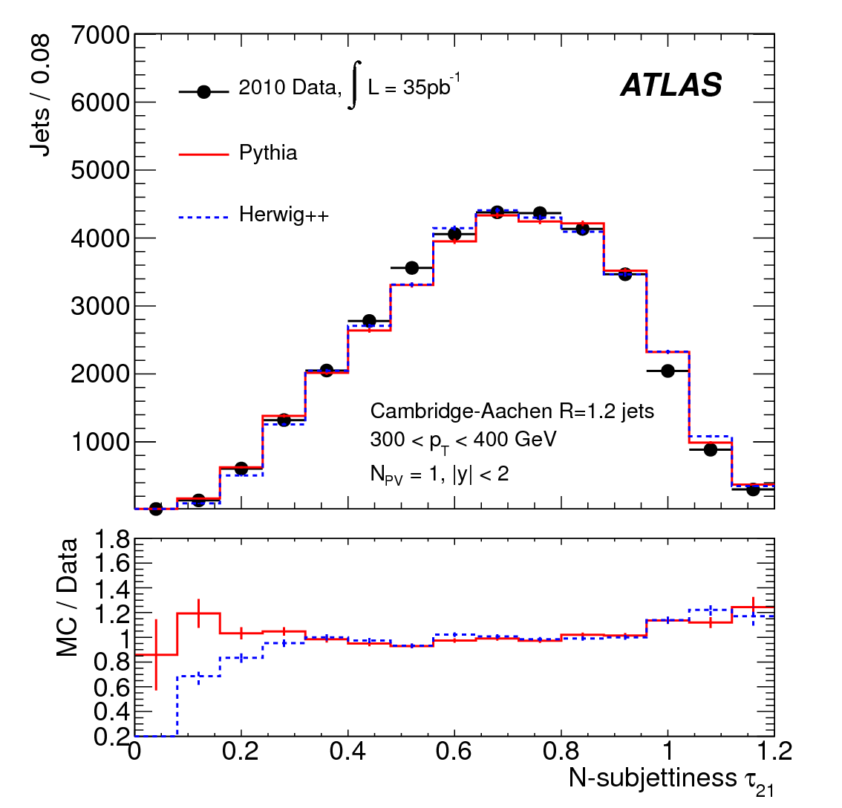
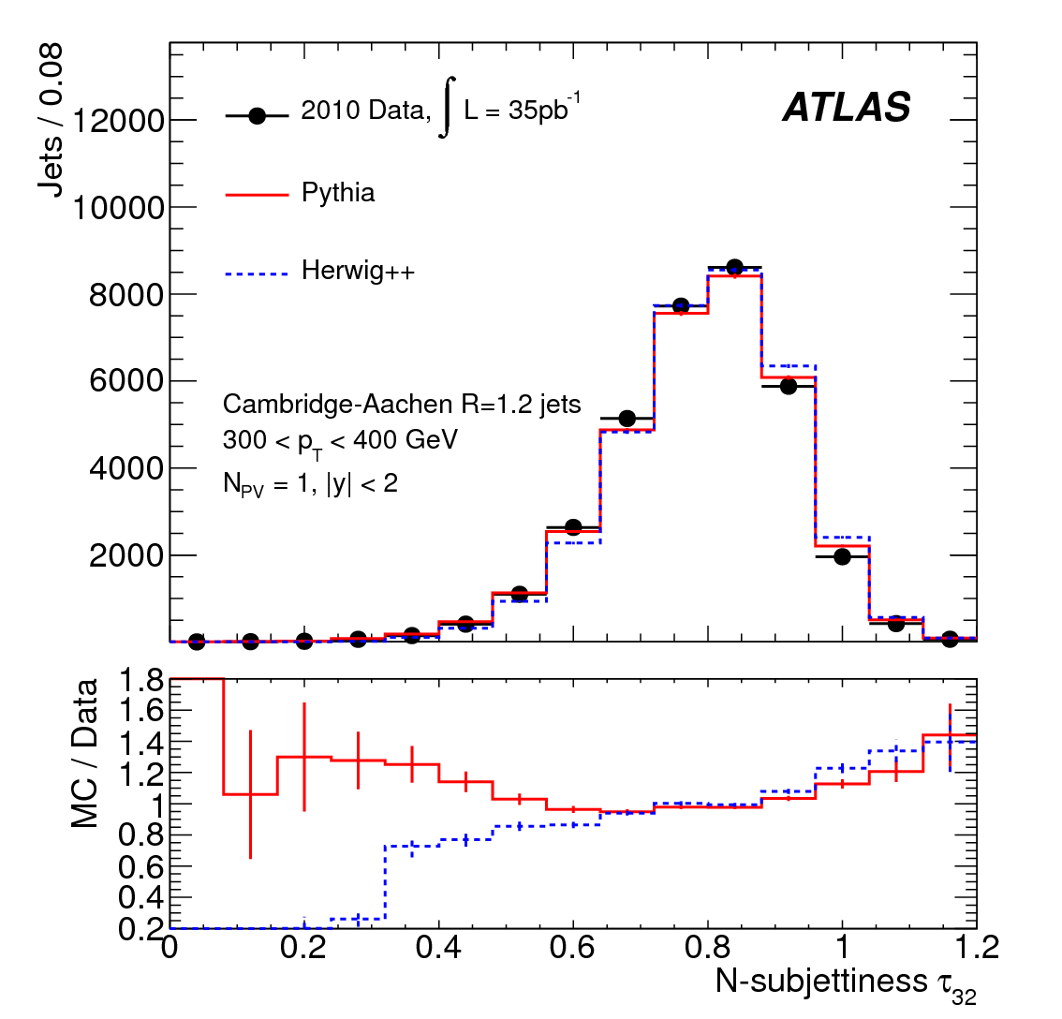
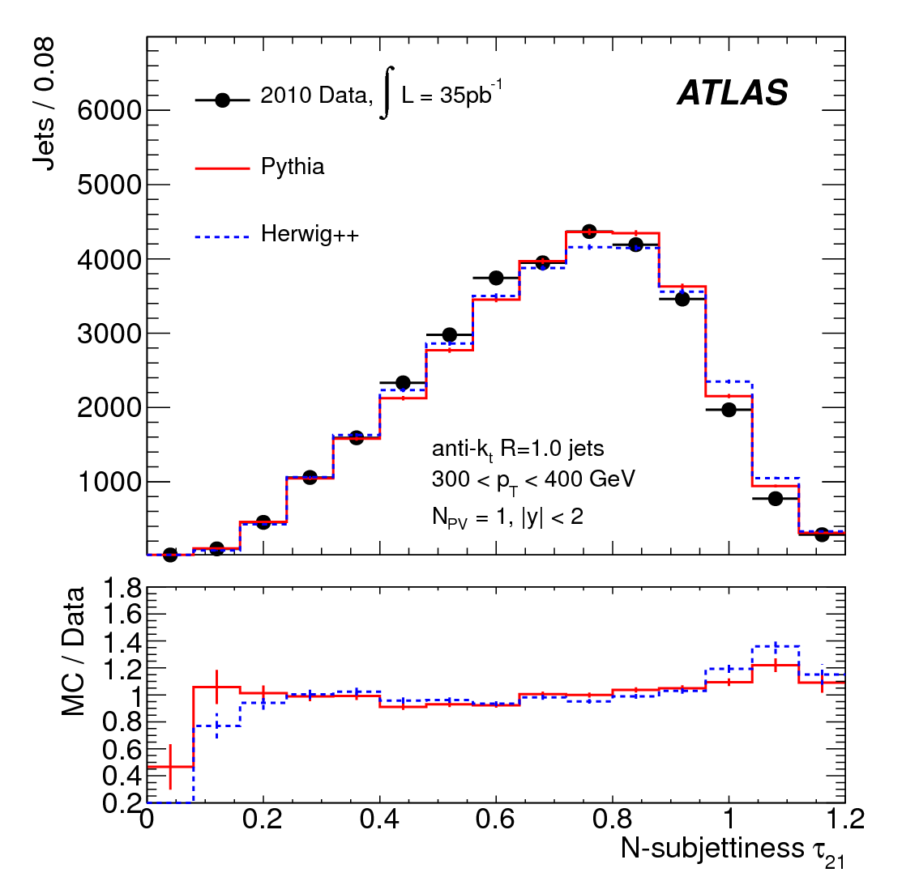
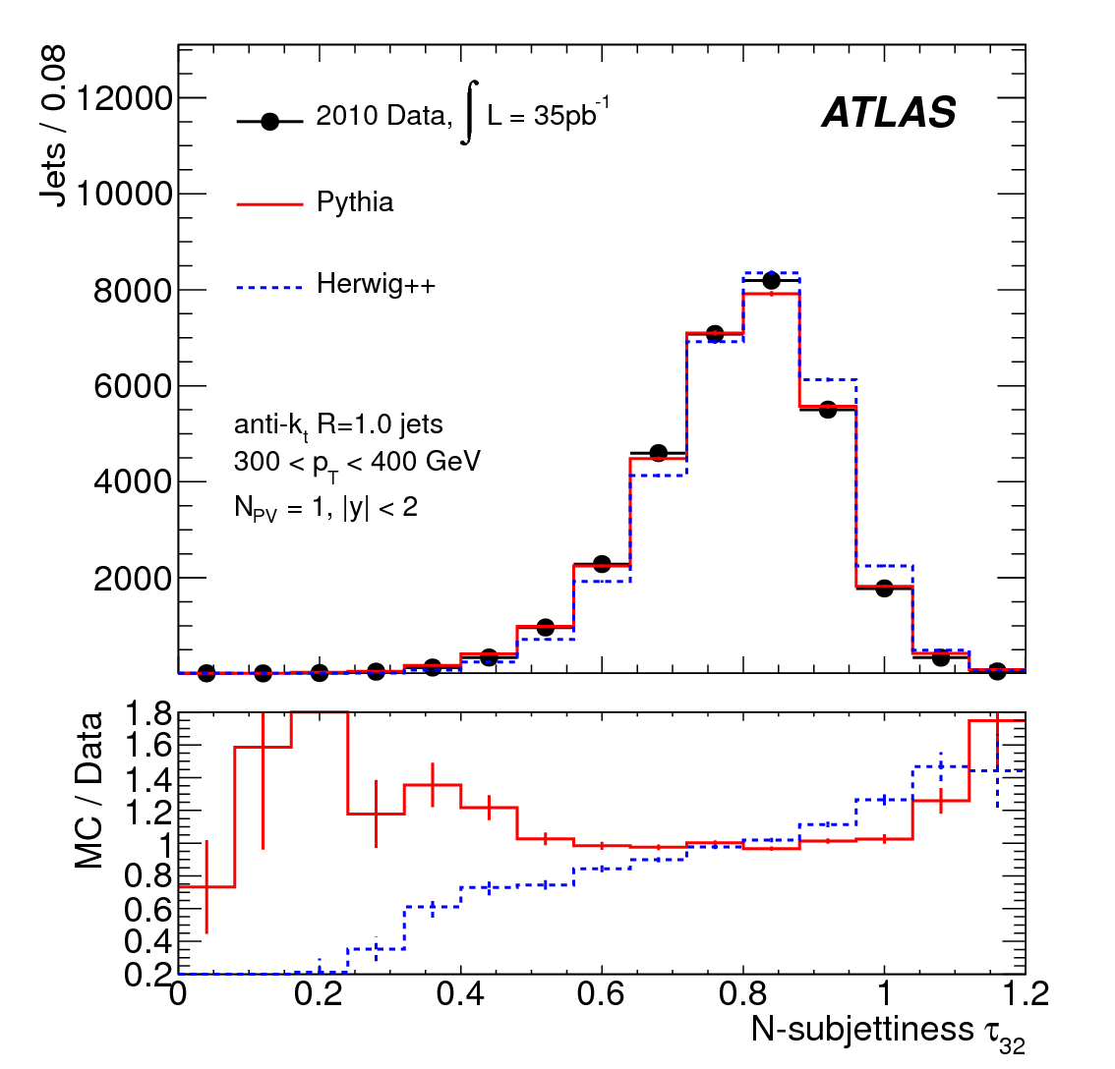
Jet Substructure: N-subjettiness (2)
Cambridge-Aachen τ₂₁
Cambridge-Aachen τ₃₂
Anti k_{t} τ₂₁
Anti k_{t} τ₃₂

Slide 31
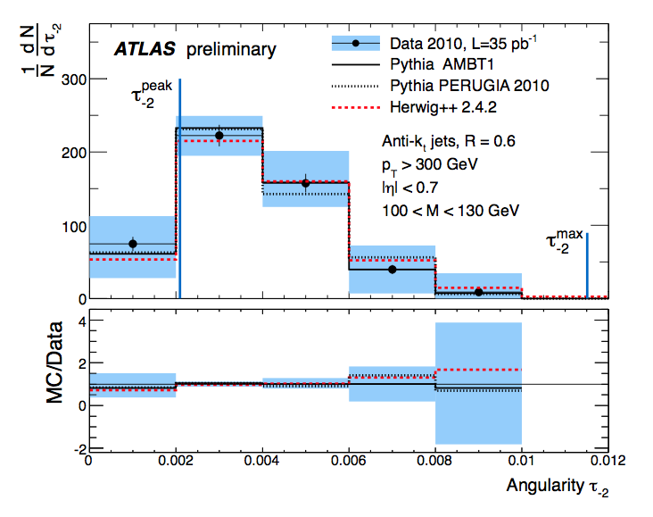
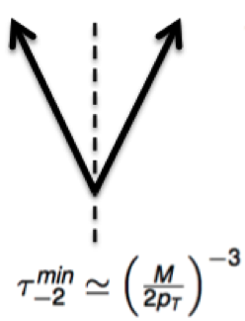
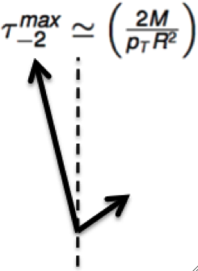
Jet Substructure: Angularity
NEW!!!
Sensitive to degree of symmetry in the energy flow inside the jet
It presents characteristic distributions for two-body decays
IR safe for a ≤ 2, the analysis uses a = -2
Small angle approximation
ATLAS-CONF-2012-044
Notes:
The τ-2 observable can be used as a discriminator in distinguishing QCD jets from boosted particle decays by virtue of the broader tail expected in the QCD distribution.
At a given high mass, the angularity of jets with two-body kinematics should peak around a minimum value of (M/2 p_{T})^{1-a} this corresponds to two hard constituents being in a symmetric pt configuration around the jet axis.

Slide 32
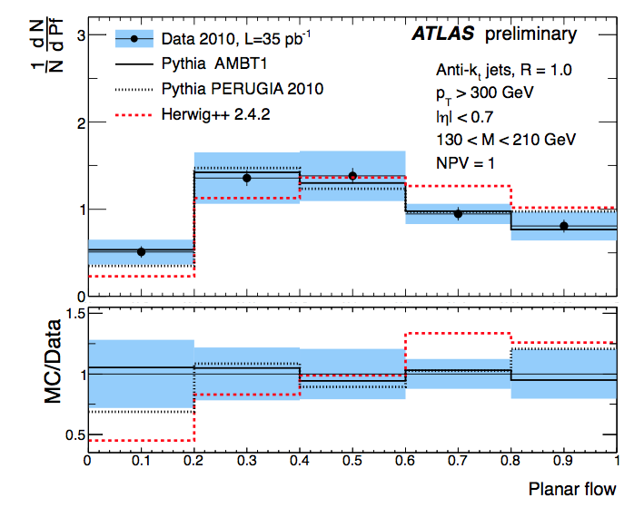
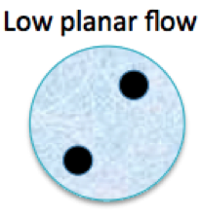
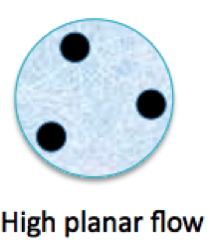
Jet Substructure: Planar Flow
NEW!!!
Measures the degree with which the jet’s energy is evenly spread over the plane across the face of the jet (high planar flow) versus spread linearly across the face of the jet (small planar flow)
Discriminates between two-body and many-body decays
Complementary to eccentricity
Vanishing or low planar flow ➔ linear energy deposition (i.e. two-pronged decay)
Unit planar flow ➔ isotropic distribution (characteristic of QCD jets)
ATLAS-CONF-2012-044
Notes:
For large jet masses (>= 100 GeV) is largerly independent of the jet mass
In this analysis the planar flow distributions are measured in the context of boosted particle searches by applying a mass cut (130 < M < 210 GeV) consistent with the window in which one would expect to observed a boosted top quark decay collimated within a single jet
Data are well described by PYTHIA AMBT1 tune, while HERWIG++ predicts more isotropic energy flow

Slide 33
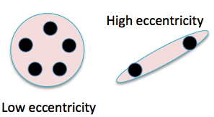
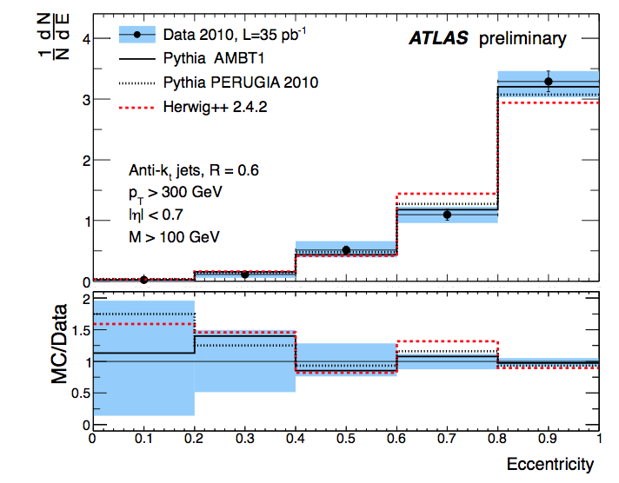
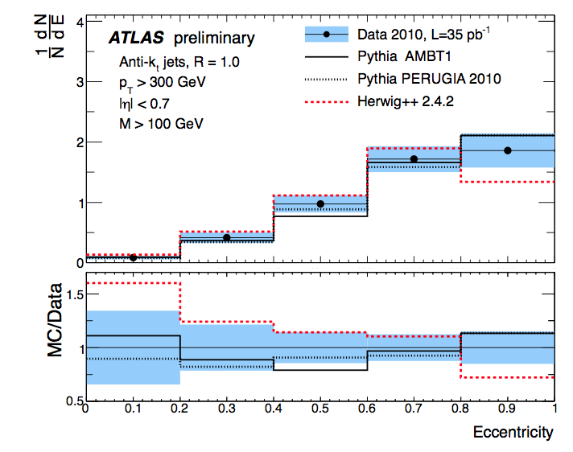
Jet Substructure: Eccentricity
NEW!!!
ATLAS-CONF-2012-044
Characterizes the deviation of the jet profile from a perfect circle in the (η,Φ) plane
ν_{max}(ν_{min}) are the maximum and minimum values of variance of the jet constituents’ positions along the principal or minor axis
R=0.6
R=1.0
Notes:
In the analysis the eccentricity for jets in the mass range M > 100 GeV is measured since this is the region of interest for Higgs boson and other massive, hadronically decaying particles

Slide 34
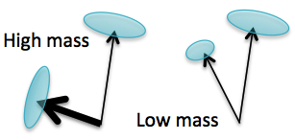
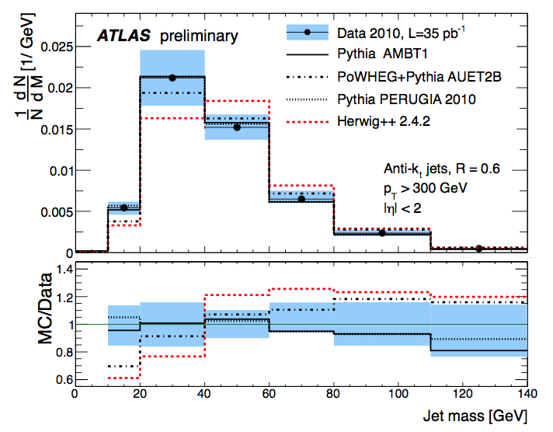
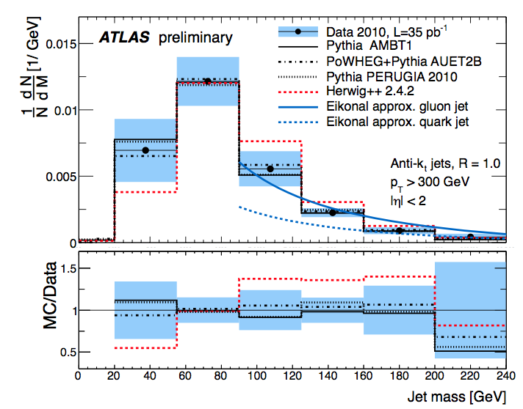
Jet Substructure:
Mass
NEW!!!
ATLAS-CONF-2012-044
R=0.6
R=1.0
MC predictions are valid down to the low mass region due to the inclusion of soft radiation and hadronization
For R= 1.0 data are compared to the calculations for jet masses using the eikonal approximation in the region mass > 90 GeV

Slide 35
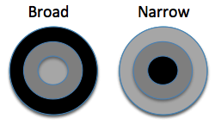
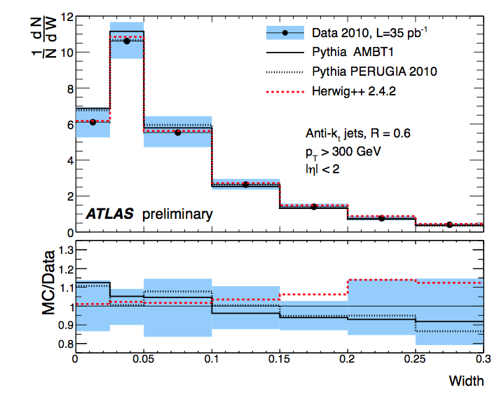
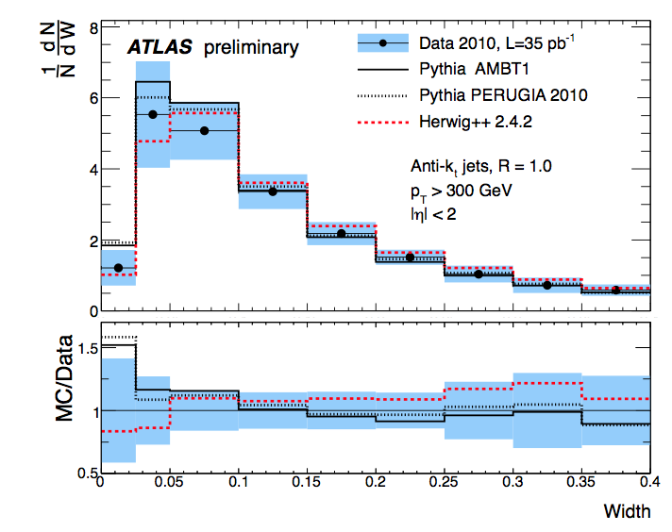
Jet Substructure:
Width
NEW!!!
Width can be considered a dimensionless relative of the jet mass which is not very sensitive to detector effects on jet energy scale and resolution
ATLAS-CONF-2012-044
R=0.6
R=1.0
Notes:
p_{T} is w.r.t. the beam axis
DeltaR^{i} is the radial distance between the jet axis and the i^{th} jet constituent

Slide 36
Jet Substructure: Interim Summary
First measurement of substructure variables at LHC
Large potential for future use in analyses
Broad agreement between data and LO parton-shower MC predictions from PYTHIA and HERWIG++
Significant reduction of pile-up impact with the usage of splitting & filtering techniques

Slide 37
Jet radiation
Measurement: di-jet production with veto on central activity

Slide 38
Jet Radiation
Probe pQCD in the region where the energy scale of the di-jet system is larger than the scale of the additional radiation Q₀ >>Λ_{QCD}
The observables used to quantify the amount of additional radiation in the rapidity interval bounded by the di-jet system are:
  Gap fraction
  Mean number of jets with p_{T} > Q₀
The measurement is targeted at :
  studying the effects of QCD radiation in regions of phase space where the standard MC generators do not present an adequate description
  searching for Higgs production via vector boson fusion in the Higgs-plus-two-jet channel in order to reject backgrounds. It will also contribute to the determination of the Higgs boson couplings by studying the cross-section as a function of the veto scale
Notes:
The gap fraction is the faction of events that do not have an additional jet with a transverse momentum greater than a given veto scale, Q0, in the rapidity interval bounded by the dijet system. The Default veto scale is Q0 = 20 GeV.
The dijet system is identified using two different selection criteria: 1) the two highest transverse momentum jets in the event are used, this probes wide-angle soft gluon radiation in pt-ordered jet configurations. 2) the most forward and backward jets in the event are used – largest rapidity separation Deltay. The second one favours BFKL-like dynamics because the dijet invariant mass is much larger than the transverse momentum of the jets.

Slide 39
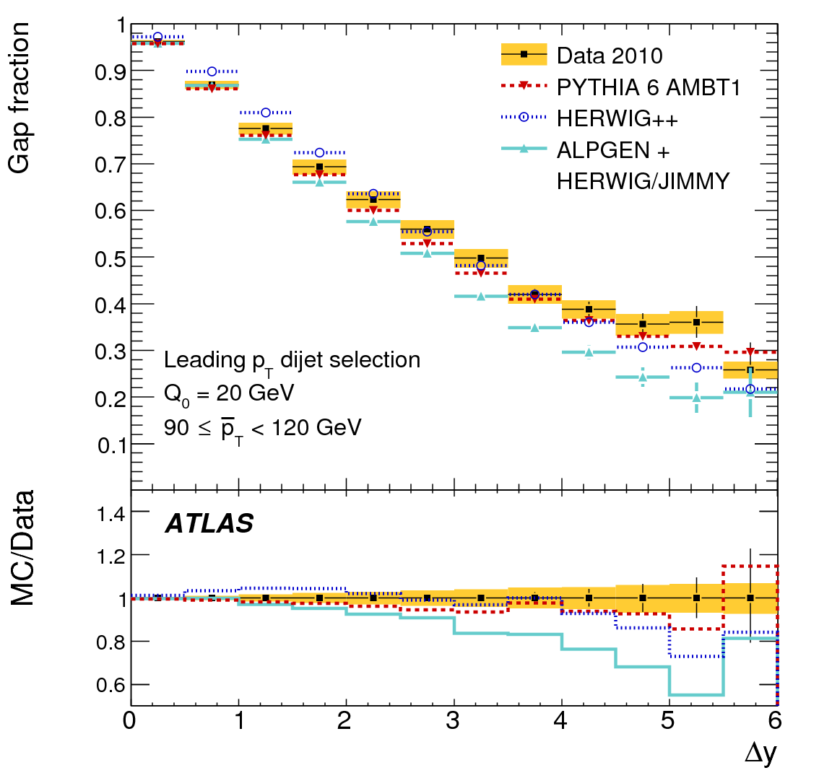
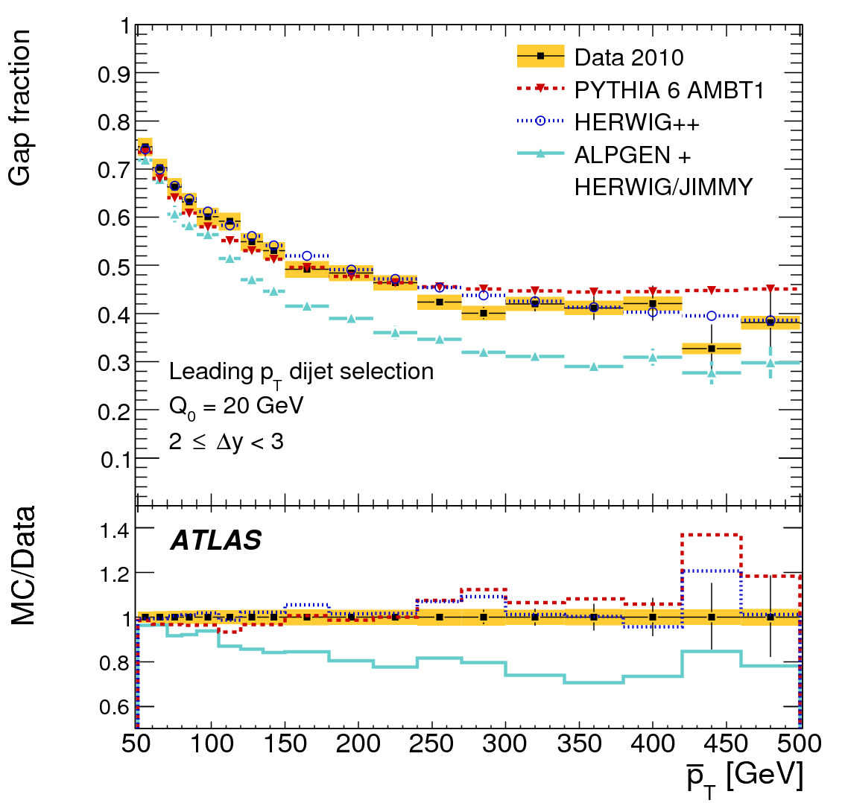
Jet Radiation: Gap Fraction
JHEP09(2001)053
PYTHIA gives best description of the data as a function of Δy, though it underestimates it for Δy ~ 3
The combination ALPGEN+HERWIG/JIMMY seems to not fare too well
The data show the expected behaviour of a reduction of gap events, or an increase in jet activity for large values of Δy and p_{T}
Notes:
Here the dijet system is defined as the two leading jets in the event

Slide 40
Example Analysis
What has been done?

Slide 41
ttbar Production with a Veto on Additional Central Jet Activity
Events are selected in the di-lepton decay channel with two identified b-jets from top quark decays
Veto is applied if event contains and additional jet with pT above the threshold (Q₀)
n(Q0): subset of events not containing additional jet in central rapidity interval
N: number of selected ttbar events
The veto criterion can be extended to probe jet activity beyond the leading additional jet by replacing n(Q₀) with the fiducial cross section for ttbar production
arXiv:1203.5015v [hep-ex]
Notes:
Anti kt R=0.4
JVF cut
Correction to particle level to account for detector effects

Slide 42
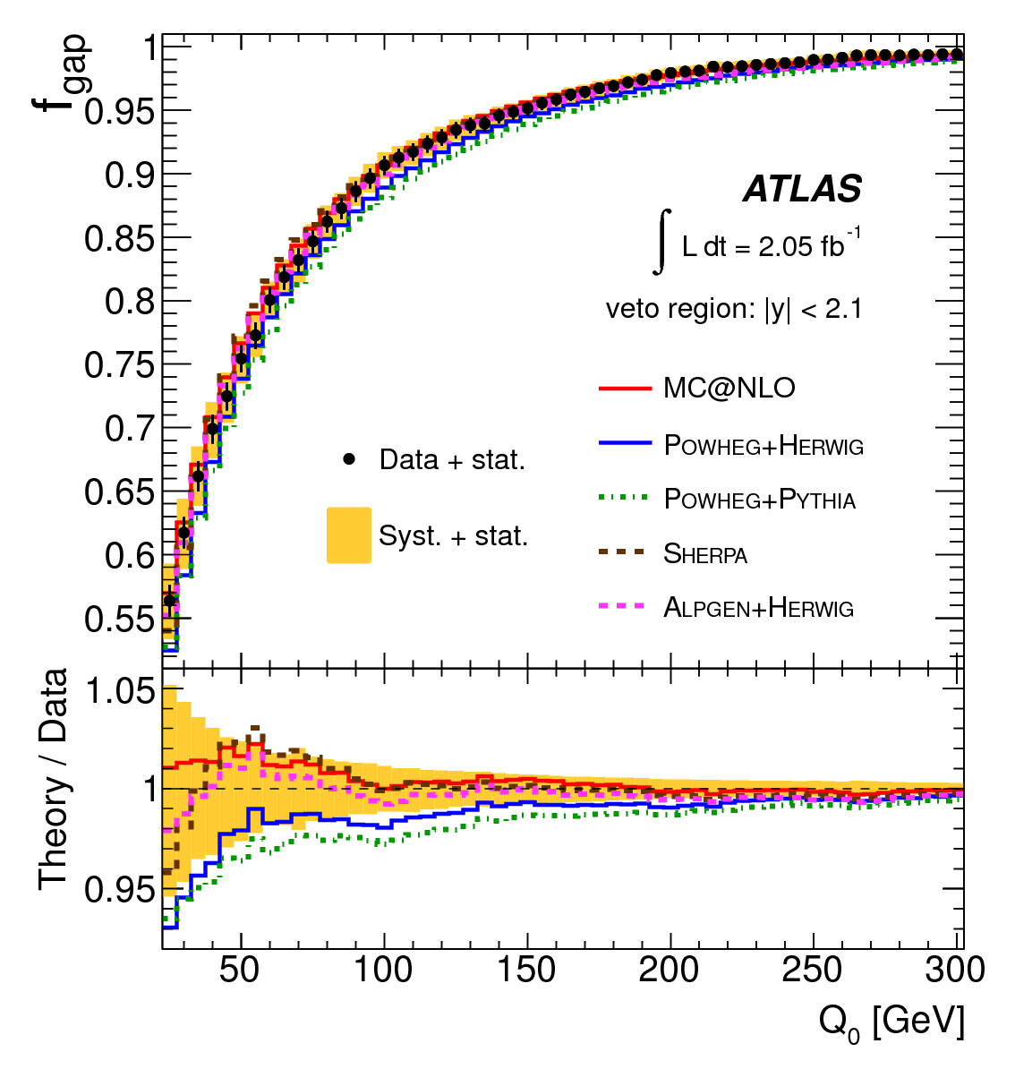
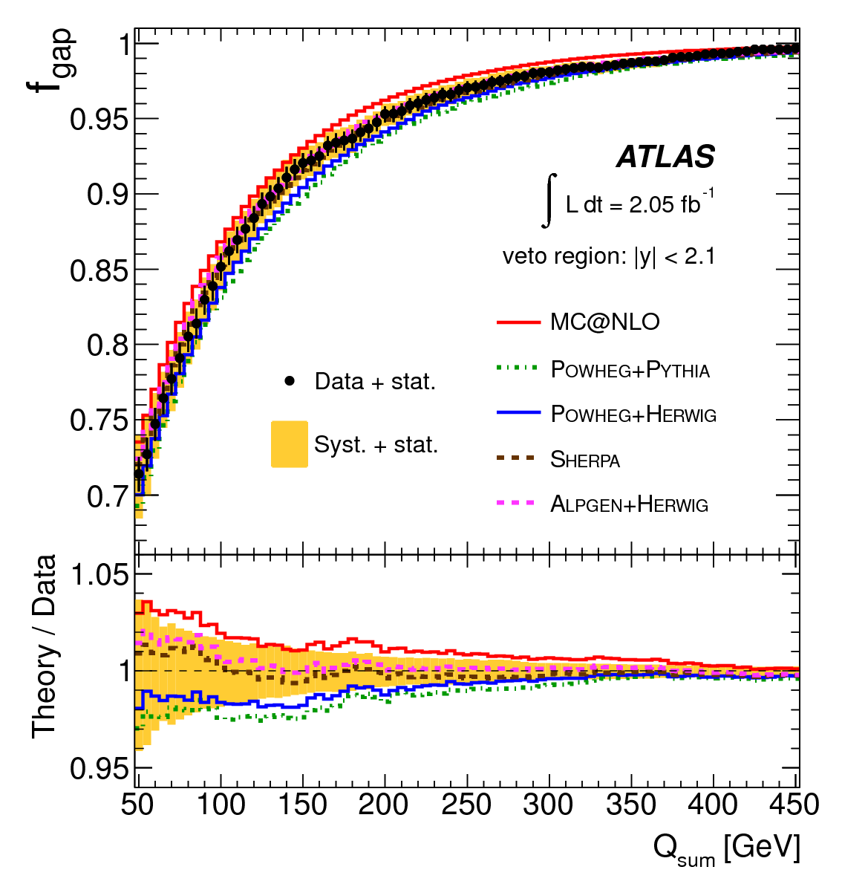
ttbar production with Veto…(cont.)
arXiv:1203.5015v [hep-ex]
Overall agreement within the full |y| < 2.1 coverage is good; however, this is not the case for individual rapidity ranges
f_{gap} as a function of Q₀ is sensitive to the leading-p_{T} emission accompanying the ttbar system, whereas as a function of Q_{sum} it is sensitive to all hard emissions accompanying the ttbar system
Notes:
Theoretical predictions are solid color lines, the gap fraction is shown until it reaches 1 or any of the limits either Q0= 300 GeV or Qsum = 450 GeV

Slide 43
Conclusions
Great progress has been made in understanding jet substructure techniques for physics analyses
These advanced techniques are being applied to searches for new physics in boosted hadronic final states
Caveat Emptor: the variable chosen needs to be carefully selected to ensure the effectiveness of the method

Slide 44
Room for discussion

Slide 45
Back-up

Slide 46
k_{t}, Anti-k_{t} & Cambridge-Aachen Jet Algorithms
k_{t} | Anti-k_{t} | Cambridge-Aachen
Successive recombination of pairs of clusters in an iterative manner starting from the lowest p_{T} w.r.t. the nearest neighbors. It selects the furthest subjets to the hard jets. | Successive recombination of pairs of clusters in an iterative manner starting from the hardest p_{T..} Regular boundary shape – unaffected by soft radiation – Jets are more circular. It selects the second closest subjets to the hard jets. | It is a k_{t}-like algorithm. It relies only on distance weighting with no k_{t} weighting at all. It selects the subjets closest to the hard jets.
The algorithms examine 4-vector inputs pairwise and construct jets hierarchically by means of different quantities (listed on table). Physically, the differences amongst the three algorithms are contained in the momentum weighting.
k_{t} is the transverse momentum of the i-th particle w.r.t. the beam axis, Δr_{ij} is the distance between particles i and j in (y,Φ) space and R is a distance parameter φ(1).
Notes:
For the CA smaller angle pairs are combined first with the freezing of soft resolved jets has beneficiary effects while reducing non-perturbative corrections and providing better jet resolution of the substructure

Slide 47
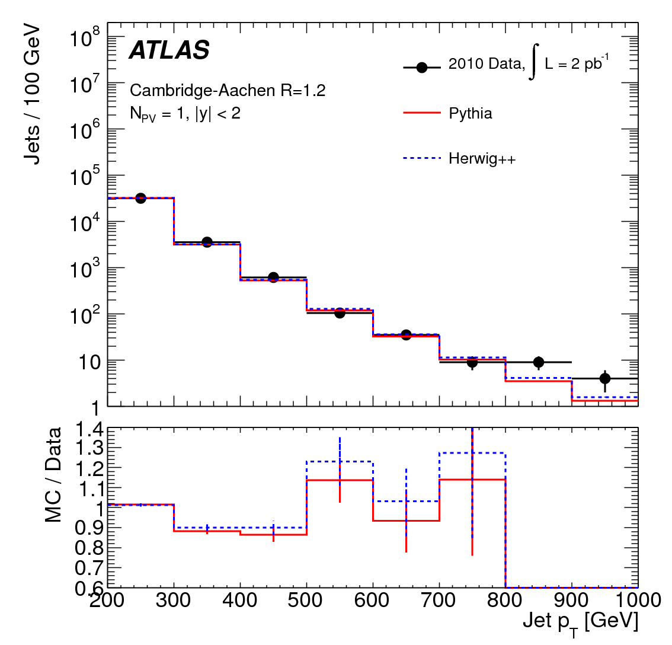
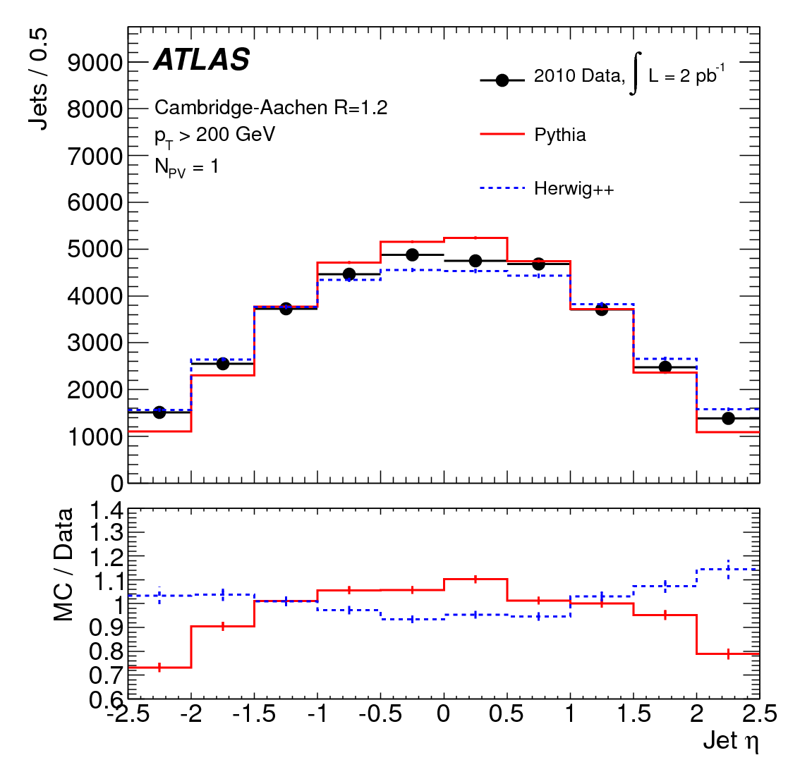
Jet Substructure: Jet Algorithms
Cambridge-Aachen jet p_{T}
Cambridge-Aachen jet η
Anti k_{t} jet p_{T}
Anti k_{t} jet η
Notes:
Before splitting and filtering!!! Differences in the high pt bins, but that is expected
Shape wise, ok

Slide 48
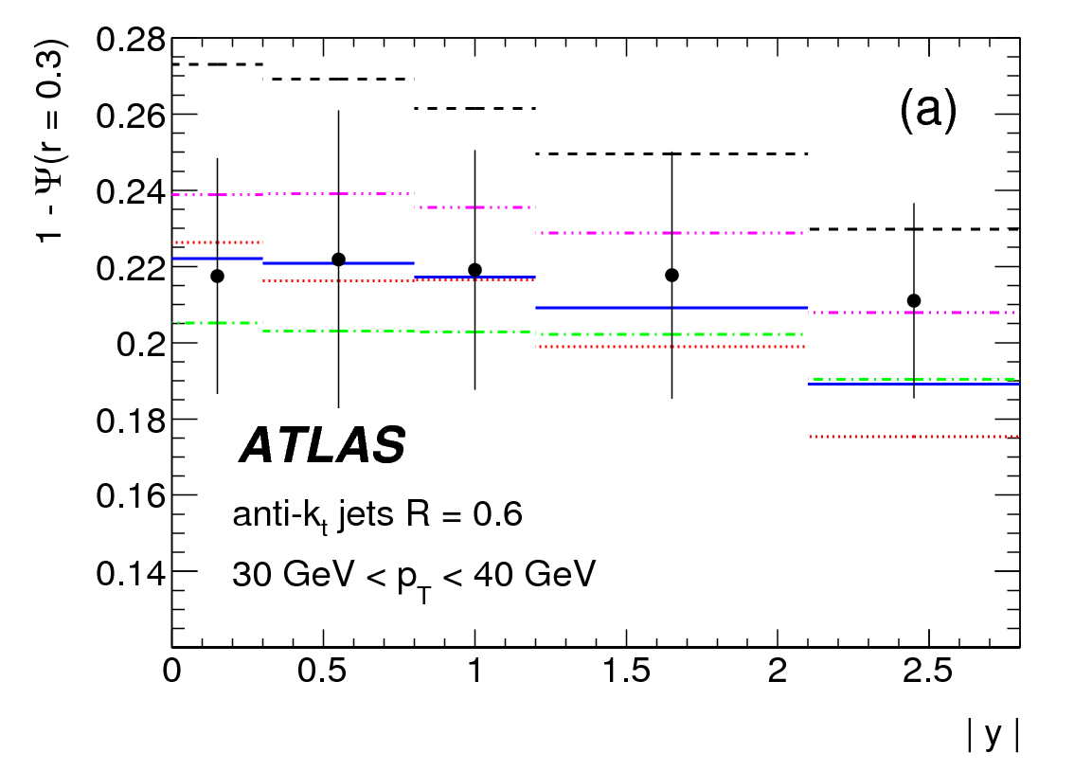
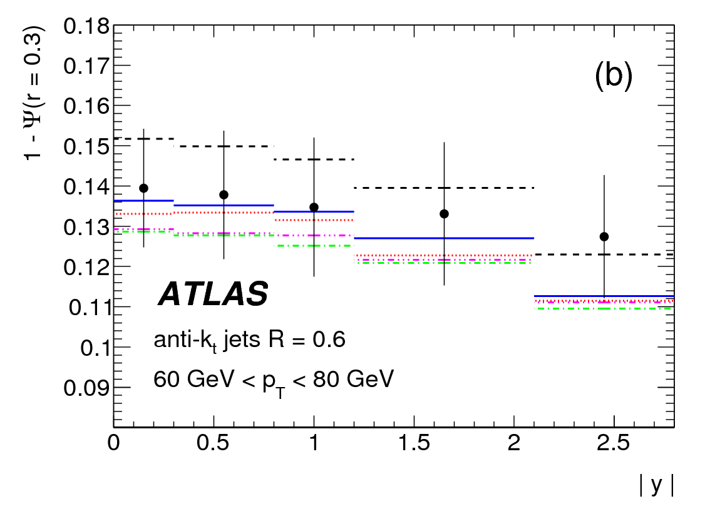
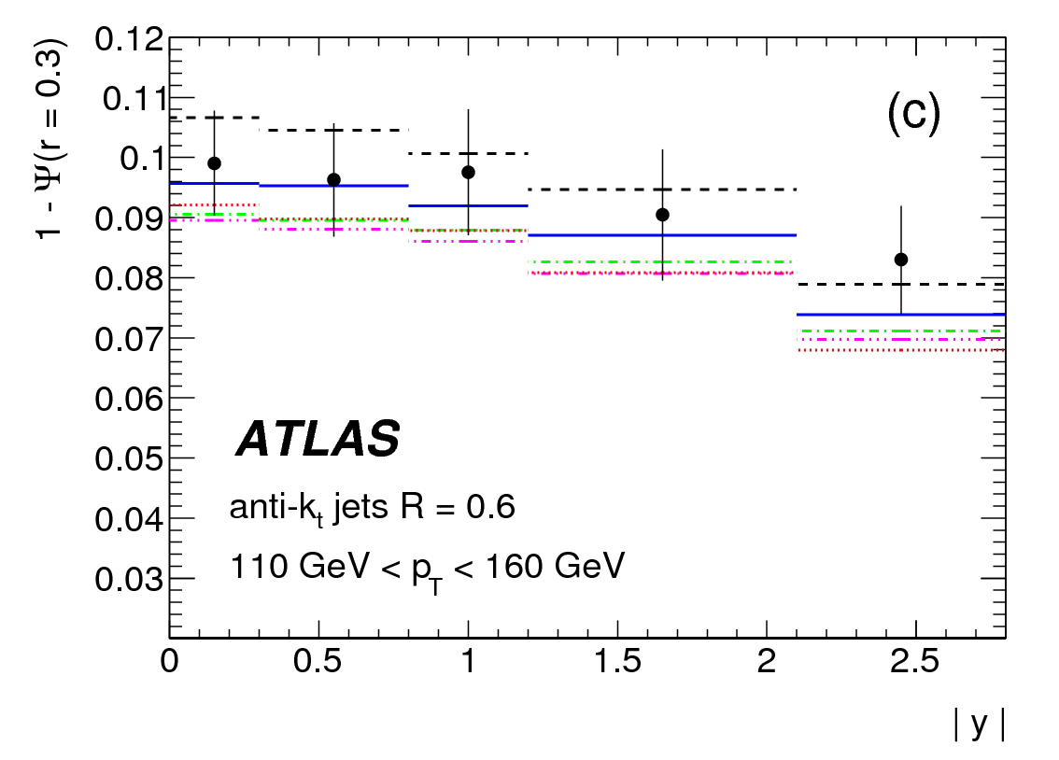
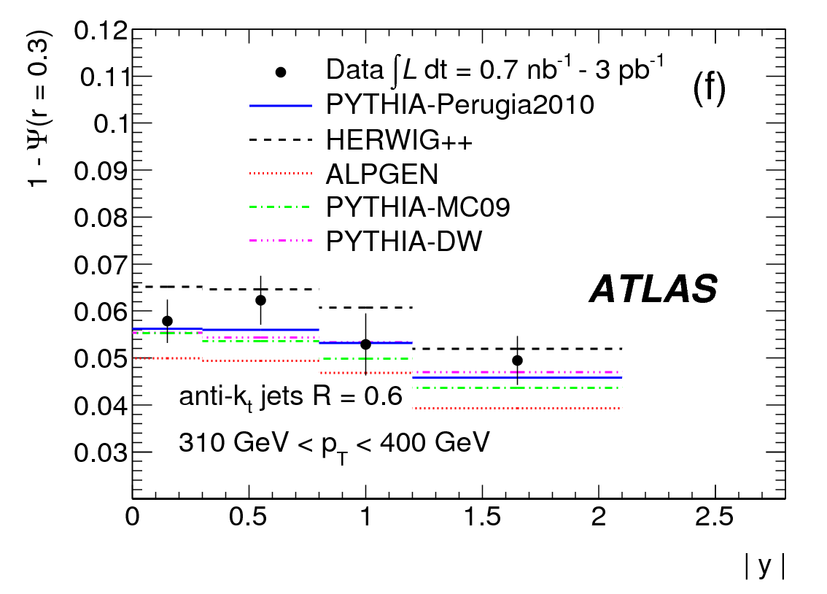
Jet Shapes Measurements: 1 – Ψ(r=0.3)
Phys. Rev. D83, 052003 (2001)
1-Ψ(r), 30 GeV < p_{T} < 40 GeV
1-Ψ(r), 60 GeV < p_{T} < 80 GeV
1-Ψ(r), 110 GeV < p_{T} < 160 GeV
1-Ψ(r), 310 GeV < p_{T} < 400 GeV
Notes:
At high pT In the forward regions there is a mild |y| dependence that indicates that jets become narrower.
We can observe that the fraction of the jet transverse momentum as a function of pT decreases as a function of pT.

Slide 49
Jet Shapes: Uncertainties of the Measurement ρ(r)
Absolute energy scale of the individual clusters belonging to the jet – Dominant (3% to 5% as r increases)
Modeling of the calorimeter showers in the MC (1% to 4% independent of p_{T} and |y|)
Variation of measured jet p_{T} by 2% to 8% to account for remaining uncertainty on the absolute jet energy scale (3% to 5%)
The 14% uncertainty on the jet energy resolution becomes 2%
Correction factors computed with HERWIG++ add and additional 2% to 10% with increasing r
No significance dependence on instantaneous luminosity
Notes:
The different systematic uncertainties are added in quadrature to the statistical uncertainty to obtain the final result.
The total uncertainty for differential jet shapes decreases for increasing pT and varies typically between 3% and 10% (10% and 20%) at r= 0.05 (r=0.55).
The total uncertainty is dominated by the systematic uncertainty except at very large pt where the measurements are still statistically limited.
In the case of the integrated jet shapes, the total systematic uncertainty varies between 10% and 2%(4% and 1%) at r = 0.1 (r=0.3) as pT increases and vanishes as r approaches the edge of the jet cone.

Slide 50
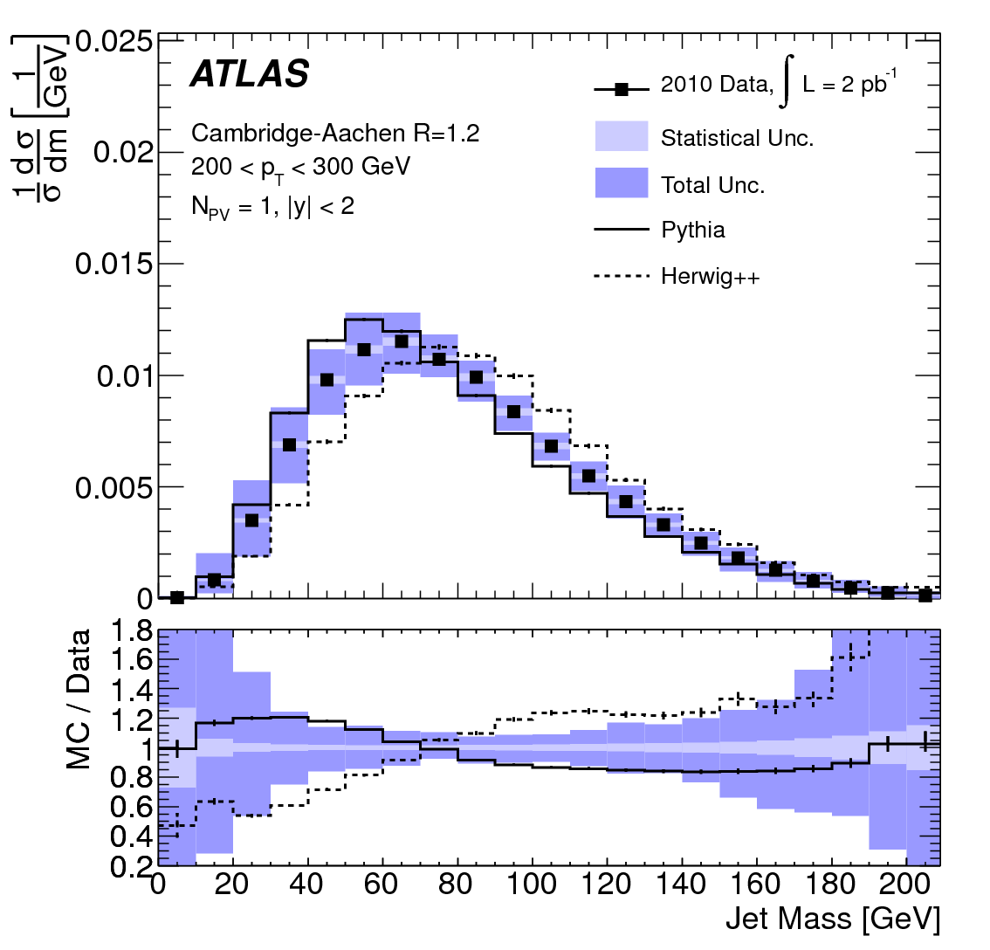
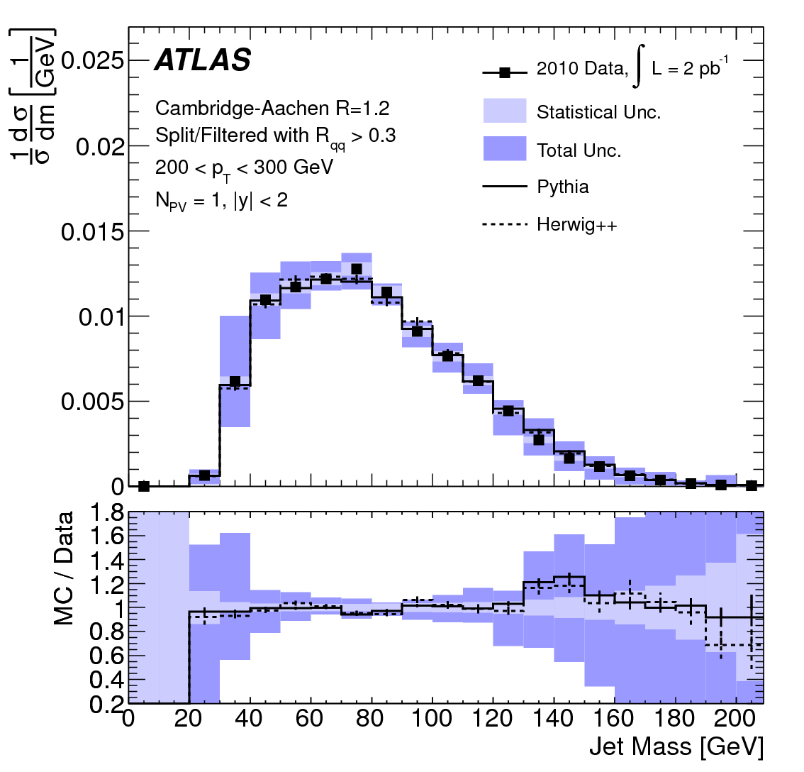
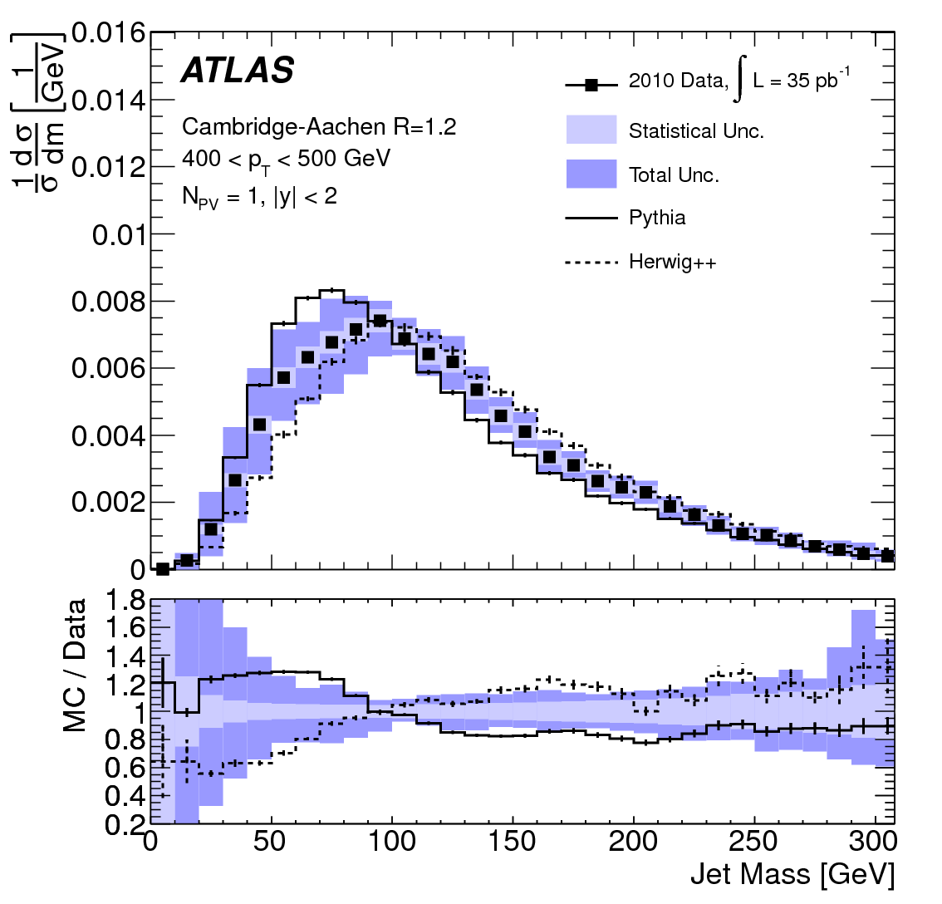
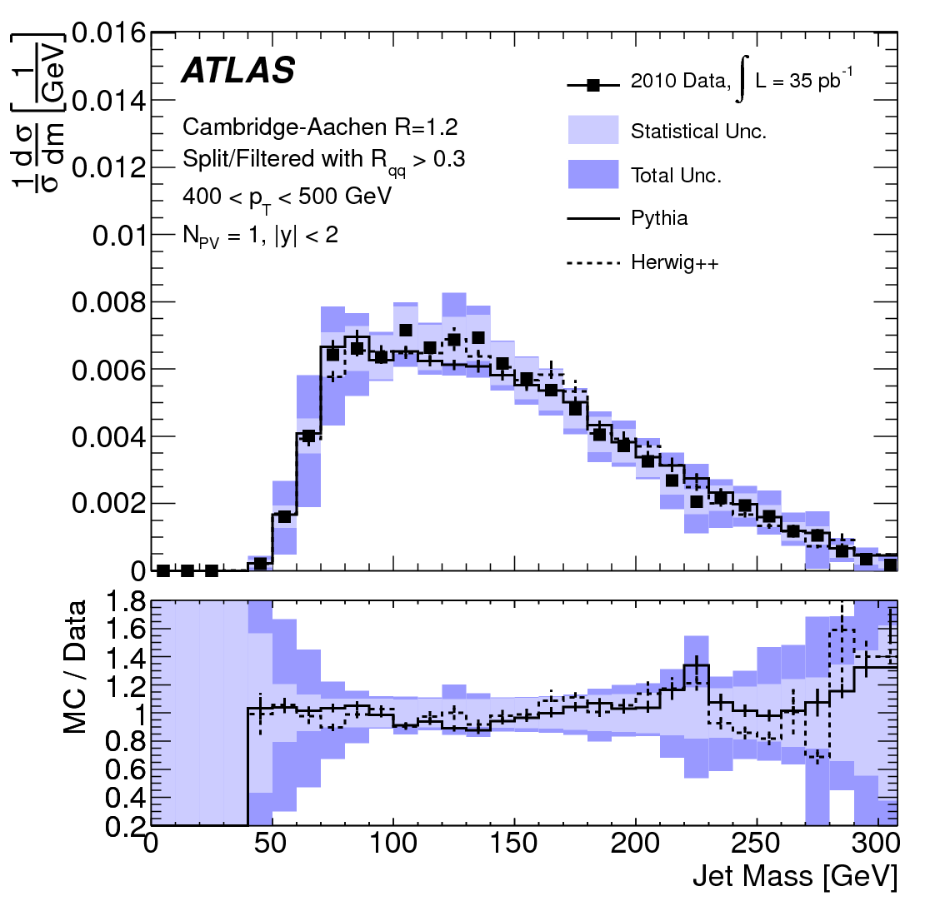
Jet Substructure: Normalized Cross Sections
Cambridge-Aachen R = 1.2 before splitting & filtering
Cambridge-Aachen R = 1.2 after splitting & filtering

