Slide 1

Inelastic neutron scattering
Applications of X-ray and neutron scattering in biology, chemistry and physics 23/8 2012
Niels Bech Christensen
Department of Physics
Technical University of Denmark
nbch@fysik.dtu.dk

Slide 2
Outline
Repetion from spectroscopy talk
Cross-sections for phonons and magnons, compared and explained
Instruments (more detailed) with examples of results
The resolution function

Slide 3
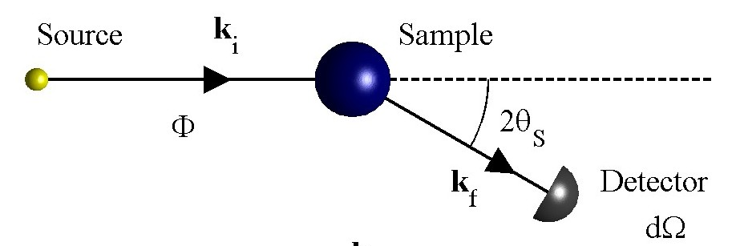
Conservation laws
Scattering triangle
k_{i}
Q
k_{f}
Momentum
Energy
Spin
(Polarization analysis)
Inelastic scattering: ħω≠0
Notes:
Crystal momentum (only defined up to tau)

Slide 4
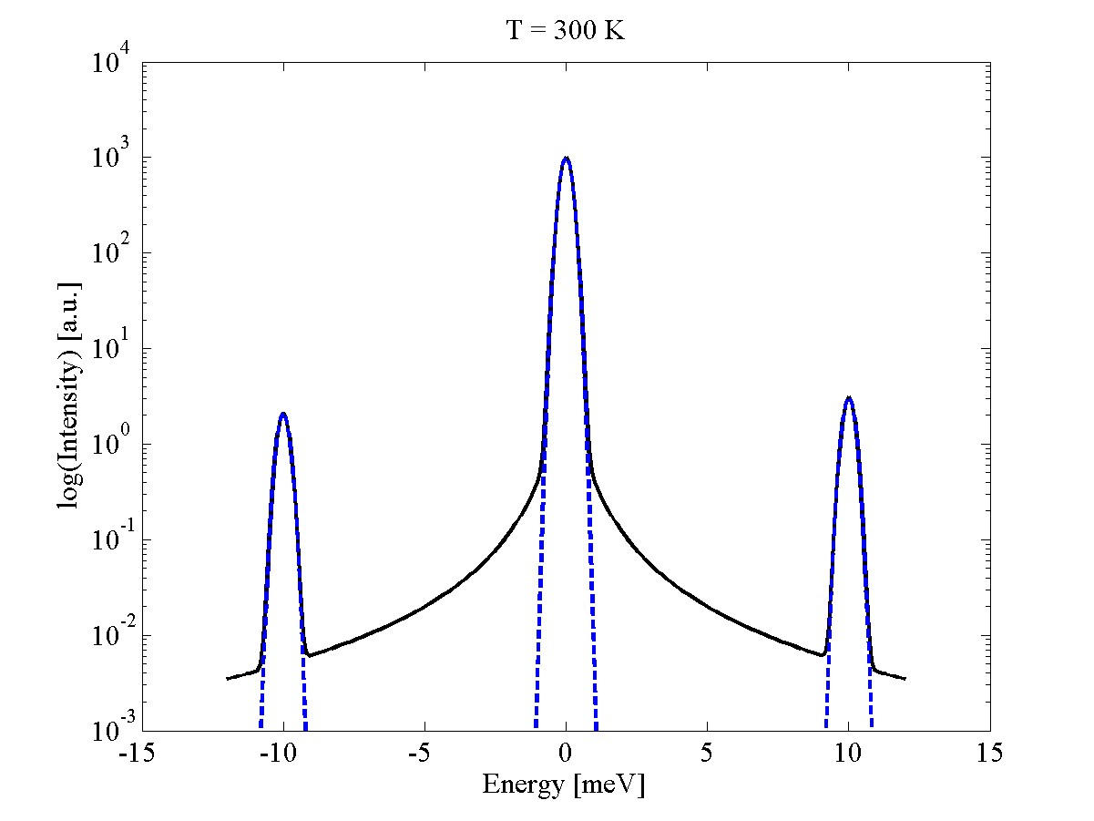
Types of scattering
Elastic
Inelastic
Inelastic
Quasi-elastic

Slide 5
Why inelastic scattering?
Because coherent propagating modes and damped modes control many physical properties of real materials
Magnetism
Lattice vibrations
Ferroelectricity
Multiferroics
Superconductors
Magnetocaloric materials
Quantum magnets
…
Thermoelectrics
Superconductors
...

Slide 6
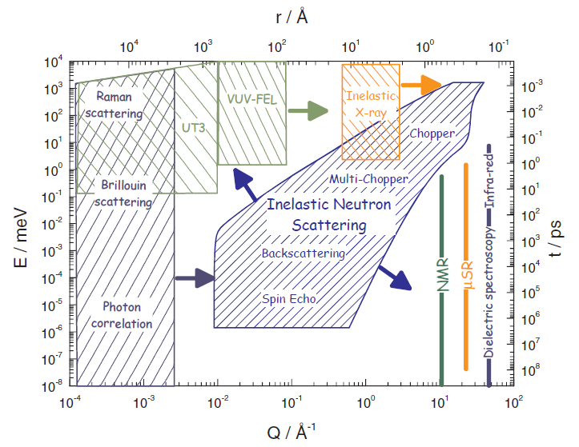
Which region do we cover?
Atomic scales and energies in the range 1-1000 meV
A certain complementarity with RIXS is developing

Slide 7
Basics
Neutrons
X-rays
Charge 0
Spin ½
m=1.675 10⁻²⁷ kg
Charge 0
Spin 1
m=0
Radiation wavelength λ=2π/k
1 Å
4 Å
40 Å (large scale structures, bio)
Neutron energy
80 meV
5.00 meV
0.05 meV
Phonons, magnons, …
(solid state physics)
Notes:
Compare dE/E for neutrons and x-rays.

Slide 8
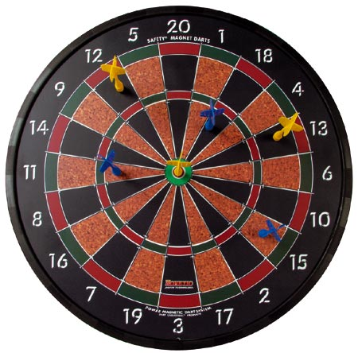
Interactions
Nuclear interaction with atomic nuclei
Magnetic interaction with the angular momenta of electrons in unfilled shells
Short range : ~10⁻¹⁴ –10⁻¹⁵ m
Isotropic, central potential V_{n}=V_{n}(r)
Typical magnitude of cross-section: 10⁻²⁸ m²
Longer range : ~10⁻¹⁰ m
Anisotropic, non-central potential V_{m}=V_{m}(r)
Typical magnitude of cross-section: 10⁻²⁸ m²

Slide 9
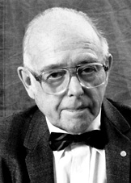

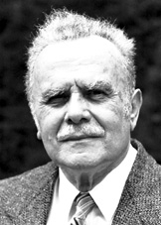
1994: Nobel price winners
"for pioneering contributions to the development of neutron scattering techniques for studies of condensed matter"
Clifford G. Shull (1915-2001), USA
"for the development of the neutron diffraction technique"
”Where atoms/spins are …
Bertram N. Brockhouse (1918-2003), Canada
"for the development of neutron spectroscopy"
”… and what atoms/spins do”
Notes:
Notes:
~40 years of delay in getting the price, primarily due to politics. Neutrons scattering is associated with atomic energy which does not have a great reputation in the broader public. Actually this price is the record for delay between work done and price received.
Ernest Wollan, who had done a lot in the early years and should have been a recipient, died in 1984.
Shull contributed to diffraction: The study of static properties of matter, or ”where atoms are”
Brockhouse received his Nobel price for the development of techniques to study dynamics properties, or ”what atoms do”
The quote specifically mentions condensed matter, but neutrons can also be used to study liquids and biological systems.

Slide 10
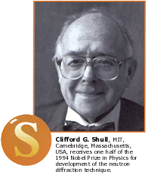
Elastic scattering: Diffraction
“…where atoms/spins are…”
Crystal structures, polymers, …
Magnetic structures, flux-line lattices, …
Charge and orbital ordering phenomena (Indirectly, through the associated small distortions of the lattice)
… as a function of pressure, electric/magnetic field and temperature.
k_{i}=k_{f}
k_{f}
Q
k_{i}
ħω=0
Notes:
Although elastic scattering is not the subject of this lecture, it clear that spectroscopy makes little sense if you don’t know what the fluctuations (lattice vibrations, magnetic waves …) are fluctuating away from.
The structure has direct links to functionality in many correlated materials, e.g. ferroelectric materials, and Michel Kenzelmann will probably say something about the link between magnetic order (symmetries) and ferroelectricity in his talk on Friday.
Therefore the natural way to conduct a research program is to first find the structure, and only then look at the excitations.
Concretely,
1) one typically first has a powder, and aims to determine its nuclear structure (using group theory etc to convert observed peak positions and peak intensities to atomic positions).
2) Then, one may want to use single crystal diffraction if the structure in question is highly symmetric (e.g. (200) and (020) occur at the same angle). These initial experiments can of course also be conducted using X-rays instead of neutrons, with well-known advantages/disadvantages having to do with flux, resolution, sensitivity to light elements.
3) Neutrons being sensitive to the magnetic moments of the unfilled shells, one would then look for Bragg reflections not explained by the (high temperature) nuclear structure, e.g. at very low scattering angles (AFM) or on top of nuclear Bragg reflections (FM). A study of the positions and relative intensities of magnetic Bragg reflections allows the determination of magnetic structure, spin directions, magnetude of the ordered magnetic moments etc.
Only with this information are we in a position to properly interpret the results of spectroscopy experiments.

Slide 11
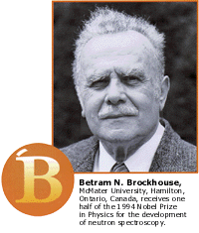
Inelastic scattering Spectroscopy
“…what atoms/spins do…”
Phonons in crystalline materials
Magnetic excitations
… as a function of pressure, electric/magnetic field and temperature.
Energy scale ~ meV
k_{i}>k_{f}
k_{i}<k_{f}
k_{f}
Q
k_{f}
Q
k_{i}
ħω>0
ħω<0
k_{i}

Slide 12
Inelastic scattering Spectroscopy
“…what atoms/spins do…”
Phonons in crystalline materials
Magnetic excitations
… as a function of pressure, electric/magnetic field and temperature.
Energy scale ~ meV
Diffraction always comes before spectroscopy!
Attempts to understand the vibrations of a given material has no logical base without the knowledge of its structure. There would be no way to model the data.
k_{i}>k_{f}
k_{i}<k_{f}
k_{f}
Q
k_{f}
Q
k_{i}
ħω>0
ħω<0
k_{i}

Slide 13
Outline
Repetion from spectroscopy talk
Cross-sections for phonons and magnons, compared and explained
Instruments (more detailed) with examples of results
The resolution function

Slide 14
Cross-sections
Partial differential scattering cross-section
≡ # neutrons hitting the detector per second, with energies between E_{f} and E_{f}+dE_{f}
Notes:
One of the basic concepts when considering scattering techniques is that of a ‘cross-section’. In neutron scattering we distinguish between several such cross-sections, the most general of which is the so-called partial differential scattering cross-section, defined as follows.
Consider the situation in the figure. A beam of flux \phi (neutrons per second per square meter) is incident on a sample from which it scatters. The number of neutrons with energies between between Ef and Ef+dEf hitting the detector per second is proportional to the flux, to the angle the detector subtends dOmega, and to the energy window dEf. By definition, the partial differential cross section is the constant of proportionality.

Slide 15
Cross-section
The cross-section is related to a quantum mechanical matrix element squared, i.e. a transition probability
Prefactor k_{f}/k_{i}
Squared matrix element of the interaction potential V
Energy conservation ensured by delta-function which contains the neutron energy transfer ħω
Notes:
Inserting the expression for the transition rate in the equations from the previous slide we find.
Note the structure of the equation in the blue box. Apart from kf/ki and some constants, the partial differential scattering cross-section is related to the matrix element of the interaction V.
Energy conservation is ensured by the delta-function. This introduces hw into our equations.

Slide 16
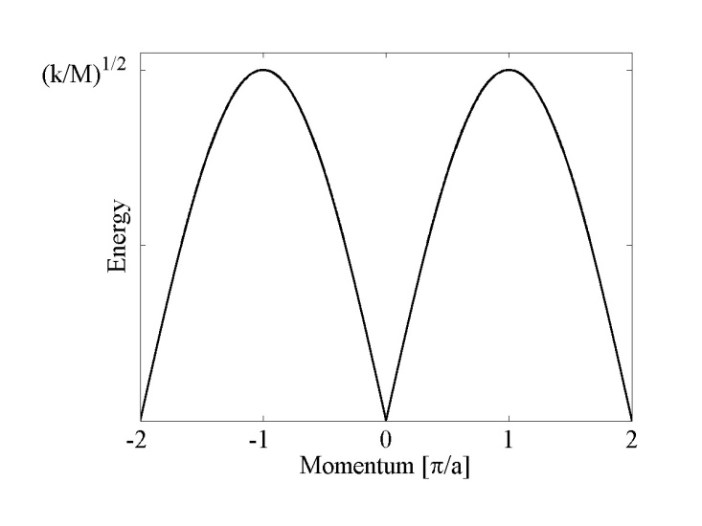
Nuclear excitations: Phonons
Lattice vibrations (Phonons)
M
K
K’s and phonon spectra can be calculated in principle, and can be measured
Bose occupation factor n(ω_{s})
Sums over nuclear Bragg peaks and mode indices s
Phonon polarization e_{s}
Debye-Waller factor (zero-point vibrations)
Notes:
K’s can be calculated in principle, but

Slide 17
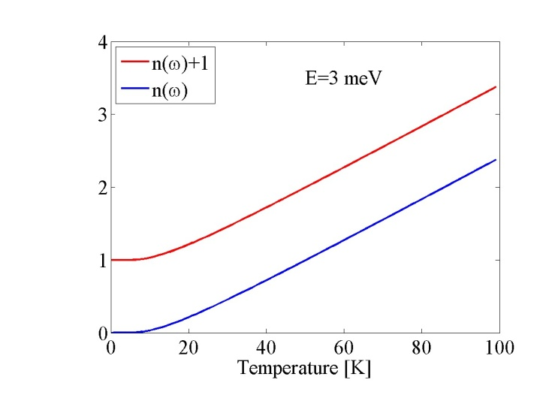
Nuclear excitations: Phonons
Lattice vibrations
M
K
K’s and phonon spectra can be calculated in principle,
but can really be measured
Phonon creation
Phonon annihilation
Increases with Q
Why? Anharmonicity, soft modes, relation to functionality (e.g. superconductivity), …

Slide 18
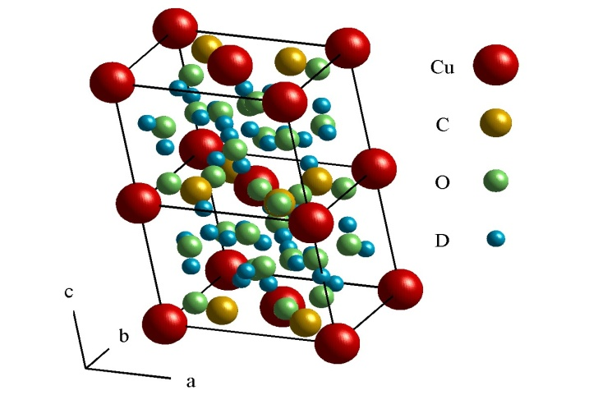
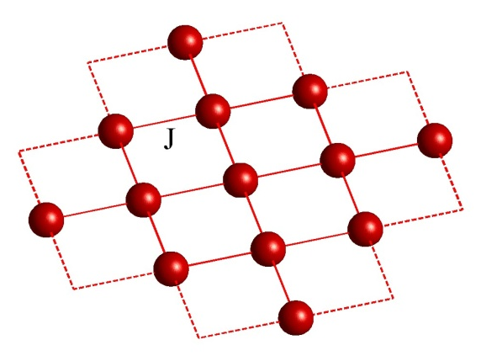
Magnetic excitations: Spin waves
2π/a
K
O
2π/a
H
Cu(DCOO)₂·4D₂O
J<0 Ferromagnet
FM: Magnetic Bragg peaks on top of the nuclear
AFM: New Magnetic Bragg peaks due to doubling of the magnetic unit cell
J>0 Antiferromagnet

Slide 19
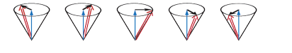
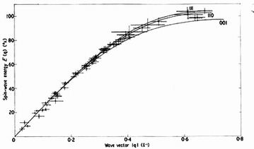
Magnetic excitations: Spin waves
RbMnF₃
Sharp excitations
Note analogies with lattice vibrations/phonons

Slide 20
Phonons vs. magnetic excitations
Phonons
Increases with Q
Increases with T
Decreases with Q
Bose statistics for simple ordered systems (FM, AFM, etc.). Spreads in Q and ћω at high T
The final kill: Neutron polarisation analysis
Notes:
Not simply true that

Slide 21
Outline
Repetion from spectroscopy talk
Cross-sections for phonons and magnons, compared and explained
Instruments (more detailed) with examples of results
The resolution function

Slide 22
Conservation laws
Scattering triangle
k_{i}
Q
k_{f}
Momentum
Energy
Spin
(Polarization analysis)
Notes:
Crystal momentum (only defined up to tau)

Slide 23
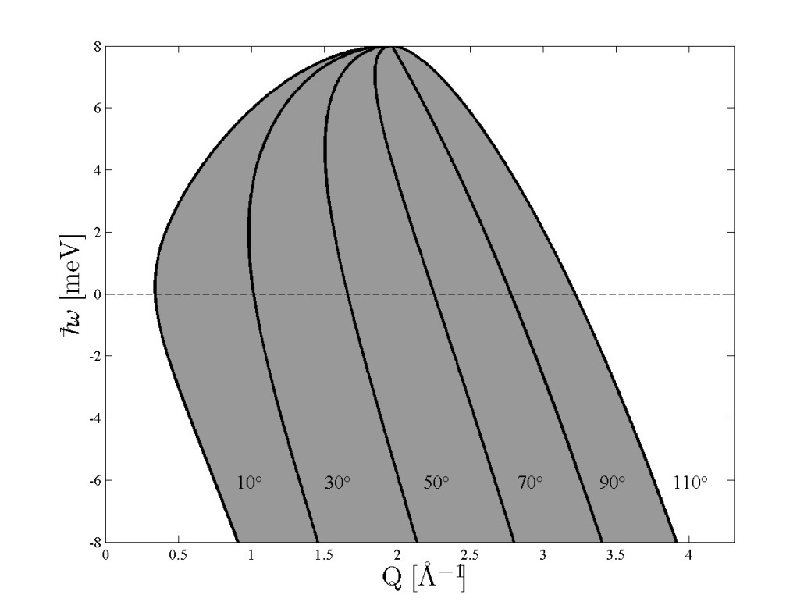
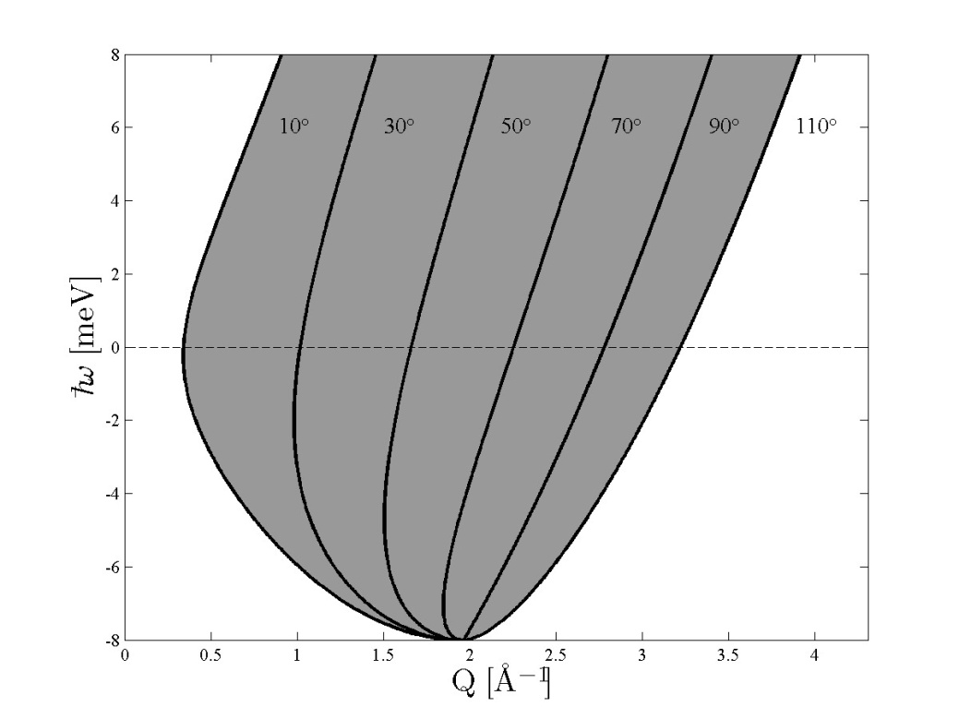
Kinematic constraints
k_{f}
(k_{f} fixed)
2θ
Q
k_{i}
(k_{i} fixed)
k_{i} fixed
k_{f} fixed

Slide 24
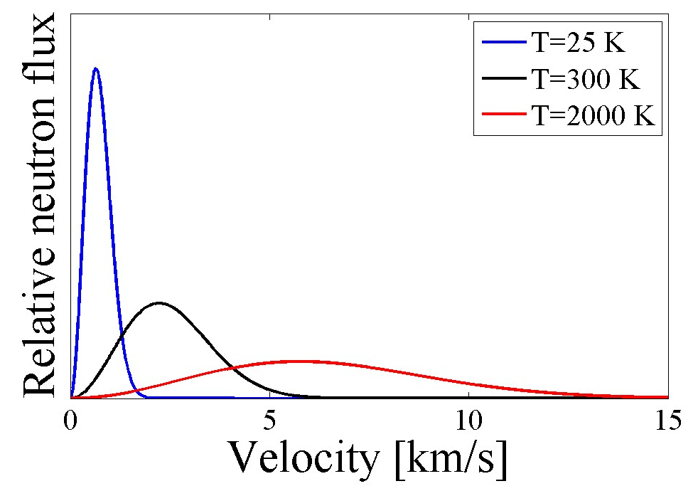
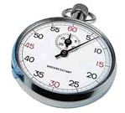
Neutron Spectroscopy Spallation Source Instruments
Remember how a spallation source works:
A pulsed proton beam hits a target made from a heavy element target
The fast neutrons are moderated, but the result is still a pulsed beam
Time-of-flight principle
Distance L
Moderator
Detector

Slide 25
Neutron Spectroscopy Spallation Source Instruments
Remember how a spallation source works:
A pulsed proton beam hits a target made from a heavy element target
The fast neutrons are moderated, but the result is still a pulsed beam
Time-of-flight principle
Impossible to determine the energy transferred
Distance L₁
Sample
Distance L₂
???
Moderator
Detector

Slide 26
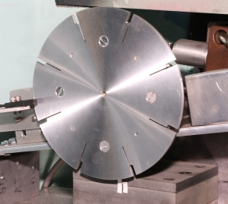
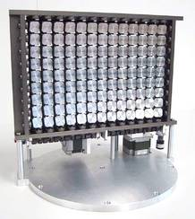
Neutron Spectroscopy Spallation Source Instruments
Remember how a spallation source works:
A pulsed proton beam hits a target made from a heavy element target
The fast neutrons are moderated, but the result is still a pulsed beam
Time-of-flight principle
Direct time-of-flight geometry:
Constant k_{i} instruments
Distance L₁
Sample
Distance L₂
Moderator
Detector
Chopper
Monochromator

Slide 27
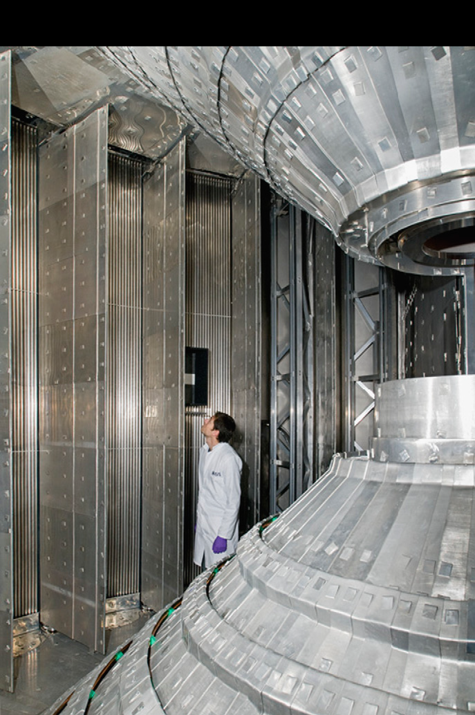
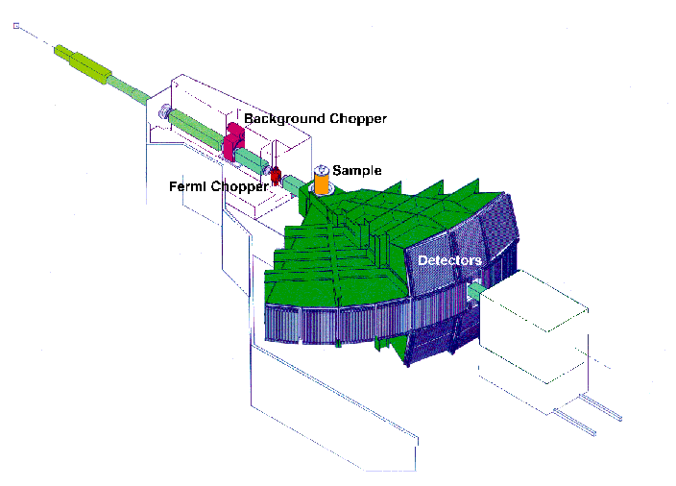
Direct time-of-flight spectrometers
k_{i} fixed
MAPS, ISIS
Choppers
Low incident flux
Low flexibility (TOF parabola)
Massive parallel data acquisition in (Q,ħω) “Making maps of magnetism”
Notes:
A direct time of flight spectrometer works in constant ki mode. Neutrons are created by a spallation process (See Peter Allenspach lecture).
Direct geometry TOF spectrometers have far fewer monochromatic neutrons incident on the sample position. They compensate for this by using
large detector arrays, collecting neutrons at many (Q,hw) simultaneously, while TAS spectrometers access (Q,hw) space one point at a time.
Example of MAPS spectrometer, ISIS facility, Oxford, UK
When a burst of neutrons is created, a stop clock is started. neutrons with a distribution of energies are emitted and slowed down by (elastic) scattering in a moderator (typically water or methane, because these are fast equillibrators?) MUST THE STOP CLOCK NOT BE AFTER THE MODERATOR?
Neutrons are emitted with a distribution of different energies. Knowing the path length from the burst position (OR MODERATOR) to the sample position, one can compute the exact time of arrival of neutrons of each energy. A system of spinning discs etc, known as choppers allow only neutrons of one particular energy to actually reach the sample, while not allowing the slowest neutrons in bunch number 1 to be overtaken by the fastest from bunch number 2 (frame overlap).
At the sample position, we therefore have a monochromatic beam (as in the case of triple axis spectrometers) of neutrons. Knowing the distances to any detector from the sample position, and measuring the time of a arrival of a neutrons at the detector, we can work out what energy these neutrons have, and hence the energy transferred to the sample. By knowing the angles to all detectors as well (MAPS potentially has 150000 individually adressable detectors, and the trend goes to higher and higher angular coverage), one can work out the momentum Q transferred to the sample as well.
A direct geometry TOF allows energies from Ei to –infty to be covered.
For low-dimensional magnetic systems (quantum magnetism in 1D and 2D, high-Tc superconductors, etc), particular sample orientations provide for very efficient data collection.
SHOULD there be a summary slide of TAS versus TOF spectroscopy? Perhaps as a sort of conclusion?

Slide 28
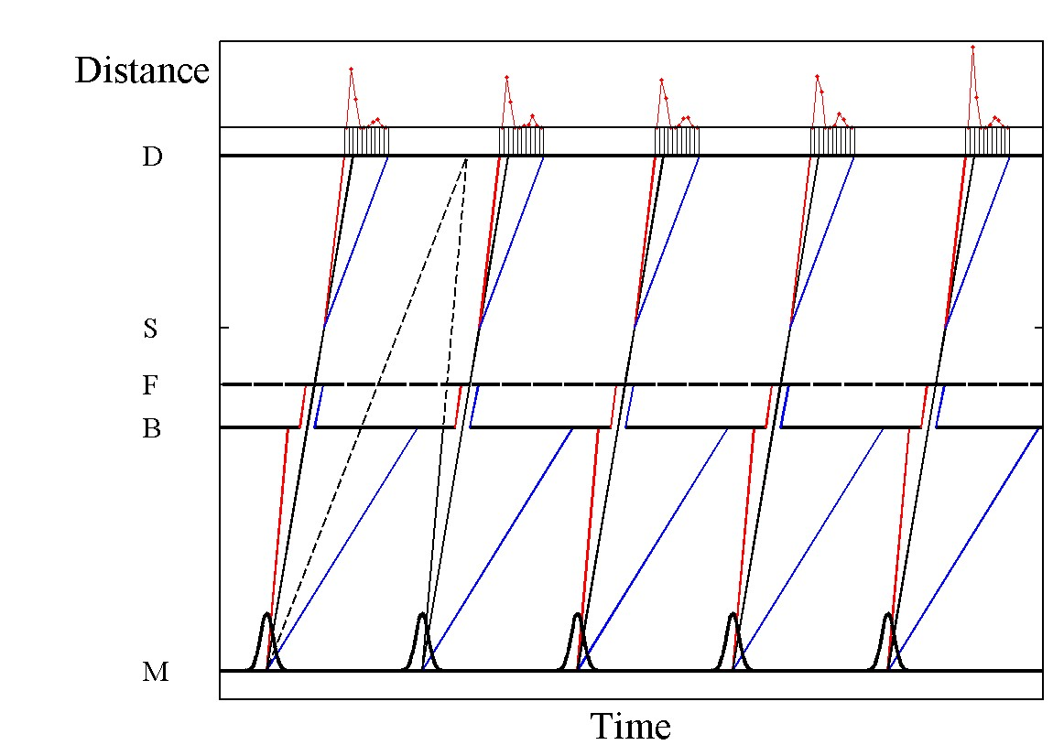
Practical direct TOF
Detector
Sample
Fermi chopper
Background chopper
Source

Slide 29
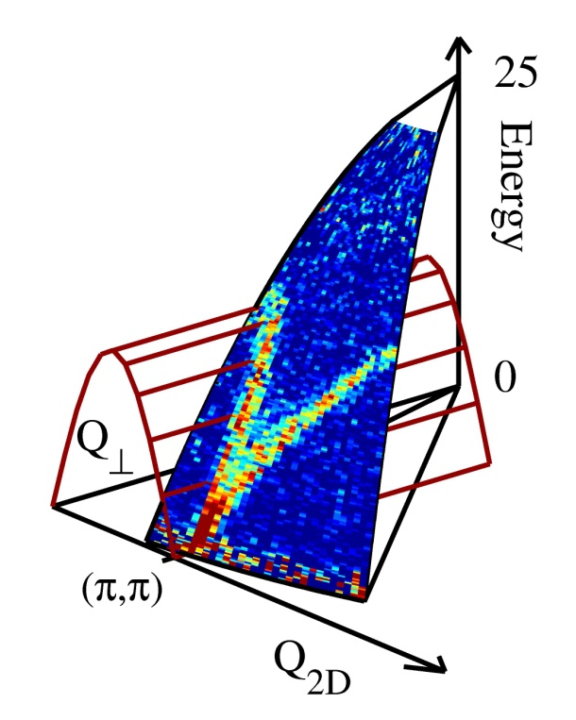
Practical TOF
Conservation laws → Time-of-flight parabola in (Q,ћω)
Q||
k_{i}
Q┴
I(Q,ћω) is probed along the TOF parabola.
Unlike TAS, constant wavevector scans are not possible (if the data are taken in one setting). At fixed (Q_{x},Q_{y}), Q_{z} varies with ћω, leading e.g. to a variation of the form factor.
Counting time ~ hours/days per “run”.
One analyses constant energy or wavevector “cuts” in a data set of corresponding values of (Q_{x},Q_{y},Q_{z},ћω) and intensities.
Incident energy E_{i}, chopper speeds (resolution) and sample orientation relative to k_{i} can be changed.

Slide 30
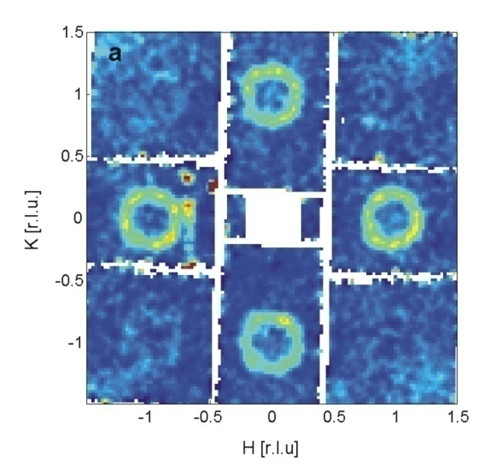
Cu(DCOO)₂·4D₂O Christensen et al
La_{5/3}Sr_{1/3}NiO₄ Woo et al., PRB 72, 064437 (2006)
La_{1.875}Ba_{0.125}CuO₄ Tranquada et al., Nature 429, 534 (2004)
Y_{2-x}Ca_{x}BaNiO₅ Xu et al., Science 289, 419 (2000)

Slide 31
Neutron Spectroscopy Research Reactor Instruments
Spectrometry can be done in three ways
Give the beam a time structure and use time-of-flight tricks
Spin echo
Triple axis spectrometers

Slide 32
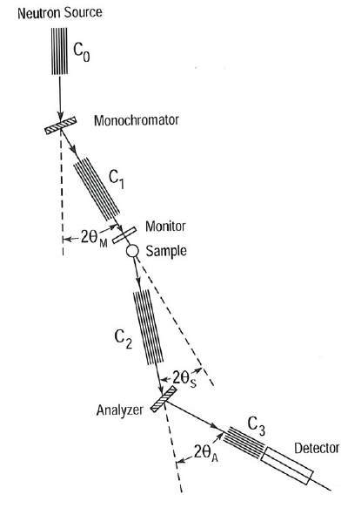
Practical TAS
Extremely simple principle due to Brockhouse
3 axes
Monochromator-Sample (a1,a2=2θ_{M})
Sample-Analyser (a3,a4 =2θ_{s})
Analyser-Detector (a5,a6= 2θ_{A})
a1,a3,a5 are rotations of the mono,sample and analyser about the vertical
The setting of a2 and a1=a2/2 defines k_{i}
The setting of a6 and a5=a6/2 defines k_{f}
The setting of a3 and a4 defines the Q of the crystal probed
Notes:
Not a complete list!

Slide 33
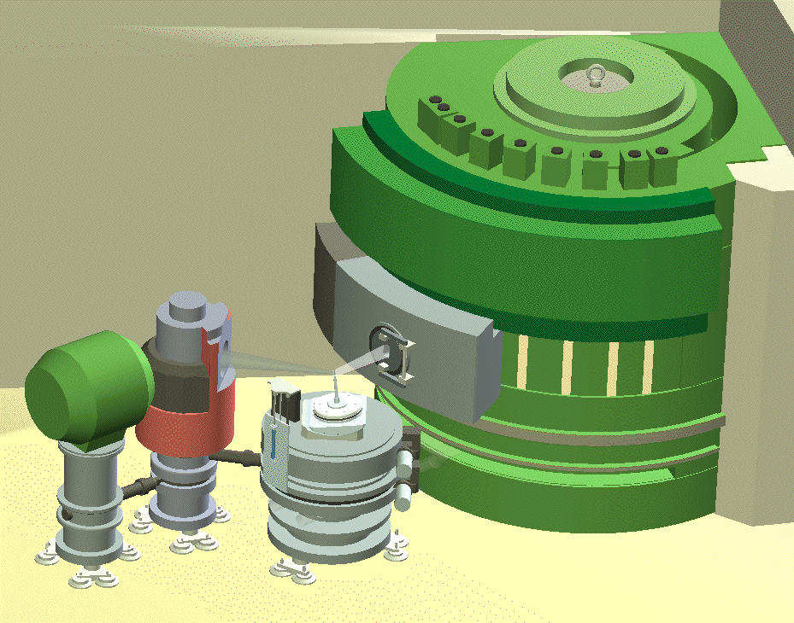
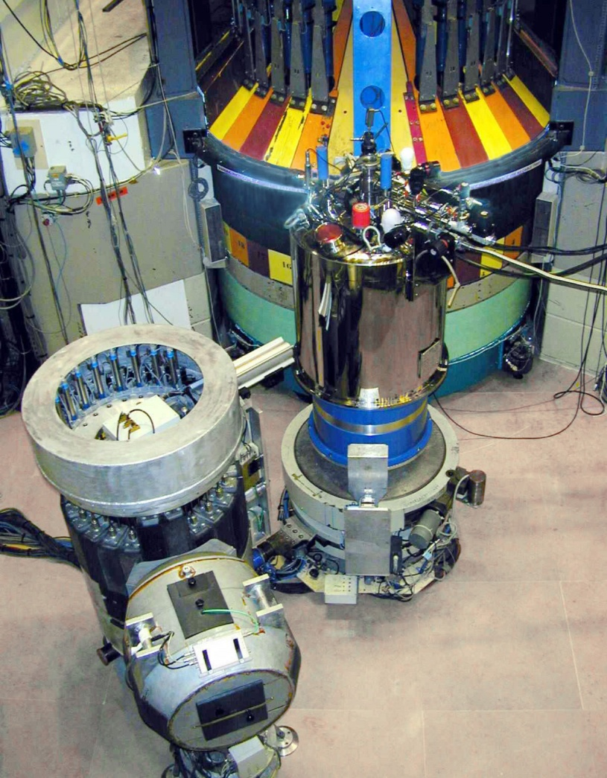
Triple-axis spectrometers
Bragg’s law
Analyzer (Bragg reflection)
λ
λ
θ
θ
Monochromator (Bragg reflection)
Sample S(Q,ω)
d
High incoming flux: O(10⁷) n/s/cm2 (IN14)
Flexible
Point-by-point measurements in (Q,ħω) space
Polarization analysis
Cold: 2 meV <E_{i}<15 meV
Thermal: 15 meV< E_{i}<100 meV
Hot: E_{i}>100 meV
Notes:
Here is a schematic figure showing how a triple-axis spectrometer looks.
Triple axis spectrometers can be used not only for the study of magnetic and nuclear excitations, but also for the study of order. In particular, the visibility of weak signals can sometimes be significantly enhanced by allowing the analyser to select only elastically scattered neutrons, whereas a conventional diffractometer also counts the inelastic processes, which may give a large incoherent “background” signal preventing unambiguous identification of the signal.
Two modes of running a TAS
Constant ki mode
Constant kf mode

Slide 34
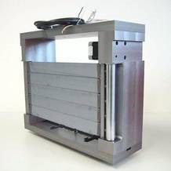
Elements: Monochromator
A good monochromator material should:
Should have a high σ_{coh}/ σ_{inc} ratio
Should have a high peak reflectivity
Should not be too perfect (due to extinction, backside does not scatter)
Modern monochromators focus in 1 or 2 directions → large gains in flux at the sample position, at the expense of increased beam divergence

Slide 35
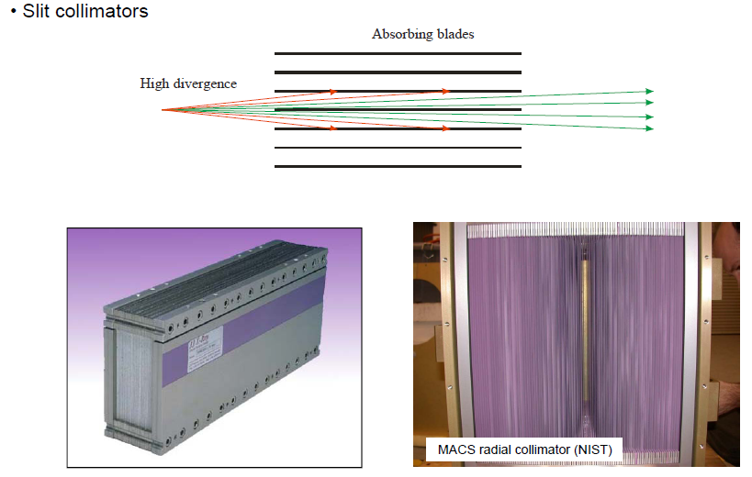
Elements: Collimators
From ETH Zürich, neutron scattering course, A. Zheludev.
Notes:
Linear and radial collimators.

Slide 36
Practical TAS
Angular beam divergence can be reduced using collimators C_{i}
Modes: k_{i} or k_{f} are kept constant. The scattering senses (left/right) at sample and analyzer positions can be changed.
Higher order reflections are allowed by Bragg’s law (n>1). Neutron filters are often inserted before and/or after the sample, to discriminate against neutrons with energies 4E, 9E,…
C
Q is essentially restricted to the plane defined by two user-chosen horizontal reciprocal lattice vectors.
ћω is varied by rotating the monochromator/analyzer. The in-plane components of Q are varied by changing 2θ (=2θ_{S}) and rotating the sample around a vertical axis.
One performs constant energy scans (Intensity versus in-plane components of Q at fixed ћω) or constant wavevector scans (Intensity versus ћω at fixed Q).
Counting time ~minutes pr. point.
Longchair
W
Plough
Notes:
Not a complete list!

Slide 37
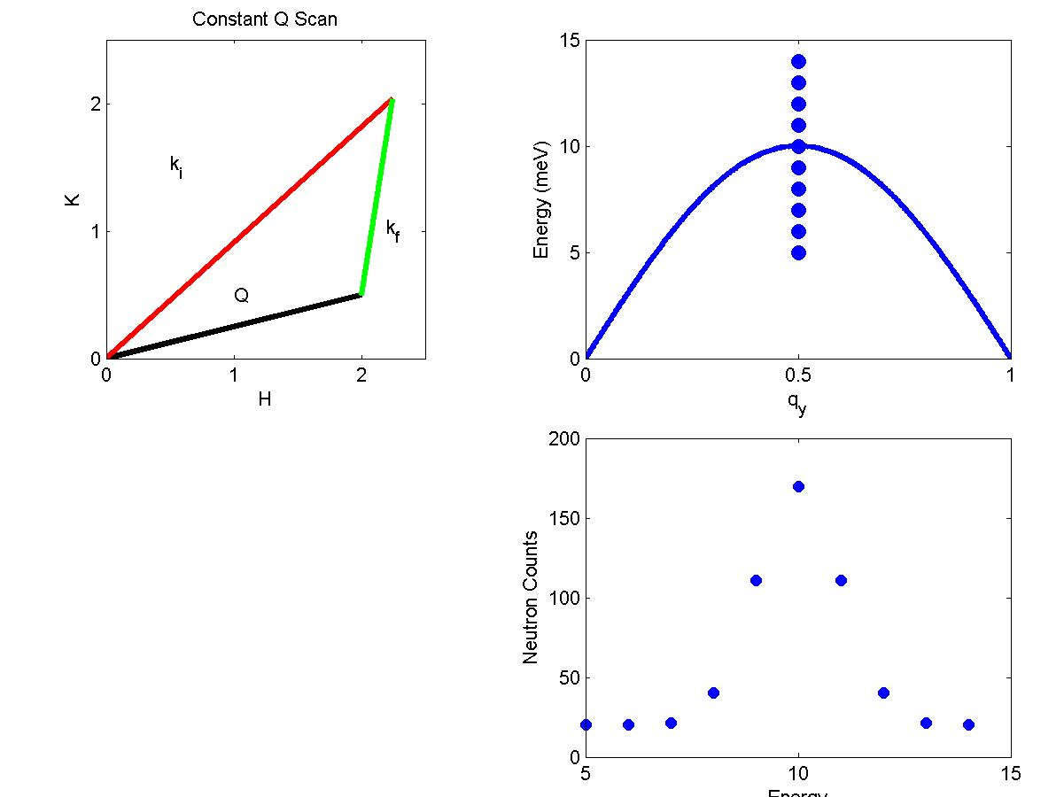
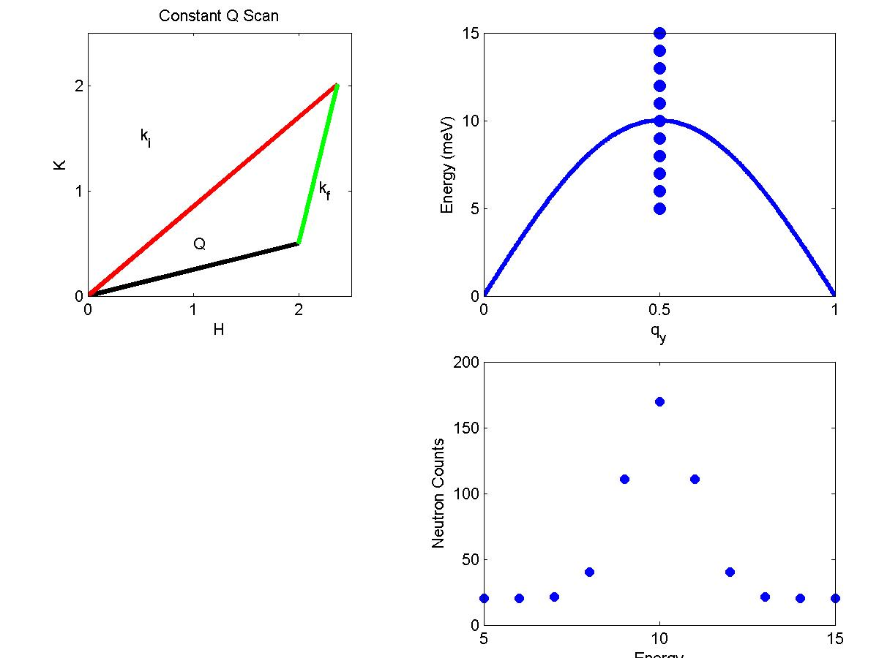
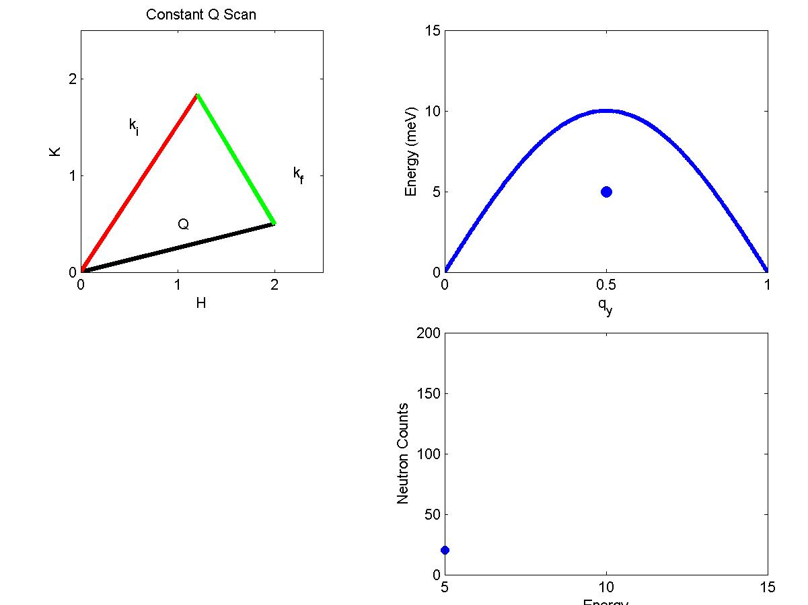
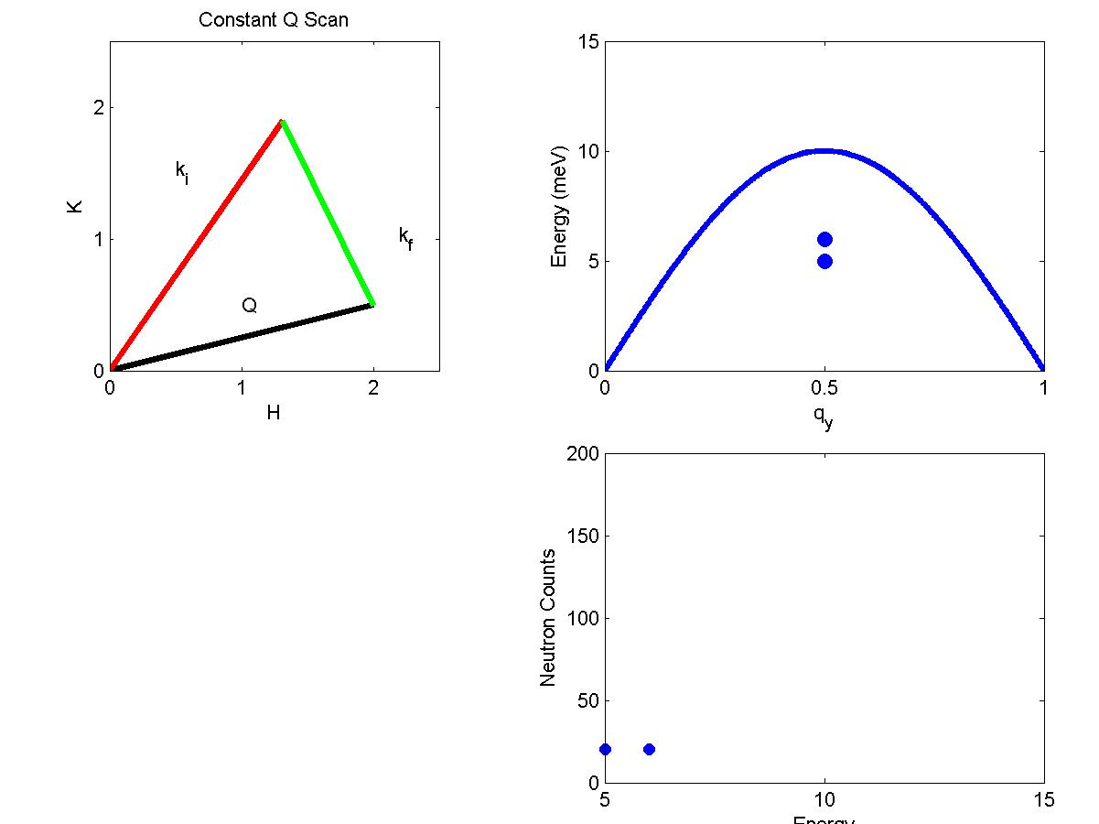

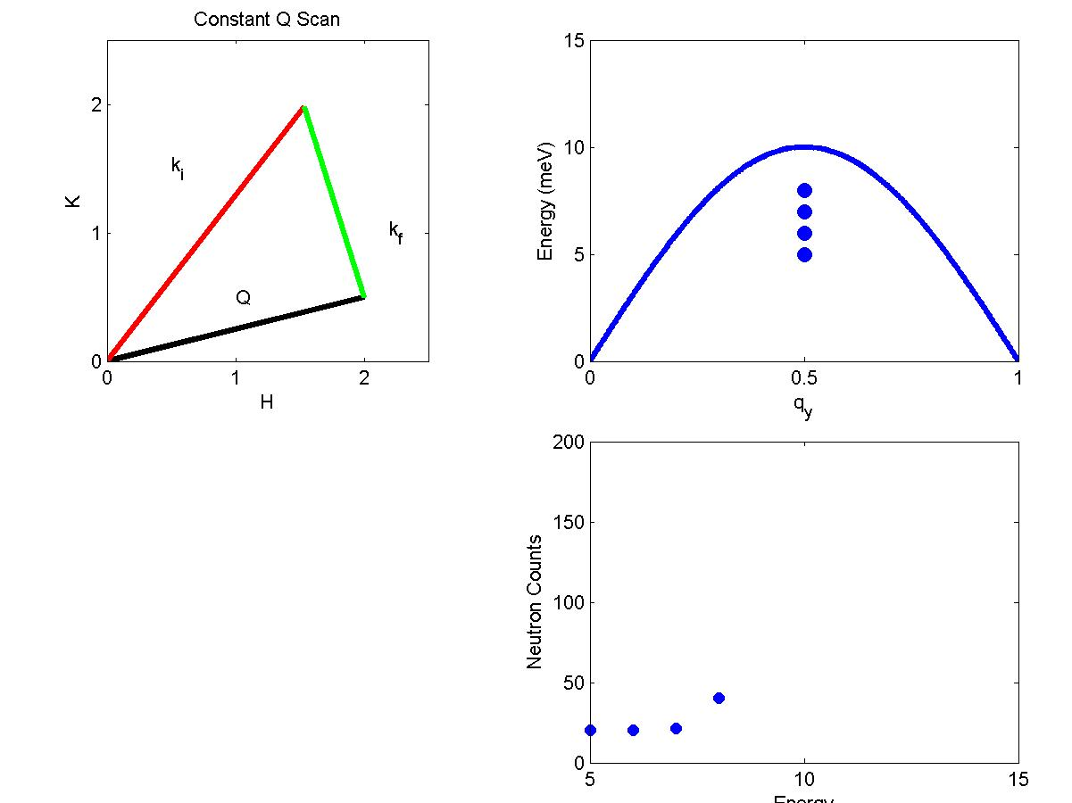
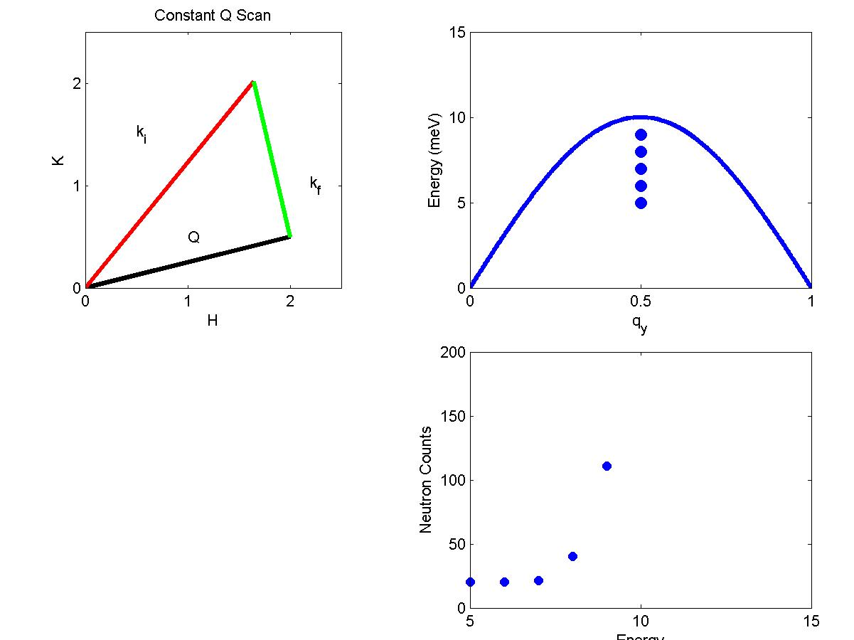
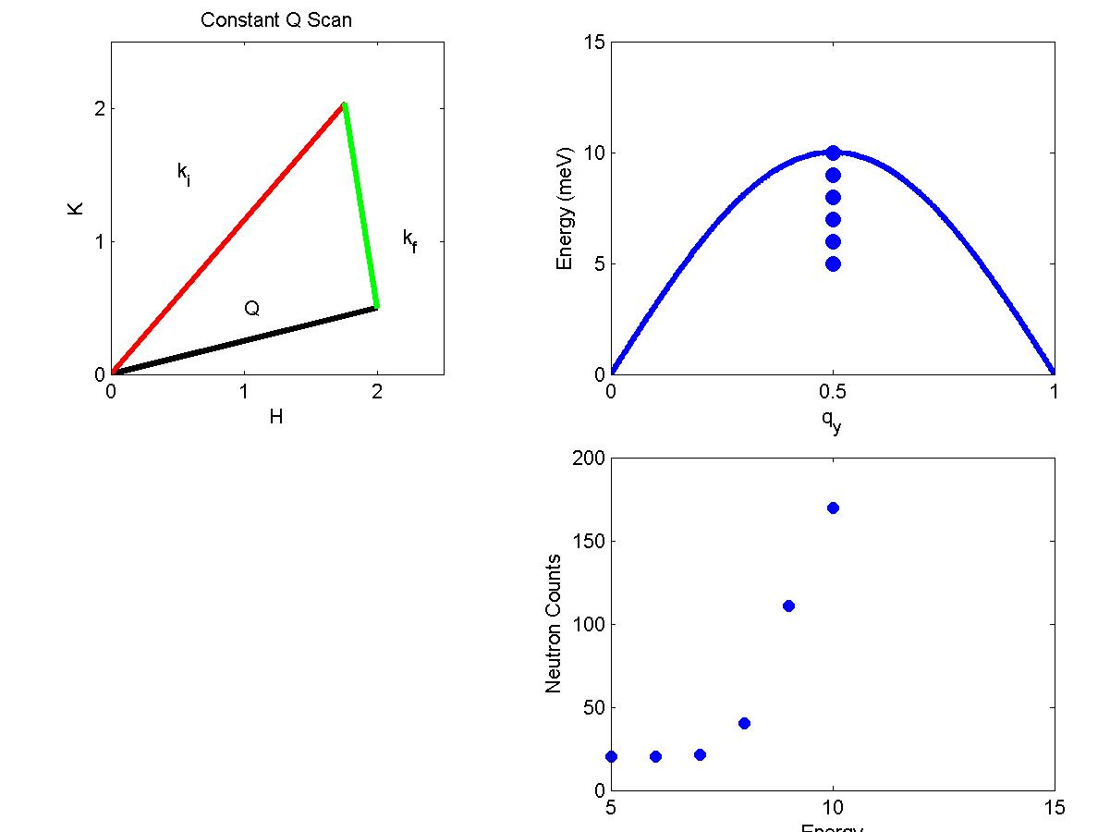
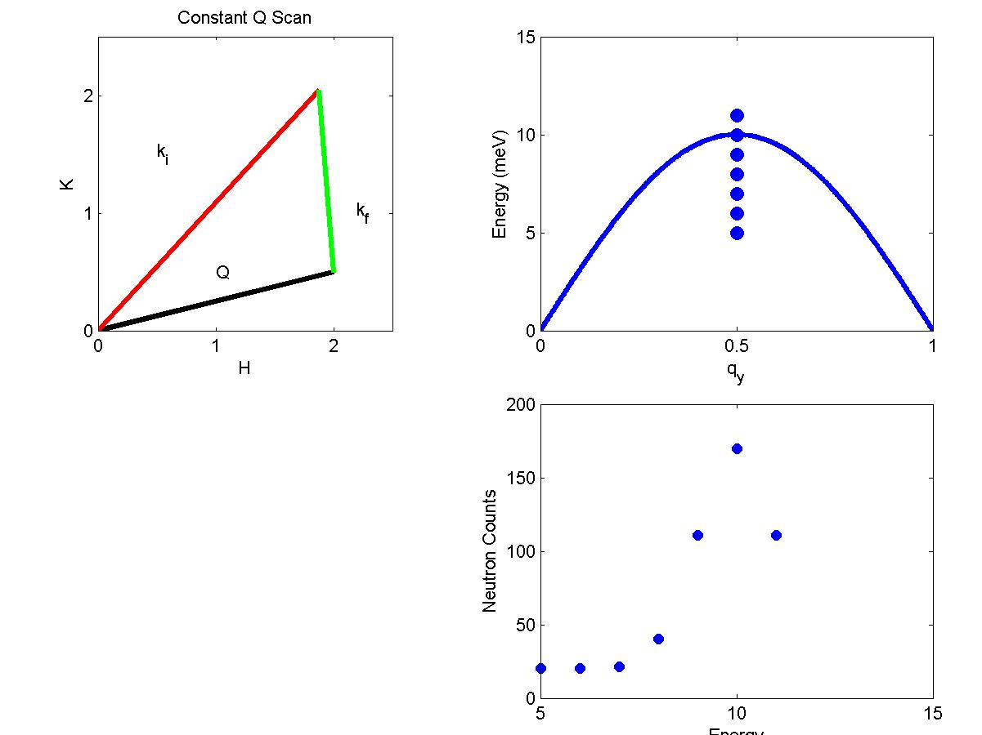
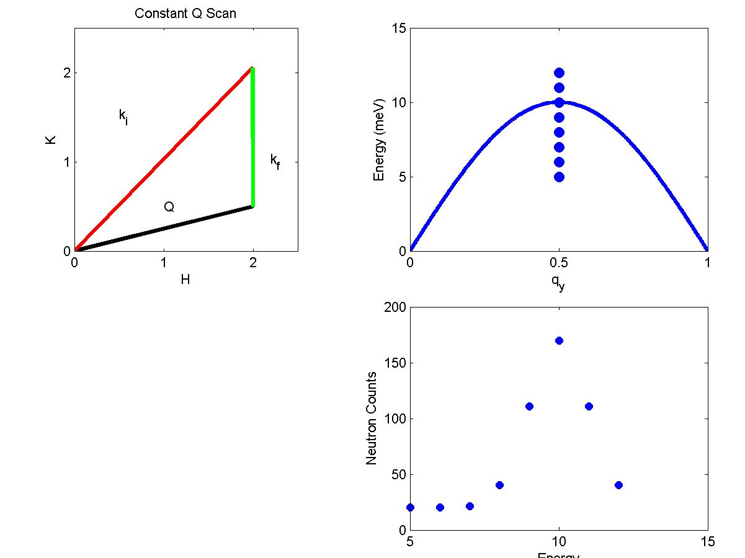
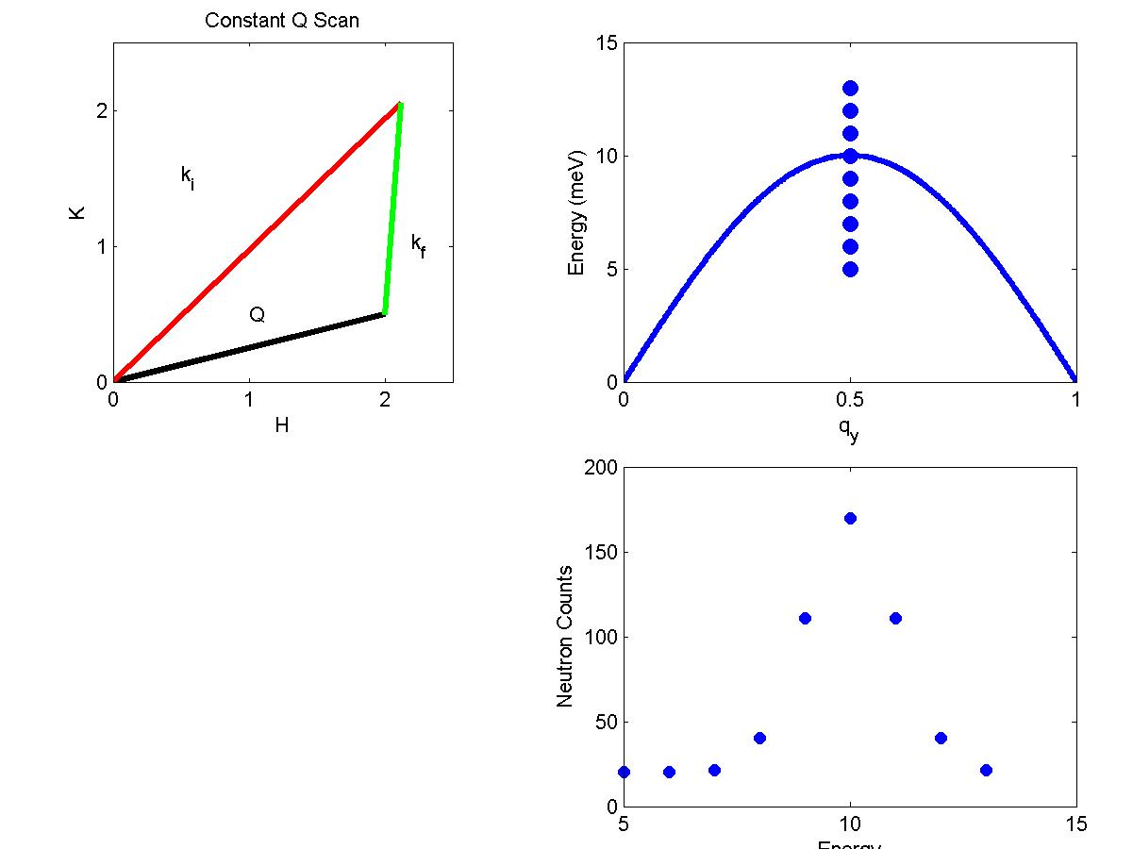
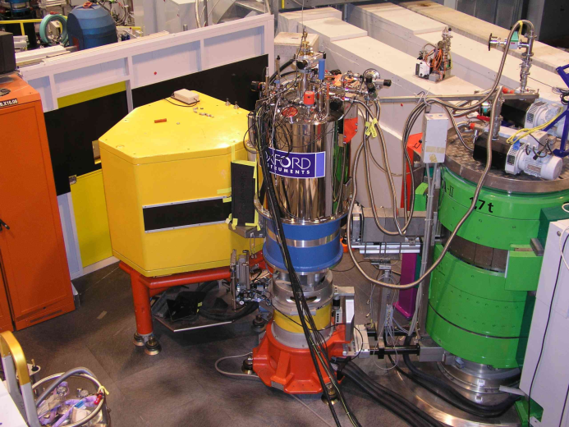
Example: Constant Q Scan with k_{f} fixed
k_{i}
φ
k_{f}
Q
q
0,0,0
G_{hkl}
h,k,l
Procedure:
k_{f} (E_{f}) and Q are fixed
For a given ω can find (E_{i}) k_{i} and φ
Hence can plot scattering triangle
Similar technique gives constant ω scans
Width of observed peak
is determined by resolution
Energy
Notes:
Cosine law.
Work with constant kf, and scan hw at fixed Q, i.e. to measure a phonon (right).
Knowing hw, we can find Ei and then isolate the scattering angle phi.

Slide 38
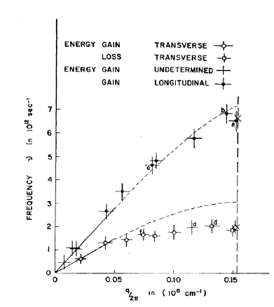
Brockhouse: phonons in Ge
B. Brockhouse (1957)
Q || (111)

Slide 39
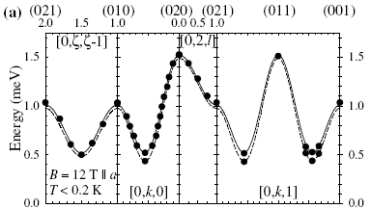
Spin waves in saturated phase of Cs₂CuCl₄ Coldea et al, PRL 88, 137203 (2002)
Phonons dispersion curves and eigenvectors in Si Kulda et al, PRB 50, 13347 (1994)
Spin gap below T_{c} in optimally doped La_{2-x}Sr_{x}CuO₄ Lake et al, Nature 400, 43 (1999)
Bose-Einstein condensation of triplet states in TlCuCl₃ Ruegg et al, Nature 423, 62 (2003)
Notes:
And that’s all … more or less.
Examples
Phonons in perfect Si
Spin waves in saturated CSCuCl4
Spin gap
BE condensation
But one can also do diffraction studies (analyser selectivity -> S/N), or e.g. 2 axis measurements where you get correlations lenghts from essential snapshots
Of the system. → Critical scattering (HMR)

Slide 40
Outline
Repetion from spectroscopy talk
Cross-sections for phonons and magnons, compared and explained
Instruments (more detailed) with examples of results
The resolution function

Slide 41
The resolution function
Idealized:
Realistic:
Distributions {k_{i}} and {k_{f}} around nominal k_{i} and k_{f} lead to distributions of Q and ћω
k_{i}
k_{i}
Q
Q
k_{f}
k_{f}
Consequence:
The measured intensity is not simply proportional to S(Q,ω), but is equal to the convolution of the dynamic structure factor S(Q,ω) with the resolution R(Q-Q₀,ω-ω₀)
R(Q-Q₀,ω-ω₀) depends on all factors influencing {k_{i}} and {k_{f}} e.g. choice of energies, beam collimations, instrument dimensions, scattering sense, crystal mosaicities (TAS) and detector dimensions, chopper speeds (TOF)
Notes:
Show how the orientation of the resolution function is basically given by the spread in scattering angle
One situation when accurate knowledge of the resolution function is key is the determination of lifetimes, as increased energy widths of the excitations.

Slide 42
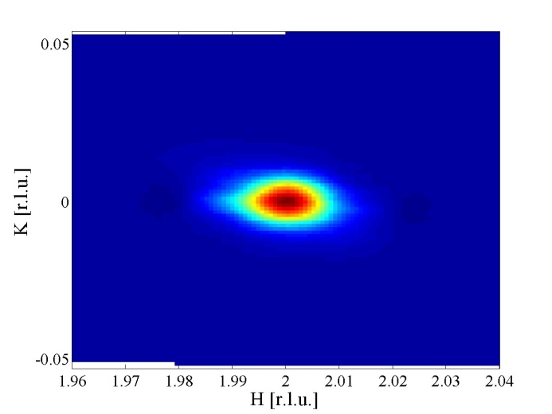
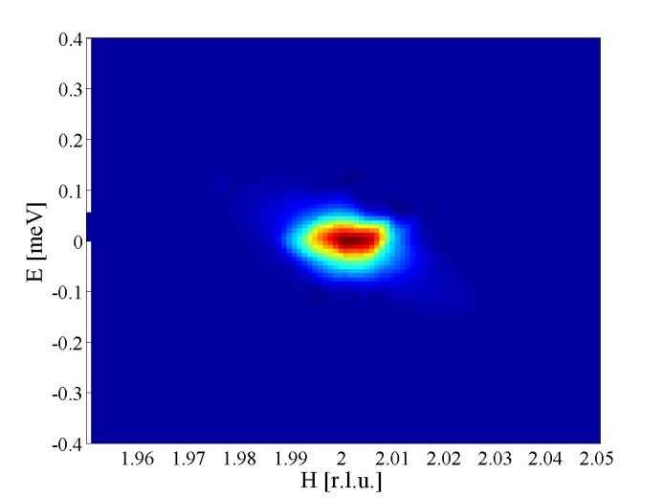
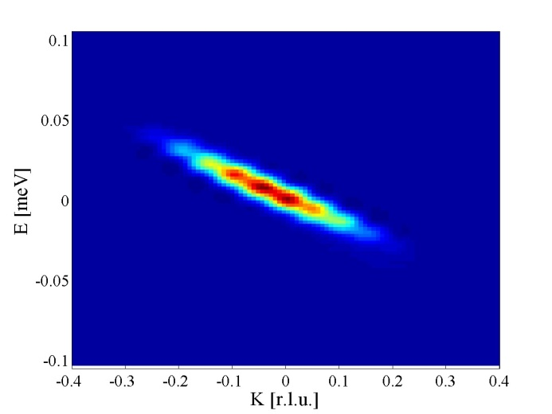
4x4 matrix
Contours of constant R are ellipsoids in 4-dimensional (Q,ћω) space
Q_{z} resolution is decoupled and typically much broader than other components
R(Q-Q₀,ω-ω₀) can be measured. At Bragg reflections
Notes:
For low-dimensional systems, this can be turned into an advantage by putting an irrelevant direction perpendicular to the scattering plane. The vertical resolution then effectively integrates over equivalent Q vectors, thus gaining signal strength. Examples: Cuprates, nickelates, layered quantum magnets, ...
There is a slight approximation involved in measuring the resolution function.
Data analysis. Choose a model for S(q,w) convolute it with R computed by program and fit to data.

Slide 43
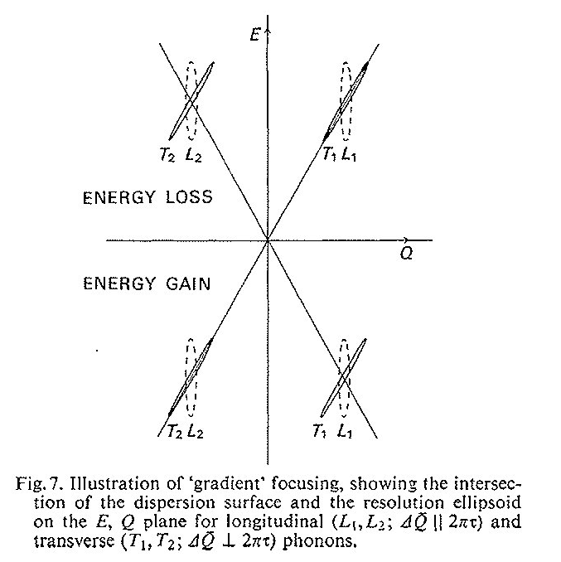
Focussing:
When the slope of R matches that of the dispersion, a sharp mode is observed. Conversely, for a large slope mismatch, a broad mode is observed. In extreme cases, the broad mode may become invisible.
Transverse acoustic phonons in MgO.
Notes:
At low energies, the resolution is insufficient to resolve the counter propagating spin wave modes.

Slide 44
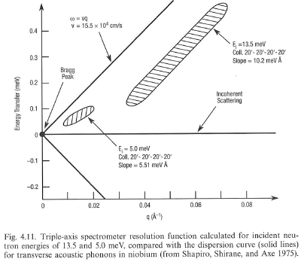
Resolution tailoring: Take advantage of the high flexibility of a TAS to optimise the resolution conditions for a given measurement, obtaining sharper spectra and better signal-to-noise levels.
Incident beam resolution volume V_{i}~ A_{i}(C₀,C₁,…)k_{i}³cot(θ_{M})
Scattered beam resolution volume V_{f}~ A_{f}(C₂,C₃,…)k_{f}³cot(θ_{A})
Notes:
Really not 2*theta as arguments???

Slide 45
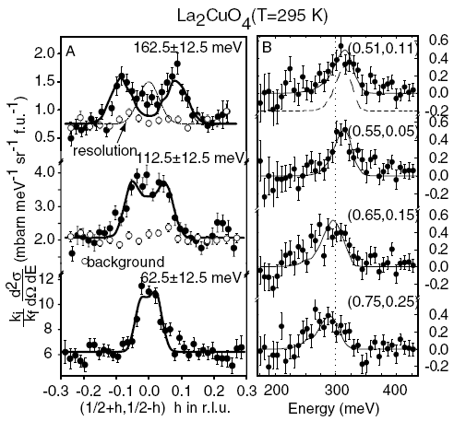
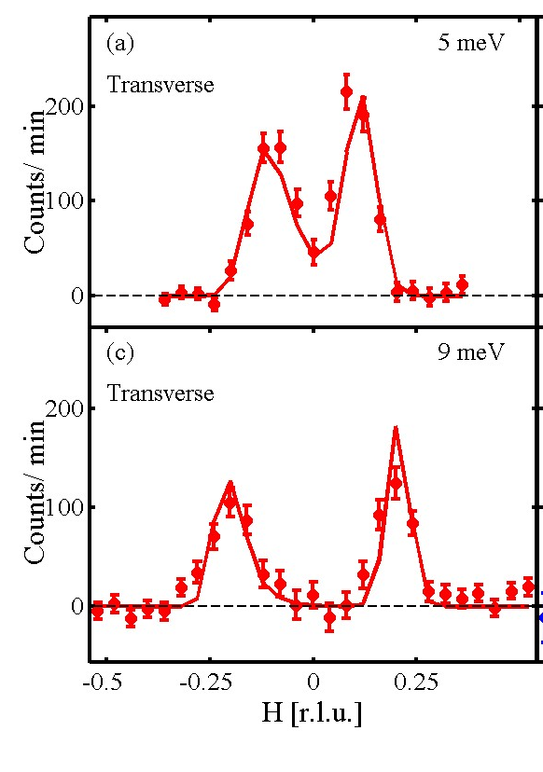
R(Q-Q₀,ω-ω₀) is computable using analytic formulas (Gaussian approximations of all contributing factors) or using Monte Carlo simulations of the neutron flight path through the instrument. See this afternoon
Data analysis: Choose a model for S(Q,ω). Convolve with R(Q-Q₀,ω-ω₀) and fit to the experimental data.
Accurate knowledge of R(Q-Q₀,ω-ω₀) is essential in order to extract trustworthy values of widths in Q and ћω, which can in turn be related to real-space correlations lengths and excitation lifetimes

Slide 46
Conclusions
Inelastic neutron scattering is the study of propagating and damped modes involving two-particle correlations (as opposed to diffusion)
Inelastic scattering lets us understand the dynamic properties of materials and extract lattice and magnetic couplings.
This, in turn, allows us to understand structure/magnetism and ultimately the functionality of materials.
Main spectroscopic tools: Direct time-of-flight, triple axis spectrometers. Each has its advantages and disadvantages in terms of flux, resolution, ease of data-analysis, …

Slide 48
Example: Effect of superconductivity on phonon lifetime

Slide 49
Electrical resistivity in metals
What determines the resistivity?

Slide 50
Electrical resistivity in metals
Electron-defect scattering
Edges, missing atoms, different atoms …

Slide 51
Electrical resistivity in metals
Electron-electron scattering

Slide 52
Electrical resistivity in metals

Slide 53
Electrical resistivity in metals
Electron-phonon scattering
Lattice vibrations

Slide 54
Electrical resistivity in metals
e-defects
e-e
e-ph

Slide 55
Electrical resistivity in superconductors

Slide 56


Superconductors
Bardeen, Cooper, Schrieffer (1957)
Superconductivity is mediated by lattice vibrations, which can cause electrons (fermions) to pair, despite the strong Coulomb repulsion. These Cooper pairs are bosons and can Bose-Einstein condense into the same ground state.
In this state the electron spectrum has a gap Δ(T) related to the cost of breaking a pair

Slide 57


Demonstration using phonon lifetime
Nb₃Sn, T_{c}=18.3K
J. D. Axe, G. Shirane, Phys. Rev. Lett. 1973

Slide 58
Neutron Spectroscopy Spallation Source Instruments
Remember how a spallation source works:
A pulsed proton beam hits a target made from a heavy element target
The fast neutrons are moderated, but the result is still a pulsed beam
Time-of-flight principle
Indirect time-of-flight geometry:
Constant k_{f} instruments
Distance L₁
Sample
Distance L₂
Moderator
Detector
Analyser

Slide 59

Indirect time-of-flight spectrometers
IRIS@ISIS
White incident beam
Bragg reflection at analysers; 2θ_{A}~180°
From E_{f}~λ_{f}⁻² and Bragg’s law, nλ_{f}=2dsin(θ_{A})
Cs₂CuCl₄
Coldea et al, PRB 68, 134424 (2003)
See Heloisa Bordallos talk for more on high resolution measurements
Notes:
Example of an indirect time-of-flight spectrometer
The beam coming from the moderator (some pulse shaping takes place?) is now allowed to hit the sample, without being monochromated. After scattering from the sample, they are Bragg reflected by a set of analyser crystals towards the detector(s).
We know the distances and angles of the instrument, analyseres and detectors. From the time of burst to the time of detection, the time t has elapsed. We know that the detected neutrons have a particular energy, and we know they have travelled a distance L2 from sample to detector. Hence, we can compute their travelling time t2 by
T2=L2/v2 where v2=sqrt(2E/m). We can then find the initial energy of a particular scattering process by finding t1=t-t2 and knowing the initial flight path L1. We then have the energies of the incident and final neutrons of a particular scattering event, and we can use our knowledge of the angles of the instrument to find Q as well.
The analysers are in near backscattering condition. This leads to very good energy resolution, as can be seen by looking at the equations.
A similar trick also applies in triple axis neutron scattering. Good energy resolution is obtained near backscattering, i.e. for low final energies.
Indirect TOF machines are often used to study low-energy magnetic processes in quantum spin systems, and I will give 1-2 examples.

