Slide 1

Introduction to spectroscopy
ħω
Applications of X-ray and neutron scattering in biology, chemistry and physics 23/8 2012
Niels Bech Christensen
Department of Physics
Technical University of Denmark
nbch@fysik.dtu.dk
Q

Slide 2
Outline
Recap of useful concepts
Problems to tackle with spectroscopic tools
Time and energy scales
Spectroscopic instrument types and principles

Slide 3
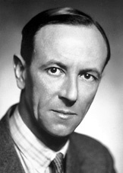

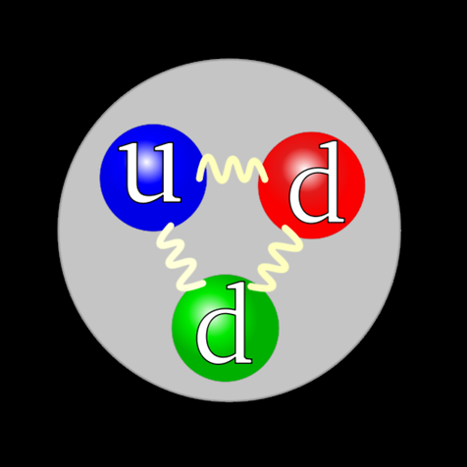
Properties of the neutron
Mass : 1.675 10⁻²⁷ kg
Charge : 0 (no Coulomb)
¹₀n → ¹₀p + e⁻ + μ_{e}
Lifetime: 886(1) sekunder
Spin : ½ (magnetic)
Magnetic dipole moment: μ = -1.913 μ_{N}
Nobel price 1935
James Chadwick
Notes:
The neutron was discovered in 1932 (results were published on the 1st of June in the Proceedings of the Royal Society) by James Chadwick, who in 1935 received the Nobel price in 1935 for this feat
For the particle physicist, the neutron is a many body problem. It consists of one up quark, and two down quarks. Each has spin ½, and the angular momenta of the three quarks sum to ½.
Nuclear magneton: mu_N = 5.05 10⁻²⁷ J/T

Slide 4
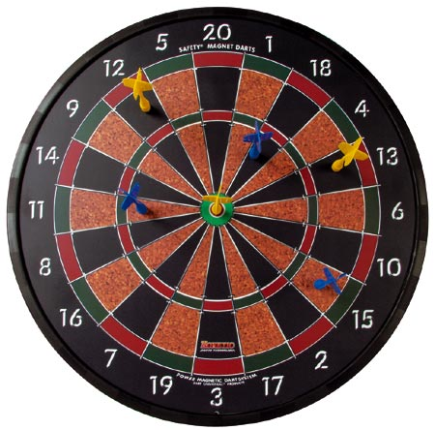
Interactions with matter
Nuclear interaction with atomic nuclei
Magnetic interaction with the angular momenta of electrons in unfilled shells
Short range : ~10⁻¹⁴ –10⁻¹⁵ m
Isotropic, central potential V_{n}=V_{n}(r)
Typical magnitude of cross-section: 10⁻²⁸ m²
Longer range : ~10⁻¹⁰ m
Anisotropic, non-central potential V_{m}=V_{m}(r)
Typical magnitude of cross-section: 10⁻²⁸ m²

Slide 5
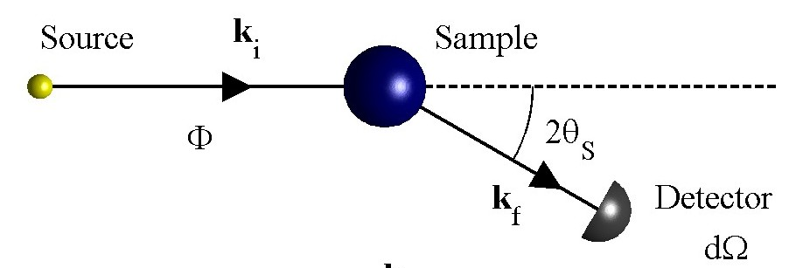
Conservation laws
Scattering triangle
k_{i}
Q
k_{f}
Momentum
Energy
Spin
Polarization analysis
Spin echo
Notes:
The picture to the left shows the basic situation in a scattering experiment: Neutrons of flux Φ (units: neutrons/s/m^2) and wavenumber ki
hit a sample (blue ball). The beam may be spin polarized (blue arrow) but mostly is not. At the sample, some neutrons are scattered through
an angle 2Ө. They may change their spin state (red/blue arrows) and wavenumber kf. Finally, they are detected by a detectors subtending
The solid angle element dΩ.
Energy and momentum have to be conserved, so we get equations for the momentum and energy imparted to the sample (Q and ħω). For polarised
Neutron experiments there is also changes in the spin state to consider. The equaltion for Q defined the scattering triangle, which is spanned by ki, kf
and Q.

Slide 6
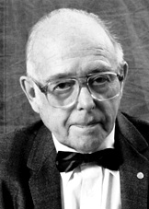
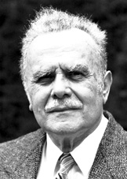
1994: Nobel price winners
"for pioneering contributions to the development of neutron scattering techniques for studies of condensed matter"
Clifford G. Shull (1915-2001), USA
"for the development of the neutron diffraction technique"
”Where atoms/spins are …
Bertram N. Brockhouse (1918-2003), Canada
"for the development of neutron spectroscopy"
”… and what atoms/spins do”
Notes:
Nobel prices in 1994:
~40 years of delay in getting the price, primarily due to politics. Neutrons scattering is associated with atomic energy which does not have a great reputation in the broader public. Actually this price is the record for delay between work done and price received.
Ernest Wollan, who had done a lot in the early years and should have been a recipient, died in 1984.
Shull contributed to diffraction: The study of static properties of matter, or ”where atoms are”
Brockhouse received his Nobel price for the development of techniques to study dynamics properties, or ”what atoms do”
The Nobel committee quote specifically mentions condensed matter, but neutrons can also be used to study liquids and biological systems.

Slide 7
Nuclear coherent and incoherent
Coherent scattering cross-section (Bravais lattice)
Incoherent scattering cross-section
Averages over isotopes and total spin states
Notes:
Coherent scattering involves scattering from different ions at different times. This can give rise to interference (for example Bragg peaks or peaks correponding to coherent propagating excitations)
By contrast, the incoherent scattering involves scattering from the same ion at different times. This cannot give interference and appears as flat or slowly varying background below the Bragg peaks.
A given Bragg peak, is easier to observe if the background is low. Hence, one would like to work with elements/isotopes which give rise to little or no background, if one is interested in structure or excitations. By contrast, if one is interested in single-particle properties, working with elements/isotopes with a large incoherent cross-section.
The expression for the mean value of b for a given element involves c_xi – the fraction of these elements being a specific isotope xi – and the nuclear spin I_xi of that isotope.

Slide 8
Nuclear coherent and incoherent
Coherent scattering cross-section (Bravais lattice)
Incoherent scattering cross-section
Fourier transforms in temporal and spatial coordinates of 2-point correlation functions (same for magnetic interactions)
Coherent scattering : Different particles (j,j sum. Interference)
Incoherent scattering : The same particle (j sum. No interference)
Notes:
Coherent scattering involves scattering from different ions at different times. This can give rise to interference (for example Bragg peaks or peaks correponding to coherent propagating excitations)
By contrast, the incoherent scattering involves scattering from the same ion at different times. This cannot give interference and appears as flat or slowly varying background below the Bragg peaks.
A given Bragg peak, is easier to observe if the background is low. Hence, one would like to work with elements/isotopes which give rise to little or no background, if one is interested in structure or excitations. By contrast, if one is interested in single-particle properties, working with elements/isotopes with a large incoherent cross-section.
The expression for the mean value of b for a given element involves c_xi – the fraction of these elements being a specific isotope xi – and the nuclear spin I_xi of that isotope.

Slide 9
Real and reciprocal space:
Fourier transformation

Slide 10
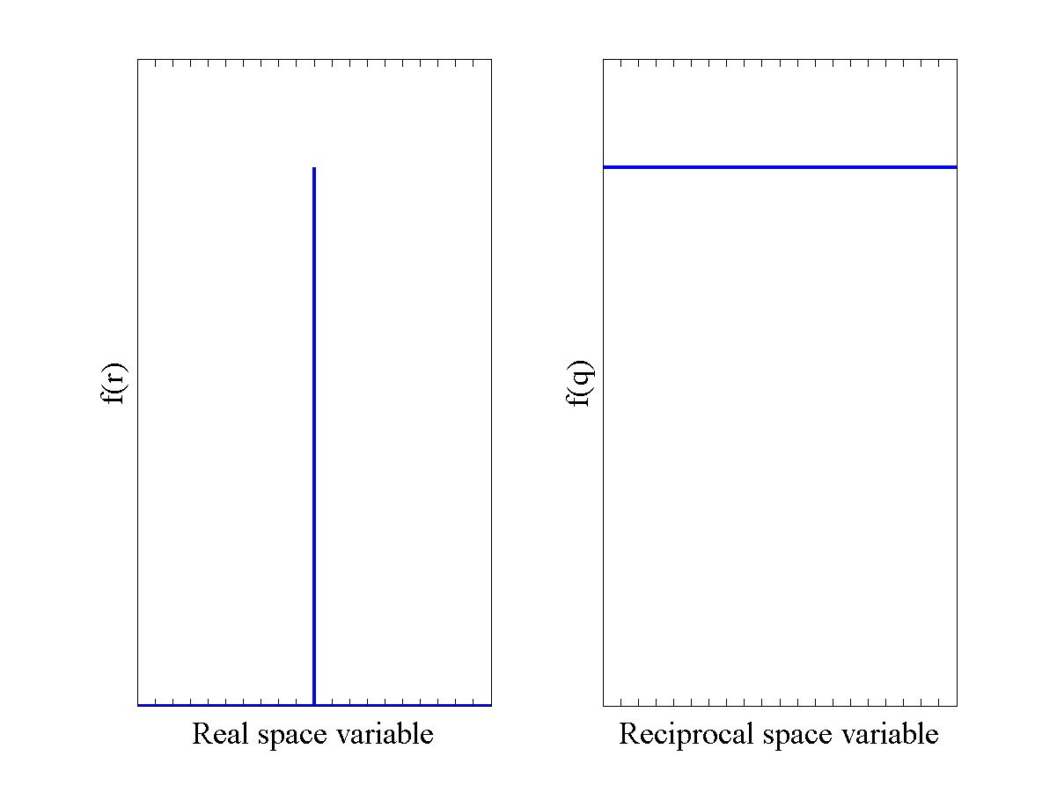
Examples of Fourier transforms
Point-like object → Constant in Q
e.g. absence of formfactor for scattering from nucleus

Slide 11
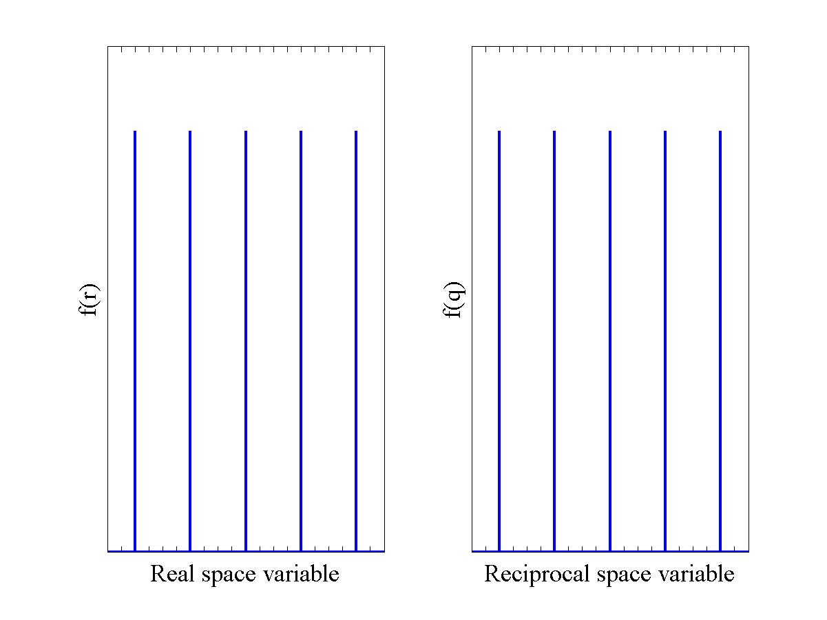
Examples of Fourier transforms
Atoms in a crystal → Bragg reflections
(for time-independent two-point correlations)

Slide 12
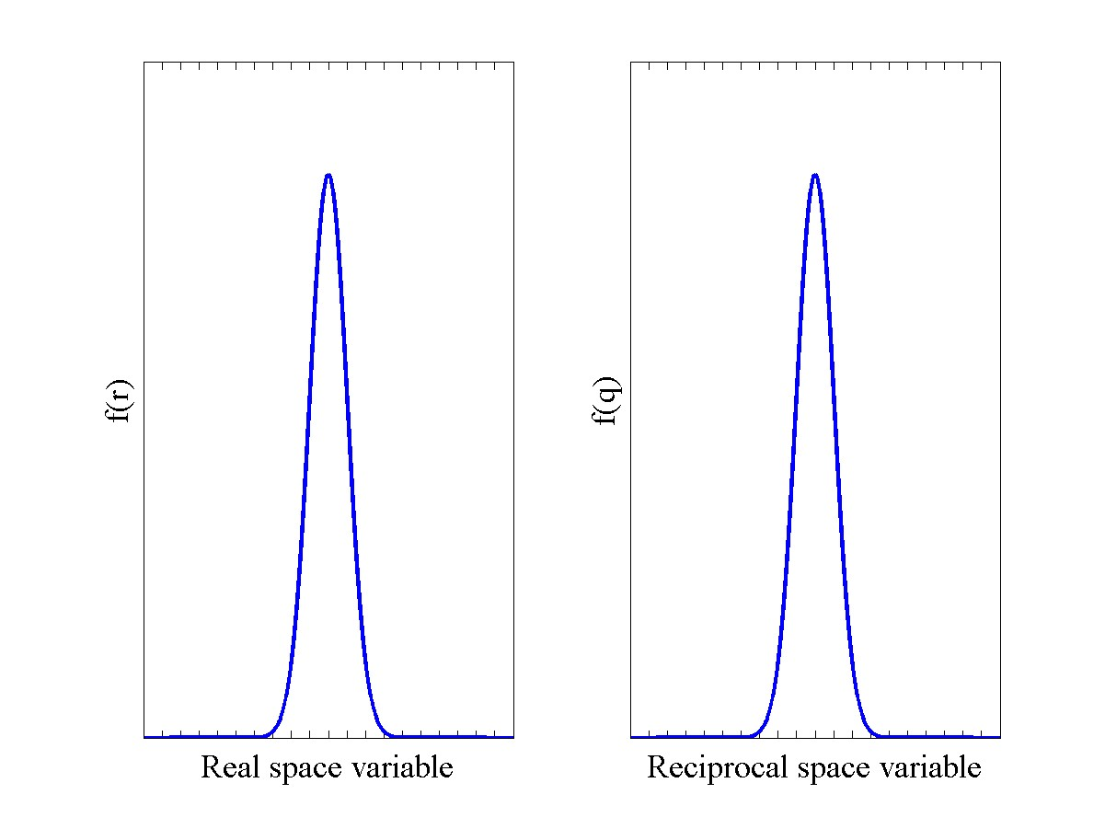
Examples of Fourier transforms
An extended object in R → An extended object in Q
e.g. formfactor for magnetic scattering

Slide 13
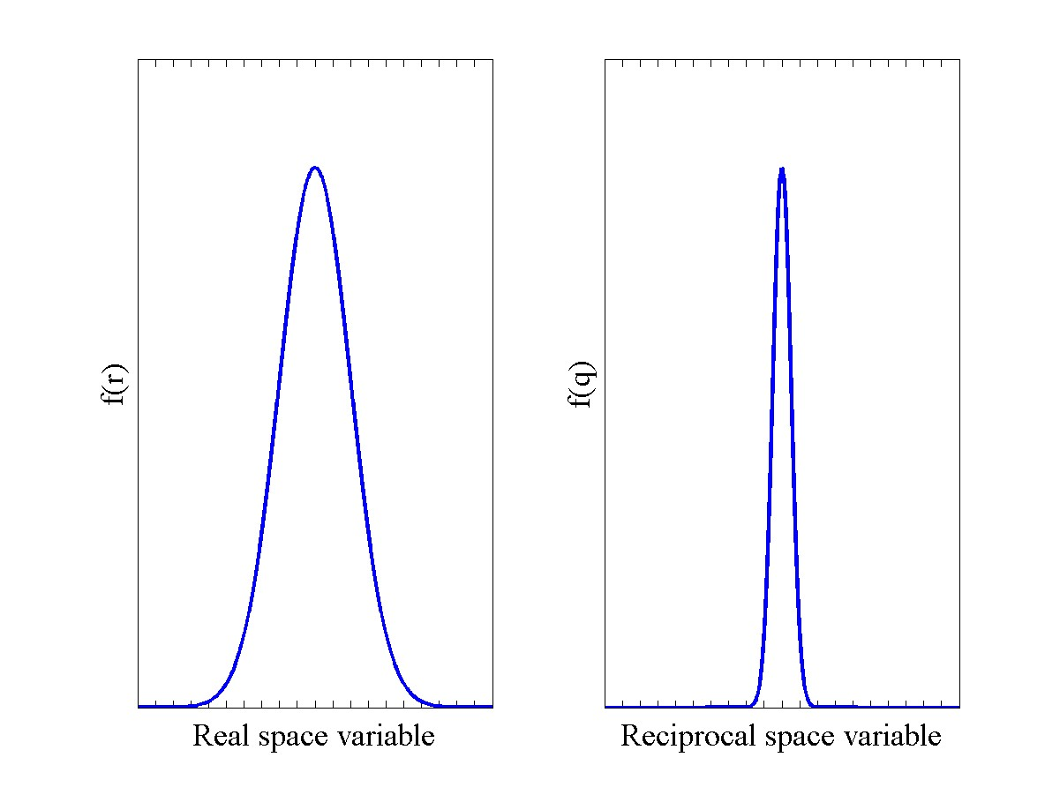
Examples of Fourier transforms
Double width in R → Width in Q decreases by factor 2

Slide 14
Time and energy:
Fourier transformation

Slide 15
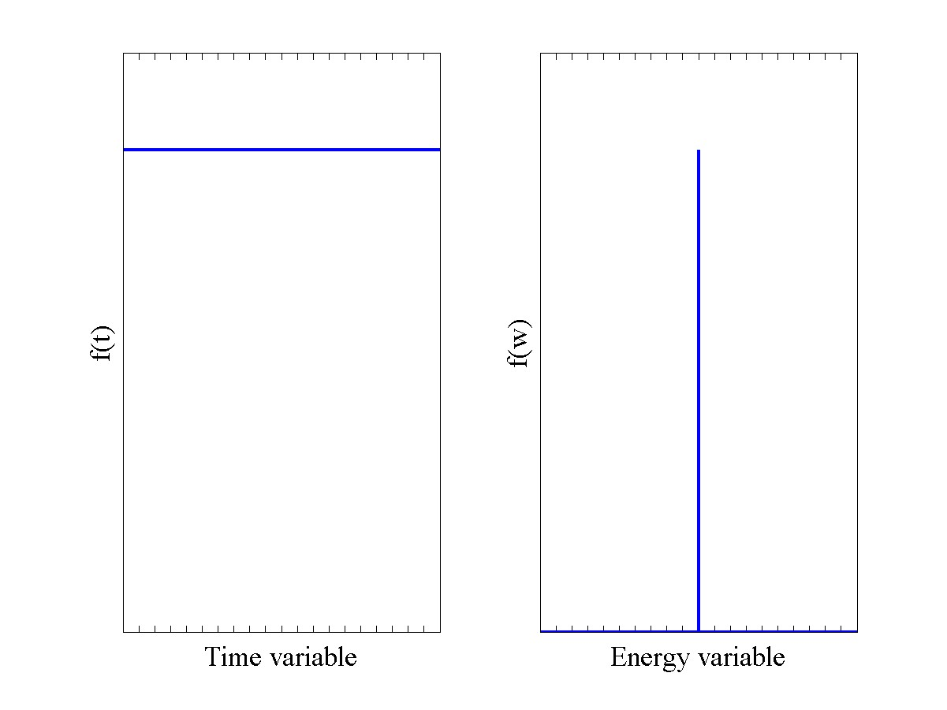
Examples
Time-independent phenomena (eigenstates) → Bragg peaks, sharp inelastic modes

Slide 16
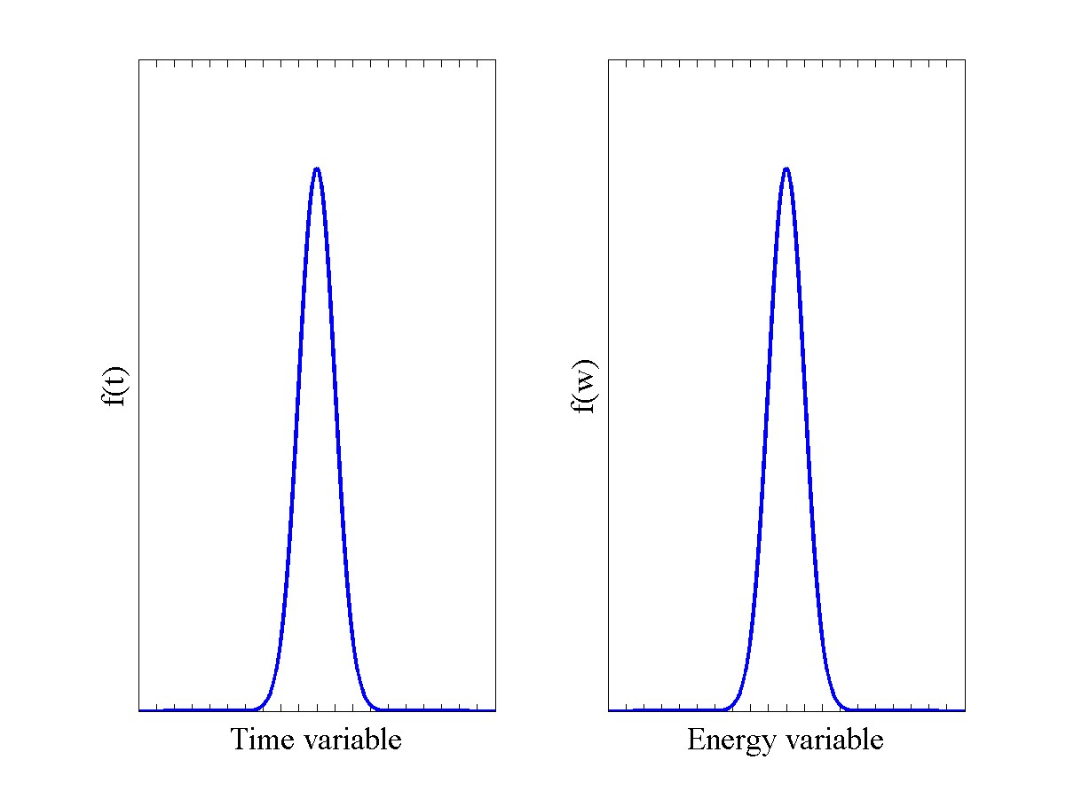
Examples
A broad distribution of time-scales → Finite width in energy

Slide 17
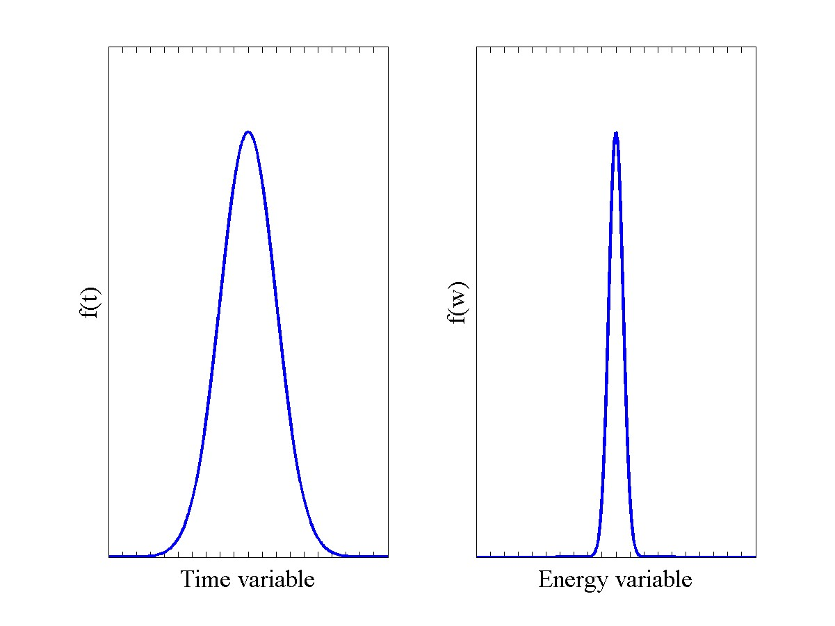
Examples
Double the width in time → Reduce the energy width by factor 2
e.g. lifetime broadening/narrowing

Slide 18
Outline
Recap of useful concepts
Problems to tackle with spectroscopic tools
Time and energy scales
Spectroscopic instrument types and principles

Slide 19
Problems to tackle by spectroscopic methods
Diffraction allows us to obtain the structure of matter (crystals, polymers, etc) but that structure is itself determined by the manner in which the constituent atoms/molecules bind, and by the strength of these couplings
Spectroscopy allows us to extract the value of the couplings from inelastic scattering, e.g. relating to the stiffness of a material, its magnetic properties etc.
Spectroscopy also allows us to extract e.g. the rates of diffusion etc from quasielastic scattering
Why do we need these values? Ultimately, because we want to be able to control the properties of future materials, which depend on the couplings. Materials design, drug development, ….

Slide 20
Problems to tackle by spectroscopic methods
Lattice vibrations : thermoelectrics, conventional superconductors, …
Magnetic excitations : magnetoelectrics, magnetocalorics, colossal magnetoresistance, unconventional superconductors,…
Fundamental physical problems : (quantum) phase transitions, skyrmionics, spin ice, glassy dynamics, …
Diffusion processes : e.g. of water in matter, hydrogen storage, …
Vibrational spectroscopy : chemistry, catalysis,
Biology and soft matter : proteins, DNA, polymers, medicine, …

Slide 21
Outline
Recap of useful concepts
Problems to tackle with spectroscopic tools
Time and energy scales
Spectroscopic instrument types and principles

Slide 22
Time and energy scales
1 meV = 1.602 10⁻²² Joule
1 THz = 4.14 meV
1 cm⁻¹ = 0.124 meV
4 μs
4 ns
4 ps
4 fs
t
250 kHz
250 MHz
250 GHz
250 THz
υ
1 neV
1 μeV
1 meV
1 eV
E
Notes:
Identify where your problem is in this plot. What is the relevant time-scale? If it is micro-seconds, forget about fs instruments.

Slide 23
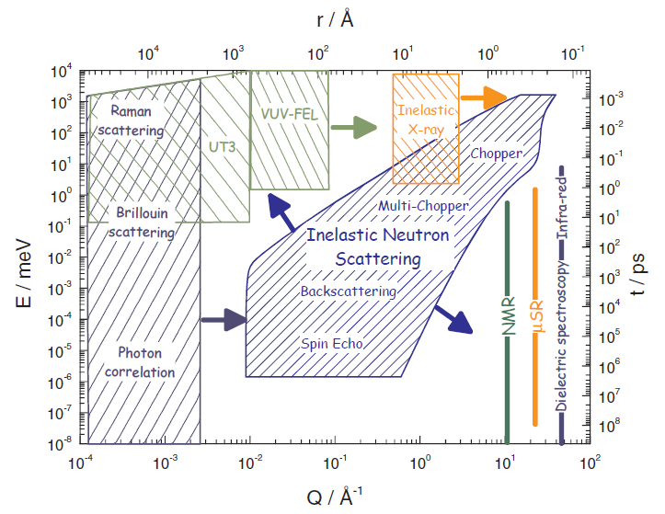
Neutrons : r and t coverage
Neutron scattering covers a very large range of (r,t) and (Q,E)
including ranges not covered by complementary techniques
Notes:
Note how neutron scattering covers a very large range in this log log plot

Slide 24
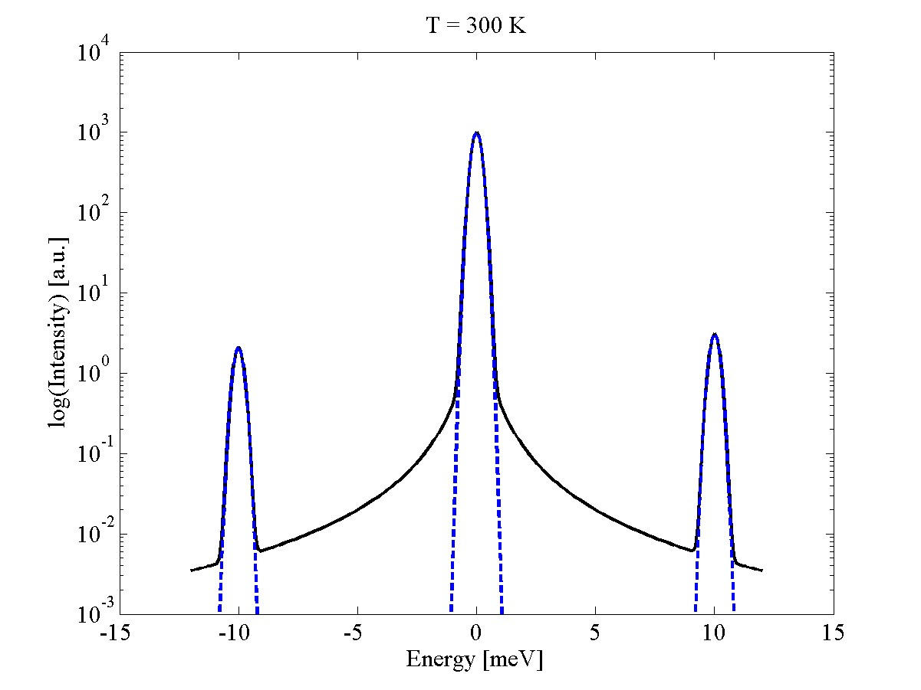
Types of scattering
Elastic
Inelastic
Inelastic
Different spectroscopic problems (characteristic times!) impose different requirements in terms of resolution.
Therefore, several spectroscopic instrument types exist
Quasi-elastic

Slide 25
Outline
Recap of useful concepts
Problems to tackle with spectroscopic tools
Time and energy scales
Spectroscopic instrument types and principles

Slide 26
Instrument types:
Triple-axis spectrometers
Time-of-flight spectrometers (direct)
Time-of-flight spectrometers (indirect)
Spin echo spectrometers

Slide 27
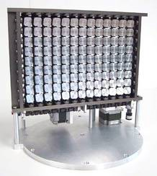
Triple-axis spectrometers
Key optical element: The monochromator/analyzer
Bragg’s law
Laue condition
A good monochromator material should:
Should have a high σ_{coh}/ σ_{inc} ratio
Should have a high peak reflectivity
Should not be too perfect (due to extinction, backside does not scatter)

Slide 28
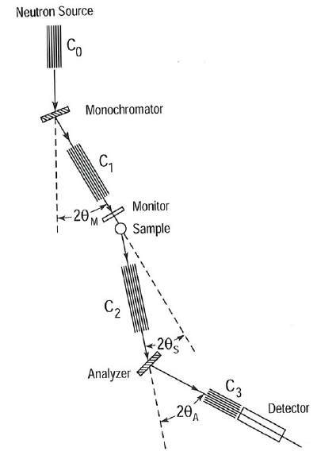

Triple-axis spectrometers
Extremely simple principle due to Brockhouse
3 axes
Monochromator-Sample (a1,a2=2θ_{M})
Sample-Analyser (a3,a4 =2θ_{s})
Analyser-Detector (a5,a6= 2θ_{A})
The setting of a2 and a1=a2/2 defines k_{i}
The setting of a6 and a5=a6/2 defines k_{f}
The setting of a3 and a4 defines the Q of the crystal probed
a1,a3,a5 are rotations of the mono,sample and analyser about the vertical
That’s all folks!
Well … not quite. Stay tuned
Notes:
Not a complete list!

Slide 29
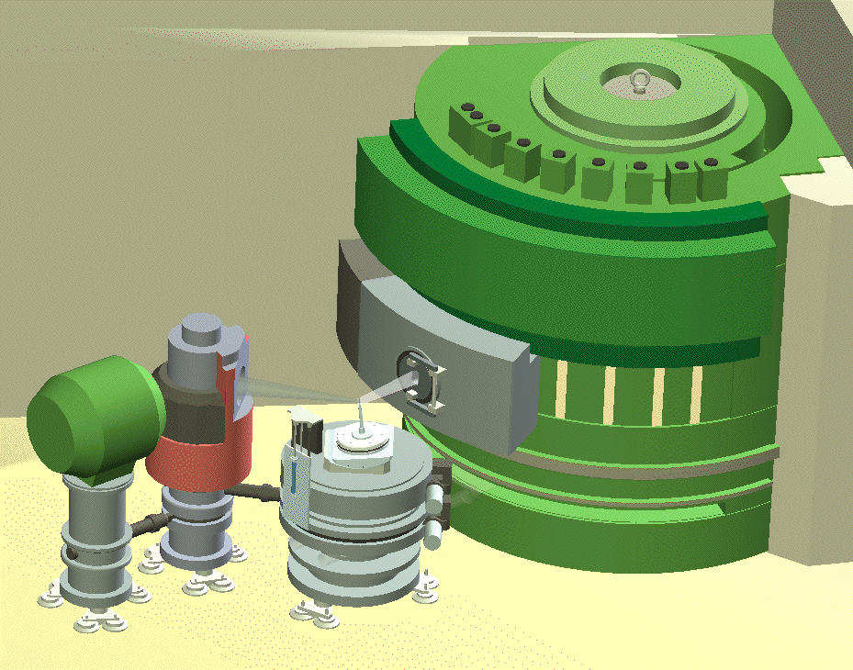
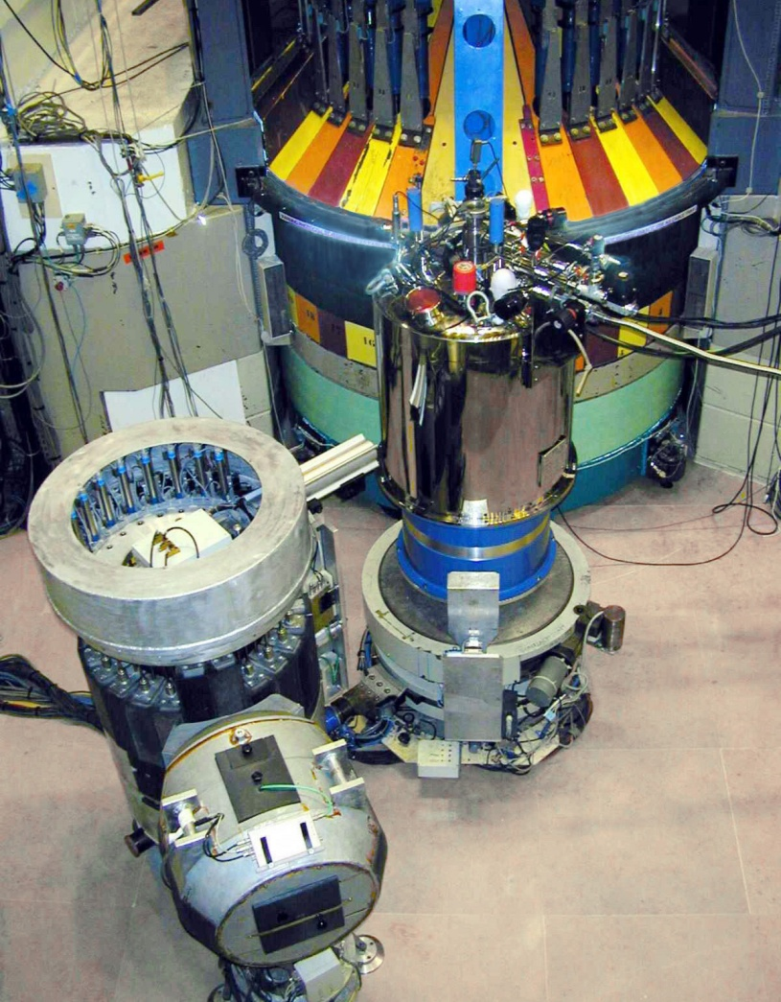
Triple-axis spectrometers
Bragg’s law
Analyzer (Bragg reflection)
λ
λ
θ
θ
Monochromator (Bragg reflection)
Sample S(Q,ω)
d
High incoming flux: O(10⁷) n/s/cm2 (IN14)
Flexible
Point-by-point measurements in (Q,ħω) space
Polarization analysis
Cold: 2 meV <E_{i}<15 meV
Thermal: 15 meV< E_{i}<100 meV
Hot: E_{i}>100 meV
Notes:
Here is a schematic figure showing how a triple-axis spectrometer looks.
Triple axis spectrometers can be used not only for the study of magnetic and nuclear excitations, but also for the study of order. In particular, the visibility of weak signals can sometimes be significantly enhanced by allowing the analyser to select only elastically scattered neutrons, whereas a conventional diffractometer also counts the inelastic processes, which may give a large incoherent “background” signal preventing unambiguous identification of the signal.
Two modes of running a TAS
Constant ki mode
Constant kf mode

Slide 30
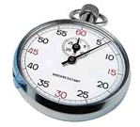
Time-of-flight spectrometers
General principles:
Pulsed beams (spallation sources or chopped beams at reactors)
Energies and momenta are deduced from measured time-differences (from pulse creation to neutron detection) and known distances and angles
Distance L
Moderator

Slide 31
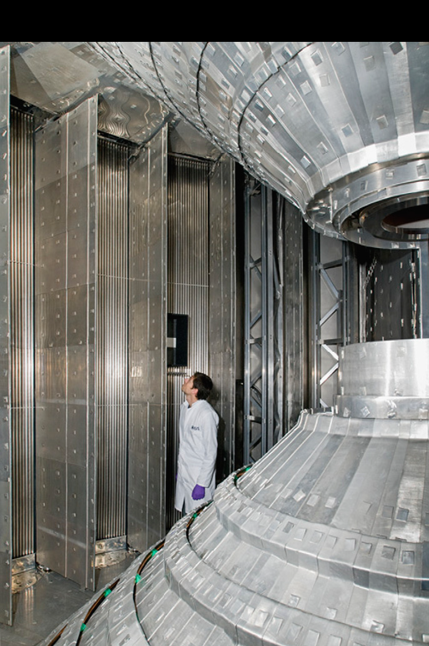
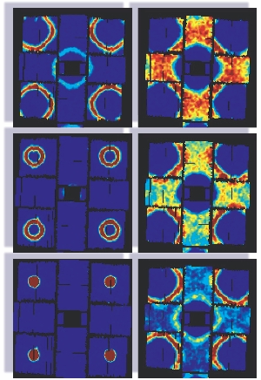
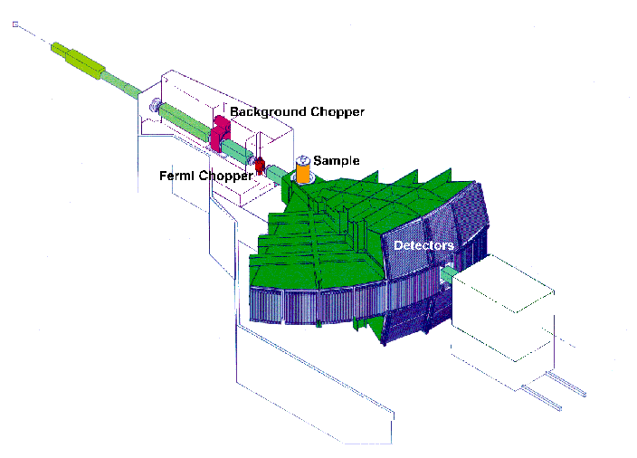
Direct time-of-flight spectrometers
k_{i} fixed
MAPS, ISIS
Choppers
Low incident flux
Low flexibility (TOF parabola)
Massive parallel data acquisition in (Q,ħω) “Making maps of magnetism”
Rb₂MnF₄
Huberman et al, PRB 72, 014413(2005)
Notes:
A direct time of flight spectrometer works in constant ki mode. Neutrons are created by a spallation process (See Peter Allenspach lecture).
Direct geometry TOF spectrometers have far fewer monochromatic neutrons incident on the sample position. They compensate for this by using
large detector arrays, collecting neutrons at many (Q,hw) simultaneously, while TAS spectrometers access (Q,hw) space one point at a time.
Example of MAPS spectrometer, ISIS facility, Oxford, UK
When a burst of neutrons is created, a stop clock is started. neutrons with a distribution of energies are emitted and slowed down by (elastic) scattering in a moderator (typically water or methane, because these are fast equillibrators?) MUST THE STOP CLOCK NOT BE AFTER THE MODERATOR?
Neutrons are emitted with a distribution of different energies. Knowing the path length from the burst position (OR MODERATOR) to the sample position, one can compute the exact time of arrival of neutrons of each energy. A system of spinning discs etc, known as choppers allow only neutrons of one particular energy to actually reach the sample, while not allowing the slowest neutrons in bunch number 1 to be overtaken by the fastest from bunch number 2 (frame overlap).
At the sample position, we therefore have a monochromatic beam (as in the case of triple axis spectrometers) of neutrons. Knowing the distances to any detector from the sample position, and measuring the time of a arrival of a neutrons at the detector, we can work out what energy these neutrons have, and hence the energy transferred to the sample. By knowing the angles to all detectors as well (MAPS potentially has 150000 individually adressable detectors, and the trend goes to higher and higher angular coverage), one can work out the momentum Q transferred to the sample as well.
A direct geometry TOF allows energies from Ei to –infty to be covered.
For low-dimensional magnetic systems (quantum magnetism in 1D and 2D, high-Tc superconductors, etc), particular sample orientations provide for very efficient data collection.
SHOULD there be a summary slide of TAS versus TOF spectroscopy? Perhaps as a sort of conclusion?

Slide 32
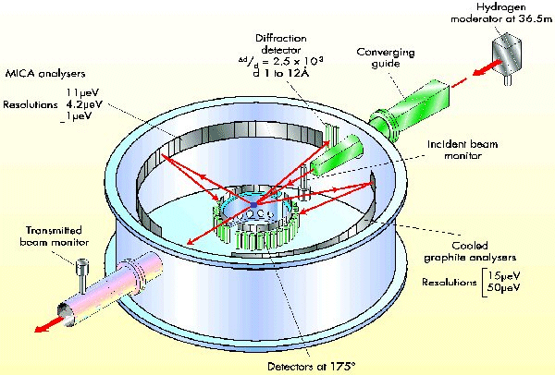
Indirect time-of-flight spectrometers
IRIS@ISIS
White incident beam
Bragg reflection at analysers; 2θ_{A}~180°
From E_{f}~λ_{f}⁻² and Bragg’s law, nλ_{f}=2dsin(θ_{A})
Cs₂CuCl₄
Coldea et al, PRB 68, 134424 (2003)
See Heloisa Bordallos talk for more on high resolution measurements
Notes:
Example of an indirect time-of-flight spectrometer
The beam coming from the moderator (some pulse shaping takes place?) is now allowed to hit the sample, without being monochromated. After scattering from the sample, they are Bragg reflected by a set of analyser crystals towards the detector(s).
We know the distances and angles of the instrument, analyseres and detectors. From the time of burst to the time of detection, the time t has elapsed. We know that the detected neutrons have a particular energy, and we know they have travelled a distance L2 from sample to detector. Hence, we can compute their travelling time t2 by
T2=L2/v2 where v2=sqrt(2E/m). We can then find the initial energy of a particular scattering process by finding t1=t-t2 and knowing the initial flight path L1. We then have the energies of the incident and final neutrons of a particular scattering event, and we can use our knowledge of the angles of the instrument to find Q as well.
The analysers are in near backscattering condition. This leads to very good energy resolution, as can be seen by looking at the equations.
A similar trick also applies in triple axis neutron scattering. Good energy resolution is obtained near backscattering, i.e. for low final energies.
Indirect TOF machines are often used to study low-energy magnetic processes in quantum spin systems, and I will give 1-2 examples.

Slide 33
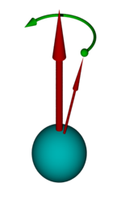
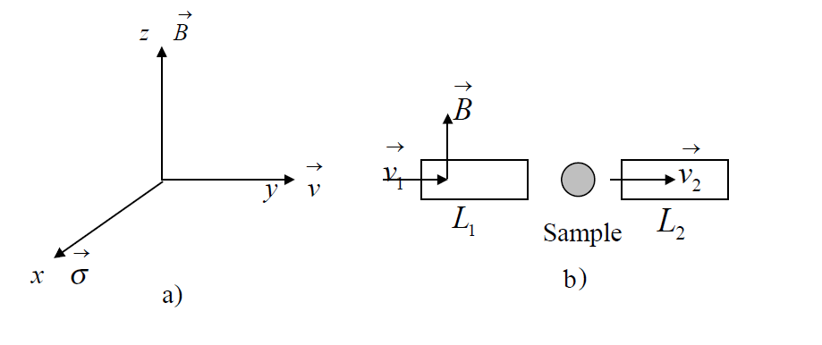
Neutron spin echo
Principle: A magnetic moment μ in a magnetic B field precesses around B at the Larmor (angular) frequency
Assume v₂= v₁ +dv (quasielastic scattering)
Total phase change:
In the time (L/v₁) it takes to pass the first field region, it precesses by the angle (L/v₁)ω_{L}. After scattering, it enters a field region with opposite field and precesses back by -(L/v₂) ω_{L.}
For elastic scattering, the total phase shift will be zero.
Finite phase shifts means finite energy transfer

Slide 34
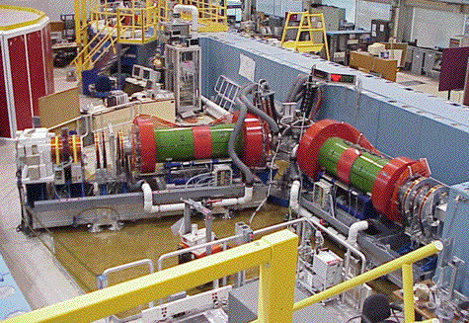
Neutron spin echo
Measured quantity : Beam polarization along x (initial polarization along y). This is proportial to the cos(ωτ_{NSE}) Fourier transform of – essentially – the scattering cross-section. See Peter Schurtenbergers talk
Because velocity is encoded in the spin-precession, one can have a broad incident flux distribution, while retaining excellent energy-resolution down to neV

Slide 35
Conclusions
A full understanding of the properties of matter – a prerequisite for control - requires us to know both structural and dynamic properties.
Dynamics can be studied using spectroscopic methods at various instrument types which probe ”motion” on different time and energy scales and with different energy-resolution conditions
Coherent, propagating modes (TAS and direct TOF spectrometers)
Quasi-elastic scattering (indirect TOF spectrometers and spin-echo spectrometers)

Slide 39
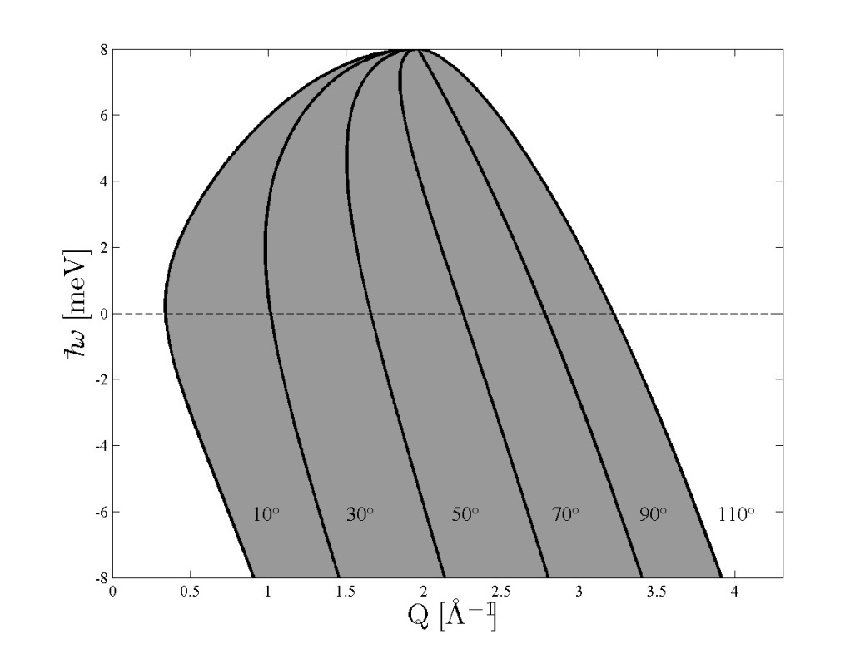
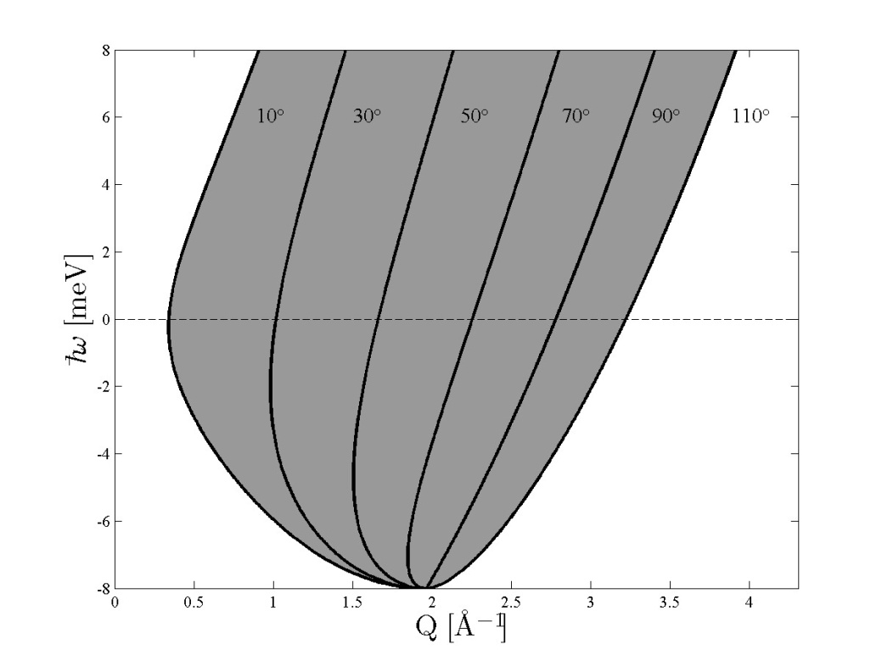
Kinematic constraints
k_{f}
(k_{f} fixed)
2θ
Q
k_{i}
(k_{i} fixed)
k_{i} fixed
k_{f} fixed

Slide 40
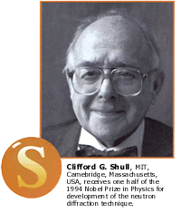
Elastic scattering
“…where atoms/spins are…”
Crystal structures, polymers, biology, …
Magnetic structures, flux-line lattices, …
Charge and orbital ordering phenomena (Indirectly, through the associated small distortions of the lattice)
… as a function of pressure, electric/magnetic field and temperature.
k_{i}=k_{f}
k_{f}
Q
k_{i}
ħω=0
Notes:
Elastic scattering is the study of the structure of matter. This can be both crystal structures, magnetic structures, the structure of poymers, biomolecules etc.

Slide 41
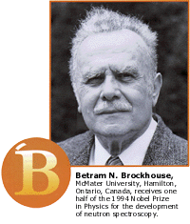
Inelastic scattering
“…what atoms/spins do…”
Phonons in crystalline materials
Magnetic excitations
… as a function of pressure, electric/magnetic field and temperature.
Energy scale ~ meV
k_{i}>k_{f}
k_{i}<k_{f}
k_{f}
Q
k_{f}
Q
k_{i}
ħω>0
ħω<0
k_{i}
Notes:
Spectroscopy or inelastic scattering is the study of excitations in materials (for example lattice vibrations) and of motions (for example diffusion of hydrogen)

Slide 42
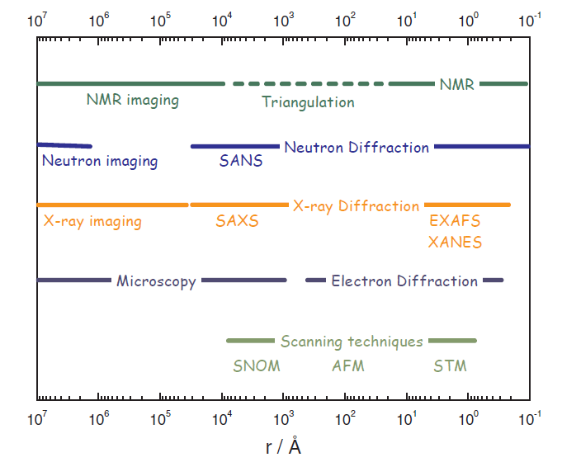
Neutrons and complementary techniques

