Slide 1


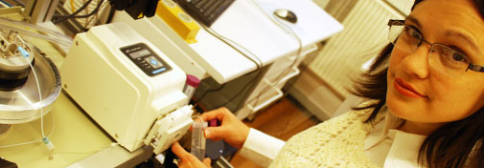
Neutron reflectivity’s day
Hanna Wacklin
ESS
Today you will learn about specular scattering and non-specular scattering.
Scattering length and contrast matching in Soft Matter.
Theory of Reflection.
Optics apply to Light, Neutrons and X-rays are all waves. Reflect over the different information that can be extracted from each of these waves
Learn to read a reflectivity curve.
Some cases in neutron reflection.
Tommy Nylander
LU
Marité Cárdenas
KU

Slide 2
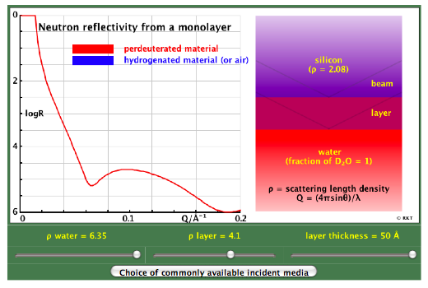
What is reflectivity?
Reflectivity refers to the fraction of incident radiation (amplitude) that is reflected by a surface.
Why is reflectivity interesting for us?
air-water
air-solid
solid-liquid
Reflectivity reveals interfacial structure
Layer thickness
Layer composition
In plane structure

Slide 3
Light, X-rays and Neutrons can be treated as waves: Same principles apply to any of them!
What are the advantages of X-rays and neutrons over light?
x-rays and neutrons have much shorter wavelength than light -> they can explore much smaller spacing (of the order of molecular dimensions).

Slide 4
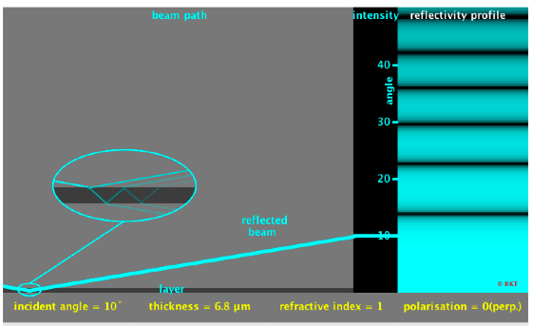
Taken from http://rktchem..ox.ac.uk/research.html
Notes:
Roughness makes reflectivity fall off faster than q4

Slide 5
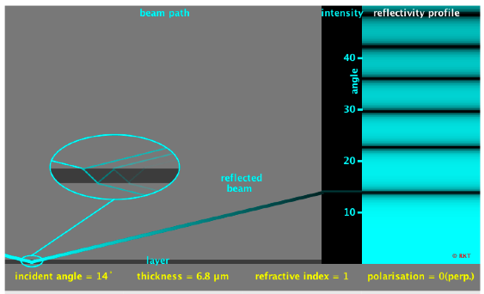
Taken from http://rktchem..ox.ac.uk/research.html
Notes:
Roughness makes reflectivity fall off faster than q4

Slide 6
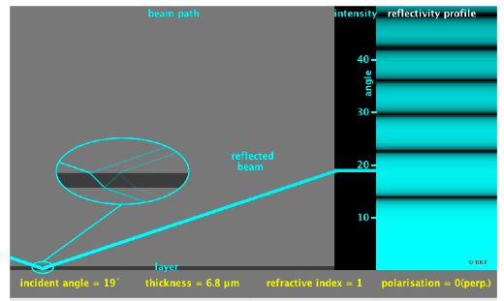
Taken from http://rktchem..ox.ac.uk/research.html
Notes:
Roughness makes reflectivity fall off faster than q4

Slide 7
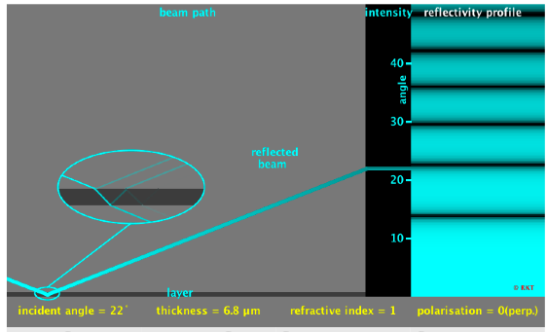
Taken from http://rktchem..ox.ac.uk/research.html
Notes:
Roughness makes reflectivity fall off faster than q4

Slide 8
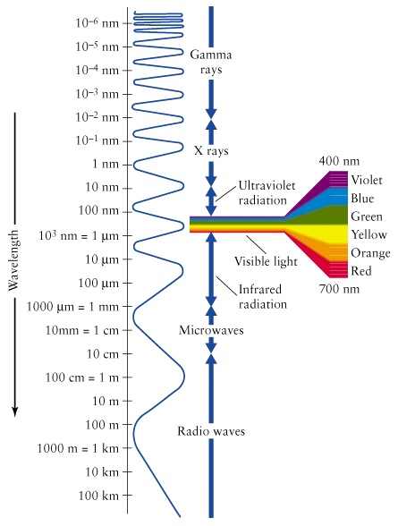
Or take advantage of radiation wavelength
Neutrons do have different energies, right?
q_{z} = 4 π/ λ * sinθ

Slide 9
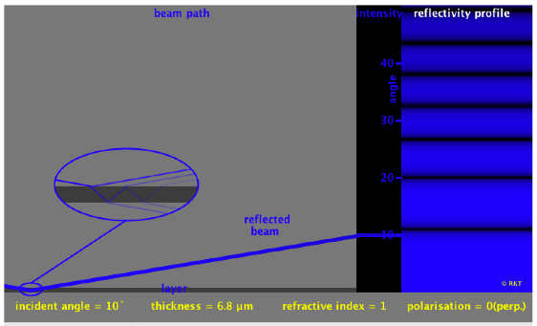

Slide 10
Taken from http://rktchem..ox.ac.uk/research.html
Notes:
Roughness makes reflectivity fall off faster than q4

Slide 11
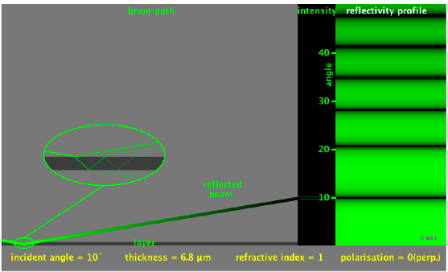
Taken from http://rktchem..ox.ac.uk/research.html
Notes:
Roughness makes reflectivity fall off faster than q4

Slide 12
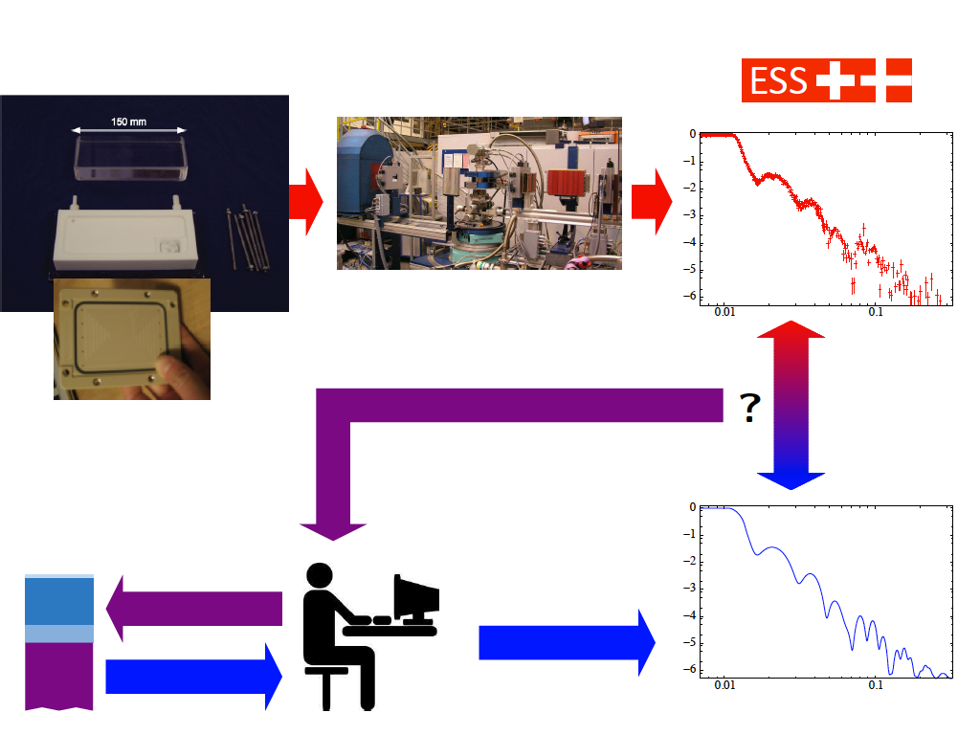
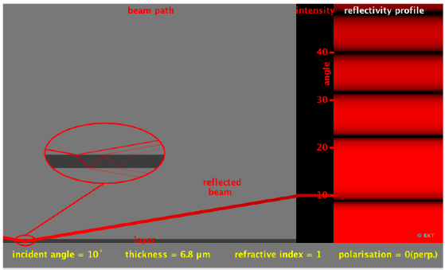
And this is how it goes when you work in our field

Slide 13
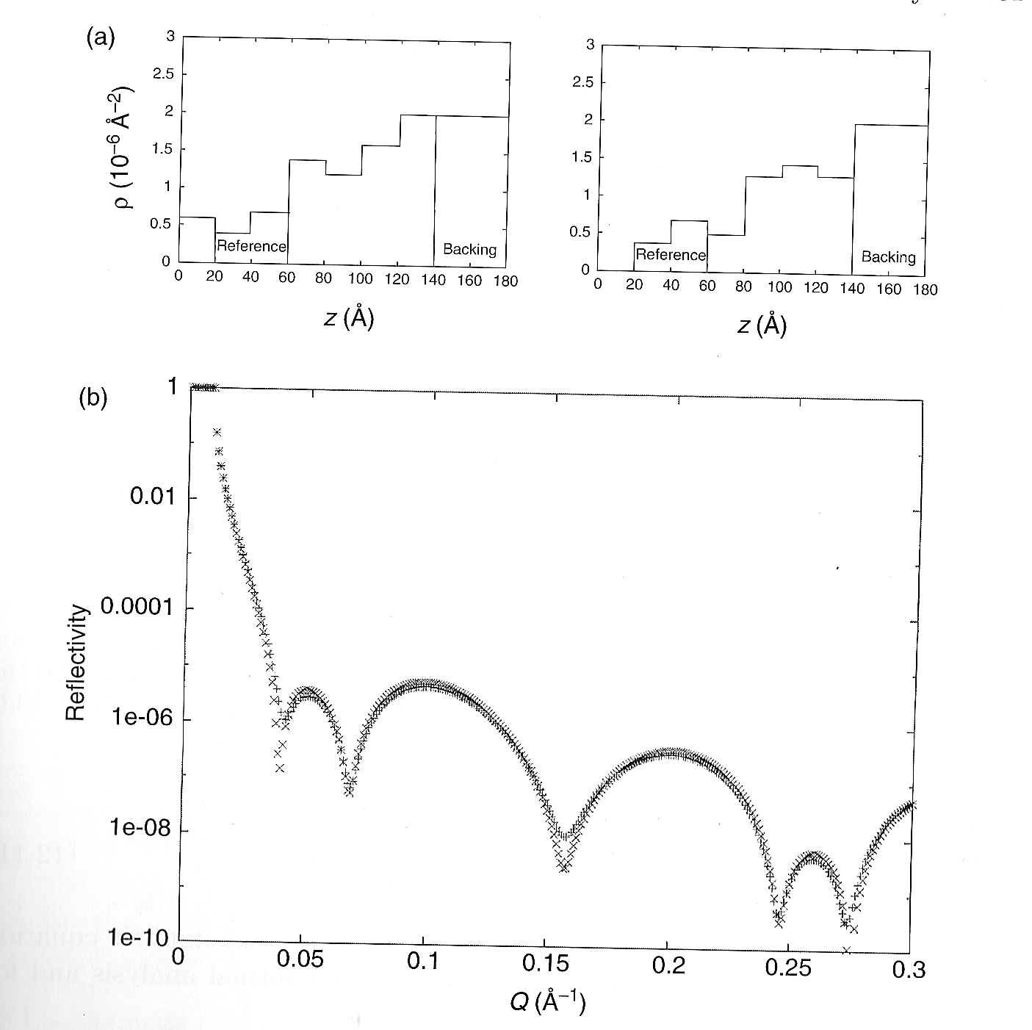
If things were just so easy… have you forget about the phase problem in scattering?

Slide 14
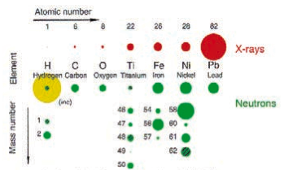
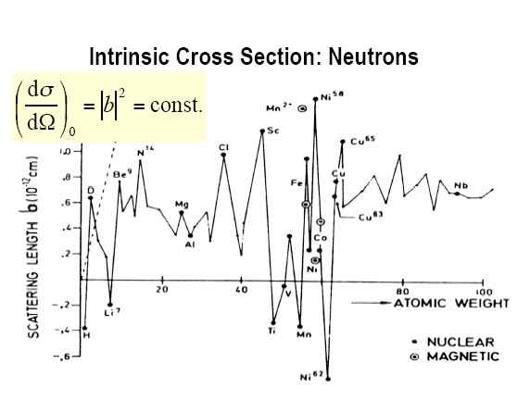
The refractive index
The real part can be expressed as:
n = 1 – λ²/2π ∗ ρ
For X-ray,
For Neutron,
ρ= Σ ni fi e² / mc²
fi is the atomic factor for specie I
ρ= Σ ni bi
ni is the number density for the nuclear specie i
bi is the scattering length of nuclear specie i
Notes:
FOR X RAY ----- the SlD is directly proportional to the atomic factor and thus to the number of electrons in the atom (atomic number)
Rho is called ELECTRON NUMBER DENSITY
SLD is neutrin is the product between the atomic number density and the atomic scattering factor
SENSITIVE TO ELECTRONIC CLOUD
FOR NETRON- b is erratic with atomic number
SENSITIVE TO NEuTRON-> ISOTOPIC COMPOSITION

Slide 15
The refractive index
q_{z}
θ
The real part can be expressed as:
n = 1 – λ²/2π ∗ ρ
Since ρ is very small, n ~ 1
GRAZING INCIDENCE is a MUST for neutrons and X-rays
Notes:
Critical angle is of a few milli radians
Using snells law cos angle critical = n cos (angulo trnasmitido o sea 0)
Neutron reflectivity measured around critical angle -
Gracing Xray reflectivity for angles below this great sensitivity thanks to the evanescence wave with penetration depth of a few nm.

Slide 16
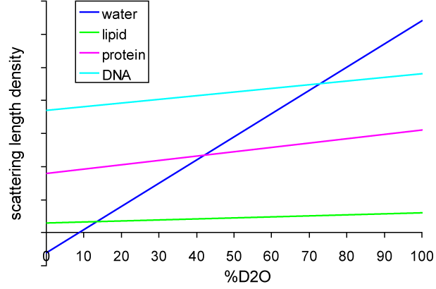


What’s the deal with bio-molecules?
Deuterated lipid/protein/DNA
6
5
4
3
2
1
0
Lipid head group
NRW
WHY such dependency for protein/DNA as compared to lipid? H/D exchange!

Slide 17
The art of contrast matching
ρ_{air}= 0
ρ_{D2O}= 6.35
ρ_{water} can be adjusted by the ratio of H2O/D2O. The lipid chain can also be fully or partially deuterated.

Slide 18
The art of contrast matching
ρ_{air}= 0
ρ_{water}= 0

Slide 19

The art of contrast matching
ρ_{air}= 0
ρ_{water}= ρ_{headgroup}

Slide 20
The art of contrast matching
ρ_{air}= 0
ρ_{water}= ρ_{lipid 2}

Slide 21
The art of contrast matching
ρ_{air}= 0
ρ_{water}= ρ_{air}
By controlling the degree of D substitution in the lipid, the lipid can be contrast matched to the protein

Slide 22
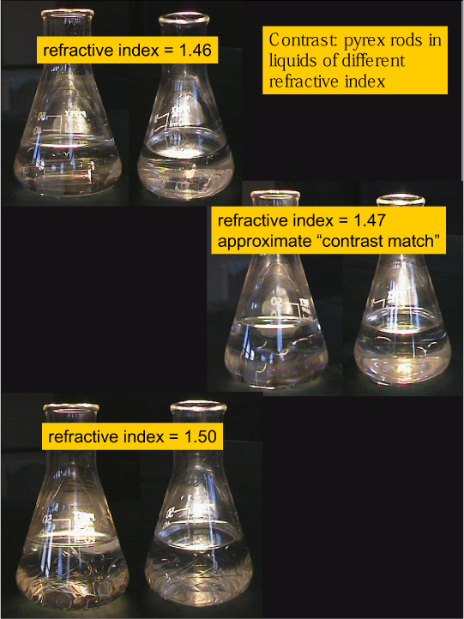
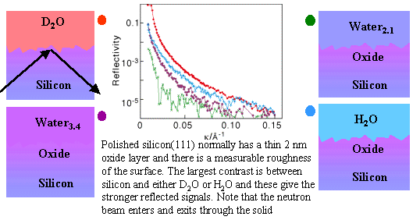
The art of contrast matching
Taken from http://rktchem..ox.ac.uk/research.html

Slide 23
So now you should be ready for the real stuff!

