Slide 1

Science cases for neutron reflectometry
Tommy Nylander
Physical Chemistry
Lund University
Lund, SWEDEN
Email: Tommy.Nylander@fkem1.lu.se

Slide 2
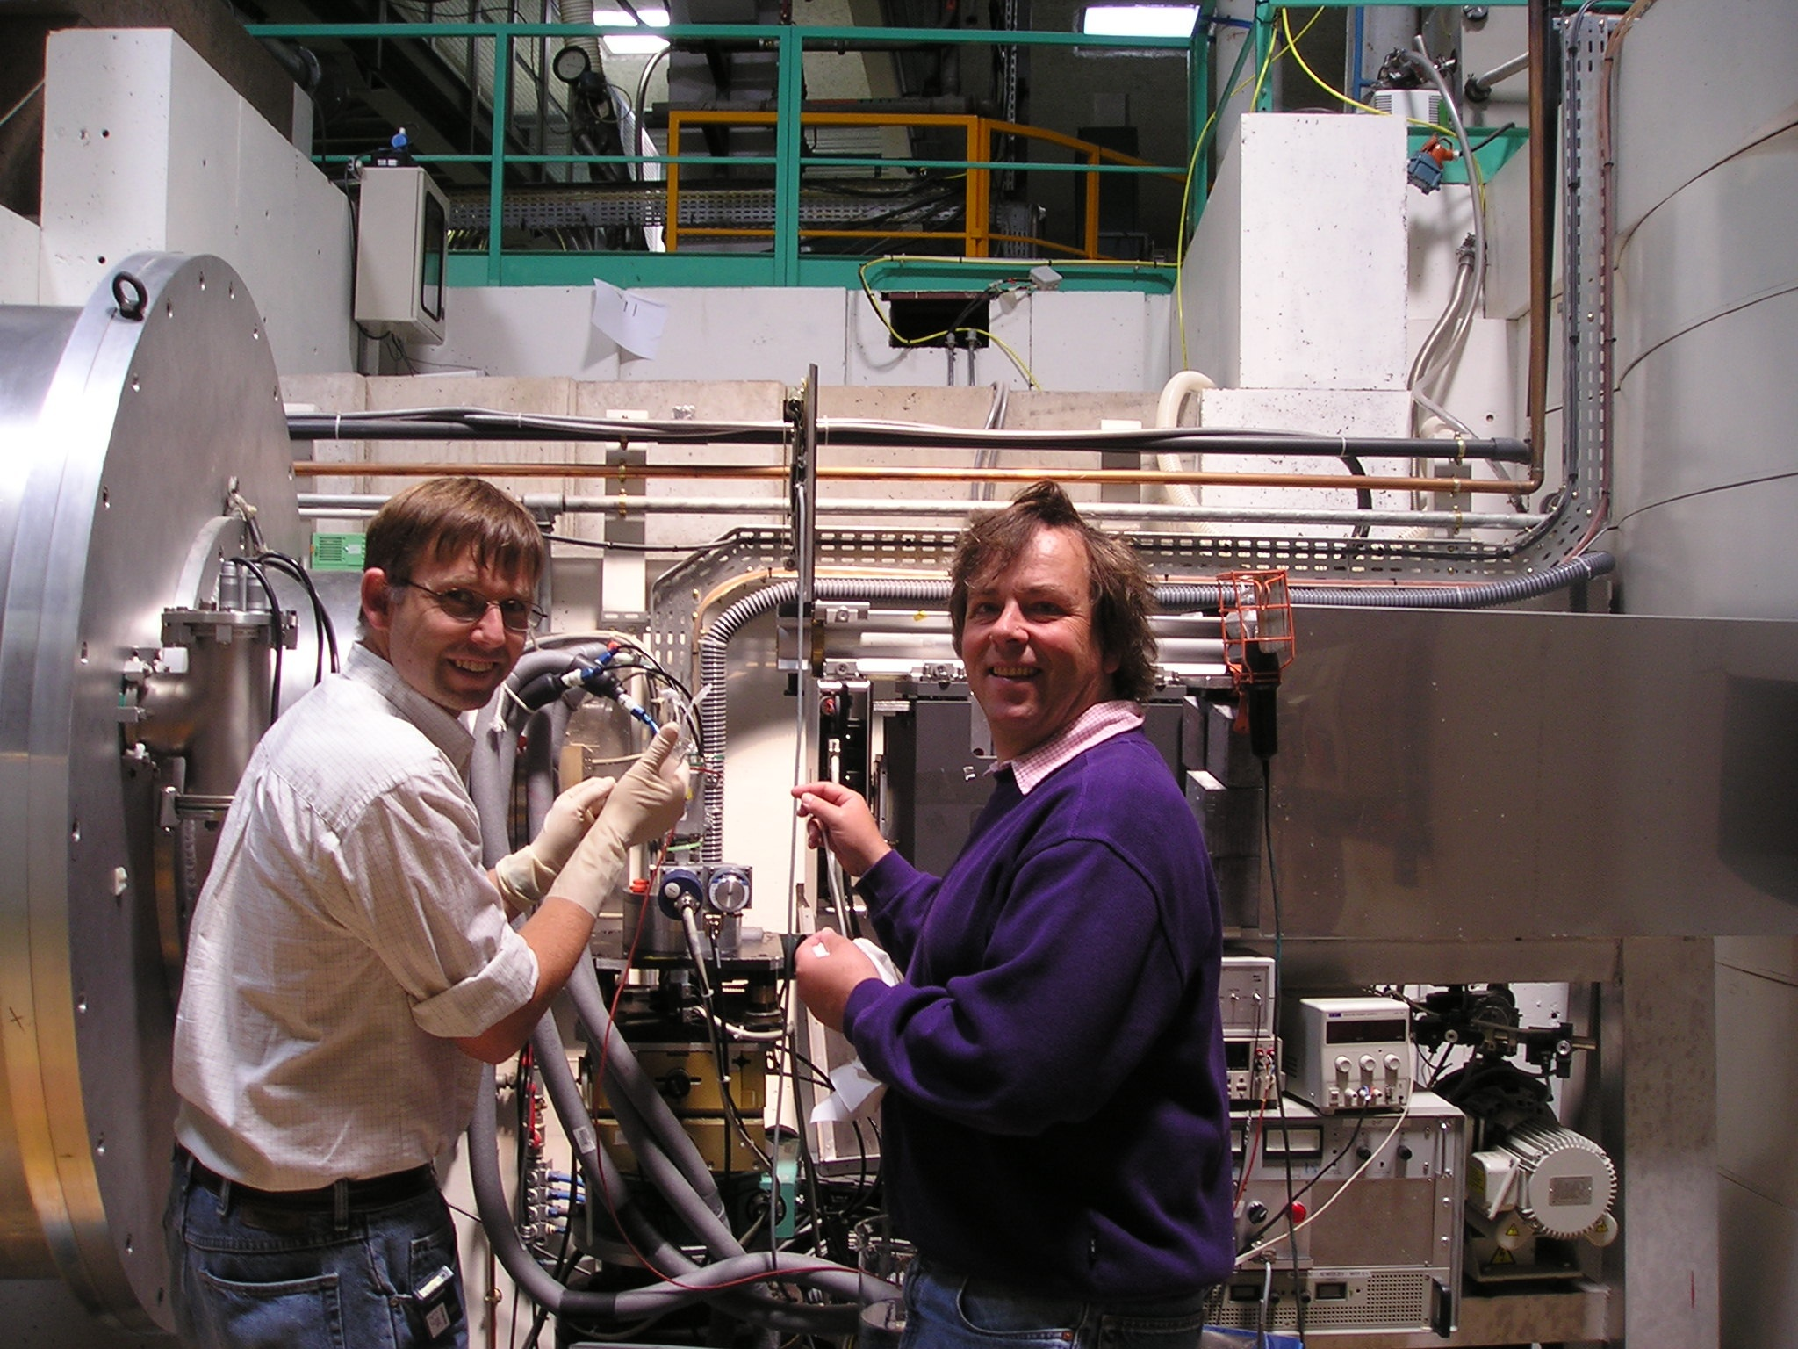
Acknowledgements to:
Kåre Larsson
Justa Barauskas
Giovanna Fragneto
Eric (Jianming) Zhang
Adrian Rennie
Arwel Hughes
Per Linse
Stefan Zauscher
Fredrik Tiberg
Bob Thomas
Marité Cardenas
Hannah Wacklin
Marie-Louise Ainalem
Bengt Jönsson
Pauline Vandoolaeghe
Richard Campbell
Emma Sparr
Agnes Michanek

Slide 3
Application solid –liquid interface

Slide 4
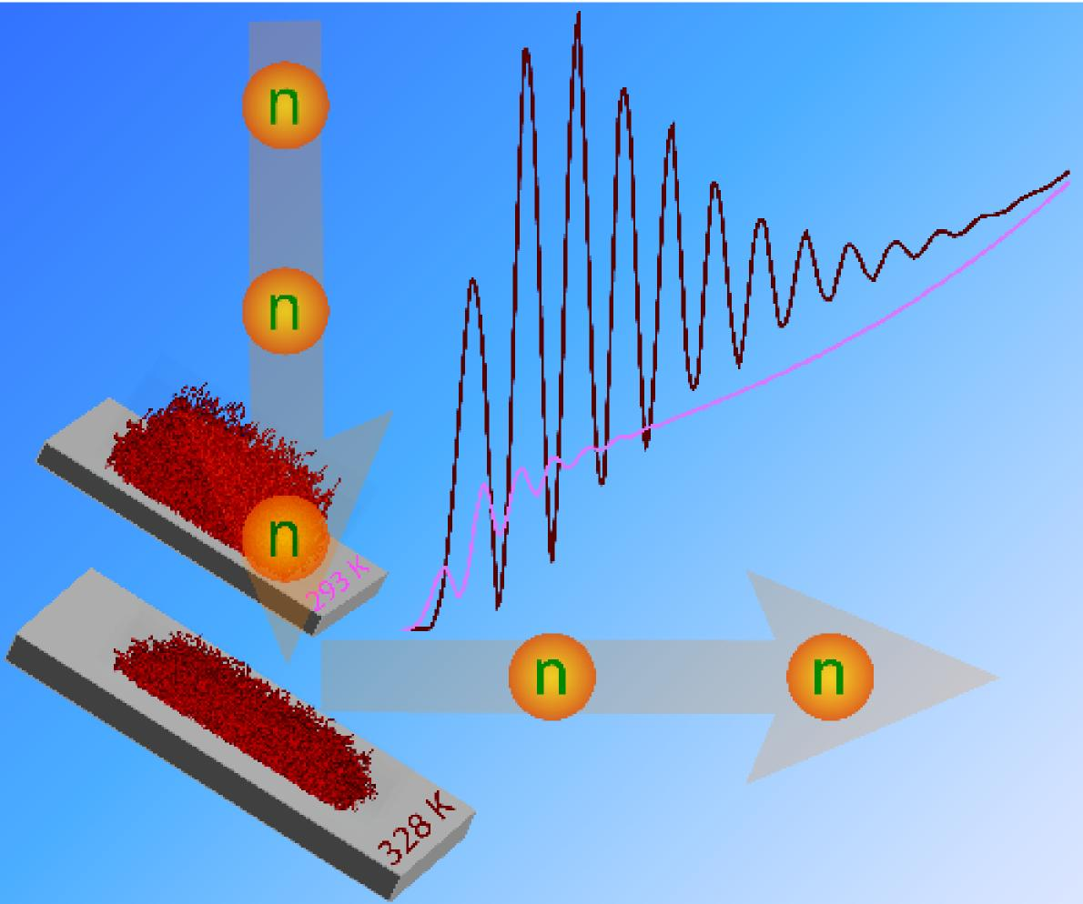
Approach to evaluate neutron reflectometry date (Example polymer brushes)
J. Zhang, T. Nylander, R. A. Campbell, A. R. Rennie, S. Zauscher, and Per Linse; Novel evaluation method of neutron reflectivity data applied to stimulus-responsive polymer brushes. Soft Matter 2008, 4, 500-509.

Slide 5
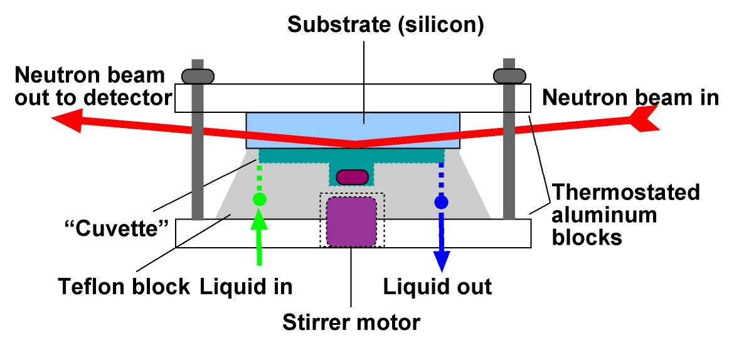
Neutron reflectometry
Neutron Reflectometry gives density profile of the interfacial layer and selective deuteration + contrast matching gives composition
Neutron scattering strongly depends on isotope, e.g. hydrogen and deuterium => very different scattering
q = (4π/λ) sin θ
Volume fraction
We need a model!!
Reflectivity
q
Distance from surface
What we measure!
What we want!

Slide 6
Polymer brushes (adapted from Per Linse)
D: distance between neighboring chain
l: brush height
D << 2R_{G} for a brush (high density of brush) =>
Surface adsorption and solvency do
only slightly affect brush properties
D
l
Brush height, l, depends on two competing factors:
1) Cost of stretching entropy => decrease the height
2) Excluded volume interactions, “crowding” => increase height
Two simple analytic theories for non-adsorbing surface (grafted chains) and good solvent (high solubility of polymer):
1) block segment density profile (Alexander 1977)
2) parabolic segment density profile
(Milner, Witten, and Cates (MWC)1988;
Zhulina, Priamitsyn, and Borisov (ZPB) 1988)

Slide 7
Neutron reflectivity: conventional evaluation
Layer model
Initial fitting parameters:
polymer density thickness
roughness
Polymer volume fraction profile
Reflectivity model*
Improved fitting parameters
R(q)
Fit to experiments
*Including roughness

Slide 8
Modeling of the polymer brushes
establish model parameters to describing the interactions in an aqueous polymer solution from fitting to experimentally determined phase behavior
predict polymer brush density profiles using molecular-based lattice mean-field theory, developed by Scheutjens and Fleer, and Gunnar Karlström

Slide 9
Neutron reflectivity: novel evaluation
Polymer brush theory
Few parameters characterizing
the polymer system
Initial fitting parameters
length scale
grafting density
Polymer volume fraction profile
Reflectivity model
Improved fitting parameters
R(q)
Fit to experiments

Slide 10
Comparison of the two approaches
Advantages of the novel approach
Fewer fitting parameters
Good correlation between model and experiment:
the experiments support the polymer theory
the theory can be used to predict properties of the brush
design of NR experiment for optimal outcome
Disadvantages of the novel approach
Need of a suitable polymer brush theory
Need of parameters characterizing the polymer brush
Adapted software for the analysis of the NR data

Slide 11
Fit of parameters characterizing the polymer
Fit of parameters describing interaction and internal degrees of freedom

Slide 12
Predicted polymer volume fraction profiles
A large structural change at increasing temperature is predicted

Slide 13
Characterization of surface without polymer
Si / SiO₂ / solvent
Si / SiO₂ / init layer / solvent

Slide 14
Polymer brush: ILL data and models

Slide 15
Parameters
Common
to both models
1 fitted parameter
Layer
model
5 fitted parameters
Lattice
model
2 fitted parameters

Slide 16
Predicted reflectivity profiles in cmSi (note more features in this contrast as Silicon substrate is matched out and we only see the oxide and polymer layers)

Slide 17
Calculated scattering length density profiles

Slide 18
Some comments
Layer profile
Fitting parameters
Scattering length density
Thickness
Roughness
Nonzero roughness in the reflectivity model is important
Lattice mean-field theory
Fitting parameters (global)
Length scale
Grafting density (here experimentally unknown)
Extensions
Polyelectrolytes (e.g., polyacrylamide)
Block copolymers
Adsorbed polymers

Slide 19
Summary
A novel evaluation method of NR data of polymer brushes based on model calculations of polymer brushes
A physical model is here invoked to handle the temperature-dependent polymer-solvent interaction of the thermo-responsive polymer
Same polymer model is used to evaluate the experimental data under different experimental conditions
Fewer fitting parameters as compared to the conventional layer model
The novel method can be utilized to optimize NR experiments

Slide 20
Adsorption of liquid crystalline nanoparticles

Slide 21
Lipid based self-assembled structures
Has a large potential as drug delivery systems:
Large capability to solubilise drugs
Can be dispersed into nano-sized liquid crystalline particles
Large variability of structures and morphologies - not only vesicles

Slide 22
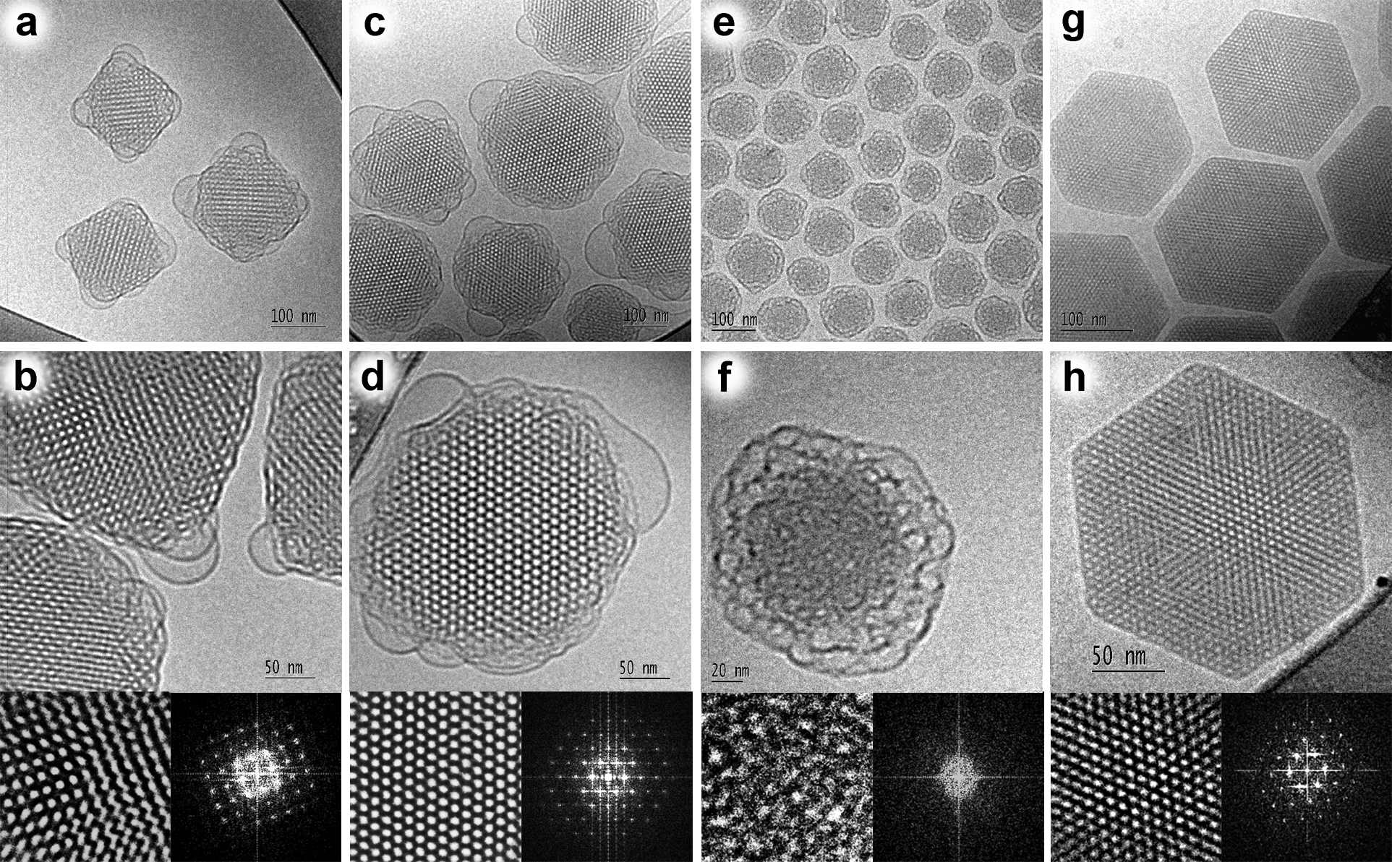
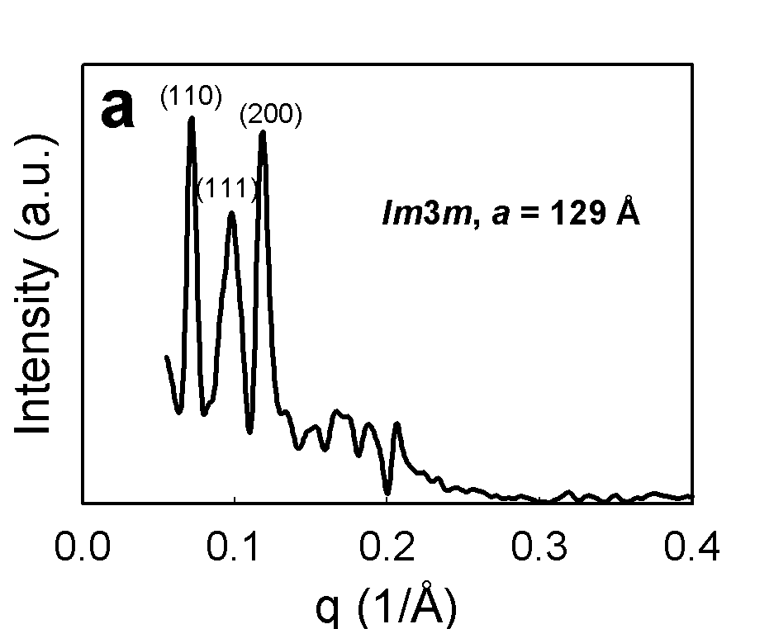
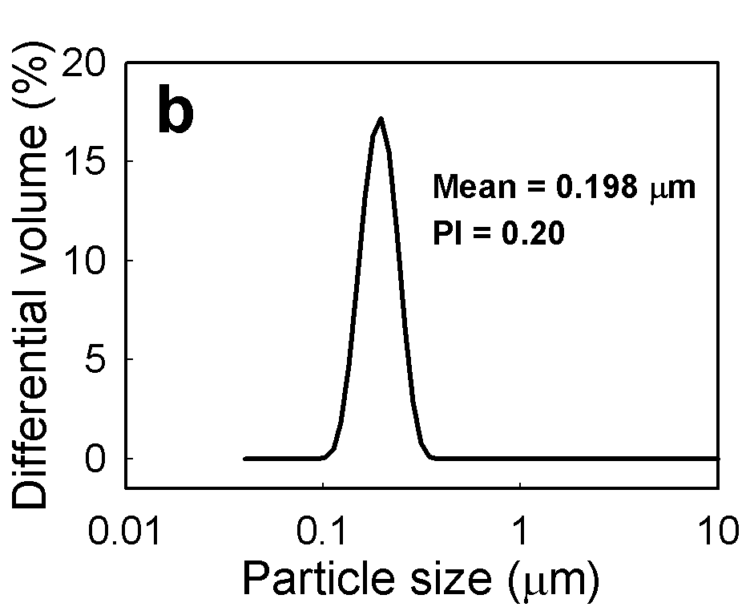
Self-assembled lipid liquid crystalline nanoparticle Beyond vesicles and liposomes
BARAUSKAS J, JOHNSSON M and TIBERG F (2005), `Self-assembled lipid
superstructures:beyond vesicles and liposomes', Nano Lett, 5, 1615-1619.

Slide 23
Interfacial behavior of drug delivery vehicles are important for
the uptake of the drugs
the biocompatibility of the delivery system
stability upon storage.

Slide 24
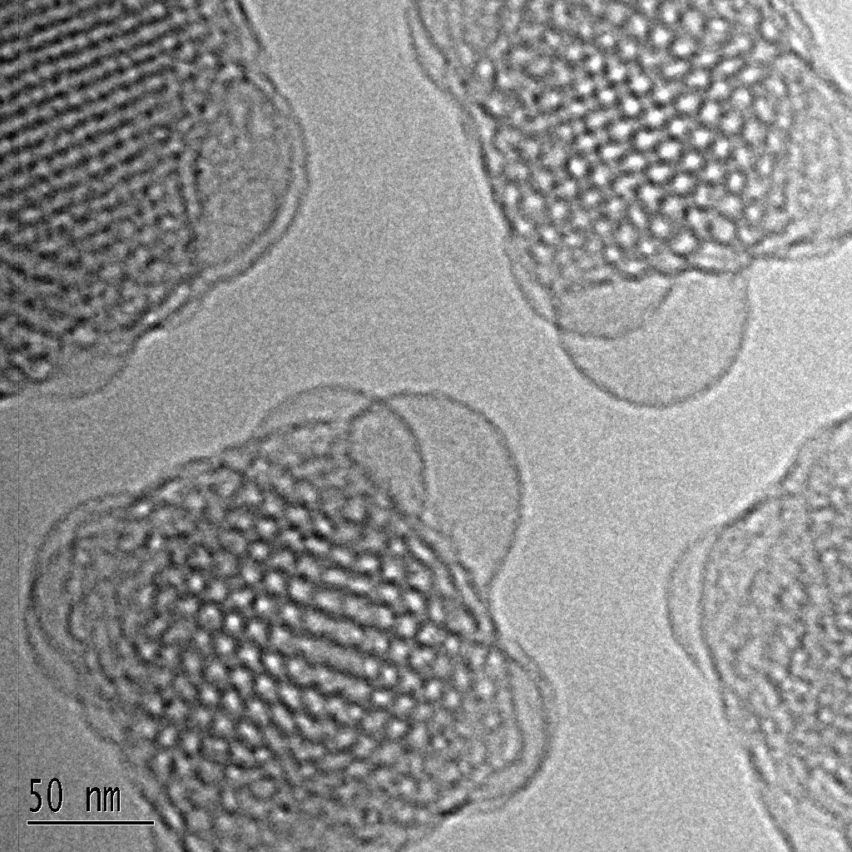
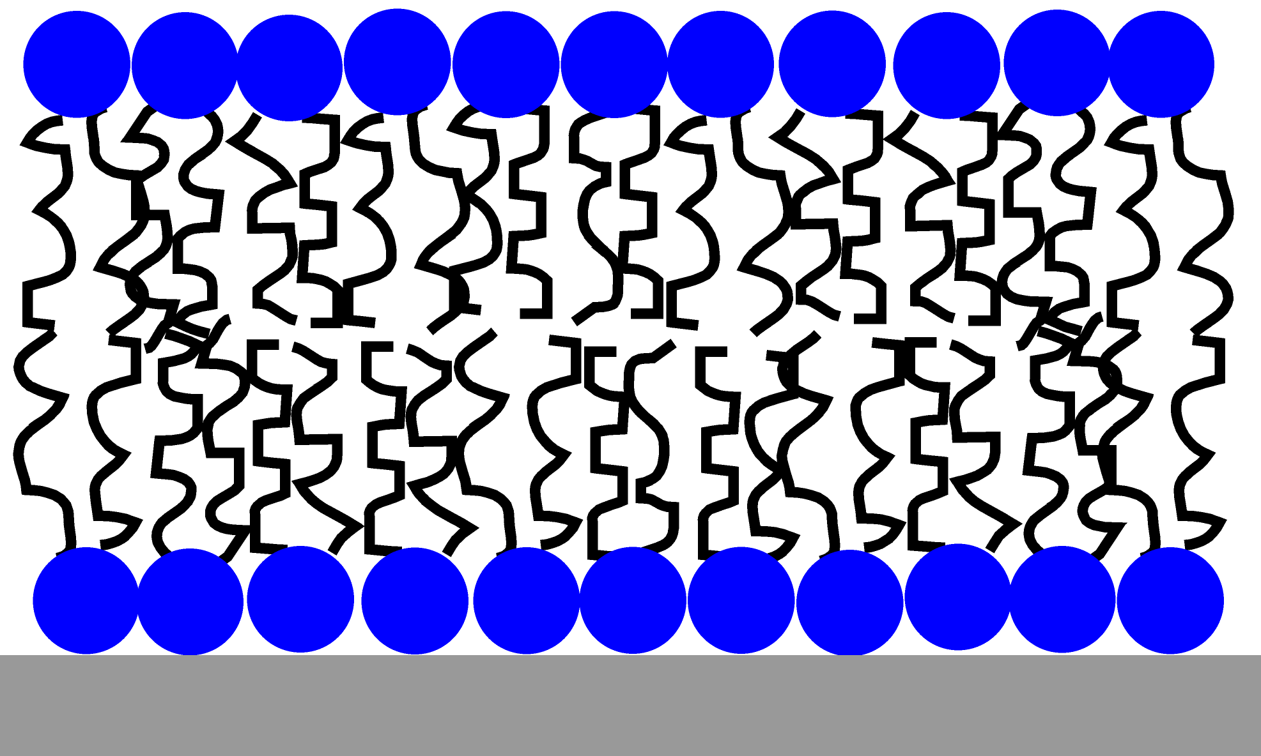
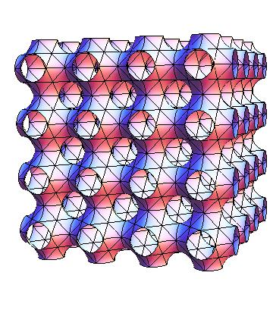
What happens when such a liquid crystalline nano particle meets a biological (model) membrane?
+
Dioleoylphosphatidylcholine (DOPC) supported bilayer
Bicontinuous cubic phase:
Curved lipid bilayer
Glycerol monoolein (GMO) based dispersions (Cubosome®)

Slide 25
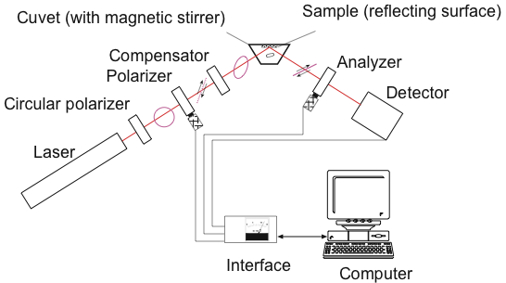
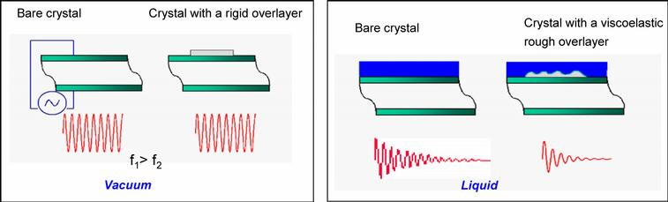
Main techniques used
Ellipsometry gives “optical” thickness and “dry” mass versus time
QCM-D gives “wet” mass with coupled water and dissipation measures the viscoelastic properties of the film
Neutron Reflectometry gives density profile of the interfacial layer and selective deuteration + contrast matching gives composition

Slide 26
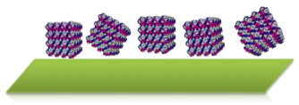
Adsorption on silica surface (simplest model of a hydrophilic surface

Slide 27
Adsorption of CPNP on hydrophilic surfaces Nature of the interaction
Driving force is likely non electrostatic
However likely to be controlled by electrostatic repulsion interaction
Anchoring of intact nanoparticles
or
surface-induced nucleation and growth process
Vandoolaeghe, P., Tiberg, F., and Nylander, T., Interfacial behavior of cubic liquid crystalline nanoparticles at hydrophilic and hycrophobic surfaces. Langmuir, 2006. 22: p. 9169-9174.
Γ mg m⁻²
d Å
0.1 M NaCl+ 0.01 M CaCl₂
pH 2
water

Slide 28
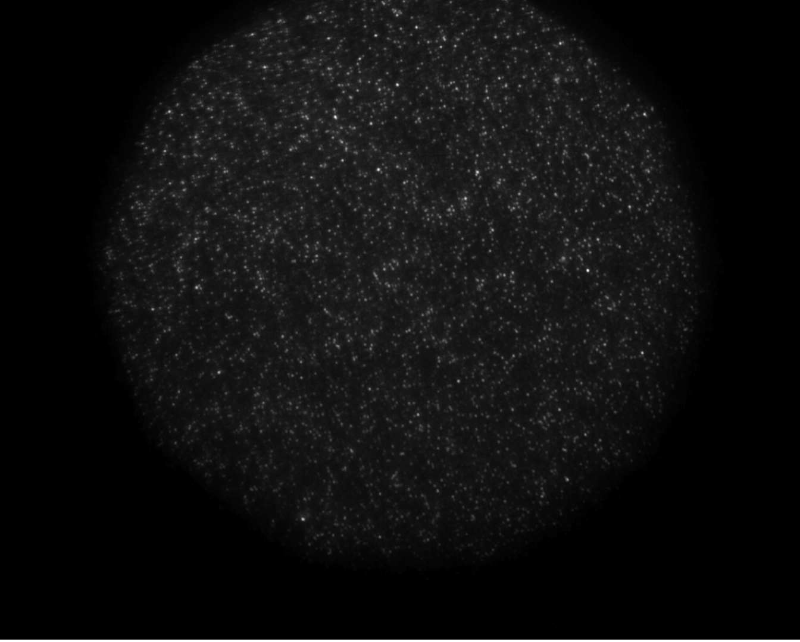

Lateral organization of CPNP on silica surface imaged by fluorescence microscopy
Layer formed of patches
No lateral organization
Size roughly the same than nanoparticles
Vandoolaeghe, P., Campbell, R.A., Rennie, A.R., and Nylander, T., Adsorption of intact cubic liquid crystalline nanoparticles on hydrophilic surfaces − lateral organization, interfacial stability, layer structure and interaction mechanism. J. Phys. Chem C. 2009, 113, 4483-4494.
17.3 x 10.1 μm²

Slide 29
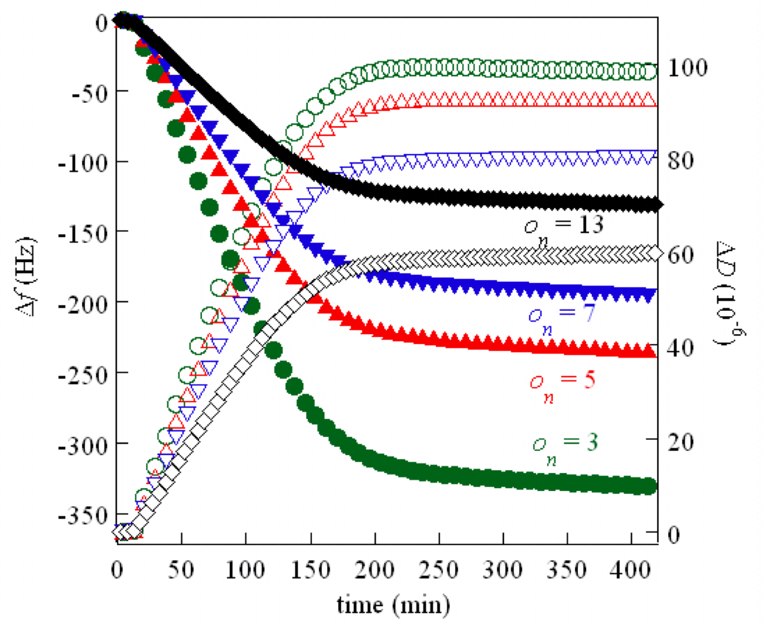
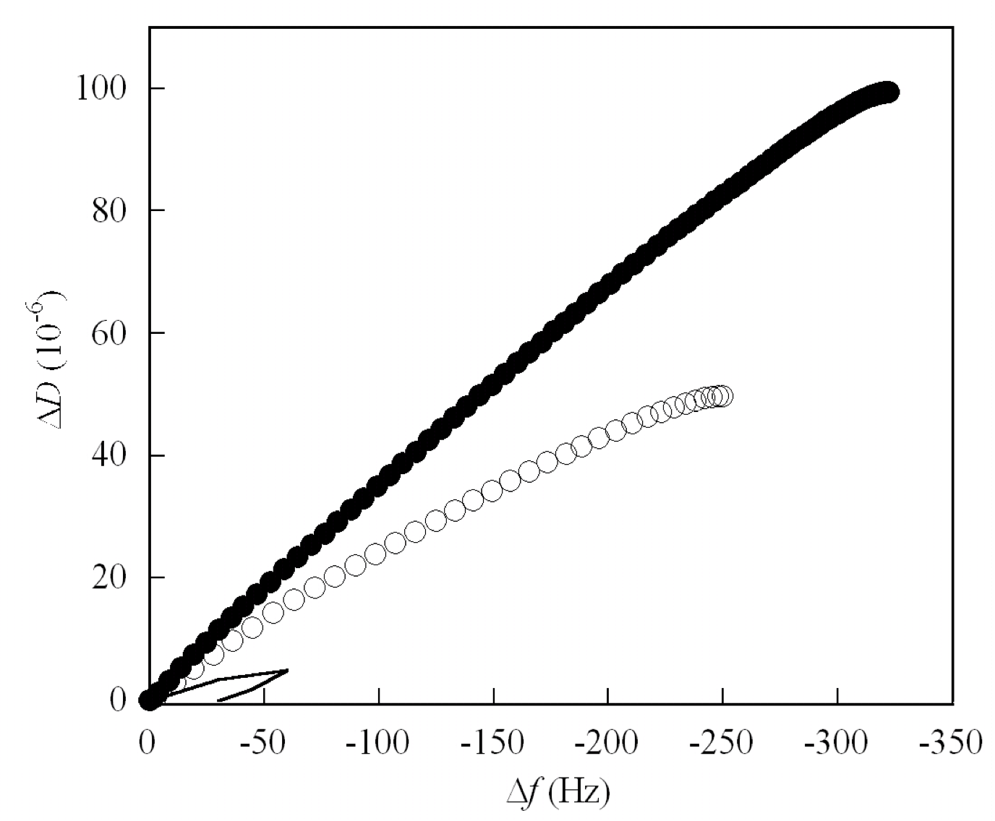
Layer of CPNP on silica formed by intact particles
Small CPNP
Large CPNP
vesicles
QCM-D
Viscoelastic properties
Large amount of acoustically coupled water
No phase transformation

Slide 30
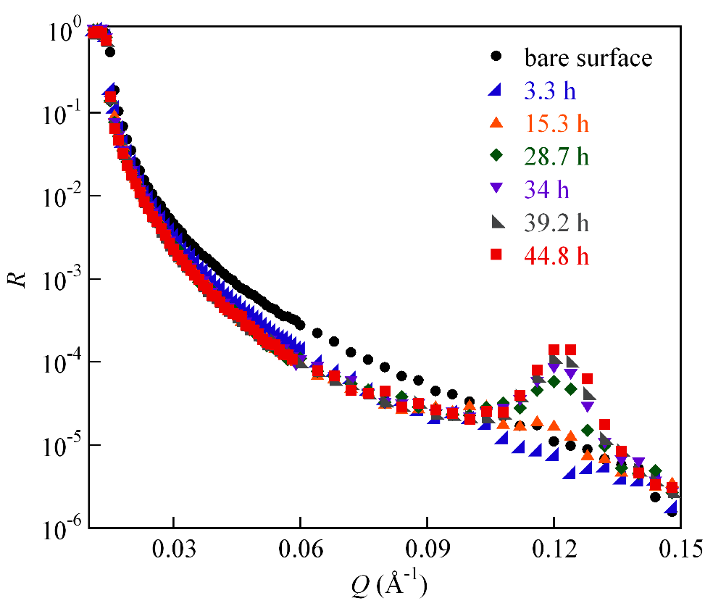
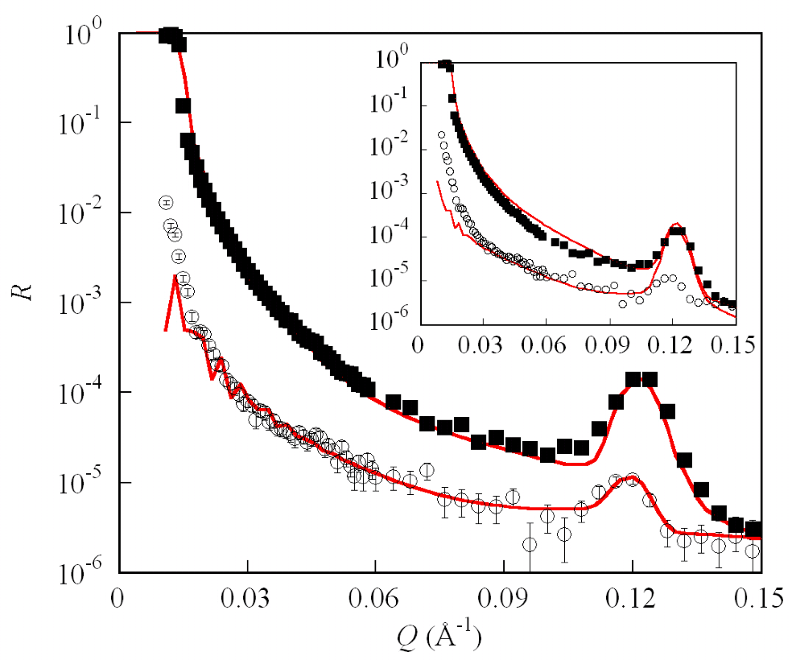
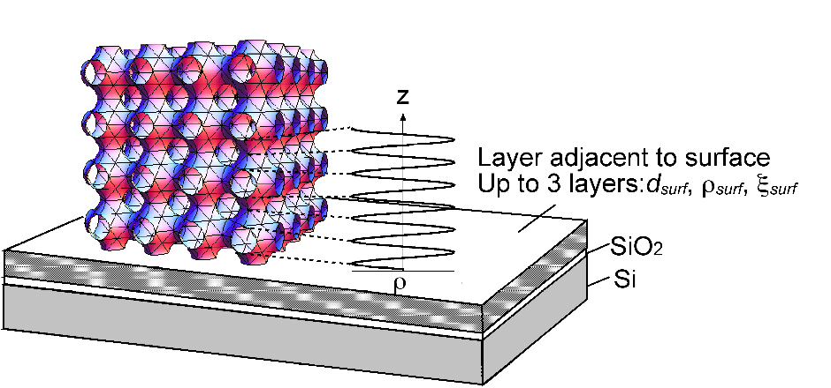
CPNP layer structure on silica from neutron reflectivity
Single layer adjacent to the surface + repeating structure
SLD following a sinusoidal function versus z

Slide 31
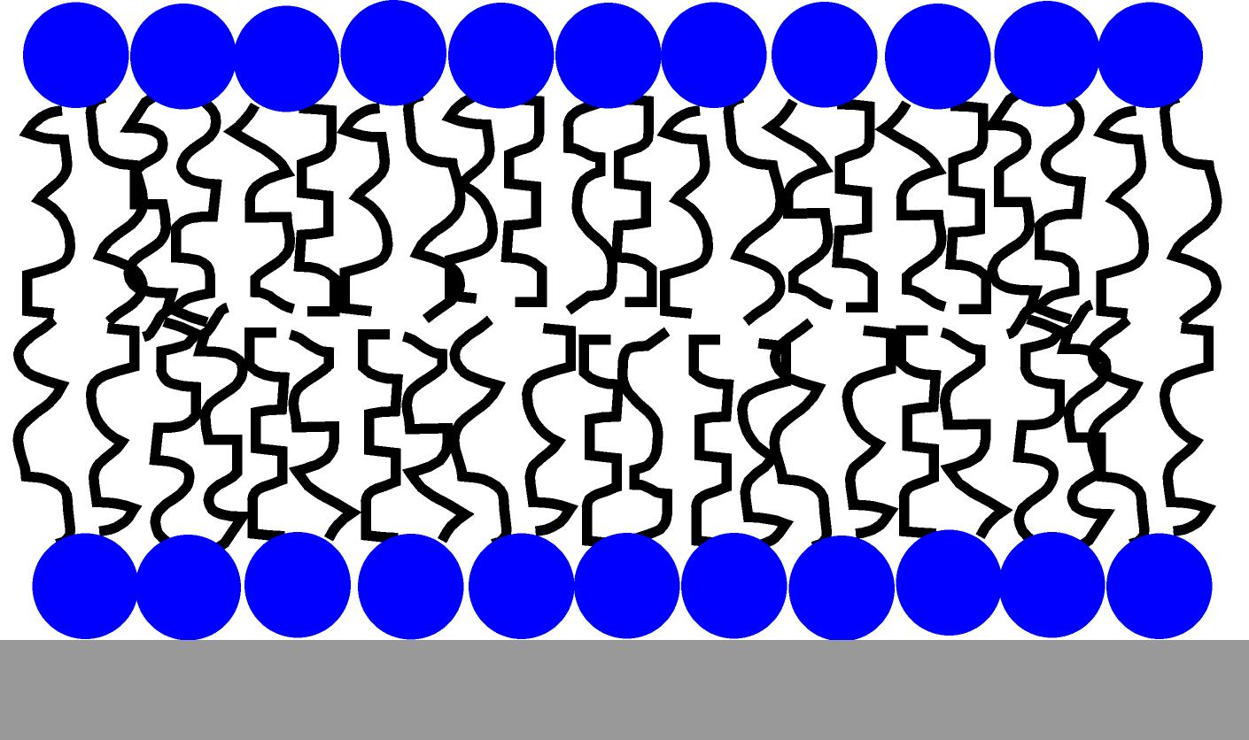
MODEL MEMBRANES: dDOPC or DOPC bilayers formed by vesicle fusion on a (negatively charged) silicon surface ≈ 90% coverage

Slide 32
ADSORPTION OF CPNP ON DOPC BILAYER-ellipsometry
Initially observed a strong adsorption of the particles on the DOPC bilayer.
Subsequent decrease in the adsorbed amount
Adsorption/desorption of particles?
Γ
d
P. Vandoolaeghe, R. A. Campbell, A. R. Rennie, R. K. Thomas, F. Tiberg, F. Höök,
G. Fragneto, T. Nylander Adsorption of cubic liquid crystalline nanoparticles on model
membranes. Soft Matter, 2008 4, 2267–2277.

Slide 33
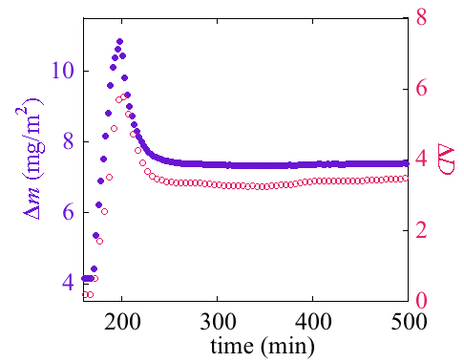
ADSORPTION OF CPNP ON DOPC BILAYER-QCM-D
Maxima after one hour in the wet mass and change in dissipation (as for adsorbed amount from ellipsometry)
Change in dissipation is large and significantly more than from molecular adsorption
Adsorption/desorption of particles!
WHY?

Slide 34
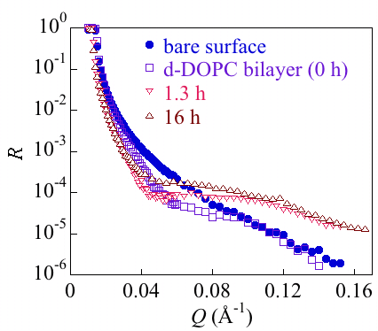
ADSORPTION OF CPNP ON d-DOPC BILAYER-neutron reflectivity (low CPNP conc)
Reflectivity in D₂O of d-DOPC (deuterated chains) bilayer after adding CPNP
ρ
(10
-6
Å
2
)
d (Å)
1.8
9
6
30
1.8
9
Initial Bilayer
Addition 0.05 mg/mL CPNP at pH 4: Integrity of bilayer seems to be kept but composition changes 20% solvent, 72% GMO, 8% DOPC
=>Lipid exchange occur

Slide 35
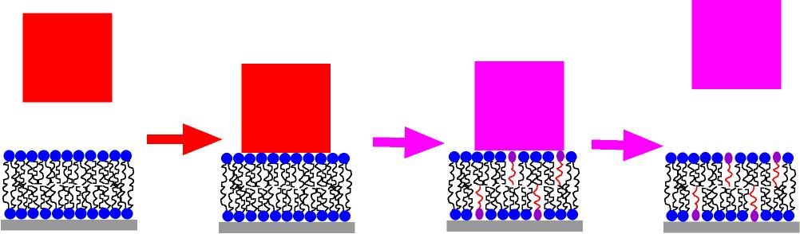
ADSORPTION OF CPNP ON d-DOPC BILAYER
Phase-diagram of D₂O-DOPC-GMO
(from Gutman et al)
Lipid exchange occur when CPNP attach to bilayer
This make interaction between CPNP less favorable
=> Detachment of some particles

Slide 36
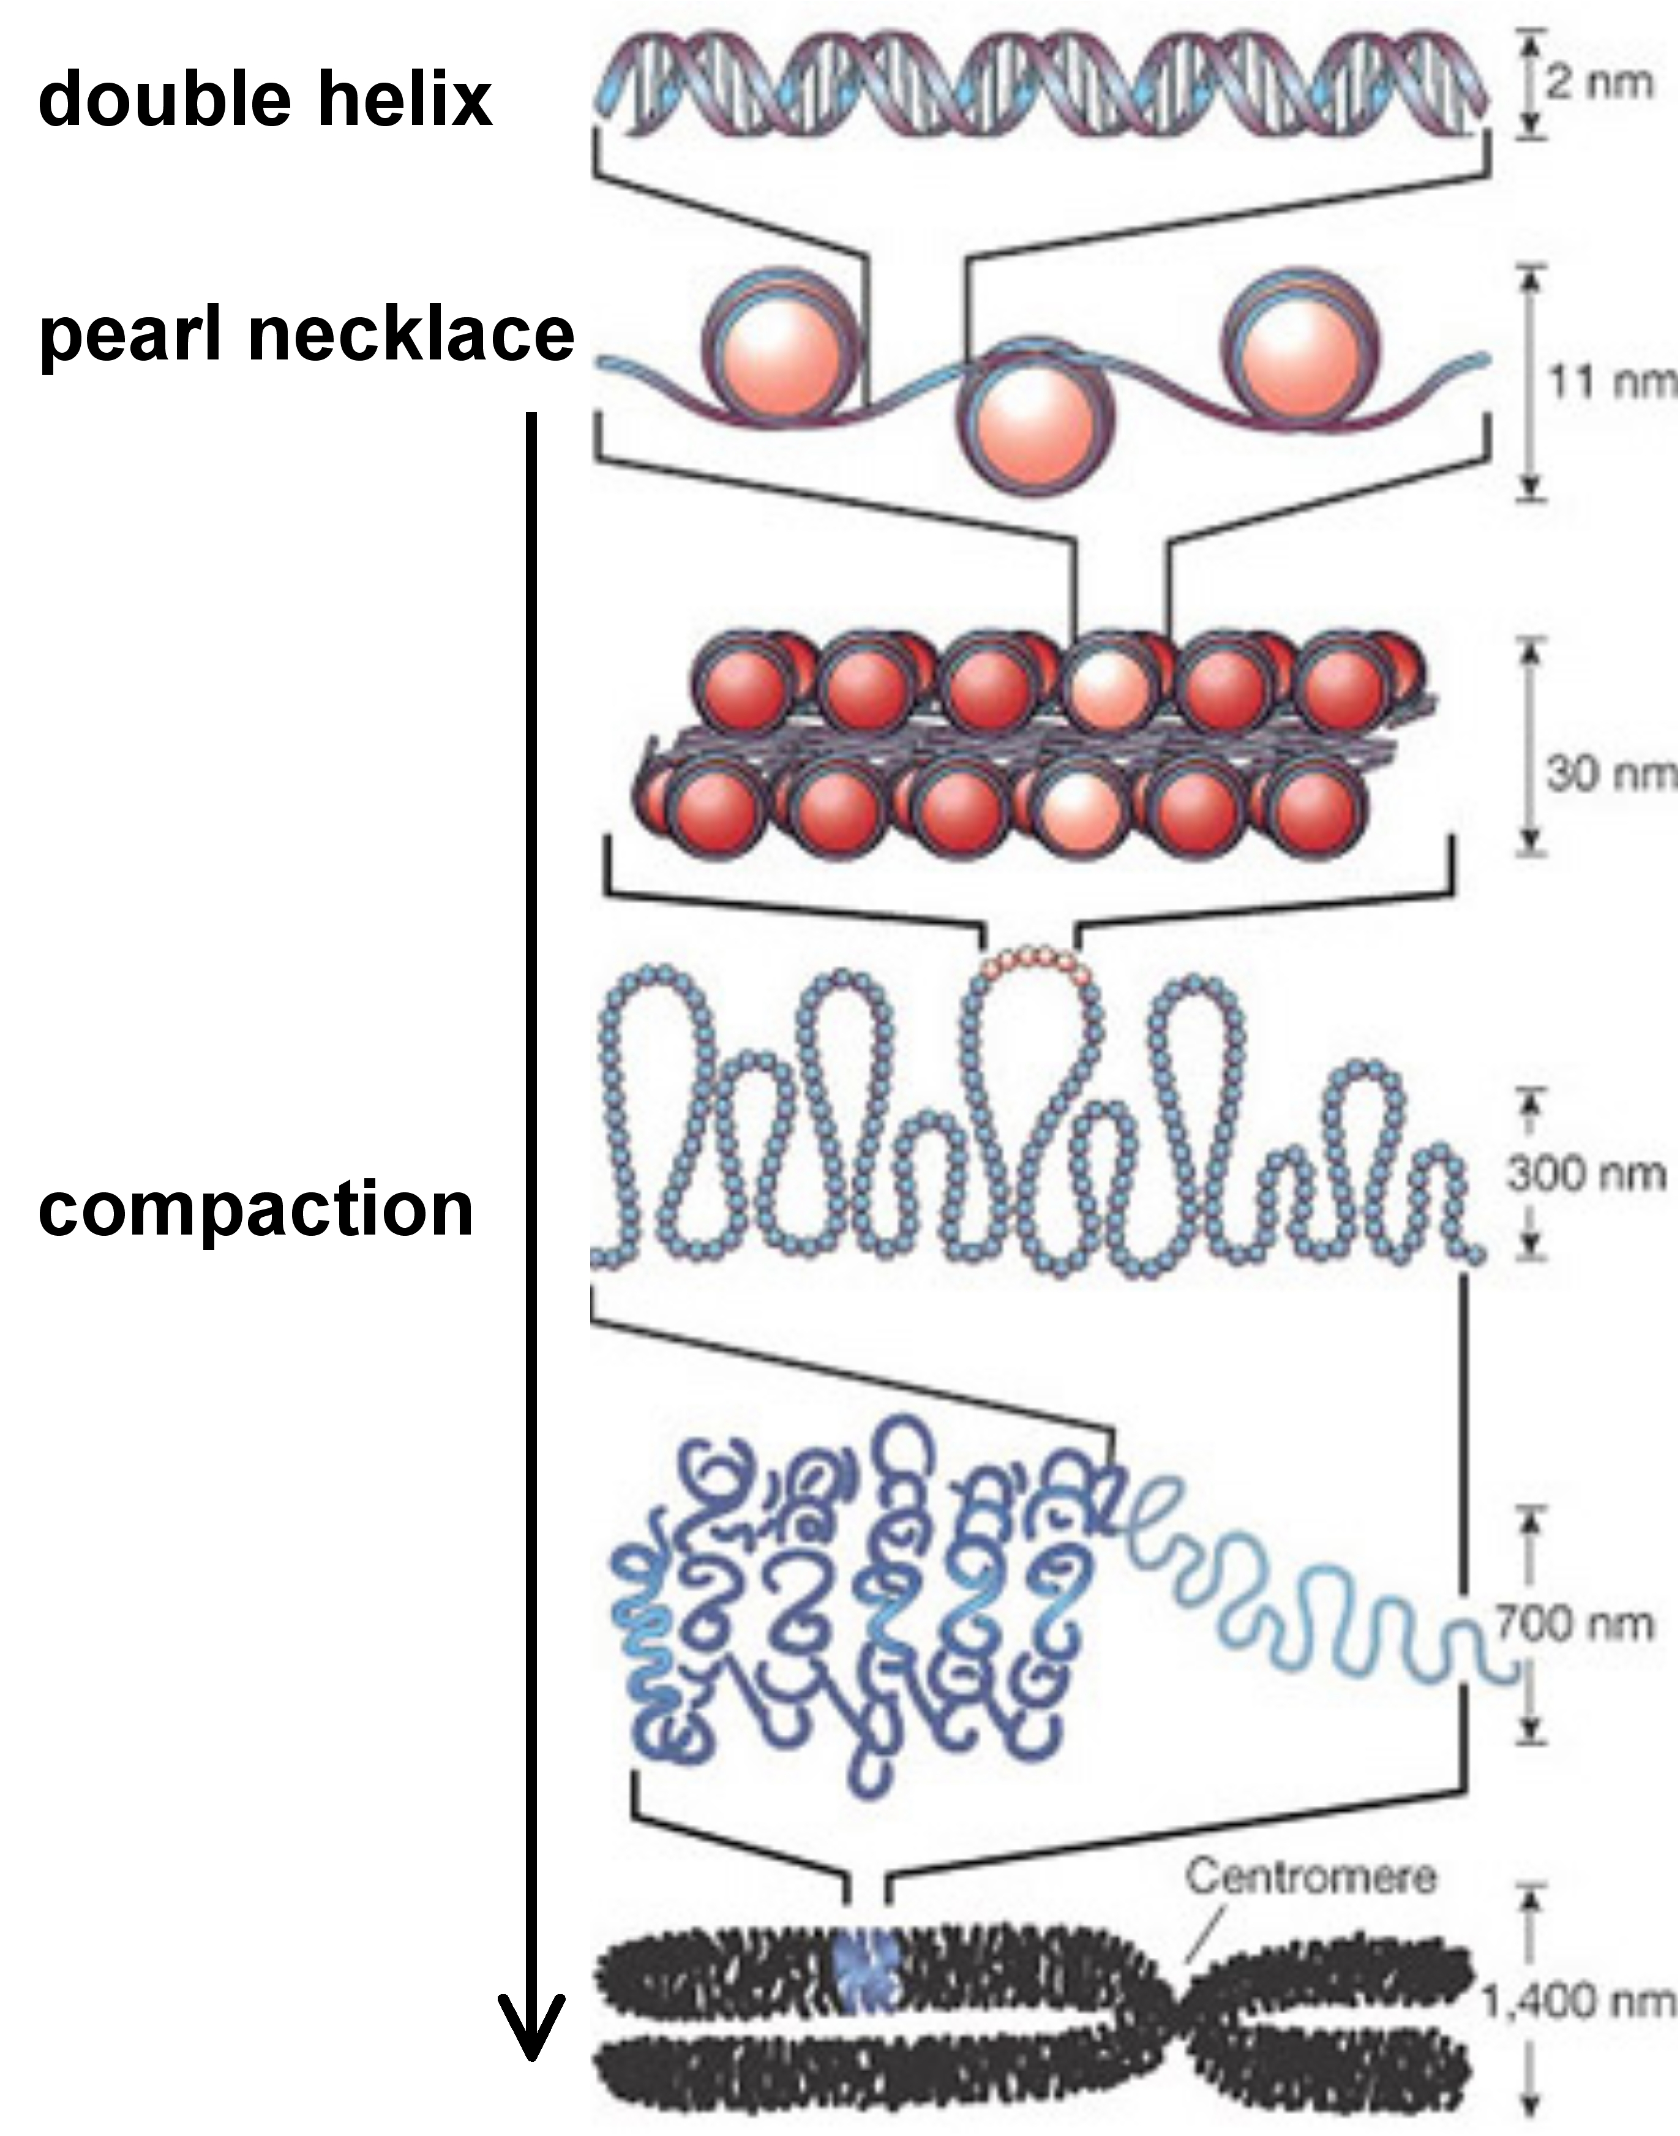
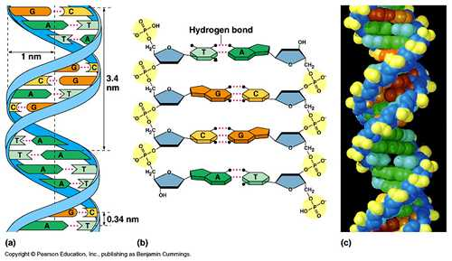
DNA (Deoxy ribo nucleic acid)
Store genetic information
Highly Negatively charged polyelectrolyte
Long L= 1.478 μm (Luciferase T7 Control
DNA (4331bp))and stiff (R_{G}= 155 nm. l_{p}= 50 nm)

Slide 37
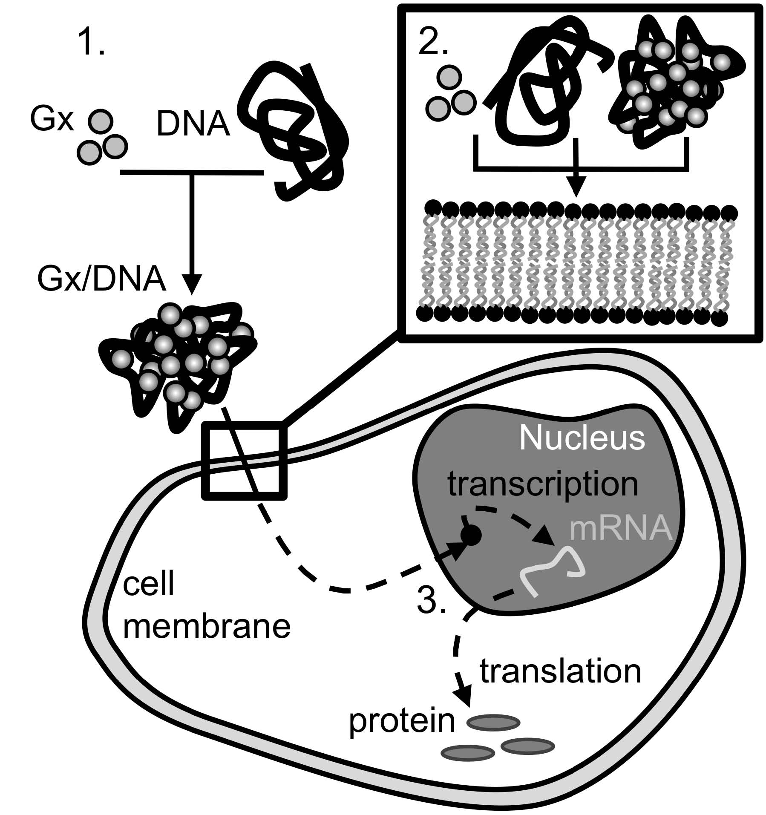
Gene therapy requires that the large hydrophilic highly (negatively) charged DNA crosses the lipid membrane
Can also be cationic
Surfactant micelles
Is this possible?
Compacting DNA with oppositely charge dendrimers (and surfactants)
Reducing size
Reducing charge
We have studied
Compaction with surfactant in bulk at interfaces
Transport of dendrimer across supported lipid bilayer
Interaction of DNA/dendrimer complex with the bilayer

Slide 38
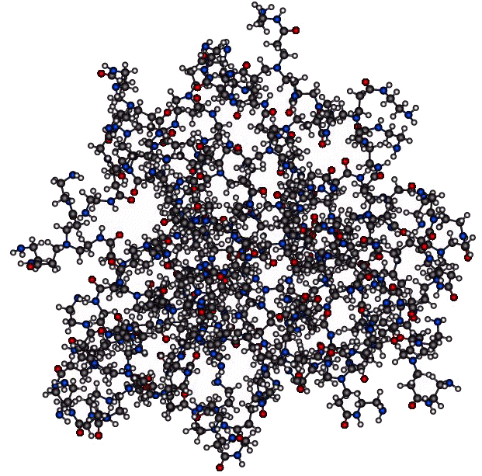
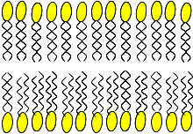
What happens when dendrimers interact with a model cell membrane?
or
or
Ainalem, M.-L.; Campbell, R.; Khalid, S.; Gillams, R.; Rennie, A.; Nylander, T. On the Ability of PAMAM Dendrimers and Dendrimer/DNA Aggregates to Penetrate POPC Model Biomembranes. J. Phys. Chem. B. 2010, 114, 7229-7244.

Slide 39
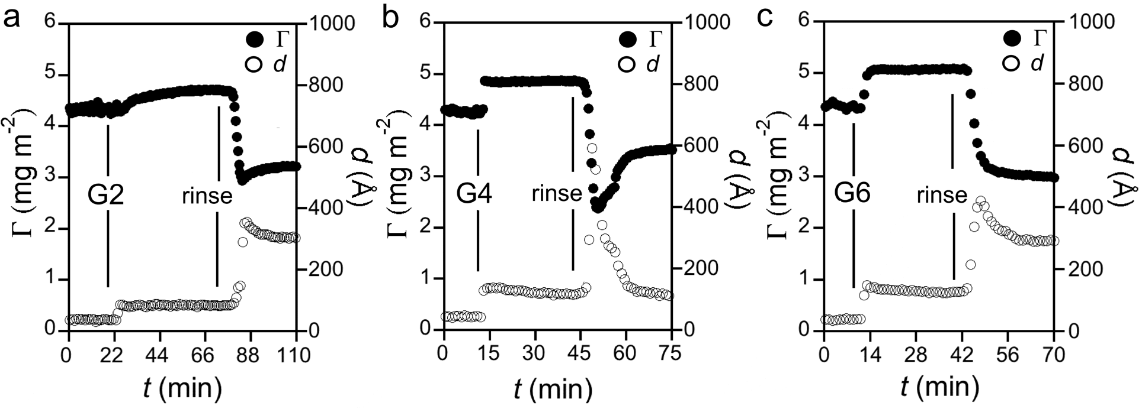
Ellipsometry give change in adsorbed amount but not location
Increase in thickness and adsorbed amount when adding dendrimers (PAMAM-G4) to lipid (POPC) bilayer

Slide 40
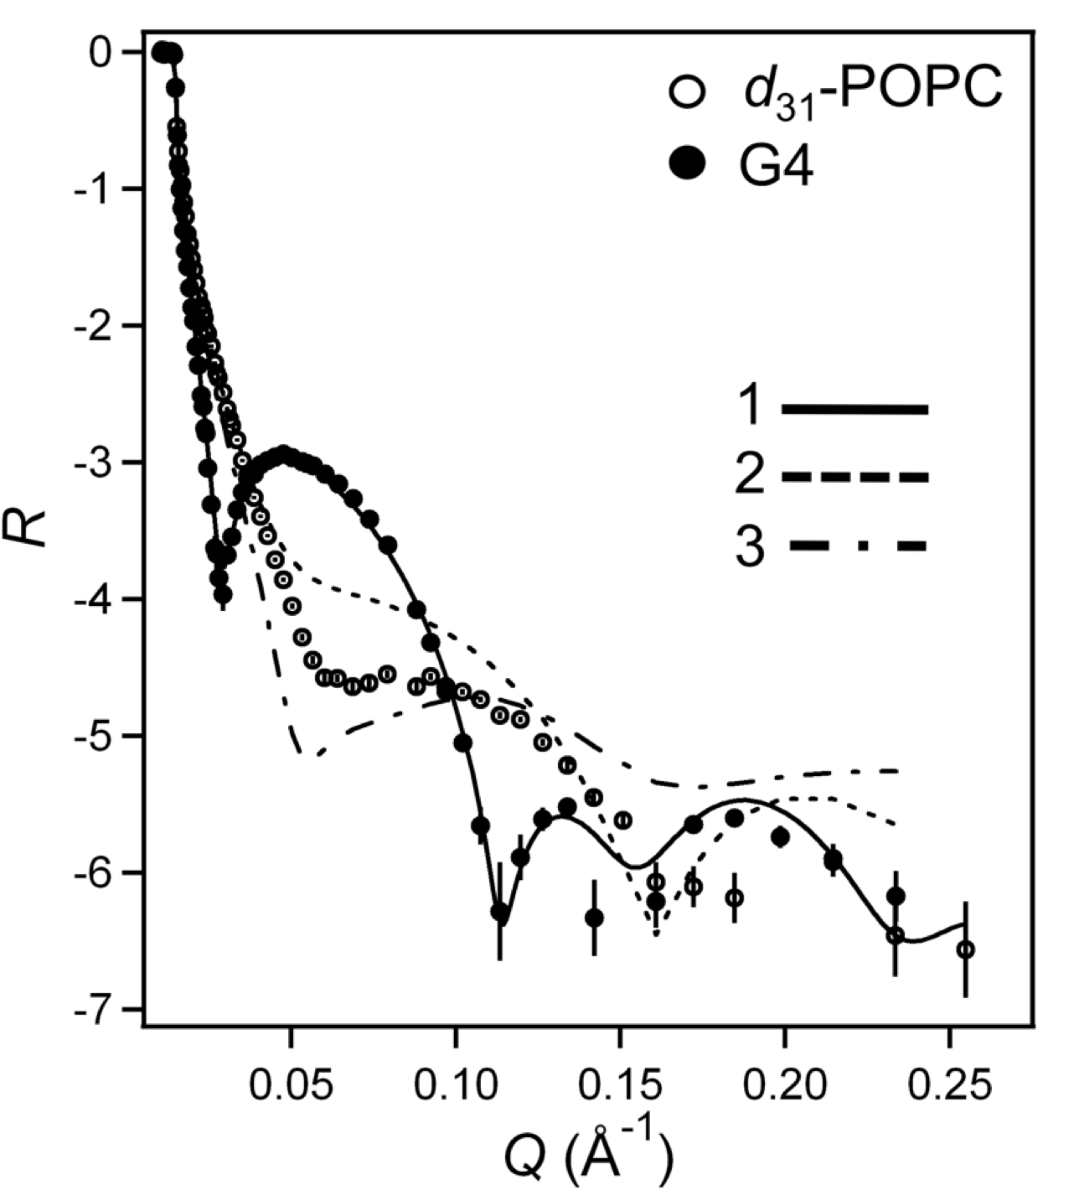
What happens when dendrimers interact with a model cell membrane?
Neutron reflectometry in D₂O
5.5 Å, 19% D₂O
or
28 Å, 8.4% D₂O
44 Å, 85% D₂O
Only possible fit with dendrimer under bilayer

Slide 41
How does different generations of dendrimers interact with the bilayer?
Generation | M (g mol⁻¹) | No charged groups | R_{H} (Å)
2 | 3256 | 16 | 13.6
4 | 14215 | 64 | 24.5
6 | 58048 | 256 | 38.0

Slide 42
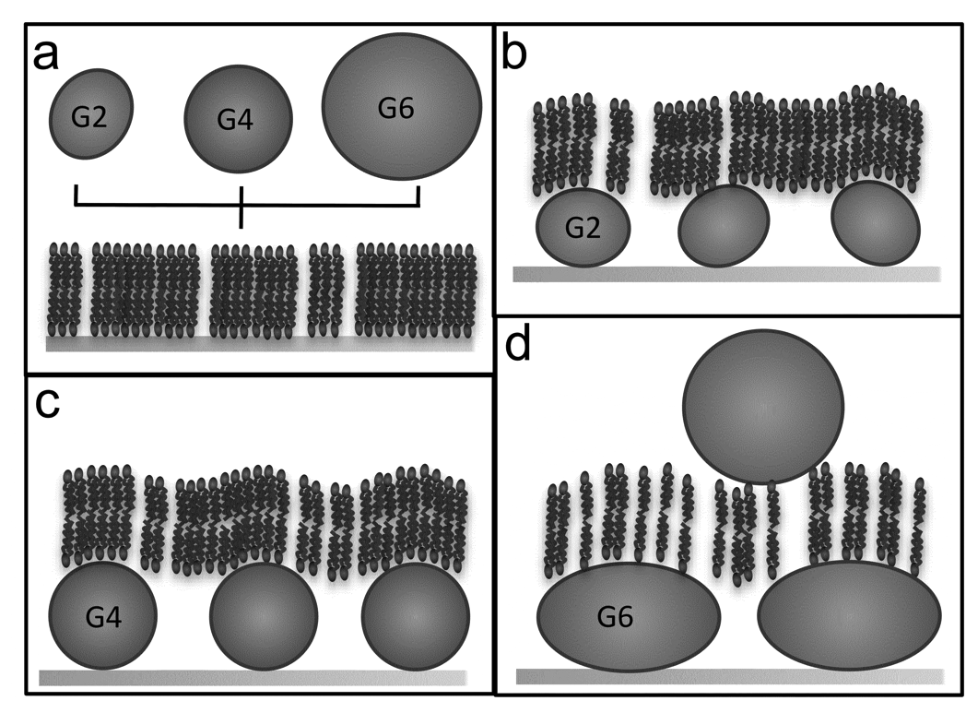
The interaction with the bilayer depends on dendrimer generation
b,c
G2 (and G4) dendrimers penetrates bilayer but leaves it intact.
d
G6 partly penetrate bilayer but partly destroys it! The interaction with bilayer is stronger as the dendrimers partly adsorbs on top of the remaining bilayer.

Slide 43
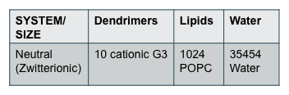
How do the dendrimers pass the bilayer?
Through defects?
Can they pass through the membrane? (AFM studies suggest this)
Corse grain simulation (Syma Khaled, University of Southampton)
Simulation (120 ns) using
GROMACS 3.3.1 simulation package
Parameters

Slide 44
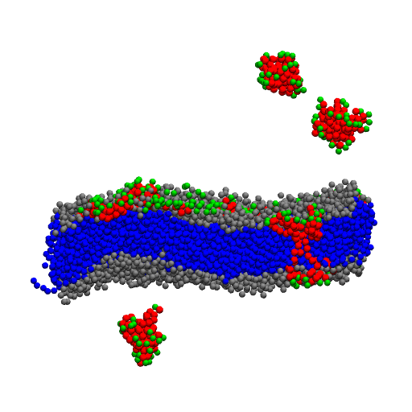
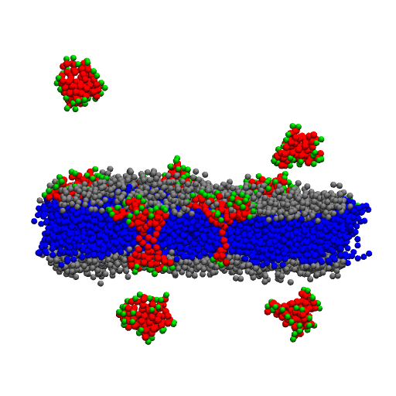
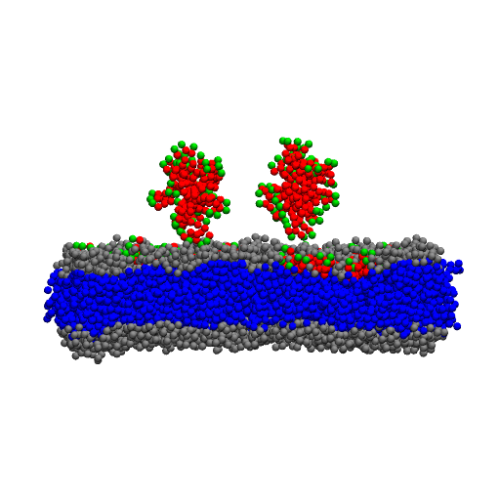
Coarse grain simulations: Dendrimers can pass through the membrane without “defects”?!
0 ns
30 ns
120 ns
…and without the attractive force between dendrimer and the negatively charge silica surface
(confirmed by prel. experiments with free standing bilayers)
Additional simulations shows that the surface seems to slow down the process…

Slide 45
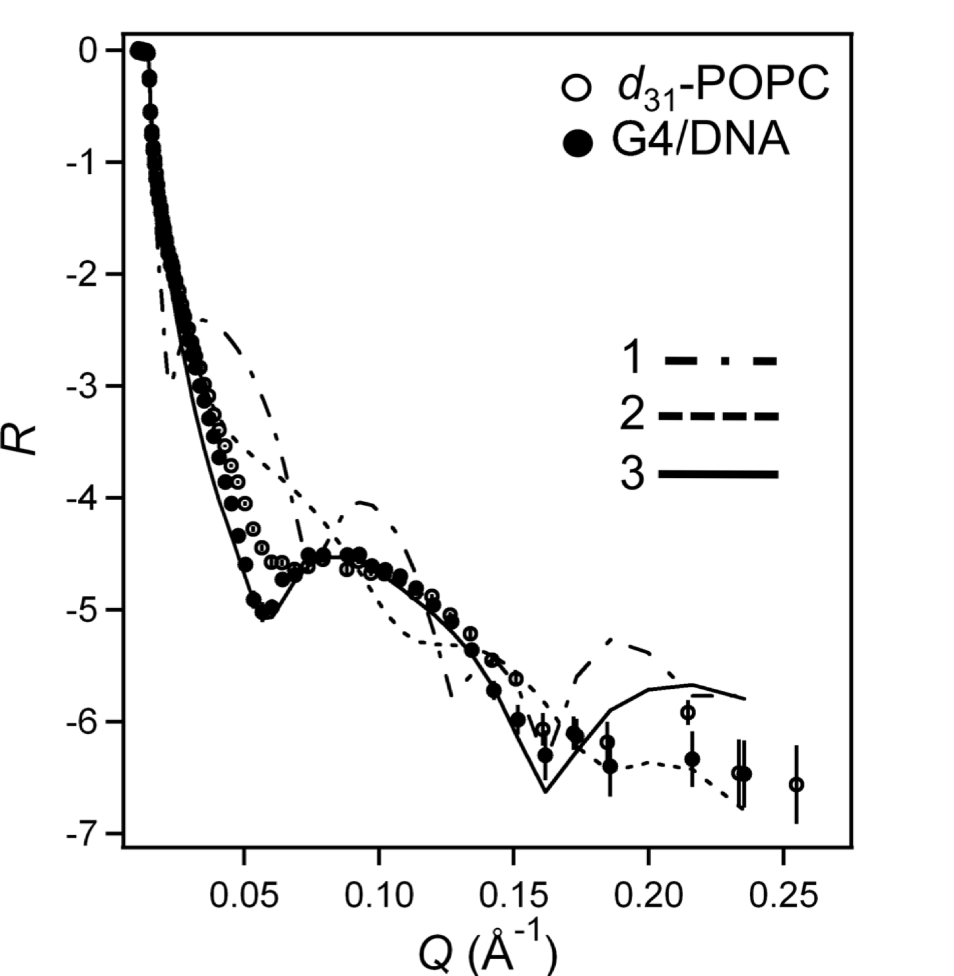
What happens when DNA/dendrimer complex interact with a model cell membrane?
Neutron reflectometry in D₂O
430 Å, 77% D₂O
Beneath bilayer
5.5 Å, 19% D₂O
28 Å, 8.4% D₂O
or
No penetration of the bilayer by G4/DNA complex
G4/DNA complex sits on top of bilayer
Spanning bilayer

Slide 46
Conclusions
Dendrimer interaction with model membranes
G2 and G4 penetrates bilayers, but G6 partly destroys bilayer. Data supporting transfecting ability.
Dendrimer/DNA complex interaction with model membranes
Complex of G4 and G6 do not penetrate bilayers and G6 do not.
Increasing ionic strength can release (G2) dendrimers form complex which penetrate bilayer
Does the efficiency of dendrimers as transfection agent rest on their ability to penetrate the membrane?

Slide 47
Neutron reflectometry at Liquid interfaces

Slide 48
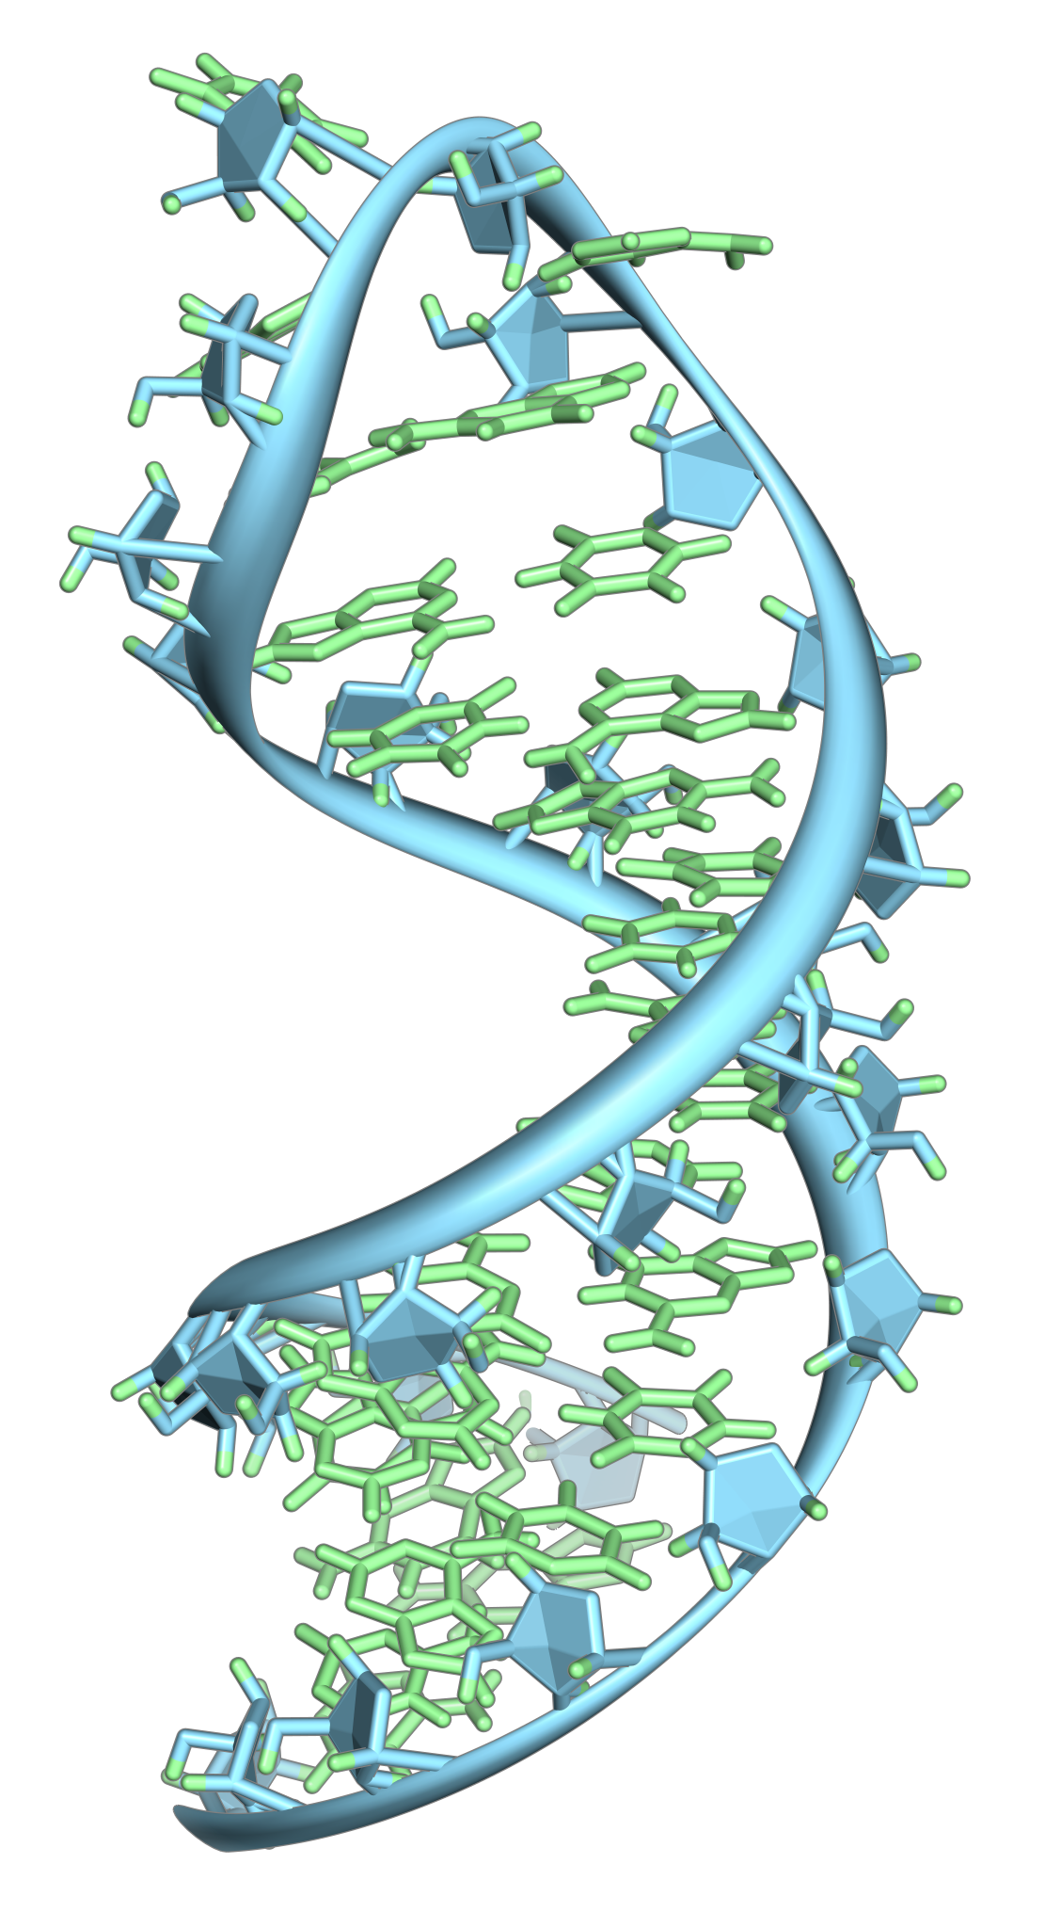
WHY STUDY SHORT RNA OLIGOMERS(miRNA)?
Important for regulatory properties in the cell, such as cell death, cell proliferation and for the initiation of several types of cancer.
There are significant amount of phospholipids in the cell nucleus and e.g. RNA in the nucleus is co-localize with these lipids.
Important for drug delivery, therapeutics, synthetic biology and fundamental understanding of biological mechanisms.

Slide 49
OBJECTIVE: REVEAL MECHANISM AND CONSEQUENCES OF INTERACTION BETWEEN NUCLEIC ACIDS AND BIOMEMBRANES
We have studied the interaction of single stranded RNA (10 bases) and double stranded DNA (2000 base pairs)
with monolayers (P= 8 and 28 mN/m) of
zwitterionic DPPC (1,2-dipalmitoyl-sn-glycero-3- phosphatidylcholine)
cationic DODAB (dioctadecyl-dimethyl-ammoniumbromide)
using surface film balance, fluroscence microscopy and neutron reflectometry.
Michanek, A.; Yanez, M.; Hughes, A.; Wacklin, H.; Nylander, T.; Sparr, E. “RNA and DNA association to zwitterionic and charged monolayers at the air-liquid interface” Langmuir, 2012, 28, 9621-9633

Slide 50
Langmuir trough to record Π-A isotherms
Wilhelmy plate to
record surface
pressure, Π
Barriers to record
area per molecule, A

Slide 51
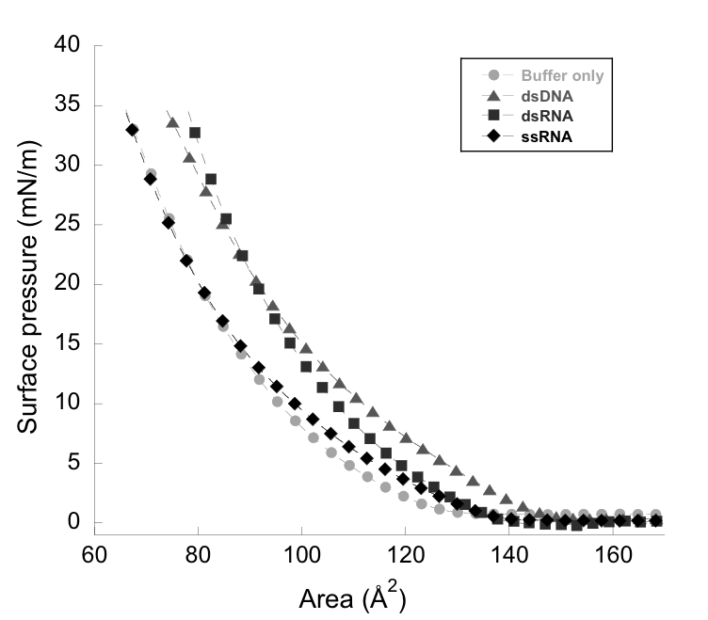
 vs. Area isotherm of cationic DODAB monolayers on 2mM imidazole pH 7 with and without 0.06 mg/ml nucleic acids in sub-phase.
The presences of nucleic acids (NA) in the sub-phase only have minor effect on the isotherm shape
Isotherm shifted towards higher area indicating incorporation of nucleic acids.
P-A isotherm probe the interaction, but no information of the location of NA

Slide 52
Neutron reflectometry can provide information on the location of nuclei acids on a lipid monolayer

Slide 53
Reflectivity profiles for DODAB monolayer on 2mM imidazole, pH 7, with and without 0.06 mg/ml ssRNA or ds DNA
Low surface pressure, Π=8.8 mN/m
ssRNA (10b)
dsDNA (2000bp)

Slide 54
Reflectivity profiles for DODAB monolayer on 2mM imidazole, pH 7, with and without 0.06 mg/ml ssRNA or ds DNA
Hiugh surface pressure, Π=28 mN/m
ssRNA (10b)
dsDNA (2000bp)

Slide 55
Properties of monolayers and nucleic acids
Layer | d (Å) | R (Å) | SLD (10⁻⁶ Å⁻²) | Solv. % | A (Å²)
DODAB Π=8.8 mN/m | 20 | 4 | -0.34 (6.23) | 42 | 96
DODAB Π=28 mN/m | 20 | 4 | -0.34 (6.23) | 22 | 71
DPPC Π=8.4 mN/m | 22 | 4 | 0.22 (5.53) | 32 | 83
DPPC Π=28 mN/m | 22 | 4 | 0.22 (5.53) | 5 | 60
RNA (10b) |  |  | 3.6 4.5 D₂O
DNA (2000bp) |  |  | 3.7 4.1 D₂O
d = thickness, R = Roughness
SLD = Scattering length density (deuterated in paranthesis)
A=area per molecule from neutron data

Slide 56
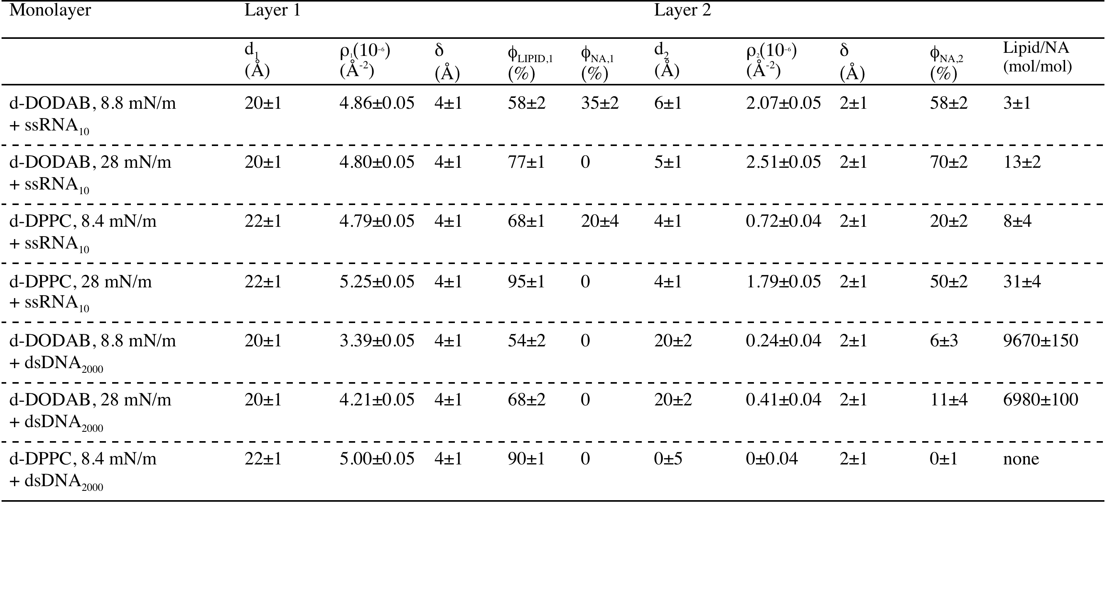
Fitting parameters

Slide 57
Neutron reflectometry results show:
ssRNA (10 bases) penetrate and adsorb on top of the cationic DODAB at low P, but do no penetration at high P. Similar, but less extensive interaction with zwitterionic DPPC.
dsDNA (2000 base pairs) partially removes the cationic DODAB monolayer both at low P and high P. dsDNA forms thicker but less dense layer on the cationic DODAB than ssRNA.

